Slide 1
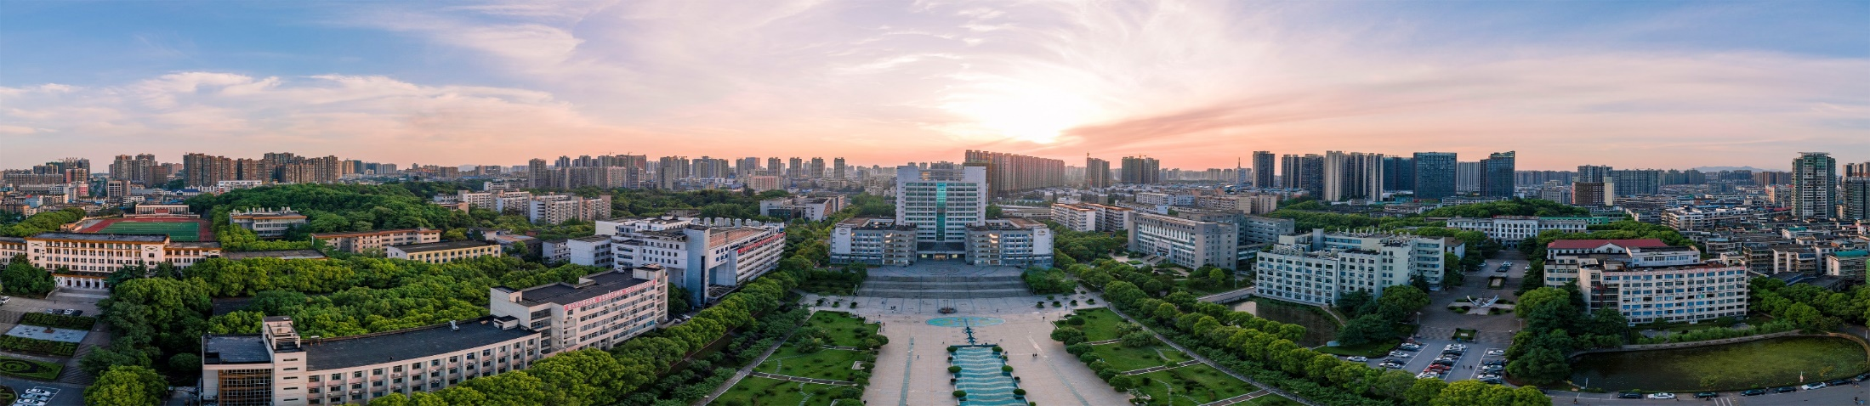

NED&CAGD2024
基于缪致X射线的径迹密度成像算法的模拟研究
汇报人：冯春添 指导老师：王晓冬
先进核能技术设计与安全教育部重点实验室 | 核科学技术学院
2024年7月17日
中国 青岛

Slide 2
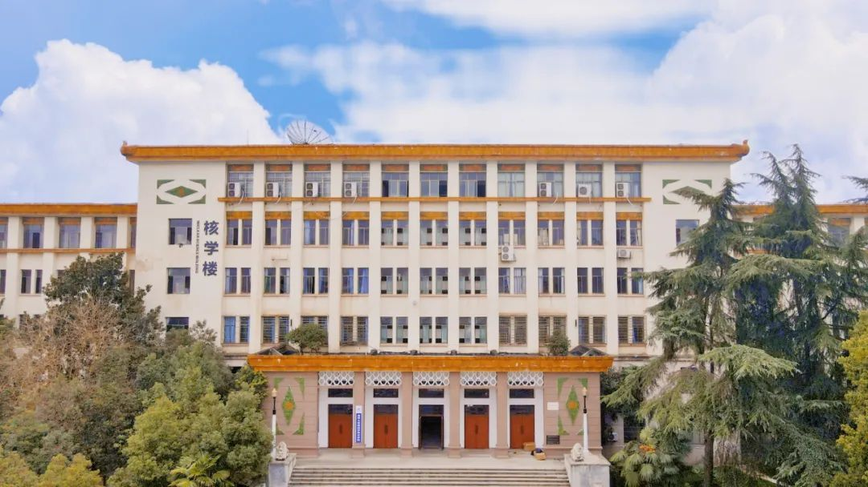
Outline
1 | 缪子的来源及其英语
2 | MIXE方法介绍
3 | 轨迹密度成像算法
4 | 总结与展望
Notes:
I will introduce my research from four aspects
我将从四个方面介绍我的研究

Slide 3
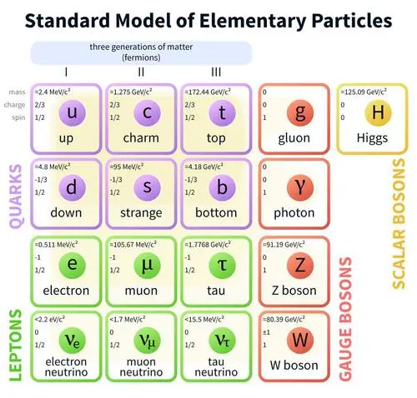
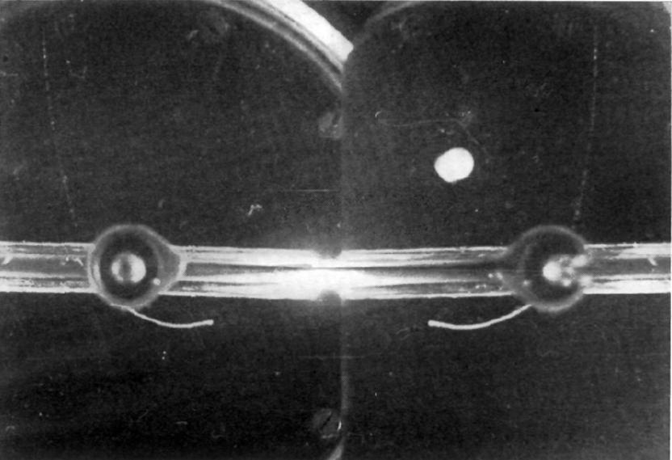
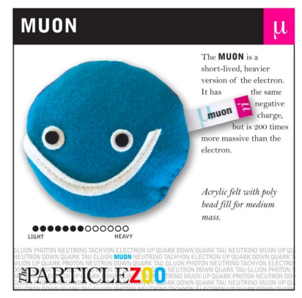



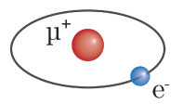

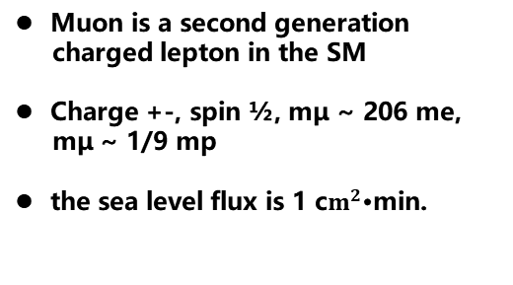
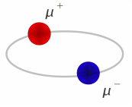

1.1 缪子概述
缪子的发现
1936年，C.D. Anderson和S.Anderson Neddermeyer发现了μ子。
μ介子可以以各种形式存在
muonium
muonic atom
dimuonium
卡尔·大卫·安德森（1905-1991）
S.H. Neddermeyer, C.D. Anderson, Phys. Rev. 54, 88 (1938)
3
Notes:
In 1936, C.D. Anderson and S.Anderson Neddermeyer discovered the muon.
1936年，C.D. Anderson和S.Anderson Neddermeyer发现了μ介子。
Muon is a second generation charged lepton in the standard model
μ介子是第二代标准模型中的带电轻子
Charge: +- (positive or negative), Spin: 1/2(one in half), Mass of muon (mμ): Approximately 206 times the mass of an electron , 1/9 (one ninth) times the mass of a proton (mp)
电荷+-，自旋1/2(one half)，质量mμ约为206 me， 质量mμ约为质子质量的1/9
Muon can exist in various forms, it can be exists in form Negative muon，Positive muon，muonium，muonic atom，dimuonium
可以以负缪子,正缪子,，缪子原子的形式存在
There are two sources of Muon，Natural Muon source-background radiation，Artificial Muon Source
μ介子有两种来源，天然μ介子源-背景辐射，人工μ介子源

Slide 4
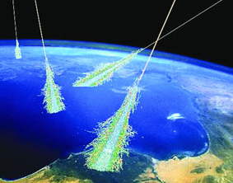
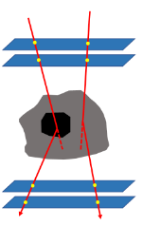
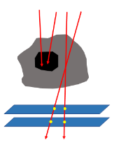
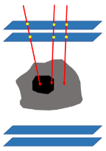
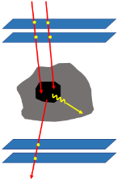
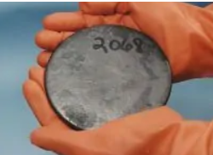
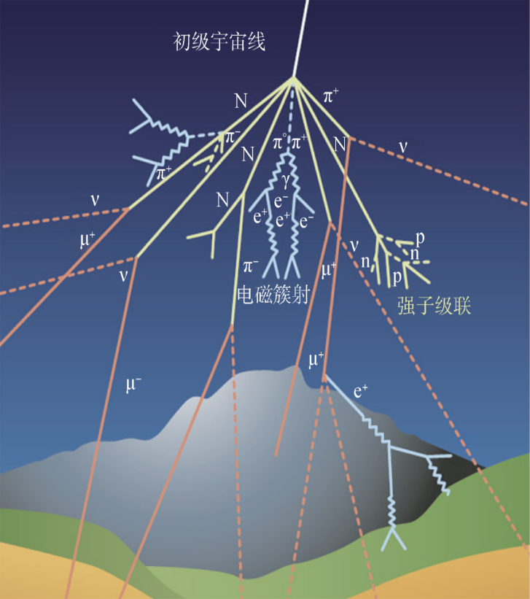
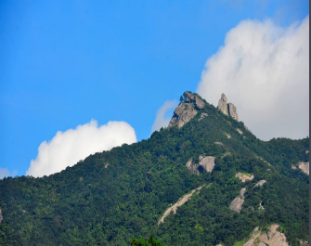

1.2 μ介子的来源
天然μ介子源-背景辐射
μ介子与物质相互作用
散射成像
1
目标：高原子序数材料
散射成像技术
散射
透射
停止
标记
能域广
透射成像
2
穿透能力强
目标：大尺寸物体
本底辐射
次级粒子成像
3
非接触式遥控无损成像
目标：中低原子序数物质
4
Notes:
The natural source of the muon comes from the decay of the pion produced by the interaction between the high-energy protons in the universe and the earth's atmosphere.
天然缪子源来自于宇宙中的高能质子与地球大气层相互作用产生的派介子衰变。
The natural source of the muon has advantages of wide energy domain and strong penetrating ability, which is the background ray, and it is used to image matter with non-contact remote control non-destructive imaging
天然缪子源具有能量域宽，穿透能力强，为本底射线的优势，并且用其对物质成像是一种非接触式遥控无损成像
Muon produces angular deflection and flux decay as it passes through an object, producing secondary particles, through which it is possible to image substances of different atomic numbers and sizes
Muon在穿过物体时会产生角度偏转，通量衰减，产生次级粒子，通过这些数据可以对不同原子序数，不同尺寸的物质进行成像
Scattering imaging technology is applied to high atomic number materials, transmission imaging technology is applied to large-scale objects, and secondary particle imaging technology is applied to medium and low atomic number materials
其中散射成像技术应用于高原子序数物质，投射成像技术应用于大尺寸物体，次级粒子成像技术应用于中低原子序数物质

Slide 5
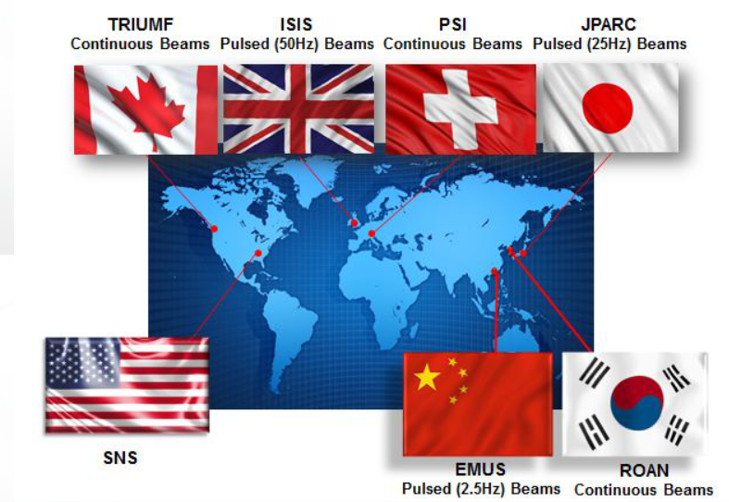
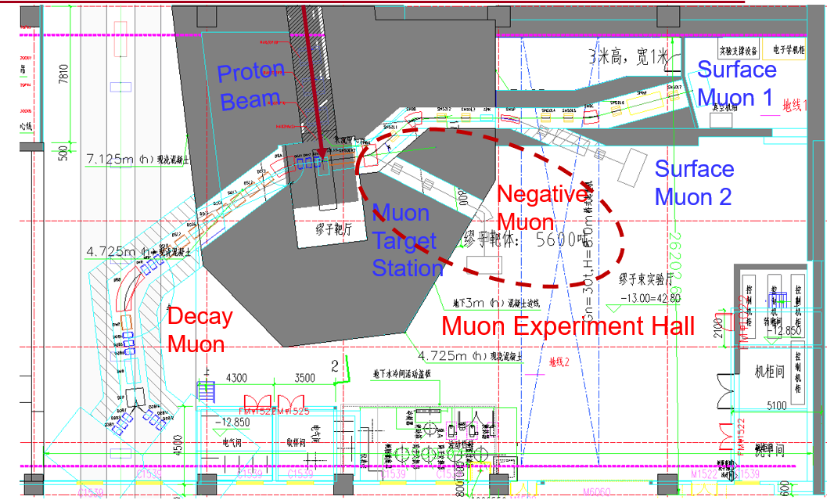
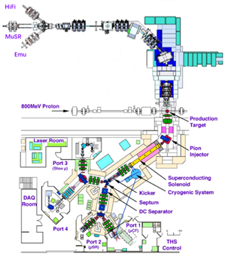
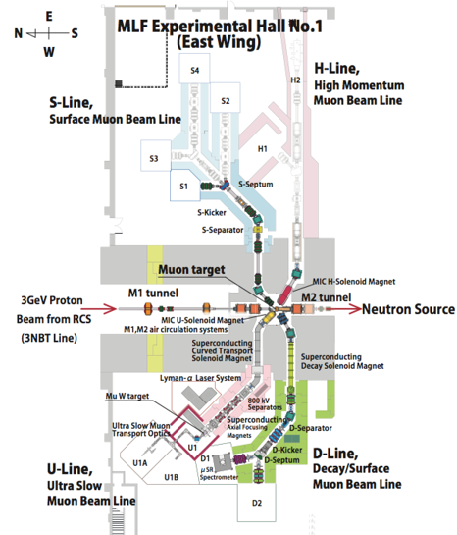
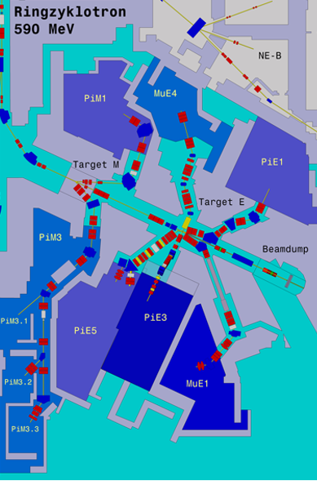
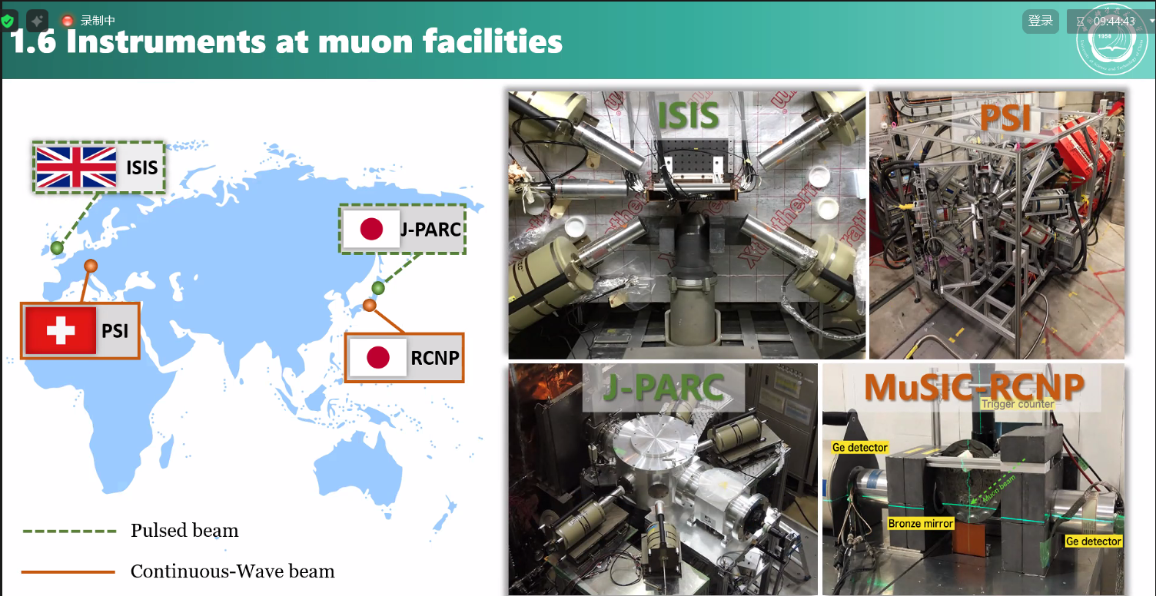
1.2 μ介子的来源
人工缪子源
国际上的μ介子来源
CSNS Melody
ISIS
J-PARC/MUSE
PSI/SμS
5
Notes:
The artificial muon source has the characteristics of high-intensity beam, energy up to several hundred MeV, and strong monochromaticity, but the cost is high.
人工缪子源具有高强度束流、能量可达几百MeV、单色性强等特点，但是成本高昂。
Currently, all muon beams worldwide are based on high-energy proton accelerators bombarding low atomic number target materials (such as carbon or beryllium nuclei) to produce pions, which then decay to generate muons, and the beam parameters are controlled through magnetic guidance.
目前，全球所有μ介子束都是基于高能质子加速器轰击低原子序数目标材料（如碳或铍核）产生π介子，然后衰变产生μ介子，束参数通过磁引导进行控制。
High-intensity muon beams require high-power proton accelerators with energies greater than 500 MeV. The main experimental muon sources worldwide are the ISIS facility in the United Kingdom, TRIUMF in Canada, J-PARC in Japan, and PSI in Switzerland.
高强度μ介子束需要能量大于500MeV的高功率质子加速器。全球主要的实验μ介子来源是英国的ISIS设施、加拿大的TRIUMF、日本的J-PARC和瑞士的PSI。
And Melody, located in Dongguan, China, will also be completed and put into use in the coming years
并且位于中国东莞的Melody也将在这几年建成投入应用

Slide 6
1.3 不同能量μ介子的应用
衰变缪子的应用
宇宙射线缪子子
MeV-TeV型
High-energy MuSR
厚样品
容器中样品
高强度磁场
Depth scan MIXE
考古学深度扫描
月球岩石
锂电池
Single Particle Effect
μ⁻的俘获截面研究
Muon
Imaging
厚样品
衰变缪子，10–80 MeV
穿透深度：0.2-4 cm
表面缪子子，
4.1 MeV
（P=29.8MeV/c）
植入深度：~ 100 μm
慢缪子, 1–30 keV
可调深度: 1–300 nm
深度敏感μSR：
用于薄膜的旋转微探针，
多层材料、纳米材料......
6
Notes:
The cosmic ray muon covers energy from MeV to TeV and is mainly used for imaging large-sized objects.
宇宙射线缪子覆盖能量从MeV-TeV，主要应用于大尺寸物体成像，
Suface Muon has an energy of 4.1 MeV, with an implantation depth of approximately 100 microns，Can be used for millimeters or less μ SR
能量为4.1MeV的为表面缪子，穿透深度大概为100微米，可用于毫米以下的μsr
decay Muon has an energy of 10-80 MeV, and an implantation depth of 0.2-4 centimeters
能量为10-80MeV的为衰变Muon，停止深度为0.2-4厘米
Slow muon, 1–30 keV tunable Depth: 1–300 nanometers Depth sensitive μSR: magnetic spin microprobe for thin films, multilayers, nanomaterials …
慢缪子，1-30 keV可调 深度：1-300纳米 深度敏感的μSR：用于薄膜、多层膜、纳米材料的磁自旋显微探针…
Decay Muon Applications have four aspect:first High energy MuSR：mainly used on Thick Samples，Samples in container，High field
衰变μ子的应用有四个方面，第一点：高能μSR：主要用于厚样品、容器中的样品、高场
Second ，Depth scan Muon Induced X-ray Emission（MIXE），used on Depth scan for archaeology, Thick moon rock， lithium battery.
第二点，深度扫描μ介子诱导X射线发射（MIXE），用于考古深度扫描，厚月岩，锂电池
Thrid Muon Imaging for Thick samples，forth Single particle effect: used for μ Large capture cross-section
第三点，缪子成像用于厚样品，第四点 单粒子效应：用于μ的大捕获截面

Slide 7



2.1 负μ介子束的产生方法
Target
7
Notes:
Negative muons are produced by high-energy protons bombarding beryllium or carbon nuclei to produce Pions, which decay to produce neutrinos and negative muons
负缪子是由高能质子轰击铍或碳原子核产生Pions，pion衰变产生中微子和负缪子
This all depends on the high-energy protons generated by the accelerator, which are over 500 Mev
这都要依赖于加速器产生的500Mev以上的高能质子

Slide 8
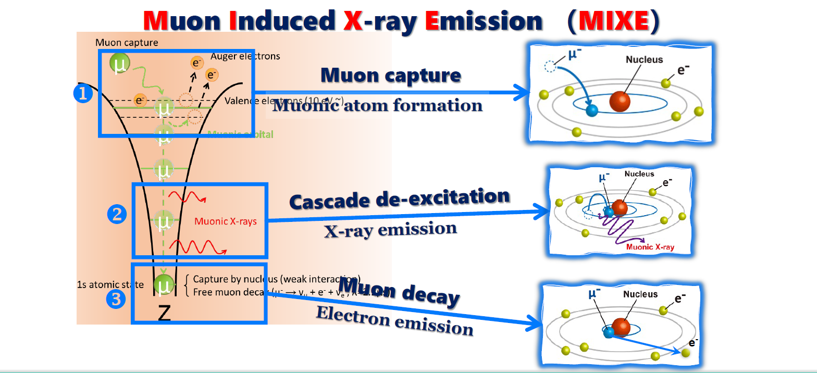
2.2. μ致X射线的发射过程
Images Courtesy Z.W.Pan @ USTC
8
Notes:
μ介子诱导的X射线发射Muon Induced X-ray Emission
When a muon enters into an object, it loses energy due to multiple Coulomb scattering and
is stopped. Since negative muons have 1/9th the mass of protons, the stopping process is similar
to that of protons, and the depth profile of stopped muons is localized in thin regions within the
object. In the muon stopping region, muons are captured by the atoms in the material, forming
muonic atoms.
当μ子进入物体时，由于多次库仑散射而失去能量并被阻止，由于负μ子的质量是质子的1/9，因此停止过程与质子类似，停止的μ子深度
分布局限于物体内部的薄区域，在μ子停止区域，μ子被物质中的原子捕获，形成μ子原子。
Muonic atoms emit atomic-specific X-rays (called to muonic X-rays) from the upper high energy levels, which cascade down to the lower energy levels.
μ子原子发射原子特定的X射线（称为μ子X射线）从高能量水平，其级联下降到低能量水平。
The Muon then decays within the atom, producing electrons that emit atoms, of which the part I studied was the part of the Muon atom that generates X-rays by deexcitation, and analyzed the energy and the direction to the detector
随后缪子在原子内衰变，产生电子发射出原子，其中我所研究的部分为Muon atom退激产生x射线的部分，并分析该能量与到达探测器的方向

Slide 9
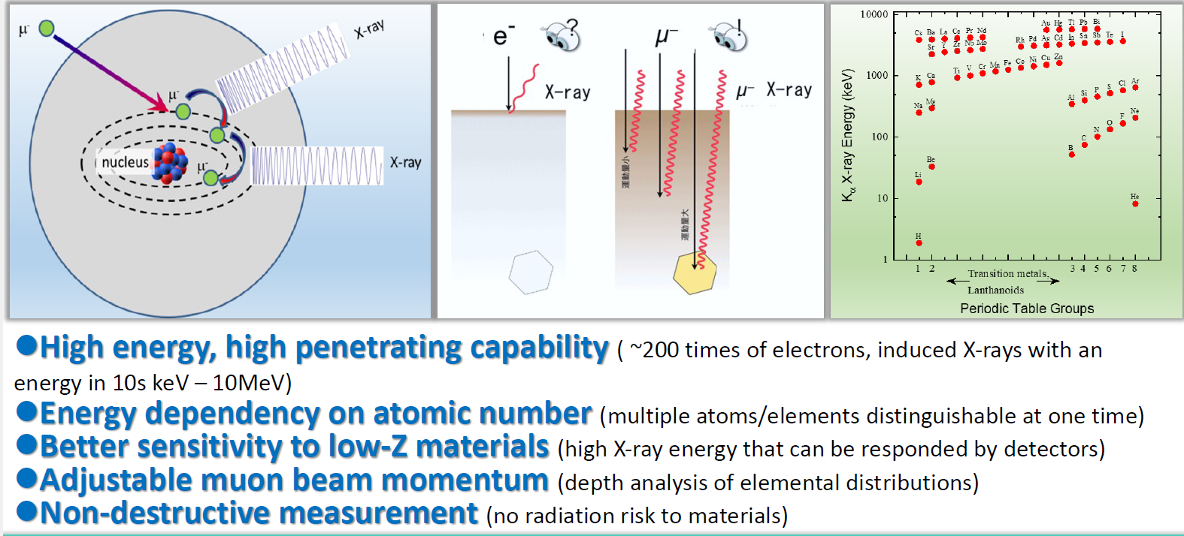
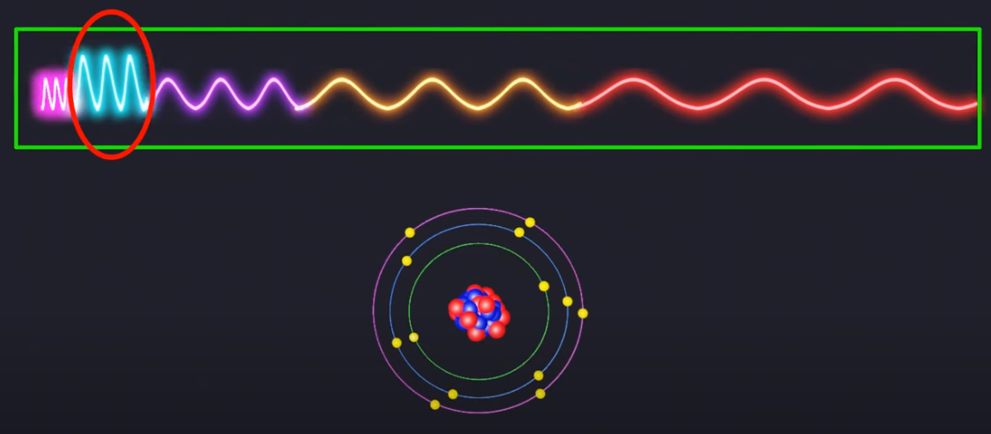
2.3 MIXE的优势
对C、N、O敏感，在其他方法中不易检测
Cl
Ar
S
P
Si
Al
Mg
Na
Ne
C
N
O
F
B
Ar
高能量，高穿透能力
(发射出 X 射线为10keV-10MeV
，200倍电子激发X射线。)
Cl
S
P
Si
Al
Mg
Na
Ne
C
N
O
F
B
无损测量
(对材料没有辐射损伤风险。)
两种特征X射线能量的比较
缪子束流能量可调节
(元素深度分析分布。)
能量大小取决于原子序数
(一次测量可确定多种元素。)
9
Notes:
MIXE is Sensitive to carbon, hydrogen, and oxygen, which are not easily detected by other methods
MIXE方法对碳、氢和氧元素敏感，这些物质在其他方法中不易检测
And negative Muon penetrates the sample about a hundred times deeper than electrons，The energy of the Muonic x-ray is much greater than that of the electron-excited X-ray, about 200 times that of the X-ray, which means that the X-ray of any element can be detected with high sensitivity without being absorbed by the sample
并且负Muon比电子穿透样品更深约百倍，Muonic x-ray的能量要比电子激发X射线的能量大得多，大约是其的两百倍，这代表着任何元素的X射线都可以高灵敏度的探测到而不会被样品吸收
Non-destructive measurement(no radiation risk to materials.)
无损测量（对材料无辐射风险）
And adjustable Muon beam momentum allows for the depth analysis of the elemental distribution.
并且可调节的μ子束动量可以得到元素的深度分析分布。
Since the Muonic x-ray energy depends on the atomic number, it is possible to distinguish between multiple elements in a single spectroscopic analysis
由于Muonic x-ray能量取决于原子序数，在一次的能谱分析中可以区分多个元素

Slide 10
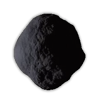
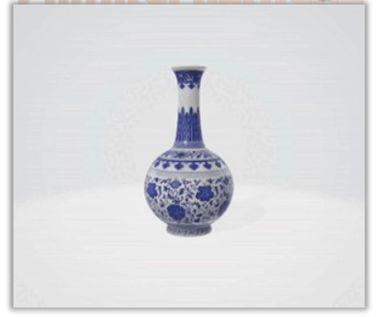
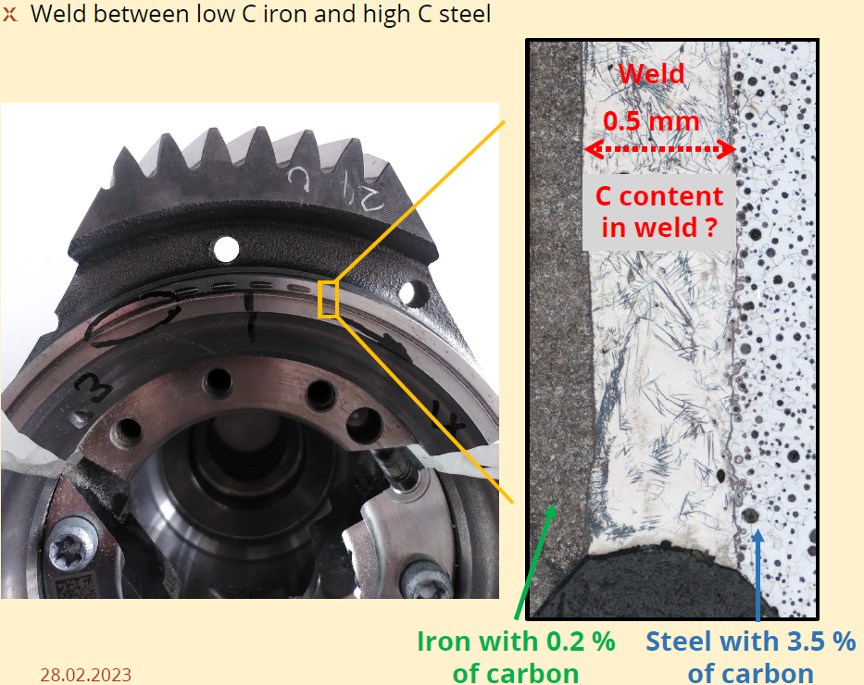
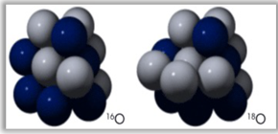
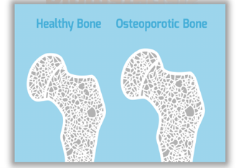
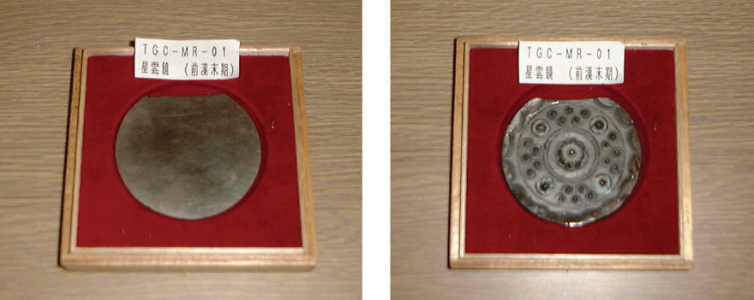
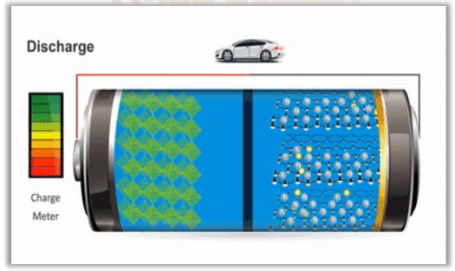
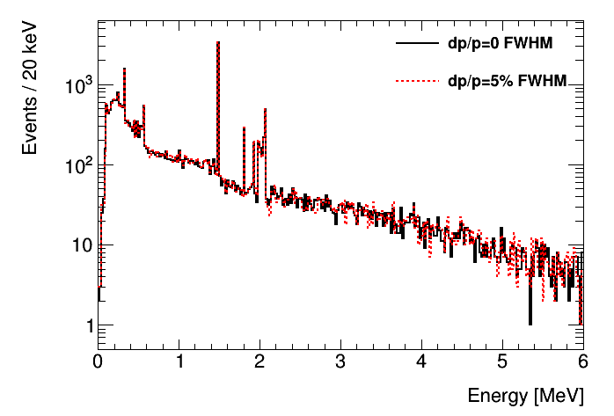
2.4 多领域应用
陨石
文物
PSI MIXE on car bearing
ISIS MIXE on ancient ROME coin
JPARC on Lithium batteries
同位素分析
生物学
JPARC MIXE on ancient Chinese Mirror
锂离子电池
Handbook of Cultural Heritage Analysis, Chapter 3
10
Notes:
Muon Induced X-ray Emission technology can be applied to the composition analysis of meteorites, cultural heritage, lithium-ion batteries, biomaterials, isotope analysis, etc
μ介子诱导的X射线发射的技术可以应用于陨石，文化遗产，锂离子电池，生物材料，同位素分析等方面的成分分析
At present, MIXE has been applied in many aspects in PSI, J-PRAC, including Asteroid or Moon samples Organic elements analysis（Carbon, hydrogen, and oxygen elements,C、N、O）
Key method for Archaeology Ancient Rome coin（ISIS）Ancient Chinese Mirror（JPARC）
Batteries :Li-ion battery（JPARC）
Carbon in car bearings Welding of car bearing (PSI)
目前MIXE已经在PSI，J-PRAC，有了多方面的应用，包括小行星或月球样本,有机元素分析（C、N、O）关键方法 考古学 古罗马硬币（ISIS）中国古镜（JPARC）
电池 锂离子电池（JPARC）
汽车轴承中的碳 汽车轴承焊接 （PSI）

Slide 11
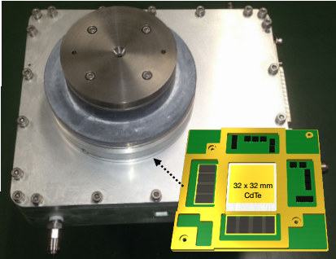
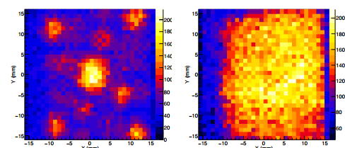
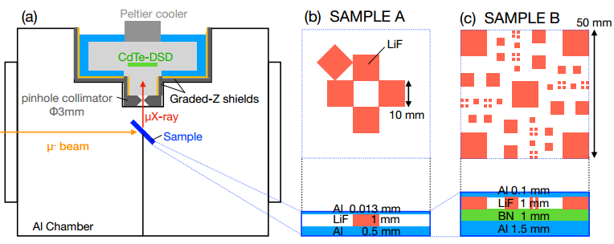
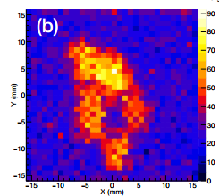
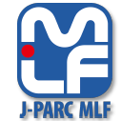
2.5 现有成像方法
单一深度+ 二维成像
M. Katsuragawa et al., NIMA 912 (2018) 140
11
Notes:
Miho Katsuragawaa,b, Motonobu Tampoc, et al used （Cadmium telluride double-sided strip detector） ，A pinhole collimator with a diameter of 3mm was used to detect a layer of five lithium fluoride with a boundary of 10mm between two aluminum plates of sample A.
Miho Katsuragawaa,b, Motonobu Tampoc，等人使用CdTe双面条探测器，使用直径3mm的针孔准直器分别探测了样品A两片铝板中间夹着一层五块边界为10mm的氟化锂，
Sample B has a total of four layers, the upper and lower layers are aluminum, and the middle two layers are lithium fluoride and boron nitride. The muon beam pulse frequency is 25HZ(Hertz), and each pulse provides 4000 negative Muons.
样品B是一共四层结构上下两层为铝，中间两层为氟化锂和氮化硼，muon beam 脉冲频率为25HZ，每个脉冲提供4000个负Muon，
The FWPH of the beam width is 60-70mm in the vertical and horizontal directions respectively, sample A is analyzed for proof of concept, sample B is used for 3d visualization.
光束宽度的fwhm在垂直和水平方向分别为60-70mm，样品A分析概念验证，B样品用于3d可视化，
Sample A was irradiated with 40MeV/c for 20 hours, μF（fluoride）-Lα (31.5keV) was taken, and A 10mm square lithium fluoride crystal arrangement was clearly visible. Sample B was irradiated with 45MeV/c and 50MeV/c Muon beam for 22 hours, respectively
照射样品A使用样品A 40MeV/c，照射时间为20小时，取μF-Lα（31.5keV），10mm的方形氟化锂晶体排列清晰可见样品B分别用45MeV/c，50MeV的Muon beam 照射22小时
The picture on the left is μF(fluoride)-Lα (31.5keV) obtained by 50MeV/c Muon beam, and the picture on the right is μN (nitride)-Lα (19.0keV) obtained by 45MeV/c Muon beam. μB(beryllium)-Kα(52.3keV) is the image of beryllium nitride plate, and the results show that it is consistent with the actual figure.
左侧的图为左侧的图为使用50MeV/c的Muon beam得到的μF(fluoride)-Lα（31.5keV）的氟化锂图像，右侧的图为45MeV/c的Muon beam得到的μN（nitride）-Lα(19.0keV)，μB-Kα(52.3keV)为氮化铍板的图像，结果证明与实际图形一致。
Miho Katsuragawaa,b, Motonobu Tampoc，等人使用CdTe双面条探测器，使用直径3mm的针孔准直器分别探测了样品A两片铝板中间夹着一层五块边界为10mm的氟化锂，
样品B是一共四层结构上下两层为铝，中间两层为氟化锂和氮化硼，muon beam 脉冲频率为25HZ，每个脉冲提供4000个负Muon，光束宽度的fwhm在垂直和水平方向分别为60-70mm，样品A分析概念验证，B样品用于3d可视化，照射样品A使用样品A 40MeV/c，照射时间为20小时，取μF-Lα（31.5keV），10mm的方形氟化锂晶体排列清晰可见样品B分别用45MeV/c，50MeV的Muon beam 照射22小时，左侧的图为使用50MeV/c的μF-Lα（31.5keV）的氟化锂图像，右侧的图为45MeV/c的μN-Lα(19.0keV)，μB-Kα(52.3keV)所测氮化铍板的图像，结果证明与实际图形一致。
Boron nitride氮化硼
CdTe-DSD（Cadmium telluride double-sided strip detector）

Slide 12
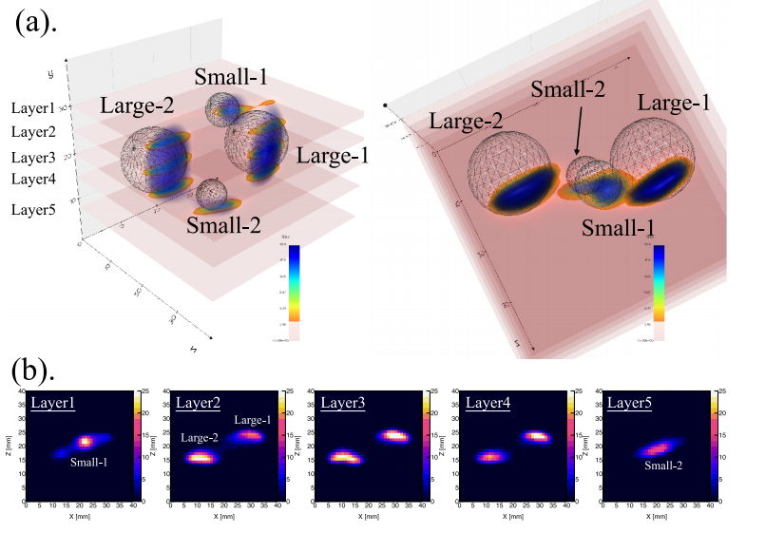
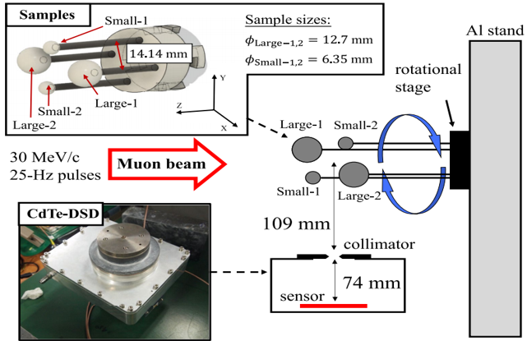
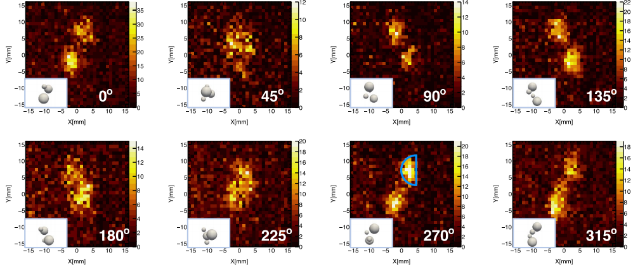
2.5 现有成像方法
单一深度+CT
I. Chiu et al., Sci. Rep. 12 (2022) 5261
12
Notes:
I‑Huan Chiu, Shin’ichiroTakeda, and others used an imaging system consisting of a 3 mm diameter pinhole collimator and large-area CdTe（Cadmium telluride double-sided strip detector） (CdTe-DSD) and prepare four polypropylene spheres.
等人使用了由直径为3 mm的针孔准直器和CdTe-DSD组成的成像系统，制备了四个聚丙烯球。
They used 16 independent projection images recorded by CdTe-DSD（Cadmium telluride double-sided strip detector） and processed them with the Maximum Likelihood Expectation Maximization (MLEM) algorithm to reconstruct the 3D volumetric model of the sample.
他们利用CdTe-DSD记录的16幅独立投影图像，并使用最大似然期望最大化（MLEM）算法对这些图像进行处理，以重建样本的3D体积模型。
Under a muon beam with a momentum of 30 MeV/c, the irradiation lasted about 34 hours.
- 在动量为30 MeV/c的μ子束下辐照了约34小时。
In this beam profile, the number of negative muons is approximately The sixth power of ten per second.
- 在这个光束剖面中，负μ介子的数量大约是每秒十的六次方个。
However, the use of a single muon energy cannot fully excite muon-induced X-rays at various positions of the polypropylene spheres, resulting in imaging effects limited to one layer of the four polypropylene spheres.
- 但是，单一缪子能量的使用不能完全激发聚丙烯球各个位置的缪致X射线，导致成像效果仅限于这四个聚丙烯球的一层。

Slide 13
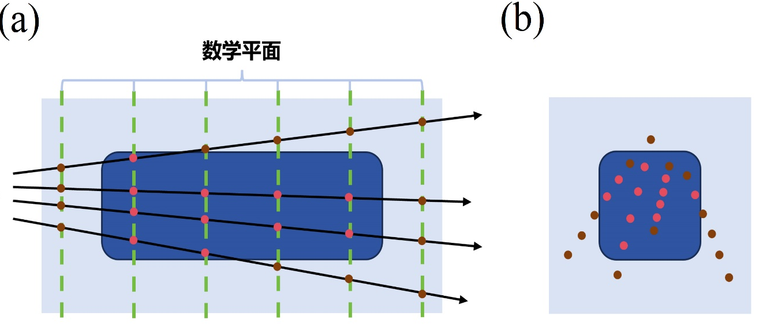
3.1 探测机理与成像算法
Detector
Muonic X-ray
Track boundary
collimator
Object
Negative muon beam
Step 1
Step 2
通过针孔准直器收集光子轨迹。
每个光子轨迹都与每个数学平面上产生一个交点。
Step 3
Step 4
通过设置阈值，选择具有最密集的交叉区域。
将区域内的交点数转换为体素赋值以重建要测量对象的图像。
13
Notes:
Step 1
the negative Muon beam interacts with the sample to produce Muonic X-rays, which are collected by the detector through a pinhole collimator, and the detector records their tracks and energies
负Muon 束流与样品作用产生Muonic x-ray，Muonic x-ray通过针孔准直器被探测器收集，探测器记录它们的径迹与能量
In the first step, a mathematical plane is set at certain distances within the range of the sample, and the photon track measured by the detector intersects with the mathematical plane
第一步，在样品所在范围内每隔一定距离设置一个数学平面，将探测器测到的光子径迹与数学平面做交点
Step 2
By setting a threshold, pick the one with the most dense intersections region.
通过设置阈值，选择具有最密集的交叉区域。
Step 3
Converts the number of intersections within a region to voxels Assign values to reconstruct the 3D image of the object to be measured.
将区域内的交点数转换为体素 赋值以重建要测量对象的 3D 图像。

Slide 14
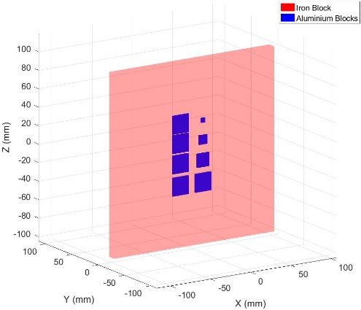
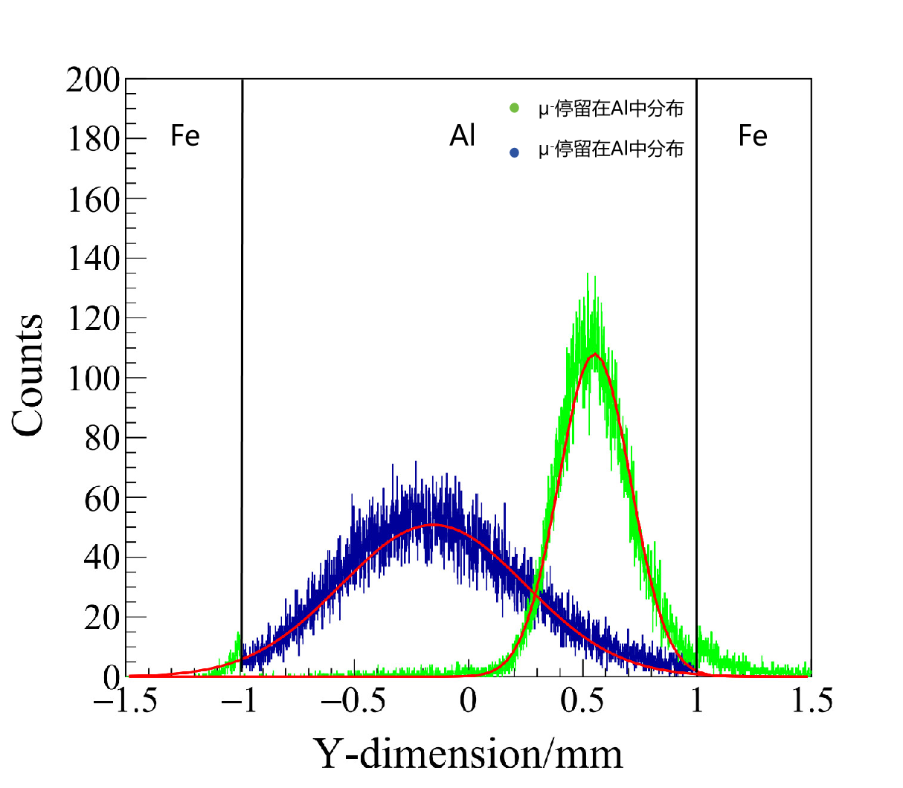
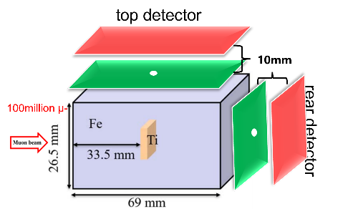
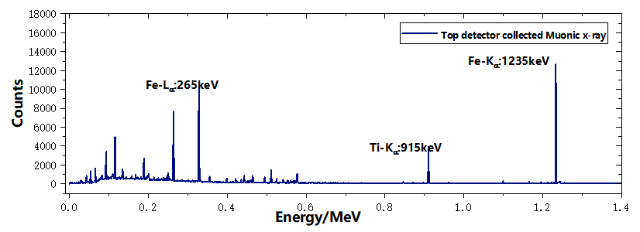
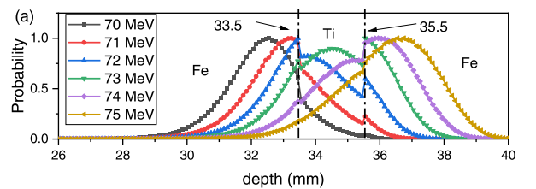
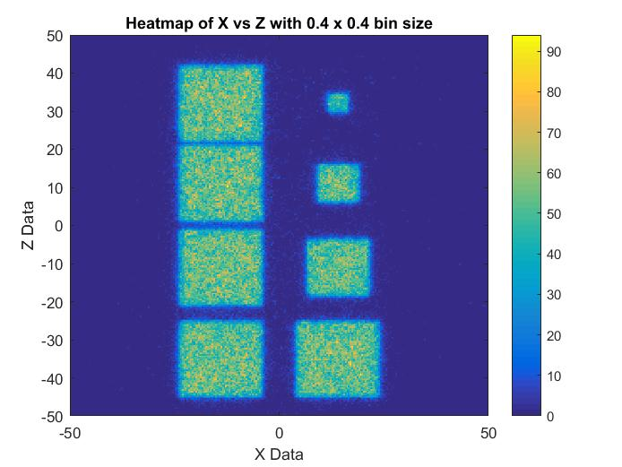
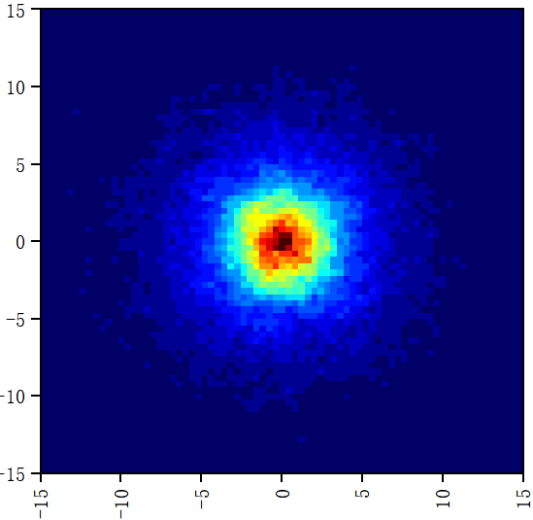
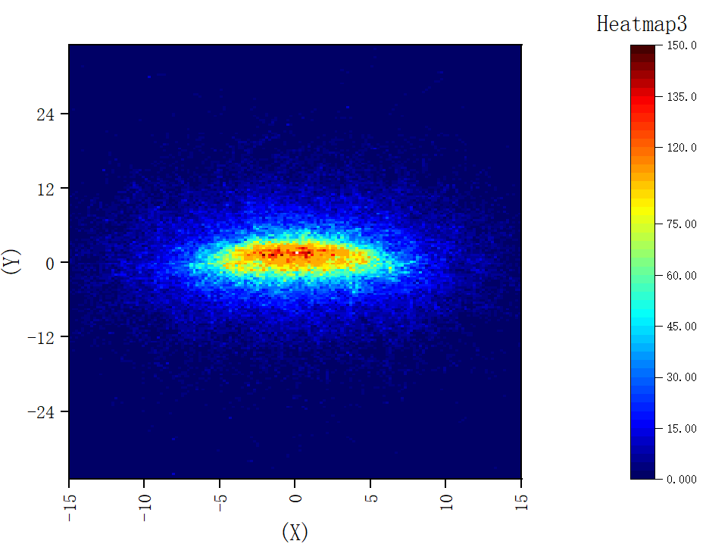
3.2 二维成像研究
对铁块包裹物体二维成像
建模图
20.4MeV下缪子在z轴的分布
xoy，xoz方向的光子轨迹密度图
分辨1mm的间隙
14
Notes:
First of all, the sample A I set is a cuboid iron block with side lengths of 26.5, 26.5, 69mm respectively wrapped with a titanium block with side lengths of 4,4,2 mm respectively
首先我设置的样品A是一个边长分别为26.5，26.5，69mm的长方体铁块包着一个边长分别为4，4，2毫米的钛块
with detectors placed on the upper and rear sides for measuring photon tracks. In order to excite most of the Muonic X-ray from the titanium block, the longitudinal muon stopping position distribution at different energies was calculated, and the most suitable muon energy was found through 3D scatter plots
在上侧与后侧各放置了一个探测器用于测光子径迹，为了使Muonic x-ray大部分由钛块激发，分别统计了不同能量下在纵向的缪子停止位置分布，与三维散点图配合找到最合适的缪束能量
It was found that when using a 73MeV muon source to bombard the sample, the number of muons staying on the titanium block was the highest, indicating that when using a 73MeV muon source to bombard the sample, the most Muonic X-ray was generated in the titanium block.
发现以73MeV的缪源去轰击样本时，停留在钛块的缪子数量最多，说明以73MeV能量的缪束去轰击样本时，在钛块中产生的Muonic xray最多。
Then, using the energy data obtained from the two detectors on the upper and rear sides, a spectrum was created to screen out the corresponding Muonic X-ray energy of the titanium element of μTi（titanium）K阿尔法 at energy of 915keV. The photon tracks of the corresponding energy obtained from the detectors were used, and the two-dimensional images of the two planes were obtained using the track density algorithm as follows:
随后利用上侧后侧两个探测器得到的能量数据做出光谱，筛选出钛元素相应的Muonic x ray ，μTi K阿尔法：915keV，通过探测器所得相应能量的光子径迹，使用径迹密度算法得到两个面的二维图像如下

Slide 15



3.3 三维重建方法
Step1
Step2
调整μ介子束能量以确定被测物质的深度
探测器收集的光子轨迹
交点
特定位置设置数学平面
探测器收集不同深度的特定能量的光子轨迹
堆叠多个 2D 图像以创建 3D 重建图像
Step4
Step3
收集从所有检测器获得的交点
每隔一定距离生成二维热图
15
Notes:
流程图 Flow chart
Step 1: Adjust the energy of the Muon beam and collect the photon energy collected by the detector to observe the energy spectrum to determine the depth range of the measured substance in the sample.
步骤1调整Muon beam的能量，收集探测器收集光子能量观察能谱以确定样品所测物质所在深度范围.
Step 2: After determining the energy range of the Muon beam, use the detector to collect the photon tracks of the Muonic X-ray and make intersections with the mathematical plane.
步骤2：在确定好Muon beam能量范围后用探测器收集Muonic xray的光子径迹，并与数学平面做交点.
Step 3: Use the intersection points obtained from multiple detectors to make a two-dimensional heat map every certain distance
步骤3：利用多个探测器得到的交点每隔一定距离做二维热图
Step 4, stack multiple 2D images to create a 3D reconstruction image
步骤4，使用多张二维成像堆叠为三维重建图

Slide 16








Generate multiple heatmaps by changing the y-axis while keeping the xz direction constant, using 3DSlicer for visualization
3.4 样本B成像结果
单物体径迹密度成像
Detector 1
Detector 2
29MeV 29-41MeV
3 mm diameter pinhole collimator
10mm
Fe
Detector 1
YOZ side
YOZ side
10mm
Ti
0.5mm
10mm
Muon:29-41MeV/c
10mm
XOYside
XOYside
三维重建成像
XOYside
XOZ side
16
Notes:
The Sample B consists of a cylindrical titanium block wrapped in an iron block, with a Muon beam diameter of 0.5mm and an energy range of 29-41MeV
模型为铁块中包裹着圆柱形钛块，Muon beam直径为0.5mm，能量范围从29-41MeV,
Obtaining a two-dimensional image of Muon beam with an energy of 29MeV, it was found that only a portion of the cylindrical titanium block was imaged
得到Muon beam能量为29MeV的二维图像发现只对圆柱体钛块有一部分的成像
When the energy of the Muon beam is 29-41Mev, it was found that the imaging sizes of the three planes yoz, xoy, and xoz are slightly larger than the former, which more fully displays the size of the titanium block,
在Muon beam 能量为29-41Mev时发现三个面yoz，xoy，xoz成像大小要比前者大一些，更为完整的将钛块尺寸显示出来
After subsequent 3D reconstruction, the image is shown below, and the overall imaging size is not significantly different from the titanium in the sample
随后三维重建后图如下，整体成像尺寸没有和样品中的钛差异不大

Slide 17







3.5 样本C成像结果
正方体尺寸 间距
20mm
15mm
10mm
5 mm
4mm
2mm
1mm
缪子能量：0.5-18MeV
材料：Al
负缪子束
间距：4mm
缪子能量：0.5-75MeV
尺寸：20mm*20mm*20mm
17
Notes:
Step 1
the negative Muon beam interacts with the sample to produce Muonic X-rays, which are collected by the detector through a pinhole collimator, and the detector records their tracks and energies
负Muon 束流与样品作用产生Muonic x-ray，Muonic x-ray通过针孔准直器被探测器收集，探测器记录它们的径迹与能量
In the first step, a mathematical plane is set at certain distances within the range of the sample, and the photon track measured by the detector intersects with the mathematical plane
第一步，在样品所在范围内每隔一定距离设置一个数学平面，将探测器测到的光子径迹与数学平面做交点
Step 2
By setting a threshold, pick the one with the most dense intersections region.
通过设置阈值，选择具有最密集的交叉区域。
Step 3
Converts the number of intersections within a region to voxels Assign values to reconstruct the 3D image of the object to be measured.
将区域内的交点数转换为体素 赋值以重建要测量对象的 3D 图像。

Slide 18








3.6 样本D成像结果
10mm
Ti
Fe
6mm
Cu
14mm
15mm
14mm
20mm
能谱信息
Muon beam
0-25 MeV/c
49mm
25MeV/c
PSI πE1.2 光束光斑特性
钛锥、铁球、铜台，及其共同重建
18
Notes:
随后我修改了Muon beam的直径，并且改变Muon beam的方向，PSI πE1.2 beamline束斑集中在半径为25mm的圆内，与我所设置的muon beam 尺寸相符，我这次设置Muon beam能量为0-25MeV，打了4000万的负Muon，得到这样的重建结果，铁球和铜圆台被良好重建出来，重建尺寸与原版几乎无差异。
Then I modified the diameter of the Muon beam and changed the direction of the Muon beam.
随后我修改了Muon beam的直径，并且改变Muon beam的方向，
PSI πE1.2 beamline energy is 25MeV/c The beam spot is concentrated in a circle with a radius of 25mm, which is consistent with the size of muon beam set by me. This time, I set the energy of Muon beam to be 0-25MeV.
PSI πE1.2 beamline能量为25MeV/c束斑集中在半径为25mm的圆内，与我所设置的muon beam 尺寸相符，我这次设置Muon beam能量为0-25MeV，
Hit 40 million negative Muon, get such a reconstruction result, the iron ball and copper table are well reconstructed, the reconstruction size is almost the same as the original.
打了4000万的负Muon，得到这样的重建结果，铁球和铜圆台被良好重建出来，重建尺寸与原版几乎无差异。

Slide 19










3.7样本C成像指标验证
引入结构相似度评价指标
14mm
10mm
Ti
Fe
6mm
Cu
15mm
14mm
20mm
3
6
9
12
SSIM 均值 均方根
Z轴位置 | -18.4mm | -14.4mm | -10.4mm | -6.4mm | -2.4mm | 1.6mm
SSIM | 0.81 | 0.87 | 0.86 | 0.67 | 0.73 | 0.75
Z轴位置 | 5.6mm | 9.6mm | 13.6mm | 17.6mm | 21.6mm | 25.6mm
SSIM | 0.71 | 0.61 | 0.67 | 0.69 | 0.64 | 0.57
铜圆台： 0.65 0.637
钛圆锥： 0.84 0.847
铁圆球： 0.71 0.715
不同z方向切出平面与理想中所成热图对比得到的SSIM值
19
Notes:
随后我修改了Muon beam的直径，并且改变Muon beam的方向，PSI πE1.2 beamline束斑集中在半径为25mm的圆内，与我所设置的muon beam 尺寸相符，我这次设置Muon beam能量为0-25MeV，打了4000万的负Muon，得到这样的重建结果，铁球和铜圆台被良好重建出来，重建尺寸与原版几乎无差异。
Then I modified the diameter of the Muon beam and changed the direction of the Muon beam.
随后我修改了Muon beam的直径，并且改变Muon beam的方向，
PSI πE1.2 beamline energy is 25MeV/c The beam spot is concentrated in a circle with a radius of 25mm, which is consistent with the size of muon beam set by me. This time, I set the energy of Muon beam to be 0-25MeV.
PSI πE1.2 beamline能量为25MeV/c束斑集中在半径为25mm的圆内，与我所设置的muon beam 尺寸相符，我这次设置Muon beam能量为0-25MeV，
Hit 40 million negative Muon, get such a reconstruction result, the iron ball and copper table are well reconstructed, the reconstruction size is almost the same as the original.
打了4000万的负Muon，得到这样的重建结果，铁球和铜圆台被良好重建出来，重建尺寸与原版几乎无差异。

Slide 20
4 总结与展望
Achievement
使用缪致X射线对不同尺寸，形状，物质类型使用径迹密度算法进行三维、二维重建，且使用结构相似度对成像质量进行评估。
Insufficient
目前探测方法中无法对光子动量进行捕捉。
多次改变μ介子能量以控制其捕获深度需要更长的照射时间，这增加了实际成本。
Future:
在三个位置使用探测器只能证明使用该算法的初步可行性，以后应该增加额外的探方向，以增加收集的光子轨迹数量，提高成像质量。
未来，我们计划结合时间信息来提高成像质量。
20

Slide 21


谢谢！
欢迎各位专家批评指正！

