Slide 1
2024/03/18
组会

Slide 2
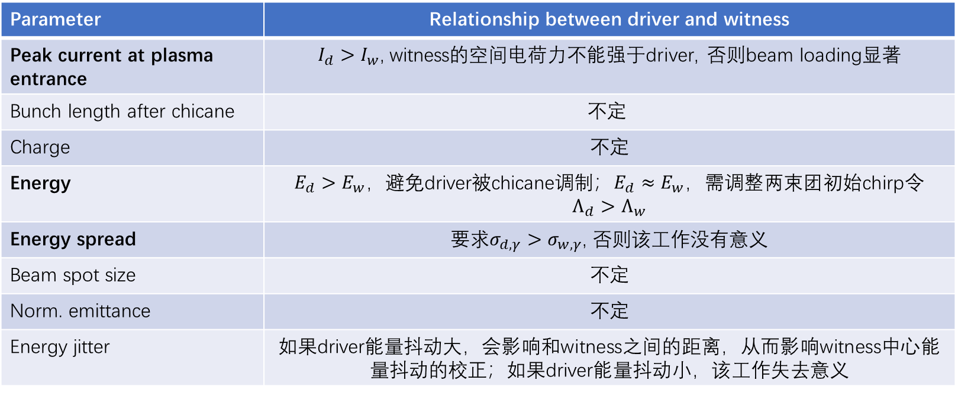
Beam-driven plasma dechirper
driver和witness的参数如何选取能令方案更有意义？Driver至少有一个参数比witness差
Parameter | Relationship between driver and witness
Peak current at plasma entrance | $I_{d}>I_{w}$, witness的空间电荷力不能强于driver, 否则beam loading显著
Bunch length after chicane | $$不定$$
Charge | 不定
Energy | $E_{d}>E_{w}$，避免driver被chicane调制；$E_{d}≈E_{w}，$需调整两束团初始chirp令$Λ_{d}>Λ_{w}$
Energy spread | 要求$σ_{d,γ}>σ_{w,γ}$, 否则该工作没有意义
Beam spot size | 不定
Norm. emittance | 不定
Energy jitter | 如果driver能量抖动大，会影响和witness之间的距离，从而影响witness中心能量抖动的校正；如果driver能量抖动小，该工作失去意义

Slide 3


Beam-driven plasma dechirper
driver和witness的参数如何选取能令方案更有意义？$E_{w}>E_{d}，$用能量低，电荷量大的driver去dechirp能量高、电荷量~nC，束长长的witness
Parameter | Relationship between driver and witness
Peak current at plasma entrance | $I_{d}>I_{w}$, witness的空间电荷力不能强于driver, 否则beam loading显著
Bunch length after chicane | $$不定$$
Charge | 不定
Energy | $E_{d}>E_{w}$，避免driver被chicane调制；$E_{d}≈E_{w}，$需调整两束团初始chirp令$Λ_{d}>Λ_{w}$
Energy spread | 要求$σ_{d,γ}>σ_{w,γ}$, 否则该工作没有意义
Beam spot size | 不定
Norm. emittance | 不定
Energy jitter | 如果driver能量抖动大，会影响和witness之间的距离，从而影响witness中心能量抖动的校正；如果driver能量抖动小，该工作失去意义

Slide 4
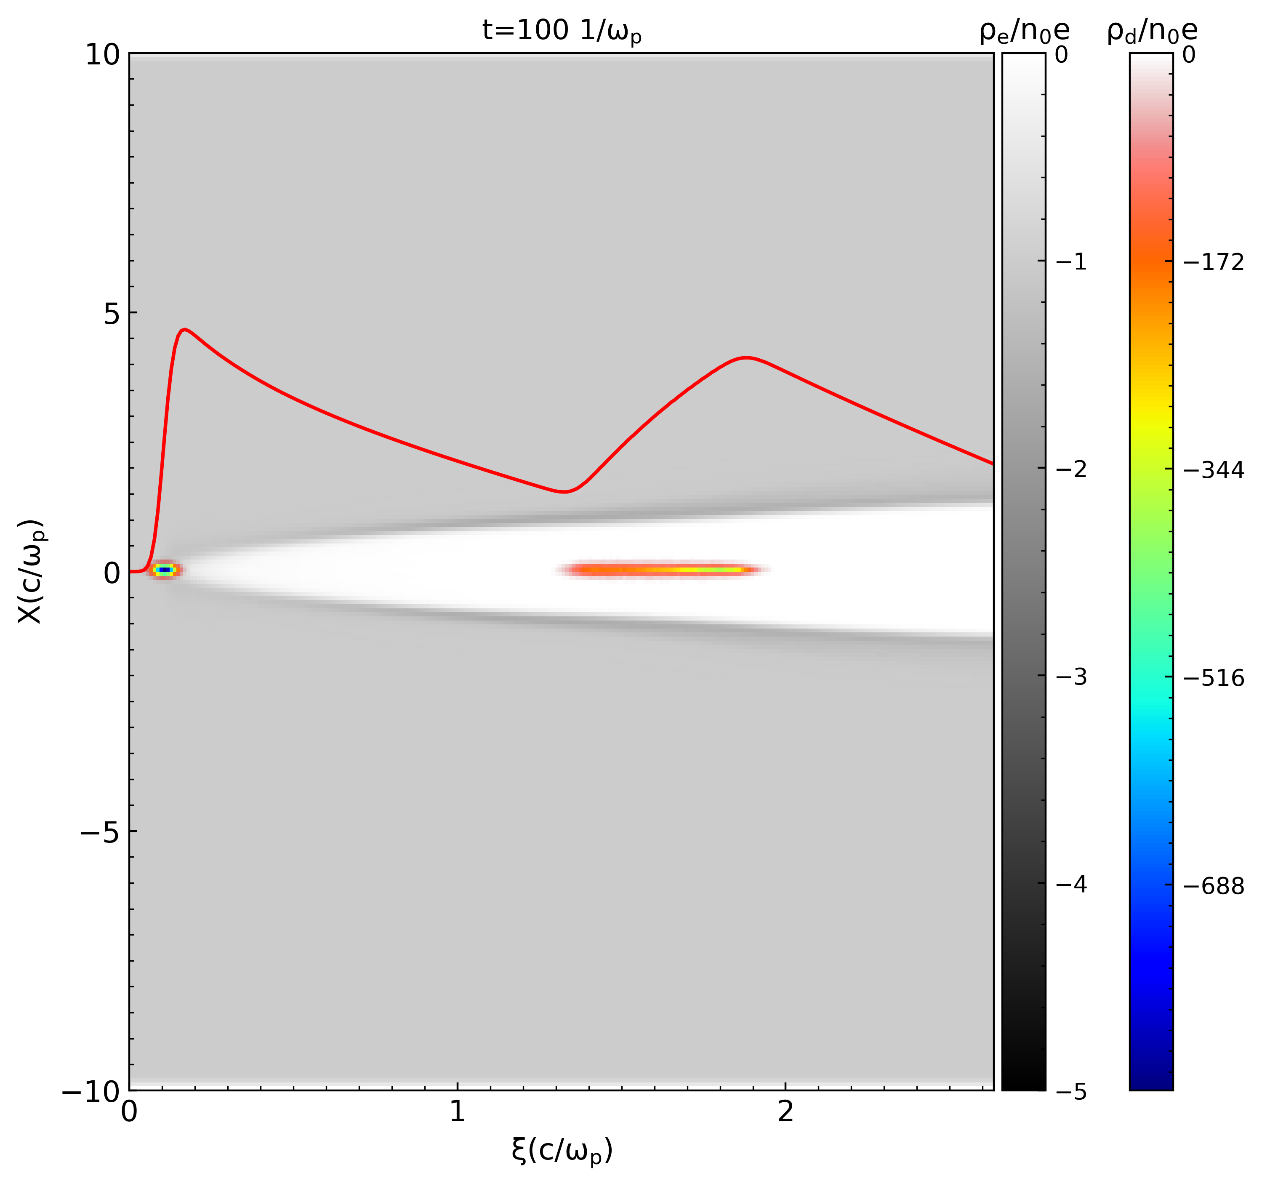

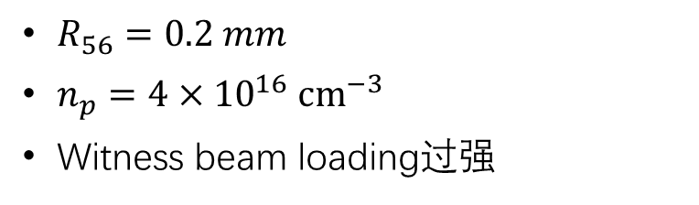
Case 1 $E_{d}≈E_{w}$
Parameter | Driver | Witness
Energy [MeV] | 500 | 500
Charge [pC] | 200 | 500
Bunch length [um] | 2 | 2
Energy spread | 1% | 1%
Norm. emit. [umrad] | 2 | 2
Energy chirp [1/m] | -5300 | 5300
$R_{56}=0.2 mm$
$n_{p}=4×{10}^{16} {cm}^{−3}$
Witness beam loading过强
Initial
After chicane
APD

Slide 5
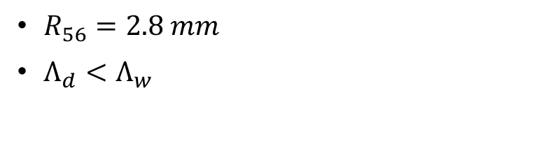

Case 2 $E_{d}>E_{w}$
Parameter | Driver | Witness
Energy [MeV] | 1000 | 500
Charge [pC] | 500 | 500
Bunch length [um] | 10 | 2
Energy spread | 5% | 1%
Norm. emit. [umrad] | 2 | 2
Energy chirp [1/m] | -5300 | 5300
$R_{56}=2.8 mm$
$Λ_{d}<Λ_{w}$
After APL1
Initial
After chicane
Driver和witness能量不同，经过同一个APL时受到的聚焦力不同

Slide 6

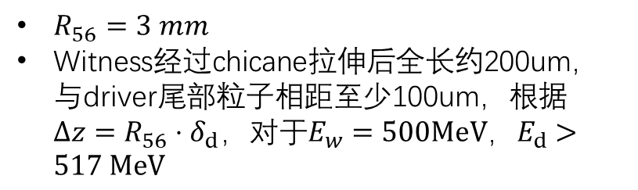
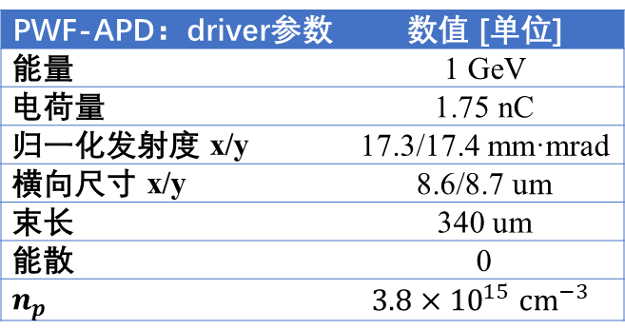
Case 3 $E_{d}>E_{w}$ $Q_{d}>Q_{w}$
PWF-APD：driver参数 | 数值 [单位]
能量 | 1 GeV
电荷量 | 1.75 nC
归一化发射度 x/y | 17.3/17.4 mm·mrad
横向尺寸 x/y | 8.6/8.7 um
束长 | 340 um
能散 | 0
$n_{p}$ | $$3.8×{10}^{15} {cm}^{−3}$$
$R_{56}=3 mm$
Witness经过chicane拉伸后全长约200um，与driver尾部粒子相距至少100um，根据$Δz=R_{56}⋅δ_{d}，对于E_{w}=500MeV，E_{d}>517 MeV$

Slide 7

当$E_{d}≈E_{w}$时，需要给两个束流合适的初始chirp，使得：driver被压缩，witness被拉伸；
当$E_{d}>E_{w}时$，如果两束流走同一条束线，会面临APL聚焦力不同的问题，以及两束流间距不能太大的问题

Slide 8
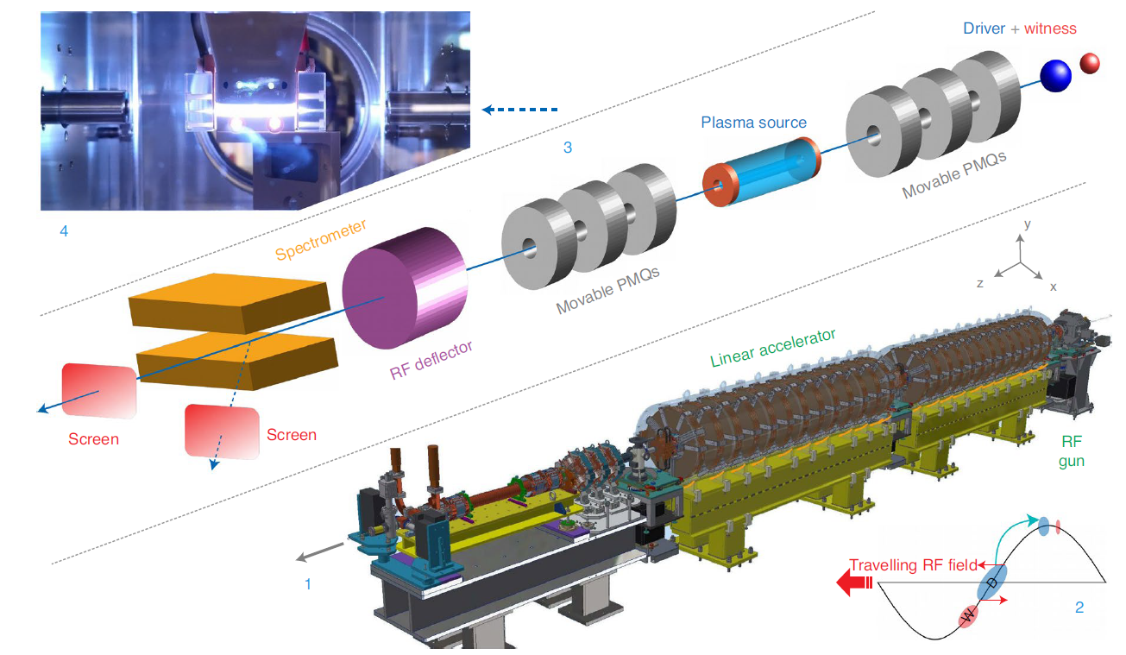
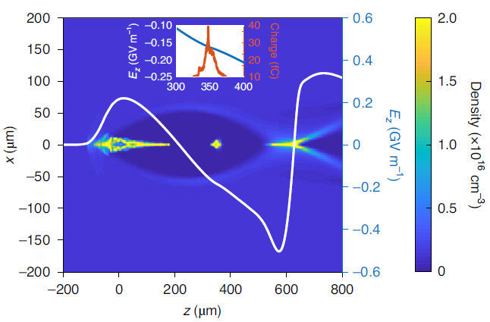
SPARC_LAB 2021 PWFA experiment
Driver & witness由传统加速器产生
Driver具有初始正啁啾; witness具有负啁啾
Parameter | Driver |  | Witness
 | initial | final | initial | final
Energy [MeV] |  | 89.5 | 89.1 | 93.1
Charge [pC] | 200 |  | 20
Bunch length [um] | 70 |  | 12
Energy spread [%] | 0.28 |  | 0.2 | 0.1
Energy stability [%] |  |  |  | 0.5
Norm. emit. [umrad] |  |  |  | 0.9
R. Pompili, etal. Nat. Phys. 17, 499–503 (2021).

