Slide 1
2024.3.18

Slide 2
$$\frac{∂E}{∂y_{1}}≈4γ\frac{eN_{0}}{\sqrt{π}}\int_{0}^{∞}{ⅆq}\left\{\frac{1}{\left(q+2σ_{y}^{2}\right)\sqrt{\left(q+2σ_{x}^{2}\right)\left(q+2σ_{y}^{2}\right)\left(q+2{\overline{σ}}_{z}^{2}\right)}}\left[\sum_{n=1}^{∞}{{\left(−1\right)}^{n+1}\exp\left(−\frac{{\left(2nh\right)}^{2}}{q+2σ_{y}^{2}}\right)\left[\frac{2{\left(2nh\right)}^{2}}{q+2σ_{y}^{2}}−1\right]}\right]\right\}$$
若$σ_{x},σ_{y},{\overline{σ}}_{z}≪h$，上式可以变为：
$$\frac{∂E}{∂y_{1}}≈4γ\frac{eN_{0}}{\sqrt{π}}\sum_{n=1}^{∞}{{\left(−1\right)}^{n+1}}\int_{0}^{∞}{ⅆq}\left[\frac{1}{q^{5/2}}\exp\left(−\frac{{\left(2nh\right)}^{2}}{q}\right)\left[\frac{2{\left(2nh\right)}^{2}}{q}−1\right]\right]$$
积分号内可以分为两部分，
$$\int_{0}^{∞}{ⅆq}\left[\frac{2{\left(2nh\right)}^{2}}{q^{7/2}}\exp\left(−\frac{{\left(2nh\right)}^{2}}{q}\right)\right]$$
和
$$\int_{0}^{∞}{ⅆq}\left[\frac{1}{q^{5/2}}\exp\left(−\frac{{\left(2nh\right)}^{2}}{q}\right)\right]$$
$$\int_{0}^{∞}{ⅆq}\left[\frac{1}{q^{5/2}}\exp\left(−\frac{{\left(2nh\right)}^{2}}{q}\right)\right]=−\int_{∞}^{0}{ⅆ\frac{1}{\sqrt{q}}2q^{\frac{3}{2}}}\left[\frac{1}{q^{\frac{5}{2}}}\exp\left(−\frac{{\left(2nh\right)}^{2}}{q}\right)\right]=2\int_{0}^{∞}{ⅆ\frac{1}{\sqrt{q}}}\left[{\left(\frac{1}{\sqrt{q}}\right)}^{2}\exp\left(−{\left(\frac{2nh}{\sqrt{q}}\right)}^{2}\right)\right]$$
类比
这里$a={\left(2nh\right)}^{2}$，上式为：
$$−2\frac{∂_{\overline{2\sqrt{a}}}^{\sqrt{π}}}{∂a}=\frac{\sqrt{π}}{2a^{\frac{3}{2}}}=\frac{\sqrt{π}}{16n^{3}h^{3}}$$

Slide 3
$$\int_{0}^{∞}{ⅆq}\left[\frac{2{\left(2nh\right)}^{2}}{q^{7/2}}\exp\left(−\frac{{\left(2nh\right)}^{2}}{q}\right)\right]=−2{\left(2nh\right)}^{2}\int_{∞}^{0}{ⅆ\frac{1}{\sqrt{q}}2q^{\frac{3}{2}}}\left[\frac{1}{q^{\frac{7}{2}}}\exp\left(−\frac{{\left(2nh\right)}^{2}}{q}\right)\right]=4{\left(2nh\right)}^{2}\int_{0}^{∞}{ⅆ\frac{1}{\sqrt{q}}}\left[{\left(\frac{1}{\sqrt{q}}\right)}^{4}\exp\left(−{\left(\frac{2nh}{\sqrt{q}}\right)}^{2}\right)\right]$$
这里$a={\left(2nh\right)}^{2}$，上式为：
$$4{\left(2nh\right)}^{2}\frac{{∂^{2}}_{\overline{2\sqrt{a}}}^{\sqrt{π}}}{∂a^{2}}=4{\left(2nh\right)}^{2}\frac{3\sqrt{π}}{8a^{\frac{5}{2}}}={2\left(2nh\right)}^{2}\frac{3\sqrt{π}}{128n^{5}h^{5}}$$
原式为：
$$\frac{∂E}{∂y_{1}}≈4γ\frac{eN_{0}}{\sqrt{π}}\sum_{n=1}^{∞}{{\left(−1\right)}^{n+1}}\int_{0}^{∞}{ⅆq}\left[\frac{1}{q^{\frac{5}{2}}}\exp\left(−\frac{{\left(2nh\right)}^{2}}{q}\right)\left[\frac{2{\left(2nh\right)}^{2}}{q}−1\right]\right]=4γ\frac{eN_{0}}{\sqrt{π}}\sum_{n=1}^{∞}{{\left(−1\right)}^{n+1}}\left[{2\left(2nh\right)}^{2}\frac{3\sqrt{π}}{128n^{5}h^{5}}−\frac{\sqrt{π}}{16n^{3}h^{3}}\right]=4γ\frac{eN_{0}}{\sqrt{π}}\sum_{n=1}^{∞}{{\left(−1\right)}^{n+1}}\frac{\sqrt{π}}{8n^{3}h^{3}}=4γ\frac{eN_{0}}{\sqrt{π}}\frac{\sqrt{π}}{8h^{3}}η\left(3\right)$$
$η\left(x\right)$是​狄利克雷Eta函数

Slide 4
$$\frac{∂E}{∂y_{1}}≈4γ\frac{eN_{0}}{\sqrt{π}}\int_{0}^{∞}{ⅆq}\left\{\frac{1}{\left(q+2σ_{y}^{2}\right)\sqrt{\left(q+2σ_{x}^{2}\right)\left(q+2σ_{y}^{2}\right)\left(q+2{\overline{σ}}_{z}^{2}\right)}}\left[\sum_{n=1}^{∞}{{\left(−1\right)}^{n+1}\exp\left(−\frac{{\left(2nh\right)}^{2}}{q+2σ_{y}^{2}}\right)\left[\frac{2{\left(2nh\right)}^{2}}{q+2σ_{y}^{2}}−1\right]}\right]\right\}$$
$$σ_{x},σ_{y},{\overline{σ}}_{z}≪h$$
$$\frac{∂E}{∂y_{1}}≈4γ\frac{eN_{0}}{\sqrt{π}}\frac{\sqrt{π}}{8h^{3}}η\left(3\right)=\frac{eN_{0}}{2h^{3}}η\left(3\right)$$
对于DC的镜像磁场：
$$Δk_{3}=B\frac{4r_{e}N}{\sqrt{π}}\sum_{p=−∞}^{+∞}{\int_{0}^{∞}{ⅆq}\left\{\frac{\exp\left(−\frac{{\left(pγλ\right)}^{2}}{q+2{\overline{σ}}_{z}^{2}}\right)}{\left(q+2σ_{y}^{2}\right)\sqrt{\left(q+2σ_{x}^{2}\right)\left(q+2σ_{y}^{2}\right)\left(q+2{\overline{σ}}_{z}^{2}\right)}}\left[\sum_{n=1}^{∞}{\exp\left(−\frac{{\left(2ng\right)}^{2}}{q+2σ_{y}^{2}}\right)\left[\frac{2{\left(2ng\right)}^{2}}{q+2σ_{y}^{2}}−1\right]}\right]\right\}}$$
$$σ_{x},σ_{y},{\overline{σ}}_{z}≪h$$
$$Δk_{3}=4γ\frac{eN_{0}}{\sqrt{π}}\sum_{n=1}^{∞}{\frac{\sqrt{π}}{8n^{3}g^{3}}}=4γ\frac{eN_{0}}{\sqrt{π}}\frac{\sqrt{π}}{8g^{3}}ζ\left(3\right)=\frac{eN_{0}}{2g^{3}}ζ\left(3\right)$$
$ζ\left(x\right)$是​黎曼Zeta函数

Slide 5
$$Δk_{1}= \frac{4r_{e}N}{β^{2}\sqrt{π}}\int_{0}^{∞}{ⅆq}\left\{\frac{1}{\left(q+2σ_{y}^{2}\right)\sqrt{\left(q+2σ_{x}^{2}\right)\left(q+2σ_{y}^{2}\right)\left(q+2{\overline{σ}}_{z}^{2}\right)}}\left[\sum_{n=1}^{∞}{{\left(−1\right)}^{n+1}\exp\left(−\frac{{\left(2nh\right)}^{2}}{q+2σ_{y}^{2}}\right)\left[\frac{2{\left(2nh\right)}^{2}}{q+2σ_{y}^{2}}−1\right]}\right]\right\}$$
$$Δk_{2}=(1−B)\frac{4r_{e}N}{\sqrt{π}}\int_{0}^{∞}{ⅆq}\left\{\frac{1}{\left(q+2σ_{y}^{2}\right)\sqrt{\left(q+2σ_{x}^{2}\right)\left(q+2σ_{y}^{2}\right)\left(q+2{\overline{σ}}_{z}^{2}\right)}}\left[\sum_{n=1}^{∞}{{\left(−1\right)}^{n+1}\exp\left(−\frac{{\left(2nh\right)}^{2}}{q+2σ_{y}^{2}}\right)\left[\frac{2{\left(2nh\right)}^{2}}{q+2σ_{y}^{2}}−1\right]}\right]\right\}$$
$$Δk_{3}=B\frac{4r_{e}N}{\sqrt{π}}\int_{0}^{∞}{ⅆq}\left\{\frac{1}{\left(q+2σ_{y}^{2}\right)\sqrt{\left(q+2σ_{x}^{2}\right)\left(q+2σ_{y}^{2}\right)\left(q+2{\overline{σ}}_{z}^{2}\right)}}\left[\sum_{n=1}^{∞}{\exp\left(−\frac{{\left(2ng\right)}^{2}}{q+2σ_{y}^{2}}\right)\left[\frac{2{\left(2ng\right)}^{2}}{q+2σ_{y}^{2}}−1\right]}\right]\right\}$$
$$σ_{x},σ_{y},{\overline{σ}}_{z}≪h$$
$$Δk_{1}= \frac{4r_{e}N}{β^{2}\sqrt{π}}\frac{\sqrt{π}}{8h^{3}}η\left(3\right)=\frac{r_{e}N_{0}}{2β^{2}h^{3}}η\left(3\right)$$
$$Δk_{2}=(1−B)\frac{4r_{e}N}{\sqrt{π}}\frac{\sqrt{π}}{8h^{3}}η\left(3\right)=(1−B)\frac{r_{e}N_{0}}{2h^{3}}η\left(3\right)$$
$$Δk_{3}=B\frac{4r_{e}N}{\sqrt{π}}\frac{\sqrt{π}}{8g^{3}}ζ\left(3\right)=B\frac{r_{e}N_{0}}{2g^{3}}ζ\left(3\right)$$
$η\left(x\right)$是​狄利克雷Eta函数
$ζ\left(x\right)$是​黎曼Zeta函数
$$Δν_{y}=−\frac{1}{4π}\left\{\int_{0}^{C}{β_{y}\left(s\right)\left[Δk_{1}\left(s\right)+Δk_{2}\left(s\right)\right]ⅆs}+\int_{mag}{β_{y}\left(s\right)Δk_{3}\left(s\right)ⅆs}\right\}$$

Slide 6
$$Δk_{1,coh}= \frac{4r_{e}N}{β^{2}\sqrt{π}}ξ$$
$$Δk_{2,coh}=(1−B)\frac{4r_{e}N}{\sqrt{π}}ξ$$
$$Δk_{3,coh}=B\frac{4r_{e}N}{\sqrt{π}}ξ$$
$$ξ=\int_{0}^{∞}{ⅆq}\left\{\frac{1}{\left(q+2σ_{y}^{2}\right)\sqrt{\left(q+2σ_{x}^{2}\right)\left(q+2σ_{y}^{2}\right)\left(q+2{\overline{σ}}_{z}^{2}\right)}}\left[\sum_{n=1}^{∞}{\exp\left(−\frac{{[(4n−2)h]}^{2}}{q+2σ_{y}^{2}}\right)\left[\frac{4{[(4n−2)h]}^{2}}{q+2σ_{y}^{2}}−2\right]}\right]\right\}$$
与之前一样，这里$a={[(4n−2)h]}^{2}$
积分号内可以分为两部分，
$$\int_{0}^{∞}{ⅆq}\left[\frac{4{[(4n−2)h]}^{2}}{q^{7/2}}\exp\left(−\frac{{[(4n−2)h]}^{2}}{q}\right)\right]$$
和
$$\int_{0}^{∞}{ⅆq}\left[\frac{1}{q^{5/2}}\exp\left(−\frac{{[(4n−2)h]}^{2}}{q}\right)\right]$$
这里$a={[(4n−2)h]}^{2}$，上式为：
$$8{[(4n−2)h]}^{2}\frac{{∂^{2}}_{\overline{2\sqrt{a}}}^{\sqrt{π}}}{∂a^{2}}=8{[(4n−2)h]}^{2}\frac{3\sqrt{π}}{8a^{\frac{5}{2}}}=\frac{3\sqrt{π}}{{[(4n−2)h]}^{3}}$$
这里$a={\left(2nh\right)}^{2}$，上式为：
$$−2\frac{∂_{\overline{2\sqrt{a}}}^{\sqrt{π}}}{∂a}=\frac{\sqrt{π}}{2a^{\frac{3}{2}}}=\frac{\sqrt{π}}{{[(4n−2)h]}^{3}}$$
$$\frac{3\sqrt{π}}{{[(4n−2)h]}^{3}}−\frac{\sqrt{π}}{{\left[\left(4n−2\right)h\right]}^{3}}=\frac{2\sqrt{π}}{{\left[\left(4n−2\right)h\right]}^{3}}=\frac{\sqrt{π}}{4h^{3}}\frac{1}{{\left(2n−1\right)}^{3}}$$
$$\frac{\sqrt{π}}{4h^{3}}\sum_{n=1}^{∞}{\frac{1}{{\left(2n−1\right)}^{3}}}=\frac{\sqrt{π}}{4h^{3}}\left(\frac{η\left(3\right)+ζ\left(3\right)}{2}\right)$$

Slide 7
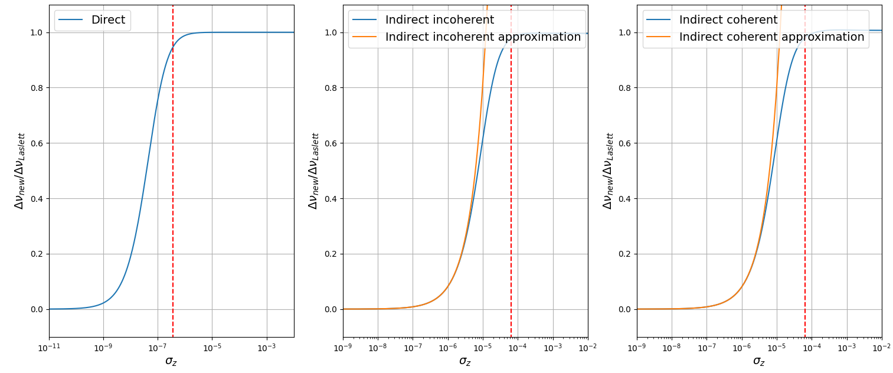
$$Δk_{1,coh}= \frac{4r_{e}N}{β^{2}\sqrt{π}}ξ$$
$$Δk_{2,coh}=(1−B)\frac{4r_{e}N}{\sqrt{π}}ξ$$
$$Δk_{3,coh}=B\frac{4r_{e}N}{\sqrt{π}}ξ$$
$$ξ=\int_{0}^{∞}{ⅆq}\left\{\frac{1}{\left(q+2σ_{y}^{2}\right)\sqrt{\left(q+2σ_{x}^{2}\right)\left(q+2σ_{y}^{2}\right)\left(q+2{\overline{σ}}_{z}^{2}\right)}}\left[\sum_{n=1}^{∞}{\exp\left(−\frac{{[(4n−2)h]}^{2}}{q+2σ_{y}^{2}}\right)\left[\frac{4{[(4n−2)h]}^{2}}{q+2σ_{y}^{2}}−2\right]}\right]\right\}$$
$$σ_{x},σ_{y},{\overline{σ}}_{z}≪h$$
$$ξ=\frac{\sqrt{π}}{8h^{3}}\left[η\left(3\right)+ζ\left(3\right)\right]$$
$$Δν_{y}=−\frac{1}{4π}\left\{\int_{0}^{C}{β_{y}\left(s\right)\left[Δk_{1}\left(s\right)+Δk_{2}\left(s\right)\right]ⅆs}+\int_{mag}{β_{y}\left(s\right)Δk_{3}\left(s\right)ⅆs}\right\}$$

Slide 8
$$Δk_{1}= \frac{4r_{e}N}{β^{2}\sqrt{π}}\sum_{p=−∞}^{+∞}{\int_{0}^{∞}{ⅆq}\left\{\frac{\exp\left(−\frac{{\left(pγλ\right)}^{2}}{q+2{\overline{σ}}_{z}^{2}}\right)}{\left(q+2σ_{y}^{2}\right)\sqrt{\left(q+2σ_{x}^{2}\right)\left(q+2σ_{y}^{2}\right)\left(q+2{\overline{σ}}_{z}^{2}\right)}}\left[\sum_{n=1}^{∞}{{\left(−1\right)}^{n+1}\exp\left(−\frac{{\left(2nh\right)}^{2}}{q+2σ_{y}^{2}}\right)\left[\frac{2{\left(2nh\right)}^{2}}{q+2σ_{y}^{2}}−1\right]}\right]\right\}}$$
这里$a={\left(2nh\right)}^{2}+{\left(pγλ\right)}^{2}$，上式为：
$$4{\left(2nh\right)}^{2}\frac{{∂^{2}}_{\overline{2\sqrt{a}}}^{\sqrt{π}}}{∂a^{2}}=4{\left(2nh\right)}^{2}\frac{3\sqrt{π}}{8a^{\frac{5}{2}}}=\frac{3{\left(2nh\right)}^{2}\sqrt{π}}{{2[{\left(2nh\right)}^{2}+{\left(pγλ\right)}^{2}]}^{5/2} }$$
积分号内可以分为两部分，
$$\int_{0}^{∞}{ⅆq}\left[\frac{2{\left(2nh\right)}^{2}}{q^{7/2}}\exp\left(−\frac{{\left(2nh\right)}^{2}+{\left(pγλ\right)}^{2}}{q}\right)\right]$$
和
$$\int_{0}^{∞}{ⅆq}\left[\frac{1}{q^{5/2}}\exp\left(−\frac{{\left(2nh\right)}^{2}+{\left(pγλ\right)}^{2}}{q}\right)\right]$$
这里$a={\left(2nh\right)}^{2}+{\left(pγλ\right)}^{2}$，上式为：
$$−2\frac{∂_{\overline{2\sqrt{a}}}^{\sqrt{π}}}{∂a}=\frac{\sqrt{π}}{2a^{\frac{3}{2}}}=\frac{\sqrt{π}}{2{[{\left(2nh\right)}^{2}+{\left(pγλ\right)}^{2}]}^{3/2} }$$
$$Δk_{1}= \frac{4r_{e}N}{β^{2}\sqrt{π}}\sum_{p=−∞}^{+∞}{\sum_{n=1}^{∞}{{\left(−1\right)}^{n+1}\left[\frac{3{\left(2nh\right)}^{2}\sqrt{π}}{{2\left[{\left(2nh\right)}^{2}+{\left(pγλ\right)}^{2}\right]}^{\frac{5}{2}} }−\frac{\sqrt{π}}{2{\left[{\left(2nh\right)}^{2}+{\left(pγλ\right)}^{2}\right]}^{\frac{3}{2}} }\right]}}=\frac{2r_{e}N}{β^{2}}\sum_{p=−∞}^{+∞}{\sum_{n=1}^{∞}{{\left(−1\right)}^{n+1}\frac{3{\left(2nh\right)}^{2}}{{[{\left(2nh\right)}^{2}+{\left(pγλ\right)}^{2}]}^{5/2} }−}}\frac{1}{{[{\left(2nh\right)}^{2}+{\left(pγλ\right)}^{2}]}^{3/2} }$$
若令$A\left(n,p\right)={\left(2nh\right)}^{2}+{\left(pγλ\right)}^{2}$，最终有：
$$Δk_{1}= \frac{4r_{e}N}{β^{2}\sqrt{π}}\sum_{p=−∞}^{+∞}{\sum_{n=1}^{∞}{{\left(−1\right)}^{n+1}\left[\frac{3{\left(2nh\right)}^{2}\sqrt{π}}{2A^{\frac{5}{2}}\left(n,p\right)}−\frac{\sqrt{π}}{2A^{\frac{3}{2}}\left(n,p\right)}\right]}}$$

Slide 9
$$Δk_{3}=B\frac{4r_{e}N}{\sqrt{π}}\sum_{p=−∞}^{+∞}{\int_{0}^{∞}{ⅆq}\left\{\frac{\exp\left(−\frac{{\left(pγλ\right)}^{2}}{q+2{\overline{σ}}_{z}^{2}}\right)}{\left(q+2σ_{y}^{2}\right)\sqrt{\left(q+2σ_{x}^{2}\right)\left(q+2σ_{y}^{2}\right)\left(q+2{\overline{σ}}_{z}^{2}\right)}}\left[\sum_{n=1}^{∞}{\exp\left(−\frac{{\left(2ng\right)}^{2}}{q+2σ_{y}^{2}}\right)\left[\frac{2{\left(2ng\right)}^{2}}{q+2σ_{y}^{2}}−1\right]}\right]\right\}}$$
$$σ_{x},σ_{y},{\overline{σ}}_{z}≪h$$
$$Δk_{3}=B\frac{4r_{e}N}{\sqrt{π}}\sum_{p=−∞}^{+∞}{\sum_{n=1}^{∞}{\left[\frac{3{\left(2nh\right)}^{2}\sqrt{π}}{2G^{\frac{5}{2}}\left(n,p\right)}−\frac{\sqrt{π}}{2G^{\frac{3}{2}}\left(n,p\right)}\right]}}$$
$$A\left(n,p\right)={\left(2nh\right)}^{2}+{\left(pγλ\right)}^{2}$$
$$G\left(n,p\right)={\left(2ng\right)}^{2}+{\left(pγλ\right)}^{2}$$
$$Δk_{1}= \frac{4r_{e}N}{β^{2}\sqrt{π}}\sum_{p=−∞}^{+∞}{\int_{0}^{∞}{ⅆq}\left\{\frac{\exp\left(−\frac{{\left(pγλ\right)}^{2}}{q+2{\overline{σ}}_{z}^{2}}\right)}{\left(q+2σ_{y}^{2}\right)\sqrt{\left(q+2σ_{x}^{2}\right)\left(q+2σ_{y}^{2}\right)\left(q+2{\overline{σ}}_{z}^{2}\right)}}\left[\sum_{n=1}^{∞}{{\left(−1\right)}^{n+1}\exp\left(−\frac{{\left(2nh\right)}^{2}}{q+2σ_{y}^{2}}\right)\left[\frac{2{\left(2nh\right)}^{2}}{q+2σ_{y}^{2}}−1\right]}\right]\right\}}$$
$$Δk_{2}=(1−B)\frac{4r_{e}N}{\sqrt{π}}\sum_{p=−∞}^{+∞}{\int_{0}^{∞}{ⅆq}\left\{\frac{\exp\left(−\frac{{\left(pγλ\right)}^{2}}{q+2{\overline{σ}}_{z}^{2}}\right)}{\left(q+2σ_{y}^{2}\right)\sqrt{\left(q+2σ_{x}^{2}\right)\left(q+2σ_{y}^{2}\right)\left(q+2{\overline{σ}}_{z}^{2}\right)}}\left[\sum_{n=1}^{∞}{{\left(−1\right)}^{n+1}\exp\left(−\frac{{\left(2nh\right)}^{2}}{q+2σ_{y}^{2}}\right)\left[\frac{2{\left(2nh\right)}^{2}}{q+2σ_{y}^{2}}−1\right]}\right]\right\}}$$
$$Δk_{3}=B\frac{4r_{e}N}{\sqrt{π}}\sum_{p=−∞}^{+∞}{\int_{0}^{∞}{ⅆq}\left\{\frac{\exp\left(−\frac{{\left(pγλ\right)}^{2}}{q+2{\overline{σ}}_{z}^{2}}\right)}{\left(q+2σ_{y}^{2}\right)\sqrt{\left(q+2σ_{x}^{2}\right)\left(q+2σ_{y}^{2}\right)\left(q+2{\overline{σ}}_{z}^{2}\right)}}\left[\sum_{n=1}^{∞}{\exp\left(−\frac{{\left(2ng\right)}^{2}}{q+2σ_{y}^{2}}\right)\left[\frac{2{\left(2ng\right)}^{2}}{q+2σ_{y}^{2}}−1\right]}\right]\right\}}$$
$$k_{1}= \frac{4r_{e}N}{β^{2}\sqrt{π}}\sum_{p=−∞}^{+∞}{\sum_{n=1}^{∞}{{\left(−1\right)}^{n+1}\left[\frac{3{\left(2nh\right)}^{2}\sqrt{π}}{2A^{\frac{5}{2}}\left(n,p\right)}−\frac{\sqrt{π}}{2A^{\frac{3}{2}}\left(n,p\right)}\right]}}$$
$$k_{2}=(1−B)\frac{4r_{e}N}{\sqrt{π}}\sum_{p=−∞}^{+∞}{\sum_{n=1}^{∞}{{\left(−1\right)}^{n+1}\left[\frac{3{\left(2nh\right)}^{2}\sqrt{π}}{2A^{\frac{5}{2}}\left(n,p\right)}−\frac{\sqrt{π}}{2A^{\frac{3}{2}}\left(n,p\right)}\right]}}$$
$$Δk_{3}=B\frac{4r_{e}N}{\sqrt{π}}\sum_{p=−∞}^{+∞}{\sum_{n=1}^{∞}{\left[\frac{3{\left(2nh\right)}^{2}\sqrt{π}}{2G^{\frac{5}{2}}\left(n,p\right)}−\frac{\sqrt{π}}{2G^{\frac{3}{2}}\left(n,p\right)}\right]}}$$

Slide 10
$$ξ=\sum_{p=−∞}^{+∞}{\int_{0}^{∞}{ⅆq}\left\{\frac{\exp\left(−\frac{{\left(pγλ\right)}^{2}}{q+2{\overline{σ}}_{z}^{2}}\right)}{\left(q+2σ_{y}^{2}\right)\sqrt{\left(q+2σ_{x}^{2}\right)\left(q+2σ_{y}^{2}\right)\left(q+2{\overline{σ}}_{z}^{2}\right)}}\left[\sum_{n=1}^{∞}{\exp\left(−\frac{{[(4n−2)h]}^{2}}{q+2σ_{y}^{2}}\right)\left[\frac{4{[(4n−2)h]}^{2}}{q+2σ_{y}^{2}}−2\right]}\right]\right\}}$$
这里$a={[(4n−2)h]}^{2}+{\left(pγλ\right)}^{2}$，上式为：
$$8{[(4n−2)h]}^{2}\frac{{∂^{2}}_{\overline{2\sqrt{a}}}^{\sqrt{π}}}{∂a^{2}}=8{[(4n−2)h]}^{2}\frac{3\sqrt{π}}{8a^{\frac{5}{2}}}=\frac{3{[(4n−2)h]}^{2}\sqrt{π}}{{\{{[(4n−2)h]}^{2}+{\left(pγλ\right)}^{2}\}}^{5/2} }$$
积分号内可以分为两部分，
$$\int_{0}^{∞}{ⅆq}\left[\frac{4{[(4n−2)h]}^{2}}{q^{7/2}}\exp\left(−\frac{{[(4n−2)h]}^{2}+{\left(pγλ\right)}^{2}}{q}\right)\right]$$
和
$$\int_{0}^{∞}{ⅆq}\left[\frac{1}{q^{5/2}}\exp\left(−\frac{{[(4n−2)h]}^{2}+{\left(pγλ\right)}^{2}}{q}\right)\right]$$
这里$a={[(4n−2)h]}^{2}+{\left(pγλ\right)}^{2}$，上式为：
$$−4\frac{∂_{\overline{2\sqrt{a}}}^{\sqrt{π}}}{∂a}=\frac{\sqrt{π}}{a^{\frac{3}{2}}}=\frac{\sqrt{π}}{{[{[(4n−2)h]}^{2}+{\left(pγλ\right)}^{2}]}^{3/2} }$$
$$ξ= \sum_{p=−∞}^{+∞}{\sum_{n=1}^{∞}{\left[\frac{3{[(4n−2)h]}^{2}\sqrt{π}}{{\{{[(4n−2)h]}^{2}+{\left(pγλ\right)}^{2}\}}^{5/2} }−\frac{\sqrt{π}}{{[{[(4n−2)h]}^{2}+{\left(pγλ\right)}^{2}]}^{3/2} }\right]}}$$
若令$A\left(n,p\right)={[(4n−2)h]}^{2}+{\left(pγλ\right)}^{2}$，最终有：
$$ξ= \sum_{p=−∞}^{+∞}{\sum_{n=1}^{∞}{\left[\frac{3{[(4n−2)h]}^{2}\sqrt{π}}{A^{\frac{5}{2}}\left(n,p\right)}−\frac{\sqrt{π}}{A^{\frac{3}{2}}\left(n,p\right)}\right]}}$$

Slide 11
$$Δk_{1,coh}= \frac{4r_{e}N}{β^{2}\sqrt{π}}ξ$$
$$Δk_{2,coh}=(1−B)\frac{4r_{e}N}{\sqrt{π}}ξ$$
$$Δk_{3,coh}=B\frac{4r_{e}N}{\sqrt{π}}ξ$$
$$ξ=\sum_{p=−∞}^{+∞}{\int_{0}^{∞}{ⅆq}\left\{\frac{\exp\left(−\frac{{\left(pγλ\right)}^{2}}{q+2{\overline{σ}}_{z}^{2}}\right)}{\left(q+2σ_{y}^{2}\right)\sqrt{\left(q+2σ_{x}^{2}\right)\left(q+2σ_{y}^{2}\right)\left(q+2{\overline{σ}}_{z}^{2}\right)}}\left[\sum_{n=1}^{∞}{\exp\left(−\frac{{[(4n−2)h]}^{2}}{q+2σ_{y}^{2}}\right)\left[\frac{4{[(4n−2)h]}^{2}}{q+2σ_{y}^{2}}−2\right]}\right]\right\}}$$
$$σ_{x},σ_{y},{\overline{σ}}_{z}≪h$$
$$ξ= \sum_{p=−∞}^{+∞}{\sum_{n=1}^{∞}{\left[\frac{3{[(4n−2)h]}^{2}\sqrt{π}}{A^{\frac{5}{2}}\left(n,p\right)}−\frac{\sqrt{π}}{A^{\frac{3}{2}}\left(n,p\right)}\right]}}$$
$$A\left(n,p\right)={[(4n−2)h]}^{2}+{\left(pγλ\right)}^{2}$$

Slide 12
单束团
$$Δk_{1}= \frac{4r_{e}N}{β^{2}\sqrt{π}}\int_{0}^{∞}{ⅆq}\left\{\frac{1}{\left(q+2σ_{y}^{2}\right)\sqrt{\left(q+2σ_{x}^{2}\right)\left(q+2σ_{y}^{2}\right)\left(q+2{\overline{σ}}_{z}^{2}\right)}}\left[\sum_{n=1}^{∞}{{\left(−1\right)}^{n+1}\exp\left(−\frac{{\left(2nh\right)}^{2}}{q+2σ_{y}^{2}}\right)\left[\frac{2{\left(2nh\right)}^{2}}{q+2σ_{y}^{2}}−1\right]}\right]\right\}$$
$$Δk_{2}=(1−B)\frac{4r_{e}N}{\sqrt{π}}\int_{0}^{∞}{ⅆq}\left\{\frac{1}{\left(q+2σ_{y}^{2}\right)\sqrt{\left(q+2σ_{x}^{2}\right)\left(q+2σ_{y}^{2}\right)\left(q+2{\overline{σ}}_{z}^{2}\right)}}\left[\sum_{n=1}^{∞}{{\left(−1\right)}^{n+1}\exp\left(−\frac{{\left(2nh\right)}^{2}}{q+2σ_{y}^{2}}\right)\left[\frac{2{\left(2nh\right)}^{2}}{q+2σ_{y}^{2}}−1\right]}\right]\right\}$$
$$Δk_{3}=B\frac{4r_{e}N}{\sqrt{π}}\int_{0}^{∞}{ⅆq}\left\{\frac{1}{\left(q+2σ_{y}^{2}\right)\sqrt{\left(q+2σ_{x}^{2}\right)\left(q+2σ_{y}^{2}\right)\left(q+2{\overline{σ}}_{z}^{2}\right)}}\left[\sum_{n=1}^{∞}{\exp\left(−\frac{{\left(2ng\right)}^{2}}{q+2σ_{y}^{2}}\right)\left[\frac{2{\left(2ng\right)}^{2}}{q+2σ_{y}^{2}}−1\right]}\right]\right\}$$
$$Δk_{1}= \frac{r_{e}N}{2β^{2}h^{3}}η\left(3\right)$$
$$Δk_{2}=(1−B) \frac{r_{e}N}{2h^{3}}η\left(3\right)$$
$$Δk_{3}=B\frac{r_{e}N}{2g^{3}}ζ\left(3\right)$$
$$σ_{x},σ_{y},{\overline{σ}}_{z}≪h$$
$$Δk_{1,coh}= \frac{4r_{e}N}{β^{2}\sqrt{π}}ξ$$
$$Δk_{2,coh}=(1−B)\frac{4r_{e}N}{\sqrt{π}}ξ$$
$$Δk_{3,coh}=B\frac{4r_{e}N}{\sqrt{π}}ξ$$
$$σ_{x},σ_{y},{\overline{σ}}_{z}≪h$$
$$ξ=\sum_{p=−∞}^{+∞}{\int_{0}^{∞}{ⅆq}\left\{\frac{\exp\left(−\frac{{\left(pγλ\right)}^{2}}{q+2{\overline{σ}}_{z}^{2}}\right)}{\left(q+2σ_{y}^{2}\right)\sqrt{\left(q+2σ_{x}^{2}\right)\left(q+2σ_{y}^{2}\right)\left(q+2{\overline{σ}}_{z}^{2}\right)}}\left[\sum_{n=1}^{∞}{\exp\left(−\frac{{[(4n−2)h]}^{2}}{q+2σ_{y}^{2}}\right)\left[\frac{4{[(4n−2)h]}^{2}}{q+2σ_{y}^{2}}−2\right]}\right]\right\}}$$
$$ξ=\frac{\sqrt{π}}{8h^{3}}\left[η\left(3\right)+ζ\left(3\right)\right]$$

Slide 13
多束团
$$A\left(n,p\right)={\left(2nh\right)}^{2}+{\left(pγλ\right)}^{2}$$
$$G\left(n,p\right)={\left(2ng\right)}^{2}+{\left(pγλ\right)}^{2}$$
$$Δk_{1}= \frac{4r_{e}N}{β^{2}\sqrt{π}}\sum_{p=−∞}^{+∞}{\int_{0}^{∞}{ⅆq}\left\{\frac{\exp\left(−\frac{{\left(pγλ\right)}^{2}}{q+2{\overline{σ}}_{z}^{2}}\right)}{\left(q+2σ_{y}^{2}\right)\sqrt{\left(q+2σ_{x}^{2}\right)\left(q+2σ_{y}^{2}\right)\left(q+2{\overline{σ}}_{z}^{2}\right)}}\left[\sum_{n=1}^{∞}{{\left(−1\right)}^{n+1}\exp\left(−\frac{{\left(2nh\right)}^{2}}{q+2σ_{y}^{2}}\right)\left[\frac{2{\left(2nh\right)}^{2}}{q+2σ_{y}^{2}}−1\right]}\right]\right\}}$$
$$Δk_{2}=(1−B)\frac{4r_{e}N}{\sqrt{π}}\sum_{p=−∞}^{+∞}{\int_{0}^{∞}{ⅆq}\left\{\frac{\exp\left(−\frac{{\left(pγλ\right)}^{2}}{q+2{\overline{σ}}_{z}^{2}}\right)}{\left(q+2σ_{y}^{2}\right)\sqrt{\left(q+2σ_{x}^{2}\right)\left(q+2σ_{y}^{2}\right)\left(q+2{\overline{σ}}_{z}^{2}\right)}}\left[\sum_{n=1}^{∞}{{\left(−1\right)}^{n+1}\exp\left(−\frac{{\left(2nh\right)}^{2}}{q+2σ_{y}^{2}}\right)\left[\frac{2{\left(2nh\right)}^{2}}{q+2σ_{y}^{2}}−1\right]}\right]\right\}}$$
$$Δk_{3}=B\frac{4r_{e}N}{\sqrt{π}}\sum_{p=−∞}^{+∞}{\int_{0}^{∞}{ⅆq}\left\{\frac{\exp\left(−\frac{{\left(pγλ\right)}^{2}}{q+2{\overline{σ}}_{z}^{2}}\right)}{\left(q+2σ_{y}^{2}\right)\sqrt{\left(q+2σ_{x}^{2}\right)\left(q+2σ_{y}^{2}\right)\left(q+2{\overline{σ}}_{z}^{2}\right)}}\left[\sum_{n=1}^{∞}{\exp\left(−\frac{{\left(2ng\right)}^{2}}{q+2σ_{y}^{2}}\right)\left[\frac{2{\left(2ng\right)}^{2}}{q+2σ_{y}^{2}}−1\right]}\right]\right\}}$$
$$k_{1}= \frac{4r_{e}N}{β^{2}\sqrt{π}}\sum_{p=−∞}^{+∞}{\sum_{n=1}^{∞}{{\left(−1\right)}^{n+1}\left[\frac{3{\left(2nh\right)}^{2}\sqrt{π}}{2A^{\frac{5}{2}}\left(n,p\right)}−\frac{\sqrt{π}}{2A^{\frac{3}{2}}\left(n,p\right)}\right]}}$$
$$k_{2}=(1−B)\frac{4r_{e}N}{\sqrt{π}}\sum_{p=−∞}^{+∞}{\sum_{n=1}^{∞}{{\left(−1\right)}^{n+1}\left[\frac{3{\left(2nh\right)}^{2}\sqrt{π}}{2A^{\frac{5}{2}}\left(n,p\right)}−\frac{\sqrt{π}}{2A^{\frac{3}{2}}\left(n,p\right)}\right]}}$$
$$Δk_{3}=B\frac{4r_{e}N}{\sqrt{π}}\sum_{p=−∞}^{+∞}{\sum_{n=1}^{∞}{\left[\frac{3{\left(2nh\right)}^{2}\sqrt{π}}{2G^{\frac{5}{2}}\left(n,p\right)}−\frac{\sqrt{π}}{2G^{\frac{3}{2}}\left(n,p\right)}\right]}}$$
$$σ_{x},σ_{y},{\overline{σ}}_{z}≪h$$
$$Δk_{1,coh}= \frac{4r_{e}N}{β^{2}\sqrt{π}}ξ$$
$$Δk_{2,coh}=(1−B)\frac{4r_{e}N}{\sqrt{π}}ξ$$
$$Δk_{3,coh}=B\frac{4r_{e}N}{\sqrt{π}}ξ$$
$$A\left(n,p\right)={[(4n−2)h]}^{2}+{\left(pγλ\right)}^{2}$$
$$σ_{x},σ_{y},{\overline{σ}}_{z}≪h$$
$$ξ= \sum_{p=−∞}^{+∞}{\sum_{n=1}^{∞}{\left[\frac{3{[(4n−2)h]}^{2}\sqrt{π}}{A^{\frac{5}{2}}\left(n,p\right)}−\frac{\sqrt{π}}{A^{\frac{3}{2}}\left(n,p\right)}\right]}}$$
$$ξ=\sum_{p=−∞}^{+∞}{\int_{0}^{∞}{ⅆq}\left\{\frac{\exp\left(−\frac{{\left(pγλ\right)}^{2}}{q+2{\overline{σ}}_{z}^{2}}\right)}{\left(q+2σ_{y}^{2}\right)\sqrt{\left(q+2σ_{x}^{2}\right)\left(q+2σ_{y}^{2}\right)\left(q+2{\overline{σ}}_{z}^{2}\right)}}\left[\sum_{n=1}^{∞}{\exp\left(−\frac{{[(4n−2)h]}^{2}}{q+2σ_{y}^{2}}\right)\left[\frac{4{[(4n−2)h]}^{2}}{q+2σ_{y}^{2}}−2\right]}\right]\right\}}$$

Slide 14
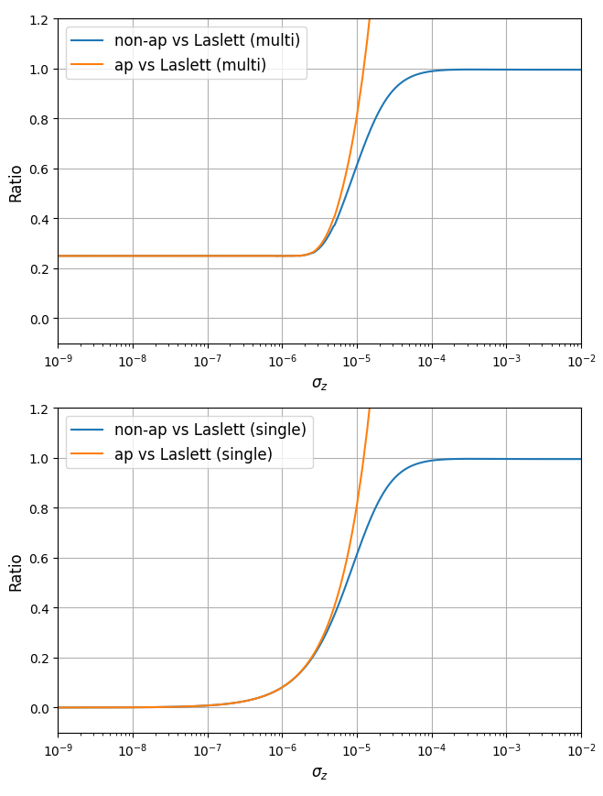
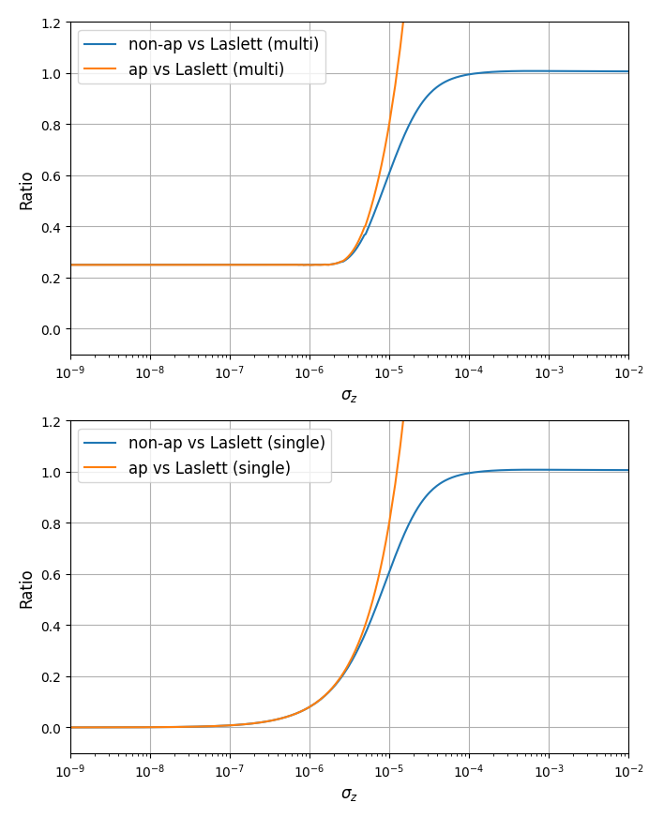
Indirect incoherent
coherent

