Slide 1
2024/05/13
组会

Slide 2
三种active dechirper对比
 | Beam-driven APD (2nC) |  |  | Laser-driven APD |  |  | X-band cavity
Witness energy [MeV] | 500 | 500 | 500 | 500 | 500 | 500 | 500 | 6000
Witness charge [pC] | 500 | 500 | 500 | 10 | 500 | 500 | 80 | 100
Ez [GV/m] | 1.3 | 0.9 | 0.4 | 5 | 30 | 80 | 0.04 | 0.06
Dechirping strength [GeV/mm/m] | 15.8 | 9.2 | 3.1 | 60 | 833 | 1282 | 0.01
Length [cm] | 1.6 | 2.2 | 4.2 | 0.68 | 0.2 | 0.13 | 50 | 500
Final energy spread | 0.27% | 0.22% | 0.19% | 0.1% | 2% | 0.67% | 0.01%
Laser peak power [TW] | / |  |  | 75 | 150 | 1000 | /
laser-driven APD的dechirping strength高，但beam loading导致的能散结果差；
X-band cavity能散结果好，但dechirping strength低，随着witness能量提高，设备尺寸成倍增长；
Beam-driven APD介于二者之间，beam loading没有强到影响能散结果，dechirping strength没有低致大占地尺寸.

Slide 3
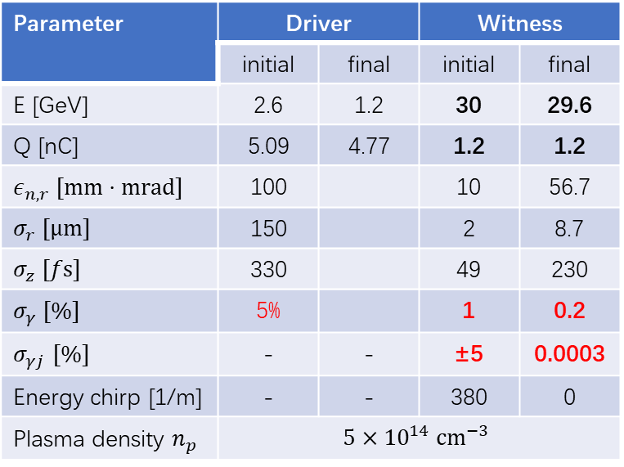
Driver: 4nC, 330fs, 12.1kA, $σ_{r}=150um, ε_{n}=100umrad$
Parameter | Driver |  | Witness
 | initial | final | initial | final
E [GeV] | 2.6 | 1.2 | 30 | 29.6
Q [nC] | 5.09 | 4.77 | 1.2 | 1.2
$ε_{n, r} [mm⋅mrad]$ | 100 |  | 10 | 56.7
$σ_{r} [μm]$ | 150 |  | 2 | 8.7
$σ_{z} [fs]$ | 330 |  | 49 | 230
$σ_{γ} [\%]$ | 5% |  | 1 | 0.2
$σ_{γj}$ $[\%]$ | - | - | ±5 | 0.0003
Energy chirp [1/m] | - | - | 380 | 0
Plasma density $n_{p}$ | $$5×{10}^{14} {cm}^{−3}$$

Slide 4

Driver: 4nC, 330fs, 12.1kA, $σ_{r}=150um, ε_{n}=100umrad$
Parameter | Driver |  | Witness
 | initial | final | initial | final
E [GeV] | 2.6 | 1.2 | 30 | 29.6
Q [nC] | 5.09 | 4.77 | 1.2 | 1.2
$ε_{n, r} [mm⋅mrad]$ | 100 |  | 10 | 56
$σ_{r} [μm]$ | 150 |  | 2 | 7.4
$σ_{z} [fs]$ | 330 |  | 49 | 230
$σ_{γ} [\%]$ | 10% |  | 1 | 0.22
$σ_{γj}$ $[\%]$ | - | - | ±5 | 0.001
Energy chirp [1/m] | - | - | 380 | 0
Plasma density $n_{p}$ | $$5×{10}^{14} {cm}^{−3}$$

Slide 5
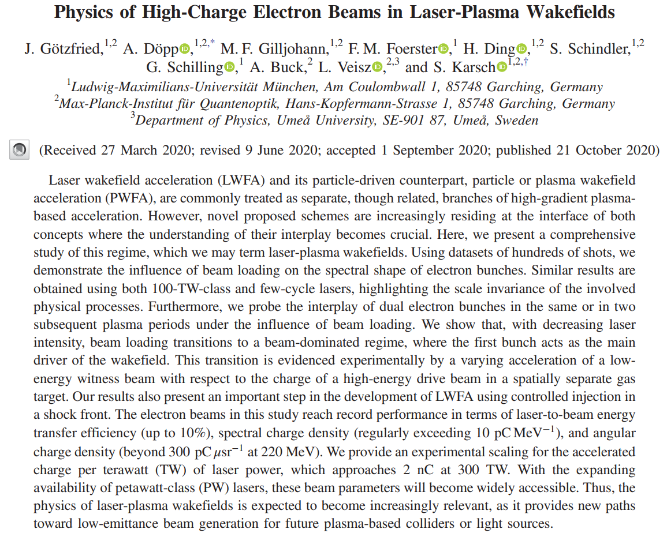
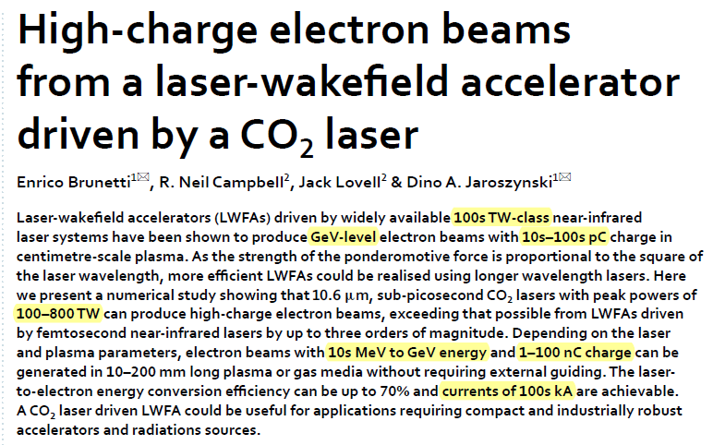
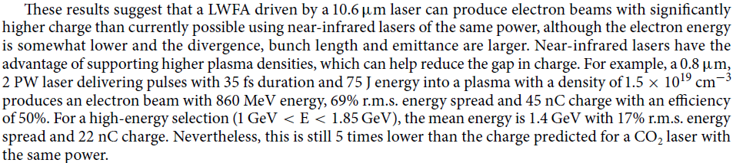
大电量LPA electron beam调研
能散百分之几十
能量不够高，百MeV

Slide 6
