Slide 1
2024/06/17
组会

Slide 2
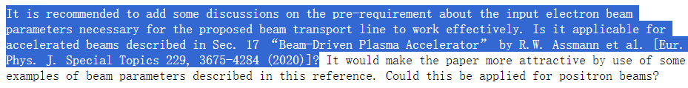
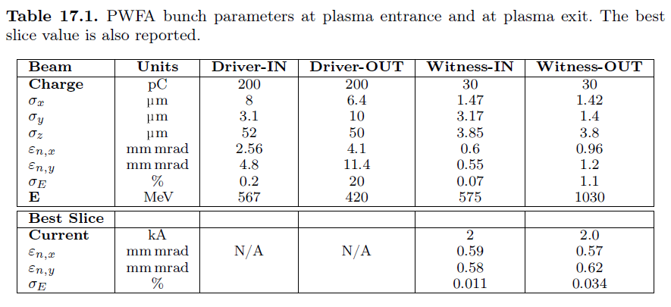
审稿人2意见1：是否适用30pC电子束？

Slide 3


结论1：适用，需要适当调参和参数优化
$$n_{p, APD}=3.8×{10}^{16} {cm}^{−3}$$
$$n_{p, PPD}=4×{10}^{16} {cm}^{−3}$$
 | Energy [MeV] | Energy jitter | RMS energy spread | Charge [pC]
PBA | 1009.40 | -2.00% | 1.37% | 30
 | 1030.00 | 0 | 1.37%
 | 1050.60 | 2.00% | 1.37%
APD (11.96mm) | 1031.05 | 0.07% | 0.53% | 29.97
 | 1030.37 | 0 | 0.56% | 30.00
 | 1031.28 | 0.09% | 0.60% | 30.00
PPD (15.94cm) | 1026.32 | 0.12% | 0.33% | 29.18
 | 1025.05 | 0 | 0.34% | 29.88
 | 1026.03 | 0.10% | 0.41% | 28.38
(a)
(b)
(c)
(d)
束流chirp未完全消除，其横向尺寸已经超出hollow channel内径，造成大量电荷损失。选取了保持较高束流传输效率下的最小能散。

Slide 4
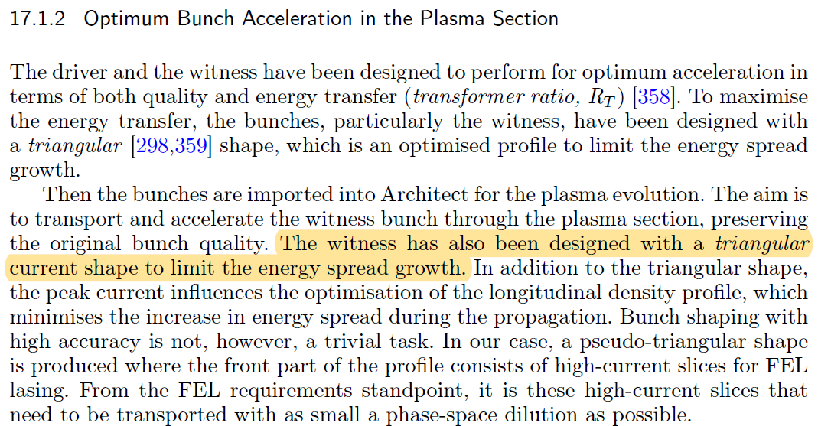

线性初始chirp
$$n_{p, APD}=1.1×{10}^{17} {cm}^{−3}$$
$$n_{p, PPD}=4×{10}^{16} {cm}^{−3}$$
 | Energy [MeV] | Energy jitter | RMS energy spread | Charge [pC]
PBA | 1009.40 | -2.00% | 1.10% | 30
 | 1030.00 | 0 | 1.10%
 | 1050.60 | 2.00% | 1.10%
APD (3.71mm) | 1030.20 | 0.06% | 0.55% | 29.96
 | 1029.56 | 0 | 0.64% | 30.00
 | 1030.05 | 0.05% | 0.67% | 30.00
PPD (35.07cm) | 1018.53 | 0.10% | 0.28% | 29.17
 | 1017.46 | 0 | 0.22% | 29.97
 | 1018.25 | 0.08% | 0.23% | 29.80
(a)
(b)
(c)
(d)

Slide 5
回复信内容part 1
Start-to-end simulations have been checked with the accelerated beams described in Sec. 17 “Beam-Driven Plasma Accelerator” by R.W. Assmann et al. [Eur. Phys. J. Special Topics 229, 3675-4284 (2020)], and the corresponding results have been added in the appendix. In addition, if properly optimize the longitudinal phase space of the accelerated beams with a linear energy chirp and the parameters of these components in the scheme, a better beam quality in term of the energy spread could be obtained by our scheme.

Slide 6
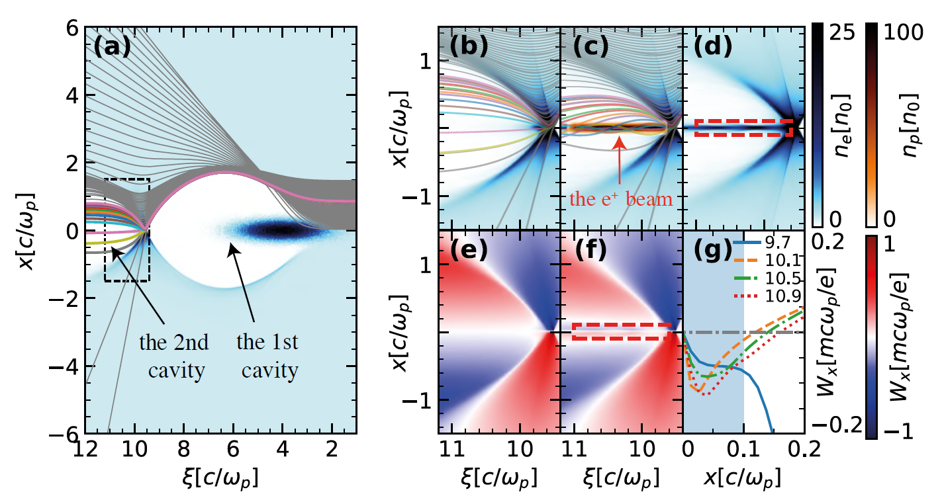
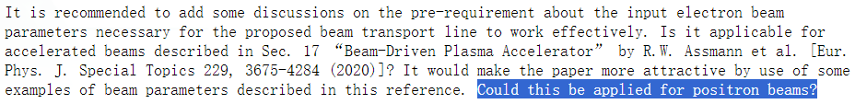
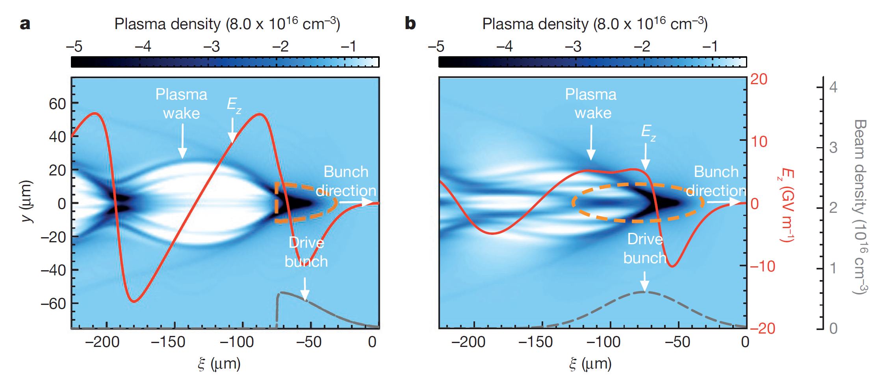
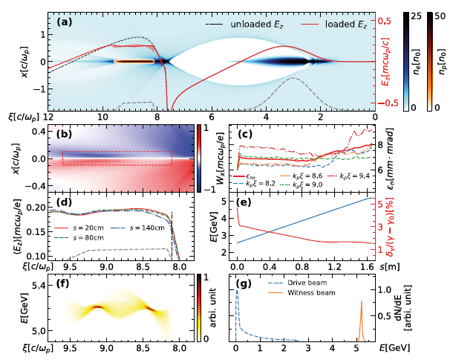
审稿人意见2：能否用于正电子束？
正电子加速调研：
Zhou, etal. arXiv:2211.07962 (2022)
S. Corde, etal. Nature 524, 442–445 (2015)

Slide 7
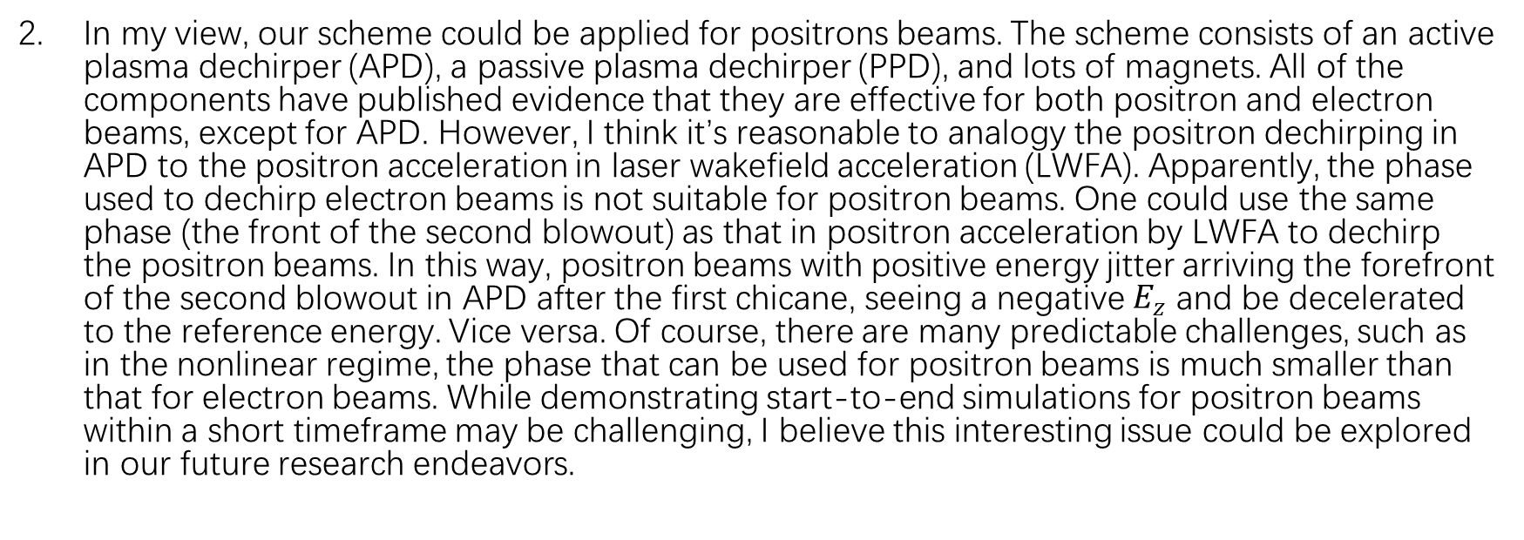
回复信内容part 2
In my view, our scheme could be applied for positrons beams. The scheme consists of an active plasma dechirper (APD), a passive plasma dechirper (PPD), and lots of magnets. All of the components have published evidence that they are effective for both positron and electron beams, except for APD. However, I think it’s reasonable to analogy the positron dechirping in APD to the positron acceleration in laser wakefield acceleration (LWFA). Apparently, the phase used to dechirp electron beams is not suitable for positron beams. One could use the same phase (the front of the second blowout) as that in positron acceleration by LWFA to dechirp the positron beams. In this way, positron beams with positive energy jitter arriving the forefront of the second blowout in APD after the first chicane, seeing a negative $E_{z}$ and be decelerated to the reference energy. Vice versa. Of course, there are many predictable challenges, such as in the nonlinear regime, the phase that can be used for positron beams is much smaller than that for electron beams. While demonstrating start-to-end simulations for positron beams within a short timeframe may be challenging, I believe this interesting issue could be explored in our future research endeavors.

Slide 8
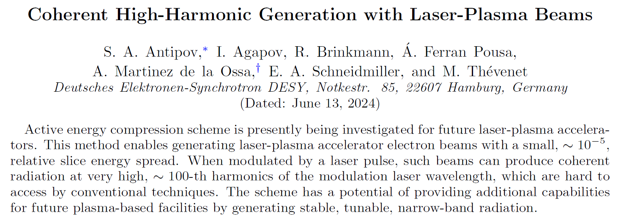
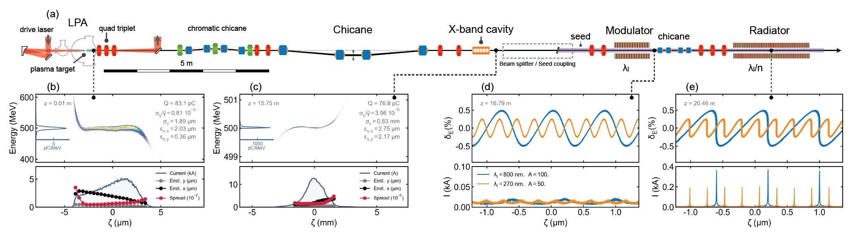
文献阅读1
chicane+X-band cavity做HGHG-FEL注入器；
Energy jitter影响FEL带宽和波长稳定性

Slide 9
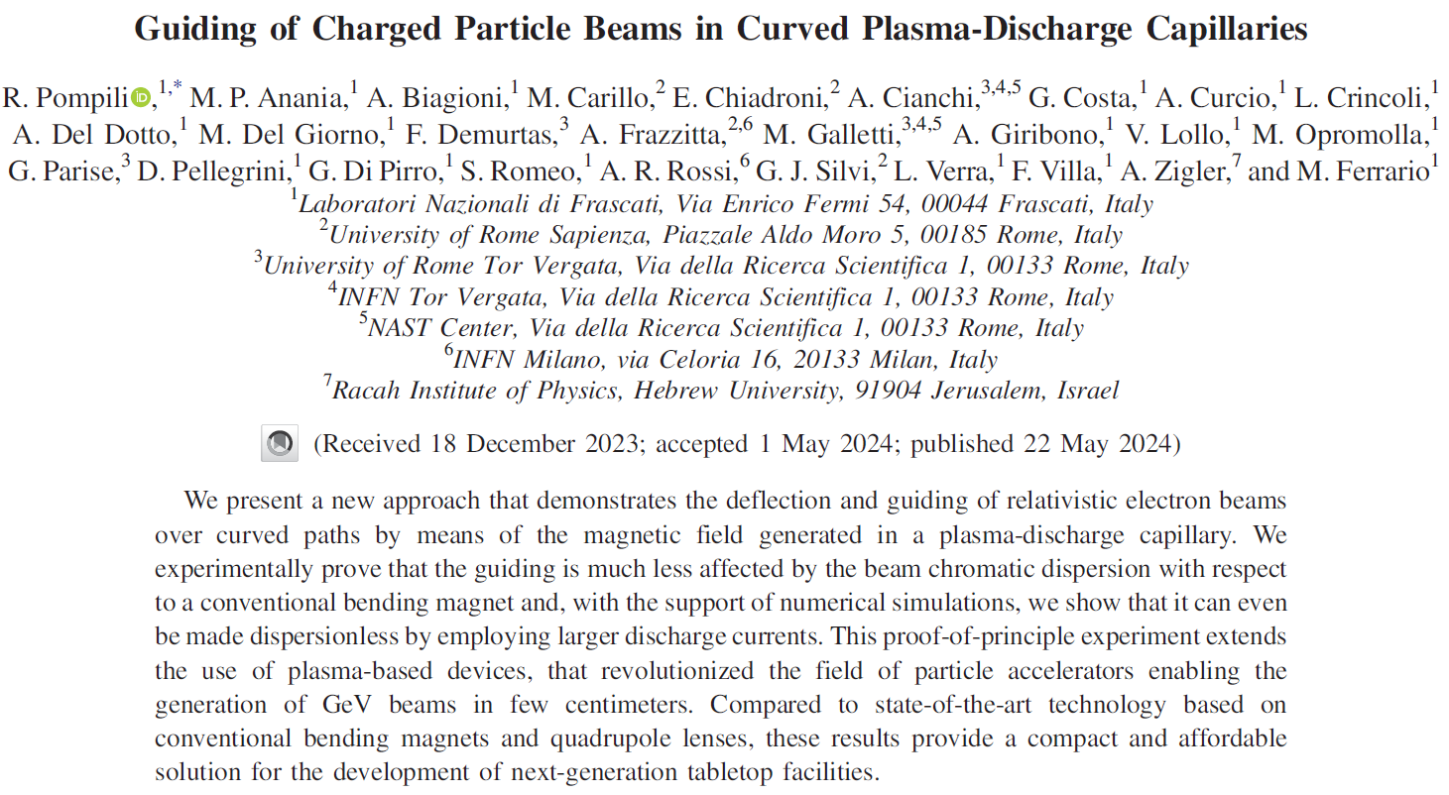
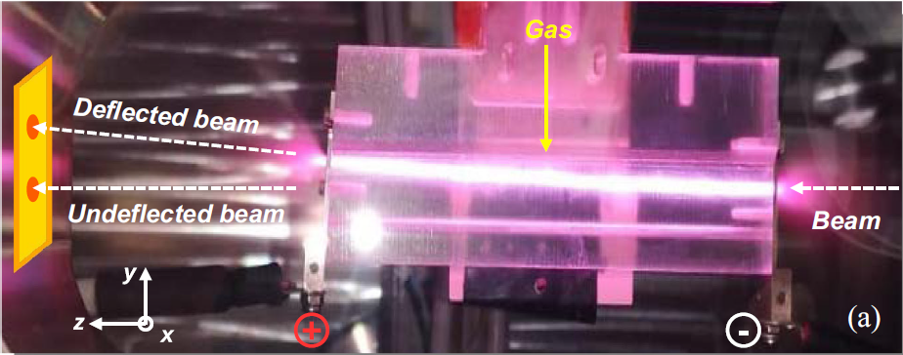
文献阅读2
实验上演示了弯曲等离子通道对带电粒子束的偏转作用（等离子体二极铁）
相比传统二极铁，色散极小；甚至可以通过增强等离子体放电电流来消除色散；
促进了紧凑型加速器装置的发展

