Slide 1
Operation Status of
SuperKEKB RF System
KEK
SuperKEKB RF Group
Takafumi OKADA

Slide 2
Outline
SuperKEKB Overview
RF systems Overview
  Normal conducting cavity –ARES
  Superconducting cavity
RF System upgrade for SuperKEKB
Operating Experience
Summary
Notes:
SuperKEKB accelerator machine overview.
Introduce the SuperKEKB RF system.
This machine has two types of cavity, normal conducting ARES cavity and Superconducting cavity
Both Cavities have unique features in order to accelerate high current beam.
I will explain the RF station construction for operating high beam current
Operating experience at high current of superconducting cavity
I will Summarize my talk

Slide 3
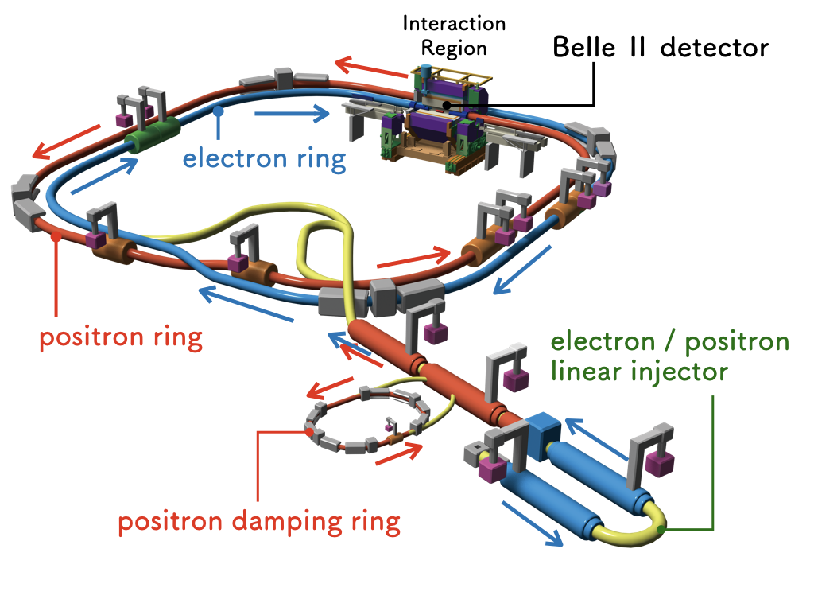
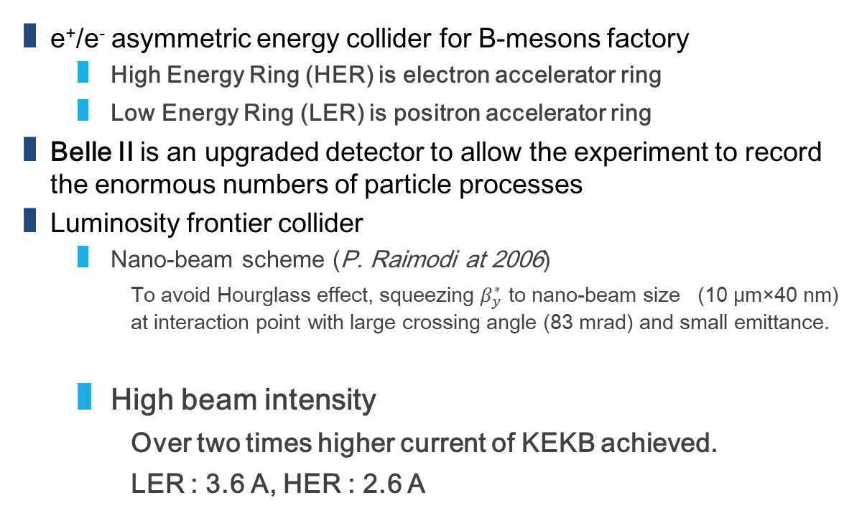
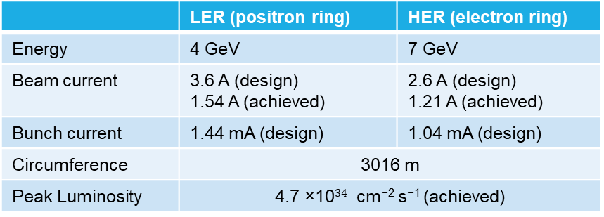
SuperKEKB Overview
e⁺/e⁻ asymmetric energy collider for B-mesons factory
  High Energy Ring (HER) is electron accelerator ring
  Low Energy Ring (LER) is positron accelerator ring
Belle II is an upgraded detector to allow the experiment to record the enormous numbers of particle processes
Luminosity frontier collider
  Nano-beam scheme (P. Raimodi at 2006)
    To avoid Hourglass effect, squeezing $β_{y}^{∗}$ to nano-beam size (10 μm×40 nm) at interaction point with large crossing angle (83 mrad) and small emittance.
  High beam intensity
    Over two times higher current of KEKB achieved.
    LER : 3.6 A, HER : 2.6 A
 | LER (positron ring) | HER (electron ring)
Energy | 4 GeV | 7 GeV
Beam current | 3.6 A (design) 1.54 A (achieved) | 2.6 A (design) 1.21 A (achieved)
Bunch current | 1.44 mA (design) | 1.04 mA (design)
Circumference | 3016 m | 3016 m
Peak Luminosity | 4.7 ×10$34$ cm⁻² s⁻¹ (achieved)
The RF system needs to be upgraded with reinforcements to run this massive beam power of SuperKEKB
Notes:
SuperKEKB is an electron and positron asymmetric energy collider for the discovery new physics experiment of Belle 2
HER is an electron and High energy, LER is low energy for positron
SuperKEKB is an upgrade machine from KEKB accelerator that is also e+/e- collider for luminosity frontier
These accelerators focus on the high luminosity.
SuperKEKB adopted the two method, Nano-beam scheme and high beam intensity.
The design current of SuperKEKB is 3.6 A and 2.6 A for positron and electron.
That is twice higher than the KEKB achieved current.

Slide 4
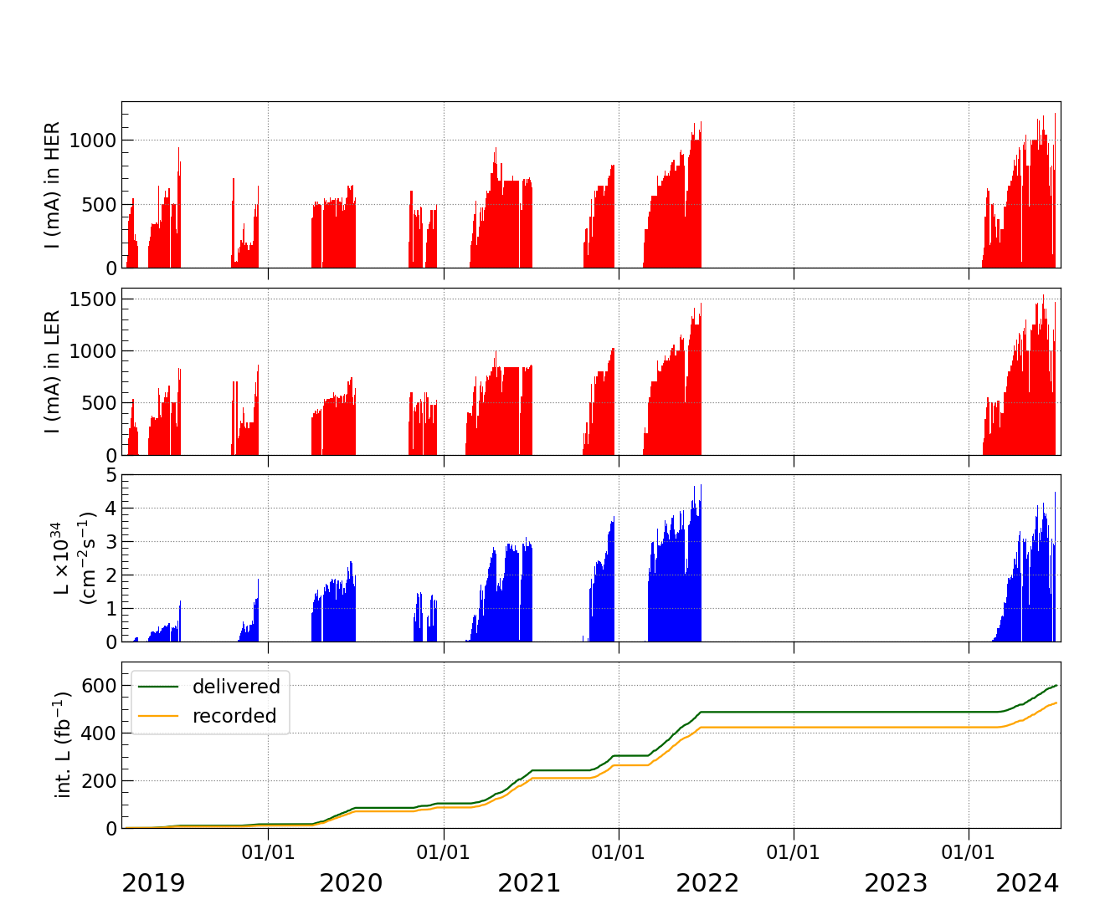
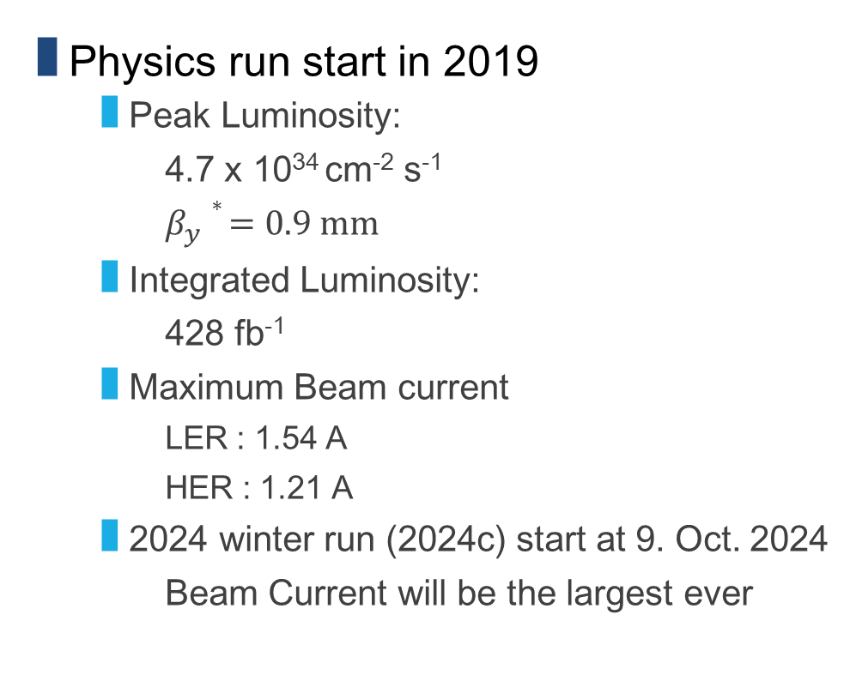

SuperKEKB operation history (March 2019 - )
1210 mA
Physics run start in 2019
  Peak Luminosity:
    4.7 x 10³⁴ cm⁻² s⁻¹
    $β_{y}∗ =0.9 mm$
  Integrated Luminosity:
    428 fb⁻¹
  Maximum Beam current
    LER : 1.54 A
    HER : 1.21 A
  2024 winter run (2024c) start at 9. Oct. 2024
    Beam Current will be the largest ever
1539 mA
4.7$×$10³⁴ cm⁻² s⁻¹
Long shutdown (LS1)
Notes:
This is a SuperKEKB recent operation history from a physics run in 2019.
The slide shows the SuperKEKB achievement parameters.
Peak luminosity achived 4.7x10^34 at beta 0.9 at the collision point
Maximum beam currents are over 1.5 A and 1.2 A for positron and electron, respectively.
We start the 2024 winter operation as 2024c on 9 Oct.The beam current will increase more and more to increase luminosity.

Slide 5
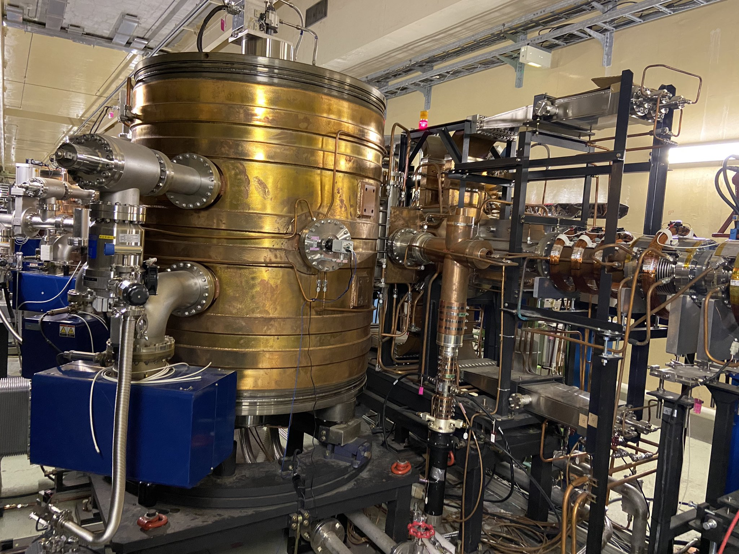
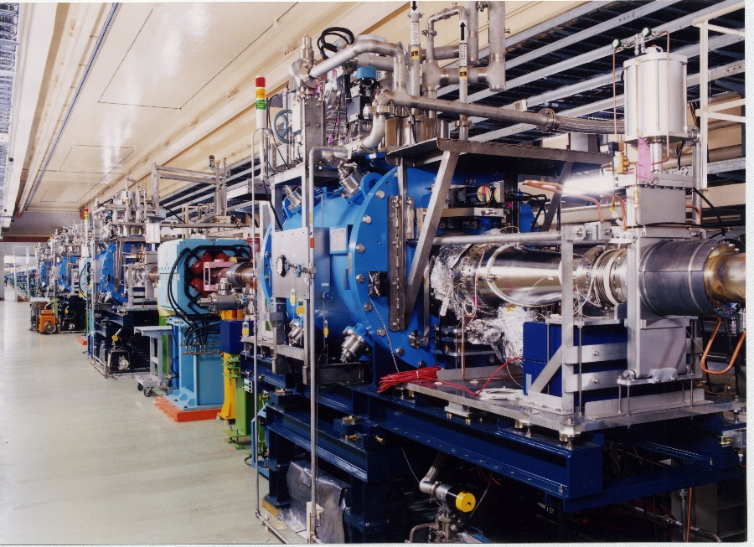
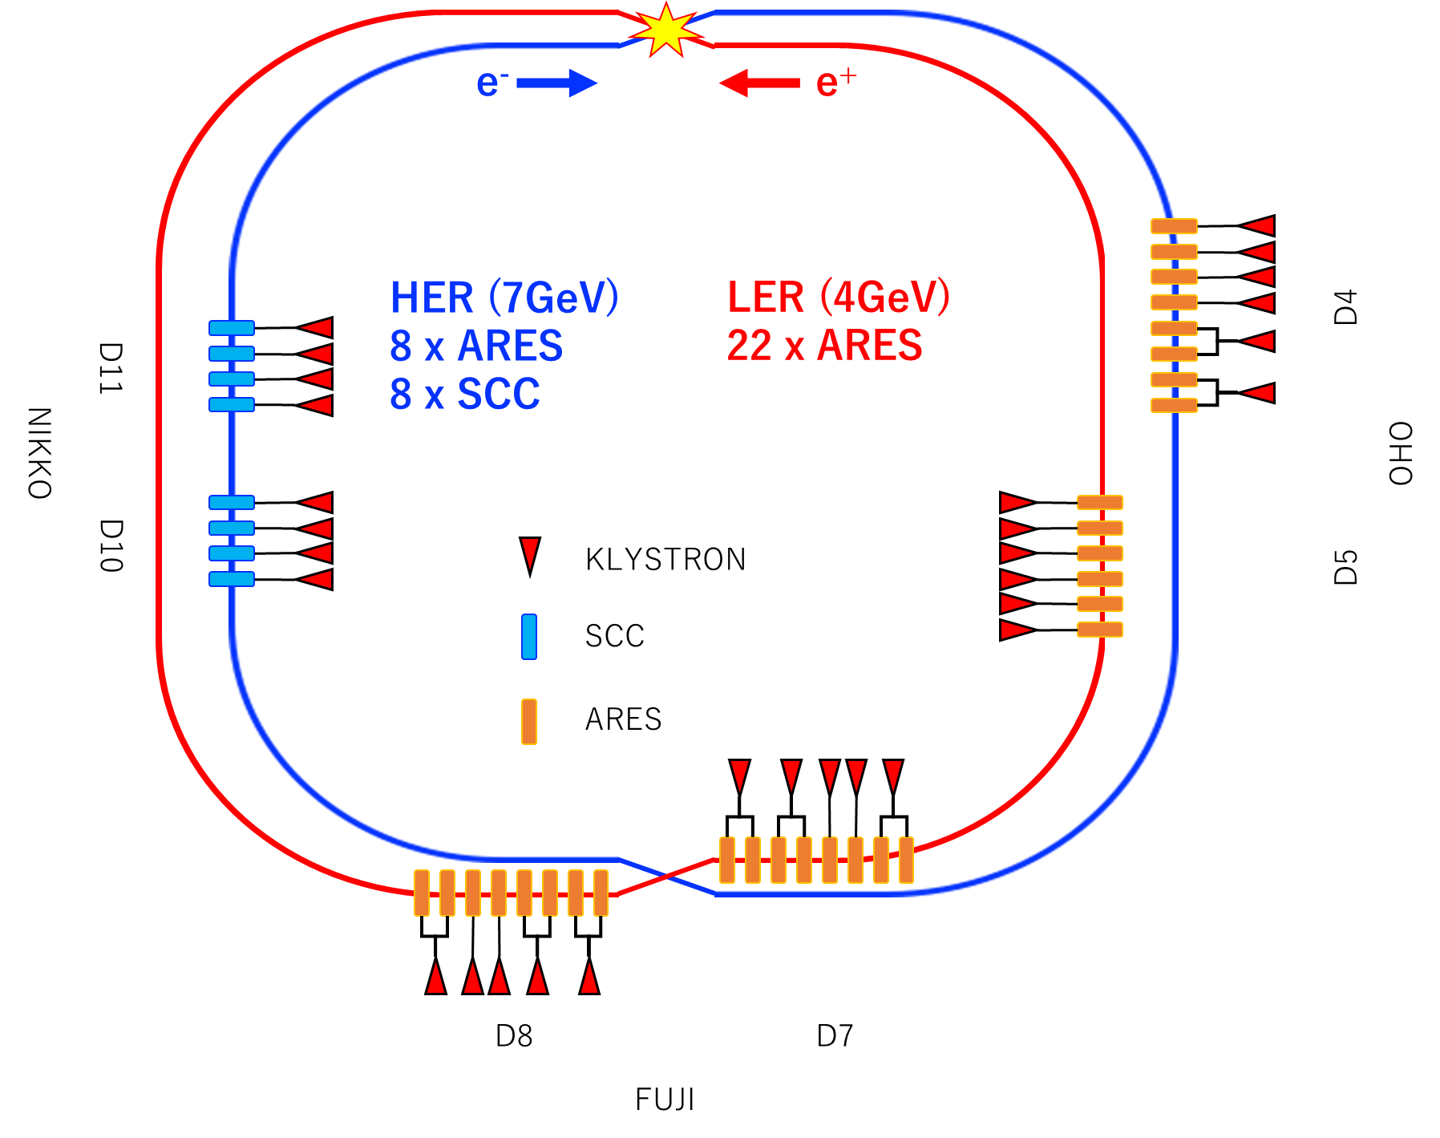
Cavity System overview of SuperKEKB
ARES cavity (normal conducting)
  HOM damped cavity
  The three-cavity system consist of energy storage cavity, accelerating cavity, and resonant coupling cavity
  8 and 22 ARES cavities have been installed LER and HER rings, respectively.
Superconducting cavity
  HOM damped single cell cavity with asymmetric beam pipes
  HER has 8 superconducting cavities.
30 RF stations
M. Nishiwaki, presented at eeFACT2022
Notes:
In the main ring of SuperKEKB, two types of accelerating cavities are used.
One is ARES as a normal-conducting cavity and the other is a superconducting cavity.
Both types of cavities have been used since the KEKB era.
These cavities are HOM-damped cavities designed with high beam currents.
The ARES cavity consists of three cavities, which will be explained on the next page.
They are installed in both the positron LER and the electron HER.
The Superconducting cavity is a single-cell cavity and is installed only in the HER, the high-energy electron ring.

Slide 6
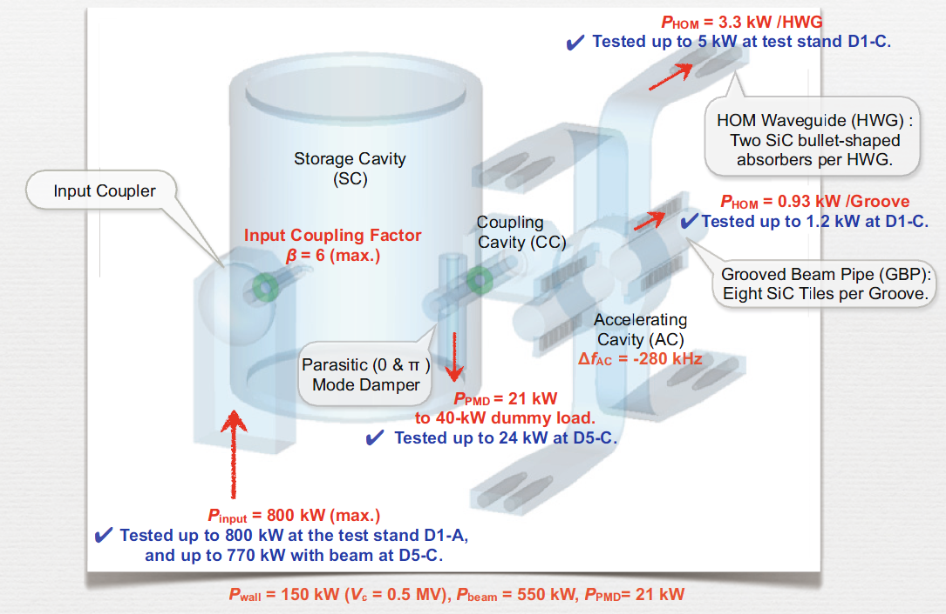
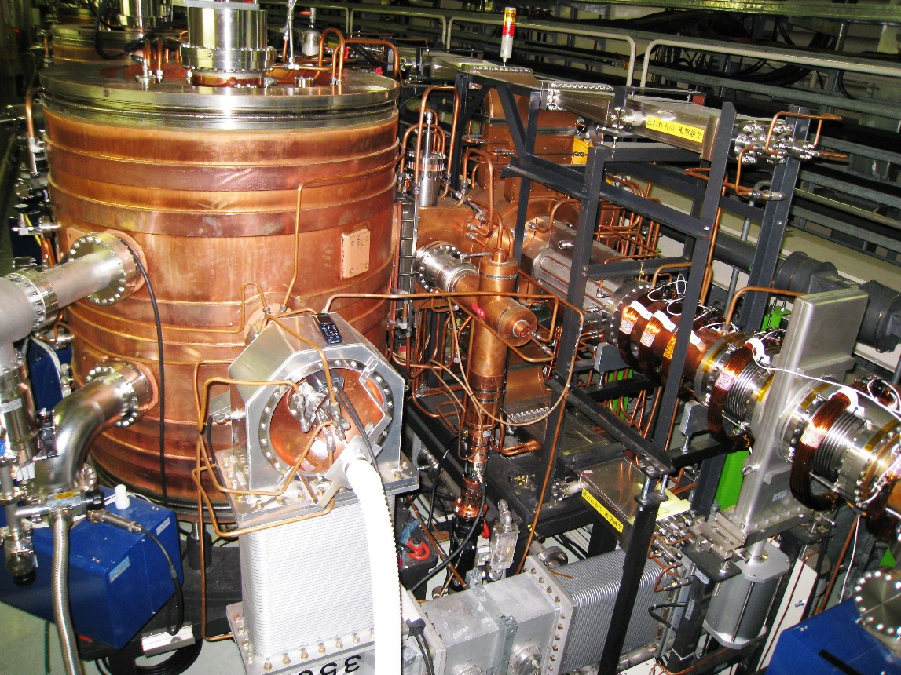
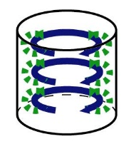
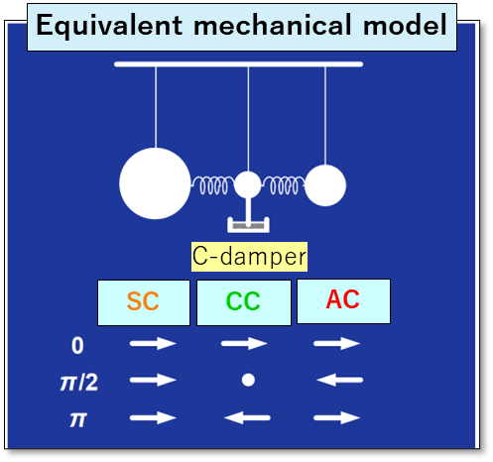
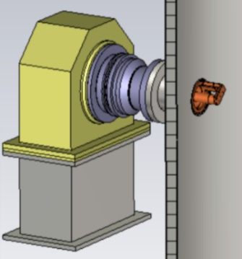
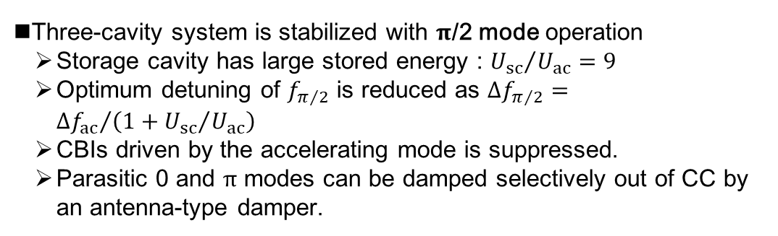
ARES : Accelerator Resonantly coupled to Energy Storage
T. Abe
CC
AC
Parameters
Freq. | 509 MHz
R_{sh}/Q₀ | 15Ω
Q₀ | ~1.1x10⁵
V_{c (spec.)} | 0.5MV/cav.
P_{wall} | 150kW
TE₀₁₃
E H
SC
Beam
(60 kW in AC, 90 kW in SC)
Input coupler
←C-damper
Three-cavity system is stabilized with $π$/2 mode operation
  Storage cavity has large stored energy : ${U_{sc}}/{U_{ac}}=9$
  Optimum detuning of $f_{π/2}$ is reduced as $∆f_{π/2}={∆f_{ac}}/{\left(1+{U_{sc}}/{U_{ac}}\right)}$
  CBIs driven by the accelerating mode is suppressed.
  Parasitic 0 and $π$ modes can be damped selectively out of CC by an antenna-type damper.
System trip rate ≈ 0.6/cavity/3 months
  (during last operation 2024ab) for the 30 ARES cavities
  No significant change since operation start-up
  Very stable for beam operation so far
Notes:
ARES is unique cavity specialized for KEKB.
The most significant characteristic is that there are three cavities,
Accelerating-Cavity,
Storage-Cavity,
and Coupling-Cavity in-between.
This three-cavity system is stabilized with accelerating which is the half pi mode.
The purpose of S-Cavity with large stored energy is to suppress the optimum detuning.
In our setting, the detuning of the accelerating mode is one tenth of A-cav detuning.
As a result, CBIs driven by the accelerating mode is suppressed by this static mechanism.
And, the parasitic 0 and pi modes can be damped selectively out of C-Cavity by an antenna-type damper.
(eeFACT nishiwaki)
In the recent operation, ARES trip rate is around 0.6 times in a cavity in 3 months.
ARES are very stable for beam operation.

Slide 7
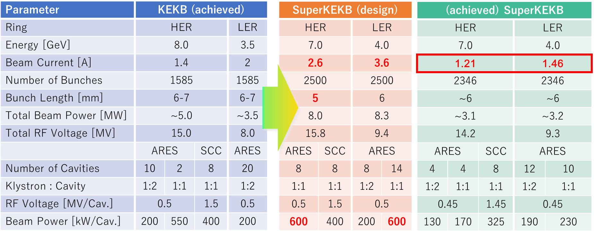
RF System Upgrade Item for SuperKEKB
RF system is re-used from KEKB with some reinforcements to handle twice high beam current and large beam power.
Increasing the number of RF stations where one klystron drives one ARES (Normal Conducting Cavity), called 1:1 station.
ARES (Normal Conducting Cavity)
  Changing Input Coupling β from 3 (1:2) to 5 (1:1).
SCC (Superconducting Cavity)
  Installation of additional HOM damper
HPRF
  Replacement of Klystrons with higher gain and more stable ones
LLRF
  Replacing with new digital LLRF a part of ARES 1:1 stations
  Development of new CBI damper
Notes:
SuperKEKB aims to achieve a current 2.6/3.6 A that is higher than the achieved current of KEKB.
Several RF system will upgrade to provide the huge beam power.
The main upgrades are In the ARES cavity, the coupling constants were changed,
and in the superconducting cavity, an additional HOM damper was added to counteract the increased HOM power,
In the high power RF, replacement with high efficiency klystrons and an increase in the number of klystrons.
In particular, the configuration of the entire RF station will be re-configured to increase the beam supply power (especially in the ARES cavity)
In particular, the one to-one ARES station will have its beam power increased from 200 kW to 600 kW.

Slide 8
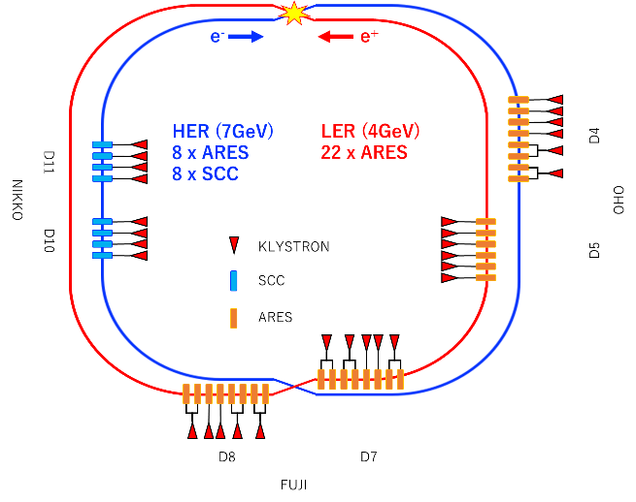
RF station construction for SuperKEKB
K. Akai
KEKB-RF
D4
OHO
D5
D7
FUJI
D8
D10
NIKKO
D11
1
2
2
2
1
2
2
2
2
1
2
2
2
2
1
C
B
A
A
B
C
E
E
D
C
B
A
A
B
C
D
E
D
C
B
A
A
B
C
D
E
F
HER
LER
SuperKEKB-RF
(present)
add 5 klystrons, HP&LL
add 3 power supplies
D4
OHO
D5
D7
FUJI
D8
D10
NIKKO
D11
2
2
2
2
2
2
1
2
2
2
2
1
2
2
2
2
H
G
F
E
C
A
A
B
C
D
E
F
E
D
C
B
A
A
B
C
D
E
D
C
B
A
A
B
C
D
Re-aligned the RF station and add klystron and ARES cavities
Increase the number of 1:1 RF station for ARES
Number of RF station will be 30 from 25 at KEKB
A part of stations uses Digital LLRF system
add 2 ARES
convert to LER
remove 4 ARES
Klystron, HP&LLRF system
2
Type “A” power supply (for two klystrons)
ARES cavity
SC cavity
SC crab
1
Type “B” power supply (for one klystron)
Notes:
In more detail,
Originally, KEKB consisted of two type of RF station
one klystron station driving one cavity (ARES, SCC) as 1 to 1 station and
one klystron station driving two ARES cavities as 1 to 2 station.
However, in SuperKEKB,
the number of 1 to 1 stations has been increased to accommodate the increased beam power.
Then, 5 klystrons and low level systems also were added include the three power supply.
The number of cavities is 22 ARES cavities for LER and 8 ARES cavities and 8 superconducting cavities for HER, respectively.
There are 30 RF station totally in SuperKEKB.
In a comment, crab stations at KEKB was removed.

Slide 9
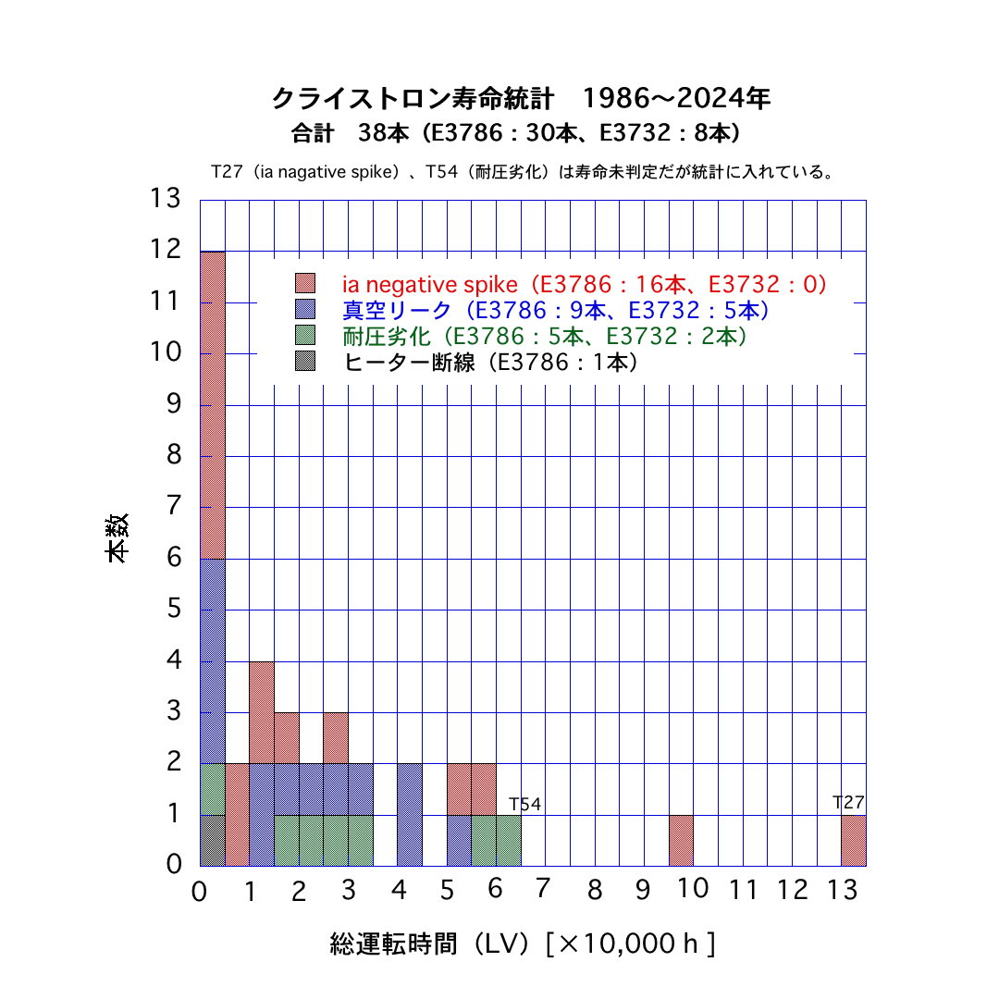
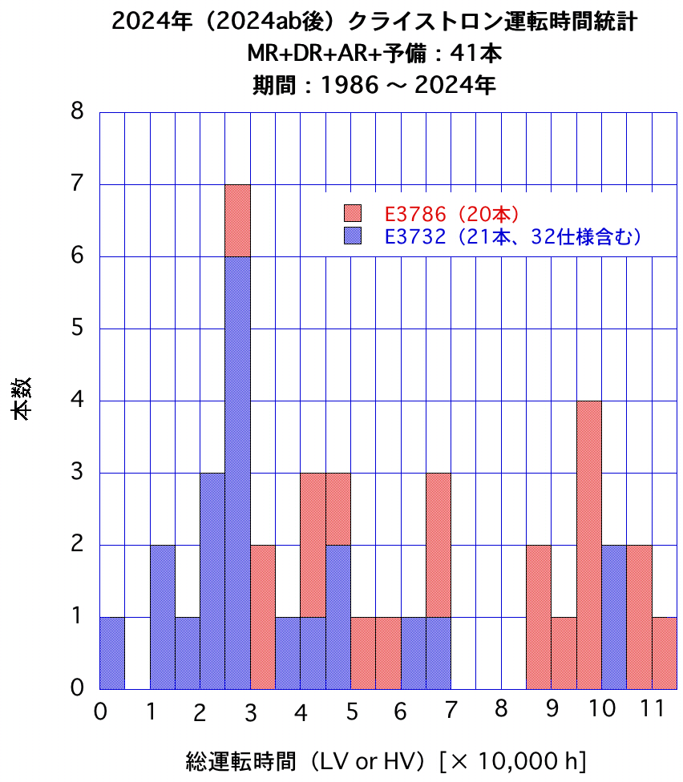
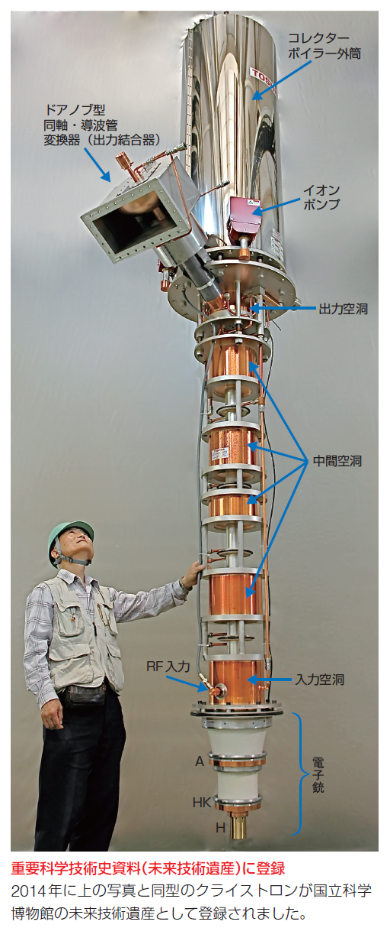
High Power RF
Klystron
  Toshiba (Canon)
  E3786, E3732,
  Power max : 1.2 MW (CW),
  Gain : 55-60 dB,
  Efficiency : ~65%
Cumulative Operating Time
Klystron Lifetime Reduction due to failures
Some klystron is still in operating over 100,000 hour (from TRISTAN era)
Number
Klystron lifetime reduced by Ia negative spike, leak, heater disconnection, etc…
Number
Total operation time
Total operation time
Update klystron and power supply required for SuperKEKB for High Beam Current
Expected lifetime of klystron is around 200,000 hour
Preparing of spare is necessary for long term operation over 10 years
Notes:
The klystrons used are Toshiba (Canon) 1.2 MW CW output
with a maximum gain of 60 db and an efficiency of about 65%,
the E3786 and its improved E3732.
The expected lifetime of klystrons is 150,000 hours to 200,000 hours by emission degradation.
However, klystrons lifetime reduced by several reasons.
The longest operating klystrons were limited to about 130,000 hours.
These klystrons, which were used in the TRISTAN in 1986,
are still in use for nearly 40 years.
Some klystron lifetime will be over 130,000 hour during SuperKEKB operation.
Therefore, it is necessary to prepare spare.

Slide 10
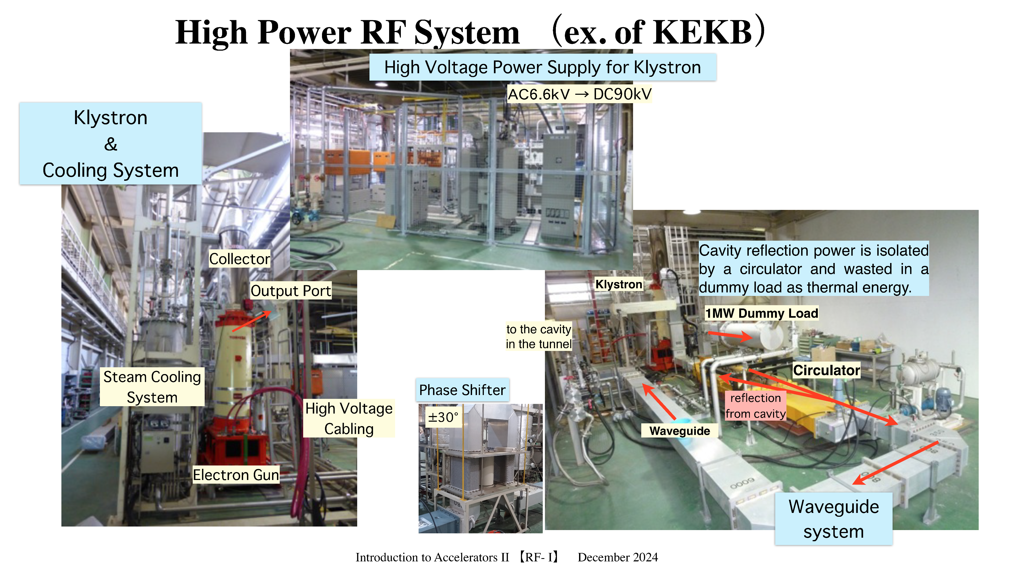
High Power RF
T. Kobayashi
Notes:
Most systems have been using for a long time from KEKB or TRISTAN.
The one of the biggest problem of RF system at SuperKEKB is deterioration.

Slide 11
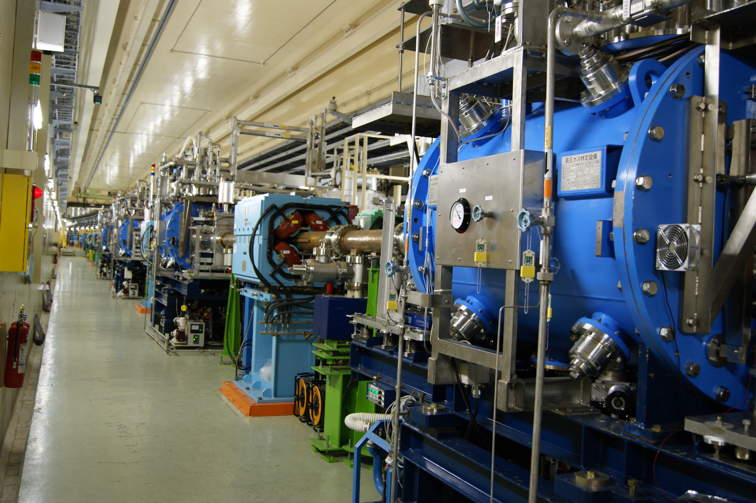
Superconducting cavity: HOM damped cavity
SuperKEKB-SCC Design Parameters
Number of Cavities | 8
Max. Beam Current [A] | 2.6
RF Voltage [MV/cav.] | 1.5
External Q | 5E+4
Unloaded Q at 2MV | 1E+9
Beam Loading [kW/cav.] | 400
HOM Loading [kW/cav.] | 37
509 MHz Nb Single-cell HOM-damped Cavity, 4.4 K Operation
Superconducting cavity installed in only HER (electron ring)
Sharing the beam power and accelerating voltage with ARESs by giving phase-offset
HER ring has 8 superconducting cavities
Main Issues in SuperKEKB for Superconducting Cavity
  Large HOM power is expected due to twice high beam current and shorter bunch length.
    Additional SiC HOM damper
  Degradation of RF performance of Qo.
    Horizontal High-Pressure Rinse
SCC Modules in SuperKEKB Tunnel
Notes:
The cavity design is single cell and HOM damped cavity. The operation temperature is 4.4 K.
material is pure niobium.
The superconducting cavity installed in only HER. that cavity was developed in the 1990s for the previous ring of KEKB.
The cavity has been optimized to achieve a CW acceleration of 1.5 MV at a high beaming of 400 kW.
The single cell has been chosen to reduce the number of HOMs
We need to consider again the condition SuperKEKB
we predict some issues will occur over 2.6 A operation and long term operation.
Large HOM power is expected
We need to pay attention Degradation of RF performance of Qo.
Trip rate 0.05/day/8station
0.05*90/8 = 0.5625

Slide 12
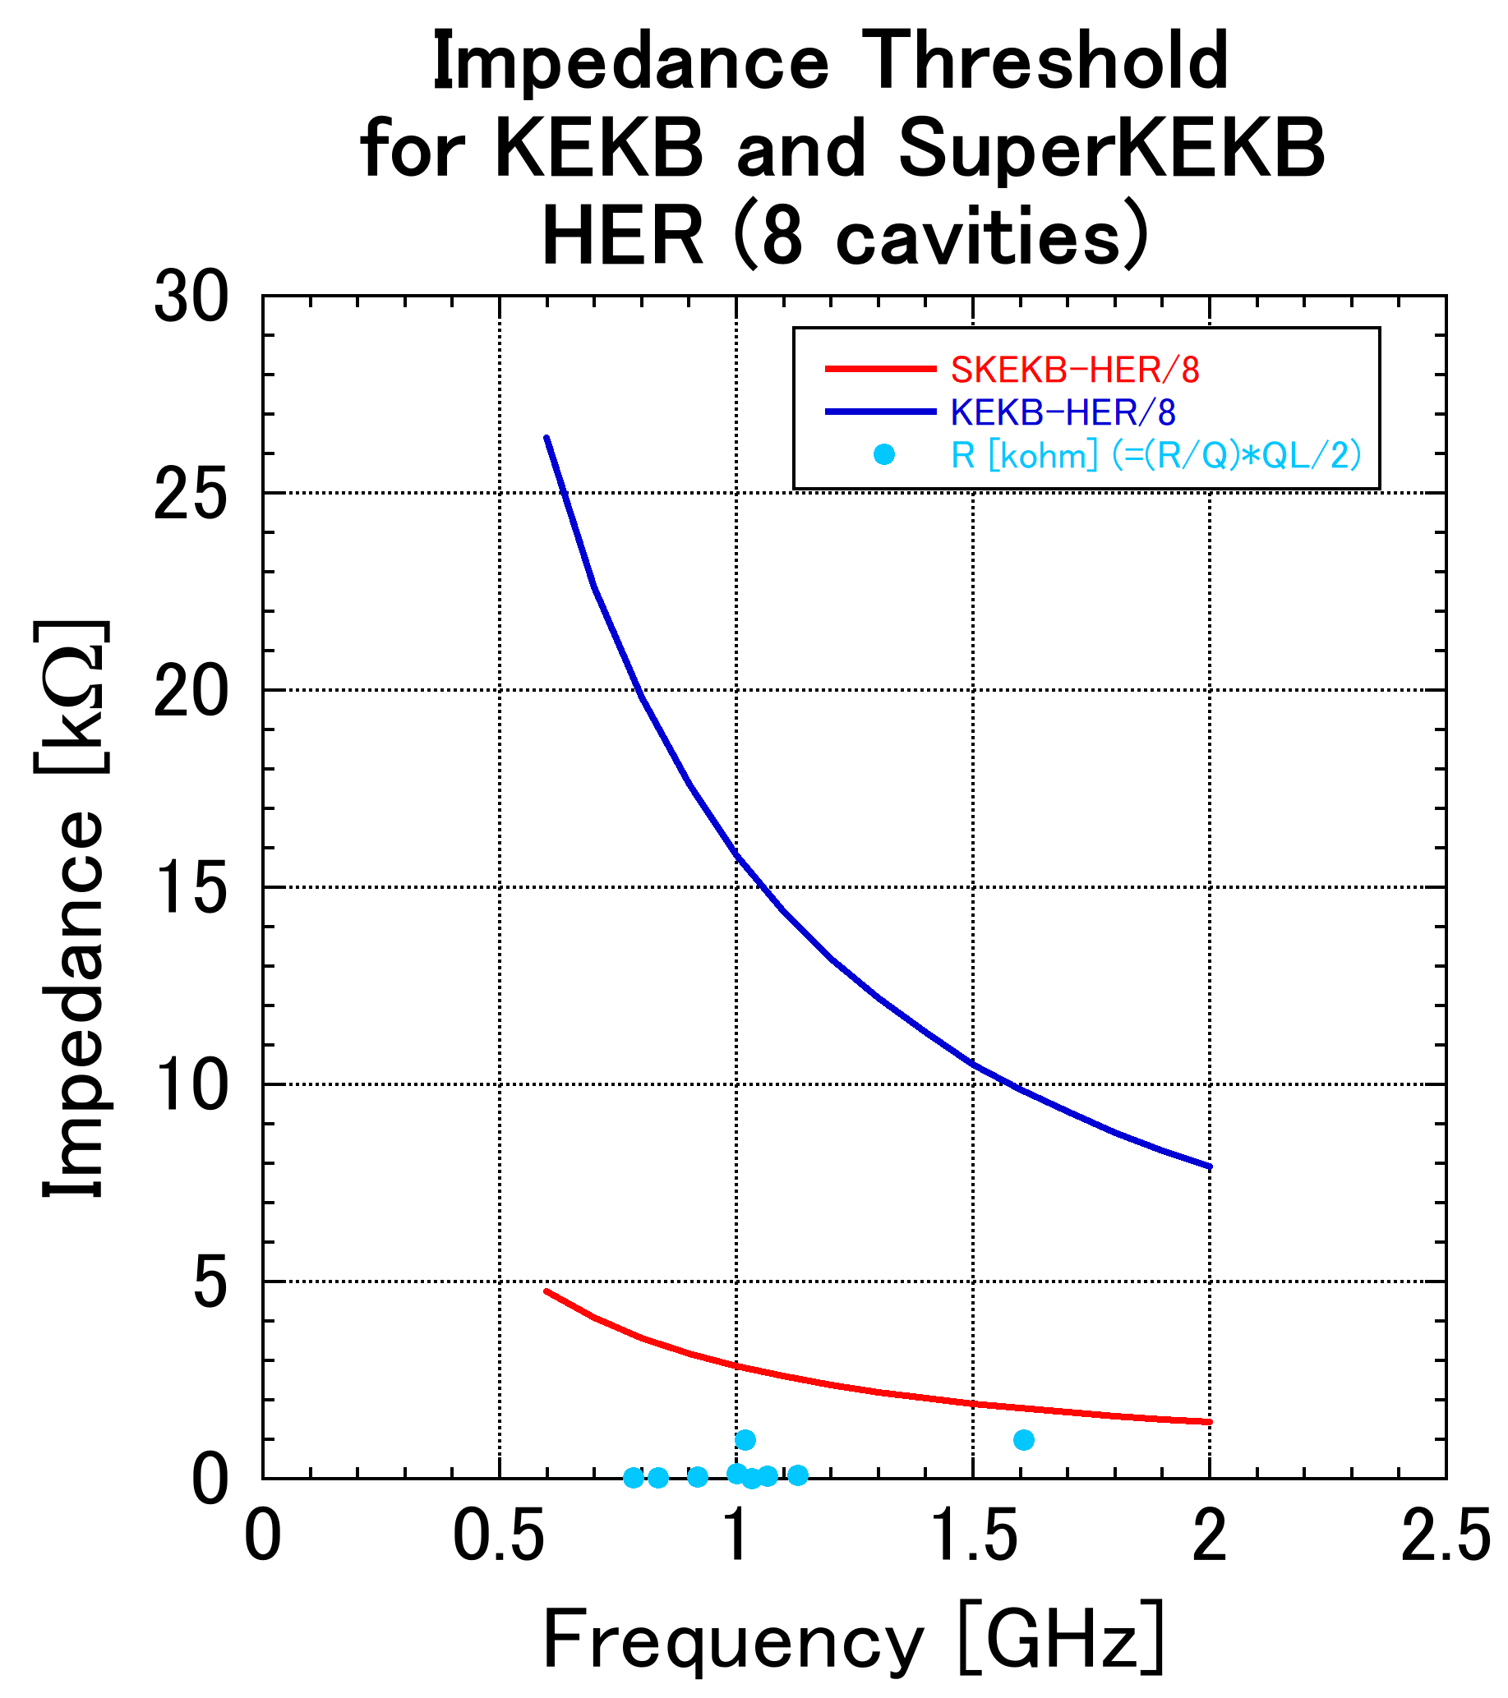
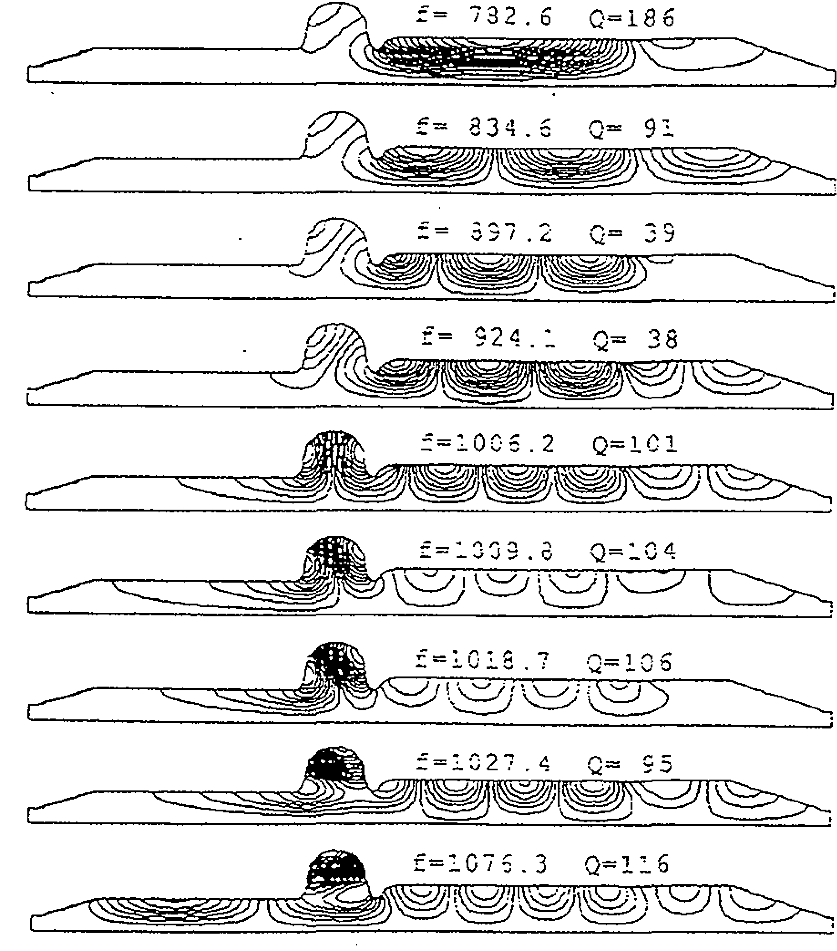
Higher Order Mode at Superconducting cavity
threshold for KEKB
(Longitudinal)
threshold for SuperKEKB
Physics and Engineering of High Performance Electron Storage Rings and Application of Superconducting Technology
impedance
M. Nishiwaki
The trapped mode HOMs are suppressed by HOM ferrite damper.
All impedance are below the threshold of CBI even on SuperKEKB.
Notes:
In SuperKEKB, the electron current will increases nearly two times and shortens the bunch length.
we consider again the against Higher Order Mode.
This is the List of the main HOM parameters of the KEKB Superconducting cavity.
From these, the impedance of the HOMs is below the threshold of the Coupled Bunch Instability of SuperKEKB.
There is no problem for SuperKEKB,
We continue to use the Superconducting cavity without changing it.

Slide 13
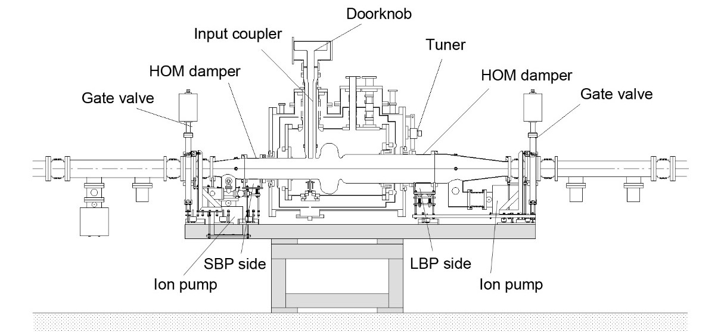
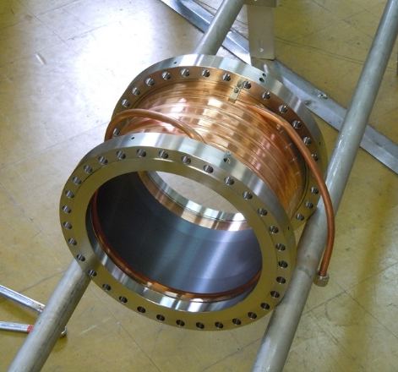
Superconducting cavity: HOM damped cavity
HOMs can propagate toward beam pipes.
A Pair of Ferrite HOM dampers for each Superconducting cavity module
  SBP damper : f220 x t4 x L120 ,LBP damper : f300 x t4 x L150
  Max. absorbed power in KEKB : 16 kW/cavity (1.4 A, s=6 mm, 10 nC/bunch)
  Expected HOM power is over 30 kW/cavity at SuperKEKB design current (2.6 A)
Ferrite HOM Damper
SBP
LBP
Copper Pipe for Cooling
e-
HIPped Ferrite (thickness: 4mm)
Notes:
The impedance of trapped HOMs are damped by HOM dampers.
The HOM for Superconducting cavity extract large and small beam pipe and absorb with a Ferrite absorber as the HOM damper.
That is installed in the room temperature section.
During KEKB operation, 16 kW of power was absorbed per cavity at 1.4 A.
This is also used as is in SuperKEKB.
However, expected HOM power is over 30 kW/cavity at SuperKEKB design current.
We consider again to solution of large HOM power.

Slide 14
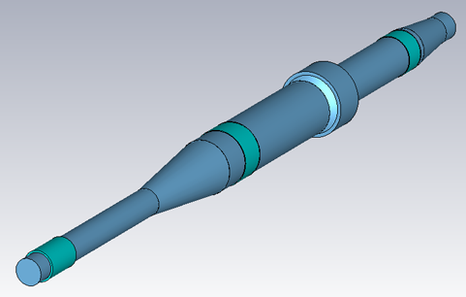
Estimation of HOM Power Flow
M.Nishiwaki, et al., Proc. of SRF2015, THPB071
M. Nishiwaki
Wake field simulation using CST Particle Studio
(3)
(1)
 | Eq.LF [V/pC] | HOM Load @2.6A[kW]
(1) Emit into upstream | 0.05 | 1.3
(2) Emit into downstream | 0.58 | 15.7
(3) Abs. by SBP Ferrite | 0.32 | 8.6
(4) Abs. by LBP Ferrite | 0.43 | 11.7
Total | 1.38 | 37.4
(5) Abs. by additional SiC | -- | --
Eq.LF [V/pC] | HOM Load @2.6A[kW]
0.05 | 1.4
0.15 | 4.0
0.35 | 9.5
0.47 | 12.8
1.02 | 27.7
0.97 | 26.1
e-
(4)
SBP Ferrite
Damper
(5)
LBP Ferrite Damper
(2)
Additional SiC Damper
Loads of SBP(3) and LBP(4) ferrite dampers are not large.
Large HOM power is emitted through the downstream beam pipe(2).
The emitted power becomes the load of the downstream cavity.
Additional SiC damper(5) can absorb enough emission power. The emission power is reduced to one-third.
SiC damper can be installed without vacuum breaking of the cavity.
e-
Additional SiC Damper
Notes:
In the SuperKEKB, the HOM power is expected to increase due to the increase in current.
When the HOM power load is estimated using the CST,
it is found that a some power of high-frequency HOMs skip over the Ferrite damper and flow through the beam pipe.
Therefore, an additional HOM damper is installed downstream to reduce the power down flow.
The additional HOM damper uses SiC absorber and it can reduce around 1/3 of total down flow.

Slide 15
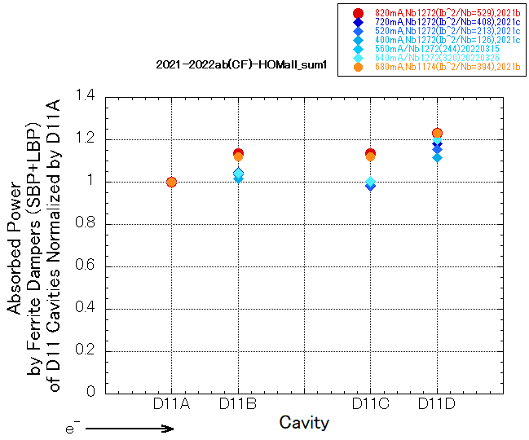
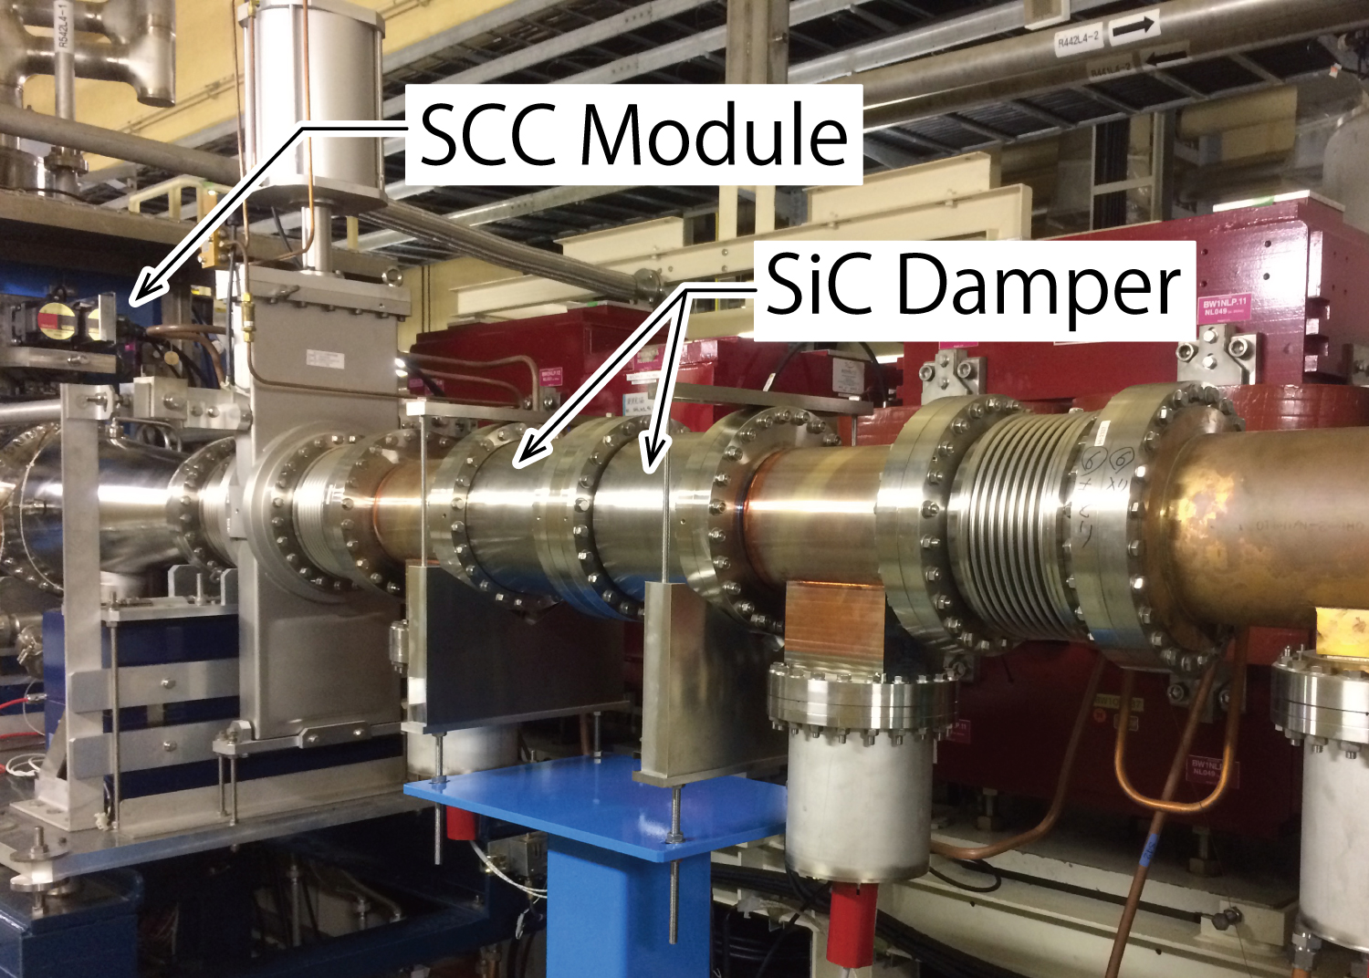
Results of Beam Test with SiC Damper
M. Nishiwaki
Layout of 8 SCCs and SiC dampers
Absorbed power by a pair of Ferrite dampers in D11 cavities
normalized by the power in D11A
without SiC
with SiC
>10% reduction by SiC damper
SiC
SiC
SiC Damper
Installed
Absorbed HOM power at 1.1A (max. current)
: ~ 8 kW/cavity
Two set of SiC dampers have been installed to SCC section for beam test. The HOM power absorbed by the ferrite dampers of downstream cavities (D11C in plot) were reduced >10% after SiC damper installation. It was confirmed that the additional SiC damper is effective to reduce the load of downstream cavities. For the future high current operation, SiC dampers will be installed to all SCC modules.
e-
Notes:
We install two set of the additional SiC HOM damper in ring.
This is the layout of cavities and SiC dampers.
This plot shows a ratio of absorbed power by a pair of ferrite dampers to the most upstream cavity, D11A.
Reddish marks are before installation of SiC damper, and Blueish marks are with SiC damper.
The absorbed power by the ferrite dampers of downstream cavity, D11C, are reduced more than 10% by SiC damper.
It was confirmed that the additional SiC damper is effective to reduce the load of downstream cavities.
For the future high current operation, SiC dampers will be installed to downstream of all SCCs.
(Nishiwaki )

Slide 16
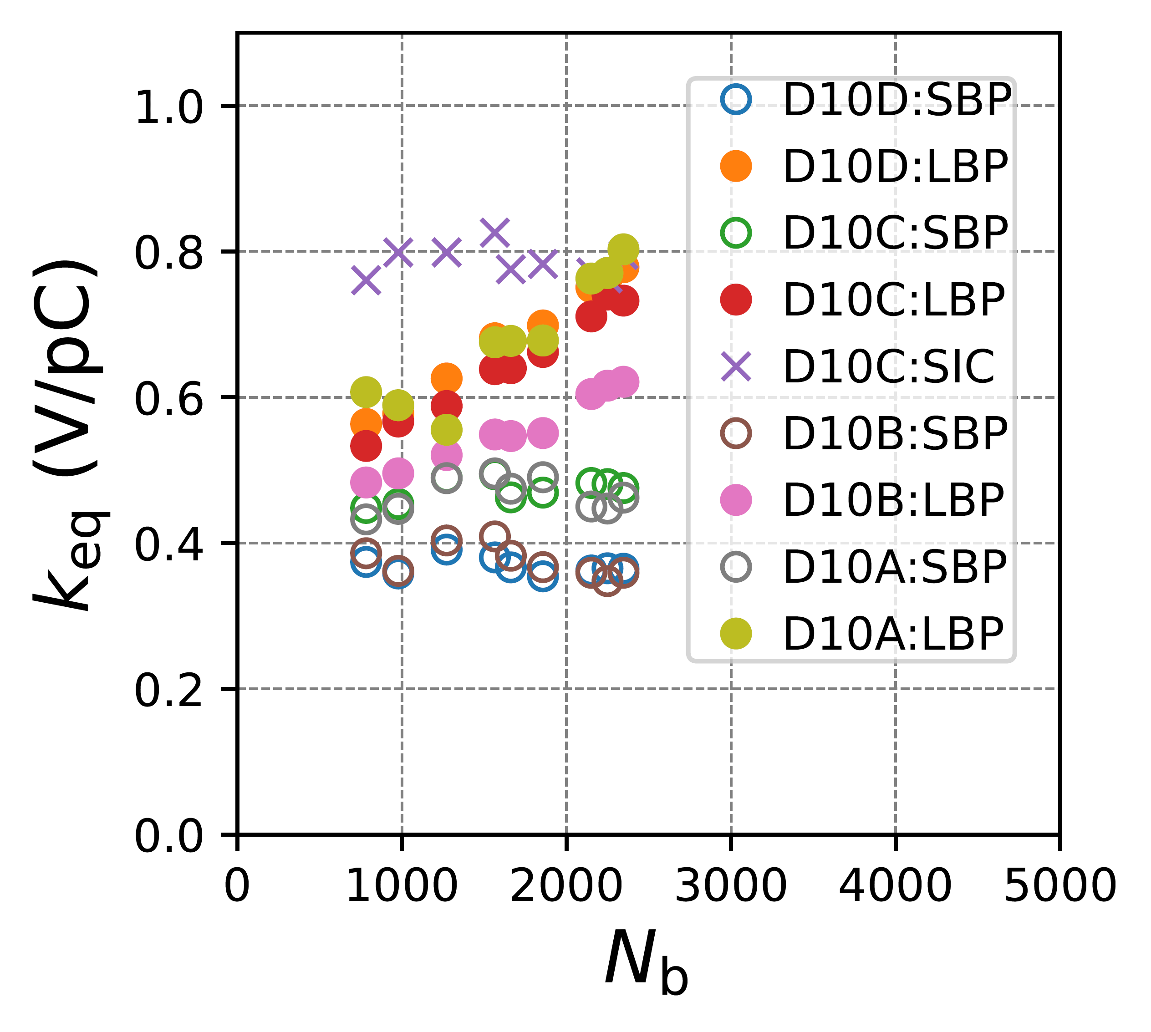
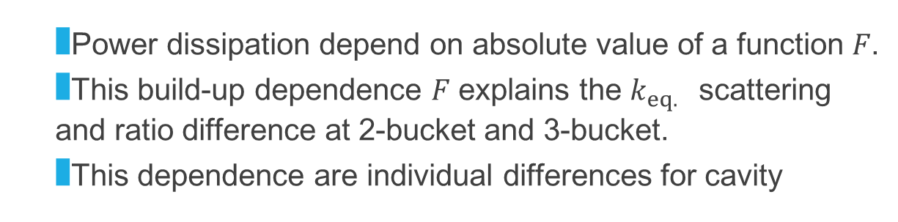
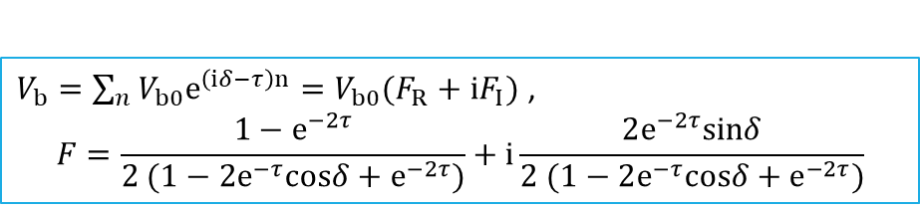
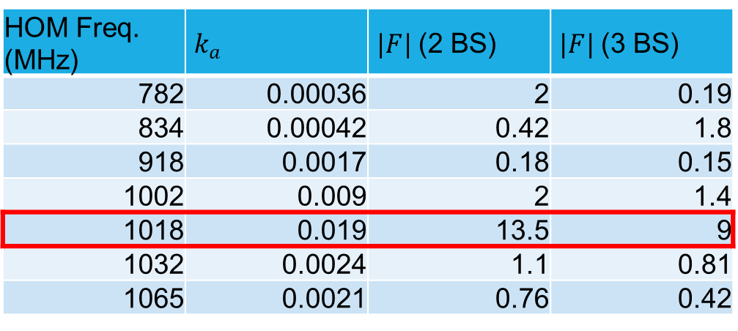
HOM build-up factor
T. Okada, et al., Proc. of SRF2023
$V_{b}=\sum_{n}{V_{b0}e^{\left(iδ−τ\right)n}}=V_{b0}(F_{R}+iF_{I})$ ,
$$F=\frac{1−e^{−2τ}}{2 (1−2e^{−τ}cosδ+e^{−2τ})}+i\frac{2e^{−2τ}sinδ}{2 (1−2e^{−τ}cosδ+e^{−2τ})}$$
HOM Freq. (MHz) | $k_{a}$ | $|F|$(2 BS) | $|F|$(3 BS)
782 | 0.00036 | 2 | 0.19
834 | 0.00042 | 0.42 | 1.8
918 | 0.0017 | 0.18 | 0.15
1002 | 0.009 | 2 | 1.4
1018 | 0.019 | 13.5 | 9
1032 | 0.0024 | 1.1 | 0.81
1065 | 0.0021 | 0.76 | 0.42
  Power dissipation depend on absolute value of a function 𝐹.
  This build-up dependence 𝐹 explains the $k_{eq. }$ scattering and ratio difference at 2-bucket and 3-bucket.
  This dependence are individual differences for cavity
HOM power at high current (narrow bunch space) is lager than expected?
Investigation is on going
Notes:
However, we get another phenomena of HOM at high current operation with large number of bunch.
The absorbed HOM power depend on the bunch spacing.
In particular, the TM011 (monopole mode) is very strongly dependent on bunch spacing, and the stacking effect is significant.
HOM power at 2 spacing differs from at 3 spacing by a factor of around 1.5 times.
TM011 will propagate mainly to large beam pipe.
LBP ferrite absorbed power increase at 2 spacing as a large number of bunch.
Additionally, this tendency has individual differences.
We need to considering of the limitation of HOM power

Slide 17
CBI caused by Acceleration mode
K. Hirosawa et al., Nucl. Instrum. Methods. Phys. Res. A 951, 163044, 2019.
The damper system is installed to ARES station with digital LLRF system.
FB loop test result of the CBI mode filter for a simulant cavity
The damper system can correspond to μ =-1, -2 and -3 modes in parallel.
Frequencies correspond μ =-1, -2 and -3 modes are racked successfully.
The new CBI damper system is working in SuperKEKB LER and HER.
Indispensable system for High current operation
Notes:
Next is a damping system by LLRF.
In SuperKEKB, because currents is large,
it is necessary to consider the instability caused not only by the higher order mode but also by the acceleration mode.
LLRF has developed and installed a digital system for SuperKEKB,
which incorporates the CBI damper system and carries out suppression of modes such as mu = -1, -2 and -3
This system is working well.
(parallel comb filter)
(SuperKEKBだと-2, -3も考慮、廣澤さんスライド)

Slide 18
Operating experience of Superconducting cavities
M. Nishiwaki
Warming Up to Room temperature twice every year
  Due to safety inspection of cryogenics by government
  Before every cooling down, we apply coupler aging with bias voltage
Maintenance day (per one month at 2024), we apply RF aging that RF power apply over breakdown level (> 2 MV (~8 MV/m))
Beam Aborts caused by | Recovery time | 2019 | 2020 | 2021 | 2022 | 2024
MP in Cavity | 2-3 min. | 2 | 2 | 12 | 7 | 5
Piezo breakdown | < 1 hour | 6 | 5 | 1 | 0 | 1
Chiller failure | < 1 hour | 1 | 1 | 3 | 0 | 0
Others |  | 0 | 0 | 2 | 2 | 2
Total |  | 9 | 8 | 18 | 9 | 8
Trip Rate [/day/8 cavities] |  | 0.06 | 0.04 | 0.09 | 0.07 | 0.03
Operation days |  | 149 | 180 | 196 | 121 | 124
All aborts (>50mA, including LER single) *except injection tuning |  | - | ~650* | ~1100 | ~730 | ~2824
  Multipacting breakdown of Cavity
  Electric breakdown of Piezo actuator for freq. tuner
    Due to Insulation failure because of humidity
    Cavity can be operated without piezo by changing tuner control settings. Recovered in 30 min.
    Fixed by dehumidification using desiccant (silica gel)
  Failure of Chiller for HOM dampers
    Due to aging degradation. Replacement is on going.
    By bypass piping to the spare and the next chillers. Recovered in 30 min.
Notes:
I go back the superconducting cavity topic.
The superconducting cavity has been very stable in operation so far,
and the trip rate has been kept low.
The cause of the trip includes not only a quench or multipacting but also a trouble of a piezo actuator or controller and a trouble of equipment such as a chiller.
In addition, RF aging is performed during maintenance to recover the emission level.
We have a domestic problem.
We need to warm up all of cavity twice a year to investigation safety by a law.
It can cause a decrease in performance.

Slide 19
Operating experience of Superconducting cavities
M. Nishiwaki
Warming Up to Room temperature twice every year
  Due to safety inspection of cryogenics by government
  Before every cooling down, we apply coupler aging with bias voltage
Maintenance day (per one month at 2024), we apply RF aging that RF power apply over breakdown level (> 2 MV (~8 MV/m))
Beam Aborts caused by | Recovery time | 2019 | 2020 | 2021 | 2022 | 2024
MP in Cavity | 2-3 min. | 2 | 2 | 12 | 7 | 5
Piezo breakdown | < 1 hour | 6 | 5 | 1 | 0 | 1
Chiller failure | < 1 hour | 1 | 1 | 3 | 0 | 0
Others |  | 0 | 0 | 2 | 2 | 2
Total |  | 9 | 8 | 18 | 9 | 8
Trip Rate [/day/8 cavities] |  | 0.06 | 0.04 | 0.09 | 0.07 | 0.03
Operation days |  | 149 | 180 | 196 | 121 | 124
All aborts (>50mA, including LER single) *except injection tuning |  | - | ~650* | ~1100 | ~730 | ~2824
  Multipacting breakdown of Cavity
  Electric breakdown of Piezo actuator for freq. tuner
    Due to Insulation failure because of humidity
    Cavity can be operated without piezo by changing tuner control settings. Recovered in 30 min.
    Fixed by dehumidification using desiccant (silica gel)
  Failure of Chiller for HOM dampers
    Due to aging degradation. Replacement is on going.
    By bypass piping to the spare and the next chillers. Recovered in 30 min.
System trip rate ≈ 0.6/cavity/3 months (≈ ARES)
  (Not only cavity trip) during last operation 2024ab
  No significant change since operation start-up
  Very stable for beam operation so far
Notes:
I go back the superconducting cavity topic.
The superconducting cavity has been very stable in operation so far,
and the trip rate has been kept low.
The cause of the trip includes not only a quench or multipacting but also a trouble of a piezo actuator or controller and a trouble of equipment such as a chiller.
In addition, RF aging is performed during maintenance to recover the emission level.
We have a domestic problem.
We need to warm up all of cavity twice a year to investigation safety by a law.
It can cause a decrease in performance.

Slide 20
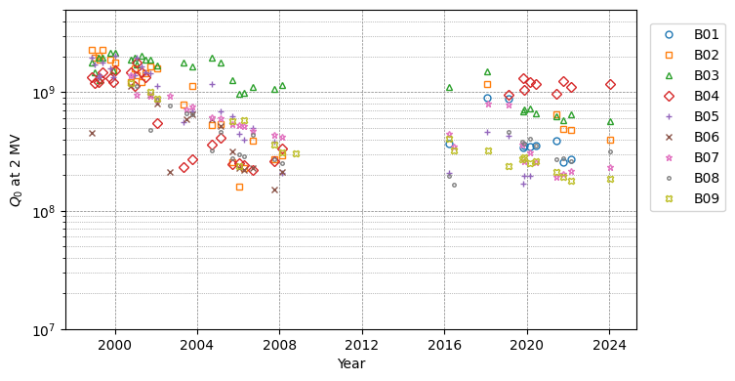
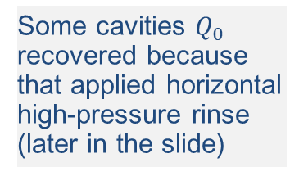
Superconducting cavity’s performance degradation in long-term operation
Data at KEKB era
from T. Furuya
Unloaded Q₀ degradation
HHPR
Some cavities $Q_{0}$ recovered because that applied horizontal high-pressure rinse (later in the slide)
KEKB era
SuperKEKB era
Vc re-calib.
Unloaded Q value at 2 MV (design maximum) of cavities slightly degrade.
Especially when there were vacuum problems, there was a big drop.
Notes:
the performance of Q0 has slightly decreased over time with field emission.
Since it has been operating for more than 20 years since KEKB,
some troubles including leak occurred.
In cooment, operation voltage is 1.5 MV and this Q_0 at 1.5 MV is not so much
there is no problem with the performance for the SuperKEKB operation.

Slide 21
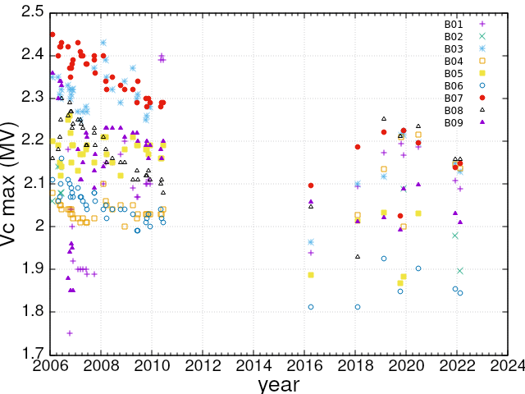
Superconducting cavity’s performance degradation in long-term operation
Quench field also tends to decrease over time.
  However, since voltage has been calibrated once, the value appears to have increased.
Performance degradation is inevitable over 20 years of operation.
Performance decreasing is enough to not interfere with operation.
However, cavity vacuum leaks cause unacceptable performance degradation.
KEKB era
SuperKEKB era
Re-calibrated
Notes:
The maximum acceleration gradient has also degraded over time.
the decreasing over time is no problem with SuperKEKB operation now.
Because operation voltage is 1.5 MV.
However, major problems such as leaks greatly reduced performance and needed to be fixed.

Slide 22
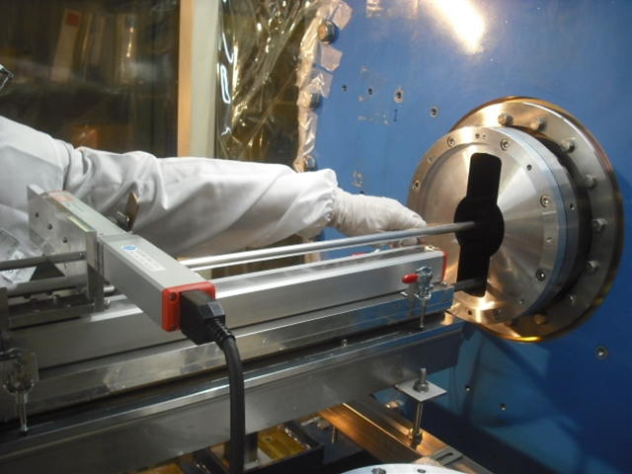
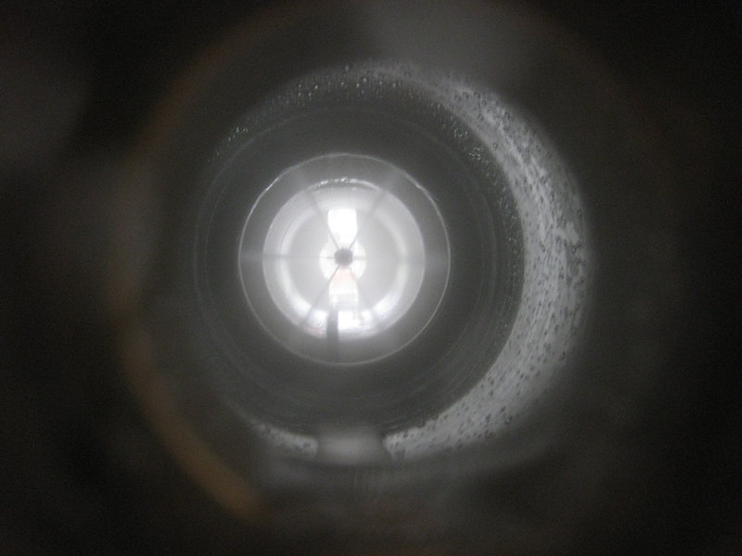
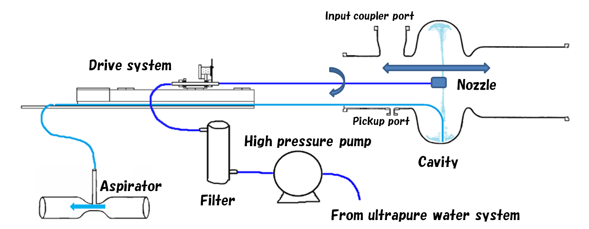
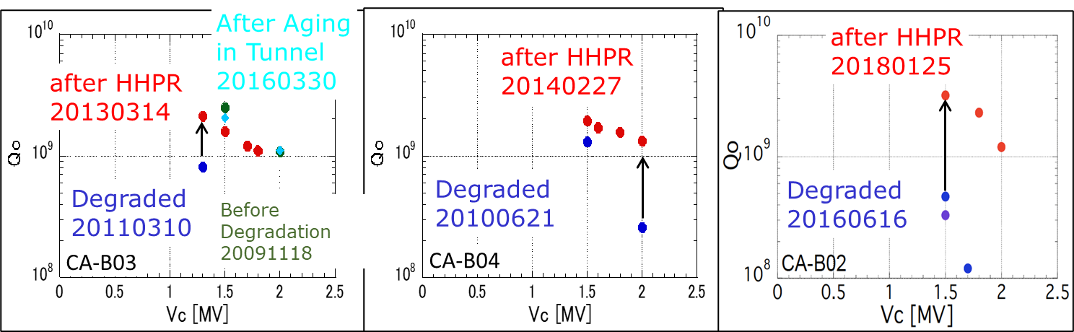
Performance recovering using
Horizontal High-Pressure Rinsing
Y. Morita
Insert Automatic Drive Nozzle
Rotating Water Jets
HHPR Parameters
Water Pressure | 7 MPa
Nozzle | φ0.54mm x 6
Driving speed | 1 mm/sec.
Rotation speed | 6 deg./sec.
Rinsing time | 15 min.
HHPR is effective in recovering performance
Notes:
One solution of the unacceptable performance degradation is rinsing with ultrapure water.
We developed high-pressure rinse system for the cavity inside module without disassembly.
Input coupler and both end groups, including ferrite HOM damper, taper chamber, bellows chamber, ion pump, vacuum gauges and GV, are removed before HHPR in a clean booth.
By using this system, we can apply HPR to the cavity in the cryomodule,
HPR nozzle automatically drive in horizontal and rotational inside the cavity in horizontal position.
dirty water in the cell is pumped up by aspiration system during rinsing.
We have already applied HHPR to three cryomodules degraded by strong FE.
Before cooling, baking were not performed.
All Cavity performances were successfully recovered. And Q0 value can be keep over 1x10^9 at 2 MV that is design value of cavity
All three cavities have been installed and operated stably in SuperKEKB.
We are planning to perform the HHPR in the accelerator tunnel.
There are many difficulties such as cleanliness, spaces, and supplying ultrapure water.
However, it has the great advantage that no extensive work is required to move the cavity out of the tunnel.

Slide 23
Summary
SuperKEKB is a collider upgraded from KEKB, aiming at extreme high luminosity with a nanobeam scheme and high current.
RF system has been and will be upgraded with reinforcements to handle the huge beam power.
ARES cavities has been reinforced to provide more beam power with revised stations and more klystrons.
Superconducting cavities will add HOM dampers to counteract the strong HOM
Damper system of CBI due to accelerating mode installed at LLRF.
Superconducting cavity has performance degradation over time and due to leaks, HHPR is an effective performance recovery.
2024c operation has just begun, RF system will continue to upgrade for SuperKEKB

Slide 24
Appendix

Slide 25
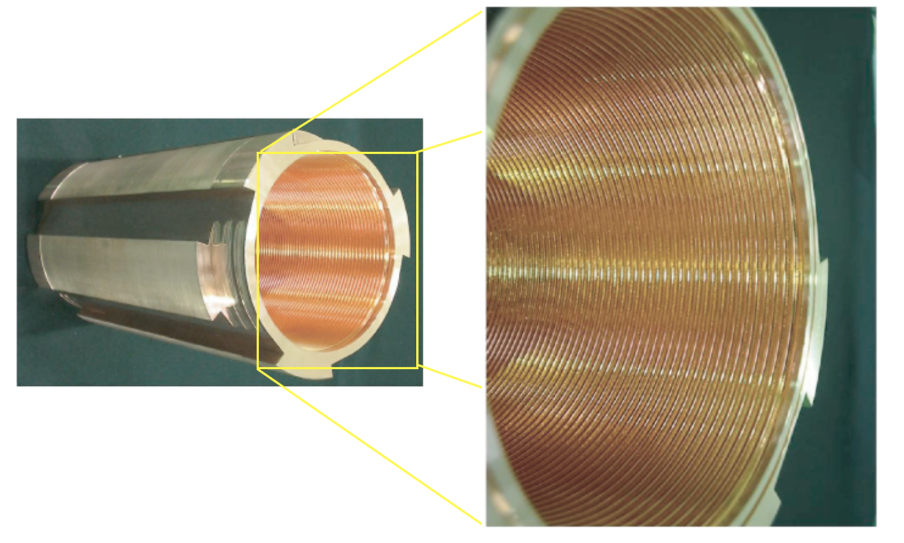
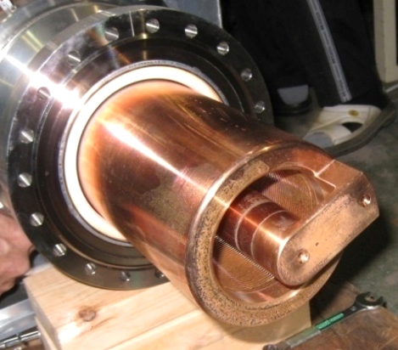
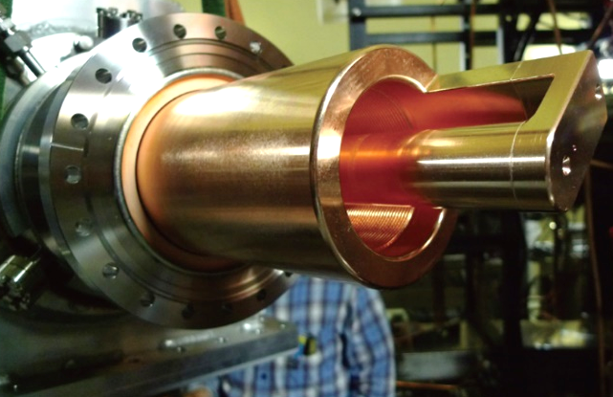
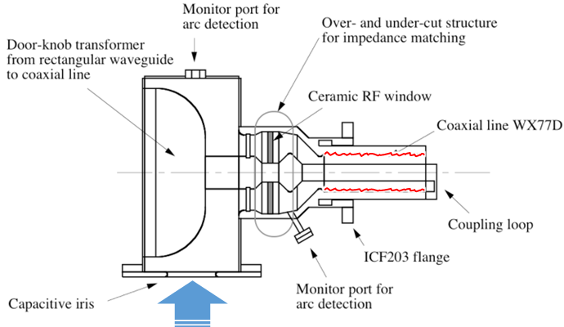
Upgrade items of ARES for SuperKEKB
For the higher RF power (400 → 800kW max.) and higher beam currents (< 2A → 3.6A max.)
T. Abe
Fine grooving of the coaxial line to completely suppress multipactoring
Increased input coupling (β_{max} = 3→6, β_{set} = 5) needed for the stations with the Kly:Cav=1:1 configuration to accelerate beams with the design current of LER
T. Abe, et al., Phys. Rev. Accel. Beams 13, 102001 (2010)
Used for KEKB
With an increased input coupling
for SuperKEKB
The 14 input couplers used for SuperKEKB beam operation have:
the fine-groove structure with no multipactoring observed so far
the increased coupling
➔ No trouble so far

Slide 26
Estimation of the growth rates of CBI
CBI damper
K. Hirosawa et al., Nucl. Instrum. Methods. Phys. Res. A 951, 163044, 2019.
LER
HER
Threshold currents for μ=-1 mode are quite below the design current.
When there are parked cavities, μ=-2 mode also has no margin.
New CBI damper system has been developed and installed.
Notes:
Estimation of the growth rates of CBI.
These plots are growth rate of u=-1,-2,-3 modes as function of the stored beam current for LER and HER.
This line shows Radiation damping rate.
The threshold current of the υ=-1 is about 1.8 A for LERand 1.2 A for HER.
At the design beam, the growth rate of the υ=-2 mode instability will be close to the radiation damping rate.
When there is a parked cavity, u=-2 mode also has no margin.
In the past operation, u=-1 mode damper was required earlier than expected due to the detuned cavity.

Slide 27
CBI damper system
CBI damper
K. Hirosawa et al., Nucl. Instrum. Methods. Phys. Res. A 951, 163044, 2019.
The damper system is installed to ARES station with digital LLRF system.
FB loop test result of the CBI mode filter for a simulant cavity
The damper system can correspond to μ =-1, -2 and -3 modes in parallel.
Frequencies correspond μ =-1, -2 and -3 modes are racked successfully.
The new CBI damper system is working in SuperKEKB LER and HER.
Notes:
This is a block diagram the LLRF system with CBI damper.
The damper system is installed to ARES station with digital LLRF.
The damper system can correspond to u=-1, -2 and -3 modes in parallel.
This is an example of FB loop test result of the CBI mode filter for a simulant cavity.
The frequency correspond each mode are racked successfully.

Slide 28
Example of CBI damper operation
CBI damper
K. Hirosawa et al., Nucl. Instrum. Methods. Phys. Res. A 951, 163044, 2019.
without CBI damper
μ=-2 mode was excited purposely by large detuning SCC.
Peak disappeared by CBI damper.
with CBI damper
Up to 1.46 A for LER and 1.14 A for HER,
CBI is not a problem with this damper systems.
Notes:
The CBI damper system is operating in SuperKEKB LER and HER.
This is an example of beam spectra without and with CBI damper.
The u=-2 mode was excited by large detuning SCC artificially.
After tuning CBI damper, the peak disappeared.
In actual beam operation with the damper system, CBI is not a problem up to 1.46A for LER and 1.14A for HER.

Slide 29
Zero-mode stability related to Robinson stability
DRFB and ZMD
K.Akai, et al., Proc. of PASJ2022, P320.
In high current operation, synchrotron frequency reduction is expected due to coherent oscillation (zero-mode).
To mitigate the beam-loading effect, Direct RF feedback (DRFB) and Zero-mode damper (ZMD) are working.
Calculated coherent oscillation frequencies with simplified one SCC for various Q_{L} (without FB for instabilities)
Calculated and measured coherent oscillation frequencies in actual HER (ARES + SCC) with DRFB Off, -6.0dB and -4.5dB
Block diagram of LLRF with DRFB and ZMD (Focused on SCC station in HER)
HER
Synchrotron frequency [kHz]
-4.5dB
Synchrotron frequency [kHz]
DRFB Off
-6.0dB
Synchrotron frequency reduction depends on Q_{L}. But, changing Q_{L} of SCC should be avoided due to the need for vacuum work and the risk of surface contamination.
Effective impedance of cavity and beam loading are reduced by DRFB. ZMD is tuned its phase to suppress the coherent oscillation.
Calculated
Measured (Beam Study)
The higher beam current can be stored stably by DRFB and ZMD in beam study.
There is no discrepancy between the quantitative analysis and the beam study results.
Coherent oscillation instability is not a problem with the DRFB and ZMD so far.
Notes:
In high current operation, fs reduction is expected due to coherent oscillation.
This is calculation of coherent oscillation frequencies as a function of stored beam current with simplified one SCC without FB.
fs reduction depends on QL.
But changing QL of SCC should be avoided.
Therefore, DRFB and ZMD system are working.
This is a block diagram of LLRF focused on SCC.
By DRFB, effective impedance of cavity and beam loading are reduced.
And, the zero-mode damper is tuned its phase to suppress amplitude of the coherent oscillation.
This plots show the calculated and measured frequencies without DRFB and different gain of DRFB.
The higher beam current can be stored stably by DRFB and ZMD in beam study.
Up to higher than 1A operation, coherent oscillation instability is no a problem with the DRFB and ZMD.

Slide 30
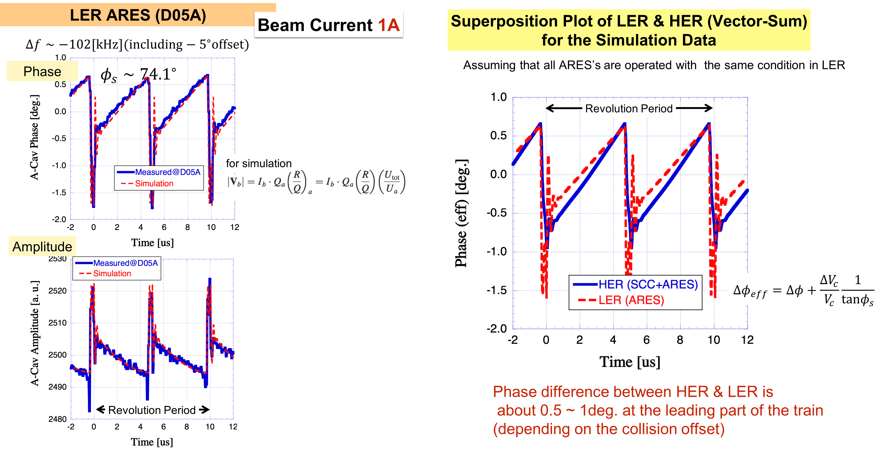

Calculation and measurement of Bunch Gap Transient
Bunch Gap Transient
T.Kobayashi and K.Akai, Phys. Rev. Accel. Beams 19, 062001, 2016.
The bunch gap modulates the amplitude and phase of the accelerating cavity field.
The longitudinal synchronous position is shifted bunch-by-bunch along the train. It is meaning that the collision point of each bunch is shifted.
Although this effect has not yet become a major problem, it will be a loss of luminosity.
Calculation and measurement of phase change in ARES A-cavity (LER, 1A, 2gaps)
Phase modulation along train
for simulation
$$\left|V_{b}\right|=I_{b}Q_{a}{\left(\frac{R}{Q}\right)}_{a}=I_{b}Q_{a}\left(\frac{R}{Q}\right)\left(\frac{U_{tot}}{U_{a}}\right)$$
The rapid phase change is attributed to the parasitic 0 and pi mode of ARES.
The feed-forward control cannot be available in our RF system for the measures to reduce the phase modulation due to the gap transient, because the klystron performance (bandwidth ~100kHz, output power) is not enough to cancel the rapid phase modulation.
Revolution Period
Rapid phase change at bunch gap
Notes:
Final topic is bunch gap transient.
The bunch gap modulates the amplitude and phase of the accelerating cavity field.
Due to this modulation, the longitudinal synchronous position is shifted bunch by bunch along the train as shown in this plot.
Then, collision point of each bunch is shifted.
It will make loss of luminosity.
This plots are calculation and measurement of phase change in ARES A-cavity in 1A with 2 bunch gap operation.
There are rapid phase change at the gap.
The rapid phase change is attributed to the parasitic 0 and pi mode of ARES.
The feed-forward control can’t be available in our RF system for the measures to reduce this modulation,
because the klystron performance such as bandwidth and output power is not enough to cancel the rapid phase modulation.

Slide 31
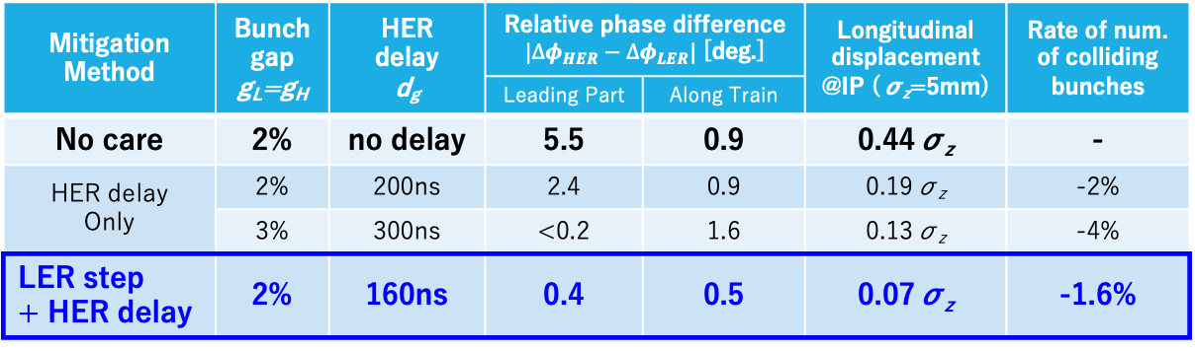
Estimation of phase difference between LER and HER (${∆φ}_{HER}−{∆φ}_{LER}$)
Bunch Gap Transient
T.Kobayashi and K.Akai, Phys. Rev. Accel. Beams 19, 062001, 2016.
Calculation at design beam currents with 1 gap
Smaller phase difference
→ Smaller loss of luminosity
Simulation study to mitigate the phase difference
Change filling pattern at leading part of LER (with step)
Gap delay for HER
small phase difference
zoom
collision
Gap length : g_{L}=g_{H}
LER step height : b_{s} (half of nominal current)
HER delay : d_{g} , LER step length : w_{s}
collision
Mitigation Method | Bunch gap g_{L}=g_{H} | HER delay d_{g} | Relative phase difference $|{∆φ}_{HER}−{∆φ}_{LER}|$ [deg.] |  | Longitudinal displacement @IP (σ_{z}=5mm) | Rate of num. of colliding bunches
 |  |  | Leading Part | Along Train
No care | 2% | no delay | 5.5 | 0.9 | 0.44σ_{z} | -
HER delay Only | 2% | 200ns | 2.4 | 0.9 | 0.19σ_{z} | -2%
 | 3% | 300ns | <0.2 | 1.6 | 0.13σ_{z} | -4%
LER step + HER delay | 2% | 160ns | 0.4 | 0.5 | 0.07σ_{z} | -1.6%
Large phase difference
at leading part of collision
Notes:
These are the simulation study of phase difference between LER and HER.
Even if the phase modulates by bunch gap transient, Reducing the phase difference between LER and HER can reduce the effect on Luminosity.
This is a calculation result without any care.
Red line is phase difference between LER and HER.
As you can see, there is a large phase difference at a leading part of the train.
To mitigate the phase difference, we considered changing the fill pattern at the leading part of LER and the gap delay for HER.
In this condition, the phase differences at leading part and along train are small with step of bunch pattern of LER and gap delay for HER.
In actual operation, it is necessary to optimize the fill pattern and gap delay while observing the luminosity.

Slide 32
Parameter | KEKB (achieved)
Ring | HER |  |  | LER
Energy [GeV] | 8.0 |  |  | 3.5
Beam Current [A] | 1.4 |  |  | 2
Number of Bunches | 1585 |  |  | 1585
Bunch Length [mm] | 6-7 |  |  | 6-7
Total Beam Power [MW] | ~5.0 |  |  | ~3.5
Total RF Voltage [MV] | 15.0 |  |  | 8.0
 | ARES |  | SCC | ARES
Number of Cavities | 10 | 2 | 8 | 20
Klystron : Cavity | 1:2 | 1:1 | 1:1 | 1:2
RF Voltage [MV/Cav.] | 0.5 |  | 1.5 | 0.5
Beam Power [kW/Cav.] | 200 | 550 | 400 | 200
SuperKEKB (design)
HER |  | LER
7.0 |  | 4.0
2.6 |  | 3.6
2500 |  | 2500
5 |  | 6
8.0 |  | 8.3
15.8 |  | 9.4
ARES | SCC | ARES
8 | 8 | 8 | 14
1:1 | 1:1 | 1:2 | 1:1
0.5 | 1.5 | 0.5
600 | 400 | 200 | 600
(achieved) SuperKEKB
HER |  |  | LER
7.0 |  |  | 4.0
1.21 |  |  | 1.46
2346 |  |  | 2346
~6 |  |  | ~6
~3.1 |  |  | ~3.2
14.2 |  |  | 9.3
ARES |  | SCC | ARES
4 | 4 | 8 | 12 | 10
1:2 | 1:1 | 1:1 | 1:2 | 1:1
0.45 |  | 1.45 | 0.45
130 | 170 | 325 | 190 | 230

Slide 33
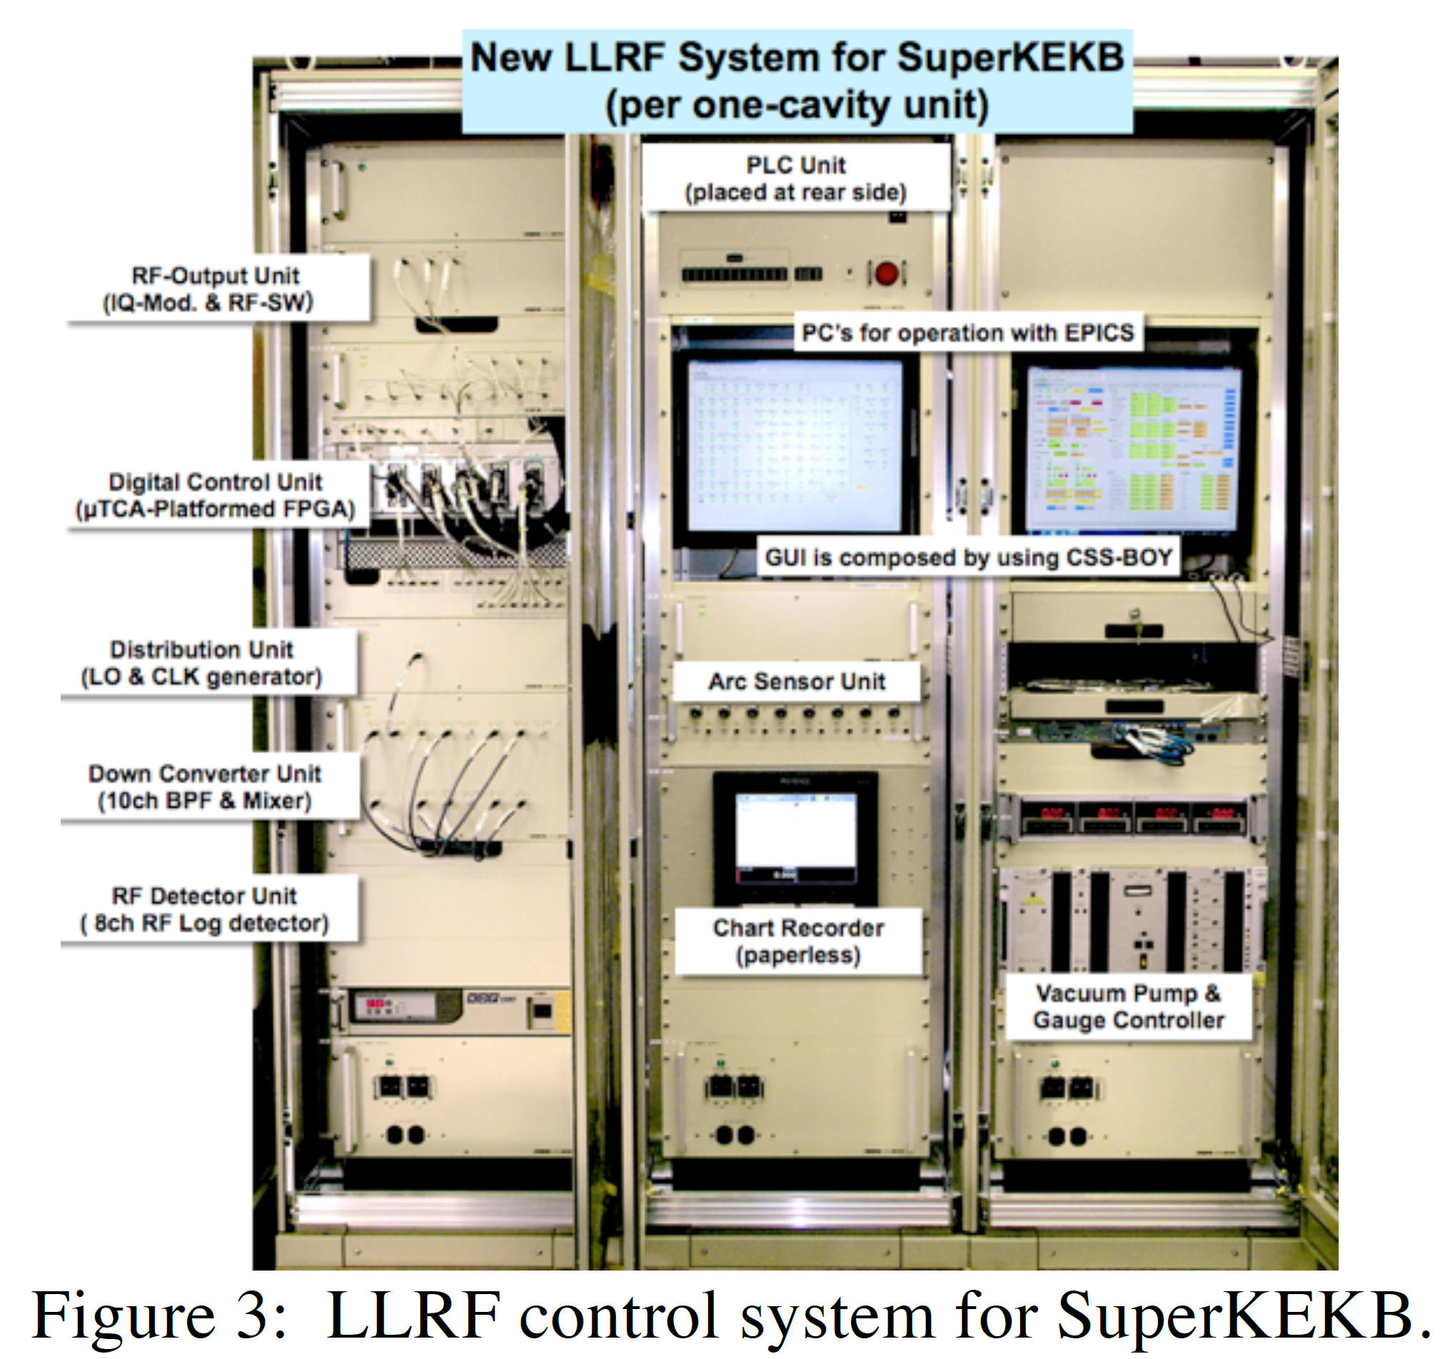
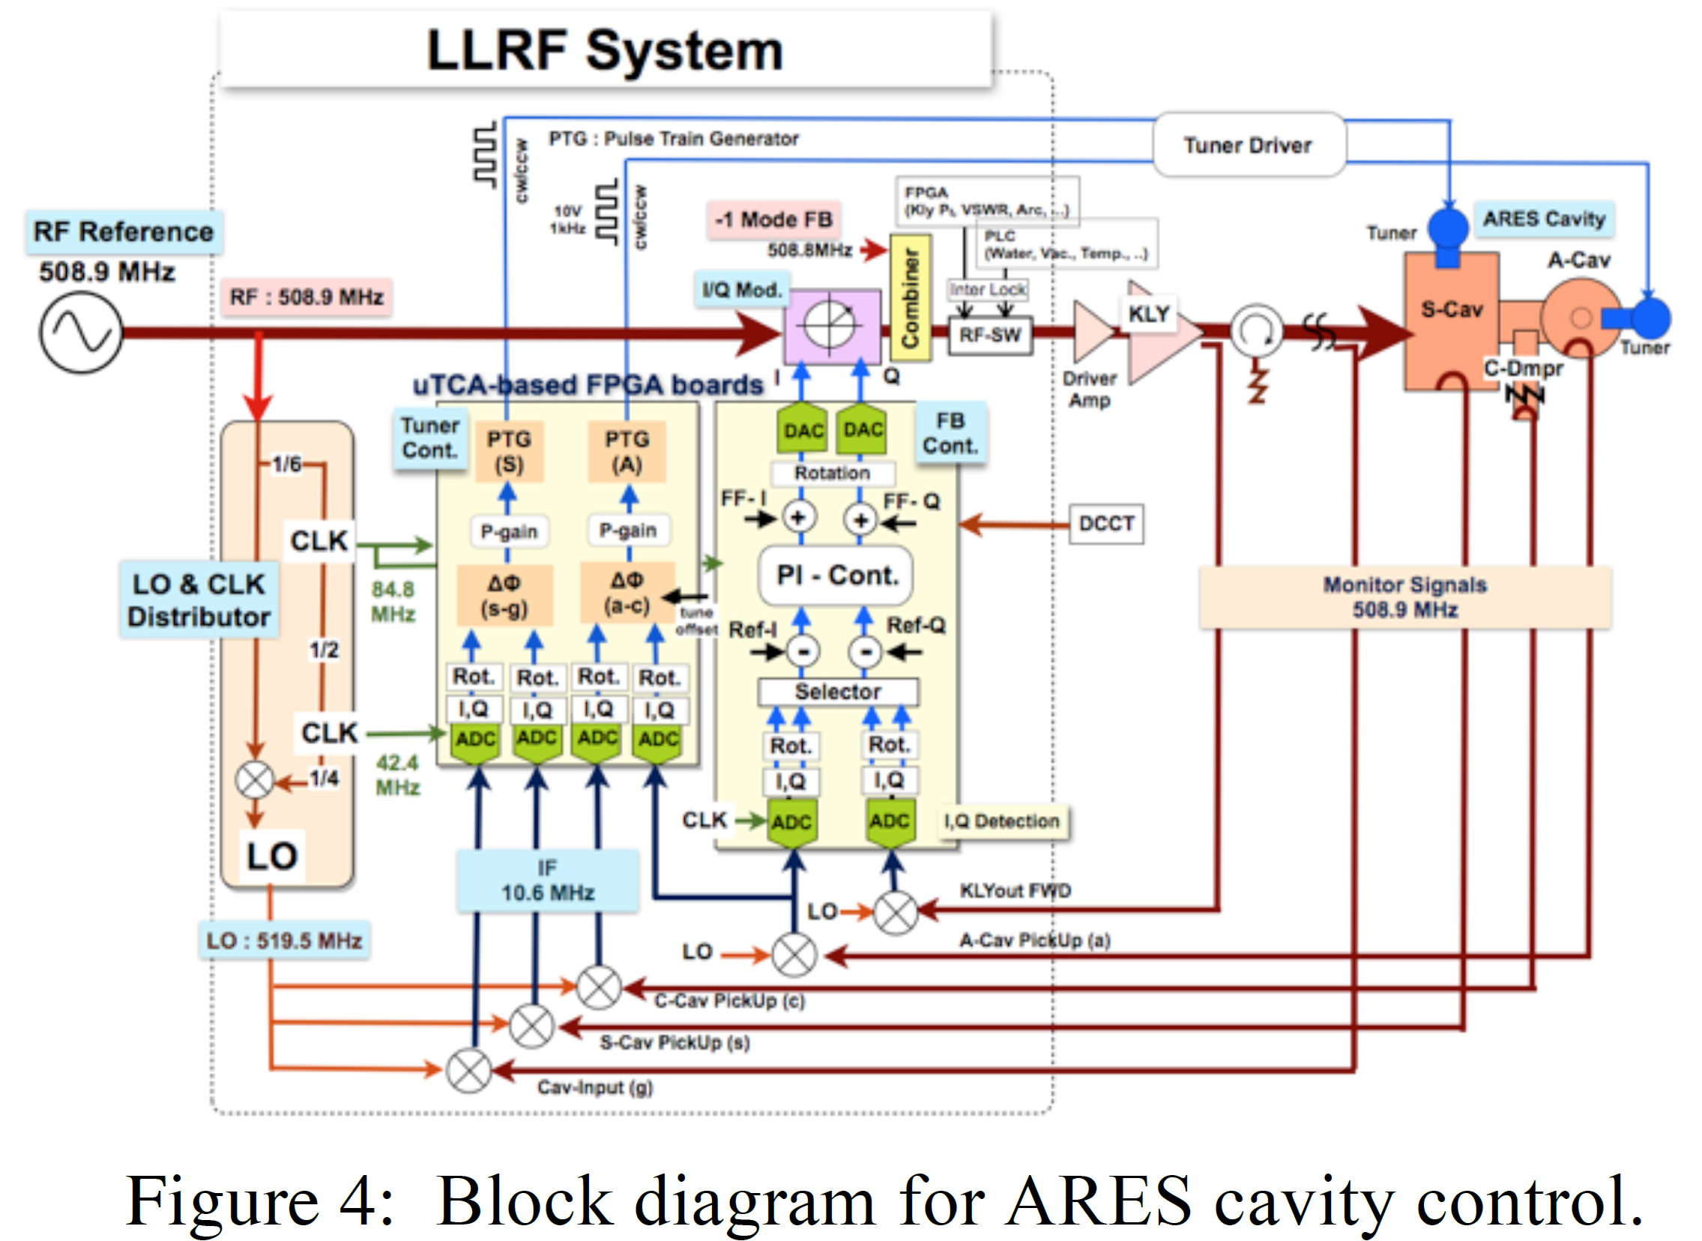
New LLRF Controls in SuperKEKB
T. Kobayashi et al, LLRF2017 https://doi.org/10.48550/arXiv.1803.09037

Slide 34
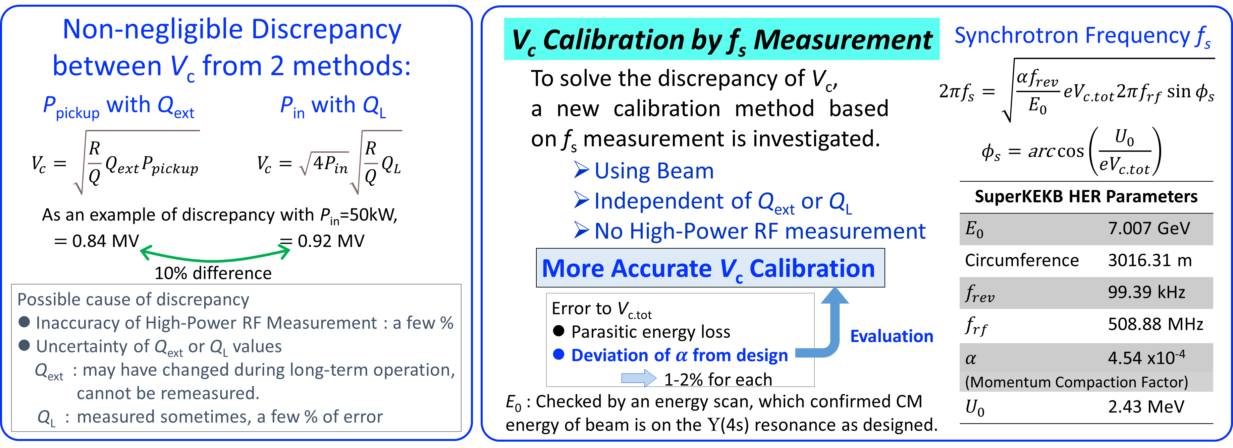
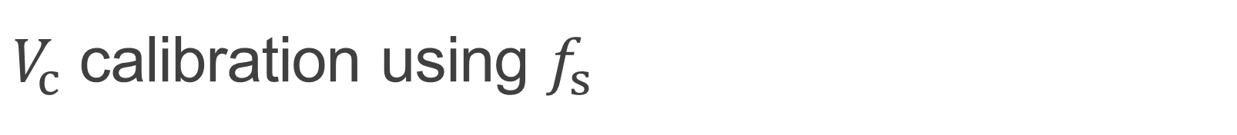
$V_{c}$ calibration using $f_{s}$
M. Nishiwaki et al, SRF2021 https://jacow.org/srf2021/papers/tupfav002.pdf

Slide 35
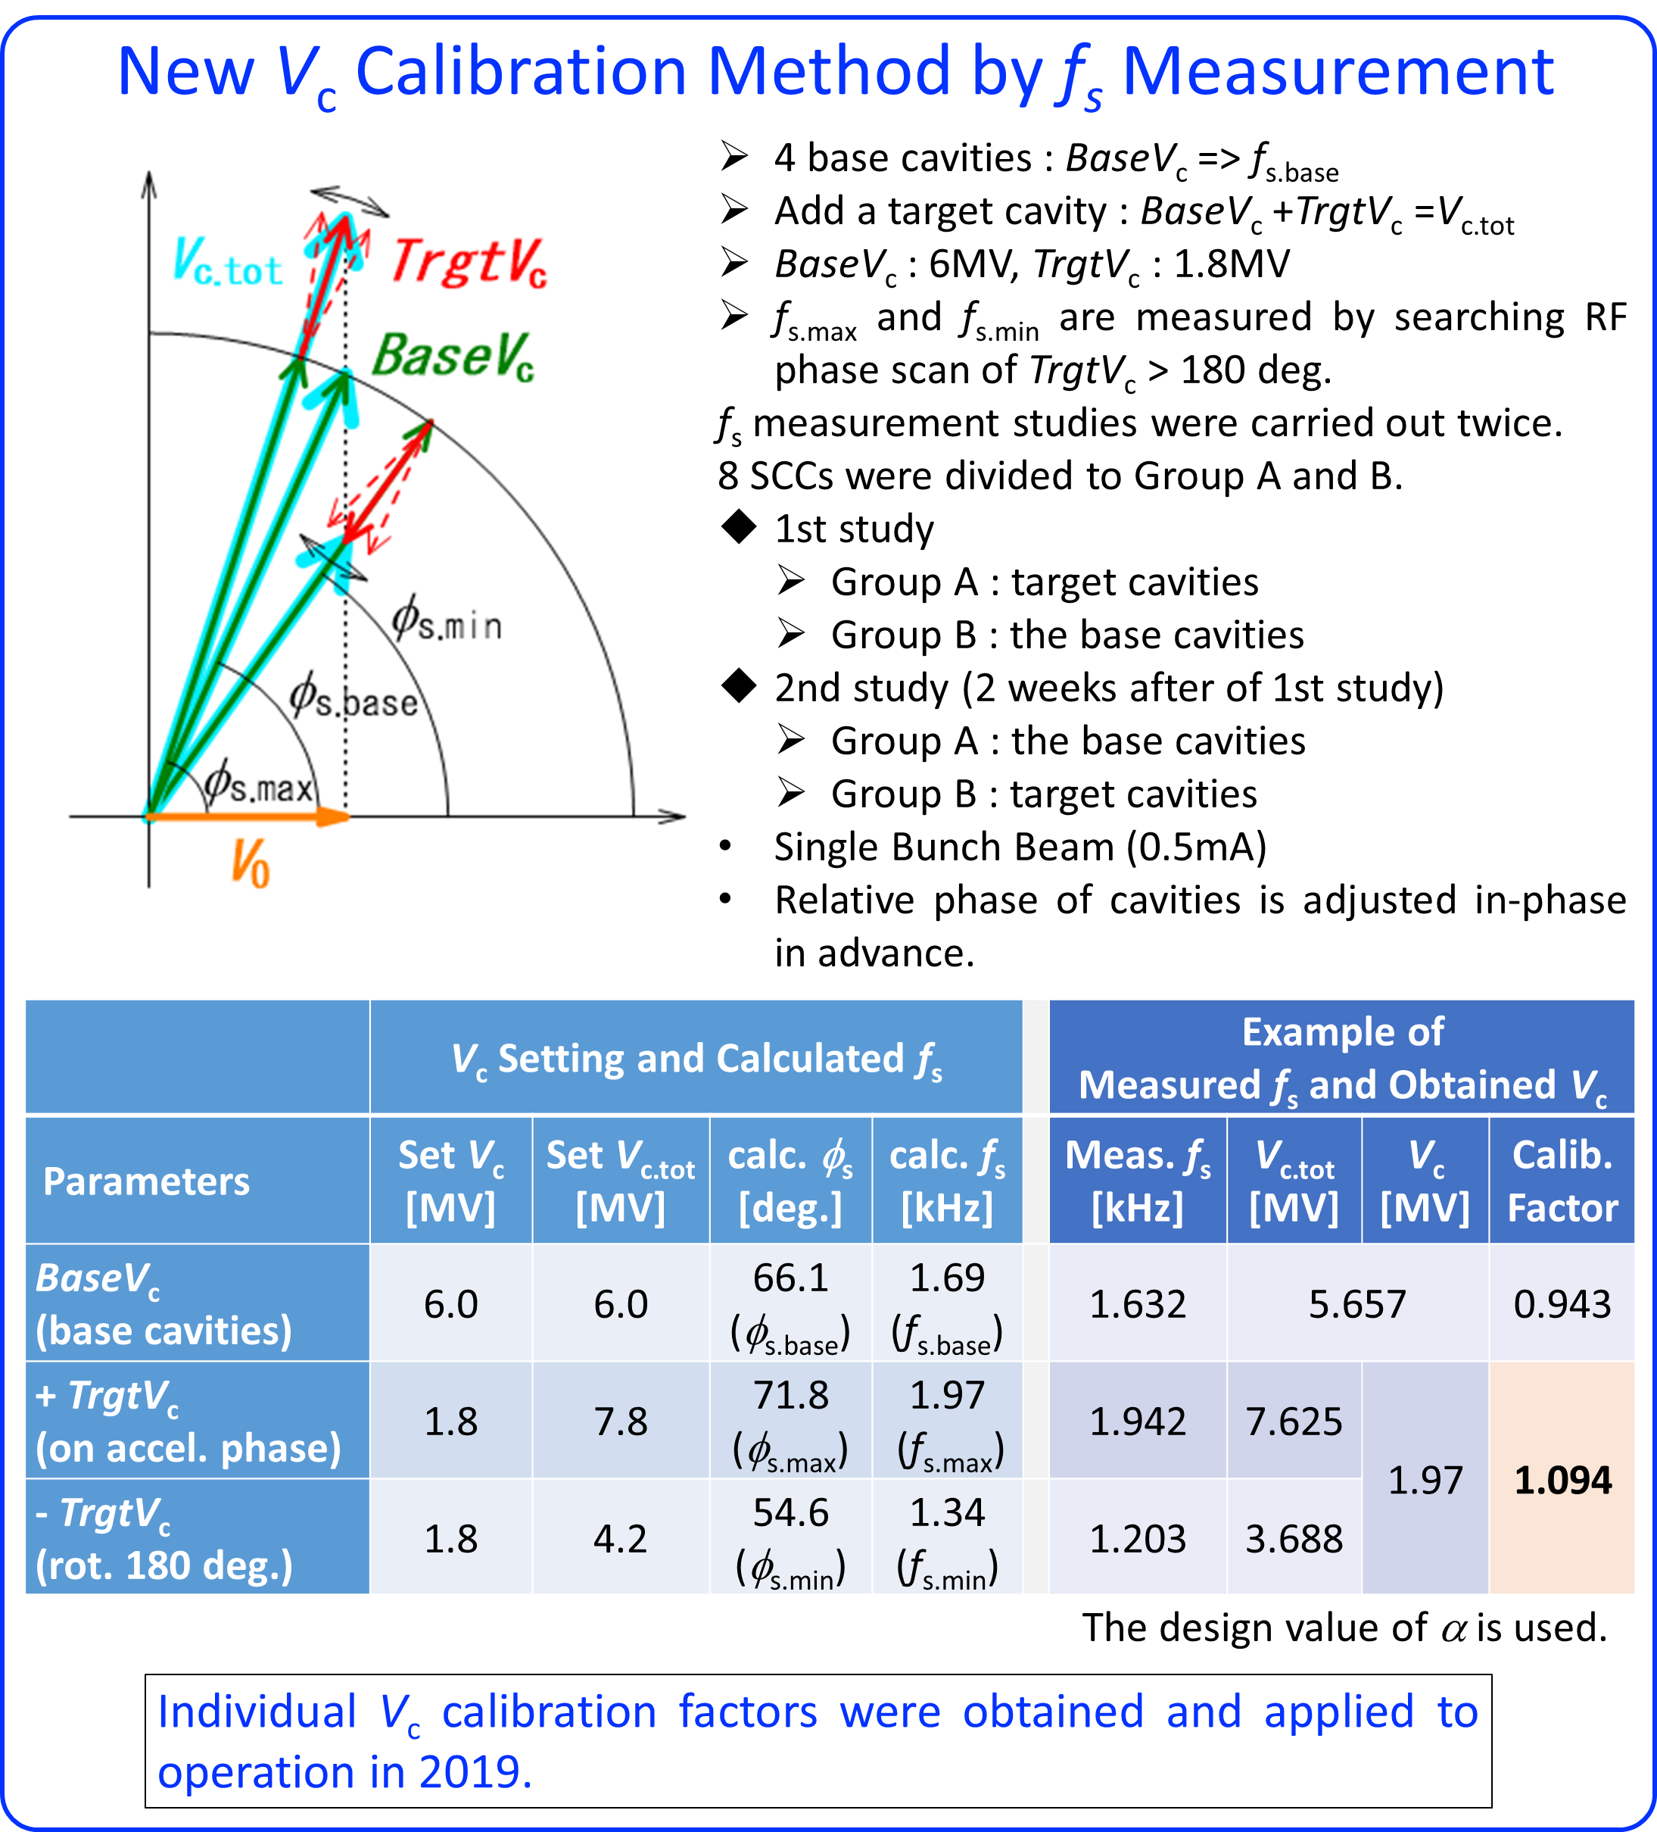
$V_{c}$ calibration using $f_{s}$
The actual V_{c} for SCCs have been around 7% lower than measurement in 2010.
M. Nishiwaki et al, SRF2021 https://jacow.org/srf2021/papers/tupfav002.pdf

