Slide 1
The new generation modular instrument platform
Everacq Technology
2024年10月25日
Notes:
Good afternoon, ladies and gentlemen.I am honored to be here and share with all of you the latest progress of our Hefei Zhongke Caixiang Technology Co., Ltd. in the field of the new generation of modular instrument platforms.
With the continuous development of technology, the requirements for the performance, reliability, and flexibility of measurement systems are getting higher and higher. Traditional instrument architectures are difficult to meet these needs. Therefore, we have proposed a new generation of modular instrument platform - μXI (micro eXtensions for Instrumentation).

Slide 2
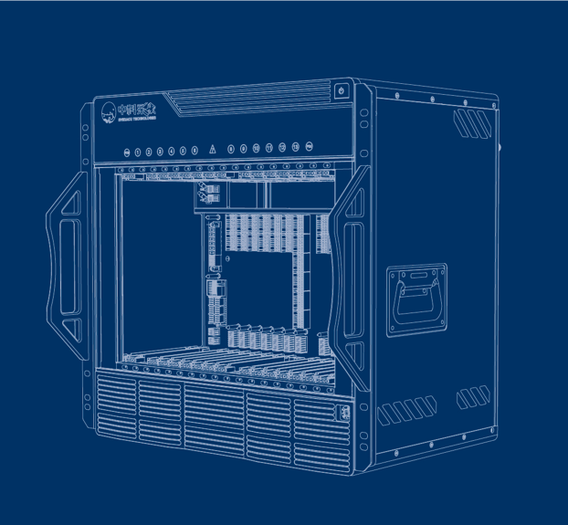
Table of Contents
The μXI Modular Instrument Platform
The product Introduction of μXI Instrument
The application scenarios of μXI instrument
Notes:
I will introduce to you the core technologies, product features, and application advantages in different scenarios of the μXI modular instrument platform.

Slide 3
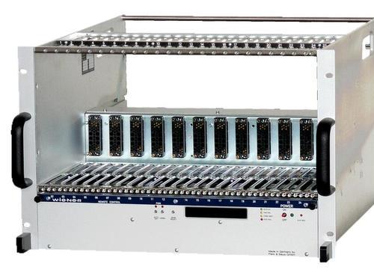
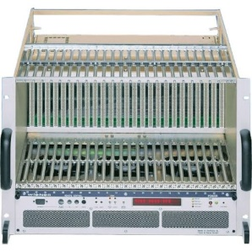
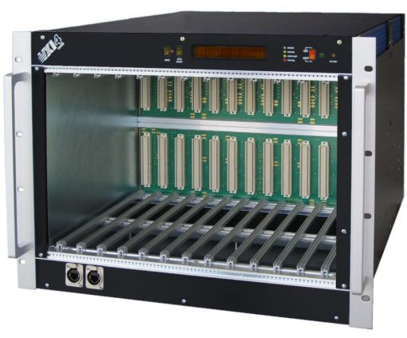
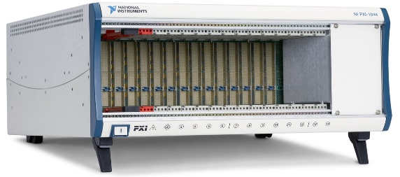
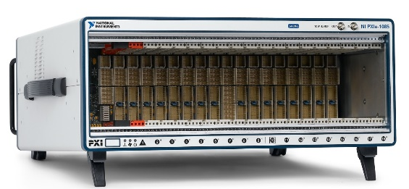
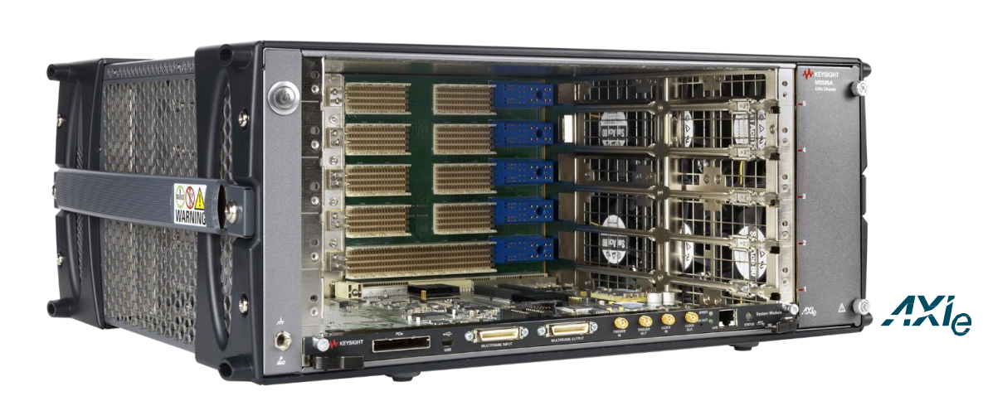
1.1
The Developmen of Modular Instrument Platforms
NIM (1964)
CAMAC (1972)
VXI (1987)
NewGeneration Instrument Platform:
Modular Design
Trigger Bus
Clock Bus
Backplane Direct Interconnection
Open Protocol
High-Speed Transmission
……
  Bus: parallel, adaptable to different CPUs
  Features：The backplane wiring is abundant
  Bus: Parallel VME Bus
  Features: Dedicated Trigger Clock Bus, hot-pluggable modules
  Bus: None.
  Features: high reliability
PXI (1997)
PXIe (2005)
AXIe (2010)
  Bus: Parallel PCI
  Features: Dedicated Trigger Clock Bus
  Bus: Parallel PXIe
  Features: Dedicated Trigger Clock Bus
  Bus: Parallel PCIe &Ethernet
  Features: Dedicated Trigger Clock Bus
Notes:
First, let's review the development history of modular instruments. From the NIM in 1964 to today's μXI, modular instruments have undergone numerous iterations, each bringing new technologies and features to meet the growing demands.
NIM (1964): No bus, only power supply. CAMAC (1972): Parallel bus, compatible with different CPUs, rich backplane wiring. VXI (1987): Parallel VME Bus, began introducing dedicated trigger and clock buses in nuclear physics, supports hot-pluggable modules. PXI (1997): Adopted parallel PCI bus. PXIe (2005): Adopted serial PCIe bus. AXIe (2010): Adopted serial PCIe & Ethernet buses, also features dedicated trigger and clock buses.

Slide 4
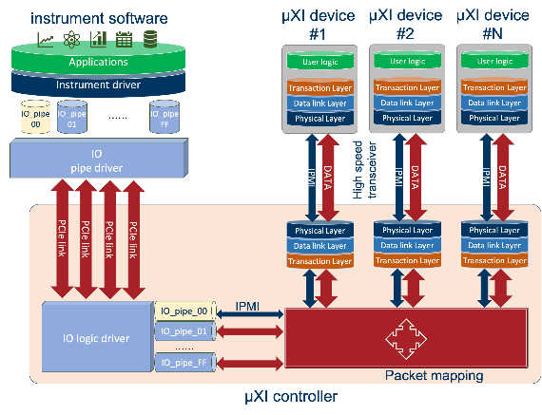
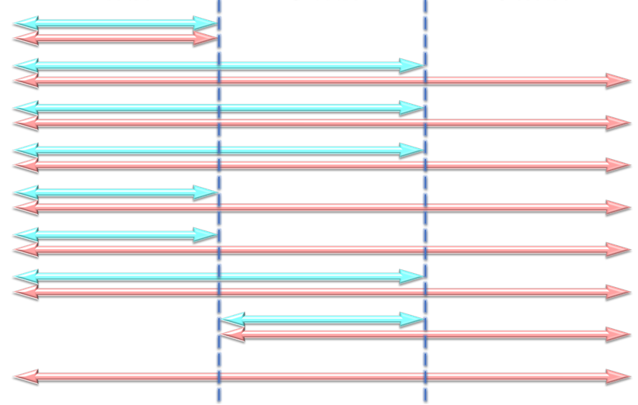
1.2
μXI Modular Instrument Platform
μXI：micro eXtensions for Instrumentation
  A new standard defined for high-performance, highly reliable, compact modular instruments
  Composition: Extending instrument definition to the software and firmware layers.
Redefining the DNA of Modular Instruments
Common Requirements
Hardware Layer
Software Layer
Firmware Layer
Mechanical Power Supply
Hot Swap
System Communication
System Management
Trigger Bus
Clock Bus
Instrument Model
Communication Protocol
Time Synchronization
μXI Modular Instrument Platform Framework
Notes:
By combining the strengths of traditional modular instrument platforms, the μXI platform extends instrument definition into the software and firmware layers,.
hardware-software interaction integrated, : Offers stable drivers and SDK development ,simplify the development process and improve efficiency.

Slide 5
1.3
μXI Platform Synchronisation Timing Controller
Key features
  Integrated CPU and FPGA processing unit
  powerful data processing capabilities and system flexibility
  Integrated trigger distribution, time synchronization
Advantages for Application
  Peripheral devices are isolated from the CPU, reliable hot swapping
  μXI bus technology shortens product update cycles
Notes:
One of the most innovative aspects of μXI is its synchronized timing controller, which integrates CPU and FPGA processing units to provide powerful data processing capabilities and system flexibility. All UXI peripheral plug-ins gather data in parallel to the root FPGA, which offers additional functions such as trigger distribution and time synchronization.

Slide 6
1.4
μXI Data Transmission Architecture
Key Features
  μXI Device Bus Abstraction
  Standardized Interface Design
  Logic firmware Interconnection Based on Transport Layer
Advantages for Application
  Stable Software and Hardware Interaction Driver
  Simplified SDK Development Support Package
  Flexible Interface Calls
Notes:
The μXI data transmission architecture adopts bus abstraction and standardized interface design, similar to USB. This primarily relies on the FPGA logic firmware interconnection at the transport layer. The advantage of this approach is

Slide 7
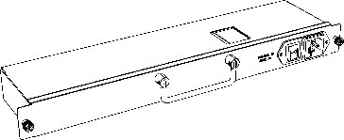
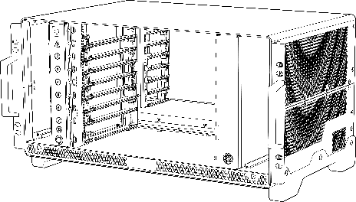
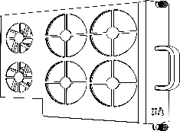

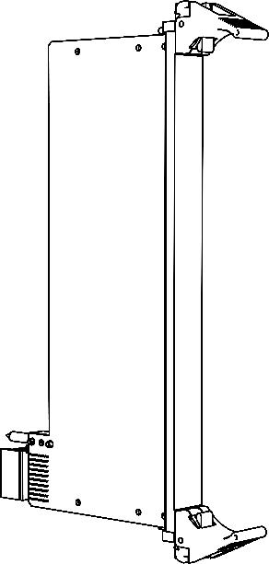
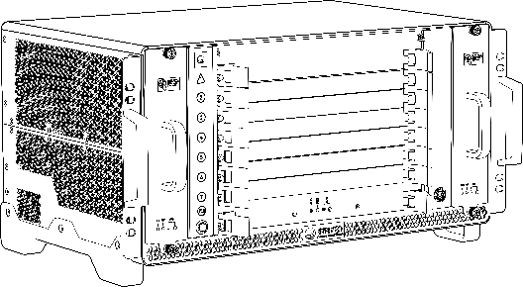
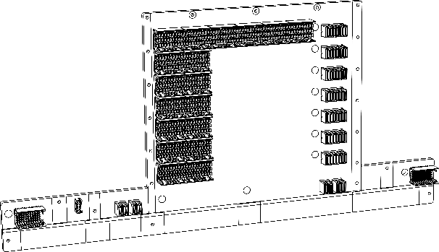
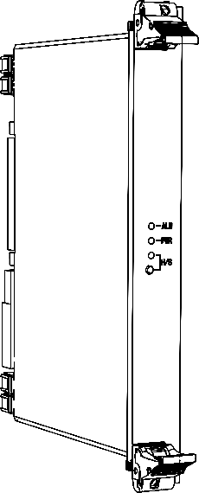
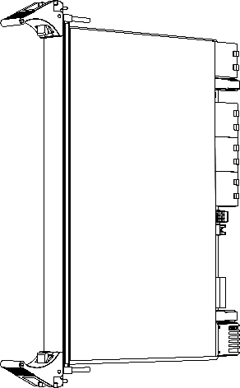
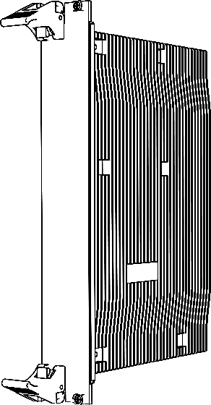
1.5
μXI Hardware Platform Framework
Key Features
Power supply
  Modular Design Concept
  Highly Reliable Intelligent Device Management
  Highly Reliable Industrial Design
Machine
Heat dissipation
Back-insert card
Backplate
Advantages for Application
  Modular design meets the needs of rapid product iteration
  Fully intelligent management of power, temperature and board status, industrial system reliability requirements
Front-insert card
System management
Controller
μXI Hardware Platform Framework
Notes:
The μXI hardware platform consists of eight parts ,It has the following key features,

Slide 8
1.6
Comparison between the μXI platform and other platforms
 | VXI | PXI | PXIe | AXIe | μXI
Chassis management | User expansion | User expansion | User expansion | IPMI Intelligent management | IPMI Intelligent management
Data bus | VME | PCI | PCIe | PCIE、ETH | PCIe + GTH/USER Define
Synchronous clock | Dedicated single - ended star - shaped clock lines | Dedicated single - ended star - shaped clock lines | Dedicated differential star - shaped trigger lines Dedicated single - ended star - shaped clock lines | Dedicated differential star - shaped trigger lines | Dedicated differential star - shaped clock lines Dedicated single - ended star - shaped trigger lines
Trigger bus and transmission speed | Dedicated single - ended star - shaped clock lines | Dedicated single - ended star - shaped trigger lines | Dedicated differential star - shaped trigger lines Dedicated single - ended star - shaped clock lines | Dedicated single - ended star - shaped clock lines | Expandable custom - defined differential trigger lines Dedicated high - speed trigger - information trigger lines
Controller | The Intel CPU has no timing granting and trigger processing capabilities and does not support FPGA |  |  |  | Support multiple architectures such as Intel, ARM, SoC, and domestic CPUs Support timing - granting and trigger - processing Support FPGA programmability.
Device Size | 3U、6U |  |  | 8U | 3U、6U、Flexible customization
Data readout | user development | user development/Labview |  | user development | Generalized data readout technology (Software Driver, Firmware Transfer)
Communication protocol | Only provide data transmission channels |  |  |  | Provide instruction sets, transport protocols
1
Intelligent chassis
2
High-performance backplane
Logical Reconfigurable Synchronization Controller
3
Multi-form Device Card
4
5
Universal Readout
function
6
Instruction Set
Notes:
Now, let's compare μXI with other platforms: Technical advantages of the μXI platform: • Intelligent chassis: Supports the IPMI intelligent management protocol for real-time monitoring of device status, improving system reliability. • High-performance backplane: Meets the needs of high-speed data transmission. • Logically reconfigurable synchronous timing controller: Supports various triggering and clock synchronization schemes to meet complex testing requirements. • Multi-format device cards: Supports various types of functional modules. • Universal readout: Supports multiple instruction sets and transfer protocols to enhance system compatibility. • Instruction set: to meet various application needs.

Slide 9
The μXI Modular Instrument Platform
The product Introduction of μXI Instrument
The application scenarios of μXI instrument

Slide 10
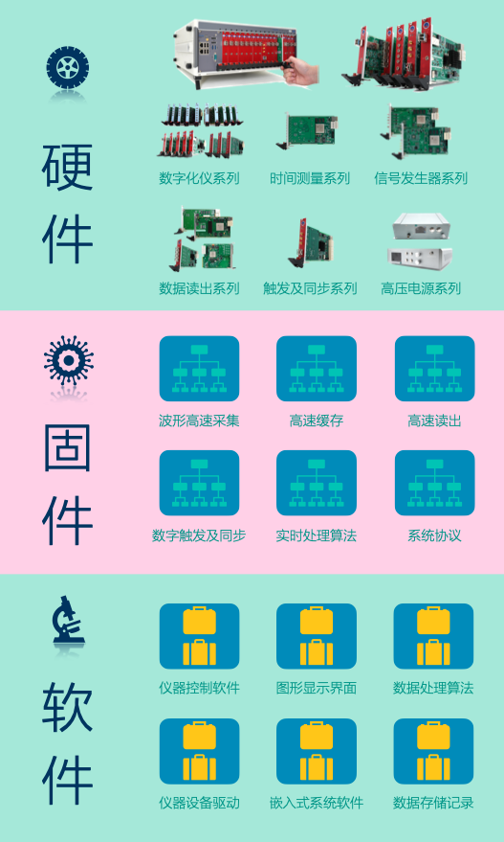
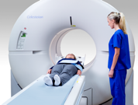
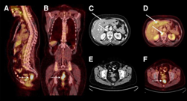
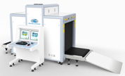












2.1
μXI Instrument Platform Product Series
1
Data Acquisition Serie
4
Synchronization and Clock Series
Digital Instruments
Low-Speed Data Acquisition
High Precision Data Acquisition
Precise Timing Measurement
Multifunctional Acquisition
Precision Time Receiver
Trigger Synchronization
5
Chassis and Controller Series
PXI Chassis
PXI Controller
2
Readout and Control Serie
6
Software and Hardware Series
Device Drivers
Instrument Drivers
Data Acquisition Software
FPGA Firmware
Equipment Management Software
Signal Processing Algorithm Library
Universal Read/Write Board
Optical Fiber Readout
Sequential Control/Digital Delay
Digital I/O
Multifunctional I/O
3
Readout and Control Serie
Arbitrary Waveform Generator
Arbitrary Pulse Generator
Random Number Generator
7
Accessories
Cables
Signal Conversion
Notes:
Here are the several instrument products based on the μXI platform, including:
Data acquisition series/Readout control series/Signal generator series/Synchronization and clock series/Chassis/Software and firmware,

Slide 11
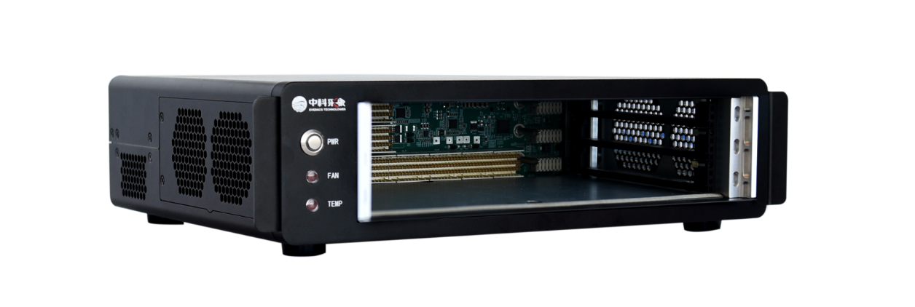
2.2
Chassis of μXI Instrument Platform
2-Slot Portable Chassis: μXI-X6050
The μXI-X6050 is a high-performance, two-slot portable chassis independently developed based on the μXI platform. Its distinctive features include: 8GB/s of backplane bandwidth, a stable and reliable power supply, ensuring data acquisition with utmost protection. Suitable for small-scale testing and measurement.
【Main Parameters】
Height: 2U Expansion Slots: 2 external and 1 system slot
Bandwidth: Up to 8GB/s backplane bandwidth, 4GB/s independent bandwidth
Backplane: μXI data transmission control bus with high-quality clock and trigger signals, supporting IPMI intelligent management protocols.
Power Requirements: 200~240VAC 350W
Operating Temperature: 0℃~50℃
Size: 333mm×216mm×77mm (W×D×H)
Notes:
Now, let's look at some specific products

Slide 12
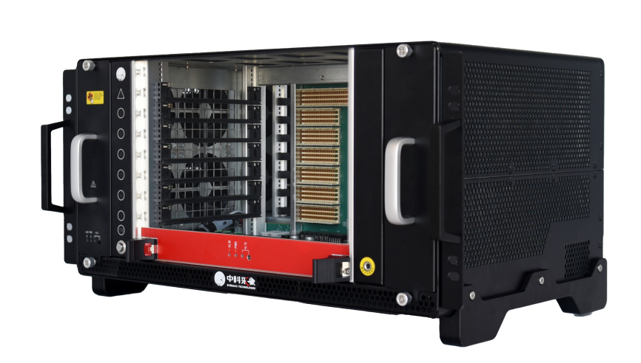
2.2
Chassis of μXI Instrument Platform
6-Slot Rack-mounted Chassis：μXI-X6030
The μXI-X6030 is a high-performance 6-slot rack-mounted chassis independently developed based on the μXI platform. It supports rear slots, providing users with additional expansion interfaces. Equipped with up to 24GB/s backplane bandwidth, outstanding cooling performance, stable and reliable power supply, and robust durability, ideal for medium-scale testing and measurement.
【Main Parameters】
Specifications: 5U height + 6 external slots + 1 system slot, supporting rear slots
Bandwidth: Up to 24GB/s backplane bandwidth, 4GB/s independent bandwidth
Backplane: μXI data transmission control bus with high-quality clock and trigger signals, supporting IPMI intelligent management protocols.
Power Consumption: 200~240VAC 1200W
Operating Temperature: 0℃~50℃
Size: 483mm×297mm×255mm (W×D×H)

Slide 13
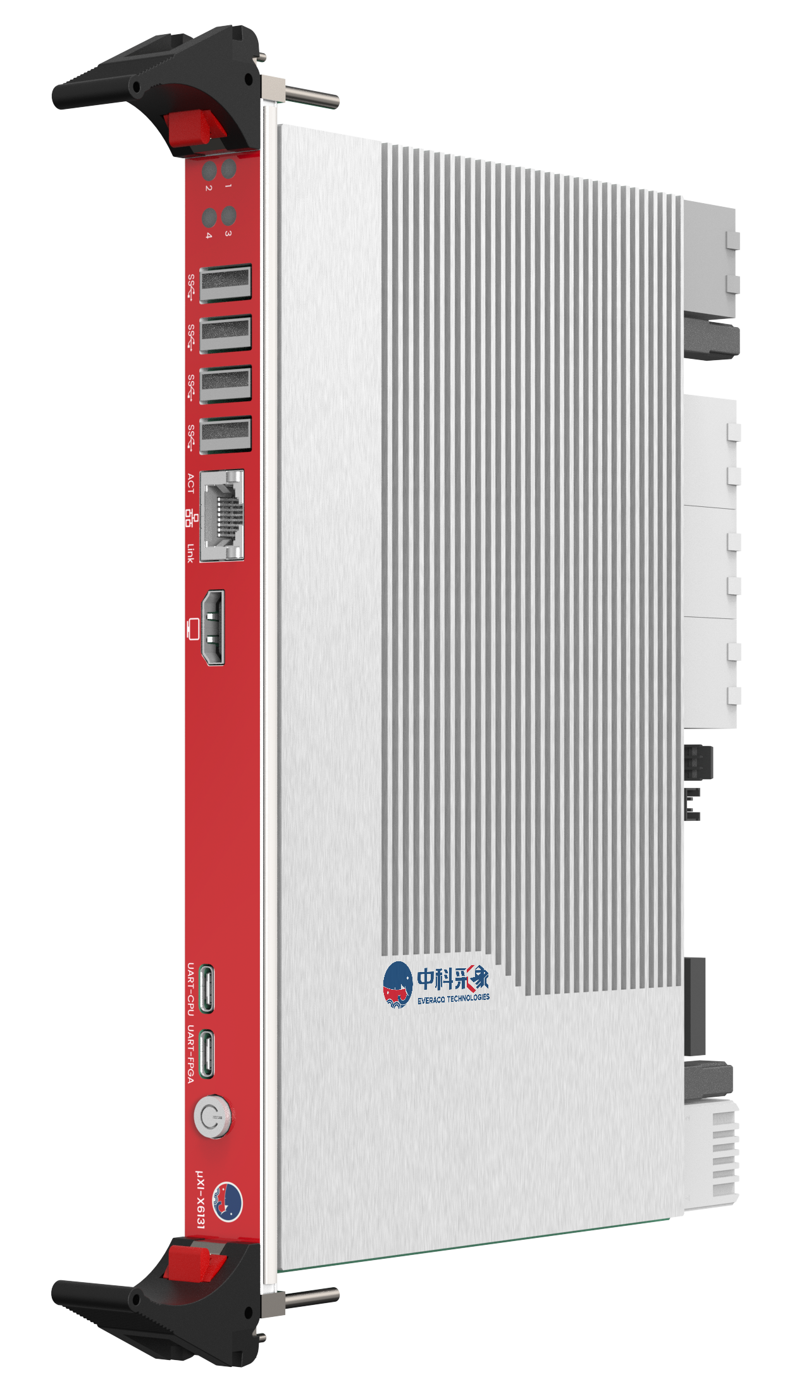
2.3
Chassis of μXI Instrument Platform
CPU + FPGA Longxin Controller：μXI-X6131
The μXI-X6131 is a high-performance CPU + FPGA Longxin controller, independently developed based on the μXI platform. The LS3A5000 quad-core industrial-grade CPU combined with the XCKU060 high-performance FPGA supports up to 128GB DDR4 onboard memory and provides SATA3.0 storage interfaces, offering users powerful data processing capabilities and high system flexibility.
【Main Parameters】
CPU Model: LS3A5000 Quad-Core CPU, 60GFLOPS@2.5GHz
FPGA Model: XCKU060-2FFVA1156I
Onboard Memory: 2× SO-DIMM, single channel supporting up to 64GB DDR4
Onboard Hard Drive: Supports HDD expansion with standard SATA3.0 interface, 500GB hard drive (optional)
Operating Temperature: 0℃~40℃
Dimensions: 6U/1 Slot, 233mm×163mm (W×D)
Operating System: Pre-installed loongnix system, compatible with Tongxin UOS and KylinKylin
Notes:
In terms of controllers, we have μXI-X6131,

Slide 14
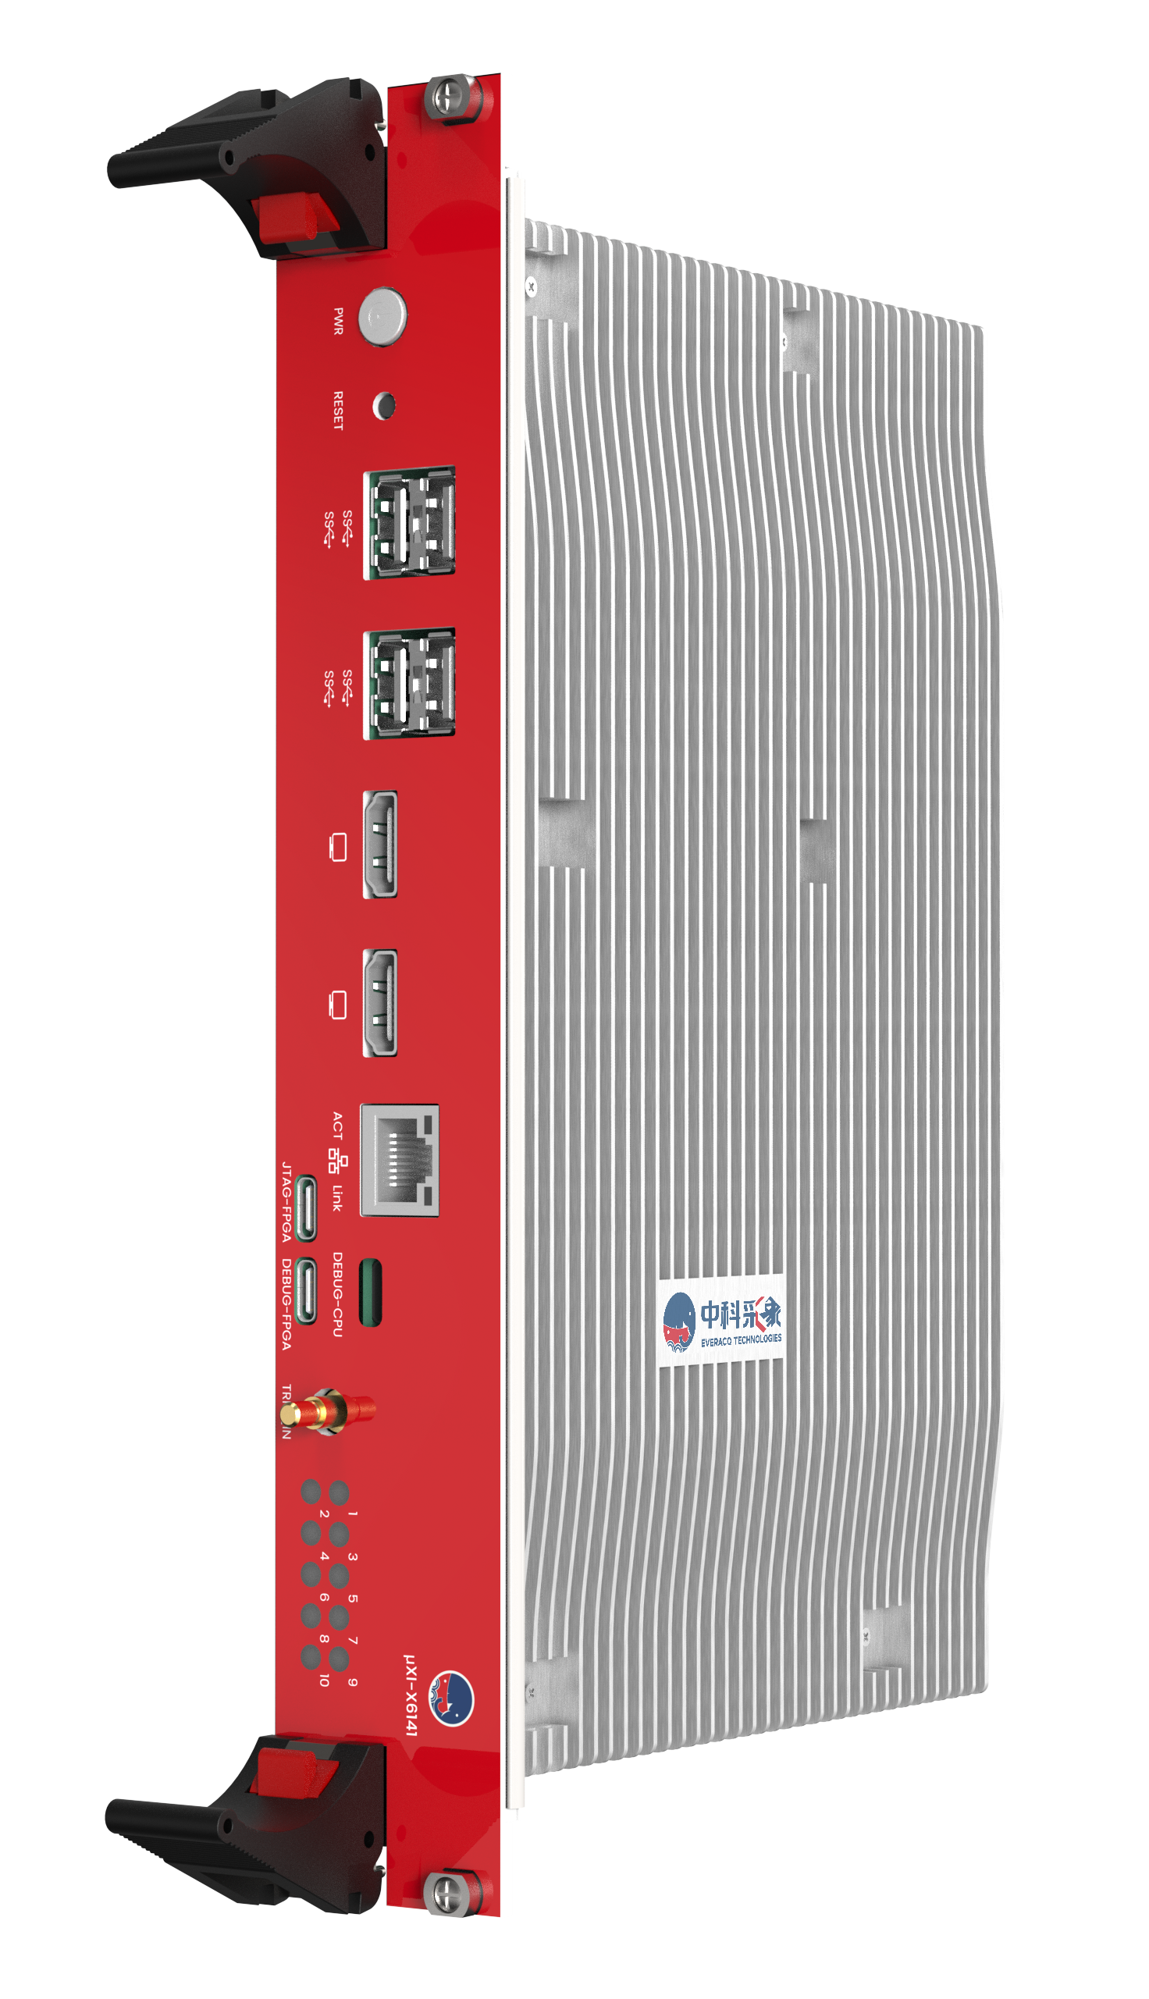
2.3
Chassis of μXI Instrument Platform
CPU + FPGA Intel Controller：μXI-X6141
The μXI-X6131 is a high-performance CPU+FPGA heterogeneous Intel controller independently developed based on the μXI platform. The 12th Gen Intel® Core™ i7-12700 desktop CPU is paired with XCKU060 high-performance FPGA and supports up to 128GB DDR4 onboard memory, providing users with powerful data processing capabilities and high system flexibility .
【Main parameters】
CPU model: 12th generation Intel® Core™ i7-12700 desktop CPU, 12 cores, 2.5GHz
FPGA model: XCKU060-2FFVA1156I
Onboard memory: 2×SO-DIMM, 64GB DDR4 support per channel
Onboard hard disk: SATA3.0, Mini-PCIe/mSATA and other storage interfaces, 500GB hard disk
Operating temperature: -20°C~50°C
Size: 6U/2Slot, 233mm×163mm(W×D)
Operating system: Win7 and above 32-bit/64-bit; Linux 64-bit

Slide 15
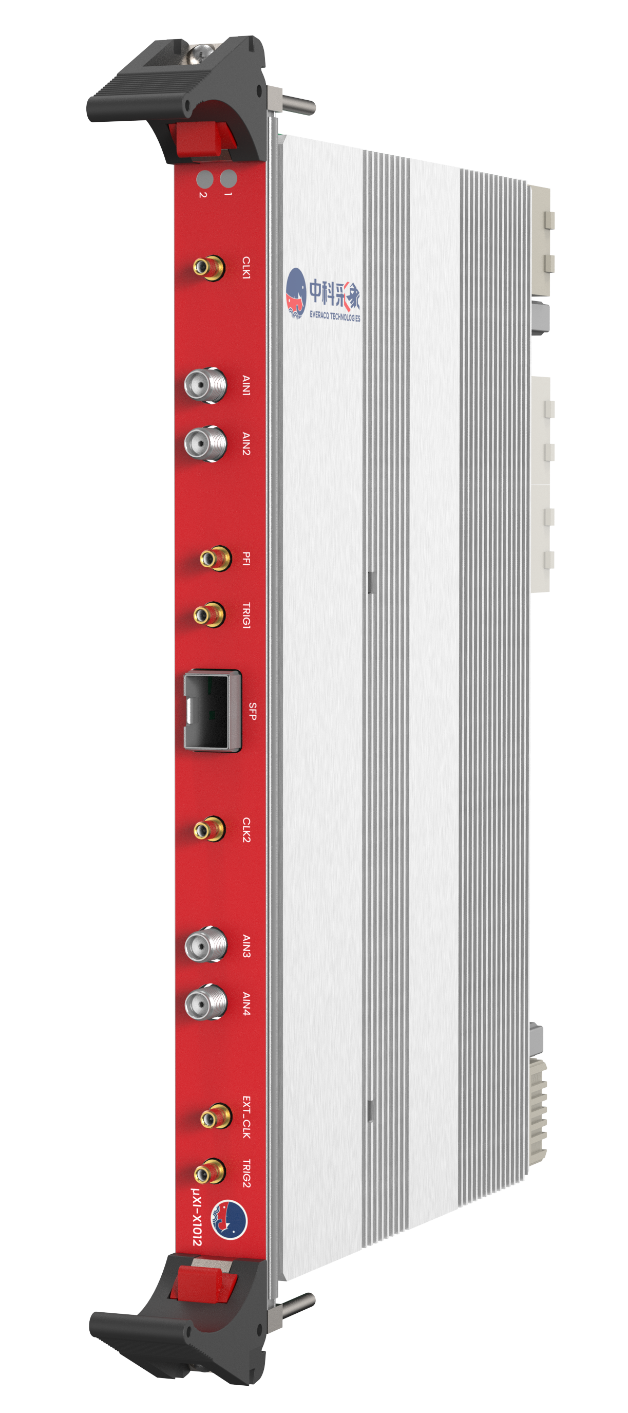
2.4
Chassis of μXI Instrument Platform
5.2GSPS/10.4GSPS, 12-bit, 2/4 Channel Digitizer：μXI-X1012
The μXI-X1012 is a high-speed digitizer independently developed based on the μXI platform, featuring 5.2GSPS/10.4GSPS, 12-bit, and 2/4 channels. It combines high-speed large-capacity data caching with high-speed data exchange technology, suitable for precise capture of high-speed, transient signals. It can be used to build multi-channel, high-precision, synchronous acquisition systems.
【Main Parameters】
High-speed, high-precision, multi-channel: 5.2GSPS/10.4GSPS, 12-bit, 4/2 channels
Analog Bandwidth: DC-3GHz
Coupling Mode: DC coupling
Input Range: 1Vpp
Effective Bits: 8-bit@100MHz
Skew: <5ps (RMS)
Power Consumption: 50W

Slide 16
The μXI Modular Instrument Platform
The product Introduction of μXI Instrument
The application scenarios of μXI instrument
Notes:
The μXI platform has been successfully applied in various fields,

Slide 17

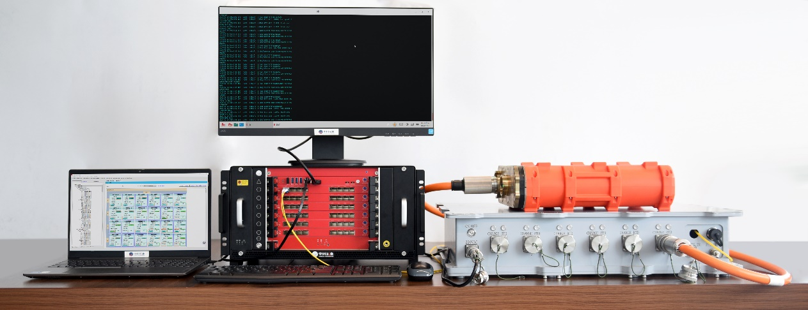
3.1
Geophysical Exploration and Derivative Applications Directions
System introduction
Scenario: Oceanographic exploration Indoor Data Reading System
Solution: μXI Longxin Controller, High-Speed Data Reading and Processing Module
Features: Flexible and Efficient Exploration System with excellent Environmental Adaptability
Advantages for Application
The highly integrated, low-power and multi-component acquisition technology
Large-Scale Precision Timing and Time Synchronization Technology, utilizing satellite navigation systems, fiber optic communication, atomic clock calibration
Notes:
such as:
3.1 Oceanographic exploration indoor data readout system: Offering a flexible, efficient exploration system with good environmental adaptability

Slide 18

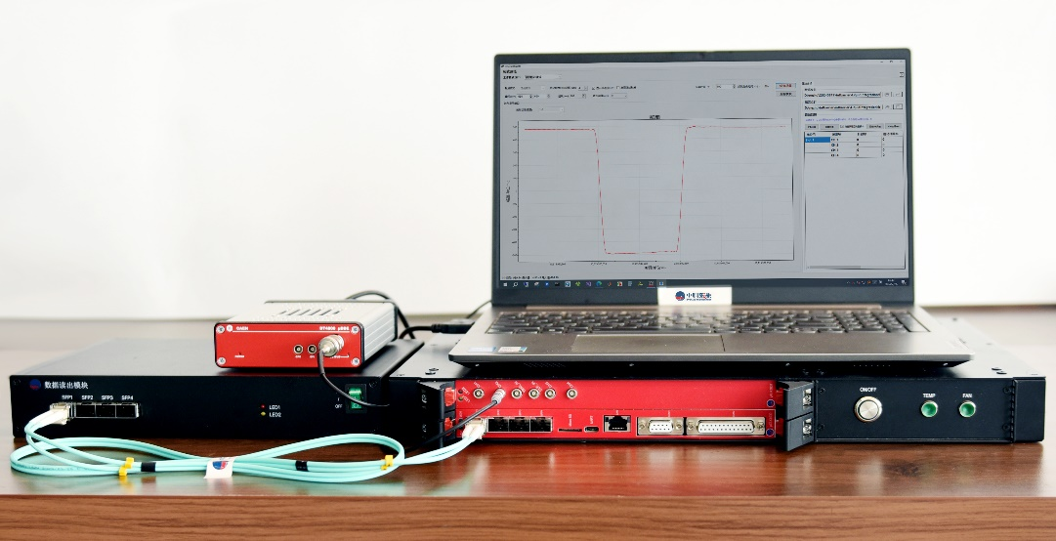
3.2
Nuclear Technology and Applications
System introduction
Scenario: Nuclear data acquisition and analysis system
Solution: μXI controller, μXI digitizer
Features: standardized interface, fast secondary development
Advantages for Application
Analog conditioning, analog-to-digital conversion, real-time processing, transmission and storage of high-speed transient signals
The new open, modular instrument chassis is compatible with a wide range of bus standards
Realize sub-second high-precision clock synchronization of multiple modules of the platform
IPMI intelligent management system real-time monitoring and intelligent fault diagnosis function
Notes:
Nuclear data acquisition analysis system: Providing standardized interfaces and rapid secondary development to meet high-precision data acquisition requirements. As an emerging modular instrument platform, μXI has broad application prospects. We will continue to devote ourselves to the development of the μXI platform, continuously enhancing its performance and functionality, to provide users with higher performance, reliability, and flexibility in test and measurement solutions.

Slide 19





以“快电子学技术” 和 “模块化仪器技术”
助您
安徽合肥市高新区中国科学技术大学先进技术研究院8楼 安徽合肥市高新区中安创谷A1栋38楼
0551-63365228

