Slide 1
LAYCAST : a proposed detector for long-lived particle searches at the CEPC
Ye Lu (陆叶)
Wuhan University of Technology (武汉理工大学)
The 2024 International Workshop on the High Energy Circular Electron Positron Collider
October 23, 2024
based on [Ye Lu, Ying-nan Mao, Kechen Wang, Zeren Simon Wang, hep-ph/2406.05770]

Slide 2
Outline
LLP Searches @ ee Colliders
Studies with LAYCAST
Summary & Discussion
LLP Searches @ ee Colliders
Studies with LAYCAST
Summary & Discussion

Slide 3
Theory Motivation
LLP Searches @ ee Colliders
Studies with LAYCAST
Summary & Discussion
LLP: Relatively long lifetime or equivalently decay length
New particles become long-lived because of:
→ feeble couplings to SM particles
→ phase space suppression
→ approximate symmetry, …
The discovery of LLPs could explain some fundamental problems: neutrino mass, dark matter, ...
LLP searches are important ways to BSM physics.
Notes:
So,how to search LLPs is also a hot topic,and our LAYCAST is a new design to detect LLP.

Slide 4
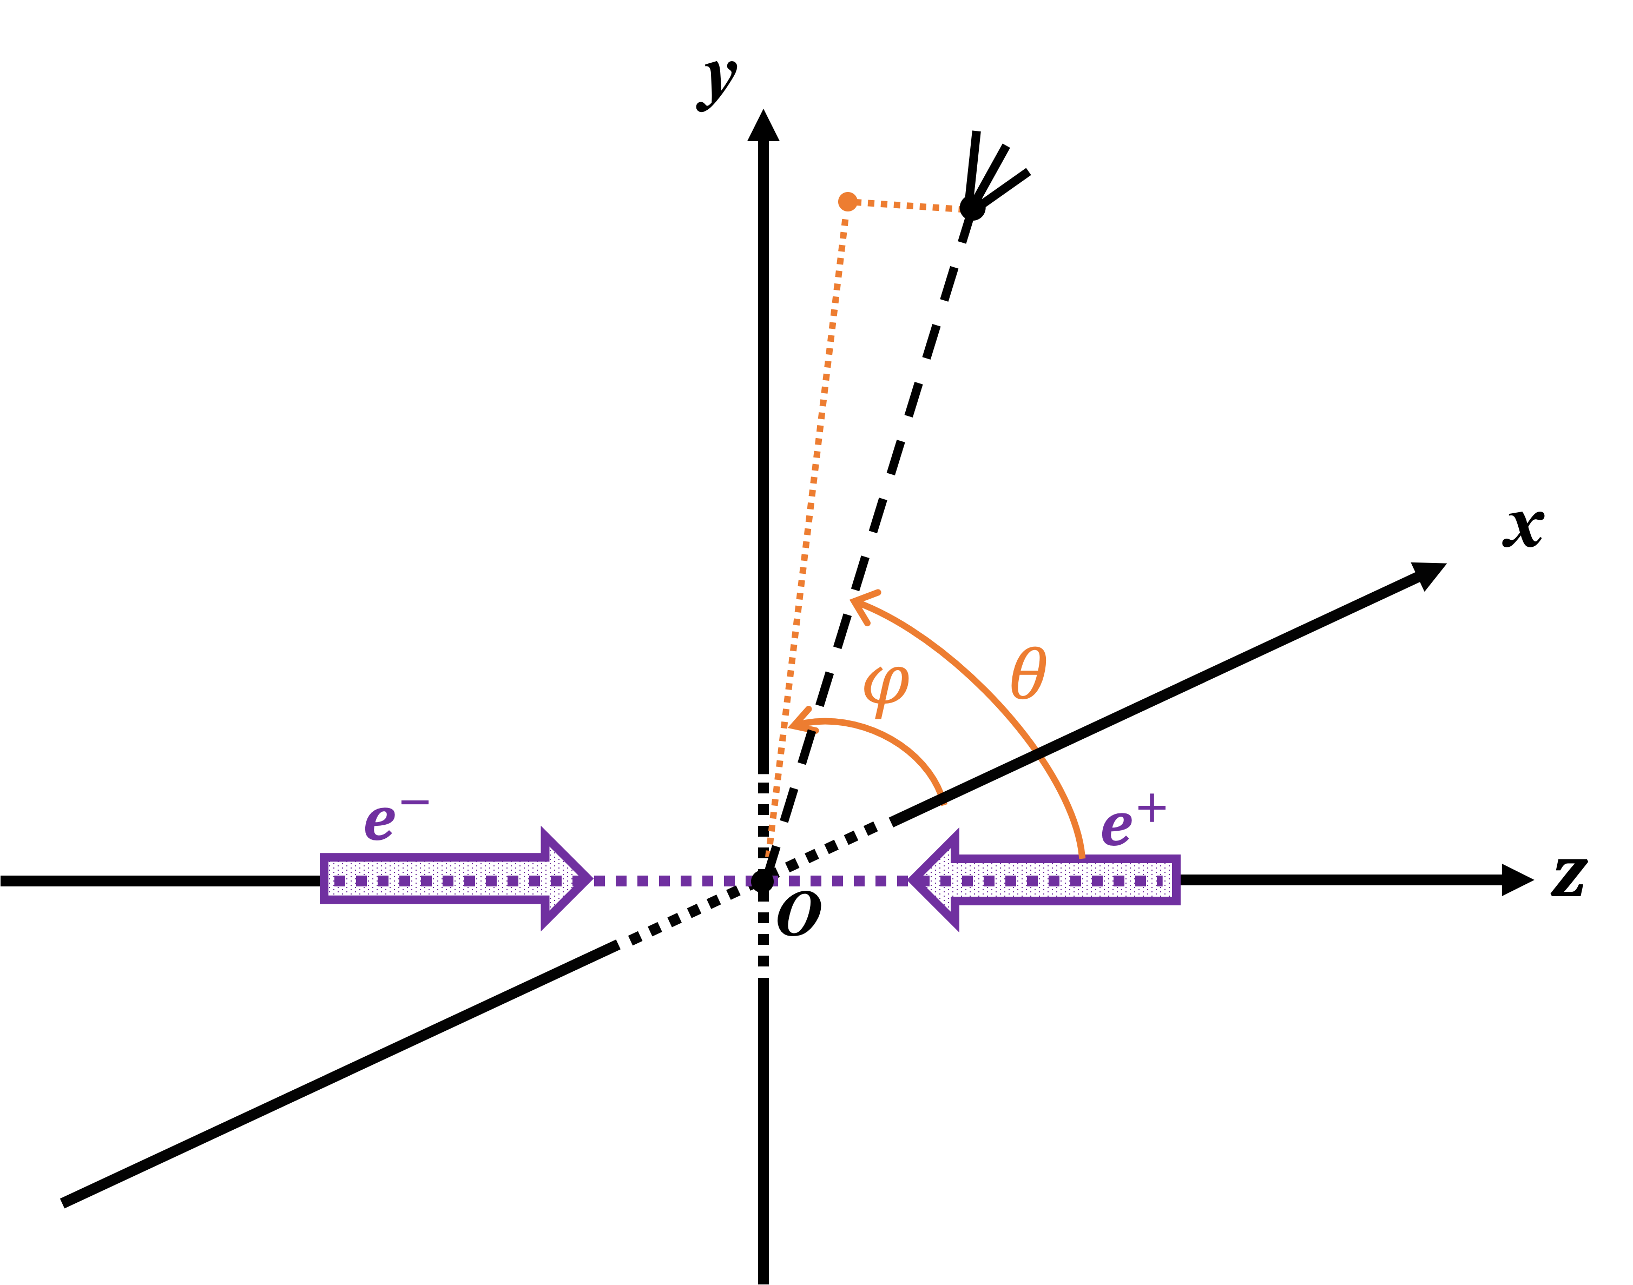

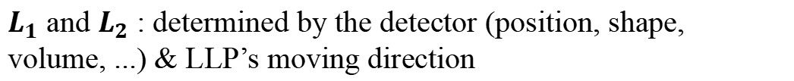


LLP Searches @ ee Colliders
Studies with LAYCAST
Summary & Discussion
Idea of LLP searches @ colliders
When a LLP produced at $0$ (usually the IP),
Probability of decaying between $L_{1}$ and $L_{2}$
$P\left(∆L\right)=e^{−L_{1}/λ }−e^{−L_{2}/λ }$
($L_{1}$ < $L_{2}$)
where decay length in the lab. frame
$$λ= βγ cτ=\left(\frac{p}{m}\right) \left(cτ\right)$$
Kinematics
lifetime in the rest frame
$L_{1}$ and $L_{2}$ : determined by the detector (position, shape, volume, ...) & LLP’s moving direction
Notes:
This formula is important for our later research

Slide 5

Signatures of LLPs in FD
LLP Searches @ ee Colliders
Studies with Far Detectors
Summary & Discussion
When $λ∼𝒪(100)$ m,
Mainly travel through and acts as missing energy in the near detector.
Far detector is more likely to observe the decay process, and reconstruct the time, position, direction, momentum, mass, etc.
Far detector can enhance the discovery potential for LLPs with very long decay length.
[1911.06576, Zeren Simon Wang and Kechen Wang, Physics with far detectors at future lepton colliders]
Notes:
The near detector is cyllidrical and include vertex detector,calorimeter and muon detector.

Slide 6
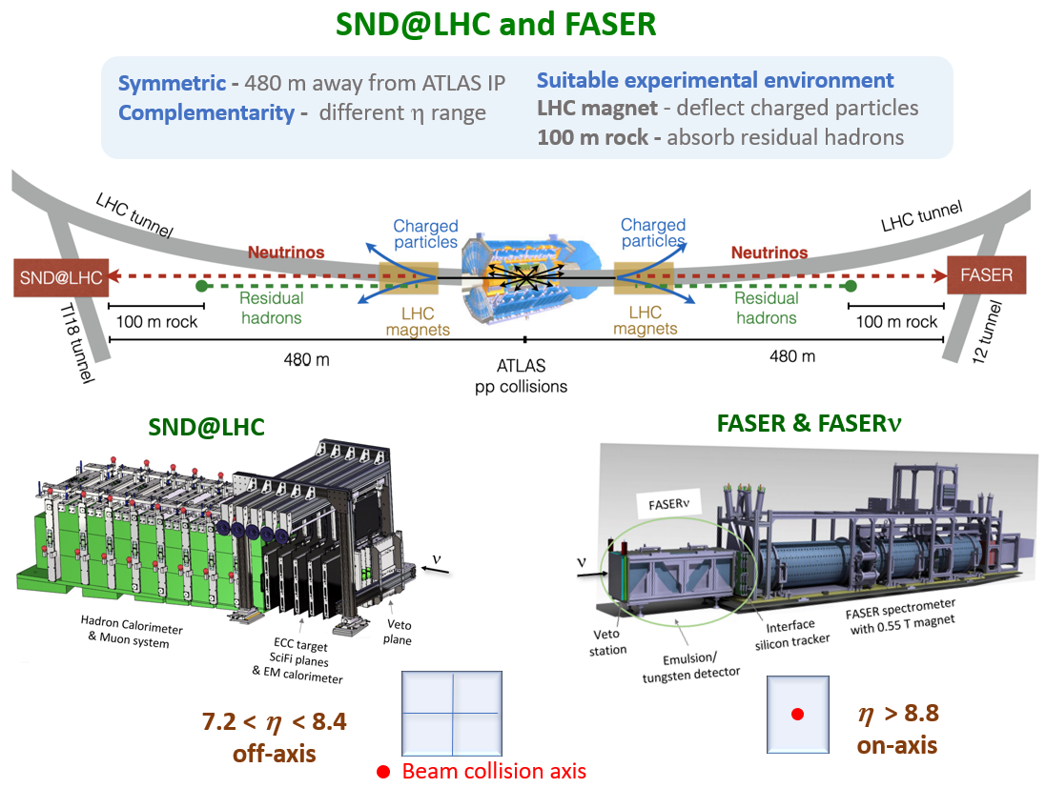
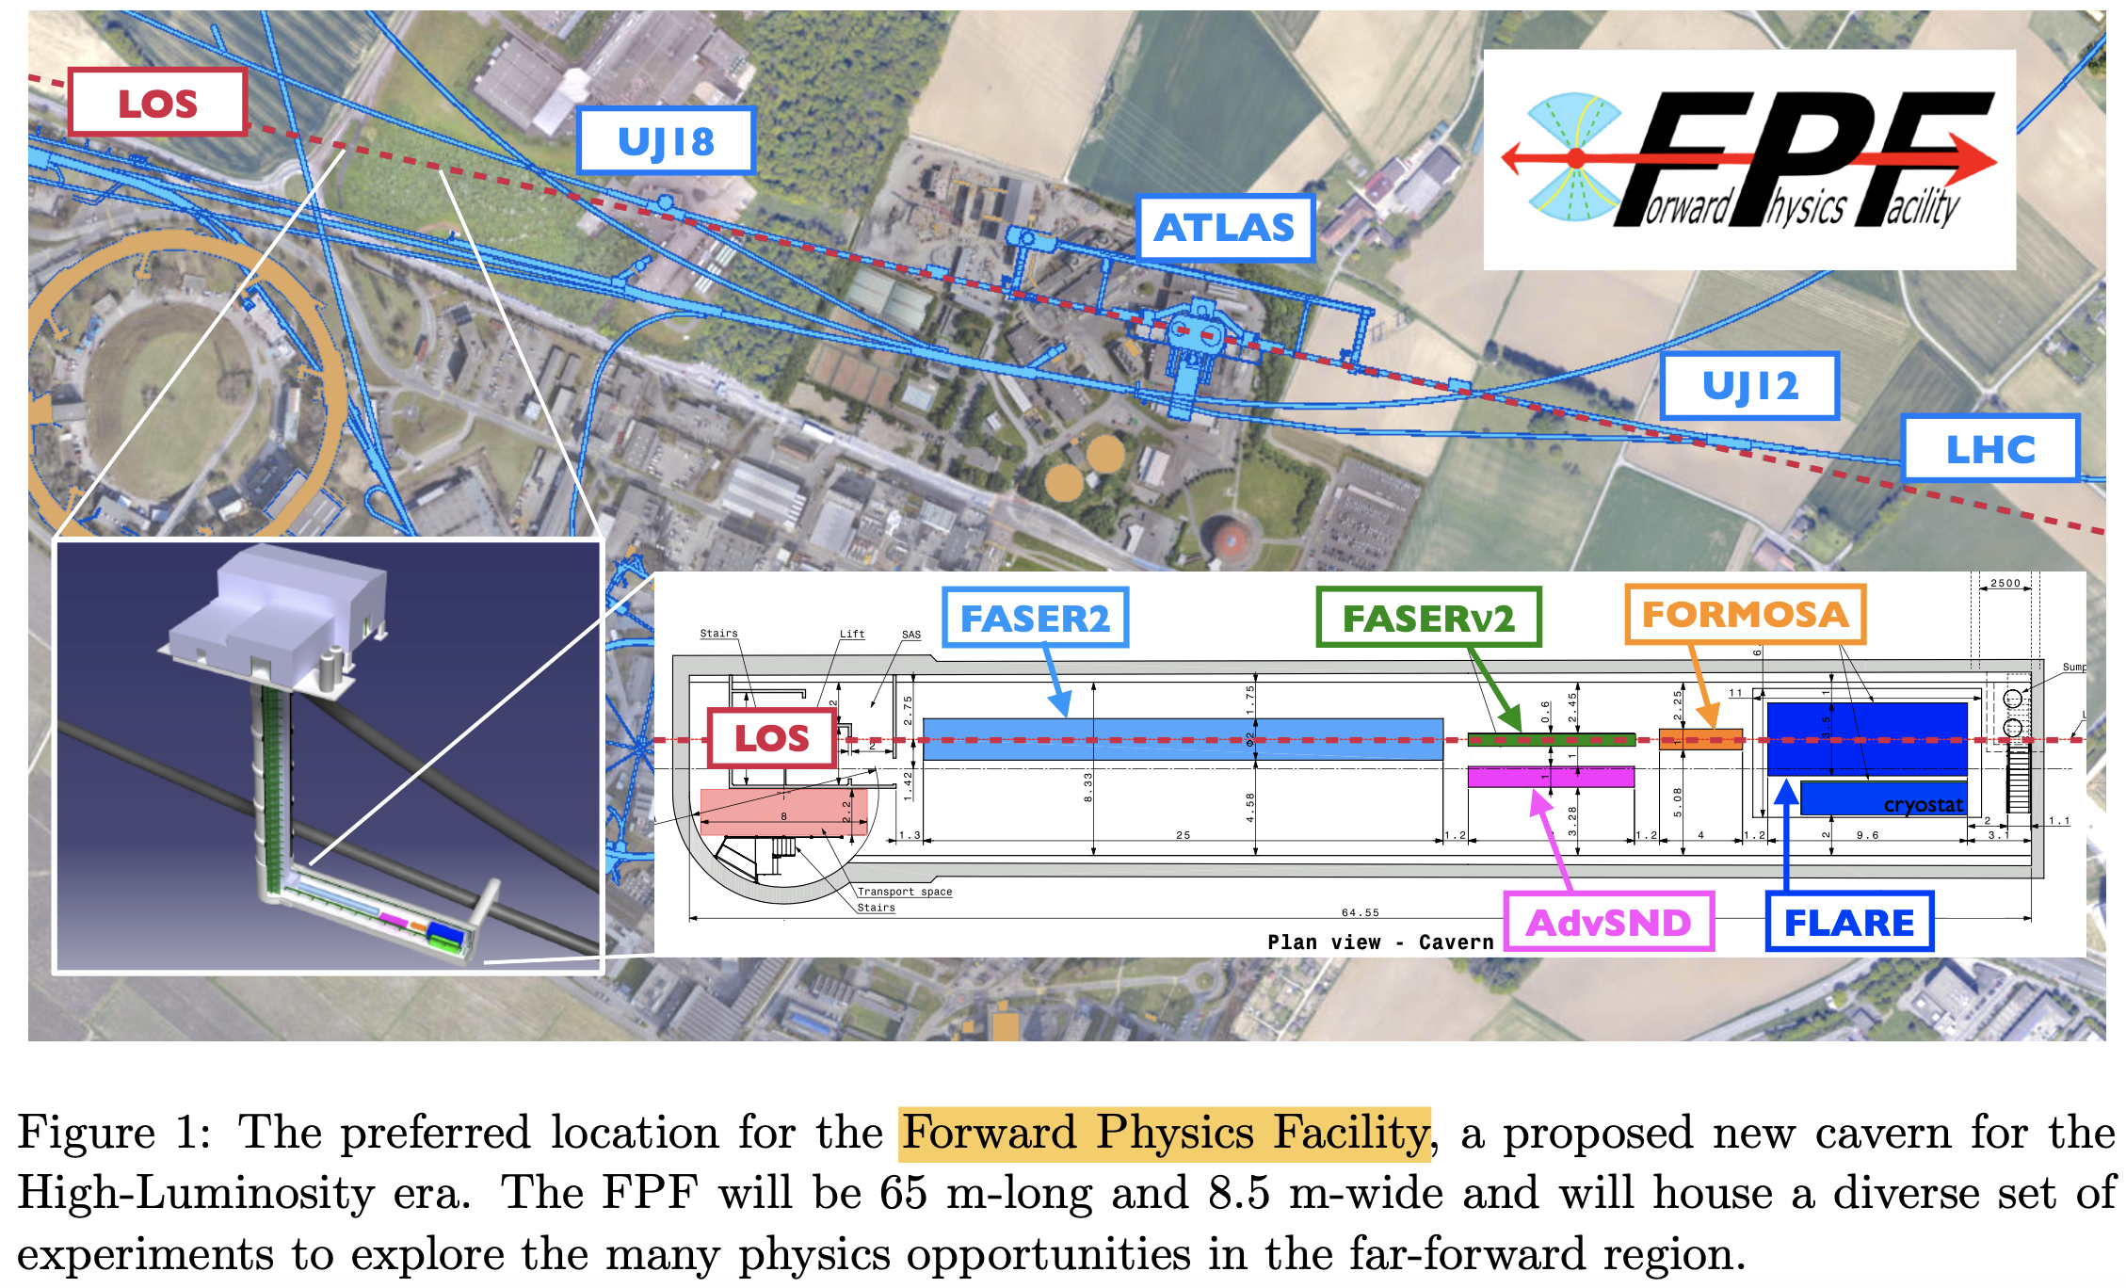
Current running
LLP Searches @ ee Colliders
Studies with LAYCAST
Summary & Discussion
FD experiments @ LHC
Proposed
[https://snd-lhc.web.cern.ch/]
Proposed FD experiments：MATHUSLA, FASER2, FASERν2, AdvSND, FLArE, FORMOSA, CODEX-b, AL3X, ...
[https://faser.web.cern.ch/index.php/]
[http://www.ship-korea.com/SND.html]
[2210.02784, SND@LHC: The Scattering and Neutrino Detector at the LHC]
[2203.05090, The Forward Physics Facility at the High-Luminosity LHC]
Notes:
So, far detectors experiments are not the strange idea.There are similar designs at CEPC.

Slide 7
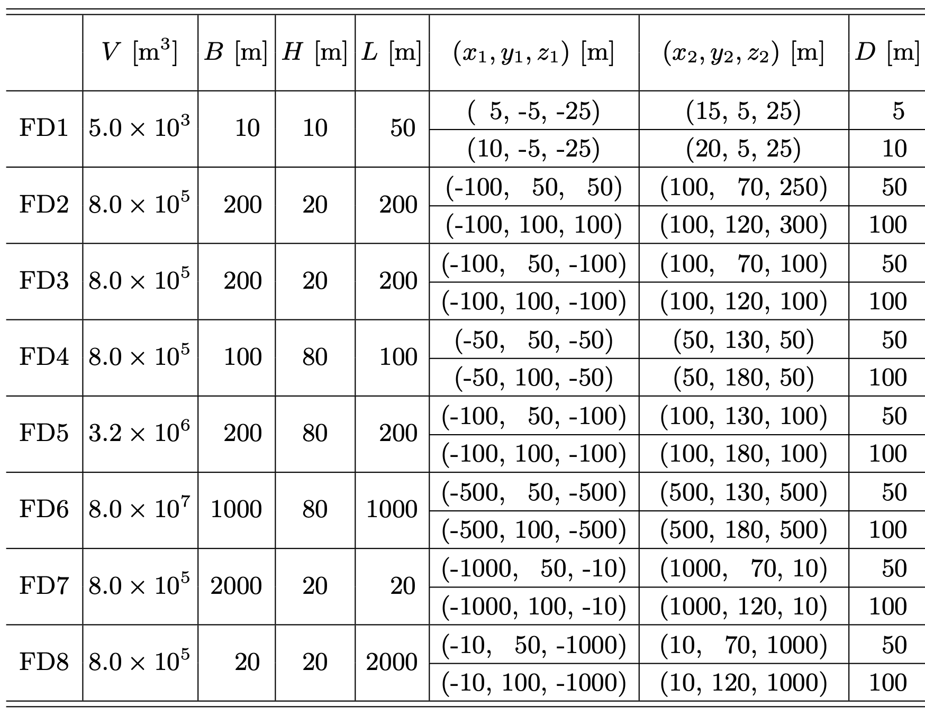
LLP Searches @ ee Colliders
Studies with LAYCAST
Summary & Discussion
FAr Detectors at the Electron Positron Collider (FADEPC)
[1911.06576, Zeren Simon Wang and Kechen Wang, Physics with far detectors at future lepton colliders]
Simple shape: cuboid, similar to MATHUSLA
Varying: position & geometry size
Notes:
Our LAYCAST is compared with the design, and the comparison results will be shown later. The FD1 is 10 meters away from the IP and has a smaller volume, while the FD3 is 100 meters away from the IP and has a larger volume. FD6 has the largest volume.

Slide 8
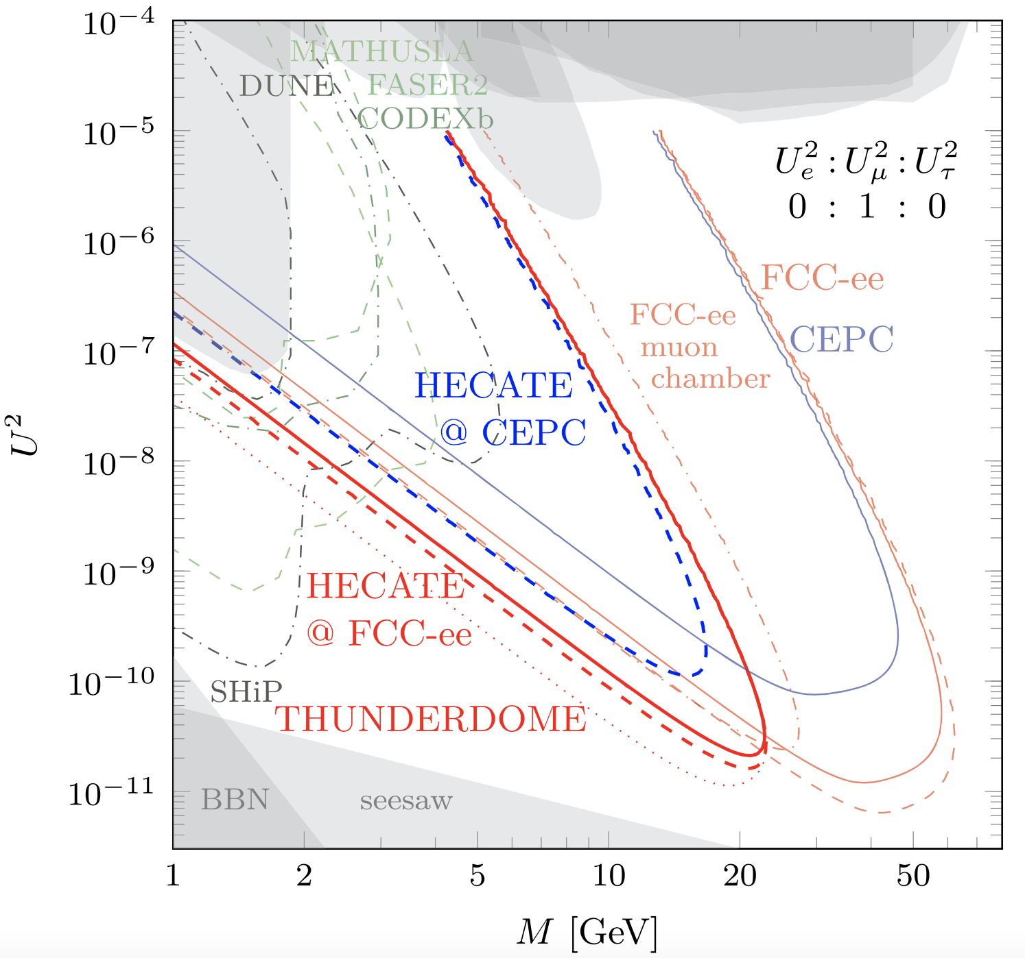
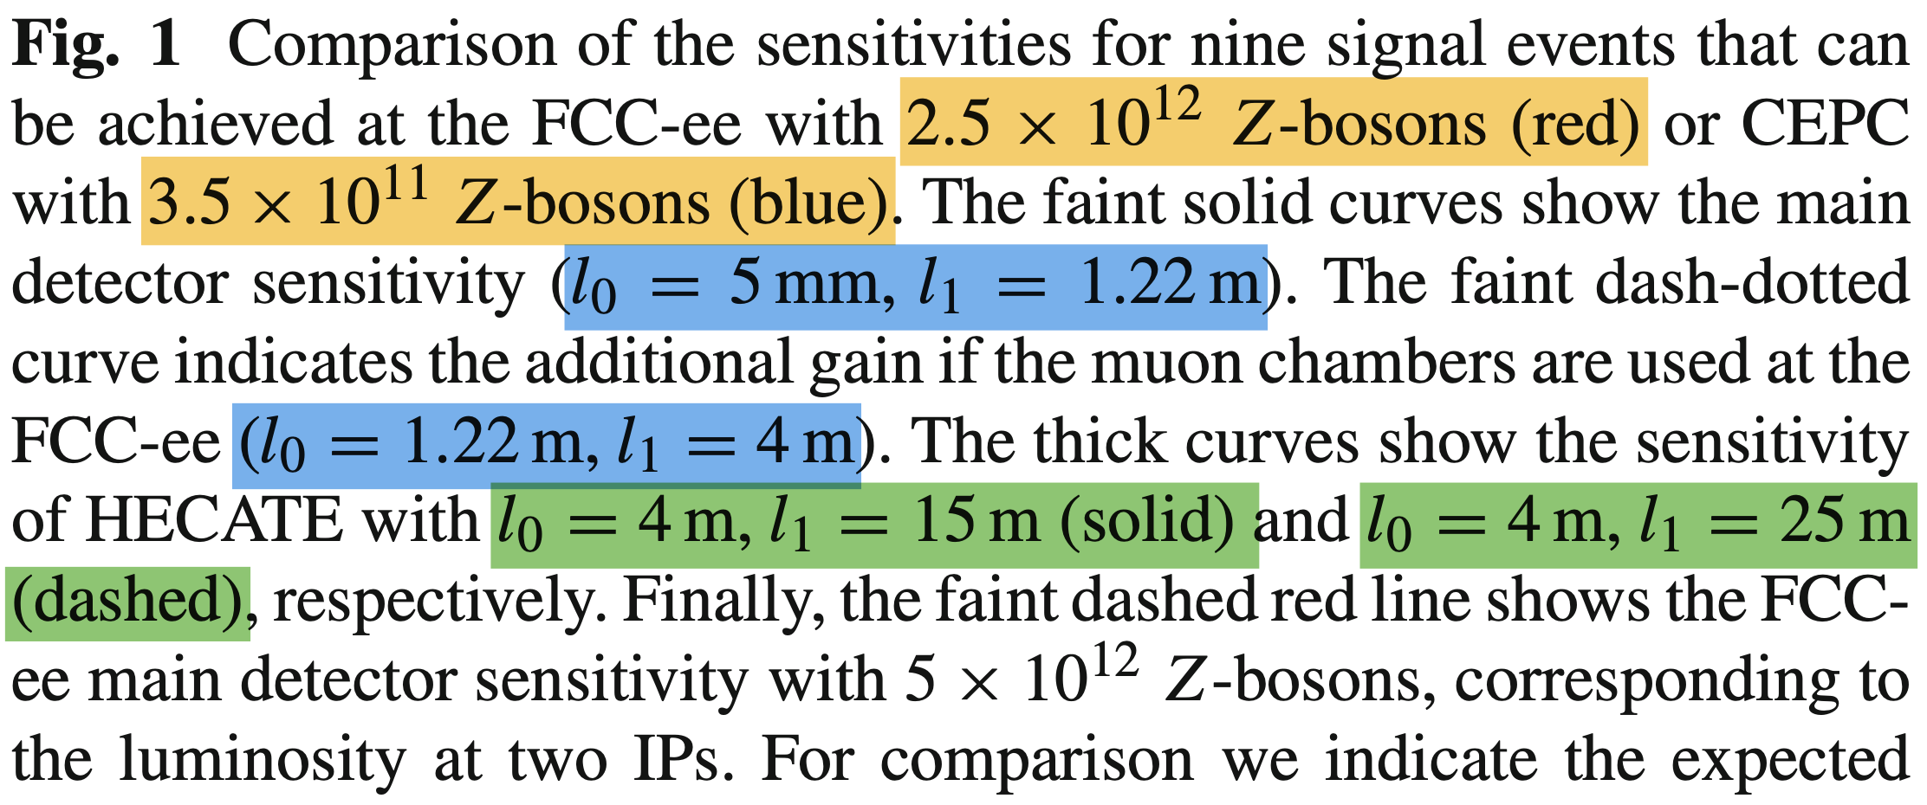


HErmetic CAvern TrackEr (HECATE)
LLP Searches @ ee Colliders
Studies with LAYCAST
Summary & Discussion
HNL: $Z→Nν @ \sqrt{s}=91.2$ GeV
[2011.01005, Marcin Chrzaszcz, Marco Drewes, and Jan Hajer, HECATE: A long-lived particle detector concept for the FCC-ee or CEPC]
the HECATE detector would consist of resistive plate chambers (RPCs) or scintillator plates, constructed from extruded scintillating bars, located around the cavern walls and forming a 4π detector.
the HECATE detector should have at least two layers of detector material separated by a sizable distance. For reliable tracking, at least four layers, along with a smaller size and/or optimised geometry of the detector plates, would be required.
Notes:
Our LAYCAST also refer to this design

Slide 9
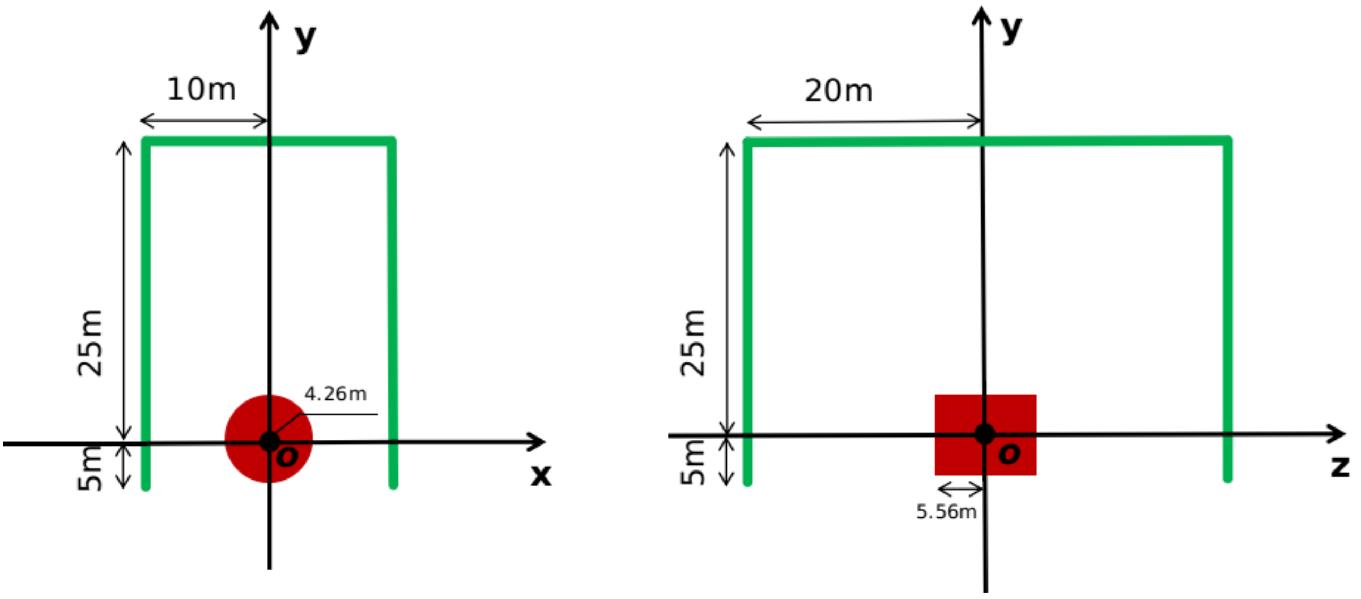
LAYered CAvern Surface Tracker (LAYCAST)
LLP Searches @ ee Colliders
Studies with LAYCAST
Summary & Discussion
[2406.05770, Ye Lu, Ying-nan Mao, Kechen Wang, Zeren Simon Wang, LAYCAST : LAYered CAvern Surface Tracker at future electron-positron colliders ]
Red – ND
Green – FD
scintillating planes hanging from the roof and four vertical walls of the experimental hall
Detect LLP decaying in the space region between the outer edge of the ND and the FD.
Notes:
These are the front and side cross-section views of the LAYCAST,the red part is the near detector, the near detector is cylindrical and has a radius of 4.26 meters and half-length of 5.56 meters . and the green part is the far detector, the point O is the interaction point. and it is 5 meters above the ground ,the z-axis is the paticle beam direction.
Since the experimental hall is 100 meters underground and a cuboid, LAYCAST is also a cuboid, and we intend to use the thin layer of the scintillating planes to hang from the roof and 4 verticle walls of the experimental hall, and has four layers of scintillator plates, in order to ensure that it can detect the direction of the charged product from the decay of long-lived particles, and precisely measure its energy and momentum. The length, width and height are 40 meters, 20 meters and 30 meters, respectively. the bottom surface consider the support frame and other equipment,so the whole detector is composed of 5 faces. And to detect LLP decaying in the space region between the outer edge of the ND and the FD.

Slide 10

LLP Searches @ ee Colliders
Studies with LAYCAST
Summary & Discussion
Number of Signal Events
$$N_{exp}=N_{pro}∙P∙Br∙ε$$
Number of LLPs produced
Probability of decaying inside the detector’s fiducial volume
Branching ratio of LLP decaying into visible final state
Detector efficiency
Expected number of signal events:
depends on theory model parameters (mass, lifetime, kinematics) & geometry and performance of detector (position, shape, volume, efficiency)
Notes:
Our results are based on the number of signal events, Here, we assume that BR and detector efficiency are 100% in our study.
We get our results by setting number of signal events equal to 3 and 20, respectively

Slide 11
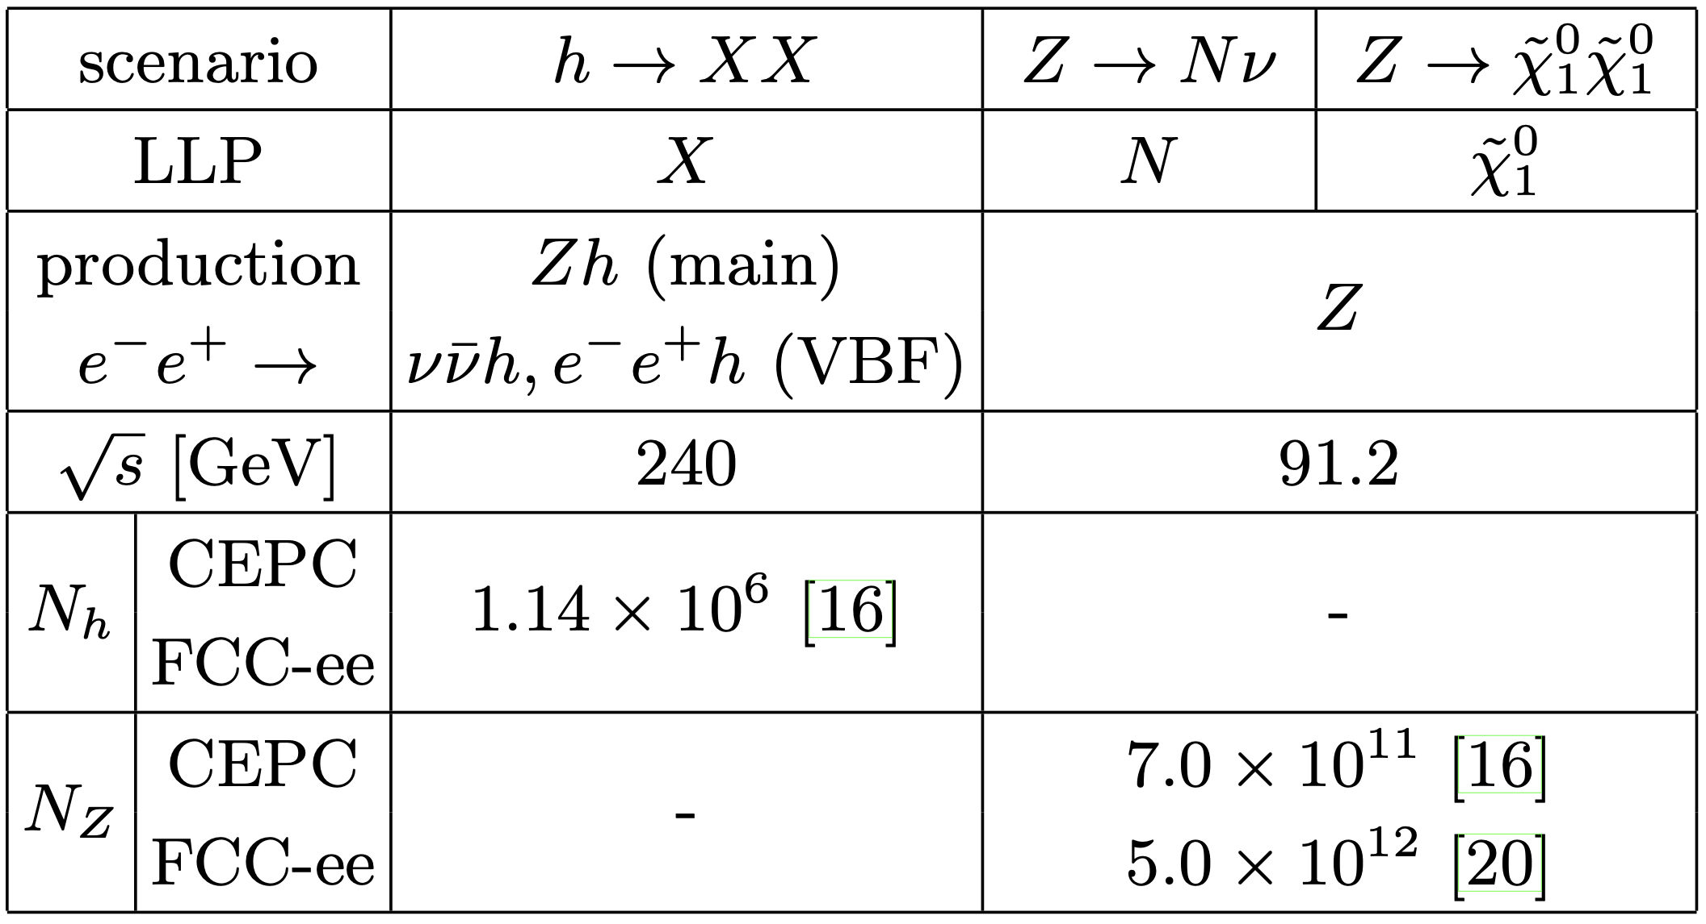




Theoretical model
LLP Searches @ ee Colliders
Studies with LAYCAST
Summary & Discussion
[1911.06576, Zeren Simon Wang and Kechen Wang, Physics with far detectors at future lepton colliders]
Exotic Higgs Decays
Heavy Neutral Leptons
Light Neutralinos in RPV SUSY
light scalar
light fermion
has been updated to $1.5×{10}^{12}$
5.6 $ab^{−1}$, 7 years, 2 IPs
16 $ab^{−1}$, 2 years, 2 IPs
150 $ab^{−1}$, 4 years, 2 IPs
Axion like particles: ${ e}^{−}e^{+}→γ a, a→γγ @ \sqrt{s}=91.2$ GeV
[2201.0896, Minglun Tian, Zeren Simon Wang and Kechen Wang, Search for long-lived axions with far detectors at future lepton colliders]

Slide 12
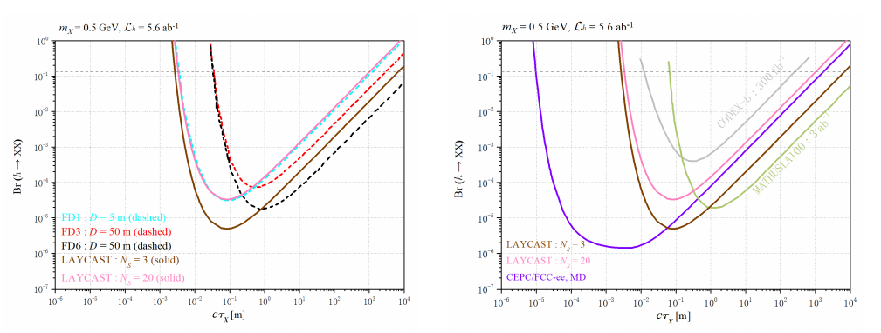
Results
LLP Searches @ ee Colliders
Studies with LAYCAST
Summary & Discussion
Higgs decays: $h→XX @ \sqrt{s}=$240 GeV
[2406.05770, Ye Lu, Ying-nan Mao, Kechen Wang, Zeren Simon Wang, LAYCAST : LAYered CAvern Surface Tracker at future electron-positron colliders ]
→ 3-signal-event sensitivity of LAYCAST is better than that of FD1
→ 20-signal-event sensitivity of LAYCAST is similar to that of FD1
→ 3-signal-event sensitivity of LAYCAST can probe additional parameter space compared with the ND.

Slide 13
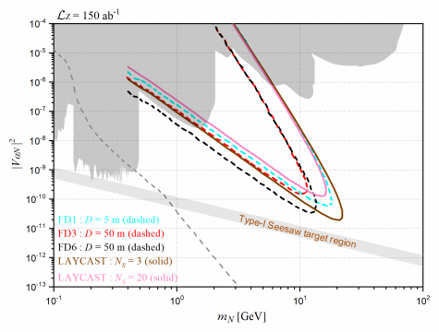
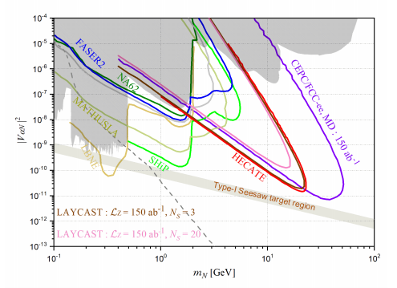

LLP Searches @ ee Colliders
Studies with LAYCAST
Summary & Discussion
Results
HNL: $Z→Nν @ \sqrt{s}=91.2$ GeV
[2406.05770, Ye Lu, Ying-nan Mao, Kechen Wang, Zeren Simon Wang, LAYCAST : LAYered CAvern Surface Tracker at future electron-positron colliders ]

Slide 14
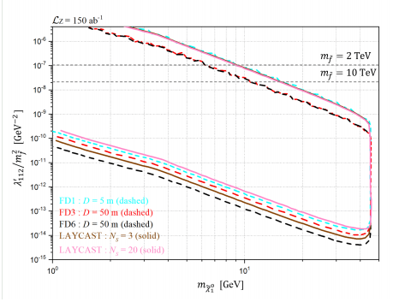
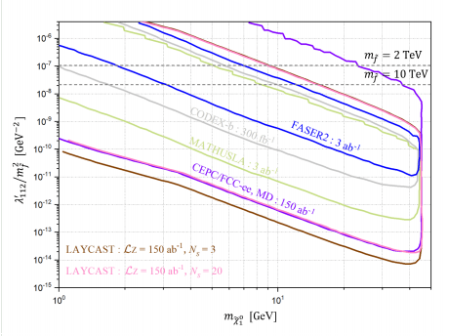
LLP Searches @ ee Colliders
Studies with LAYCAST
Summary & Discussion
Results
RPV-SUSY neutralinos: $Z→{\tilde{χ}}_{1}^{0 }{\tilde{χ}}_{1}^{0} @ \sqrt{s}=91.2$ GeV
[2406.05770, Ye Lu, Ying-nan Mao, Kechen Wang, Zeren Simon Wang, LAYCAST : LAYered CAvern Surface Tracker at future electron-positron colliders ]

Slide 15
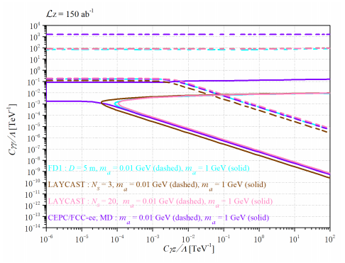
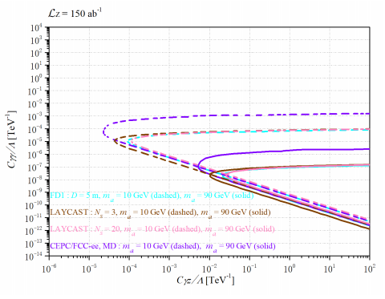
LLP Searches @ ee Colliders
Studies with LAYCAST
Summary & Discussion
Results
Axion like particles: ${ e}^{−}e^{+}→γ a, a→γγ @ \sqrt{s}=91.2$ GeV
[2406.05770, Ye Lu, Ying-nan Mao, Kechen Wang, Zeren Simon Wang, LAYCAST : LAYered CAvern Surface Tracker at future electron-positron colliders ]

Slide 16
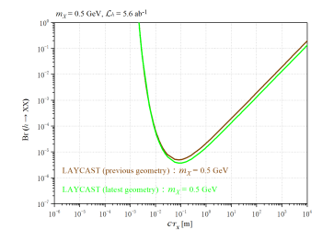
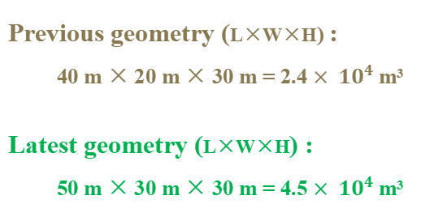
LLP Searches @ ee Colliders
Studies with LAYCAST
Summary & Discussion
Effects of varying the cavern geometries
Higgs decays: $h→XX @ \sqrt{s}=$240 GeV
[2406.05770, Ye Lu, Ying-nan Mao, Kechen Wang, Zeren Simon Wang, LAYCAST : LAYered CAvern Surface Tracker at future electron-positron colliders ]
Previous geometry (L×W×H) :
40 m × 20 m × 30 m = 2.4 $× {10}^{4}$m³
Latest geometry (L×W×H) :
50 m × 30 m × 30 m = 4.5 $× {10}^{4}$m³
[J. Gao, CEPC Accelerator Overall Status: https://indico.cern.ch/event/820586/contributions/3511478/attachments/1908468/3152728/CEPC_ Accelerator_Overall_Status-V2.pdf , 2019.]
[CEPC Study Group, W. Abdallah et al., CEPC Technical Design Report – Accelerator (v2), (2023), arXiv:2312.14363, IHEP-CEPC-DR-2023-01, IHEP-AC-2023-01]

Slide 17
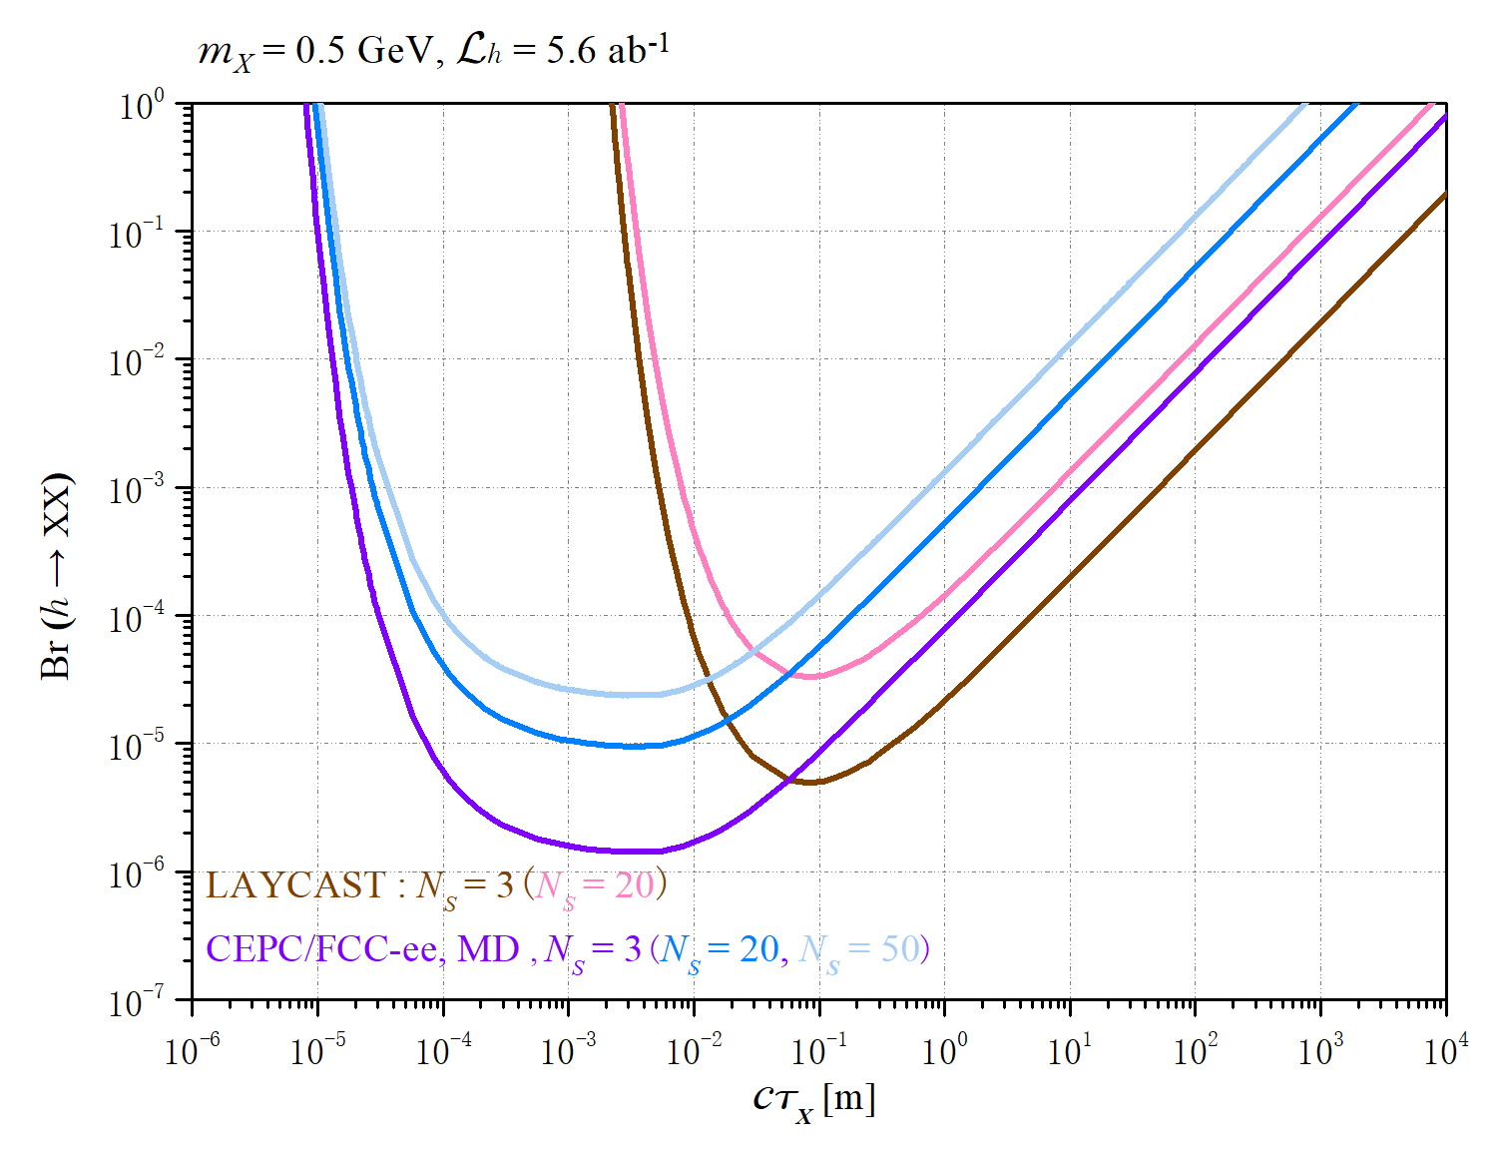
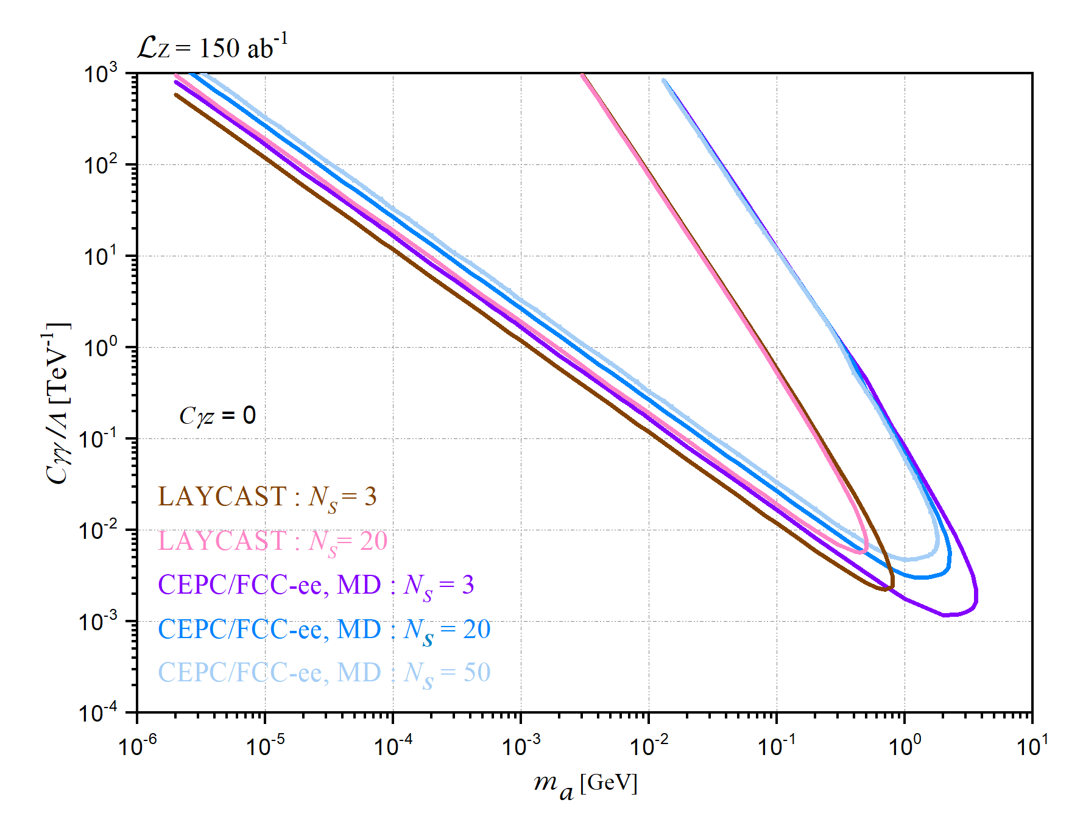


LLP Searches @ ee Colliders
Studies with LAYCAST
Summary & Discussion
Discussion on the number of signal events
[2406.05770, Ye Lu, Ying-nan Mao, Kechen Wang, Zeren Simon Wang, LAYCAST : LAYered CAvern Surface Tracker at future electron-positron colliders ]
Higgs decays:
$h→XX @ \sqrt{s}=$240 GeV
Axion like particles:
${ e}^{−}e^{+}→γ a, a→γγ @ \sqrt{s}=91.2$ GeV
effects of the background events: 95% C.L. : N_{s} = 3, 20, 50 ←→ N_{b} ~ 0, 100, 625
Notes:
At 95 percent confidence level, the 3, 20, and 50 signal events corresponds to 0,100,625 backgrounds,and they are purple,bliue,light blue curve for near detector respectively.

Slide 18
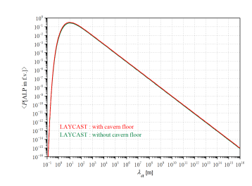
LLP Searches @ ee Colliders
Studies with LAYCAST
Summary & Discussion
Effects of adding the cavern floor
Axion like particles: ${ e}^{−}e^{+}→γ a, a→γγ @ \sqrt{s}=91.2$ GeV
[2406.05770, Ye Lu, Ying-nan Mao, Kechen Wang, Zeren Simon Wang, LAYCAST : LAYered CAvern Surface Tracker at future electron-positron colliders ]
Notes:
The average decay probability as a function of the decay length ,The red curve represents the detector that has the bottom surface , which corresponding to the top right picture .
The green curve represent the detector that has no the bottom surface,which corresponding to the bottom right picture.

Slide 19
LLP Searches @ ee Colliders
Studies with LAYCAST
Summary & Discussion
Summary & Discussion
LLPs searches @ ee colliders have unique characteristics (high lum., clean environment, transverse direction, recoil strategy ) and are important ways to BSM physics.
The search for long-lived particles can be aided by the design of suitable detectors, such as Far Detectors.
Studies with proposed detector - LAYCAST
→ Different designs
→ Higgs decays, HNL, SUSY, ALP, ...
More issues
→ optimization: detector material & design with low cost ?
→ more LLP theory models ...
Notes:
More studies are very welcome!

Slide 20
Thank you for your listening!

