Slide 1



CEPC MDI EDR plan and status
Sha Bai
On behalf of CEPC MDI group
22-27. Oct. 2024, Hangzhou, The 2024 International Workshop on the High Energy Circular Electron Positron Collider

Slide 2
Content
Introduction
EDR goal, scope and plan
EDR progress and Key milestones from 2024-2027
Conclusion

Slide 3
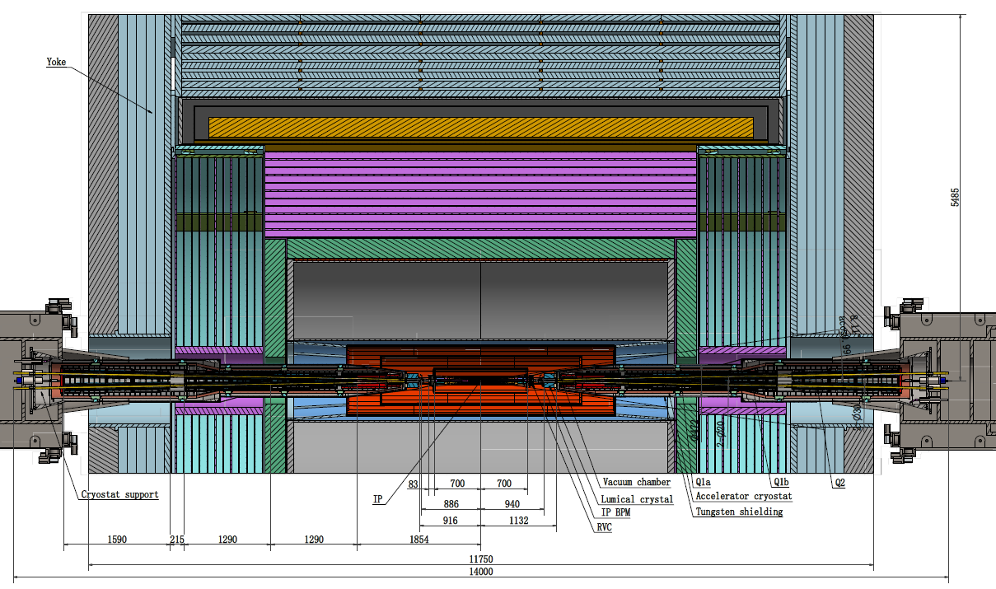
Introduction - MDI layout and IR design
The Machine Detector Interface (MDI) of CEPC double ring scheme is about ±7m long from the IP.
The CEPC detector superconducting solenoid with 3T magnetic field (2T in Z).
The accelerator components inside the detector are within a conical space with an opening angle ~detective angle: acos0.99
The e+e- beams collide at the IP with a horizontal angle of 33mrad and the final focusing length is to 1.9m.

Slide 4
Introduction - MDI parameters
 | range | Peak field in coil | Central field gradient | Bending angle | length | Beam stay clear region | Minimal distance between two aperture | Inner diameter of beam pipe | Outer diameter of beam pipe | Critical energy (Horizontal) | Critical energy (Vertical) | SR power (Horizontal) | SR power (Vertical)
L* | 0~1.9m |  |  |  | 1.9m
Crossing angle | 33mrad
MDI length | ±7m
Detector requirement of accelerator components in opening angle | 8.11˚
Q1a/Q1b |  | 4.3/3.4T | 142/85T/m |  | 1.21m | 14.9/18.2mm | 62.71/105.28mm | 20/23mm | 26/29mm | 724.7/663.1keV | 396.3/263keV | 212.2/239.23W | 99.9/42.8W
Q2 |  | 4.5T | 96.7T/m |  | 1.5m | 24.48mm | 155.11mm | 32mm | 38mm | 675.2keV | 499.4keV | 472.9W | 135.1W
Lumical | 0.95~1.11m |  |  |  | 0.16m
Anti-solenoid before Q1 |  | 8.7T |  |  | 1.1m
Anti-solenoid Q1 |  | 3T |  |  | 2.5m
Anti-solenoid Q2 |  | 3T |  |  | 1.5m
Beryllium pipe |  |  |  |  | ±85mm |  |  | 20mm
Last B upstream | 64.97~153.5m |  |  | 0.77mrad | 88.5m |  |  |  |  | 33.3keV
First B downstream | 44.4~102m |  |  | 1.17mrad | 57.6m |  |  |  |  | 77.9keV
Beampipe within Q1a/Q1b |  |  |  |  | 1.21m |  |  |  |  |  |  | 1.19/1.31W
Beampipe within Q2 |  |  |  |  | 1.5m |  |  |  |  |  |  | 2.39W
Beampipe between Q1/Q2 |  |  |  |  | 0.3m |  |  |  |  |  |  | 26.5W

Slide 5
MDI EDR goal, scope and plan
IR magnet system & Cryostats
  FF Quads & Correctors
  Solenoid compensation & anti-solenoid design update
  Cryomodule design update, thermal and mechanical analysis of the structure, optimization of heat and mass transfer of the helium, design of current leads. PI&D scheme determination, assembly process design and alignment considerations.
Beam induced backgrounds
  The MDI region is now improved as more realistic, and software model developed. Narrow the difference with future experiments.
  Backgrounds, collimators, IR beam losses, SR, IR radiation level & fluences
Heat loads in IR region
  HOM heating, SR, Beam loss backgrounds, Beam pipe thermal analysis
IR Mechanical model, including vertex and lumical integration, and assembly concept
  Cooling for vertex and vacuum chambers
  Remote Vacuum connection, IR BPMs, Supporting system
  Integrate in the design an alignment system
  Overall integration and installation for all components in the MDI. Specific installation procedure.

Slide 6
MDI EDR goal, scope and plan
2024:
Improve the efficiency and accuracy of background simulation to narrow the difference with future experiments.
Iteration and finalize design requirements for SC quadrupole magnets, refined design and comparison of design options for quadrupoles magnets (CCT, Serpentine, etc), calculate magnet deformation on cantilever support, update the design of anti-solenoid, optimize solenoid field distribution;
Update the design of the cryomodule, thermal and mechanical analysis of the structure, optimization of heat and mass transfer of the helium, design of current leads.
2025:
Processing and manufacturing of IR beam pipes, including beryllium pipe and tungsten alloy beam pipe. To make prototypes of the beryllium beam pipe, and to improve the key technology such as the manufacture of the pure beryllium pipe, the choice of the coolant, the estimation between the coolant and the pipe in radiation environments, the welding between beryllium and other materials like aluminum, the window to LumiCal, and so on.
Detailed magnetic field analysis, mechanical design and stress analysis, quenching analysis. Finish full 3D magnetic field analysis with all MDI magnetic components together. Evaluate magnetic performance of each superconducting magnet (LTS/HTS);
PI&D scheme determination, assembly process design and alignment considerations.

Slide 7
MDI EDR goal, scope and plan
2026:
Overall integration and installation for all components in the MDI. Specific installation procedure. Cryostat including Final doublet installation alignment. Lumical and Beryllium pipe installation alignment.
Summary of SC magnet design, main parameters, and magnetic field calculation results. Determination of magnet processing and manufacturing technology. Draft and revise the engineering design report for superconducting magnets. Cost evaluation of CEPC MDI Superconducting magnets and cryomodule;
Machine-finishing technological design, cryogenic performance test of critical component
2027:
Final performance test of critical component.

Slide 8
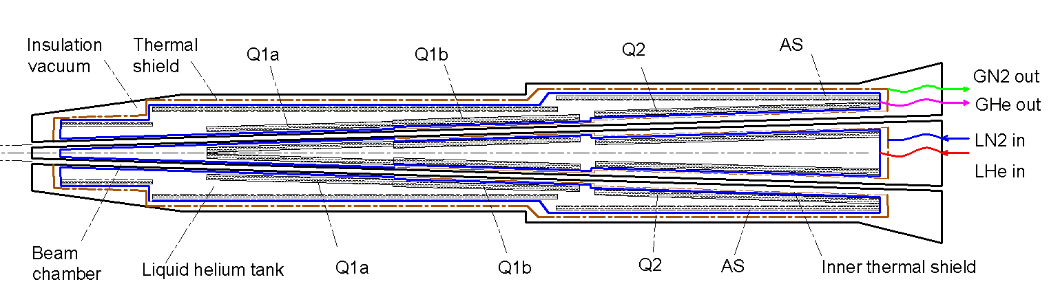
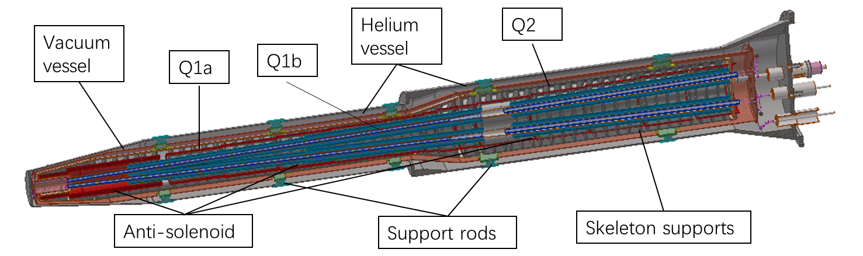
SC magnets and cryostat
In CEPC, there are two combined-function Superconducting magnets in MDI
Each combined-function magnet includes double aperture high gradient quadrupole (Q1a, Q1b, Q2) and anti-solenoid, around each side of the IP point, placed on a cantilever support.
Iron-free structure is selected for CEPC IR SC magnets
The cryostat is used to provide the cryogenic environment for SC magnets, which is below 5.0 K.
Superconducting magnets are immersed in the helium tank for the low temperature.
One thermal shield is set for the heat interruption from the ambient temperature.
The shield is extended between the helium tank and the beam chamber.
The 4K cold mass is cooled by supercritical or subcooled helium, and the shield is by liquid nitrogen.

Slide 9
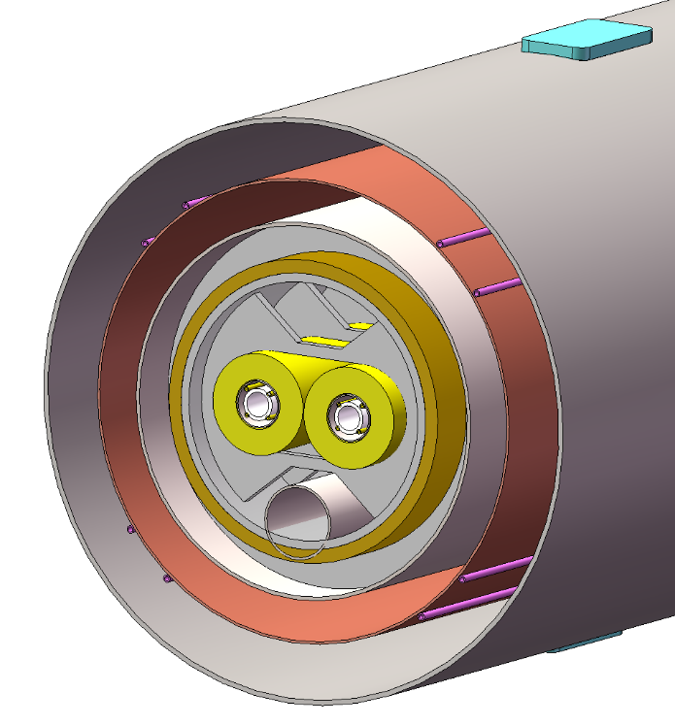
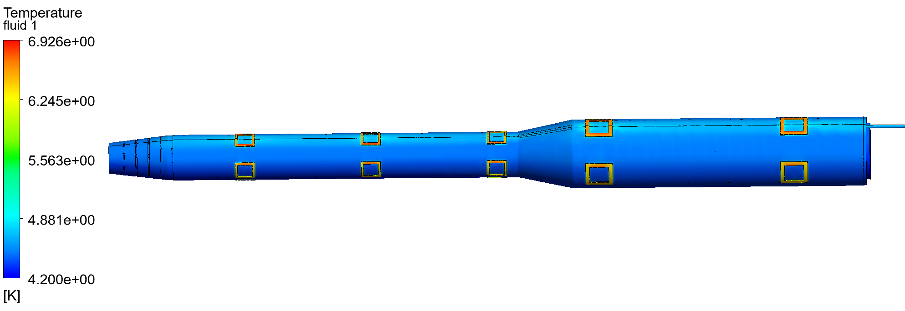
SC magnets and cryostat
Vacuum
Thermal shield
LHe tank
Support
Anti-solenoid
Currently:
The cryostat has been updated as the optimization of the SC magnets.
Supercritical/ Subcooled liquid helium is used as the cold source.
Double cooling channels of SC magnets can be used, if the mechanical space is allowed.
A subcooled LHe circulation is designed, which can increase the flow rate largely.
Current lead and cryogenic system is designed initially;
Q1a
Beam chamber
In the future:
Optimization of the cryostat; Thermal and mechanical analysis; (quench protection, energy storage , supports )
Current lead design；
Measurement requirements; (temperature/pressure/BPM)
Initial consideration of processing and manufacturing technology;
outlet
inlet

Slide 10
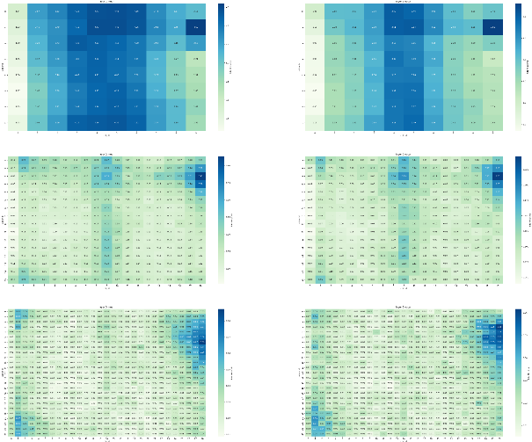
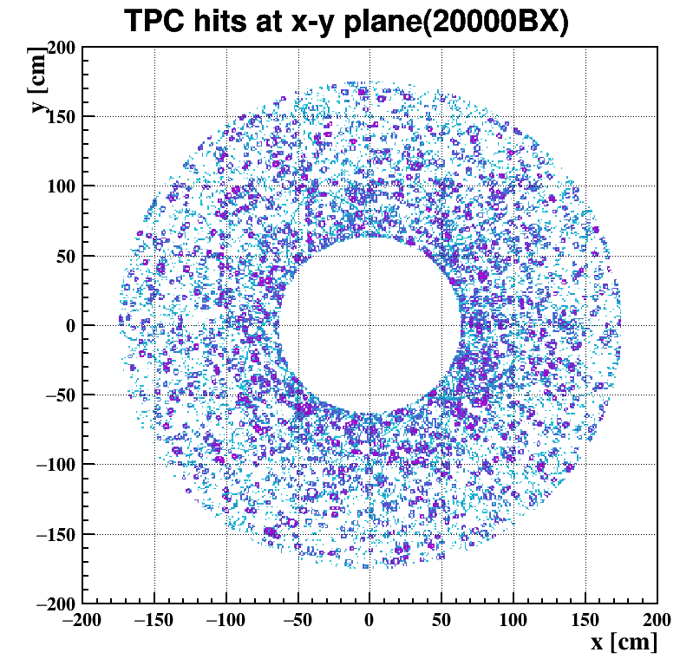
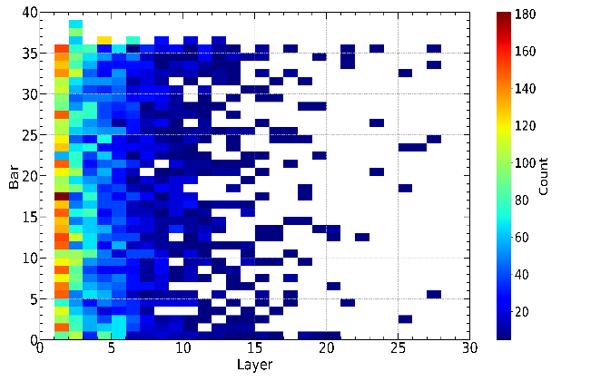

Radiation background
  Background sources:
  Photon backgrounds: SR, Pair production
  Beam loss backgrounds
    Radiative Bhabha scattering
    Beam Gas scattering
    Beam Thermal photon scattering
  Injection background
VTX
Currently:
Geometry after TDR with modification updated
  Accelerator Beampipe changed to Tungsten
  Coolant of central beampipe changed to Water
  Cross-section is improved and more specific.
Preliminary results of Higgs mode is acceptable by sub-detectors
Detector | Layer | Inner/outer | M hit rate MHz/chip | M hit density MHz/cm2
Vertex | 1 | i | 4.604 | 1.405
 |  | o | 3.808 | 1.162
 | 2 | i | 0.427 | 0.130
 |  | o | 0.247 | 0.075
 | 3 | i | 0.087 | 0.027
 |  | o | 0.062 | 0.019
TPC |  |  |  | 0.08
ECal | Barrel | / | 0.3/bar(1MeV thd) | /
 | EndCup | / | 0.2/bar(1MeV thd) | /
In the future:
ECal
  Improve the efficiency and accuracy of simulation. Narrow the difference with future experiments.
  Apply and test the toolkit on existing machines like BEPCII and SuperKEKB, to validate the toolkit, and use the new toolkit to simulate CEPC beam backgrounds.

Slide 11
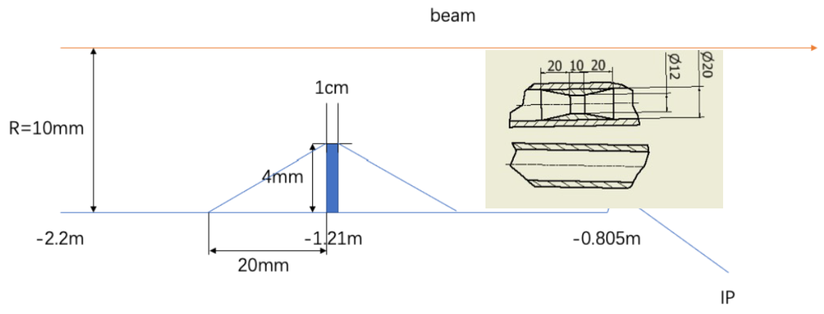
SR mitigation – mask and gold plating
Methods | Photon hitting number on Be/BX | Deposition power on Be(W)
No mask | 39400.0 | 30.57*e-5
1.21-mask-Cu | 1736.0 | 1.45*e-5
1.21-mask-W | 1698.0 | 1.36*e-5
2.2-mask-Cu | 1147.0 | 0.94*e-5
1.21-mask-Cu-5㎛Au | 216.0 | 0.273*e-5
Masks design(two masks/IP/ring) :
  Tungsten
  One locates at -1.21m with 4mm height and 10mm long
  The other at -4.2m with 0.6mm height
Currently:
5㎛ gold plating as baseline
Photons hitting number on Be/BX reduced by two orders of magnitude
Deposition power on Be pipe suppressed to acceptable level by vertex detector
In the future:
Mask and gold plating can be improved for future with more realistic IR
Masks will be processed and manufactured along with Tungsten alloy IR beam pipe

Slide 12
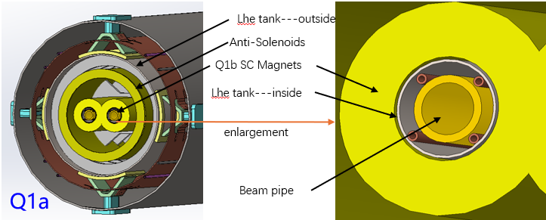
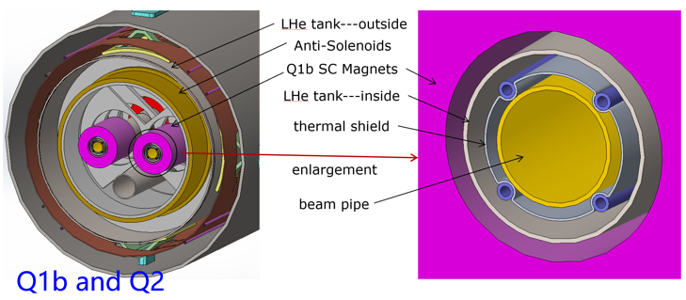
Shielding
Shielding in MDI including 4 parts:
Tungsten alloy IR beam pipe
Gold plating on beryllium pipe (~5µm)
Tungsten shielding around cryostat
Shielding for detector hall
In the future:
Beam pipe model more realistic, detail simulation
Seek for better new shielding material in EDR
Vacuum chamber of Tungsten alloy will be processed and developed in EDR
Currently:
The very tight space ~Tungsten IR beam pipe
NEG coating is suggested to the fork vacuum chambers
Water cooling pipe is designed due to the high thermal load of impedance at high light Z model
SR absorber will be used on the upstream of MDI to decrease the gas load of Synchrotron radiation.

Slide 13
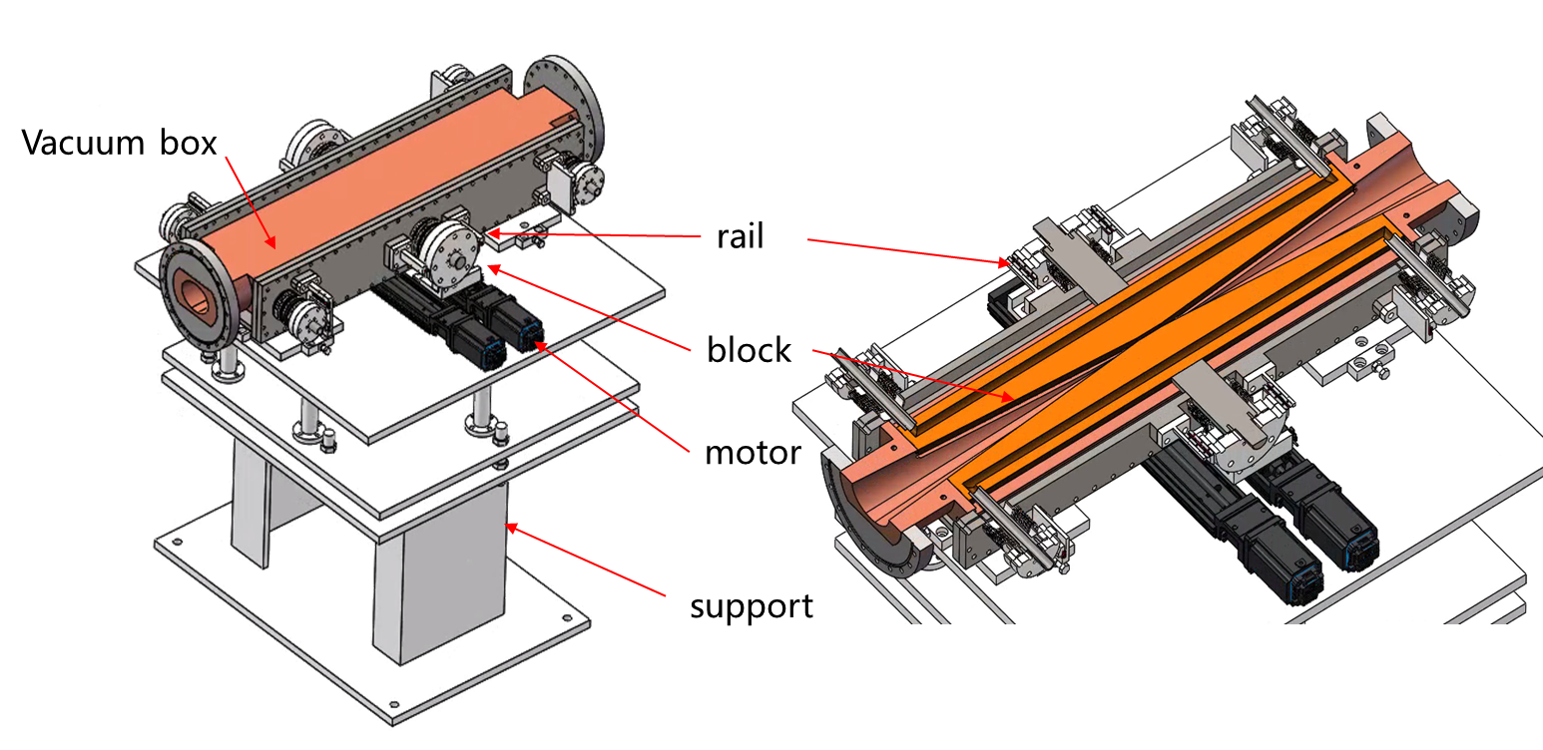
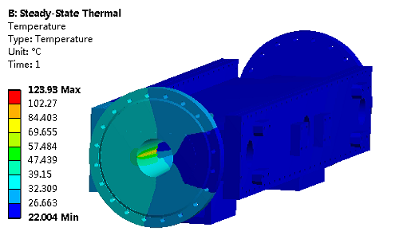
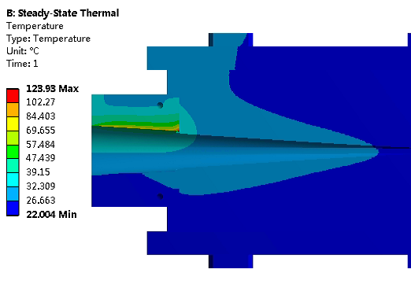
Movable collimators
  In TDR, we made a preliminary design of movable collimators for background mitigation.
  Jaw and vacuum vessel material: Glidcop Al-15, can endure the SR and HOM power in normal operation.
Plan in EDR:
  The structure design and detailed FEA, beam-material interaction and impedance.
  The necessary technique study if possible (eg. Tip material and connecting technique with jaw body. )
Aim:
  Collimators can work theoretically.
  Thermal conductivity of new material ≥600 W/(m.K）
  Connection strength higher than 90% strength of base material.
Highest temperature: 124 ℃

Slide 14
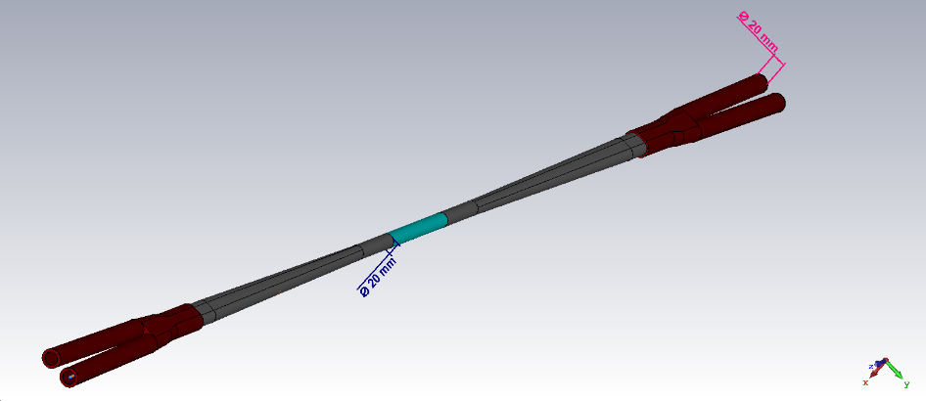
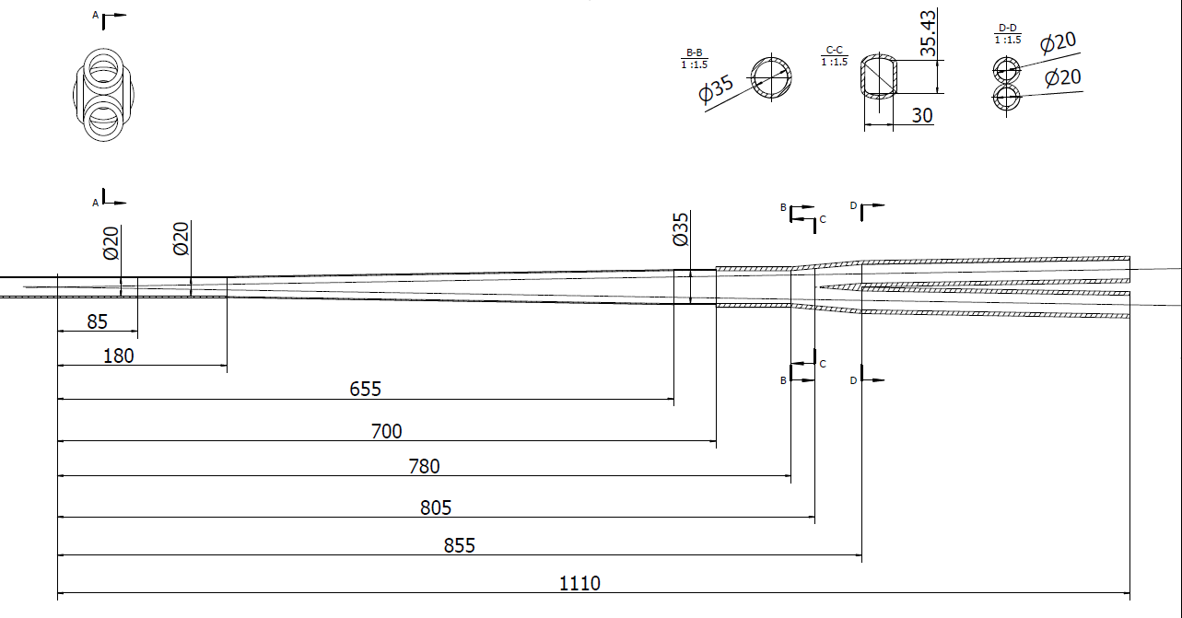
Heat load in IR
  Heat load source:
  Impedance
  Synchrotron radiation
  Beam loss backgrounds
Currently:
Heat load in IR from impedance, SR and beam loss background from the process of RBB, BS, BG, and BTH hitting the IR beam pipe are analyzed.
Most serious in RVC bellows without cooling, ~0.3 W/cm²
Can endure a heat flux of 1 W/cm², ~ acceptable.
Heat load in IR from beam loss background is so small, compared to synchrotron radiation and impedance.
In the future:
More realistic model
The photons generated from the process of RBB, BS, and BG with small angle and large energy, will be analysed.

Slide 15
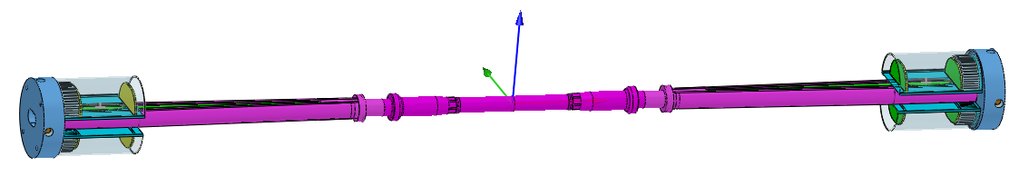
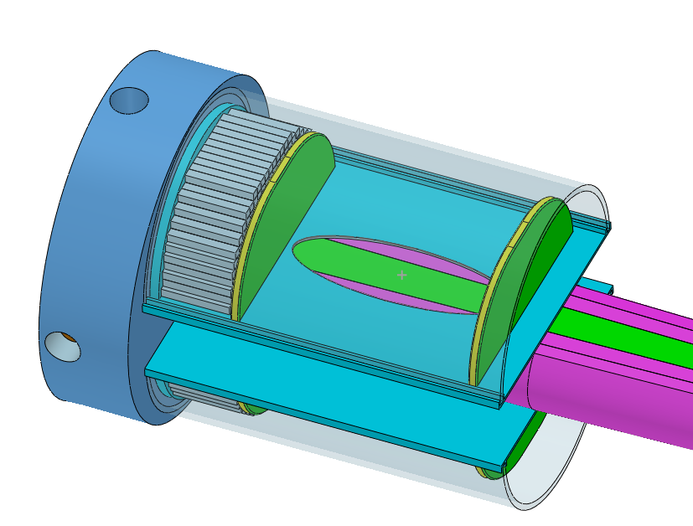
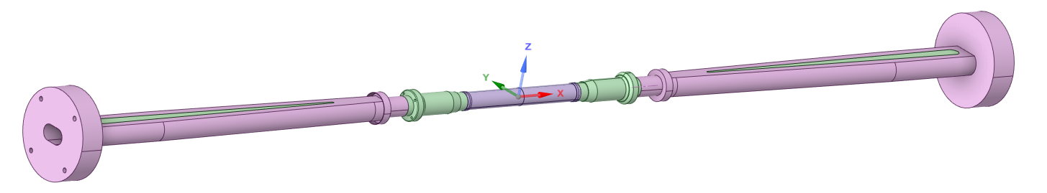
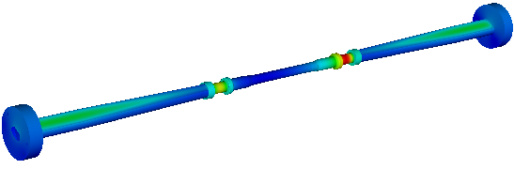

The central beampipe design
New design in EDR:
inner Be pipe increase from 160mm to 220mm (to facilitate welding with short Al pipes at thicker locations)
central Be pipe segment increase to 380mm, the inner diameter decrease to 20mm, the inner Be pipe thickness ~0.2mm, the outer Be pipe thickness~ 0.15mm (to improve the accuracy of vertex)
the cooling gap~0.35mm
Si wafer
LYSO bars
Highest temperature position
Difficulty: manufacture of Be pipe
(Currently, manufacture 100mm long and 0.2mm thick Be pipes in possible)
Water was chosen to be the coolant
Dynamic temperature/pressure could meet the requirements.
Highest temperature: 26.7℃

Slide 16
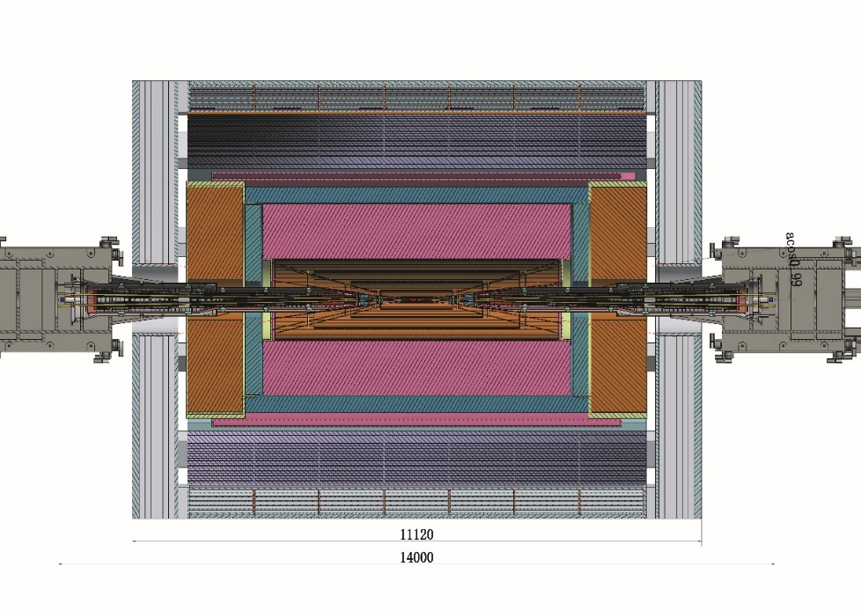
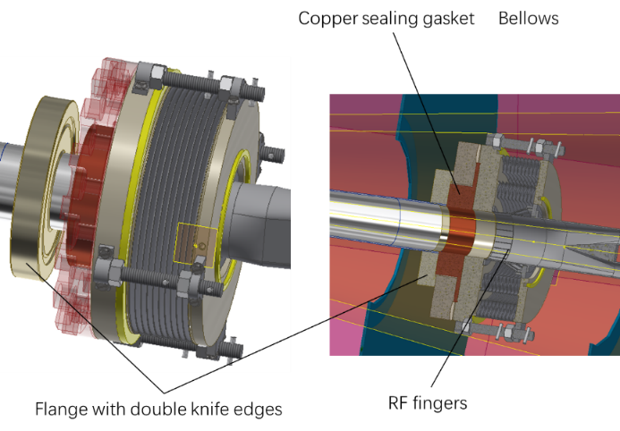
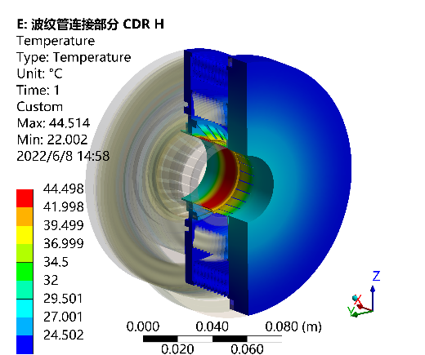
Remote Vacuum Connector plan in EDR
  Plan in EDR: further assessment and mechanical design of the RVC, and a prototype if possible in EDR.
  Aim: RVC leak rate~ 2.7 ×10^{–11} Pa·m³/s
  Can endure a heat flux of 1 W/cm², even without cooling

Slide 17
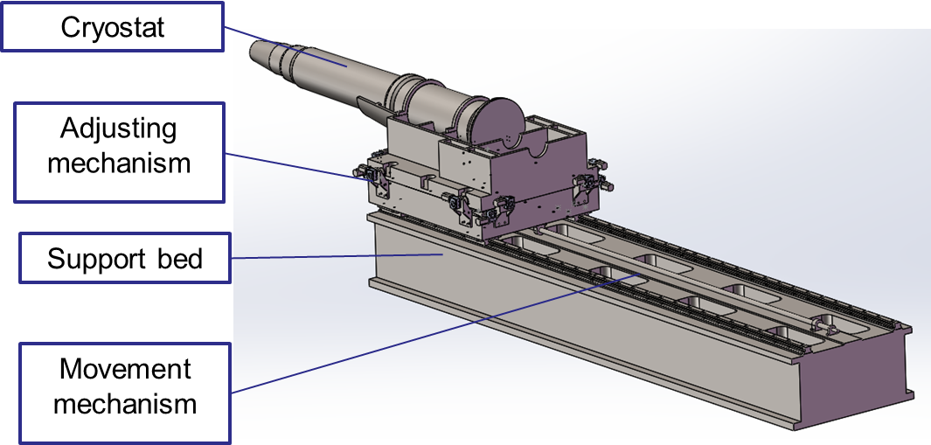
SC magnet support system
  The cryostat is about 5.7m long. The cantilever length is 5283mm.
  After the optimization of the supports in the cryostat, the total weight of the cryostat and the devices inside is 2.0 ton.
Plan in EDR
  The basically determined structure design of the support for cryostat at MDI, the detailed FEA of structure and stability, including the rough assessment of Lorenz force, quench cases and temperature change.
  The necessary technique study if possible (eg. Vibration, movement and alignment related techniques).
  Aim: The resolution requirement of the adjusting mechanism < 5 μm. Support can work theoretically.

Slide 18
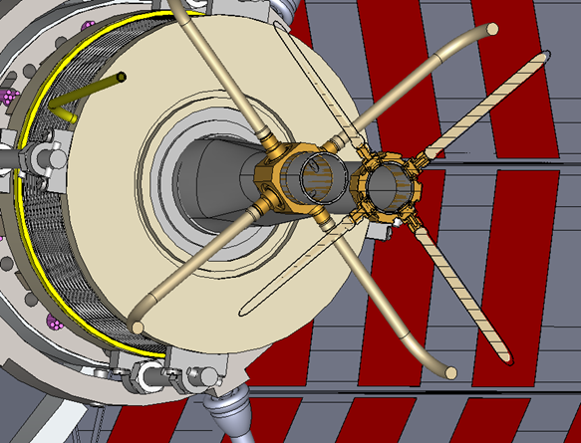
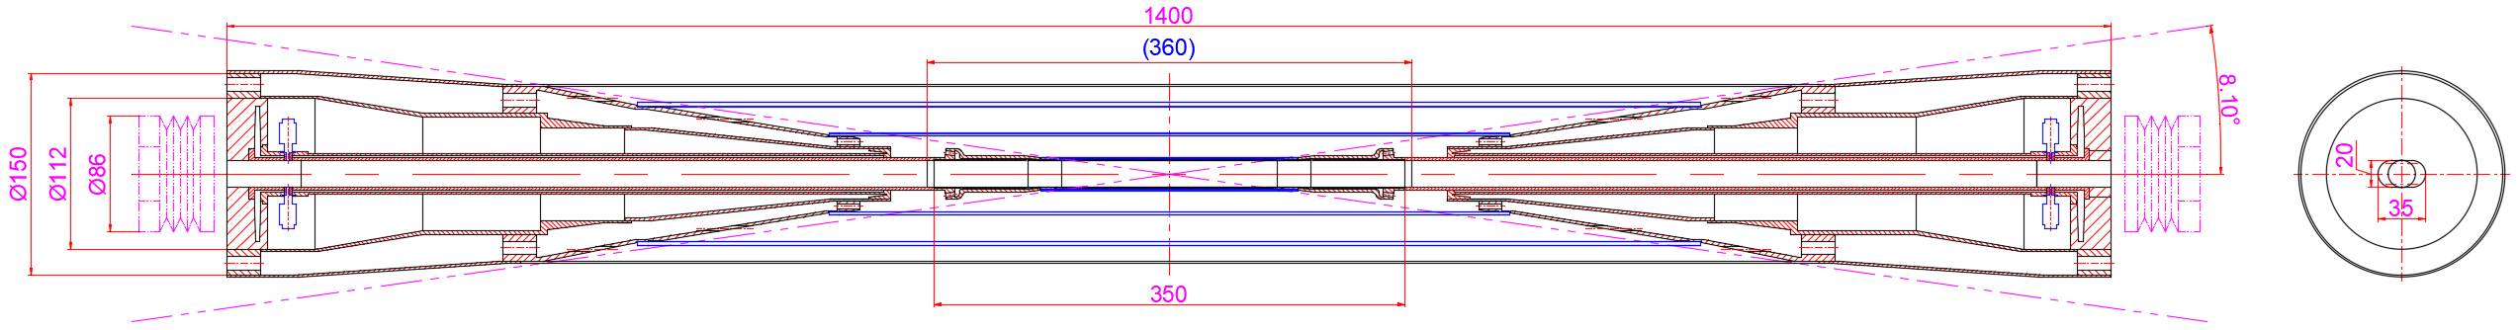
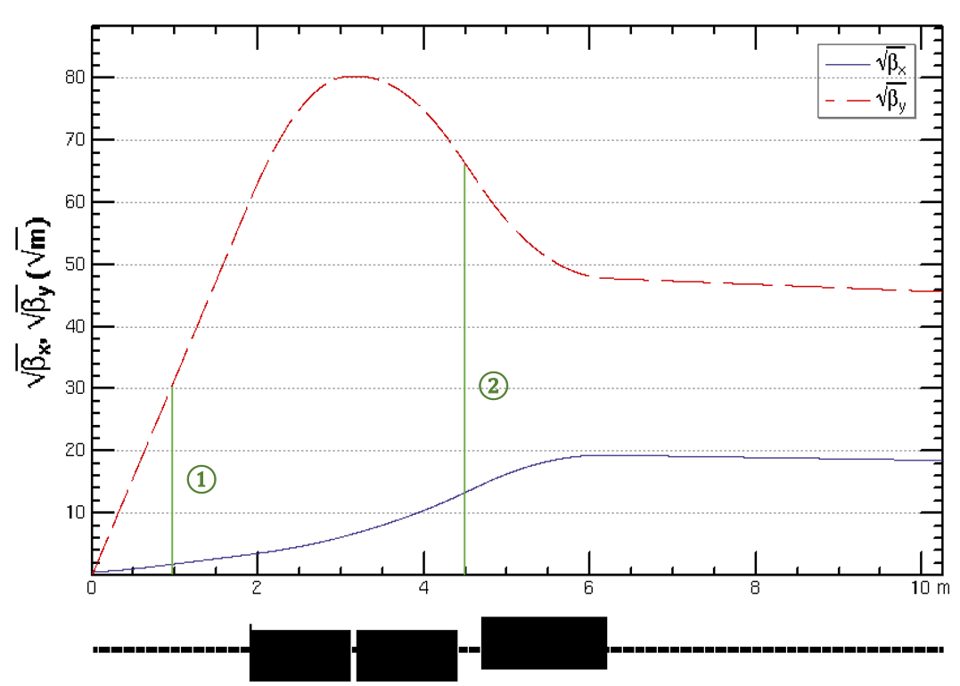
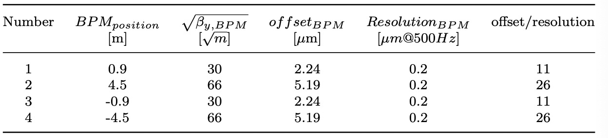
IR BPMs
Considering response time and calibration difficulty, two 4 button electrodes BPM in double pipe and one 2 button electrodes BPM in single pipe at each side of CEPC IR are adopted.
2 button electrodes BPM for measuring the arrival time.
Utilize two pairs of BPMs for vertical beam orbit feedback (fast lumi monitor for horizontal), placed at symmetric positions on each side of the IP, located at distances of 0.9m and 4.5m

Slide 19
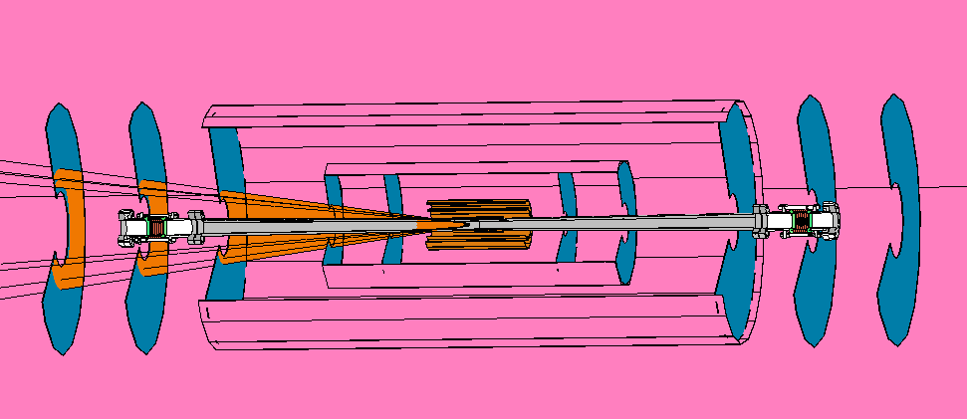
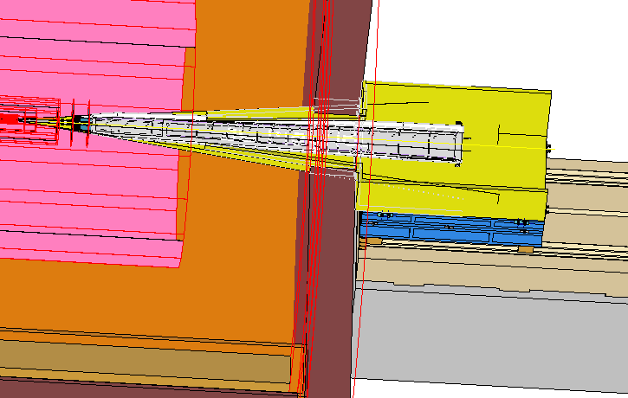
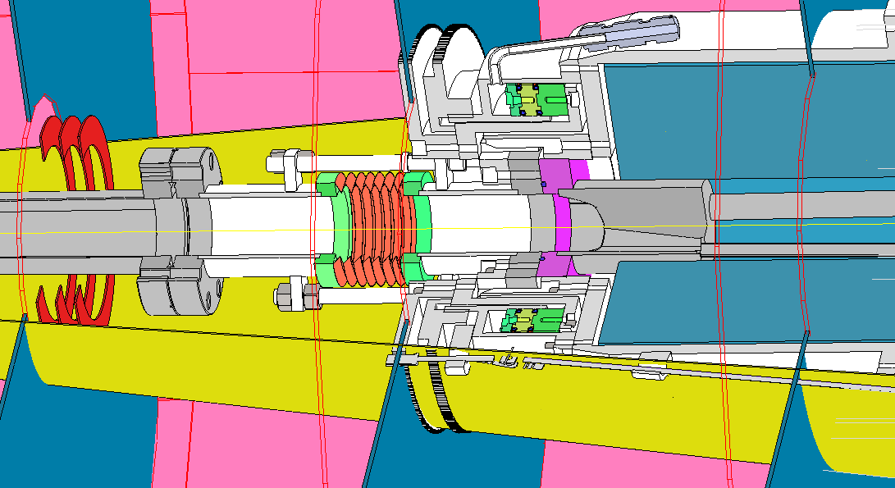
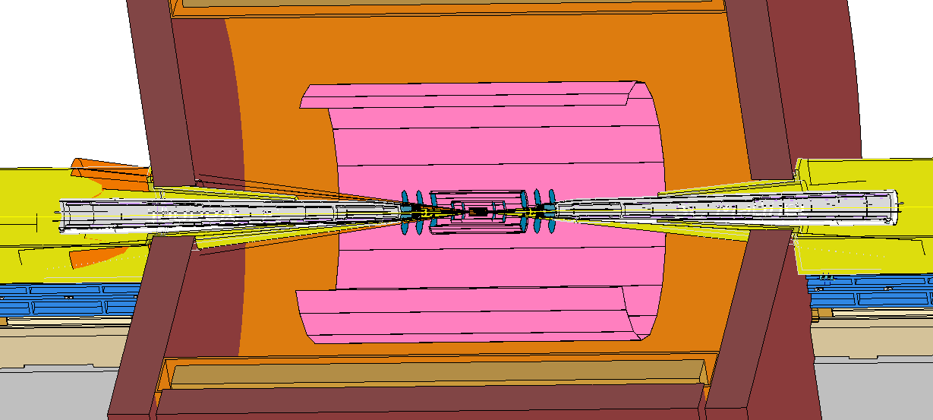
Integration and Assembly
The integration and installation procedure of accelerator in MDI is specified supposing that detector part already installed and aligned.
Cryostat including Final doublet installation alignment under laboratory.
Part of Lumical installed and aligned with cryostat.
In future, the integration and assembly will be more specified along with detector designed in detail.

Slide 20
Alignment precision during installation and positioning
 | From detector |  |  | From accelerator | MDI requirement
 | Shape tolerance(mm) | Installation (mm) | Position (mm) | Mechanical processing accuracy, including deformation requirements, should be less than（mm）
Yoke | ± 1 | None | None | None | None
Magnet | Outer: 0 to -5, Inner: 0 to +5 | None | ± 0.2 | ± 0.1 | ± 0.1
HCAL | Outer: 0 to -5, Inner: 0 to +5 | ± 2 | ± 0.5 | ± 0.3 | ± 0.3
ECAL | Outer: 0 to -5, Inner: 0 to +5 | ± 2 | ± 0.5 | ± 0.3 | ± 0.3
TPC | Outer: 0 to -2, Inner: 0 to +2 | ± 2 | ± 0.3 | ± 0.2 | ± 0.2
ITK | Outer: 0 to -2, Inner: 0 to +2 | ± 2 | ± 0.3 | ± 0.2 | ± 0.2
Beampipe | Outer: 0 to -0.3, Inner: 0 to +0.3 | ± 0.5 | ± 0.1 | ± 0.05 | ± 0.05

Slide 21
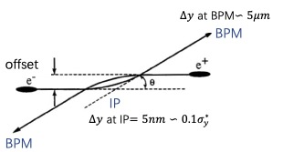
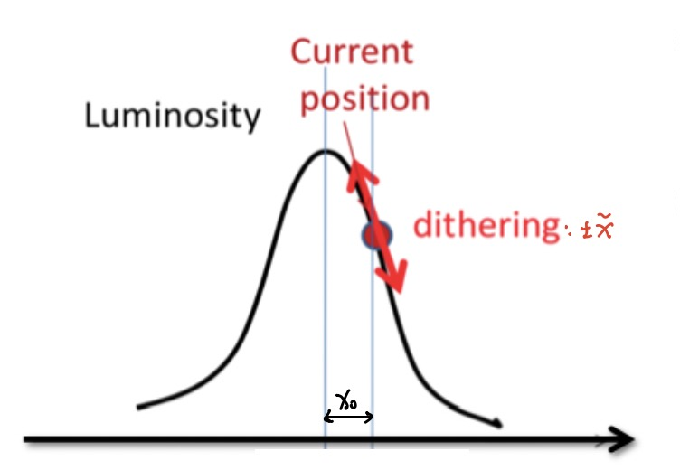
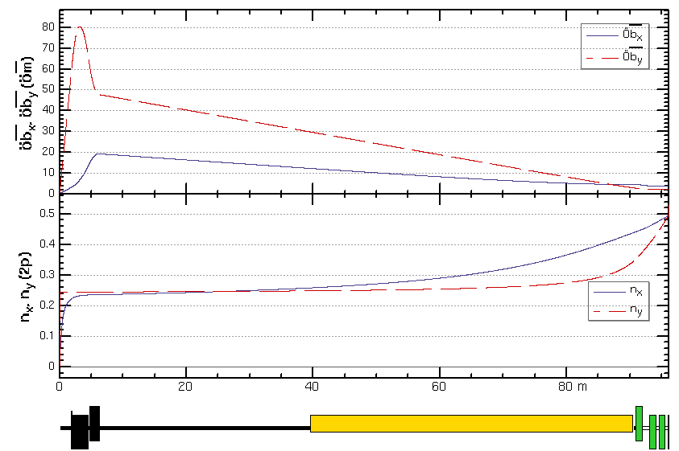
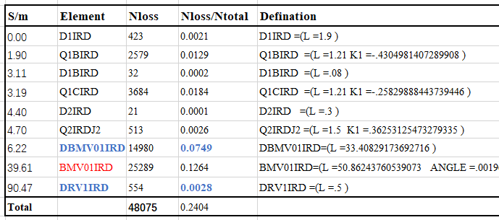
Fast luminosity tuning system
Motivation
With very small beam sizes at IP and the presence of strong FFS quadrupoles in the CEPC, the luminosity is very sensitive to the mechanical vibrations, It is essential to the fast luminosity measurements and IP orbit feedback.
In principle, there are two possible methods used for the IP orbit feedback system.
  Beam-Beam deflection driven method for vertical
  Fast luminosity monitor for horizontal
IP
1
2
3
  Currently,
  The proposed approach involves utilizing the beam-beam deflection driven method based on BPMs for vertical orbit feedback and a luminosity-driven method for horizontal feedback.
  Candidate positions for BPMs and luminosity detector have been identified.
  The detailed design of the detectors is getting started.
In the future,
  Start to end the feedback simulation to specify the precision requirement;
  Radiation dose simulation (important for detector choice);
  Detailed simulation in Geant4 to estimate the real signal in the detector;
  Design of the BPM and feedback electronics, the design of detectors and data acquisition system.
Three potential locations of fast lumi monitor were considered: before, inside, and after the first bending magnet

Slide 22
Conclusions
MDI progress toward EDR are presented.
  The MDI layout is compatible and no interference for the design.
  SC magnets and cryostat are designed and improved.
  Φ20mm~ Φ20mm IR beam pipe is well designed.
  The estimation of the radiative background has been estimated with real beam.
  The mitigation efforts of every kinds of background dedicated to the mask, collimator and shielding has been designed.
  The thermal analysis including HOM heating, synchrotron radiation, beam loss background and beam pipe thermal analysis meet the requirement.
  IR BPMs are designed.
  The SC magnet supports inside the cryostat are designed and optimized.
  Fast Luminosity Tuning System, including fast BPMs and fast luminosity monitor, initially designed.
EDR plans for 2024 to 2027 were presented.

Slide 23
Thanks for your attention

