Slide 1
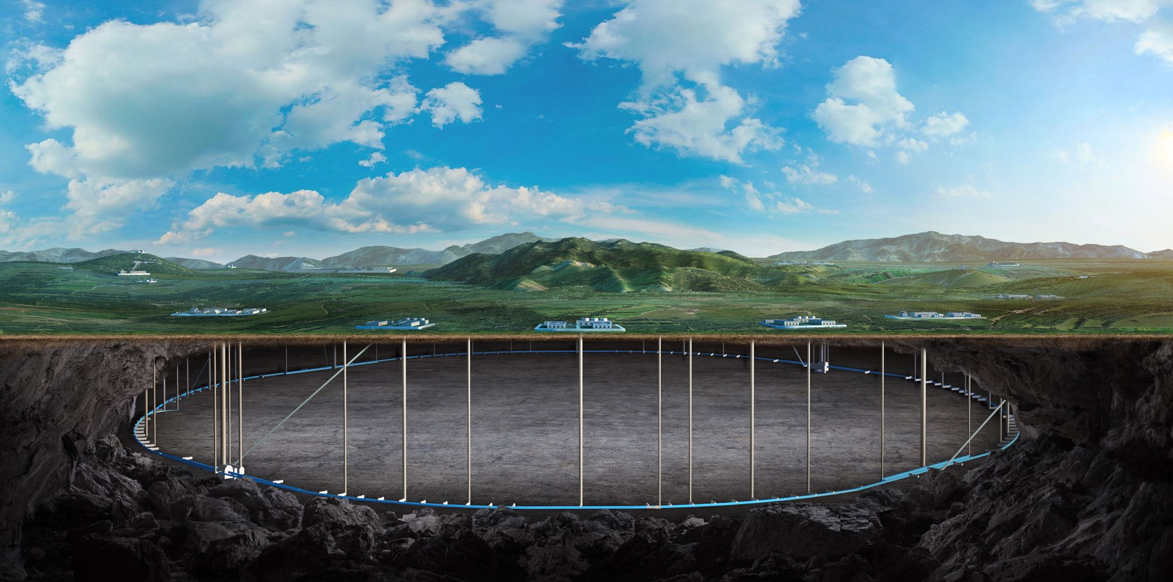


CEPC cryogenic system EDR plan and status
Rui Ge, Mei Li
On behalf of CEPC cryogenic system
Contributors: Miaofu Xu, Xiangzhen Zhang, Yang Xiaochen, Shaopeng Li, Ruixiong Han, Zhengze Chang, Jiyuan Zhai, Wang Haijing, etc.
CEPC workshop, 2024, October 23-27th, School of Physics, Zhejiang University, Hangzhou, China
Notes:
Good morning, everyone, This is Mei Li from IHEP, and I am honored to be here to give you a report “CEPC cryogenic system EDR plan and status” .

Slide 2
Content
Introduction
EDR goal, scope and plan
EDR progress
Process flow cooling scheme optimization;
Large refrigerator R&D；
SRF 650MHz cavity Cryomodule design and optimization;
Industrialization preparation progress and status
Conclusion
Notes:
The outline is including 4 parts

Slide 3
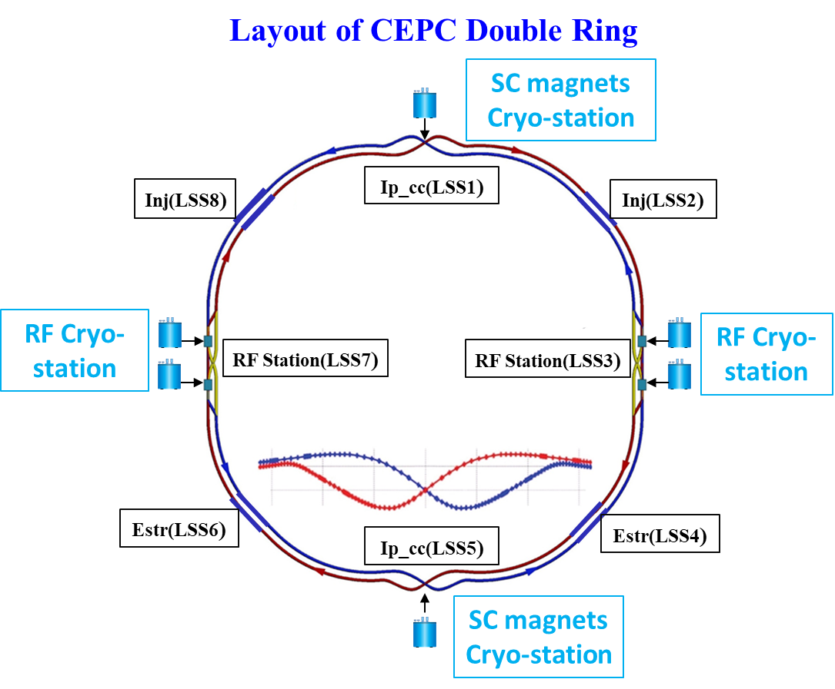
CEPC Cryogenic System Brief Introduction
CEPC is a positron and electron collider, and the beam is accelerated to 30 GeV by linear acceleration section, and then further accelerated to 120 GeV by RF cavities in the Booster and Collider ring.
Cryogenic system is designed to provide a reliable and stable cooling environment (4.5K or 2K) for RF cavities and SC magnets.
  Booster ring:
1.3 GHz 9-cell cavities, 96 cavities
12 cryomodules
3 cryomodules/each station
Temperature: 2K
  Collider ring:
650MHz 2-cell cavities, 240 cavities
32 cryomodules for Higgs 30MW, 56 for Higgs 50MW
8 or 14 cryomodules/each station
Temperature: 2K
Zhang Xiangzhen’s talk
  IR magnets:
4 IR magnets , 32 Sextuple magnets (room temperature)
4 cryostats
Temperature: 4.5K/2K
  Detectors:
2 detector magnets
HeI/Thermosiphon cooling
SRF cryomodule: 4×15kW@4.5K
Overview of the CEPC cryogenic system
Notes:
For the CEPC cryogenic system, there are four RF cryo-stations locate east and west side, and four individual refrigerator with the cooling capacity of 15 kW will be adopted.

Slide 4
Cryogenic-TDR and EDR Works Summarized table
 | Cryogenic system Composition |  | TDR | EDR
1 | Process flow scheme design and simulation | SRF side | Completed 2K, 5~8K circuit, 40~70K TS Process flow scheme design and calculation; | Finalize the Cryogenic system peer review (End of 2024)
 |  | SC magnet side | Completed MDI/Detector cryostat preliminary cooling scheme design & calculation | MDI/detector more detailed scheme design & calculation, verification in EDR
2 | Cryomodule/Cryostat design | SRF cavity cryomodule | Completed 1.3GHz high performance cryomodule design, manufacturing and 2K HT test; achieved word-leading results | Need to complete full-size 650MHz cryomodule cryogenic test in 2025/2026 beginning
 |  | SC magnet cryostat | Completed MDI cryostat preliminary structural design, heat transfer design; | MDI/detector mechanical design determination, Assembly process design and alignment considerations, machine key component verification in EDR
3 | Large helium refrigerator |  | The CAS pilot project for 18 kW @4.5K manufacturing has completed in 2024: jointly with FULLCRYO Corporation. | The 18 kW @4.5K or 15 kW @4.5K is expected to finalize the commissioning test by the mid of 2025.
4 | Mechanical design |  | Completed preliminary Cryogenic hall, tanks zone and tunnel layout | Need to Complete detailed Cryogenic hall, tanks zone and tunnel layout diagram
5 | JT heat exchanger |  | Completed HX Basic Design and Optimization, test platform design and Manufacturing | CEPC kilowatts-scale 2K HX Cryogenic experiment will be finished in 2024.12
6 | Cryogenic fluid transfer and distribution design | High-performance cryogenic TL | Completed the scheme design, the test platform equipment manufacturing | Need to complete the experimental verification test in EDR
 |  | Distribution valve box | Completed similar equipment design, manufacture and test in PAPS/HEPS project, accumulated experience prepared for CEPC | Continue to design and optimize, collaborate well with the supplier fully prepared for CEPC Continue to design 100km tunnel helium quench protection scheme
7 | Helium recycling and purification system |  | Completed similar helium recovery system design, manufacture and test in PAPS/HEPS project, accumulated experience prepared for CEPC | Continue to design and optimize, collaborate well with the supplier
8 | Liquid nitrogen system |  | Completed similar liquid nitrogen system design, manufacture and test in PAPS/HEPS project, accumulated experience prepared for CEPC | Continue to design and optimize, collaborate well with the supplier
9 | Cryogenic Control system |  | Completed similar Cryogenic Control system design, manufacture and test in PAPS/HEPS project, accumulated experience prepared for CEPC | Continue to design and optimize, collaborate well with the supplier
10 | Cryogenic safety design |  | Completed similar Cryogenic safety design, test in PAPS/HEPS project, accumulated experience prepared for CEPC | Continue to design 100km tunnel helium quench protection scheme

Slide 5
Cryogenic System Key Milestones in EDR plan
2024:
•Completing the CEPC cryogenic system design peer review
•Completing the 650 MHz full-size cryomodule design works and key component order, including horizontal test (HT) cooling scheme design, the purchase procedure of the sensors, heat exchanger, and cryogenic valve, etc.
2025~2026:
•Jointly with FULLCRYO Corporation, expected to finalize the commissioning test of 18kW@4.5K helium refrigerator by the mid of 2025:.
•Completing the cryogenic experimental test of the 650 MHz cryomodule in beginning of 2026.
• Completing the CEPC Proposal of the cryogenic system in 2025~2026.
2027 (June):
•Complete EDR documentation and optimize the power consumption and construction cost tables of the cryogenic system.

Slide 6
Content
Introduction
EDR goal, scope and plan
EDR progress
Process flow cooling scheme optimization;
Large refrigerator R&D；
SRF 650MHz cavity Cryomodule design and optimization;
Industrialization preparation progress and status
Conclusion
Notes:
The outline is including 5 parts

Slide 7

TDR/EDR-Higgs 30MW Heat Loads
Cavity RF voltage 11.5MV
Higgs Mode 30MW | Unit | Collider |  |  | Booster
 |  | 40-80K | 5-8K | 2K | 40-80K | 5-8K | 2K
Predicted module static heat load | (W/module) | 300 | 60 | 12 | 140 | 20 | 3
Predicted module HOM static heat load | (W/module) | 2.4 | 1.2 | 0.1 | 0 | 0 | 0
Predicted module Input coupler static heat load | (W/module) | 6 | 3 | 0.3 | 16 | 8 | 0.8
Predicted module dynamic heat load (RF) | (W/module) | 0 | 0 | 123.2 | 0 | 0 | 40.9
Predicted module HOM dynamic heat load | (W/module) | 2.9 | 1.4 | 0.2 | 7.1 | 3.6 | 0.6
Predicted module Input coupler dynamic heat load | (W/module) | 90.1 | 22.5 | 3.8 | 208 | 20.8 | 2.6
Module dynamic heat load | W | 44.4 | 23.9 | 127.2 | 215.1 | 24.4 | 44.1
Each Module total heat load | W | 401.4 | 88.1 | 139.6 | 371.1 | 52.4 | 47.9
Cryomodule number | - | 32 | 32 | 32 | 12 | 12 | 12
EVB heat loss | W | 50 | 10 | 5 | 50 | 10 | 5
EVB number | - | 32 | 32 | 32 | 12 | 12 | 12
MDVB heat loss | W | 50 | 30 | 10 | 50 | 30 | 10
MDVB number | - | 4 | 4 | 4 | 4 | 4 | 4
Total cryogenic transfer line length | m | 552 | 552 | 552 | 168 | 168 | 168
cryogenic transfer line heat loss per meter | W/m | 2 | 0.5 | 0.3 | 2 | 0.5 | 0.3
Total cryogenic transfer line heat loss | W | 1104 | 276 | 165.6 | 336 | 84 | 50.4
Total heat load | kW | 15.7488 | 3.5352 | 4.8328 | 5.5892 | 0.9528 | 0.7252
Overall net cryogenic capacity multiplier |  | 1.54 | 1.54 | 1.54 | 1.54 | 1.54 | 1.54
equiv. heat load with multiplier | kW | 2.81 | 4.90 | 36.69 | 1.00 | 1.32 | 5.50
4.5K equiv. heat load with multiplier | kW | 44.39 |  |  | 7.82
Total 4.5K equiv. heat load with multiplier | kW | 52.21
Installed power (COP(219W/1W)) | MW | 9.72 |  |  | 1.71
4×15kW@4.5K refrigerator
7
Notes:
This table shows the Higgs 30MW heat loads. There are total 32 cryomodules in the collider and 12 cryomodules in the booster. The estimated heat loads at 4K is about 52kWs, and four cryo-plants with the cooling capacity of 15kW for each station will be used.

Slide 8
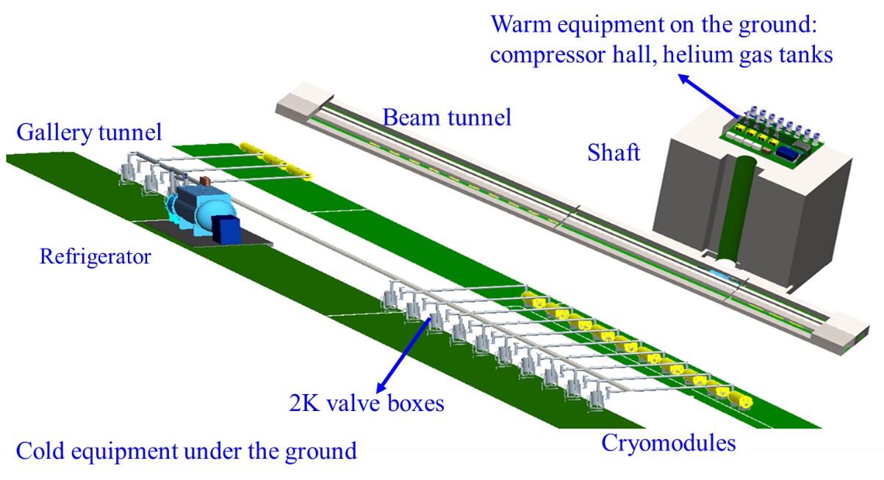
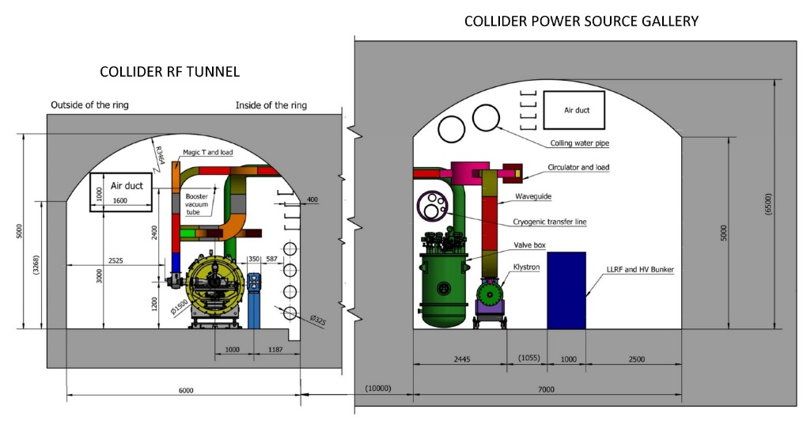
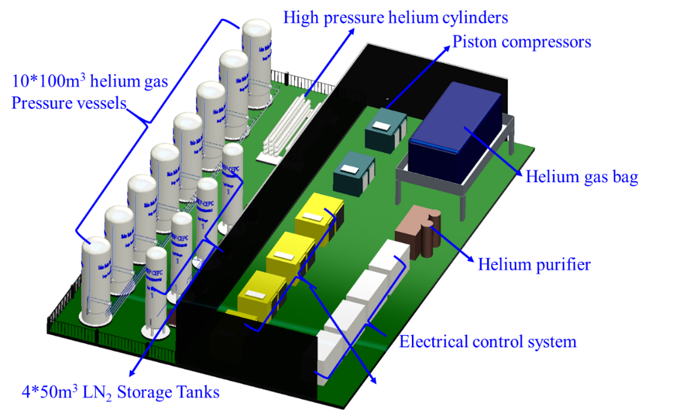
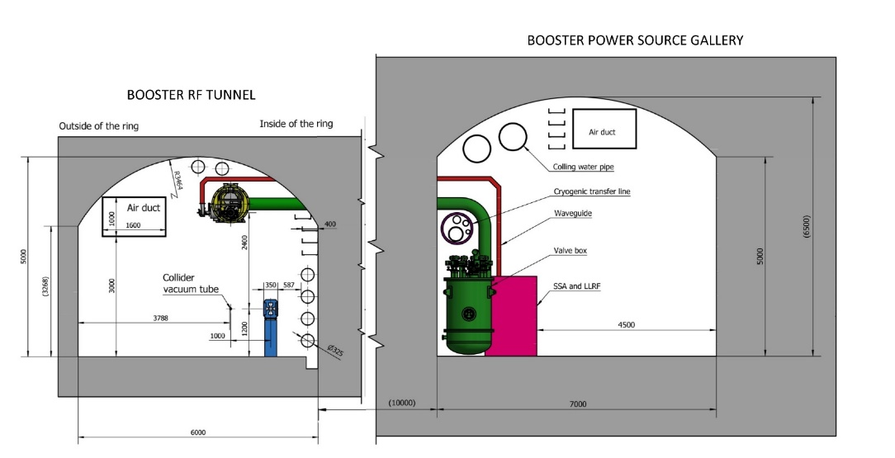
CEPC RF Cryogenic System and Tunnel Layout
Upper cold box (300K-80K)
Auxillary tunnel:
Lower cold box (80K-4.5K)
2K coldbox
Valvle box
Control cabinet
Collider 650 MHz cryomodules mounted on tunnel floor. Cavities operate in CW mode.
100000
Booster 1.3 GHz cryomodules hung from ceiling at a different beamline. Cavities operate in fast voltage ramp mode.
60000

Slide 9
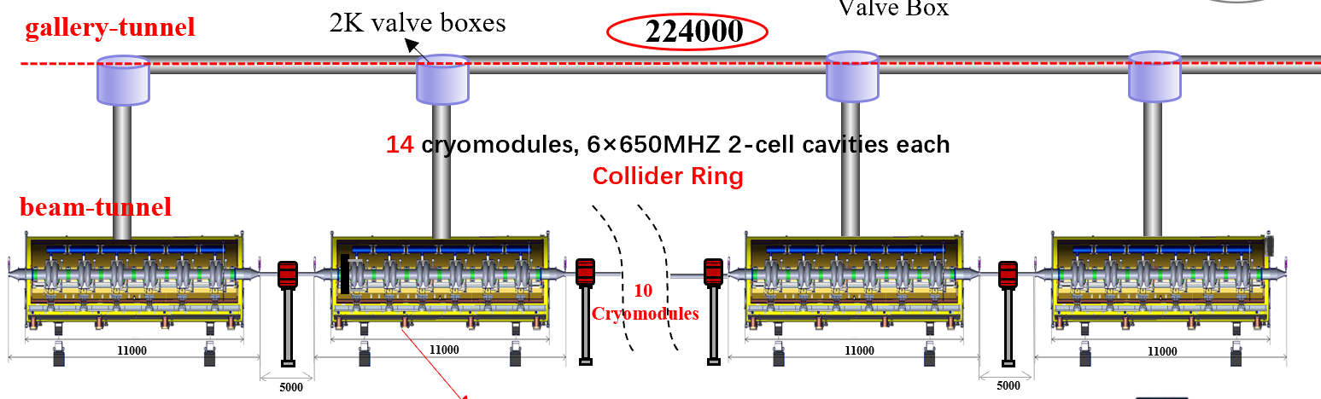
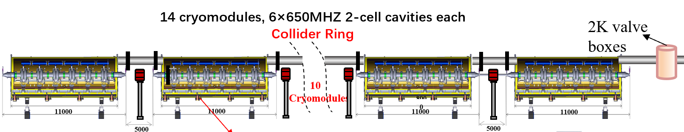
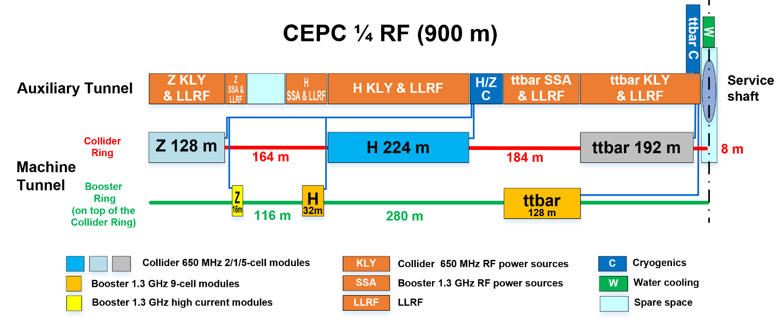
Tunnel Layout Optimization from TDR to EDR
C
D
R
EDR-Aug. 2024
TDR
TDR
45000
1000
Height 5000
1000
1000
1000
Height 5000
Height 6000
Height 6000
4000
Cryogenic electrical
Cabinet
4000
Main distribution VB
4000
Refrigerator 2K Coldbox
4000
Refrigerator 80K-4.5K Lower Coldbox
2000
6000
2000
6000
2000
10000
2000
13000
2000
Continue to deeply optimize the SRF cooling scheme design;
Expected to finalize the cooling scheme in the next two months and hold an peer review by the end of this year.
Notes:
From CDR to TDR, the cooling scheme of both booster and collider cryomodules have been modified, from parallel to series. In this way, there will not have a lot number of small valve boxes in the tunnel, and the process scheme looks easier, and reduce the cost , save spaces in the tunnel. As for EDR stage, we team mates have discussed to improve the tunnel layout, we want to move the cryogenic system equipment, including the lower coldbox, 2K coldbox, control cabinet, in the auxillary tunell to this section. Why we modified like this, because it facilitate the cryogenic transfer and distribution. It will reduce the length of transferlines.

Slide 10
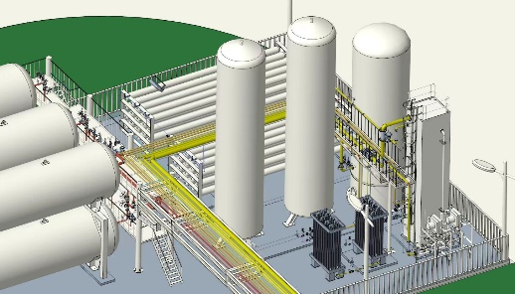
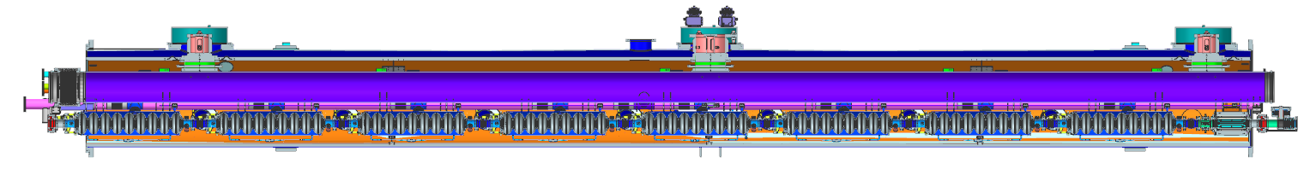
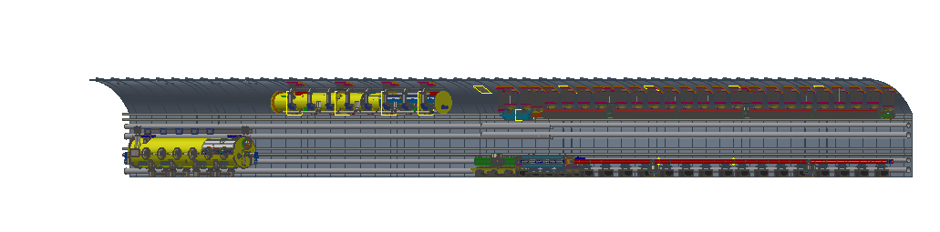
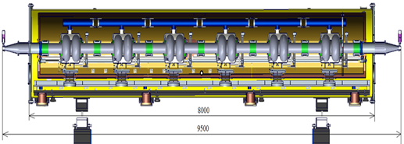
EDR—Flow chart of SRF Scheme
Underground surface
Tanks zone
5K@3bara supercritical helium is subcooled to 4.5K in the lower coldbox, and then further be cooled to 2.4K@3bara by a large heat exchanger (~90g/s of each, total four HX);
2.4K@3bara helium is transferred to the beam tunnel, then is throttled by JT valve inside CM to produce the 2K superfluid helium;
Return GHe goes through 2K HX and cold compressors to recover the cold quantity, then returns to CB and compressors LP side to finalize the whole cycle;
40-80K thermal shield is set to reduce the radiation loss.
5-8K circuit is set to cool down the coupler (conduction cooling).
Upper Cold Box
（300K-80K）
Compressor group
Auxiliary tunnel
15kW@4.5K
100m shaft
Control cabinet
Lower Cold Box
（80K-4.5K）
2K coldbox
10m
3 cryomodules, 8×1.3GHZ 9-cell cavities each
Booster Ring
2KVB
10m
1
Cryomodules
11000
20m
11000
8000
32m
Beam tunnel
12
Cryomodules
From Haijing Wang
Phase seperator
8000
80m
Higgs 50MW
95000
224m
9500
14 cryomodules, 6×650MHZ 2-cell cavities each
Collider Ring
Notes:
This is the flow chart of the SRF EDR scheme.

Slide 11
Higgs--2K process calculation and optimization
Optimization results
 |  | Case 1 | Case 2 | Case 3 | Case 4 | Case 5 | Case 6 | Case 7 | Case8 | Case 9 | Case 10
 |  | Higgs30MW | Higgs50MW | Higgs30MW | Higgs50MW | Higgs30MW | Higgs50MW | Higgs30MW | Higgs50MW | Higgs30MW | Higgs50MW
heat loss per meter | W/m | Supply and return TL-0.3W/m | Supply and return TL-0.3W/m | Supply and return TL-0.3W/m | Supply and return TL-0.3W/m | Supply 0.1W/m，return 0.2W/m | Supply 0.1W/m，return 0.2W/m | Supply 0.1W/m，return 0.2W/m | Supply 0.1W/m，return 0.2W/m | Supply 0.15W/m，return 0.3W/m | Supply 0.15W/m，return 0.3W/m
Collider-2KRT-Main Pipe | Di/mm | 174 | 174 | 174 | 174 | 174 | 174 | Between Collider CM HGRP: 174mm，integrated together TL” 90m, DN250，Di 266mm | Between Collider CM HGRP: 174mm，integrated together TL” 90m, DN250，Di 266mm | Between Collider CM HGRP: 174mm，integrated together TL” 90m, DN250，Di 266mm | Between Collider CM HGRP: 174mm，integrated together TL” 90m, DN250，Di 266mm
Collider-2KRT-Mian TL length | m | 202 | 298 | 202 | 298 | 202 | 298 | 202 | 298 | 202 | 298
Booster-2KRT-Main Pipe-internal CM | Di/mm | 318 | 318 | 318 | 318 | 318 | 318 | 318 | 318 | 318 | 318
Booster-2KRT-Main Pipe-external CM | Di/mm | 110 | 110 | 110 | 110 | 110 | 110 | 110 | 110 | 110 | 110
Booster-2KRT-Mian TL length | m | 202 | 298 | 202 | 298 | 202 | 298 | 202 | 298 | 202 | 298
Collider/Booster-Branch TL | Di/mm | 85 | 85 | 85 | 85 | 85 | 85 | 85 | 85 | 85 | 85
Collider/Booster-Branch TL length | m | 1.5 | 1.5 | 1.5 | 1.5 | 1.5 | 1.5 | 1.5 | 1.5 | 1.5 | 1.5
roughness | m | Mild Steel: 4.57E-5 | Mild Steel: 4.57E-5 | electrical polish: 8E-7 | electrical polish: 8E-7 | electrical polish: 8E-7 | electrical polish: 8E-7 | electrical polish: 8E-7 | electrical polish: 8E-7 | electrical polish: 8E-7 | electrical polish: 8E-7
Collider CM No. |  | 8 | 14 | 8 | 14 | 8 | 14 | 8 | 14 | 8 | 14
Booster CM No. |  | 3 | 3 | 3 | 3 | 3 | 3 | 3 | 3 | 3 | 3
Collider CM Q/W-each-ZJY | W | 139.6 | 56.5 | 139.6 | 56.5 | 139.6 | 56.5 | 139.6 | 56.5 | 139.6 | 56.5
Booster CM Q/W-each-ZJY | W | 47.9 | 48.7 | 47.9 | 48.7 | 47.9 | 48.7 | 47.9 | 48.7 | 47.9 | 48.7
Collider CM Q/W-each-Considering 1.3 times magin | W | 181.48 | 73.45 | 181.48 | 73.45 | 181.48 | 73.45 | 181.48 | 73.45 | 181.48 | 73.45
Booster CM Q/W-each-Considering 1.3 times magin | W | 62.27 | 63.31 | 62.27 | 63.31 | 62.27 | 63.31 | 62.27 | 63.31 | 62.27 | 63.31
Collider CM Total | m/(g/s) | 77.54 | 58.09 | 77.54 | 58.09 | 75.49 | 54.98 | 75.49 | 54.98 | 75.99 | 55.73
Booster CM Total | m/(g/s) | 10.41 | 10.56 | 10.41 | 10.56 | 10 | 10.16 | 10 | 10.16 | 10.18 | 10.31
2K HX - mass flow rate | m/(g/s) | 87.95 | 68.65 | 87.95 | 68.65 | 85.49 | 65.14 | 85.49 | 65.14 | 86.17 | 66.04
RT-valve | delp_P/Pa | DN180-90Pa | DN180-60Pa | DN180-90Pa | DN180-60Pa | DN180-90Pa | DN180-60Pa | DN180-90Pa | DN180-60Pa | DN180-90Pa | DN180-60Pa
helium vessel pressure | Pa | 3130 | 3130 | 3130 | 3130 | 3130 | 3130 | 3130 | 3130 | 3130 | 3130
Coldside-in HX | Pin/Pa | 2816 | 2897 | 2901 | 2964 | 2908 | 2979 | 2982 | 3020 | 2981 | 3016
Coldside-out HX | Pout/Pa | 2730 | 2730 | 2730 | 2730 | 2730 | 2730 | 2730 | 2730 | 2730 | 2730
pressure drop barget of Return gas from HV to CC | delt_P/Pa | 400 | 400 | 400 | 400 | 400 | 400 | 400 | 400 | 400 | 400
pressure drop of return valve | delp_P/Pa | 90 | 60 | 90 | 60 | 90 | 60 | 90 | 60 | 90 | 60
main and branch TL | delp_P/Pa | 224 | 173 | 139 | 106 | 132 | 91 | 58 | 50 | 59 | 54
Removing piping and valves with 400 Pa leaves delt_P in HX coldside | delt_P/Pa | 86 | 167 | 171 | 234 | 178 | 249 | 252 | 290 | 251 | 286
Collider's last module liquid mass fraction after throttled | % | 77.73 | 66.97 | 77.73 | 66.97 | 82.25 | 77.31 | 82.25 | 77.31 | 81.11 | 74.5
Booster's last module liquid mass fraction after throttled | % | 76.77 | 76.85 | 76.77 | 76.85 | 79.53 | 79.6 | 79.53 | 79.6 | 77.49 | 77.57
Return gas pressure drop is 400Pa (same as LCLSII/PIPII design target), meet requirement
≥75%, meet requirement
Notes:
About the detailed 2K process calculation and optimization, we have conducted 10 different cases and sensitivity analysis, through adjusting the heat loss of TL, the roughness of the pipe wall, and the segmented diameter selection of helium gas return pipe. The case No. 9 and 10 are the optimization results.

Slide 12
Higgs--2K process calculation and optimization
Optimization results
Higgs 50MW
P: 3bar
T: 4.5K
x: 0
m: 66.04g/s
P: 2.990bar
T: 2.4K
x: 0
m: 66.04g/s
P: 2.989bar
T: 2.411K
x: 0
m: 10.31g/s
0.15W/m
P: 2.989bar
T: 3.087K
x: 0
m: 3.540g/s
14 cryomodules, 6×650MHZ 2-cell/CM
Collider Ring
P: 2.982bar
T: 3.390K
x: 0
m: 4.28g/s
3 cryomodules, 8×1.3GHZ 9-cell/CM
Booster Ring
P: 2730bar
T: 3.643K
x: 1
m: 66.04g/s
△P=286Pa budget
HX coldside
P: 2.989bar
T: 2.411K
x: 0
m: 55.73g/s
P: 3016bar
T: 2.482K
x: 1
m: 66.04g/s
Collider CM: 73.45W(*1.3 safety factor)
Booster CM: 63.31W (*1.3 safety factor)
90m
224m
externalΦ114×2 Internal DN300
Φ273×3.5
Φ180×3 ，electrical polish 2K HGRP, roughness 8E-7m
0.3W/m
3 cryomodules, 8×1.3GHZ 9-cell/CM
Booster Ring
14 cryomodules, 6×650MHZ 2-cell/CM
Collider Ring
Higgs 30MW
P: 3bar
T: 4.5K
x: 0
m: 86.17g/s
P: 2.990bar
T: 2.4K
x: 0
m: 86.17/s
P: 2.989bar
T: 2.4K
x: 0
m: 10.18g/s
P: 2.977bar
T: 2.859K
x: 0
m: 9.75g/s
P: 2.989bar
T: 3.092K
x: 0
m: 3.5g/s
Not running
△P=251Pa budget
HX coldside
P: 2730bar
T: 3.453K
x: 1
m: 86.17g/s
P: 2.989bar
T: 2.4K
x: 0
m: 75.99g/s
Collider CM:
181.48W (*1.3 safety factor)
Booster CM: 62.27W (*1.3 safety factor)
P: 2981bar
T: 2.294K
x: 1
m: 86.17g/s
90m
128m
externalΦ114×2 Internal DN300
Φ273×3.5
Φ180×3 ，electrical polish 2K HGRP, roughness 8E-7m
Notes:
These diagrams show the key node parameters for the optimization cases. In this diagrams, the temperature, pressure, and mass flow rate information can be reviewed, which lays the foundation for the further CM design, multiple TL design, and valve box design. In this same way, we also conducted the 5~8K circuit, 40~80K TS process calculation.

Slide 13
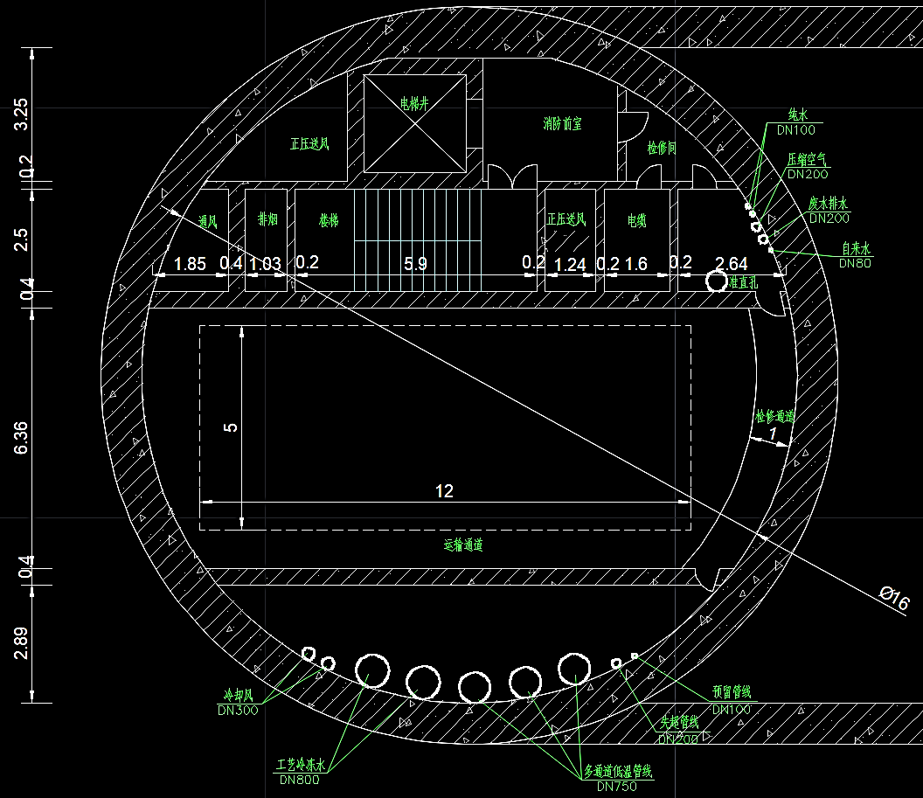
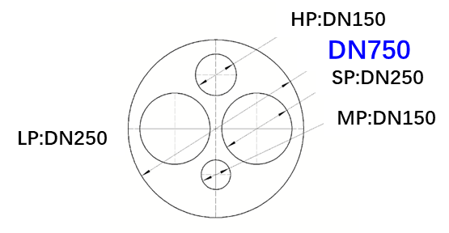
EDR- CEPC Cryo-layout at RF section
Higgs 30MW/50MW
Compressor system
RF
shaft
He Gas Tanks
H30MW:
4.83(Collider)+0.72(booster)=5.55kW@2K
3.54+0.95=4.49kW@5K~8K
15.8+5.6=21.4kW@40K~70K
Total (*1.54) 52.21kW@4.5K
4*15kW@4.5K large helium refrigerator
LN2 system
Upper coldbox
Underground surface
LHe
Dewar
Lower coldbox
Multiple TL: 1*DN750
(ttbar add 2*DN750)
Quench TL: 1*DN300
Reserve TL: 1*DN100
2K valve box
Auxiliary tunnel
DN420
Collider CM internal/external Multiple TL
Beam tunnel
Operating parameters | A | B | C | D | E | F | H
Pressure / [bara] | 3 | 0.031 | 3 | 2.5 | 13 | 10 | 3
Temperature / [K] | 2.4 | 2 | 5 | 8 | 40 | 70 | 300K~4.5K(CD)
Nominal Pipe Size Outside diameter×Thickness / [mm] | Φ42×1.6 | Φ180×3 | Φ42×1.6 | Φ42×1.6 | Φ42×1.6 | Φ42×1.6 | Φ34×1.6
Collider CM
(14 cryomodules, 6×650MHZ 2-cell/CM)
Phase seperator
C
B
A
D
F
E
90m
224m
Booster CM external Multiple TL
Booster CM
(3 cryomodules, 8×1.3GHZ 9-cell/CM)
Operating parameters | A | B | C | D | E | F
Pressure / [bara] | 3 | 0.031 | 3 | 2.5 | 13 | 10
Temperature / [K] | 2.2 | 2 | 5 | 8 | 40 | 70
Nominal Pipe Size Outside diameter×Thickness / [mm] | Φ34×1.6 | External Φ114×2 Internal DN300 | Φ34×1.6 | Φ48×1.6 | Φ34×1.6 | Φ34×1.6
C
B
A
D
30m
32m
F
E
Notes:
After the detailed process calculation, we have selected the proper TL sizes for the different temperature zone.

Slide 14
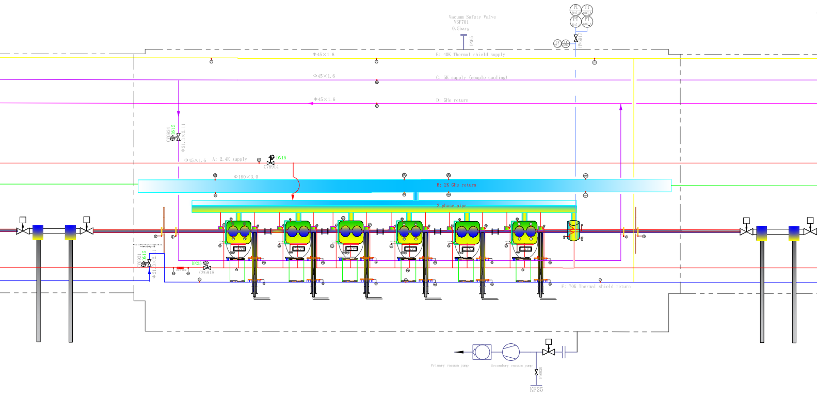
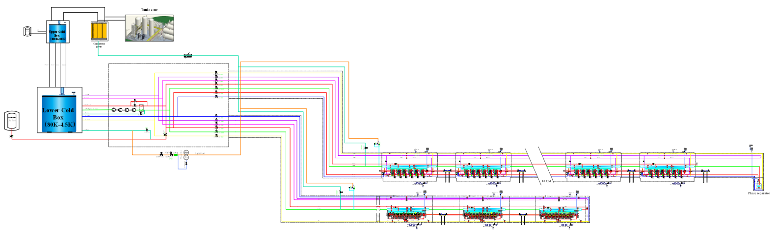
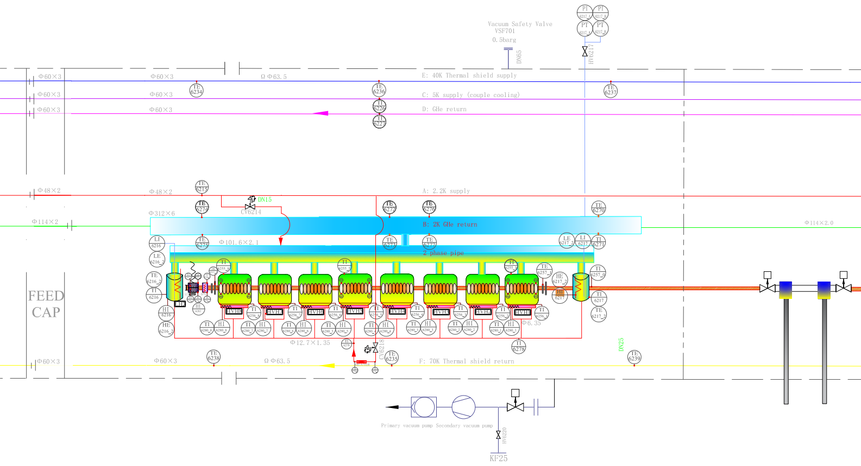
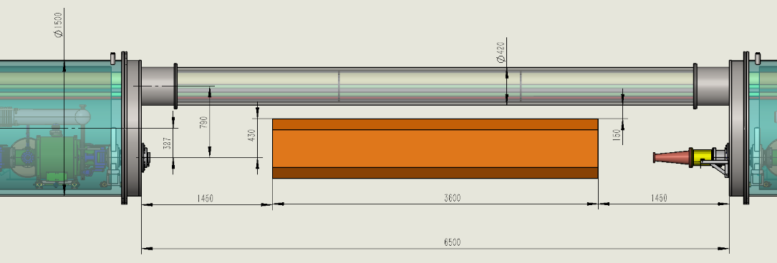
EDR- Cryogenic system process flow diagram in the SRF system
End phase separator
Collider CM: 6×650MHZ 2-cell cavities each
Refrigerator
2K coldbox
14 cryomodules, 6×650MHZ 2-cell cavities each
Collider Ring
3 cryomodules, 8×1.3GHZ 9-cell cavities each
Booster Ring
RF CM series connection
LCLS-II
150mm
Booster CM: 8×1.3GHZ 9-cell cavities each

Slide 15
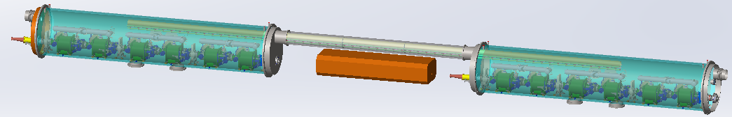
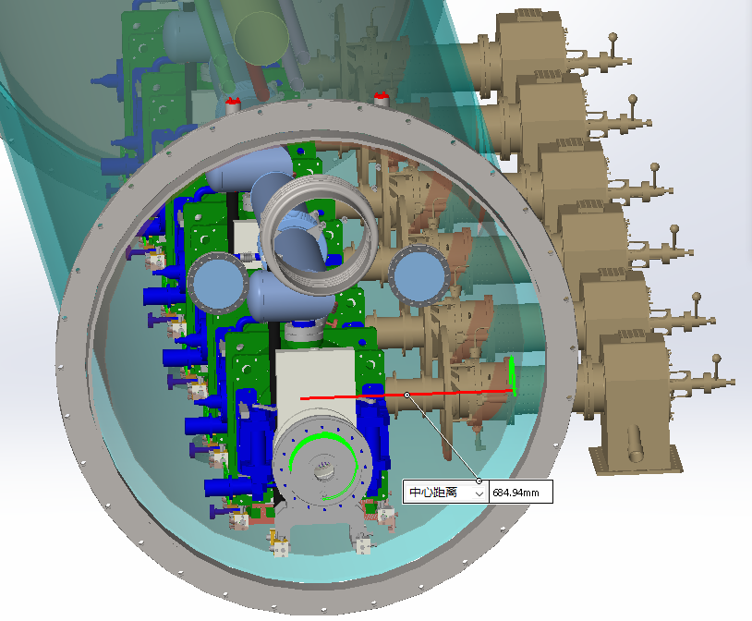
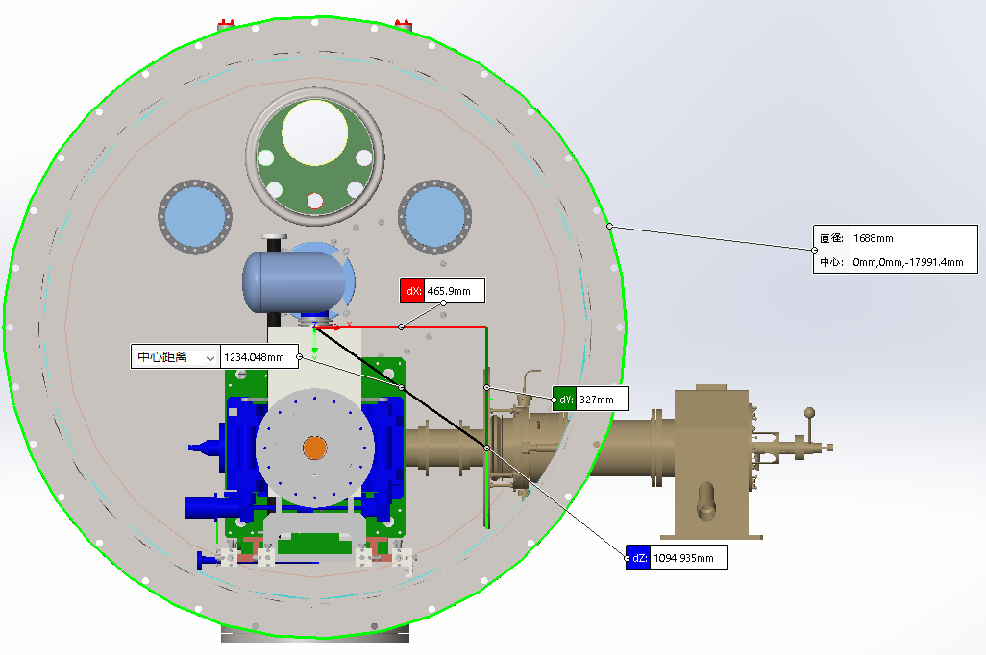
RF cryomodule series connection diagram
Series collider CM
Room temperature magnet
Series collider CM
1500mm diameter

Slide 16
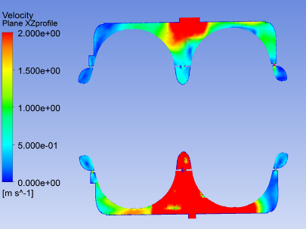
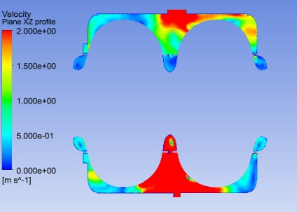
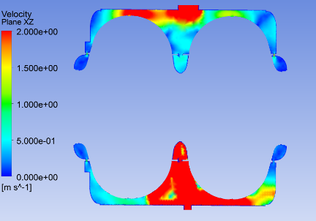
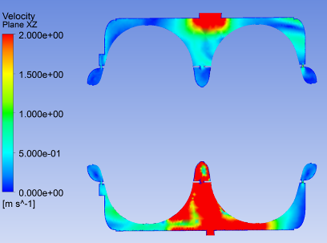
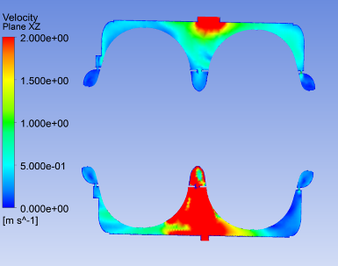
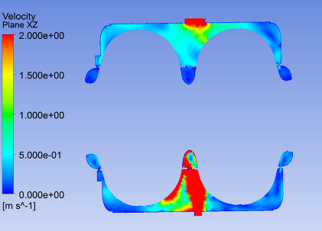
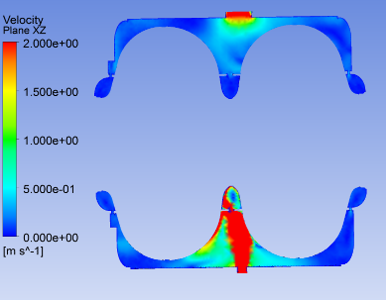
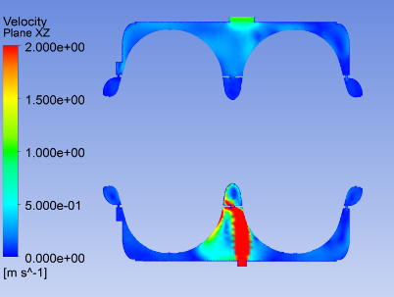
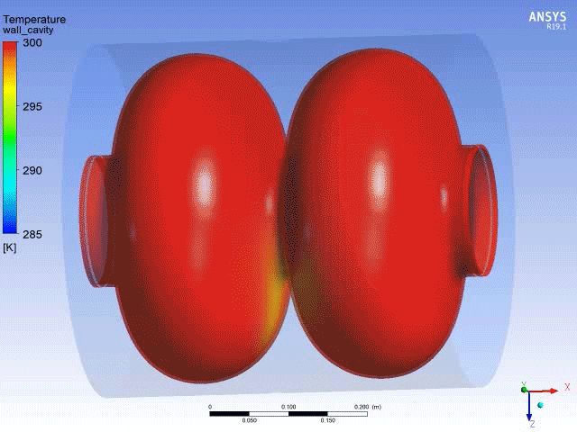
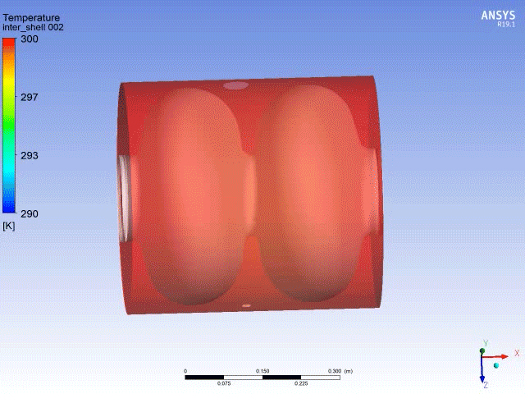
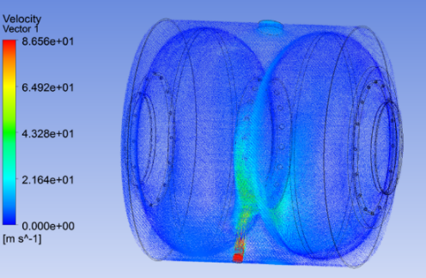

Unsteady-state cooldown simulation
for 650MHz short PCM
The cooling rate of the superconducting cavity needs to be strictly controlled;
three-dimensional flow field non-stationary numerical simulation was performed.
A certain simulation basis was laid for the automatic cooling.
a) 260K b) 220K c) 180K
d) 140K e) 100K f) 60K
g) 40K h) 20K
Non-stationary analysis of superconducting cavity cooling process
Global velocity distribution
Research Foundation
https://doi.org/10.1016/j.applthermaleng.2022.118178 (Q1,IF 6.4)
https://doi.org/10.1016/j.applthermaleng.2023.120767 (Q1,IF 6.4)
https://doi.org/10.1016/j.tsep.2023.102007 (Q1, IF 4.8)
https://doi.org/10.1016/j.tsep.2021.101100 (Q1, IF 4.8)
https://doi.org/10.1016/j.cryogenics.2024.103824 (Q3, IF 2.1)
https://doi.org/10.1016/j.applthermaleng.2023.119973 (Q1, IF 6.4)
2022.01-2025.12 No.12175250. Dynamic simulation modeling and advanced process control strategies for large helium cryogenic system of superconducting accelerator.
2020.01-2023.12 No.11905230. Study on Flow and Heat Transfer Mechanism and Automatic Control Technology in Superconducting Cavity Cooling Process

Slide 17
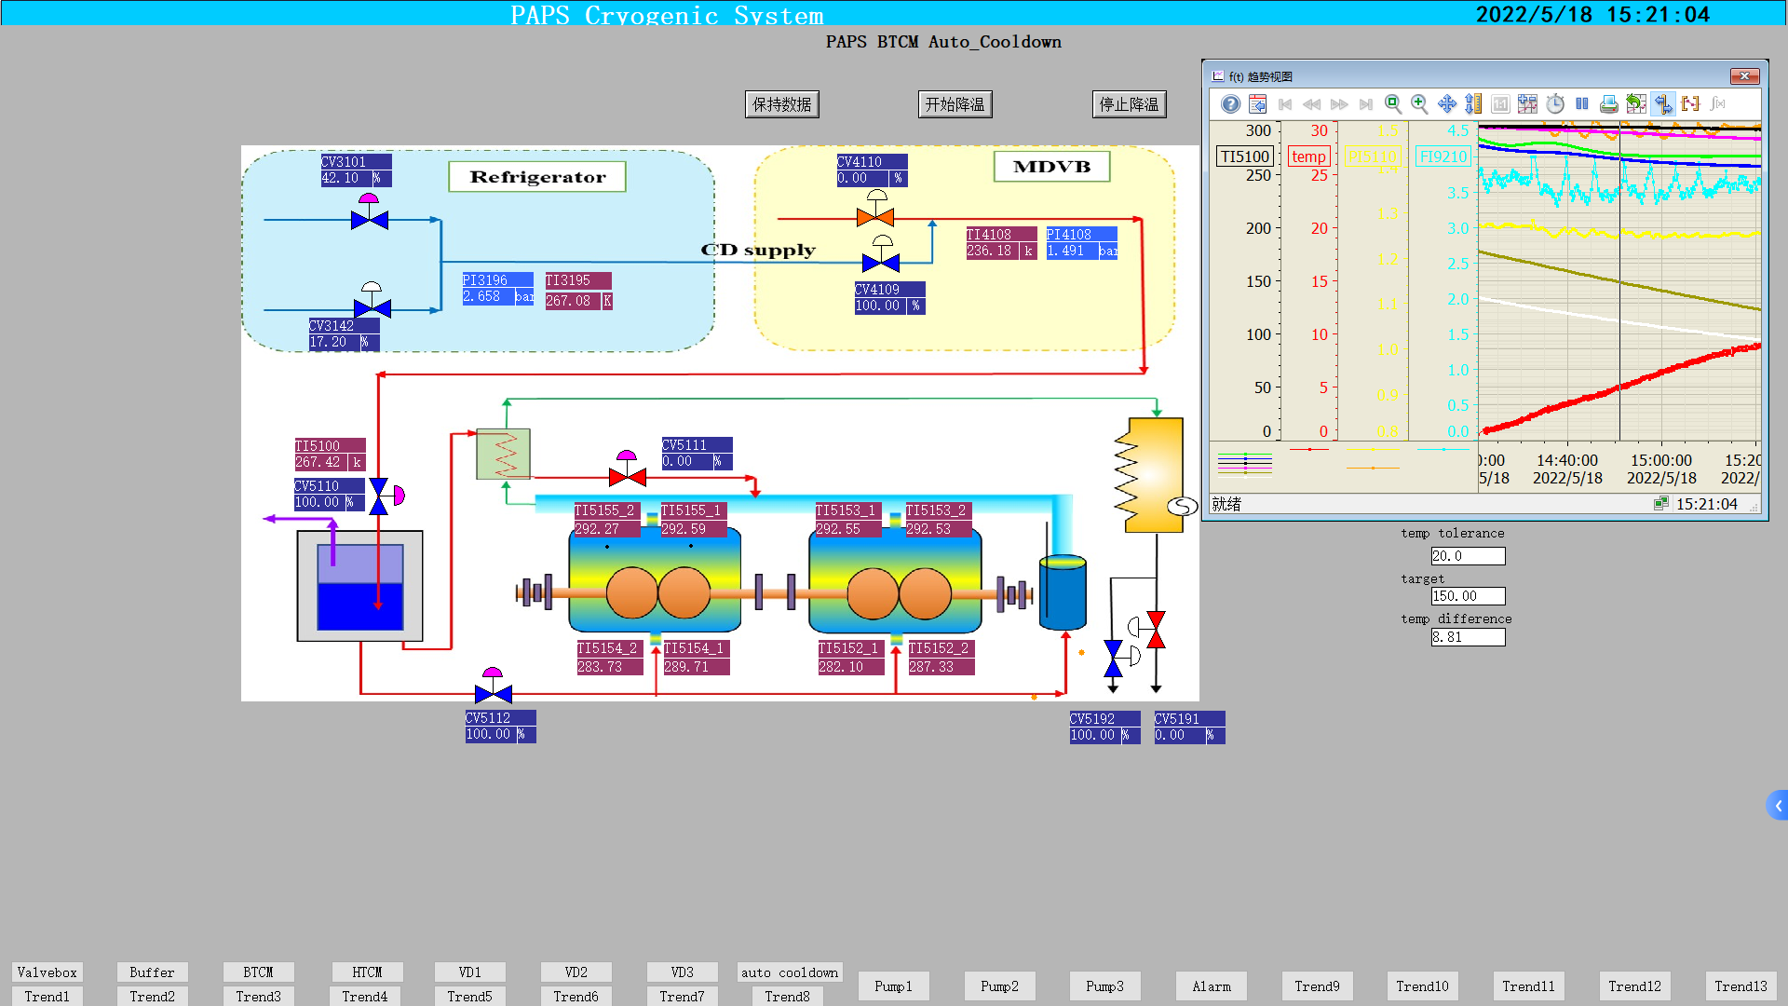
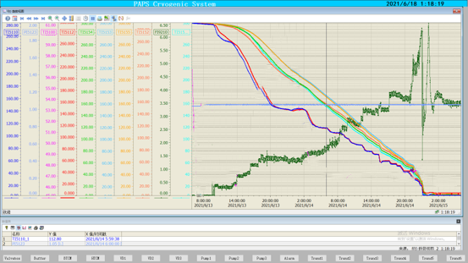
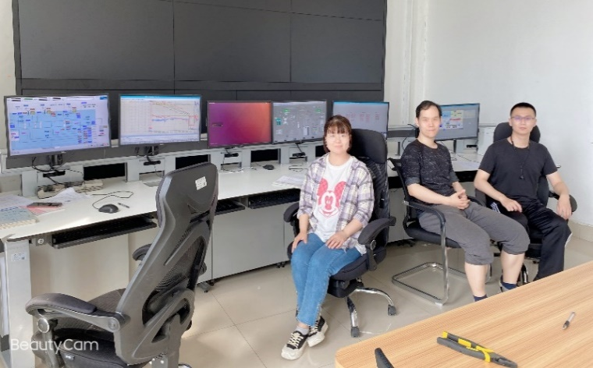
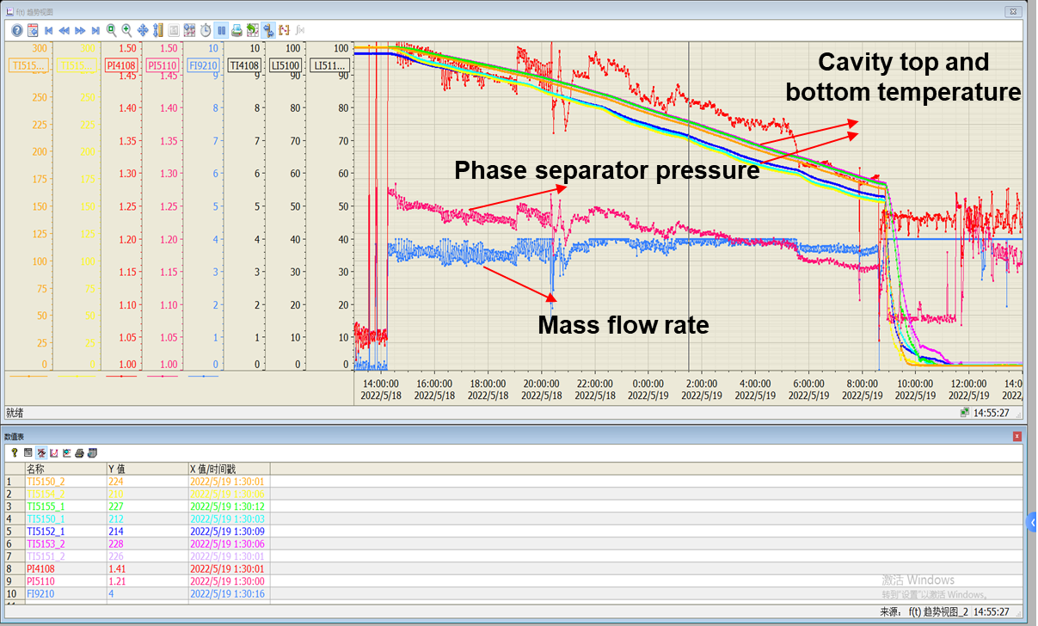
Advanced control strategy research status for
650MHz short PCM
Designed and implemented automatic cool-down/warming-up procedure for SRF cavity cryomodule with Model Predict Control (MPC) method & Artificial Neural Network (ANN)
Module automatic cooldown research progress: the MPC control method has successfully tested in PAPS 650MHz 2-cell cavities BTCM cryomodule (first time in China)
It is verified that the MPC method has better control stability. The foundation for a more intelligent automated control of future CEPC large cryogenic systems has been laid.
Former method:
Manual adjustment
Not stable
~34h
Improved method:
MPC; ANN
Stable
Fast cooldown
Efficiency increase 29%
~24h
29%
300 to 150 K: < 10 K/hr. Cavity top and bottom ΔT < 20 K
150 to 4.5 K: rate > 2.4 K/min, fast cooldown
4.5 to 2 K
加速器中心低温组

Slide 18
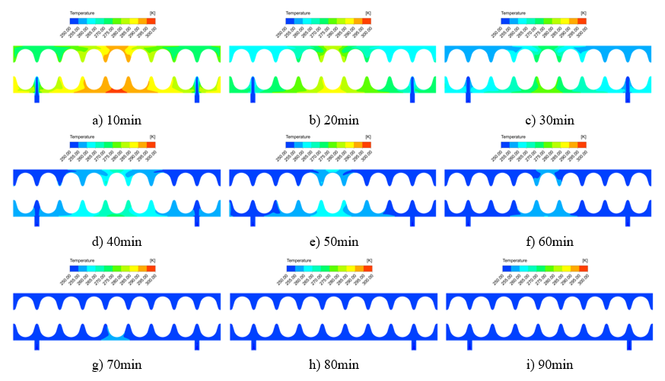
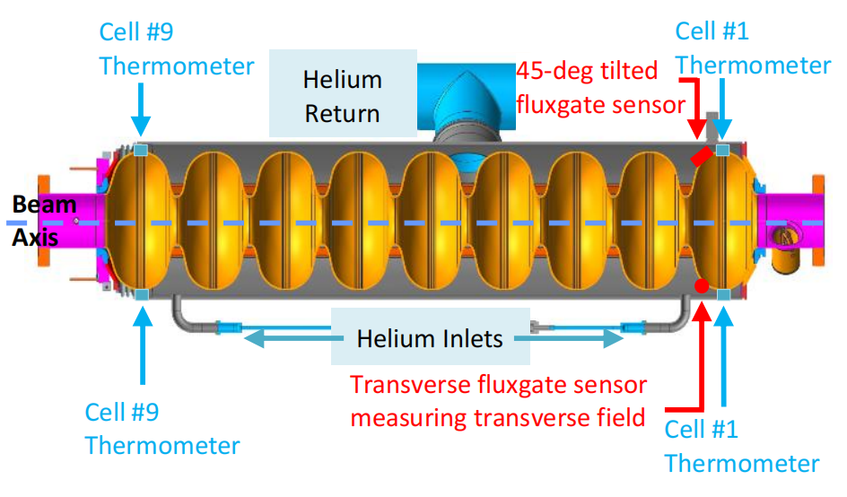
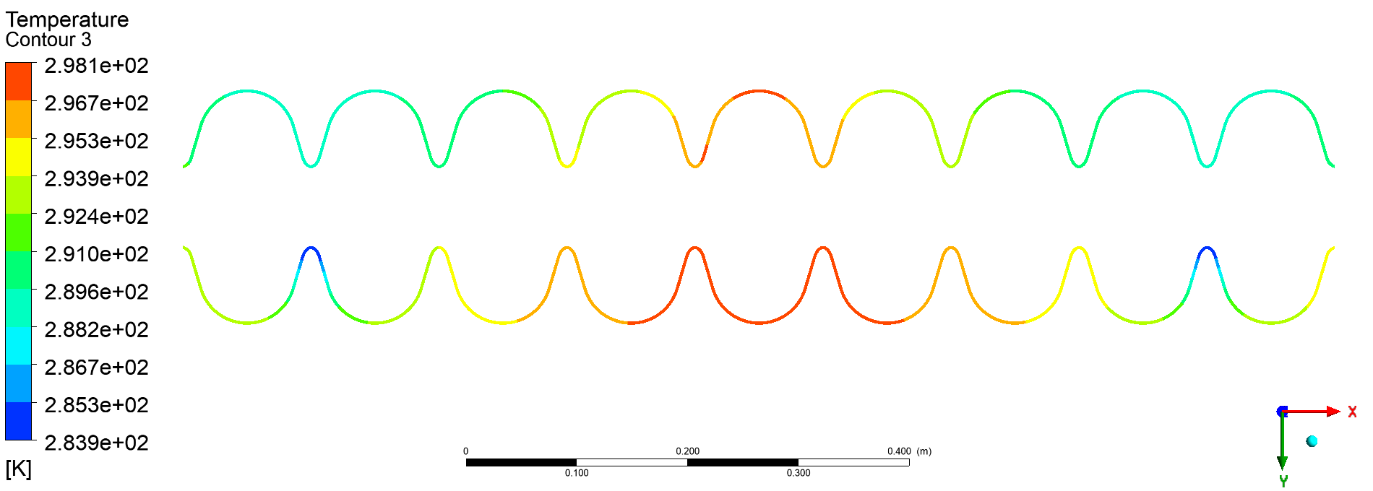
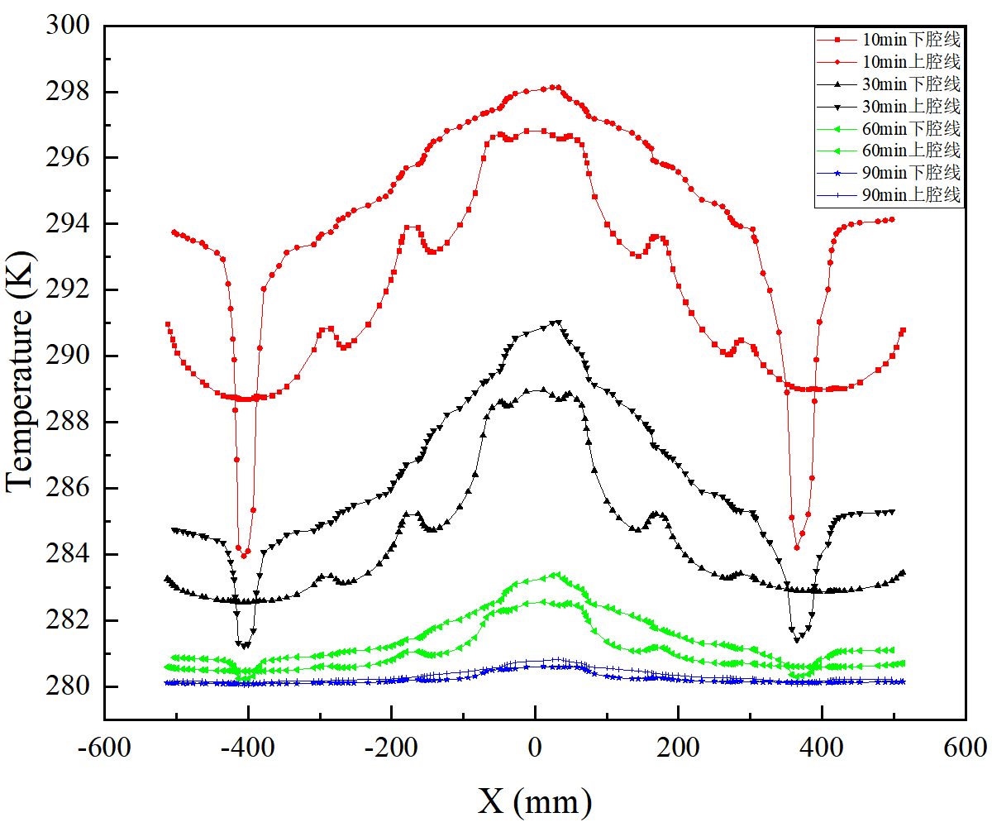
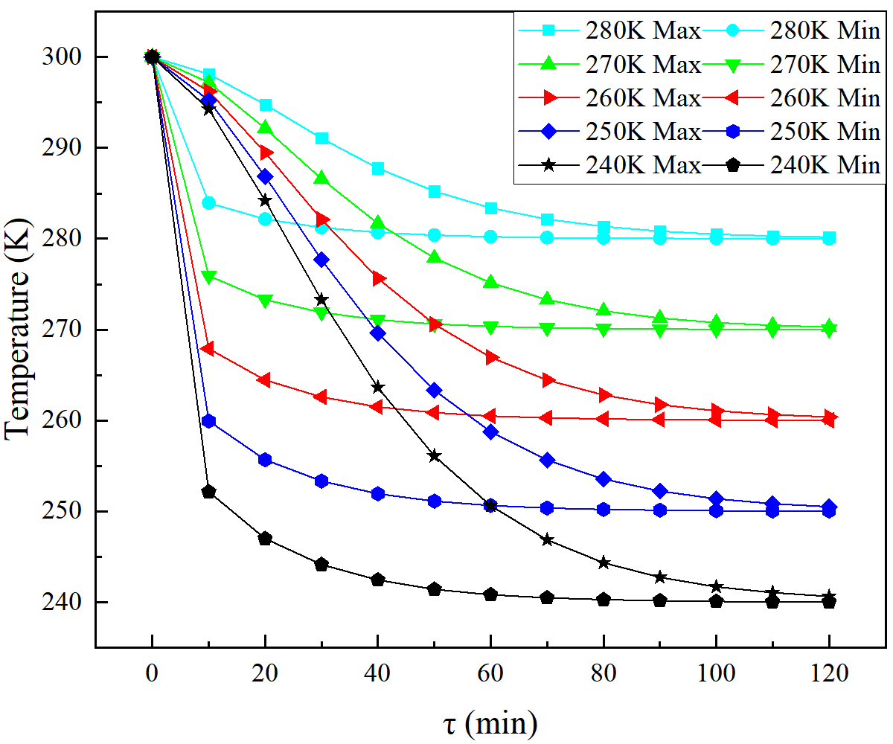
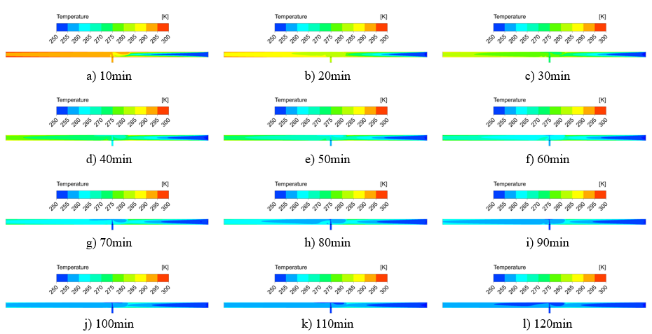
Unsteady-state cooldown simulation for
1.3GHz RF cavity in Booster
Fig. 1 Temperature field distribution in the longitudinal section of the cavity and helium gas return pipe versus cooling time
Fig. 2 Distribution of temperature by position in the upper and lower intersecting lines of the superconducting cavity versus cooling time
Fig.3 Variation of maximum/minimum temperature of superconducting cavity with cooling time

Slide 19
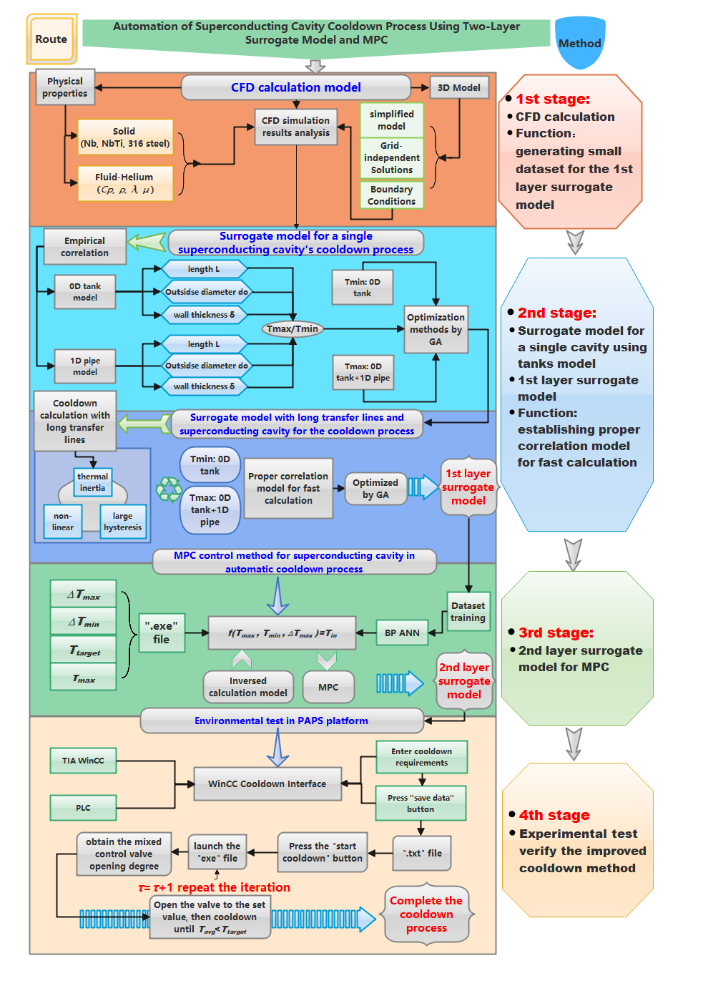
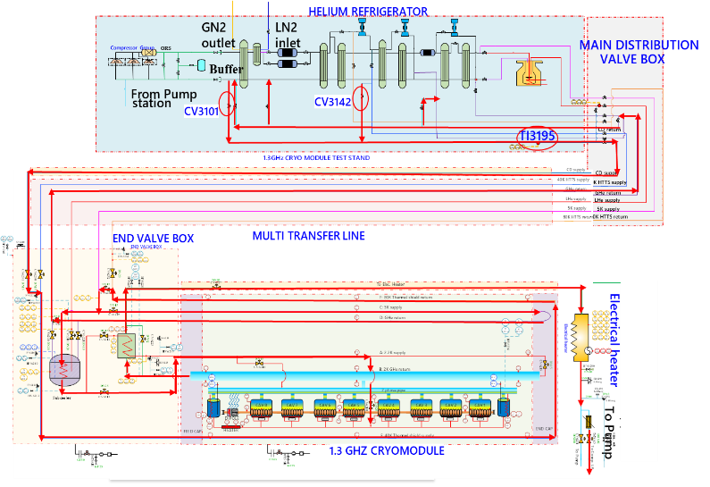
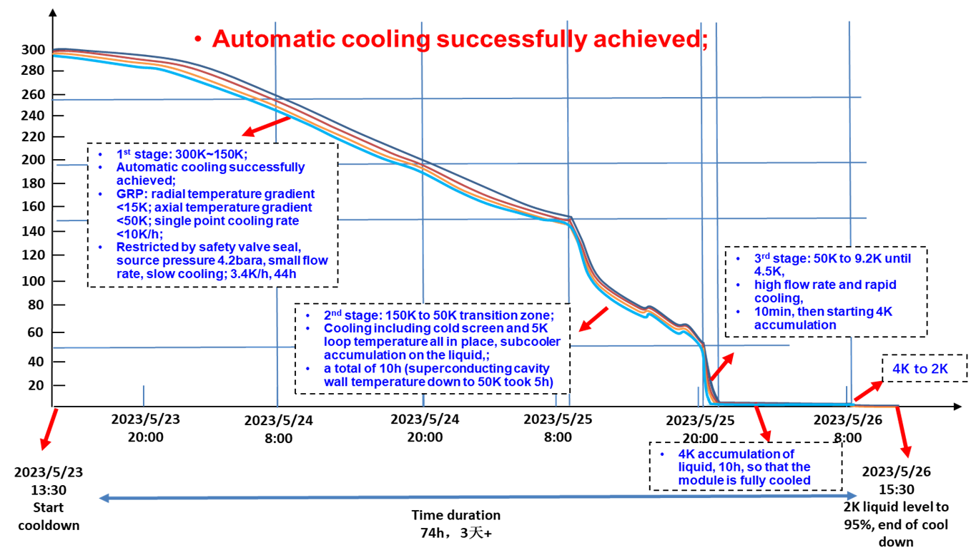
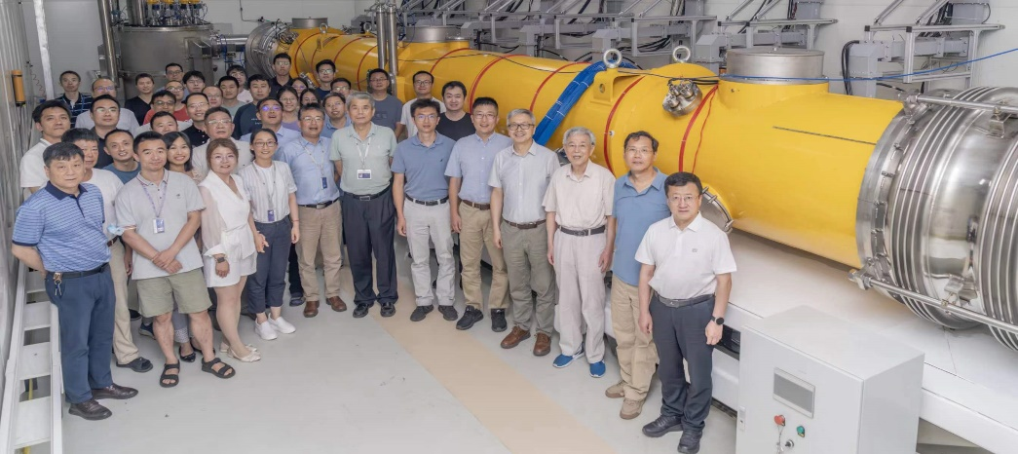

Automatic cooldown applied in 1.3GHz RF cavity for Booster
Module automatic cooldown research progress has successfully tested in PAPS 1.3GHz SRF cryomodule, and the cooldown process is more efficient than the traditional manual adjustment scheme.

Slide 20
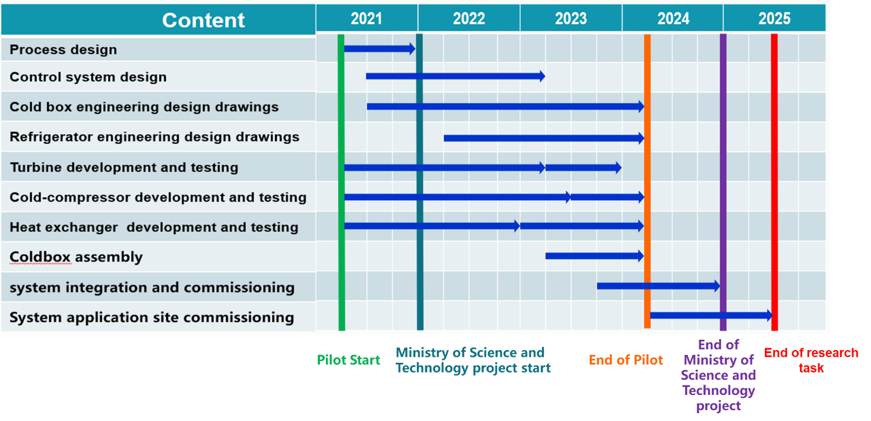
Large refrigerator Plan by FULLCRYO
Large refrigerator
The CAS pilot project for the 18 kW @4.5K or 15 kW @4.5K (required for CEPC) manufacturing has completed in 2024, expected to finalize the commissioning test by the mid of 2025; jointly with FULLCRYO Corporation.
Notes:
Now, the coldbox assembly and integration works are underway, and it’s expected to finish the commissioning works in the next year.

Slide 21
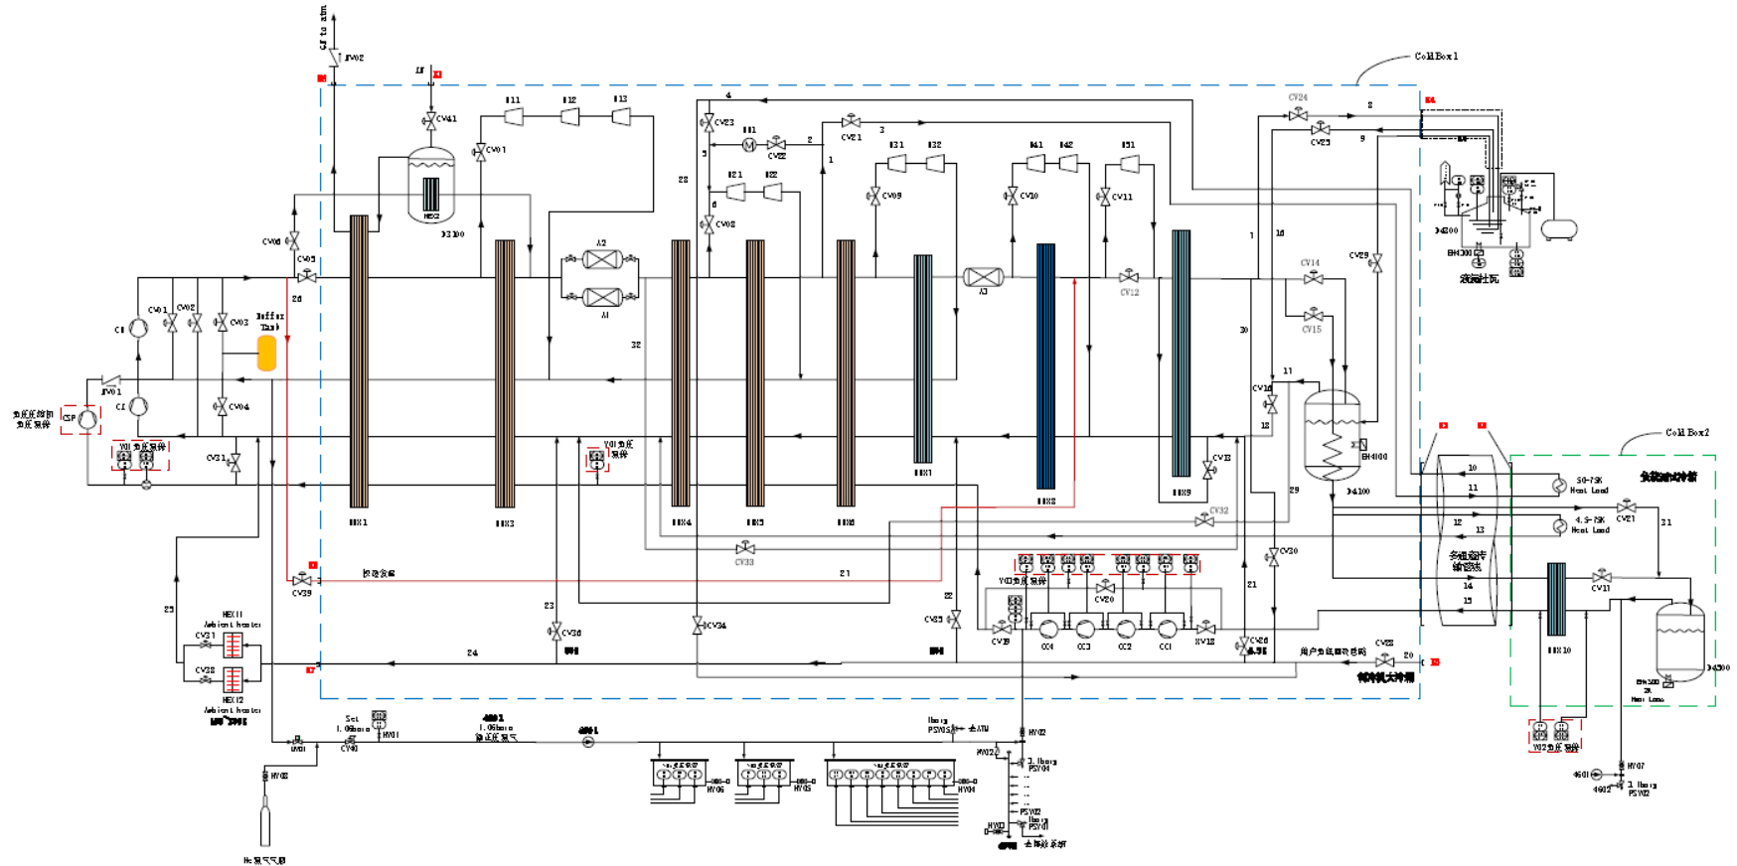
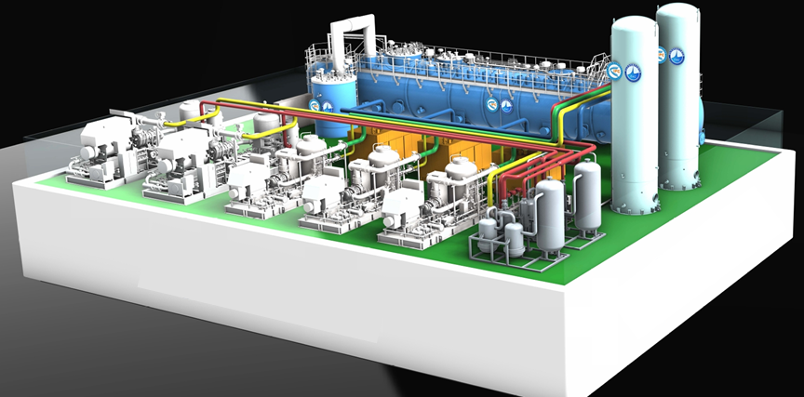
Large refrigerator Plan by FULLCRYO
18kW@4.5K large refrigerator PID diagram
Mechanical layout
18kW@4.5K large refrigerator estimated heat load
8 Compressors（2×3×3): 4 pressure levels
10 static gas bearing expansion turbines
With/without LN2 Precooling
Push-Pull 80K adsorbers
Temperature (K) | P（bar） | Heat load（W）
2.0K | 0.03 | ≥4400
50~75K | 10~20 | ≥13500
4.5~75K | 3~1.15 | ≥4300

Slide 22

Large refrigerator Parameters
18kW@4.5K large refrigerator
Parameters of the refrigerator
TIPC, CAS & Zhongshan Institute of Advanced Cryogenic Technology
Other parameters | Precooled by Turbin expanders | Precooled by liquid nitrogen
The consumption of the Liquid Nitrogen | 0g/s (0L/h) | 428.7g/s(2043L/h)
Gas flow for precooling | 100g/s | 0g/s
Gas flow（g/s） | 1668g/s | 1551g/s
Power Consumption（KW） | 3935.13 | 3721.3
Parameters of the compressors
Parameters | The high pressure compressor | The medium pressure compressor | The low pressure compressor
Gas flow (g/s)* | 1668.00 | 862.80 | 230.7
Pressure of the inlet (bara) | 4.05 | 1.05 | 0.40
Pressure of the outlet (bara) | 18.54 | 4.05 | 1.05
Adiabatic efficiency （%） | 85 | 85 | 85
Power consumption (kW) | 2568 | 1155 | 196.3
22

Slide 23




Large refrigerator Mechanical Design
a) 4K coldbox
b) 2K coldbox

Slide 24



Large refrigerator R&D progress & Plan
From Li Zhengyu (FULLCRYO)
Cold Box
Compressor station
Oil Removal system
Process design
Construction
Commissioning
Parts improvement
June 2024
Finished
Oct 2024
Liquefaction mode >3000L/h
June 2025
4K&2K refrigeration mode
Aim achieved

Slide 25


EDR-650MHz cavity Cryomodule for Collider
Including six 2-cell 650 MHz superconducting cavities, six high power couplers, six mechanical tuners and two HOM absorbers
Cryomodule performance |  | Specification
Number of leakage | He →insulation | 0
 | He →beam pipe | 0
 | Insulation →coupler | 0
 | Insulation →beam pipe | 0
 | Coupler →beam pipe | 0
Alignment x/y inside (Cavities) |  | ±0.5mm
Alignment z inside |  | within 2 mm
Coupler antenna design z |  | within 2 mm
Notes:
Ok, the above-mentioned content is the 1.3GHz 9-cell cavity cryomodule, another type cryomodule is 650MHz 2-cell cavities cryomodule. This diagram shows the cross section view, Including six 2-cell cavities, high power couplers, mechanical tuners and Higher-Order-Mode (HOM) Absorbers. The total length is about 9.5 meters. These two table shows the parameters.

Slide 26


CEPC full-scale 650MHz Prototype Cryomodule (PCM)
Innovation point: cryomodule combined with multi-channel cryogenic line; save spaces and share vacuum
It combines the features of cryomodule、valve box and cryogenic pipeline;
Shared vacuum, make full use of space , low cost
5K~8K-- for cold coupler, Ø45, the number of two;
40K~70K-- for cold screen, Ø45; The number of two;
2K --GRP tube, DN200; The number is one;
3Bara@5K--- supercritical supply, Ø45; The number is one;

Slide 27


CEPC 650MHz Prototype Cryomodule (PCM) 2K HT
Test stand of PAPS platform
Schedule to complete the construction of the cryogenic test platform at the begining of 2026 in BTCM or North Horizontal test stand at PAPS project;

Slide 28
CEPC 650MHz Prototype Cryomodule (PCM)
2K HT Process calculation
The 3bar@5K supercritical helium passes through the MDVB and TL to the 2K valve box, where it is subcooled by the 1.3bar saturated liquid helium from the Dewar, and then through the JT heat exchanger and the JT valve to produce the 31 mbar@2K in the helium vessel. The GHe is heated by the electric heater and goes to the roots pumps group, and then returns to the low-pressure side of the compressors.
If the heat load of the helium vessel is calculated according to 200W, the latent heat of vaporization of saturated liquid helium at 3130Pa is 23046J/kg, and the flow rate of liquid helium corresponding to 200W is calculated to be 8.678g/s, while that of 150W corresponds to 6.509g/s and that of 100W corresponds to 4.339g/s;
①
②
③
④
⑤
⑥
⑦
⑧
⑨
⒆
⑩
⒅
⑾
⑿
⒀
⒄
⒃
⒂
⒁

Slide 29

CEPC full-scale 650MHz PCM 2K HT—PID diagram
2K production scheme adopts electrical heater + room temperature pumps group
2K valve box for 650MHz cryomodule HT
Full-size 650MHz cryomodule

Slide 30






Industrialzation preparation progress and status
Cooperation Industrialzation members
Completing the development of Large helium refrigerator: jointly with FULLCRYO Corporation, the development of 15kW/18kW@4.5K helium refrigerator will be finished in the end of 2025.
Manufacturing development with factories to conduct the valve boxes, 2K JT heat exchangers, cryomodule, multiple cryogenic transfer lines, etc. design works
Hefei Juneng Electro Physics High-tech Development Co., Ltd
Wuxi Innovation Technology Co., Ltd
Vacree Technologies Co., Ltd
TOKO/WEKA/Cryote cryogenic valves
CryoPride Cryogenic Technology
Wuxi Innovation Technology Co., Ltd
TOKO cryogenic valves

Slide 31
Conclusion
Previous CDR and TDR works have laid a good foundation for the further design.
The main work in the EDR phase of the cryogenic system mainly includes:
Completion of the full size 650MHz cryomodule test
System process design and optimization;
Overall layout improvement;
Carrying out research on some key equipment and technologies (2K HX, digital twin cryogenic system);
……
Further optimization works are going on, and fully prepared for the completion of CEPC EDR!
Thanks for Your Attention！

