Slide 1



CEPC Magnet Power Supply System
in EDR
Bin Chen, Xiaoling Guo, Fengli Long
( On Behalf of Power Supply Group, IHEP )
Oct 23~27. 2024, Hangzhou, CEPC Workshop

Slide 2
Content
A Introduction
B Magnet Power supply R&D in EDR phase
C Summary

Slide 3
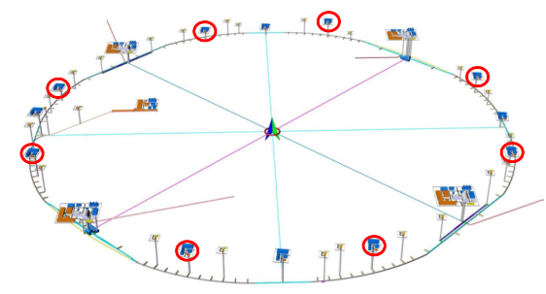
Introduction
  Last June in Hong Kong, we completed the TDR international review of CEPC magnet power supply system.
    Requirement of the power supplies for CEPC ：27023
    There are about 600 high-power power supplies with power exceeding 50kW, about 2,600 medium-power supplies with power between 1kW and 50kW, and about 23,800 low-power supplies with power below 1kW
Collider | Dipole |  | Quadrupole |  | Sextupole | Corrector | Trim | SC
 | D-aperture | S-aperture | D-aperture | S-aperture
 | 32 | 38 | 328 | 600 | 1096 | 7088 | 11904 | 88
Booster | Dipole |  | Quadrupole |  | Sextupole | Corrector | Trim
 | 28 |  | 336 |  | 100 | 1200 | 3200
Linac | Dipole |  | Quadrupole |  | Solenoids | Corrector
 | 19 |  | 250 |  | 37 | 277
Damping Ring | Dipole |  | Quadrupole |  | Sextupole | Corrector
 | 8 |  | 104 |  | 2 | 60
Transport Line | Dipole |  | Quadrupole |  | Sextupole | Corrector
 | 26 |  | 148 |  | 0 | 54
Total | 27023

Slide 4
Introduction
  Power consumption in H mode : 57.65MW
    Magnet power consumption is about 74% of the total loss.
    Cables are copper, cable current density is less than 2A/mm² and cable loss is about 16% of the total loss.
Location | Magnet (MW) | PS (MW) | Cable (MW) | Total (MW)
Collider | 31.22 | 4.22 | 6.72 | 42.16
Booster | 5.18 | 0.85 | 2.43 | 8.46
Transport Line | 4.31 | 0.49 | 0.08 | 4.89
Linac | 1.28 | 0.16 | 0.13 | 1.57
Damping Ring | 0.49 | 0.06 | 0.03 | 0.58
Total | 42.49 | 5.76 | 9.40 | 57.65

Slide 5
Introduction
  Key issues to be solved in EDR phase
    1. Reduce the cost of PS system
    2. Reduce power consumption of PS system
    3. Improve the reliability of PS system operation ( installation in auxiliary tunnel )
    4. Consider the power expansion of PS system in tt-bar mode
  Magnet Power supply R&D
    SST+DC-DC convertor ( 1./ 2./ 4. )
    Modularity and Redundancy (hot swap and hot spare) ( 3./ 4. )
    Digital Power Supply Control Module upgrade

Slide 6
Distributed Power Supply System Based on 10kV SST for CEPC

Slide 7
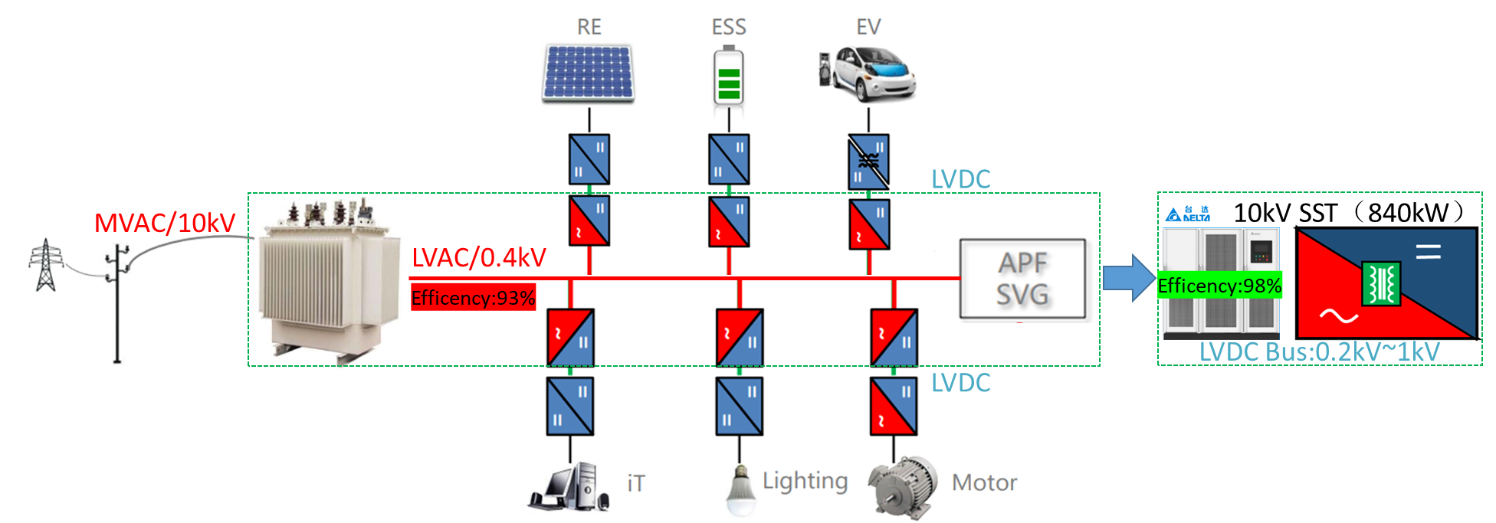
Distributed Power Supply Structure Based on 10kV SST
  To save the cost and power consumption of CEPC, a novel power supply structure is proposed, which is based on new 10kV Solid State Transformer (SST) technology.
  SST is an advanced power electronic device that uses modern semiconductor technology to replace traditional electromagnetic transformers. The main features of solid-state transformers include:
    The advantages: Higher efficiency, Smaller size, More functions, Fast dynamic response.
    The disadvantages: High cost, technical complexity, reliability issues.

Slide 8
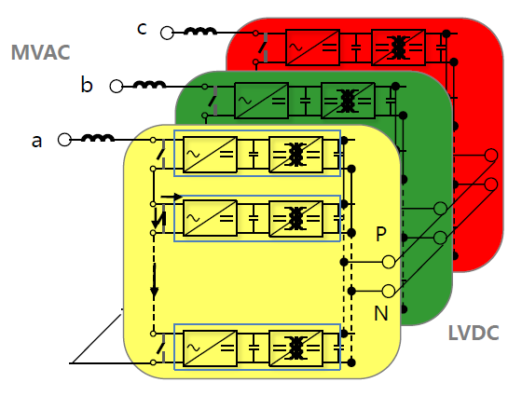
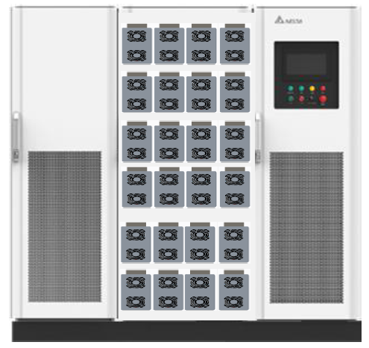
Distributed Power Supply Architecture Based on 10kV SST
  The Solid State Transformer
    The main power part is composed of a number of AC-DC power units in series, the structure adopts modular scalable redundancy design.
    the power module adopts SiC MOSFET rectifier technology, the control of a single module adopts distributed design, relying on external system manager for communication management, ensuring the independence between modules.
    The module shell adopts the shield solid insulation design, which has the characteristics of cold plug and quick maintenance.
SiC MOSFET rectifier technology is adopted
Single module power: 40KW
System output voltage range is adjustable:200Vdc~ 1000 Vdc
Schematic diagram of SST

Slide 9
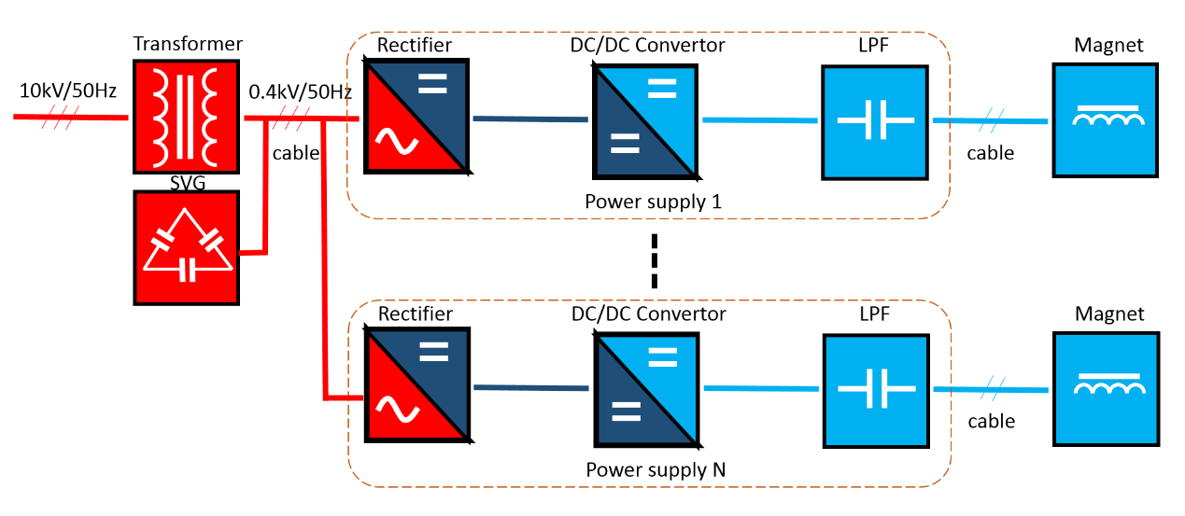
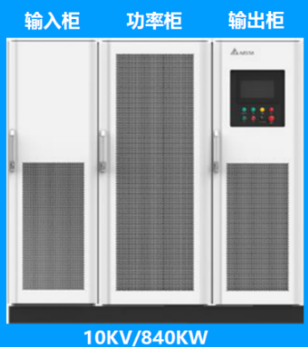
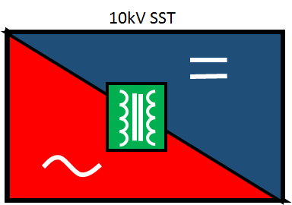
Traditional magnet power supply system
  The new distributed power supply with DC bus voltage can be applied to simper power supply structure
H-power P.S.
(1300A/500V)
3%
5%
4%
28%
60%
Power Consumption(100%)
Efficiency of magnet

Slide 10
New magnet power supply system based on 10kV SST
  Increase efficiency by 6%, Saving electricity: 160,000RMB / years
H-power P.S.
(1300A/500V)
2%
4%
28%
66%
Power Consumption(100%)
Efficiency of magnet

Slide 11
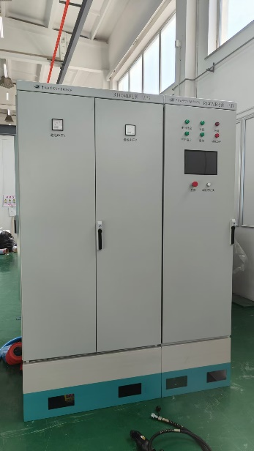
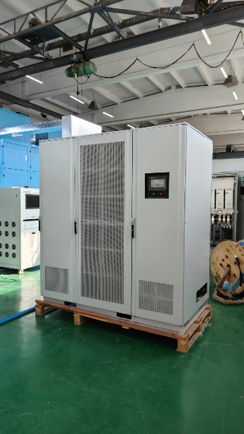
New magnet power supply system based on 10kV SST
  Magnet power supply - topology
10kV SST
(1200A/200V)

Slide 12
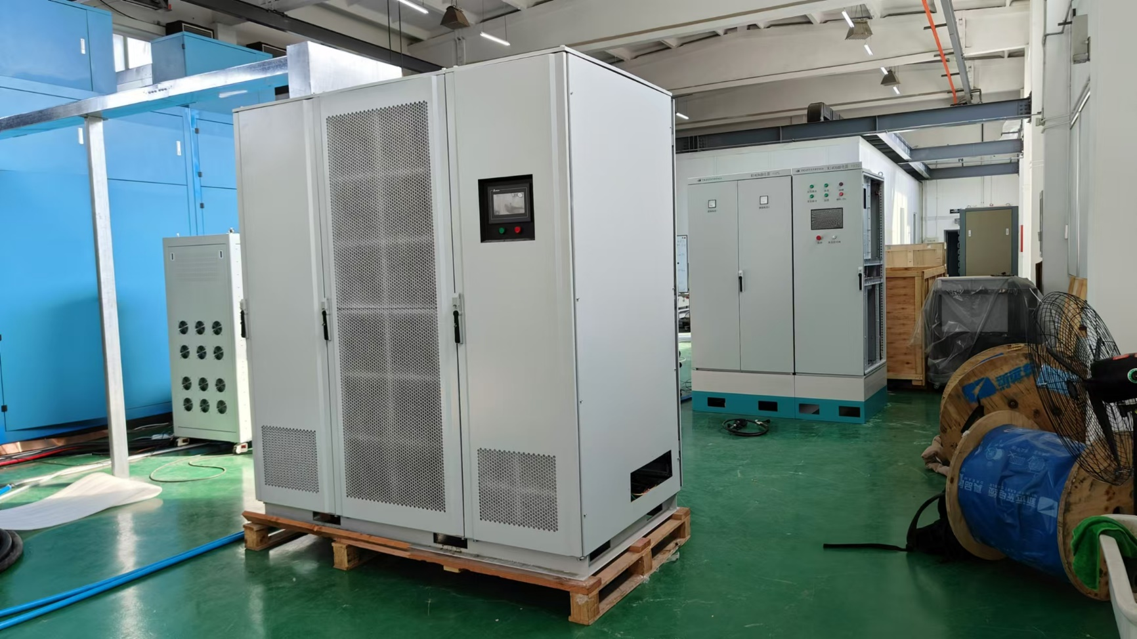
New magnet power supply system based on 10kV SST
  Magnet power supply - Test

Slide 13
Modularity and Redundancy in Optimizing the Reliability of Power supply System

Slide 14
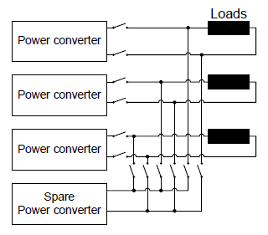
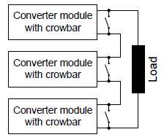
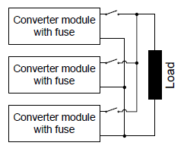
Magnet Power supply R&D
  Modularity and Redundancy
    The accelerator of CEPC will require a very large number of power converters. So the reliability of the whole power supply system will be a major issue. The use of a modularity and redundancy may help increasing the overall machine availability.
    Since the power supplies are mainly installed in the auxiliary tunnels, the PS system cannot tolerate any downtime, a redundant power-supply configuration should be considered.
    The operating energy of the accelerator will be increased from 120GeV to 180GeV, and the power supply needs to expand the output capacity. Using redundancy and modularity is a solution.
    Redundancy can be achieved within several configurations: serial, parallel or with hot spares.
Serial redundant configuration
Parallel redundant configuration
Hot spare configuration

Slide 15
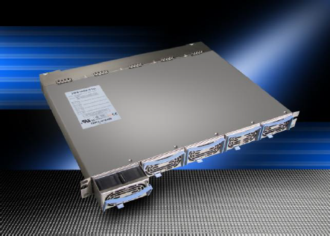
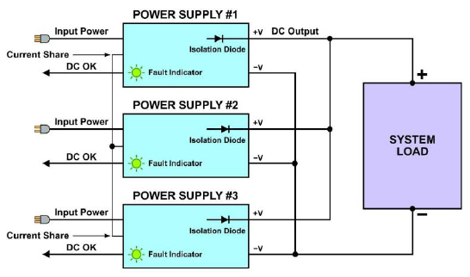
Magnet Power supply R&D
  Modularity and Redundancy
    Parallel redundant configuration
    The redundant power supplies are connected in parallel with isolation diodes, which construct a fault-tolerant power system . This means that even if one of the paralleled supplies should fail, the system will continue to provide full power to its power bus - this is sometimes referred to as 100% power availability.
    Hot Swapping
    The failed supply is designed to be replaced, or “hot-swapped,” while the system input and output power remains on. Therefore, it can be replaced at the user’s convenience without impeding the operation of the system.
    Scalable Power
    With a redundant power system, the original configuration can consist of some number of power supplies with blanking plates covering the unused slots. As the system needs more power, one or more blanking plates then can be removed and additional hot-swap power supplies can be added to supply additional power.
In this typical redundant power system,
three power supplies interface in parallel
to the system load via internal ORing diodes.

Slide 16
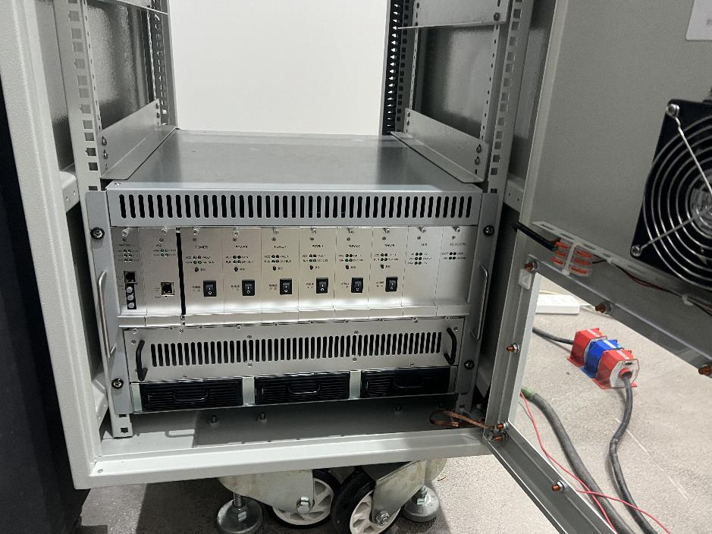
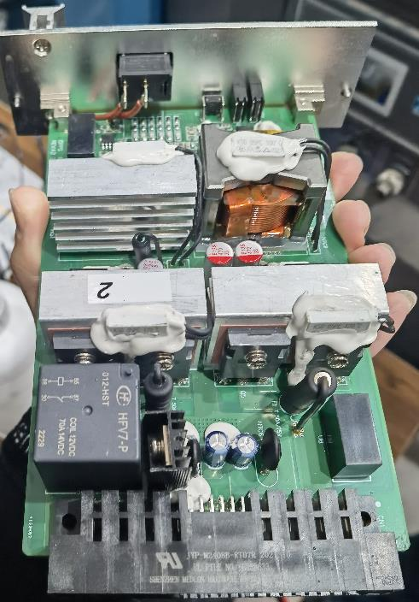
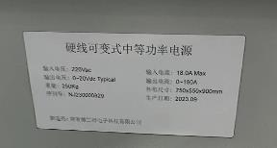
Magnet Power supply R&D
  Modularity and Redundancy
Hot swap power supply (180A/20V), SHINE, Shanghai
30A20V

Slide 17
Magnet Power supply R&D
  Modularity and Redundancy
    Hot spare
    The principle of the hot spare approach is to keep a working power converter ready for replacing failed unit. When any failure is detected, the power converter is directly replaced by the hot spare through a connection system. This method reduced the mean time to repair (MTTR) to a minimum since it allows running the converters immediately at once and postponing the diagnosis phase.
    The connection switches can be mechanical but their configuration grows in complexity when one spare covers more power converters. If one converter of a group fails, the hot spare can replace any converter of the group by bypassing the failed converter and connecting the spare to the corresponding load. This method is easily combined with a modular/redundant approach.
    Key issue is the reliability of the bypass system. If the reliability of the bypass system is poor, then redundancy adds in fact more failures than the simple configuration with a single power converter.
Hot spare configuration

Slide 18
Digital Power Supply Control Module upgrade

Slide 19


Magnet Power supply R&D
  Digital Power Supply Control Module ( DPSCM ) - Upgrade
    Intelligent management of power supply based on AI
How
Proactively inspect and monitor the operation status of power supplies.
Actively report the power supply status that may have problems and need to be monitored.
Predict and diagnose power supply’s failure.
Record and query the parameters and historical data of power supply
Why
* There are a large number of power supplies which located in tunnels in CEPC.
* The traditional power supply management is manual inspection, and a large number of spare parts are prepared in advance
* In CEPC, it is difficult to maintain power supply offline after the fault occurs.

Slide 20
Magnet Power supply R&D
  Digital Power Supply Control Module ( DPSCM ) - Upgrade
    Adaptive control of power supply
Automatically identify the power supply type
Automatic identify the parameter
Monitor operational status
Automatically report suspicious status

Slide 21
Magnet Power supply R&D
  Digital Power Supply Control Module ( DPSCM )
    DPSCM hardware framework
    One control more
    Isolate digital inputs and outputs
    Multiple isolated high speed PWM outputs
    Remote control interface
    Optional current loop temperature control ADC
    Multi-channel analog acquisition
    Optional external trigger synchronization input
    Other monitoring interfaces

Slide 22
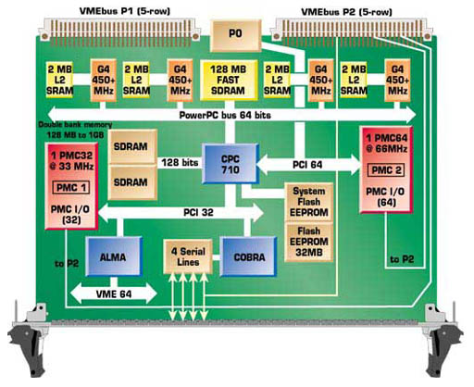
Magnet Power supply R&D
  Digital Power Supply Control Module ( DPSCM )
    Hardware: adopt SOC FPGA ( System on Chip )
    Core ARM + FPGA, embedded in EPICS system.
    In terms of cost, the cost of hard core SoC FPGA is close to that of soft core SOPC FPGA.
    In terms of performance, SoC FPGA are far superior to SOPC FPGA.
I/O
CPU
Flash
I/O
SDRAM
I/O
I/O
I/O
DSP
I/O
FPGA
FPGA
CPU
DSP
Solution: Replace External Devices
with Programmable Logic

Slide 23
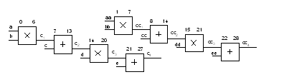
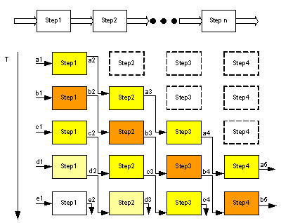
Magnet Power supply R&D
  Digital Power Supply Control Module ( DPSCM )
    Software: including closed loop control, AD control, logic protection…
    Functions of the software are divided into multiple modules implemented by FPGA
    Using Pipeline design, each control program runs in parallel and is independent of each other.
Modular time-sharing multiplexing
Pipeline design

Slide 24
Summary
  According to the latest physical parameters, about 27,000 power supplies are needed to power the magnets.
  Key issues need to be solved in EDR phase are reduce the cost of PS system, reduce power consumption, improve the reliability of PS system operation and the power expansion of PS system in tt-bar mode.
  SST + DC-DC convertor is a new type of power supply structure, which is more efficient. Its performance is be testing.
  Modularity and Redundancy, Hot swap and Hot spare will be under study for reliability and power expansion.
  The digital control module is the core component of the power supply, and it needs to be upgraded to be more powerful and intelligent. The development based on SOC FPGA is ongoing.

Slide 25
Thank You!

Slide 26
Distributed Power Supply Architecture Based on 10kV SST
APF (Active Power Filter) 和 SVG (Static Var Generator) 是两种用于改善电力系统电能质量的现代电力电子设备。它们的主要功能和区别如下：
APF（有源电力滤波器）
主要功能： APF主要用于实时抑制电网中的谐波电流，也就是滤除非线性负载产生的各种频率的谐波，从而净化电源电流，提高电能质量。
工作原理： APF通过电流互感器（CT）检测负载电流，控制器根据检测到的信号计算出谐波成分，并通过逆变器产生与负载谐波电流大小相等、方向相反的补偿电流注入电网中，实现对谐波的抵消。
额外功能： 除了滤波之外，APF也可以提供一定的无功功率补偿能力，但其重点在于精确滤波。
SVG（静止无功发生器）
主要功能： SVG主要用来动态补偿电网中的无功功率，它能够快速、连续地调节无功输出，保持系统的电压稳定，优化功率因数，减少输电损耗。
工作原理： SVG基于IGBT等电力半导体器件构建的桥式变流电路，通过PWM（脉宽调制）技术控制逆变器的输出，使其在需要时发出容性无功或吸收感性无功，以满足系统无功平衡需求。
附加特性： SVG还具有良好的谐波抑制能力，尤其是当配备专门的滤波设计时，可以同时进行无功补偿和一定程度的谐波治理。
总结来说，APF更侧重于解决电能质量中的谐波问题，而SVG则专注于动态无功补偿，两者虽然在技术上有所交叉，但在实际应用中各有专攻。在很多情况下，二者可能会结合使用来全面改善电能质量

Slide 27
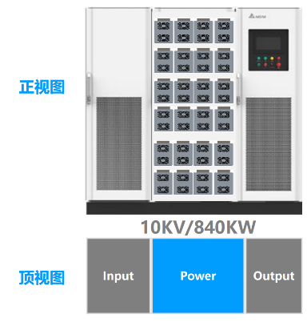
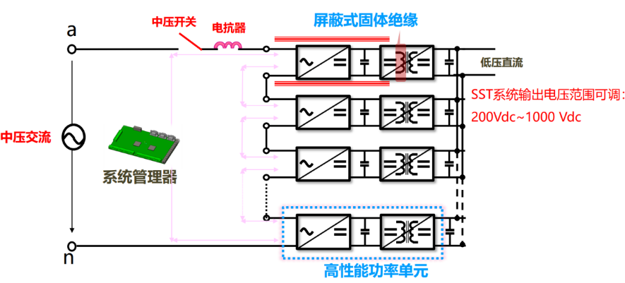
模块化设计
主功率部分由多个功率单元串联组成，结构形式上采用模块化可扩展冗余设计，功率模块采用SiC MOSFET整流技术，单模块的控制采用分布式设计，依靠外部的系统管理器进行通讯管理，保证了模块之间的独立性，无单点失效问题，有利于热备份冗余设计。模块外壳采用屏蔽式固体绝缘设计，具有冷插拔，快速维修的特点，可维护性大大提高。单个模块设计功率为40kW，单柜功率模块数量采用21+3（冗余）设计，不考虑冗余单柜功率高达960kW。

