Slide 1



CEPC MDI Cryomodule design status
Xiangzhen Zhang, Xiaochen Yang
On behalf of cryogenics system
2024.10.24
The 2024 CEPC Workshop, Hangzhou, Zhejiang

Slide 2
Content
Introduction
Cryogenic scheme of the cryostat
Structural design of the cryostat
Calculation and simulation
Current leads design
Summary and plan

Slide 3
  Introduction
In CEPC, there are two combined-function Superconducting magnets in each MDI.
Each combined-function magnet includes three high gradient quadrupoles (Q1a, Q1b, Q2) and one anti-solenoid.
The cryostat is used to provide the cryogenic environment for SC magnets , which is lower than 5.0 K.
ITEM | Q1a | Q1b | Q2 | Anti-solenoid
Central field gradient (T/m) | 142.3 | 85.4 | 96.7
Cooling type | LHe | LHe | LHe | LHe
Operating current (A) | 780 | 650 | 770 | 1300
Magnetic storage energy (KJ) | 11.5 | 11 | 33.2 | 630
Cross section parameter (mm) | Φ40~61 | Φ52~78 | Φ62~88 | 100 sections
Magnet length (m) | 1.21 | 1.21 | 1.53 | 5.1
Net weight (Kg) | 25 | 32 | 43 | 302
Total weight of magnets (Kg) |  |  |  | 402
From Yingshun Zhu

Slide 4
  Introduction
Works to be done in cryogenic engineering.
Scheme and structure of the cryostat.
Scheme of the cryogenic system.
Heat and mass transfer in the cryostat.
Scheme of the current leads.
From Yingshun Zhu

Slide 5
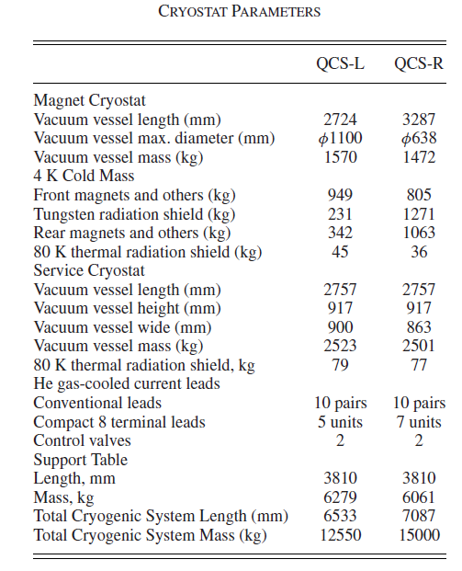
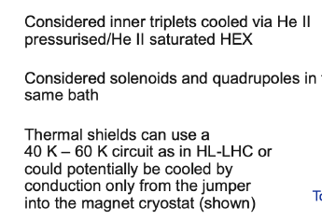
  Introduction
KEK and FCC
The length is approximately 3.3 m, and diameter is 1.1 m.
The weight of the magnet cryostat is 1570kg.
It is cooled by subcooled liquid helium at the pressure of 1.6 bara.
The length is approximately 3.36 m initially, and 6.24 m for second option.
It is cooled by superfluid helium He∥. (2.0 K)

Slide 6
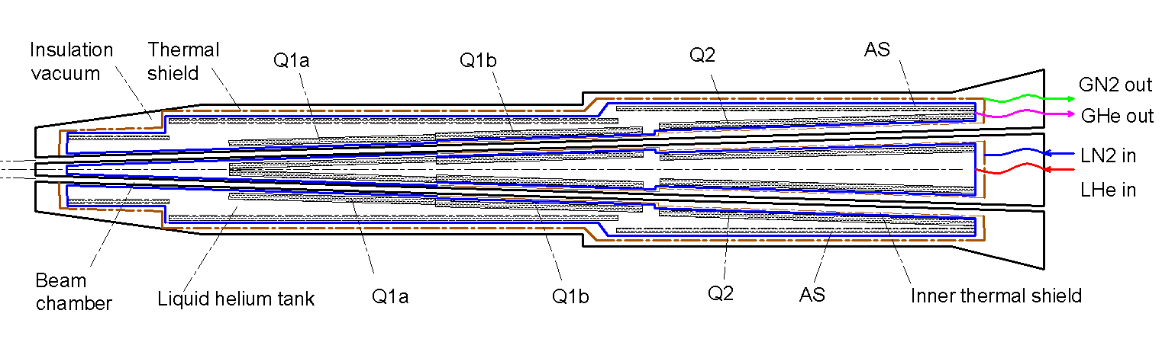
Cryogenic scheme of the cryostat
Cryostat scheme
Superconducting magnets are immersed in the helium tank for the low temperature.
One thermal shield is set for the heat interruption from the ambient temperature.
The shield is extended between the helium tank and the beam chamber.
The 4 K cold mass is cooled by supercritical or subcooled liquid helium, and the shield is by liquid nitrogen.

Slide 7
Cryogenic scheme of the cryostat
Cooling system
Conventional helium cooling scheme: Subcooled liquid helium or supercritical helium is directly provided by helium refrigerator. The flow rate is limited.
Helium circulation (Potential): A closed helium circulation can be established depending on a pump to increase the flow rate. The scheme will be introduced later.
Superfluid helium(HeⅡ, Potential): Perfect cooling uniformity; Stable pressure; Higher magnet current.

Slide 8
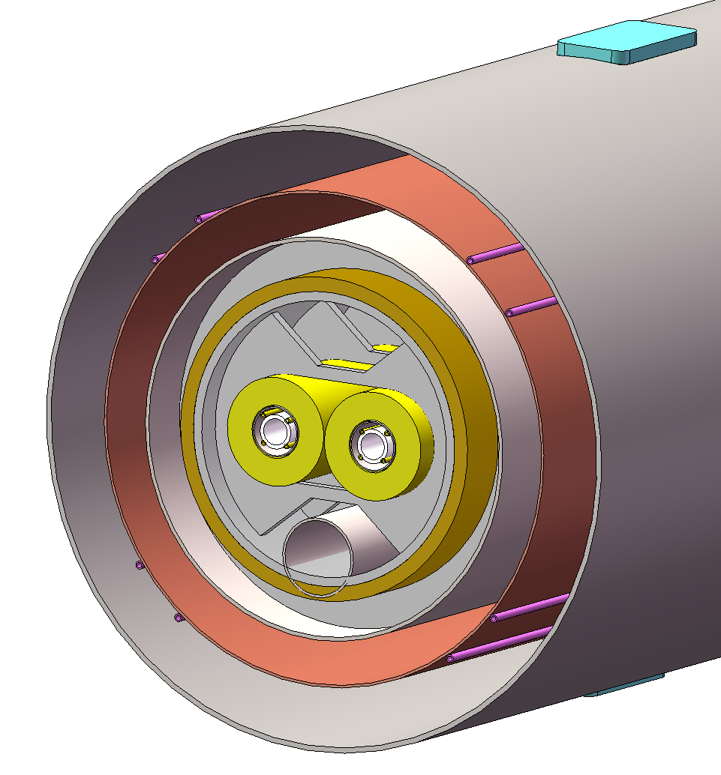
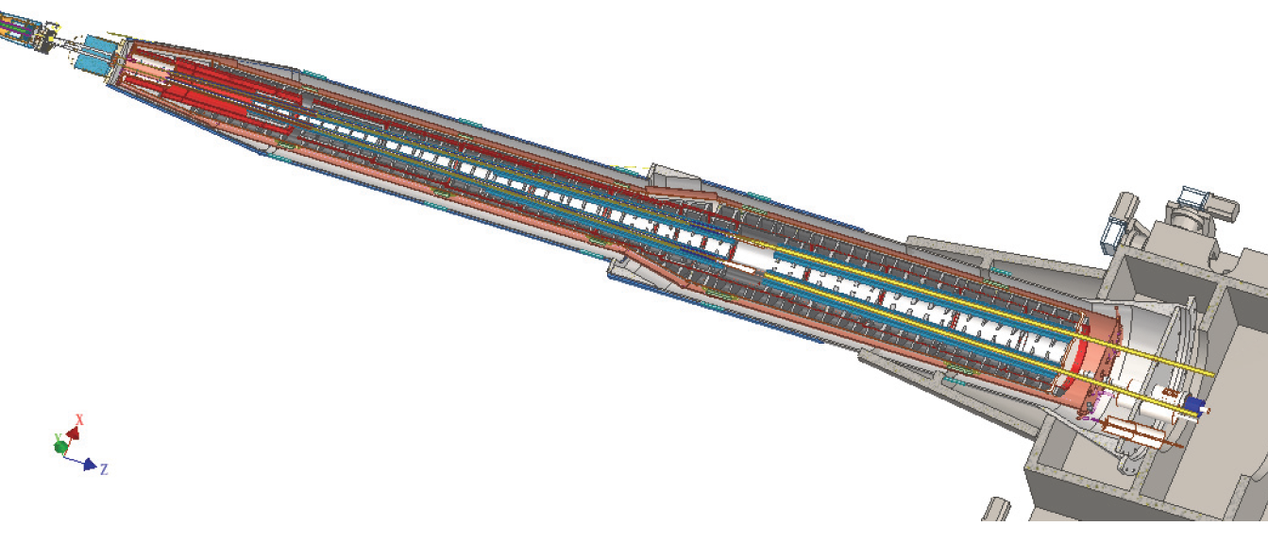
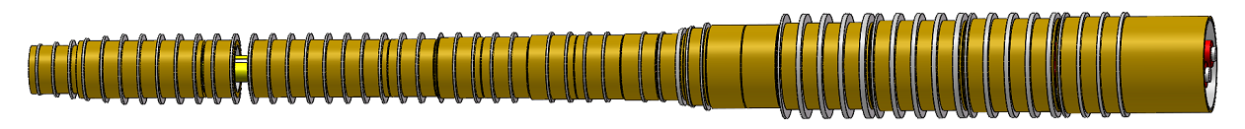
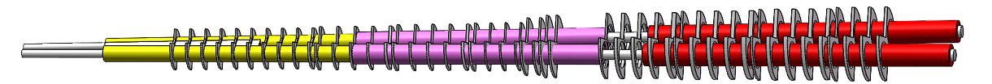
Structural design of the cryostat
Support of SC magnet
The superconducting magnets Q1a,Q1b and Q2 are supported on the inner wall of the solenoid.
The anti-solenoid is supported by a ring on the inner wall of the helium tank.
Vacuum
Thermal shield
1985mm
LHe tank
1915mm
Support
Anti-solenoid
2885mm
Anti-solenoid
Q1a
Beam chamber
Q1a
Q1b
Q2
Notes:
标注尺寸

Slide 9
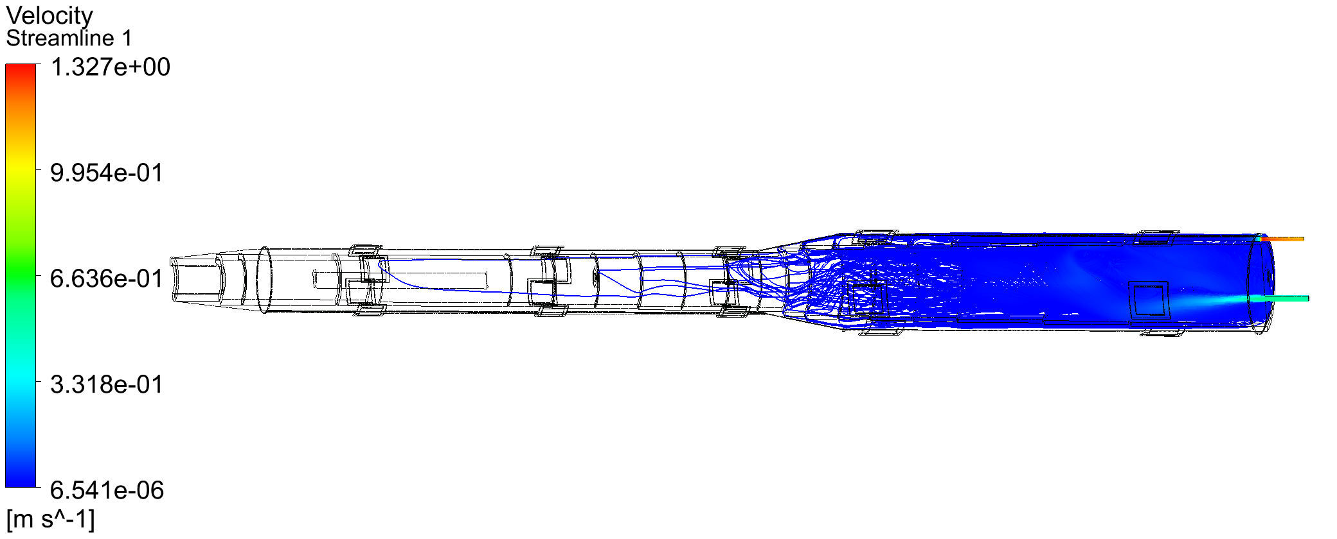
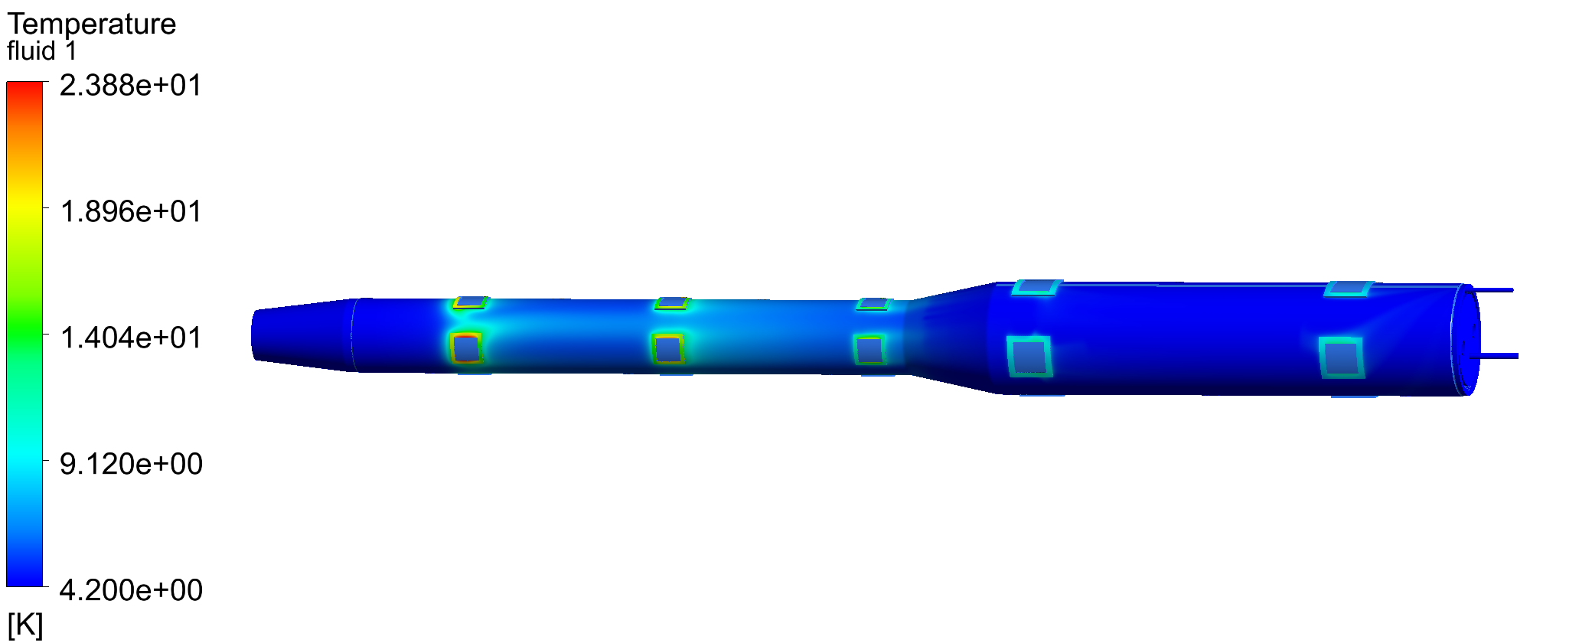
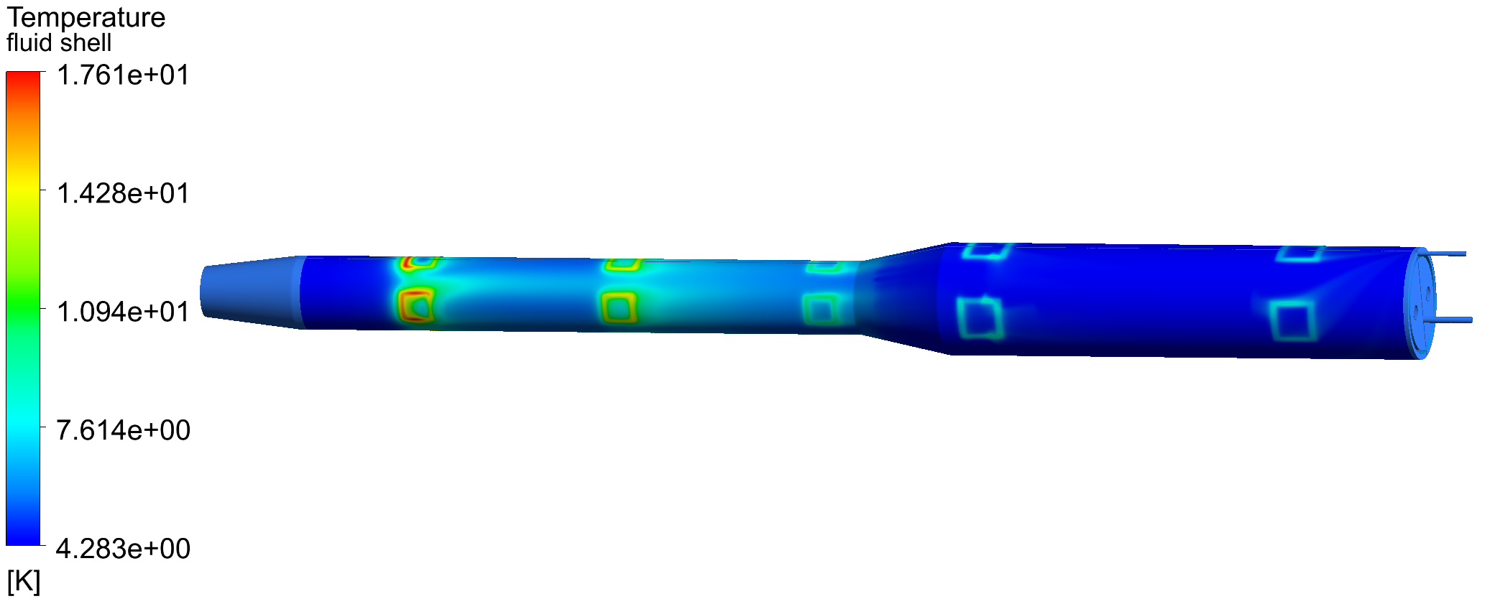
Calculation and simulation
Cooling of anti solenoid
Cooling flow: One-way in and out
Heat conduction of support is 13.68 W; Heat flux of thermal radiation is 0.1 W/m²;
Helium inlet flow is at 4.2 K.
outlet
inlet
Outer cylinder of helium tank
Not feasible！
Fluid domain

Slide 10
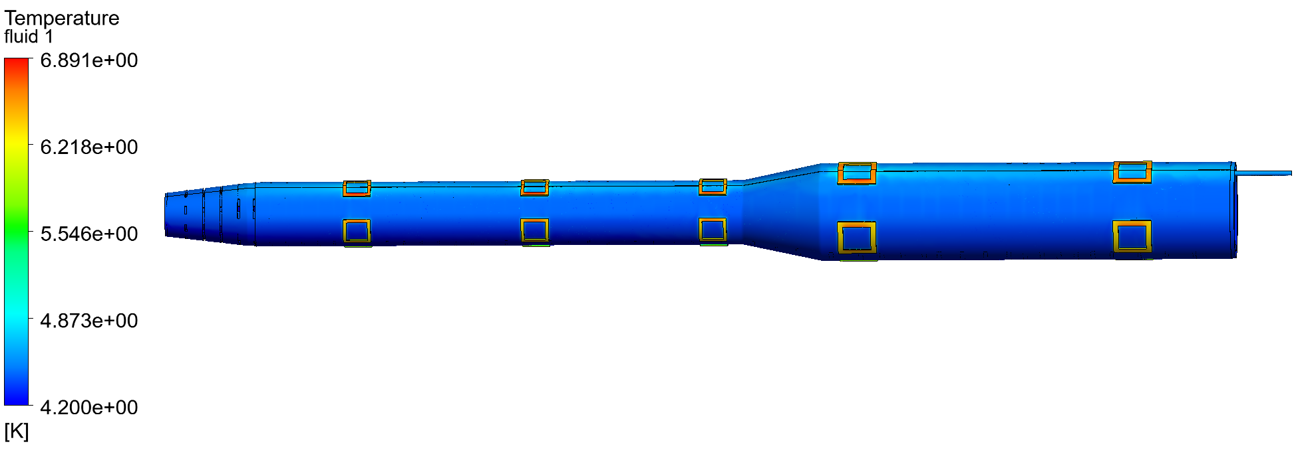
Calculation and simulation
Cooling of anti solenoid
Cooling flow: Outer single-layer flow channel
inlet
outlet
Temperature distribution of the outer cylinder of the helium tank: 4.2K 10g/s

Slide 11

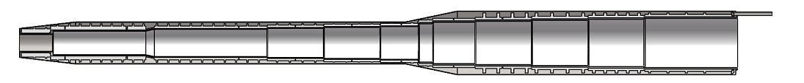
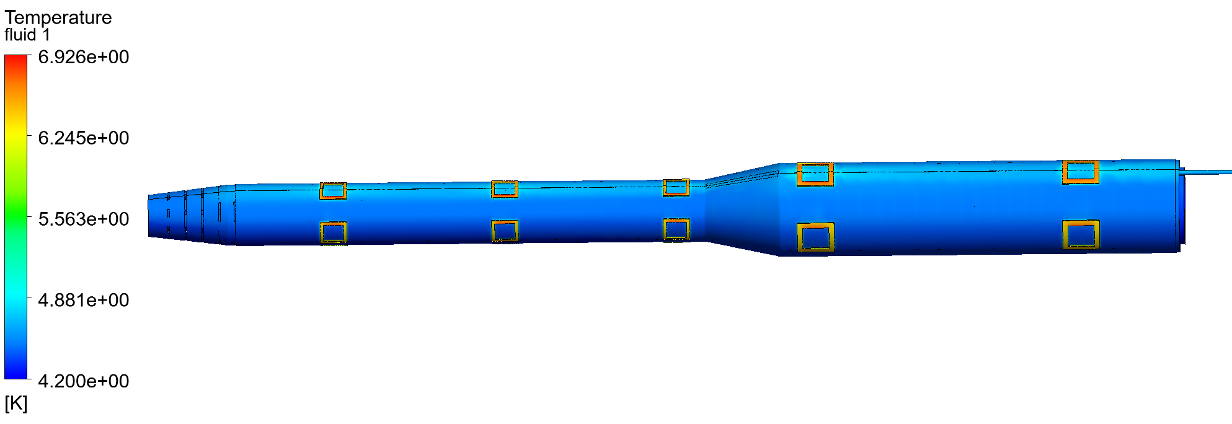
Calculation and simulation
Optimized helium channel
Inner and outer double flow channel design：
Minimum gap is 4mm
outlet
inlet
Comparison of single-layer and double-layers cooling channels ：
The double-layers flow channel is more effective compared to a single-layer flow channel, especially when the helium flow rate is low ；
Some other advantages with double heat exchange surface, including the heat management, quench recovery or magnet cooling time.

Slide 12
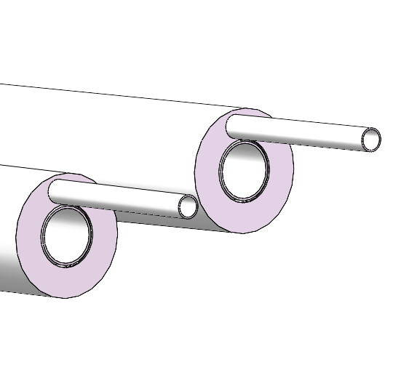
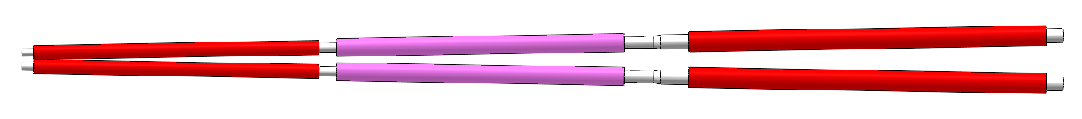
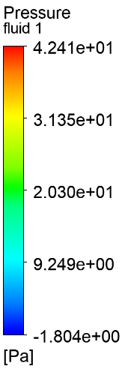
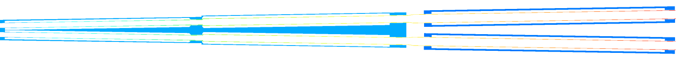
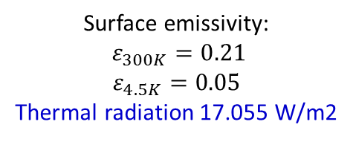
Calculation and simulation
Cooling of quadrupole coils
Q1-A
Q1-B
Q2
Surface emissivity:
$ε_{300K}=0.21$
$$ε_{4.5K}=0.05$$
Thermal radiation 17.055 W/m2
Thermal radiation 0.2 W/m2
Thermal radiation 0.2 W/m2
Helium flows into the inner channel and out from the outer channel.
Fluid pressure difference diagram (Inlet flow rate 10g/s)

Slide 13
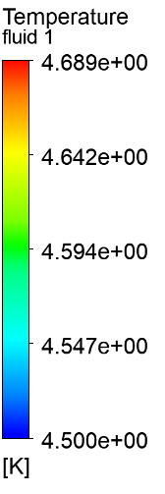

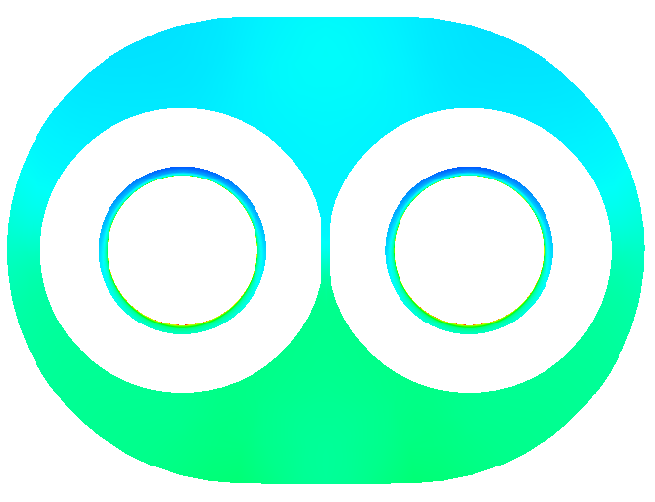



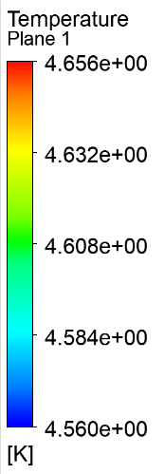

Calculation and simulation
Cooling of quadrupole coils
Inlet flow rate 10g/s
Helium fluid is heated in the inner channel.
The temperature of the fluid in the inner channel varies greatly near Q1-A.
X
x=2.500 m
x=0.060 m
x=1.250 m
x=1.400 m
Temperature distribution of helium fluid
x=3.500 m

Slide 14
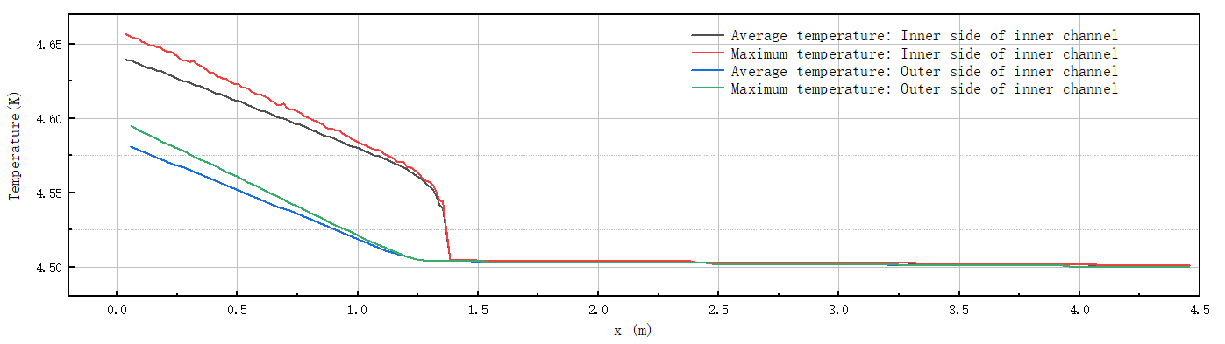
Calculation and simulation
Cooling of quadrupole coils
Temperature distribution inside the inner channel
Temperature distribution outside the inner channel
X
After passing through Q2 and Q1-B, the helium temperature increases by approximately 0.04K.
When subcooled helium flows through Q1-A, its temperature rises rapidly, with a gradually increasing temperature difference at the same X position.

Slide 15
Calculation and simulation
Cooling of quadrupole coils
The static thermal radiation of a quadrupole focusing magnet is constant.
The higher the flow rate is, the lower the temperature of the Q1-A magnet will be.
The flow rate of subcooled helium is determined based on the temperature of the magnet.

Slide 16
Calculation and simulation
Subcooled LHe Circulation
A tank is used to control the pressure.
The flow rate can be improved largely.
Temperature distribution can be more uniform.
The system is complicated.

Slide 17
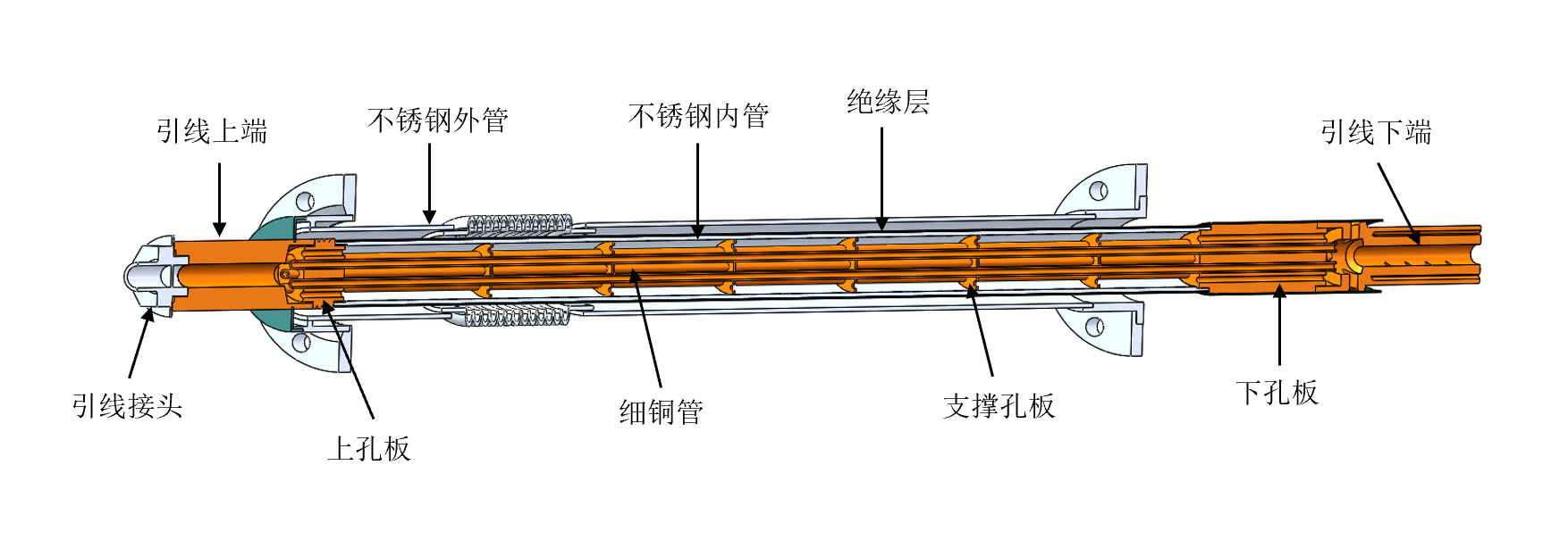
Current leads design
MDI superconducting anti-solenoid magnet need to develop 1.3 kA level current leads;
The traditional pure copper leads are not easy to meet the requirements, and binary current leads are used based on high-temperature superconductivity;
The superconducting wire welding resistance optimization, safe protection and low-temperature insulation and other issues are considered;
Current lead in BEPC2

Slide 18
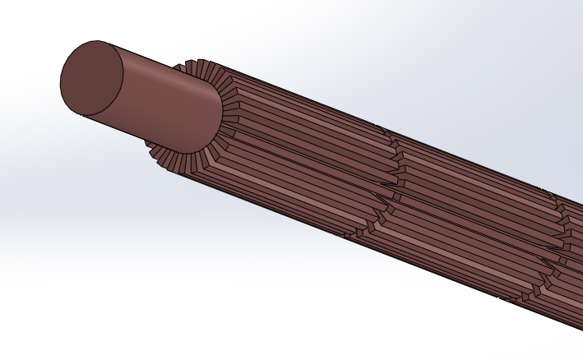
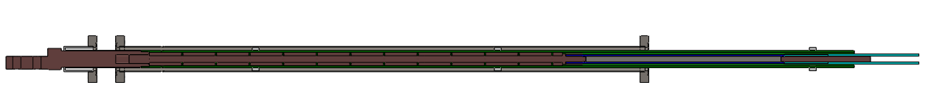
Current leads design
HTS current lead
1.3 KA HTS current lead cooled by helium gas
Oxygen free copper
HTS
LTS
 | 1300A current lead |  | 800A current lead
Sections | HTS | Copper part | HTS | Copper part
Cooling | 5K helium gas | 5K helium gas | 5K helium gas | 5K helium gas
Structure | Bi-2223 | RRR40 copper | Bi-2223 | RRR40 copper
Temperature | ＜60K | ＜60K-300K | ＜60K | ＜60K-300K
Current | 1500 A+ | / | 900 A+ | /
Heat load | ＜0.15 | / | ＜0.1 | /
Flow rate | / | ＜0.1g/s | / | ＜0.05g/s
New heat exchange method
Current leads cooled by liquid nitrogen or helium are designed based on Bi-2223 high-temperature superconductor and high-purity copper;
With the help of numerical simulation, for the cooling of the copper section is designed; An enhanced heat transfer scheme is proposed；

Slide 19
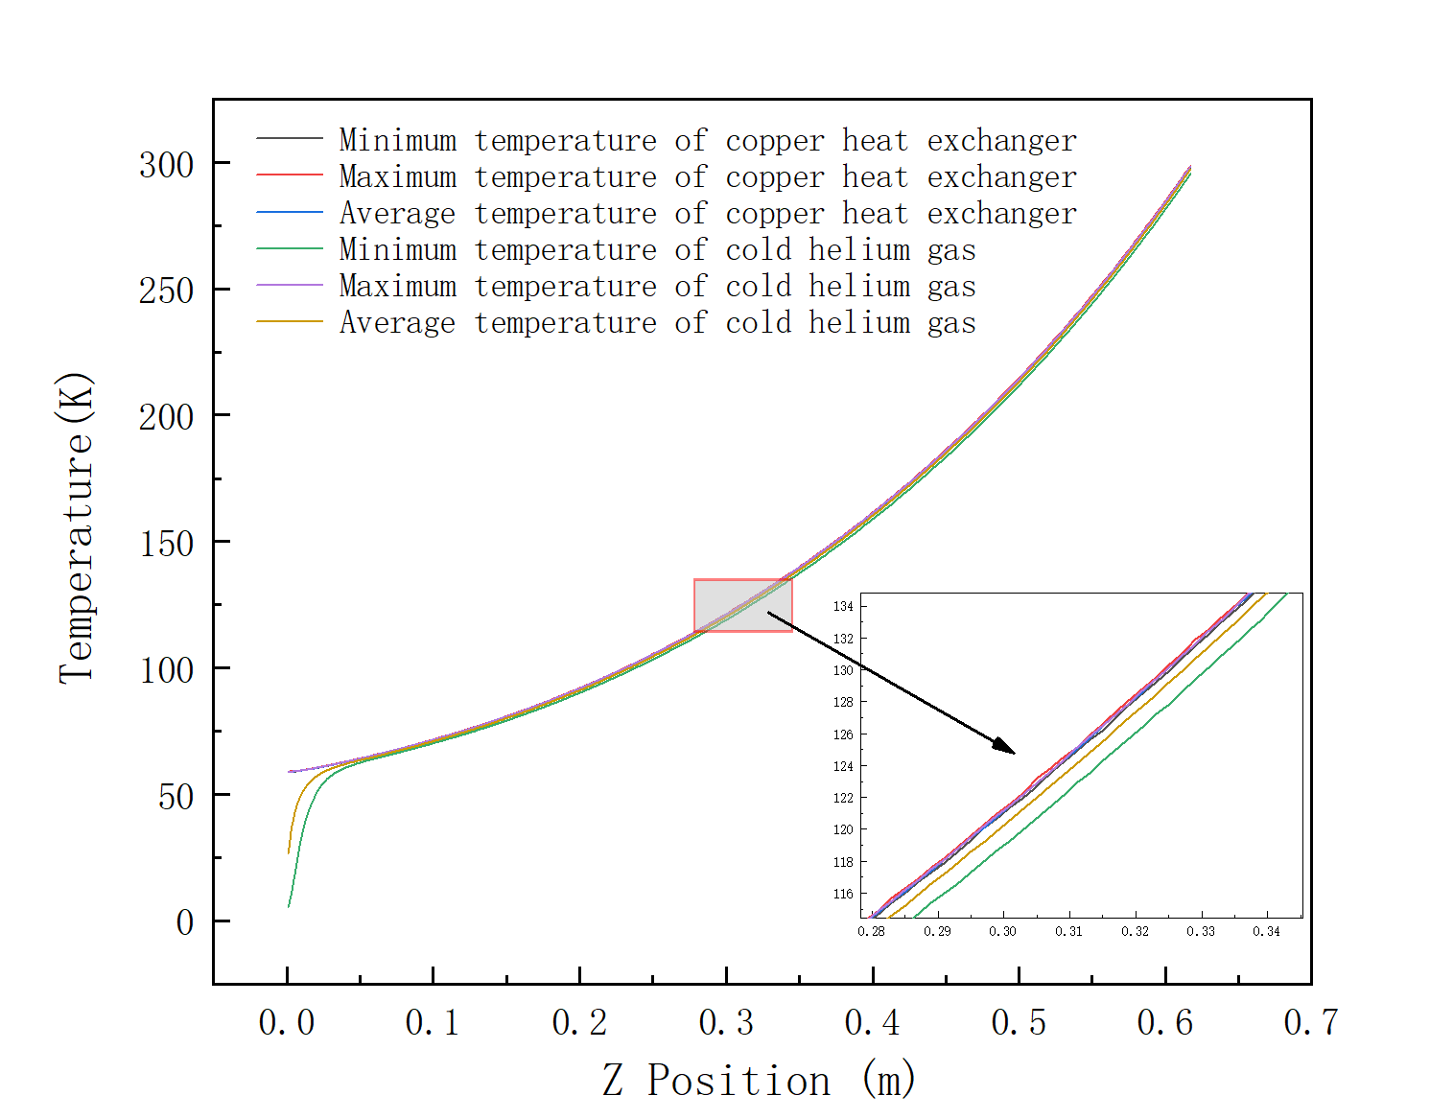
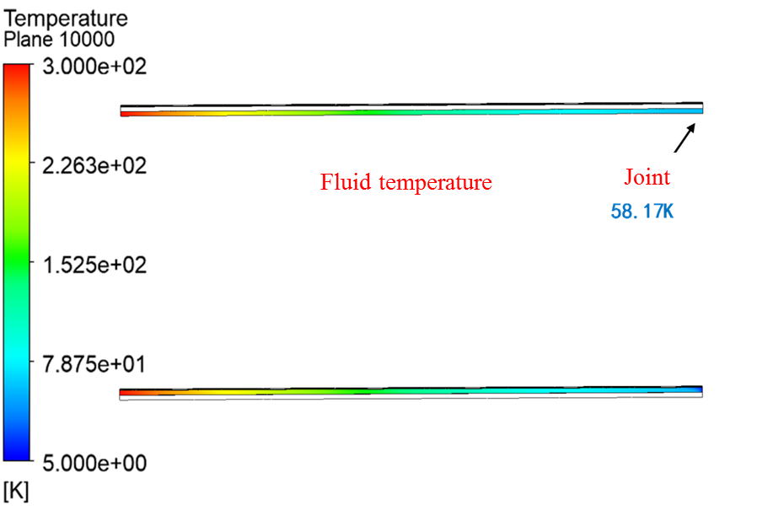
Current leads design
For the 1300A current lead, the temperature of the cold end can be controlled to be lower than 60 K with a flow rate of 0.06 g/s.
Meanwhile, the heat load on the liquid helium temperature is 0.12 W.

Slide 20
Summary
Design status of cryomodule:
The cryostat is designed now and will be updated as the optimization of the SC magnets in future.
Supercritical/ Subcooled liquid helium is used as the cold source and the calculation is performed.
A subcooled LHe circulation is designed, which can increase the flow rate largely.
Current leads for the magnets are designed;
Works to be done next:
Optimization of the cryostat;
Thermal and mechanical analysis; (quench protection, energy storage , supports )
Measurement requirements; (temperature/pressure/BPM)
Consideration of processing and manufacturing technology;

Slide 21
Thanks for your attention!

