Slide 1



CEPC Interaction Region engineering design status
Haijing Wang, on behalf of the MDI staff
2024.10.22-27

Slide 2
Content
Introduction
MDI layout
SC magnet, cryostat and support design
RVC
Conclusion

Slide 3
Introduction
This report is about the CEPC IR engineering design, including the MDI layout, the structure design and relative analyses of accelerator devices at MDI, and the EDR plans.
The main engineering updates from TDR:
  MDI layout: Q3 and anti solenoid next to Q3.
  SC magnets: iron → iron free.
  Cryostat: remove the thermal shields inside Q1a.
  Cryostat support: structure update according to relative updates
  Detector: structure updates

Slide 4
Introduction
The MDI group is aiming to carry out a technically feasible engineering design in EDR stage.
Main engineering requirements
Items | Requirements
MDI layout | The layout should fulfill the physics and technical requirement with all the devices included. A detailed installation and alignment schedule should be made.
SC magnets | Position accuracy: ≤100 μm Vibration as small as possible
RVC | A safe and reliable structure within the detective angle of acos 0.99. RF shielded. Leak rate: ≤2.7 ×10^{–11} Pa·m³/s
Relative position accuracy requirement of adjacent components（1 σ） From Xiaolong Wang
Component | Transversal/mm | Vertical/mm | Longitudinal/mm | Roll/mrad | Pitch/mrad | Yaw/mrad
IR Quadrupole | 0.1 | 0.1 | --- | 0.1 | 0.2 | 0.2

Slide 5
Introduction
EDR engineering scope and plans
Items | 2024 | 2025 | 2026 | 2027
MDI layout | More detailed layout, identify the MDI interface dimensions The locations for additional BPMs |  | Continuously updating according to the physical and technical design Detailed installation and alignment schedule | Wrap up the unfinished work. Prepare the EDR report.
Cryostat design | More detailed structure design Cryogenic design and analyses |  | Design updating according to layout design
Cryostat support design | More detailed support structure and FEA Design of auxiliary support |  | Vibration decreasing methods, eg. damping material
RVC design | Mechanical design Prototype development and leak rate experiment |  | Structure optimization Finish the leak rate experiment
SC magnets design | Finish magnet design, and summarize parameters |  | Finish magnet engineering design
Alignment | Identify the alignment and installation scheme |  | Key technology study

Slide 6
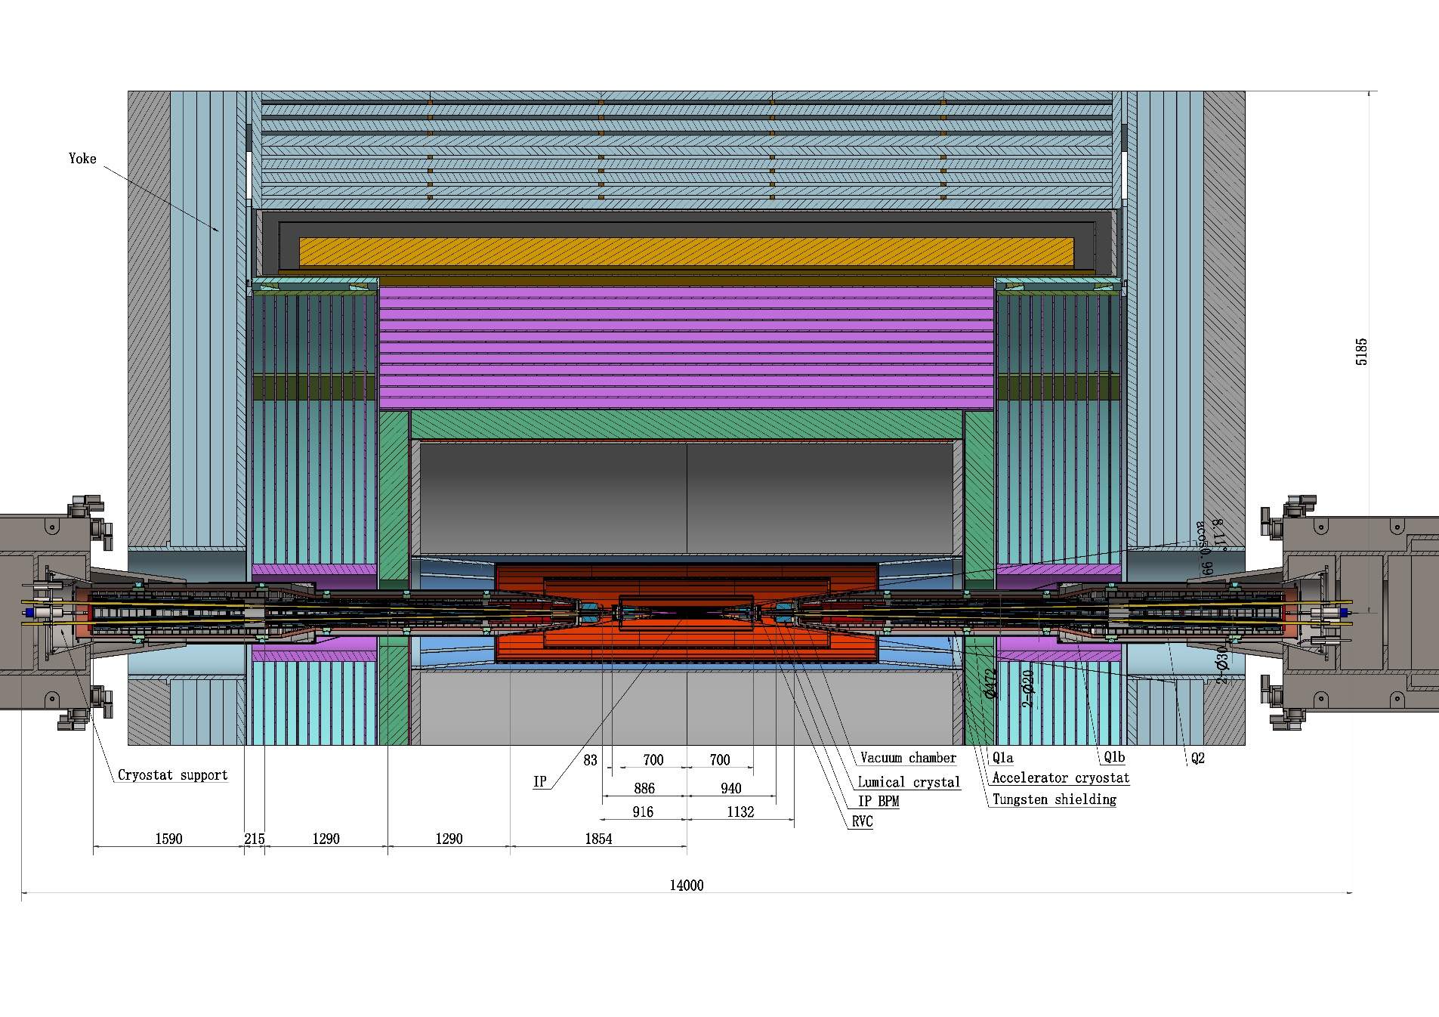
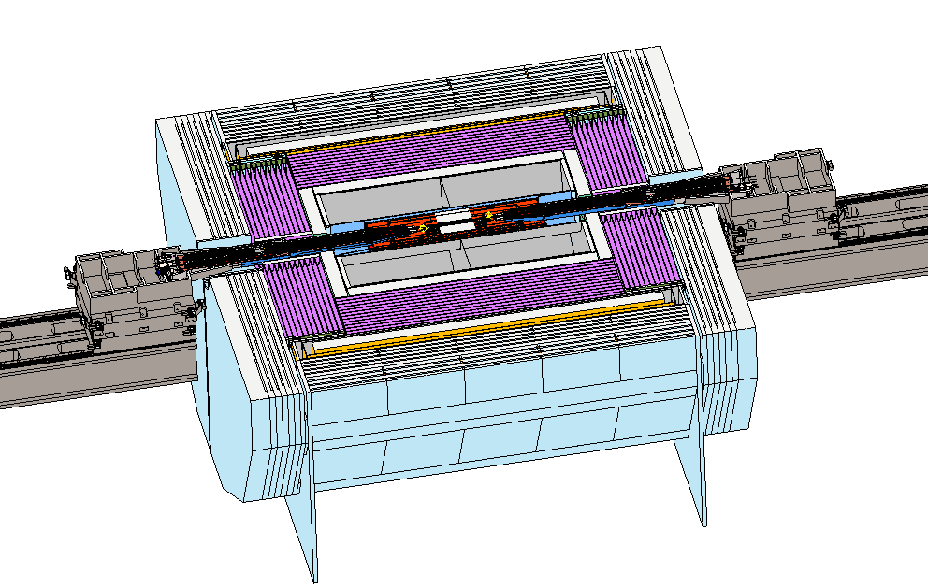
MDI layout
MDI layout
  Detective angle: acos0.99
  IP chamber：±700mm
  Yoke length：11750mm

Slide 7
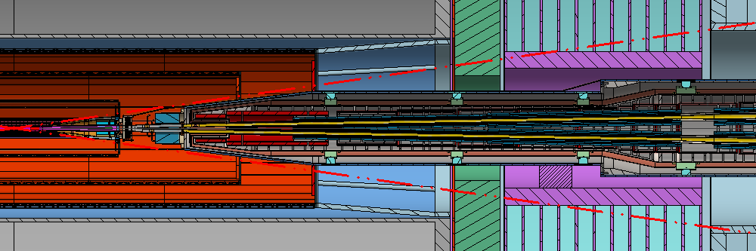
MDI layout
Be-Al chamber
Z: -700~700mm
Y chamber
Z: 783~855mm
Lumical crystal
Z: 940-1100mm
Q1a Q1b &Q2
Z: 1870~6245mm
IP
RVC
Z: 700~783mm
IP BPMs
Z: 855~950mm
Auxiliary support
Z: 3300~3700 mm
BPM possible location
Z: 4420~4650 mm
Disrance to detective angle
  IP chamber flange: 5.3mm RVC: 14.9mm (pressure tube) Shielding outside cryostat: 16.5mm

Slide 8
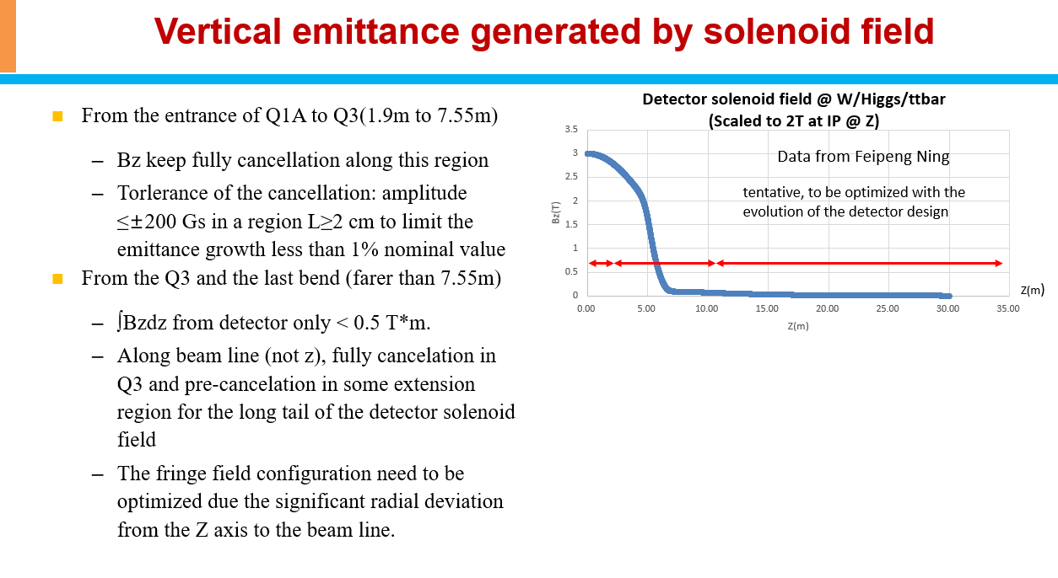
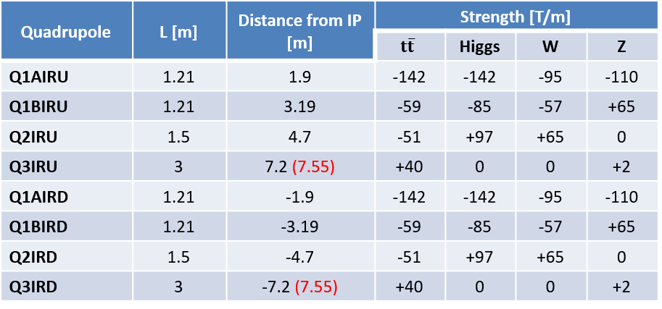
MDI layout
From Yiwei Wang

Slide 9
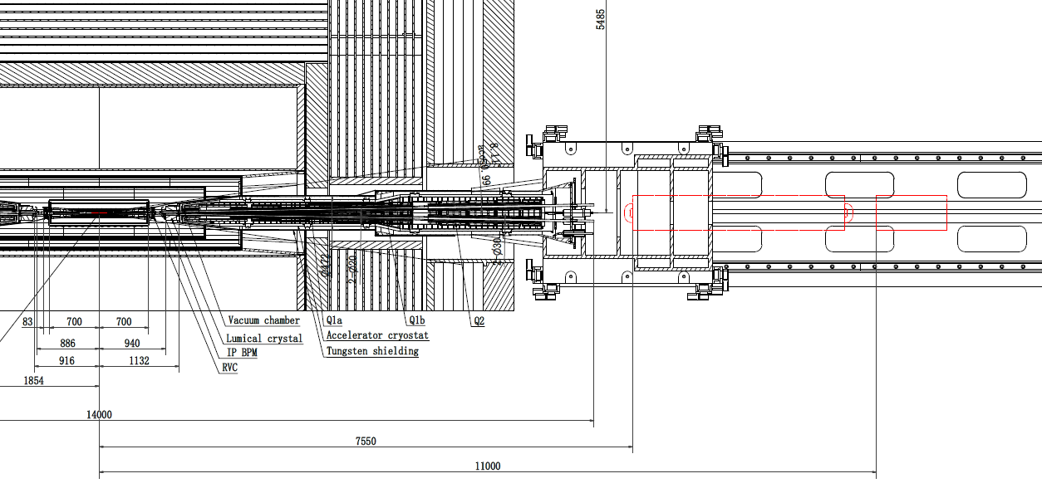
MDI layout
MDI layout
  Q3 and anti-solenoid are at the support bed of cryostat, should be removed first once the cryostat be pulled out.
  Q3: 7.55~10.55m
  Anti-solenoid: 11~12m
Q3
Anti-solenoid

Slide 10
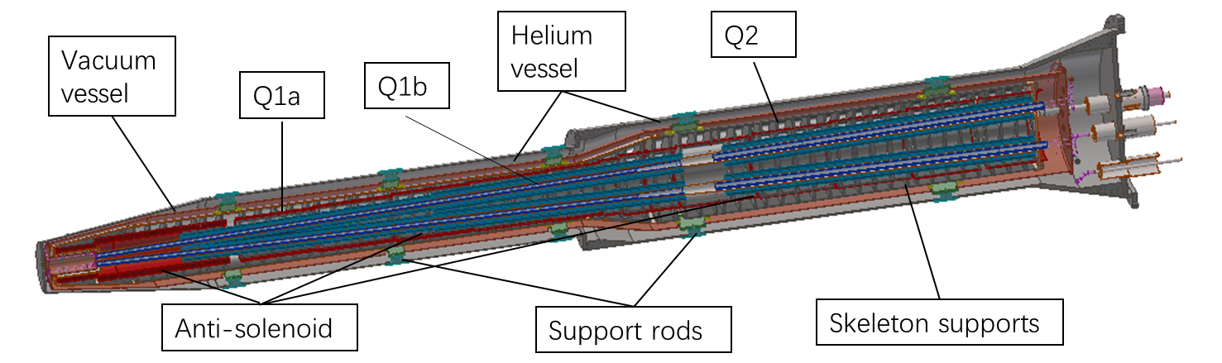
SC magnet, cryostat and support design
Items | Weight (kg) | Main materials
Vacuum vessel | 1184 | SS
Helium Vessel | 195 | SS
Thermal shield and pipes | 43 | Copper & Aluminum
SC quadrupoles | 100 | Copper & Aluminum
Anti-solenoids | 302 | Copper & Aluminum
Skeleton supports | 116 | Aluminum
Liquid Helium | 90 | Liquid Helium
Total weight | 2030
Cryostat length: ~5.7 m
Total weight: ~2ton
Notes:
增加与TDR重量对比

Slide 11
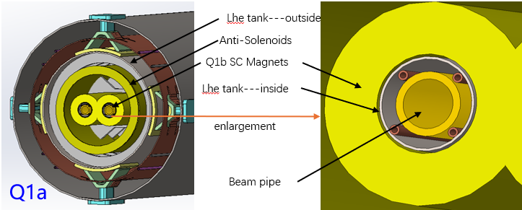
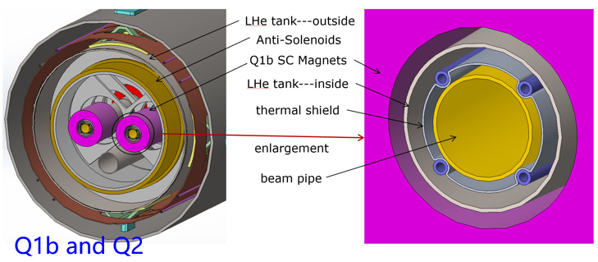
SC magnet, cryostat and support design
From Xiaochen Yang and Yingshun Zhu
Structure update
  The iron-free SC magnets are selected recently, aiming at reducing the total weight and deformation.
  Thermal shields inside SC magnets begin at Q1b, owing to a limited space at Q1a.
  The detailed cryogenic simulation is on-going, and we hope to have a result recently.
 | TDR dimensions（Øi-Øo, mm） | Updated dimensions（Øi-Øo, mm）
Q1a | 40-88 | 40-61
Q1b | 52-103.4 | 52-78
Q2 | 62-126.4 | 62-88
Anti-solenoid | 130-374 | 130-350

Slide 12
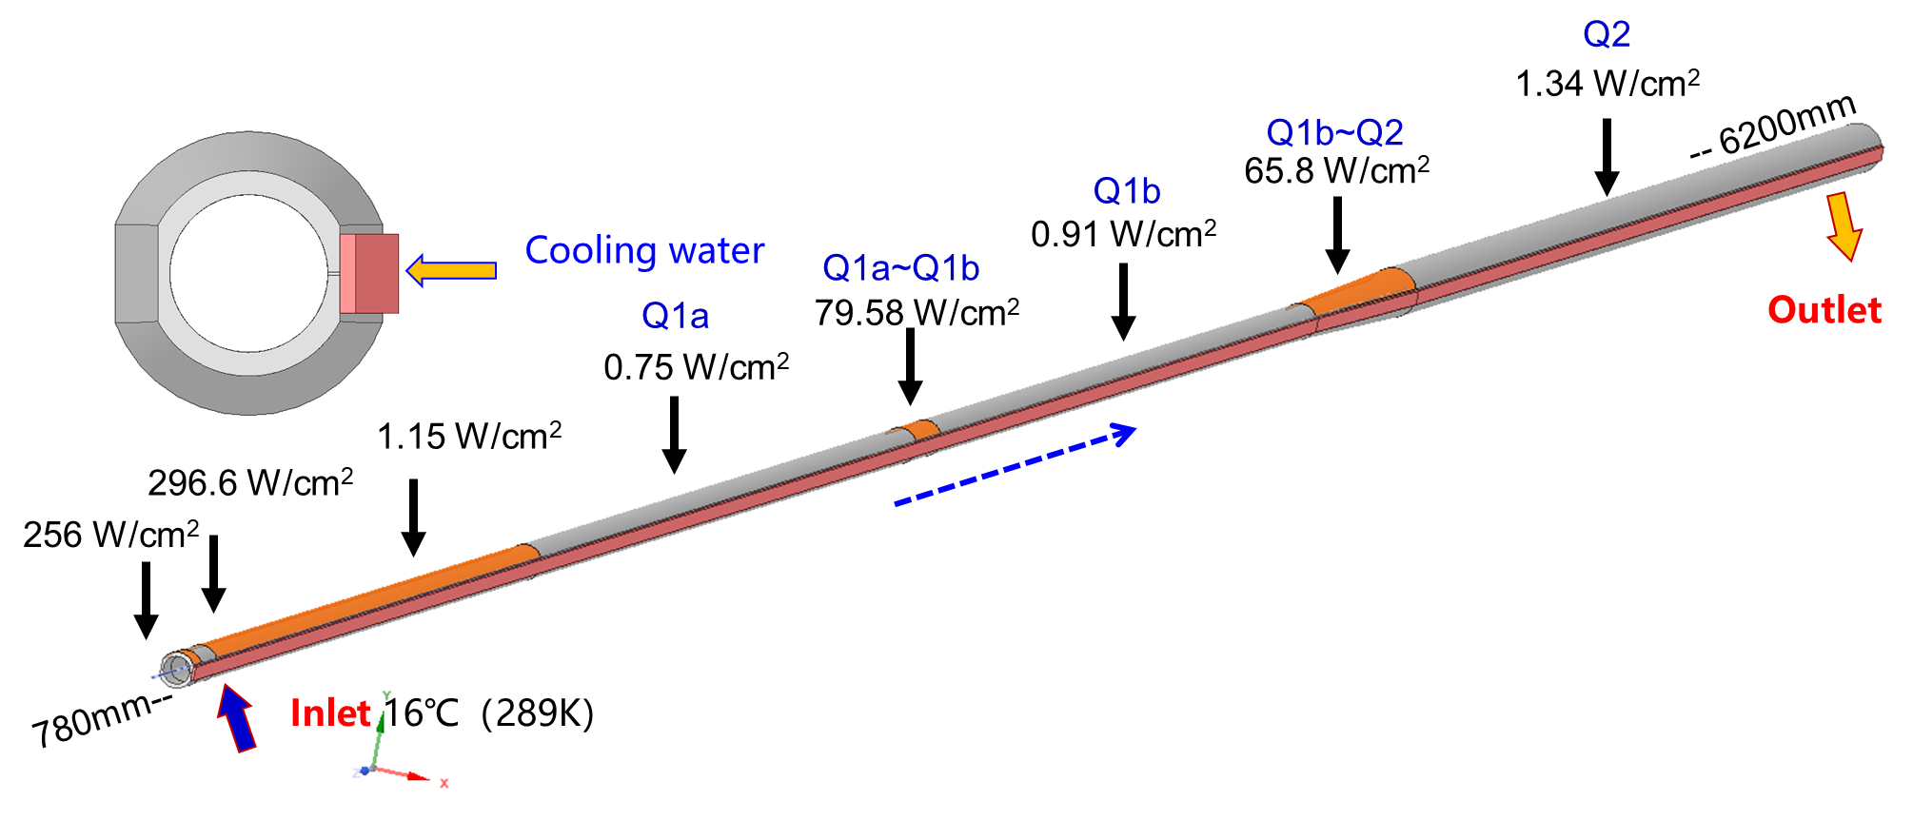
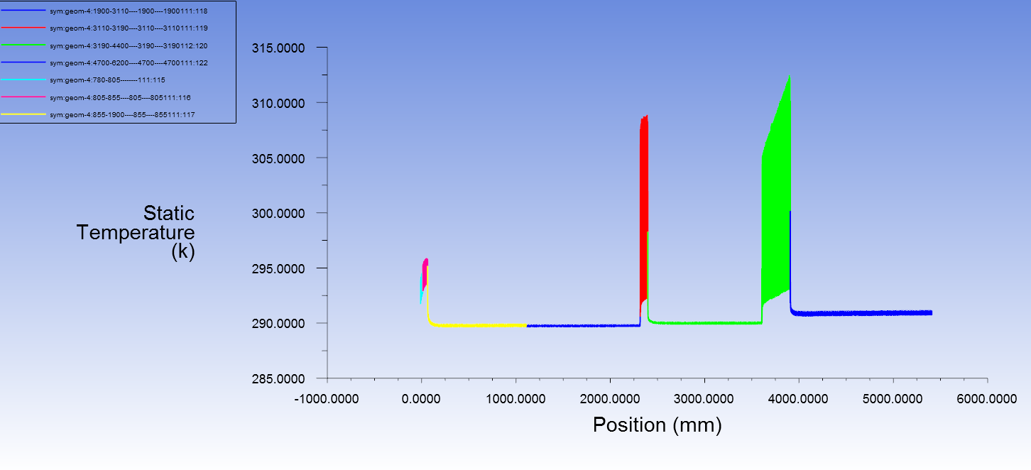
SC magnet, cryostat and support design
From Xiangzhen Zhang
Thermal analyses of beam pipe at cryostat @Higgs, 30MW
  Total SR power: 189W
  Total HOM power: 12W
  Cooling water temperature: 16 ℃ (289K)
  Maximum temperature on beam pipe: 40 ℃ (313K)
The detailed structure design including the space arrangement is under-going.

Slide 13
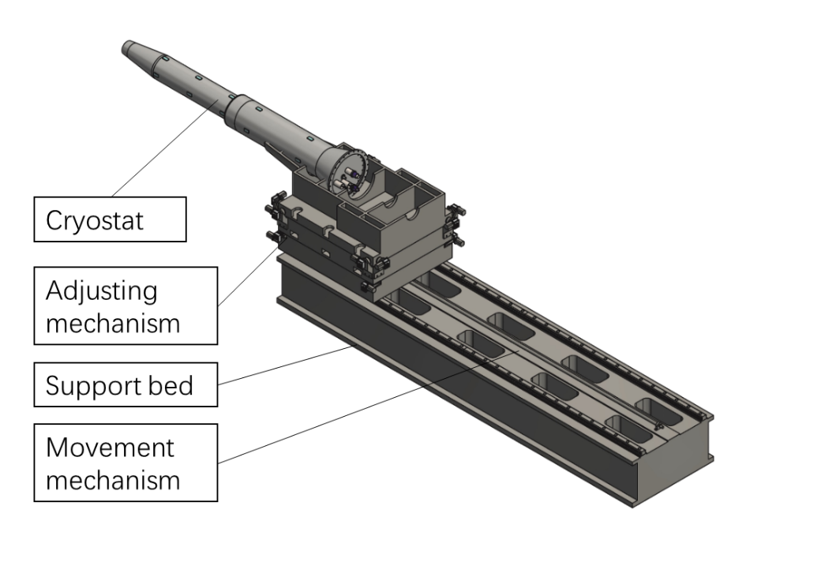
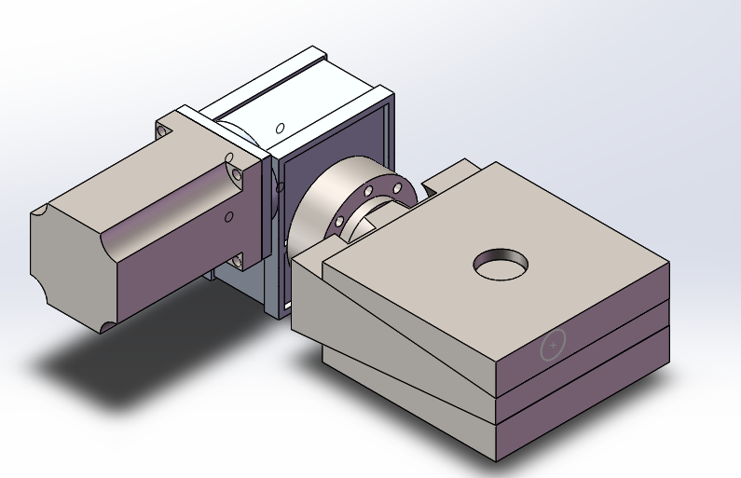
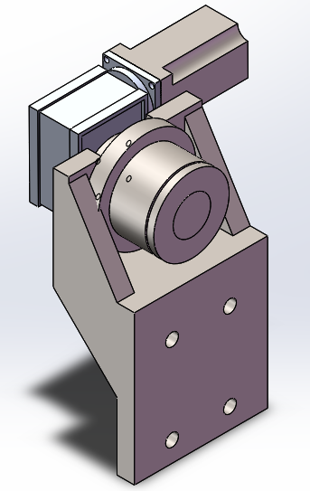
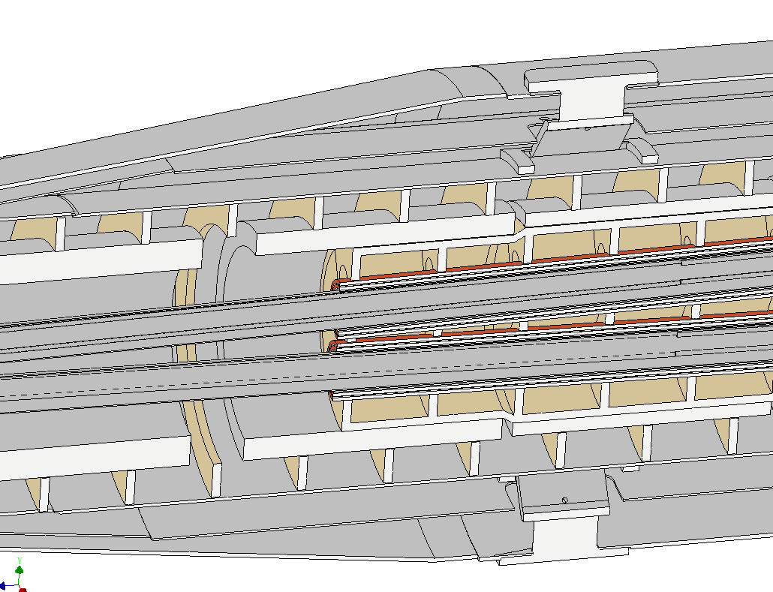
SC magnet, cryostat and support design
Cryostat support design
  Steel weldment as a bed
  Auto-tuning wedge adjustment at the end of the cryostat
  Auxiliary support at HCAL
  Skeleton support inside helium vessel for magnets
Key points
  Stability (static and dynamic)
  Accuracy
  Easy-operating
  Dimensions
SC quadrupole support
Anti solenoid support

Slide 14
SC magnet, cryostat and support design
  Misalignment and vibration of magnet can lead to beam emittance growth and luminosity degradation.
  The steps on the inner wall of vacuum can generate HOMs.
 | Related requirements | Response now | Other related factors
Position accuracy (X/Y) of SC magnets≤100μm | Adjusting resolution≤5μm | ≤5μm,from experience | Alignment method, ground settlement、correctors…
 | Small uneven deformation | FEA，~30μm
Small vibration | High natural frequency | Under simulation | Damping，installation foundation stability, ground vibration…
 | Low amplification factor
Related requirements | Response now | Other related factors
Deformation at the front of vacuum chamber<0.5mm | FEA，~0.5mm | Installation error and so on
Notes:
表述修改，更准确

Slide 15
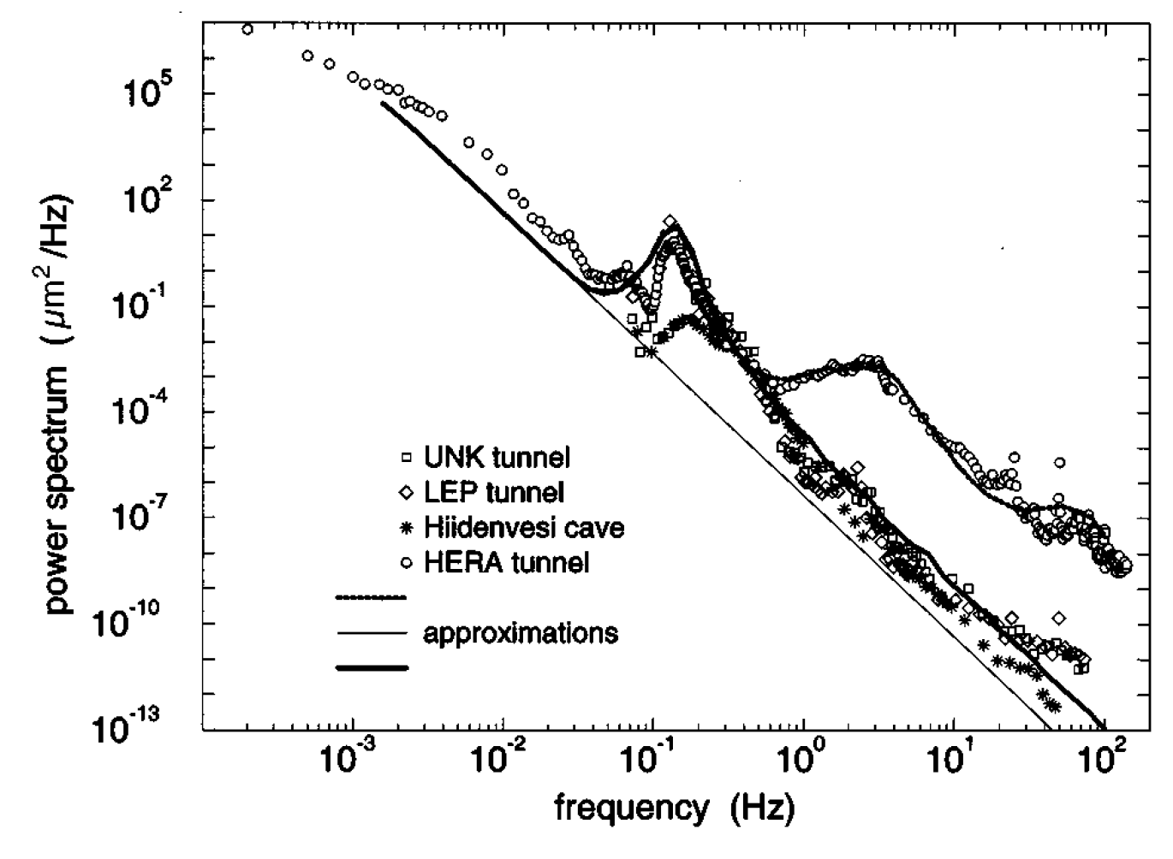
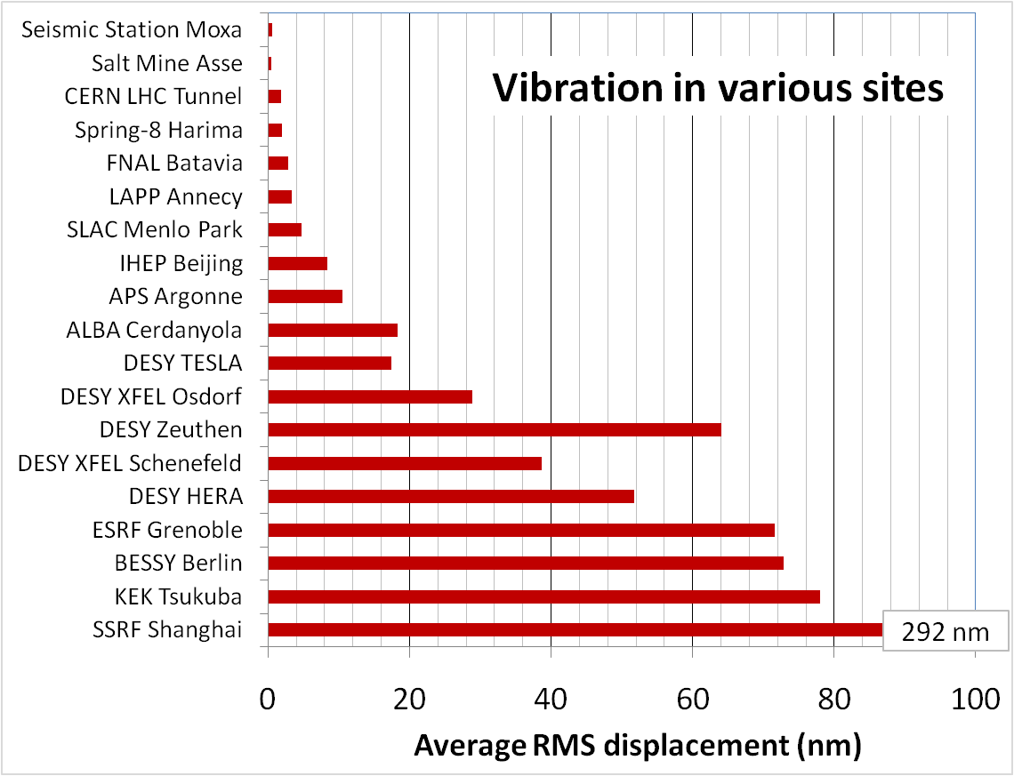
SC magnet, cryostat and support design
Mechanical dynamic stability (vibration)
  Ground vibration requirement: better than 4 nm at MDI, RMS, 1-100 Hz displacement integral
  Magnet-support assembly: natural frequency? Amplification factor?
  Damping devices: damping material? active vibration technology?
  Slab and pedestal
Enhancing the natural frequency is an effective method to decrease vibration.
HEPS site

Slide 16
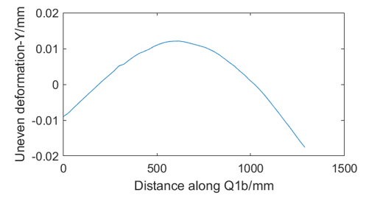
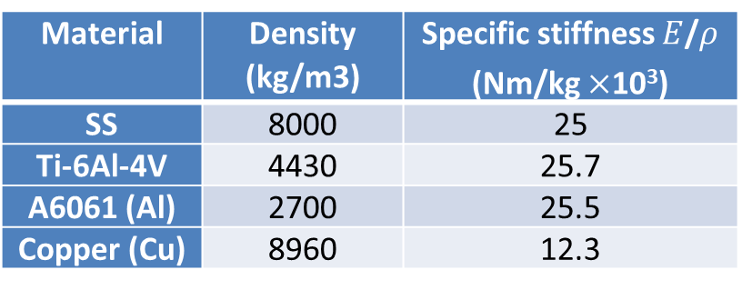


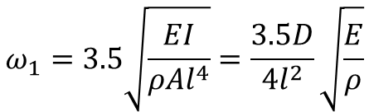

SC magnet, cryostat and support design
FEA
  For cylinder cantilever under gravity
  For concentric cylindrical cantilever under gravity
  Shape factors: $l, D$; material factors: $E$/$ρ$, $ρ^{′}$/$ρ$
$$y_{max}=−\frac{ql^{4}}{8EI}=\frac{l^{4}ρ}{πED^{2}}$$
$$ω_{1}=3.5\sqrt{\frac{EI}{ρAl^{4}}}=\frac{3.5D}{4l^{2}}\sqrt{\frac{E}{ρ}}$$
$$y_{max}\sim \frac{ρl^{4}}{32EI}(D^{2}−d^{2}+\frac{ρ^{′}}{ρ}d^{2})$$
Material | Density (kg/m3) | Specific stiffness $E$/$ρ$ (Nm/kg $×$10³)
SS | 8000 | 25
Ti-6Al-4V | 4430 | 25.7
A6061 (Al) | 2700 | 25.5
Copper (Cu) | 8960 | 12.3
Temperature | uneven deformation in Y direction (um) |  |  | Displacement in Z direction (mm)
 | Q1a | Q1b | Q2 | Q1a | Q1b | Q2
295K | 5 | 31 | 14 | 0.3 | 0.26 | 0.24
4.2K | 7 | 30 | 12 | Contract with temperature

Slide 17
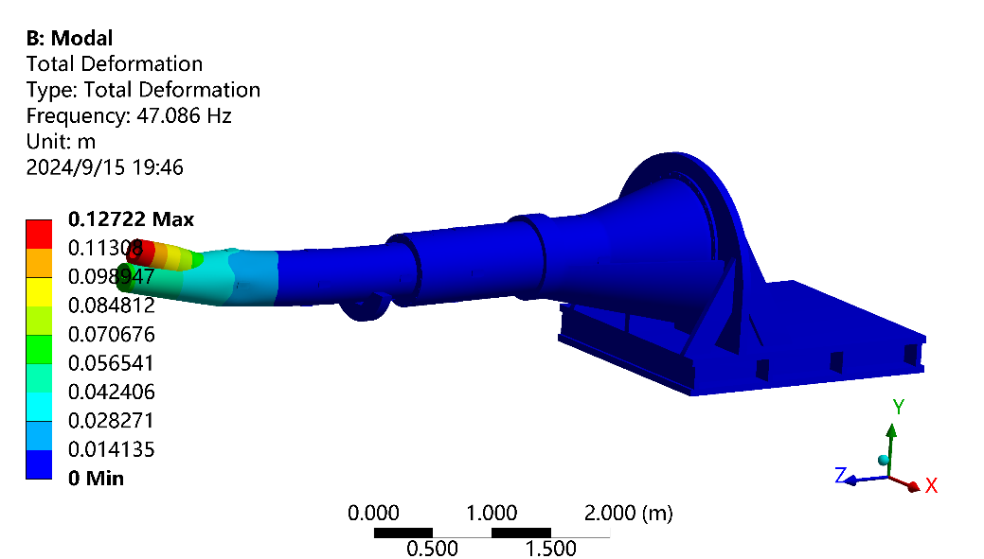
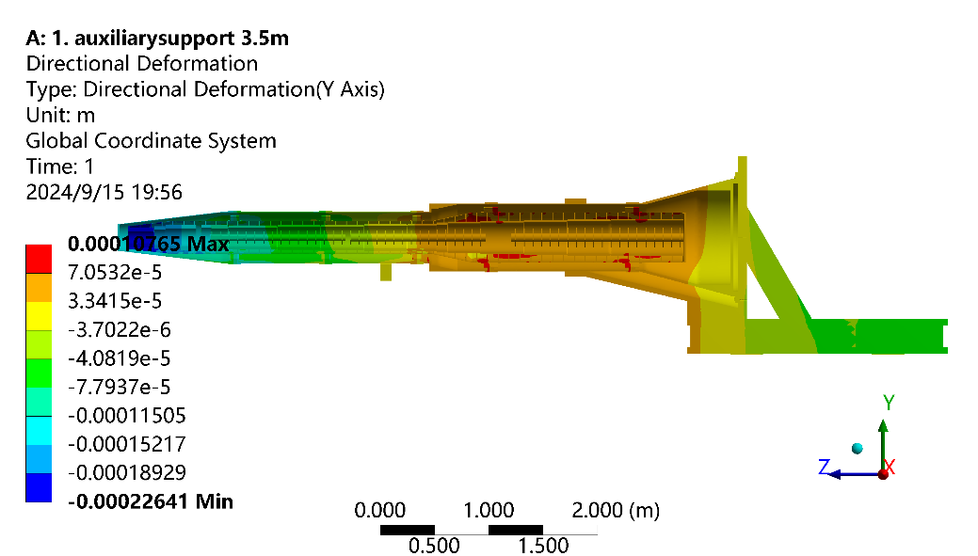
SC magnet, cryostat and support design
FEA
  Auxiliary constraint: V groove, translational in beam direction.
No. of order | Frequency (Hz) | Mode
1 | 47 | Q1a Y sway
2 | 58 | Q1a X sway
3 | 68 | Cryostat assembly Z-translation

Slide 18
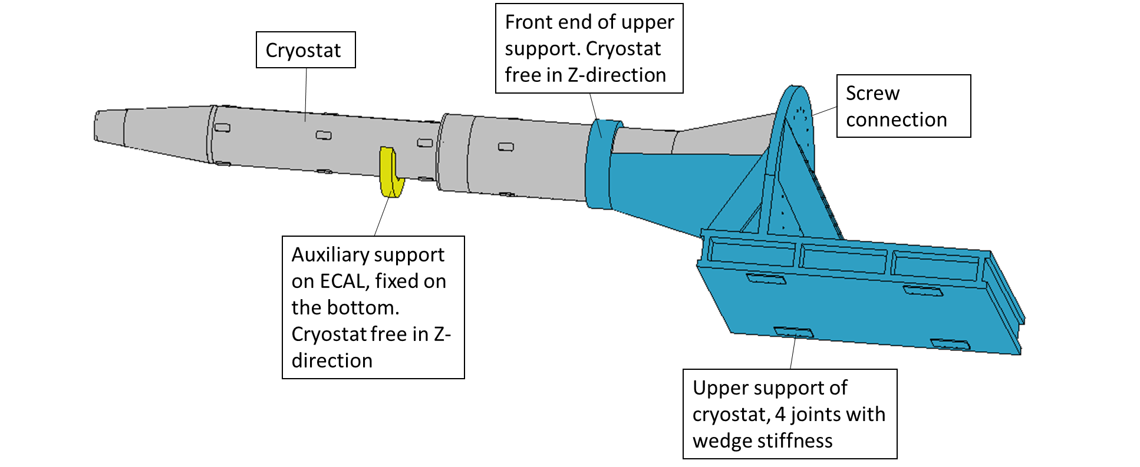
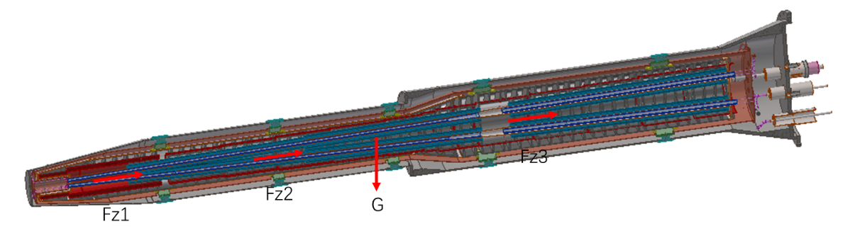
SC magnet, cryostat and support design
FEA
  The auxiliary support is on the HCAL, 3.3 m from the IP.
  Only upper support of the cryostat is included now, the stiffness of the wedge joints is set at the bottom.
  The Lorenz forces are set same as the TDR ones.
  Considering the total support assembly, the analyses results may be worse. More detailed FEA will be done with more detailed mechanics design.

Slide 19
SC magnet, cryostat and support design
More detailed design and simulation are planned
  Cryogenic simulation
  Deformation simulation and skeleton structure optimization, accident cases such as quench
  Modal and harmonic response simulation with the cryostat support included
  Vibration response using the geological exploration of ground vibration as input
  Consider the use of damping materials and other vibration decreasing scheme if needed, and do the modal and response simulations

Slide 20
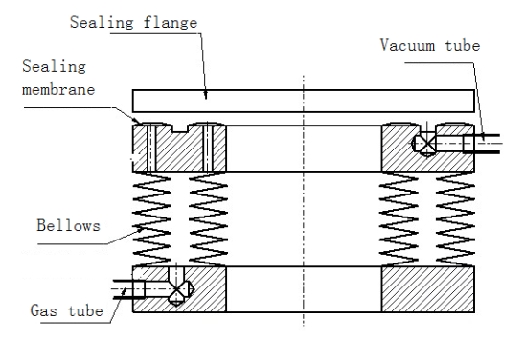
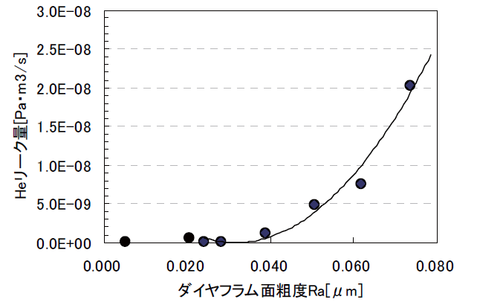
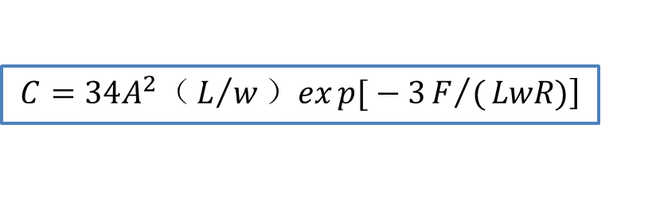
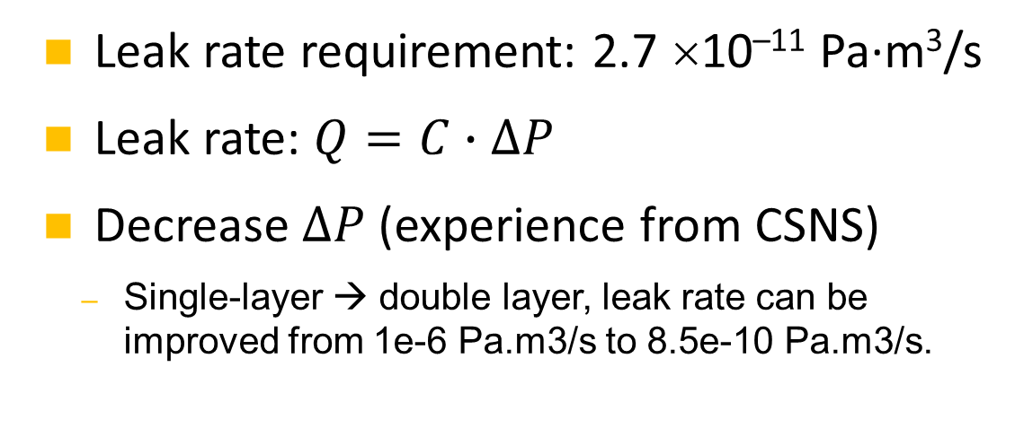
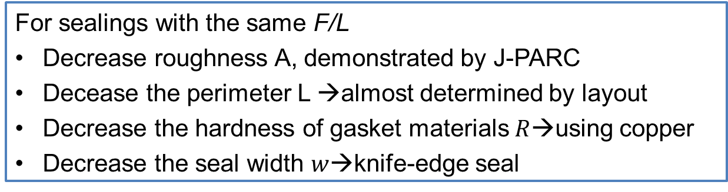
RVC
    Leak rate requirement: 2.7 ×10^{–11} Pa·m³/s
    Leak rate: $Q=C∙∆P$
    Decrease $∆P$ (experience from CSNS)
  Single-layer → double layer, leak rate can be improved from 1e-6 Pa.m3/s to 8.5e-10 Pa.m3/s.
Inflatable seal
$$\left.C=34A^{2}（L/w）exp{[}−3F/(LwR)\right]$$
  For sealings with the same F/L
  Decrease roughness A, demonstrated by J-PARC
  Decease the perimeter L →almost determined by layout
  Decrease the hardness of gasket materials$R$→using copper
  Decrease the seal width $w$→knife-edge seal
Roughness and conductance, J-PARC

Slide 21
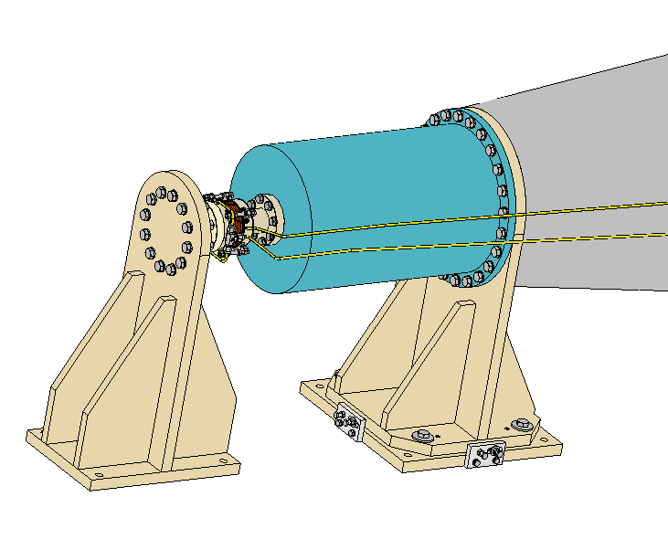
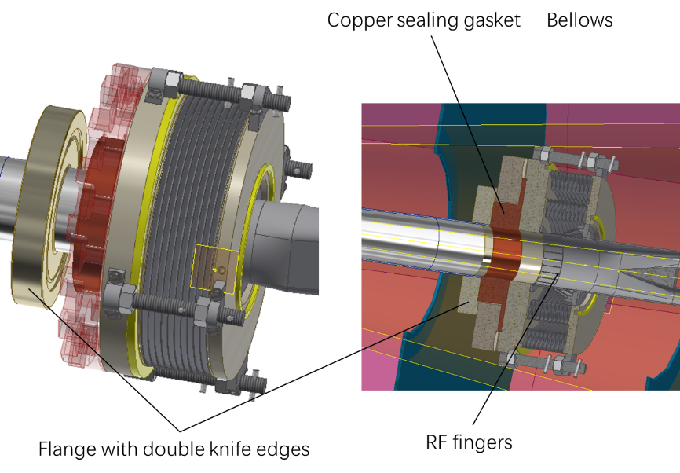
RVC
A prototype will be developed.
The influence of RVC displacement on the leakage rate will be simulated through an adjustment mechanism.
Fake model of vacuum vessel
Fake model of IP chamber, fixed
Adjustment mechanism
RVC

Slide 22
Conclusion
The overall aim of MDI engineering design in EDR is a comprehensive design of all components working together.
The designs are updating from TDR. The main progress includes the MDI layout updating, the refinement of the cryostat and its support, and the RVC design.

Slide 23
Thank you for your attention!

