Slide 1
WP1: R&D&I at currently operating state-of-the-art accelerator facilities
H2020-MSCA-RISE 2019
Faus-Golfe
On behalf of all the WP1

Slide 2
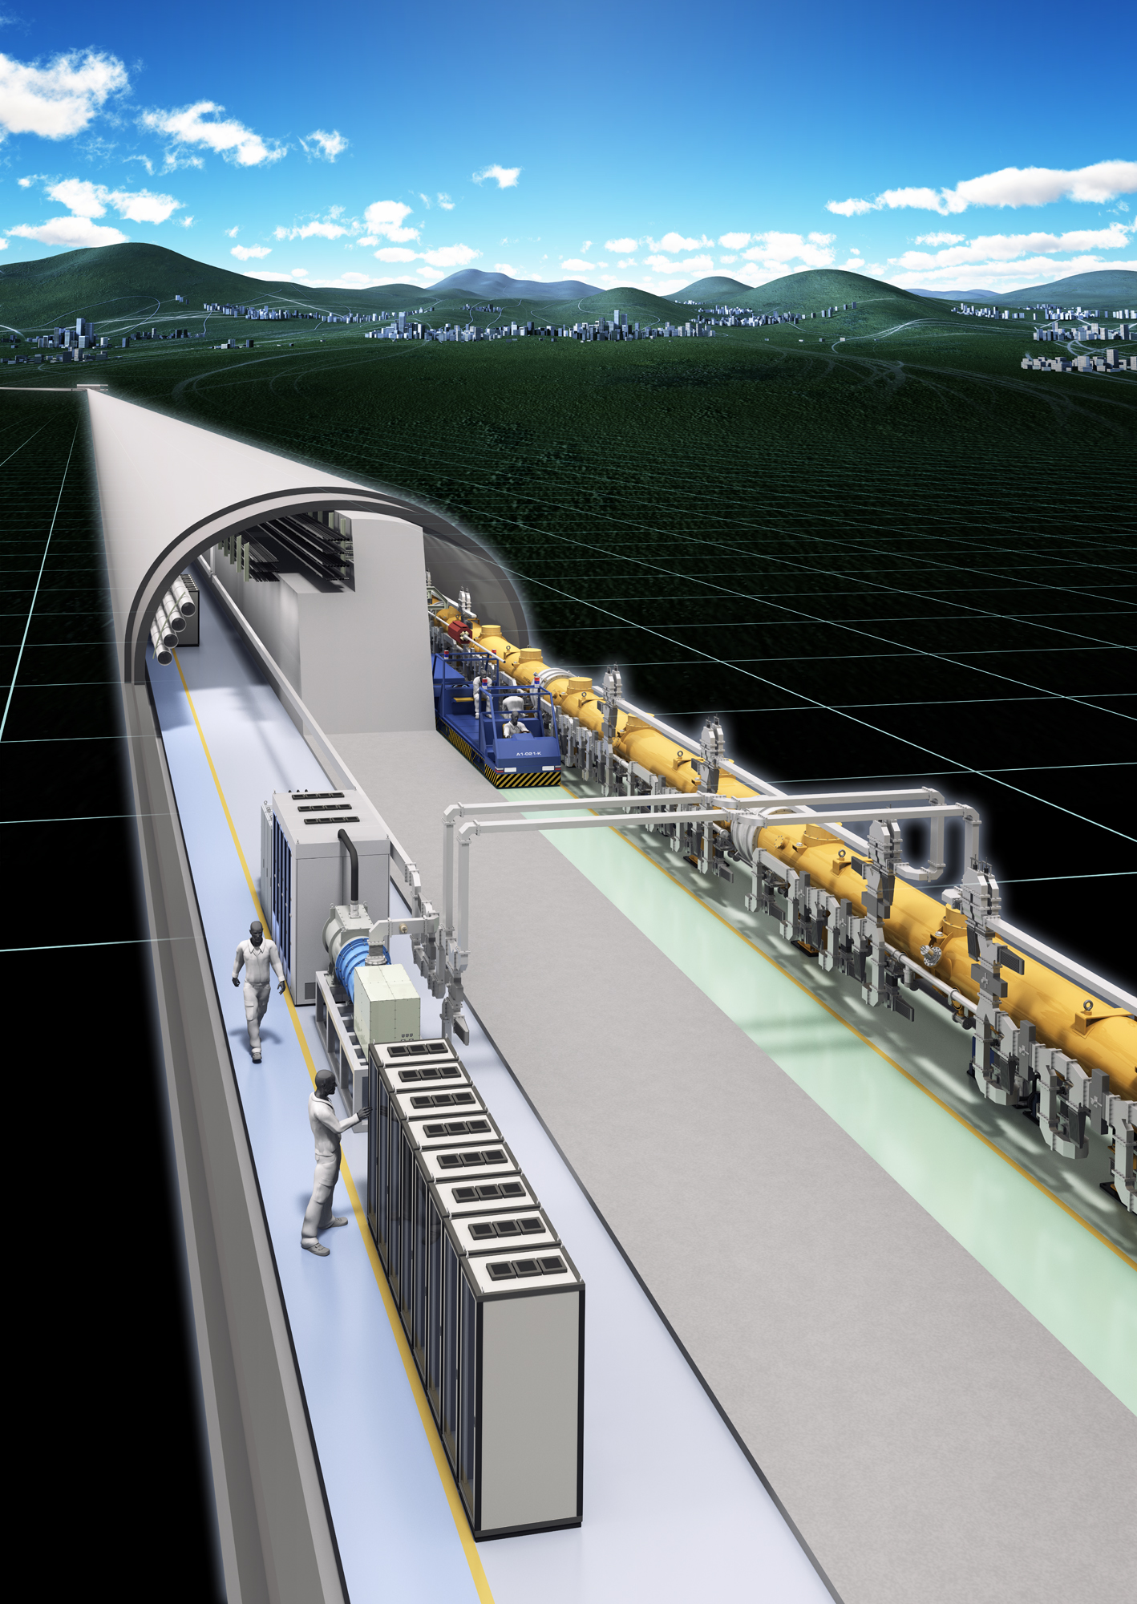
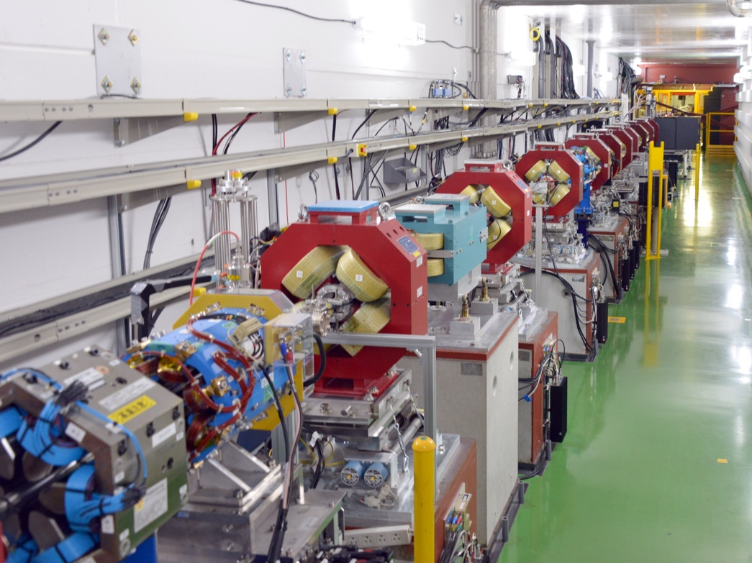
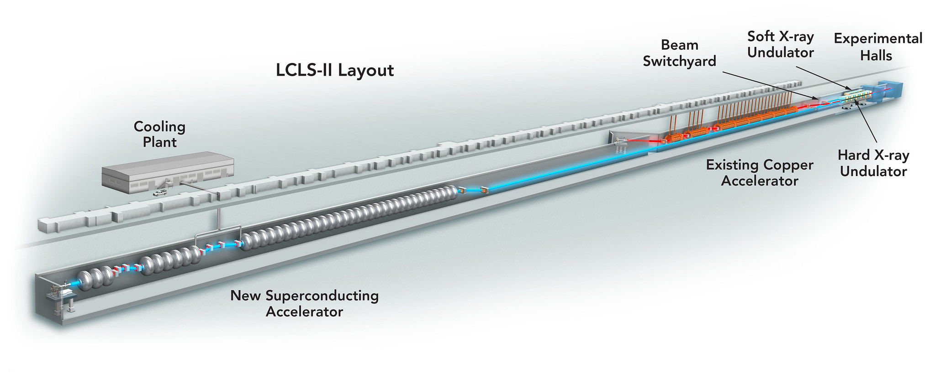
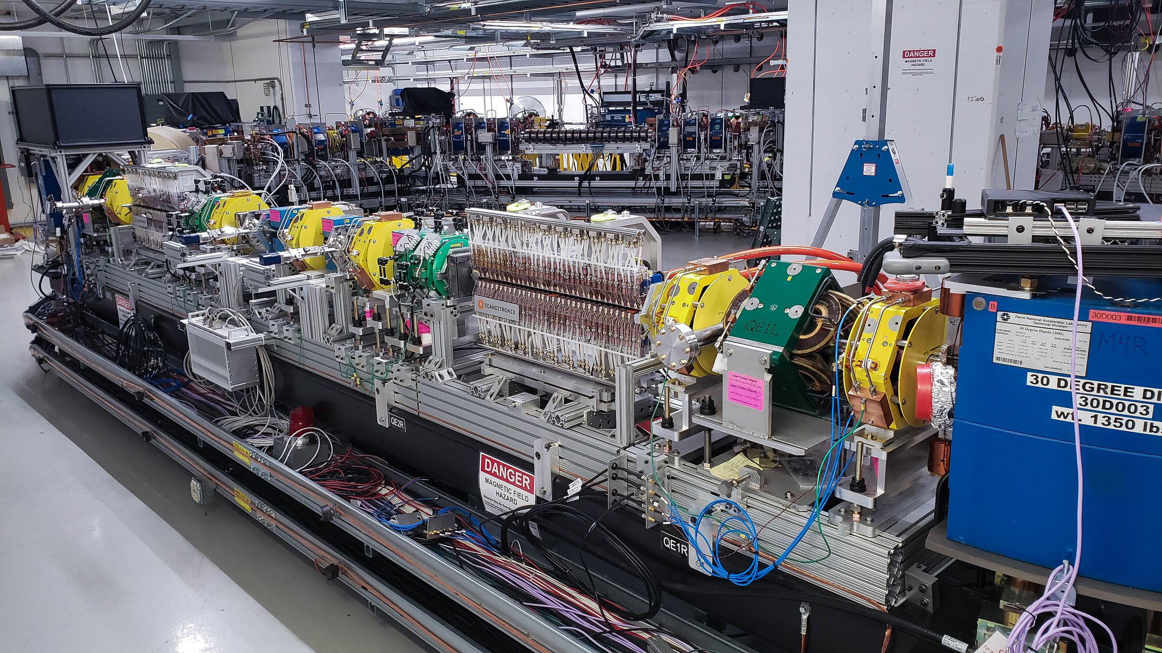
Task 1.1: Future e⁺e⁻ linear collider studies (CERN, CEA, CNRS, CSIC/IFIC DESY, UOX, 57 (34) person-months)
R&D objectives of the ATF3 linear collider test facility at KEK, to maximize the luminosity potential of the next generation linear-collider-based Higgs factories, focused on ILC and CLIC final focus system (FFS). The main topics are (1) long-term stability and availability in routine operation, (2) vibration monitoring and beam-based feed-back / feed-forward, (3) wakefield mitigation, (4) high-order aberration control and in ultra-low-β_{y}* optics, and (5) AI-based machine learning beam tuning techniques.
Main linac linear collider subsystem: LCLS II at SLAC is ideal to acquire experience with issues specific to operating SC RF linacs, relative to beam dynamics and collective effects as well as to efficiency considerations of the CW RF modules.
High-current and high-gradient superconductive RF linac operation experience at FAST-IOTA at FNAL can be acquired, especially with respect to emittance preservation in the presence of beam loading. Knowledge on non-integrable optics, amplitude detuning techniques, AI based machine-learning tools, including simulation benchmarking, will also be acquired.
ATF2 @ KEK
LCLS II @ SLAC
IOTA @ FNAL

Slide 3
Secondment Task 1.1/1.2
Name: Angeles Faus-Golfe
Institution: IJCLab - CNRS
Dates: ATF2: 22/9/2023 – 03/10/2023, 09/12/2023 – 16/12/2023, 05/07/2024 – 13/07/2024
SLAC: 18/05/2024 – 13/06/2024
Visiting Labs: ATF2-3 KEK and SLAC
Objectives
Results
Small and ultra-low β∗ operation in fall 2023 winter ATF2-3 running
Synergies of different LCs projects (ILC, CLIC, C3, ReLIC, HELEN,..) and upgrades (L and E)
EAJADE Workshop on Sustainability in Future Accelerators (WSFA2023) https://indico.desy.de/event/39980/
CFS/MDI Mini-Workshop (29 September 2023) https://indico.desy.de/event/40176/
Familiarization and used the ultra-low β*_{y} lattice for the first time since March 2020.
LCs global vision

Slide 4
Secondment Task 1.1
Names: Andrii Pastushenko (Postdoc), Enrico Manosperti (PhD)
Institution: CERN
Dates: 03/12/2023 – 16/12/2023
Visiting Lab: ATF2-3 KEK
Results
Objectives
Became familiar with the correction routines and aberrations control techniques at ATF2.
Uploaded and used the ultra-low β*_{y} lattice for the first time since March 2020.
Successfully used the optics matching routines written in MAD-X to match the ultra-low β*_{y} optics.
Train in the small beam size tuning at ATF2-3.
Upload, set up, and verify the ultra-low β*_{y} optics at ATF2-3.

Slide 5
Secondment Task 1.1
Names: Laura Karina Pedraza, Pablo Martínez Reviriego, Eduardo Martínez López (PhDs)
Institution: IFIC (Universidad de Valencia – CSIC)
Dates: 20/11/2023 – 20/12/2023
Visiting Lab: ATF2-3 KEK
Objectives
Understanding of the procedures in ATF2-3 to attain small and ultra-small β*_{y}
Participated to C-band BPMs pulse injection source work, aimed to calibrate the BPMs without a beam and compensate static signals caused from misalignment
Engaged closely with work related to the L-band BPMs performance (calibration and spatial resolution measurements)
Training at ATF2-3 facility and participation in multiple shifts, facilitating direct observation and interaction with the accelerator components and operating system.
Take part on cavity BPM activities in ATF2-3 conducted during the visit.
Results

Slide 6
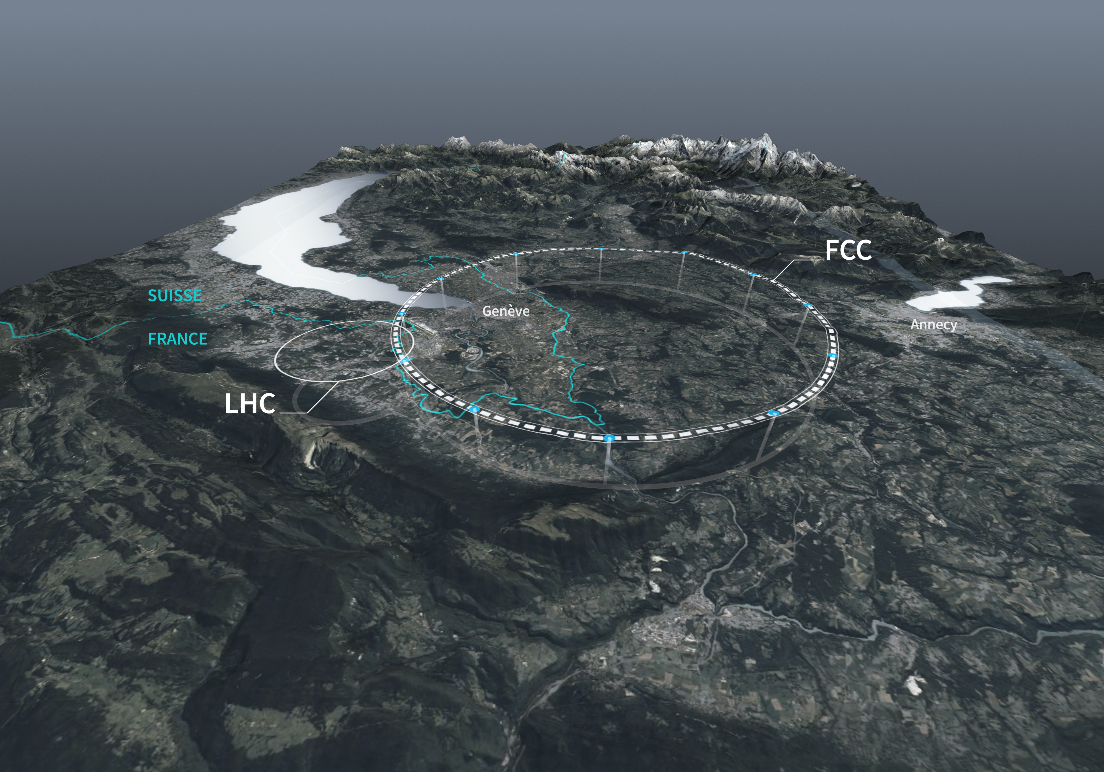
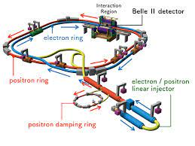
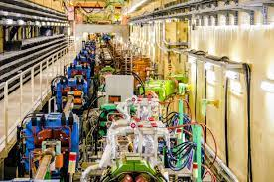
Task 1.2: Future e⁺e⁻ circular collider studies (CERN, CEA, CNRS, INFN, 30 person-months)
SuperKEKB is a state-of-the-art facility operated at KEK which is particularly well suited to study some of the main issues and challenges for future circular colliders, especially the FCC-ee Higgs factory under consideration at CERN. The main topics to be addressed are: (1) luminosity monitoring and extraction of beam parameters at interaction point (IP), (2) feedback control of IP beam offsets, (3) monitoring of final focus magnet vibration with benchmarking of simulation and evaluation of luminosity impact, (4) beam optics tuning with very low β_{y}* and crab-waist collision scheme, (5) impact of collective effects on performance, (6) benchmarking of linear and non-linear optics, (7) beam lifetime, (8) evaluation of beam-induced background in interaction region and mitigation via collimation, (9) machine-detector interfacing.
SuperKEKB @ KEK

Slide 7
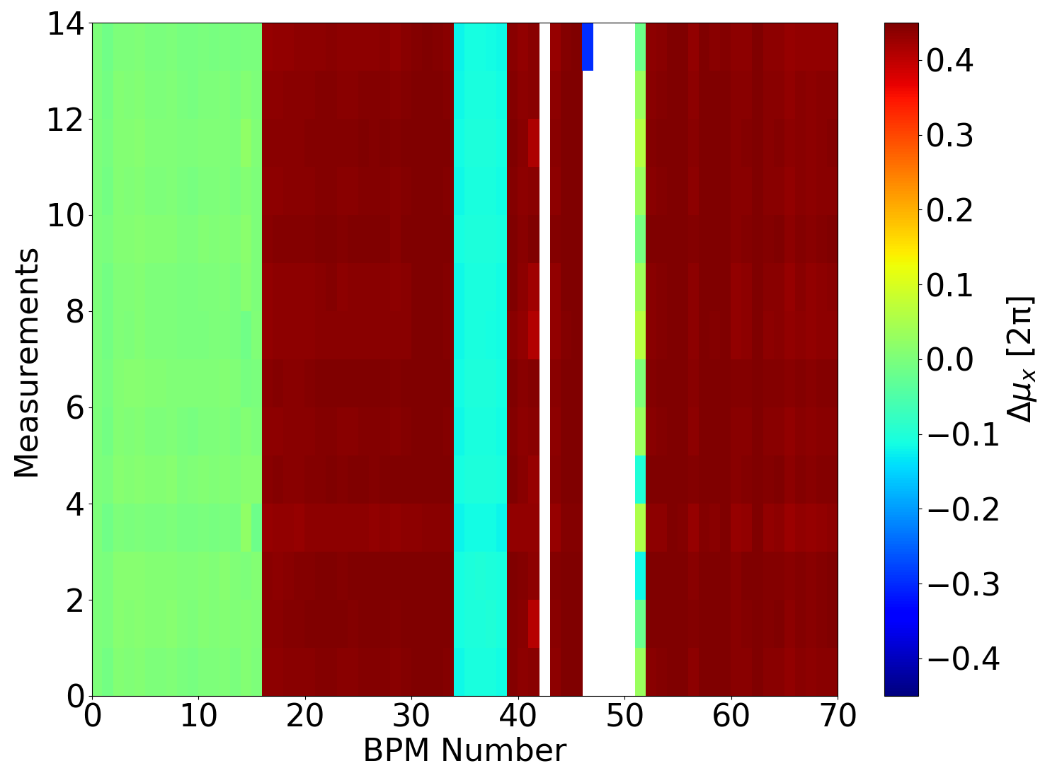
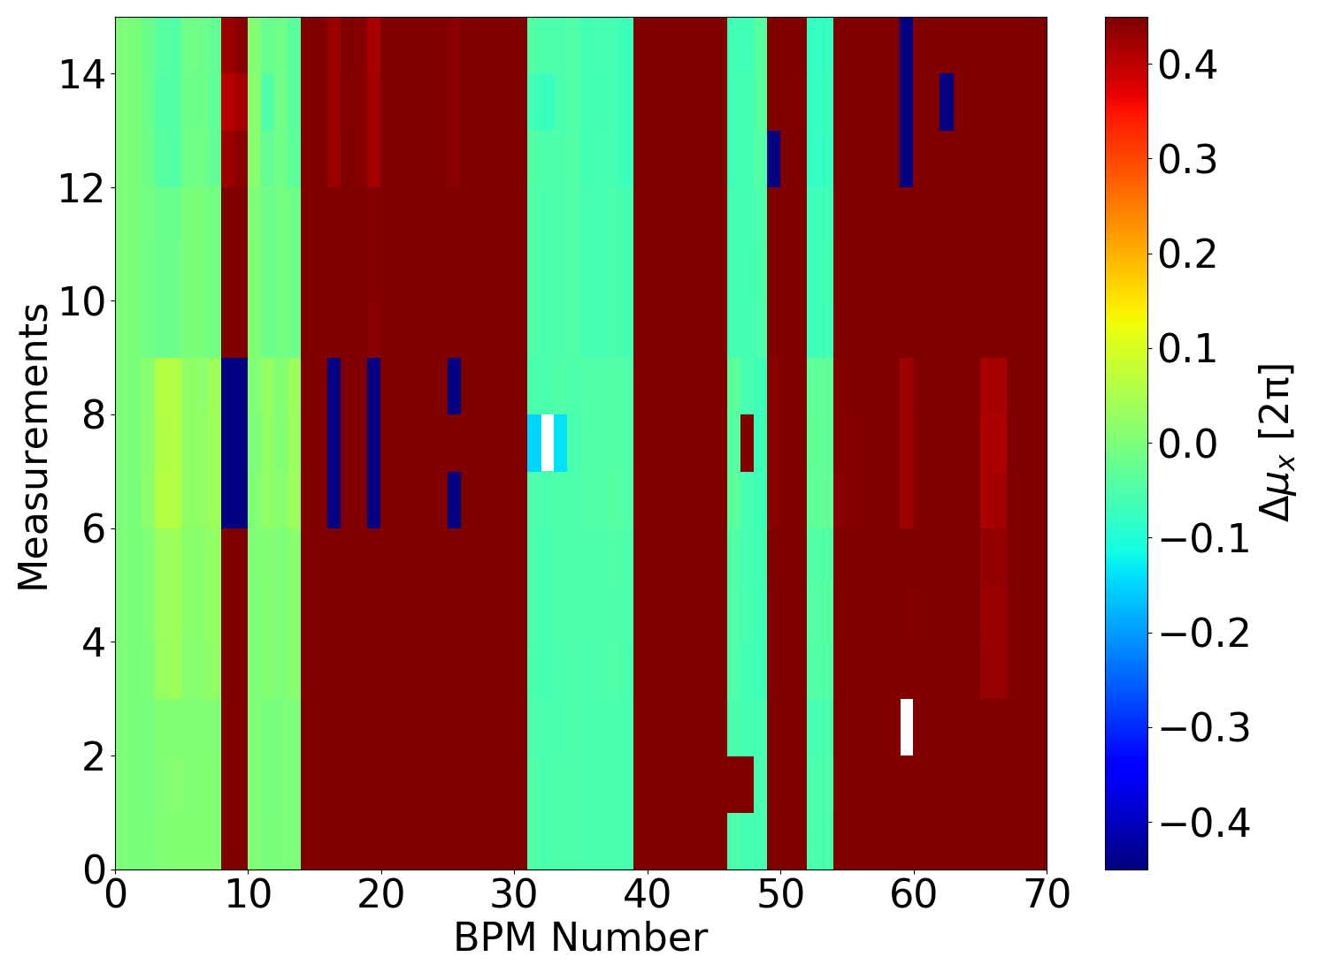
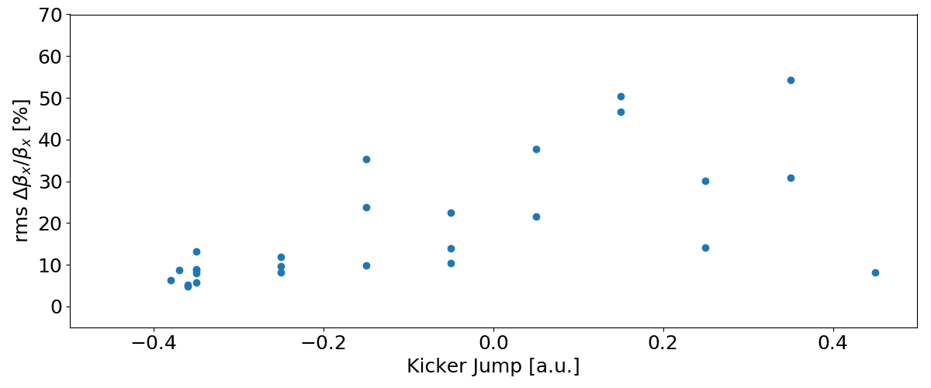
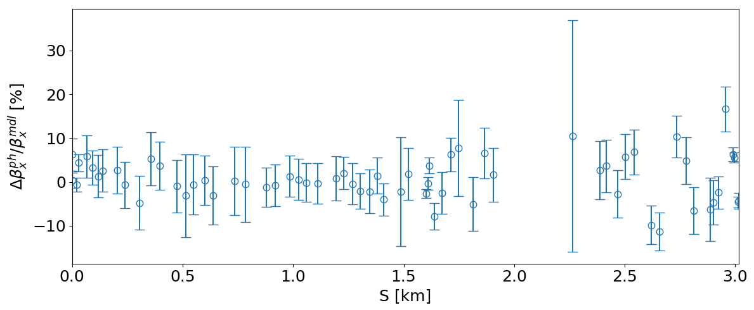
Secondment Task 1.2
LER BPM synchronization error – 2024 vs 2019
Name: Jacqueline Keintzel (Postdoc)
Institution: CERN
Dates: 03/02/2024 – 17/02/2024
Visiting Lab: SuperKEKB KEK
Objectives
Results
Ensure knowledge transfer for SuperKEKB optics measurements analysis code to international collaborators
Analyze BPM performance for turn-by-turn (TbT) measurements and comparison to previous data
Find improved settings to perform TbT optics measurements
Similar BPM synchronization found compared to 2019, however, fewer available BPMs in both rings
Injection kicker strengths scans revealed preferred settings for LER injection kicker for TbT measurements
Transverse optics could not be measured using purely longitudinal kicks
Transverse optics measurements successfully performed, which have shown 5 % rms beta-beating, however with large error bars (de-noising performed by collaborators)
No BPMs around non-linear collimator in 2024
7 May 2024
2nd EAJADE General meeting
7

Slide 8
Secondment Task 1.2
Name: Le Garrec Maël (PhD)
Institution: CERN
Dates: 03/03/2024 – 03/04/2024
Visiting Lab: SuperKEKB KEK
β-beating RMS under 5% horizontal and 15% vertical for most optics
Identification of sextupolar lines in the spectrum, corresponding to (1,2) and (3,0) resonances.
Some Resonance Driving Terms can be observed for the first time
Non-Linear chromaticity observed
Objectives
Results
Measure linear optics of SuperKEKb
Attempt non-linear measurements
Measure chromaticity

Slide 9
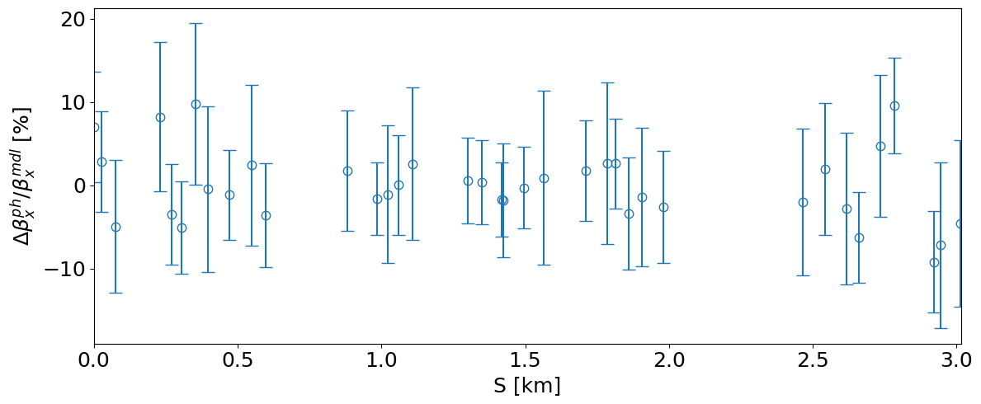
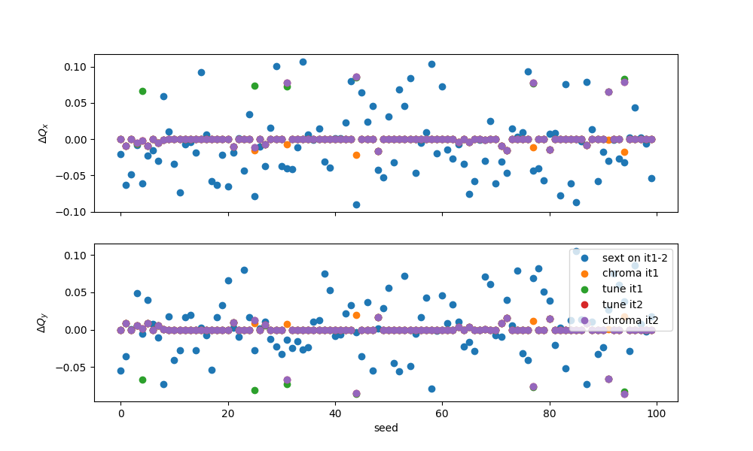
Secondment Task 1.2
HER H Kick 2024 Feb 07
Names: Barbara Dalena and Quentin Bruant (PhD)
Institution: CEA IRFU
Dates: 5/02/2024 -19/02/2024
Visiting Lab: SuperKEKB KEK
Training on machine commissioning, optics measurements and correction of electron positron accelerator and extrapolation in FCC-ee
Training in Dynamic Aperture measurements
Training in turn by turn BPMs optics measurements
Objectives
FCC-ee HEB linear imperfections study
Results
Turn-by-turn BPMs signals can provide beta-beating estimations with small error bars but with high beta-beating values for several BPMs.
These optics values reconstructed are highly dependent on the optics and measurements conditions.
Selecting quadrupole and sextupoles in the dispersion suppressor and matching section region (as in SuperKEKB) improves quality of tunes and chromaticity matching for the FCC-ee high energy booster.

Slide 10
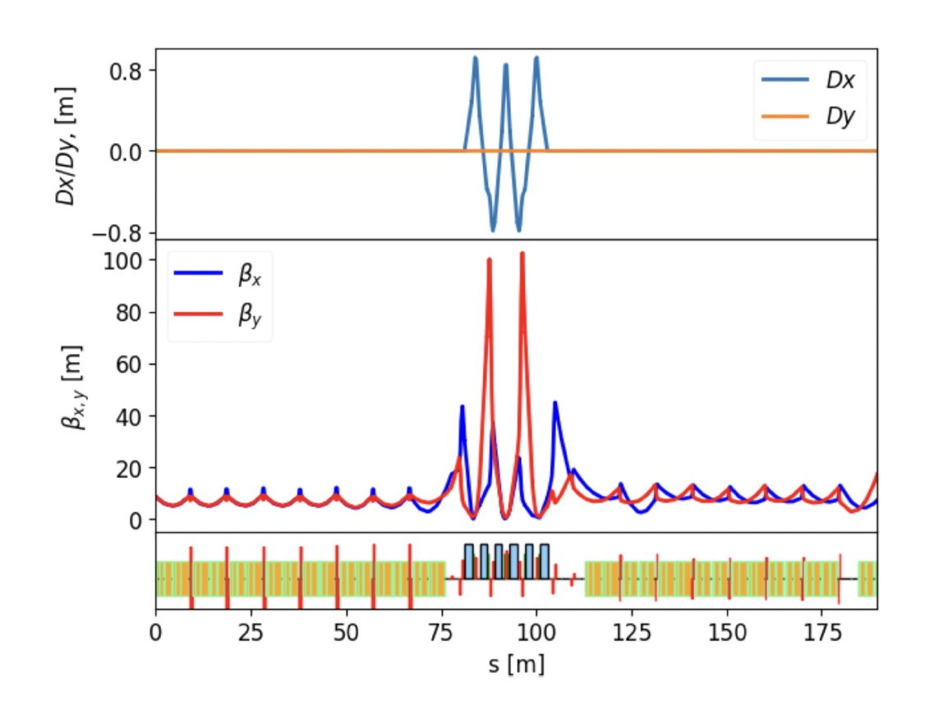
Secondment Task 1.2
Name: Ilya Agapov
Institution: DESY
Dates: 03/04/2024 – 12/04/2024
Visiting Lab: SuperKEKB KEK
Understanding luminosity performance limitations of SuperKEKB in view of FCC-ee
Taking part in the collider tuning in collision
Understanding the injector complex performance
Results
Objectives
Took part in several machine studies (non-linear collimator, luminosity tuning, injector tuning)
Converted linac optics from SAD to ocelot and performed beam dynamics modeling
Confirmed CSR-induced emittance growth in first linac part (‘JARC’)

Slide 11
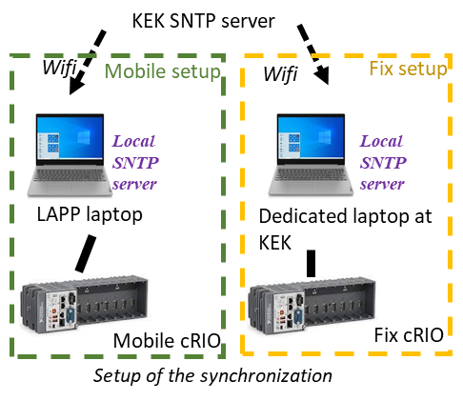
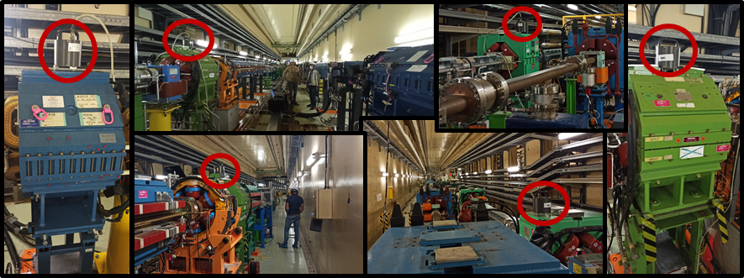
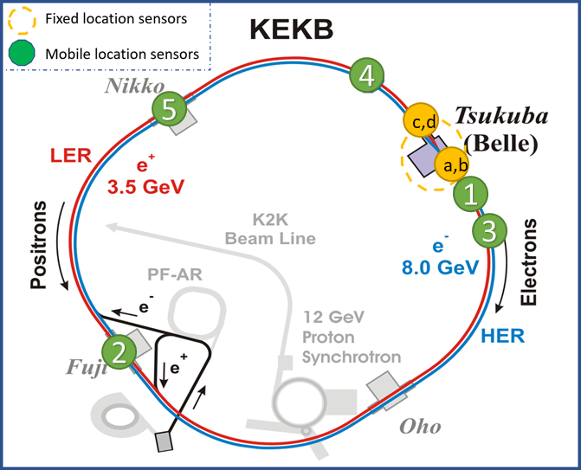
Secondment Task 1.2
Name: F. Poirier, G. Balik
Institution: LAPP - CNRS
Dates: 17/11/2023 - 24/11/2023
Visiting Lab: superKEKB KEK
Results
Objectives
Timing discrepancy measured of a few ms attributed to WiFi latency => No impact on the data
Measurements with permanent and mobile sensors on ground and quadrupoles vibration. Coherence power spectral density.
Real-time measurement and synchronization between both setup (using 2 national instrument cRIO and SNTP server synchronization) of vibration of GROUND and QLC7RE, QLC3RP, QX3RE, QLB1RE, QLB1RP, QLB1LE, QLB1LP, QW7NRP
Meeting with the SuperKEKB Diagnostics group: Identified a possible acquisition development via the TCA for IPBPM
Recalibration of the permanent sensors
Development of synchronization system for distant measurements
Perform first measurements of the vibration at several location around the SuperKEKB ring.
Exchange on potential data acquisition from IPBPM

Slide 12
Secondment Task 1.2
Name: Meng Li (PhD), Philip Bambade, Sandry Wallon
Institution: IJCLab - CNRS
Dates: PB: 23/09/2023 – 27/10/2023 and 15/02/2024 – 01/03/2024 , SW: 30/09/2023 – 07/11/2023 (break from 21/10/2023 – 05/11/2023), ML: 15/02/2024 -15/03/2024
Visiting Lab: SuperKEKB KEK
Validation of LumiBelle2 fast luminosity monitor data acquisition and handling and comparison with other luminosity measurements including the Belle II ECL and ZDLM devices. Definition of LumiBelle2 EPICS Process Variables suitable for usage in SuperKEKB IP beam tuning software according to beam conditions.
Improved realistic simulation of injection beam loss in HER of SuperKEKB following Expert advice at KEK
Joint measurements with SuperKEKB expert of injection efficiency during scan of injection parameters in HER (offset, angle, energy,...). First measurements of beam loss patterns at each turn using fast beam loss monitors at critical collimated distributed along the HER, synchronised with the WhiteRabbit protocol and triggered by the injection, both during dedicated injection tuning and during Physics Operation with continuous top-up injection.
Results
Inventory and functional tests of installed and spare LumiBelle2 sensors and amplifiers. Operational test and improvement of LumiBelle2 acquisition and data handling software in a modified setup in preparation for SuperKEKB 2024 operation
Check of LumiBelle2 fast luminosity monitor operation during starting phase of SuperKEKB 2024 operation
Collaboration with SuperKEKB and Belle II MDI staff on characterizing beam loss resulting from the continuous injection scheme of SuperKEKB
Objectives

Slide 13
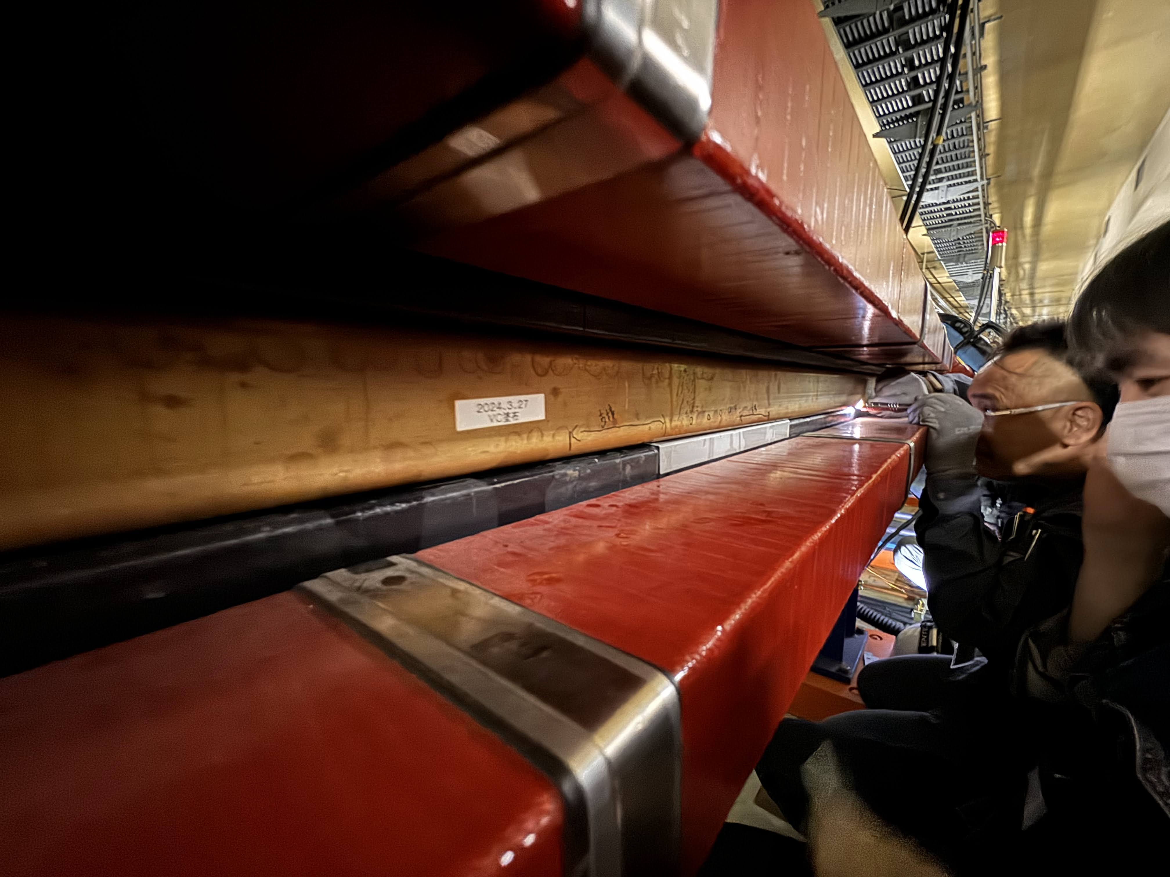
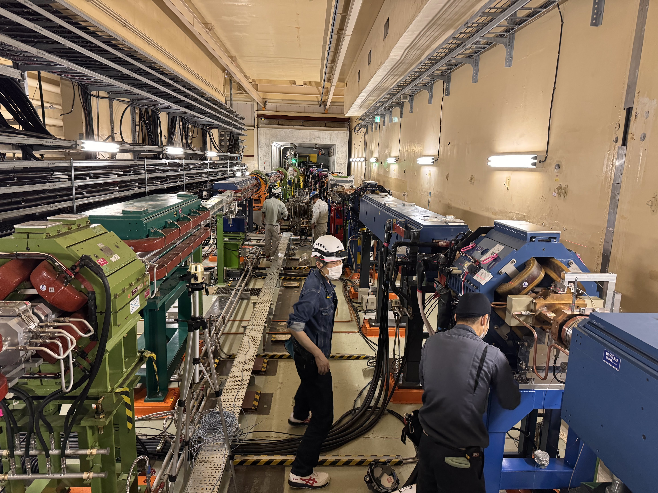
Secondment Task 1.2
Name: Marton Ady (Technical student)
Institution: CERN
Dates: 01/04/204 – 21/06/2024
Visited lab: KEK
Objectives
Observe commissioning of SuperKEKB thorugh daily control and weekly vacuum meetings, with focus on vacuum and synchrotron radiation issues
Visit machine and participate in vacuum maintenance tasks
As a tri-party collaboration (KEK, ALBA, CERN), perform photon simulated desorption measurements on different high-temperature superconductors at KEK’s Photon Factory
Top: vacuum leak detection in a dipole of the SuperKEKB beam pipe
Bottom: Mechanical support change near the Belle2 detector

Slide 14
Secondment Task 1.1/1.2
Name: Karsten Buesser
Institution: DESY
Dates: KEK: 22/9/2023 – 5/10/2023, SLAC: 13/05/2023 – 20/05/2023
Visiting Lab: ATF2 and SuperKEKB KEK and SLAC
Impact from beam parameters on interaction regions for ILC, FCC-ee
Looking for exchange of experience and possible collaboration with Belle-II/SuperKEKB
CFS/MDI Mini-Workshop (29 September 2023) https://indico.desy.de/event/40176/
International Workshop on Future Linear Colliders LCWS2023 https://indico.slac.stanford.edu/event/7467/
Discussions on MDI
Possible lessons from SuperKEKB/Belle-II
Mini-Workshop on CFS and MDI
Talks at LCWS2023
Results
Objectives

Slide 15
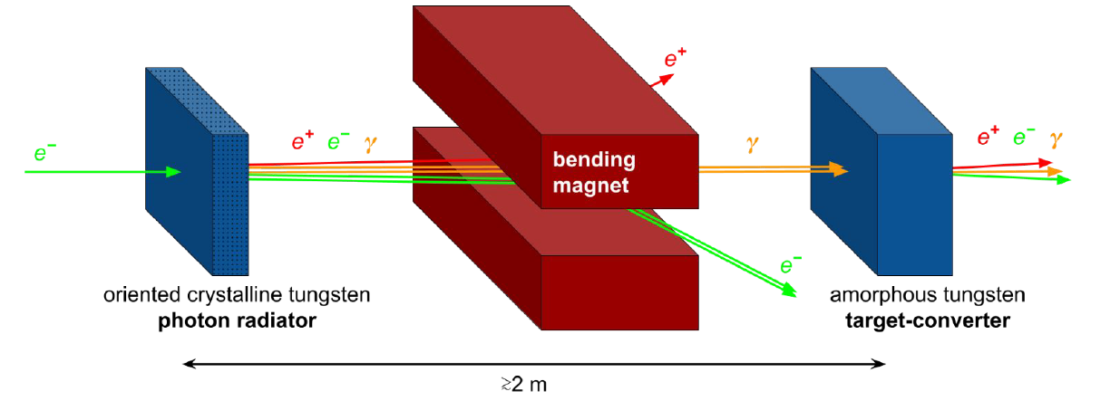
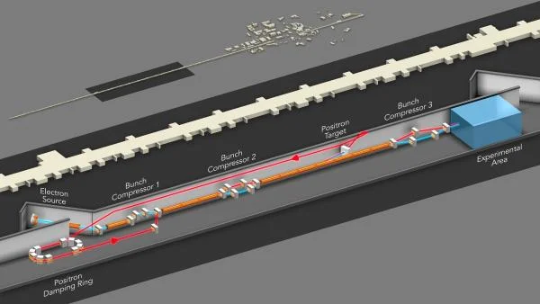
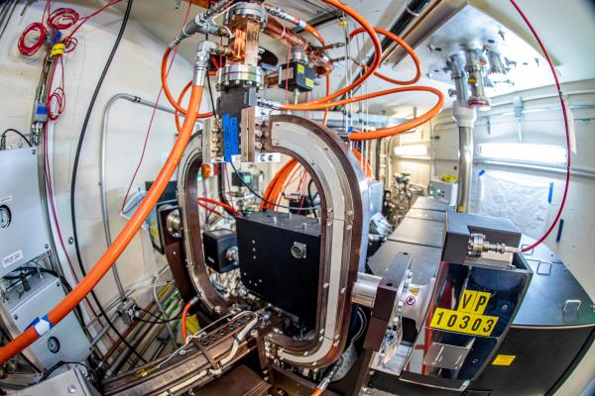
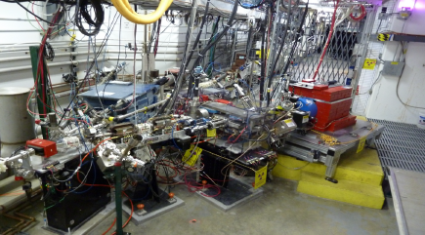
Task 1.3: e⁺ production for next e⁺e⁻ colliders (CNRS, CERN, 19 person-months)
Crystal-based target Hybrid scheme
SuperKEKB offers unique opportunities for pursuing significant research on positron production at a currently operating state-of-the-art facility, including the injector linac. The focus will be on novel hybrid targets and capture systems such as SC solenoids.
An innovative aspect is the prediction and control of the positron yield with advanced optimisation methods. SLAC also has a history of experience and expertise in designing and operating high-intensity positron sources, and is moreover nowadays much involved in novel laser- and beam-driven plasma accelerator concepts. FACET-II is the only facility providing high-energy positron beams for acceleration in plasmas, where advanced artificial intelligence (AI) based optimisation methods, e.g. to maximize the positron yield and control the plasma wakefield acceleration process, can be properly developed and assessed.
In addition, polarized positrons are essential for linear colliders. The polarized positron facility at JLAB will be ideal to gain experience with a low-energy conventional yet highly efficient positron source based on Bremsstrahlung from polarized electrons with subsequent positron capture, focusing both on assessing the corresponding production issues and scaling to high energy.
FACET II @ SLAC
Polarized Electrons for Polarized Positrons (PEPPo) @ CEBAF

Slide 16
Secondment Task 1.3
Name: Fahad Alharthi (PhD), Iryna Chaikovska, Viacheslav Kubytsky
Institution: IJCLab - CNRS
Dates: FA: 11/11/2023 - 23/12/2024 and IC and VK: 19/11/2023 - 25/12/2023
Visiting Lab: SuperKEKB KEK
Participation in the injector optimization and machine studies for the next SuperKEKB run in December 2023
Experimental campaign and data analysis for the benchmarking of the positron source simulation tools
Discussions and application of the AI-based optimization techniques for the positron sources
Discussions on the FCC-ee and ILC positron source common R&D studies
Results
Objectives
Exchange of experience in accelerator operation, and positron source operation and development in particular.
Successful experimental campaign, data taking. Preliminary data analysis and discussion.
Successful application of AI-based optimization technique (Bayesian optimization) to enhance positron source performance of SuperKEKB, demonstrating the potential for advanced optimization methods in positron injectors.
Productive discussions and alignment of research goals for common R&D studies on positron sources between FCC-ee and ILC. Exchange of information and data sharing for the simulations of the ILC positron production and capture.

Slide 17
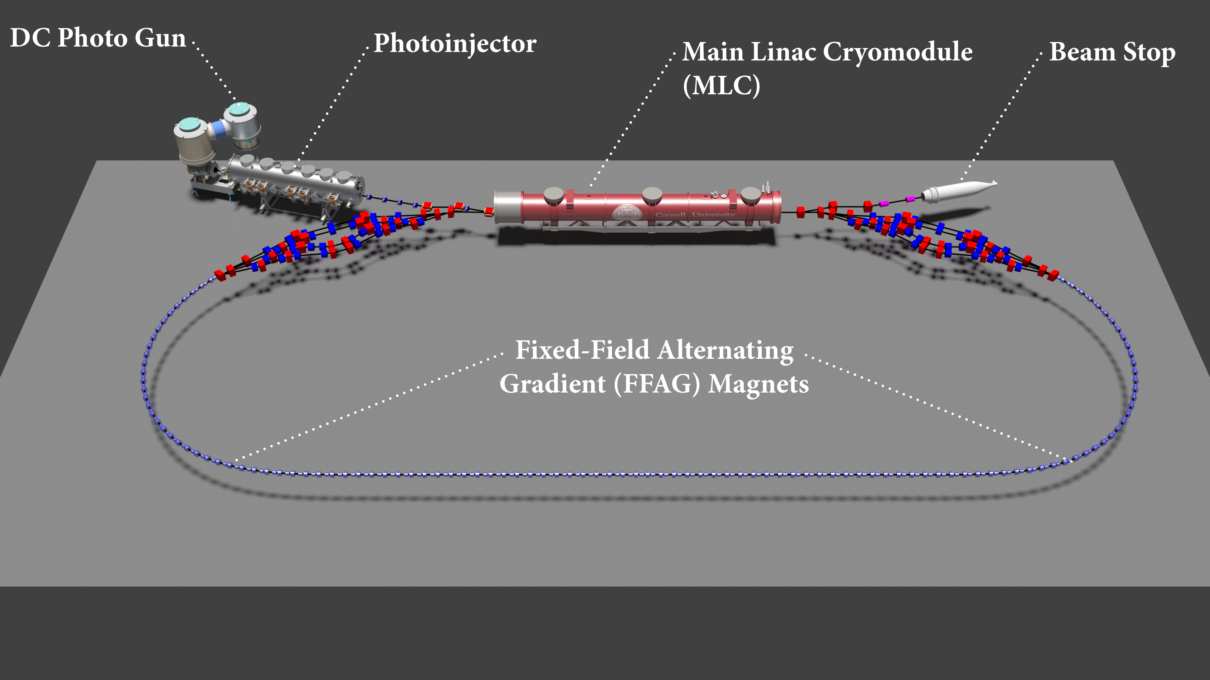
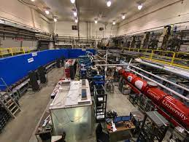
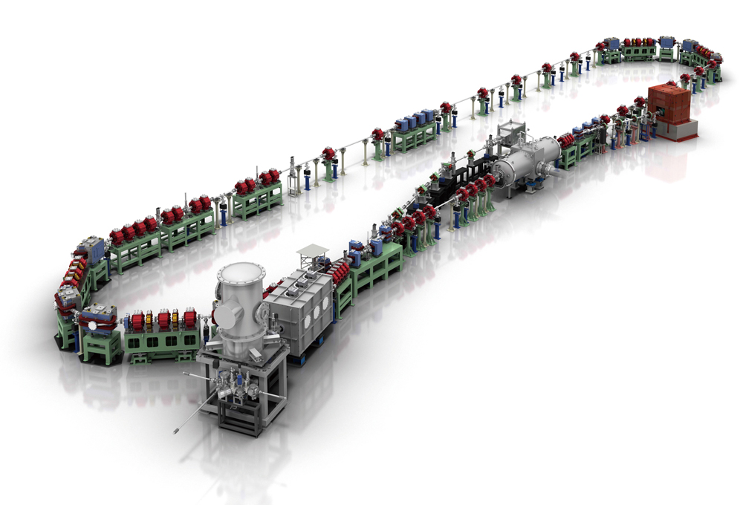
Task 1.4: R&D on Energy Recovery Linacs (CNRS, 6 person-months)
ERL technologies have been identified among the most promising alternatives to efficiently use the accelerated beams in future colliders, both linear and circular. Different ERL-based accelerators are now operating at JLAB, cERL in KEK and CBETA at Cornell University. Participating in the operation of these facilities will be a unique opportunity to assess the viability of this type of technology and consolidate the expertise of European staff. The main activities will be focused on (1) operation of DC-gun in high-current and dominated space charge regime, (2) multipass ERL operation, (3) HOM modes control and mitigation, (4) beam characterization, loss monitoring and control, fast feedback and mitigation techniques.
CBETA @ Cornell
eERL @ KEK

Slide 18
Secondment Task 1.4
Name: Alex Fomin
Institution: IJCLab - CNRS
Dates: 31/08/2023 – 29/09/2023
Visiting Lab: CEBAF JLab
Objectives
Results
Exchange of experience in the field of design, simulation, tolerance analysis and diagnostics of ERLs
Participation in the FFA’23 Workshop at JLab, Sept 10-15 2023
Optimisitation the PERLE lattice design.
Got acquainted with codes (ELEGANT and BMAD) used for CEBAF ERL tolerance analysis and correction scheme, and checked the possibility of their application for PERLE simulations
Lessons learned from CBETA commissioning: pros and cons of various schemes and hardware used for diagnostics and tuning
Gave a seminar: Lattice Design and Beam Dynamics Studies for PERLE

