Slide 1
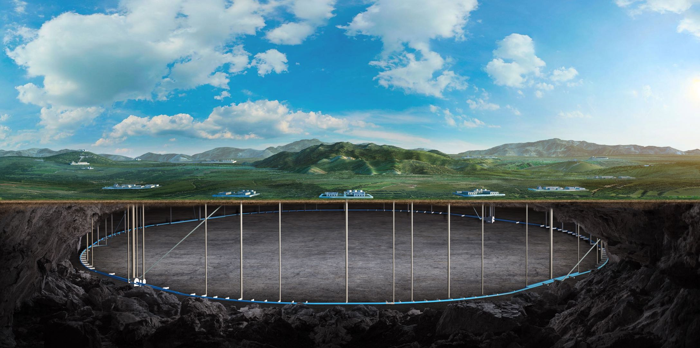
Radiation in the tunnel and its mitigation for CEPC EDR
Guangyi Tang
On behalf of CEPC RP Group
18-20. Sep. 2024, CEPC IARC meeting

Slide 2
Content
Introduction: what we did in TDR stage
EDR goal
EDR progress
Radiation in collider tunnel
Environment impact assessment
Summary and outlook

Slide 3
Radiological Impact
Main consideration aspects
Impact factors |  | Characteristics
Prompt radiation | Synchrotron radiation | Radiation damage to magnets coils; Over heat load to ventilation system; Formation of ozone and nitrogen oxides in the air; Slightly activation to the material around;
 | Random beam loss | Cause secondary radiation inside the tunnel; Determine the bulk shielding thickness;
 | Hot spots | MDI, collimators, collider/linac dumps, injection/extraction points;
Radiological impact on environment (induced radiation) |  | Dose from stray radiation emitted during machine running Radionuclides in the cooling water, underground water, tunnel air, soil/rock. Radioactivity analysis for the solid components and waste

Slide 4
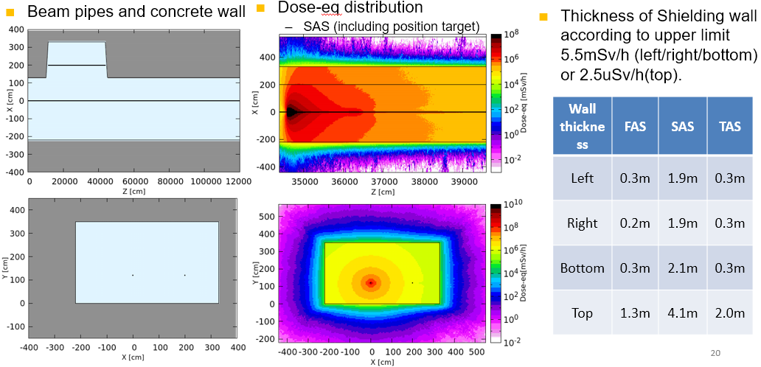
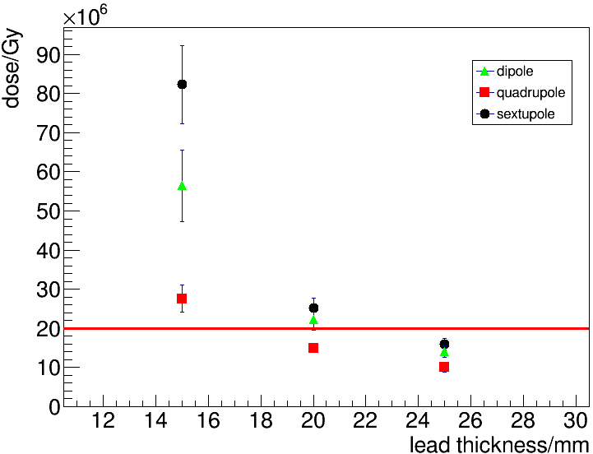
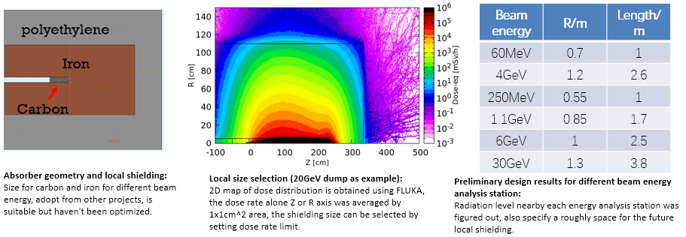
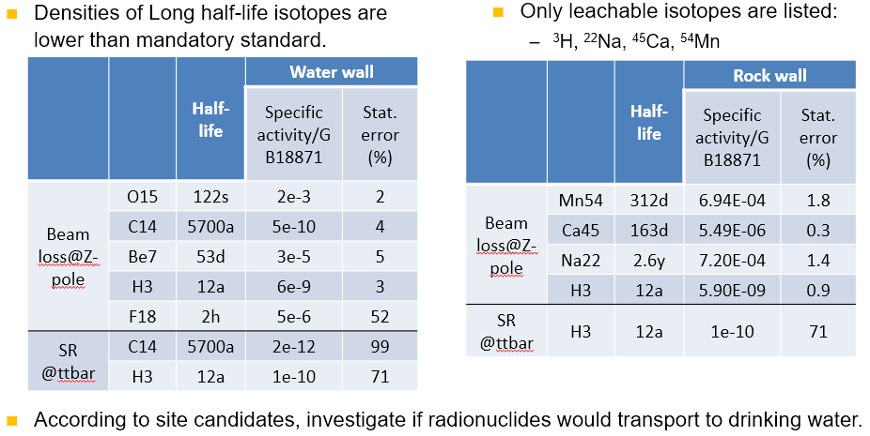
What we did in TDR
Estimate absorbed doses to booster and collider magnets and lead shielding design.
Absorbed dose after 18-year operation
Design linac and collider dumps
Determine linac bulk shielding
Radionuclide Production
In the air/water/tunnel wall in the linac/collider tunnel/dump hall

Slide 5
EDR goal
Radiation level simulation
Now, in the tunnel, linac, dump hall;
In the future, around collimators/injection point/extraction point, around IR (photon dump).
Environment impact assessment of CEPC proposal
Prompt radiation estimation
In linac, collider/booster, damping ring, transport line, collimator, RF hall, IR hall, SR hall, dump hall.
Induced radioactivity estimation
In linac, collider/booster, damping ring, transport line, collimator, RF hall, IR hall, SR hall, dump hall.
Design radiation dose monitor system
Design personal protection system
Radiation-sensitive equipment protection for CEPC
Electronics: power supply, BPM, control system, etc.
Optical fiber, Cable/insulation
Engineering design: support, cooling, …
First priority: lead cooling design

Slide 6
Content
Introduction: what we did in TDR stage
EDR goal
EDR progress
Radiation in collider tunnel and shielding
Environment impact assessment
Summary and outlook

Slide 7
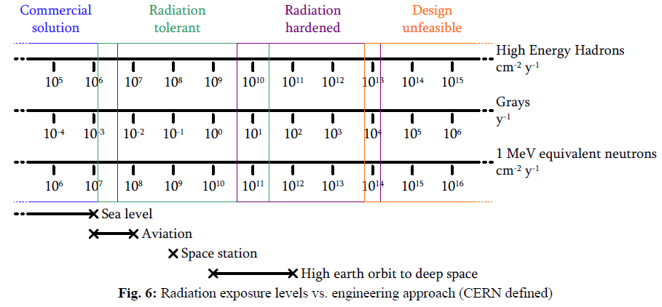
Radiation level for electronics, optical fibers and cables
Radiation-sensitive equipment: electronics, optical fibers and cables/insulations.
In the collider tunnel, the radiation level is much higher than in the linac/transport line/damping ring. Electronics in the collider tunnel without shielding may be broken soon.
First priority to design shielding in collider tunnel.
Use absorbed dose, 1MeV-equivalent neutron fluence and high energy hadron fluence to assess the radiation exposure levels.
For electronics:
High Energy hadron fluence < $2×{10}^{10} cm^{−2}y^{−1}$
Absorbed dose < 20 Gy/y
1MeV equivalent neutron fluence < $2×{10}^{11} cm^{−2}y^{−1}$
CAS - CERN Accelerator School: Power Converters, 245-263

Slide 8
Radiation level for electronics, optical fibers and cables
Radiation-sensitive equipment: electronics, optical fibers and cables/insulations.
In the collider tunnel, the radiation level is much higher than in the linac/transport line/damping ring. Electronics in the collider tunnel without shielding may be broken soon.
First priority to design shielding in collider tunnel.
Use absorbed dose, 1MeV-equivalent neutron fluence and high energy hadron fluence to assess the radiation exposure levels.
For optical fibers:
Absorbed dose < 100 Gy/y considered for ordinary optical fiber
Absorbed dose < 10 kGy/y considered for radiation-resistant optical fiber
Fiber routing and radiation protection under study
For cables/insulations:
Absorbed dose < 1 MGy considered for polyethylene

Slide 9
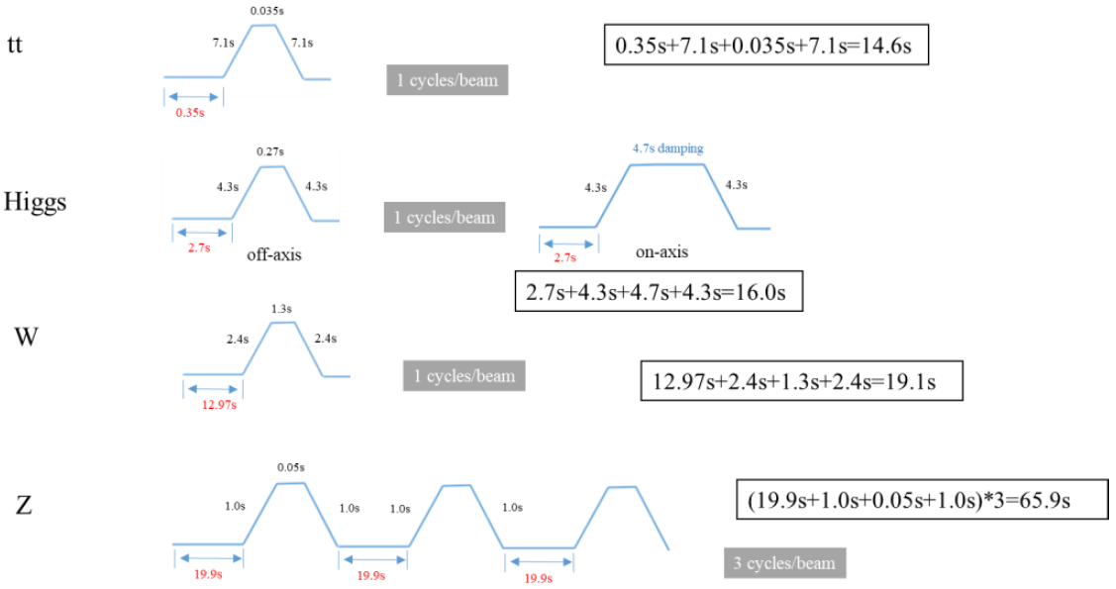
CEPC Parameters: 50MW
Collider
Assuming beam losses are uniformly distributed along beampipe.
For collider, $N_{beam}=N_{e}×\text{Exp}\text{(}−\frac{t}{life time}\text{)}$, then $Max\left(N_{beamloss}\right)=\frac{Ne}{life time}$.
For booster, $N_{beamloss}=\frac{\left(1−90\%\right)×Ne}{injection interval}$
Beam losses from collider (1st row) and booster (2nd row)
Booster (transport efficiency 90%)
 | Higgs | Z | WW | ttbar
Beam energy (GeV) | 120 | 45.5 | 80 | 180
Ne (${10}^{10}$) | 13$×$446 | 21.4$×$13104 | 13.5$×$2162 | 20$×$58
Current (mA) | 27.8 | 1340.9 | 140.2 | 5.5
Life time (min) | 20 | 81 | 25 | 18
 | Higgs | Z | WW | ttbar
Current (mA) | 0.98 | 14.4 | 2.85 | 0.11
Time with beams (s) | 23.4 | 125.7 | 33.3 | 15.0
Injection interval (s) | 38.0 | 153.5 | 155.0 | 65.0
 | Higgs | Z | WW | ttbar
$Max\left(Δcurrent\right)$ (mA/s) | 0.023 | 0.276 | 0.093 | 0.005
$Δcurrent$ (mA/s) | 0.003 | 0.009 | 0.002 | 0.0002

Slide 10
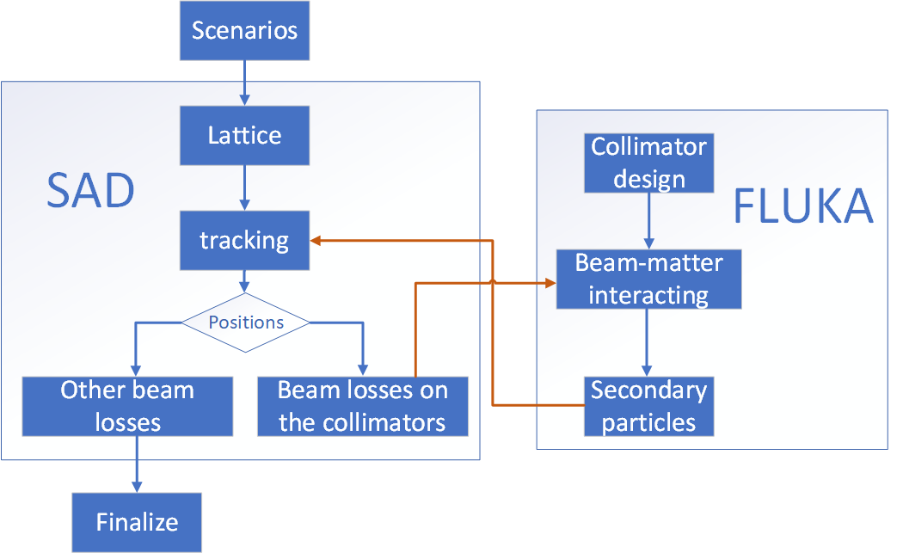
CEPC Parameters: 50MW
Booster (transport efficiency 90%)
Collider
No collimators effects in the random beam losses calculation.
The number of beam losses at non-collimation region using life time is conservative.
The local beam losses around collimators will be higher than random beam losses. Design local shielding carefully.
SAD + FLUKA simulation tool is well developed to estimate the radiation level in the tunnel. More realistic results than random losses cases will coming soon.
 | Higgs | Z | WW | ttbar
Beam energy (GeV) | 120 | 45.5 | 80 | 180
Ne (${10}^{10}$) | 13$×$446 | 21.4$×$13104 | 13.5$×$2162 | 20$×$58
Current (mA) | 27.8 | 1340.9 | 140.2 | 5.5
Life time (min) | 20 | 81 | 25 | 18
 | Higgs | Z | WW | ttbar
Current(mA) | 0.98 | 14.4 | 2.85 | 0.11
Time with beams(s) | 23.4 | 125.7 | 33.3 | 15.0
Injection interval(s) | 38.0 | 153.5 | 155.0 | 65.0

Slide 11
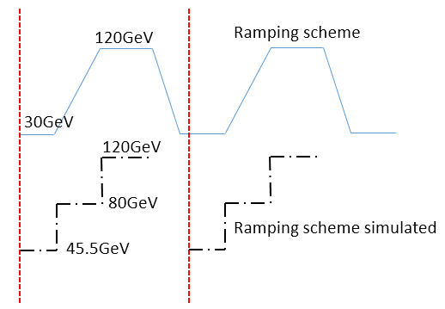
CEPC Parameters: 50MW
Booster (transport efficiency 90%)
Collider
With bending radius of 10.7km, the number of SR can be calculated using parameters above.
Ramping simulation: example @Higgs
More smooth ramping simulation than TDR.
 | Higgs | Z | WW | ttbar
Beam energy (GeV) | 120 | 45.5 | 80 | 180
Ne (${10}^{10}$) | 13$×$446 | 21.4$×$13104 | 13.5$×$2162 | 20$×$58
Current (mA) | 27.8 | 1340.9 | 140.2 | 5.5
Life time (min) | 20 | 81 | 25 | 18
 | Higgs | Z | WW | ttbar
Current(mA) | 0.98 | 14.4 | 2.85 | 0.11
Time with beams(s) | 23.4 | 125.7 | 33.3 | 15.0
Injection interval(s) | 38.0 | 153.5 | 155.0 | 65.0
In TDR
Now
120 GeV
120 GeV
Ramping scheme simulated
30 GeV
30 GeV

Slide 12
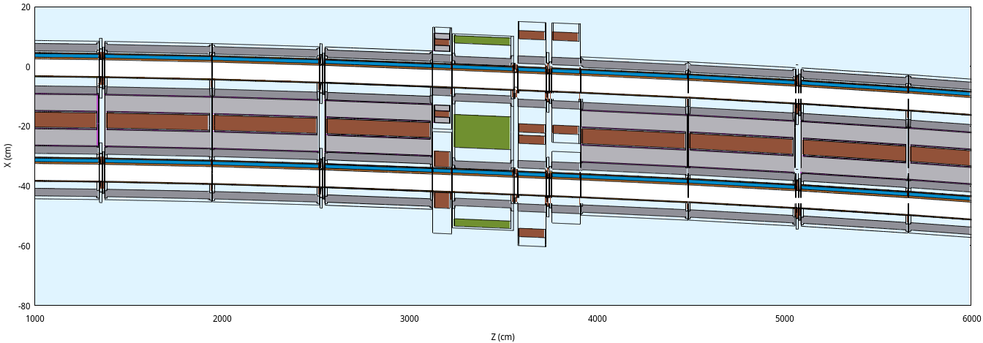
Simulation Setup: collider arc
According to mechanical arrangement
Dipoles with bellows and pumps -> Correctors -> Quadrupole -> BPMs -> Sextopoles -> Dipoles with bellows and pumps

Slide 13
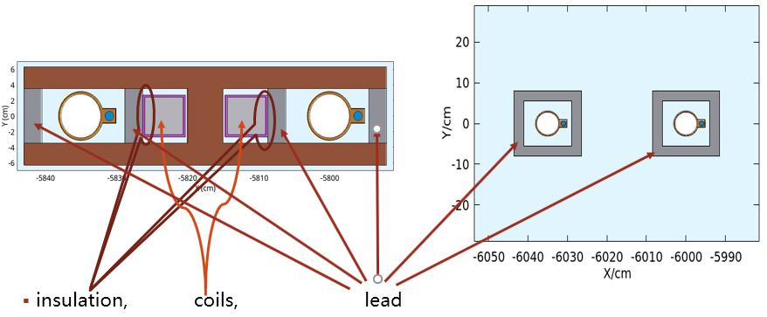
Simulation Setup: collider magnet and beampipe
Dipole
Insulation, coil, lead
Drift chamber

Slide 14
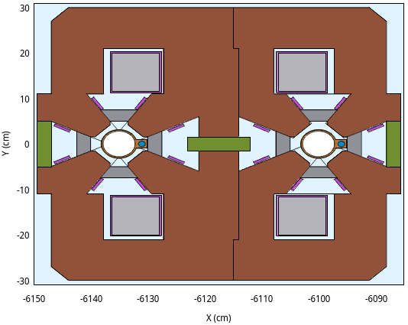
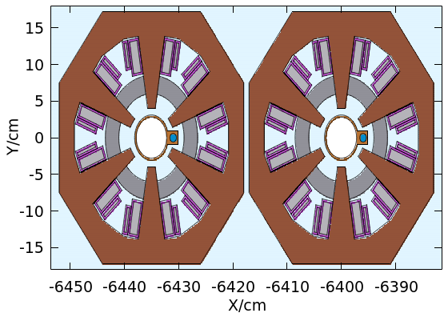
Simulation Setup: collider magnet
Sextupole
Quadrupole (new)
Insulations, coils lead

Slide 15
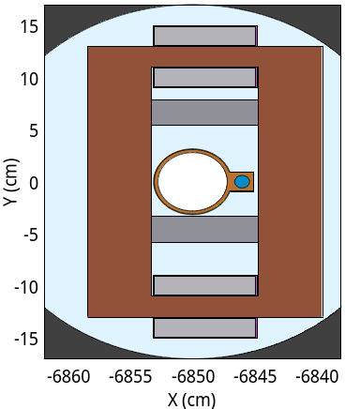
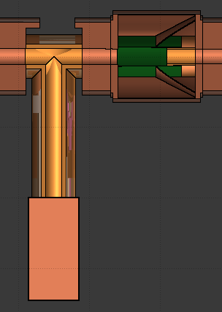
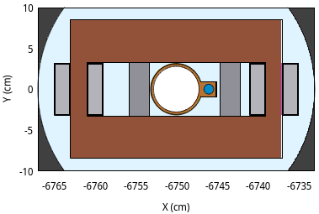
Simulation Setup: collider magnet, etc.
Vertical and horizontal corrector
Also, 2.5 cm lead in the correctors.
Pump and bellow for collider

Slide 16
Simulation Setup: booster arc
According to mechanical arrangement
Dipoles with bellows and pumps -> Sextopole -> bellow, pump and BPM -> Quadrupole -> Corrector -> Dipoles with bellows and pumps

Slide 17
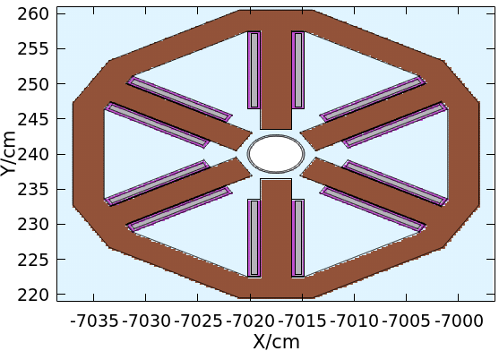
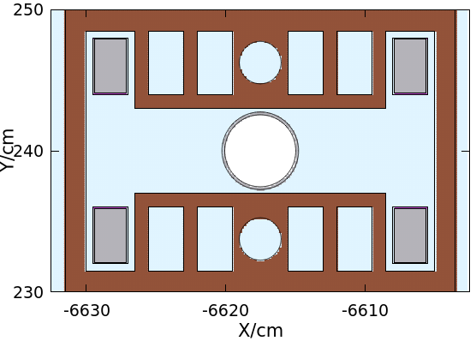
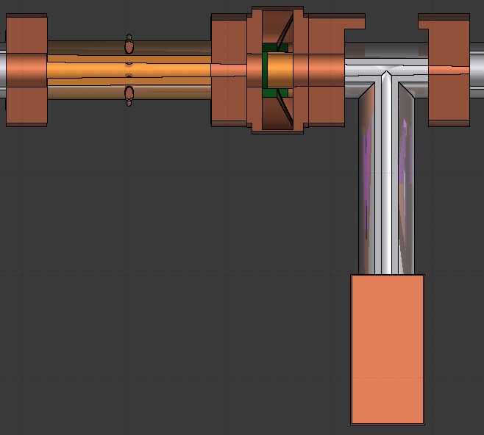
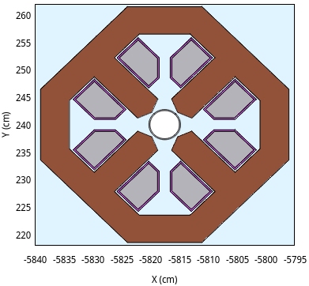
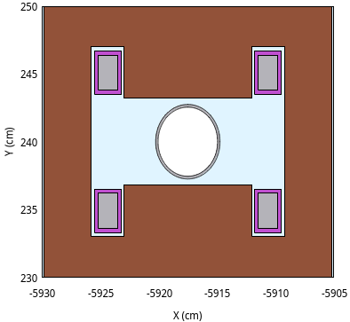
Simulation Setup: booster magnet, etc.
Magnets
BPM, bellow and pump for booster

Slide 18
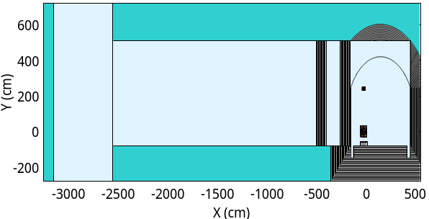
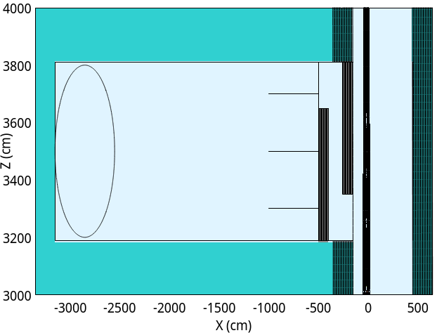
Simulation Setup: collider tunnel
Use maze, cable trench and gap between supports to shield radiations
Roughly, 70k electronics in the tunnel: magnet power supplies, beam instrumentation devices, etc.
Most of electronics (more then 50k) are placed in auxiliary tunnel behind maze, others (less than 20k) are placed in gaps between supports
Most of optical fibers and cables are placed in trenches, others are closed to beampipes
X-Y/X-Z cross section of the collider and auxiliary tunnel
3-leg maze with 1m-thick concrete wall
Cable trenches close to the wall of the tunnel contain optical fibers and cables.
Collider tunnel
Maze
Maze
Auxiliary tunnel
Booster
Auxiliary tunnel
Collider
Inner trench outer trench

Slide 19
Simulation Setup: support and shielding
Y-Z cross section of supports and shields between supports.
Each dipole has 4 supports, the spaces between supports are shielded with lead and concrete.
Each quadrupole has 3 supports, the spaces between supports are shielded with lead and concrete.
Booster
Collider

Slide 20
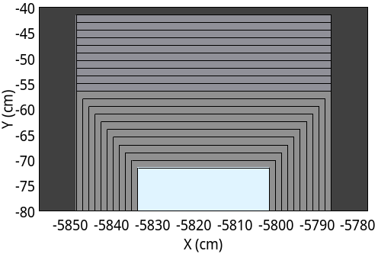
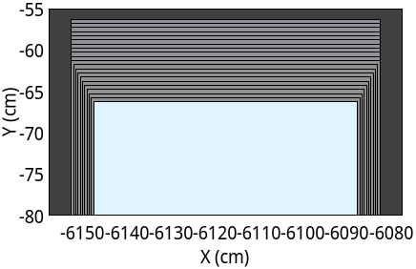
Simulation Setup: support and shielding
$∩$-shape shielding between supports
Concrete frame covered by lead
∩-shape : lead cover + concrete frame
Notes:
∩: intersection

Slide 21
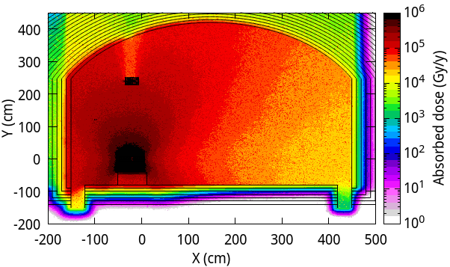
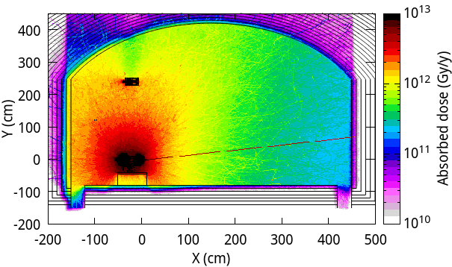
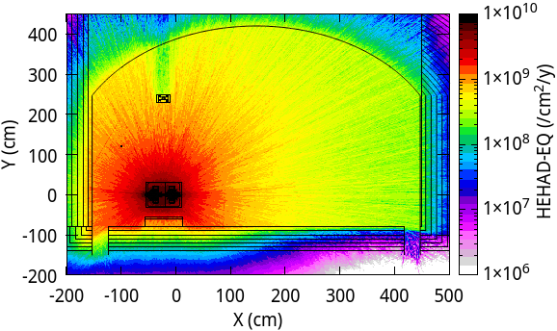
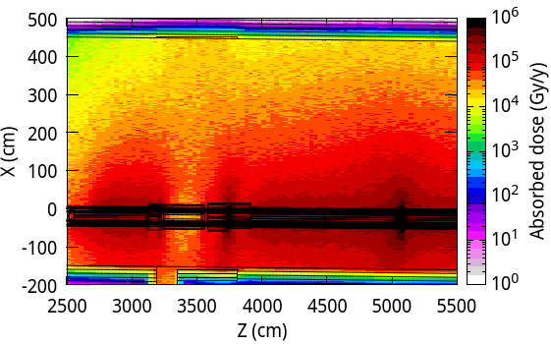
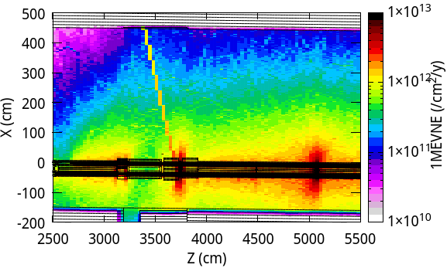
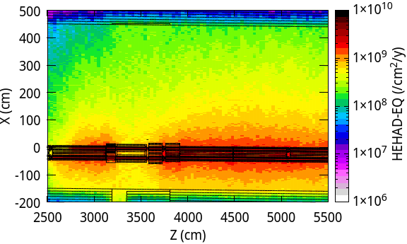
Radiation @180 GeV
Absorbed dose, 1MeV-equivalent neutrons and high energy hadron fluences
Upper limit:
20 Gy/y
$2×{10}^{11} cm^{−2}y^{−1}$
$2×{10}^{10} cm^{−2}y^{−1}$

Slide 22
Radiation in the auxiliary tunnel and in gaps between supports
For electronics
With a 3-leg maze, radiation in the auxiliary tunnel decreases to a safe level
By shielding with 20cm lead and 20cm concrete, radiation in gaps between supports decreases to a safe level.
Optimize the thickness of lead and concrete, and engineering design is needed to realize this structure.
 | Upper limit | 3-leg maze with 1m-thick concrete wall | 20-cm lead + 20-cm concrete | 15-cm lead + 15-cm concrete
High energy hadron fluence (${cm}^{−2}{ y}^{−1})$ | $$2×{10}^{10}$$ | $$<3×{10}^{6}$$ | $$\text{< }3×{10}^{8}$$ | $$\text{< }6×{10}^{8}$$
Absorbed dose (Gy/y) | 20 | $\text{< }\text{1}\text{0}$ (1m far from entrance) | <20 | <80
1MeV equivalent neutron fluence (${cm}^{−2}{ y}^{−1})$ | $$2×{10}^{11}$$ | $$<3×{10}^{8}$$ | $$\text{< }3×{10}^{10}$$ | $$\text{< }4×{10}^{10}$$

Slide 23
Radiation in trenches
Upper limit for ordinary optical fiber: absorbed dose < 100 Gy/y Upper limit for radiation-resistant optical fiber: absorbed dose < 10 kGy/y
Radiation-resistant optical fibers are safe in the inner trench with thicker-than-30cm concrete cover and safe in the outer trench thinner-than-10cm concrete cover.
Ordinary optical fibers need thicker shields.
For cables and insulations (polyethylene): absorbed dose <1 MGy
Cables are safe in the trench with concrete cover.
The shielding for cables close to the beampipe and for ordinary optical fibers are under studying.
 | Trench with no cover | Trench with 10-cm concrete cover | Trench with 30-cm concrete cover
inner trench | <400 kGy/y | <200 kGy/y | <40 kGy/y
outer trench | <50 kGy/y | <5 kGy/y | <300 Gy/y

Slide 24
Content
Introduction: what we did in TDR stage
EDR goal
EDR progress
Radiation in collider tunnel
Environment impact assessment
Summary and outlook

Slide 25
Environment impact assessment
In TDR stage, the linac bulk shielding, dumps are designed, radionuclide productions and toxic gases for linac/collider tunnel/dump hall are estimated.
In EDR stage, the bulk shielding of damping ring/transport lines/RF hall/IR hall/SR hall will be determined, so are the radionuclide and toxic gas productions.
The beam losses for damping ring/transport lines are estimated. Conservative parameters are listed bellow.
The parameters for transport line from collider/booster to dump will be estimated with machine protection system design.
Position | Length | Beam energy | Number of bunches [s⁻¹] | Beam loss/bunch [nC] | Number of particles [$10^{10}$/s]
Damping ring | 147 m | 1.1 GeV | --- | 37 | 24
Linac to Damping ring | 120 m | 1.1 GeV | 200 | 0.04 | 5
Linac to Booster | 1500 m | 30 GeV | 200 | 0.04 | 5
Booster to Collider | 240 m | 120 GeV | 35 | 0.12 | 2.6
Collider/Booster to Dump | 100 m | --- | --- | --- | ---

Slide 26
Environment impact assessment
Radiation Dose Monitor System and Personal Protection System are begin to design, based on HEPS and CSNS experiences.
Begin writing the document, based on experiences on HEPS and CSNS.

Slide 27
Summary and outlook
Environment impact assessment of CEPC proposal will be finished in the middle of 2025.
Electronics in the auxiliary tunnel and in gaps between supports are safe.
Maze, lead and concrete shielding can reduce radiation to a safe level.
Engineering designs are needed.
Radiation-resistant optical fibers can be placed in trenches with cover
Ordinary optical fibers cannot
Cable/insulation (polyethylene) can be placed in trenches with cover.
Validation between simulations and measurements based on HEPS are on the way.
2024/12
2025/06
2026/12
MC simulation
Environment impact assessment
radiative-sensitive equipment shielding
HEPS tunnel
Thank you

