Slide 1


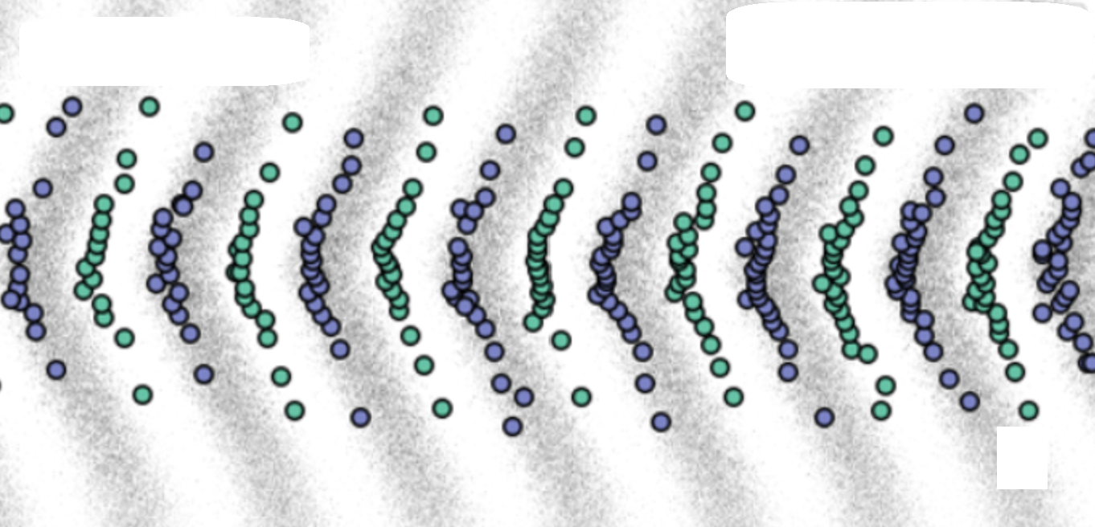
On capture and acceleration of slow muon (from MeV to GeV) beam by plasma wakefield
Xuezhi Wu，Xinlu Xu，Xueqing Yan
School of Physics, Peking University Beijing Laser Acceleration Innovation Center
CEPC Workshop
2024.10.25
xz.wu@pku.edu.cn
Notes:
Hello everyone, I am Xuezhi Wu from Peking University. This presentation was originally supposed to be delivered by my advisor, Professor Yan. Howver today, on his behalf, I am honored to share with you our recent explorations in accelerating low-energy muons using laser-driven plasma wakefields. The title of my presentation is:
各位老师、同学下午好，我是来自北京大学物理学院的吴学志，非常荣幸有机会在这里向大家汇报我们近期在使用激光驱动的等离子体尾波场来加速低能谬子的一些探索。

Slide 2


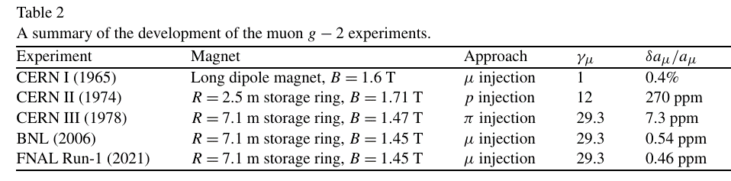

Muon
An unstable fundamental particle with a short lifetime at rest, 2.2 $μ$s, Mass: ~207 $m_{e}$.
To explore the physics beyond the Standard Model: Muon collider; Precise measurement of the anomalous magnetic moment, ...
Applied physics: 𝜇SR (muon spin spectroscopy), muon radiography …
The measured value is approximately 3 standard deviations from the Standard Model prediction
A. Keshavarzia, et al., Nuclear Physics B 975 (2022) 115675.
Notes:
First, let me briefly introduce the muon. A muon is an unstable fundamental particle, which can be understood as a larger electron, but with a short lifttme, 2.2 microsecond. Muons are important in both fundamental and applied sciences. Recently, both the U.S. and Europe have highlighted the need to build muon colliders. Another important topic is the muon's anomalous magnetic moment. Experiments show that the muon's magnetic moment differs from what the Standard Model predicts by three standard deviations. Measuring this precisely could help verify the Standard Model or even uncover new physics. In applied science, muon spin spectroscopy is crucial for studying superconducting and magnetic materials, and muon radiography has numerous applications.
之前不少报告中都提到了谬子，简单说，它是第二代基本粒子，可以认为是大号的电子，它的质量是电子的200多倍，它不稳定，静止寿命2.2微秒。
作为一种基本粒子，谬子在基础科学和应用科学上都有着重要的价值。基础科学上，近期美国和欧洲都指出了建设谬子对撞机的紧迫性；另一个重要的事情是谬子反常磁矩，实验中测得谬子磁矩偏离标准模型理论预测3个标准差，对它的精确测量不仅有助于验证标准模型，还可能揭示新物理的存在。
在应用科学上，谬子自旋谱学也就是uSR是研究超导和磁性材料的重要方法；谬子成像有着很多应用场景。

Slide 3
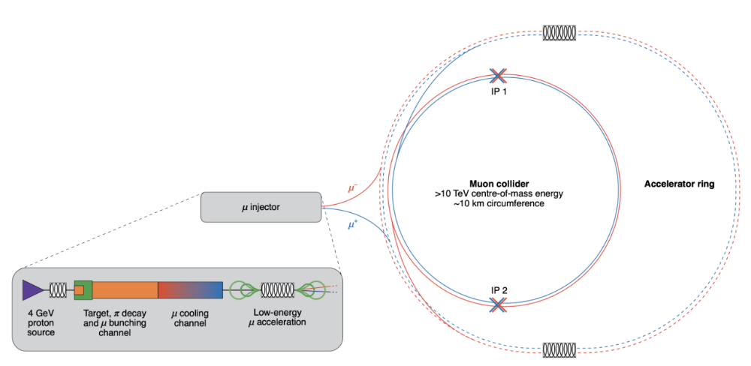
Muon Collider
Compared to electron-positron colliders, much less synchrotron radiation losses
10 TeV muon collider would provide similar discovery potential to a 100 TeV proton-proton collider (100-km-long Future Circular Collider (FCC-hh)
… we recommend targeted collider R&D to establish the feasibility of a 10 TeV pCM muon collider.
The U.S. Particle Physics Project Prioritization Panel (P5) report, 2023
“An increased level of R&D effort is justified at the current time, because the muon collider promises an alternative path toward high-energy, high-luminosity lepton collisions that extends beyond the expected reach of linear colliders.”
- CERN's accelerator R&D roadmap, 2022
Notes:
In recent years, the international high-energy physics community has shown great interest in muon colliders. This is because, compared to electron colliders, muons have much lower synchrotron radiation losses due to their heavier mass. This means that muon colliders can achieve higher energy levels in the same size. Compared to proton colliders, muons, being fundamental particles, have a simpler structure, offering significant advantages in precision, background noise, and collision mechanisms. A 10 TeV muon collider has a similar potential for discovering new physics as a 100 TeV proton collider.
The U.S. P5 report released last year clearly stated the goal of pursuing research and development for a 10 TeV muon collider. Similarly, the European accelerator research and development roadmap from 2022 emphasized strengthening efforts for muon colliders.
近几年，国际高能物理界对谬子对撞机产生了浓厚的兴趣。这是因为相比于电子对撞机，谬子由于其更重的质量，它的同步辐射损失远低于电子对撞机，也就是说在同样的尺寸时，谬子对撞机的能量可以更高。相比于质子对撞机，谬子作为一种基本粒子，结构简单，在精确度、背景噪声、碰撞机制等方面具有显著优势。10 TeV的缪子对撞机与100 TeV的质子对撞机有类似的探索新物理的可能性。
在去年出炉的美国P5报告中明确指出要以10TeV谬子对撞机为目标进行R&D。22年的欧洲加速器R&D计划中也指出要加强谬子对撞机的R&D。

Slide 4
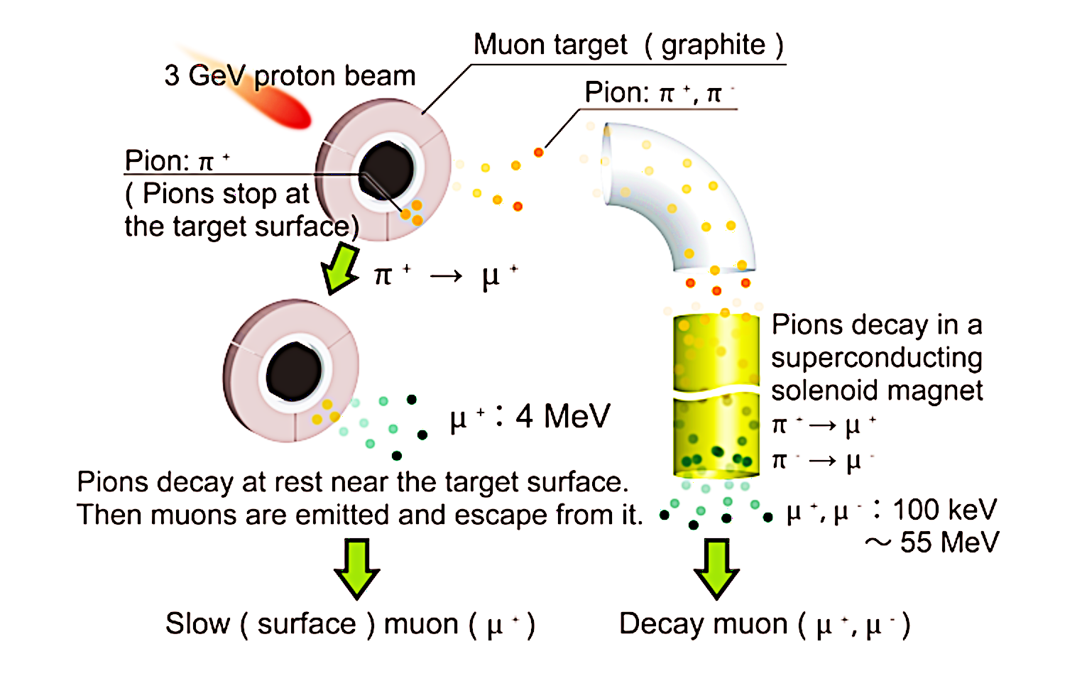
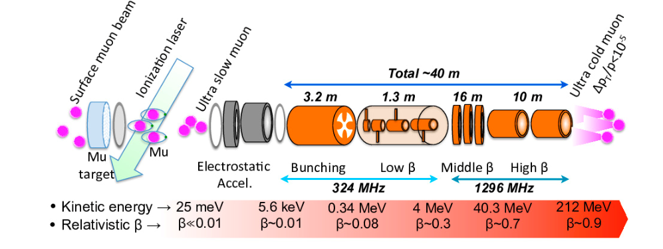
Muon acceleration
Source：~GeV proton beam bombards with a low-Z target. surface muon：~4 MeV μ⁺ ; decay muon：μ⁺ μ⁻ with a continuous energy spectrum
Acceleration: Cooling and Multiple structures
β
Cooling
Electrostatic acceleration
Radio-frequency quadrupole linac (RFQ)
Drift tube linac (DTL)
Disk-and-washer coupled cavity linac (DAW)
R. Kitamura et al., IOP Conf. Series: Journal of Physics: Conf. Series 874 (2017) 012055.
Notes:
These important applications of muons need high-energy, high-quality muon beams. Let's look at how muons are currently produced and accelerated.
The main way to produce muons is by using GeV proton beams to hit low-Z targets, creating muons through nuclear reactions. There are two main types of muons produced: surface muons with about 4 MeV energy, and decay muons with a continuous energy spectrum.
Because muon sources have a large emittance, muons usually need to be cooled before being collected and accelerated. As muons speed up, different accelerators are used at different stages. For example, the 210 MeV muon accelerator at Japan‘s J-PARC, which is used for precise measurements of muon anomalous magnetic moment, uses a series of accelerators: an electrostatic accelerator, a radio-frequency quadrupole (RFQ), a drift tube accelerator, and a disk-and-washer (DAW) linac.
谬子的这些重要应用都要高能高品质的谬子束流。让我们看看现在的谬子产生与加速。
主流的谬子产生方案是用GeV高能质子束打low z靶，通过一系列核反应产生谬子。主要的谬子产物分为两类：第一种是能量在4MeV附近的表面谬子；另一种是能谱连续分布的衰变谬子。
由于谬子源的发射度极大，一般需要先将谬子进行冷却，然后再进行收集加速。在整个加速过程中，谬子的速度变化极大，在不同的速度阶段需要使用相应的加速器。如左图日本J_PRAC为反常磁极精确测量设计的210 MeV 谬子加速器，就依次使用了静电加速器，射频四极场加速器（ RFQ ），漂移管加速器，盘荷波导结构（DAW）的直线加速器。

Slide 5
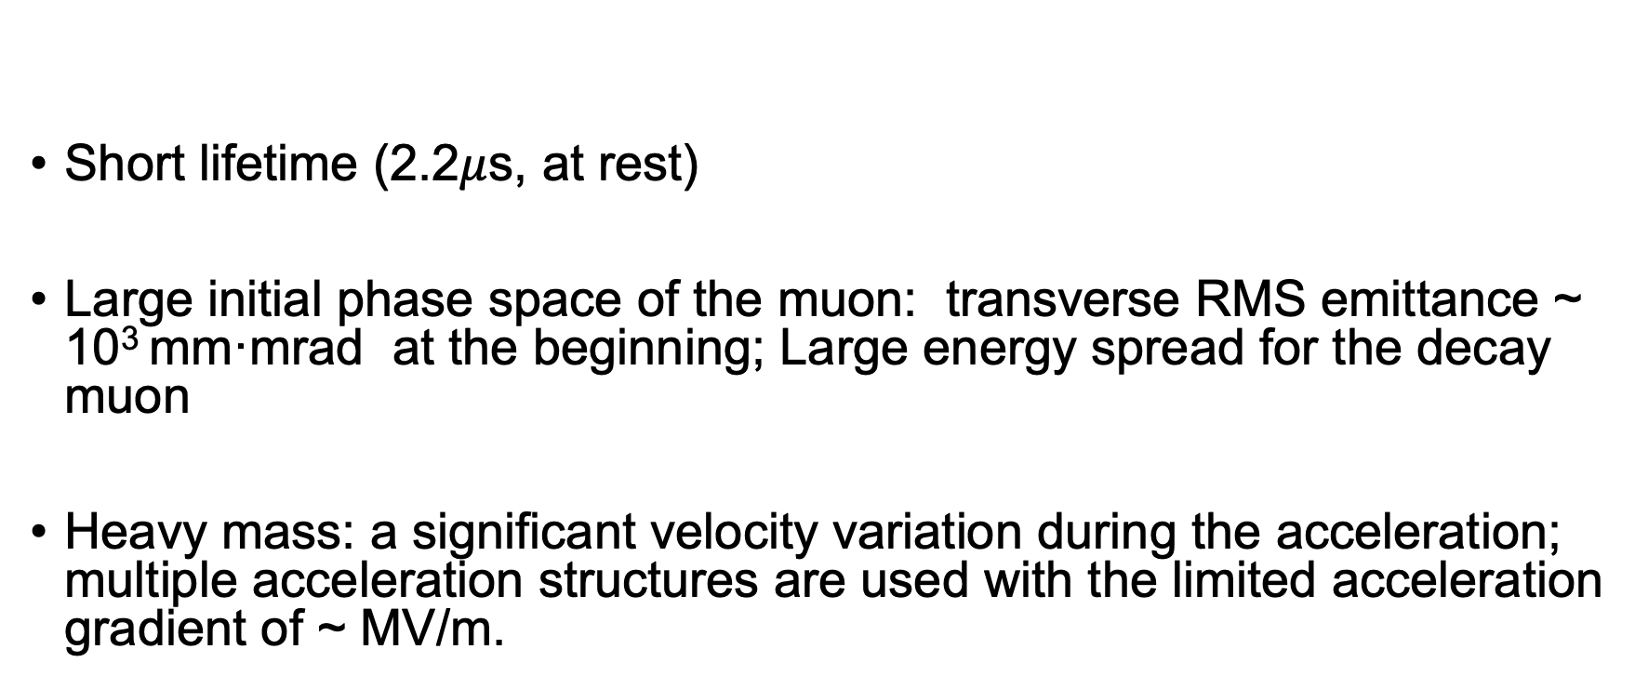
Challenges of Muon accelerator:
Short lifetime (2.2$μ$s, at rest)
Large initial phase space of the muon: transverse RMS emittance ~ 10³ mm·mrad at the beginning; Large energy spread for the decay muon
Heavy mass: a significant velocity variation during the acceleration; multiple acceleration structures are used with the limited acceleration gradient of ~ MV/m.
Notes:
To summarize the challenges of muon acceleration:
Muons have a microsecond-level lifetime, so they need to be cooled and accelerated very quickly.
The large phase space volume at the source makes collection very challenging.
Due to the muon's large mass, its speed changes significantly during acceleration. A single type of accelerator can't bring it close to the speed of light, so multiple types of accelerators are needed for different speeds. This makes the acceleration structure complex, with acceleration gradients of several MV/m.
We note that the short lifetime of muons actually favors high-gradient acceleration methods.
总结一下谬子加速所面临的挑战：
1. 它的微秒级寿命需要尽快的加速
2. 谬子源处相空间体积大，对收集造成了巨大的挑战。
3. 由于谬子的大质量，加速过程中速度变化大，无法使用单一种类的加速器将其加速至近光速，需要多种适合不同速度的加速器联合使用，整个加速结构复杂，加速梯度为数MV/m。
我们注意到谬子的短寿命其实是青睐高梯度的加速方式。

Slide 6

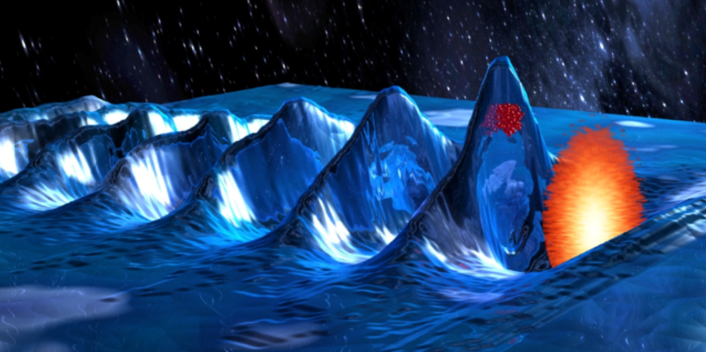
Laser Wakefield Acceleration
Wakefields induced by ultra-short, ultra-intense lasers in plasma with phase velocities close to the speed of light.
Extremely high acceleration gradient: ~GV/cm
Record electron acceleration energy: ~10 GeV over 30 cm plasma [A. Picksley et al., arXiv:2408.00740]
Light electrons quickly approach the speed of light and achieve phase locking with the wakefield.
Heavy muons move slower and rapidly slip out of the acceleration phase.
electron
Laser
Wakefield
Image: https://loa.ensta-paris.fr/research/upx-research-group/laser-wakefield-acceleration-lwfa/
Notes:
In recent decades, the most rapidly developing high-gradient acceleration method is laser wakefield acceleration. an ultra-short, ultra-intense laser pulse shot into a plasma. The laser's ponderomotive force pushes plasma electrons aside, and as the laser passes, these electrons oscillate in the charge separation field, creating a "wakefield." The phase velocity is near the speed of light. If electrons are placed in the accelerating phase, they gain energy continuously, like surfers riding a wave.
Since the plasma is fully ionized, laser wakefield acceleration can maintain acceleration gradients of GV/cm. This year, a 10 GeV electron beam is obtained in a 30 cm plasma at LBNL.
However, muons at the sources, especially surface muon, their speeds are far below the speed of light, and their larger mass means their speed increases slowly. If muons are injected into the wakefield, they will quickly slip out of phase. so it is very difficult to use this wakefield to accelerate low-energy muons.
近几十年来发展最迅猛的高梯度加速方式就是激光尾波加速。它是通过将一束超短超强激光打入等离子体中，激光的有质动力会排开等离子体电子，在激光经过之后，电子会在电荷分离场的作用下进行等离子体振荡，形成所谓的尾波场。它的相速度等于激光的群速度，接近光速。如果把被加速电子放在加速相位，那它们就会像运动员在海浪中冲浪一样，在尾波中不断的获得能量。
由于等离子体已经完全电离，激光尾波加速可以维持GV/cm的加速梯度，今年，LBNL的研究人员使用20 J的激光在30厘米长等离子体中产生了10GeV的电子束。
但是谬子源产生的谬子速度远低于光速，且其较大的质量使得其速度增长较慢，可以想象将谬子注入加速相位后，它会很快的滑出加速相位，无法获得有效的加速。

Slide 7
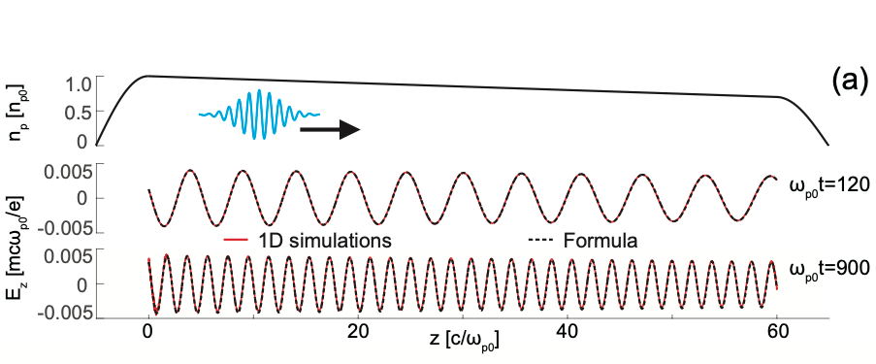
Low-energy muon acceleration using an evolving plasma wakes
Self-evolution of Plasma Waves in Density-Tailoring Plasmas
A Downramp Plasma：
An Uniform Plasma
Notes:
To address this issue, we propose exciting wakefields in a downramp plasma, using the self-evolution of the wakefield to achieve resonant acceleration of low-energy muons.
First, let's consider the phase velocity of the wakefield. After excitation, the wakefield oscillates at the plasma frequency. In a uniform plasma, the phase velocity of the wakefield equals the speed of the driving laser.
However, in a nonuniform plasma , such as the downramp in the figure, the left side has higher density and oscillates faster, while the right side has lower density and oscillates slower. Over time, the wavelength of the wakefield shortens, and its phase velocity decreases. At this point, the phase velocity becomes a function of both time and position.
为了解决这个问题，我们提出了在等离子体密度下降区域激发尾波场，利用尾波场的自演化来实现低能谬子的共振加速。
我们首先来看一下尾波场的相速度。在激发之后，尾波场按照等离子体频率进行振荡，可以写出相位的表达式。在密度均匀等离子体中，我们可以根据定义求出尾波场的相速度，等于驱动激光的速度。
但是在密度变化等离子体中，比如图中所示的密度下降区域，左边的密度更高一些，振荡的更快一些，而右边密度低，振荡的慢；经过一段时间后，尾波场的波长会变短，相应的其相速度会变慢。此时相速度是一个时间和位置的函数。

Slide 8
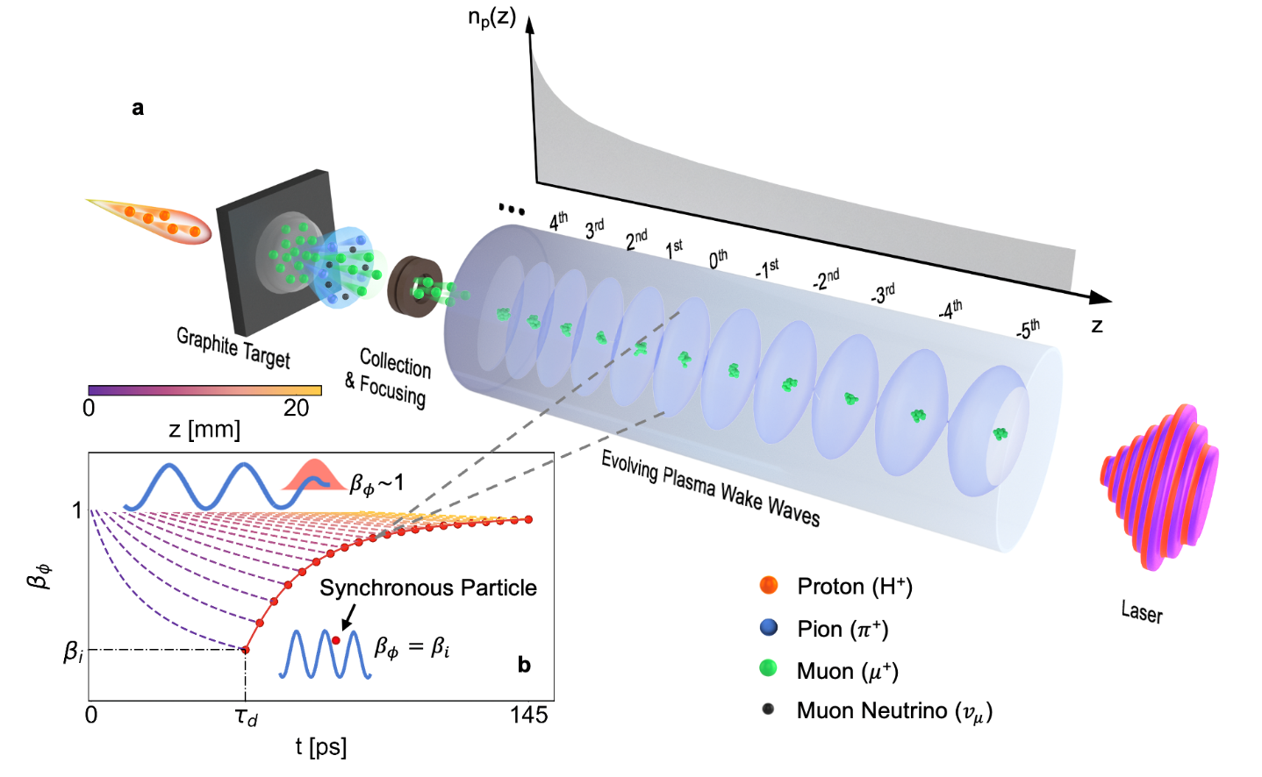
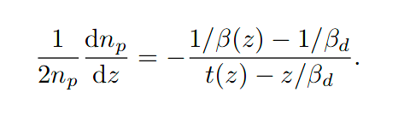
Motion equation of the Synchronous Particle (SP)
Notes:
Using this concept, we can design a plasma density profile where the phase velocity matches the muon velocity, achieving phase locking and continuous muon acceleration. As this figure shows, we first direct a non-relativistic laser into a plasma with decreasing density, driving the linear plasma wakefield. In this Figure , the dashed lines represent the evolution of the phase velocity at different positions, which is represented by the color. When the phase velocity at the left boundary, this is purple line, decreases to match the incoming muon velocity, we inject muons into the accelerating phase The red line represents the muon velocity. As muons are accelerated, their speed increases. By designing the plasma density profile, we can ensure that the muon speed at any position matches the local phase velocity during acceleration. Which means that muon accelerating phase \(\phi_s\) is constant. Such particles with constant phase are called synchronous particles.
This is motion equation of synchronous particles, and The phase change depends on the difference between the synchronous particle's speed and the local wakefield phase velocity. For synchronous particles, the phase change is zero, and the required plasma density distribution can be derived from this condition.
利用这一点，我们就可以设计出一个等离子体密度下降沿，保证其相速度始终和谬子速度相同，从而实现相位锁定，持续不断的加速谬子。如图a所示，我们先将一束超短超强激光打入密度下降等离子体中，等离子体尾波被激发并持续不断的演化。图b中灰色虚线代表不同位置的尾波相速度的演化。当左边界相速度降低至入射谬子速度时，我们将谬子注入至加速相位\phi_s。红线代表谬子速度。谬子被加速，速度不断增加，通过设计等离子体密度分布，可以实现谬子在加速过程中任意位置的速度都等于此处尾波场的相速度，谬子从而一直处在加速相位\phi_s，不断获得能量。这个相位不变的粒子被称为同步粒子。
我们可以写成同步粒子的运动方程，动量的变化等于尾波场电场做的功，相位的变化取决于同步粒子的速度与局部的尾波场相速度。对于同步粒子而已，相位变化为0，需要的等离子体密度分布可以从此条件解出。

Slide 9
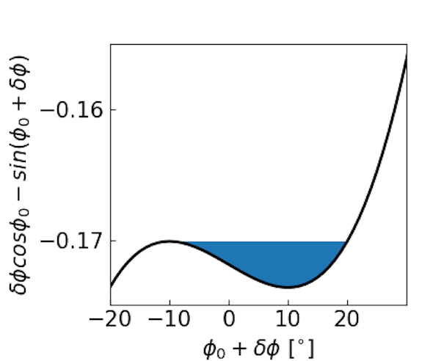

Phase Stability Analysis
If a particle is injected with a different phase (axial coordinate) or energy than the SP, can it be accelerated stably?
𝜙_{s0}=10º
SP
$$0^{°}$$
𝜙_{s0} close to 0º, High gradient, Small trapping Area
𝜙_{s0} close to 90º, Low gradient, Large trapping area
$${90}^{°}$$
Notes:
Now, Our scheme just can make sure the synchronous particles can be accelerated, but they are rare, but can it also accelerate particles with deviations? This is very important
Using traditional accelerator analysis, we define the momentum and phase differences as δp and δϕ. These satisfy a simple harmonic oscillator equation. For positively charged particles, if the phase is in this region, non-synchronous particles oscillate harmonically and gain energy similar to synchronous particles. otherwise, δϕ grows rapidly,muons experineces acceleration and deacceleration without energy gain.
For example, From this potential well, we can see that a synchronous phase is 10 degrees, particles from -10 to 20 degrees can be captured and accelerated.
Choosing the synchronous phase involves a trade-off between the trapping efficiency and acceleration gradient. Near 90 degrees, the capture area is large but the gradient is low, vice versa.
Later we see that our scheme can automatically achieve adiabatic changes in the accelerating phase, balancing high acceleration gradients with large capture efficiency.
至此，我们的方案可以加速同步粒子，那很自然的问题就是能否加速与同步粒子在能量或相位上有一定偏差的粒子？这个非常重要，毕竟同步粒子的数量极其稀少。
我们按照传统加速器的方法对这个方案进行分析，定义非同步粒子与同步粒子的动量差为delta p和delta phi，并写出它们满足的方程，可以进一步写成关于delta phi的二阶微分方程。这是一个简谐振子方程。对于带正电荷的粒子，如果0≦𝜙_{s0}<𝜋/2，非同步粒子做简谐振动，可以获得与同步粒子相似的能量增益。如果-𝜋/2≦𝜙_{s0}<0, 那么delta phi会迅速增长，也就是这些粒子在加速和减速之间来回切换，无法获得有效的加速。
我们可以将这个简谐振动的势能曲线画出来，如图所示。使用传统加速器的语言就是存在一个俘获相位区间。比如如果选择同步相位为10度，那么处于-10度到20度的粒子就可以被俘获加速。
很明显，同步相位的选择涉及到俘获区间与加速梯度的一个取舍。如果同步相位接近90度，那么俘获区间就很大，但加速梯度低；如果接近0度，则加速梯度高但俘获区间小。
后面我们会看到我们的方案可以自动实现加速相位的绝热变化，从而兼顾高加速梯度与大俘获效率。
For positively charged particles,
if , non-synchronous particles perform harmonic oscillations and can achieve energy gains similar to SP

Slide 10
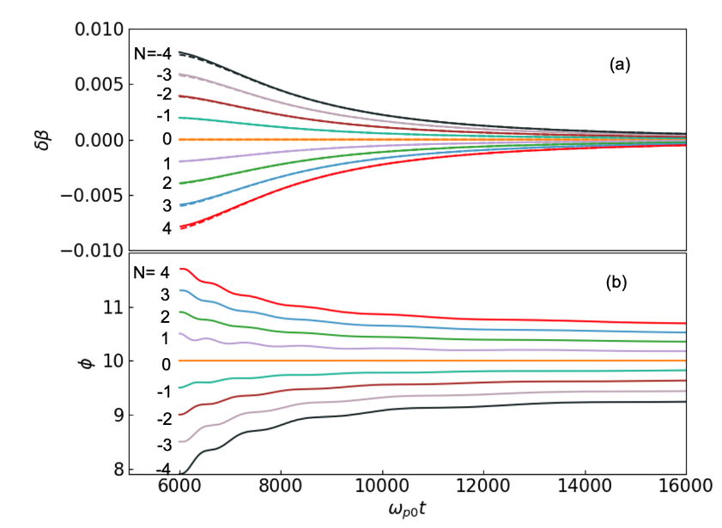
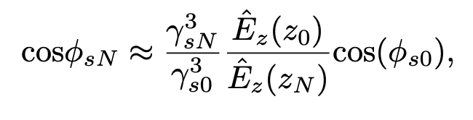
Generalization of the phase stability principle to other buckets
…
N^{th}
…
3rd
2nd
1st
0th
-1st
-2nd
-3rd
tens of fs
Quasi-synchronous Particles
Notes:
OK, SP stays in this bucket, and density-tailoring to make sure this bucket can achieve resonant acceleration, we call zero bucket, However, the size of the bucket is usually much smaller than the injected beam, so participle will be injected in other buckets, So for these buckets, particle still can get accelerated or not?
The phase velocity of each bucket is different, compared to zero bucket, these are slower, these are faster. One simple idea is the acceleration gradient for particles in other buckets also needs to make sure their speed always matches the phase velocity.
Simply put acceleration phase of muon in other buckets will vary to adjust the acceleration gradient to achieve quasi-phase stable acceleration. This figure shows the evolution of velocity and phase differences of synchronous particles in different buckets over time. The velocity differences between particles in different buckets decrease, meaning that the energy of accelerated particles in these buckets becomes more similar. For the later bucket, their synchronous phase decreases from an initially larger value, automatically achieving a large capture efficiency initially and a high acceleration gradient later.
We can see that the phase stability principle can be realized in many buckets, which is crucial for improving muon capture efficiency.
分析表明我们提出的加速方案可以在选定的尾波中加速非同步粒子，但是其最大俘获区间也就是等离子体波长的一半，几十飞秒，远短于谬子束流的长度，俘获效率会很低。
我们注意到我们的尾波场其实是一串，有很多个周期结构，每个波的相速度演化曲线并不相同。那其它的波能否加速谬子了？
我们发现对于其他的尾波，其实也存在同步粒子和同步相位。对于选定的尾波，我们称之为第0个波之后的波，由于它们的相速度降的更低，相应的同步粒子的初始速度需要更低，但对应的同步相位更接近90度。上面这张图展示的是不同尾波中同步粒子的速度差随时间演化，下图是同步相位随时间演化。我们注意到不同波中粒子的速度差越来越小，也就是说不同尾波中加速粒子的能量越来越接近；对于靠后的尾波中，其同步相位会从一开始较大的值逐渐变小，那它就自动实现了在初始时具有大俘获区间，而之后又拥有大加速梯度。
当然这里面有很多细致的物理过程，时间原因，只是简单说了一下结论。可以看到，我们可以在一连串很多个尾波场中实现稳相原理，这对提高谬子的俘获效率至关重要。

Slide 11
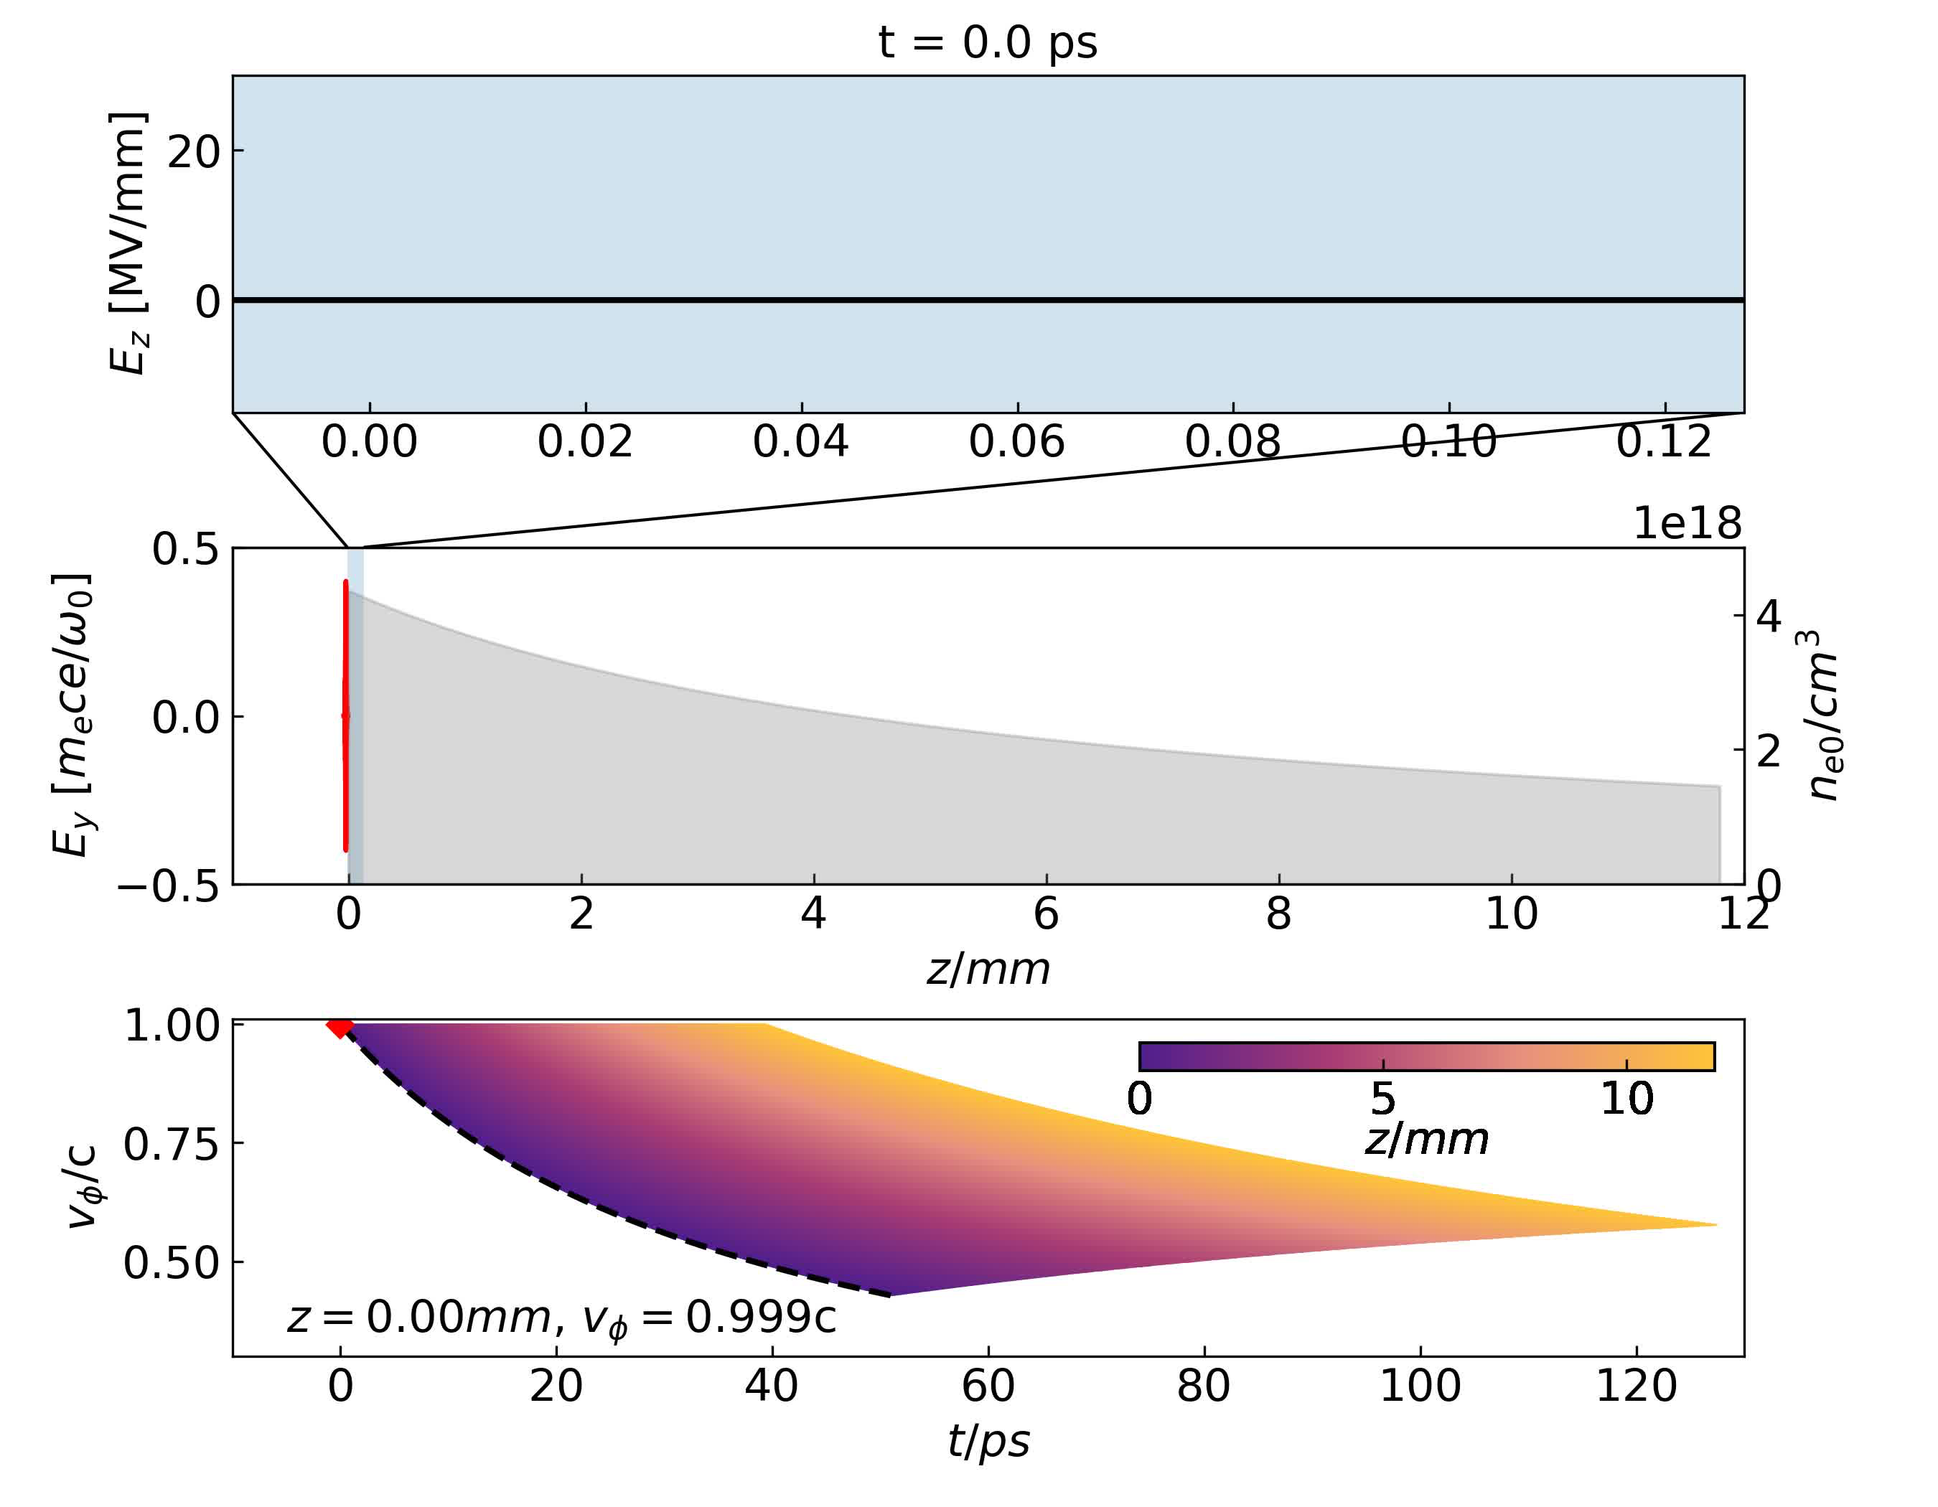
1D PIC Simulation
Plasma Wakes (black line)
Muon (red dots)
Laser light (red line)
Time evolution of phase velocity of the wakes and the muon speed
Notes:
Here is 1D PIC simulation animation, Fisrt we can see that the wavelength of the wakes at the left boundary becomes shorter and shorter. means that the phase veolcity is decreasing. then the muons are injected. at any posisiton, muon speed always equal to the local phase velocity. Most particles slip out the phases. some particles are trapped and accelerated.

Slide 12
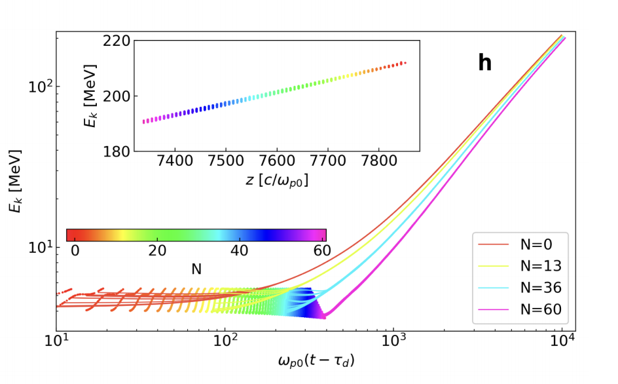
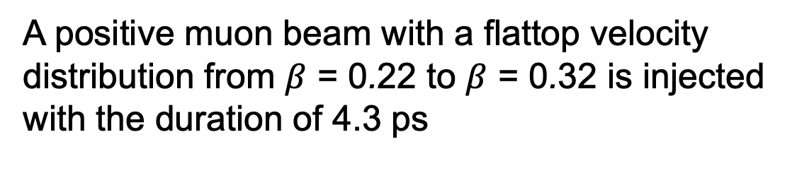
1D PIC Simulation
4 MeV to 210 MeV over 20 mm plasma (10 GV/m)
Laser: a0=0.4, 𝜏=34 fs
Plasma: np=4.4×10¹⁸ cm⁻³
Synchronous phase: 𝜙_{s0}=10º
Acceleration time: 85 ps
Trapping efficiency: ~1% (could be improved to ~10%)
Sub-femtosecond bunch train
Energy spread (RMS): 0.8% (Each Micro beam: 0.1%)
A positive muon beam with a flattop velocity distribution from $β$ = 0.22 to $β$ = 0.32 is injected with the duration of 4.3 ps
Notes:
For 4 MeV surface muons, we designed a 20 mm plasma to accelerate them to 210 MeV with an acceleration gradient of 10 GV/m. This single-stage acceleration process takes only 85 ps, much shorter than the muon lifetime. In this example, the capture efficiency is 1%. we can increase the capture efficiency to 10% by delaying the muon injection time.
we also see that sub-femtosecond muon bunch train is formed, with single micro-bunch energy spread at 0.1% and the entire bunch energy spread close to 1%.
The different colored lines represent the acceleration of synchronous particles or quasi-sp in various buckets. The inset shows the longitudinal phase space distribution at the end.
针对4MeV的表面谬子，我们设计了20mm长的等离子体，可以将其能量加速至210 MeV，加速梯度为10GV/m。整个加速过程只需85ps， 远小于谬子寿命。这个例子中俘获效率达到1%。但是根据上一页PPT中提到的物理理解，我们可以通过滞后谬子注入时间，将俘获效率提升至10%.
稳相过程最终形成了亚飞秒谬子脉冲束，单个微束团能散在千分之一，整个束团能散接近1%.
这些不同颜色的曲线表示不同尾波场中同步粒子的加速，插图是加速出口的纵向相空间分布，可以看到微束团结构。

Slide 13
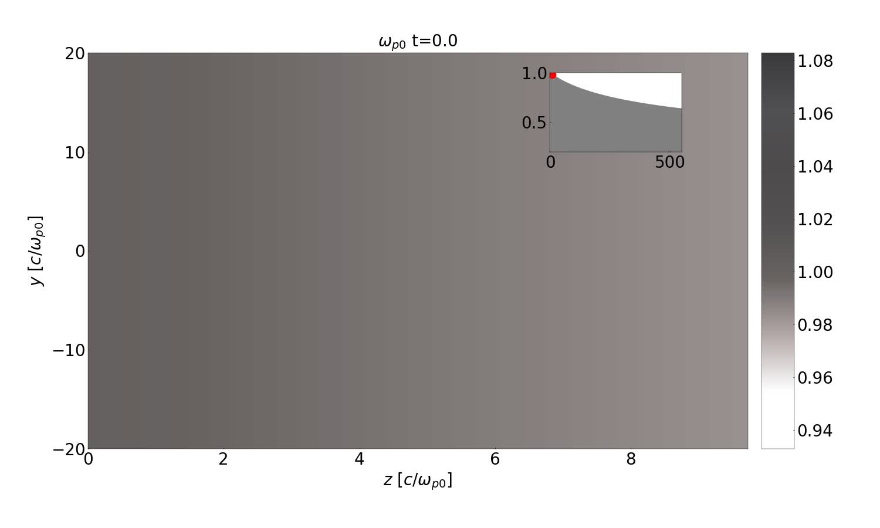
High-dimensional effects
Evolution of Laser: Self-focusing and Diffraction
Evolution of Plasma Waves: curvature of the waves
Transverse Dynamics and Acceptance of Muon Beams
Notes:
Next, we consider the high-dimensional effects. In higher dimensions, we need to examine the effect of laser self-focusing and diffraction affect, evolution of plasma wave evolution abd the transverse dynamics of the muon beam
here is a two-dimensional simulation animation. It shows the curvature of plasma waves in two dimensions, but the injected muon beam still can be accelerated. We also see the transverse oscillations of muons. Due to the symmetry of the linear wakefield focusing field, positive and negative muons can be accelerated simultaneously.
接下来我们考虑更实际的情况，在高维情况下整个方案的可行性。高维时，我们需要考虑激光的自聚焦和衍射会不会对加速有影响？等离子体波在高维时的演化会不会有什么不同？谬子束流的横向动力学以及整个方案的横向接受度。
右侧是一个二维模拟的动画。可以看到二维时等离子体波的弯曲，但是注入的谬子束流依然实现了相位锁定和持续不断地加速。同时也观察到了谬子在尾波中横向聚焦场作用下的横向振荡。因为线性尾场聚焦场的对称性，我们可以实现正负muon的同时加速

Slide 14
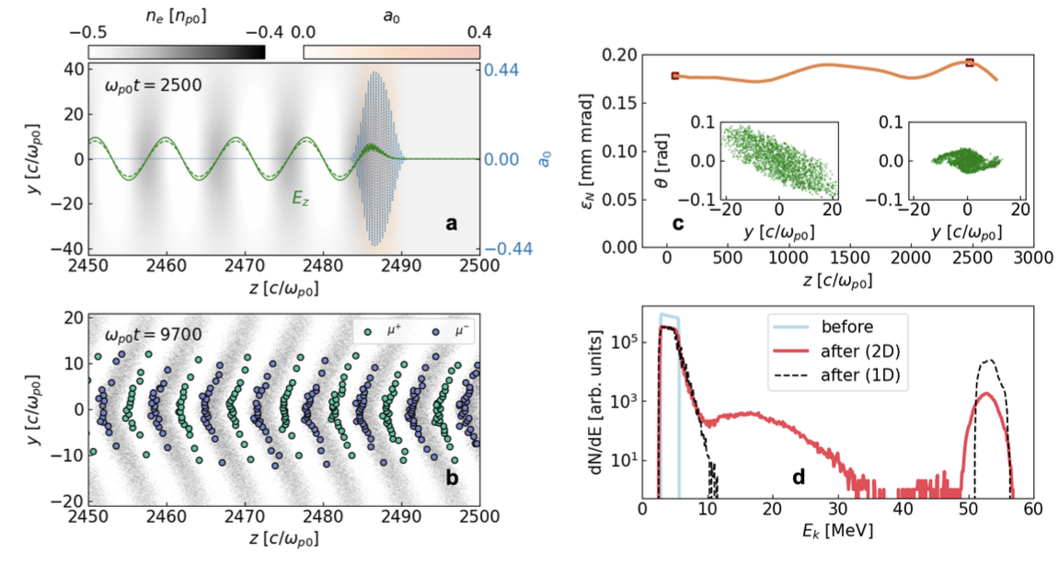

Transverse Dynamics and Acceptance of Muon Beams
6 mm plasma: 4 MeV to 66 MeV
Laser: a0=0.4, 𝜏=34 fs, w₀=122 𝜇m,
P=85 TW
Plasma: np=4.4×10¹⁸ cm⁻³
Synchronous phase: 𝜙_{s0}=30º
Injected muon:
w_{𝜇}=102 𝜇m, 𝜃_{𝜇}=0.22 rad
Trapping efficiency ：~0.4% (2D) vs ~ 8%(1D)
Energy spread (RMS)： ~2%
Transverse emittance：0.18 mm·mrad，
Notes:
In a larger-scale two-dimensional simulation, we accelerated muons from 4 MeV to 66 MeV using an 85 TW laser with a large spot size of 122 microns to achieve a quasi-one-dimensional wakefield.
a stronger wakefield is excited due to laser self-focusing, but the phase stability principle ensures the muons still can be accelerated.
This Figure shows the evolution of the muon beam‘s emittance, the quasi-linear focusing force keep the emittance almost the same. This means the acceptance is 0.18 mm mrad, comparable to traditional muon accelerators.
Further analysis show that acceptance is proportional to the square root of laser power. Using multi-PW lasers could increase acceptance to the mm mrad level.
在一个更大规模的二维模拟中，我们将谬子从4 MeV加速至66 MeV。我们使用了85 TW的激光，一个很大的光斑，122 微米，去实现准一维的尾波场。
模拟中发现激光的自聚焦会激发更强的尾波场，但是稳相原理保证了整个加速过程依然顺利进行。
通过滞后注入和选择更大的同步相位，一维俘获效率可达8%. C图展示的是谬子束流的发射度演化，可以看到准线性聚焦力保证了发射度不增加，为0.18 mm mrad，也就是说该参数下整个方案的接受度为0.18 mm mrad，可以与传统的谬子加速器相当。横向动力学及接受度。分析表明接受度正比于根号下激光功率，如果使用数PW激光，可以将接受度提升至mm mrad 级别。

Slide 15
Conclusion
We explore the acceleration of low-energy muons using high-gradient laser-driven wakefields in plasma. By leveraging the self-evolution of wakefields in plasma with decreasing density, we achieve resonant acceleration of low-energy muons.
The accelerated muons exhibit sub-femtosecond micro-bunch structures, with a single bunch energy spread of approximately 0.1%, potentially enabling new applications.
This method can also be used to accelerate other "heavy" particles, serving as an essential component of high-quality, high-energy particle sources or colliders.
Notes:
In conclusion, our study demonstrates the feasibility of using plasma wakefield acceleration for muons, achieving significant energy gains within a short timeframe. The phase stability principle plays a crucial role in maintaining efficient acceleration for our regime.

Slide 16
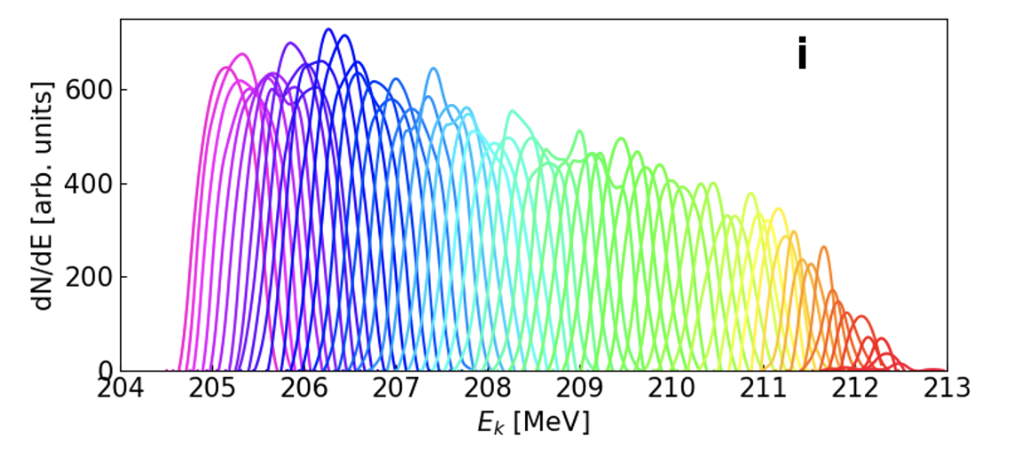
Backup Slides

Slide 17
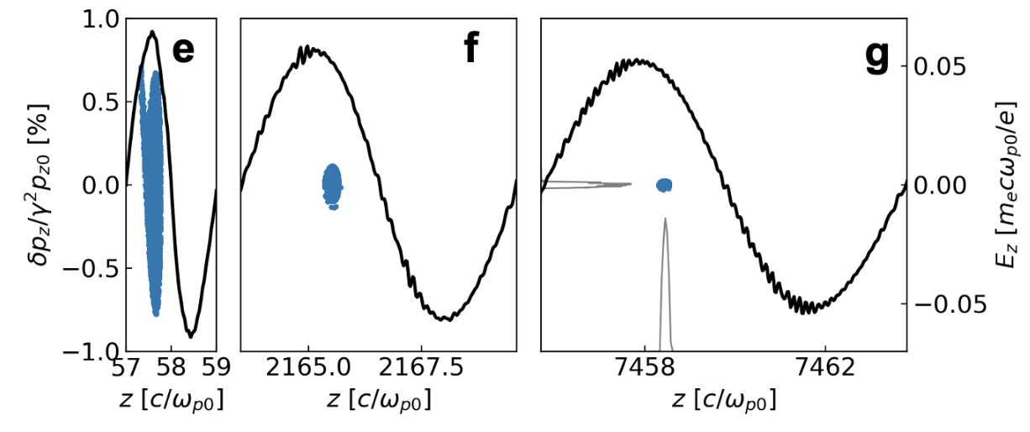
Backup Slides

Slide 18
