Slide 1
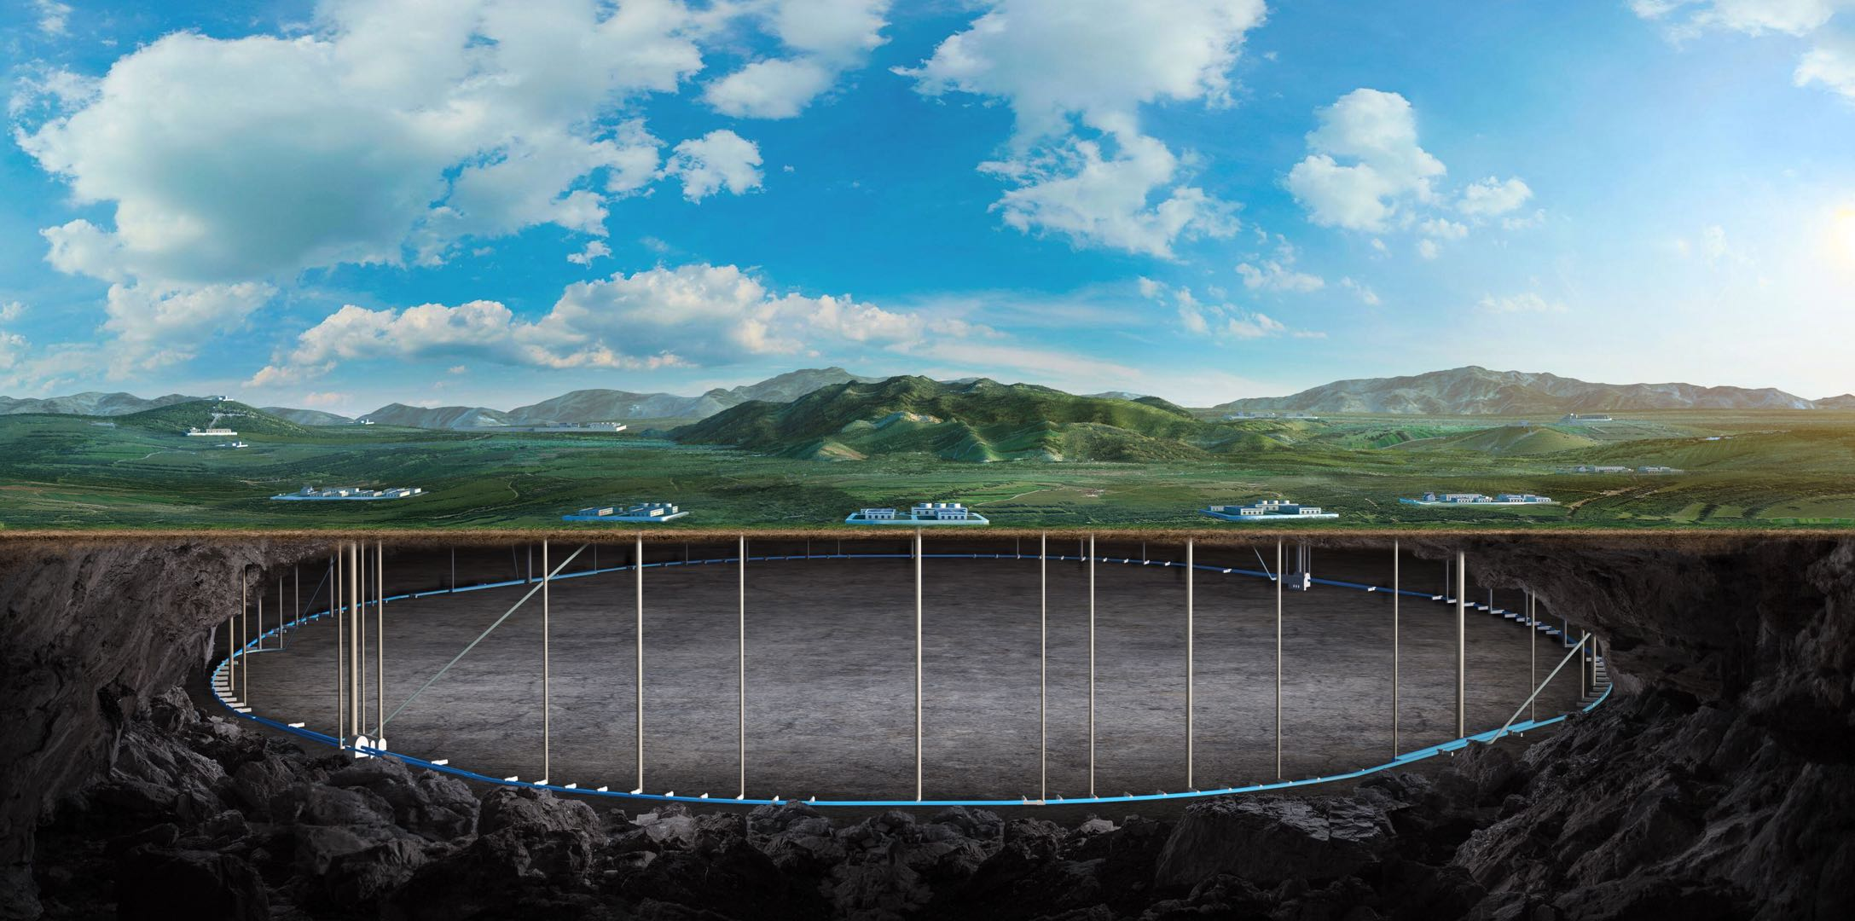
CEPC machine protection and transfer lines
EDR status and plan
Xiaohao Cui (IHEP)
on behalf of CEPC AP group
Hangzhou, Oct 23-27, The 2024 international workshop on the high energy Circular Electron Positron Collider

Slide 2
Content
Part1: machine protection
Part2: Transfer lines
Summary

Slide 3
Part1. Machine protection

Slide 4
1. Why we need machine protection in CEPC
 | Higgs | W | Z | ttbar
Energy (GeV) | 120 | 80 | 45.5 | 180
Bunch Number | 268 | 1297 | 11934 | 35
Bunch Charge (nC) | 20.8 | 21.6 | 22.4 | 32
Energy/bunch (kJ) | 2.5 | 1.73 | 1.02 | 5.76
Energy/beam (MJ) | 0.67 | 2.24 | 12.17 | 0.2
The z mode machine has the largest energy storage in the beam, and tt mode machine has the larges energy per bunch.
The energy stored in the machine is very high compared to other lepton colliders.

Slide 5
2. CEPC machine protection system
Active machine protection: for slow beam loss (~ms)
Beam dump system;
Interlock system;
……
Passive machine protection: for quick beam loss
Collimators;
Radiation shieldings;
……

Slide 6
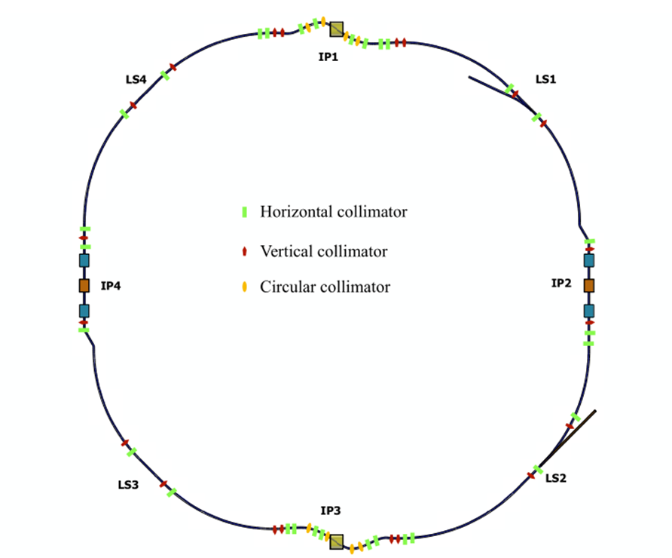
3. CEPC collimator system
In the CDR stage, Yuting Wang did many studies and simulations.
58 collimators added in one ring.
With all these collimators, beam loss under control for RF and magnet failures.

Slide 7
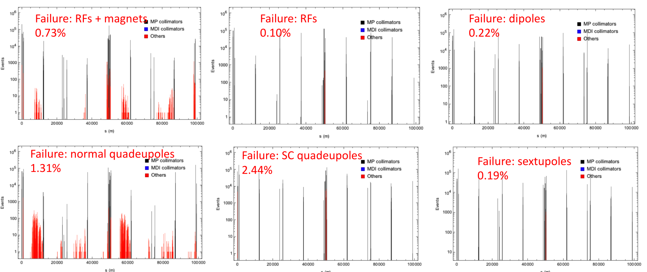
3. CEPC collimator system
Y.T. Wang
For more details, please check 2023 CEPC workshop

Slide 8
3. CEPC collimator system
When we consider the collimator issue from machine design, we find that there are some problems that need to be optimized:
1. Large impedance
2. small collimator radius
3. Non-optimized collimator position

Slide 9
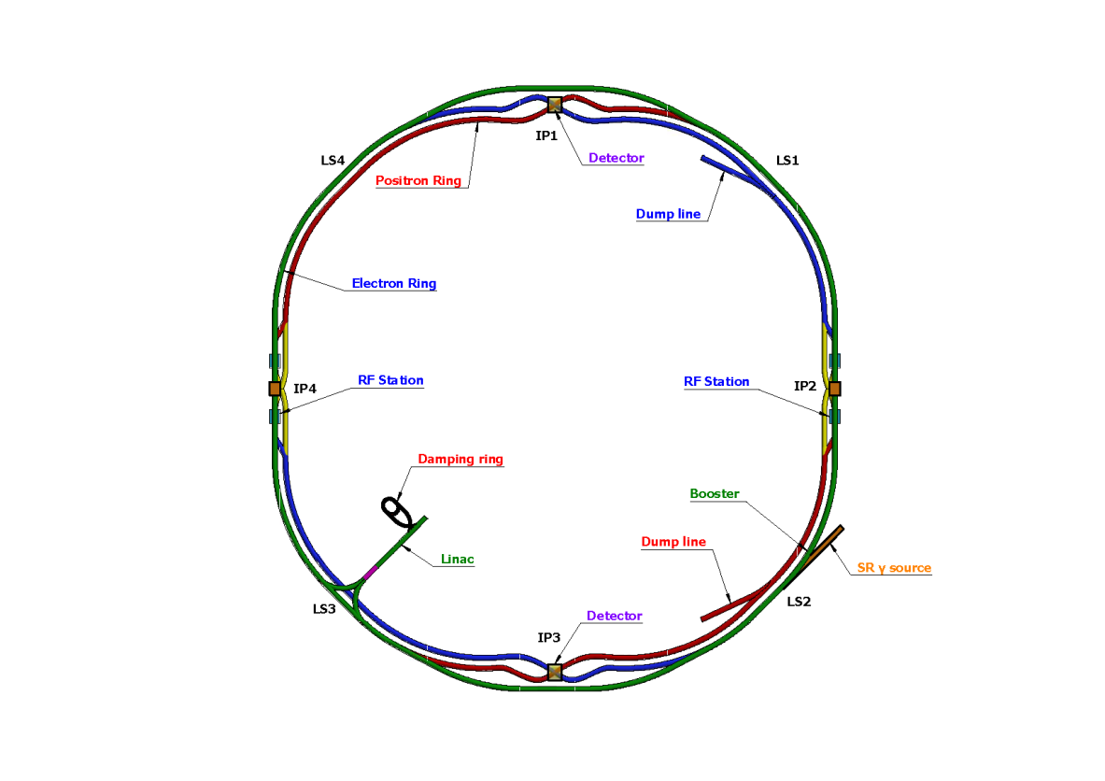
3. CEPC collimator system
After some simulation and optimization: reduced to a tentative version: a total of 34 collimators in each ring
16 MDI collimators:
8 horizontal betatron collimators
4 momentum collimators
6 vertical collimators

Slide 10
3. CEPC collimator system
The optimization of collimator system is still in progress:
1. Simuation of more beam loss situtations;
2. iterations with the MDI;
3. Energy deposition simuation;
……

Slide 11
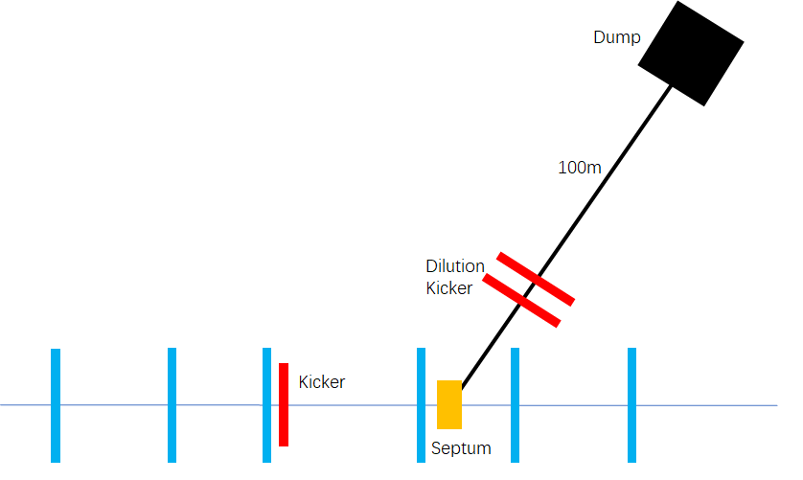
4. Active machine protection
The active protection system needs to detect beam losses in the accelerator very fast, transmit the signal to the control center, and initiate beam dump
For now, we designed a beam dump for each ring;

Slide 12
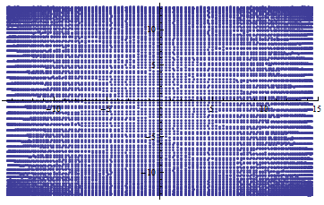
4. Active machine protection
Use one kicker and one septum to extract the beam, so all bunches can be dumped in one turn;
Horizontal and vertical dilution kickers are used to change the position of different bunches at the dump, in order to reduce the beam damage to the dump.

Slide 13
Part2. Transfer Line

Slide 14
1. Transfer line status
In the CDR stage, we have base design of all transfer lines.
2. In the EDR phase, we need optimization considering transfer efficiencies, hardware designs,……
Damping Ring
Positron
Linac
Booster
Electron
Collider

Slide 15
2. Transfer efficiencies
Assuming the injection system injects 3% of the bunch charge each time.
The Linac system of the CEPC can generate 1.5nC of charge per bunch
 | Higgs | W | Z | ttbar
Energy (GeV) | 120 | 80 | 45.5 | 180
Bunch Number | 268 | 1297 | 11934 | 35
Injection Bunch Charge (nC) | 0.624 | 0.648 | 0.672 | 0.96

Slide 16
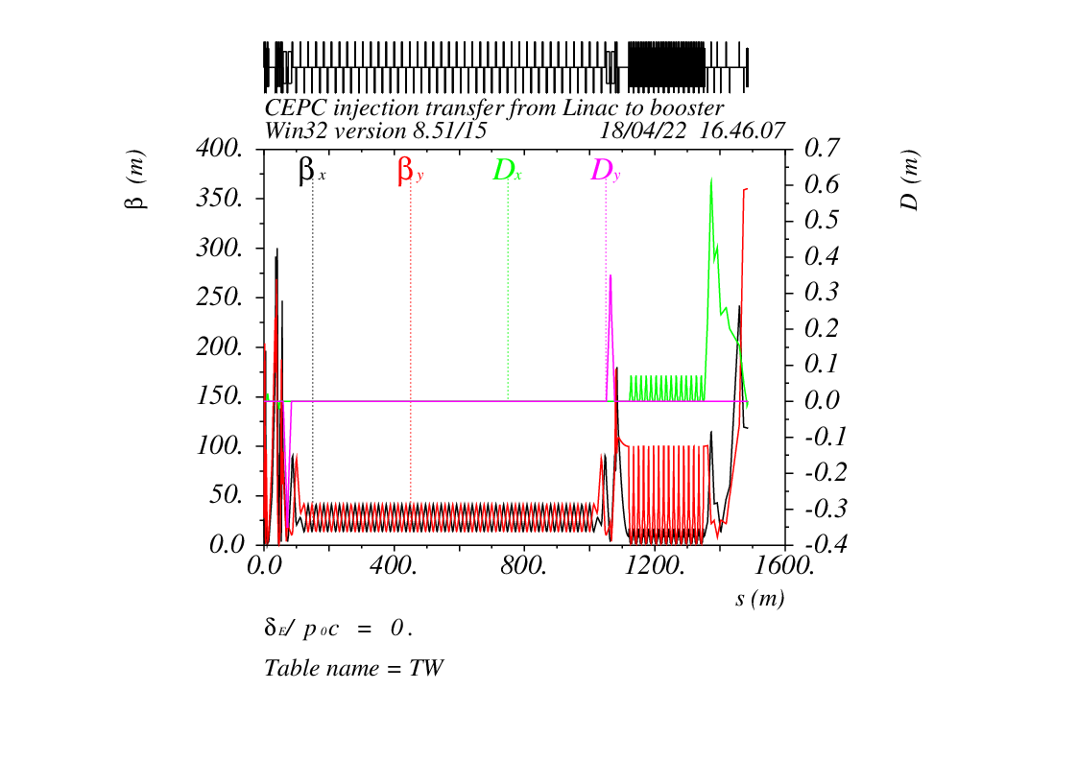
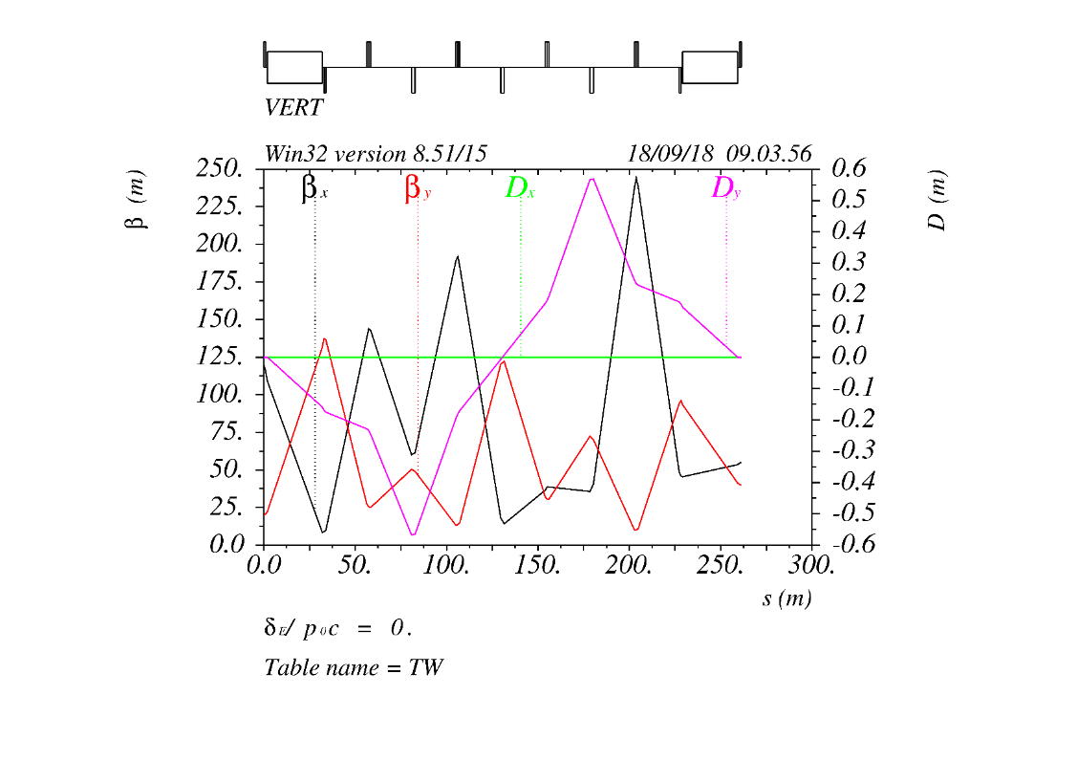
2. Transfer efficiencies
For the off-axis injection system, the transmission efficiency requirements from the Linac to the booster and from the booster to the collider is not very high.

Slide 17
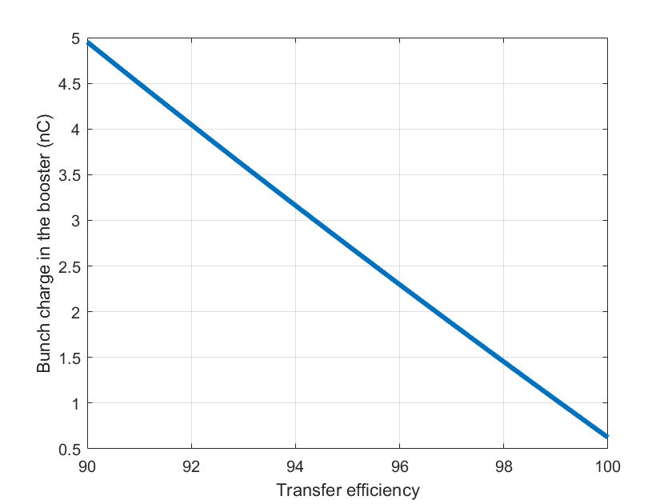
3. swap-out injection
For the swap-out injection, we need to transfer the whole bunch from collider to booster and back,
this poses a high demand on the efficiency of the transport lines
The booster bunch charge needed vs efficiency

Slide 18
Summary
We have a tentative design of collimators, in optimization.
For active machine protection, we have a dump design.
For off-axis injection, the requirement on the transfer efficiency are modest.
The swap-out injection requires us to optimize the transfer and injection efficiency between the booster and the collider as much as possible

Slide 19
Thank You!

