Slide 1
Needed R&D for running a TPC at a circular collider
Hangzhou, October 25th, 2024
P. Colas (CEA/Irfu U. Paris Saclay)
CEPC workshop
…and strategy for the future

Slide 2
Field cage
Talk by Oliver Schäfer at LCWS2024 in Tokyo
New prototype field cage being built at DESY
  Previous one used until 2019 was skewed
  Keep in-house know-how
  New precision mandrel
  HV stability issues 2020-21
  now solved
  Simplified stip pattern with negligible impact on
  field homogeneity : 1-piece foil produced at CERN

Slide 3
Pixel readout
See Peter Kluit’s and Huirong Qi’s talks

Slide 4
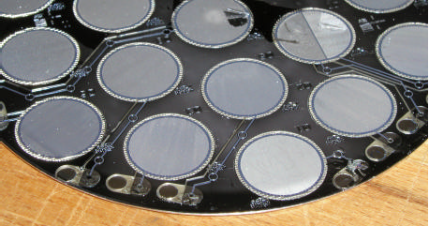
A bit of history :
Ingrid and GridPix, 20 years ago
By post-processing on silicon wafers, with Twente and Nikhef colleagues, we were able to deposit 0.8 µm Al meshes. The ‘Integrated Grid’ InGrid was born.

Slide 5
A bit of History
Timepix
The first tests were carried out with Medipix.
By adding a clock distributed in all the pixels, we changed the ‘grey level’ for photon counting into a time measurement on all pixels, changing the imaging chip into a TPC (digital) readout.
We could fund this, from the chip design (Xavier Lloppart) to the wafer production, and tests (David Attié) within an EU project, EUDET, from 2006 on.
In the following years, we carried out many studies using TimePix : Octopuce, an 8-chip module, study of avalanche fluctuations (Michael Lupberger), many studies on Micromegas (Max Chefdeville), and improved the protection against sparks with a 15 µm resistive layer…

Slide 6
CEPC reference detector
CEPC Reference Detector team chose a TPC for the high energy running (first 10 years + 6 years of top) : excellent choice, following ALEPH, DELPHI at LEP success, and ALICE at LHC.
They opted for a pixel TPC : small pads give low electronic noise. Then digital TPC becomes possible : necessary to optimize pad size for momentum resolution and cluster counting.
Choice of a digital chip : timepix 3 or 4, or else?
Study protection against sparks (for instance 15 µm or Si_{x}N_{y}) bulk resistivity ~10¹³ Ω.cm and test with prototype.

Slide 7
Gas choice
Base gas :
  Ar for largest ionization : 97 e-ion pairs in ~35-40 clusters
  He for well-separated clusters easing dN/dx (but cannot set field to the maximum drift velocity over 2 m)
Additional gases
  Isobutane : quencher, cuts UVs to avoid avalanche propagation
  CF₄ : increases electron drift velocity and reduces diffusion in magnetic field by a factor of ~10 at 3.5 T and ~5 at 2T.
  Low e attachment (keep O₂ and H₂O below ~10 ppm to drift over 2m) velocity)
T2K gas Ar:CF4:Isobutane 95:3:2 satisfies all requirements for a TPC
Note that the optimal gas is not the same for cluster counting (He) and for space resolution (large ωτ for low diffusion: ‘fast gas’)

Slide 8
Other needs
Make sure that a t₀ can be obtained (from silicon enveloppe) and associated to the TPC track (non-trivial as the drift time in the TPC is several tens of µs)
Study mechanical quality of the endplate at the few tens of µ if possible, and define a strategy to correct by software if not reached
Define the cooling strategy (Nikhef’s with Saclay’s 2-phase CO2 3D-printed cooling plate)
Carefully study interfaces with other subdetectors: heating by the Ecal? Each subdetector should remove the heat it produces, but this might be impossible -> assess what is acceptable

Slide 9
Distortions from ion space charge
Large ionization at the Z peak produces a large ion density. As ions drift very slowly (O(m/s)) the TPC integrates a high ion space charge, which causes a transverse electric field, which in turn makes large distortions of the ionization electrons paths.
These have been calculated (K. Fujii, S. Ganjour et al.) and amount to ~60 µm at the HZ for ILC, and O(mm) distortions for the tracks at the Z pole at the TeraZ, counting only the ionization from physics events.
Correcting for this is necessary and is similar to what Alice attempts to do at the Pb-Pb run
See my talks at HKUST 2024, FCC workshop in Krakow, etc…

Slide 10
Beamstrahlung background at ILD and FCC
Daniel Jeans presented simulation results at LCWS2024 in July, and again at a FCC detector concept meeting on September 9 and also at this CEPC workshop
Beamstrahlung BG produced ~200 times
more ionization than hadronic Z decays (20mm
distortions)
Beamstrahlung higher at ILC, but MDI more
intrusive at FCC. Optimization of MDI necessary
if one is to use a TPC at TeraZ
For the time being forget about using a TPC at the Z at 2. 10³⁶ lumi, and go directly to HZ, as CEPC plans

Slide 11
Can a TPC be aligned/calibrated?
Maybe not enough cosmics
ILD studies : can go to 91 GeV (large Z cross-section). But to be done at very ‘low’ luminosity (10³⁴ /cm²/s ?) to keep similar environment as for the HZ signal. One month enough to obtain 2.10⁵ Z->µµ.
But also Z returns (e+e- -> Zγ) in the 240 GeV sample can be used for alignment and dN/dx calibration.

Slide 12
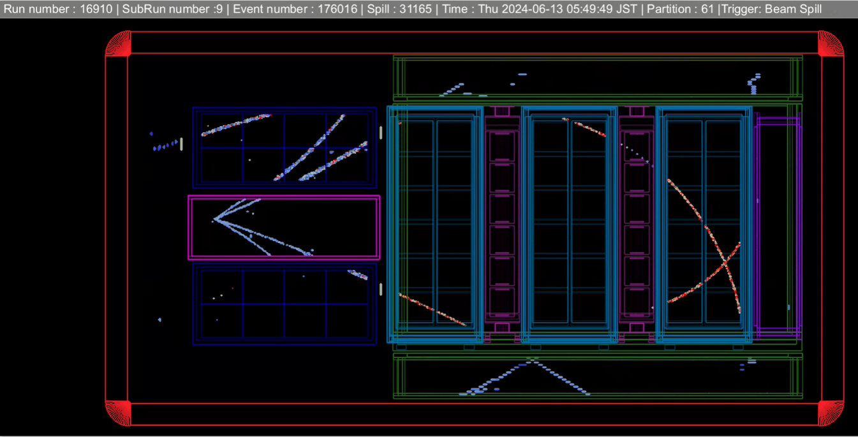
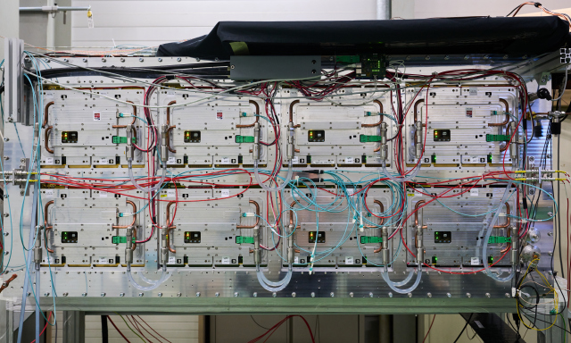
Alternative : Micromegas with charge sharing
T2K built two TPCs for ND280 upgrade, with the new resistive-capacitive charge spreading developped for ILC
Started operation in September 2023 and May 2024 at JPARC
Gained experience in operating, calibration and measuring the RC parameter which governs the charge spreading

Slide 13
Alice is facing similar distortions in Run3 Pb-Pb collisions at 50 kHZ. We contact them to try and learn from their experience in correcting space charge distortions
Jens Wiechula, talk at LCTPC annual meeting in January 2023

Slide 14
Application to Long-Lived Particles (LLP) search
The continuous tracking allowed by a TPC can help finding a LLP signal by revealing kinks (Daniel Jeans, Jurina Nakajima, KEK/SOKENDAI)
Presentation at LCWS2024 by Jurina
MC study of K⁻ -> π⁻ π⁰ . Trackfinder in MarlinTPC: efficiency 80% at p_{K}=10 GeV/c
ILD work in progress
Estimate of Δm between track1 and track2
Next : extend to other momenta, kinematic fitting
Interpretation in BSM

Slide 15
A word on worldwide strategy for the future
Circular collider is good for EW and Higgs Physics, but limited for top and higher energy
Linear collider is complementary, as it can go to higher energy. A collider starting at the toponium energy (340-360 GeV) and extending to at least 550 GeV would have a lot of interest.
The idea that the toponium does not form because the free quark lifetime as given by electroweak partial width calculation is smaller than the bound state orbiting time might be wrong (as the lifetime of many neutron-containing nuclei is much more than the neutron lifetime ~15 minutes)
There is a hint at CMS for a narrow toponium (John Ellis’s interpretation of CMS data presented at the 50th anniversary of J/psi discovery, IHEP, 20th of October).
e+e- physics requires two colliders, a circular one at very high luminosity for EW physics and a linear, with polarized beam, at higher energy for ttbar, toponium spectroscopy and multi-Higgs. There is lot of fundamental physics there, at the meeting point of weak and strong interactions.

