Slide 1
CEPC workshop
Hangzhou, 25/10/2024
The IDEA drift chamber
Paolo Giacomelli
INFN Bologna
These projects have received funding from the European Union’s Horizon Europe Research and Innovation programme under Grant Agreements No. 101004761 (AIDAinnova), 101057511 (EURO-LABS).

Slide 2
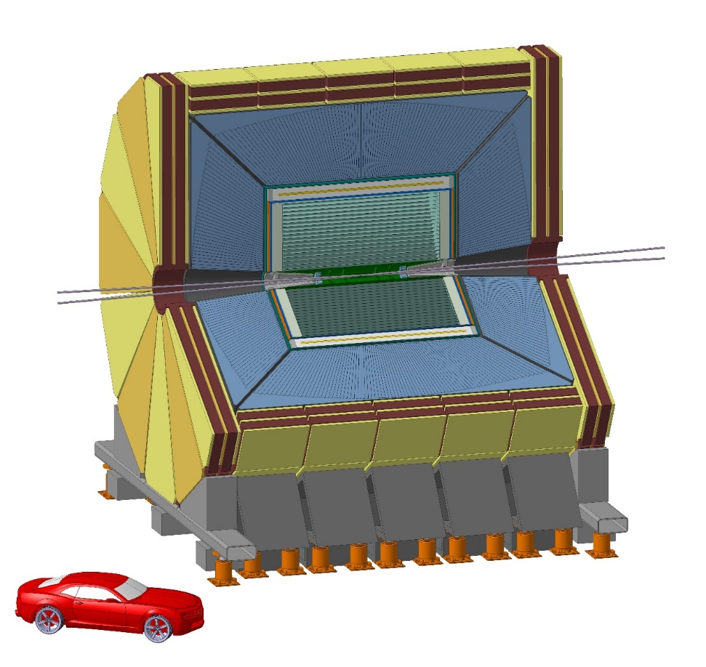
The IDEA detector concept
New, innovative, possibly more cost-effective concept
Silicon vertex detector
Short-drift, ultra-light wire chamber
Dual-readout calorimeter
Thin and light solenoid coil inside calorimeter system
Small magnet ⇒ small yoke
Muon system made of 3 layers of μ−RWELL detectors in the return yoke
https://pos.sissa.it/390/
IDEA concept (proposed also in CEPC CDR)
Innovative Detector for e⁺e⁻ Accelerator
Acknowledgments
I need to thank many colleagues, in particular:
N. de Filippis

Slide 3
IDEA detector layout
Beam pipe: R∼1.0 cm
Vertex:
5 MAPS layers
R = 1.37-31.5 cm
Drift Chamber: 112 layers
4 m long, R = 35-200 cm
Outer Silicon wrapper:
Si strips
Superconducting solenoid coil:
2 T, R ∼ 2.1-2.4 m
0.74 X0, 0.16 λ @ 90°
Preshower: ∼1 X0
Dual-Readout Calorimeter:
2m / 7 λint
Yoke + Muon chambers

Slide 4
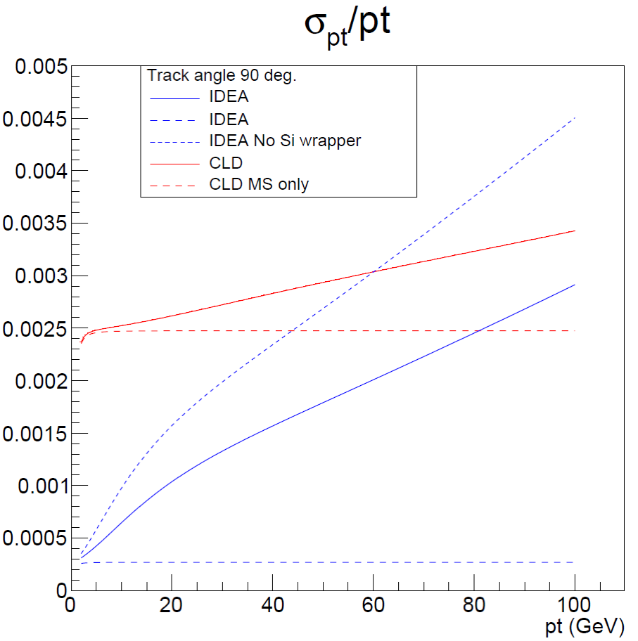
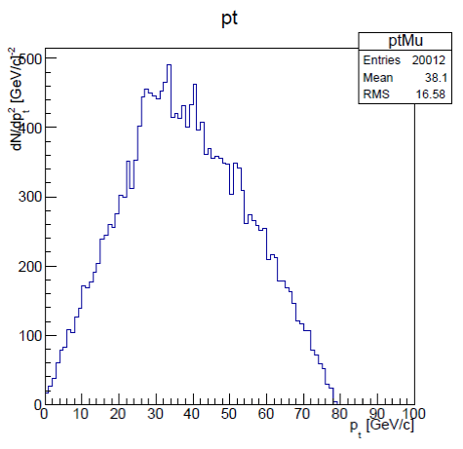
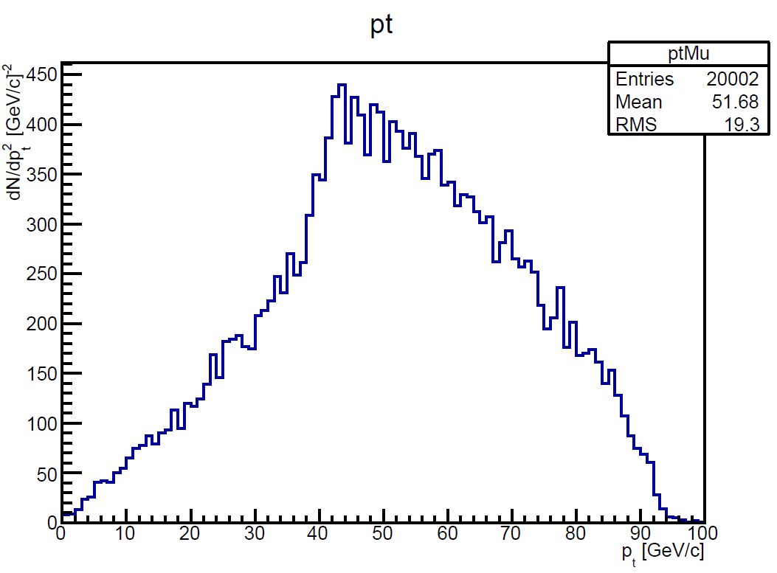
Momentum measurement
Z or H decay muons in ZH events have rather low pt
Transparency more important than asymptotic resolution
MS only
ZH (H→μμ)
Muon pt
ZH (H→μμ)
Muon pt
ZH (Z→μμ)
Muon pt
90 degree

Slide 5
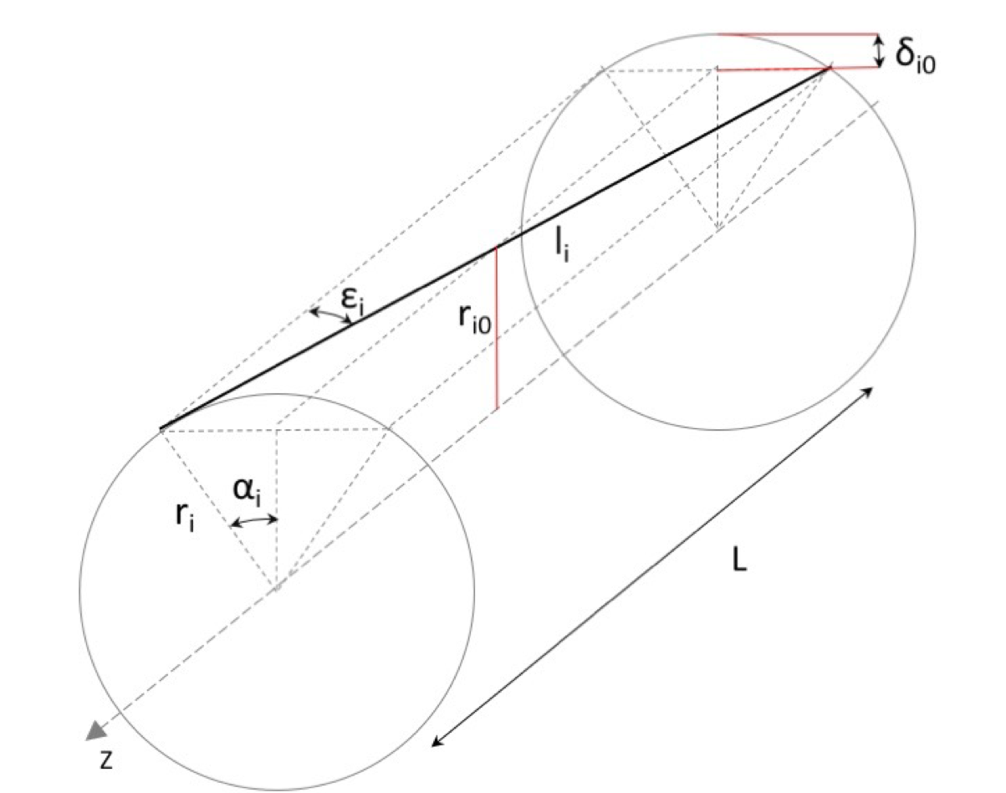
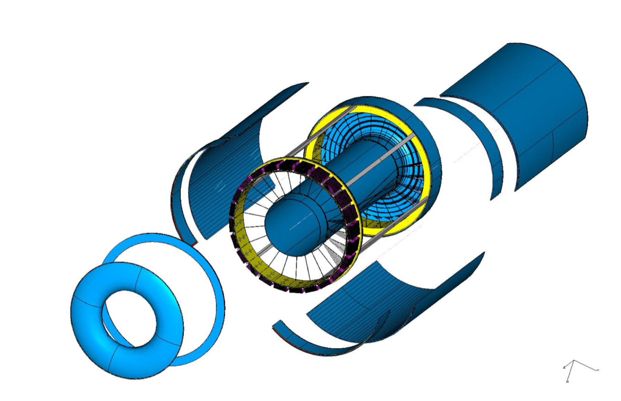
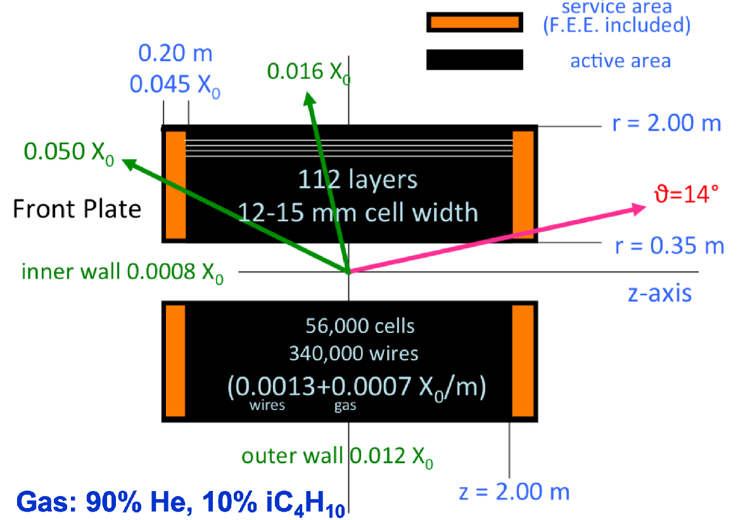
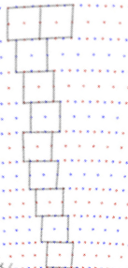
Drift chamber
IDEA: Extremely transparent Drift Chamber
Gas: 90% He – 10% iC₄H₁₀
Radius 0.35 – 2.00 m
Total thickness: 1.6% of X₀ at 90º
All stereo wires (56448 cells, 343968 wires)
Tungsten wires dominant contribution
112 layers for each 15º azimuthal sector
max drift time: 350 ns
L = 4m
IDEA DC

Slide 6
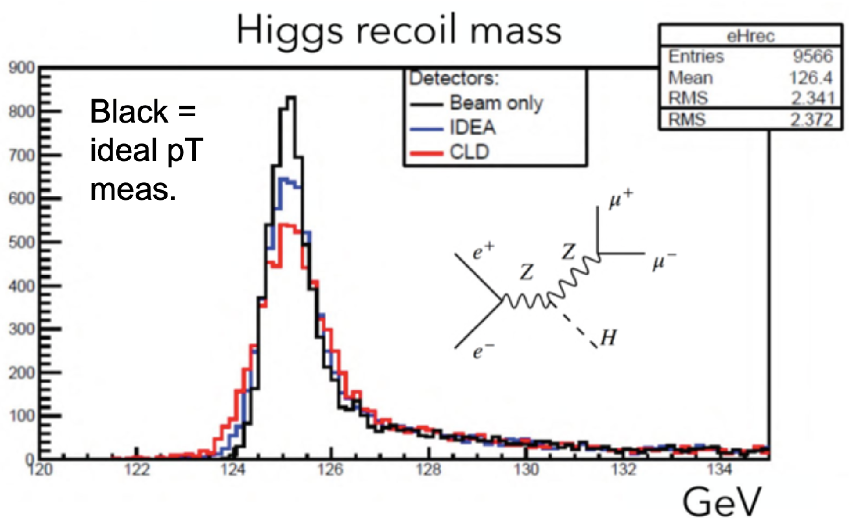
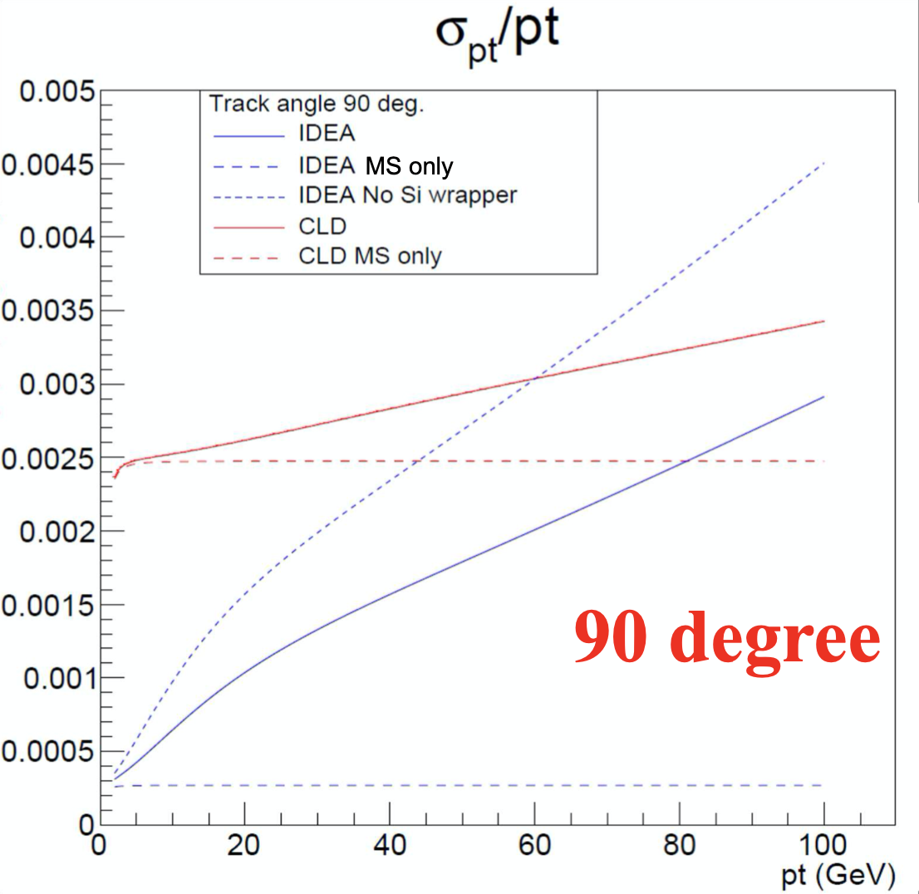
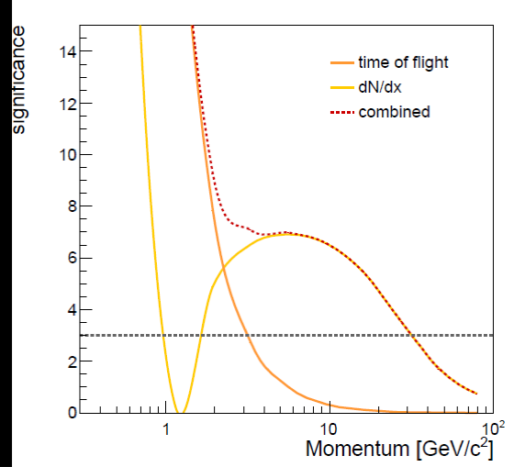
Drift chamber
In general, tracks have rather low momenta (p_{T} ≲ 50 GeV)
Transparency more relevant than asymptotic resolution
Drift chamber (gaseous tracker) advantages
Extremely transparent: minimal multiple scattering and secondary interactions
Continuous tracking: reconstruction of far-detached vertices (K⁰_{S} , Λ, BSM, LLPs)
Outstanding Particle separation via dE/dx or cluster counting (dN/dx)
>3σ K/π separation up to ~35 GeV
dN/dx from Garfield++

Slide 7
Challenges for large-volume chambers

Slide 8
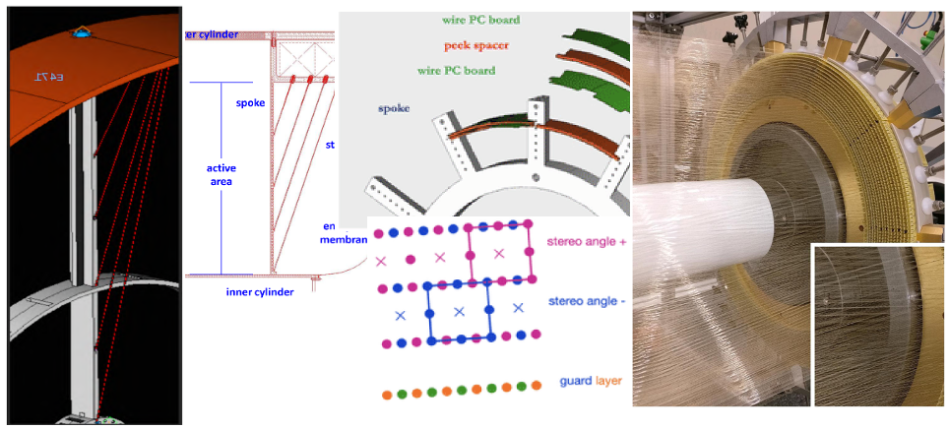
Drift chamber - mechanical structure

Slide 9
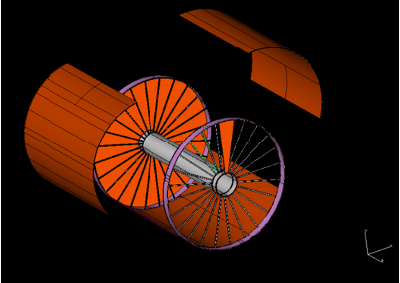
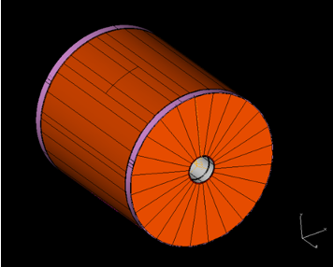
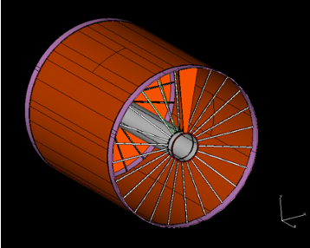
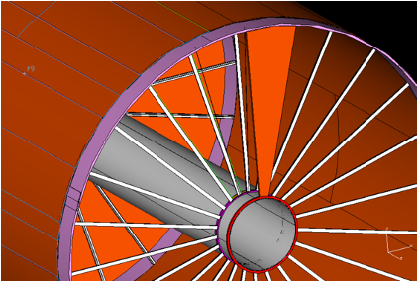
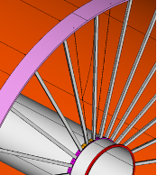
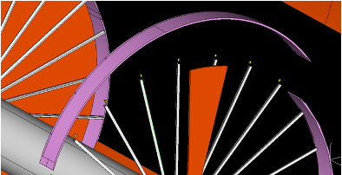
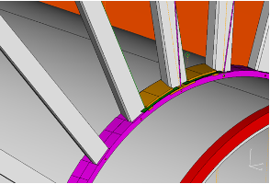
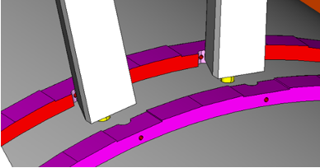
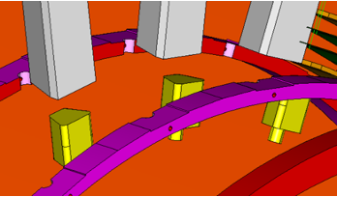
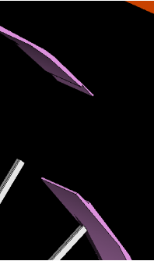
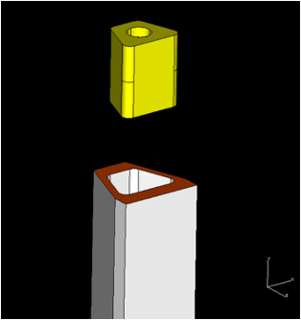
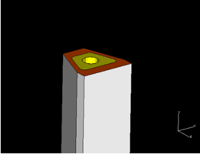
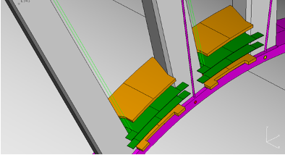
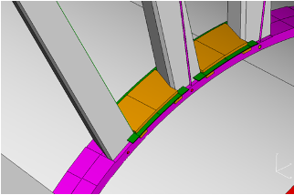
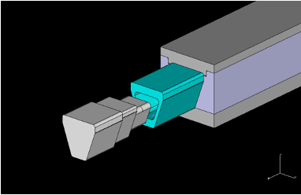
Mechanical structure: a complete model

Slide 10
Full length prototype - goals

Slide 11
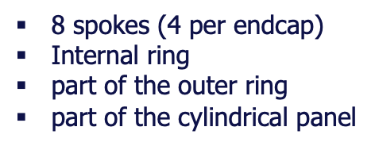
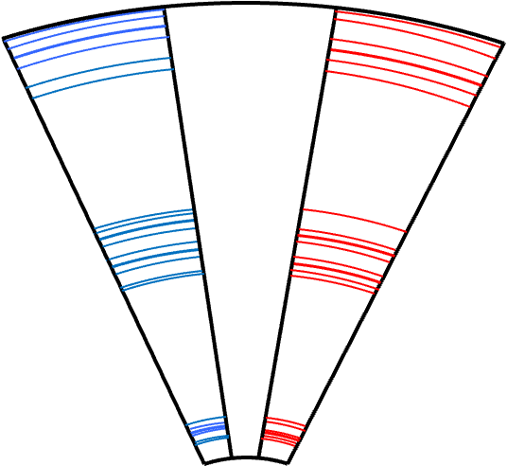
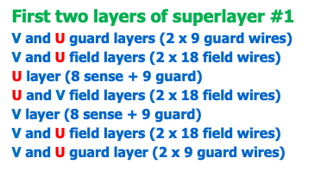
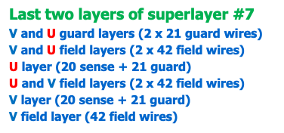
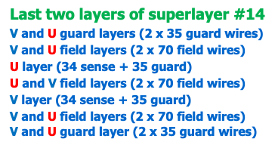
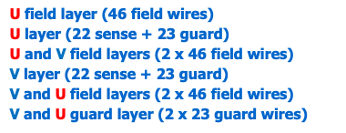
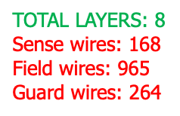
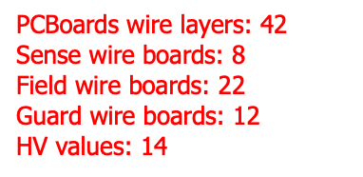
Full length prototype - wiring

Slide 12
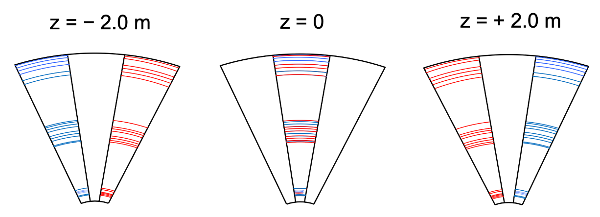
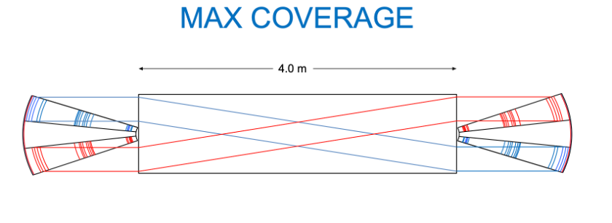
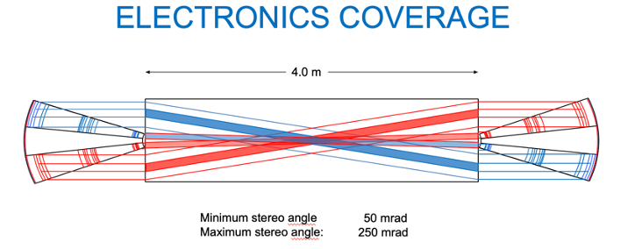
Full length prototype - coverage

Slide 13
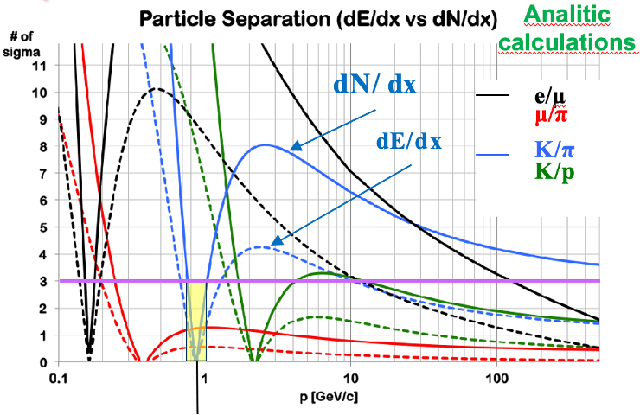
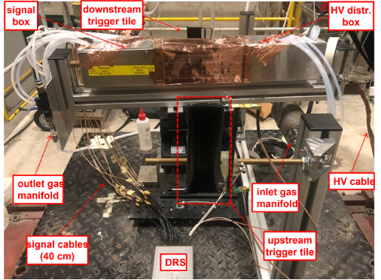
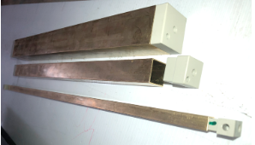
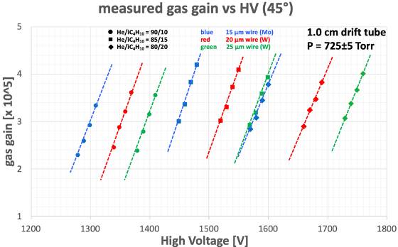
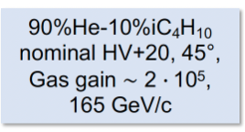
Cluster counting

Slide 14
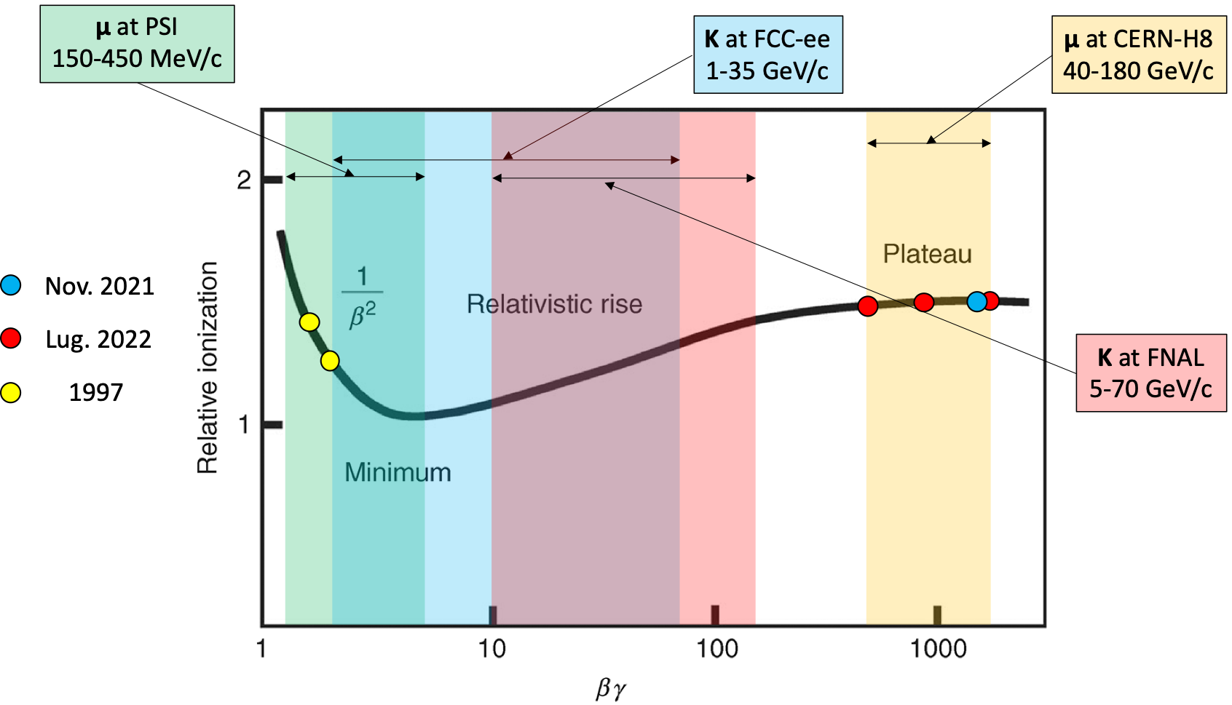
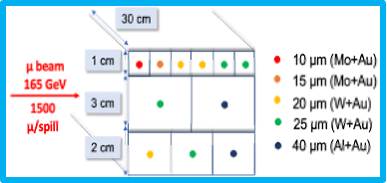
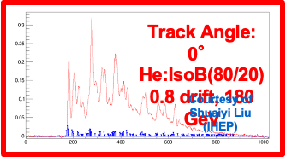
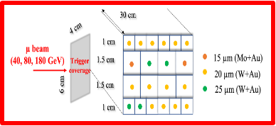
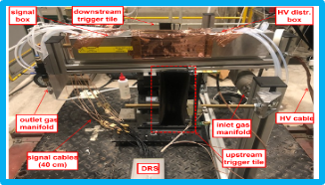
Beam tests in 2021, 2022 and 2023

Slide 15
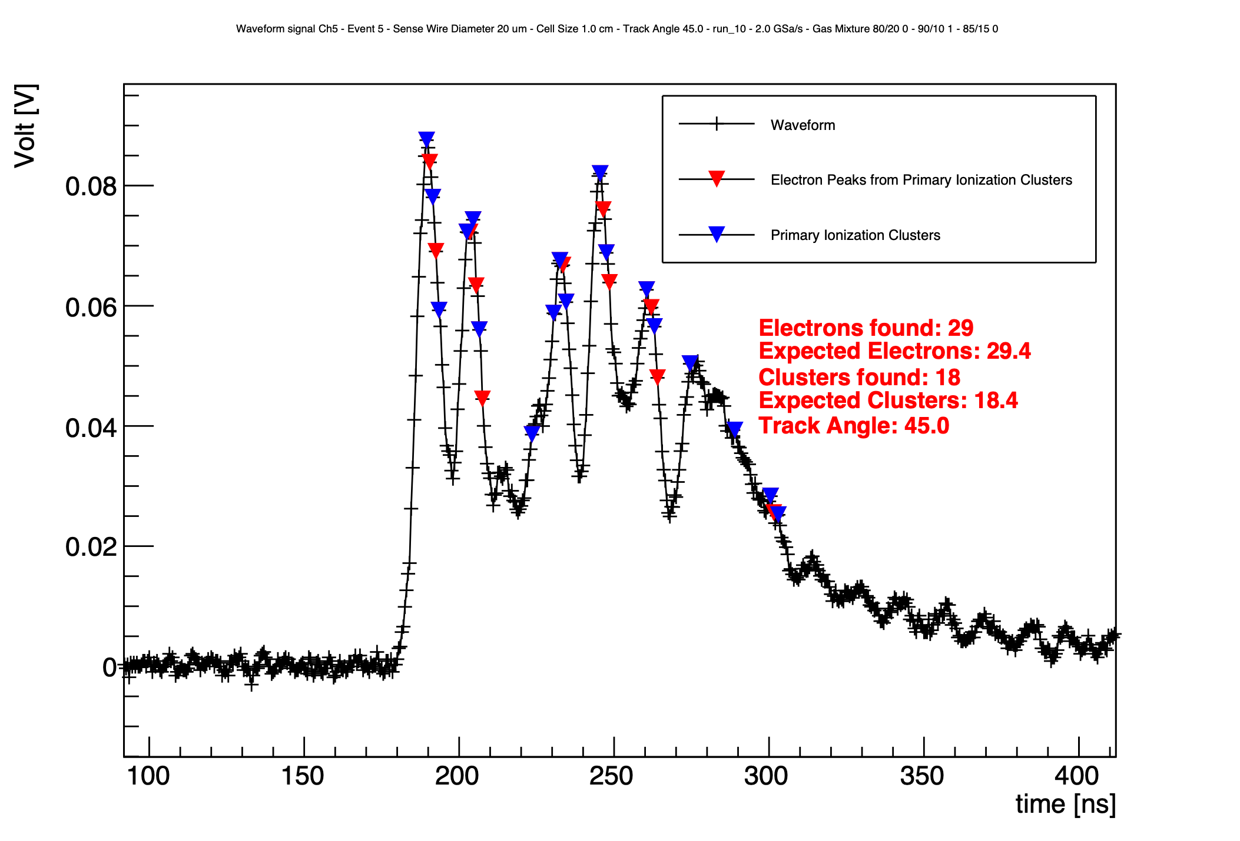
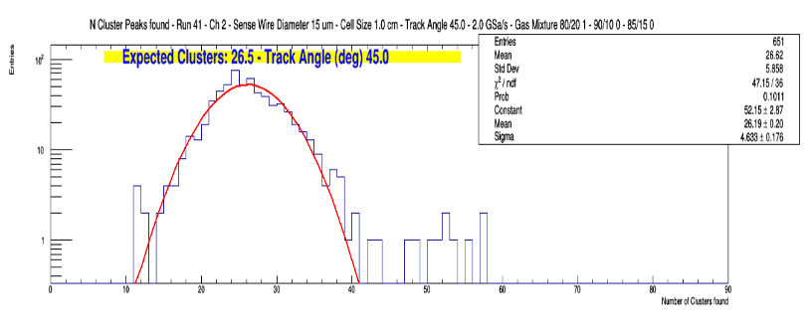
Beam tests in 2021, 2022 and 2023

Slide 16
Beam tests: resolutions

Slide 17
Conclusions
Good progress on:
Mechanical structure design
Ongoing effort to build a full-length prototype in 2025
Testbeam data analysis → NEW and quite conclusive results
Plenty of areas for collaboration
detector design, construction, beam test, performance
local and global reconstruction, full simulation
physics performance and impact
much more...
Efforts to build an international collaboration enforced
Well established with IHEP for NN-based cluster counting algorithms

Slide 18
Backup

Slide 19
Drift chamber
90% He - 10% C₄H₁₀ – All stereo – σ ~ 100 μm
Small cells, max drift time ~ 350 ns
Wire Cage
Gas envelope
Based on MEG2 experience
Based on MEG2 experience

Slide 20
Drift chamber future plans
Complete mapping of dN/dx data in all relevant βγ regions (few years)
Understand details of cluster counting performance
Build large mechanical prototype (few years)
Build full length functioning prototype with few cells (few years)
Develop on-detector cluster counting electronics (few years)
Towards a drift chamber TDR

Slide 21
Cluster counting
Cluster counting 2x better than dE/dx
Poisson vs . Landau → no large tails
Sample signal few GHz → on detector electronics R&D
Test beam 2024
Test beam data 2022
For dN/dx method:
RTA algorithm has been used for peak finding.
dN/dx resolution dependence on the track length L^{-0.5}
~ 2 times improvement in the resolution using dN/dx method as expected from the analytical calculation.

