Slide 1


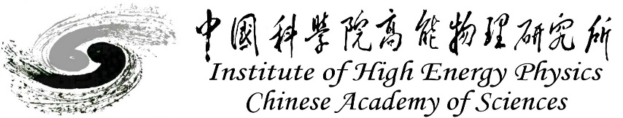
CEPC Detector Magnet
Feipeng Ning
On behalf of Detector magnet team
Oct. 23-27, 2024, CEPC workshop, Hangzhou

Slide 2
Content
Introduction of detector magnet
Physical design of the magnet
Mechanical design of the magnet
Cryogenics system design
R&D progress
  Aluminum stabilized superconducting cable development
  Dummy coil development
  High strength and high RRR Al stabilizer
Team and cooperation
Summary

Slide 3
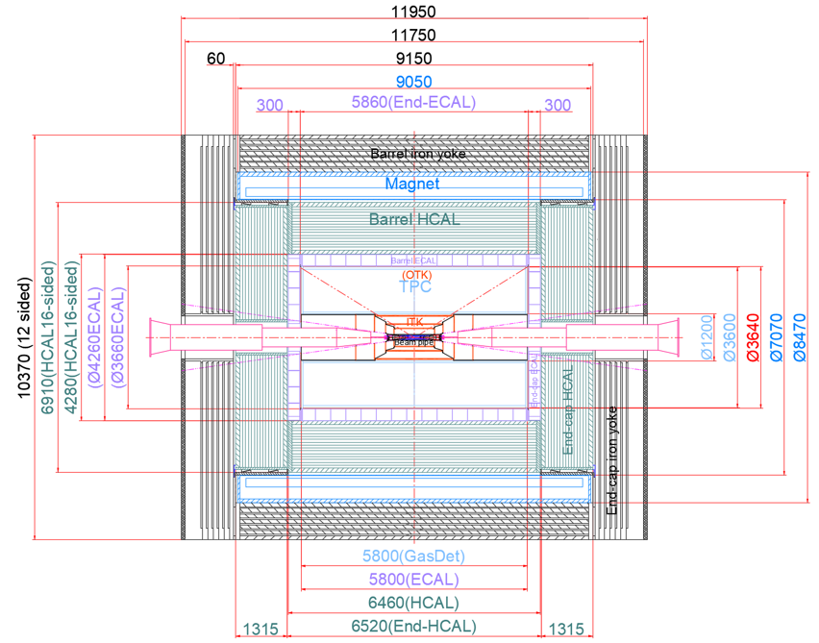
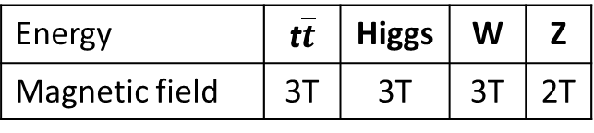
Introduction of detector magnet
Position and size
Magnetic field
Inner diameter | 7070 mm
Thickness | 700 mm
Outer diameter | 8470 mm
Length | 9050 mm
Magnet
Energy | t$\overline{t}$ | Higgs | W | Z
Magnetic field | 3T | 3T | 3T | 2T
Magnet

Slide 4
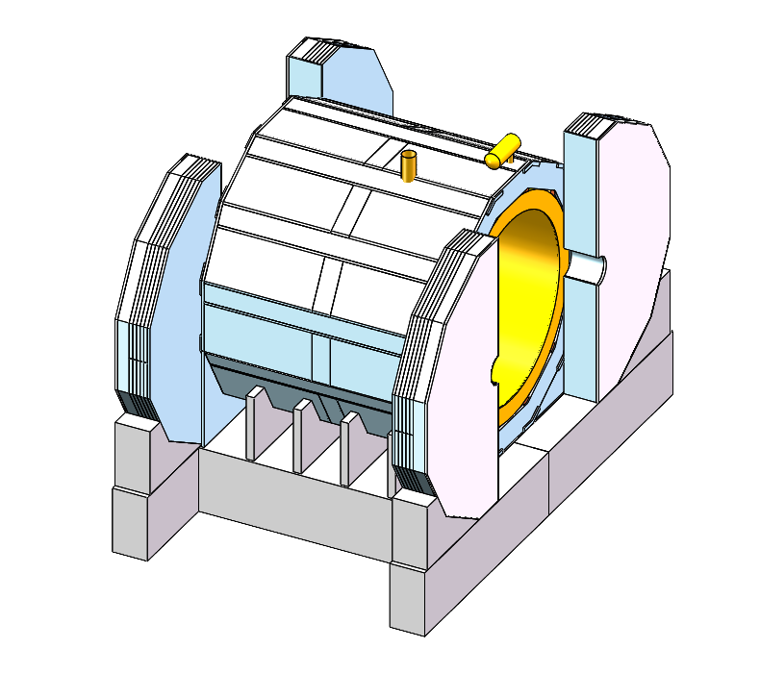
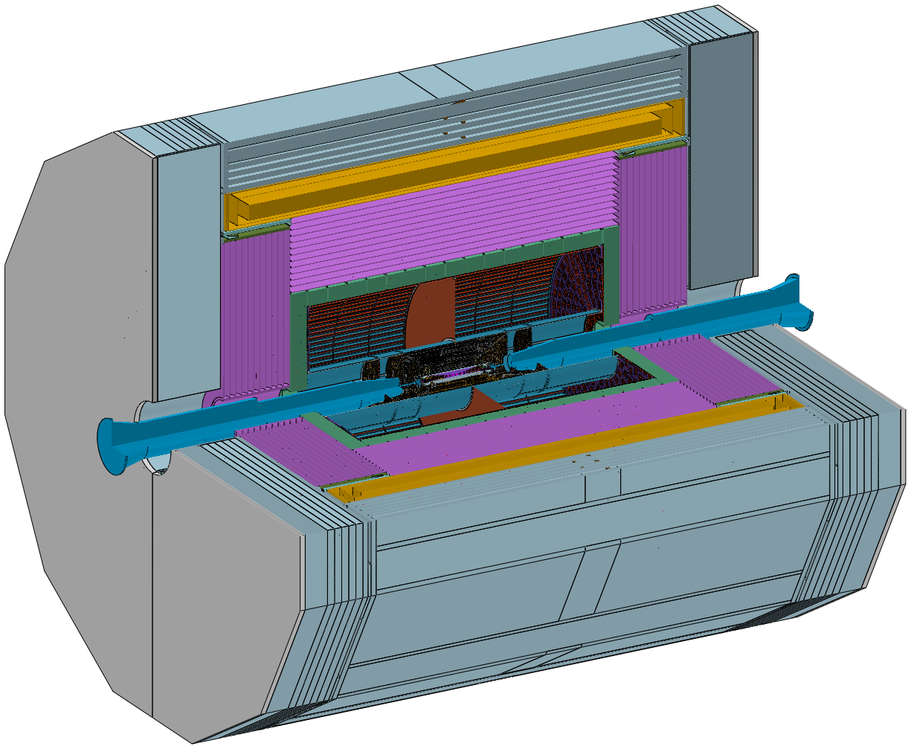
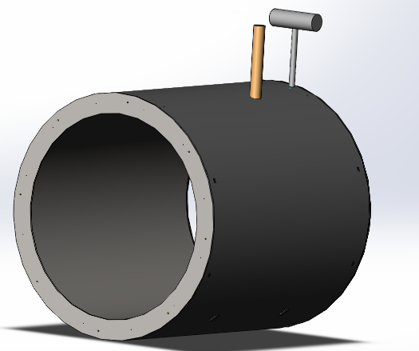
Physical design of the magnet
Design of the magnet
Magnet parameters:
Yoke + Muon
Central magnetic field | 3 T
Inner diameter | 7070 mm
Outer diameter | 8470 mm
Thickness | 700 mm
Length | 9050 mm
Cold mass | 185 tons
Yoke weight | 2960 tons
Magnet weight | 290 tons
Solenoid magnet
HCal
4

Slide 5
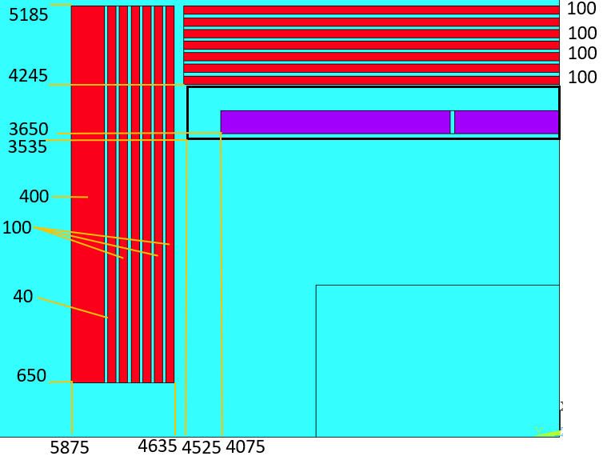
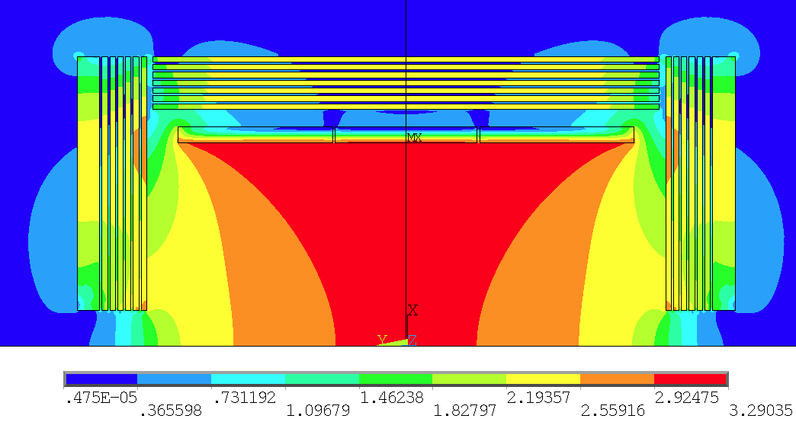

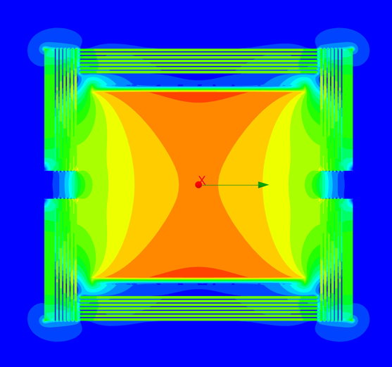

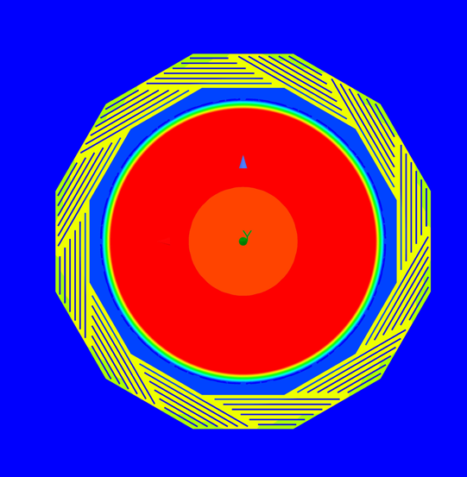
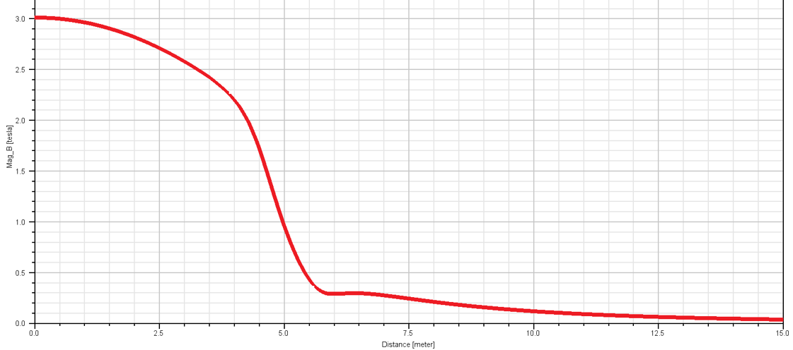
Physical design of the magnet
Physical design of the magnet
Coil parameters:
Central magnetic field | 3 T
Inner diameter | 7300 mm
Operating current | 17000 A
Cable length | 33 km
Inductance | 11 H
Stored Energy | 1.54 GJ
2D Magnetic field simulation
5
Magnetic field distribution on the axis
3D Magnetic field simulation
3D Magnetic field simulation

Slide 6
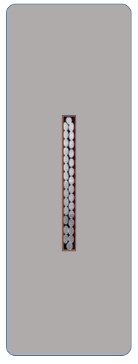

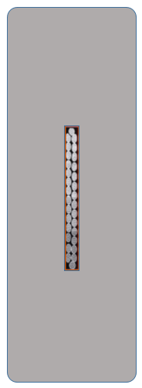
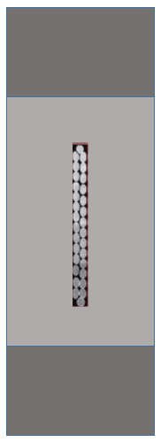
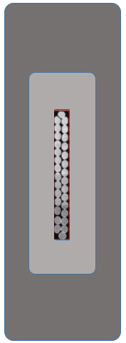
Physical design of the magnet
More details see Wang Menglin’s talk
Stress analysis：
 | High strength Al stabilizer | NbTi | 5083 Al alloy
Yield stress@4.2K | 105 MPa | 800 MPa | 500 MPa
Cable structure | 56*22 mm² | 56*22 mm² CMS Type | 56*22 mm² BOX Type | 56*28 mm² | 68*22 mm²
Coil at 4.2 K
Aluminum stabilizer | - | 4.7-79.2 | 12.8-96.5 | 54.3-95.6 | 4.4-86.1
SC cable | - | 205-307 | 188-246 | 190-248 | 174-243
Al alloy | - | 2.5-20.8 | 30.2-57.1 | - | -
Support | - | - | - | 3.27-24.7 | 4.6-36.2
Coil at 4.2 K, energized
Aluminum stabilizer | 103 | 46.7-94.2 | 52.5-102 | 58.3-103 | 42.4-89.1
SC cable | 288 | 111-283 | 80-223 | 88.9-243 | 134-216
Al alloy | - | 46-98 | 46.7-125 | - | -
Support | 126 | - | - | 58.9-152 | 34.4-80.4

Slide 7
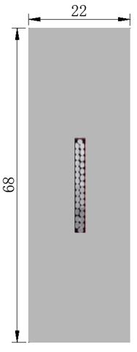
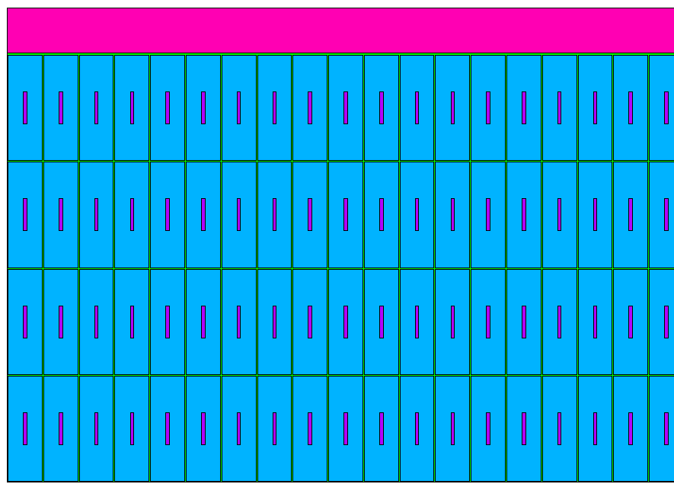
Physical design of the magnet
More details see Wang Menglin’s talk
Physical design of the magnet
Stress analysis
NbTi Rutherford cable
Material | Von Mises stress (MPa)
Coil at 4.2 K
Aluminum stabilizer | 4.4-86.1
SC cable | 174-243
Al alloy support | 4.6-36.2
Coil at 4.2 K, energized
Aluminum stabilizer | 41.5-95.9
SC cable | 54.9-221
Al alloy support | 43.2-87.4
High strength and High RRR Al stabilizer
Coil structure
Cable structure
The maximum stress of each part of the coil is controlled within the stress range of the material.
7

Slide 8
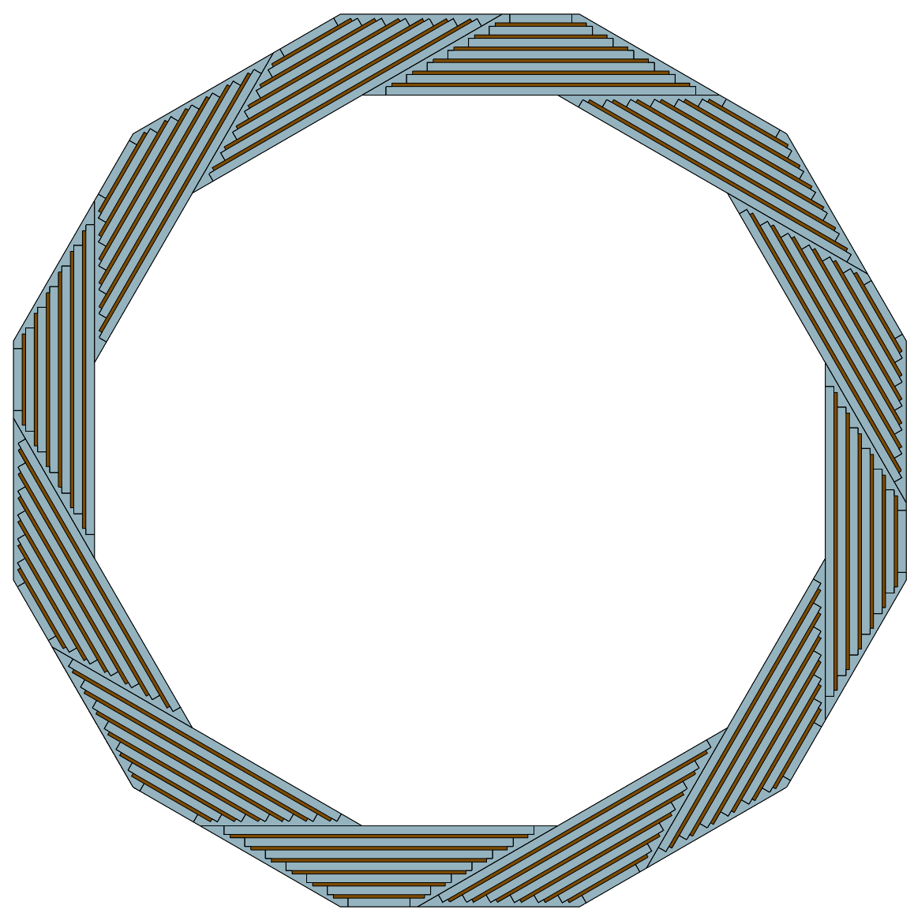
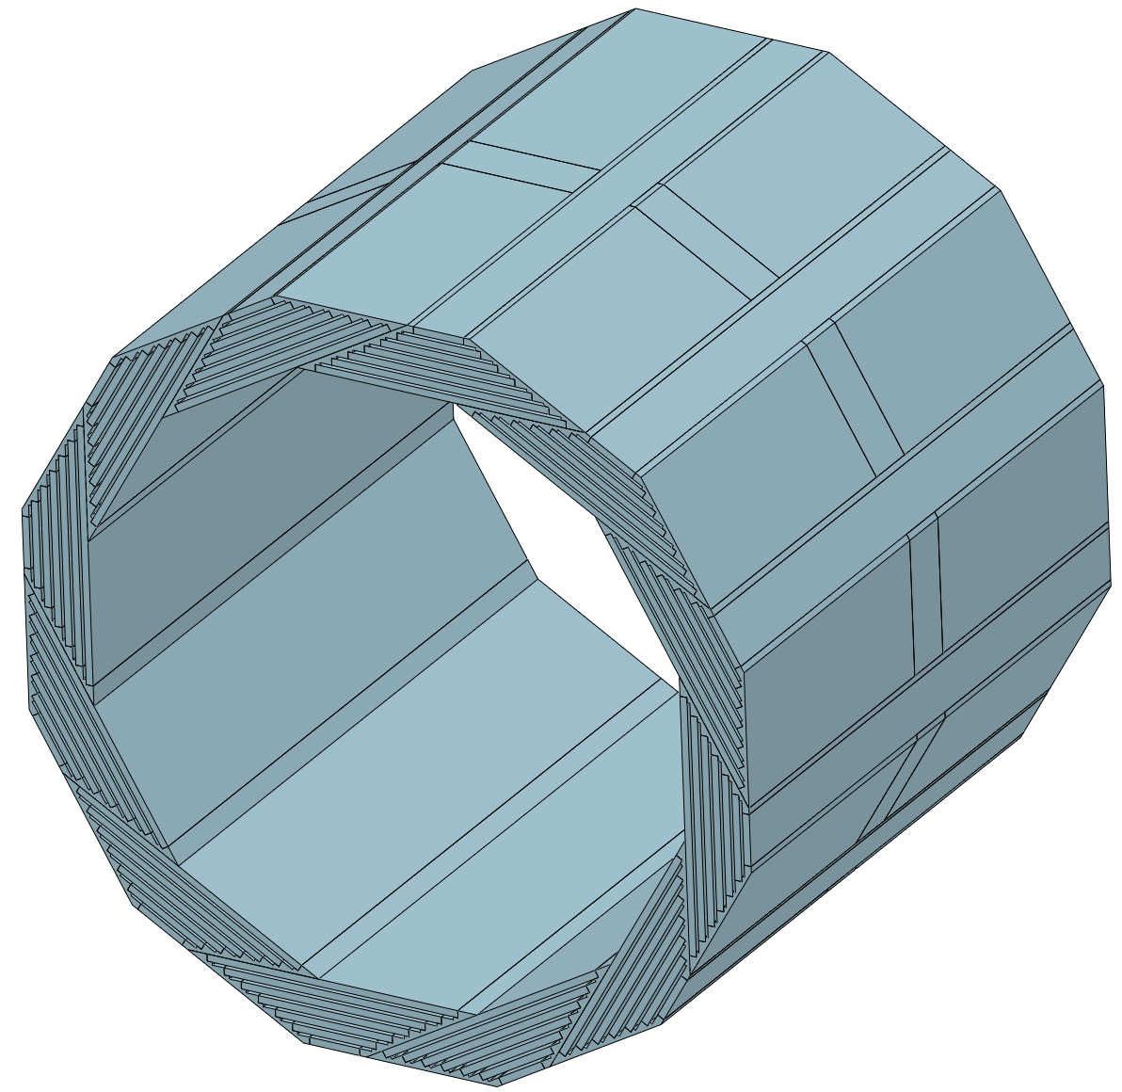
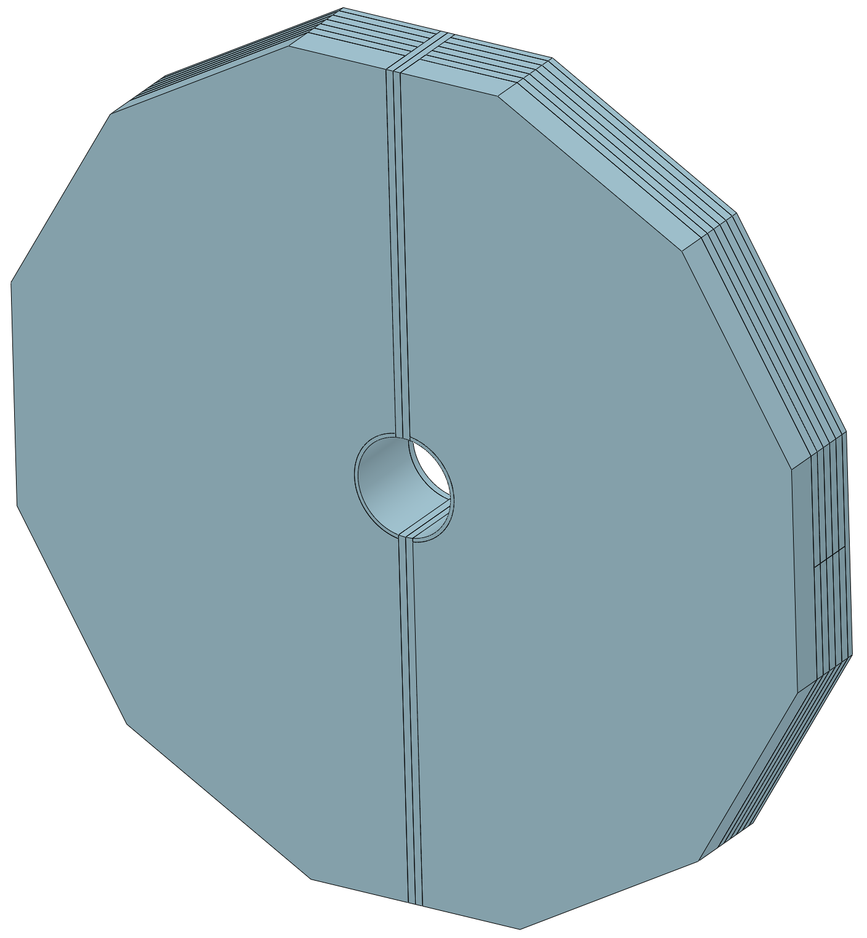
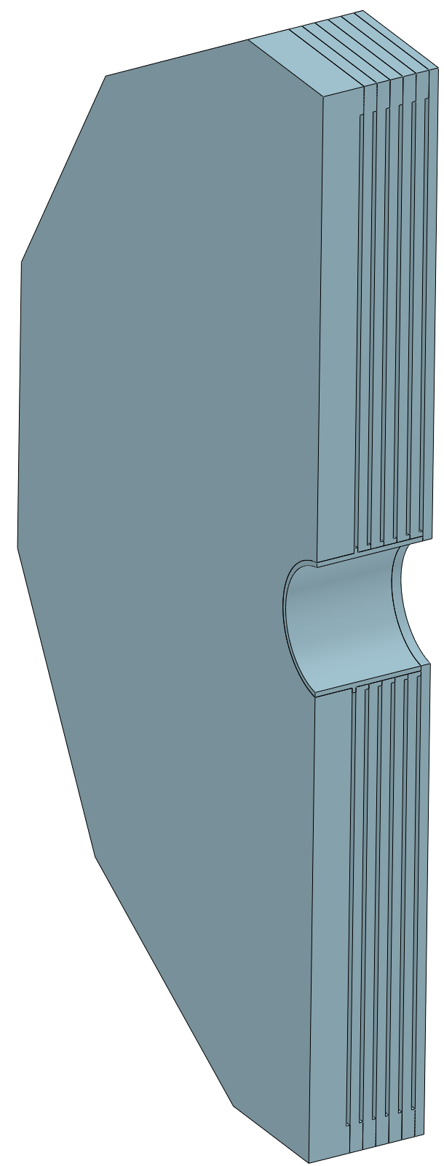
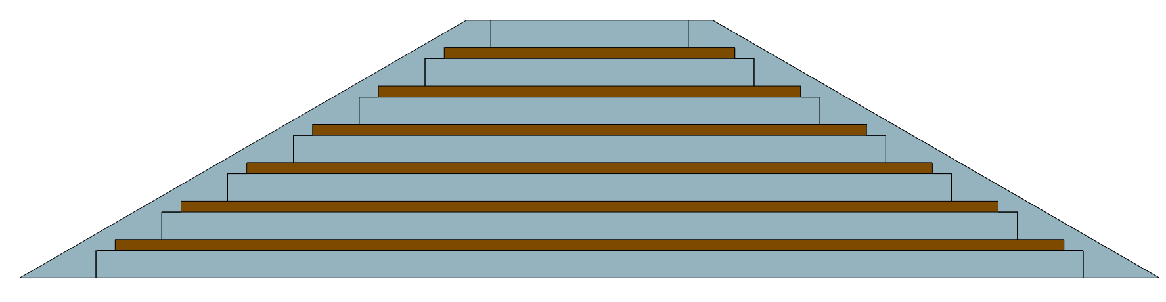
Physical design of the magnet
Yoke
Yoke parameters：
In order to reduce the detection dead zone of the muon detector, the barrel yoke is designed as a spiral structure.
Barrel yoke (ton) | 1560
Each End yoke (ton) | 700
Total Yoke (ton) | 2960
Diameter(m) & length (m) | 10.37&11.75
Barrel yoke: 1560 tons
Single module of the barrel yoke
130 tons
End yoke
700 tons
8

Slide 9
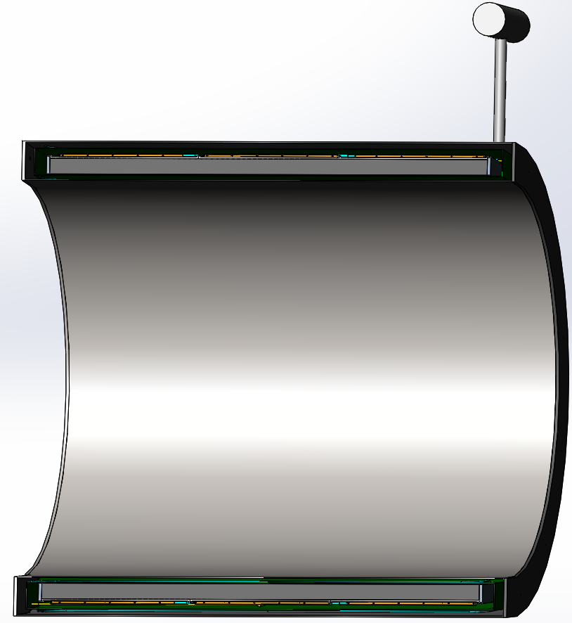
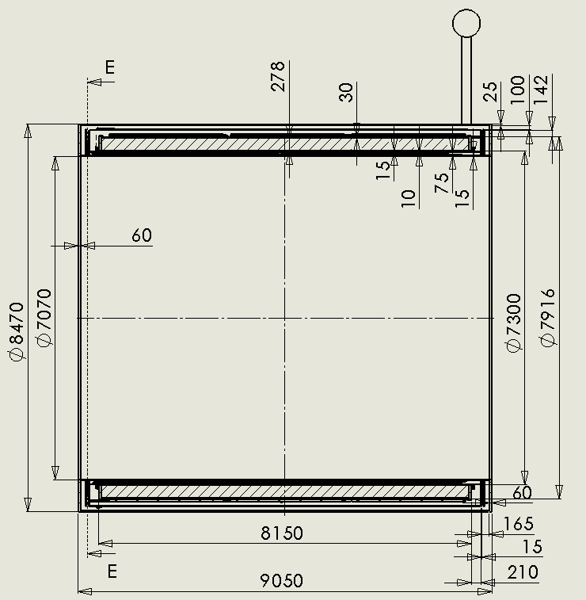
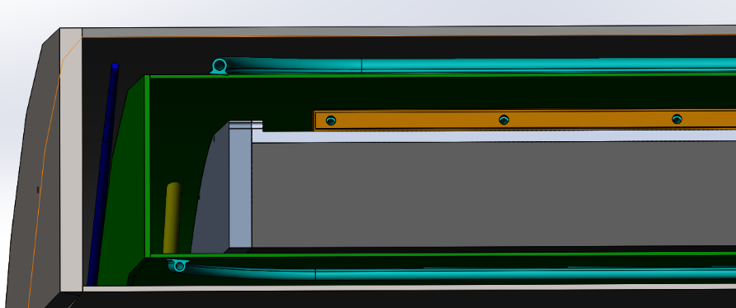
Mechanical design of the magnet
More details see Hou Zhilong’s poster
2D
Completed the design of the 2D chain and the space occupied by each component.
3D
Completed the design of the 3D structure, added suspension system, cooling pipes, and connection structure.
Thermal shield
coil
suspension rod

Slide 10
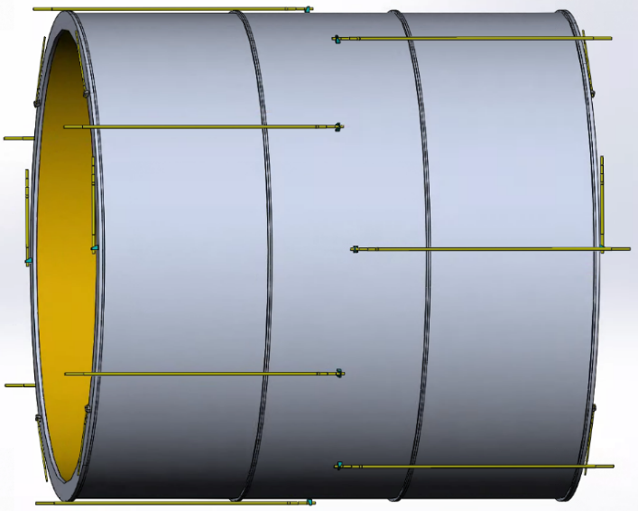
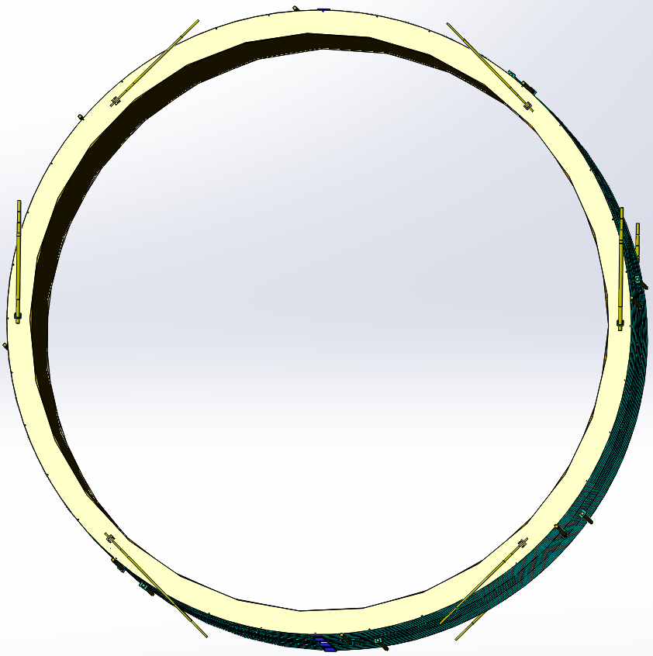
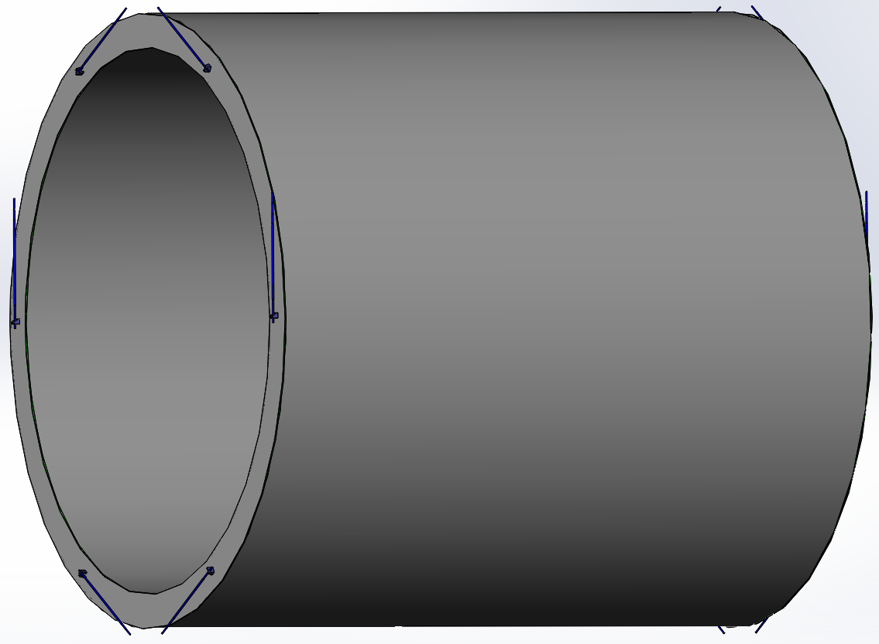
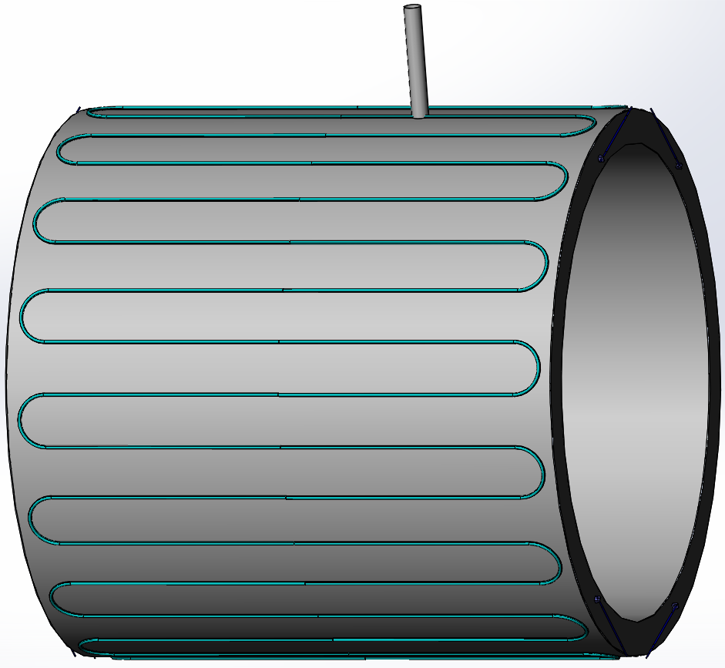
Mechanical design of the magnet
Suspension system
More details see Hou Zhilong’s poster
Coil suspension system (185 tons):
8 axial rods each end
6 radial rods each end
Material: titanium alloy
 | Diameter | Length | amount
Axial rods | 30 mm | 3530 mm | 16
Radial rods | 40 mm | 1700 mm | 8
Main pull rods | 48 mm | 1650 mm | 4
Forces and torques resulting from axial and radial offset, and from angular tilt of the coil.
Thermal shield suspension system:
6 radial rods each end
Material: titanium alloy
Axial displacement (cm) | 1 | 3 | 10
Axial force (kN) | 484 | 1498 | 5034
Radial displacement (cm) | 1 | 3 | 10
Radial force (kN) | 34.3 | 236 | 656
Angular tilt (angle) | 1/407.5 =0.14° | 3/407.5 =0.42° | 10/407.5 =1.41°
Torque (kN.m) | 1965 | 6170 | 19935

Slide 11

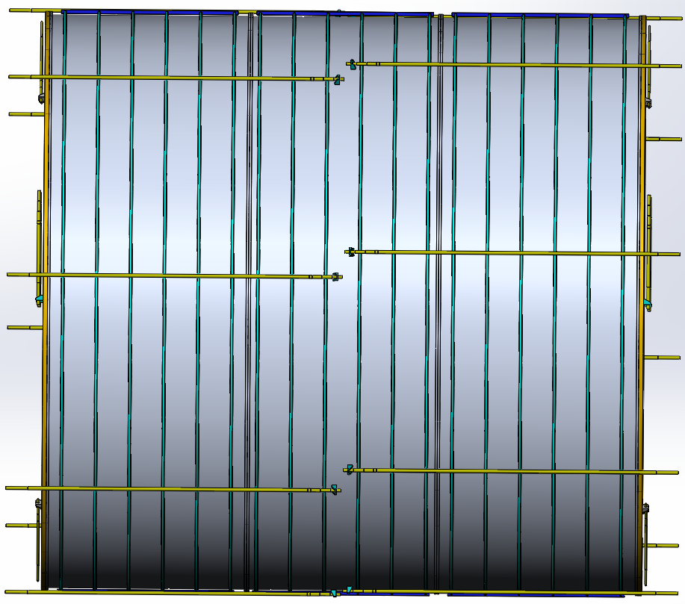
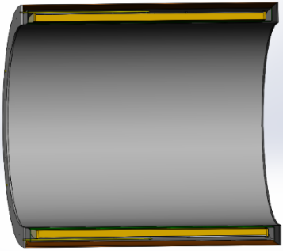
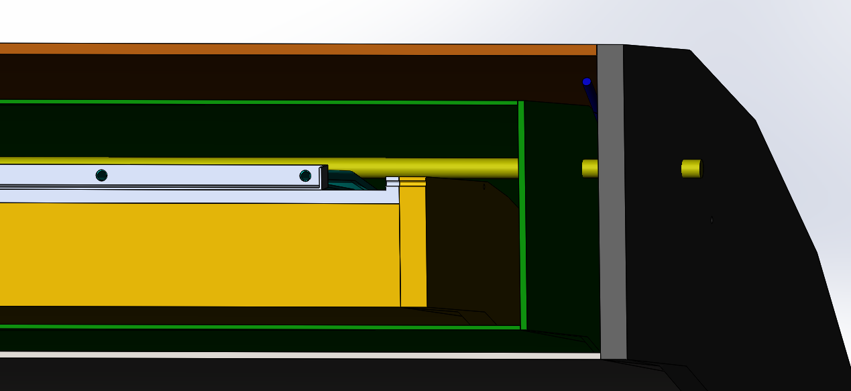
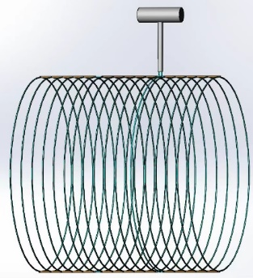
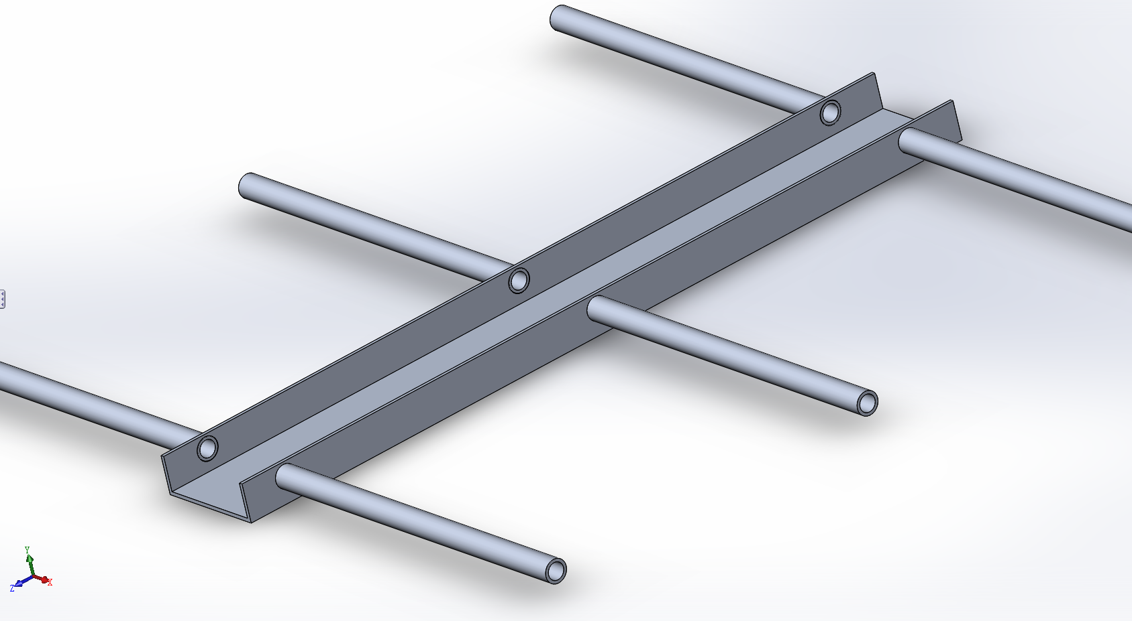
Mechanical design of the magnet
Main Technical Challenges:
Large-size and high-strength Aluminum stabilized superconducting cable;
Suspension system of the huge coil (185 tons);
High precision machining and assembly of large scale coil；
There are lots of welds in low-temperature pipes, including pipes and coil supports, pipes and liquid/gas helium tanks.
In summary, most of the challenges are related to processing techniques.

Slide 12
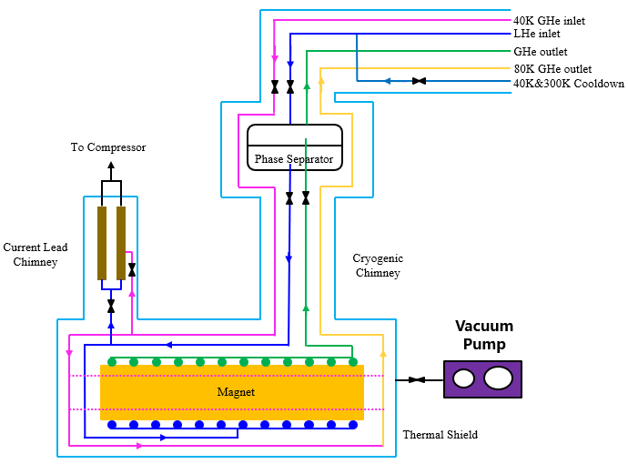
Cryogenic system
Cooling methods: Thermal siphon
Uniform temperature distribution;
High heat transfer efficiency, not limited by source pressure and pressure drop;
Low cost. No need for liquid helium circulation pump
The verification experiment are being design.
Cooling process diagram
12

Slide 13
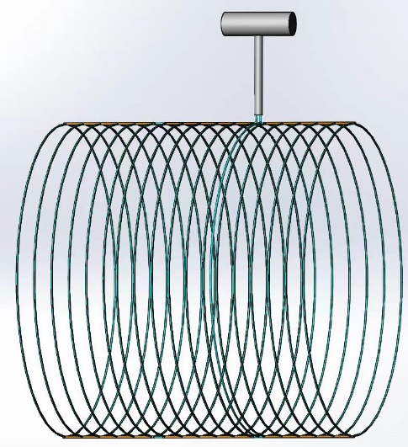
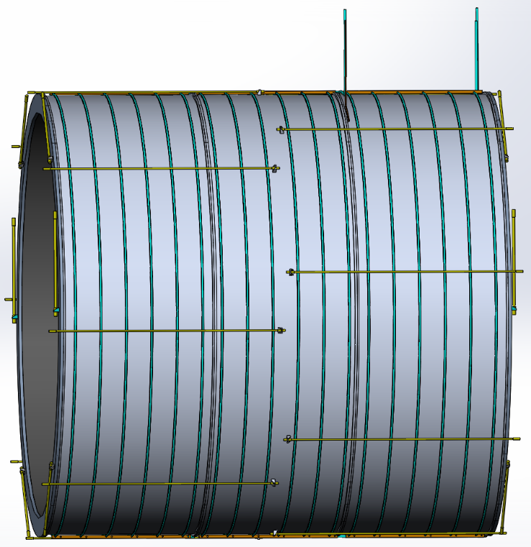
Cryogenic system
Cooling methods: Thermal siphon
Heat loads:
Items | Heat loads@4.2K (W) | Heat loads@60K (W)
Heat radiation | 35 | 373
Suspension rods | 7 | 55
Current leads | 100 | 2000
Cable joints | 4 | 0
Dynamic loads | 193 | 65
Static loads | 30 | 160
Total | 369 | 2653
Cooling structure
13

Slide 14
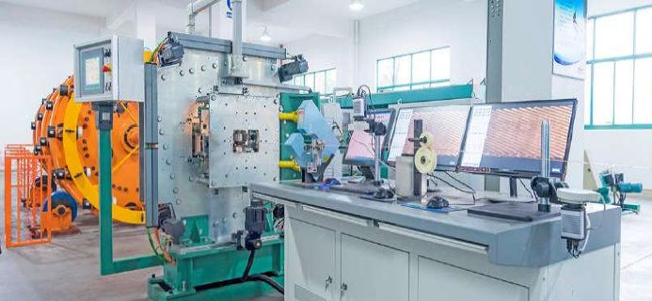
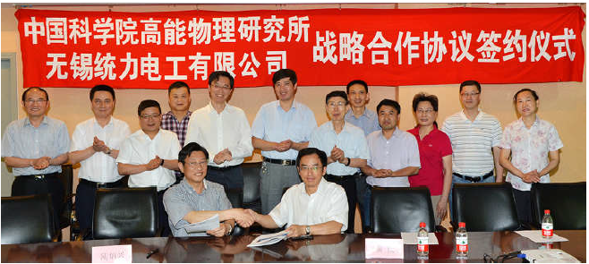
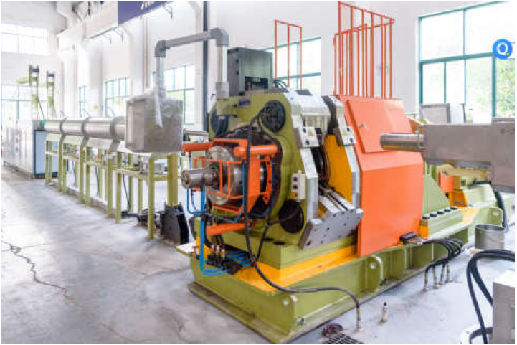
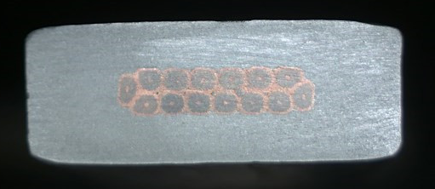
R&D progress
Conductors
  Conductor is the foundation of the magnet development. Most of the detector magnets used or will use the Aluminum-stabilized Nb-Ti/Cu conductors.
Rutherford Cable
Aluminum stabilized NbTi/Cu conductor
The IHEP and Toly company have jointly established an aluminum coated conductor production line in 2015.
Extrusion machine
14

Slide 15
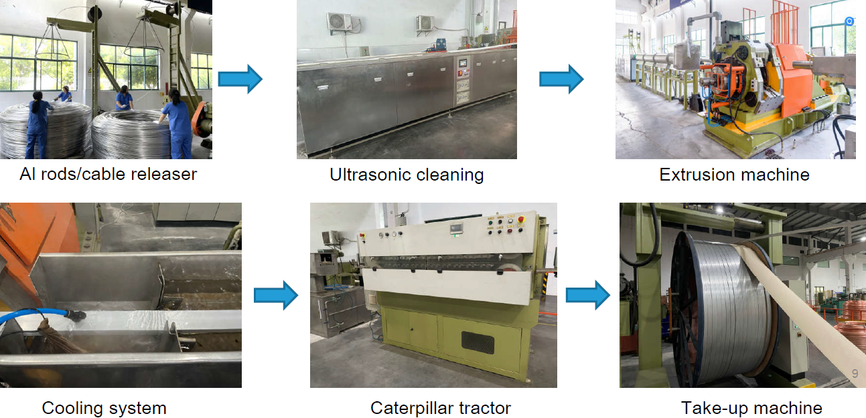
R&D progress
More details see Zhao Ling’s poster
Aluminum coated conductor production line
This is the only aluminum coated superconducting cable production line in the world at present.
15

Slide 16
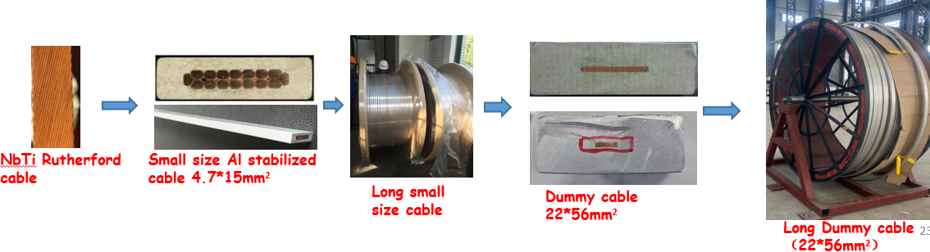
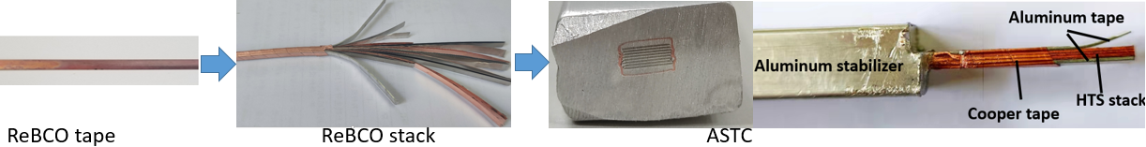
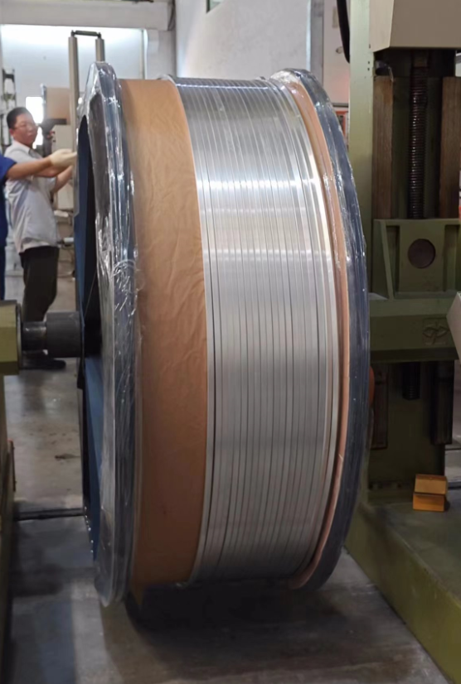
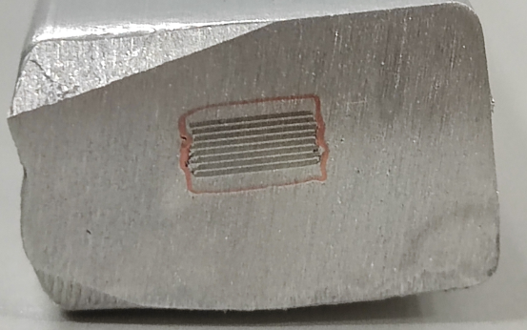
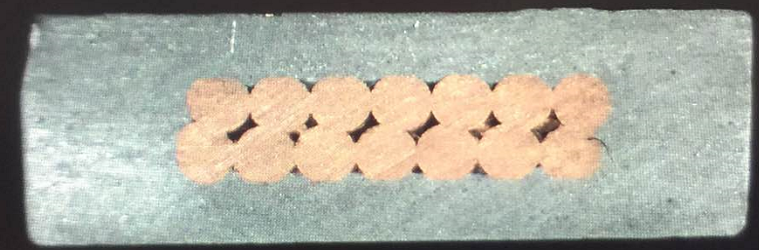
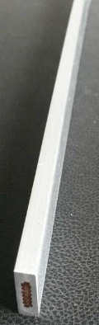
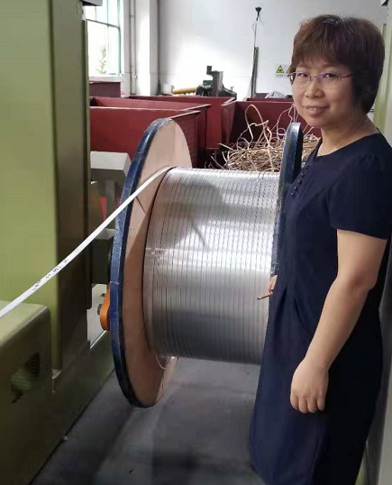
R&D progress
Aluminum stabilized superconducting conductors
More details see Zhao Ling’s poster
LTS: NbTi cable
Aluminum stabilized NbTi Rutherford cable
HTS: ReBCO cable
Aluminum stabilized Stacked REBCO Tape Cable
Dimensions: 15*4.7mm²
Number of strands ：14
Materiel : Al(99.99% purity)
Complete time:2017.8
Shear strength (COPPER &Al) > 35MPa
Length: 1.5 km
Dimensions: 15*10 mm²
Number of tapes ：14
Materiel: Al 1100
Complete time: 2023.12
Length: 100 m
1.5 km
100 m

Slide 17
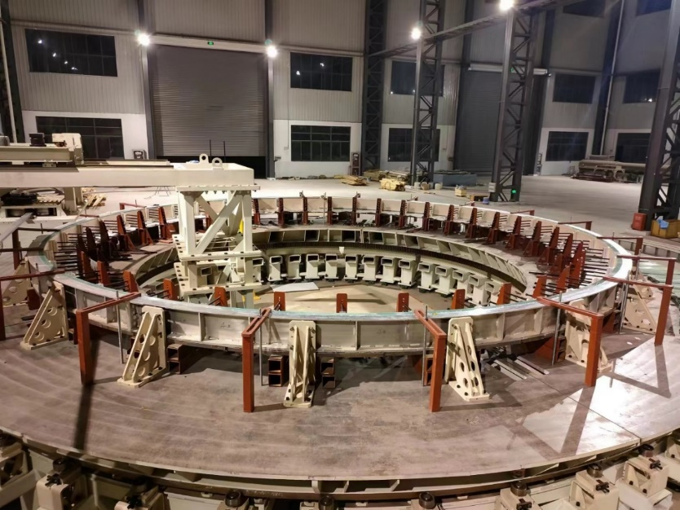


R&D progress
Dummy coil development
Coil winding, vacuum leak detection, epoxy impregnation curing.
Large scale superconducting coil winding platform
Coil winding
Coil winding
17

Slide 18




R&D progress
Dummy coil development
φ7.2m dummy coil
vacuum leak detection
4 layers*10 turns
Dummy coil
The manufacturing accuracy is controlled within ± 1mm
18

Slide 19



R&D progress
R&D of High Strength and High RRR(Residual Resistivity Ratio) Aluminum- Stabilizer for Superconducting Cable
Yield strength > 100 MPa@4.2K, 74 MPa at room temperature, RRR value > 400
By doping Ni-0.025% Be-0.025%
The Al-0.025%Ni-0.025%Be alloy prepared from 4N8-aluminum achieved high 0.2% yield strength of 75MPa (R.T.) with RRR of 417
High strength and High RRR aluminum stabilizer
Poisson’s ratio | 0.33/0.34
Young modulus | See the curve
Thermal expansivity | 14.23×10⁻⁶ K⁻¹
4.2KRp_{0.25} | 105MPa
19

Slide 20

Research Team
IHEP: staff 13; engineer 5; post doctor 1; students 3
Cooperative institutes and Universities: SJTU, SWJTU, NCEPU, TSINGHUA, IEE, IPC, IPP and so on.
Cooperative companies: Wuxi Toly (aluminum stabilized conductors), Hefei Keye ( coil winding platform and dummy coil development), Xinjiang Zhonghe ( Aluminum stabilizer), SSCT ( HTS tapes), to be added.
Welcome international cooperation.

Slide 21
R&D plan
R&D items | Time
Further optimize the physical design of the coil, including magnetic field distribution, conductor structure, quench calculation and so on | 2024.11
Optimize the workflow of cryogenic system | 2024.12
Refine the design of mechanical structures | 2025.3
Full size superconducting conductors development | 2025.12
HTS plan R&D | 2027.12

Slide 22
Summary
1. We carried out the physical design, mechanical design, and cryogenic system design of the CEPC detector magnet.
2. A lot of R&D work is underway.

Slide 23
Thank you for your attention!
Oct. 23-27, 2024, CEPC workshop, Hangzhou

