Slide 1
Physical design of CEPC detector magnet
Menglin Wang
IHEP,CAS
The 2024 International Workshop on the High Energy Circular Electron Positron Collider
Hangzhou, China
25/10/2024

Slide 2
CONTENTS
CEPC Detector SC Magnet overview
Magnetic field design
Stress distribution on the coil
Eddy loss during charging
Quench Protection
Summary
Notes:
the CEPC detector magnet is located at the collision point of the ring. The positioning of the magnet is conventional: it is situated outside the hadronic calorimeter and the electromagnetic calorimeter, while being nested inside the muon detector and the yoke. The inner diameter of the entire magnet is 7070 mm, and I will not go into further detail regarding specific dimensions, as Dr Ning Feipeng has provided a clear introduction in his earlier presentation.

Slide 3
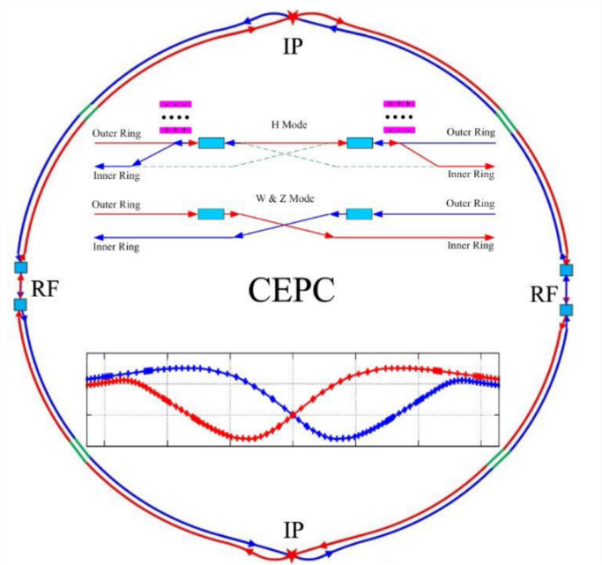
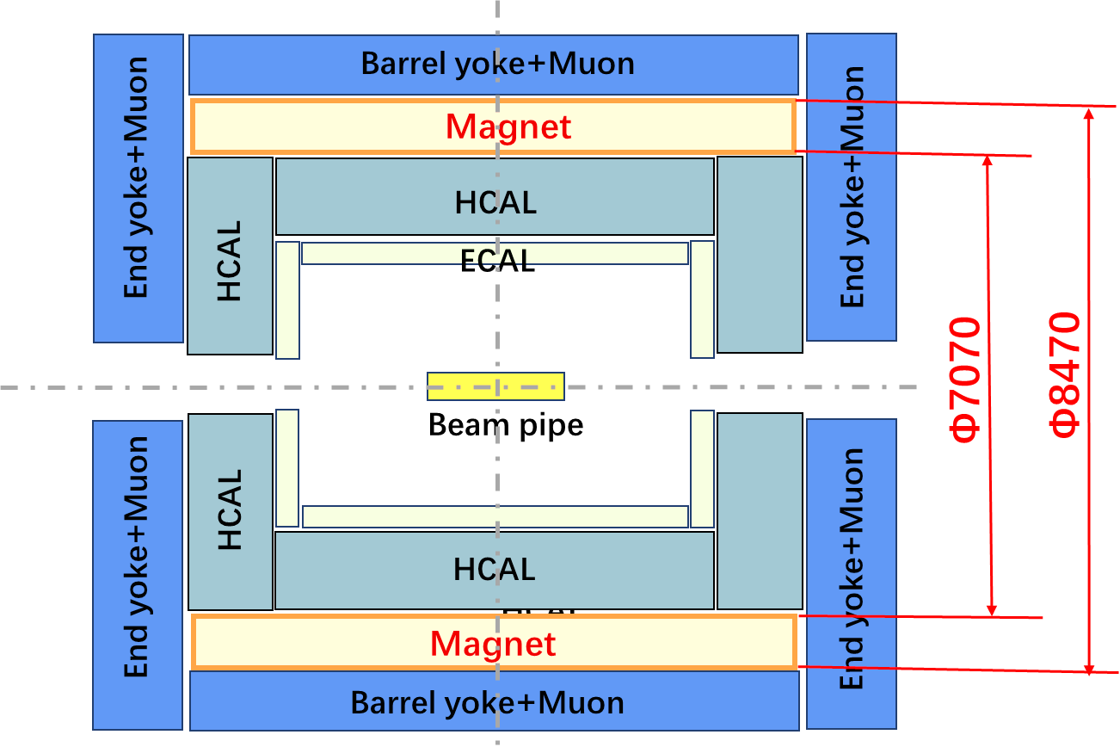
CEPC Detector SC Magnet
Position
Overview
9 m long coil, 7.07 m room temperatur bore diameter, 3T field
Operating Temperature 4.5 K
Conductor: Al stabilized NbTi/Cu Rutherford Cable
Notes:
the CEPC detector magnet is located at the collision point of the ring. The positioning of the magnet is conventional: it is situated outside the hadronic calorimeter and the electromagnetic calorimeter, while being nested inside the muon detector and the yoke. The inner diameter of the entire magnet is 7070 mm, and I will not go into further detail regarding specific dimensions, as Dr Ning Feipeng has provided a clear introduction in his earlier presentation.

Slide 4
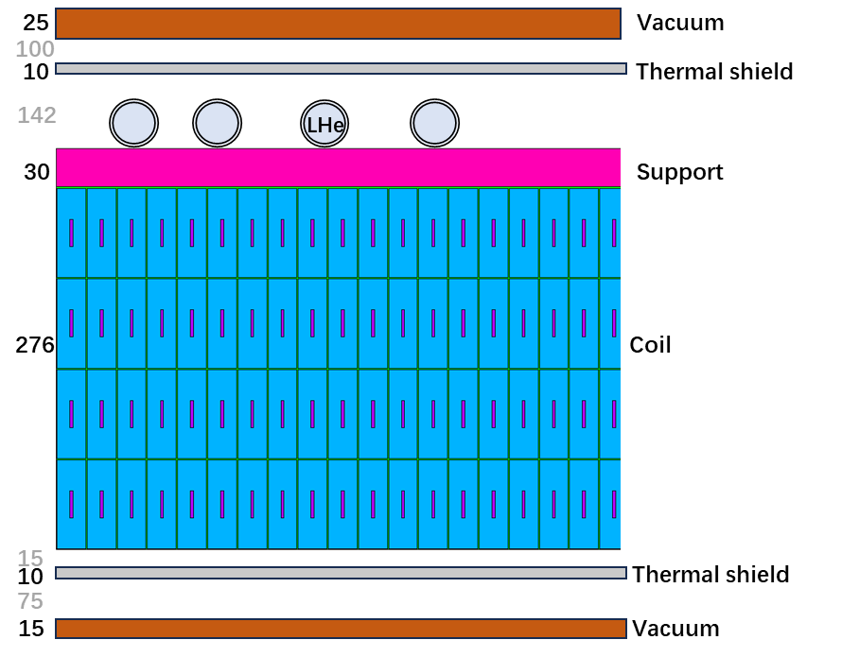
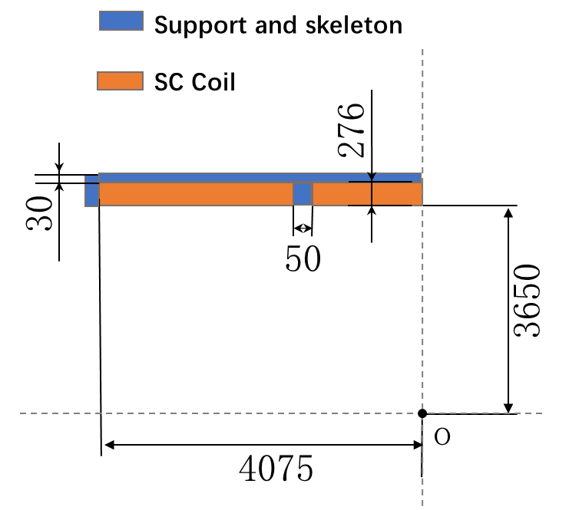
Layout and parameters
Notes:
This diagram illustrates the internal layout of the magnet, which includes the outer vacuum chamber, thermal shields, the coils themselves, the external support frame for the coils, and the liquid helium pipe used for coil cooling. The coil consists of four layers with a total of 1,400 turns, organized into three modules with a 50 mm gap between each module.

Slide 5
Layout and parameters
Coil Inner diameter | 7300 mm
Coil Outer diameter | 7916 mm
Coil length | 8150 mm
B@(0,0,0) | 3 T
Operating current | 17 kA
Coil Module gap | 50 mm
Inductance | 11 H
Stored Energy | 1.54 GJ
Inductance matrix / H
 | Coil 1 | Coil 2 | Coil 3
Coil 1 | 2.01 | 0.73 | 0.27
Coil 2 | 0.73 | 1.75 | 0.73
Coil 3 | 0.27 | 0.73 | 2.01
Notes:
Here, we present some key coil parameters and the inductance matrix.

Slide 6
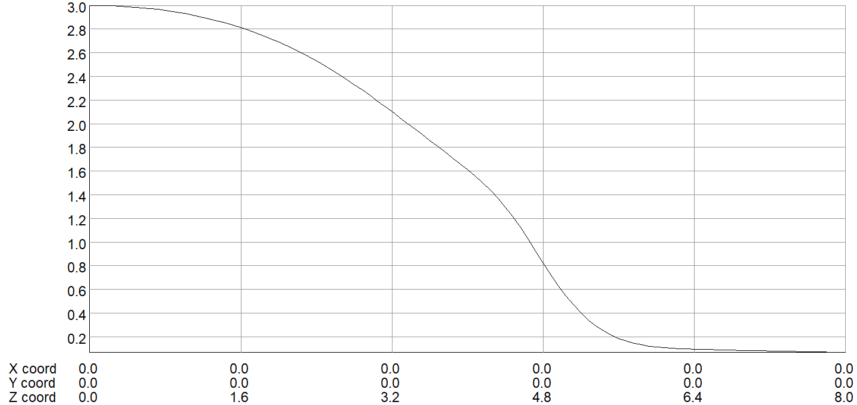
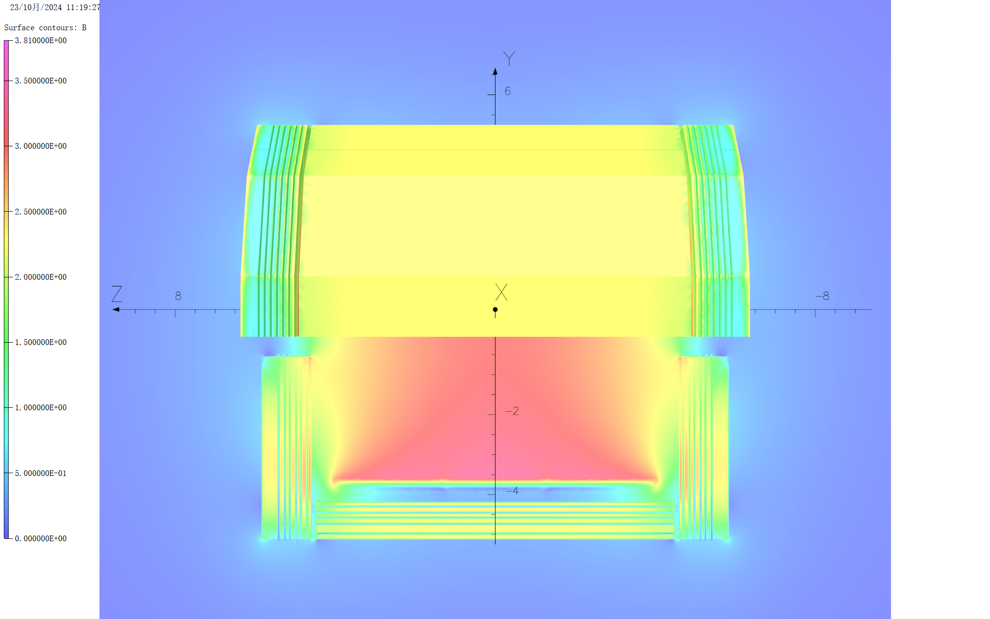
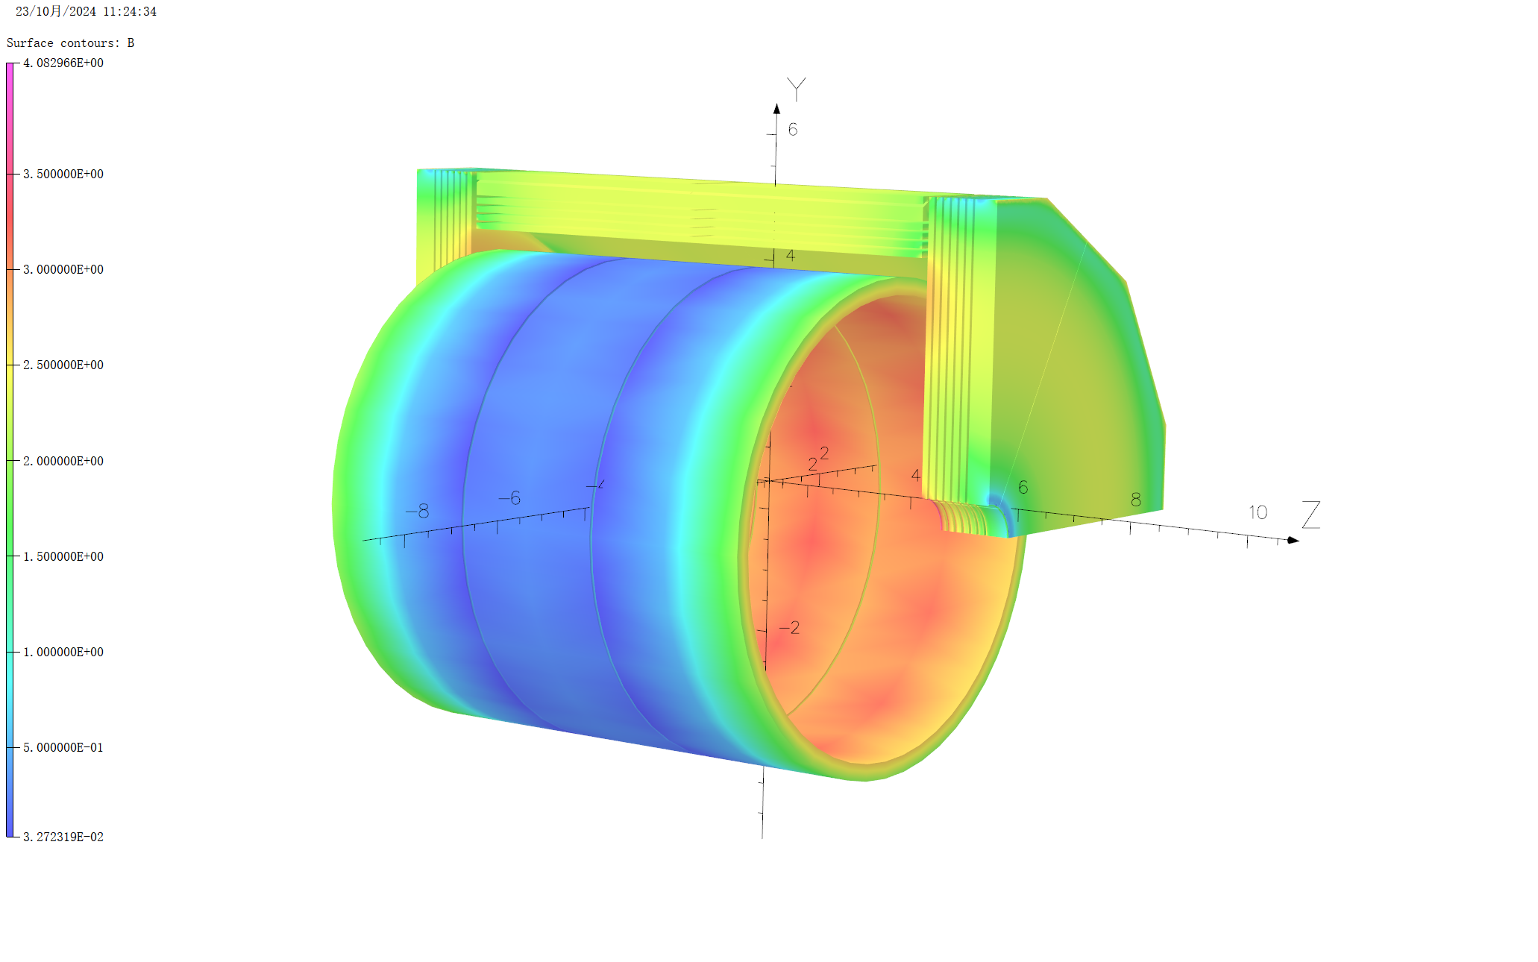
Magnetic field design
3D Magnetic field distribution
Bcenter=3.01T
B along Z axis / T
Bpeak on cable: 3.81T
Notes:
The central magnetic field strength is 3 T, and we can observe the three-dimensional magnetic field distribution with the maximum field on the coils reaching 3.81 T.

Slide 7
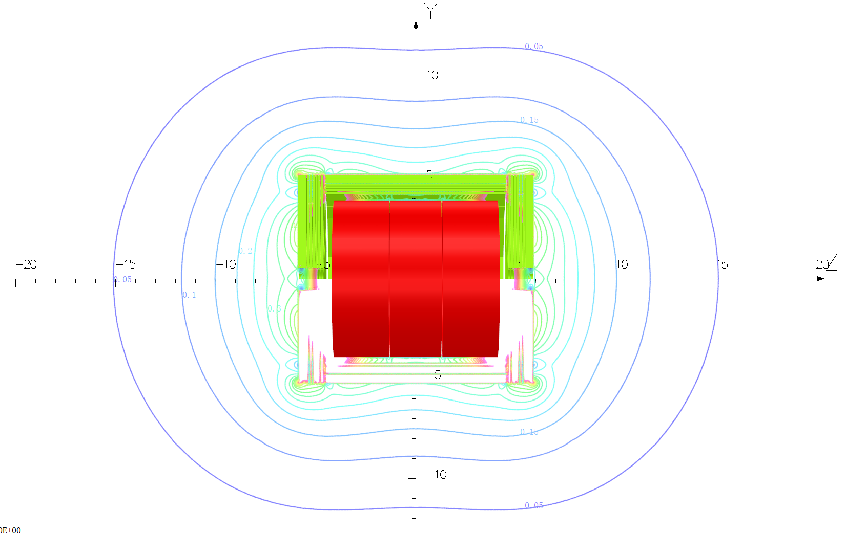
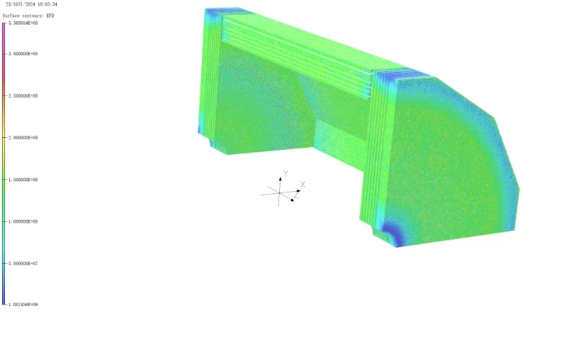
Magnetic field design
Stray field
Lorentz force density on the yoke iron
Max: 3.36E8 N/mm³, located on the stiffener
Face of B=100 Gs
Face of B=500 Gs: R~11m, z~15 m
Notes:
To the left, the distribution of the stray magnetic field is displayed, which includes the 100 gauss lines, 100 gauss surfaces, and 500 gauss surfaces. The 500 gauss surface is located at 15 meters axially and 11 meters radially. However, due to the current lack of specific requirements for stray magnetic fields from other related components, we have not conducted a more detailed leakage magnetic field design as of yet. To the right, we present the Lorentz force calculations for the yoke. The peak force density is 3.36 N/mm³, primarily situated on the reinforcement ribs between the different layers of the yoke.

Slide 8
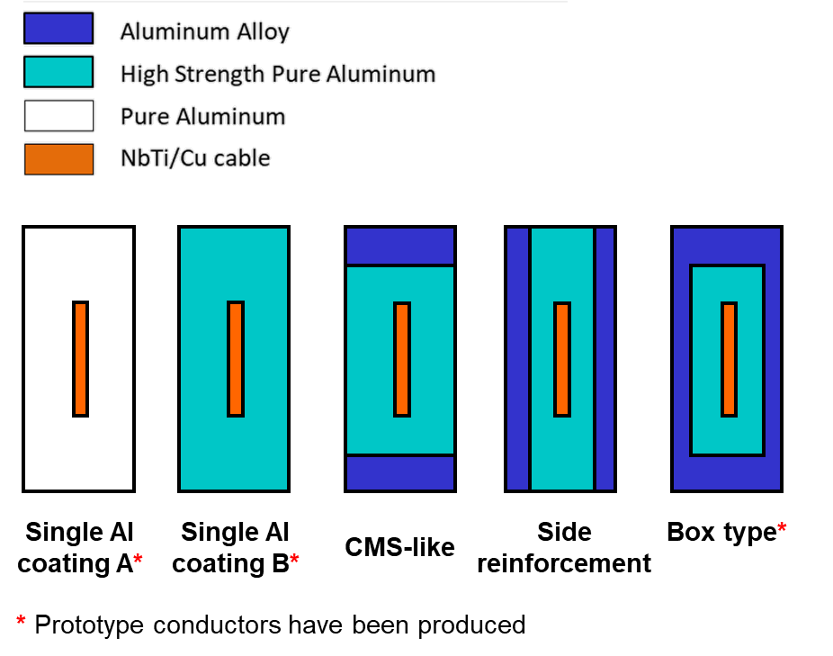
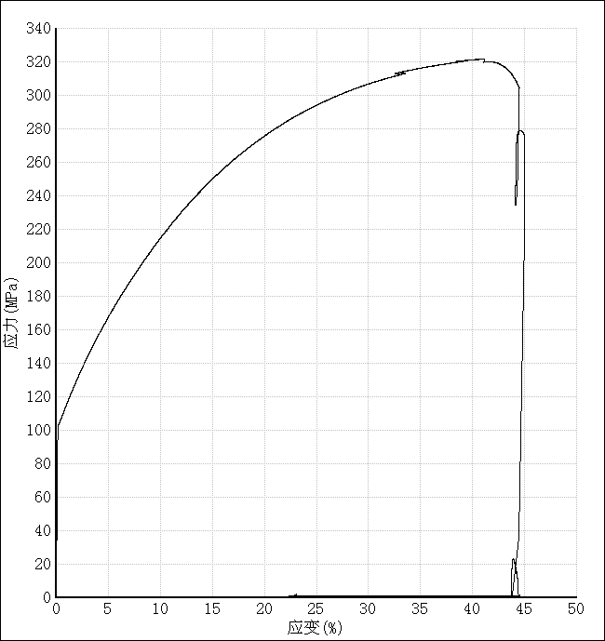
Cable and Stress
Optional cable scheme
Materials
SC core: NbTi/Cu Rutherford Cable, 2.2mm*20.5 mm
Reinforce: 5083 Al
Stabilizer: 4N8 Al doped with 0.025%Ni-0.025%Be[1]
Stress-strain curve of 4.2K
Poisson’s ratio | 0.33/0.34
Young modulus | See the curve
Thermal expansivity | 14.23×10⁻⁶ K⁻¹
Rp_{0.25}@4.2 K | 105MPa
[1] M. Wang, et al. Development of High Strength and High RRR Aluminum-Stabilizer for Superconducting Cable in CEPC Detector Magnet.
IEEE Trans. Appl. Supercond., 2023, 33(2):1-5.
Notes:
Regarding the core component of the coil—the cable—five options for aluminum-stabilized niobium-titanium copper cables have been listed. The differences lie in the aluminum stabilization coating processes, such as using pure aluminum and high-strength doped pure aluminum for a standard single-layer coating, as well as adding an aluminum alloy reinforcement structure externally. For instance, the CMS-type conductor employs a similar approach, with reinforcements on both sides of the cable and a box-type reinforcement.
The three cables marked with red stars have already produced prototype conductors and have undergone relevant testing. The cross-sectional dimensions of the niobium-titanium Rutherford cable are 2.2 mm by 20.5 mm. The typical external reinforcement structure utilizes 5083 aluminum, while the aluminum stabilization employs 4N8 aluminum, doped with 0.025% nickel and 0.025% beryllium. The table below presents detailed parameters and the stress-strain curves we've measured at 4.2 K, revealing a yield strength of 105 MPa at this temperature.

Slide 9
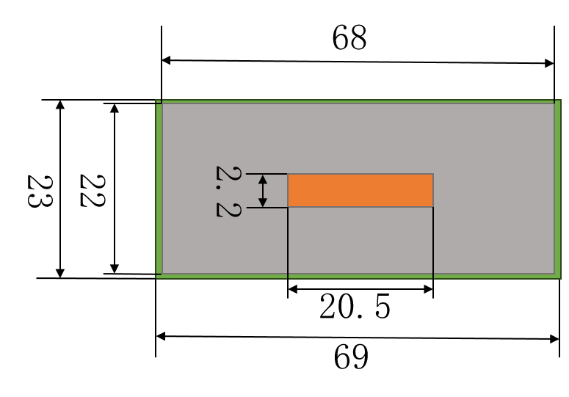
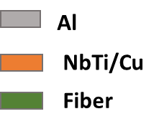
Cable and Stress
Optional cable scheme
The additional al alloy reinforcement has a very small effect on reducing the stress on the stabilizer, but carries additional manufacturing difficulties and costs.
Increasing the length of the cable will inevitably significantly reduce the Lorentz force on the cable, and the width of the cable has little effect.
Final selection: Cable section size is 68mm*22mm(Single Al coating B)
Cable parameter | 56*22 Single Al coating B | 56*22 CMS-Like | 56*22 Side | 56*22 box | 68*22 Single Al coating B | 80*22 Single Al coating B | 56*28 Single Al coating B
Coil at 4.2 K
NbTi | 172-242 | 181-256 | 174-254 | 188-246 | 174-243 | 174-243 | 174-245
Al Stabilizer | 5.5-88.3 | 1.2-92.5 | 1.3-99.8 | 12.8-96.5 | 4.4-86.1 | 3.9-86.3 | 4.3-89.5
Support | 5.65-36.3 | 1.8-70.2 | 0.9-69.4 | - | 4.6-36.2 | 3.9-35.8 | 4.2-36
Al Reinforce | - | 1-81 | 0.4-80.7 | 30.2-57.1 | - | - | -
Coil at 4.2 K, energized
NbTi | 20.9-208 | 61-221 | 33-217 | 80-223 | 54.9-221 | 73.1-214 | 31.3-211
Al Stabilizer | 47-103 | 38.5-99.7 | 44.3-103 | 46.7-105 | 41.5-95.9 | 36.5-92.6 | 44.7-102
Support | 49.5-115 | 33.8-112 | 39.6-123 | - | 43.2-87.4 | 37.5-74 | 46.9-104
Al Reinforce | - | 37.8-124 | 43.3-128 | 52.5-102 | - | - | -
Notes:
This table lists the equivalent stress distributions calculated via simulations for coils using different cables subjected to cooling and excitation. The initial cable dimensions were 56 mm × 22 mm, utilizing a high-strength pure aluminum single-layer coating, yielding a peak stress of 103 MPa on the aluminum stabilizer, nearing the safety margin.
Three aluminum alloy reinforcement methods—CMS-like, edge reinforcement, and box reinforcement—were tested for similar cross-sectional areas, but their impact on reducing peak stress on the aluminum stabilizer was limited. Additionally, the manufacturing complexity and costs increased significantly with these methods. However, when the cable's cross-sectional dimensions were increased to 68 mm × 22 mm, maintaining the same single-layer aluminum coating structure, the peak stress dropped to 95 MPa, which aligns with theoretical expectations. Further increasing to 80 mm reduced the stress to 92 MPa, but this size was dismissed due to increased manufacturing difficulty. Likewise, widening the cable dimensions to 56 mm × 28 mm showed negligible stress variation on the aluminum stabilizer. Consequently, we ultimately selected the 68 mm × 22 mm single-layer aluminum cable with an external 0.5 mm thick insulating material.

Slide 10
Von Mises Stress distribution
Coil at 4.2 K
NbTi/Cu
Al stabilizer
support
Notes:
Next, we examine the equivalent stress distribution across various components of the coil, highlighting the changes in stress after cooling and excitation. The maximum stress for niobium-titanium is 211 MPa, with aluminum at 95 MPa, aluminum alloy at 87 MPa, and shear stress on the epoxy at 9 MPa, all within their respective safety limits. The localized magnification shows that the peak stress on the aluminum stabilizer occurs at the interface with niobium-titanium, a very small area, with most regions on the aluminum stabilizer below 70 MPa, which is within the safe range.

Slide 11
Von Mises Stress distribution
Coil at 4.2 K, energized
NbTi/Cu
Al stabilizer
support

Slide 12
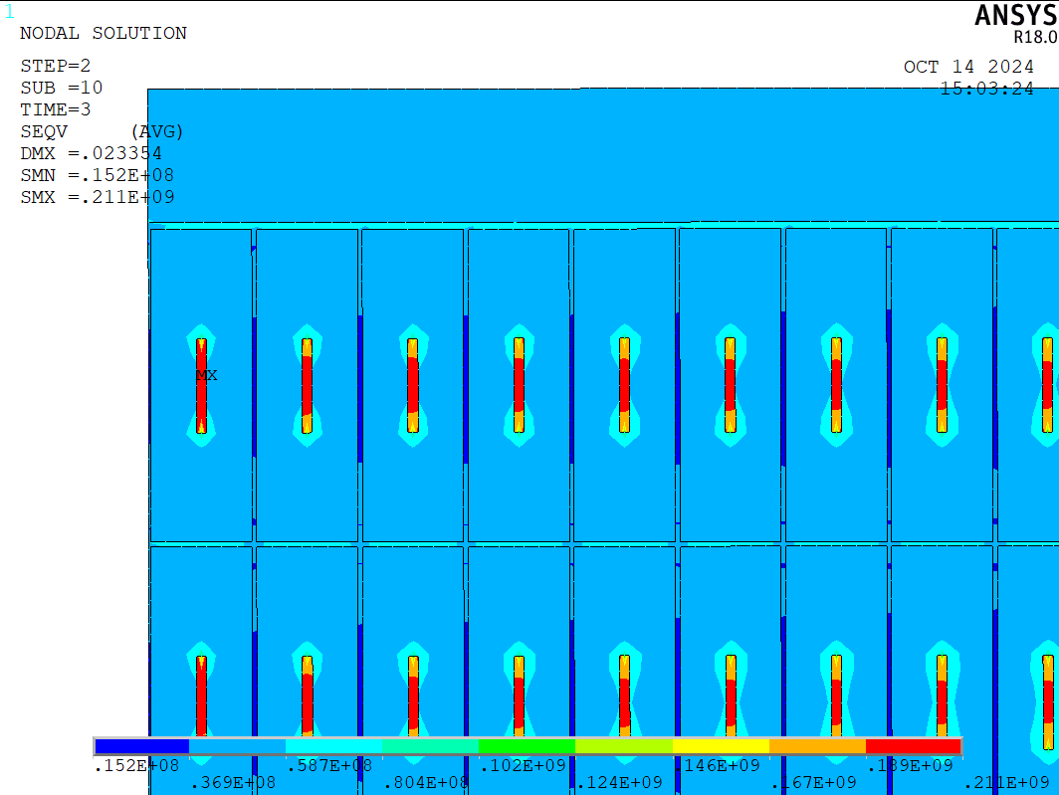
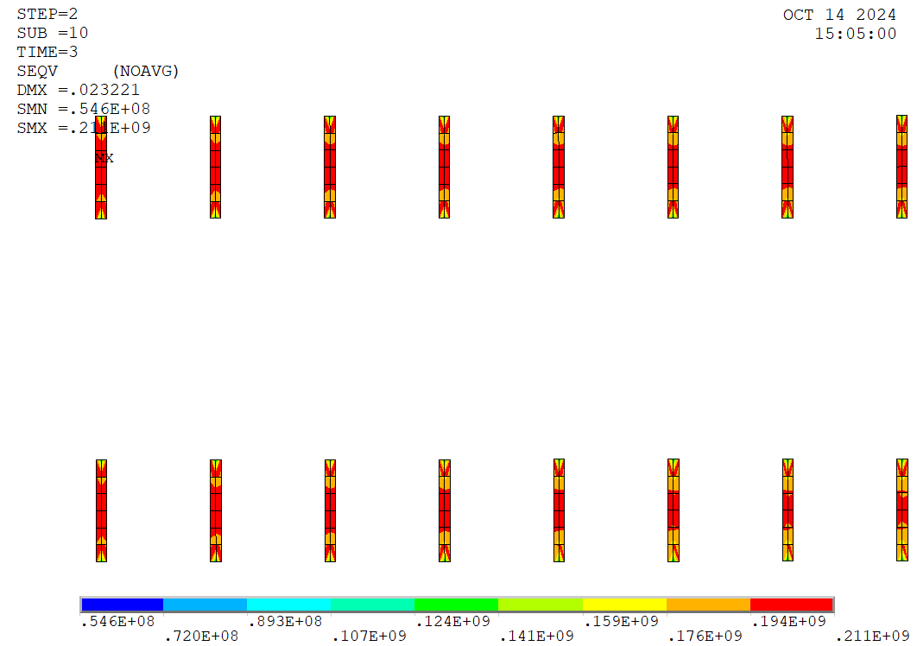
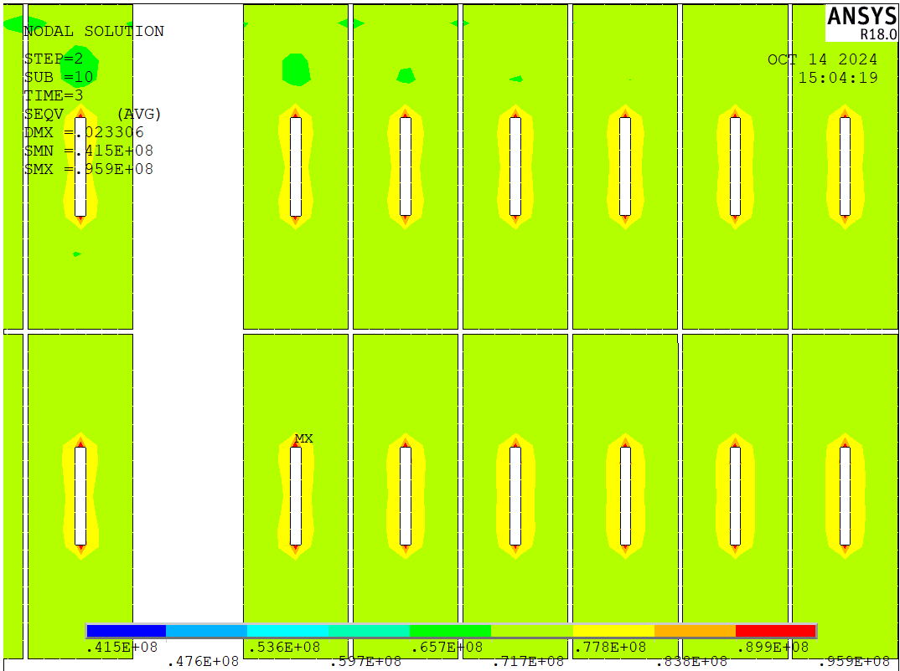
Von Mises Stress distribution
Coil at 4.2 K, energized
insulation（Shear stress）
Locally enlarged image
Notes:
The locally enlarged image shows that the peak stress on the aluminum stabilizer occurs at the interface with niobium-titanium, and its a very small area, with most regions on the aluminum stabilizer below 70 MPa, which is within the safe range.

Slide 13
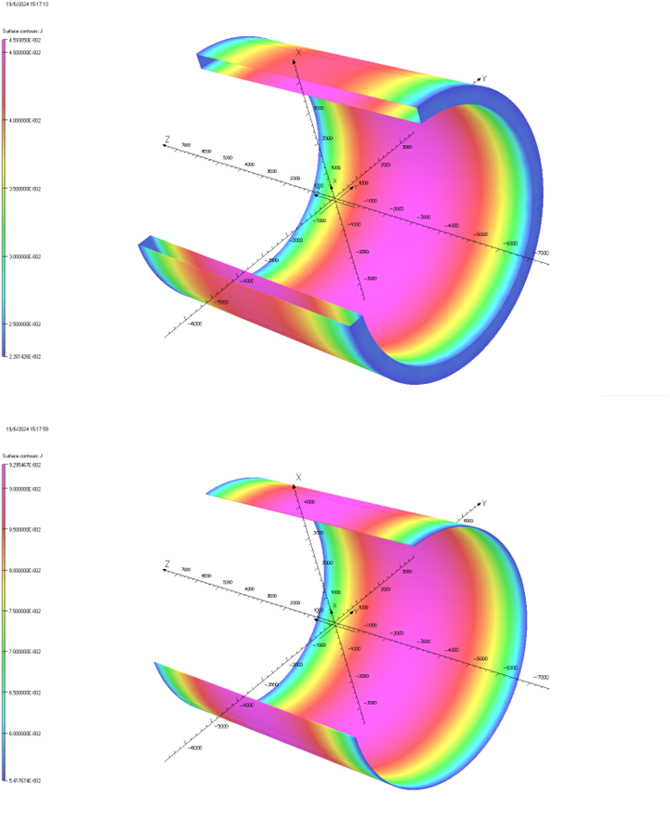
Eddy losses
Eddy loss during charging
Eddy current density on thermal shield（A/mm²)
Parts:
Support cylinder: Aluminum alloy, RRR=4
60K Thermal shield: Aluminum alloy, RRR=2
Charging speed: 1.5A /s uniform excitation, duration 185min
Iop:17 kA
Thermal shield:
Maximum current density: 4.59E-2A/mm2
eddy current loss: 65W
Support cylinder:
Maximum current density: 9.29E-2A/mm2
eddy current loss: 193W
Eddy current density on the support cylinder（A/mm²)
Notes:
The next section discusses eddy current losses in the coil during the charging process, focusing on two key components: the supporting cylinder and the external 60 K thermal shield, both made of aluminum alloy. We selected a relatively fast charging speed of 1.5 A per second, taking approximately three hours overall. During the charging phase, the maximum eddy current density on the thermal shield reached 4.05 A/mm², resulting in a loss of 65 Watts, while the thicker supporting cylinder incurred a loss of 193 Watts.

Slide 14
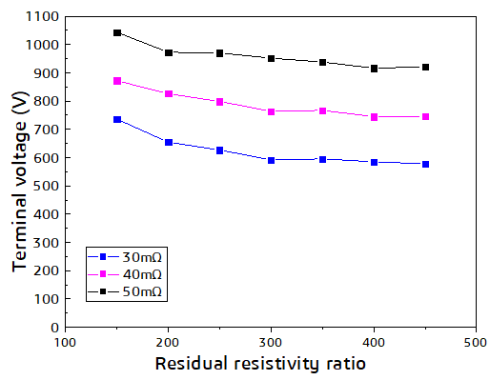
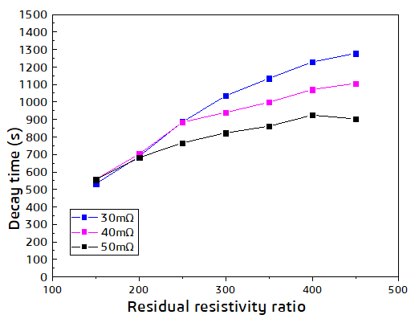
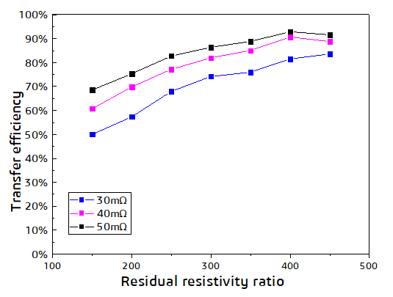
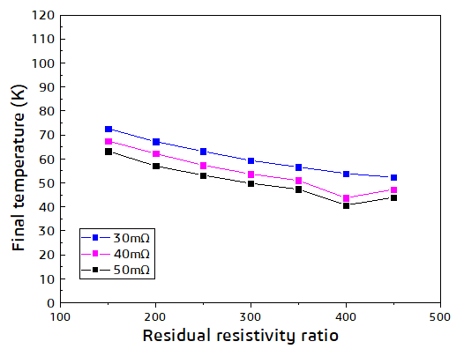
Quench Protection
The coil protection system is based on a dump resistor.
Preferred area
The best resistance value of the dump resistor is 50 mΩ,
The RRR of the cable aluminum stabilizer should be greater than 300
Notes:
This section details the quench protection for the coils, employing a scheme based on energy-dissipating resistors. Different resistor values under varying RRR (Residual Resistivity Ratio) conditions for the aluminum stabilizer have been listed, showing that as the RRR increases, the quench voltage decreases. Notably, when the RRR exceeds 300, the impact begins to diminish.
With a resistance value of 50 mΩ and a lower RRR value, there is a risk of exceeding 1000 V for the endpoint voltage. Similarly, as the RRR increases, the energy discharged through the resistors rises significantly, leading to lower coil temperatures. Although longer decay times for the coil currents accompany increased RRR values, this is not a stringent requirement. Hence, I propose that the optimal resistance for energy-dissipating resistors is 50 mΩ, while the RRR of the aluminum stabilizer should exceed 300.

Slide 15
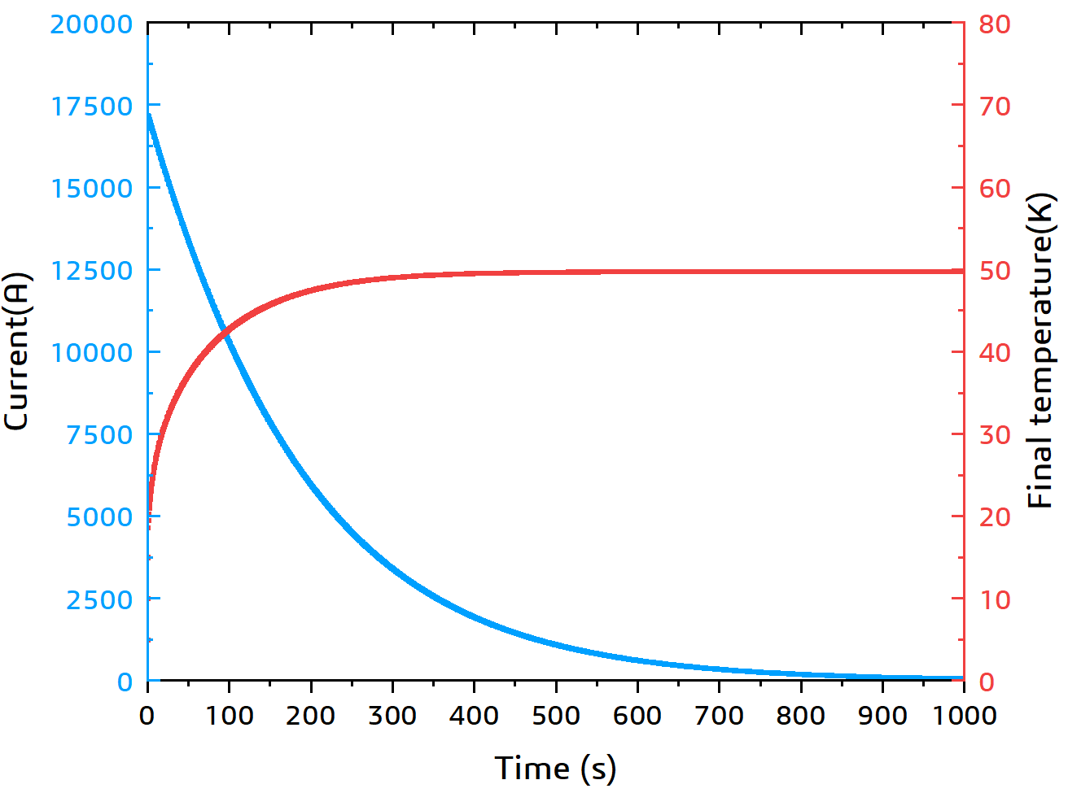
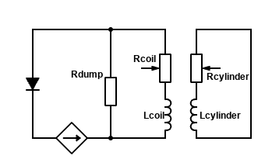
Quench Protection
Fast dump discharge
The Al alloy support cylinder is also used for quench back.
Protection
resistor
Winding
Quench back
cylinder
Delay time | 0.03 s
Dump resistance | 50 mΩ
Terminal voltage | 951.7 V
Coil internal voltage | 92.13 V
Final temperature | 49.84 K
Extracted energy ratio | 86.39%
Decay time* | 823 s
The quench analysis considering the protection resistance and quench back is in progress
*time when the current is I = I0 /100= 170 A.
Notes:
Here is the decay curve for the coil current and temperature change based on 50 mΩ resistance and an RRR value of 300. The table outlines some quench parameters, with a delay time to activate quench protection set at 30 ms.
Role of the Supporting Cylinders: Additionally, the aluminum alloy support cylinder will play a vital role during the quench process, serving as feedback. Besides providing a protective circuit through the resistor, the support cylinder will also utilize the mutual inductance with the coils to generate eddy currents, thereby heating up and returning heat to the coils, which further accelerates the decay of the coil current. Consideration for practical feedback and detailed quench simulations is currently ongoing.

Slide 16
Summary
Completed the calculation of coil magnetic field, mechanical and fast lapse scheme of the CEPC detector magnet.
There are some more detailed designs that need to be done, such as the quench simulation that takes into account quench back.
The full physical design will be completed this year and published in the REF-TDR in 2025.
Notes:
In summary, we have successfully completed the magnetic field calculations, mechanical strength assessments, and rapid quench protection scheme calculations for the CEPC detector magnet coil. However, numerous design details still await further optimization, such as market feedback simulation. We plan to release our comprehensive physical design report in the CEPC detector's Ref-TDR in 2025.
Thank you for your attention, and I look forward to your questions!

Slide 17
Thank you
Any advice and suggestions are appreciated !
Menglin Wang, IHEP
wangmenglin@ihep.ac.cn

