Slide 1

Mechanical Design of the Beampipe and Lumical
Institute of High Energy Physics, Chinese Academy of Sciences
Longyan He
2024.10.25
Notes:
Hello everyone, the topic of my presentation today is Mechanical Design of the Beampipe and Lumical

Slide 2
Contents
Research on beampipe design
CEPC beampipe structure design
Static analysis of beampipe
Beampipe heat transfer analysis
Summary
2
Notes:
I will introduce it from the following five aspects

Slide 3
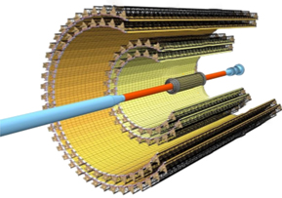
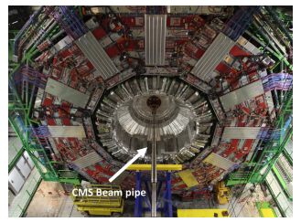
European beampipe design survey
In 2009, CERN officially established the Large Hadron Collider (LHC), consisting of four detector populations (ATLAS, CMS, ALICE, LHCb). The beampipe size parameters are shown in the following table:
Detector | Number of layers | Material | Inner diameter/mm | thickness/mm | length/m
ATLAS | Single layer | Be | 58 | 0.8 | 7.3
CMS | Single layer | Be | 43.4 | 0.8 | 1.6
CMS(Second generation) | Single layer | Be | 43.4 | 0.8 | 3.1
ALICE | Single layer | Be | 38 | 0.8 | 6
ALICE（The third generation） | Double layer | Be | 32 | 0.8 | 6
Beampipe and Detector Structure in ALICE
(Second Generation)
Beampipe structure in CMS (physical drawing)
Notes:
As shown on the right

Slide 4
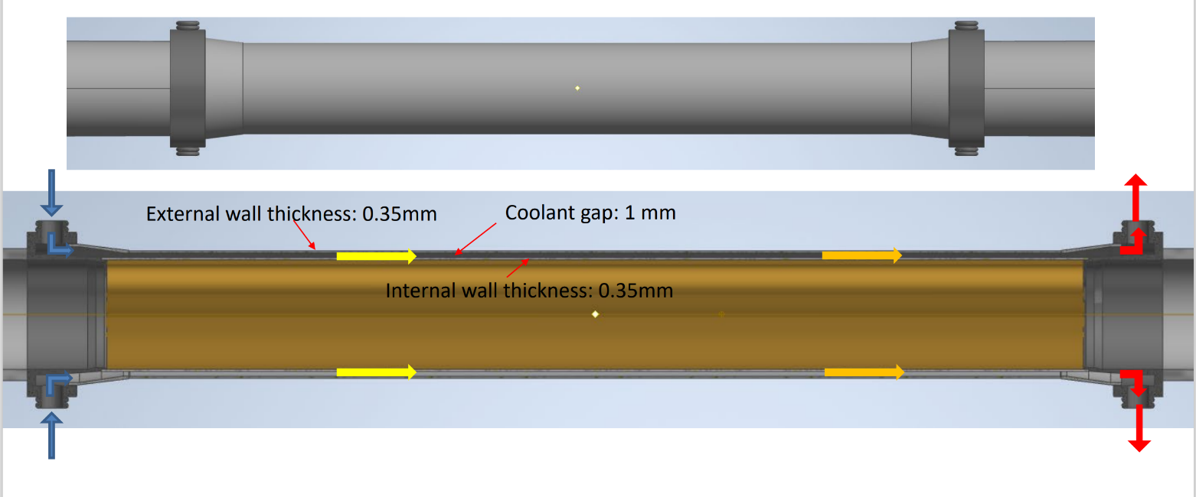
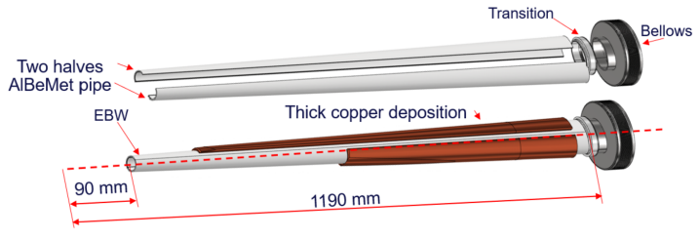
European beampipe design survey
In June 2020, the Council of the European Organization for Nuclear Research (CERN) unanimously adopted the 2020 European Strategy for Particle Physics. The new strategy places the highest priority on building the electron-positron Collider and the future Ring Collider (FCC).
Beampipe structure in FCC
The central section of the beampipe in FCC is made of aluminum-beryllium alloy material with a length of 180mm and a double-layer structure. The thickness of the inner and outer Be pipe walls is 0.35mm, and a cooling gap of 1mm is left in the middle. The epitaxial pipe is also made of aluminum-beryllium alloy material with copper coating on the surface. It is a two-half conical pipe design with a length of 1100mm.

Slide 5
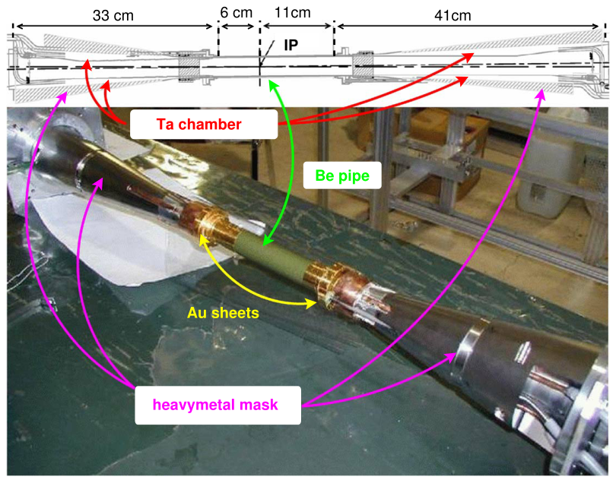
Japanese beampipe design survey
After four iterations of the beampipe used by the High Energy Accelerator Research Organization (KEK) in Japan, the first generation beampipe was used for experimental research in 1999. The third generation of the beampipe was designed in 2000, and the main detector of the beampipe (Belle-A) will only be used for two years. By 2003, it had been upgraded (Belle-B), and the beampipe had been improved to the fourth generation. From 2016, the second generation electron collider (SuperKEKB) has been initially built, and by the end of 2018, the detector (BelleII) has been officially put into use.
Detector | Length of Bepipe/mm | Inner diameter of Bepipe/mm | Inner Bepipe thickness/mm | Outer Bepipe thickness/mm | Inner and outer Bepipe clearance/mm | Total length/mm
Belle-A | 160 | 40 | 0.5 | 0.5 | 2.5 | 940
Belle-B | 170 | 30 | 0.6 | 0.35 | 0.5 | 940
BelleII | 170 | 20 | 0.6 | 0.4 | 1 | 965
Belle-B beampipe
According to the structure diagram of the Belle-B beampipe, the central section of the beampipe is a beryllium pipe structure, and the symmetrical conical aluminum pipe structure is on both sides.

Slide 6
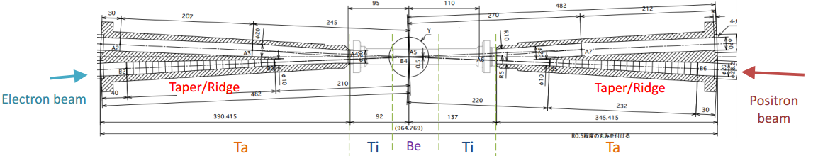
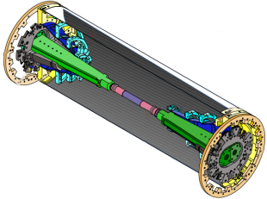
Japanese beampipe design survey
BelleⅡ beampipe structure
It can be seen from the figure that, compared with the beampipe of Belle-B, the epitaxial pipe changes from the original conical shape to a gradual runway structure with the upper and lower surfaces designed to be planar, and the material changes from aluminum to tantalum. The beryllium pipe and the epitaxial pipe are connected by a titanium pipe.

Slide 7
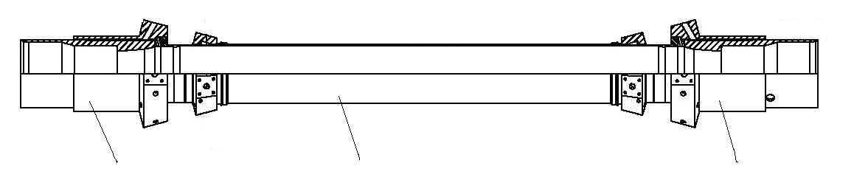
American Beampipe Design Survey
The accelerator at Cornell University in the United States is called CESR, and its detector population (CLEO) was completed during the electron collision experiment between 1990 and 1995, and the detector was updated to the third generation (CLEOIII) in 2000, and the corresponding beampipe has been designed to the third generation.
2
1
2
CLEOIII beampipe（1. Center beampipe2. Epitaxial beampipe）
The beampipe of CLEOIII has a total length of 593mm and an inner diameter of 20mm, which is composed of a central beampipe and an epitaxial beampipe at both ends. The central beampipe is composed of inner and outer beryllium pipes and two aluminum amplifying cavities, and the cooling medium is PF200-IG. Epitaxial beampipe material is copper,The cooling medium is water.

Slide 8
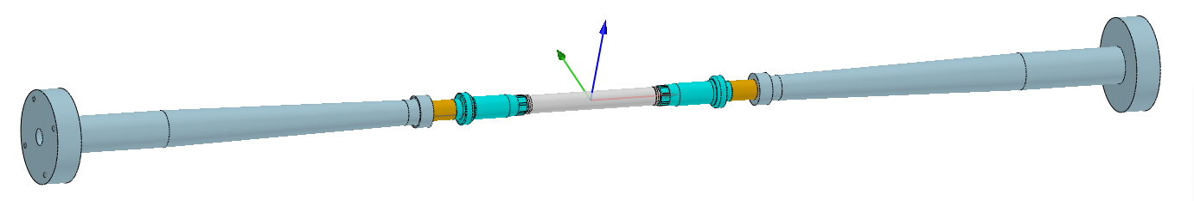
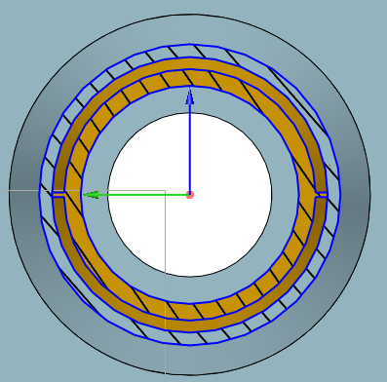
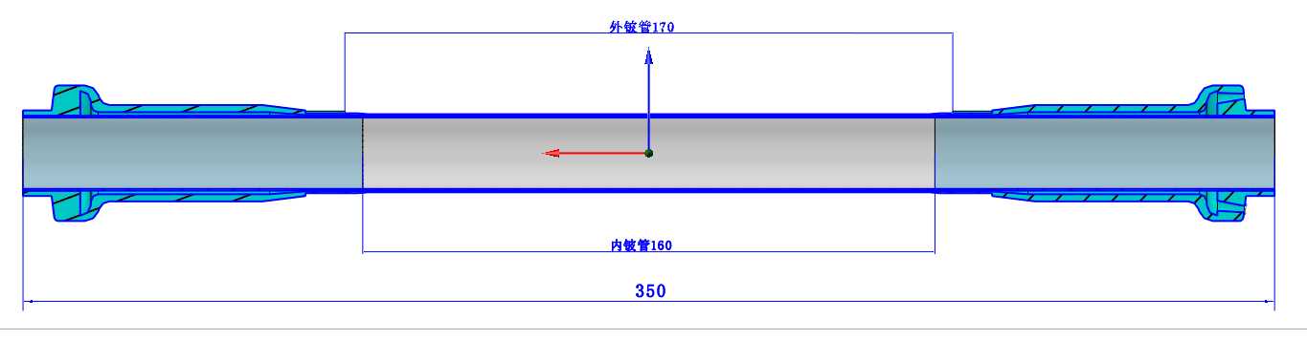
CEPC beampipe structure design（ver2023.6）
The beampipe has a total length of 1400mm and a double beryllium pipe structure in the center section. The inner diameter is 28mm, the inner beryllium pipe is 0.35mm thick, the outer beryllium pipe is 0.25mm thick, and the middle gap is 0.35mm, which is used to pass the cooling medium.
The central beryllium pipe has a symmetrical epitaxial aluminum pipe on both sides, adopts a double-layer design, a gradual conical structure, and passes a cooling medium in the middle.
Design requirement：
The detection Angle is 8.1 degrees, and all the components of the beampipe cannot exceed the range of the included Angle；
The thickness of the pipe wall should be as thin as possible to ensure that there is less mass in the detection path.
Radial profile of an epitaxial aluminum pipe

Slide 9
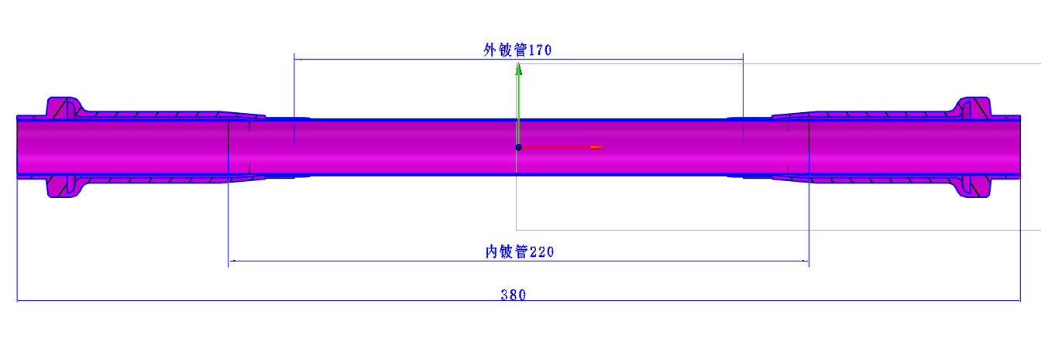
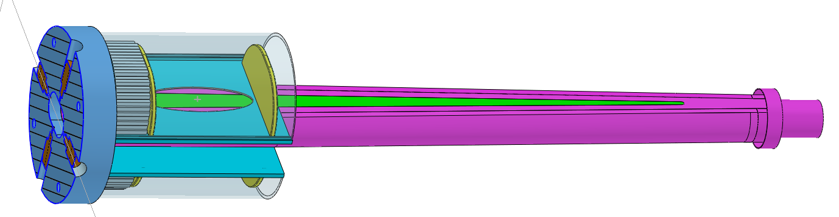
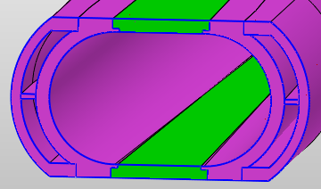
CEPC beampipe structure design （Current structure）
Major update：
The inner beryllium pipe is increased from 160mm to 220mm（In order to connect with a short aluminum pipe at a large thickness, it is easy to weld），The total length of the central beryllium pipe section is increased to 380mm, the inner diameter is reduced to 20mm, the inner beryllium pipe thickness is 0.2mm, and the outer beryllium pipe thickness is 0.15mm（Improved vertex detection accuracy），Cooling medium gap 0.35mm;
The epitaxial aluminum pipe is changed from a gradual cone type to a gradual runway type structure, with cooling medium channels on the left and right sides, and beryllium plates with a thickness of 2mm are embedded in the upper and lower planes（Beryllium has less mass than aluminum）；
Lumical detector is installed near the flange on the upper and lower planes of the epitaxial aluminum pipe；
BPM into the end flange.
Beryllium plate
Lumical
Difficult point: Manufacture of beryllium pipe！
BPM（There are 4 circumferentially distributed）
（According to research，China is currently capable of manufacturing 100mm long 0.2mm thick beryllium pipe）
Radial profile of an epitaxial aluminum pipe

Slide 10
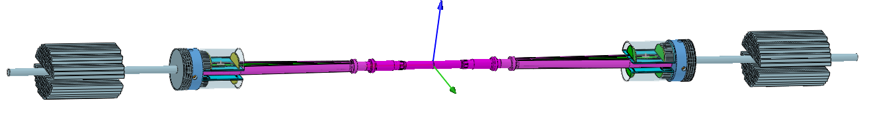
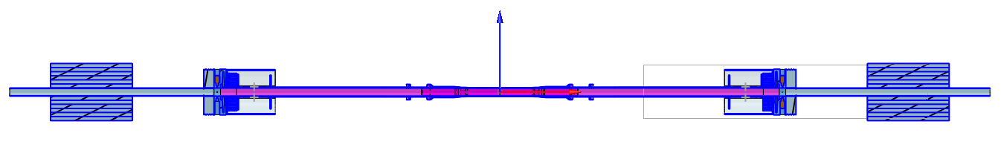
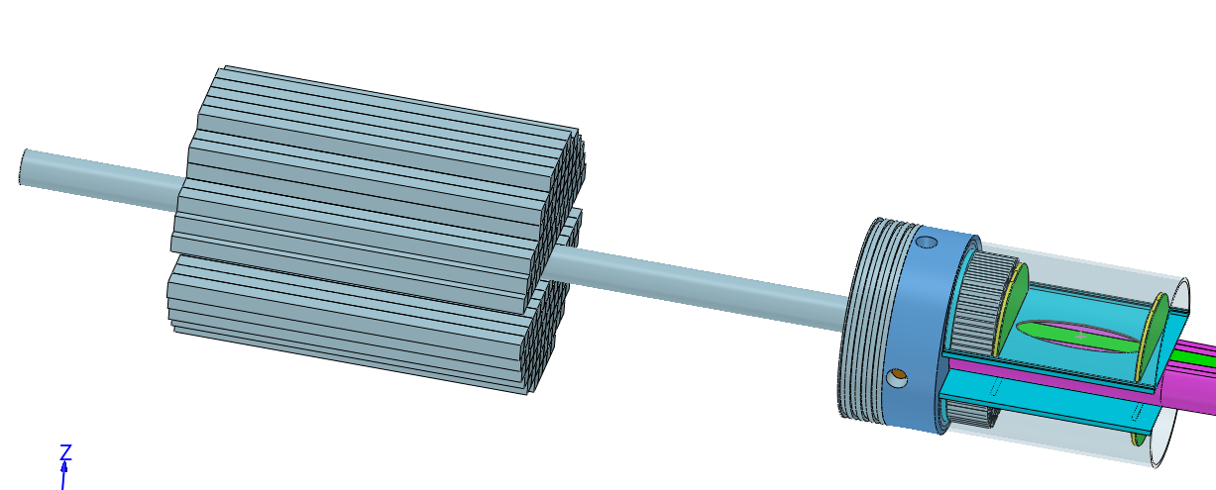
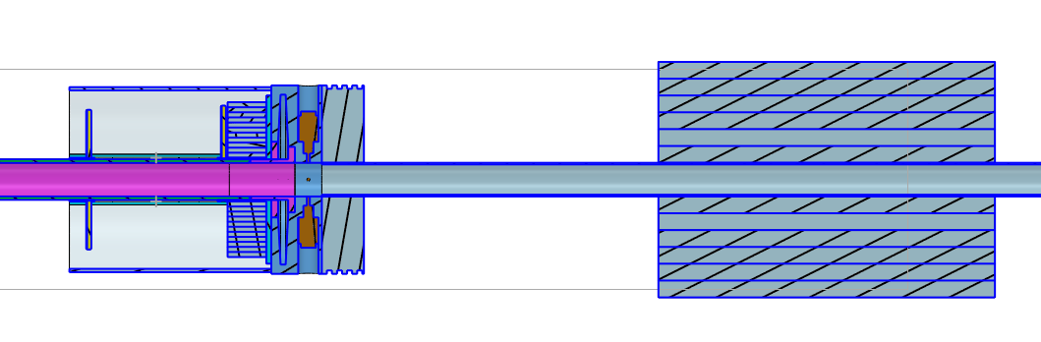
CEPC beampipe structure design
LYSO bars
Si wafer
Notes:
This is the overall structure of the beampipe

Slide 11
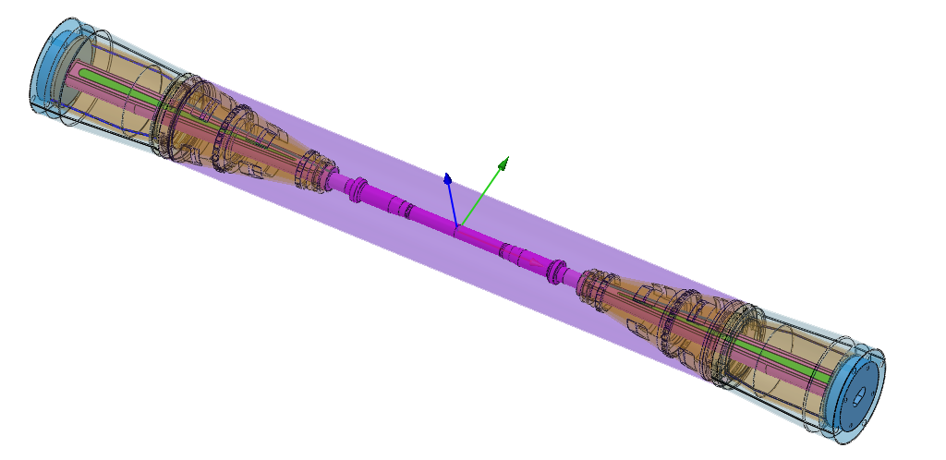
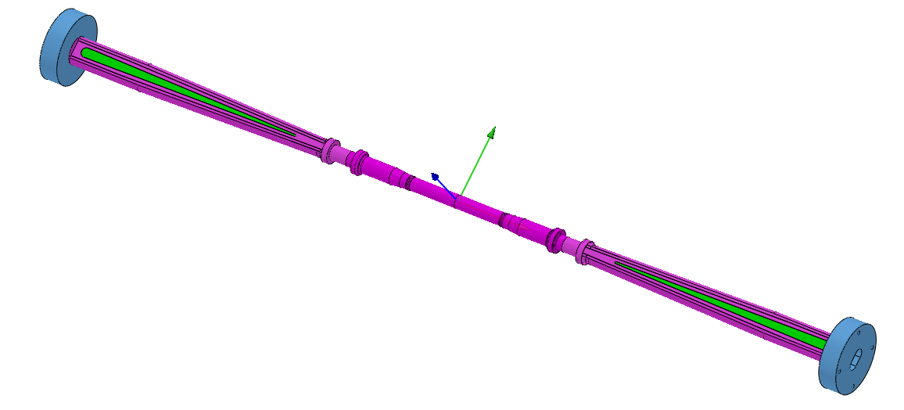
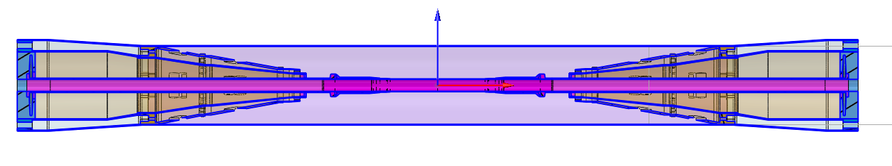
Static analysis of the beampipe
In this static calculation, four kinds of working conditions are calculated to simulate the installation state and working state of the beampipe with or without reinforced pipe：
1. When there is no reinforced pipe, the end flange 1 is fixed, and the rest is cantilever;
2. When there is no reinforced pipe, both ends are fixed ；
3. When there is a reinforced pipe, the end flange 1 is fixed, and the rest is cantilever；
4. When there is a reinforced pipe, both ends are fixed.
(In this calculation, Lumical is simplified and loaded on the beampipe. A single Lumical weighs 0.475kg)
The end of the flange1
Reinforced pipe (carbon fiber)
Weight loading place of Lumical（0.95kg）
Weight loading place of Lumical
The end of the flange2
Notes:
Next, I carry out static analysis of the beampipe

Slide 12
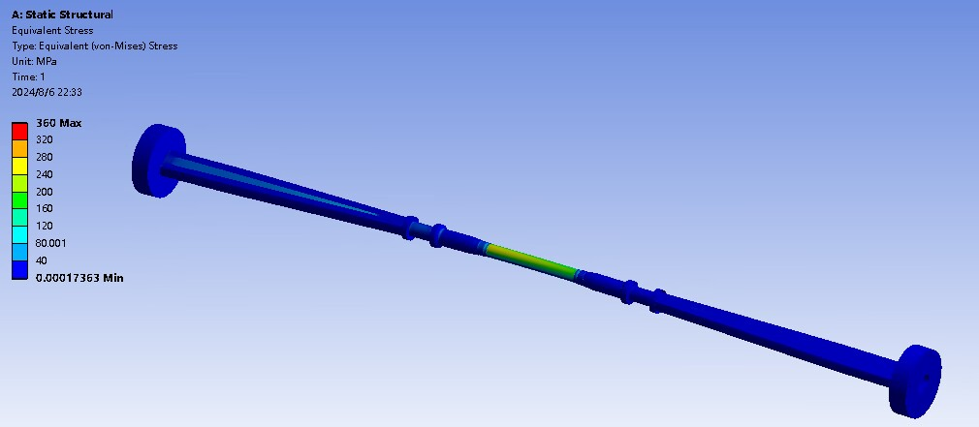
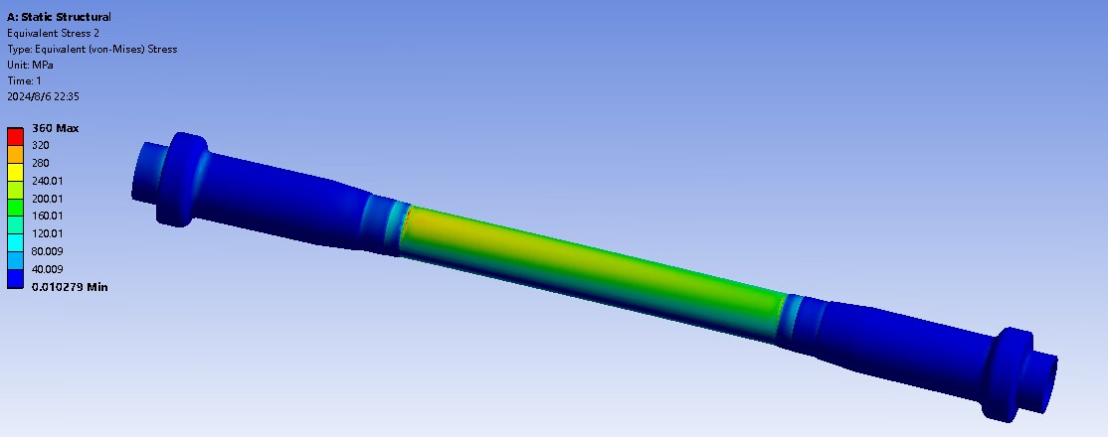
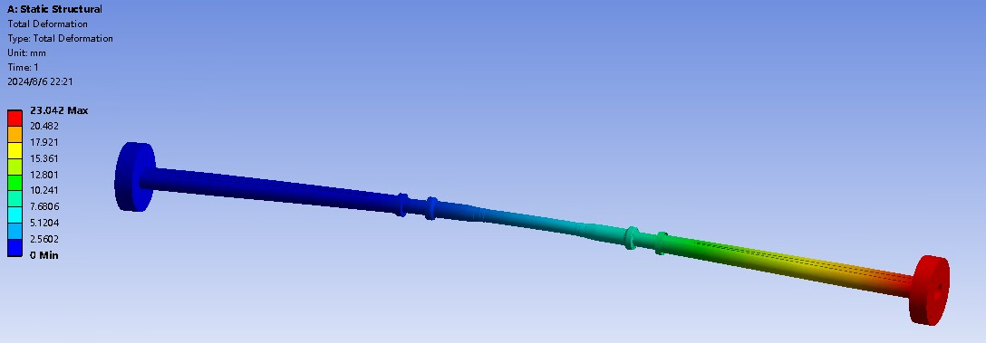
Static analysis of the beampipe
Working condition 1: When there is no reinforced pipe, the end flange 1 is fixed, and the rest is cantilever.
Maximum stress：360MPa
Maximum deformation：23.04mm
Tensile strength of beryllium at room temperature：390-460MPa
The outer beryllium pipe is in danger of breaking！
Notes:
We can conclude that. It can be seen from the stress/deformation cloud map

Slide 13
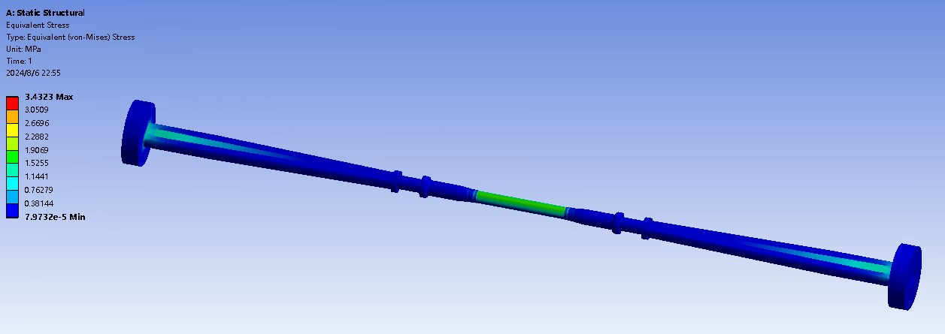
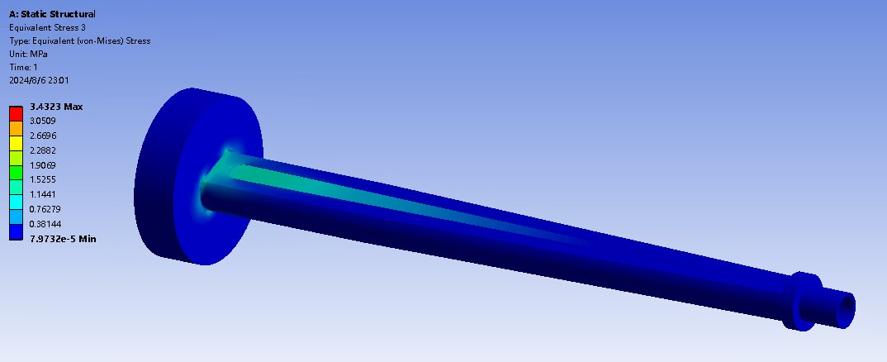
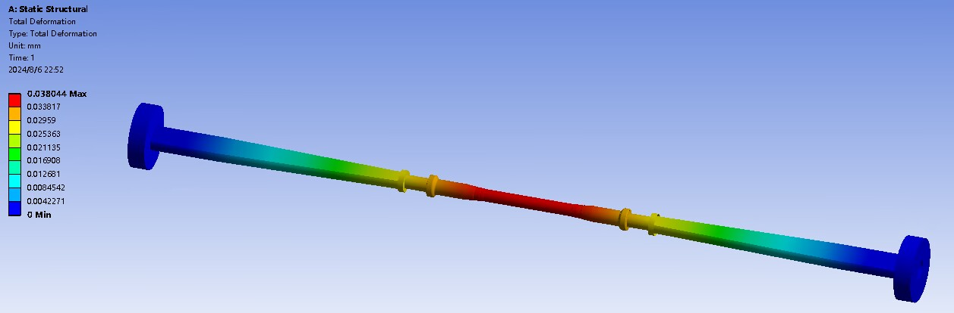
Static analysis of the beampipe
Working condition 2: When there is no reinforced pipe, both ends are fixed .
Maximum stress ：3.43MPa
Maximum deformation ：0.038mm
Yield strength of aluminum：280MPa
No reinforced management of working condition safety

Slide 14
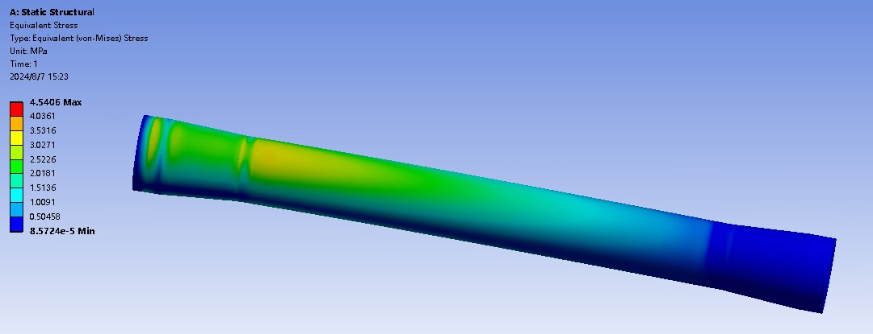
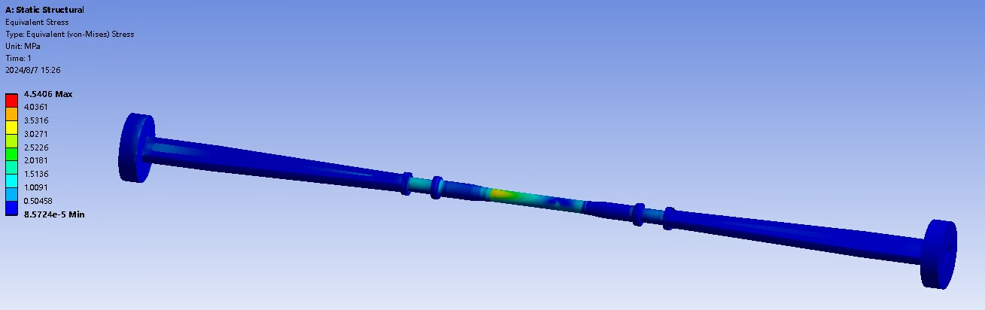
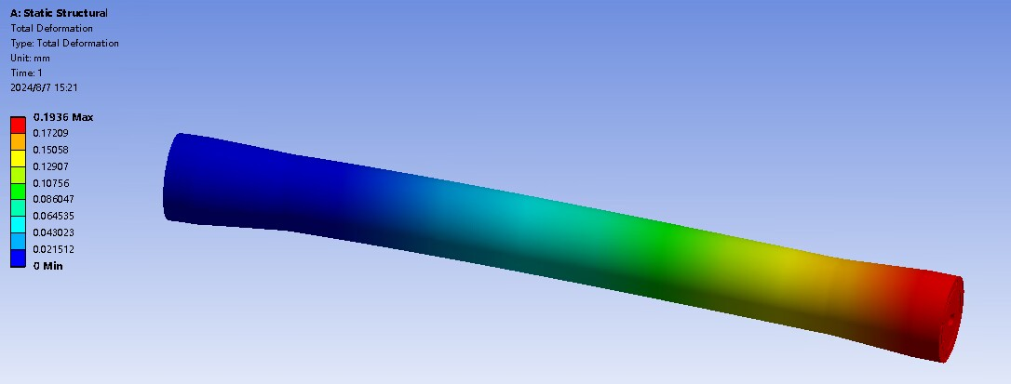
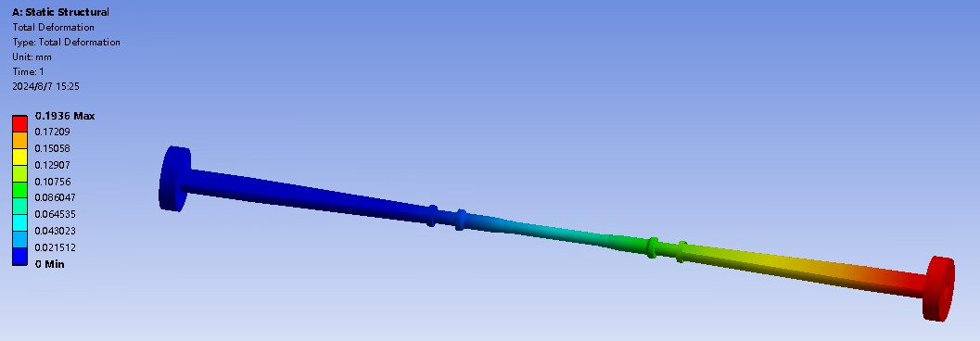
Static analysis of the beampipe
Working condition 3: When there is a reinforced pipe, the end flange 1 is fixed, and the rest is cantilever.
Maximum stress ：4.54MPa
Maximum deformation ：0.19mm
There are reinforced pipe installation state safety

Slide 15
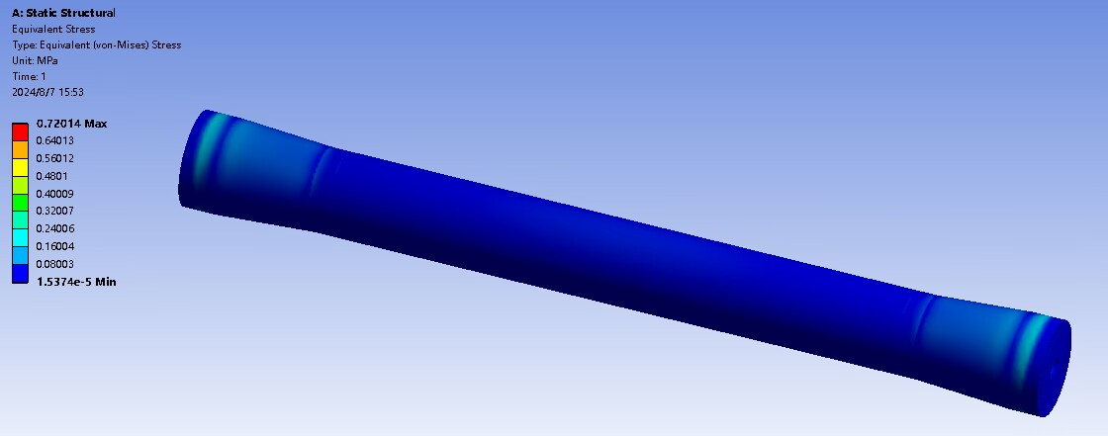
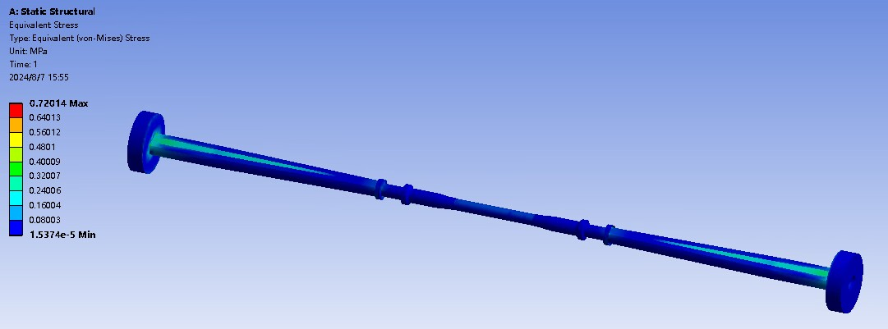
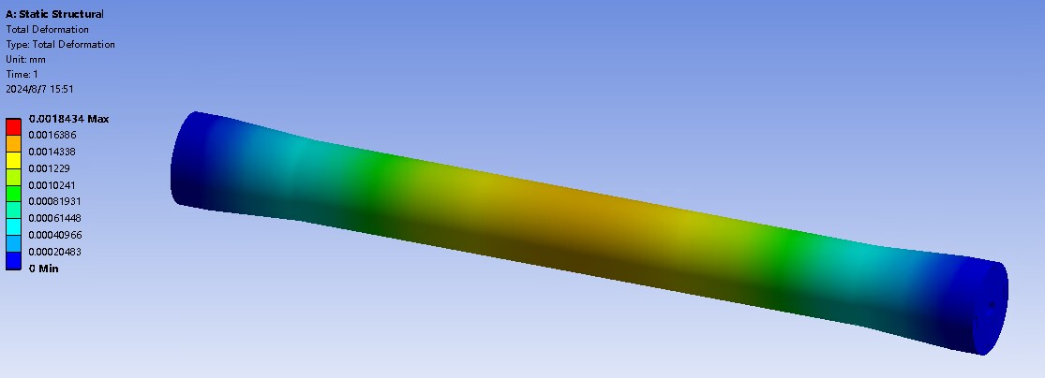
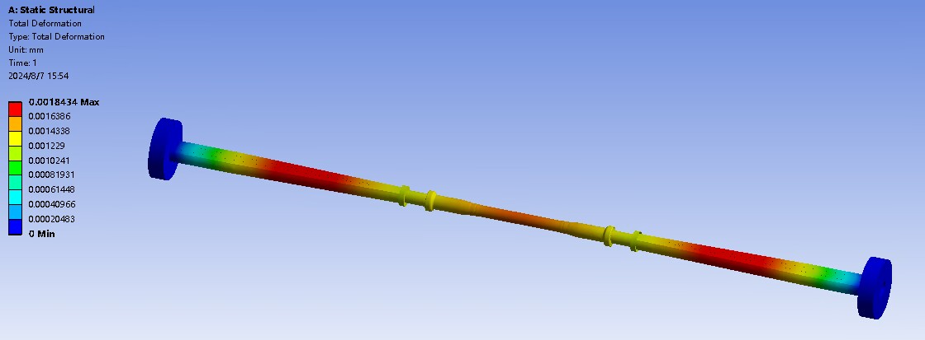
Static analysis of the beampipe
Working condition 4: When there is a reinforced pipe, both ends are fixed.
Maximum stress ：0.72MPa
Maximum deformation ：0.0018mm
There are reinforced pipe installation state safety

Slide 16
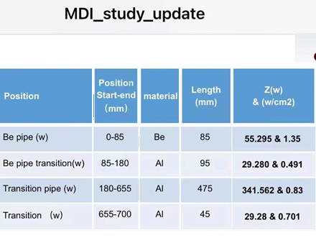
Beampipe heat distribution
The total heat of one side is 455.4W；
In the calculation, the allowance is considered, and the total heat of each side is 600W, that is, the heat of each place is multiplied by 1.31747
Beampipe heat loading
Location | Unilateral aggregate | Total amount on both sides | area | Heat flux density
mm | W | W | m2 | W/cm2
0~80 | 72.85 | 145.70 | 0.0100519 | 1.449
80~175 | 38.58 | 77.15 | 0.0119348 | 0.646
175~700 | 488.57 | 977.15 | 0.0843314 | 1.159
total | 600 | 1200
Notes:
Next I calculate the beampipoe heat transfer

Slide 17
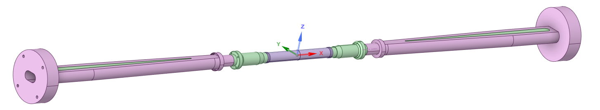
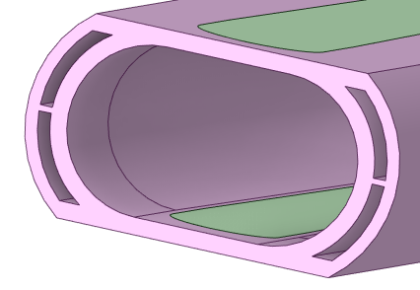
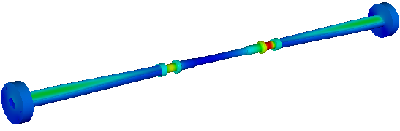


Beampipe heat transfer calculation results - whole
Beryllium plate
A
A’
A-A’ profile
Center beryllium pipe：
Four imports, four exports
Cooling medium：Water or spark oil
Inlet temperature：16℃
Inlet velocity：0.8m/s (1.1L/min)
Laminar flow
Epitaxial aluminum pipe：
Two imports, two exports
Cooling medium: water
Inlet temperature：16℃
Inlet velocity：1m/s (3.4L/min)
Turbulence, down in, up out
Heat transfer requirements: the outer beryllium pipe temperature is less than 20℃
Maximum temperature position
Cooling medium: oil
Cooling medium: water
Overall temperature distribution of beampipe
Maximum temperature: 26.7℃
Maximum temperature: 31.1℃
17

Slide 18

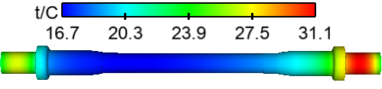
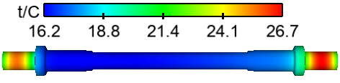
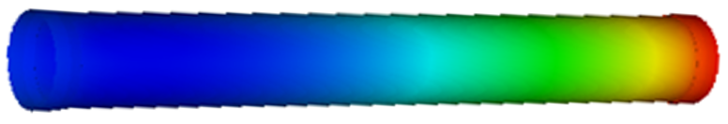
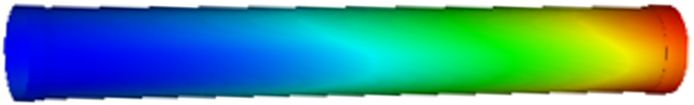
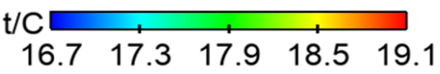

Heat transfer calculation results of beampipe - center Bepipe
Cooling medium: oil
Cooling medium: water
Δt=2.4 ℃
Δt=1.0 ℃
ΔP=37.3 kPa
joint
ΔP= 21kPa
Temperature cloud image of outer beryllium pipe
Temperature cloud image of outer beryllium pipe
Oil cooling: temperature meets requirements!
Water cooling: temperature meets requirements!
Use water cooling effect is better!
Notes:
By comparison

Slide 19
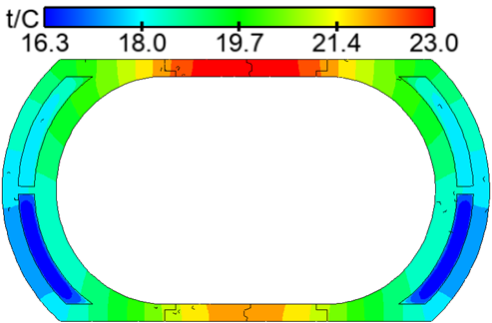
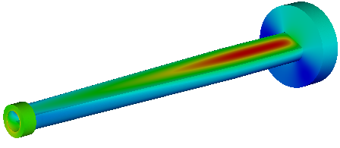


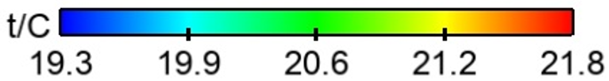
Heat transfer calculation results of beampipe- epitaxial al pipe
Temperature cloud image of epitaxial aluminum pipe
Temperature cloud image of epitaxial al pipe section(x=585mm)
Upper beryllium plate temperature
Temperature cloud image of beryllium plate
Lower beryllium plate temperature

Slide 20
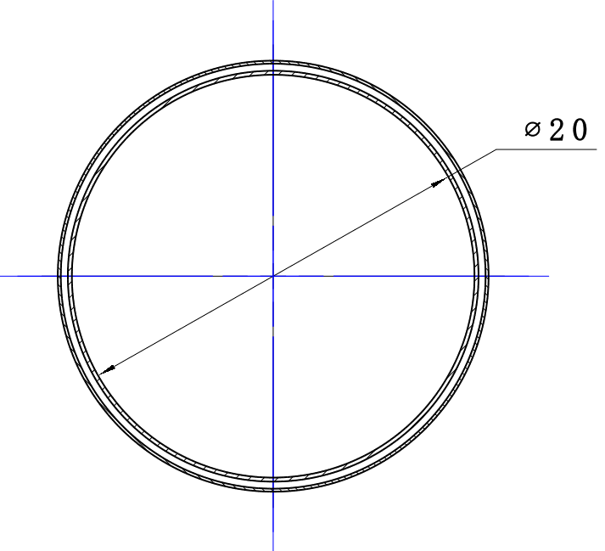
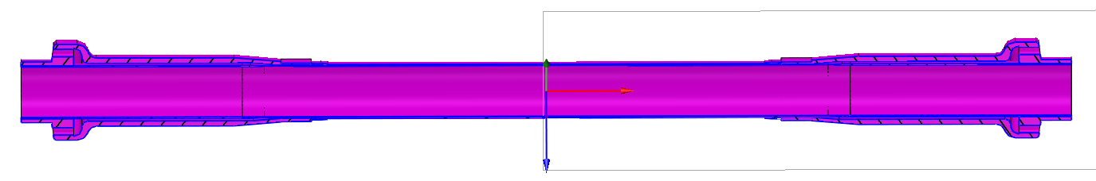
Parameter optimization of central Bepipe cooling ring channel
CEPC spectrometer requires that part of the beampipe material mass as little as possible, and requires that the heat load generated inside the beampipe be taken away through the cooling medium, so the cooling ring channel size of the central beryllium pipe is optimized (design requirements: The maximum temperature of the outer beryllium pipe is less than 20℃, and the inner beryllium pipe meets the structural strength requirements). Through simulation calculation, the optimal channel width of the oil and water cooling methods are selected respectively.
Cooling medium inlet
Velocity of flow：0.8m/s
temperature：16℃
Cooling medium outlet
Center beryllium pipe calculation model
Cooling ring channel，0.1-0.35mm
Inner Bepipe wall thickness 0.2mm, outer Bepipe wall thickness 0.15mm

Slide 21
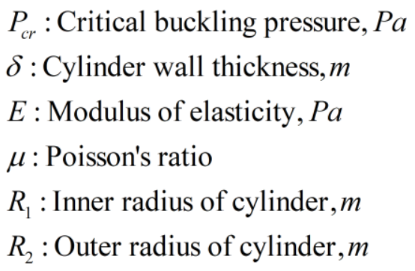
Parameter optimization of central Bepipe cooling ring channel
Before optimizing the cooling parameters of the central beryllium pipe, it is necessary to calculate the compressive strength of the inner beryllium pipe and determine the maximum working pressure of the coolant. The physical properties of beryllium metal are shown in the following table。
There is an ultra-high vacuum inside the beampipe. When the central beryllium pipe is cooled, the inner beryllium pipe is subjected to external pressure of the fluid. Therefore, the critical buckling pressure of the inner beryllium pipe under external pressure needs to be calculated：
Physical properties of beryllium
Physical characteristics | Parameter value
density（kg/m^3） | 1844
Specific heat（J/(kg*K)） | 1925
Thermal conductivity（W/(m*K)） | 216
Linear expansion coefficient（*10^(-6)/℃） | 11.5(20~100℃)
Modulus of elasticity（GPa） | 303
Poisson's ratio | 0.1
Tensile strength（MPa） | 390~460
The critical buckling pressure of the inner beryllium pipe is calculated to be 0.594MPa, and the safety factor is 3, then the critical buckling pressure of the inner beryllium pipe is 0.2MPa (absolute pressure). Considering the vacuum condition inside the beampipe, the cooling pressure of the central beryllium pipe can reach the maximum gauge pressure of 0.1MPa.

Slide 22
Parameter optimization of central Bepipe cooling ring channel
By changing the width of the cooling channel, the different center beryllium pipe models with the cooling channel width of 0.1~0.35mm were obtained. The calculation results were as follows：
Cooling channel width/mm | Outer bepipe maximum temperature (oil cooled)/℃ | Outer bepipe maximum temperature (water cooling)/℃
0.1 | 21.7 | 17.9
0.15 | 21.6 | 17.9
0.2 | 21.1 | 17.7
0.25 | 20.3 | 17.5
0.3 | 19.8 | 17.4
0.35 | 19.2 | 17.2
As can be seen from the figure, with the narrowing of the width of the cooling channel, the effects of oil cooling and water cooling gradually deteriorate. The overall cooling effect of water cooling is better than that of oil cooling, and water cooling has always met the design requirements. When the width of the oil cooling channel is less than 0.3mm, the maximum temperature of the outer beryllium pipe is greater than 20℃, which does not meet the design requirements。

Slide 23
Parameter optimization of central Bepipe cooling ring channel
Pressure drop at inlet and outlet under different width of cooling channel
Cooling channel width/mm | Pressure drop (oil cooling)/KPa | Pressure drop (water cooling)/KPa
0.1 | 1254.11 | 698.03
0.15 | 363.03 | 199.28
0.2 | 167.04 | 92.83
0.25 | 94.76 | 52.67
0.3 | 55.26 | 30.88
0.35 | 36.15 | 20.34
It can be seen from the figure that the inlet and outlet pressure drop of the cooling channel decreases with the increase of the width of the cooling channel. When the channel width is less than 0.2mm by water cooling, the pressure drop is greater than 0.1MPa, which does not meet the strength requirements of the central beryllium pipe. When the channel width is less than 0.25mm by oil cooling, it does not meet the requirements.
Based on the temperature and pressure drop diagram, considering the design safety and temperature control requirements, the cooling channel width is 0.3mm when the oil cooling mode is used, and 0.2mm when the water cooling mode is used.

Slide 24
Summary
Can do so far：
The inner diameter of beryllium pipe is 20mm, 0.2mm inner beryllium pipe +0.2mm water +0.15mm outer beryllium pipe is currently the shortest particle detection path in the world!
the particle penetrates the least mass！
In the case of reinforced pipe, the beampipe structure strength meets the requirements!
Beampipe temperature can meet the requirements of vertex detector!
Existing Problems：
The beryllium pipe manufacturing technology of 220mm long 0.2mm thick still needs to be solved!

Slide 25
Thank you！

