Slide 1
heat load and stress studies for target and collimator materials
O. S. Adeyemi¹, V. Kovalenko¹, G. Moortgat-Pick^{1;2}
L. Malysheva , S. Riemann², F. Staufenbiel², A. Ushakov¹
¹University of Hamburg
²DESY
- modelling a positron target and collimator system for the ILC accelerator
- temperature simulations in a photon collimator system
- time dependent simulations for the collimator system with ANSYS software
- conclusion

Slide 2
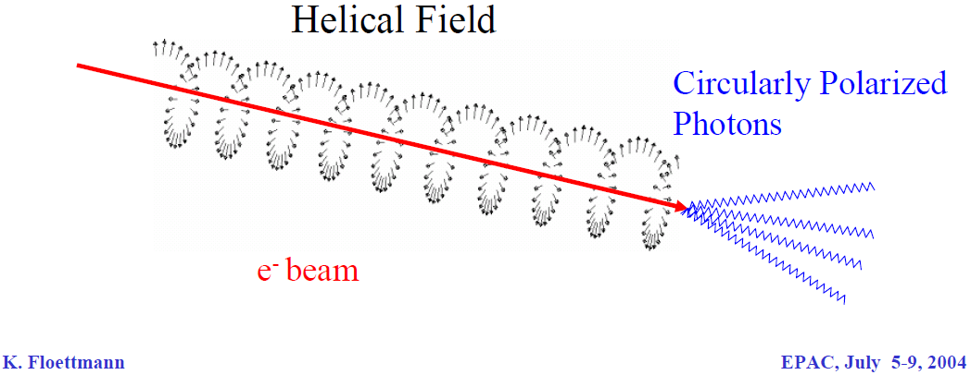
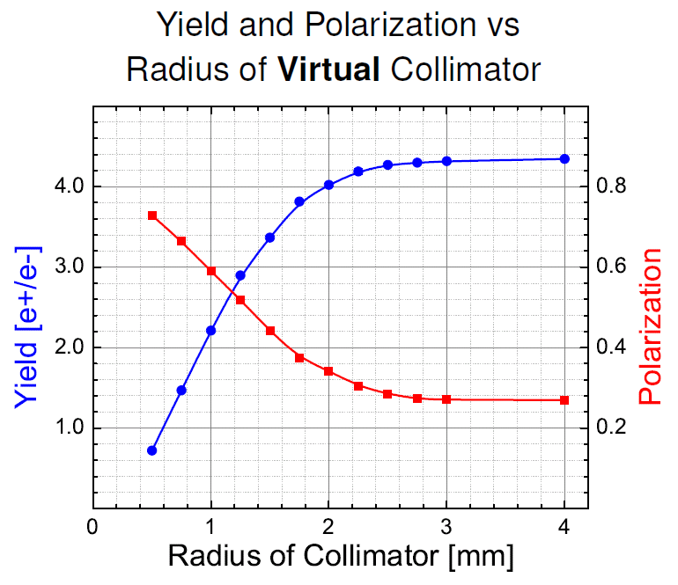
polarised positron production
collimator
 | Pe+ | Yield [e+/e-]
no collimator | 27 % | 4.4 (100%)
2 mm | 35 % | 4.0 (91%)
1.4 mm | 47 % | 3.2 (73%)
1.0 mm | 60 % | 2.2 (50%)

Slide 3
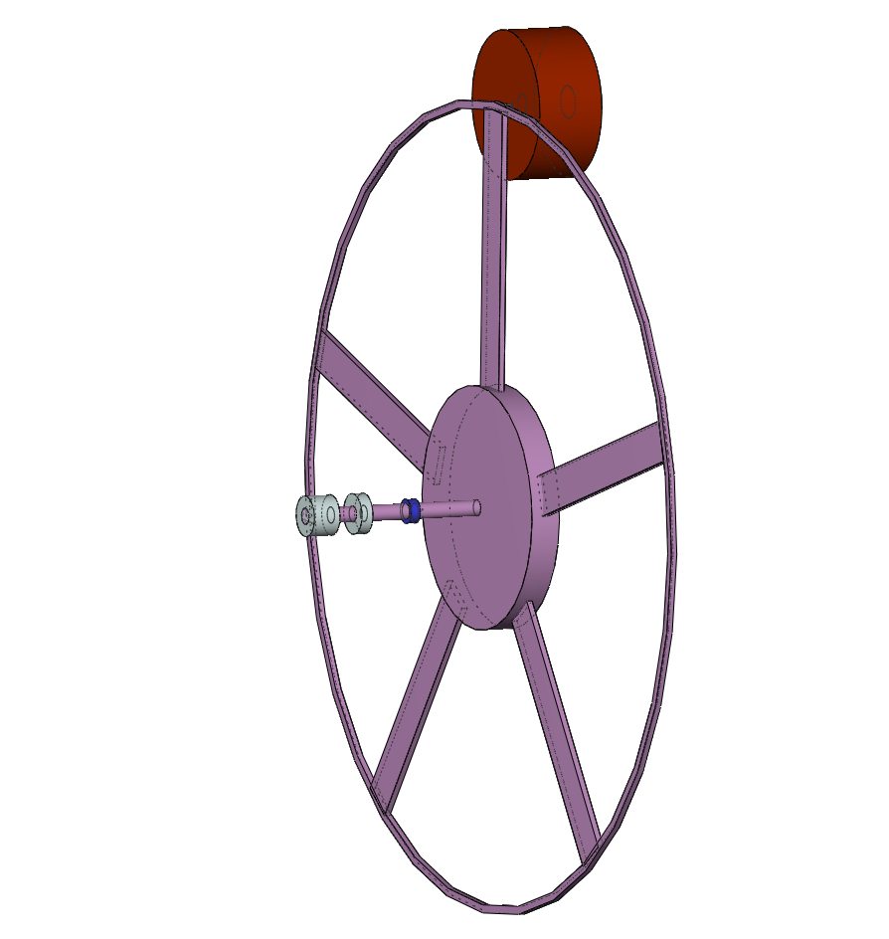
modelling the ILC-target unit
2*10¹⁰ e⁻ / bunch = 3.2 nC / bunch
2625 bunch / train (0.97ms) = 2.7052 MHz repetition rate
5 train / s
-> 4.6*10¹⁵ photon / train
Titan target for polarised positron production
~ 14.4 MeV e⁺
250 GeV e⁻
~ 28.8 MeV photon beam
helical undulator
distribution of
heat load !!
v_{rim} = 100 m/s
( 955 rpm = 15.9Hz )
r
r = 1 m

Slide 4
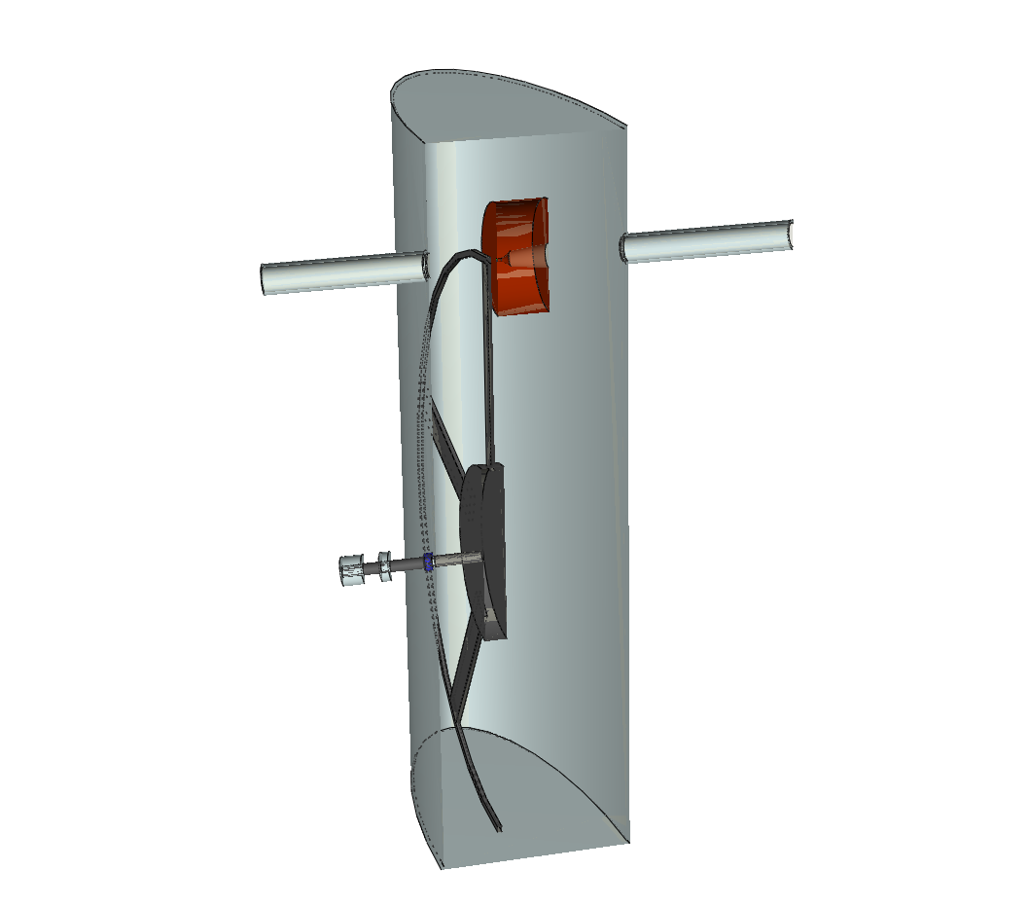
modelling the ILC-target unit
flux concentrator
beam pipe
~ 28.8 MeV photon beam
bearing
chamber
motor
d₁ = 1.0 cm , l₁ = 5.0 cm
d₂ = 5.0 cm , l₂ = 3.0 cm
d₃ = 8.0 cm , l₃ = 12.5 cm
vacuum seal

Slide 5
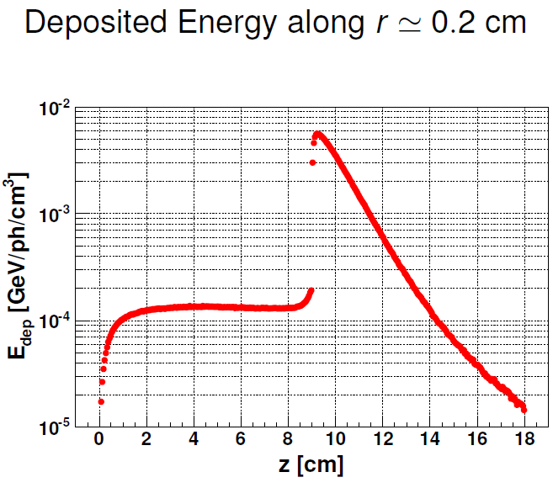
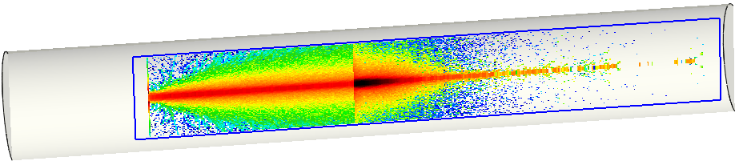
flux concentrator
Δ Q
~
beam pipe
~
T_{W} = 1800 K / train
m c_{v}
C W
collimator
~ 28.8 MeV photon beam
r = 0.1 cm -> _____ K / train
14 000
???
this is to much !!
bearing
chamber
motor
vacuum seal

Slide 6
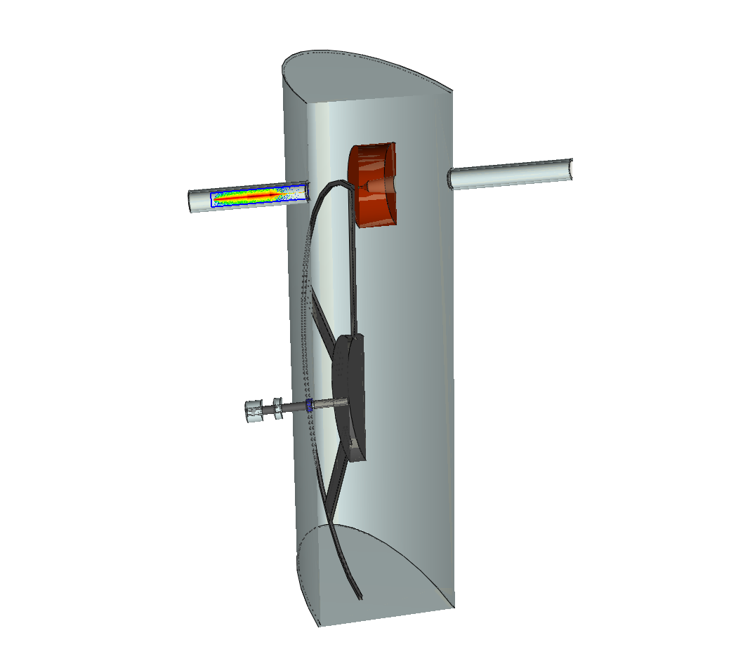
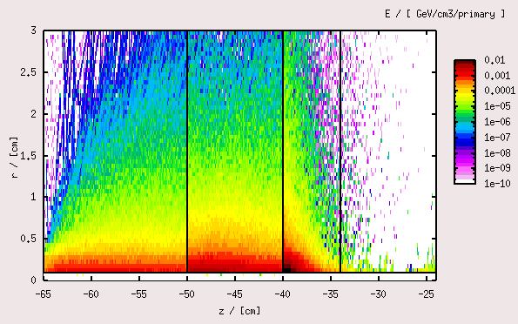
modelling the collimator
C Ti W
r = 0.1 cm
~
Δ T_{C} 500 K / train
~
~
Δ T_{Ti} 1300 K / train
~
~
Δ T_{W} 3600 K / train
~
but this is still to much !!

Slide 7

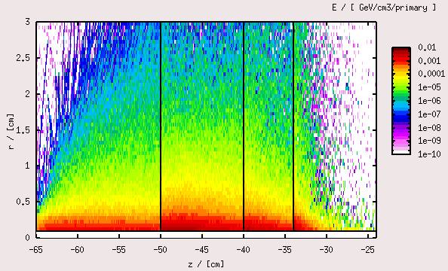
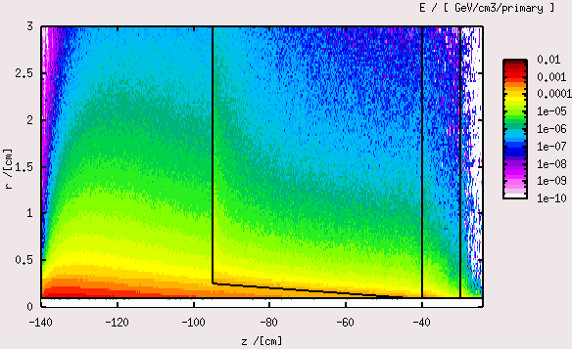
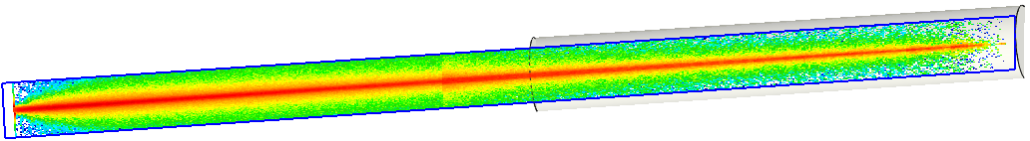
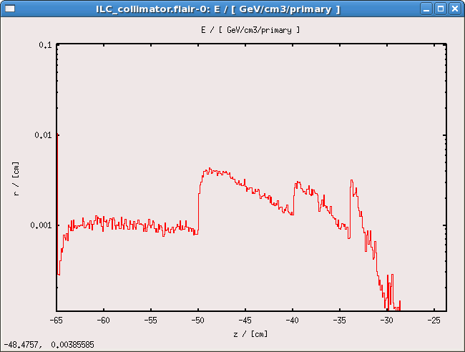
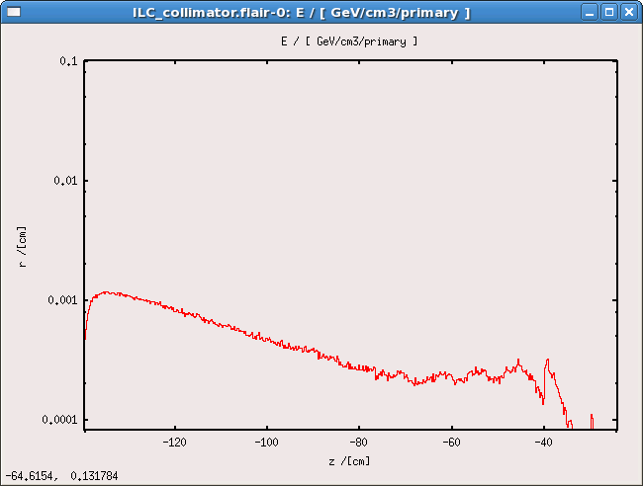
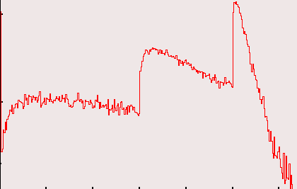
modelling the collimator
C Ti Fe W
C Ti Fe W
C Ti W
r = 0.1 cm
~
z = 1.2 m
Δ T_{C} 500 K / train
~
~
-> 40 K / train
Δ T_{Ti} 1300 K / train
~
~
-> 40 K / train
Δ T_{Fe} 600 K / train
~
~
-> 20 K / train
Δ T_{W} 900 K / train
~
~
Δ T_{W} 3600 K / train
~

Slide 8
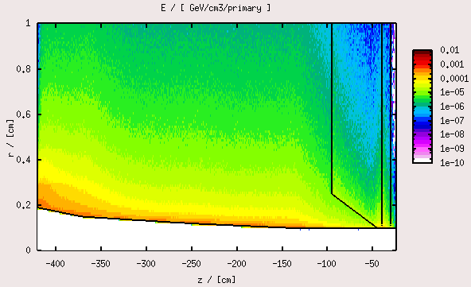
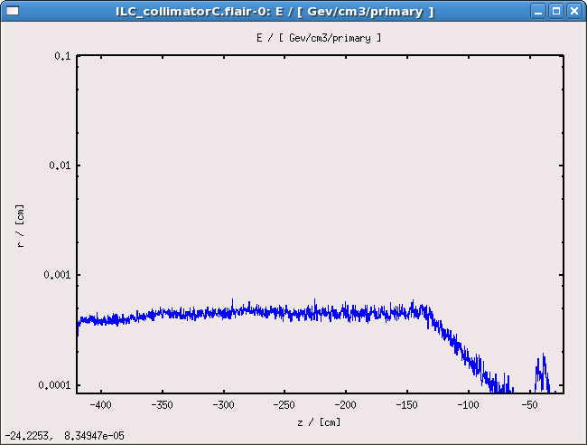
modelling the collimator
C Ti
r = 0.1 cm
~
-> 200 K / train
z = 1.2 m
Δ T_{C} 500 K / train
~
~
-> 40 K / train
z = 4.0 m
Δ T_{Ti} 1300 K / train
~
~
-> 40 K / train
Δ T_{Fe} 600 K / train
~
~
-> 20 K / train
Δ T_{W} 900 K / train
~

Slide 9
modelling the collimator
300K
l = r – r₀
C Ti Fe W
r = 0.1 cm
800K
z = 1.2 m
~
Δ T_{C} 500 K / train
~
~
-> 40 K / train
Δ T_{Ti} 1300 K / train
~
~
-> 40 K / train
Δ T_{Fe} 600 K / train
~
~
-> 20 K / train
Δ T_{W} 900 K / train
~
.
λ_{C} A ΔT
Q_{C} =
l
λ : heat conduction coefficient [W/m/K]
A_{zyl} : mean girthed area of the collimator [m²]
l : heat conduction path length [m]
ΔT : difference in temperature [K]
.
Q : heat current

Slide 10
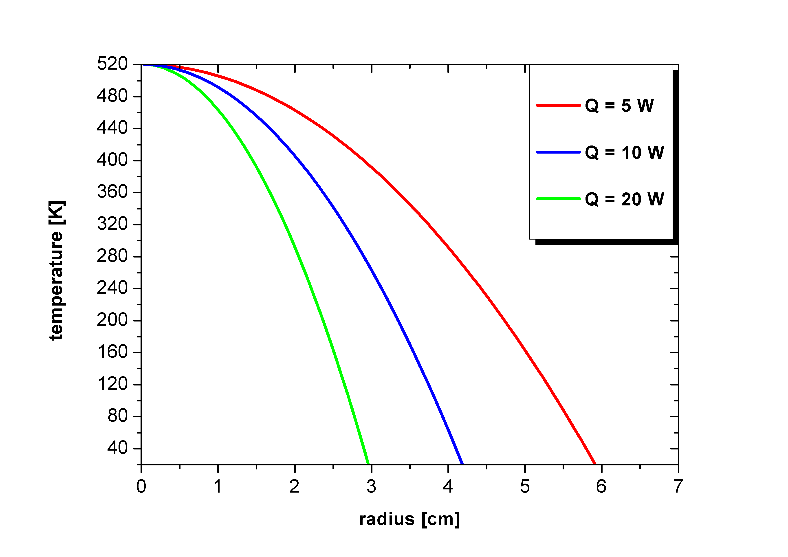
modelling the collimator
z = 1.0 cm
.
.
.
r = 0.1 cm
.
λ_{C} A ΔT
zyl.
λ_{C} 2π ( r-r₀ ) z ΔT
Q_{C} =
l
=
ln( r / r₀ )
λ : heat conduction coefficient [W/m/K]
A_{zyl} : mean girthed area of the collimator [m²]
l : heat conduction path length [m]
ΔT : difference in temperature [K]
.
Q : heat current

Slide 11
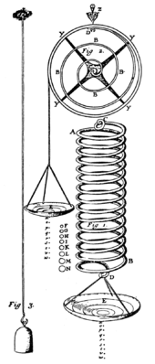
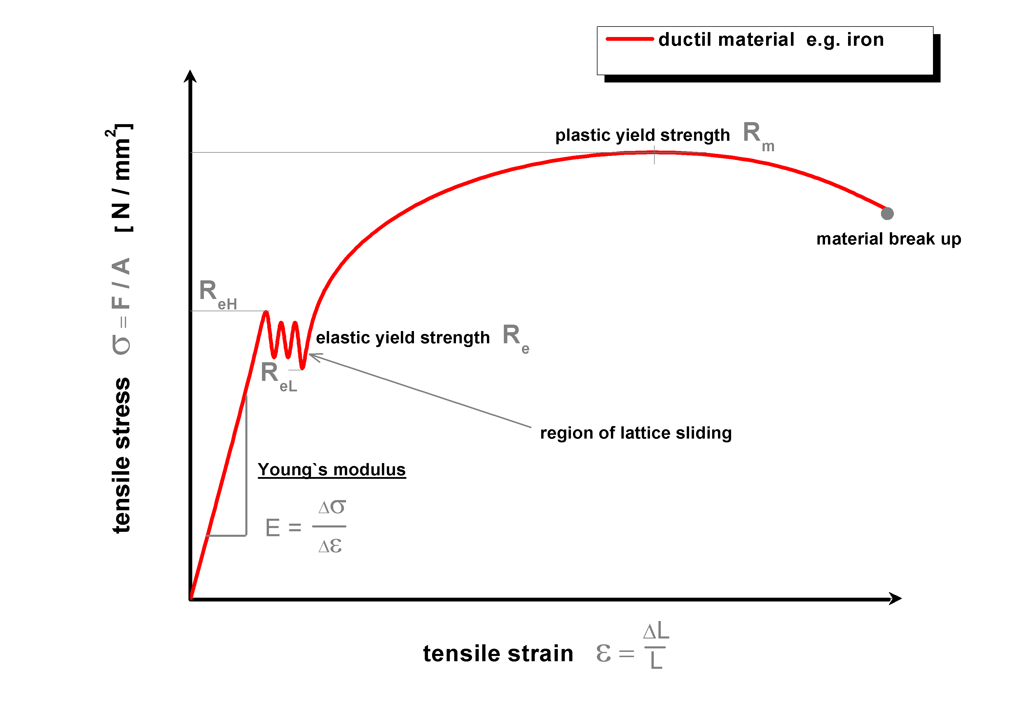

basics of material science
Robert Hooke (* 1635 +1703)
Thomas Young (* 1773 +1829)
F = D ΔL
D : spring constant
ΔL : displacement of the spring
Δσ
Δε
E =
iron

Slide 12
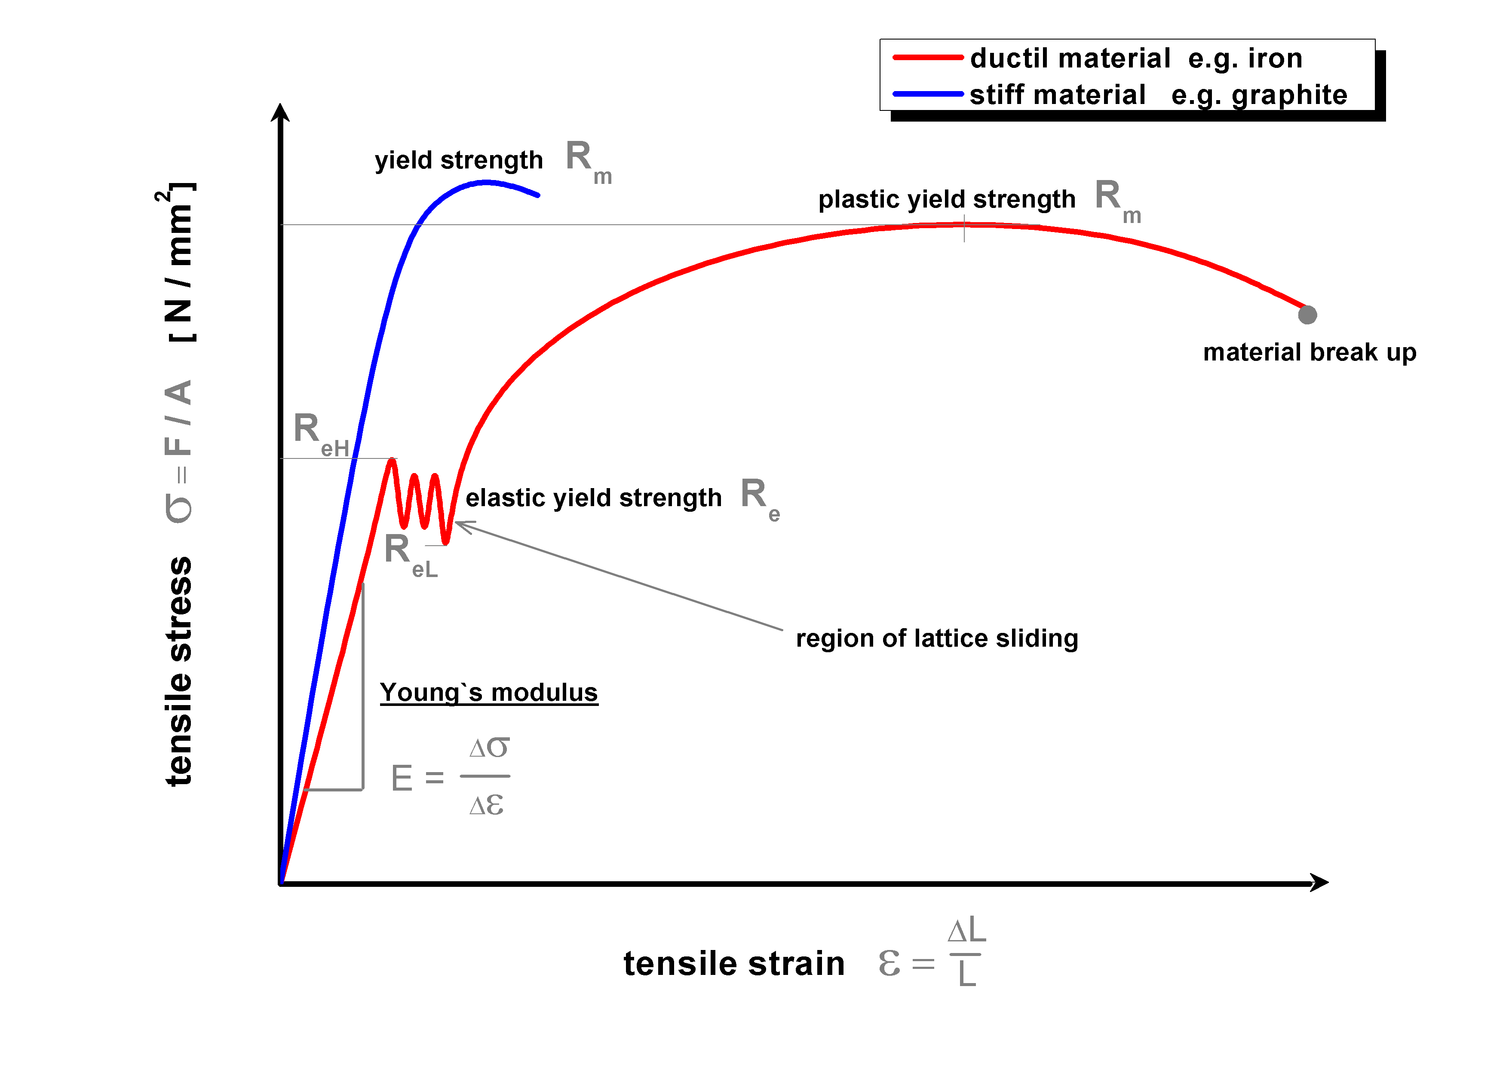
basics of material science
Robert Hooke (* 1635 +1703)
Thomas Young (* 1773 +1829)
Δσ
Δε
E =
graphite
iron

Slide 13
basics of material science
Robert Hooke (* 1635 +1703)
Thomas Young (* 1773 +1829)
poisson ratio ν
E
2G
ν = -1
Δσ
Δε
shear modulus G
E =
E
2+2ν
G =
bulk modulus K
E
3-6ν
K =

Slide 14
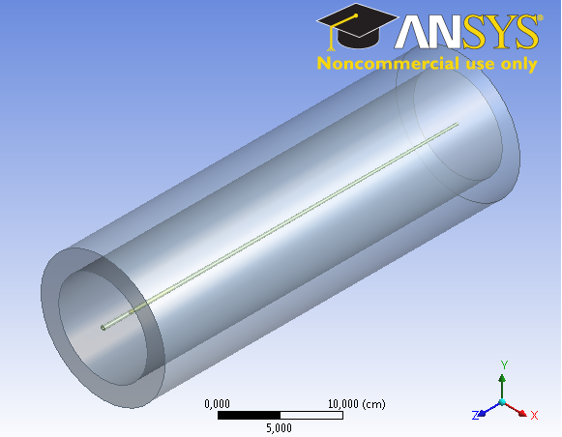
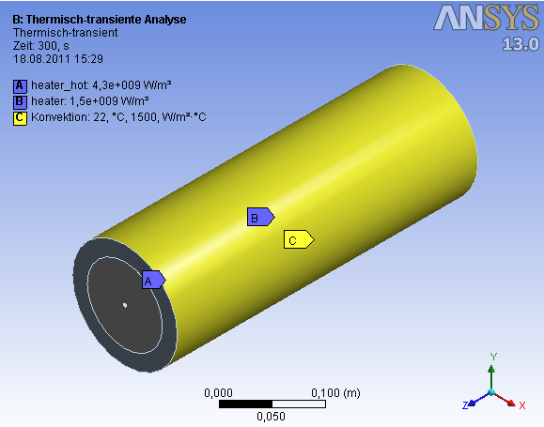
time dependent simulations with computer aided engineering software

Slide 15
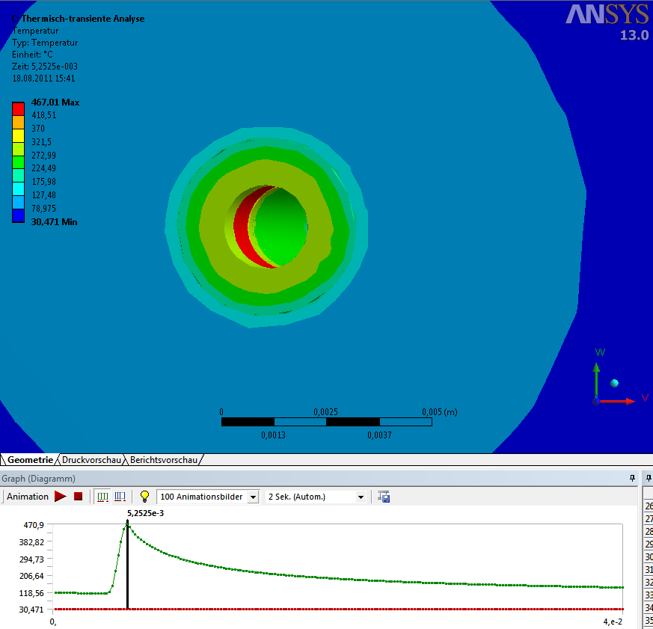
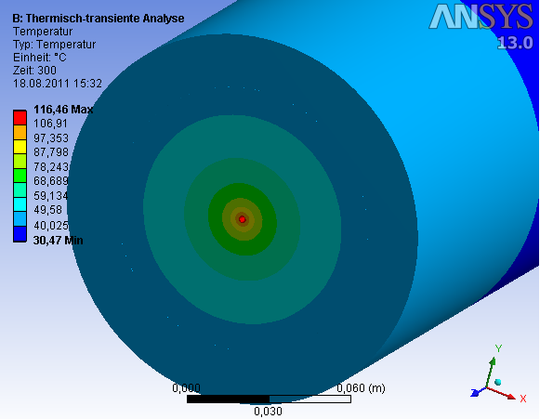
time dependent simulations with computer aided engineering software
C Ti

Slide 16
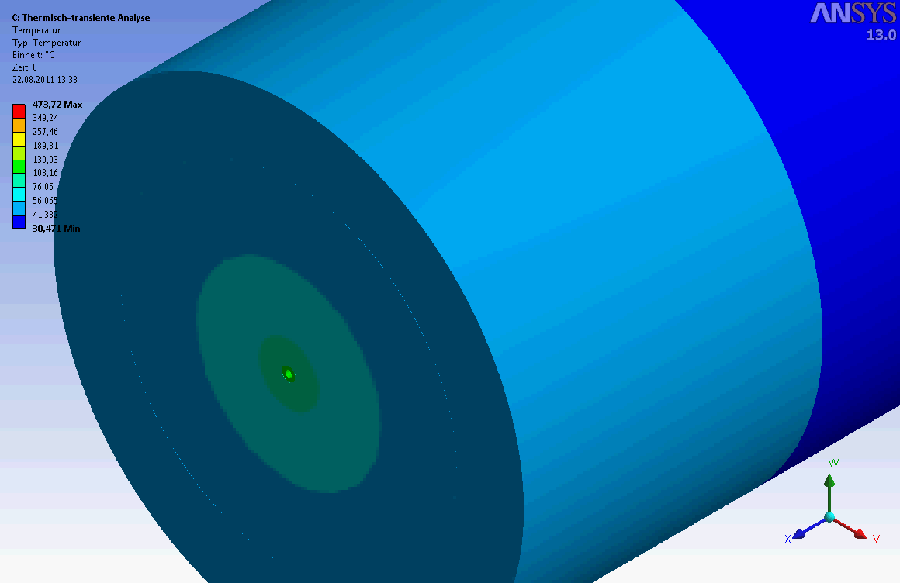
time dependent simulations with computer aided engineering software

Slide 17
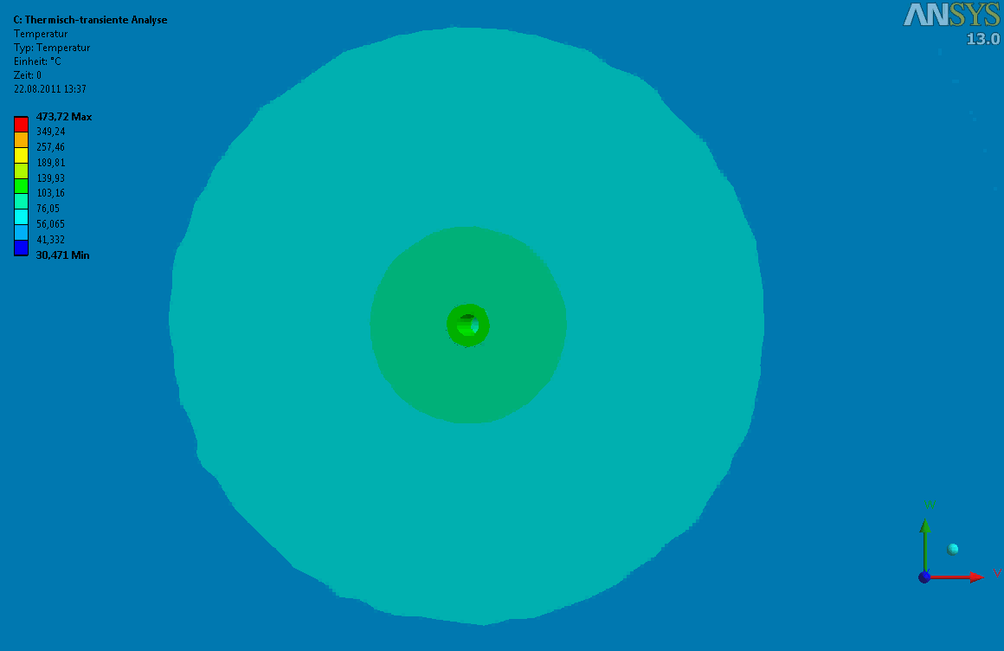
time dependent simulations with computer aided engineering software

Slide 18
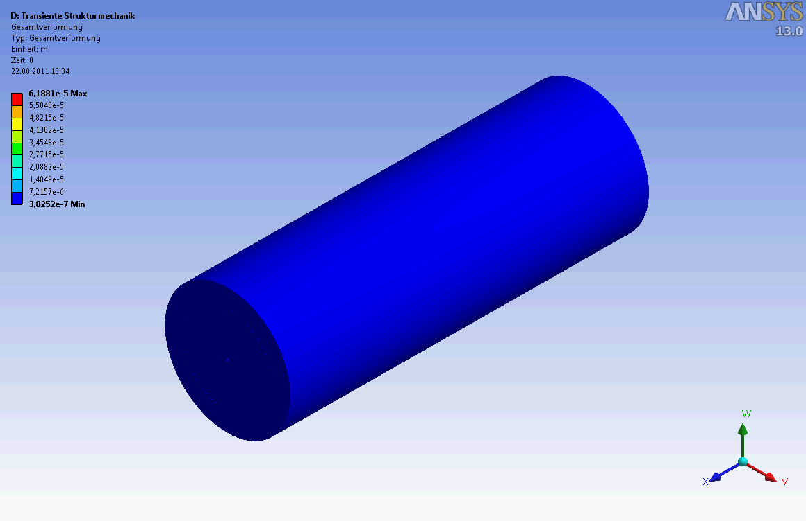
time dependent simulations with computer aided engineering software

Slide 19
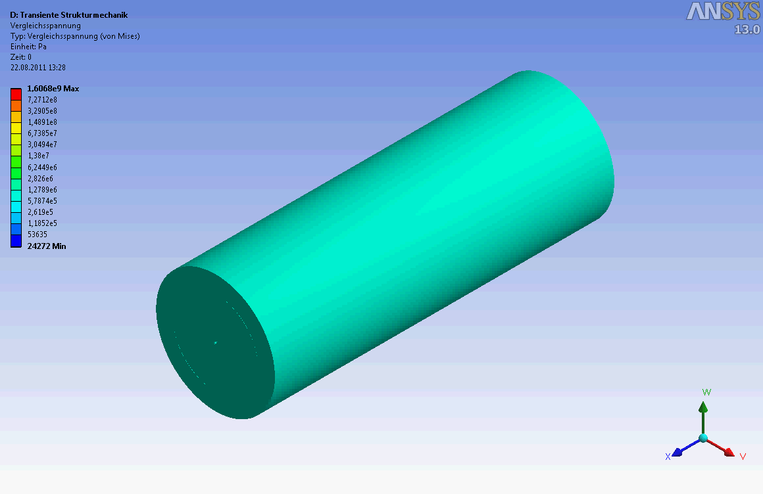
time dependent simulations with computer aided engineering software

Slide 20
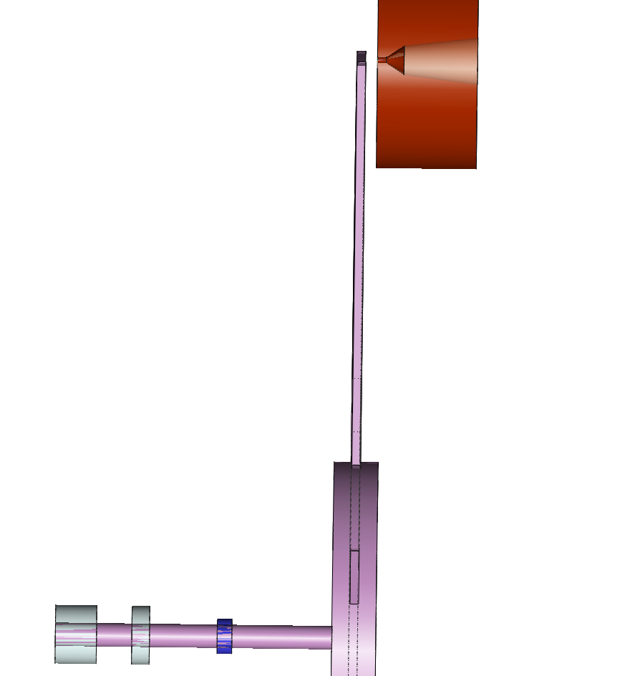
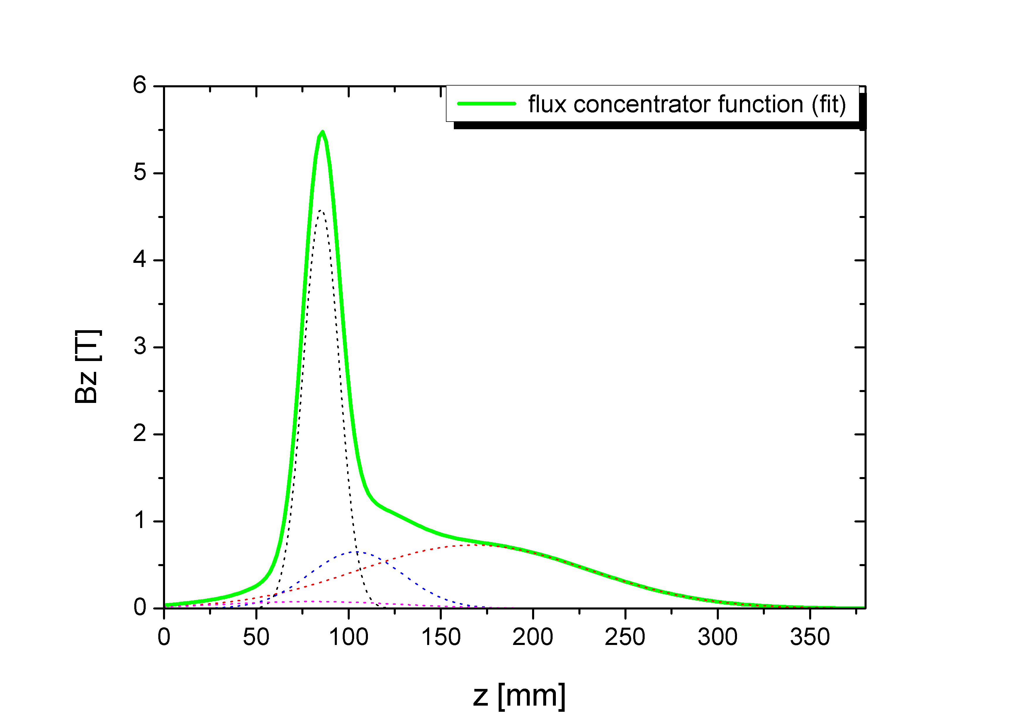
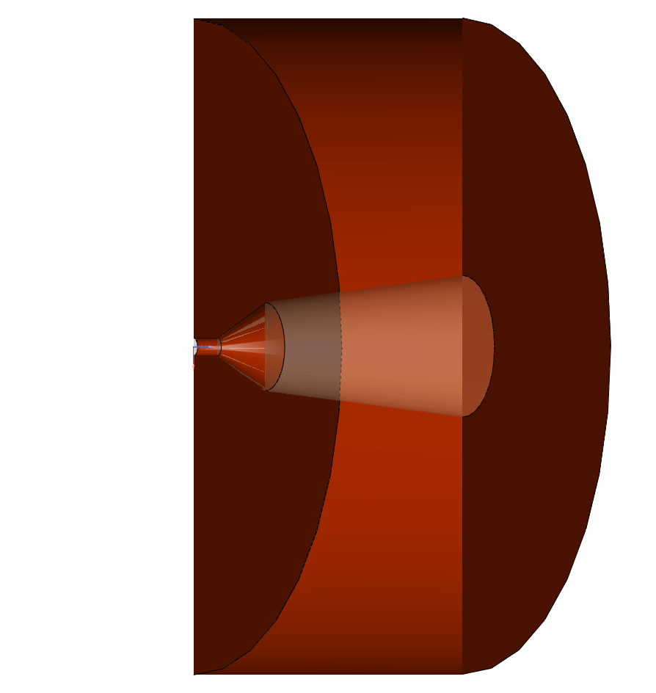
modelling the flux concentrator
2.0 cm
m
b
s
l₁
a b c d
d₁
d₂
d₃
l₂
l₃
d₁ = 1.0 cm , l₁ = 5.0 cm
d₂ = 5.0 cm , l₂ = 3.0 cm
d₃ = 8.0 cm , l₃ = 12.5 cm

Slide 21
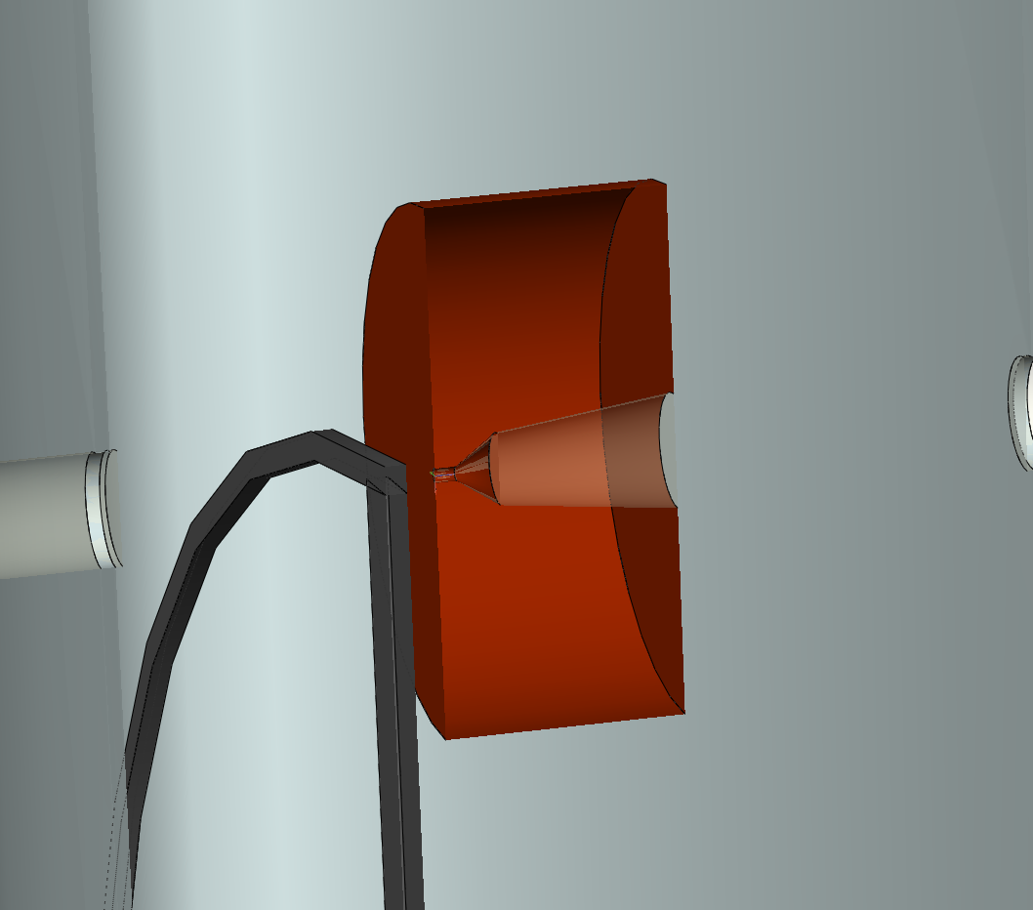
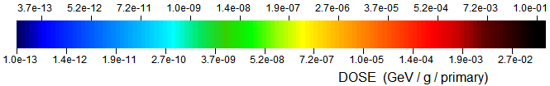
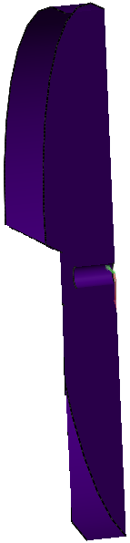
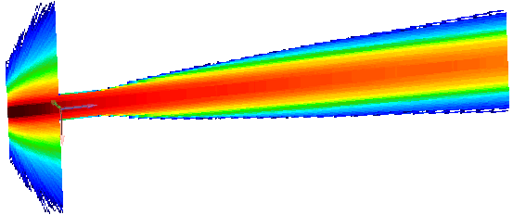

~ 130 K / train
|
2.0 cm
-
POSITRON beam
Q_{Ti target}
~
6 (x 52.5)kW / train
~
1.5 cm
v_{rim} = 100 m/s
-> 50 pulses hits in
the same position
tungsten collimator
for flux concentrator

Slide 22
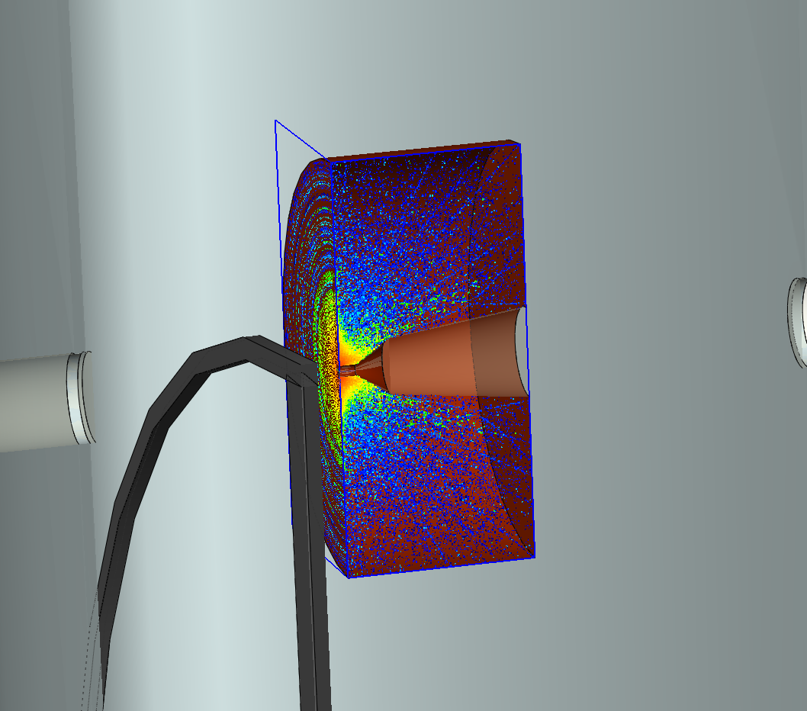
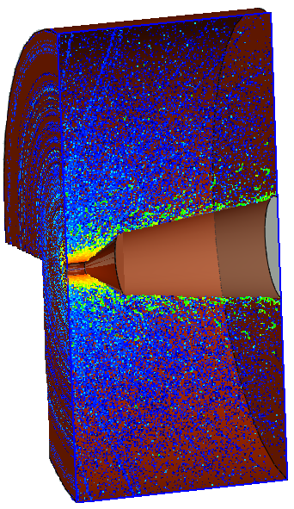
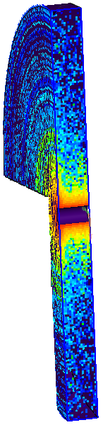
~ 50 K / train
|
~ 80 K / train
|
~ 320 K / train
|
flux concentrator
-
Q_{Ti target}
~
6 (x 52.5)kW / train
~
-
Q_{W colli}
~
115 kW / train
~
-
Q_{flux con+W}
~
20 kW / train
tungsten collimator
for flux concentrator
~
-
Q_{flux con-W}
~
100 kW / train
~

Slide 23
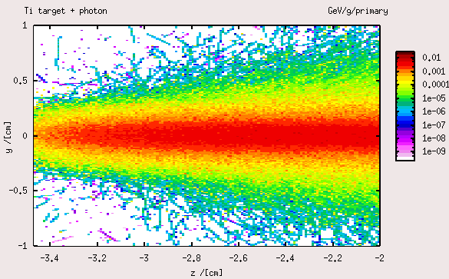
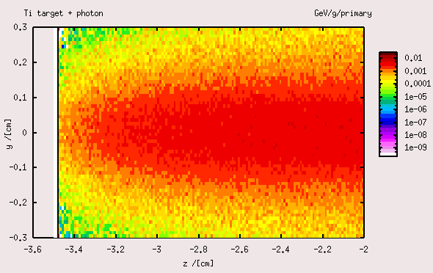

Slide 24
conclusion
- heat loads (temperatures) for different collimator designs are simulated
-> transfered in manageable regions
->
C Ti W
C Ti Fe W
->
C Ti Fe W

Slide 25
conclusion
- heat loads (temperatures) for different collimator designs are simulated
-> transfered in manageable regions
- time dependent heat and structural loads are simulated with ANSYS software
grahite collimator | simulation | theoretical _{max}
temperatur | 800 K | ~ 4000 K
deformation | 45 μm | -
stress | 10 MPa | 20-70 MPa

Slide 26
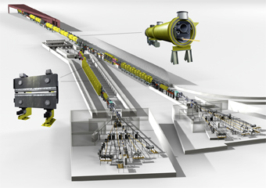
conclusion
- heat loads (temperatures) for different collimator designs are simulated
-> transfered in manageable regions
- time dependent heat and structural loads are simulated with ANSYS software
grahite collimator | simulation | theoretical _{max}
temperatur | 800 K | ~ 4000 K
deformation | 45 μm | -
stress | 10 MPa | 20-70 MPa
- what is now to do ?
-> a experimental setup for shock wave studies have to developed @ DESY/FLASH

Slide 27
end of show

