Slide 1


Conceptual design in 2005
Snowmass
92.243cm
35.77cm
γ-ray
92.243cm
Laser
35.77cm
x 30
Multi-Compton chamber system
8 degree
electron beam
5.03cm
Laser
power detector
Big progress
During R&D
Piezo
X 5 at present
°
parabolic mirror

Slide 2
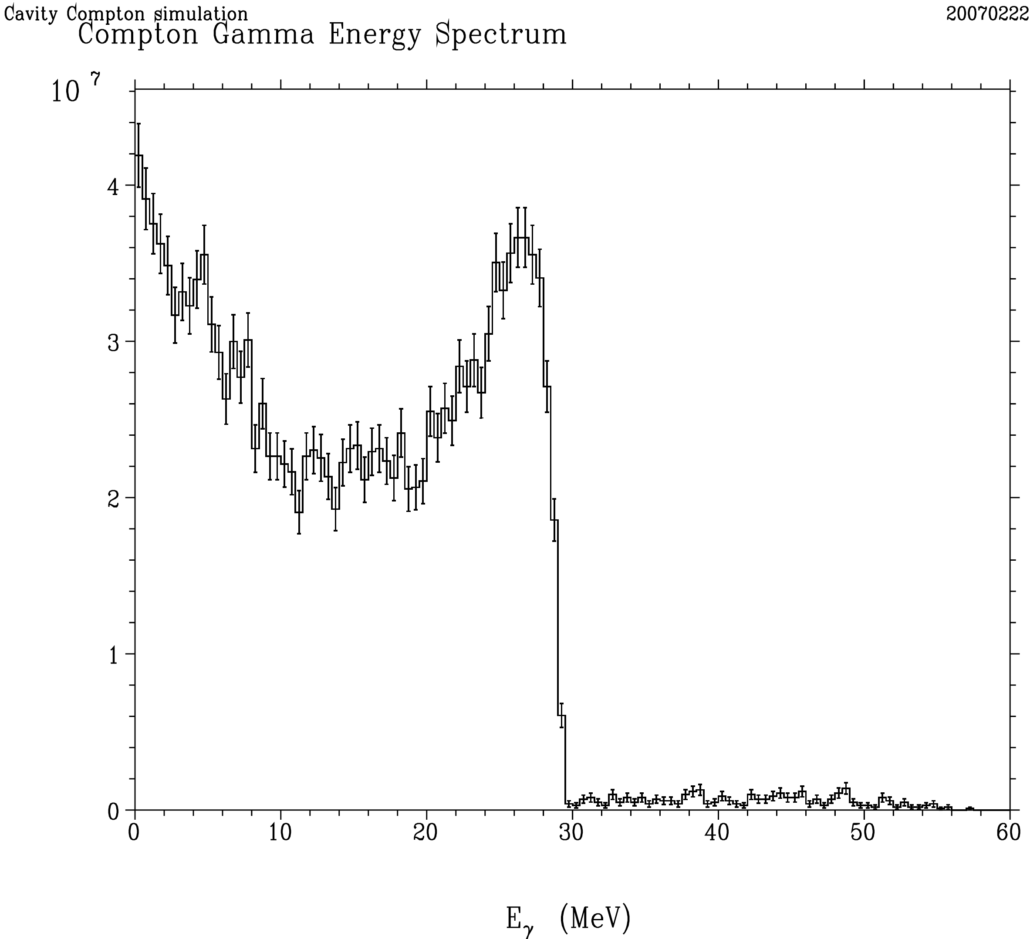
10⁶
γ-ray generation by CAIN
E_{pulse} = 600 mJ
N_{e} = 1 x 10⁹
X-ing = 5 deg
--->
Nγ = 1.6 x 10⁸
ERL case

Slide 3
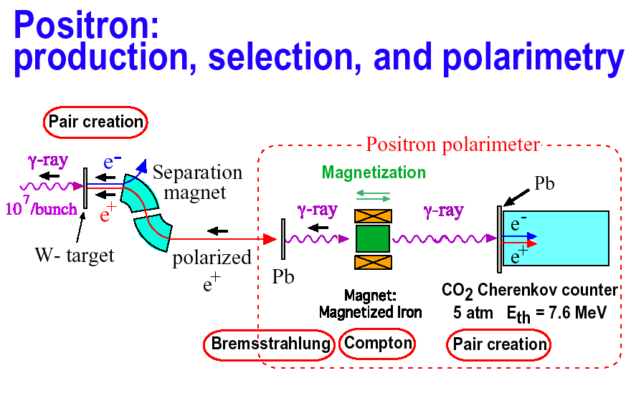

Slide 4
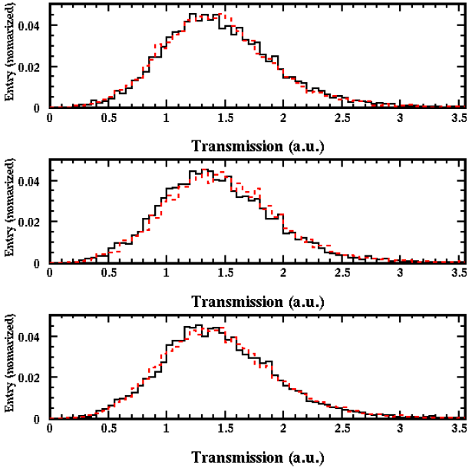
Experimental Results
Polarization of positron beam
72+/-21%, predicted cal. value 77+/-10%
e⁻ spin in Iron
e⁺ beam spin
A(R)= +0.60± 0.25%
e⁻ spin in Iron
e⁺ beam spin
A(L)= -1.18± 0.27%
e⁺ beam spin
non
e⁻ spin in Iron
A(0)= -0.02± 0.25%

Slide 5
Multi-bunch electron beam generation with 2.8nsec bunch spacing at ATF
300 bunches/train, 100Hz operation is possible?
940 μJ/100 pulses with 2.8nsec spacing,
UV 266nm, 7psec（FWHM)
Farady Cup to measure multi-bunch
Current, 400nC/100 bunches

Slide 6
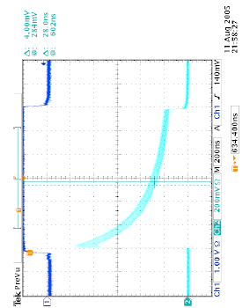
Quick test on 443 pulse train with 12.5Hz operation (1.24μsec). Amplification by two pass 9mmφYAG rod
3.6μJ/pulse
65μJ/pulse
660μJ/pulse

Slide 7
Memorial Conclusion in 2005 Snowmass
1. The polarized-positron generation scheme which we propose is very flexible, and of moderate size. It provides a fully independent system which means that we can perform the ILC beam commissioning at full beam power without the need of a 150GeV electron beam. The design of the Compton ring, the Compton collision chamber, and the laser system will be optimized with respect to tolerances.
2. Except for beam stacking into damping ring, we can do test of almost full system at KEK-ATF. (This is extremely difficult experiment because of difficulty on ATF DR tuning.)

Slide 8
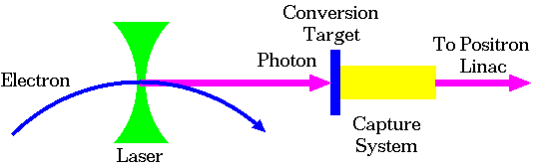
Polarized Positron Soure
Compton Scheme
An independent system based on the dedicated electron driver is a big advantage.
Obtaining enough positron, is a technical challenge.
  High intensity electron beam: Linac, Storage ring, ERL
  High intensity photon beam: High power laser, optical cavity.
  Stacking scheme: DR stacking, Pre-DR, etc.

Slide 9
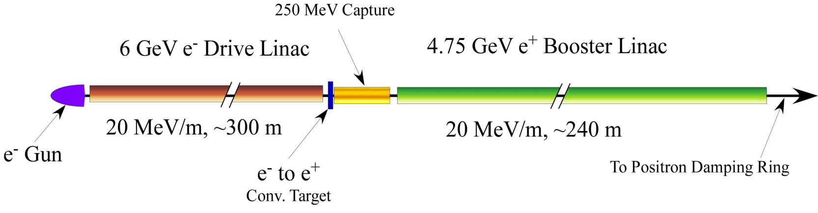
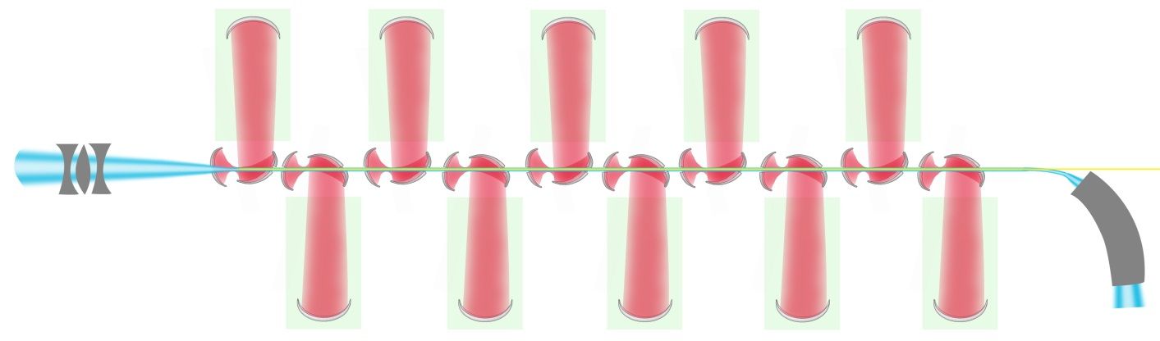
Linac Scheme
Conventional Non-Polarized Positrons:
Conventional Positron source (Electron linac driven) is upgraded with a simple modification.
polarized γ-ray beam is generated in the Compton back scattering inside optical cavity of CO₂ laser beam and ~6 GeV e-beam produced by linac.
The required intensities of polarized positrons are obtained due to 5 times increase of the e-beam charge (compared to non polarized case) and 10 CO₂ laser system IPs.
6GeV e⁻ beam
γ to e⁺ conv. target
30-60MeV
γ beam
30-60MeV
e⁺ beam
Capture system
~2 m

Slide 10
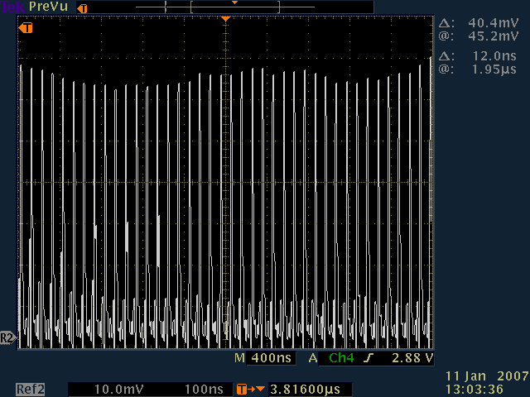
Optical cavity: Simplified test setup
3% over 1 μs
Very encouraging results obtained with simplified cavity test setup: ~200 ps pulse of the order of 100 mJ circulated for >1 μs.
Further test would require pulse length monitoring and high pressure or isotope mixture based amplifier (to sustain 5 ps beams).

Slide 11
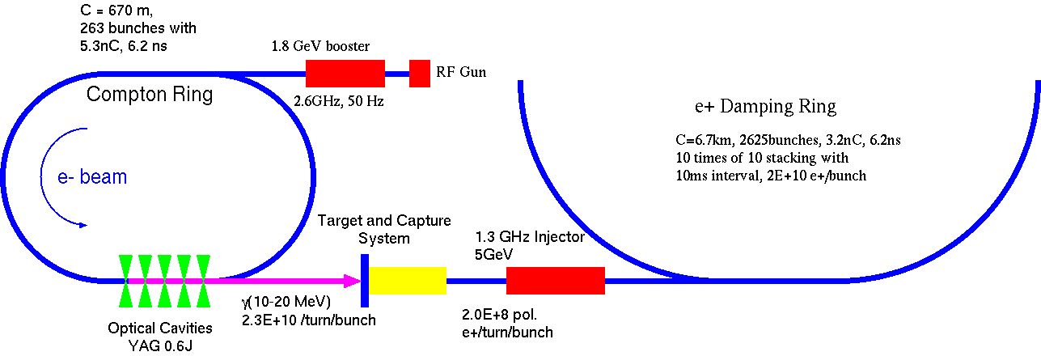
Compton Ring
A storage ring for electron driver:5.3nC, 6.2ns, 1ps, 1.8GeV, 0.6Jx5CP.
Positron Ne+:2.0E+8/bunch is generated.
10 bunches are stacked on a same bucket. This process is repeated 10 times with 10ms interval for beam cooling.
Finally, Ne+:2E+10 is obtained.

Slide 12
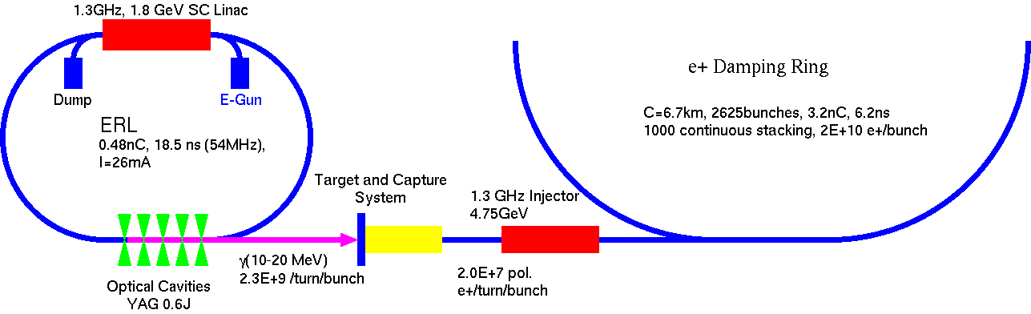
ERL
ERL(Energy Recovery Linac) is employed as the dedicated electron driver.
  0.48nC, 18.5ns (54MHz) ~ 26mA, E=1.8GeV
  Nγ=2.3E+9 by 0.6 Jx5 CP, Ne+=2.0E+7/bunch
By a semi-CW operation (50ms), 1000 times stacking in DR is performed and Ne+=2.0E+10 is obtained.

Slide 13
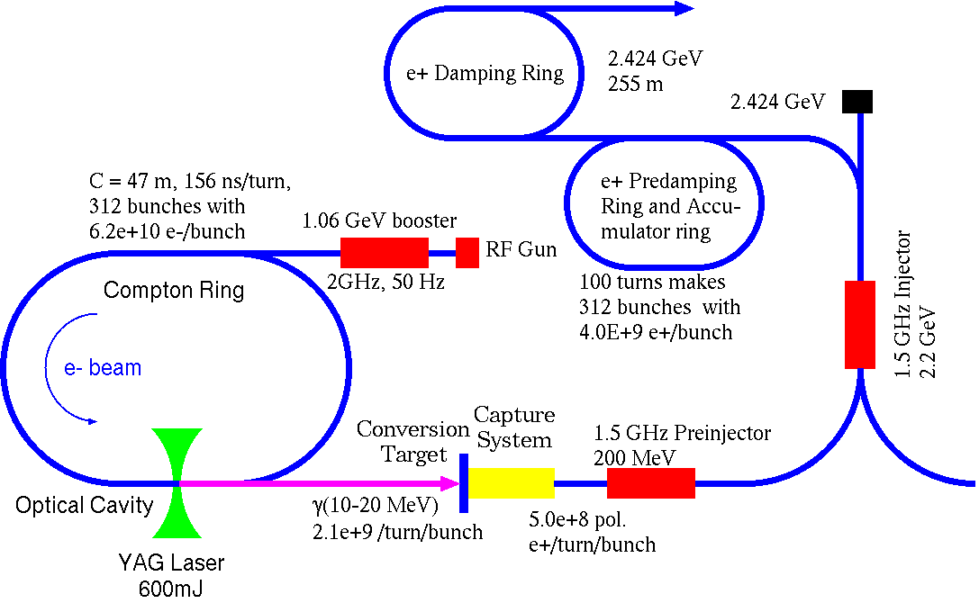
CLIC Compton Scheme
Storage ring with a single optical cavity.
9.8E+6 e+/bunch is generated.
450 times stacking in Pre-DR make the full intensity beam.

Slide 14
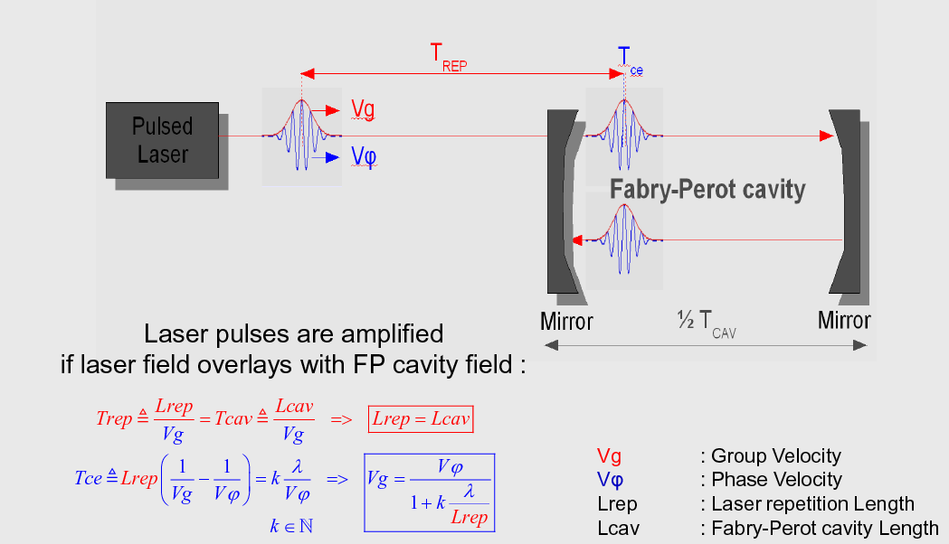
Pulse Stacking Optical Cavity at LAL
High power mode lock laser is “stored” in an optical cavity.
Both group velocity and phase velocity should be matched for high enhancement.
30000 finess was achieved in September 2008.

Slide 15
2 steps R&D by LAL with ATF
Started end 2008
STEP ONE: commissioning a 4-mirror cavity at ATF by end 2010
STEP TWO: upgrade mirrors & laser power
~50W
→200W
Oscillator
=0.2W, 1032nm
Δt~0.5ps frep=178.5MHz
Amplifier
photonic fiber
Yb Doped
4-mirror
Fabry-Perot cavity
Gain~1000
→10000
Digital feedback
ATF clock
STEP ONE
With cavity laser/coupling ~50% ➔Power_cavity~25kW
~50x1.5 vs 2-mirror cavity
➔~5 E9 γ/s (Emax=28MeV)
STEP TWO
With cavity laser/coupling ~50% ➔Power_cavity~500kW
~2000x1.5 vs 2-mirror cavity
➔~2 E11γ/s
Goal: to reach the MW average power
ATF 2-mirror cavity paper: Miyoshi, arXiv:1002.3462v1

Slide 16
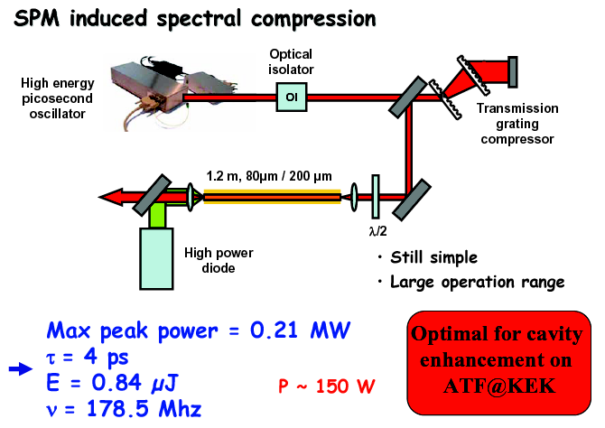
High power ps fiber amplifier by LAL G.
E. Cormier
Fiber laser amplification with CPA and without CPA has demonstrated
average power from 100W to 1kW recently due to high efficiency of LD.

Slide 17
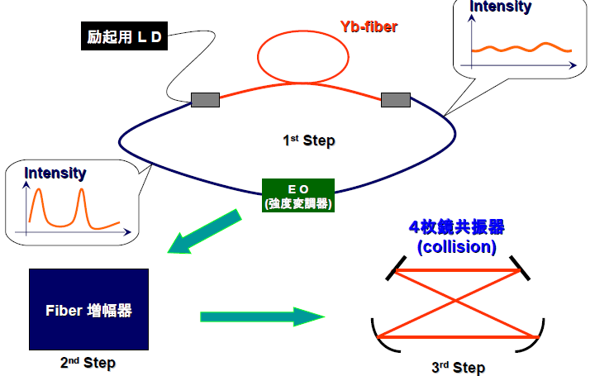
Laser System Development for Optical Cavity for Q-project and ILC
Pump LD
162.5MHz mode-locking
100mW Oscillator
Then, amplified to 30W
Fiber Amplification
300nJ/pulse
30uJ/pulse
300mJ/pulse
Burst Amp.
By 100 times

Slide 18
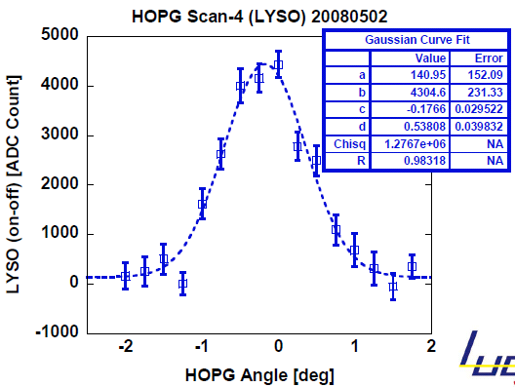
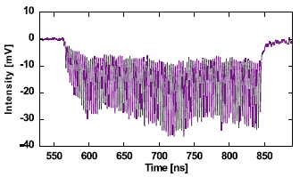
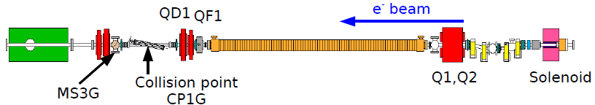
Pulse laser storage in optical cavity and X-ray measurement in 2009.2
X-ray generation with 1000 enhancement by optical cavity
Average power :40kW,
7psec(FWHM),
next step :2MW
Status ： 0.2mJ/pulse,
target ：10mJ/pulse
X-ray measurement
at 20 degree crossing angle
MCP waveform
background subtracted.
Detected X-ray flux
1.2x10⁵ Hz/~10%b.w.
Electron beam size 60μm in σ
Beam collision technique
X-angle 20 deg.
43MeV Multi-bunch beam+ Super-Cavity = 33keV X-ray.
LUCX results
X-ray
Detector
Laser size:30μm in σ, target:electron beam size:10μm in σ, laser waist size:8μm in σ

Slide 19
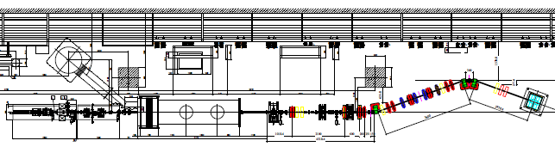
Change to head collision scheme to get another enhancement of 5 and
to increase laser pulse duration ~30ps.
Quantum project
at STF
Beam size 10μm

Slide 20
Two laser pulses are circulating with the spacing of 6.15ns in a ring
optical cavity.

Slide 21
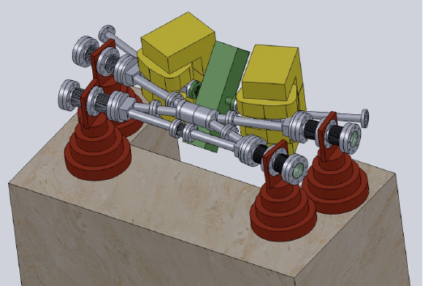
WFS (Wave Front Sensing) feedback will be used for the stabilization of 4 mirror cavity.

Slide 22
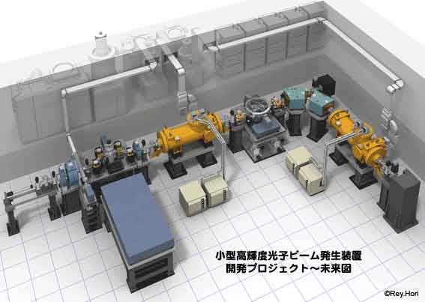
Q-Beam and cERL ‏
Quantum-Beam project is a strategic R&D for X-ray source for various applications based on the SC linac.
1st step: Pulsed X-ray generation with SC linac; It will be carried out at KEK-STF, 2010-2011.
2nd step: CW X-ray generation with SC ERL; It will be carried out at cERL-KEK, 2012~.
Energy : 25-30 MeV
Micro pulse rep.:162.5MHz,
Current in macro pulse:16mA,
Macro pulse rep: 10Hz
http://kocbeam.kek.jp/project/index.html

Slide 23
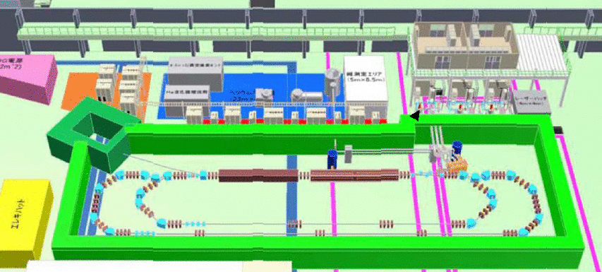
Q-Beam and cERL ‏
cERL is a test machine to prove the technical feasibility of 5GeV class ERL machine for future light source.
It will be constructed in the east counter hall of ex-KEK-PS.
The operation will be started from 2012.
  The energy 35-65 MeV.
  Average current : 10mA
  Emittance : 1.0 π mm.mrad

Slide 24
High brightness X-ray generation by ERL
Demonstration by beam experiment if possible
Early 2013 experiment
From STF
Change to head-on
Pulse laser optical cavity
X-ray
-
E-bunch
Laser
Energy recovery
Beam dump
Injector
Super-conducting linac
35MeV electron beam x 1μm laser = 23keV X-ray

Slide 25
Laser Compton R&D
A proof of principle experiment of the polarized positron generation by the inversed laser Compton has been done already at KEK-ATF.
Demonstration of the system feasibility is the next milestone.
  Demonstration of CR scheme : The experiment at ATF.
  Demonstration of Linac scheme: BNL-ATF, 1st phase of Q-beam at KEK.
  Demonstration of ERL scheme: 2nd phase Q-beam and cERL at KEK.

Slide 26
Suggestion for future R&D
Should consider multi-laser pulses in a ring cavity which means
the development of larger optical cavity for γ-γ collider.
One optical cavity has about 10 laser pulses with 6.15 ns spacing
and mirror cooling is necessary.
2. Positron bunch stacking into damping ring should be no beam
lose. We have to invent new scheme, maybe asymmetric strong laser
cooling.
3. Strong high reflectivity mirror should be developed for future
high field physics and laser beam acceleration.
4. Redesign the scheme with head collision. How many optical cavities
will be needed?
Thank you for your attention.

Slide 27


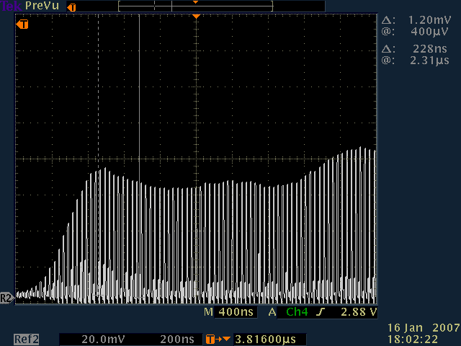
Polarized Positrons Source for ILC, CLIC, Super B
Conventional Non-Polarized Positrons:
Polarized γ-ray beam is generated in the Compton back scattering inside optical cavity of CO2 laser beam and 6 GeV e-beam produced by linac.
Laser cavity needs R&D.
6GeV e⁻ beam
60MeV
γ beam
γ to e⁺ conv. target
30MeV
e⁺ beam
~2 m
First tests of the laser cavity:
3% over 1 μs

Slide 28
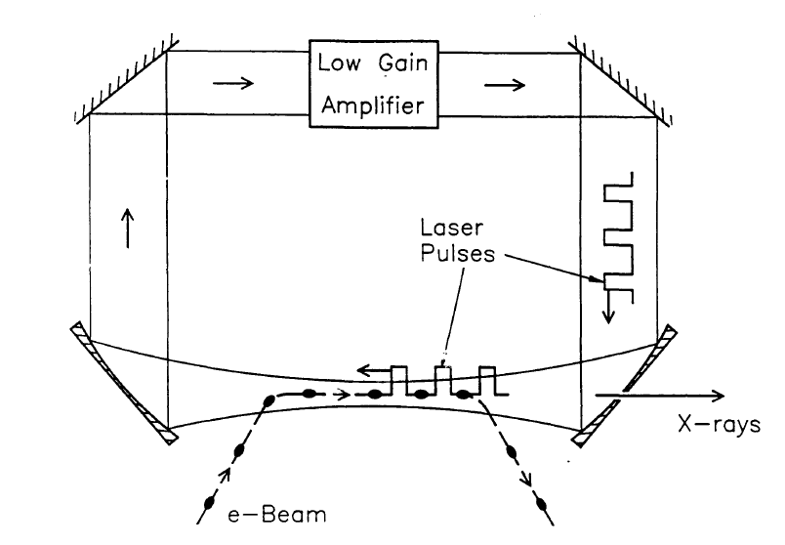
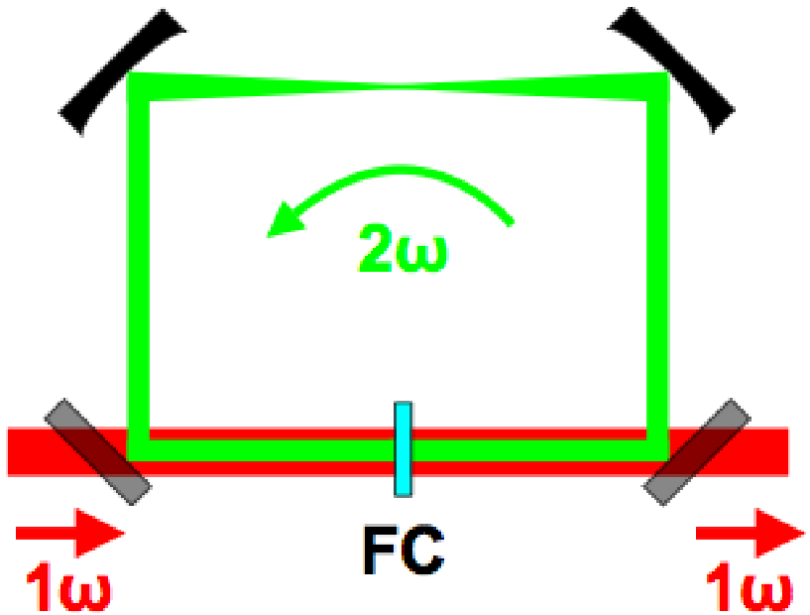
Single-Collision schemes
Regenerative cavity
Sprangle et al. JAP72(1992)5032
TeraWatt, but
low rep rate …
(e.g. Chingua Univ.
& Daresbury project)
Non linear cavity (LLNL)
Jovanovic et al.,NIMA578(2007)160
Fabry-Perot cavity
Huang&Ruth, PRL 80(1998)976
Mode lock laser beam can be stabilised
to Fabry-Perot cavities:
Jones et al., Opt.Comm.175(2000)409, Jones
et al., PRA69(2004)051803(R)
A priori no limitation from dispersion induced
by mirror coatings in picosecond regime:
Petersen&Luiten,OE11(2003)2975,
Thorpe at al., OE13(2005)882

Slide 29
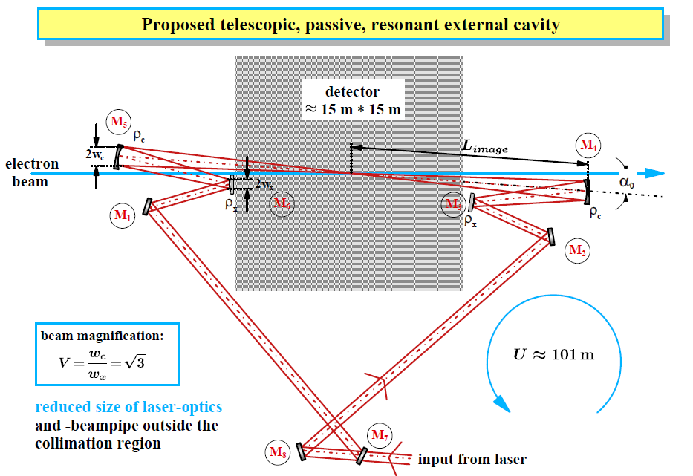
an idea
Klemiz, Monig

Slide 30
an idea
Klemiz, Monig
no dedicated R&D program for photon colliders
but projects for laser-Compton scattering with optical cavity
Polarized positron sources
x-ray sources

