Slide 1
Multi banch generation Experiment at ATF
Tohru Takahashi
Hiroshima University
KEK – Hiroshima and close conatact with Waseda University, Seikei University and LAL Orsay
Previsous study
Multi-bunch measurement
Future prospect
August 2011
PosiPol2011, IHEP Beijing

Slide 2
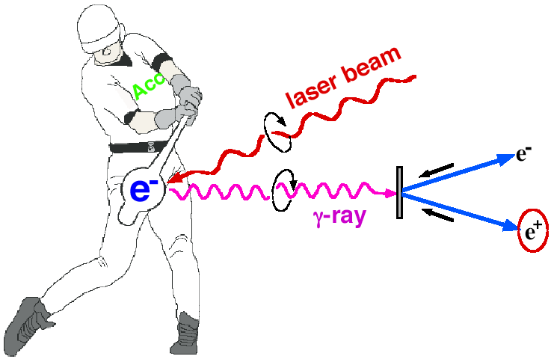
Introduction
Polarized e+ by laser Compton Scheme
Omori
Ee~1GeV for 10MeV gammas
easy to control polarization
Toward the positron sources
-> increase intensity of gamma rays

Slide 3
Miyoshi PosiPol2010
L_{cav}
λ
dL∝λ/enhancement ~0.1nm
for enhancement ~1000

Slide 4
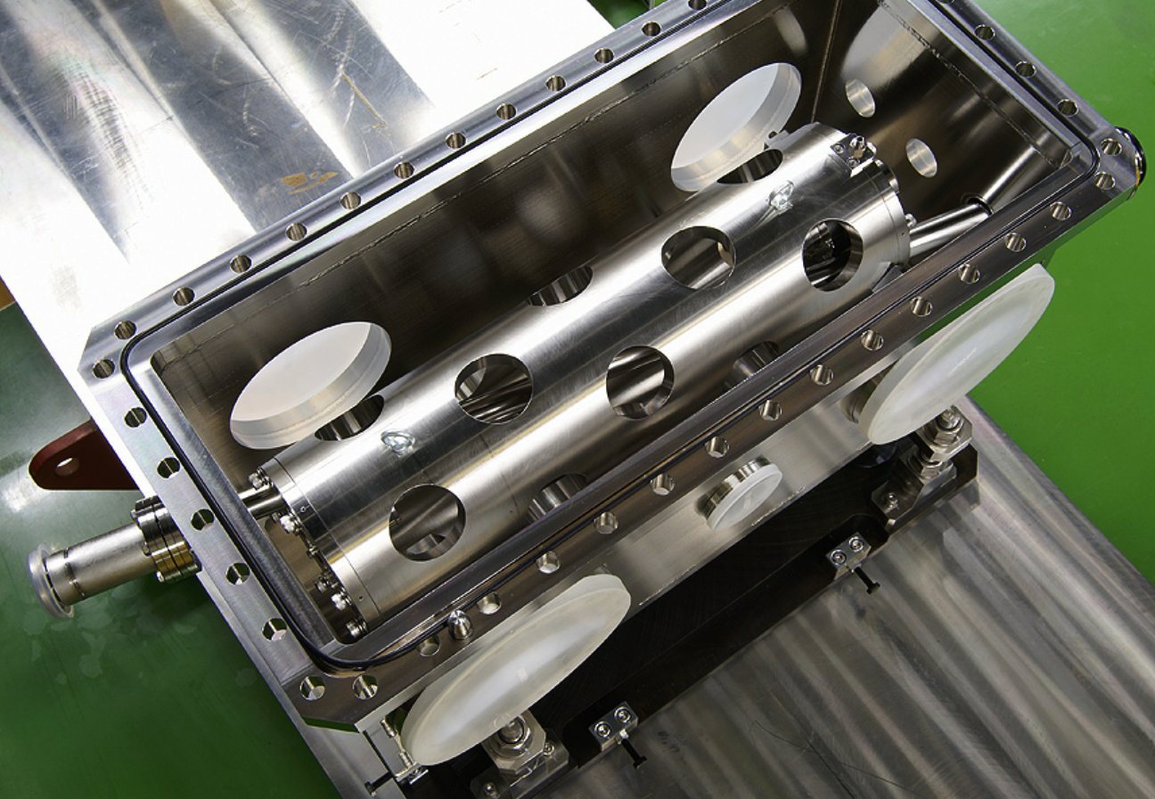
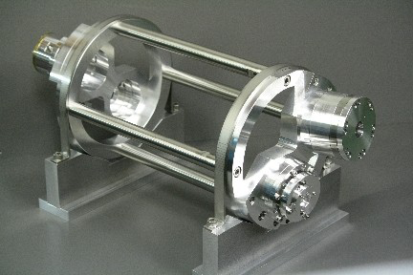
Two Prototype Cavities
2-mirror cavity
(Hiroshima / Weseda /
Kyoto / IHEP / KEK)
4-mirror cavity
moderate enhancement
moderate spot size
simple control
high enhancement
small spot size
complicated control
demonstration of γ ray gen.
accum. exp. w/ cavity and acc.
intense γ ray generation

Slide 5
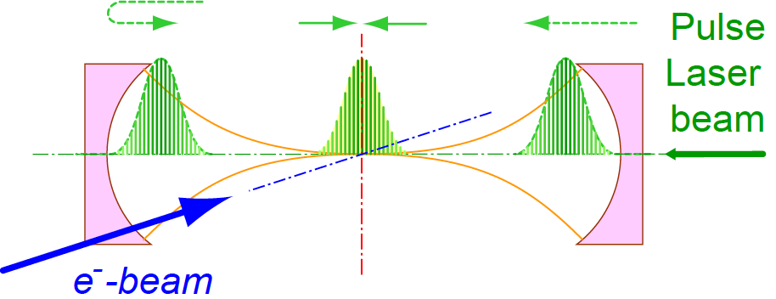
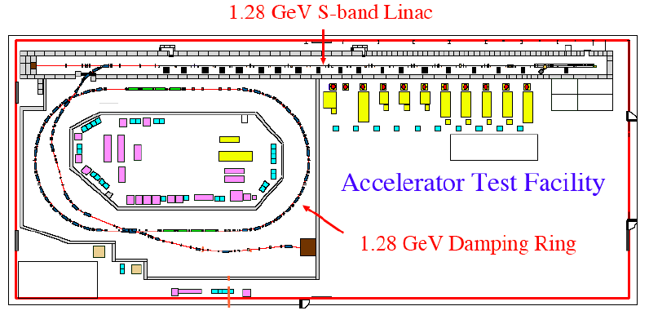
Experimental R/D in ATF
Hiroshima-Waseda-Kyoto-IHEP-KEK
Make a fist prototype
2-mirror cavity
L_{cav} = 420 mm
.
Put it in ATF ring

Slide 6
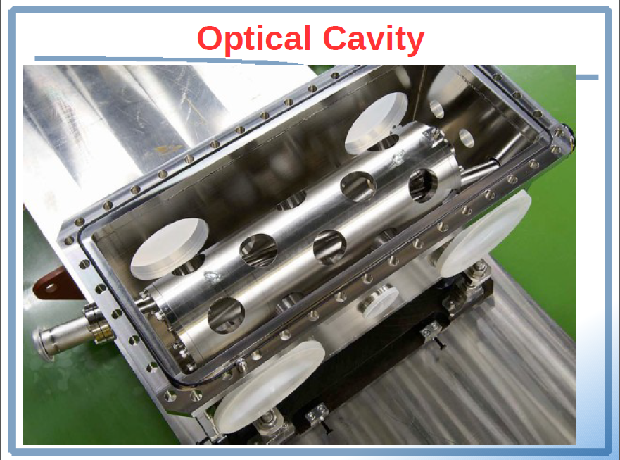

Slide 7
Progress of the 2M cavity
2007/2008 -- installed into the ATF
γ ray signal comfirmed
2008/2009 --- synchronized w/ e-
500W, γ ray generation
2008/2009 -- more encasement (750)
2.5kW, γ ray generation
2010-
bunch by bunch measurement
Aug 2011
removed for the 4M installatoin
reported in previous meeting

Slide 8
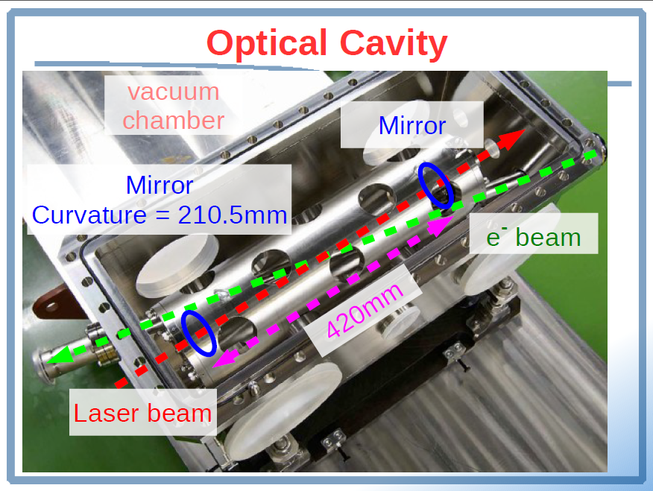

Slide 9
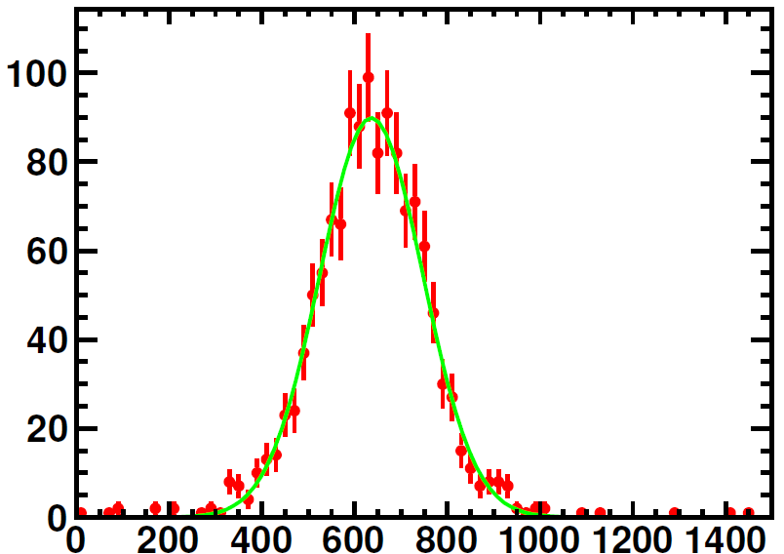
in 2010 operation
laser power
enhancement 750
stored 1.5kW
γ rays
10 bunches
~10 γ/bunch in the detector
number of counts
energy in the detector [MeV]

Slide 10
Miyoshi PosiPol210

Slide 11
Miyoshi PosiPol210

Slide 12
Miyoshi PosiPol210

Slide 13
Miyoshi PosiPol210

Slide 14
Miyoshi PosiPol2010

Slide 15
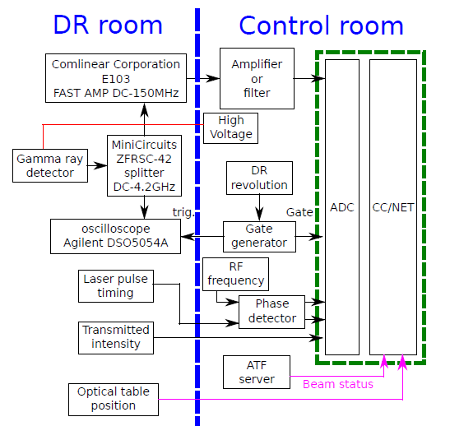
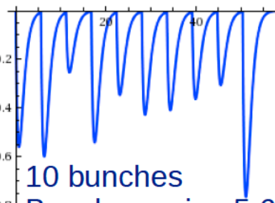
Data Acquisition
ADC to
count total
# of γs
Scope for
wave form

Slide 16
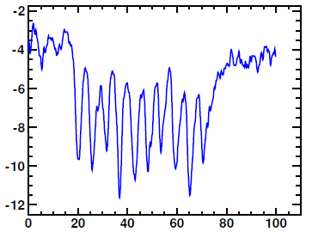
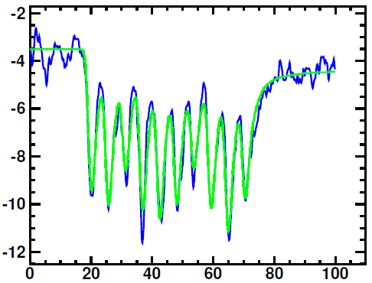
Observed signal with 10 bunch
pulse height [mV]
T [ns]
Fitted w/ scintillation + detector response
+ ,,,,,,,,,,,

Slide 17
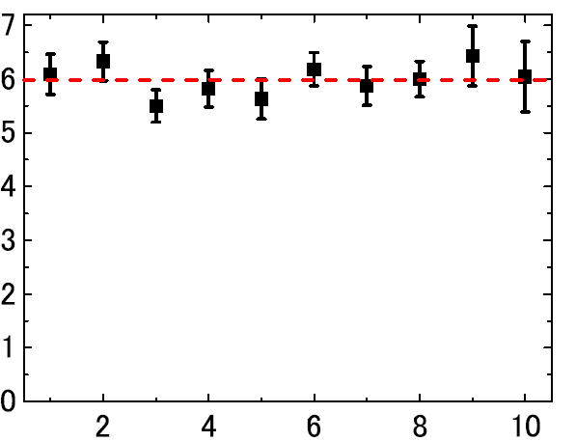
bunch by bunch γ rays
normalized γ rays [/kW/mA
head
bunch number
tail
no bunch position dependence in a train
absolute # is consistent w/ estimation

Slide 18
summary
ATF is back On
See Omori san for detail
rays from multibunch beam was observed
Multi-bunch detection system will be updated for
wider dynamic range
faster and continuous data acquisition
The two mirror cavity completed
removed from the beam line
4 mirror cavity will be installed soon (beginning of october hopefully)
all experiences will be inherited to future studies

