Slide 1
Using machine learning to optimize the measurements of anomalous gauge couplings
郭禹辰（ Yu-Chen Guo ）
主要合作者：杨冀翀
28th Mini-workshop on the frontier of LHC
2024 . 07 . 09 吉林·通化

Slide 2
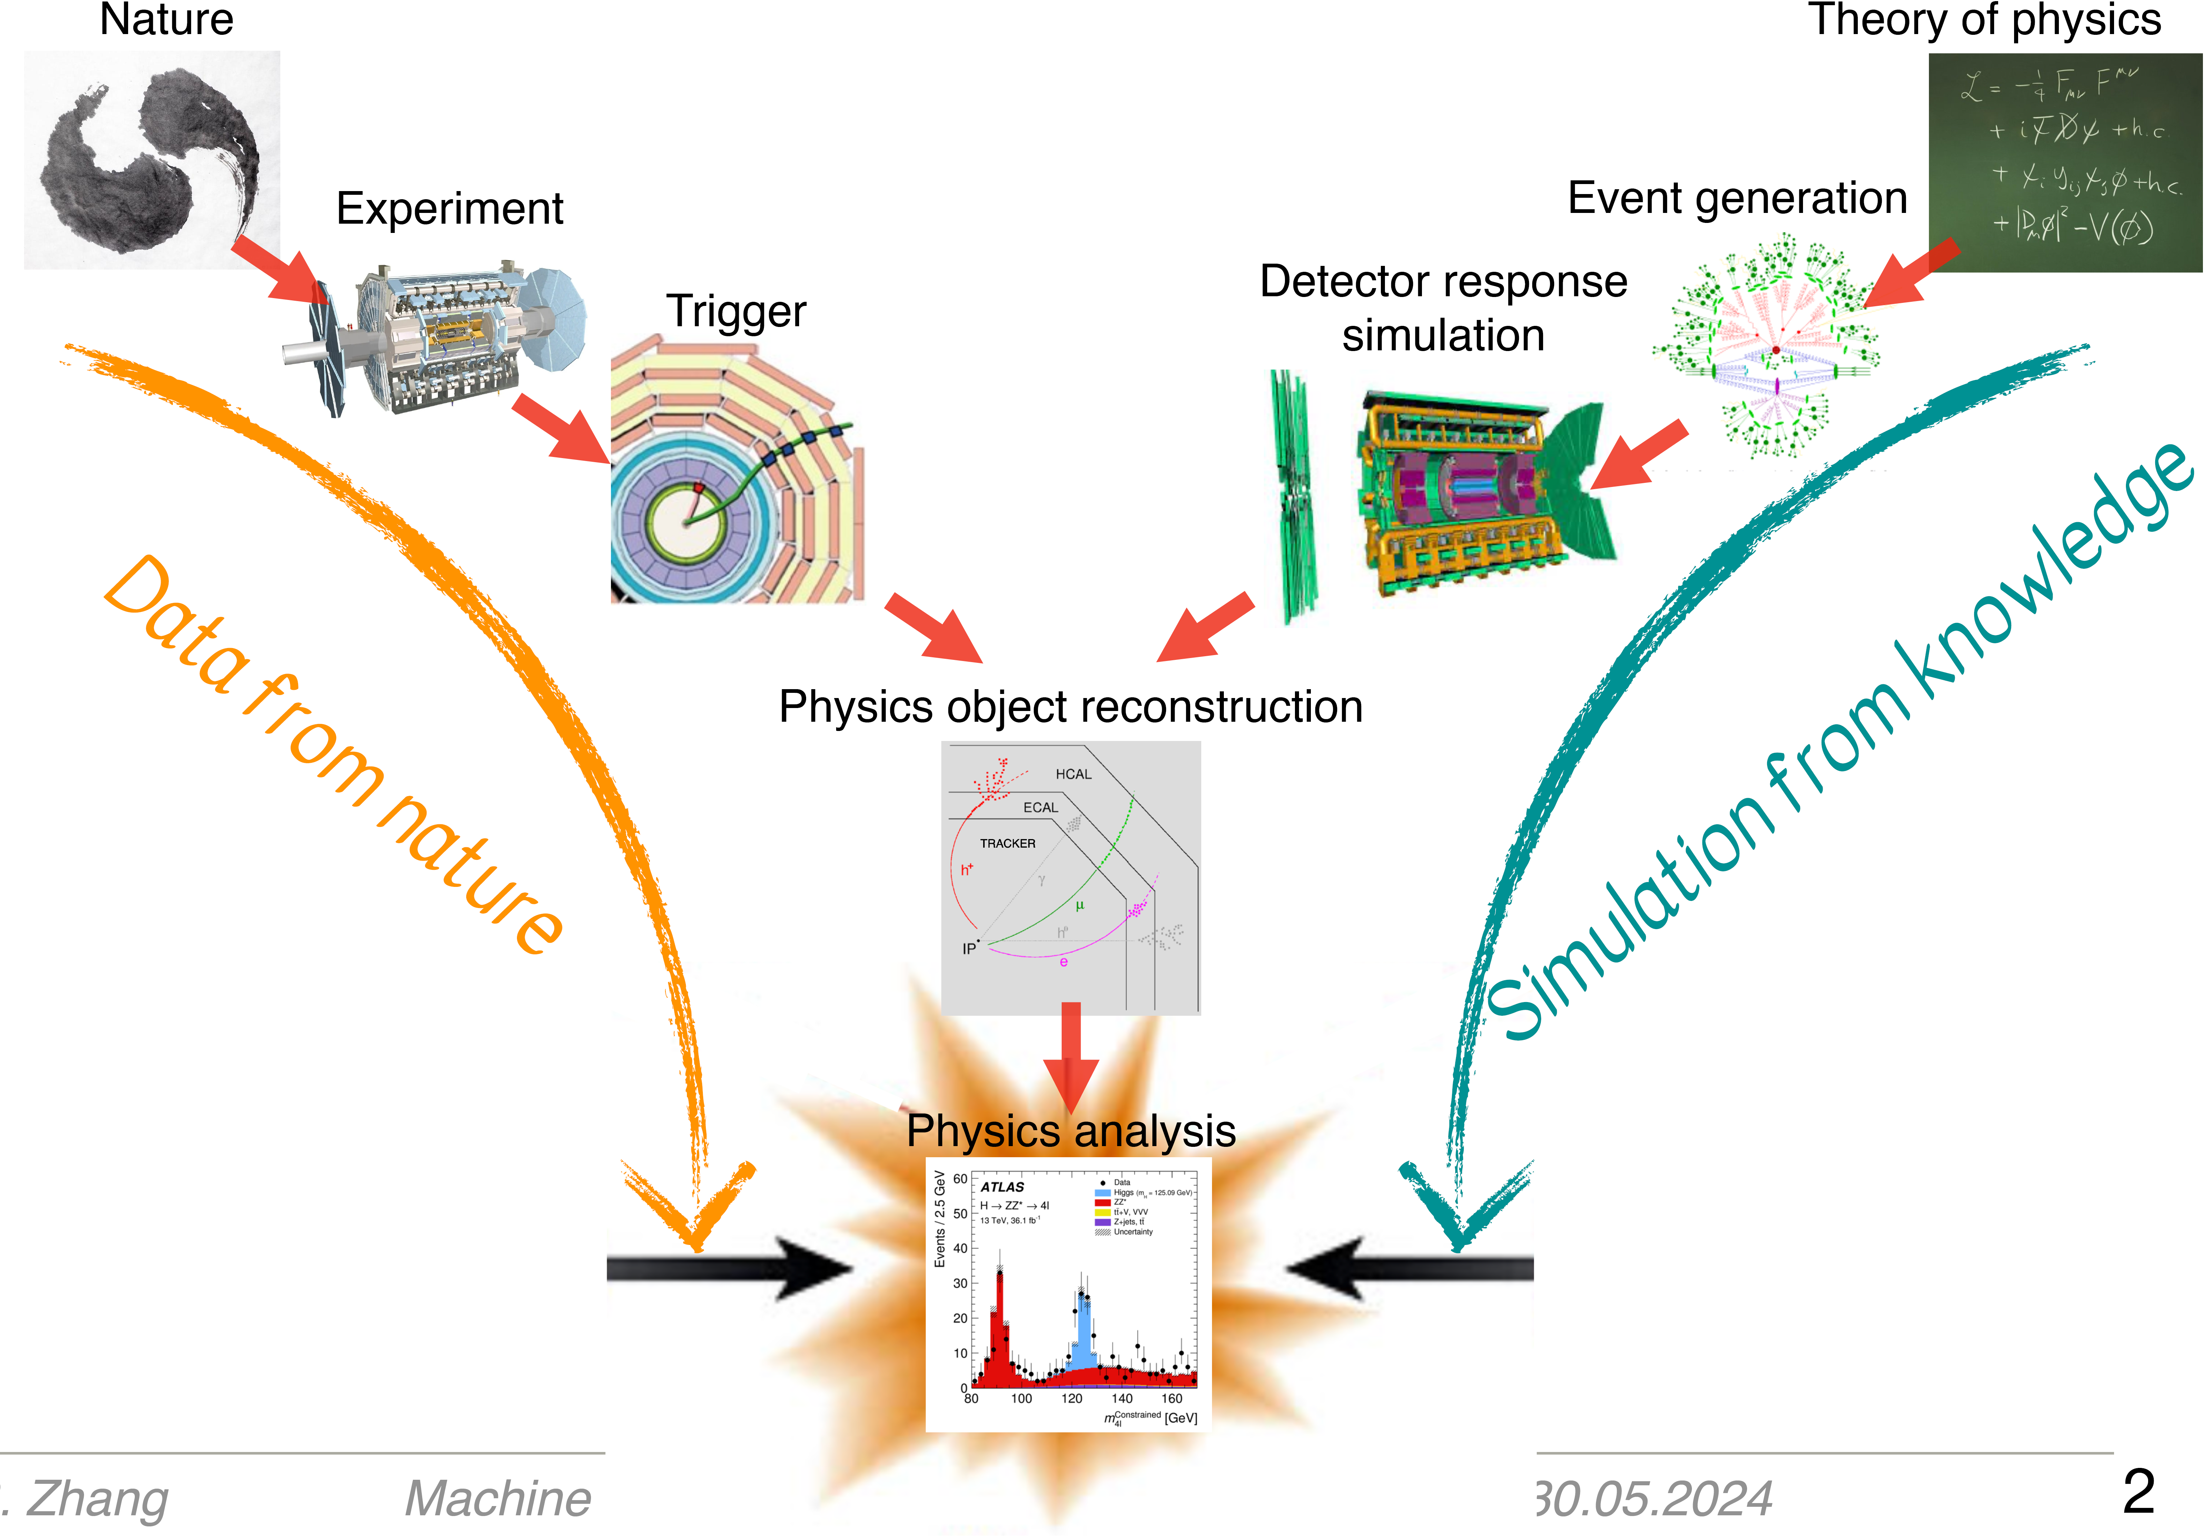
Machine learning in HEP

Slide 3
Why do we need ML in new physics study
Precision tests of the SM era
Very large data set
Rare processes with many final state particles
Many SMEFT operators

Slide 4
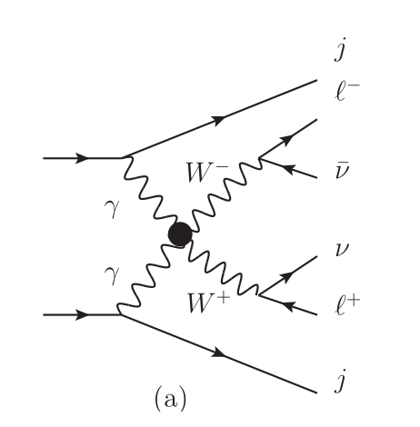
Data set: SMEFT and Monte Carlo
SMEFT: All possible operators, only SM fields
What is the results of MC? Events!
MadGraph $→$ Pythia $→$ Delphes $→$ Events ( root , lhco )
18 variables
Four-vectors of 4 particles +
x,y direction of neutrino momentum
= $V_{0}$, $V_{1}$，…，$V_{17}$

Slide 5
ML Tool: MLAnalysis
Guo, Yang, et al. Comput.Phys.Commun. 294 (2024) 108957
Now we have events. They are LHE/LHCO files
Data preparation (Data cleaning & Standardization)
Export to csv file (convert it to a data set for ML)
Do some ML algorithms
MLAnalysis
https://github.com/NBAlexis/MLAnalysis
latest codes
https://github.com/NBAlexis/CutExperiment

Slide 6
Code example for Data preparation

Slide 7
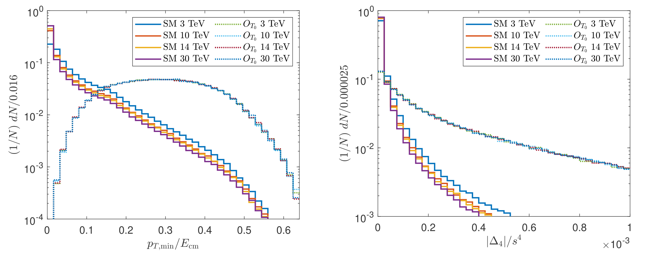
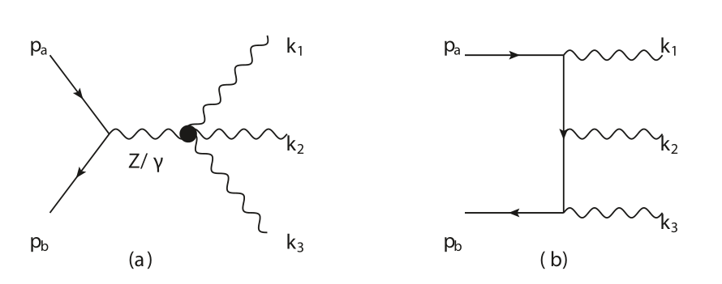
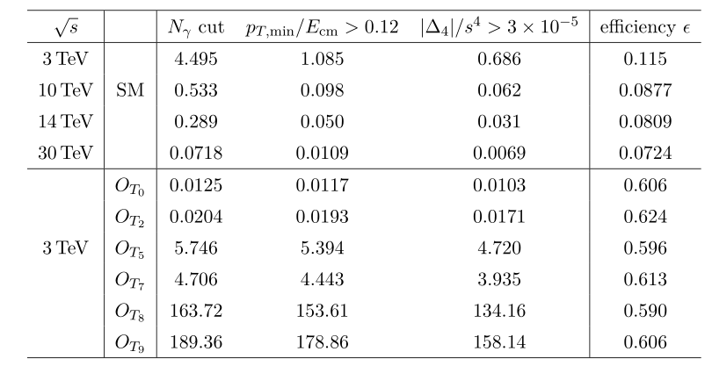
Traditional analysis for aQGCs
aQGC in the μ⁺ μ⁻→𝛾𝛾𝛾 process
Yang, Qin, Han, Guo & Li, JHEP 07(2022)053
aQGC
(signal)
(background)

Slide 8
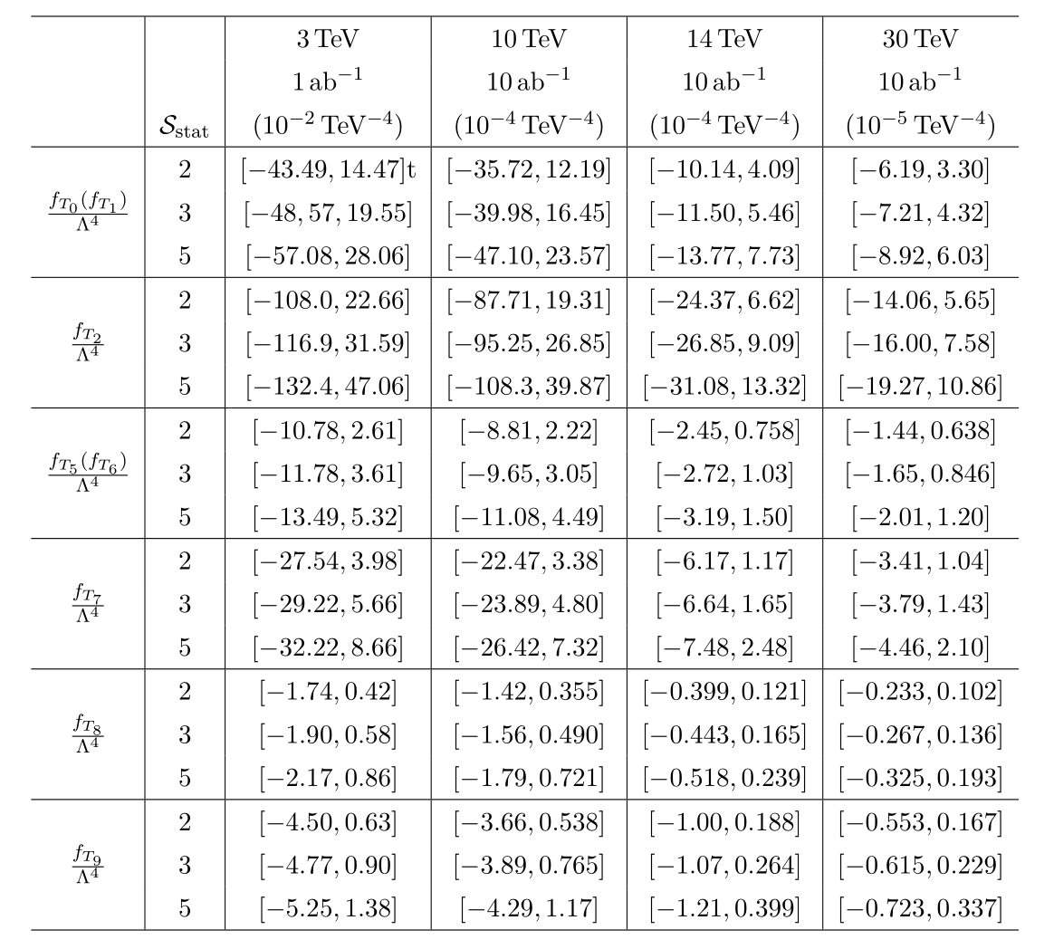
Traditional analysis for aQGCs
Take 14TeV T_{0,2} operators as an example

Slide 9
ML example on event selection strategy
K-Means
Principal Component Analysis (PCA)
Support Vector Machine (SVM)
Isolation Forest (IF)
Nested Isolation Forest (NIF)
Local Outlier Factor (LOF)
K-Nearest Neighbor (KNN)

Slide 10
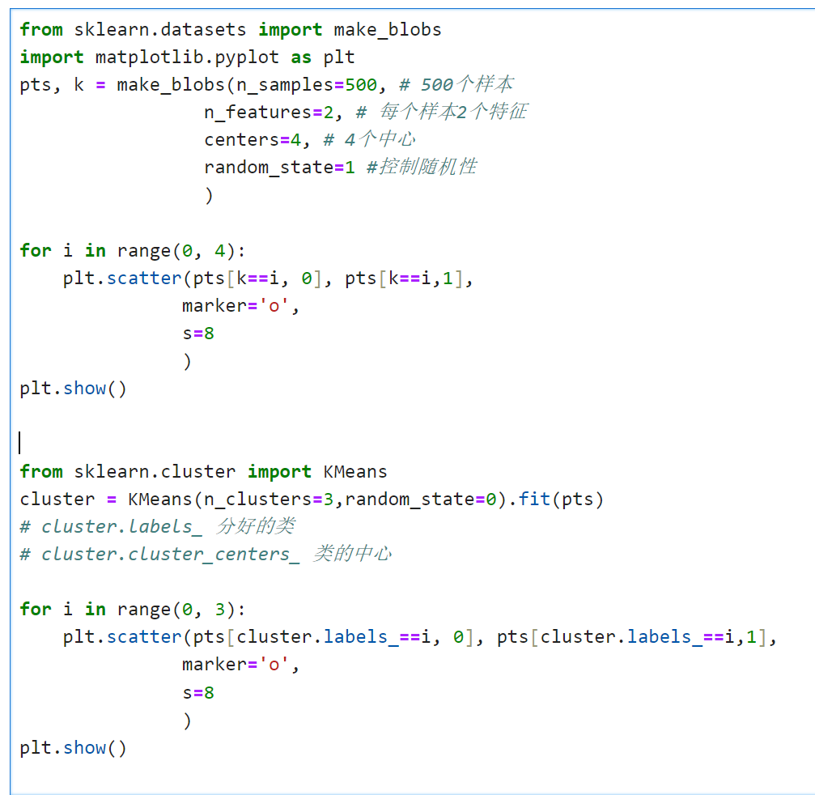
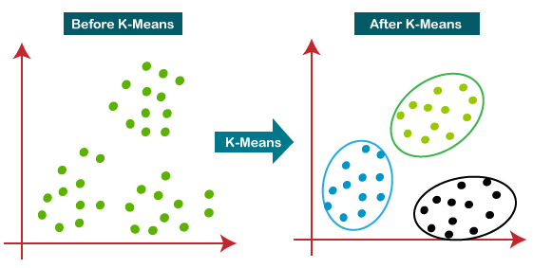
Clustering Algorithm: K-Means
Unsupervised Learning algorithm
The smaller the distance, the more similar

Slide 11
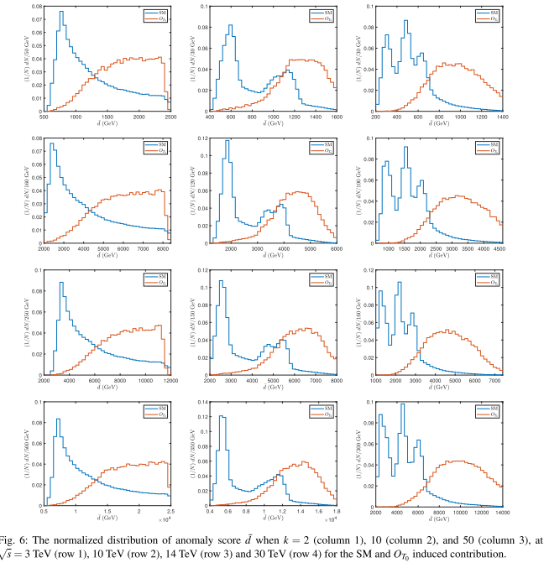
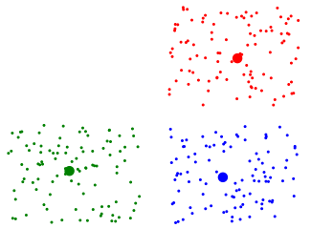
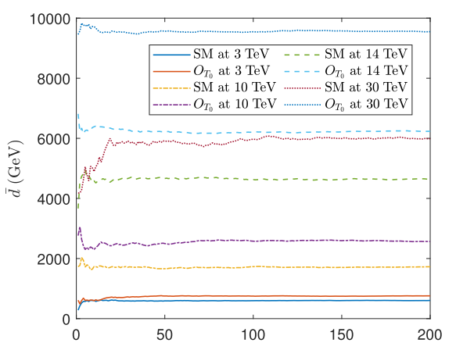
An example of K-Means
Zhang, Yang & Guo, EPJC (2024) 84:142
Use k-means Clustering
anomaly score d for aQGC
the number of k
Event Selection Strategy

Slide 12
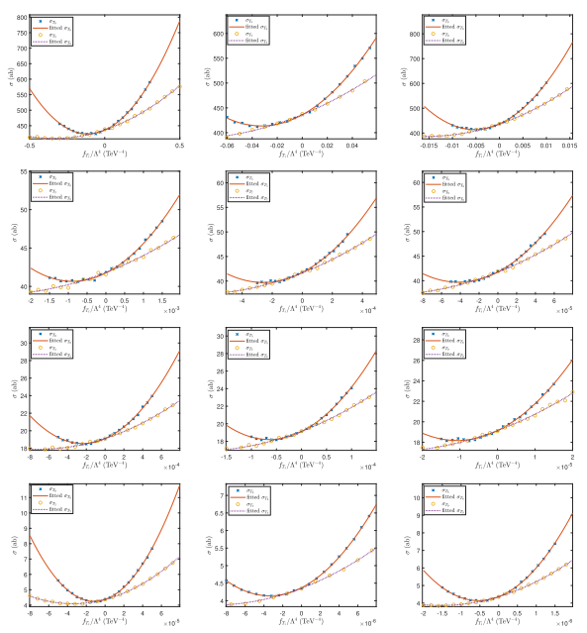
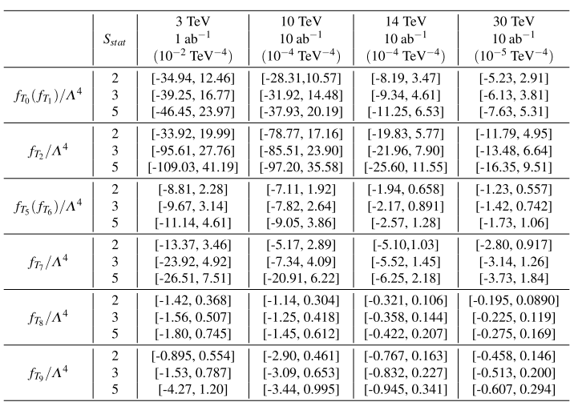
An example of K-Means

Slide 13
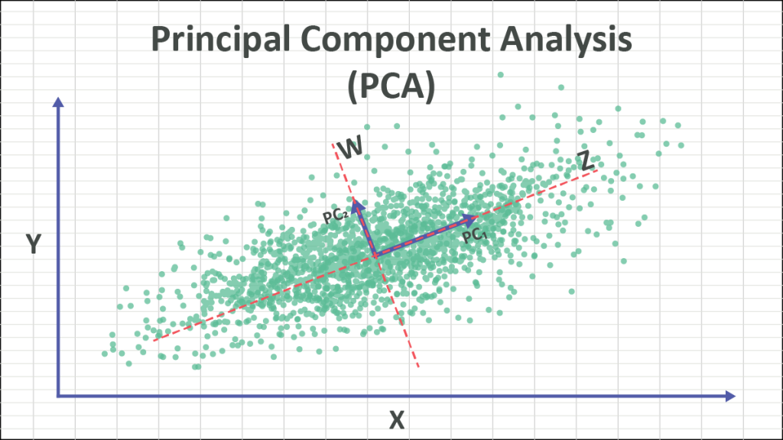
Principal Component Analysis (PCA)
PCA is a technique for dimensionality reduction.
PC capture the maximum variance in the data.

Slide 14
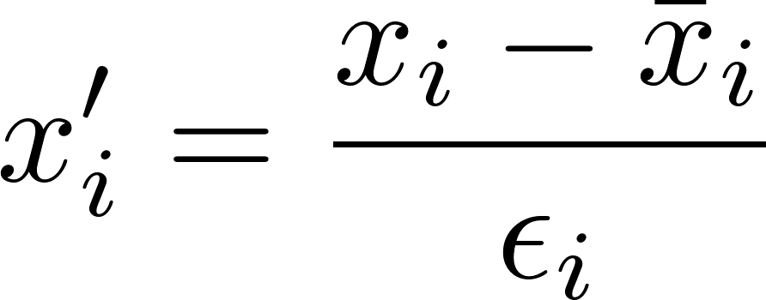
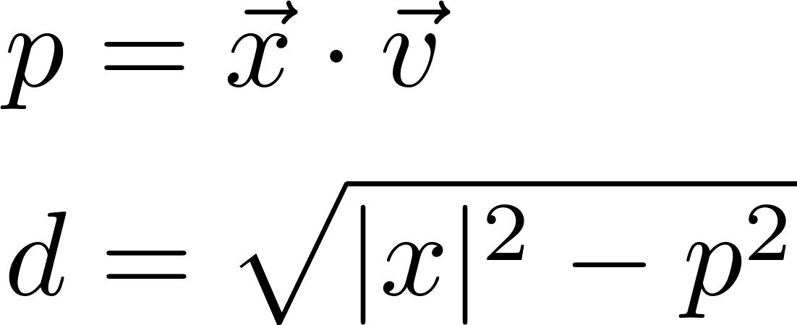
PCA AD
1. Data preparation: z-score standardization
2. Divide Data in Train and Test
3. Find the axis of principal component
(The eigen vector corresponds to the largest eigen value)
4. Calculate |x| and p, and then d
d : distance of a point to the axis of principal component of background

Slide 15
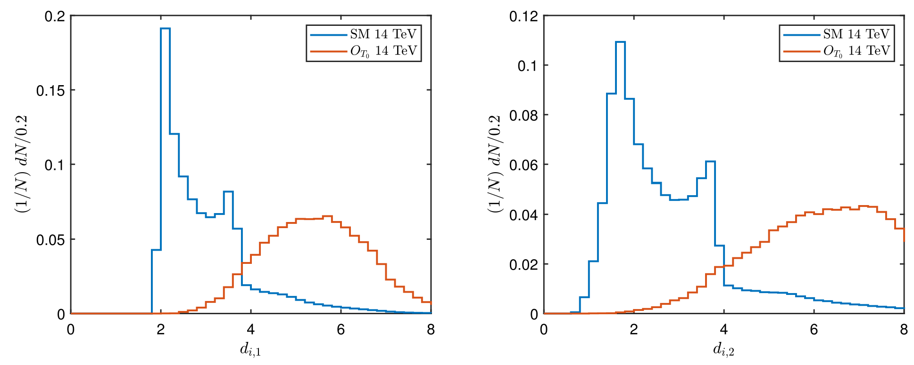
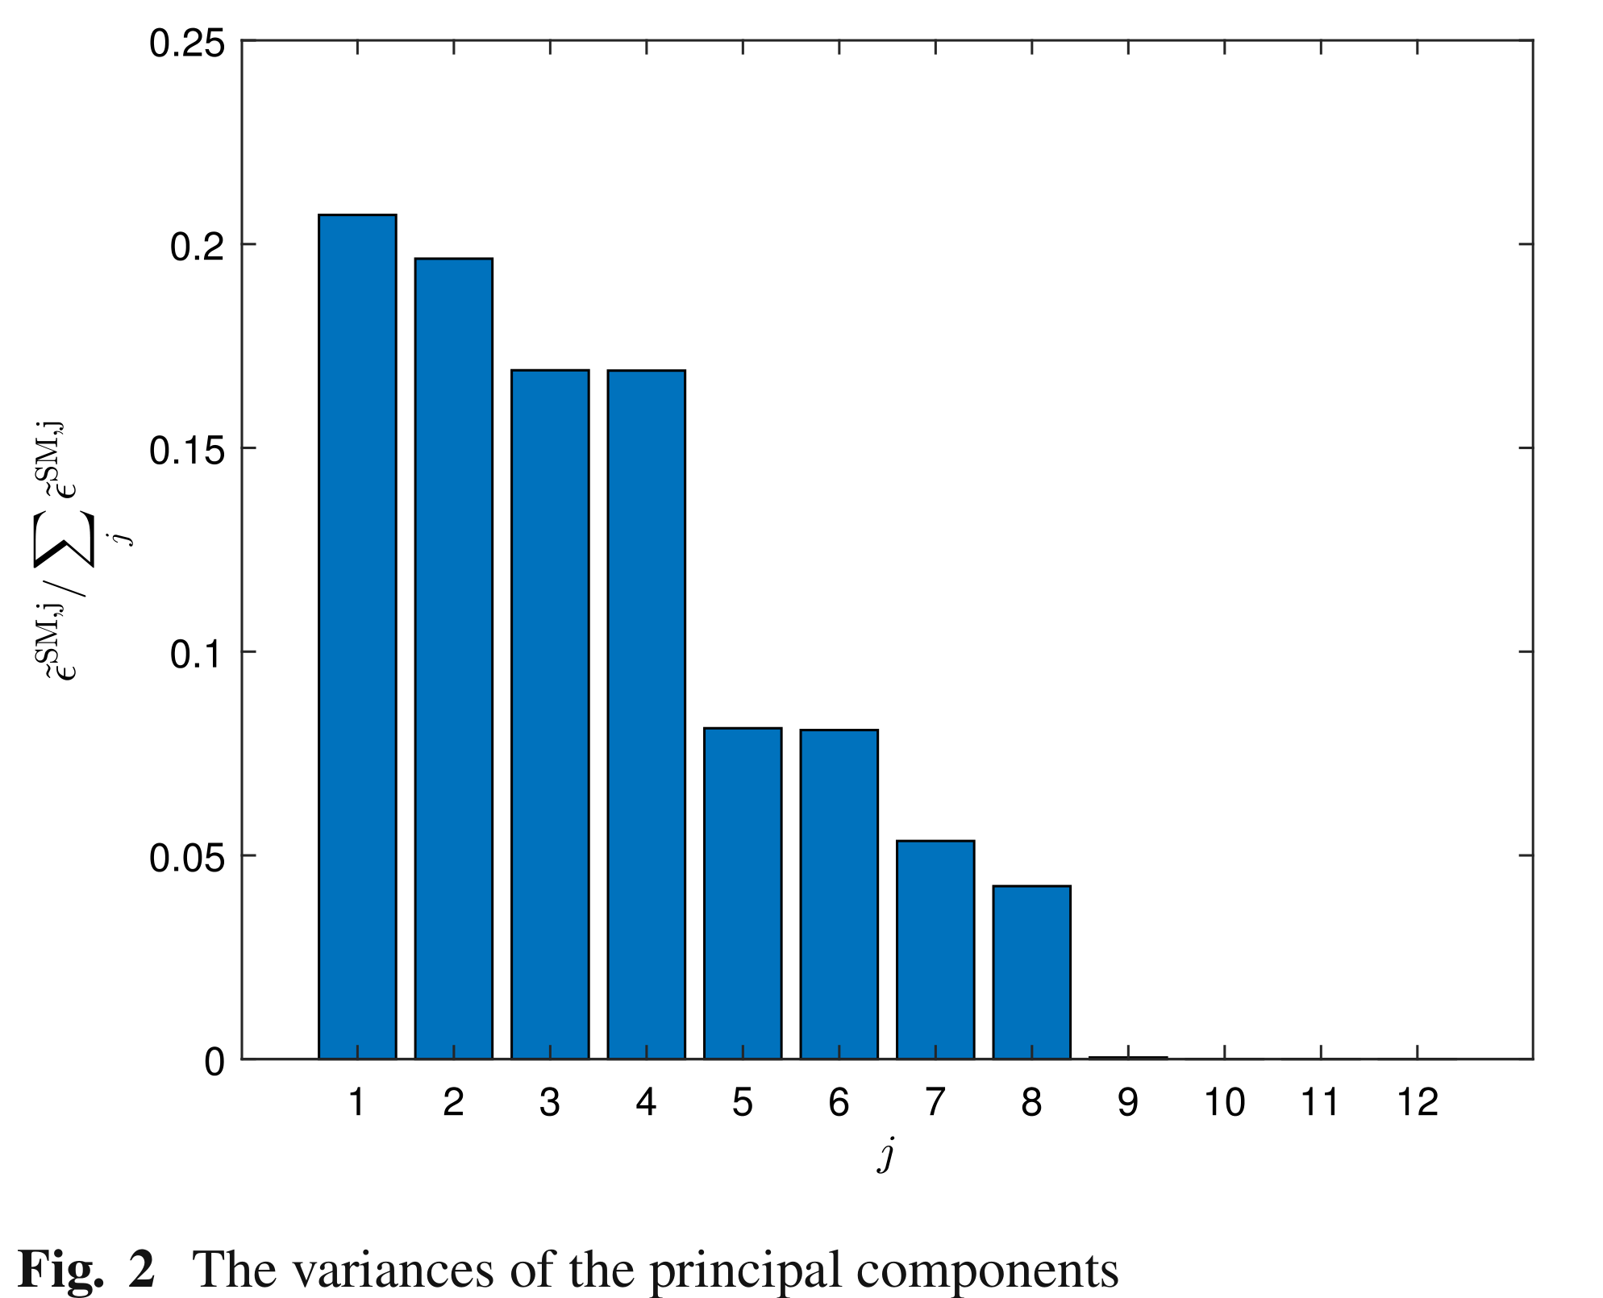
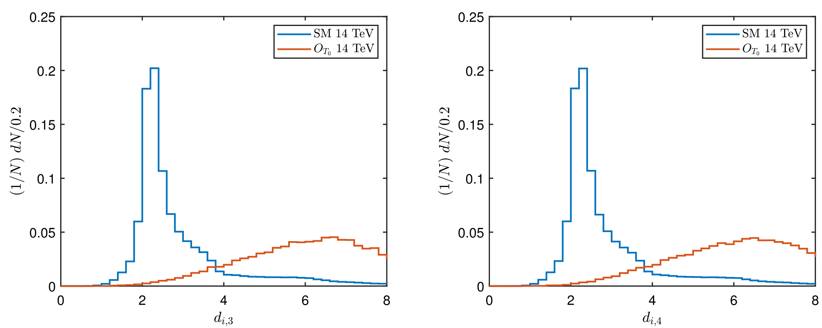
An example of PCA
Dong, Mao & Yang, EPJC (2024) 84:142

Slide 16
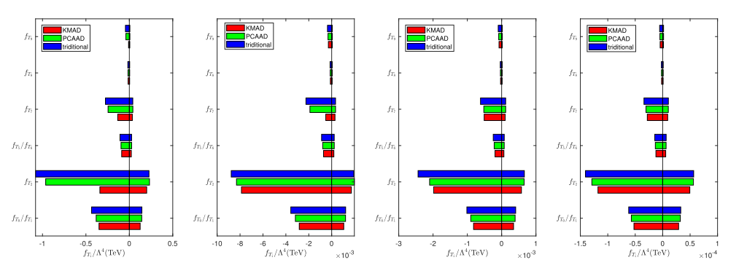
An example of PCA
$\sqrt{s}=3, 10, 14, 30$TeV，constraints on the operator coefficients by “KMAD”、“PCAAD” and “traditional”

Slide 17
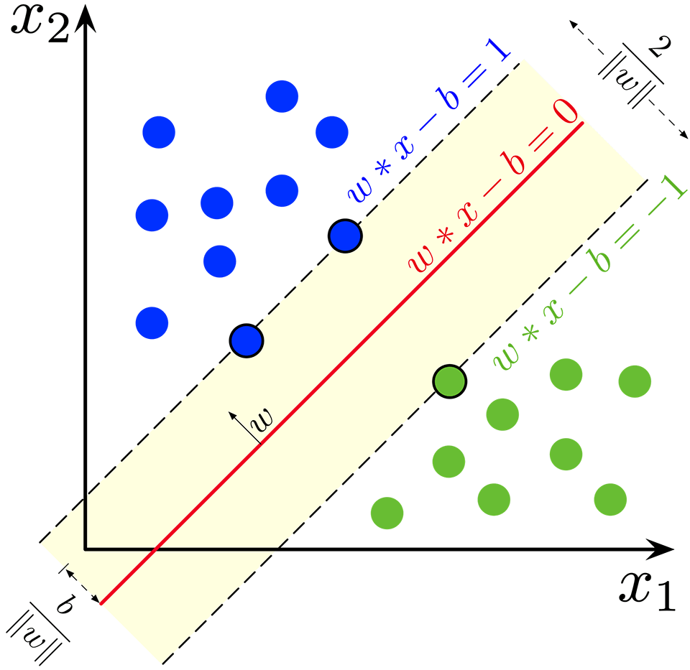
Support Vector Machine (SVM)
SVM: a generalized linear classifier for binary classification base on supervised learning.
Basic idea: classify the data by solving the maximum margin hyperplane.

Slide 18
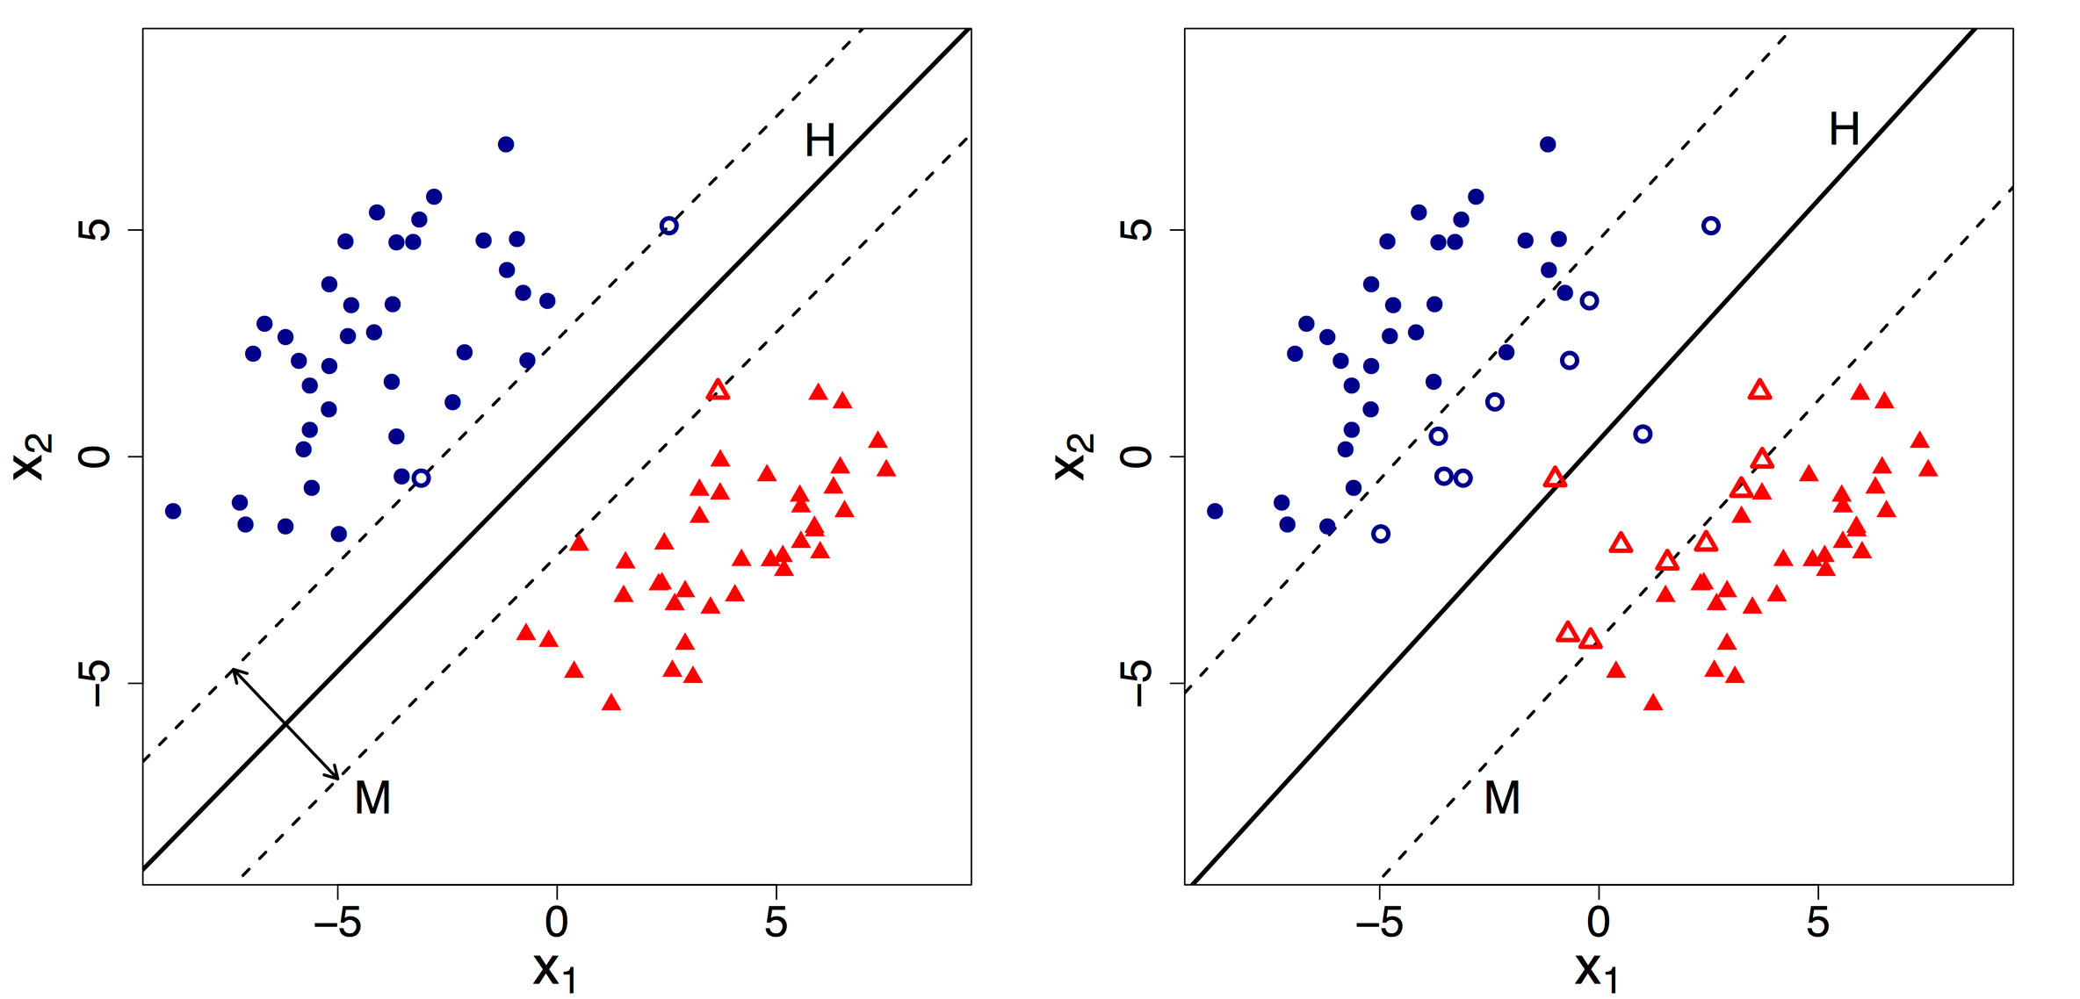
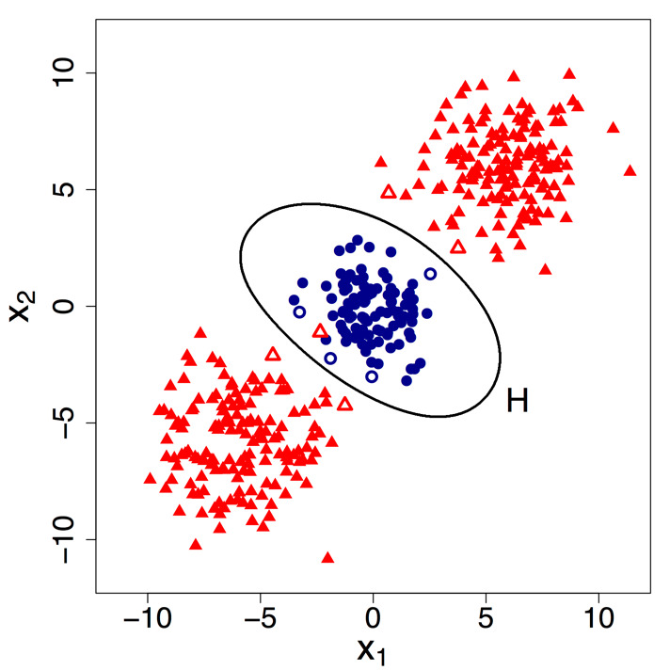
Support Vector Machine (SVM)
An SVM as a boundary setter, support vectors influence the placement of the boundary
linearly separable (Hard Margin)
Linear separable (Soft Margin)
Nonlinear SVM classification
H is the classification hyperplane and M is maximal margin, are Support vectors.

Slide 19
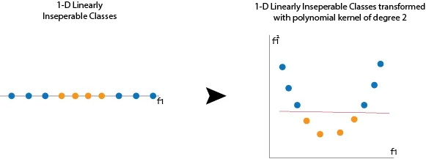
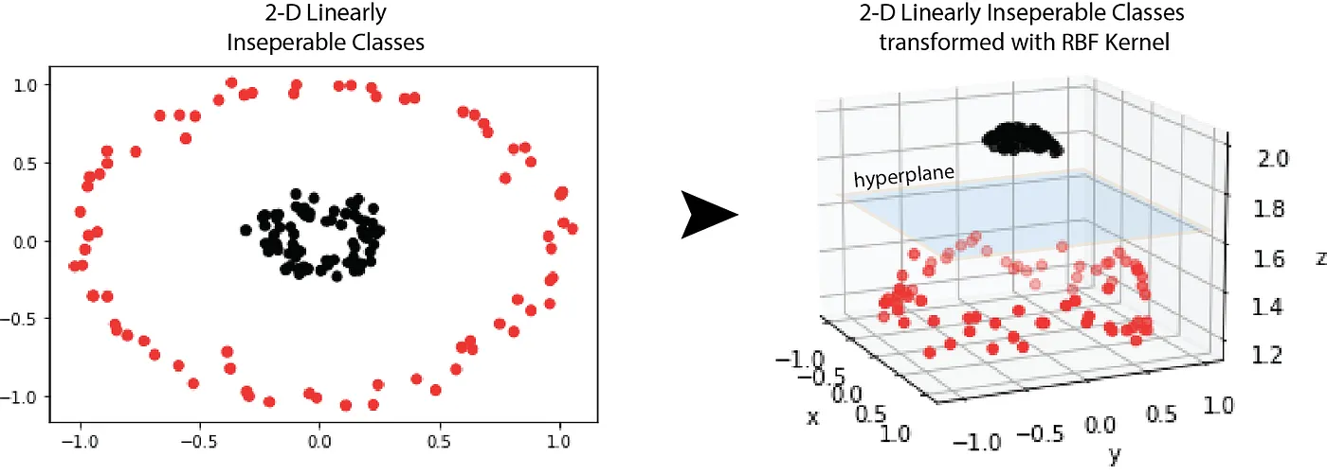
Support Vector Machine (SVM)
What happens if the sample data is nonlinear?
Make the nonlinear data linearly separable
Solution:
By selecting a Kernel function, low-dimensional nonlinear data is mapped to a high-dimensional space
construct the optimal classification hyperplane

Slide 20
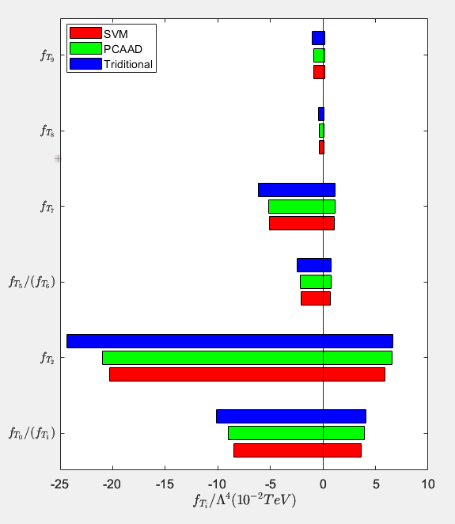
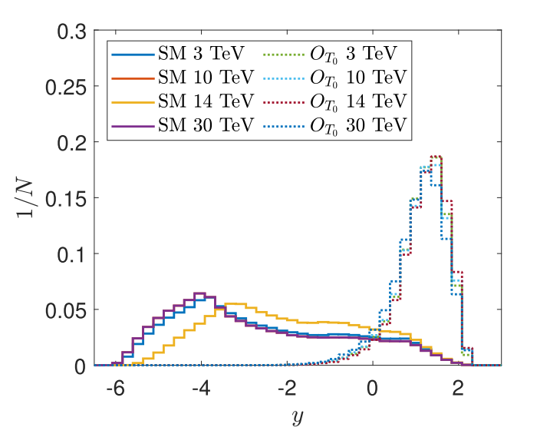
An example of SVM
Zhang, Guo & Yang, arXiv: 2311.15280
$${\sum_{i}{W_{i}\left(p_{i}−\overline{p_{i}}\right)}}/{d_{i}}+b_{th}>y_{th}$$

Slide 21
Anomaly detection
Why anomaly detection?
Typical Searches
Anomaly Detection
Model agnostic/ independent search
Looking for deviations from background only
Less sensitive to any specific model, but can look for multiple different models
Looking for a specific, physics motivated signal
Maximum sensitivity for a specific model
Not very useful for other signal models

Slide 22
Two types of anomaly detection
Outlier Detection
Searching for unique or unexpected events
In HEP, this is the tails of distributions or uncovered phase space
[1807.10261, 1808.08979, 1808.08992, 1811.10276, 1903.02032, 1912.10625, 2004.09360, 2006.05432, 2007.01850, 2007.15830, 2010.07940, 2102.08390, 2104.09051, 2105.07988, 2105.10427, 2105.09274, 2106.10164, 2108,03986, 2109.10919, 2110.06948, 2112.04958, 2203.01343,2206.14225, 2303.14134, 2304.03836, 2306.03637, 2308.02671, 2309.10157, 2309.13111, ... ]
Overdensity detection
Analogous to the traditional bump hunting
[1805.02664, 1806.02350, 1902.02634, 1912.12155, 2001.05001, 2001.04990, 2012.11638, 2106.10164, 2109.00546, 2202.00686, 2203.09470, 2208.05484, 2210.14924, 2212.11285, 2305.04646, 2305.15179, 2306.03933, 2307.11157, 2309.12918, 2310.06897, 2310.13057, ....]

Slide 23
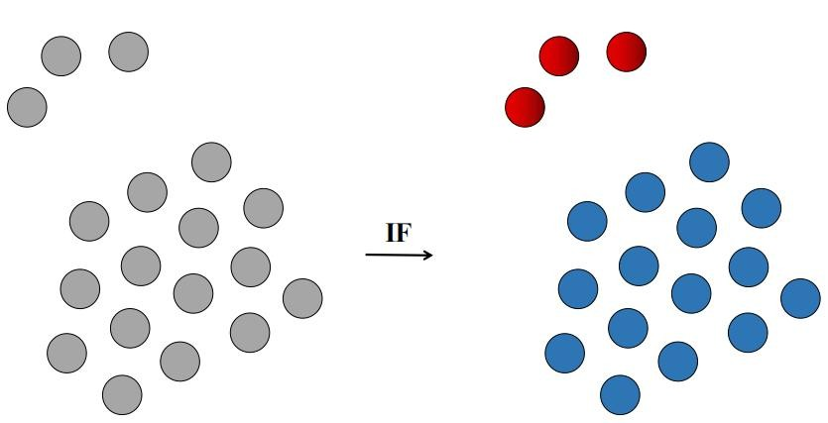
Isolation Forest (IF)
IF ：anomaly “few and different”
Define anomaly score to quantify the distance between the data point and the center point
New physics
Dim-2 data for example，NP and SM background

Slide 24
Isolation tree
Randomly choose a undivided leaf
Randomly choose a dimension
Divide

Slide 25
anomaly points are easier to isolate
0
01
0
01
01
01
01
0
0
00
0
00
00
00
00
0
1
10
10
100
100
10
100
100
1
10
10
10
101
1010
1
110
1010
110
10100
110
110
1101
1101
11
1
110
110
110
110
11
1100
1100
1
10
10
10
101
1011
1011
1011
1
111
111
111
111
111
111
1
11
10
10
10
10101
101
1010
1010

Slide 26
Tree -> Forest
Isolation tree:
Isolation forest:

Slide 27
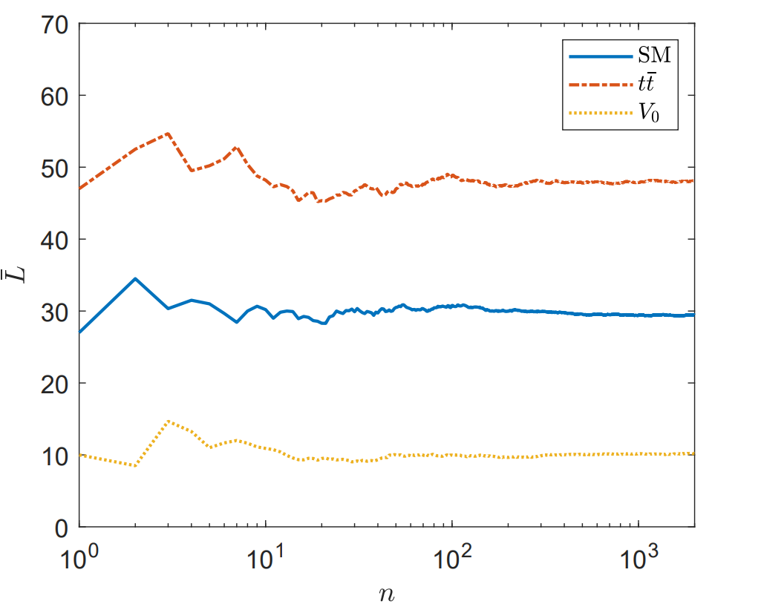
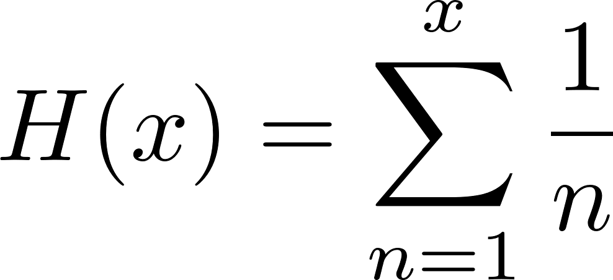
An example of IF
For exclusive γγ W⁺W⁻ VBS processes
Jiang, Yang, Guo, Phys. Rev. D 104, 035021 (2021)
The effect of IF depends on the number of events, it works only when the number of anomalous points is very small
Calculate anomaly score using average depth
$a=2^{−\frac{\overline{L}}{c\left(N\right)}}$ ，with $c\left(N\right)=2H\left(N−1\right)−\frac{2\left(N−1\right)}{N}$
Average depth depends on the number of events of the whole data set.
Anomaly score is some “normalization” so that the result is independent of the number of events of the whole data set

Slide 28
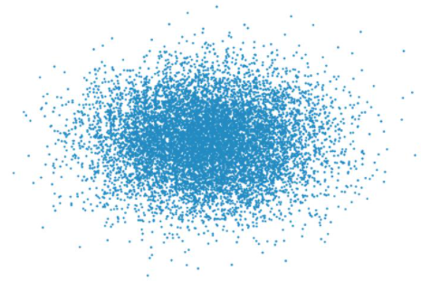
Advantage of IF:
Transparency: only quantify“anomaly”
Model-independent and Operator-independent
Disadvantage:
How about signal events are rare but NOT very different from SM?
For example, when the Wilson coefficient is very small,
the interference term becomes very important.

Slide 29
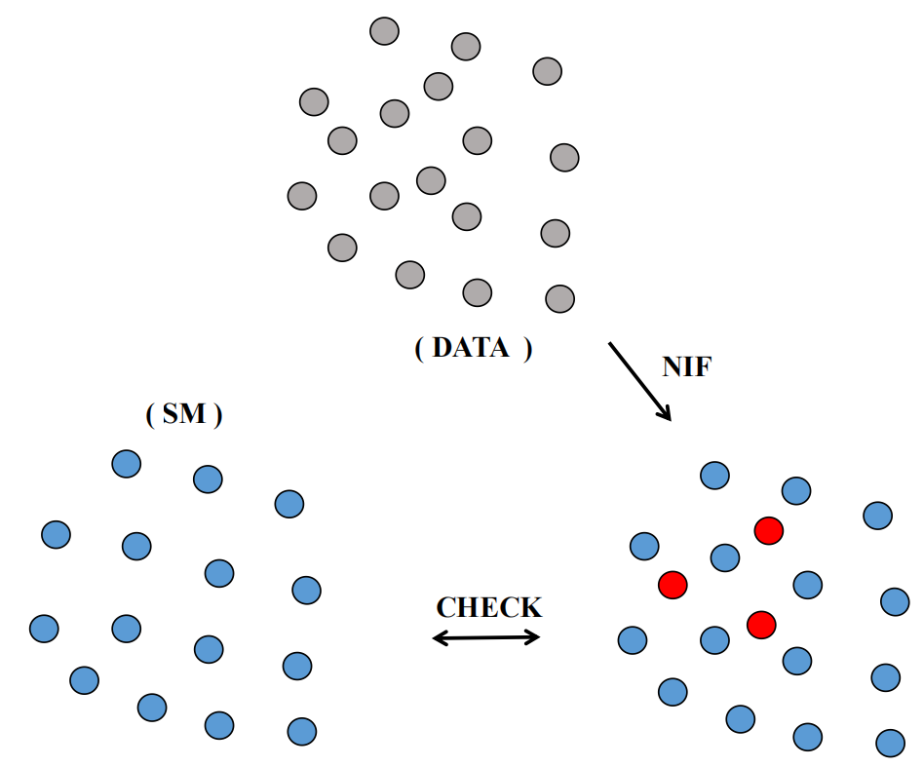
Nested IF (NIF)
Nested Isolation Forest（NIF）：
When interference effects of new physics and the SM dominate
Training Dataset: use MC data of SM to establish a reference value for the anomaly score distribution.
Value of anomaly score change：

Slide 30
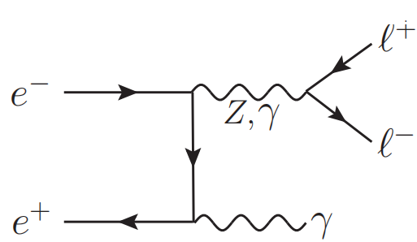
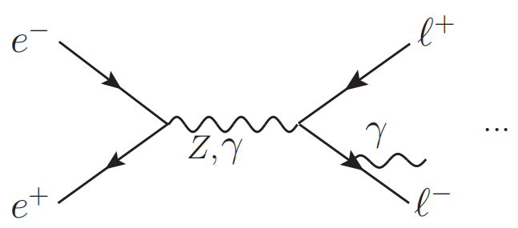
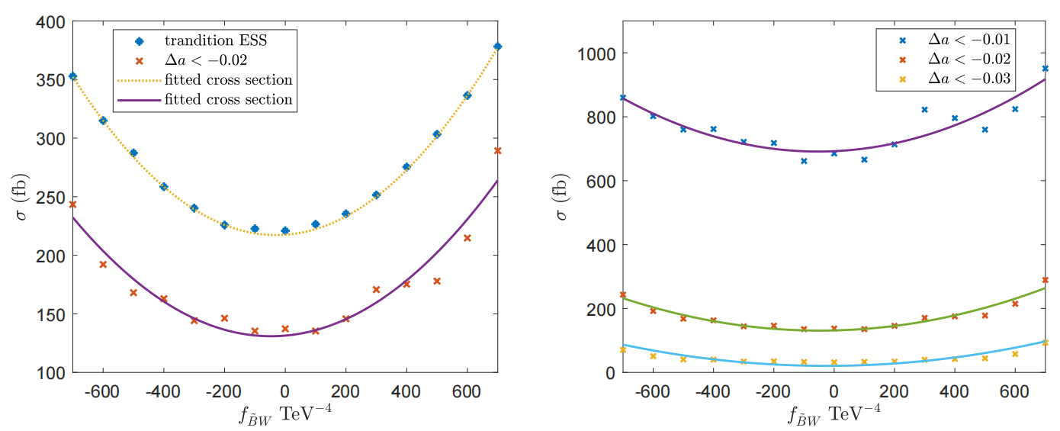
An example of NIF
nTGC in the 𝑒⁺ 𝑒⁻→ 𝑍𝛾 process
Yang, Guo, Nucl. Phys. B 977 (2022) 115735
NP signal:
SM background:

Slide 31
Summary
Search for new physics indirectly as well as directly.
ML serves as a valuable assistant, continues to unlock breakthroughs within the realm of HEP
MLAnalysis (arxiv: 2305.00964 ) can help users apply ML in HEP research
Thank you !

