Slide 1
Distilling circularly polarized photon emission from magnetized chiral plasmas
Xinyang Wang
Center for Fundamental physics
Anhui University of Science and Technology

Slide 2
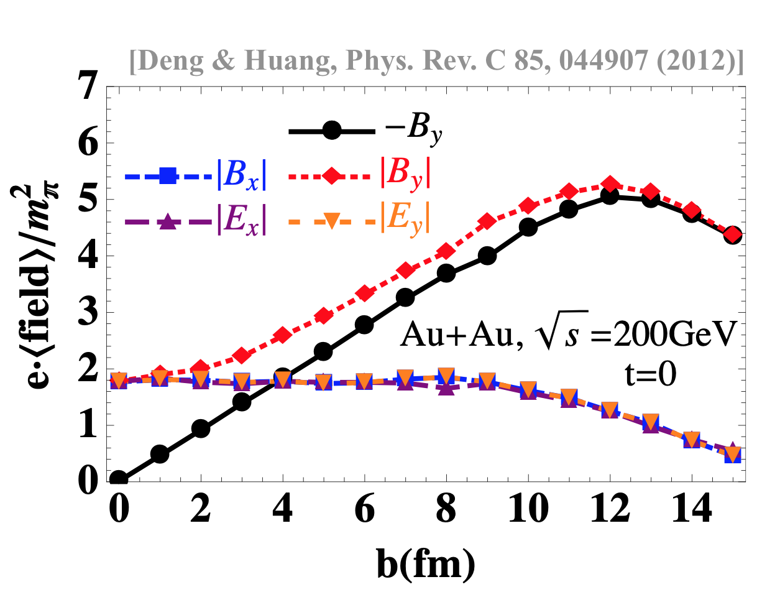
Magnetic field in Heavy-ion collisions
QGP produced at RHIC/LHC is magnetized
Using Lienard-Wiechert potential, one finds
z
z
B
y
+
v
+
+
v
+
y
x
[Rafelski & Müller, PRL, 36, 517 (1976)]
[Kharzeev et al., arXiv:0711.0950]
[Skokov et al., arXiv:0907.1396]
[Voronyuk et al., arXiv:1103.4239]
[Bzdak &. Skokov, arXiv:1111.1949]
[Deng & Huang, arXiv:1201.5108]
[Bloczynski et al, arXiv:1209.6594]
…

Slide 3

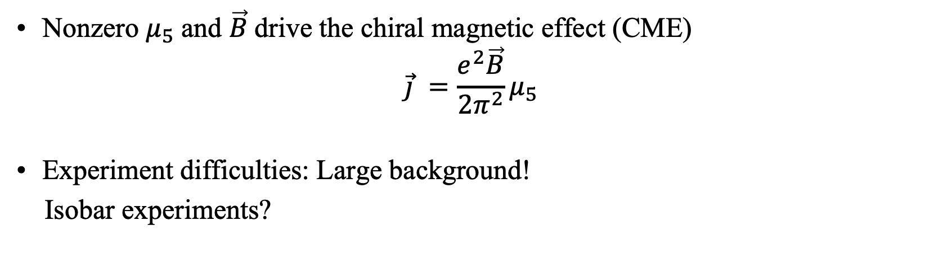
Magnetic field in HIC
Nonzero $μ_{5}$ and $\vec{B}$drive the chiral magnetic effect (CME)
$$\vec{j} =\frac{e^{2}\vec{B}}{2π^{2}}μ_{5}$$
Experiment difficulties: Large background!
Isobar experiments?
Any other possible idea?
[STAR Collaboration, 2014]
No positive official results now!

Slide 4
Photons in HIC
Photons is a Thermometer of QGP
Photons are emitted at all stages of evolution
Weak interacting with matter
https://u.osu.edu/vishnu/category/visualization/

Slide 5
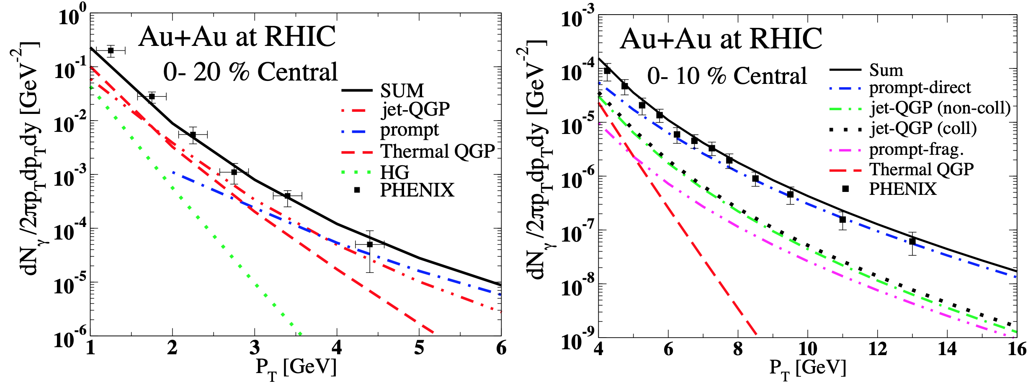
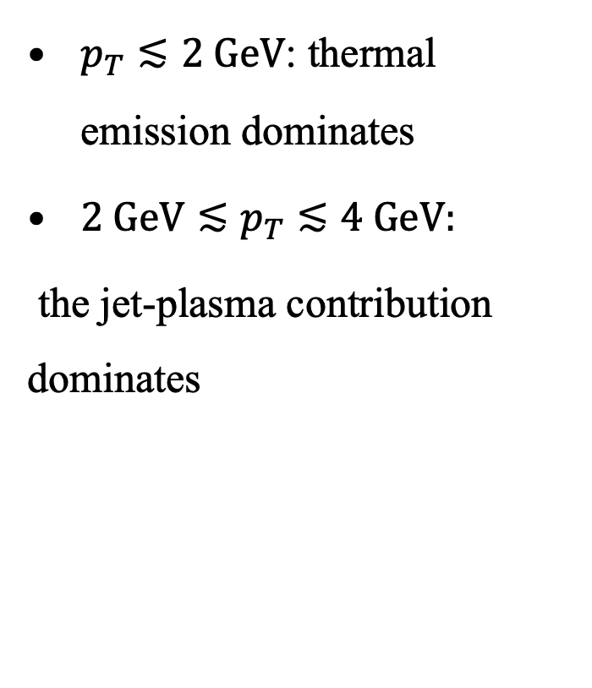
Photon sources in HIC
[Turbide et al,, Phys. Rev. , 2008]
$p_{T}≲2 GeV$: thermal emission dominates
${2 GeV≲p}_{T}≲4 GeV:$
the jet-plasma contribution dominates

Slide 6
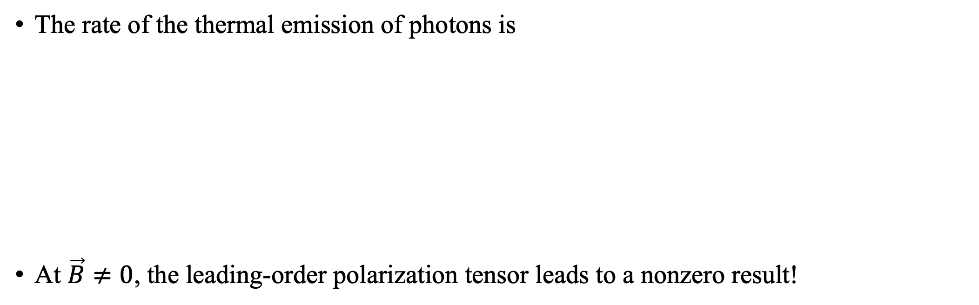


Thermal photons
The rate of the thermal emission of photons is
At $\vec{B}≠0$, the leading-order polarization tensor leads to a nonzero result!
$$✗$$
$$✓$$
$$✓$$

Slide 7
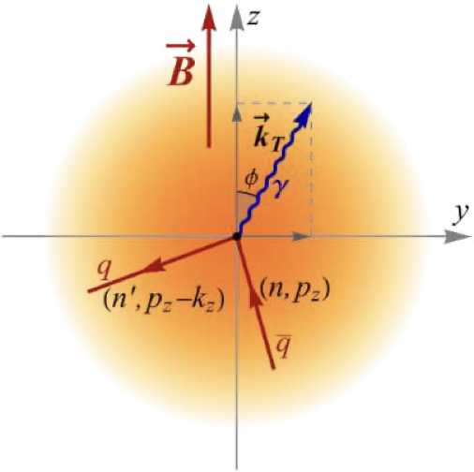

Photon thermal rate
The expression for the rate is
At $\vec{B}≠0$, the imaginary part is
[X.W., Igor Shovkovy, Lang Yu, Mei Huang, PRD, 2020]

Slide 8

The thermal photon production rate
  decreases with energy ($k_{T}$) at large $k_{T}$
  increases with temperature
  goes to zero when $k_{T}→0$ (quantization effects), has a peak at small nonzero $k_{T}$
  relatively large

Slide 9
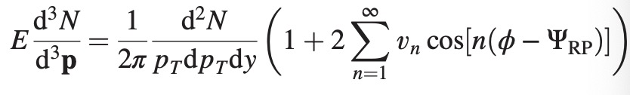
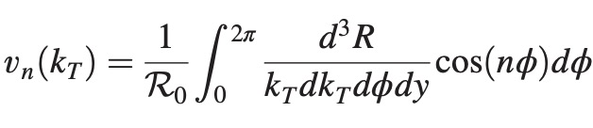
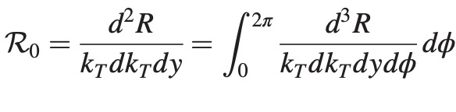
Nonzero elliptic “flow” ($v_{2}$)

Slide 10

Photon $v_{4 }and{ v}_{6}$
[X.W., Igor Shovkovy, PRD,2024]

Slide 11
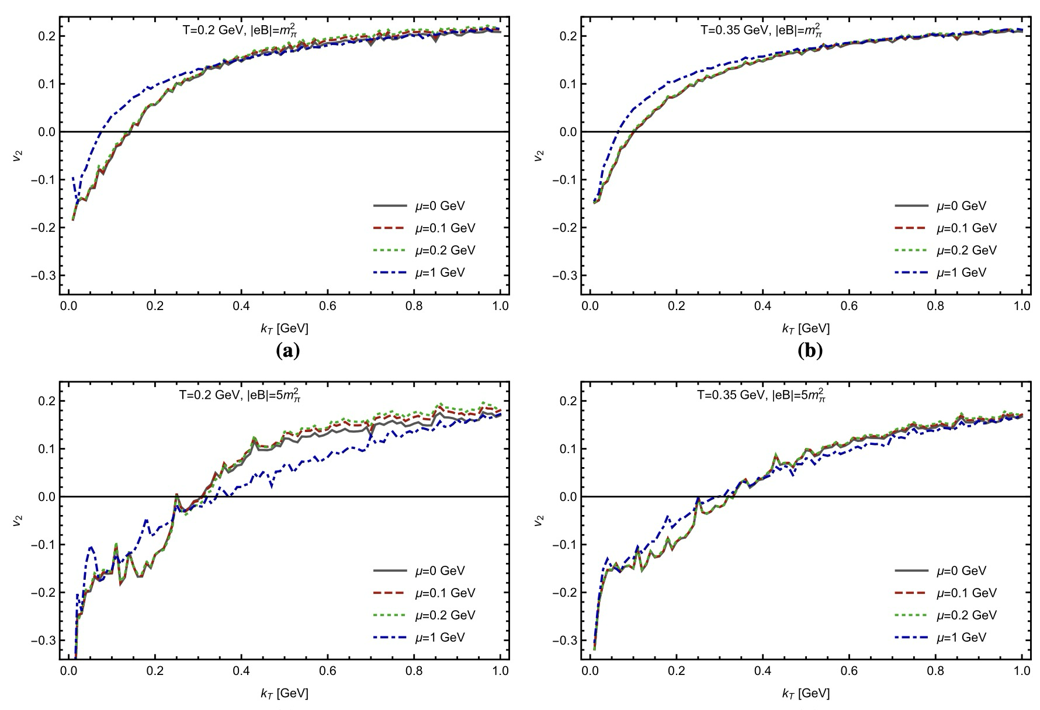
Finite chemical potential
[X.W., Igor Shovkovy, EPJC,2021]

Slide 12
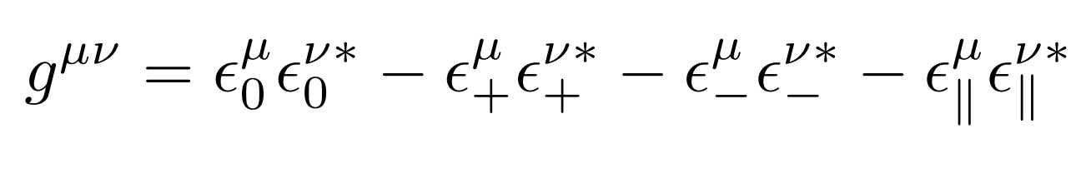
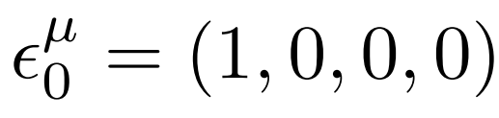
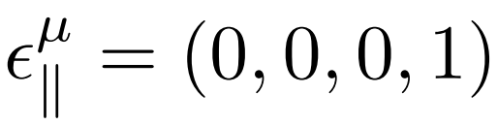
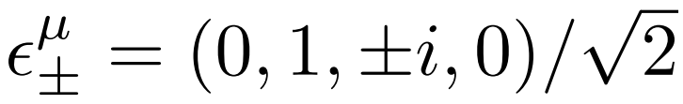
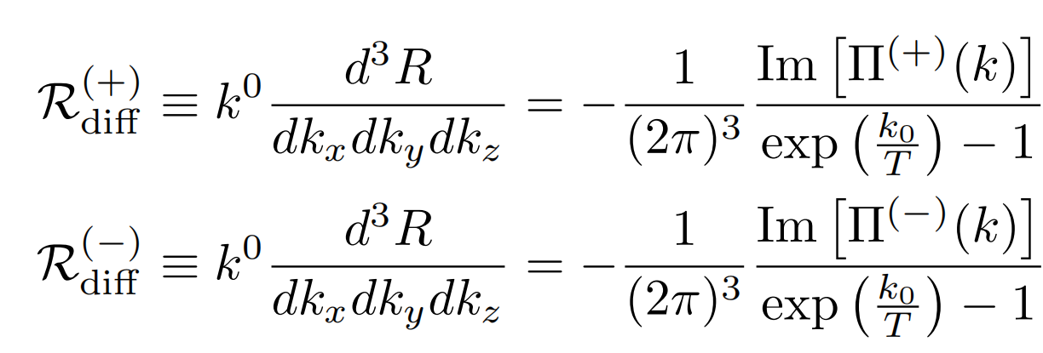
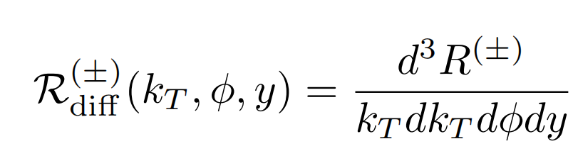
Polarization decomposition
[X.W., Igor Shovkovy, ArXiv:2407.06271]

Slide 13
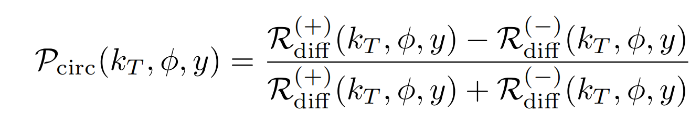
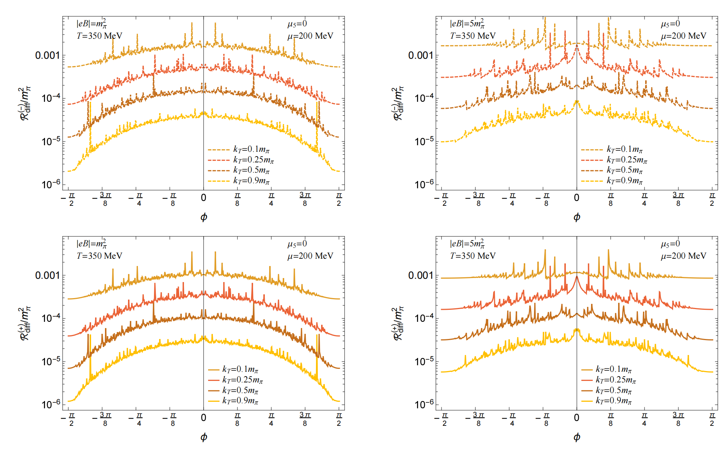
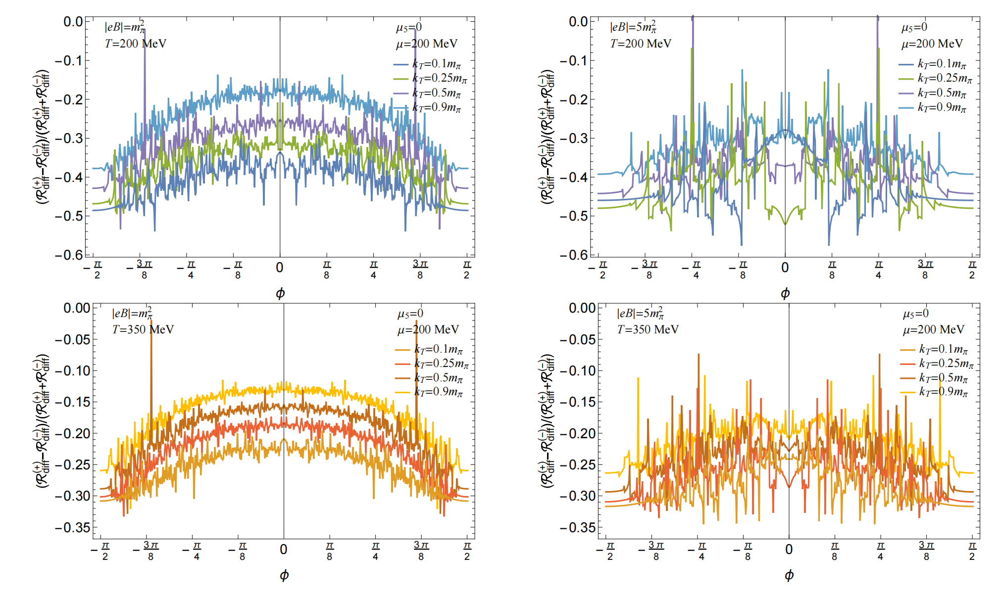
𝛍≠0

Slide 14
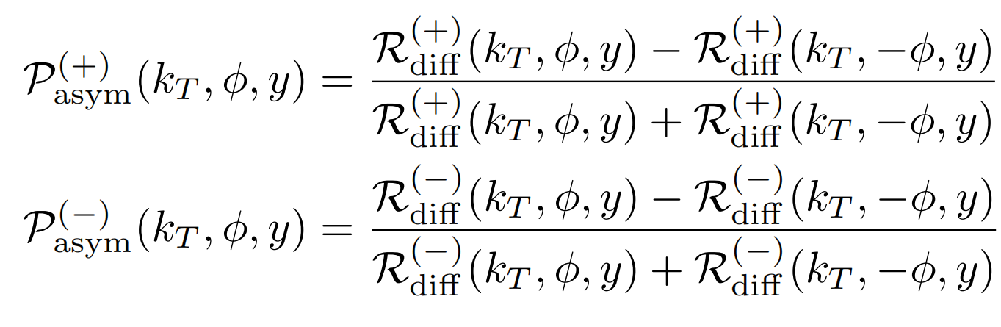
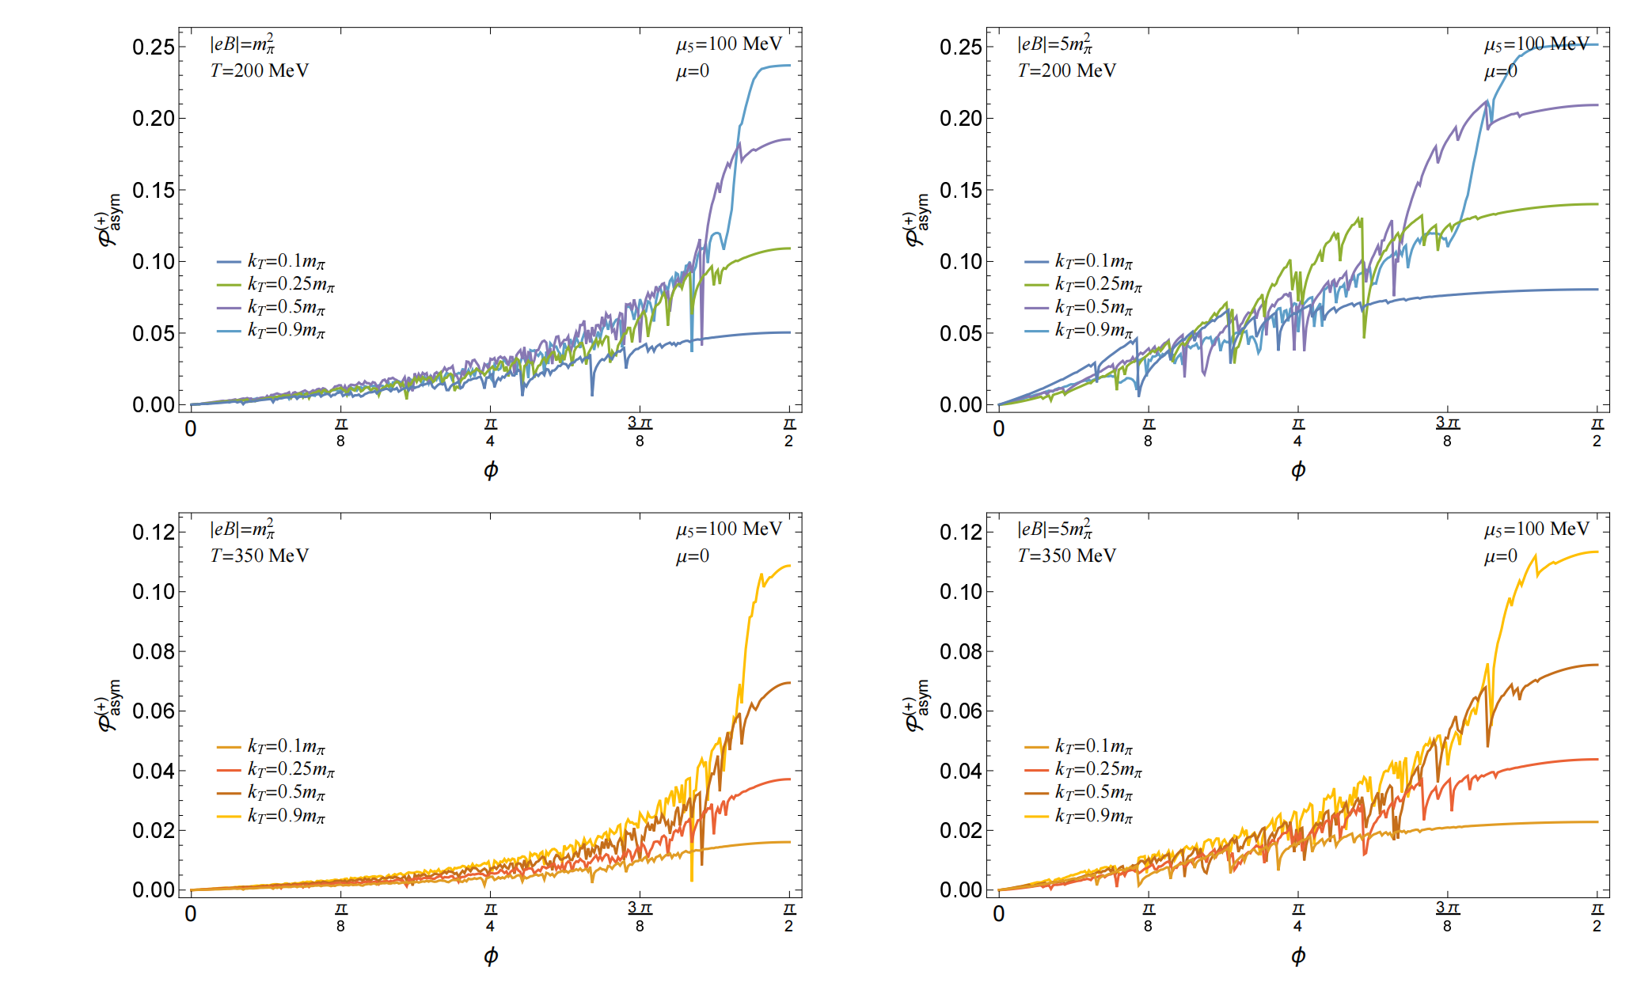
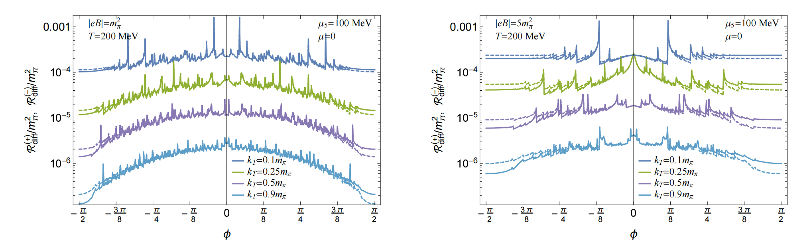
𝛍₅≠0

Slide 15
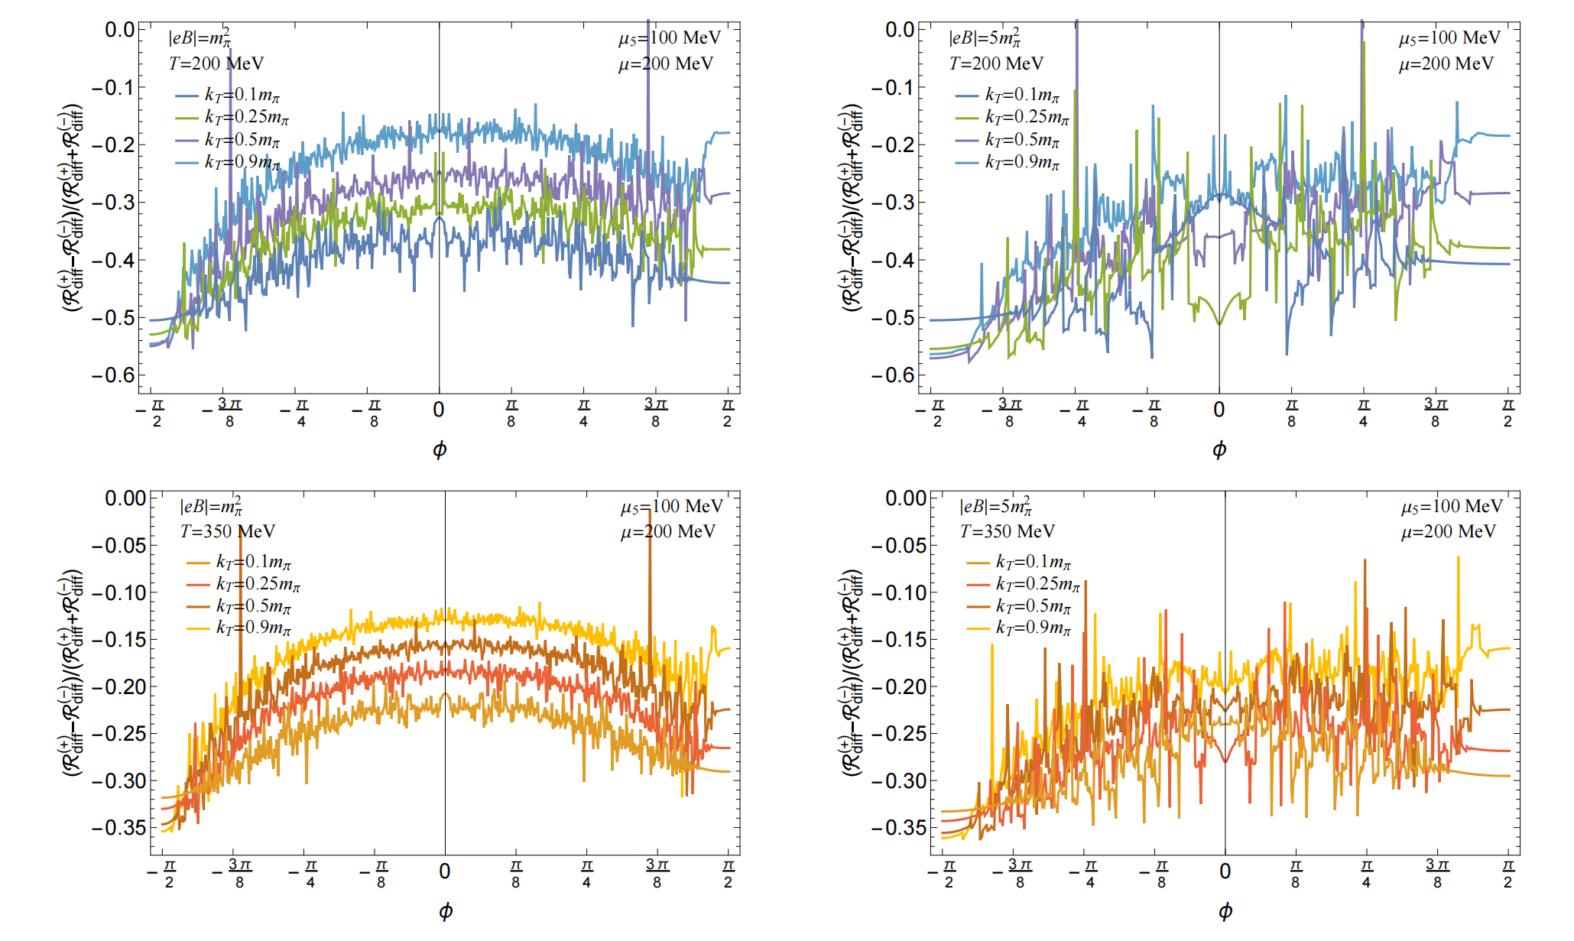
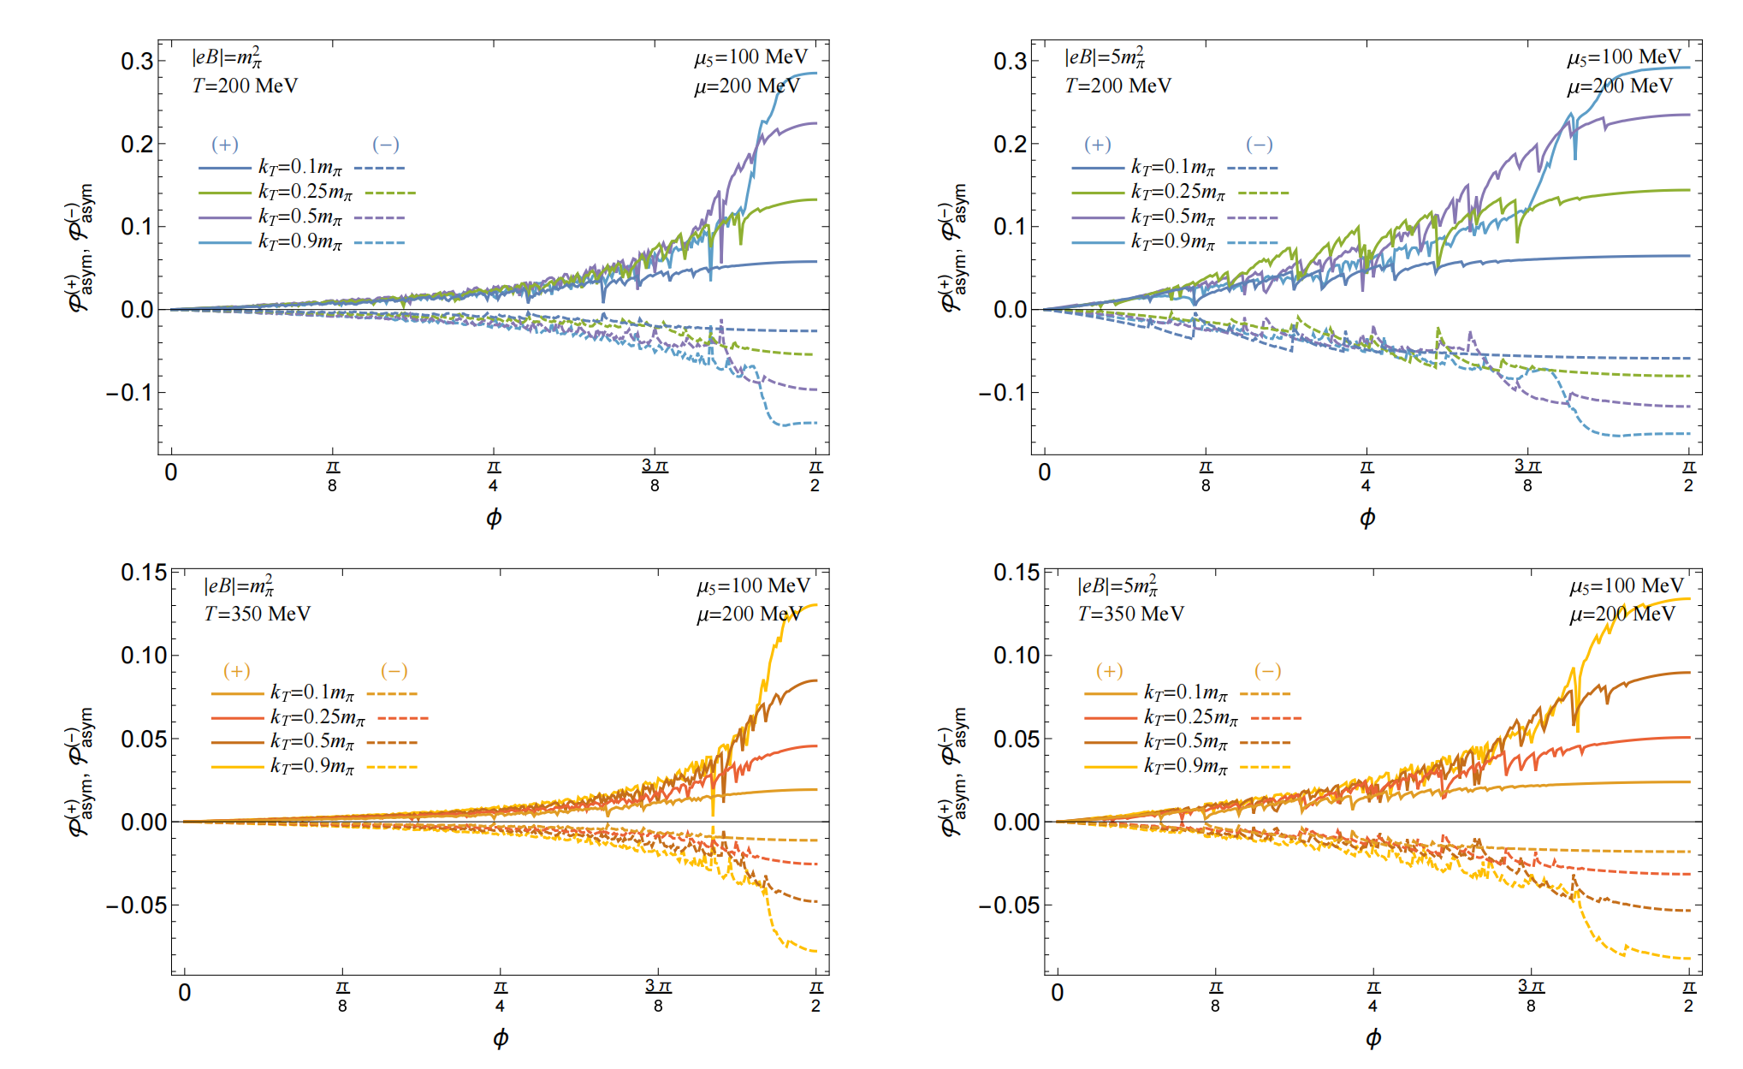
𝛍, 𝛍₅ ≠0

Slide 16
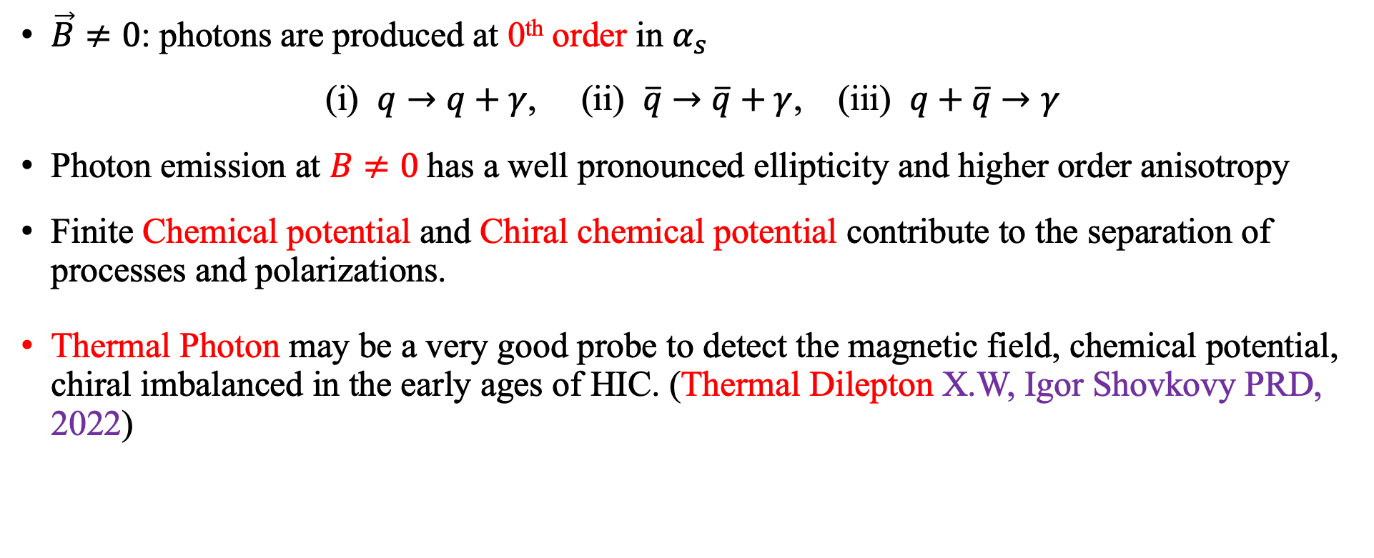
Summary
$\vec{B}≠0$: photons are produced at 0th order in $α_{s}$
(i) $q→q+γ$, (ii) $\overline{q}→\overline{q}+γ$, (iii) $q+\overline{q}→γ$
Photon emission at $B≠0$has a well pronounced ellipticity and higher order anisotropy
Finite Chemical potential and Chiral chemical potential contribute to the separation of processes and polarizations.
Thermal Photon may be a very good probe to detect the magnetic field, chemical potential, chiral imbalanced in the early ages of HIC. (Thermal Dilepton X.W, Igor Shovkovy PRD, 2022)

Slide 17
Thank you!

