Slide 1
CEPC vertex detector towards TDR
Zhijun Liang,
On behalf of CEPC vertex working group

Slide 2
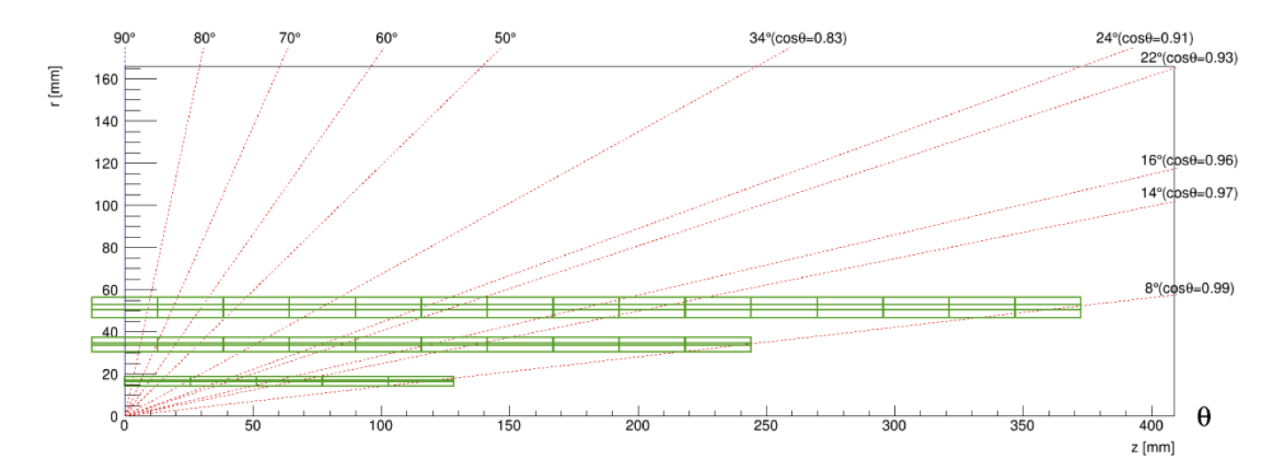
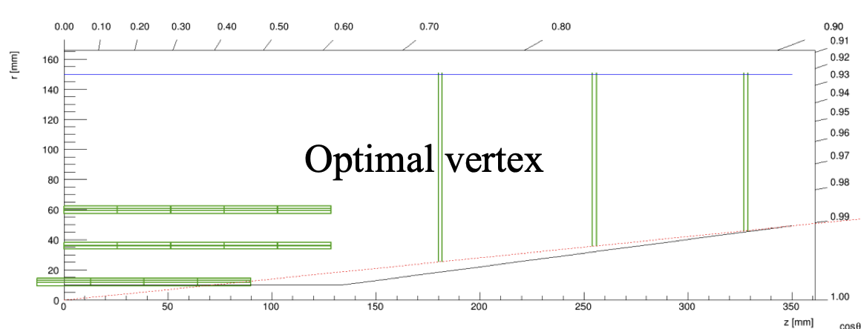
Plan : geometry and layout optimzation
Aim to have 1st draft of the detector geometry and mechnical design
Physics Layout optimization (mainly focus on layout for endcap )
Feasibility study of 2 layout ( mechanics support, cooling, cable ….)
Vertex detector MOST2 prototype layout has been implement in CEPCSW
Try to perform further optimization with full simulation
Long barrel
Short barrel + endcap

Slide 3
Long barrel cabling
Optoelectronics module is proposed.
Radiation hardness of Optoelectronics module
Optical fiber and power cable goes out from cabling space below
Space for Optoelectronics module and cabling enough ?
Optoelectronics : 5mm height, Power module: 5mm height
Next step: need dimension of Optoelectronics module and fit them into engineering design
Example from CERN vtrX

Slide 4
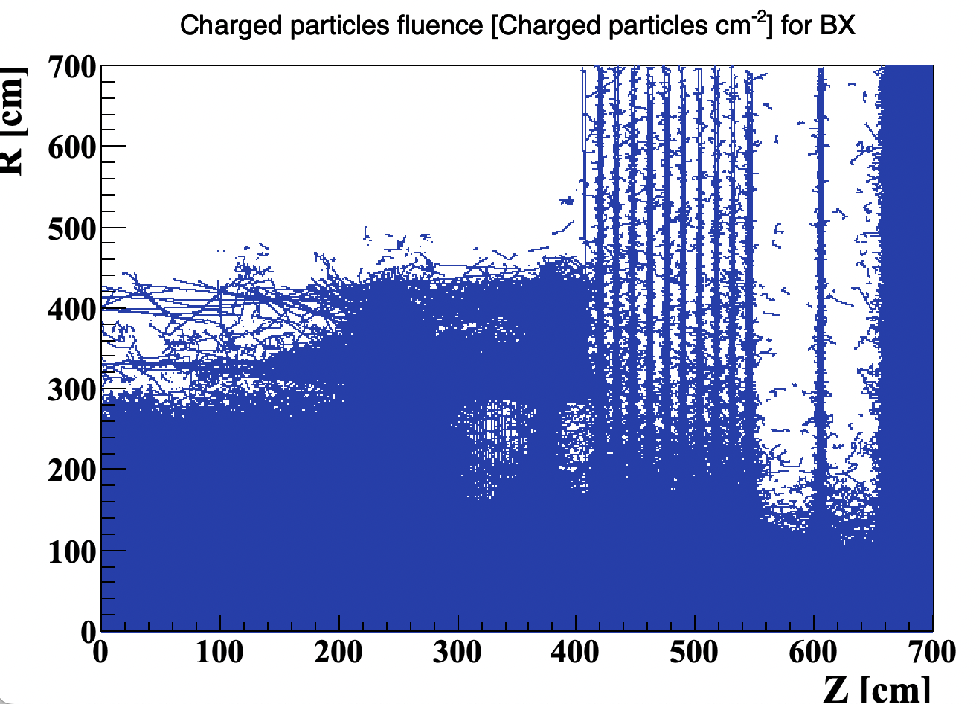
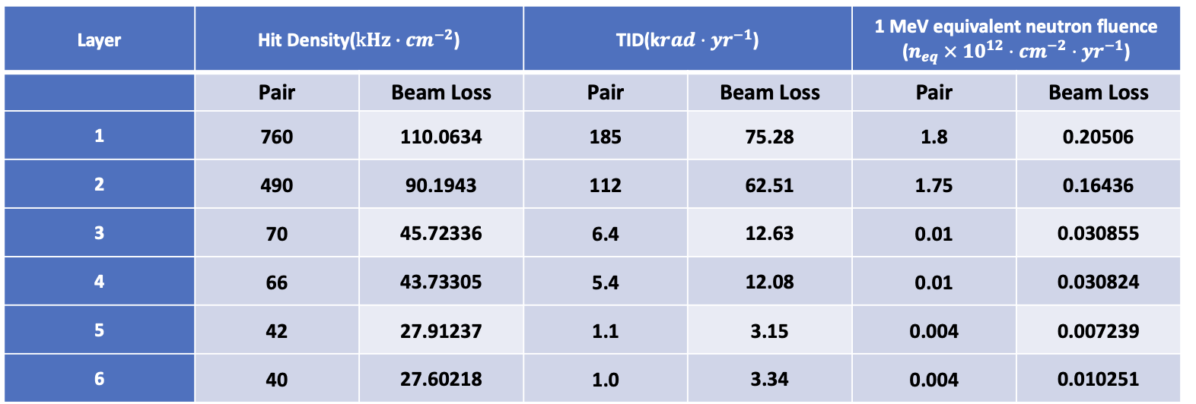
Beam background (from MDI group)
2D pair production background from Haoyu at the end of last week
Will re-visit the data rate and readout scheme for vertex in next two weeks
Pairs: /cefs/higgs/shihy/work/cepc_bkg/Results/Ref-TDR/20240312/Higgs/Pairs.root
BeamLoss: /cefs/higgs/shihy/work/cepc_bkg/Results/Ref-TDR/20240312/Higgs/BeamLoss.root
ZH runs beam backgroun ( from Haoyu)

Slide 5
Summary
Feedback from CEPC day by Yifang
Mechanical design (connection to beam pipe)
Material budget, vibration
Power consumption, air cooling simulation
Space for cabling and service need to be refined urgently
Feedback to Quan Ji about the space in 1~2 weeks
Revisit the data rate and readout scheme using the latest MDI background
In next 1~2 weeks
Vertex detector layout optimization is in progress using CEPCSW
Plan to converge in about 1~2 months

Slide 6
Beam pipe Cooling discussion
Discussion with Quan and experts from Hunan University about beam pipe cooling
Water cooling vs paraffin cooling
Converging on water cooling solution
Advantage Better cooling power , Less material budget (a factor of 2 lower)
Disadvantage: Beam pipe corrosion by water during Radiation hardness (need more study)
Beam pipe coating as one of possible solution to be studied

Slide 7
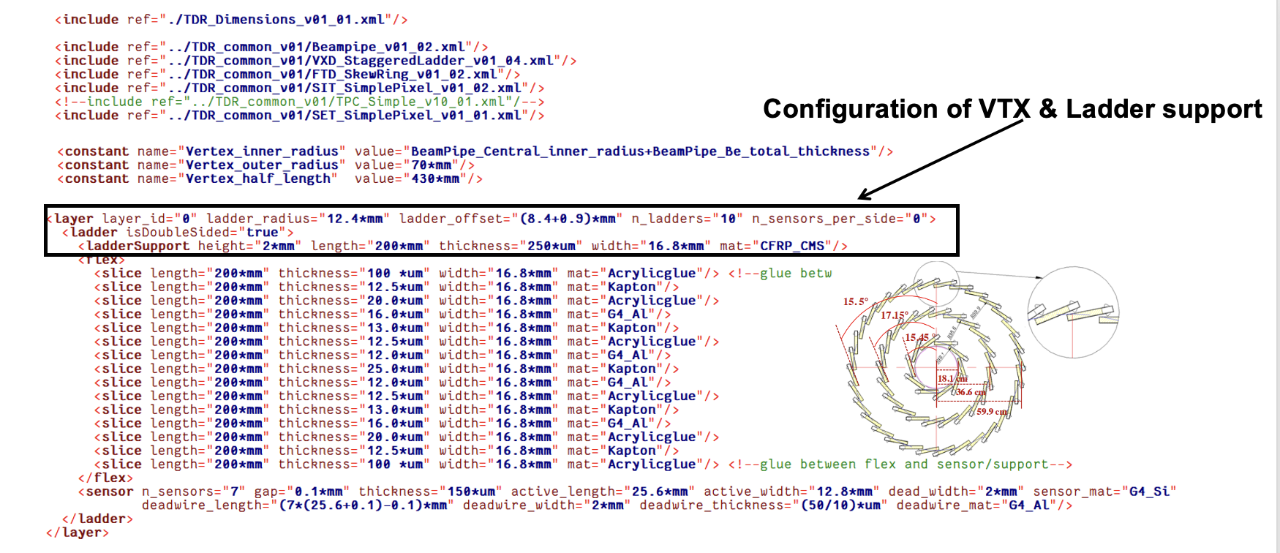
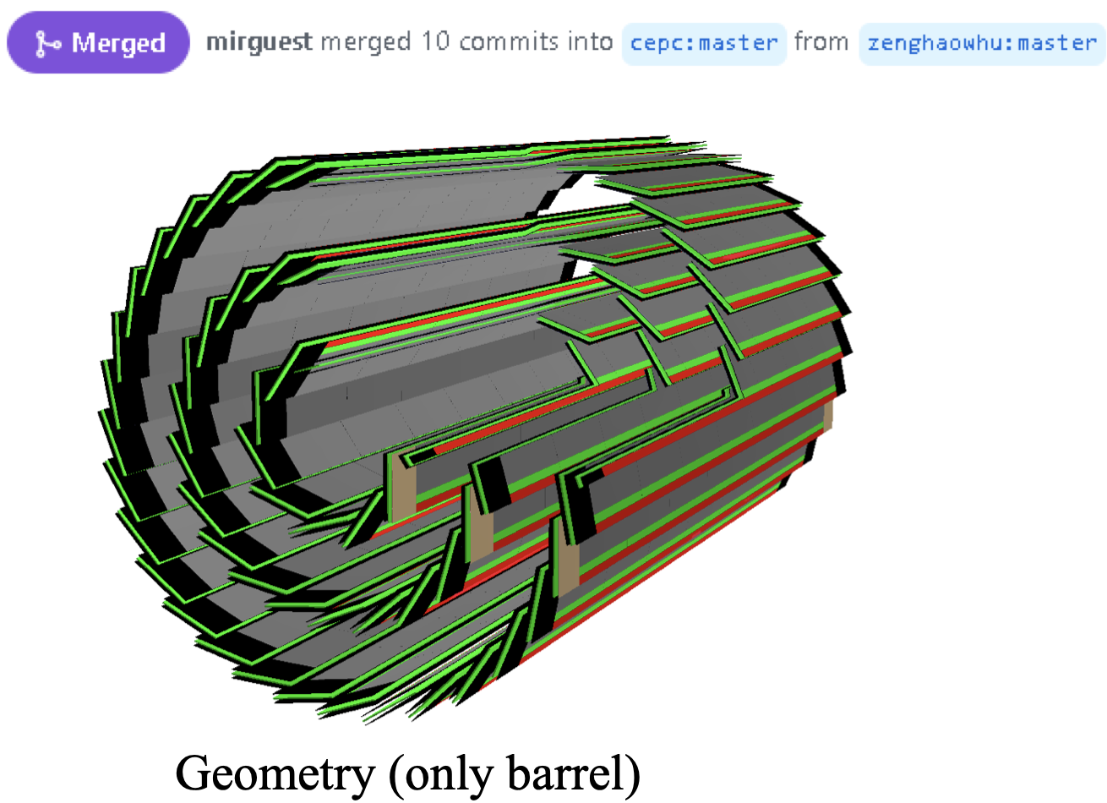
Layout optimization: CEPCSW full simulation
MOST2 prototype layout has been implemented in CEPCSW
Layout Optimization for reference-TDR is based on CEPCSW
Long barrel and short barrel layout are optimized in parallel

Slide 8
Backup

Slide 9
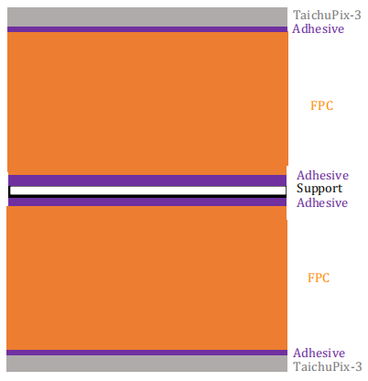
backup: CEPCSW full simulation
50um Si
12.5um Acrylicglue
12.5um Kapton
12.5um Acrylicglue
8um G4_Al
13um Kapton
12.5um Acrylicglue
8um G4_Al
13um Kapton
12.5um Acrylicglue
12um G4_Al
25um Kapton
12um G4_Al
12.5um Acrylicglue
13um Kapton
8um G4_Al
12.5um Acrylicglue
13um Kapton
8um G4_Al
12.5um Acrylicglue
12.5um Kapton
12.5um Acrylicglue
250um CFPR
12.5um Acrylicglue
12.5um Kapton
12.5um Acrylicglue
8um G4_Al
13um Kapton
12.5um Acrylicglue
8um G4_Al
13um Kapton
12.5um Acrylicglue
12um G4_Al
25um Kapton
12um G4_Al
12.5um Acrylicglue
13um Kapton
8um G4_Al
12.5um Acrylicglue
13um Kapton
8um G4_Al
12.5um Acrylicglue
12.5um Kapton
12.5um Acrylicglue
50um Si
50um Si
12.5um Acrylicglue
12.5um Kapton
12.5um Acrylicglue
8um G4_Al
13um Kapton
12.5um Acrylicglue
12um G4_Al
25um Kapton
12um G4_Al
12.5um Acrylicglue
13um Kapton
8um G4_Al
12.5um Acrylicglue
12.5um Kapton
12.5um Acrylicglue
250um CFPR
12.5um Acrylicglue
12.5um Kapton
12.5um Acrylicglue
8um G4_Al
13um Kapton
12.5um Acrylicglue
12um G4_Al
25um Kapton
12um G4_Al
12.5um Acrylicglue
13um Kapton
8um G4_Al
12.5um Acrylicglue
12.5um Kapton
12.5um Acrylicglue
50um Si
layer1
layer2、3 (for each ladder with more than 10 sensors)

Slide 10
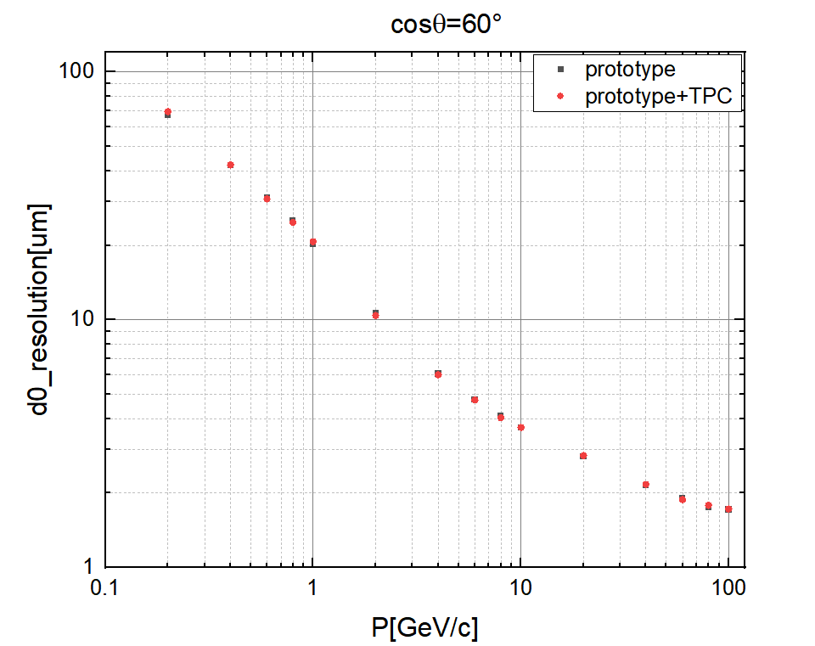
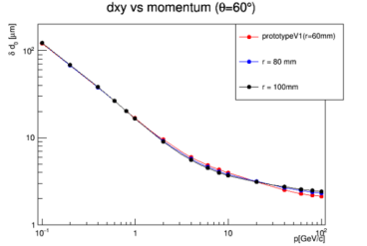
backup: CEPCSW full simulation Vs tklayout (fastsim)
相同结构，在0.1~0.6GeV/c和8~100GeV/c,CEPCSW有较好的d0分辨率
0.6~8GeV/c，tklayout有较好的分辨率。

Slide 11
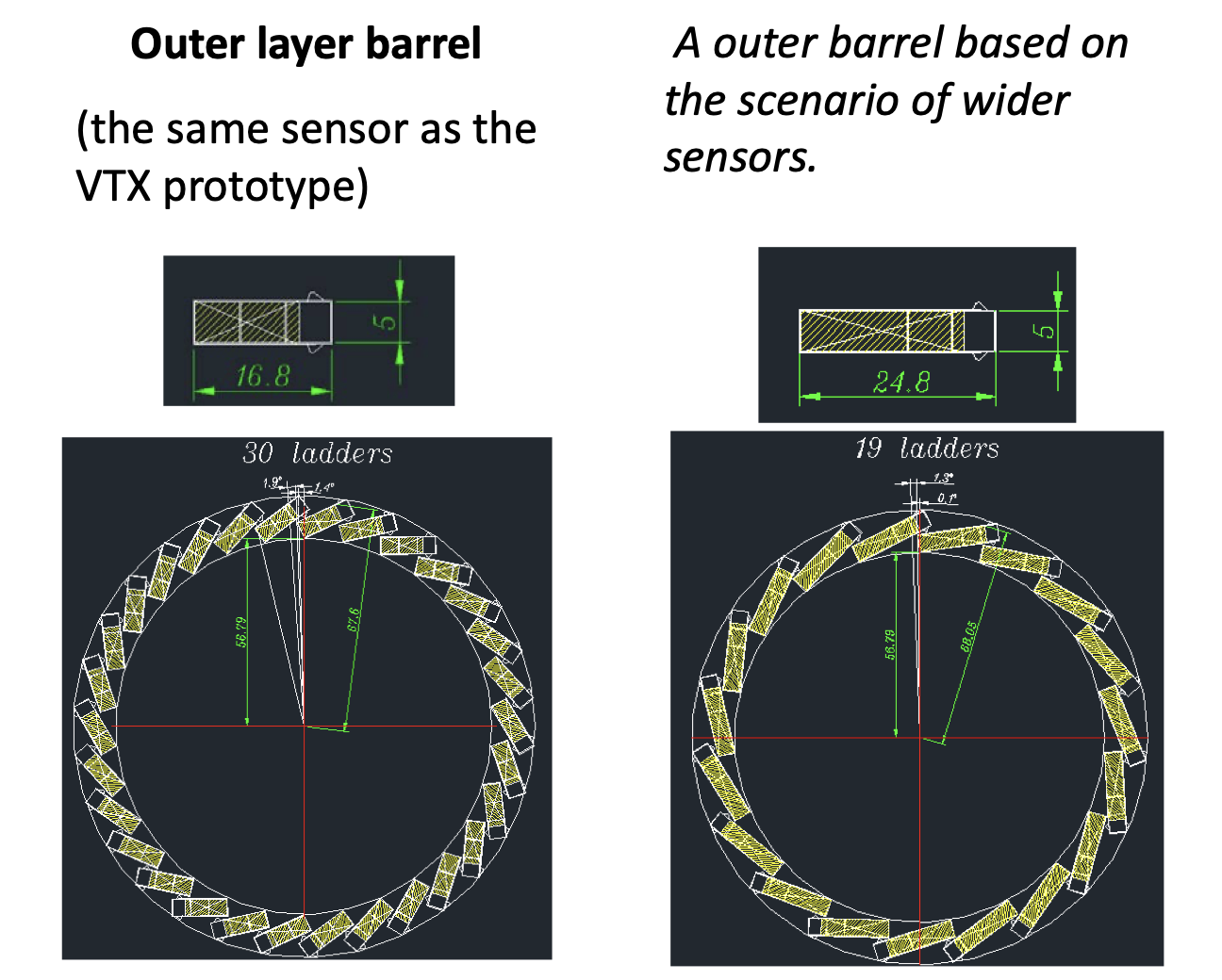
Toward geometry update for CEPCSW release
Need to converge on a few things soon, toward the CEPCSW release
Sensor chip dimension
Narrow chip for inner layer
Wider chip for middle and outer layer
Ladder dimension
Flexible PCB
Carbon fiber support
Support design for short barrel
Channel number: 128 * X

Slide 12
Decay length
$$L= γτβc=cτ \frac{|\vec{p}|}{mc}$$
for b-hardon:
$B^{±}$: $m= 5.279GeV/c^{2}$, $τ= 1638fs$, $cτ= 0.4914mm$
$|\vec{p}|$: $1GeV/c\sim 100GeV/c$, $L$: $0.093\sim 9.3 mm$
for c-hardon:
$D^{+}$: $m= 1.87GeV/c^{2}$, $τ= 1033.6fs$, $cτ= 0.31008mm$
$|\vec{p}|$: $1GeV/c\sim 100GeV/c$ , $L$: $0.166\sim 16.6 mm$
$D^{0}$: $m= 1.87GeV/c^{2}$, $τ= 408.5fs$, $cτ= 0.12255mm$
$|\vec{p}|$: $1GeV/c\sim 100GeV/c$ , $L$: $0.066\sim 6.6 mm$
$D_{s}^{+}$: $m= 1.97GeV/c^{2}$, $τ= 467fs$, $cτ= 0.14mm$
$|\vec{p}|$: $1GeV/c\sim 100GeV/c$ , $L$: $0.071\sim 7.1 mm$
$Λ_{c}^{+}$: $m= 2.29GeV/c^{2}$, $τ= 201.5fs$, $cτ= 0.06045mm$
$|\vec{p}|$: $1GeV/c\sim 100GeV/c$ , $L$: $0.026\sim 2.6mm$

Slide 13
Layout optimization: CEPCSW full simulation
MOST2 prototype layout has been implemented in CEPCSW
Long barrel： can be optimized using CEPCSW
Short barrel+ endcap: Need to implement Endcap disk geometry into CEPCSW
Need to work with software group

Slide 14
Weekly meeting
Group Meeting every Thursday afternoon (2nd meeting last Thursday)
https://indico.ihep.ac.cn/event/21543/
From last meeting, Discussion about the choice of technology
Discussion with L3 Stitching (Mingyi) and SOI (Yunpeng)
Agree to focus CMOS pixel for reference TDR baseline

Slide 15
Key parameters
Single-point spatial resolution (now and in the next 5 years)
Time stamp precision requirement (to be discussed with Shengsun Sun)
Material budget
Cost estimation
Occupancy
Max data rate that can be handled by this technology (now, and in the next 5 years)
Radiation hardness (now, and in the next 5 years)
Power dissipation (now, and in the next 5 years)
Expected Technology availability in the future
Technology Readiness

Slide 16
Towards TDR
Aim to have a draft of TDR by the end of 2024.
System level design, choose baseline technology
Electronics, service and mechanics needs to be included
Major change from CDR to TDR
Beam pipe diameter: 28mm (CDR) → 20mm (TDR) (reduce 30%)
Instant Luminosity per IP:
Z pole: 32×10³⁴ cm⁻²s⁻¹ (CDR) → 192 ×10³⁴ cm⁻²s⁻¹ (TDR, 50MW) (6 times increase)
ZH: 5.6×1034 cm-2s-1 (CDR) → 8.3 ×10³⁴ cm-2s-1 (TDR) (~1.5 times increase)

