Slide 1


Two-loop QCD Corrections to Pion EM form factors
arXiv:2312.17228
陈龙斌
合作者：陈文、冯锋、贾宇
2024/4/5
华中师范大学

Slide 2
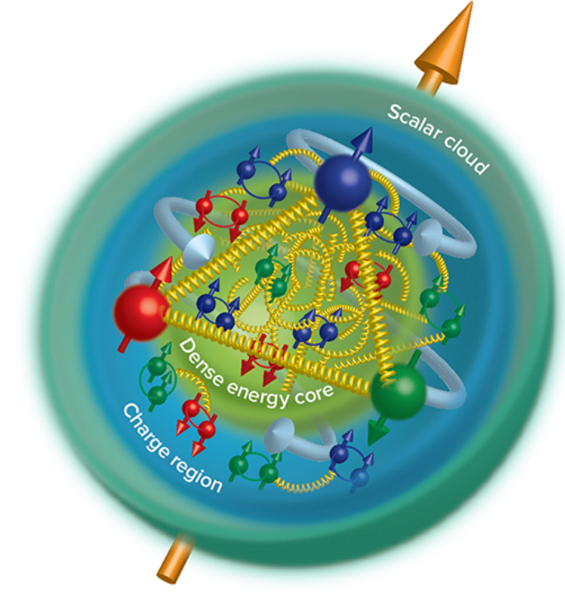
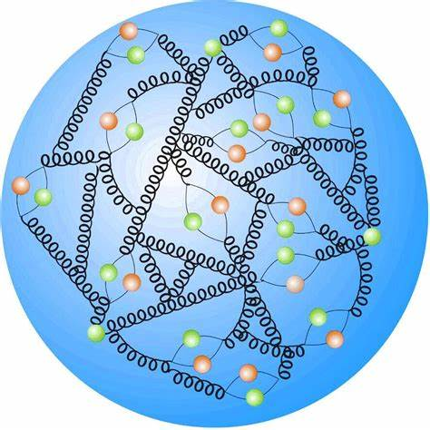
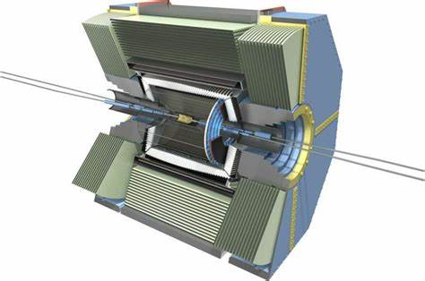
Study of EM form factors is a crucial way to unveiling the inner structure of hadron.
QCD
Hadron Structure

Slide 3
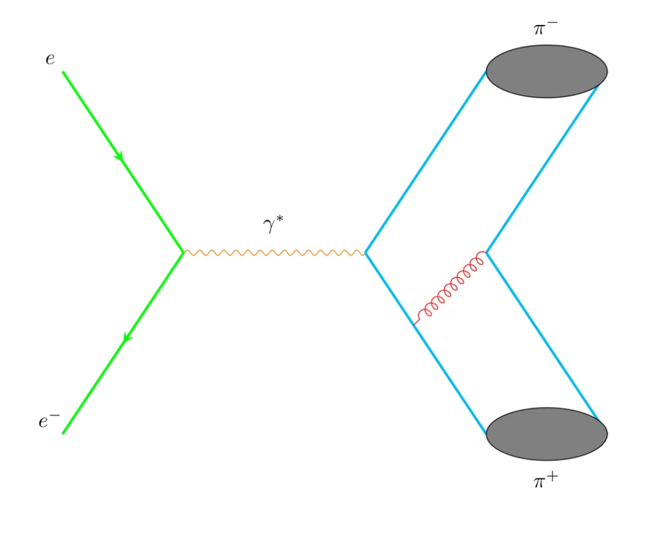
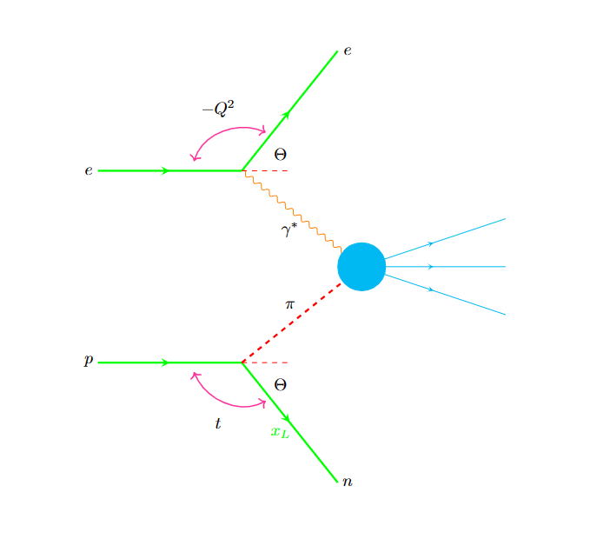
Space Like
Time Like
Probing pion Form Factors

Slide 4

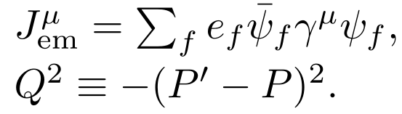
Probing the internal structure of hadrons
Charge Pion Form Factors:

Slide 5
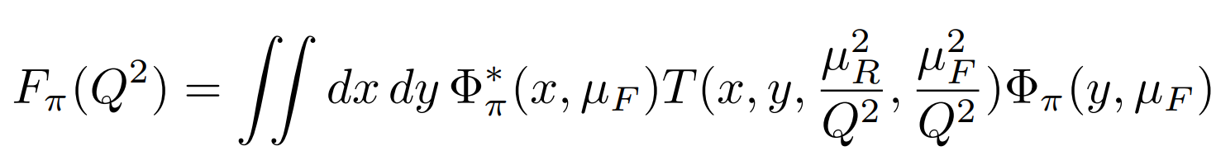
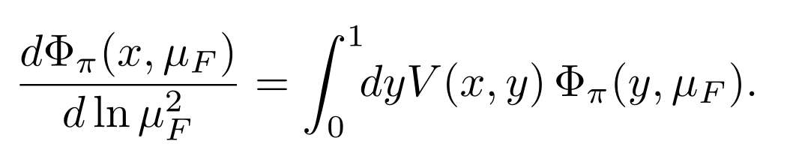
In framework of Collinear Factorization
(Lepage, Brodsky, Efremov, Radyushkin, Duncan, Mueller)
Leading-Twist Pion LCDA:
ERBL evolution equations:

Slide 6
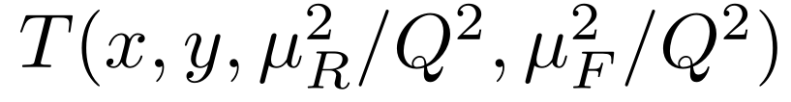
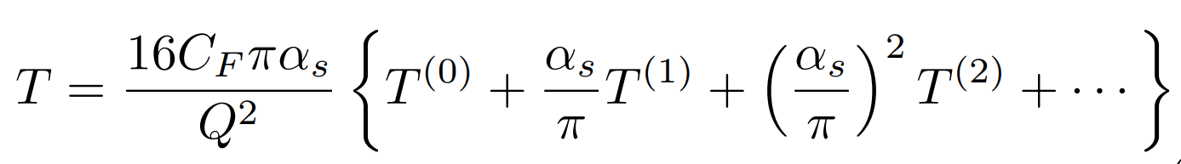
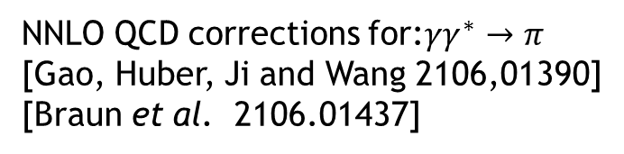
Hard Kernel
Pertubative Expansion:
LO: 1977-1980 Lepage, Brodsky, Efremov, Radyushkin, Duncun, Muller…
NLO: Field, Gupta, Otta, Chang(1981), Dittes, Radyushkin(1981), Sarmadi (1984),
Braaten,Tse(1987), Melic, Nizic and Passek (1998).
Our goal on this work is to achieve NNLO calculations.(2023)
NNLO QCD corrections for:$γγ^{∗}→π$
[Gao, Huber, Ji and Wang 2106,01390]
[Braun et al. 2106.01437]

Slide 7
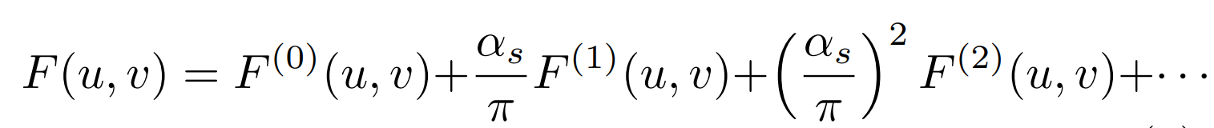
Perturbative expansion
Renormalized “pion” LCDA can be expressed as :

Slide 8
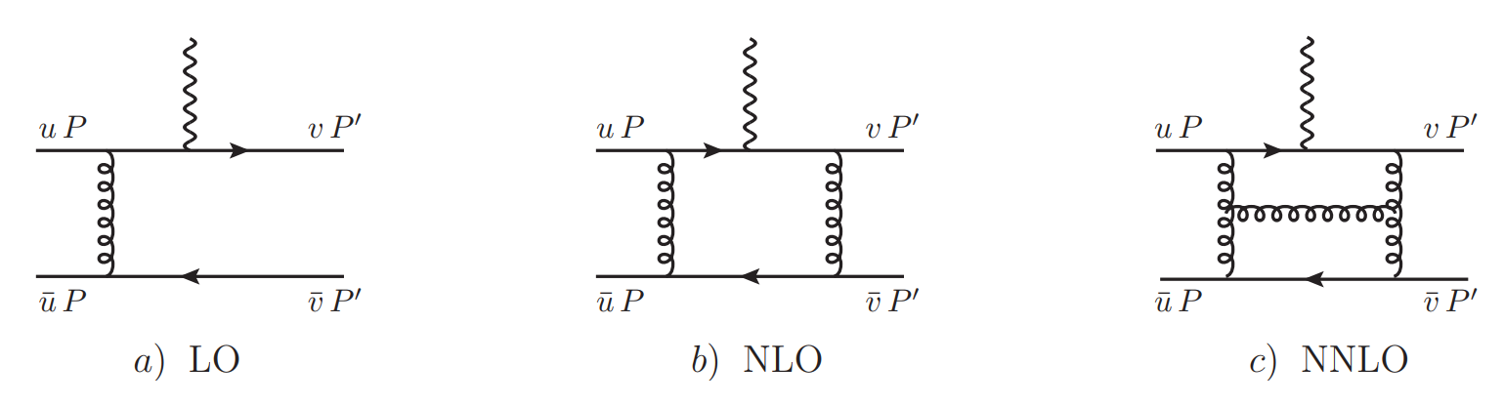
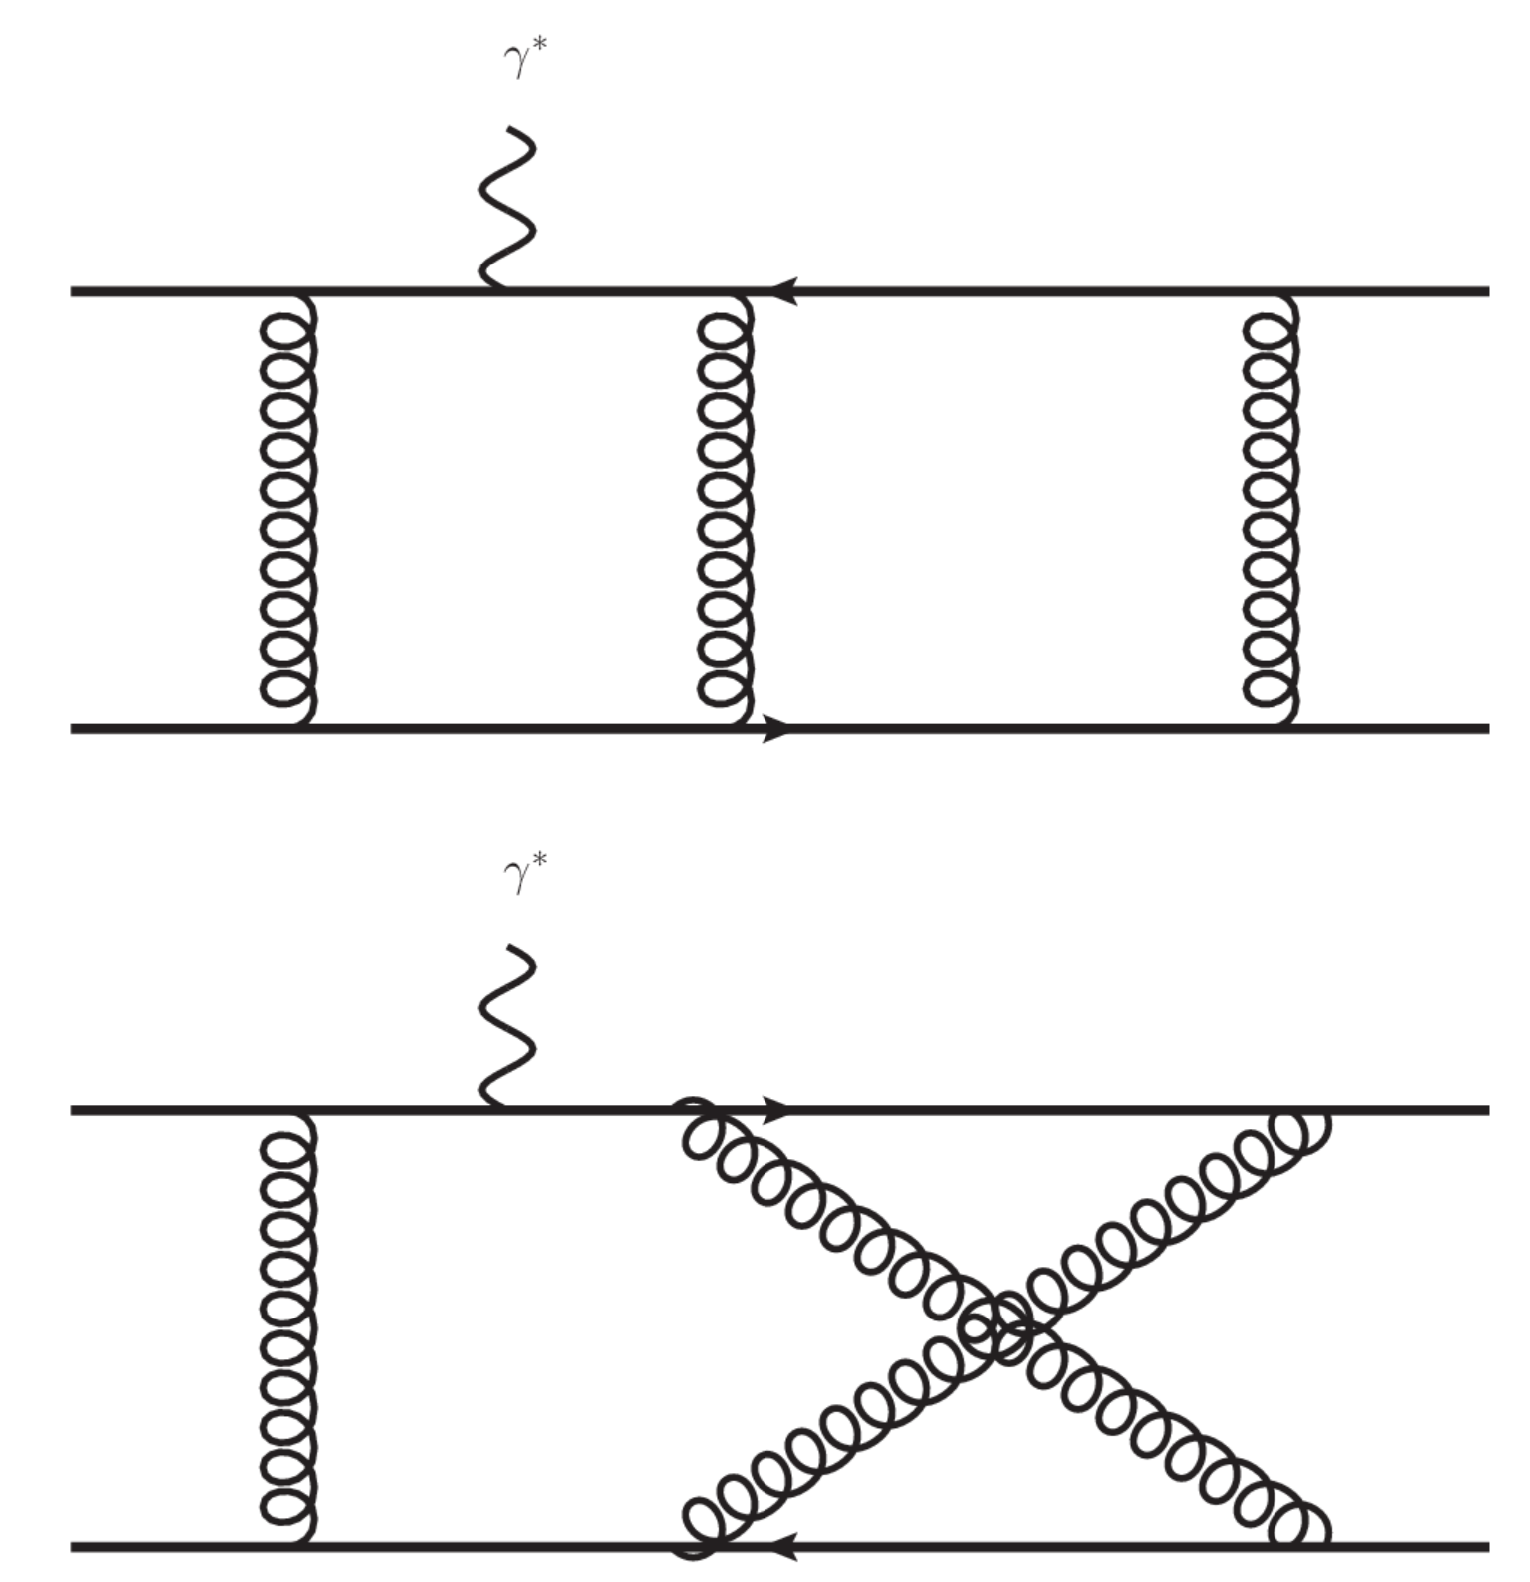
Feynman Diagrams(about 1600)
HepLib,FeynArts
Partonic process

Slide 9
Calculation Methods
Diagrams and amplitudes : HepLib, FeynArts.
Partial Fraction: Apart.
Integrals Reduction: FIRE.
Master Integrals Calculation: Differential Equations.
Validations of analytic results for MIs: AMFLOW.

Slide 10
Integral Reduction and calculation

Slide 11
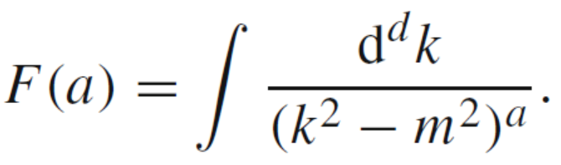
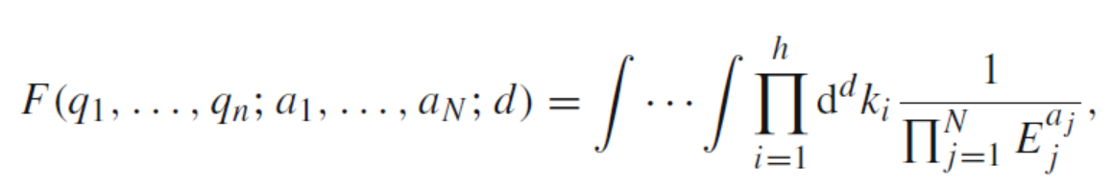
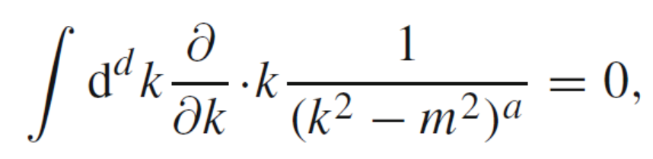
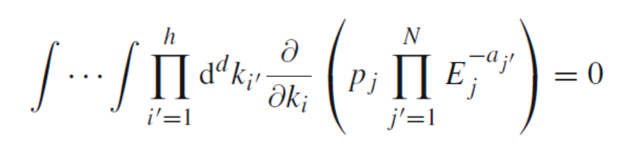
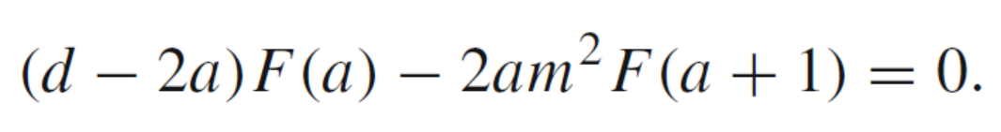
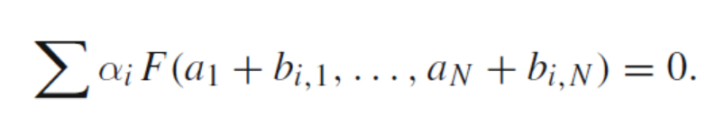
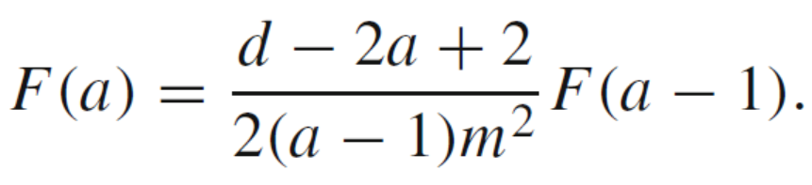
Integrals Reduction: IBP (integration-by-parts)

Slide 12
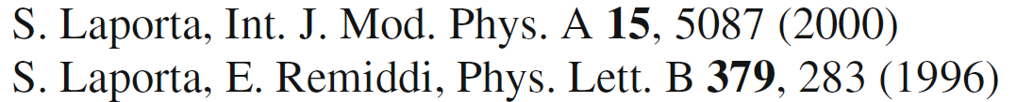
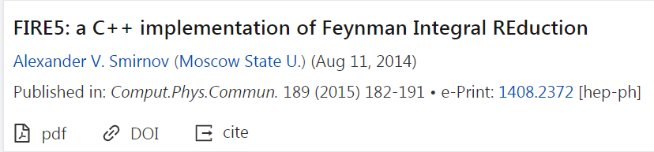
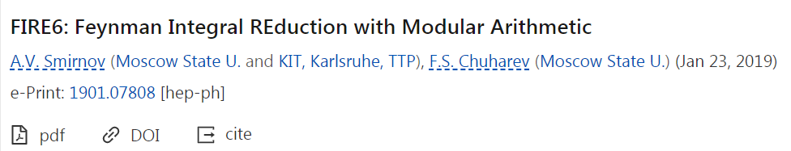
Reduction Packages:
FIRE, Reduze, Kira…

Slide 13
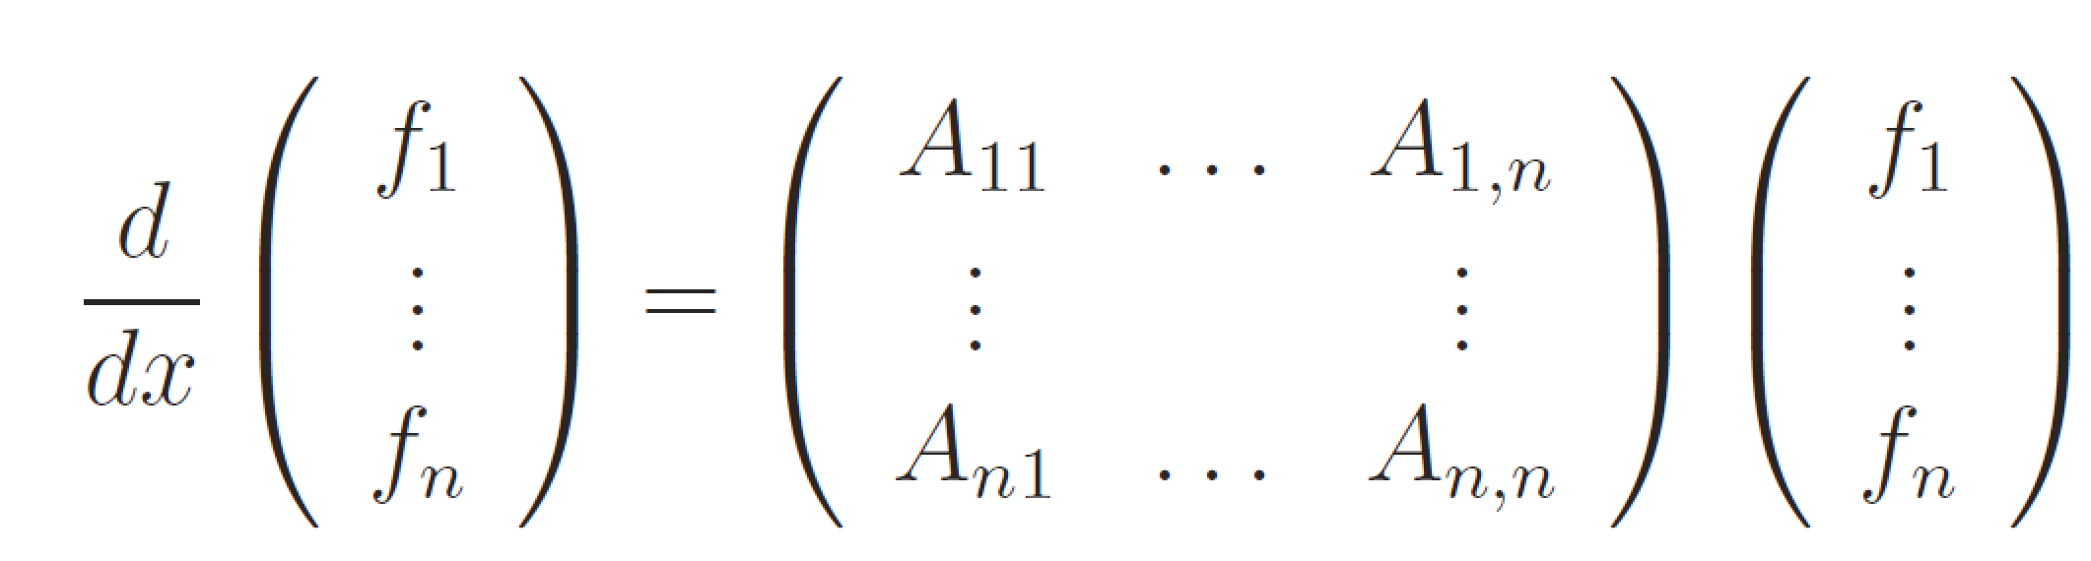
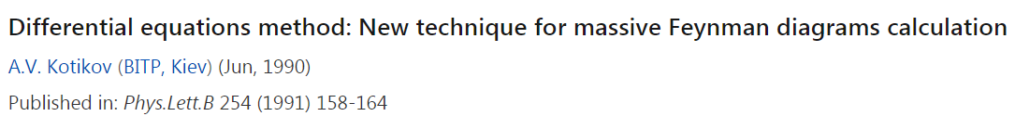
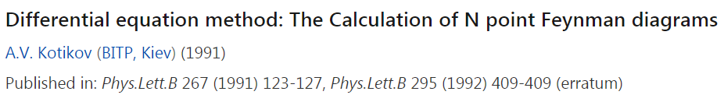
Differential Equations (DE):
x can be Lorentz invariant kinematics

Slide 14
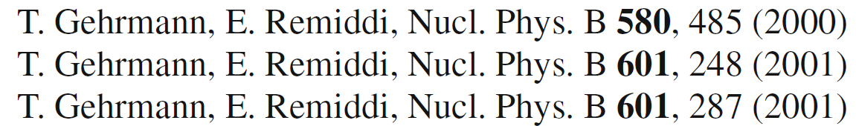
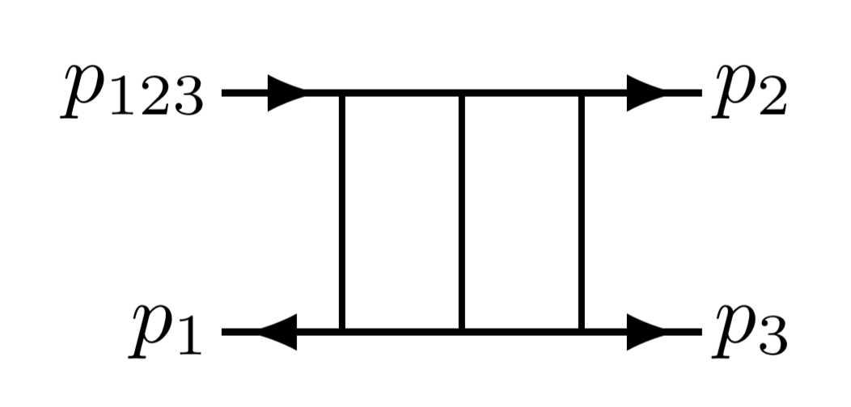
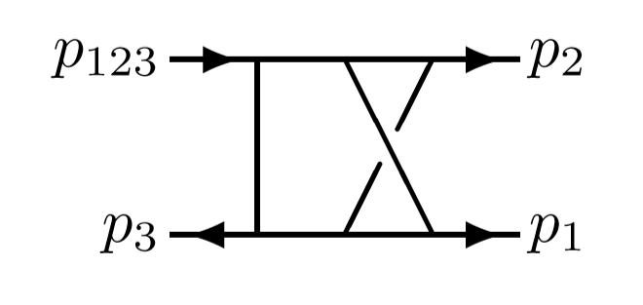
Progress in DE method:
Can be used to NNLO corrections to gamma gamma* Pi?

Slide 15
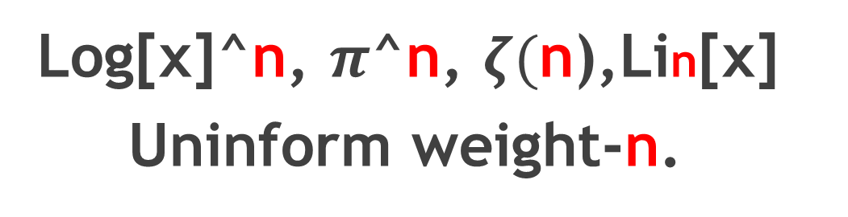
Weight / Transcendentality
Log[x]^n, $π$^n, $ζ($n),Lin[x]
Uninform weight-n.

Slide 16
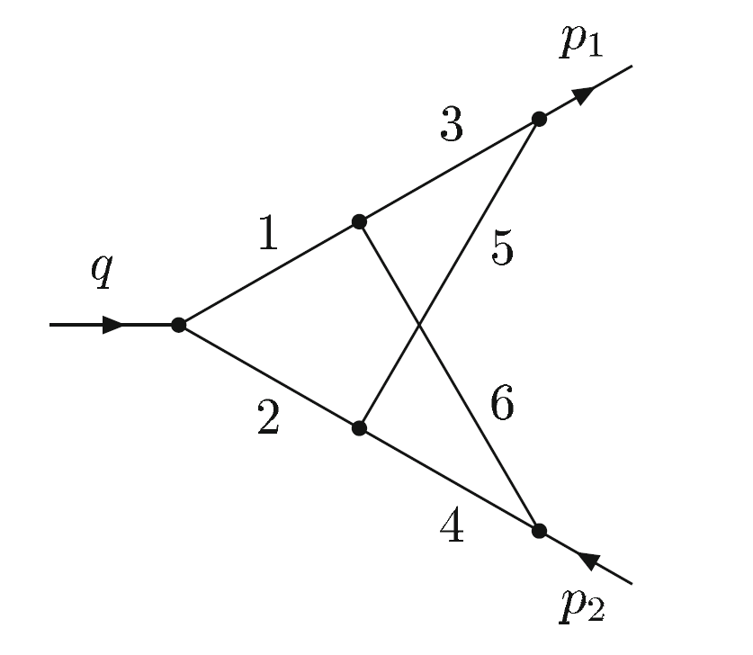
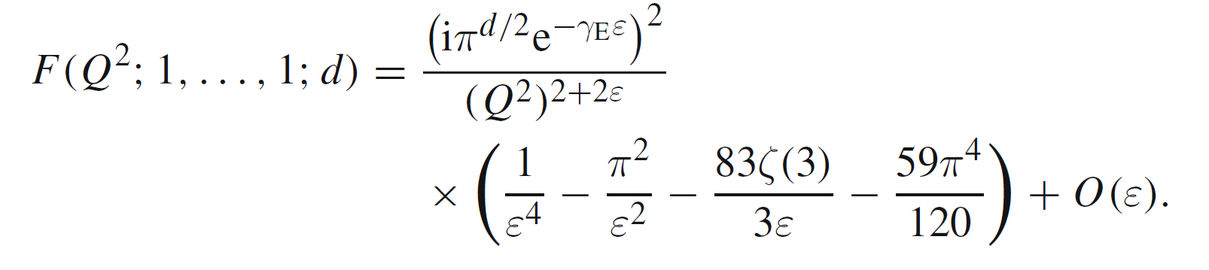
Example
Can be evaluated by Feynman parameters

Slide 17
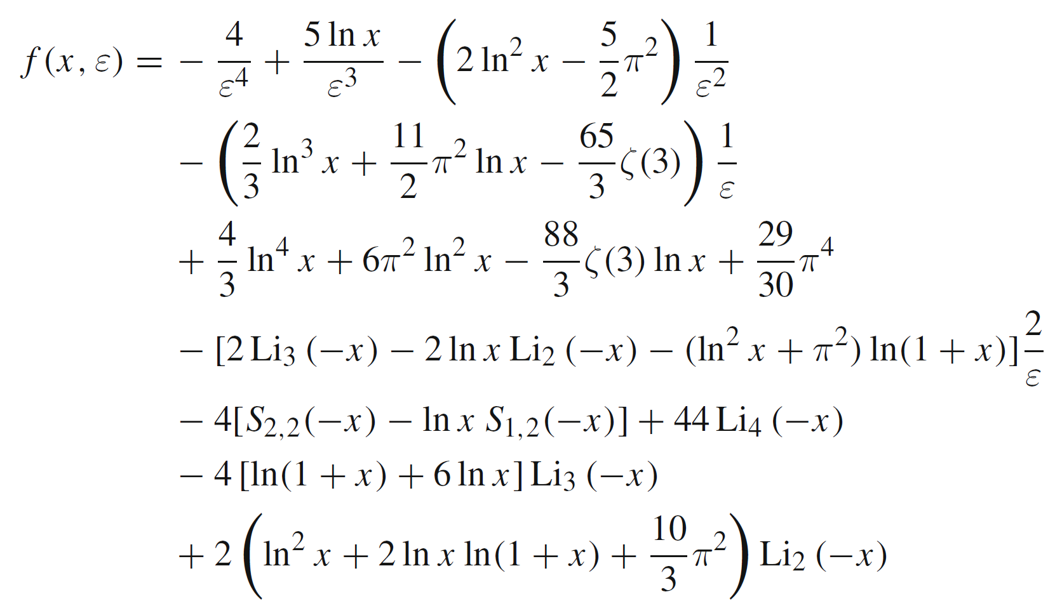
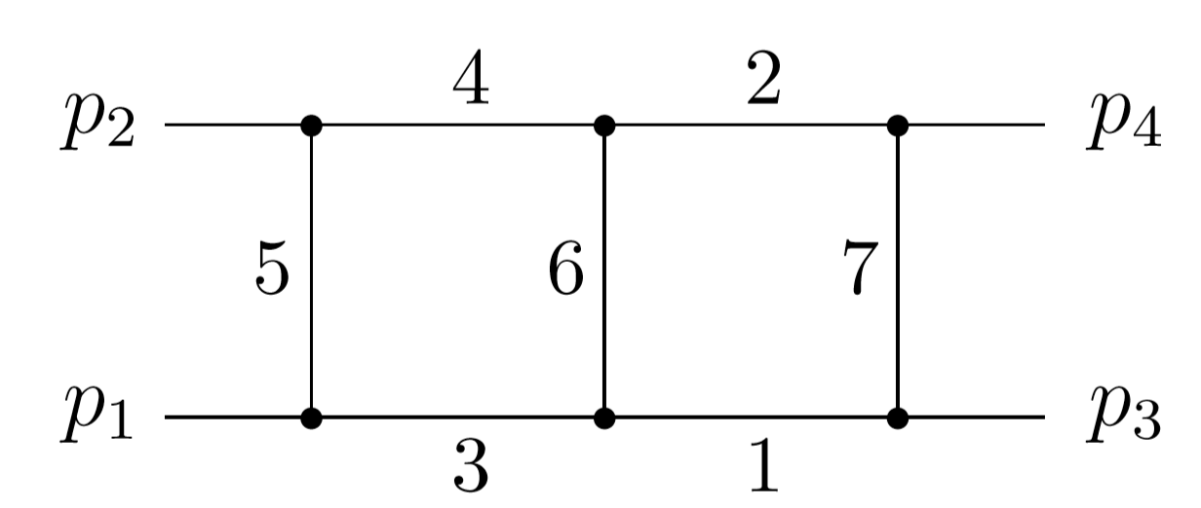
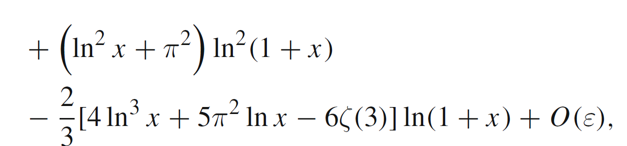
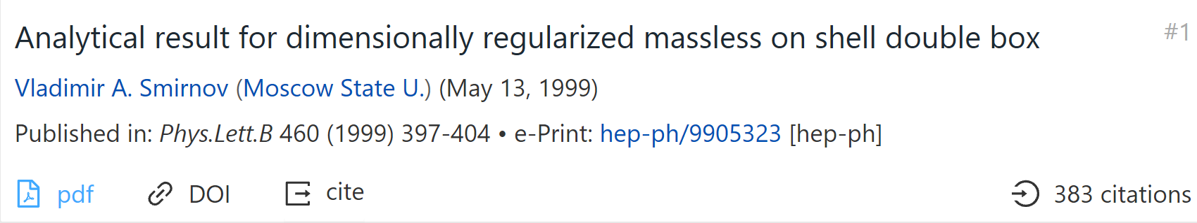
Based on MB representation
Planar

Slide 18
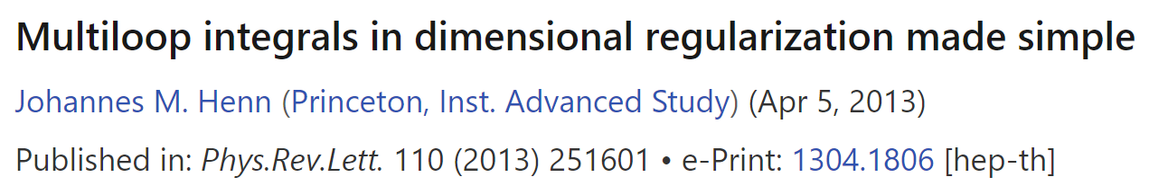
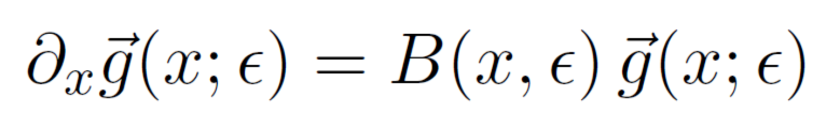
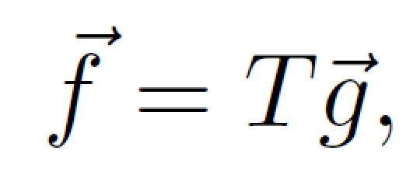
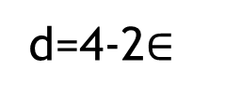
Choosing canonical basis (Basis with uniform transcendentality)
For random integral basis g，we have:
We can choose new basis f:
d=4-2$∈$

Slide 19
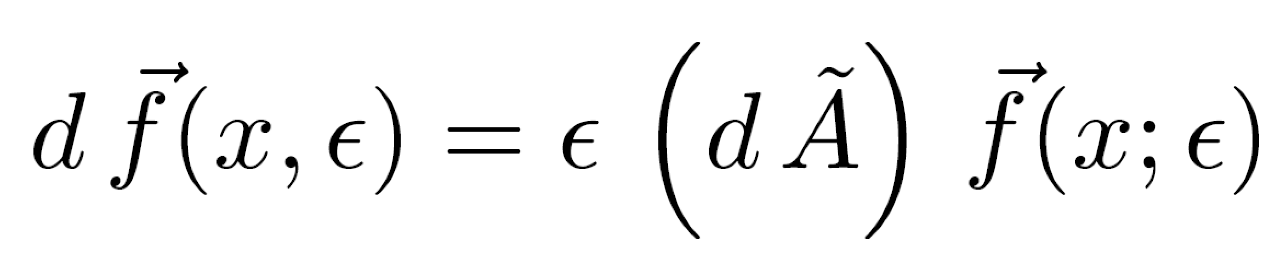
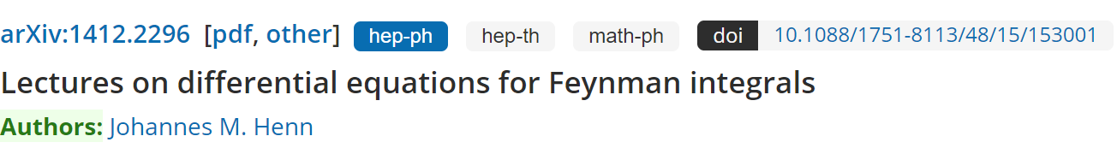

Slide 20
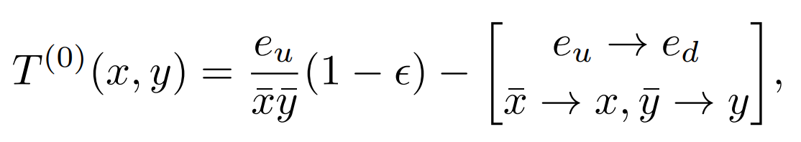
LO kenerl:

Slide 21
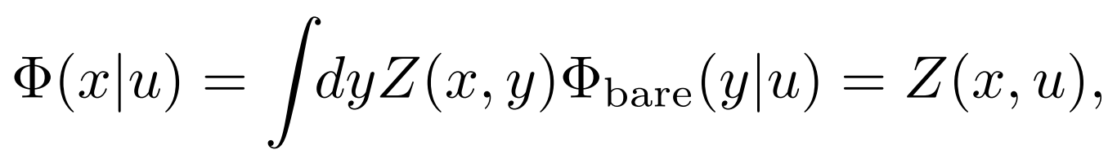
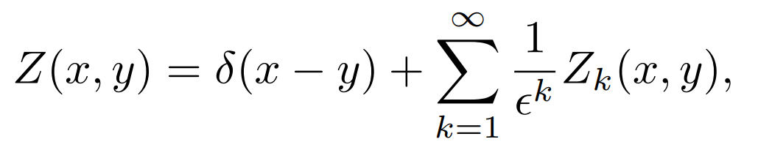
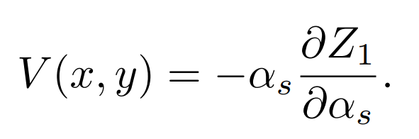
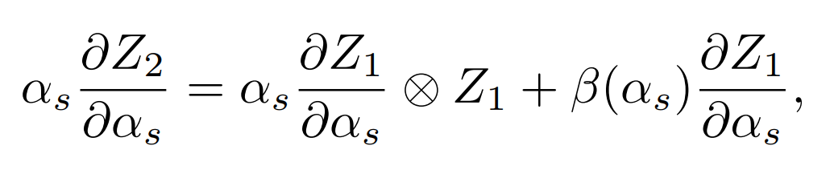
Validations of Factorization
Relation with EBRL kernel
arXiv:hep-ph/0512208

Slide 22
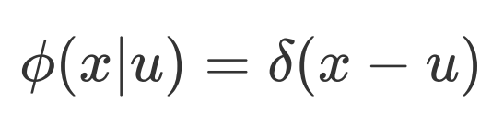
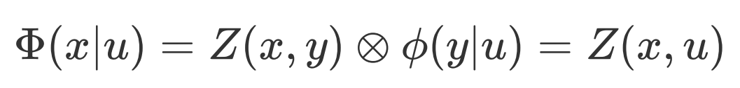

Validations of Factorization
arXiv:hep-ph0512208
Bare LCDA:
Renormalizied LCDA:

Slide 23




Slide 24


Matching
LO and NLO:

Slide 25

NNLO matching:
The convolutions above are calculated analytically.

Slide 26


NLO matching relation
NNLO matching relation

Slide 27


Asympotic Expression of Kernel
$$T^{1}$$
NLO results agree with previous calculations

Slide 28

$$T^{(2)}$$

Slide 29

$$T^{(2)}$$
Can the endpoint logarithms be resummation?

Slide 30
Phenomenological Exploration

Slide 31

Leading-twist pion LCDA
a_i can be calculated by Lattice QCD

Slide 32


The pion EM form factor :
Convolution:

Slide 33


The convolutions can be evaluated analytically
About 10^5 terms in the calculation of convolutions

Slide 34

Numerical Results of Convolution.

Slide 35


Phenomenological exploration
Inputs:(Gegenbauer Moments)
LPC:
Based on LaMET 1305.1539
RQCD:
1909.08038
2201.09173

Slide 36

Phenomenological exploration
Results with LPC inputs:
Space Like FF
Time Like FF

Slide 37

Results with RQCD inputs:
Space Like FF
Time Like FF

Slide 38
Conclusion
The EM form factors for pion have been calculated up to NNLO QCD corrections.
We verify the validity of the collinear factorization for this observable.
The matching kernel have been obtained analytically.
The NNLO corrections turn out to be positive and significant.
The NNLO results can provides strong constraint on the Gegenbauer moments.
Extend this calculation to Kaon and proton FF?

Slide 39
谢谢！
欢迎批评指正！

