Slide 1
LGAD based time of flight and outer tracker
Yunyun Fan，Mengzhao Li，Xinhui Huang，Zhijun Liang
Friday, March 29, 2024

Slide 2
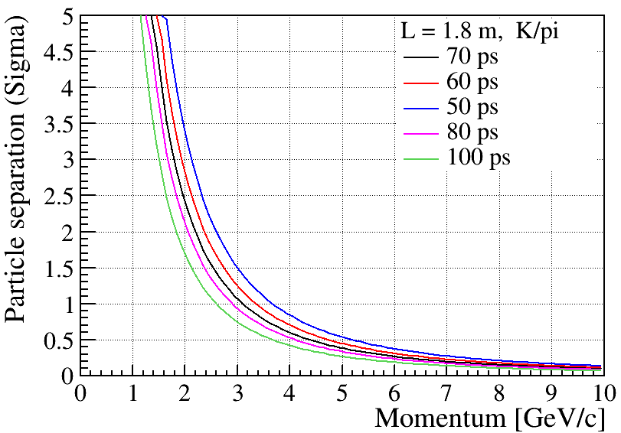
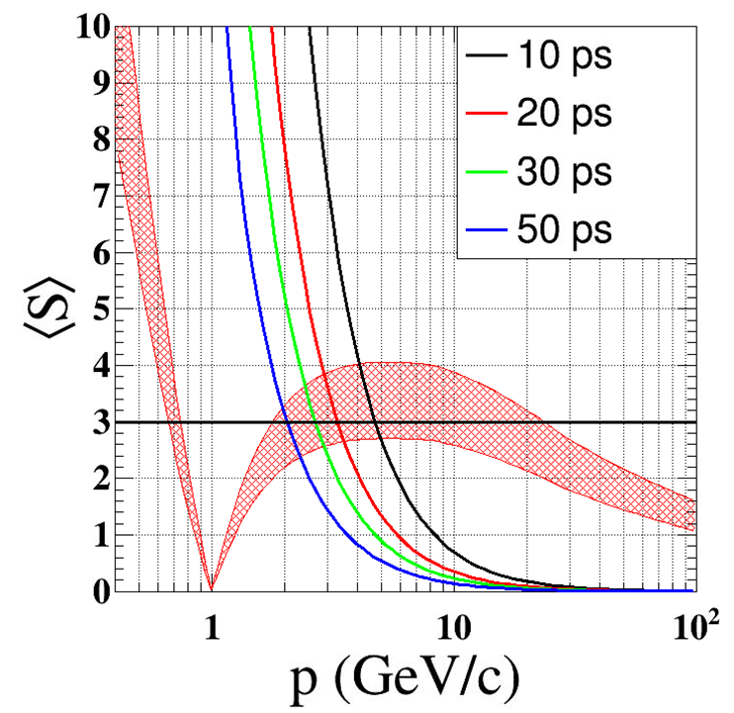
Physics requirement
3 sigma K/pi seperation below 2GeV
  50 ps precision is the target

Slide 3
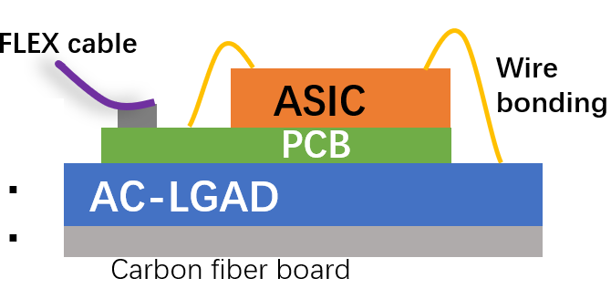
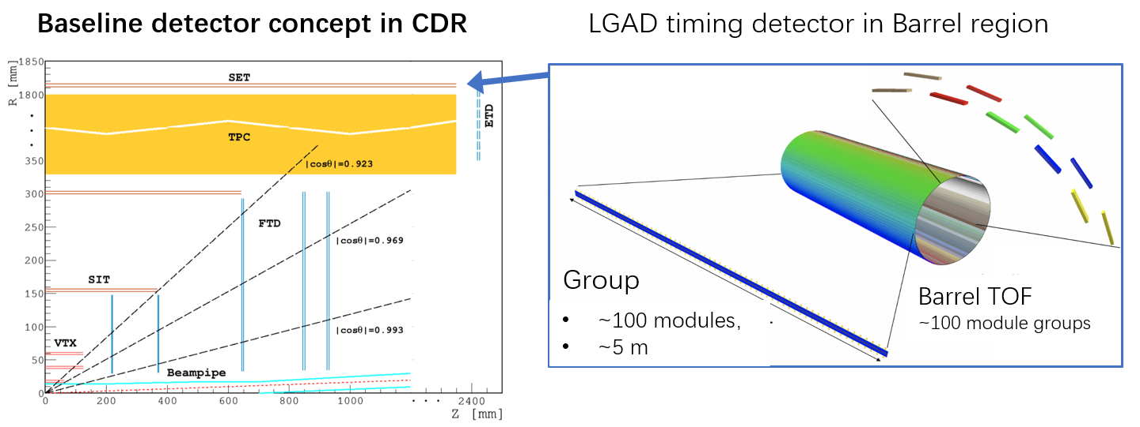
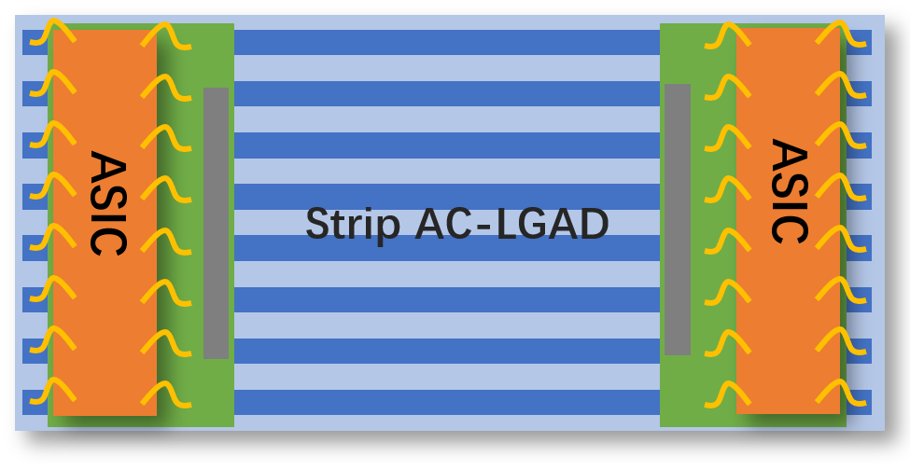
CEPC 4D outer tracker
CEPC 4D outer tracker concept design：
Y
  Should be part of SET (silicon wrapper layer outside TPC or drift chamber)
  Serve as Timing detector and part of the tracker
  Barrel : 50 m² , Endcap 20 m² , ~ 10⁶ channels
  Strip AC-LGAD ( each strip: 4 or 10 cm × 0.05cm)
    Timing resolution: 30-50 ps
    Position resolution: ~ 10 μm @ R-phi direction
    ~ 1mm @ z direction
Z
Strip AC-LGAD + ASIC ：
TOT->amplitude->charge sharing->position
TOA+TOT->timing (time–amplitude correction)
mzli@ihep.ac.cn

Slide 4
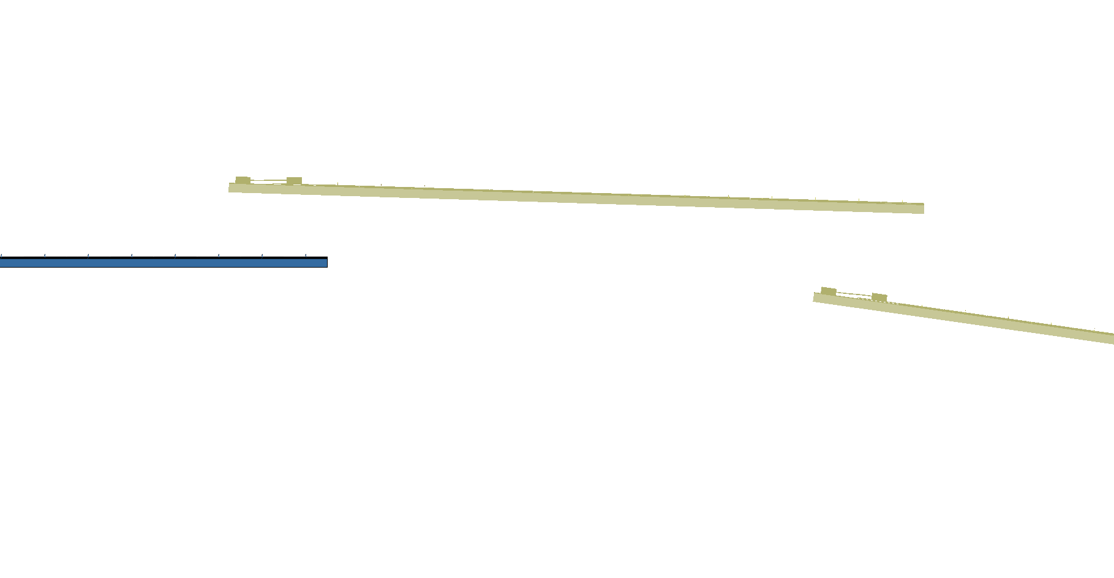
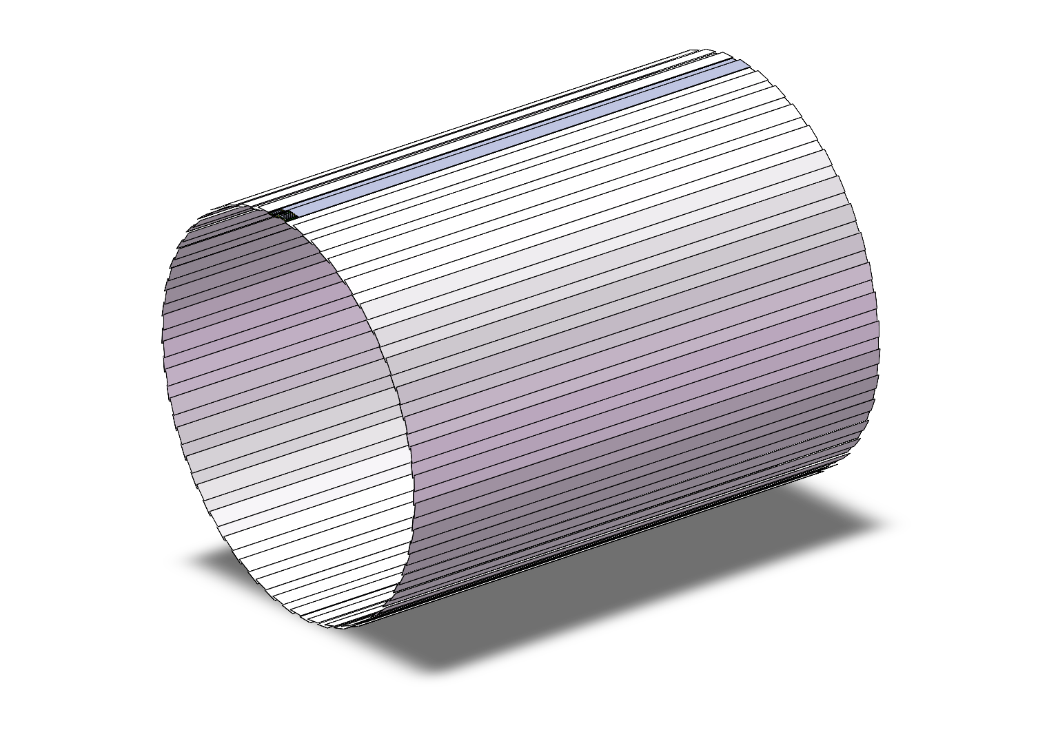
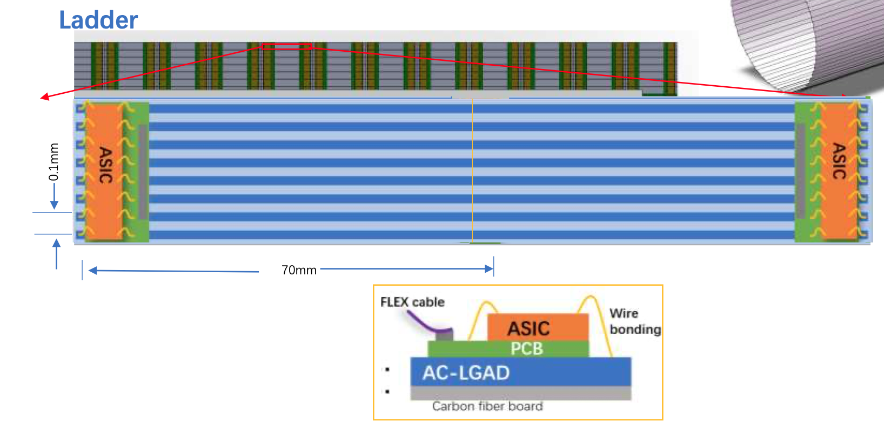
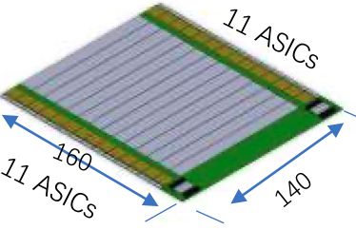
Arrangement of the ToF with strip LGAD：Barrel
One layer ToF
R= 1800 mm
H～5800mm
One layer: 3780 modules
  90 ladders，45 ladders each side,
  42 modules/ladder，
  22 ASIC/module，128 Channel/ASIC
Module
140mm x 160mm

Slide 5
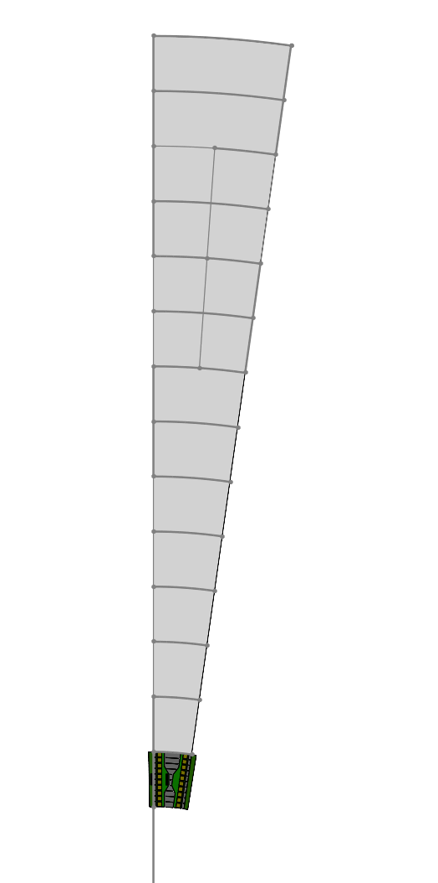
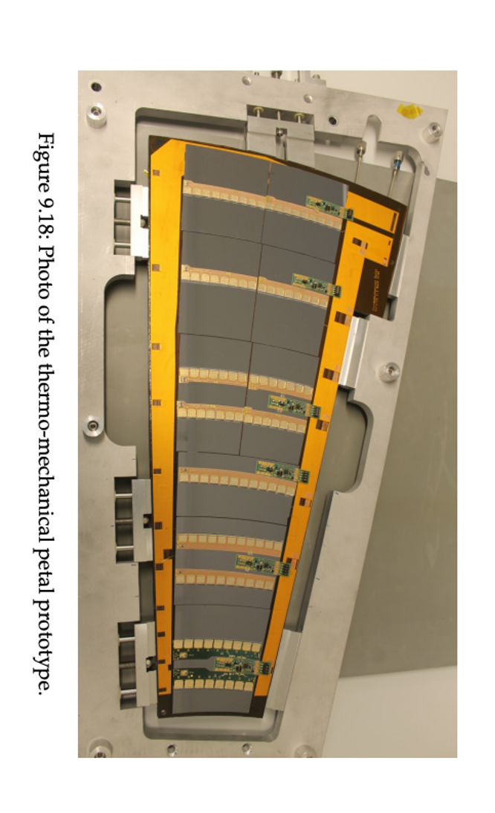
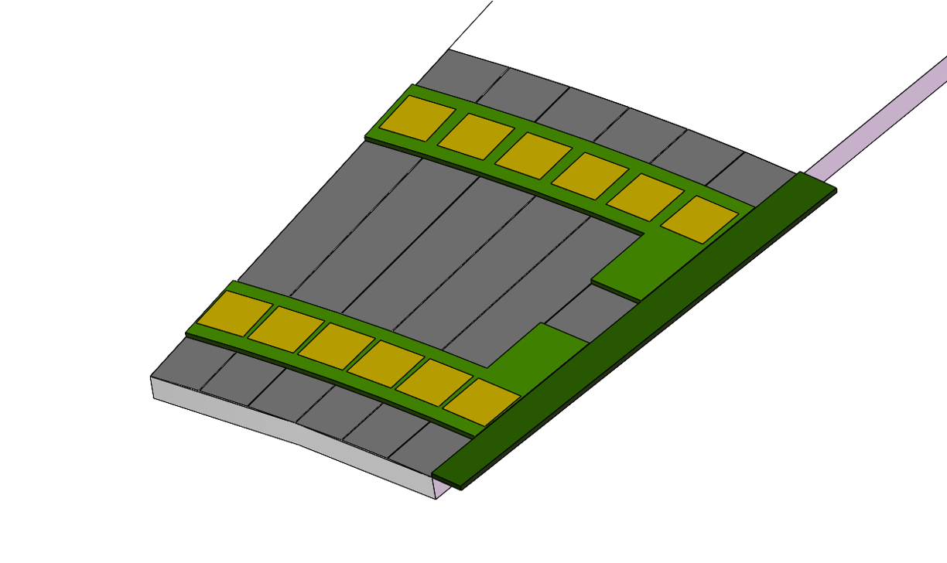
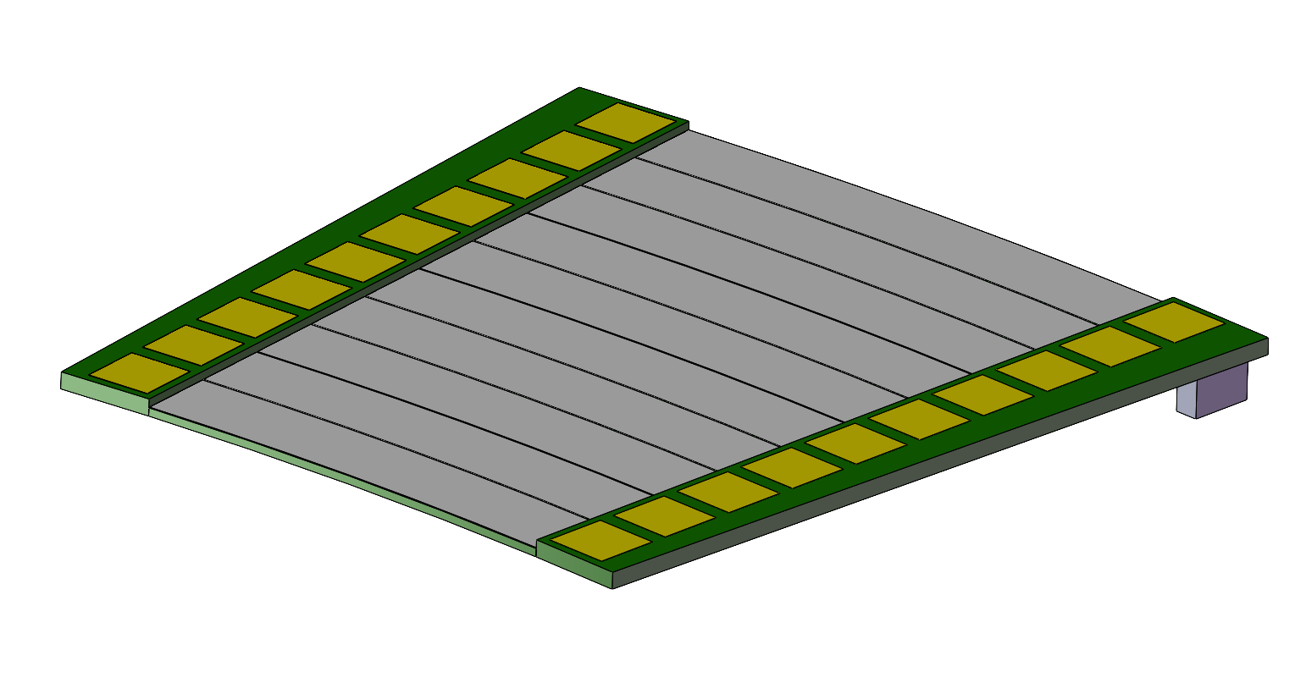
Arrangement of the ToF with strip LGAD ：Endcap
Petals： one petal each 8°× 45 = 360°
Total modules：~ 450(14cm × )
R：400 mm - 1800 mm
8°
Module
Longest side：140mm

Slide 6
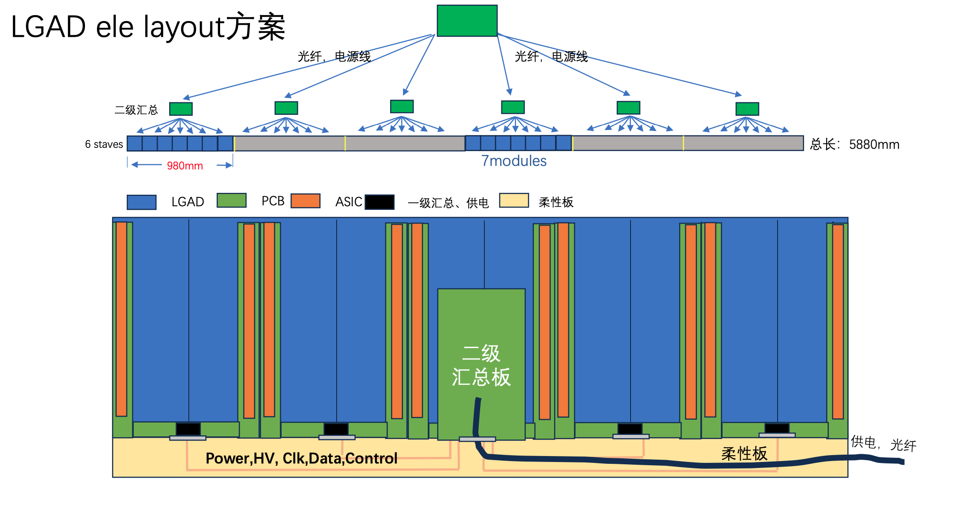
Layout of the Electronic System for LGAD ToF & oTracker

Slide 7
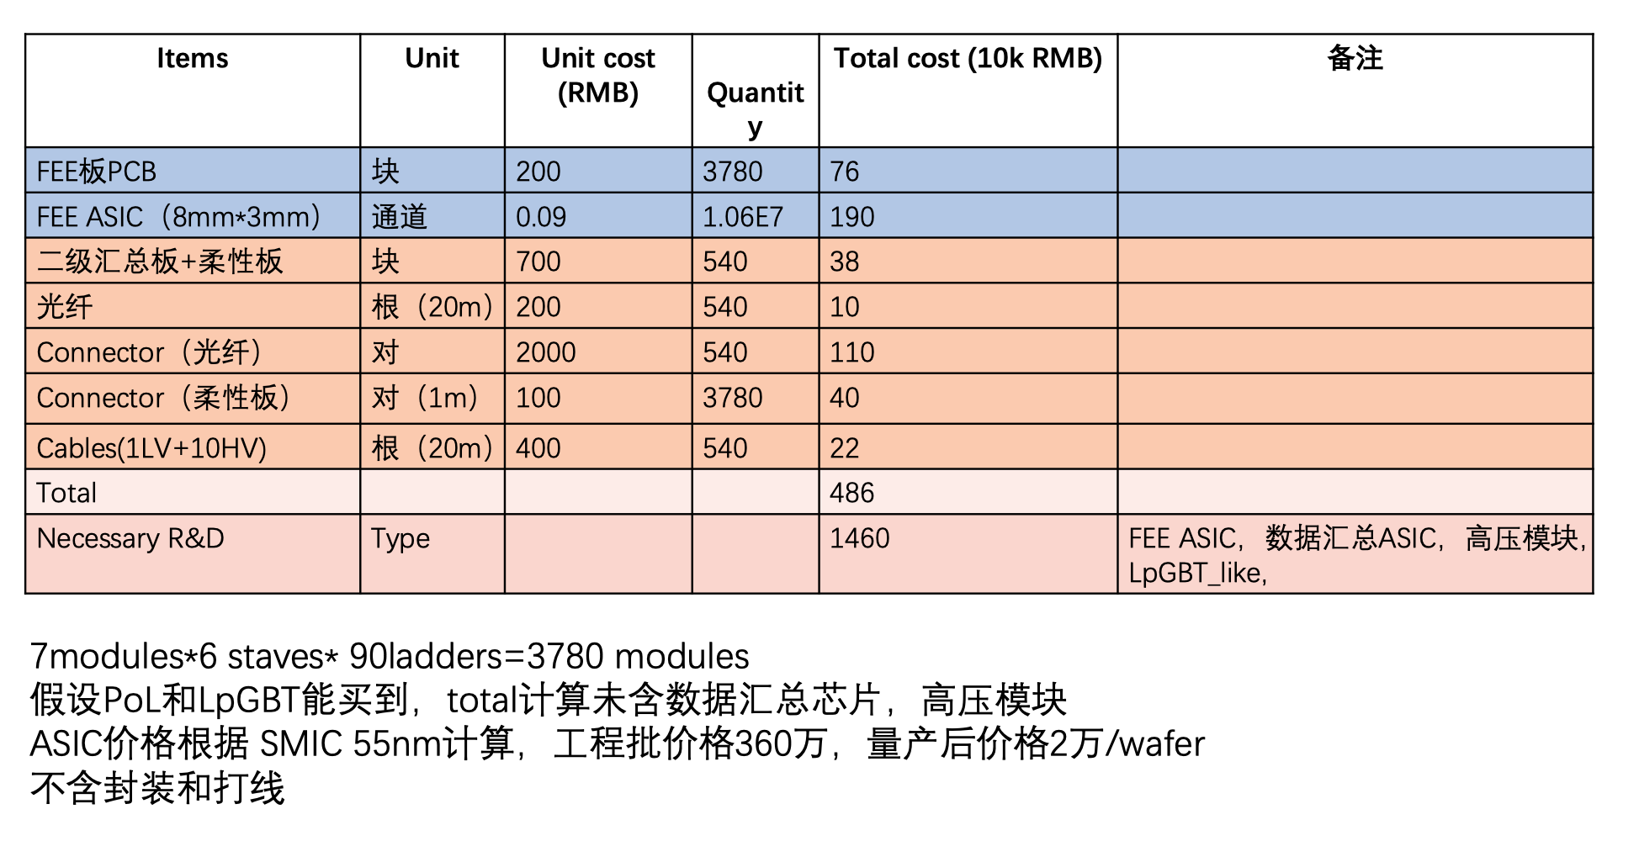
Electronic System Cost of LGAD ToF and OTracker

Slide 8
LGAD ToF & outTracker
 | CEPC TOF barrel | CEPC TOF endcap
Area (m²) | ~ 70 | ~9.7
Granularity | 70mm × 0.1mm (10平方厘米，每个芯片128道） | 70mm × 0.1mm (10平方厘米，每个芯片128道）
Capacitance | ~10 pF | ~10 pF
Charge | >15fC | >15fC
Channel number | ~ 1×10⁷ (10644480) | ~ 1×10⁶
Module assembly | Wire bonding at strip | Wire bonding at strip
MIP Time resolution | ~50 ps | ~50 ps
Spatial resolution | ~ 10 μm | ~ 10 μm （r or φ）
Number of Module | 3780 (14cm*14cm) | ~ 450 (14cm*) (一个扇形8°×扇形数45 = 360°)
Number of channels per module | 2816 (22 芯片，128道） | 2816 (22 芯片，128道）
Data size | 16 bit (9 TOT, 7 TOA) + channel(7bit, 128) +bunch ID(8bit) + chip ID (4-5 bit) ~40-48 bits | 16 bit (9 TOT, 7 TOA) + channel(7bit, 128) +bunch ID(8bit) + chip ID (4-5 bit) ~40-48 bits
Data rate | 5Hz/ cm2 | ?Hz/ cm2

Slide 9
Cost Estimation of LGAD ToF & outTracker
Cost （RMB） | CEPC barrel | endcap
LGAD sensor | 35M（70m²） | 4.85M（9.7m²）
Electronics total | 4.86M | 0.565M
Total (sensor+elec.) | 39.86M | 5.415M
Electronics R&D | 14.6M
Total | 59.875M

Slide 10
Backup

Slide 12
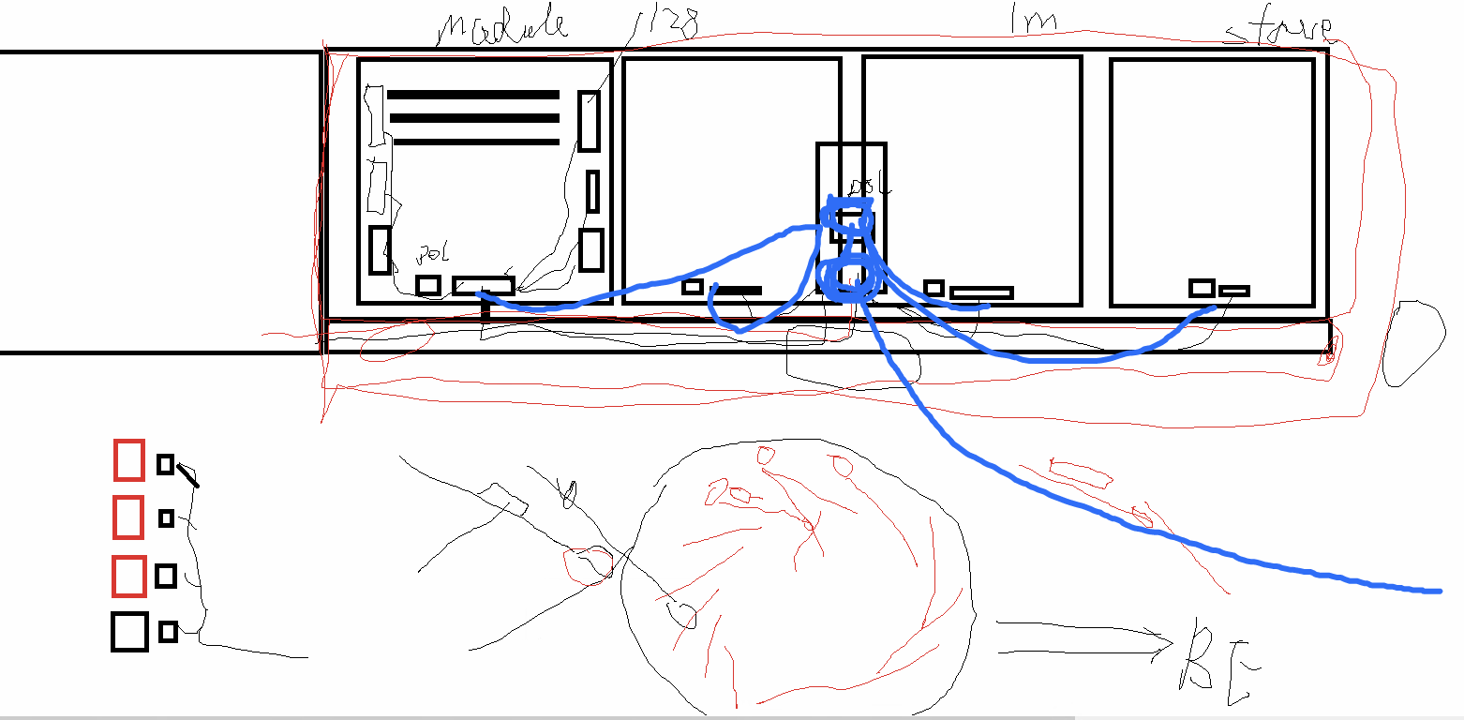
确定了电子学框架

Slide 13
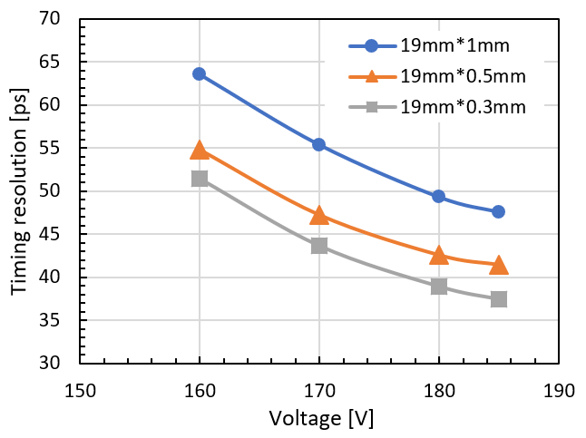
Timing resolution (different dimension of strip )

Slide 14
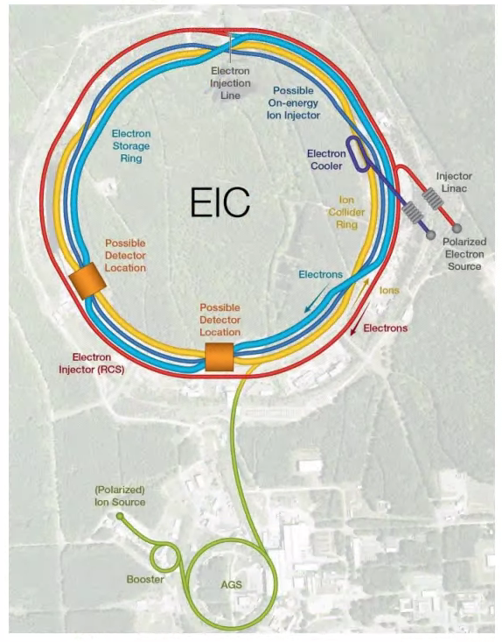
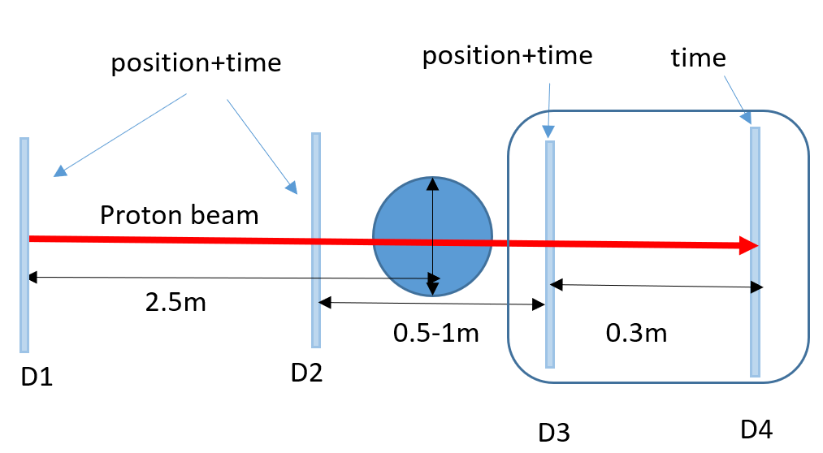
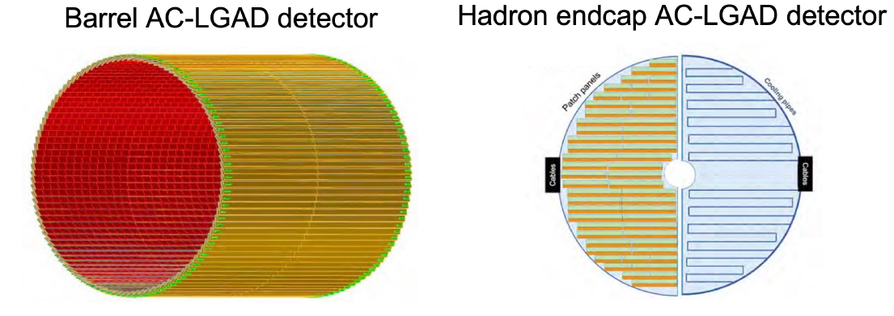

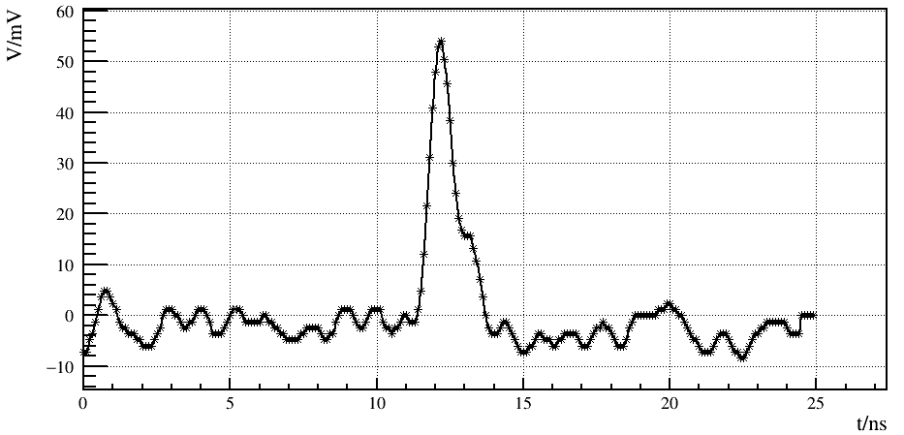
Application of AC-LGAD
Electron-Ion Collider (EIC)：Timing-tracker
Nuclear Medicine Instruments：
Such as proton therapy and proton CT
10.9 m²
2.22 m²
X-ray detectors @ advanced light sources
HEPS @ Beijing
other applications
Beam Telescope for Beam Test Platform
LiDAR: Positioning and Navigation
Track and time detectors in other particle physics and nuclear physics experiments
…
6 KeV X-Ray
mzli@ihep.ac.cn

Slide 15
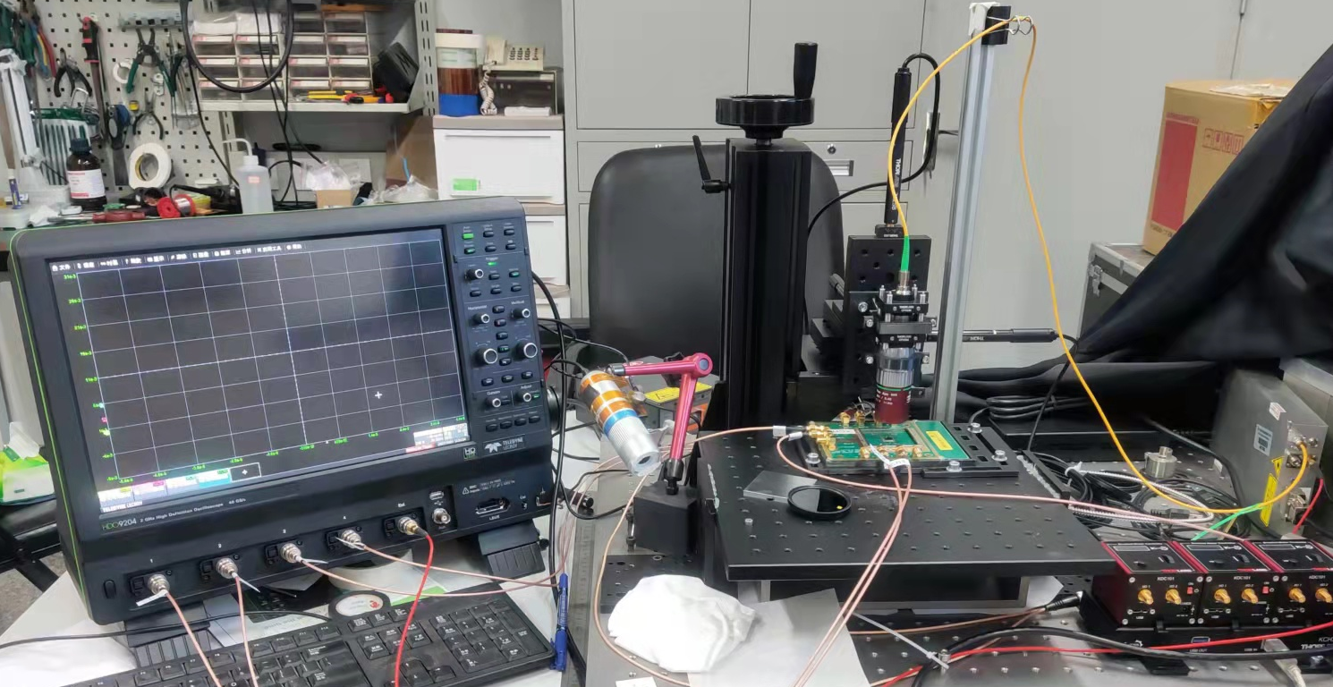
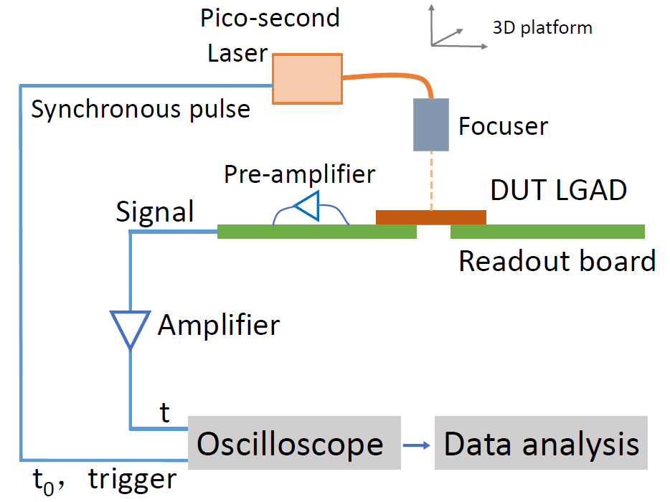
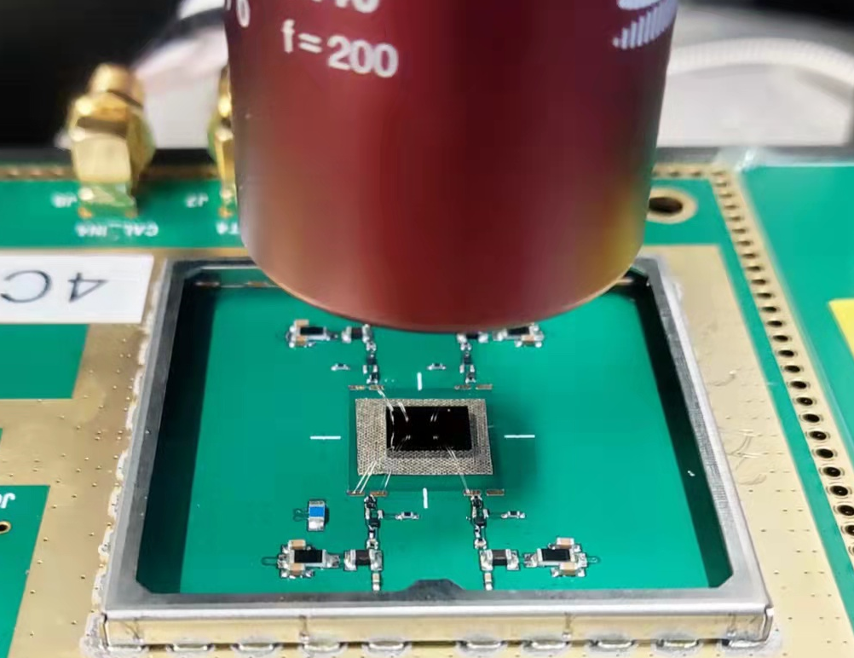
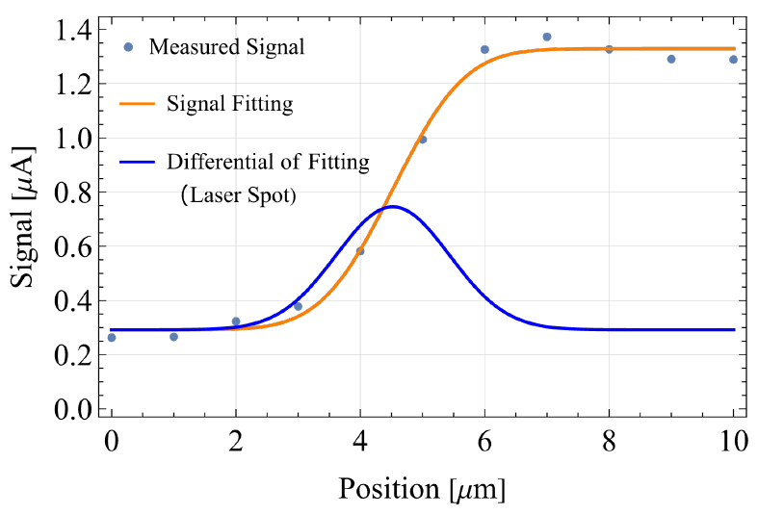
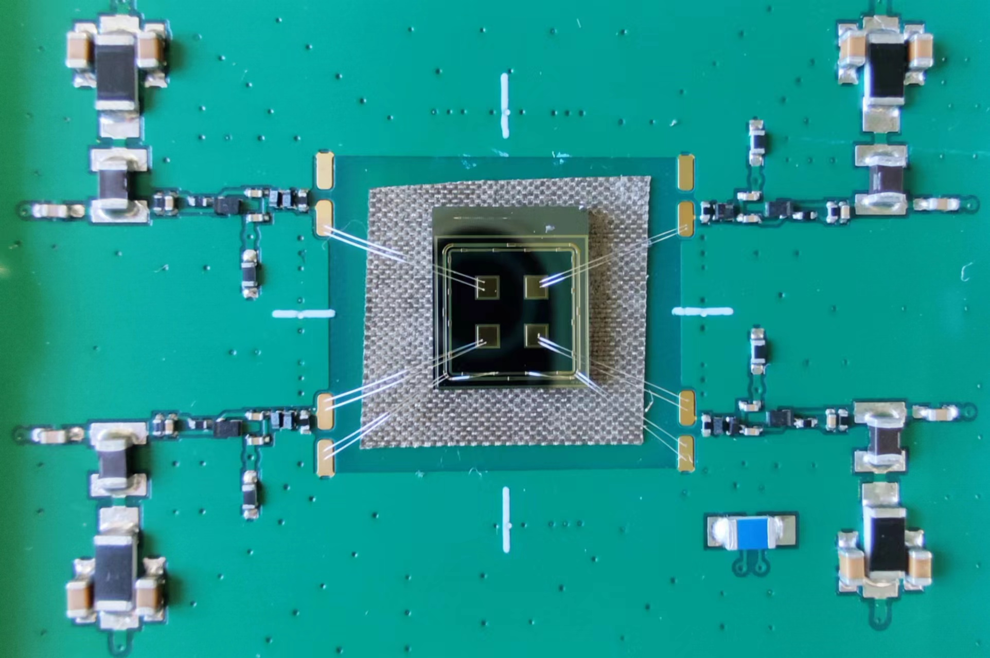
4.1 AC-LGAD sensor test ： Picosecond laser test
Picosecond laser scanning system
3D platform
Sensor & Board
focuser
Picosecond laser 1064nm
Picosecond laser scanning system
Displacement accuracy 1 μm
Automated scanning
Picosecond laser 1064nm
Spot size 2~5 μm
mzli@ihep.ac.cn

Slide 16
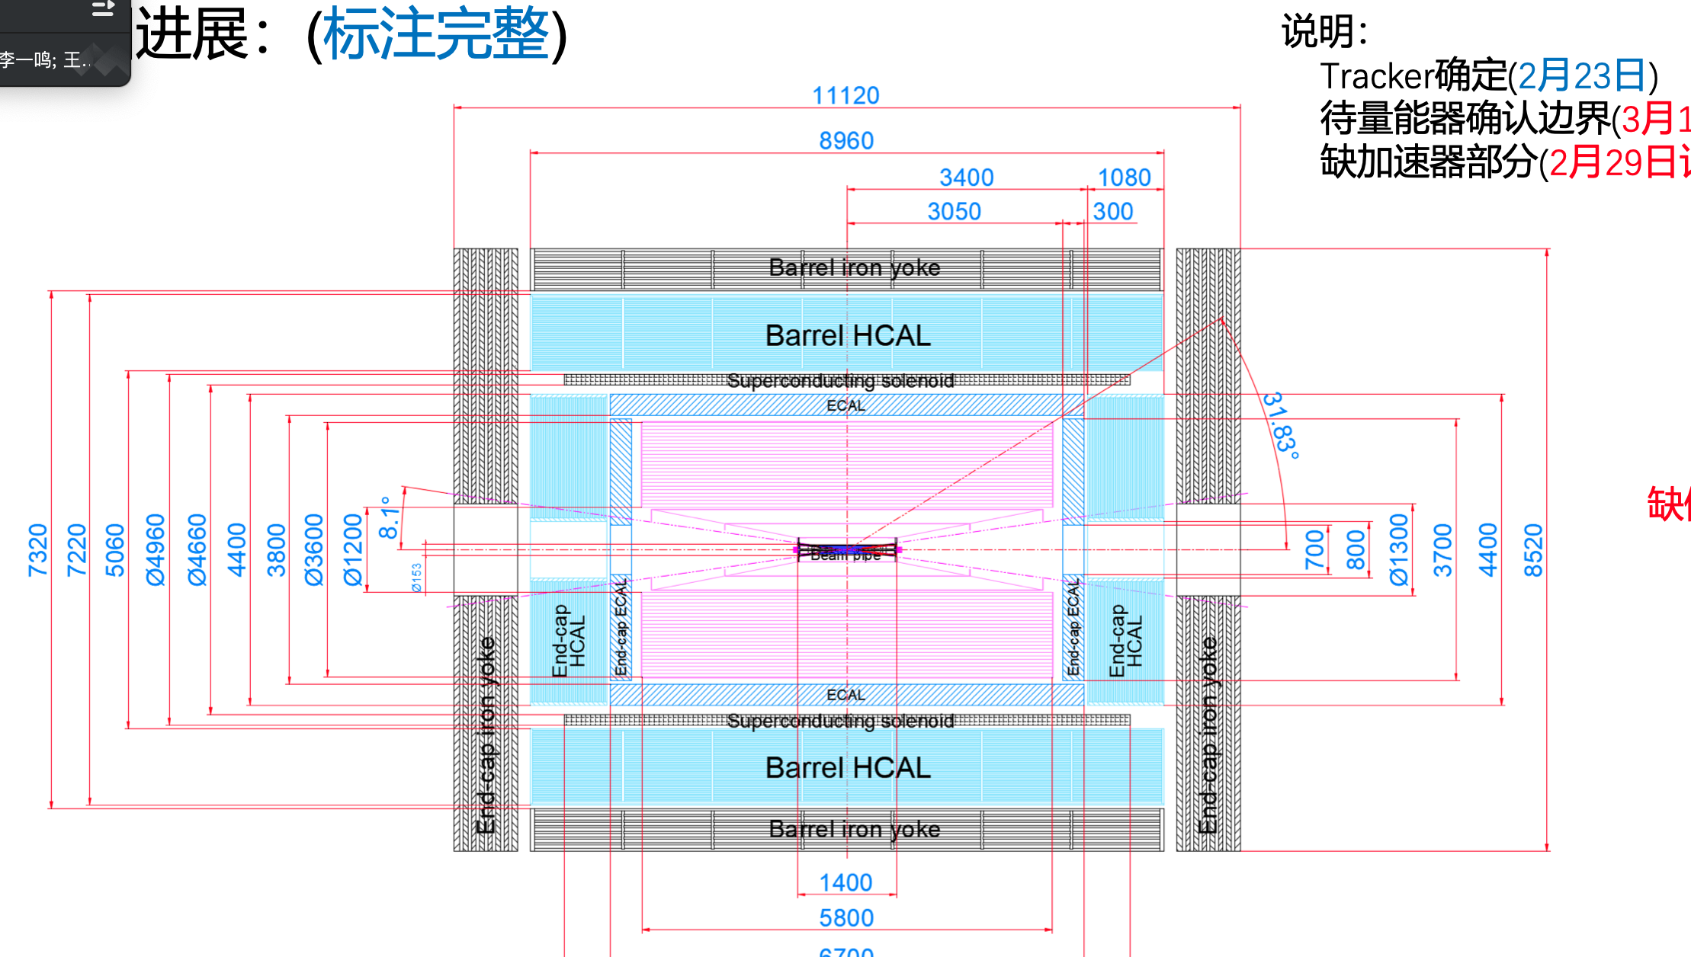

Slide 17
