Slide 1
Performance and Validation of AHCAL
Diao Hongbin & Du Dejing

Slide 2
Directory
calibration parameters
pedestal
high-lowgain ratio
mip
spe
simulation and digitization
energy response
electron
pion

Slide 3
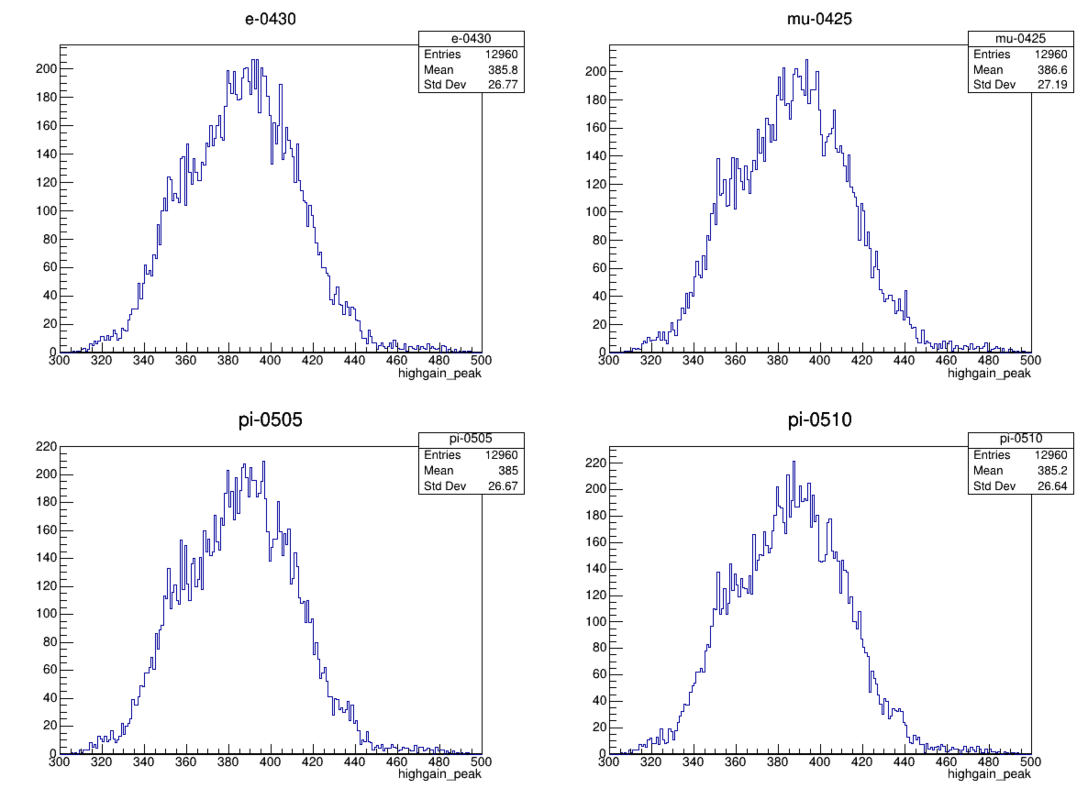
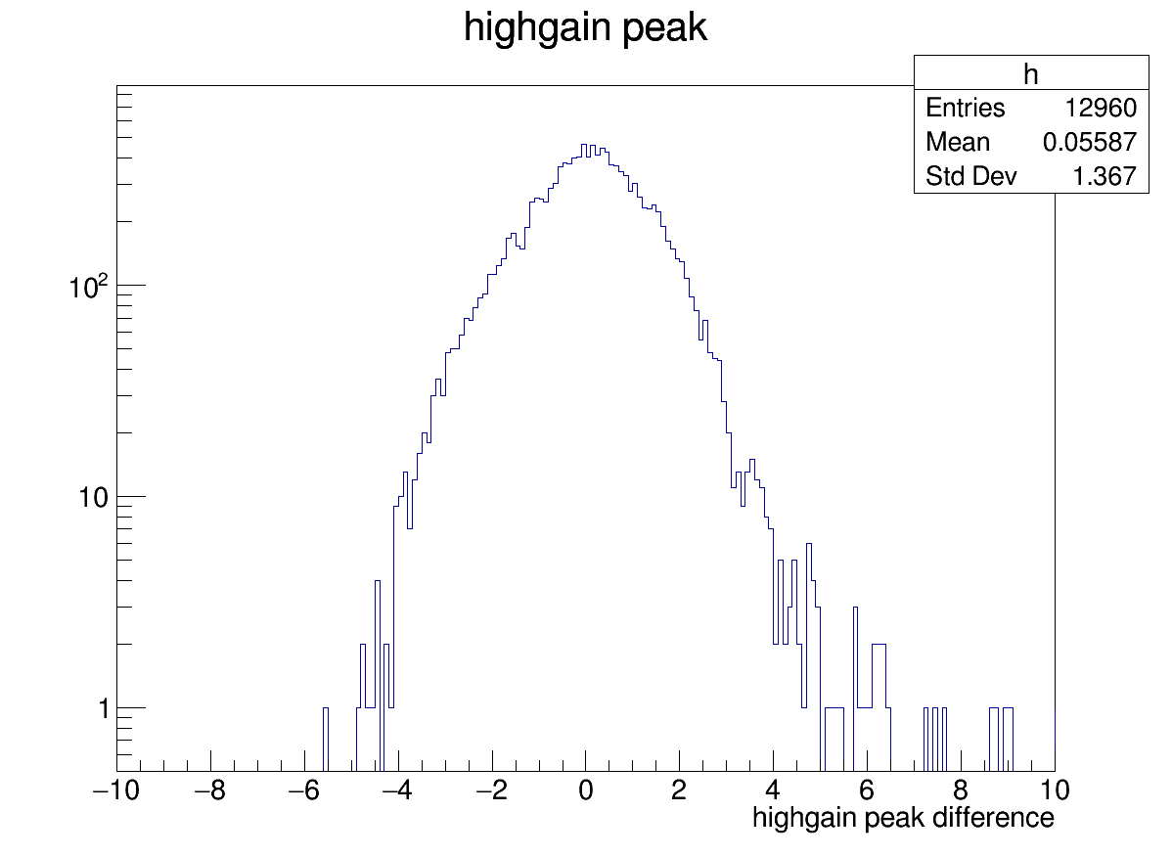
Pedestal calibration
pedestal is obtained from force-trigger-mode file to prevent
potential problems.
pedestal is stable during beam test in SPS or PS
and for different particles
the highgain pedestal comparison in different time and different particles
calibrated from beam test
highgain pedestal of PS minus SPS

Slide 4
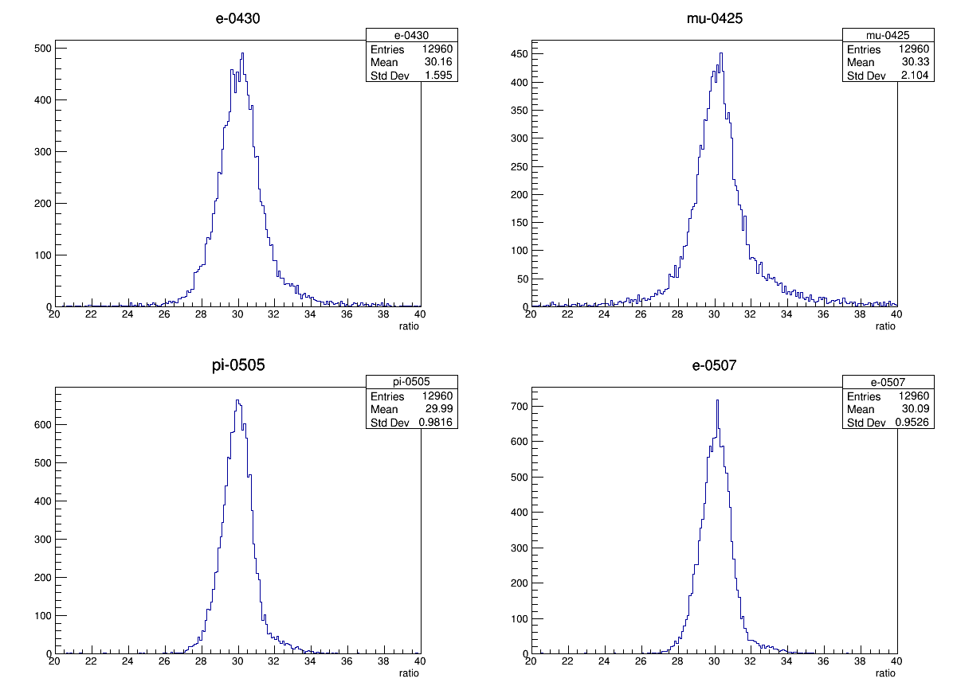
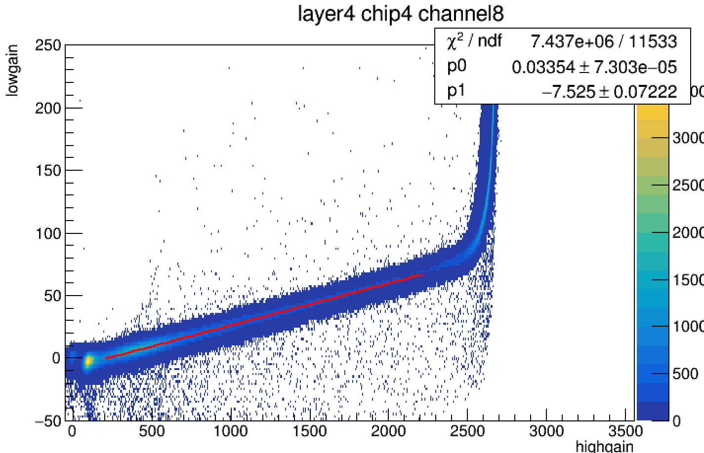
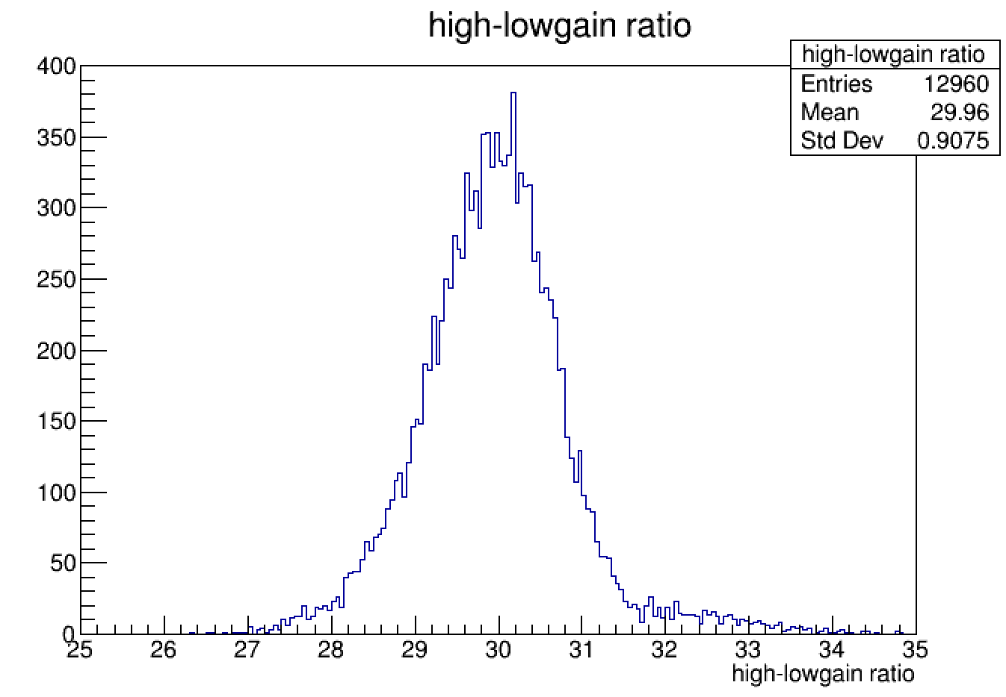
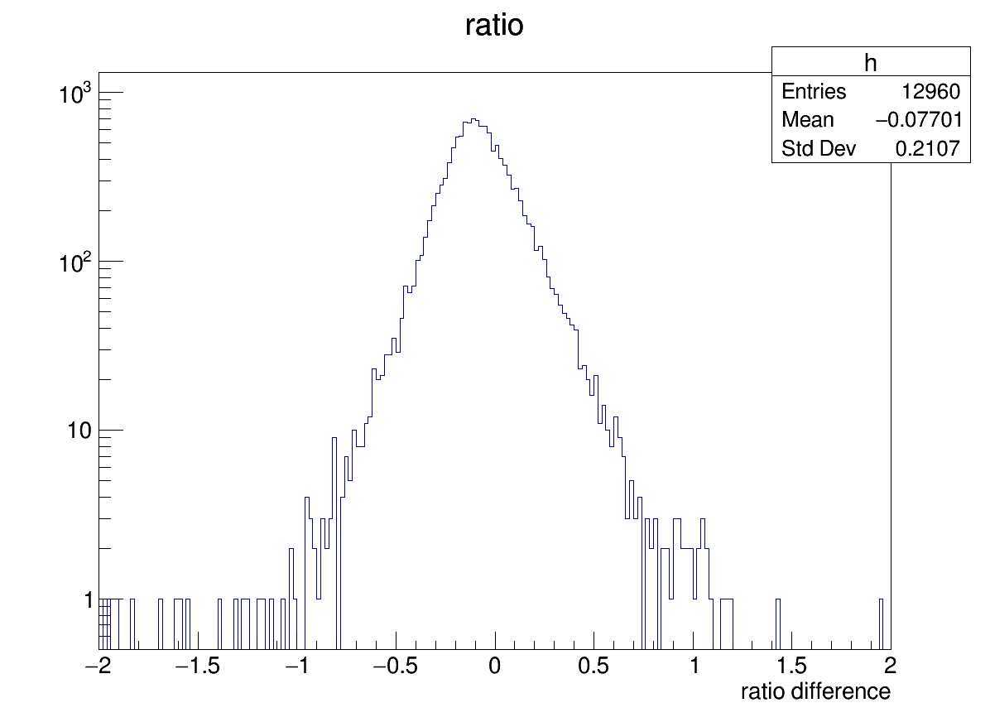
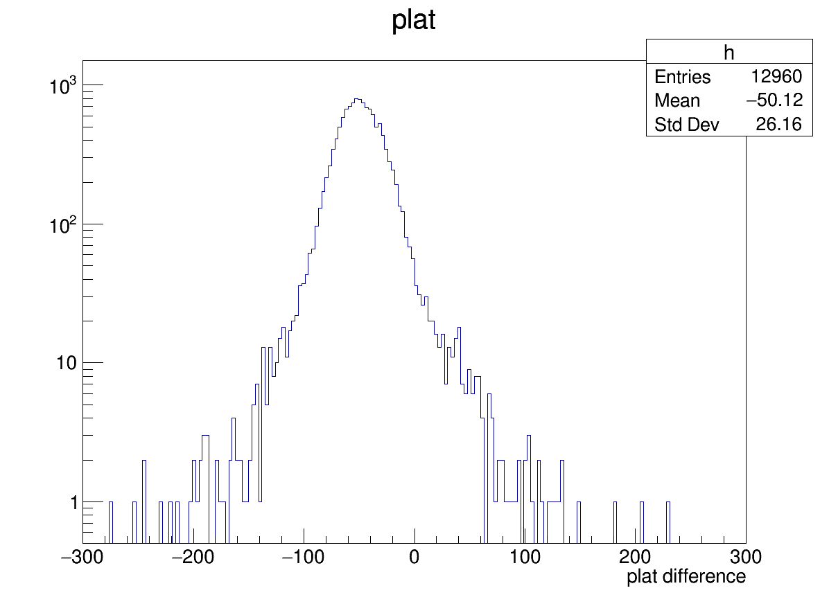
High gain and low gain intercalibration
SPIROC2E chip has two gain modes to cover larger
dynamic range
get the max highgain adc
set fit range as (200,max highgain-500)
ratio is stable during beam test in SPS or PS
and for different particles
the ratio comparison in different time and different particles
ratio and max highgain of PS minus SPS

Slide 5
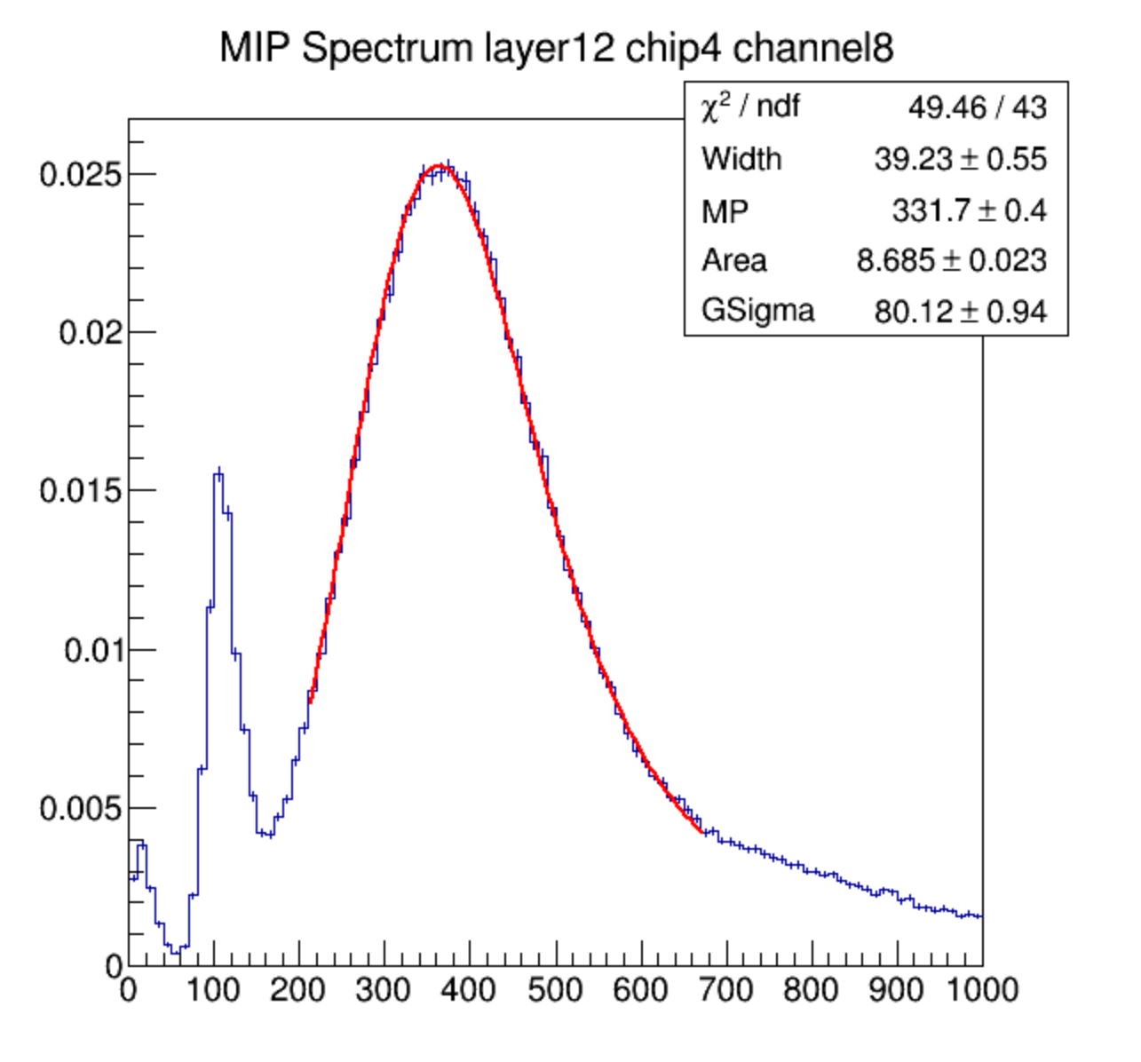
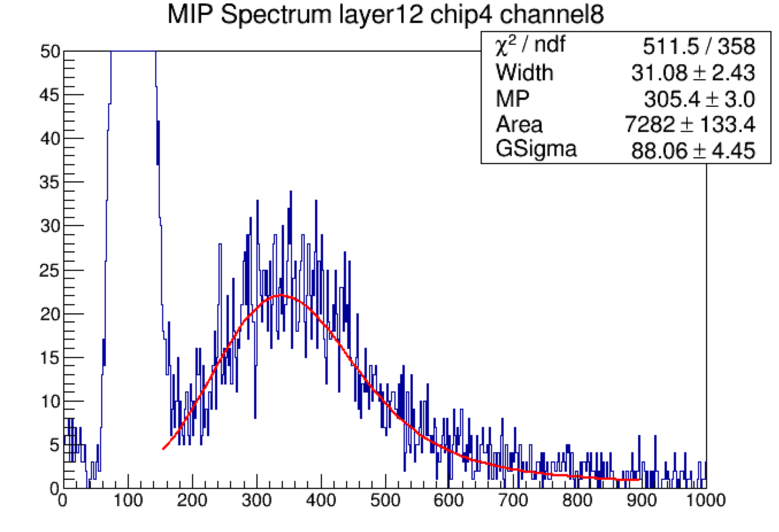
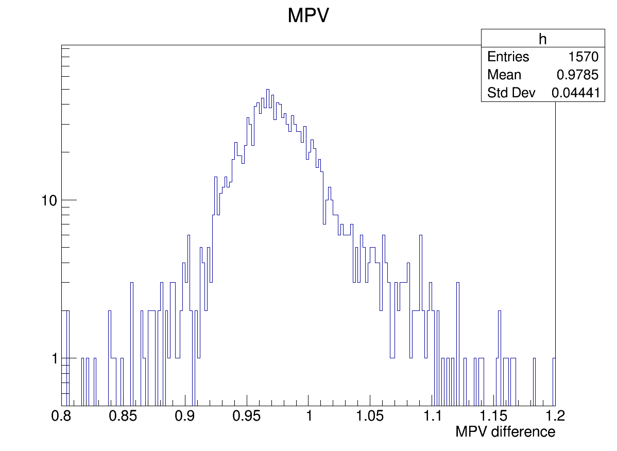
MIP calibratio
MIP peak value is obtained by fitting 100GeV/c
muon- events with Landau Convoluted Gaussian function
MPV is not stable during beam test in SPS or PS
SPS is bigger than PS
SPS
PS
MPV of channels whose entries >2000
of PS divided by SPS

Slide 6
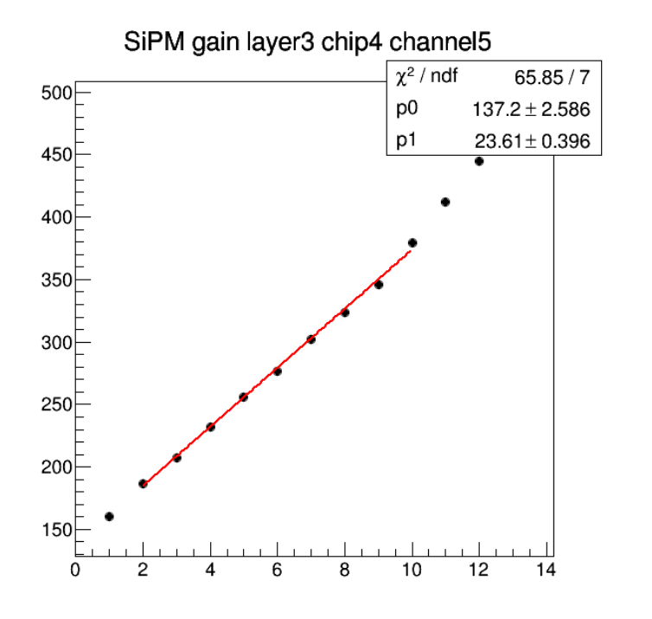
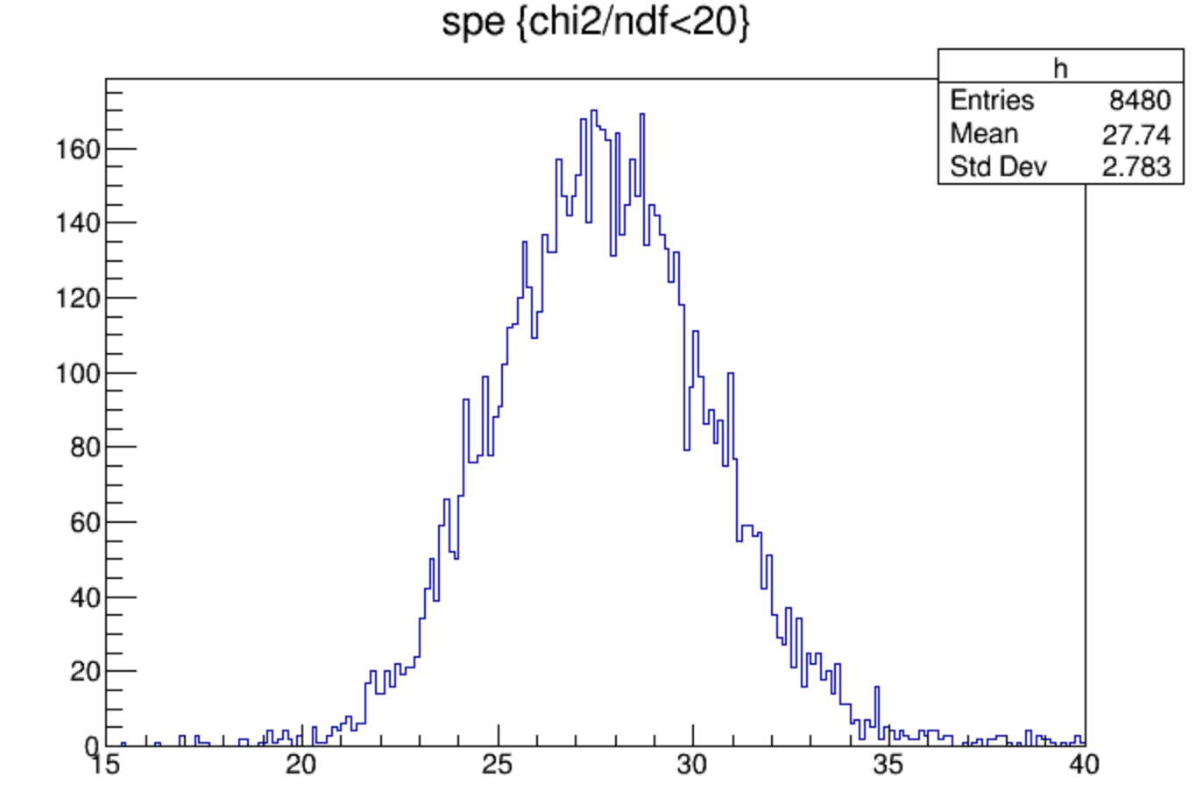
SPE calibration
muon- data are fitted with multi-gaussians
to calculate SiPM gain for each channel

Slide 7
Simulation setup
incident particle
based on baohua’s code
change the thickness of ESR to 65um, and material to 1.38g/cm^3 C10H8O4
add front trigger detector, thickness is variable
add copper in PCB
the thickness of Cu and PCB is variable
front trigger detector: polystyrene
gap: air, 1.5m
Absorber: steel: 2 mm
Scintillator: polystyrene: 3 mm
PCB: FR4
Cu
gap: air
Absorber: steel: 18 mm

Slide 8
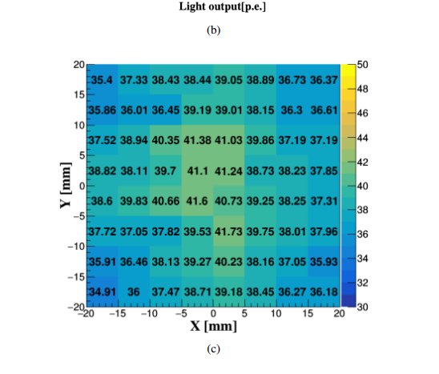
Digitization
4.8% gassian smear because non-uniformity of light output
energy to photon (poisson distribution)
photon to phoelectron (binomial distribution, PDE=0.32)
SiPM response model
gaussian smear with sigma
phoelectron to adc
gaussian smear (sigma of single phoelectron peak sqrt(n)*3)
adc to highgain and lowgain

Slide 9
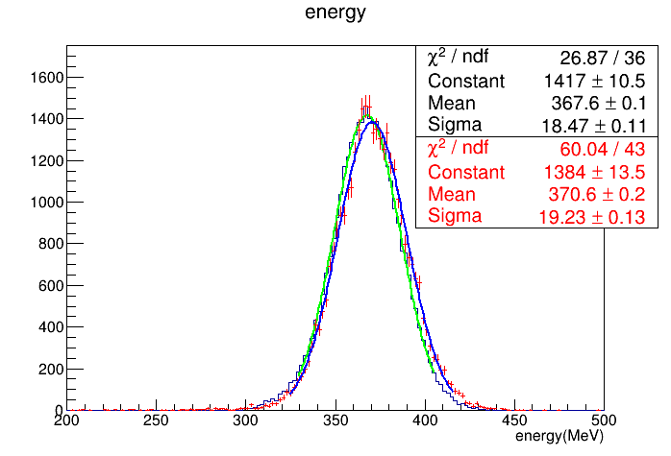
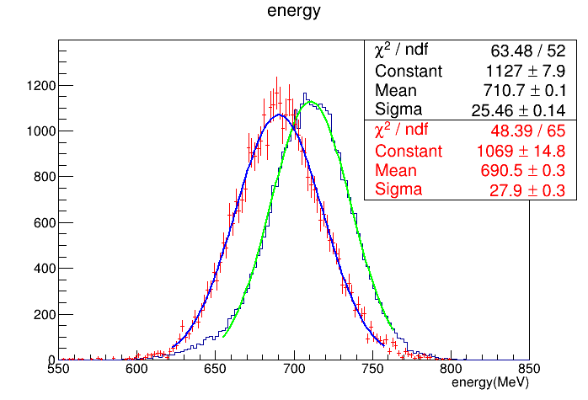
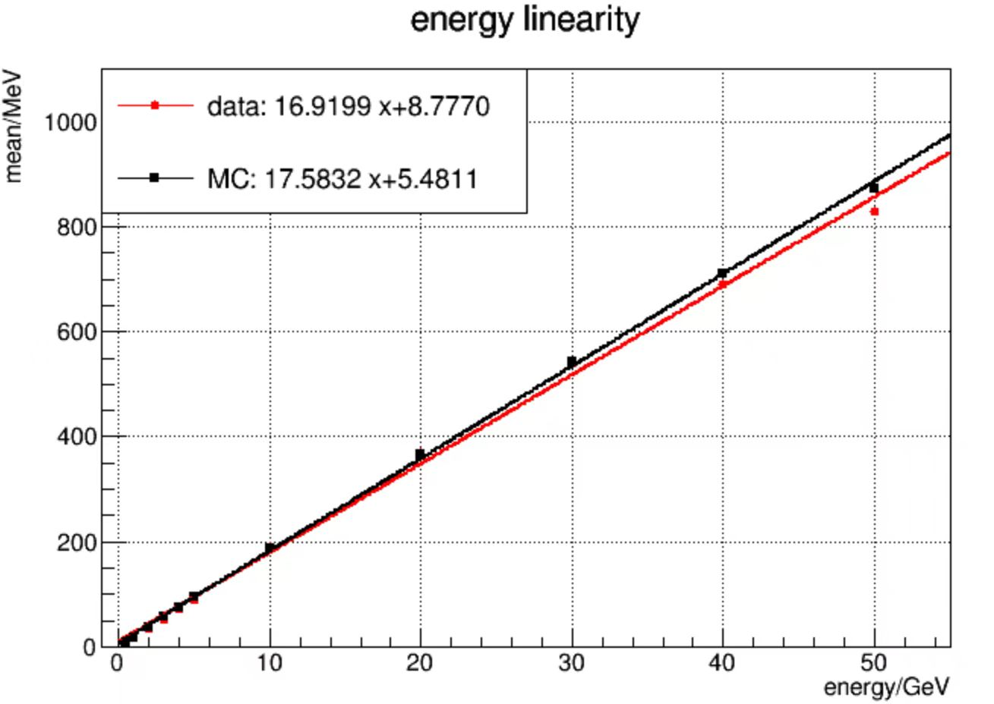
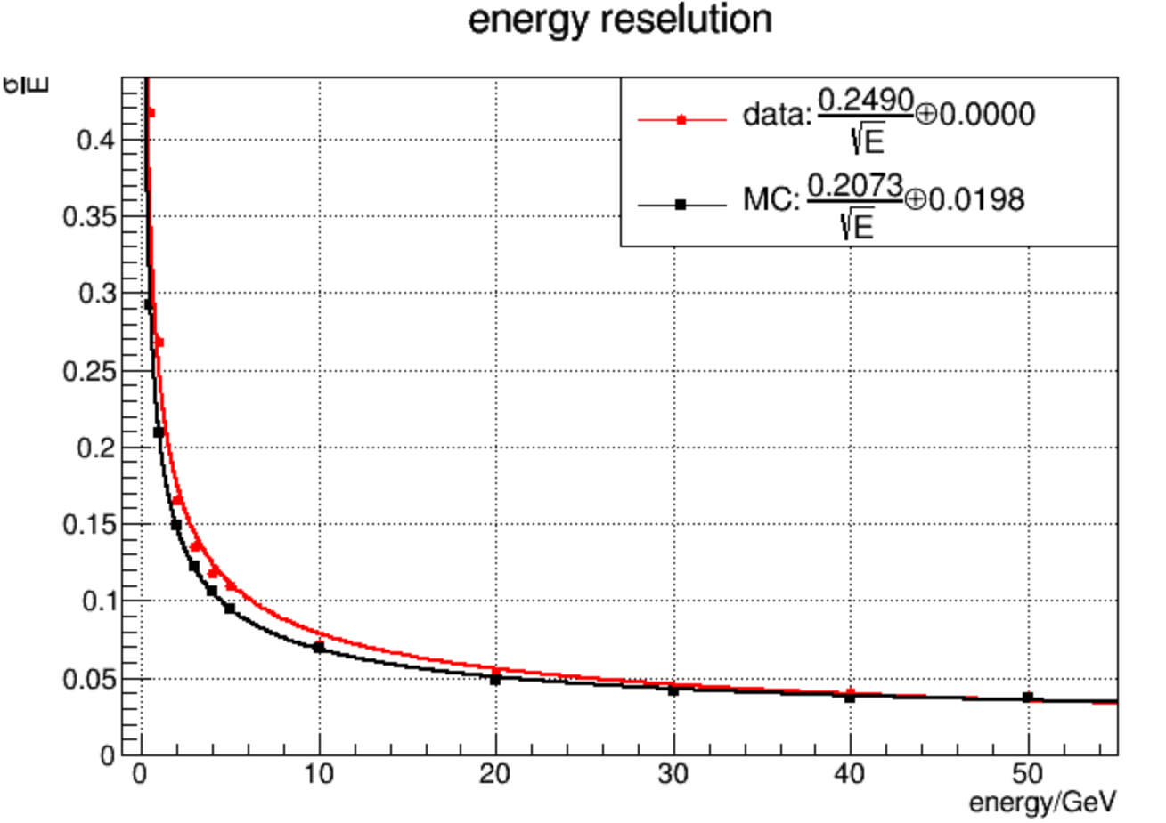
Electron energy response
position cut of energy center has
been done (similar to jiaxuan)
20GeV e-
40GeV e-

Slide 10
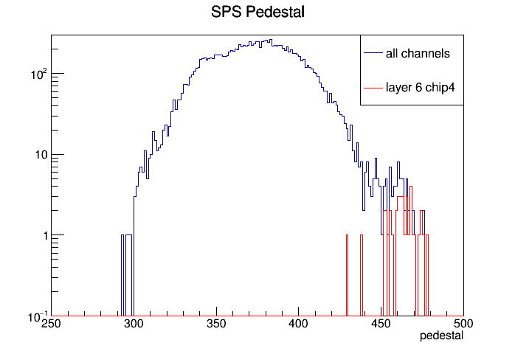
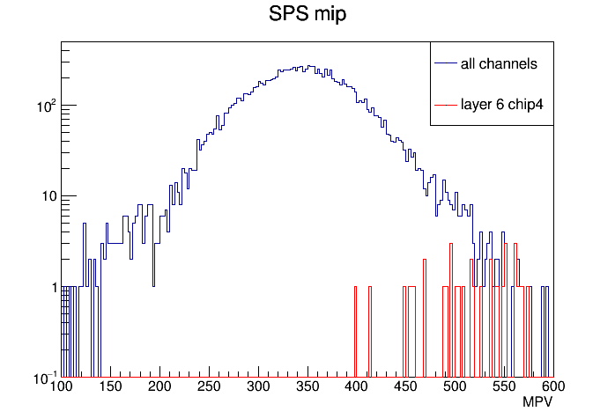
Layer profile
20GeV electron with 100mm front trigger detector
parameters of layer6 chip4
(fit is well)

Slide 11
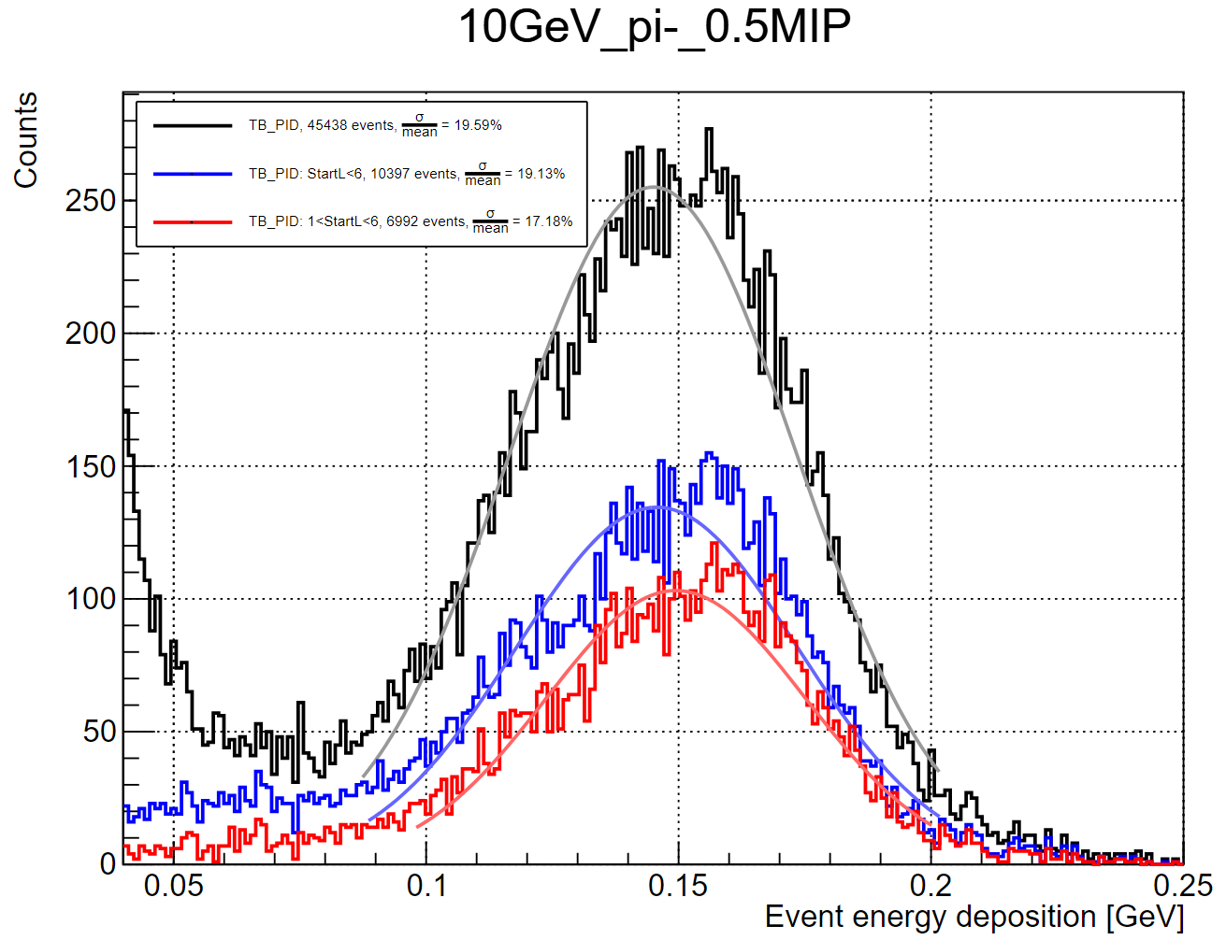
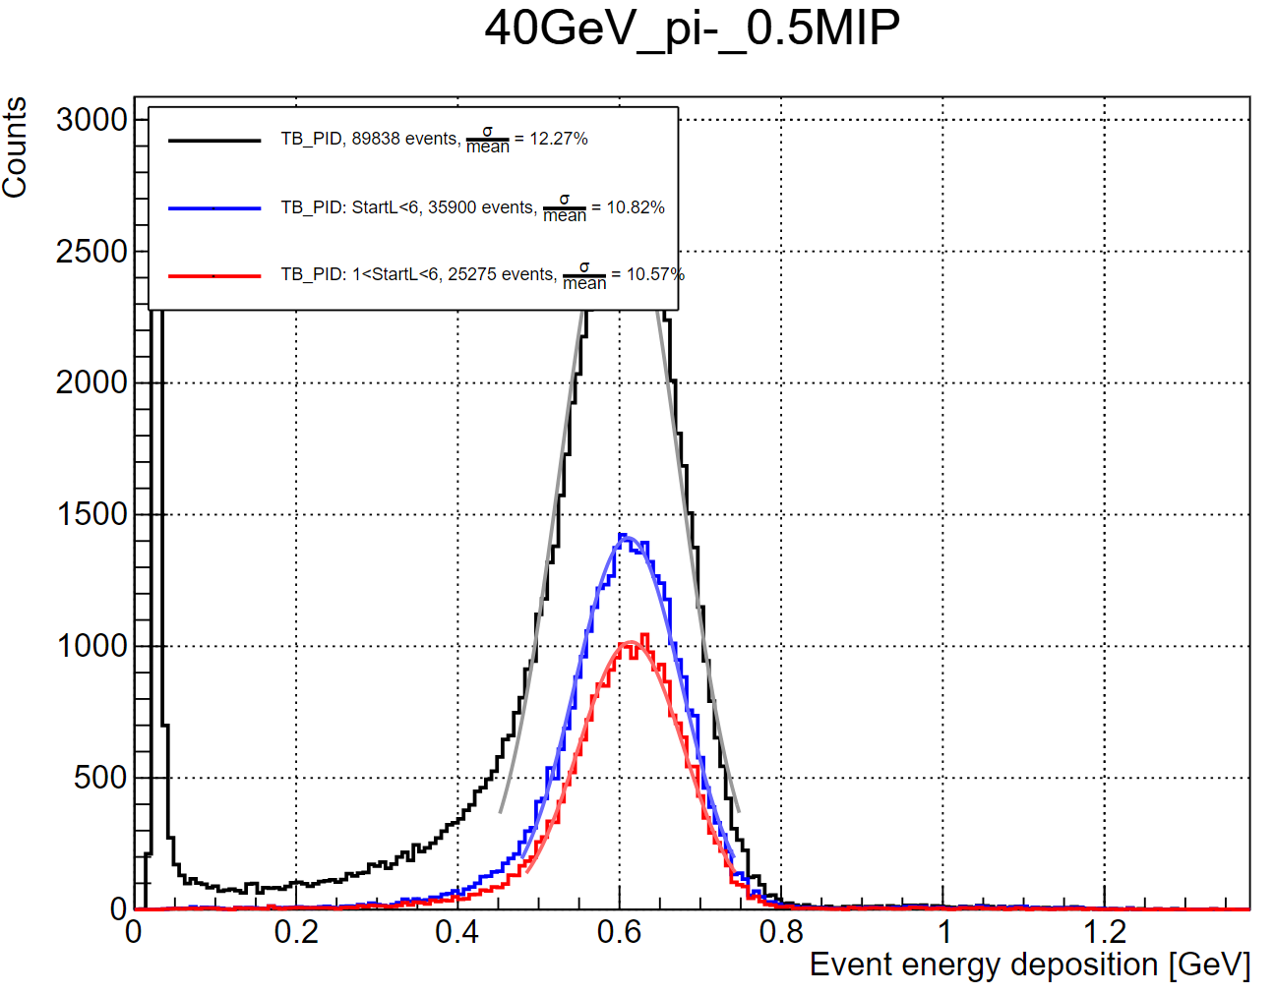
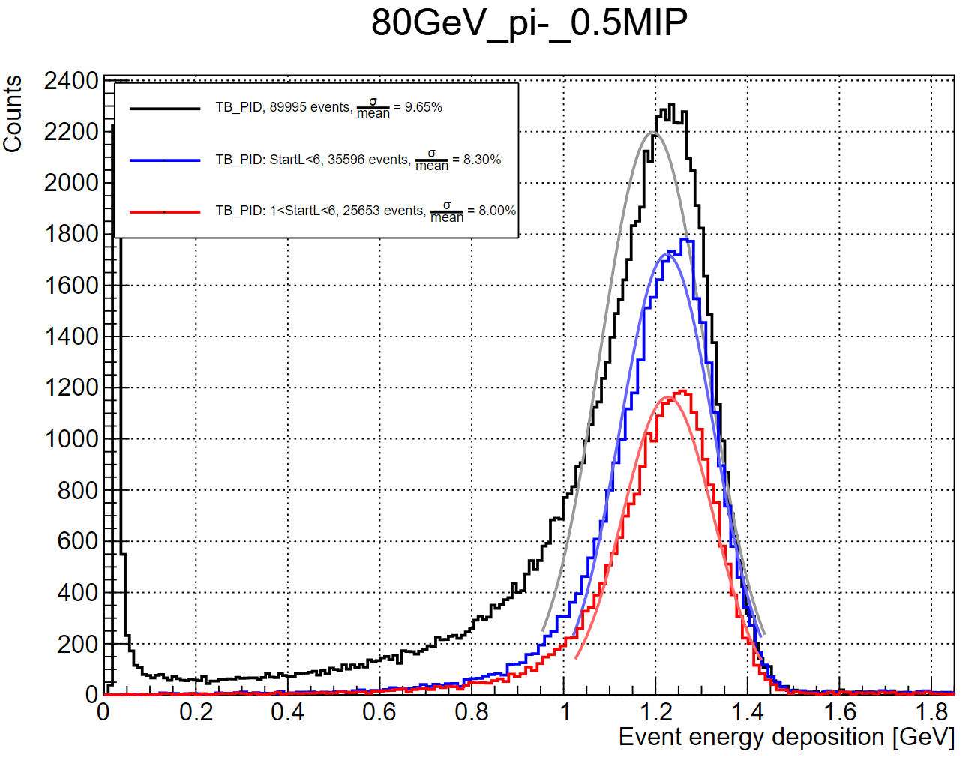
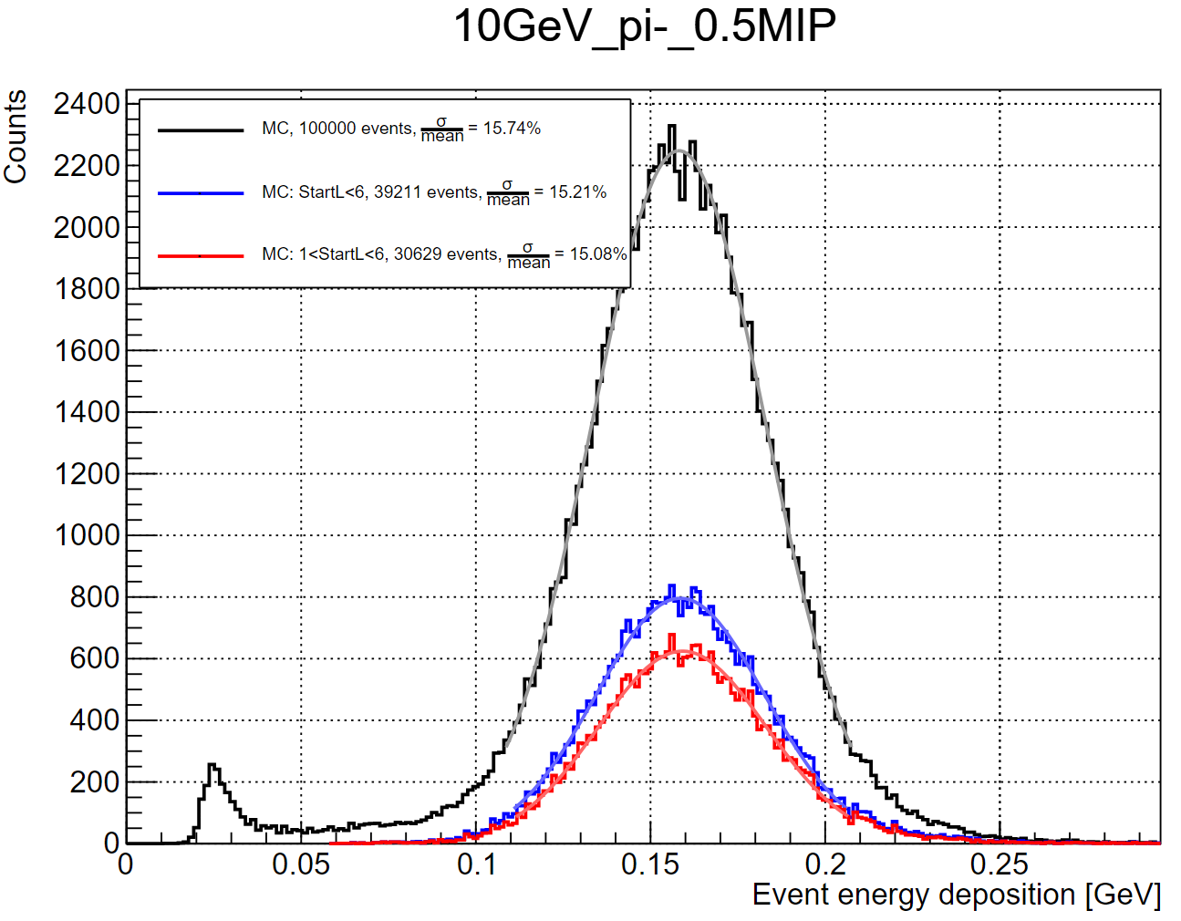
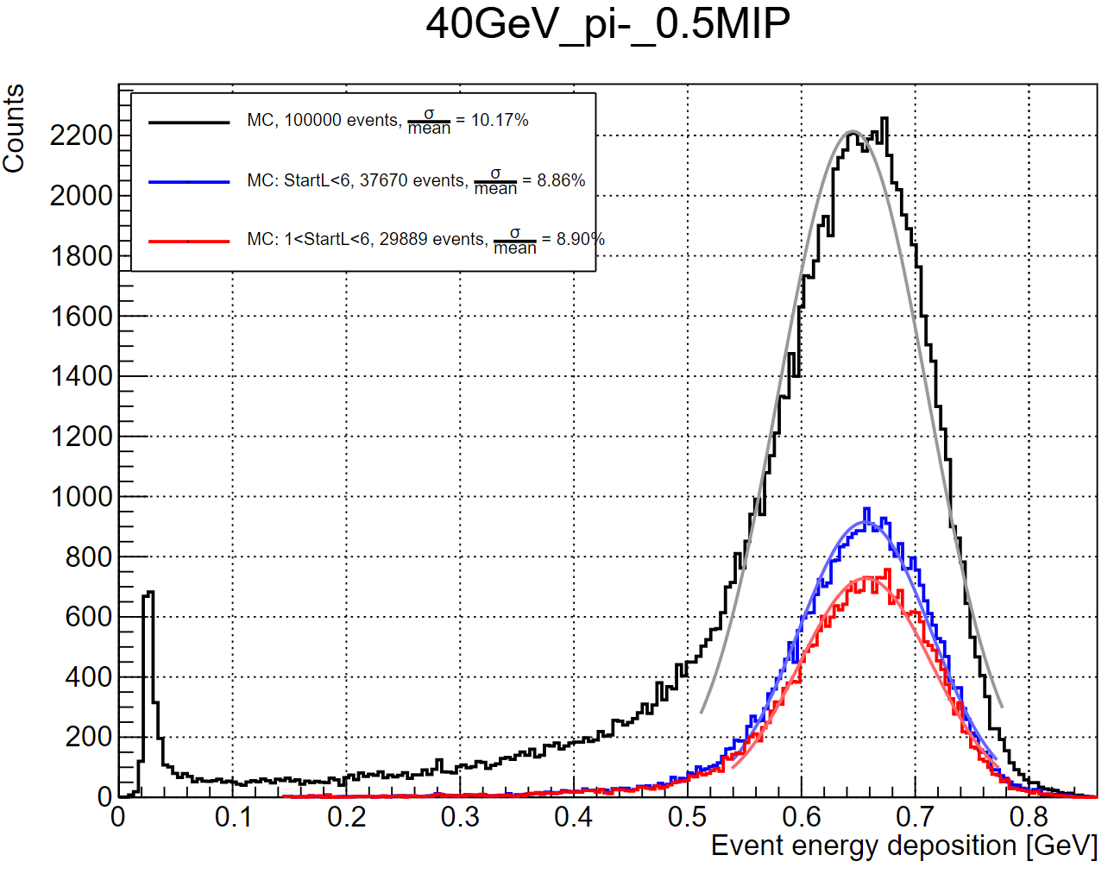
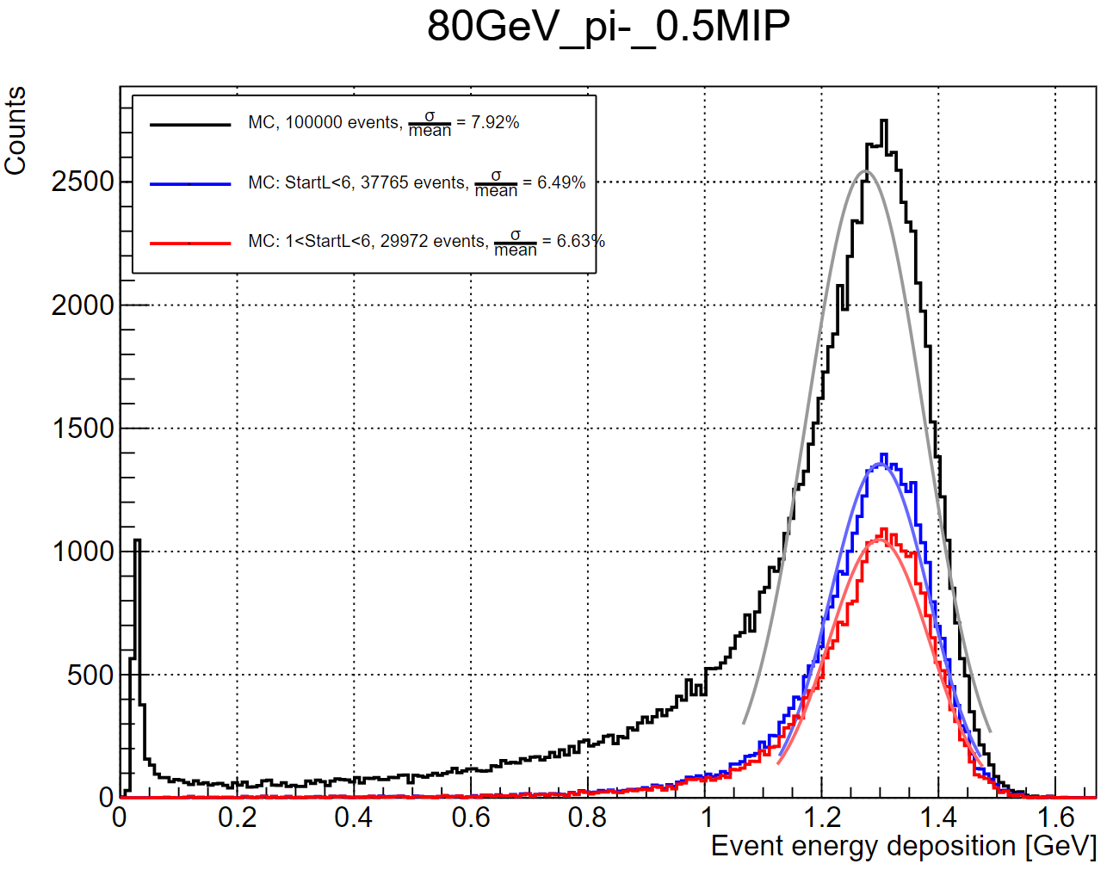
Pion energy response: cut for energy leakage (dejing)
TB data with PID
Calibrated by Hongbin
PID from Xin
Optimized shower start algorithm
MC sample
Simulated by Baohua
Digitization: ch by ch
Optimized shower start algorithm
Limiting the shower starting layer can effectively improve the energy resolution
The effect of pre-shower is significant in beam data, especially at low energy, and cut of starting layer > 1 can be improved

Slide 12
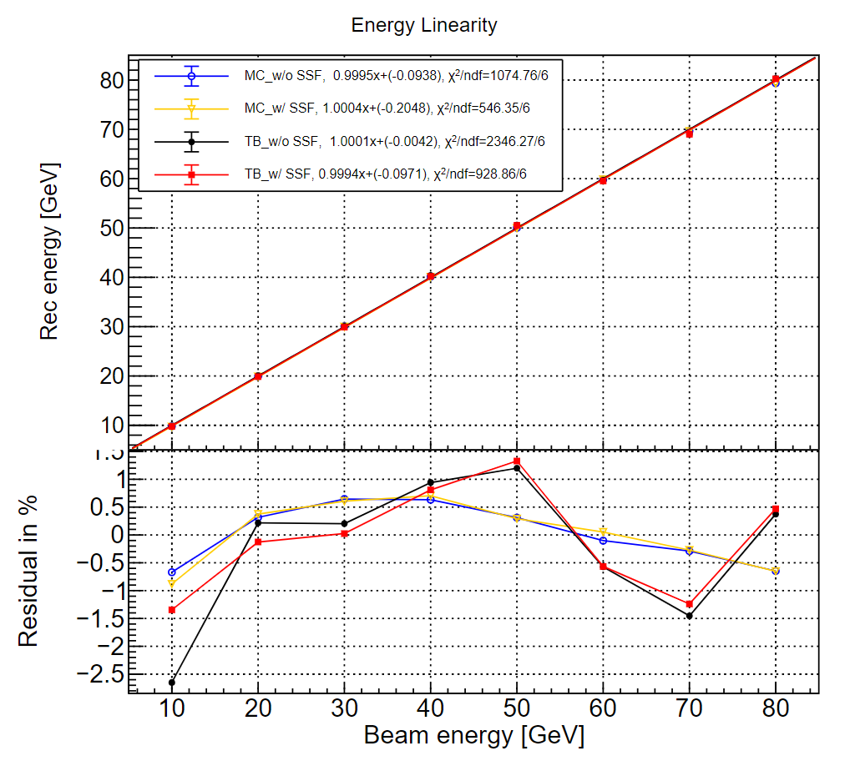
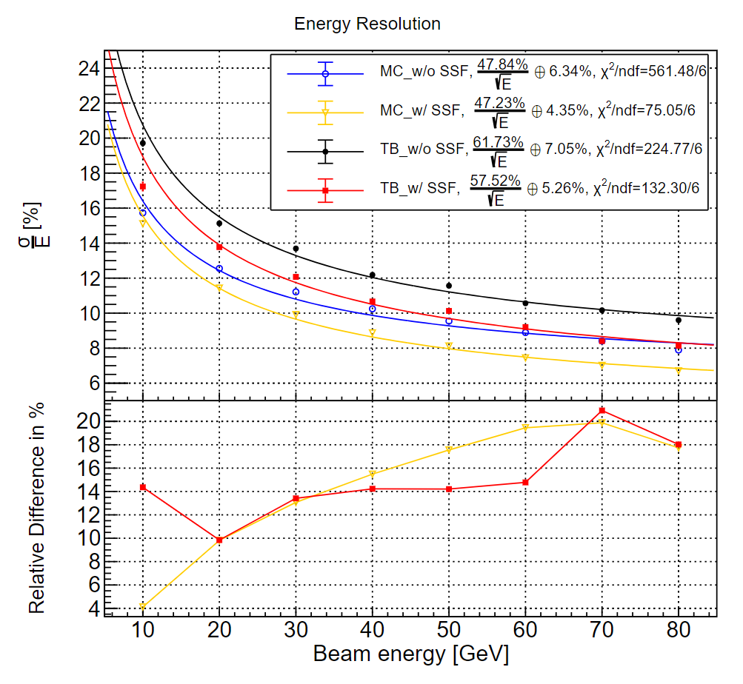
Pion energy response: MC vs. TB (dejing)
The limitation of the shower starting position can significantly improve energy resolution
Energy linearity: TB better than ±1.5%, MC better than ±1%
Energy resolution: TB ($\frac{57.5\%}{\sqrt{E}}⊕5.3\%$), MC ($\frac{47.2\%}{\sqrt{E}}⊕4.4\%$)
The constant term needs to be further improved

Slide 13
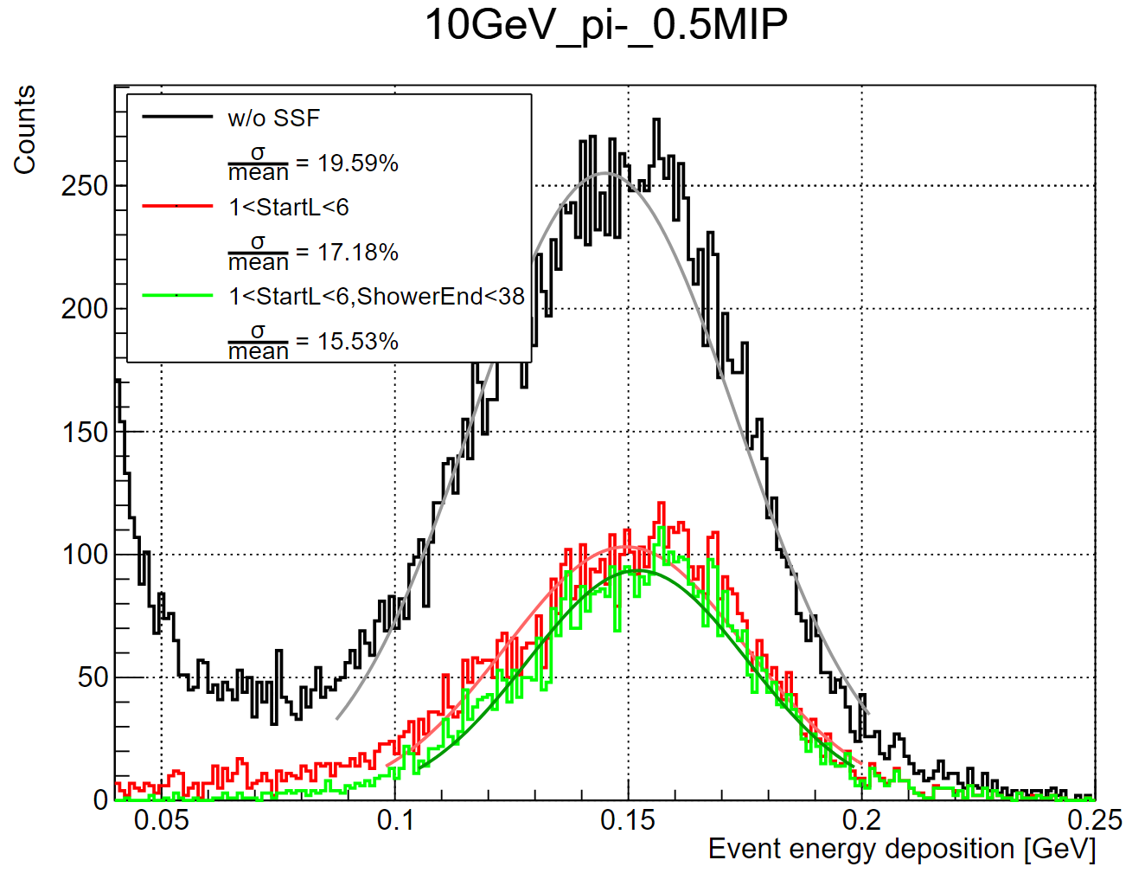
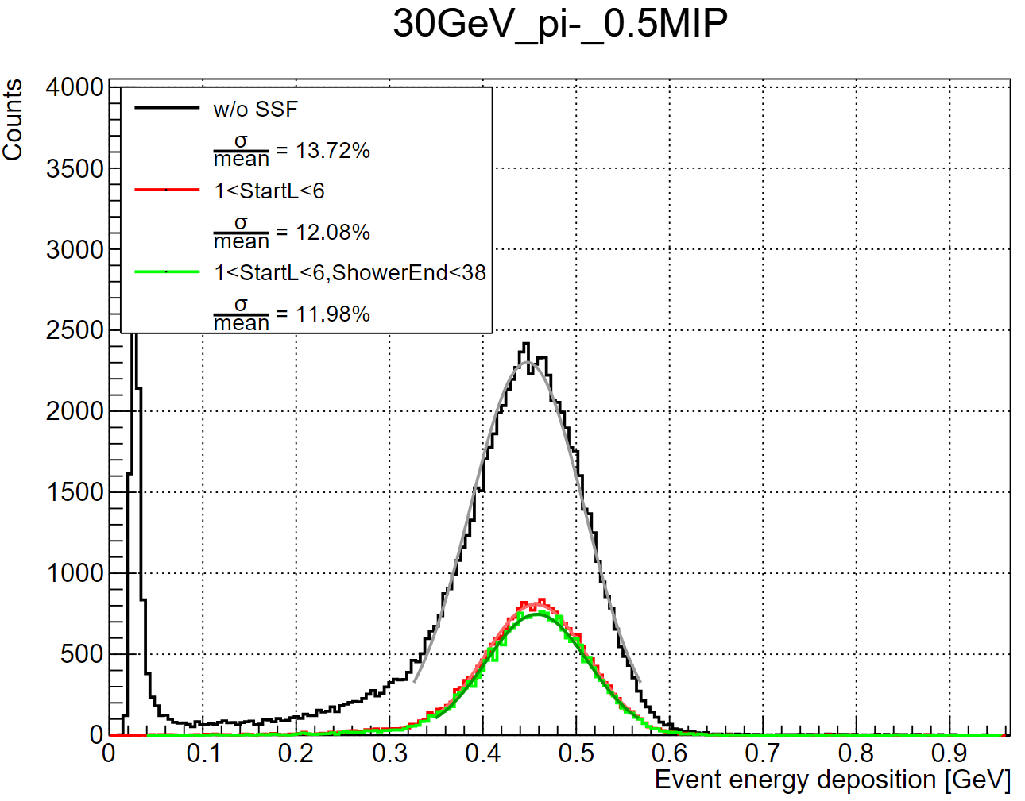
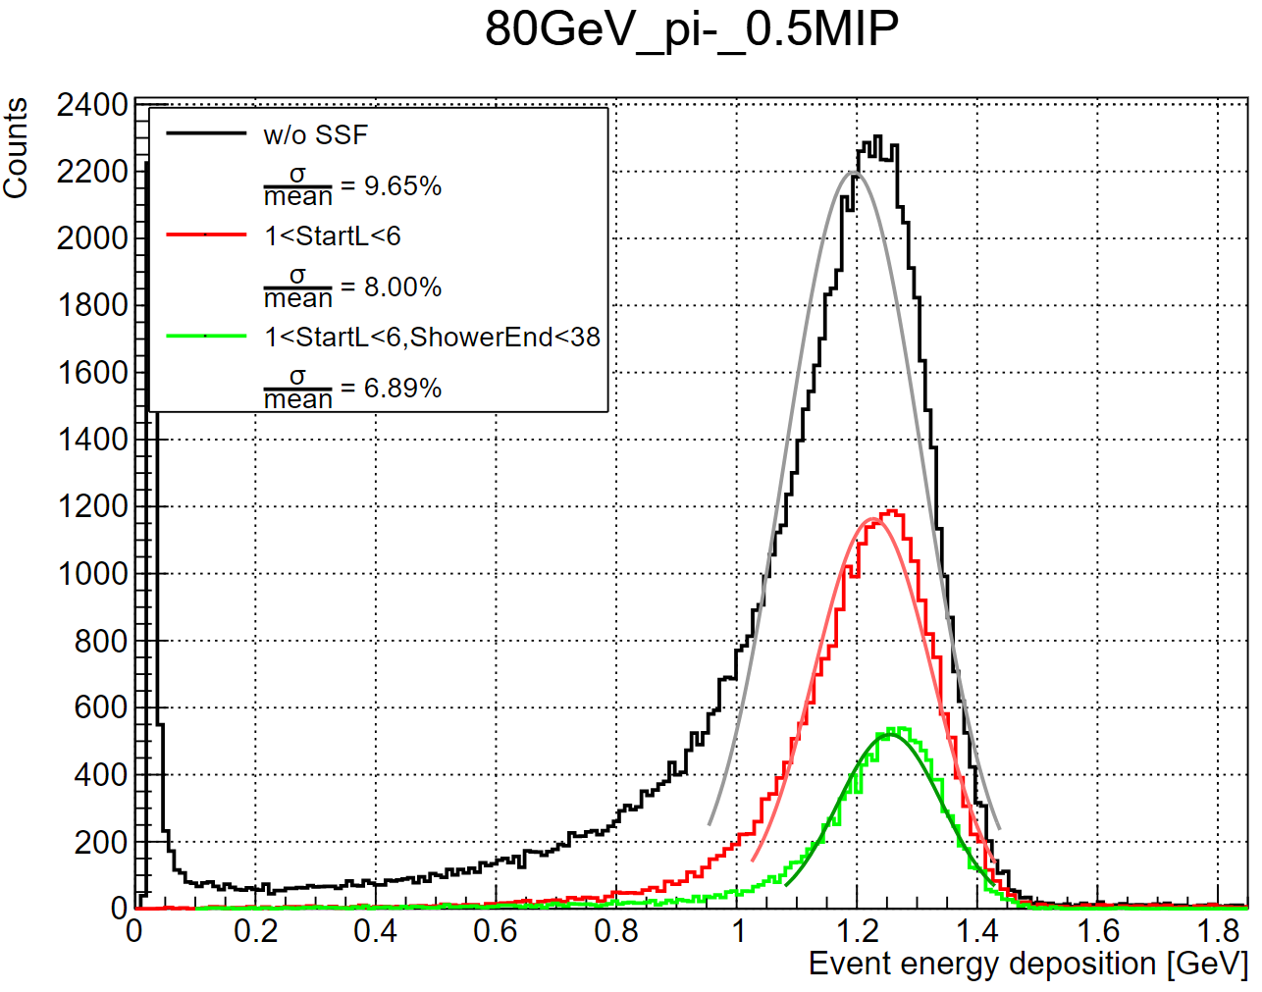
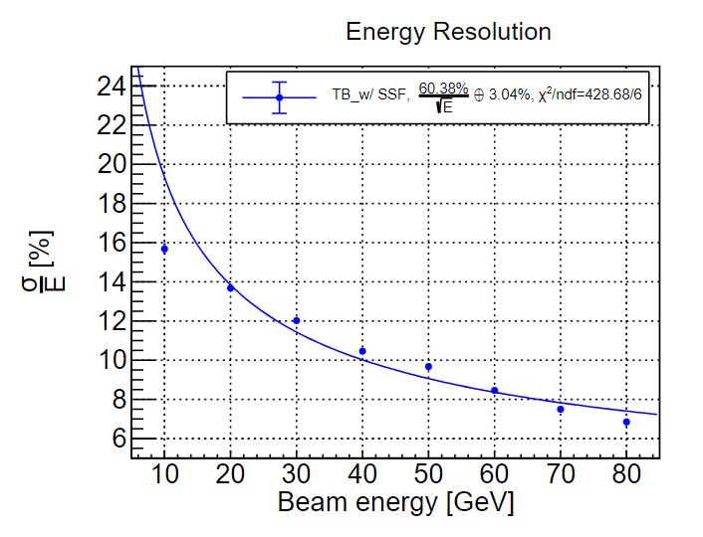
Pion energy response: impact of shower end (dejing)
Testbeam data with PID and SSF cut
PID cut from Xin
1 < Start layer <6
Shower end layer < 38
At low or high energy, this cut significantly improves energy resolution; at middle, there is little improvement
This cut is biased !!
Need to find other methods to improve energy resolution

Slide 14
Summary
pedestal and high-lowgain ratio are stable during beam test in SPS or PS and for different particles
MPV of SPS is about 3% bigger than that of PS
for electron, after position cut of energy center,
reconstructed energy and MC fits well at low energy level except few layers
at high energy level, electronic satruration effect become more obvious
for pion,
shower starting cut can significantly improve energy resolution

Slide 15
backup

Slide 16
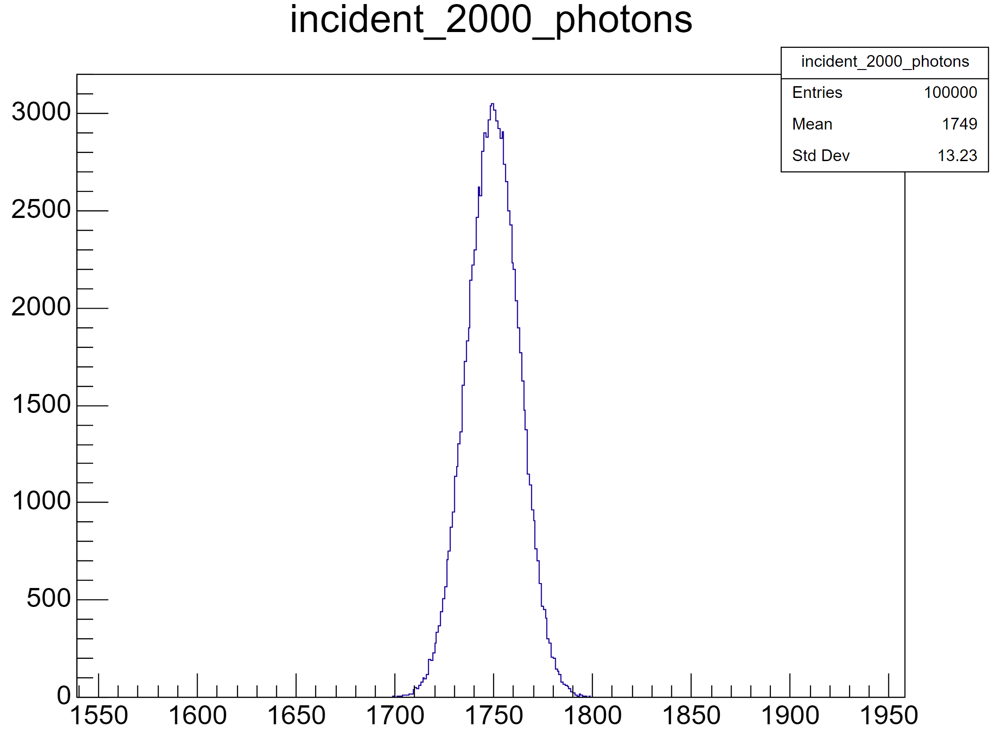
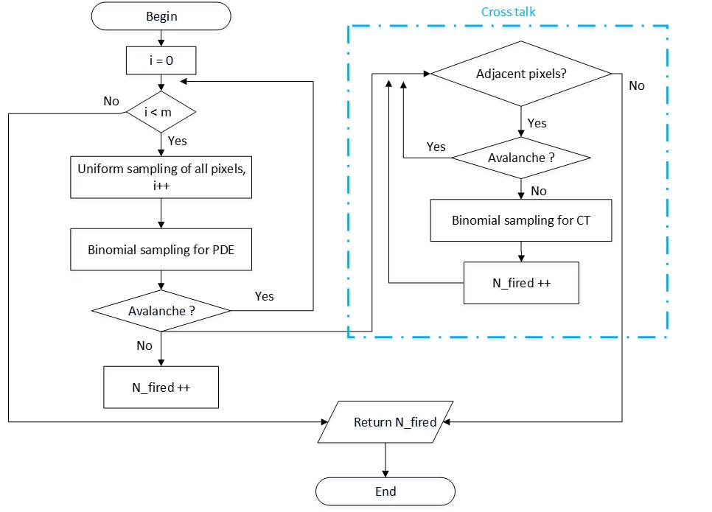
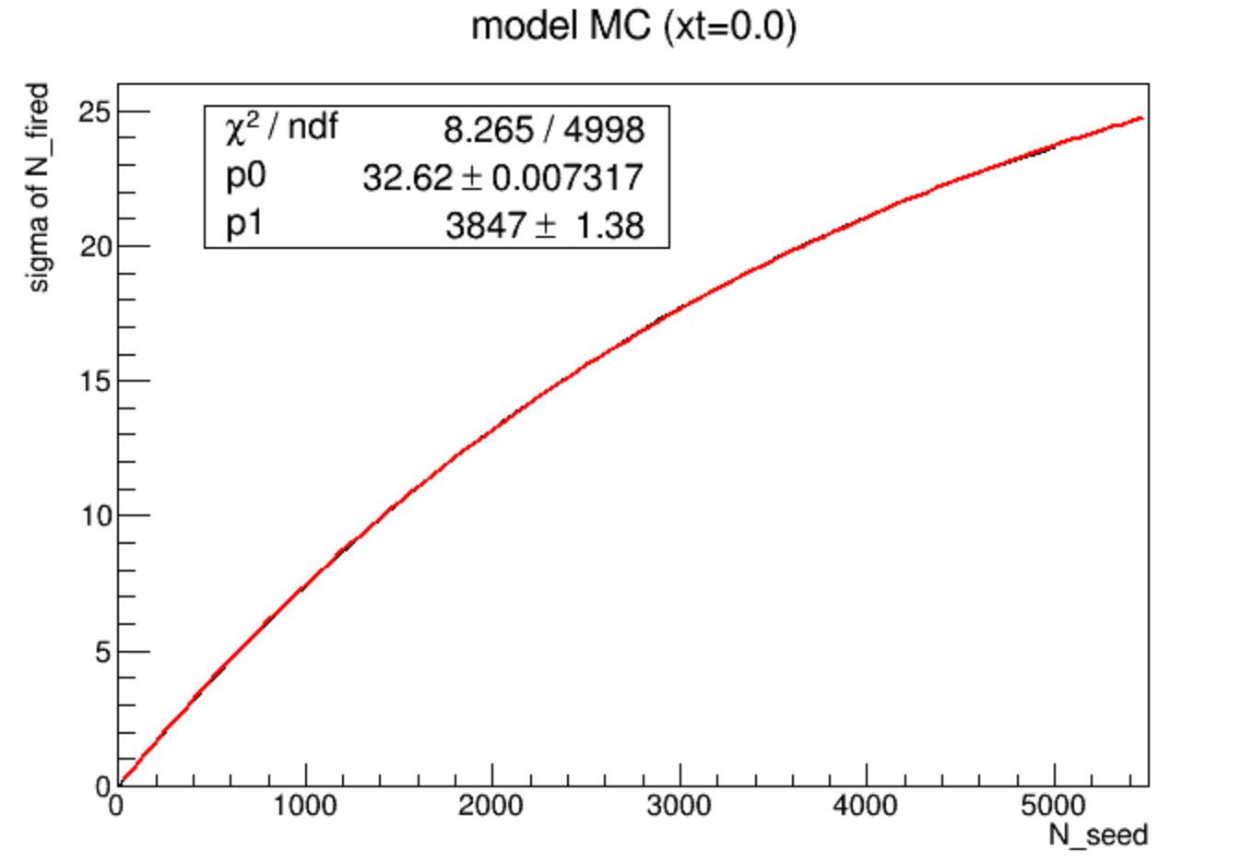
SiPM response simulation

Slide 17
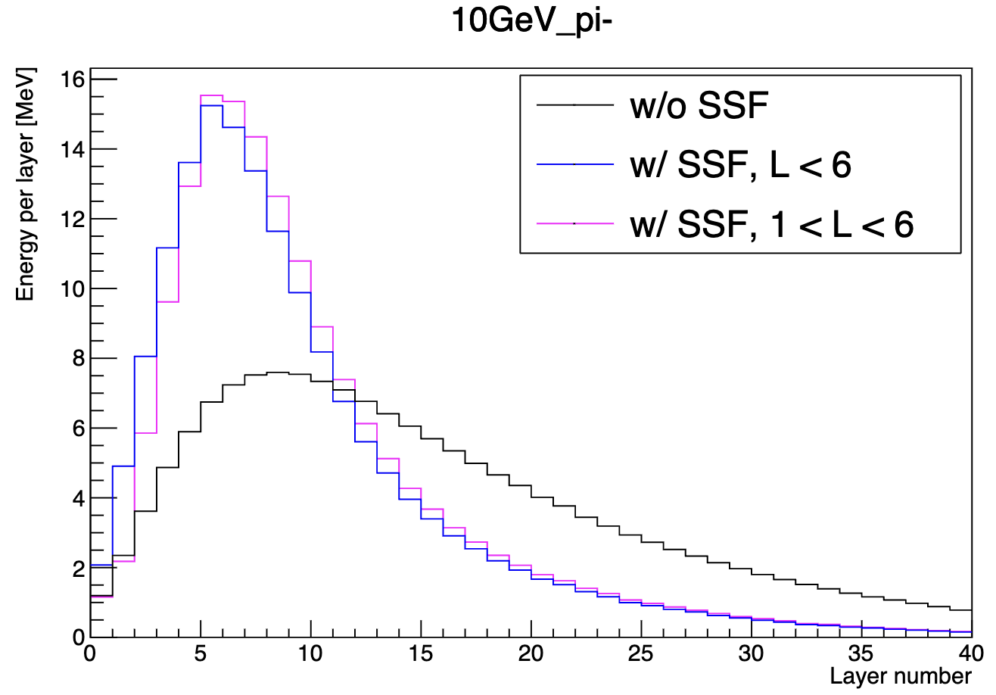
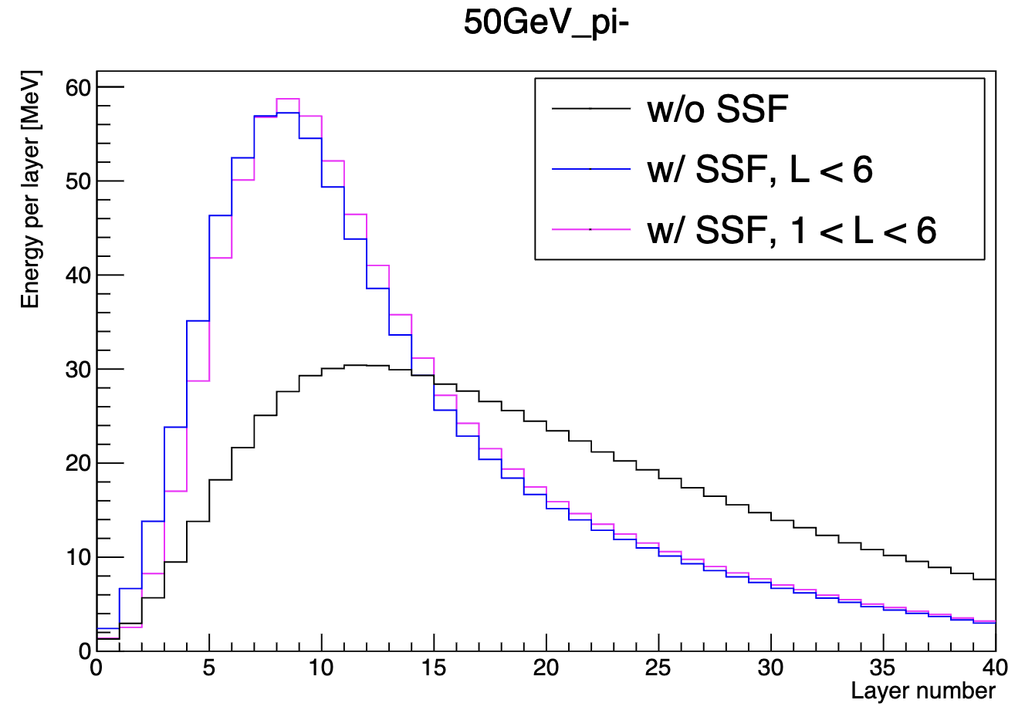
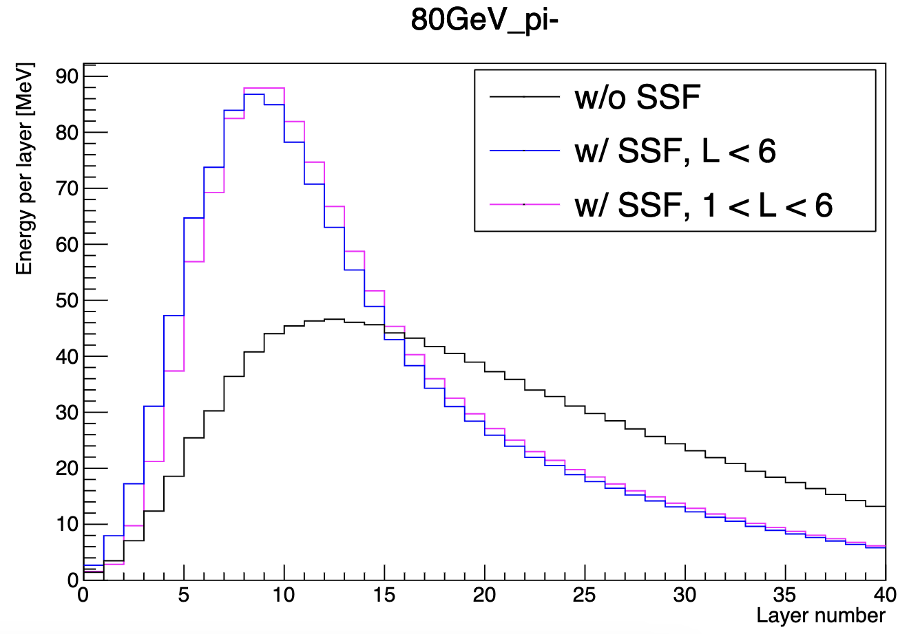
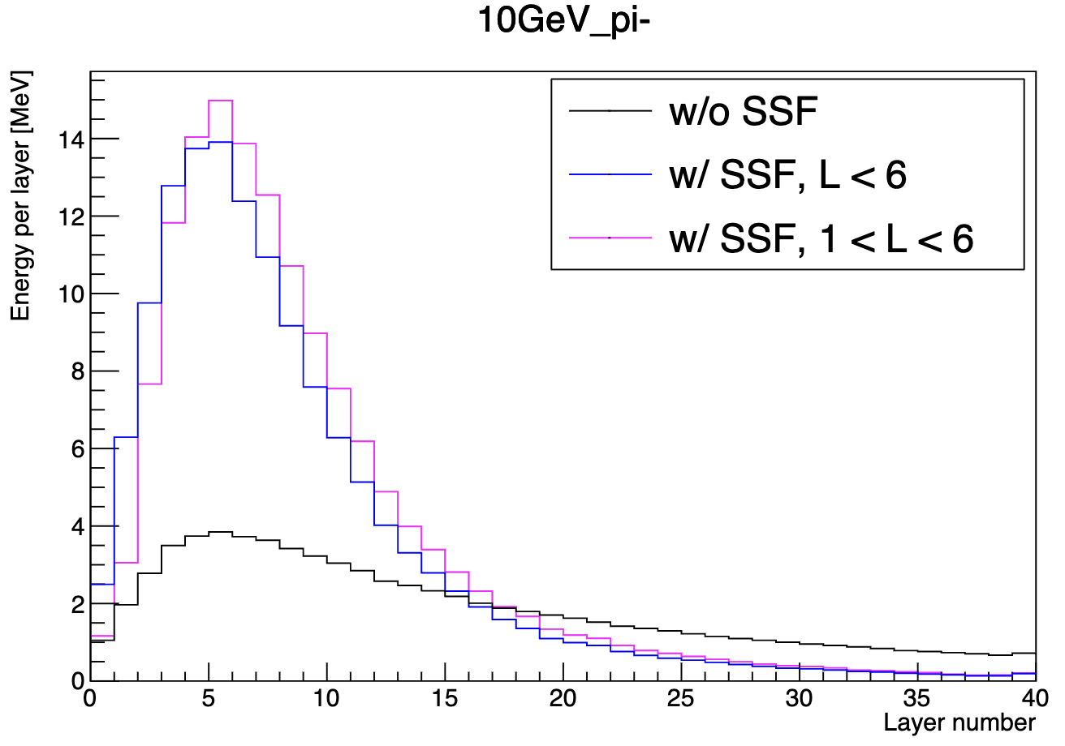
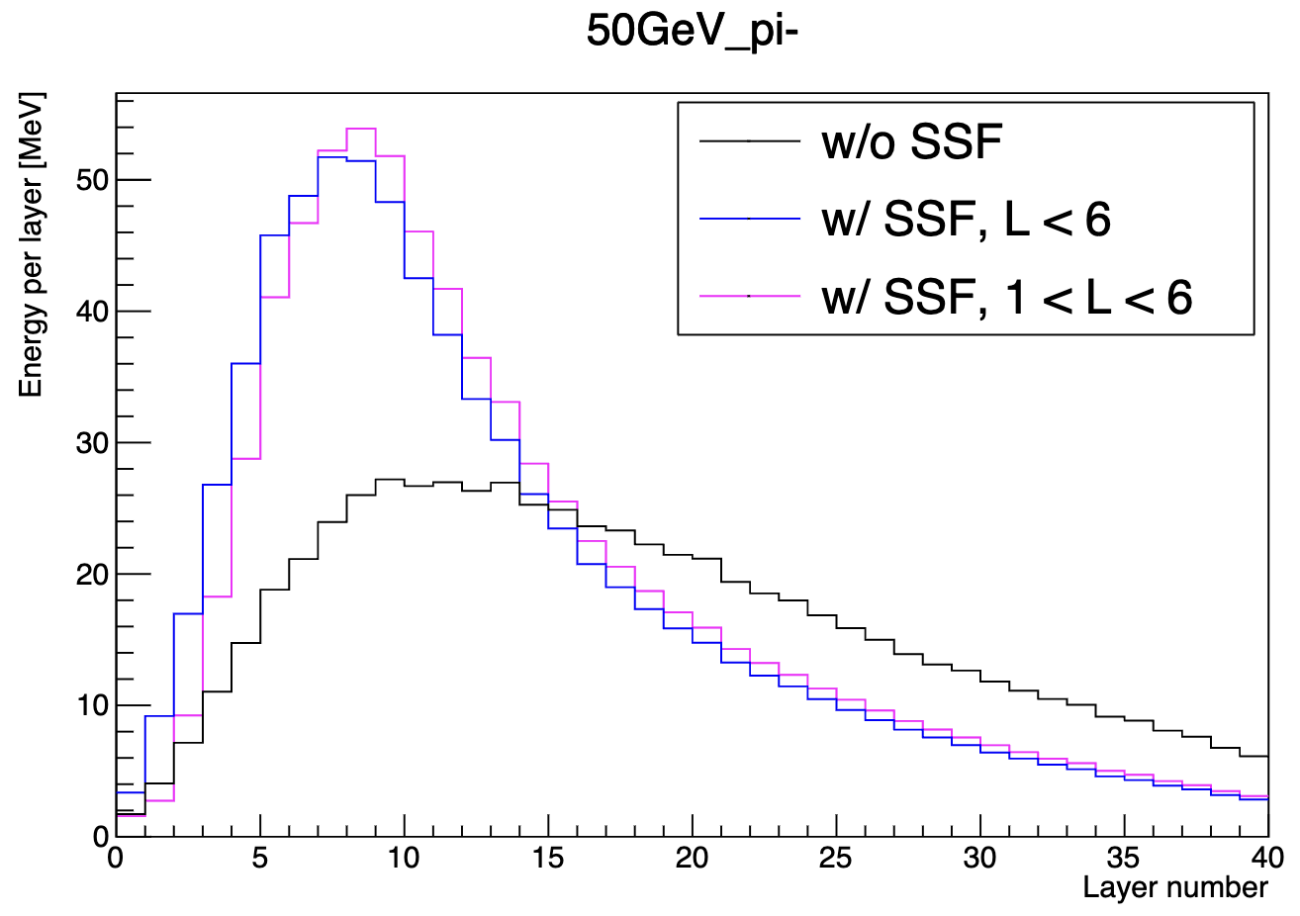
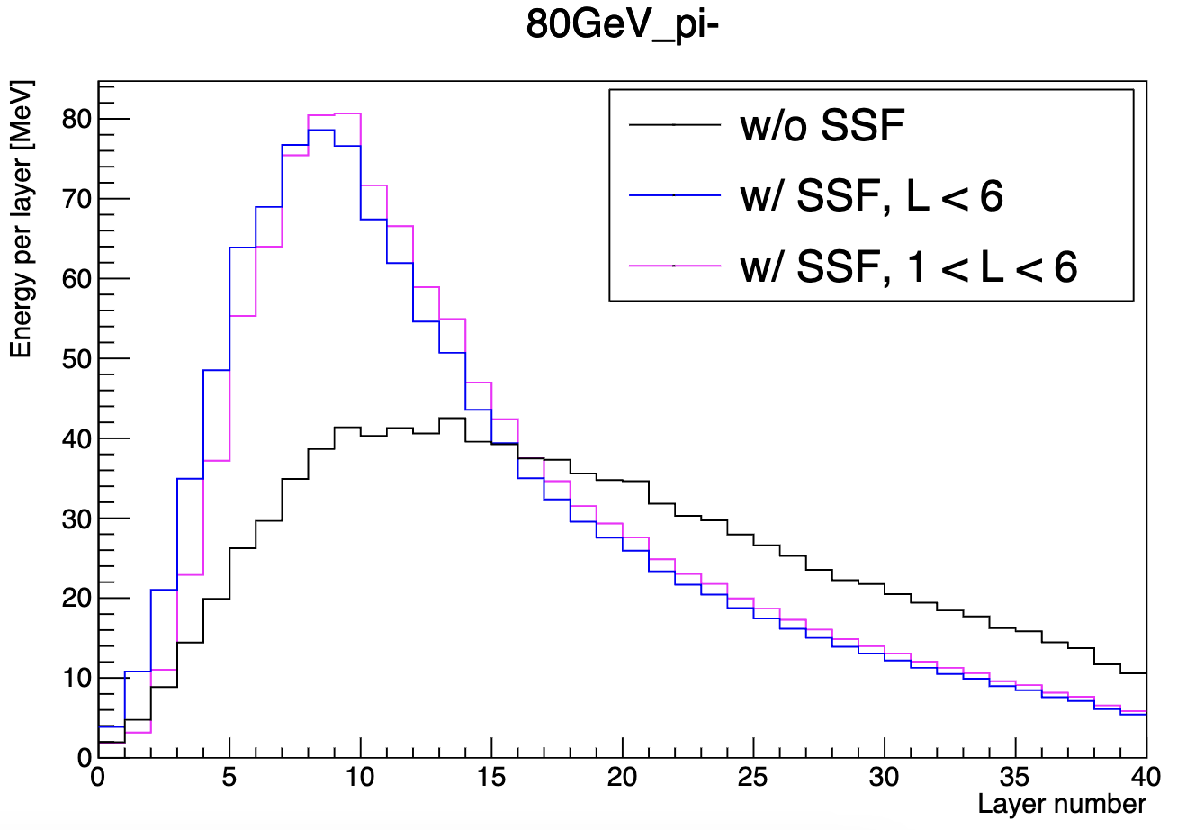
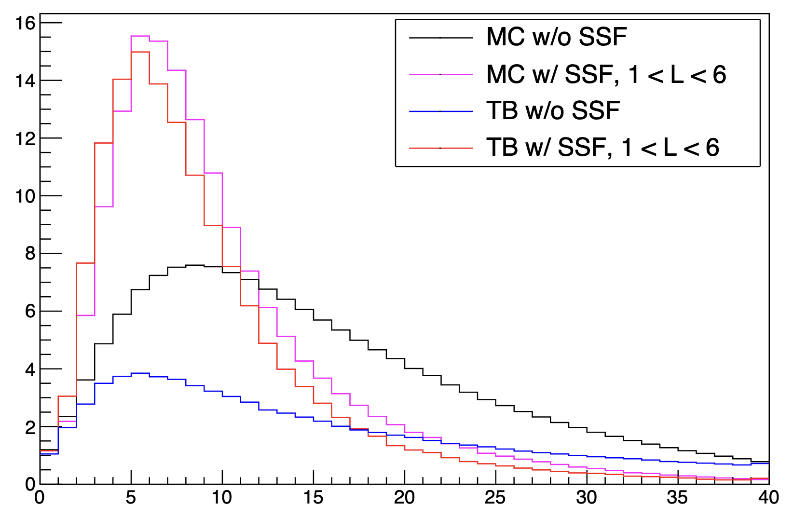
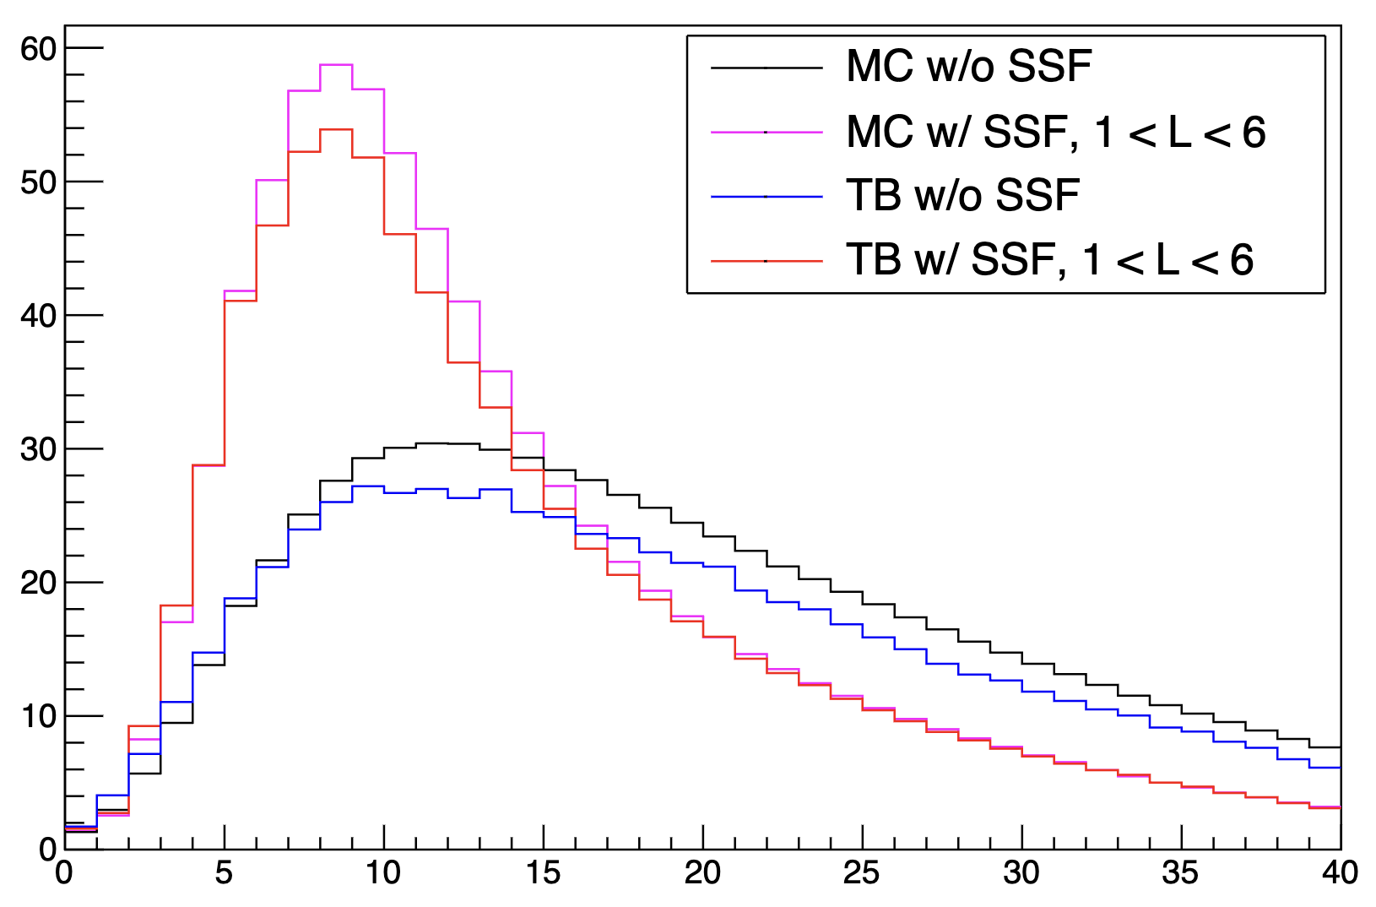
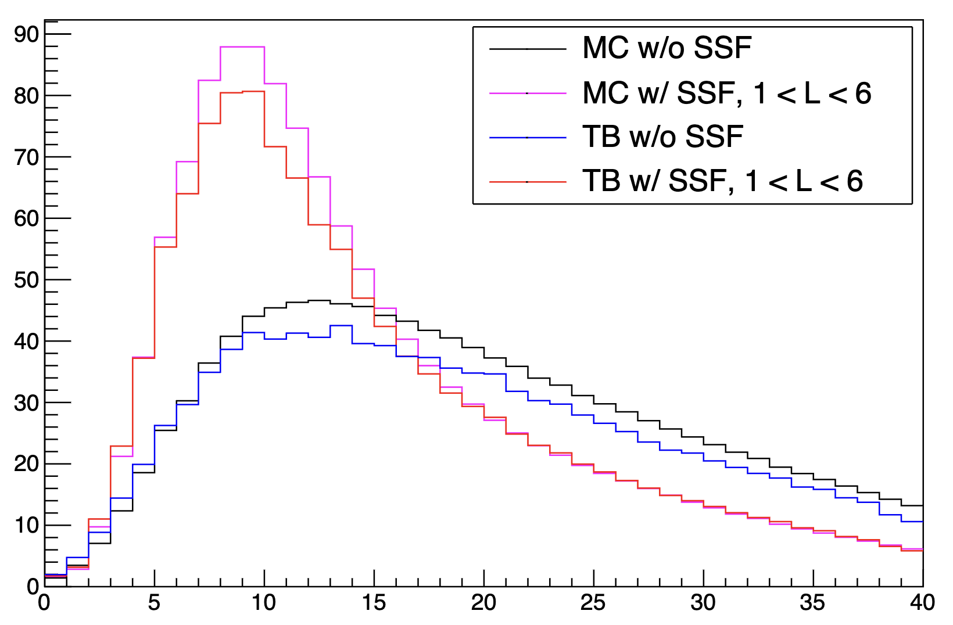
Pion shower longitudinal profile
MC
TB with PID
MC vs. TB

