Slide 1

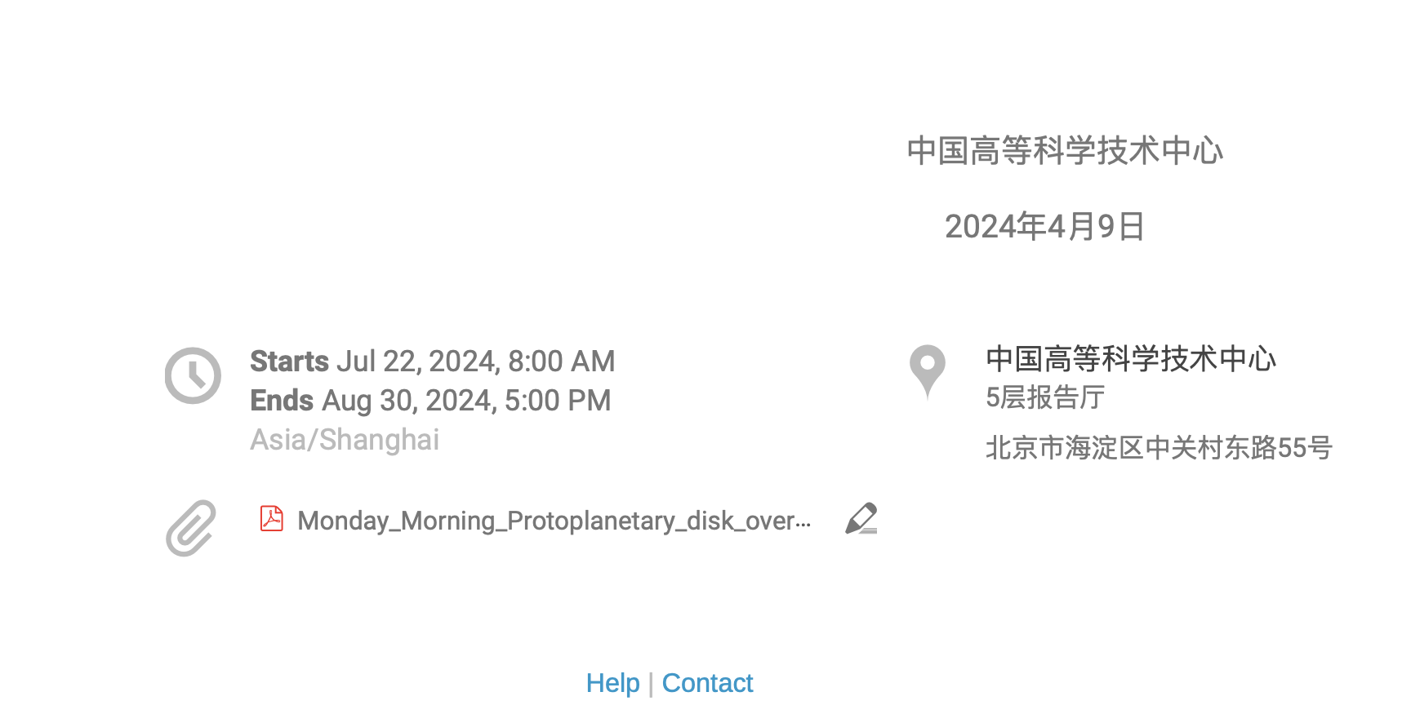
Hydrodynamics
Zhuo Chen
Institute for advanced study
Tsinghua University

Slide 2




Hydyodynamic approximation
$$L$$
Physical length scale $L=A/∇A$.
Finite “cell” length scale $l$.
Mean particle distance $λ$.
$L≫l≫λ$.
Within a finite cell, there are $N={\left(\frac{l}{λ}\right)}^{3}≫1$ particles, which enables the equilibrium description and the Boltzmann distribution when collision is frequent.
Ideal gas law, $p=nk_{b}T$.
$$l$$
$$λ$$

Slide 3

Eulerian description:
  The cell does not move, nor deform.
  The flow enters the cell or leave the cell.
  You cannot step into the same river twice.
Lagranian description:
  The cell moves with the fluid, exactly enclosing the same fluid element at all time.
  The cell moves and deforms.
For any field variable, $Q(\vec{r},t)$,
  $$\frac{dQ(\vec{r}+d\vec{r},t+dt)}{dt}=\frac{∂Q}{∂t}+\frac{∂\vec{r}}{∂t}⋅∇Q=\frac{∂Q}{∂t}+\vec{v}⋅∇Q$$
风动
幡动

Slide 4







Transport and conservation
In Eulerian description, gas flows in and out
$$\frac{∂q}{∂t}=\frac{F_{x}\left(x,t\right)−F_{x}(x+Δx,t)}{Δx}=−\frac{∂F_{x}}{∂x}$$
Combine all three directions,
$$\frac{∂q}{∂t}=−\frac{∂F_{x}}{∂x}−\frac{∂F_{y}}{∂y}−\frac{∂F_{z}}{∂z}$$
Apply divergence law in the Cartesian coordinate,
$$\frac{∂q}{∂t}+∇⋅\vec{F}=0$$
The Lagrangian form is,
$$\frac{∂q}{∂t}+∇⋅q\vec{u}=\frac{dq}{dt}+q∇⋅\vec{u}=0$$
$$F_{x}(x,t)$$
$$F_{x}(x+Δx,t)$$
$$q$$
$$x$$
$$Δx$$
$F(x,t)$ is the flux on the surface at $x$ enters the cell. It has the dimension of $F∼q\vec{u}$, where $q$ is the conserved quantity at the surface, $\vec{u}$ is the average velocity at the surfaces.

Slide 5



Momentum equation
The momentum equation is Newton’s law,
$$\vec{F}=m\vec{a}$$
In Lagrangian description, if there is pressure on the surface of the gas parcel, and gravitational force,
$$\vec{F}=m\vec{g}+∫d\vec{f}=m\vec{g}−∫∇⋅pIdV$$
$$\vec{F}=m\vec{g}−V∇p$$
Divide both size by $m=ρV$
$$\vec{a}=\vec{g}−\frac{∇p}{ρ}$$
Surface force
$$d\vec{f}=−d\vec{S}⋅pI$$
$$\vec{f}=m\vec{g}$$
Body force

Slide 6






Surface stress
Sometimes, exchange of some physical quantities, such as momentum and energy is done at the surfaces of the cells, for momentum,
$$ρ\frac{d\vec{u}}{dt}⋅\hat{x}=\frac{{dσ}_{xx}}{dx}+\frac{dσ_{xy}}{dy}+\frac{dσ_{xz}}{dz}$$
$$ρ\frac{d\vec{u}}{dt}=∇⋅σ_{ij}$$
If there is also transport,
$$\frac{∂ρ\vec{u}}{∂t}+∇⋅(ρ\vec{u}\vec{u}−σ_{ij})=0$$
When we only consider the press, not the stress,
$$\frac{∂ρ\vec{u}}{∂t}+∇⋅(ρ\vec{u}\vec{u})=−∇p$$
In particular, the Lagrangian form is very simple,
$$ρ\frac{d\vec{u}}{dt}=−∇p+ρ\vec{g}$$
$$σ_{xx}(x,t)$$
$$σ_{xx}(x+Δx,t)$$
$$σ_{yx}(x,t)$$
$$x$$
$$Δx$$
$σ_{xx}(x,t)$ is the surface stress on the cell. It is induced by the microscopic process such as: particle collision and magnetic force.

Slide 7







Viscous effect
There is a kind of stress induced by the relative motion that is tangential to the surface, the shear stress,
$$σ_{xz}=C\frac{∂u_{x}}{∂z}, σ=C∇\vec{u}$$
This shear force will not only make the cell to move, it will also rotate the cell, to make it irrotational, we symmetrize the tensor
$$σ=C\left(∇\vec{u}+{\left(∇\vec{u}\right)}^{T}\right)$$
Now, the stress tensor still has compressional or tensional force, as its trace $Tr\left(σ\right)=∇⋅\vec{u}$ may not be zero. To make it shear stress only,
$$σ=C\left(∇\vec{u}+{\left(∇\vec{u}\right)}^{T}\right)−\frac{2C}{3}\left(∇⋅\vec{u}\right)I$$
It turns out that $C=ρν$, and $ν$ is the kinematic viscosity.
$$\frac{∂ρ\vec{u}}{∂t}+∇⋅\left(ρ\vec{u}\vec{u}−σ\right)=−∇p$$
$$u_{x}$$
$$z$$
$$x$$
$$σ_{xz}(z+Δz,t)$$
$$Δz$$
$$σ_{xz}(z,t)$$

Slide 8

Viscous effect
We ignore pressure gradient for simplicity,
$$Re=\frac{ρu^{2}}{σ}=\frac{uL}{ν}$$
Reynolds number $Re≫1$ means the transport of momentum is much larger than the viscous effect.
If $Re≪1$, that means the viscous effect governs that hydrodynamic evolution, that means,
$$\frac{ρu}{t}∼\frac{ρνu}{L^{2}}, t∼\frac{L^{2}}{ν}$$
For hydrogen gas, the kinematic viscosity is approximately,
$$ν≈1\sqrt{\frac{T}{300K}}\frac{cm^{2}}{s}$$
The typical length scale for protoplanetary disk is more than ${10}^{14}$ cm, thus,
$$t∼\frac{L^{2}}{ν}∼{10}^{28} s≫t_{ppd}∼{10}^{7} yr$$
Molecular viscosity is not responsible for most astrophysical evolution.

Slide 9


Energy equation
Thermodynamics $dε=dq−dW$ should be considered.
$$\frac{dε}{dt}=\frac{dq}{dt}−\frac{pdV}{dt}=\dot{Q}+\frac{pdρ}{ρ^{2}dt}$$
There is gravitational potential energy $Ψ$, and $\vec{g}=−∇Ψ$
$$\frac{dρΨ}{dt}=\frac{ρdΨ}{dt}+\frac{Ψdρ}{dt}$$
Define the total energy as
$$E=ρ(\frac{1}{2}v^{2}+Ψ+ε)$$
and take the time derivative.
$$\frac{dE}{dt}=\frac{E}{ρ}\frac{dρ}{dt}+ρ(\vec{u}⋅\frac{d\vec{u}}{dt}+\frac{dΨ}{dt}+\frac{dε}{dt})$$
Make use of the continuity and momentum equations
$$\frac{dρ}{dt}+ρ∇⋅\vec{u}=0$$
$$ρ\frac{d\vec{u}}{dt}=−∇p−ρ∇Ψ$$
$$\frac{dΨ}{dt}=\frac{∂Ψ}{∂t}+\vec{u}⋅∇Ψ$$
We can obtain the full energy equation
$$\frac{∂E}{∂t}+∇⋅\left[\left(E+p\right)\vec{u}\right]=ρ\dot{Q}+ρ\frac{∂Ψ}{∂t}$$
The heating/cooling source $\dot{Q}$ could be cosmic ray, radiation transport, viscous heating, or heat conduction.

Slide 10


Hydrodynamic equations
Eulerian description with constant external gravitational field.
$$\frac{∂ρ}{∂t}+∇⋅ρ\vec{u}=0$$
$$\frac{∂ρ\vec{u}}{∂t}+∇⋅\left(ρ\vec{u}\vec{u}+p\overline{\overline{I}}\right)=−ρ∇Ψ$$
$$\frac{∂E}{∂t}+∇⋅\left[\left(E+p\right)\vec{u}\right]=ρ\dot{Q}$$
$$E=ρ(\frac{1}{2}v^{2}+Ψ+ε)$$
Conserved quantities are $[ρ,ρ\vec{u},E]$, which correspond to mass, momentum and energy conservation.
Fluxes are $[ρ\vec{u},ρ\vec{u}\vec{u}+p\overline{\overline{I}},\left(E+p\right)\vec{u}]$ at the surfaces.
Lagrangian description with constant external gravitational field.
$$\frac{dρ}{dt}=−ρ∇⋅\vec{u}$$
$$ρ\frac{d\vec{u}}{dt}=−∇p−ρ∇Ψ$$
$$\frac{dE}{dt}=\frac{d}{dt}\left(\frac{ρu^{2}}{2}+ρΨ\right)+\frac{dρε}{dt}$$
The energy equation in the Lagrangian description is reduced to,
$$\frac{dε}{dt}=\dot{Q}−p∇⋅\vec{u}$$
Thus, $∇⋅\vec{u}$ is a very important quantity in Lagrangian description, so is $p$.

Slide 11

Linear waves
Consider perturbations on top of a homogeneous fluid at rest (𝜌=𝜌₀, v=v₀=0), and assuming isothermal EoS (P=𝜌c_{s}²) for simplicity.
Recall the general fluid equations:
Note, for adiabatic gas, dP = 𝛾(P/𝜌)d𝜌, and we have the same equation except that c_{s}²= 𝛾(P/𝜌).
To first-order, perturbation equations read (Eulerian form):
$$ρ^{′}=ρ+δρ, v^{′}=v+δv, p′=p+δp$$
Notes:
\frac{\partial\rho}{\partial t}=-{\boldsymbol v}\cdot\nabla\rho-\rho\nabla\cdot{\boldsymbol v}
\frac{\partial\boldsymbol v}{\partial t}+{\boldsymbol v}\cdot\nabla{\boldsymbol v}=-c_s^2\nabla\rho/\rho

Slide 12
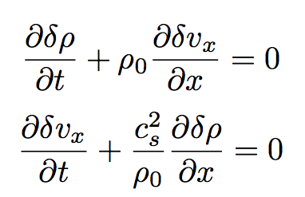
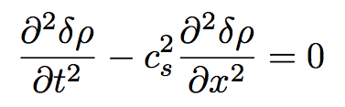

Linear waves
Consider 1D problem, and also restrict velocity to that dimension, perturbation equations becomes:
This is a wave equation, with general solution:
where R, L are arbitrary functions.
Disturbances propagate to right and left at velocity c_{s}.
Q: for a incompressible fluid, are there sound waves?
Notes:
\frac{\partial\rho}{\partial t}=-{\boldsymbol v}\cdot\nabla\rho-\rho\nabla\cdot{\boldsymbol v}
\frac{\partial\boldsymbol v}{\partial t}+{\boldsymbol v}\cdot\nabla{\boldsymbol v}=-c_s^2\nabla\rho/\rho

Slide 13

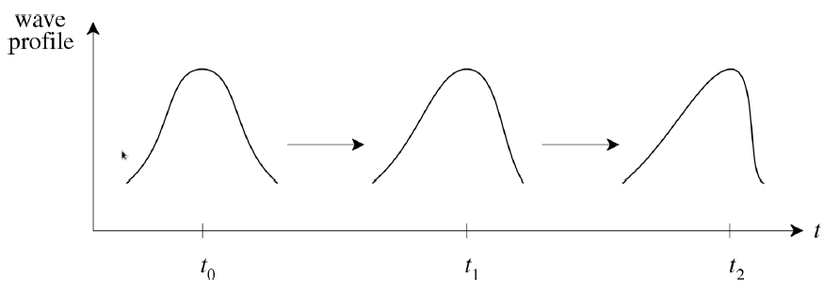
Non-linear steepening of sound waves
Recall that in an ideal gas, sound speed is given by
In linear analysis, this is considered to be constant (homogeneous background).
To the next order, however, c_{s} is slightly larger in higher-density regions.
=> the crest of a wave propagates faster than the leading/trailing edge
Slightly non-linear sound waves will steepen to form a discontinuity: shock
Notes:
higher density regions undergo compression -> slightly hotter -> P/rho is larger

Slide 14
Shocks and discontinuities
Fluid equations are PDEs: discontinuous solutions do not hold in a classical sense.
Physically, more fundamental are the integral form of the conservation laws, which do admit discontinuous solutions.
Shock is one type of discontinuity, which usually forms when the flow speed becomes supersonic.
There are other types of discontinuities as we shall see.
Microscopic dissipation (e.g., viscosity) is important across the discontinuities.
Notes:
In Landau’s book; can use Bernoulli theorem to analyze 1D flow and address sub-to-super sonic transition. But this does not work for shocks because entropy generation.
The flow of gas behaves differently between sub-sonic and super-sonic regimes.
A distinctive feature of supersonic flow: it can form shock waves (or simply shocks), which propagate faster than sound speed.
Not all discontinuities are shocks (as we shall see).
\frac{\partial}{\partial t}\int({\rm Density\ of\ A})\ dV+\int({\rm Flux\ of\ A})\cdot d{\boldsymbol S}=0

Slide 15

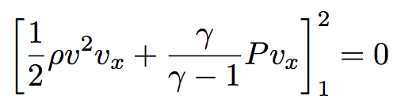
Surface of discontinuity
We work in the co-moving frame with the surface of discontinuity.
The fluxes of mass, momentum, energy across this surface must be continuous.
1
2
𝜌₁,v₁, P₁
𝜌₂,v₂, P₂
Mass conservation:
x
Momentum conservation:
Energy conservation:
where we have used

Slide 16



Tangential discontinuity
1
2
If there is no mass flux through the surface:
𝜌₁,v₁, P₁
𝜌₂,v₂, P₂
Mass conservation:
Momentum conservation:
x
P₁=P₂, while v_{y} and v_{z} can be discontinuous by any amount.
For discontinuous tangential velocities, the interface is subject to the Kelvin-Helmholtz instability:
The special case with continuous tangential velocities:
, all other quantities are continuous.
This is called a contact discontinuity.

Slide 17

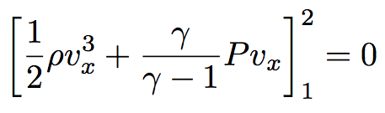
Shocks jump conditions
If the mass flux across the surface is non-zero, we obtain the shock jump conditions:
upstream (1)
downstream (2)
Mass conservation:
𝜌₁,v₁, P₁
𝜌₂,v₂, P₂
shock front
x
Momentum conservation:
Energy conservation:
This is a set of 3 algebraic equations with 3 unknowns, which are called “Rankine-Hugoniot” conditions.
Notes:
to be included: S85 of Landau on shock adiabatic
to be included: Murphy’s slides with solutions.

Slide 18




Grid-based code adopts the Eulerian description, which is natural to its domain decomposition.
All field variables are cell centered, all fluxed, associated with the conservation law, are surface centered.
Smoothed-particle hydrodynamics adopts the Lagrangian description.
It uses volume-weighted function to calculate field variables at any place.
$$q_{smoothed}\left(\vec{r}\right)=∫q\left(\vec{r}\right)W\left(\vec{r}−\vec{r^{′}},h\right)d\vec{r^{′}}$$
It needs to determine $∇⋅\vec{u}$.
It uses the equation of state to determine $p$.
$$m, \vec{u}, ε$$
$$ρ, \vec{u}, p, ε…$$
$$F_{mass}, F_{momentum}, F_{energy}$$

Slide 19
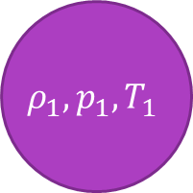




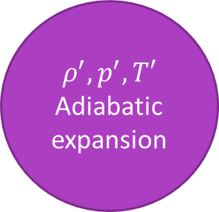
Convective instability
Convective instability happens inside stars, accretion disks, and your kitchens.
First consider the adiabatic expansion case, a blob of gas at $z$ moves upward. The blob is always in pressure equilibrium with its surrounding environment, but not necessarily exchanging energy with the surrounding gas. Under adiabatic expansion, $\left[ρ_{1}, p_{1}, T_{1}\right]→\left[ρ^{′},p^{′},T^{′}\right], p=ρ^{γ}$.
$$ρ^{′}=ρ_{1}{\left(\frac{p′}{p_{1}}\right)}^{1/γ}$$
The original static equilibrium state has another $\left[ρ_{2}, p_{2}, T_{2}\right]$ at $z+dz$.
$$ρ_{2}=ρ_{1}+\frac{dρ}{dz}dz$$
$$p_{2}=p_{1}+\frac{dp}{dz}, p_{2}=p′$$
Substitute $p^{′}$ with $p_{2}$,
$$ρ^{′}=ρ_{1}+\frac{ρ_{1}}{γp_{1}}\frac{dp}{dz}dz$$
$$ρ^{′}−ρ_{2}=\left(\frac{ρ_{1}}{γp_{1}}\frac{dp}{dz}−\frac{dρ}{dz}\right)dz$$
$$ρ^{′},p^{′},T′$$
Adiabatic expansion
$$ρ_{2},p_{2},T_{2}$$
$$dz$$
$$ρ_{1},p_{1},T_{1}$$
$$z$$

Slide 20

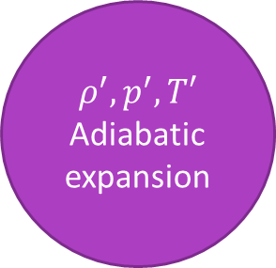
Convective instability
The blob is heavier than the surrounding gas and stable, if
$$ρ^{′}−ρ_{2}= \left(\frac{ρ_{1}}{γp_{1}}\frac{dp}{dz}−\frac{dρ}{dz}\right)>0$$
The blob is lighter than the surrounding gas and unstable, if
$$ρ^{′}−ρ_{2}= \left(\frac{ρ_{1}}{γp_{1}}\frac{dp}{dz}−\frac{dρ}{dz}\right)<0$$
Replace ${[ρ}_{1},p_{1}]$ with $[ρ,p]$,
$$\frac{1}{γ}\frac{dlnp}{dz}−\frac{dlnρ}{dz}=\frac{dln\left(\frac{p}{ρ^{γ}}\right)}{dz}=\frac{ds}{dz}$$
The sign of $\frac{ds}{dz}$ is an important quantity in determining convective instability. The region is marginally stable if $\frac{ds}{dz}=0$.
In a marginally stable setup, what will happen there is cooling when the blob moves upward? (stable)
$$ρ^{′},p^{′},T′$$
Adiabatic expansion
$$ρ_{2},p_{2},T_{2}$$
$$dz$$
$$ρ_{1},p_{1},T_{1}$$
$$z$$

Slide 21






Rayleigh-taylor and kelvin-helmholtz instabilities
The RTI and KHI start with incompressible and irrotational flow. In 2D, the flow can thus be expressed by a gradient,
$$\vec{u}=−∇Φ, ∇^{2}Φ=0$$
The top and bottom flow are in equilibrium state initially, separated by the dashed line.
From the momentum equation,
$$−∇\frac{∂Φ}{∂t}+∇\left(\frac{u^{2}}{2}\right)=−∇\left(\frac{p}{ρ}\right)−∇Ψ$$
$$−\frac{∂Φ}{∂t}+\frac{u^{2}}{2}+\frac{p}{ρ}+Ψ=F(t)$$
In the equilibrium case, there is no time dependence.
The pressure is continuous at the interface,
$$ρ\left(F_{1}−\frac{U^{2}}{2}−Ψ\right)=p_{0}=p_{0}′=ρ′\left(F_{2}−\frac{U^{′2}}{2}−Ψ\right)$$
equilibrium
$$\vec{g}=−∇Ψ$$
$$ρ′,U′$$
$$ρ, U$$
$$z$$
$$x$$

Slide 22



Rayleigh-taylor and kelvin-helmholtz instabilities
Some displacement perturbation $ξ(x,t)$ is applied to the interface, since the flow is incompressible, the two flow cannot penetrate into each other,
$$−∇Φ=\vec{u}=U\hat{x}−∇φ, ∇^{2}φ=0$$
$U\hat{x}$ is horizontal, the displacement of the interface $ξ(x,t)$ is due to $−∇φ$. It is the displacement function,
$$v_{z}=−\frac{∂φ}{∂z}=\frac{dξ}{dt}=\frac{∂ξ}{∂t}+U\frac{∂ξ}{∂x}$$
Assume the top and bottom flow is infinitely large and $v_{z}$ vanishes at $±∞$,
$$φ=Ce^{i\left(kx−ωt\right)+hz}, z<0, h>0$$
$$φ^{′}=C′e^{i\left(kx−ωt\right)−hz}, z>0, h>0$$
Using $∇^{2}φ=0$, we can get $h=k$, and
$$ξ=Ae^{i\left(kx−ωt\right)}$$
$$i\left(ku_{2}−ω\right)A=−kC$$
$$i\left(ku_{1}−ω\right)A=kC′$$
perturbed
$$\vec{g}=−∇Ψ$$
$$ρ^{′},U′$$
$$ξ(x,t)$$
$$ρ, U$$
$$z$$
$$x$$

Slide 23

Rayleigh-taylor and kelvin-helmholtz instabilities
The perturbed momentum equation is time-dependent,
$$\frac{∂Φ}{∂t}+\frac{u^{2}}{2}+\frac{p}{ρ}+Ψ−gξ=F$$
The pressure for the top and bottom fluid are,
$$p=ρ\left(F_{1}−\frac{∂φ}{∂t}−\frac{u^{2}}{2}−Ψ+gξ\right),u^{2}=U^{2}−2U\frac{∂φ}{∂x}$$
$$p^{′}=ρ′\left(F_{2}−\frac{∂φ^{′}}{∂t}−\frac{{u^{′}}^{2}}{2}−Ψ+gξ\right),{u′}^{2}={U′}^{2}−2U′\frac{∂φ′}{∂x}$$
Substitute $F_{1}, F_{2}$ from the equilibrium state,
$$p=ρ\left(−\frac{∂φ}{∂t}+U\frac{∂φ}{∂x}+gξ\right)+p_{0}$$
$$p^{′}=ρ^{′}\left(−\frac{∂φ^{′}}{∂t}+U^{′}\frac{∂φ^{′}}{∂x}+gξ\right)+p_{0}′$$
perturbed
$$\vec{g}=−∇Ψ$$
$$ρ^{′},U′$$
$$ξ(x,t)$$
$$ρ, U$$
$$z$$
$$x$$

Slide 24

Rayleigh-taylor and kelvin-helmholtz instabilities
The interface function is,
$$ρ\left(−\frac{∂φ}{∂t}+U\frac{∂φ}{∂x}+gξ\right)=ρ^{′}\left(−\frac{∂φ^{′}}{∂t}+U^{′}\frac{∂φ^{′}}{∂x}+gξ\right)$$
$$ρ\left[−i\left(kU−ω\right)C+gA\right]=ρ^{′}[−i\left(kU^{′}−ω\right)C′+gA]$$
Substitute $C=−\frac{i\left(kU−ω\right)A}{k},C′=−\frac{i\left(kU′−ω\right)A}{k}$ from the displacement function, we get
$$ρ{\left(kU−ω\right)}^{2}+ρ^{′}{\left(kU^{′}−ω\right)}^{2}=kg(ρ−ρ′)$$
Solve the quadratic equation for $ω$,
$$\frac{ω}{k}=\frac{ρU+ρ^{′}U′}{ρ+ρ′}±{\left[\frac{g}{k}\frac{ρ−ρ′}{ρ+ρ′}−\frac{ρρ^{′}{\left(U−U^{′}\right)}^{2}}{{\left(ρ+ρ^{′}\right)}^{2}}\right]}^{\frac{1}{2}}$$
If $ω$ or $k$ has imaginary part, i.e., the square root has imaginary component, $ξ=Ae^{i\left(kx−ωt\right)}$ has exponential growing part, and the perturbation is not stable.

Slide 25
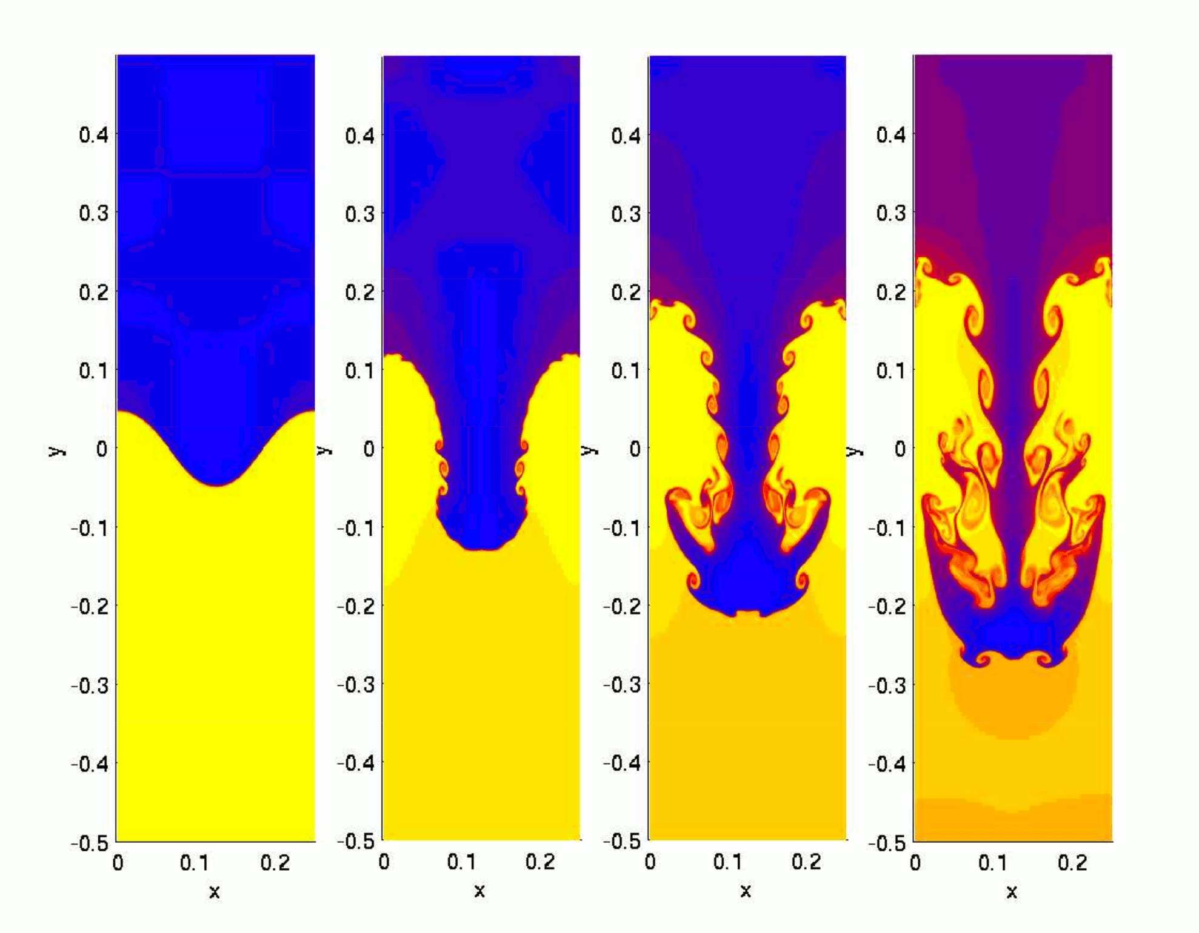


Rayleigh-taylor instablity
Kelvin-helmholtz instablity
When the gas is stationary,
$$\frac{ω}{k}=±\sqrt{\frac{g}{k}\frac{ρ−ρ′}{ρ+ρ′}}$$
Light top and heavy bottom $ρ>ρ′$ is stable.
Heavy top and light bottom $ρ′>ρ$ is unstable.
When the gas is moving, if
$$\frac{g}{k}\frac{ρ−ρ′}{ρ+ρ′}−\frac{ρρ^{′}{\left(U−U^{′}\right)}^{2}}{{\left(ρ+ρ^{′}\right)}^{2}}<0$$
the flow will be unstable.
Short wavelength perturbation is more likely to become unstable,
$$k>\frac{g\left(ρ^{2}−ρ^{′2}\right)}{ρρ^{′}{\left(U−U^{′}\right)}^{2}}$$

