Slide 1
Radiation transport
Zhuo chen
Institute for advanced studies
Tsinghua university

Slide 2
What is radiation transfer?
Radiation transport, also known as radiation transfer, refers to the physical process by which radiation (energy in the form of particles or electromagnetic waves) travels through and interacts with a medium. This concept is crucial in fields like astrophysics, nuclear engineering, atmospheric science, and medical physics.
Radiation Types:
  Electromagnetic Radiation: Includes visible light, ultraviolet light, infrared radiation, X-rays, and gamma rays.
  Particle Radiation: Includes alpha particles, beta particles, neutrons, and other charged particles.
Interactions with Matter:
  Absorption: Radiation is absorbed by the medium, transferring energy to the atoms or molecules and potentially causing ionization or excitation.
  Scattering: Radiation is deflected in different directions due to interactions with particles in the medium.
  Emission: The medium can emit radiation as a result of the energy it absorbs.
  Polarization: The orientation of the oscillations of the electromagnetic waves in a particular direction. Polarization can occur naturally or be induced through interactions with matter.

Slide 3
In astrophysics
Observational Astronomy:
  Data Interpretation: Radiation transport models help interpret the light we receive from astronomical objects, allowing us to derive physical properties such as temperature, density, and composition.
  Spectroscopy: Detailed models of how radiation interacts with matter are essential for analyzing spectral data and understanding the physics of astronomical sources.
Radiative Transfer in Disks and Accretion:
  Protoplanetary Disks: Radiation transport is essential in modeling the thermal structure and evolution of disks around young stars where planets form.
  Accretion Disks: Around black holes and neutron stars, the intense radiation emitted by the accretion process is key to understanding these extreme environments.
Modeling Star Formation and Evolution:
  Protostars: During the early stages of star formation, radiation transport affects the heating and cooling of the gas and dust clouds.
  Main Sequence Stars: Radiation transport helps to model the energy transfer from the core to the surface of stars.
  Late Stages: In the red giant and supernova phases, understanding how radiation is transported is crucial for predicting the star’s evolution and eventual fate.

Slide 4
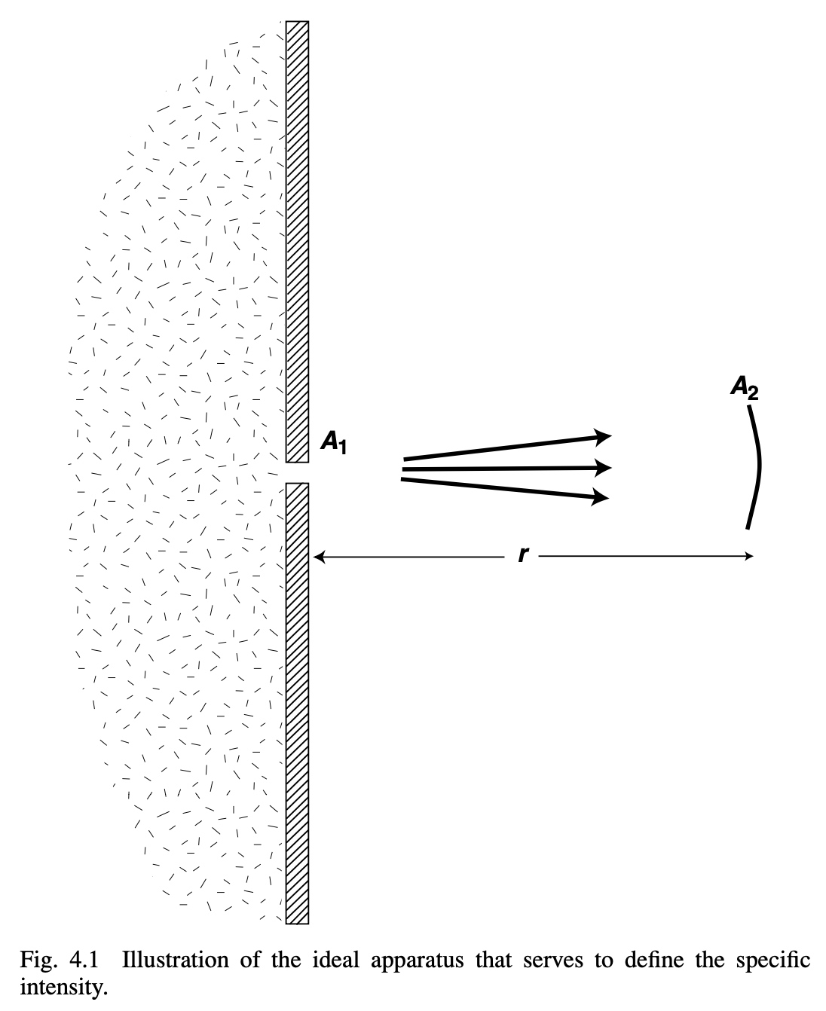

Specific Intensity
Imagine a beam of light travel through a pinhole with area $A_{1}$ on the wall, someone with a detector of area $A_{2}$ collects the photons of frequency $ν$ to $ν+Δν$ at a distance of $r$.
After $Δt$, the person collected $ΔE_{ν}$ energy of photon, thus,
$$ΔE_{ν}=I_{ν}\frac{{A_{1}A}_{2}}{r^{2}}ΔνΔt$$
$$ΔE_{ν}=I_{ν}A_{1}ΔΩΔνΔt$$
The specific intensity is defined as energy per unit area, per solid angle, per frequency and per unit time,
$$I_{ν}=\frac{{ΔE}_{ν}}{A_{1}dΩdνdt}$$
It has a relation to the energy density of the beam,
$$I_{ν}=\frac{{ΔE}_{ν}c}{A_{1}dΩdν(cdt)}=\frac{{cE}_{ν}′}{dΩdν}=\frac{{cE}_{ν}}{dΩ}$$

Slide 5

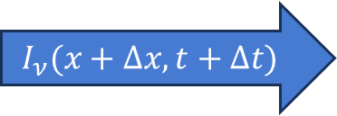




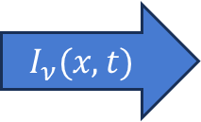



Emission and absorption
$$j_{ν}$$
A slab that emits photon, the photon merges into the beam.
$$I_{ν}(x,t)+j_{ν}cΔt=I_{ν}(x+Δx,t+Δt)$$
If we follow the intensity,
$$\frac{1}{c}\frac{{dI}_{ν}}{dt}=\frac{1}{c}\frac{{∂I}_{ν}}{∂t}+\frac{∂I_{ν}}{∂x}=j_{ν}$$
$$I_{ν}(x+Δx,t+Δt)$$
$$I_{ν}(x,t)$$
$$Δx=cΔt$$
$$k_{ν}$$
A slab that absorbs photon, how many photons the slab can capture is proportional to the incoming intensity,
$$I_{ν}\left(x,t\right)−k_{ν}I_{ν}cΔt=I_{ν}(x+Δx,t+Δt)$$
If we follow the intensity,
$$\frac{1}{c}\frac{{dI}_{ν}}{dt}=\frac{1}{c}\frac{{∂I}_{ν}}{∂t}+\frac{∂I_{ν}}{∂x}=−k_{ν}I_{ν}$$
$$I_{ν}(x,t)$$
$$I_{ν}(x+Δx,t+Δt)$$
$$Δx=cΔt$$

Slide 6
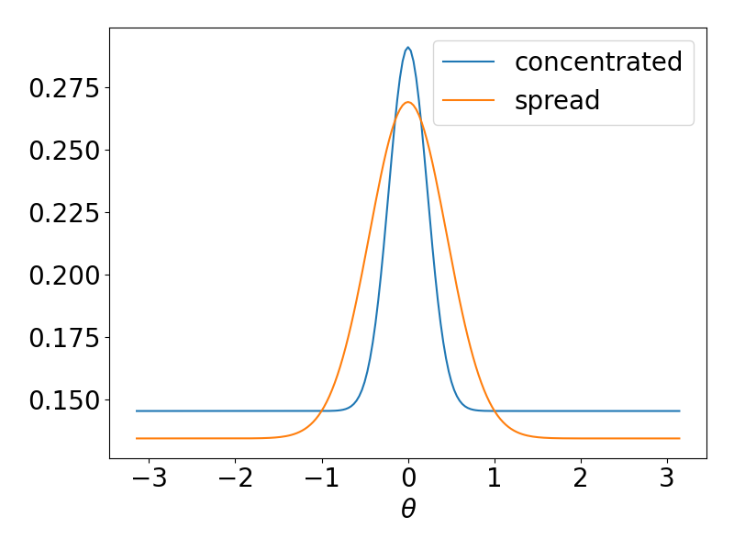







Scattering
$I_{ν}\left(Ω,ν\right)=∫ψ\left(Ω,Ω^{′},ν,ν^{′}\right)I\left(Ω^{′},ν^{′}\right)dΩ^{′}dν^{′}$. The scattering profile function $ψ\left(Ω,Ω^{′},ν,ν^{′}\right)$ is a normalized function to approximate the complex scattering.
If $ψ\left(Ω,Ω^{′},ν,ν^{′}\right)=δ\left(Ω^{′}\right)δ(ν′)$, means the incident photon is identical to the outcome photon. Equivalent to no scattering.
If $ψ\left(Ω,Ω^{′},ν,ν^{′}\right)=\frac{1}{4π}$, means isotropic scattering.
Let $cosθ=\hat{Ω}⋅\hat{Ω^{′}}$.
$$I_{ν}(Ω,ν)$$
$$I_{ν}(Ω′,ν′)$$
$$θ$$
$$θ$$
$$I_{ν}(Ω,ν)$$
$$I_{ν}(Ω′,ν′)$$

Slide 7





The Full radiative transfer equation
If we consider absorption, emission and scattering, the full intensity based radiative transfer equation is,
$$\frac{1}{c}\frac{∂I_{ν}}{∂t}+n_{x}\frac{∂I_{ν}}{∂x}+n_{y}\frac{∂I_{ν}}{∂y}+n_{z}\frac{∂I_{ν}}{∂z}=j_{ν}−(k_{ν}+σ_{s})I_{ν}+∫σ_{s}(Ω^{′},ν′)ψ\left(Ω^{′},ν^{′}\right)I_{ν}dΩ^{′}dν^{′}$$
$$I_{ν}=I_{ν}\left(Ω,ν\right), n_{x}=\hat{x}⋅\hat{Ω},n_{y}=\hat{y}⋅\hat{Ω},n_{z}=\hat{z}⋅\hat{Ω}$$
The scattering mean free path is dependent on the incident angle and frequency, $σ_{s}=∫σ_{s}\left(Ω^{′},ν^{′}\right)dΩ^{′}dν^{′}$. Scattering processes can scatter other angle and frequency into current angle and frequency, it can also scatter current angle and frequency into other angles and frequency.
This equation is deceptively easy to solve. The difficulty is in dimensionality catastrophe.
There are 7 variables $(x,y,z,θ,φ,ν,t)$, with 3 dummy variables $(θ^{′},φ^{′},ν′)$
$$\hat{z}$$
$$I_{ν}(Ω,ν)$$
$$I_{ν}(Ω′,ν′)$$
$$\hat{n}$$
$$θ$$
$$\hat{y}$$
$$θ$$
$$I_{ν}(Ω,ν)$$
$$\hat{x}$$
$$I_{ν}(Ω′,ν′)$$

Slide 8
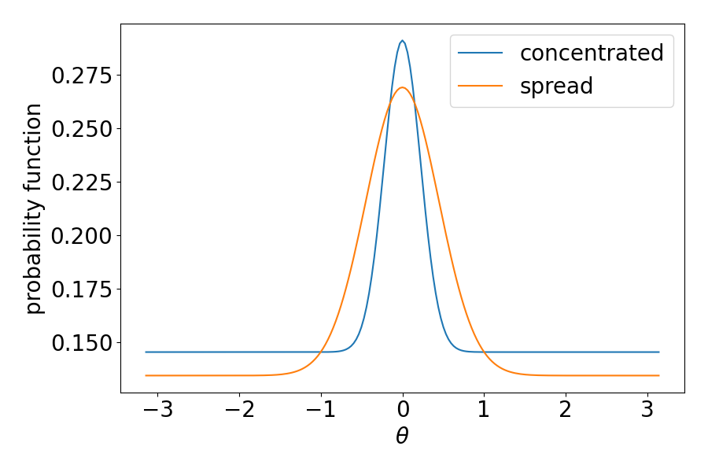
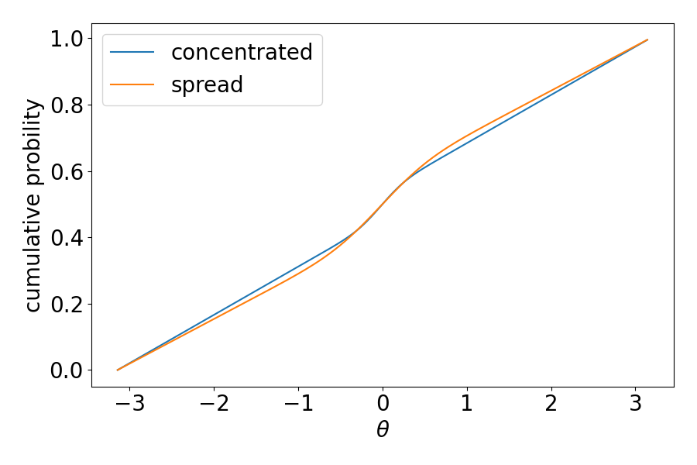

Monte-Carlo approach – in a naïve way
A plain thought of solving the radiative transfer equation is to approximate the continuous $I_{ν}$ with packets of photon $dE_{ν}(\vec{r},Ω,ν)$, with $∫dE_{ν}\left(\vec{r},Ω,ν\right)dΩdν$ equal to the total energy released at a place.
How long can the photon packet travel?
How will the photon packet be scattered?
Probability distribution function (PDF) and cumulative distribution function (CDF)
$$F\left(x\right)=∫f\left(x\right)dx$$

Slide 9


Monte-Carlo approach – in a naïve way
What is the CDF of distance of absorption?
$$\frac{dI_{ν}}{ds}=−k_{ν}I_{ν}$$
$$I_{ν}(s)=I_{ν}\left(0\right)e^{−k_{ν}s}$$
that means, the probability of not being absorbed is $F\left(s\right)=e^{−k_{ν}s}$, and the CDF of distance is
$$s_{a}=−\frac{\ln\left(1−p\right)}{k_{ν}}, p∈(0,1)$$
What is the CDF of distance of scattering and angle of scattering?
$$s_{s}=−\frac{\ln\left(1−p\right)}{σ_{ν}}, p∈(0,1)$$
$$θ_{s}=θ\left(p\right)=θ(∫ψsinθdθ), p∈(0,1)$$
$$φ=\frac{1}{2π}$$
$$θ$$

Slide 10
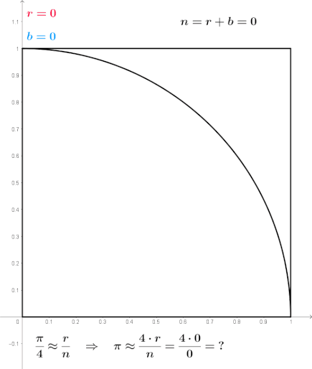

Monte-Carlo approach – Poisson noise
In an experiment to approximate $π$, we randomly generate points $\left\{x,y\right\}∈\left[0,1\right]×[0,1]$. We count how the number of points of red $r$ and divide it by the total number $n$ of points to approximate $π$.
Each point is independent, thus it obeys the Poisson distribution,
$$P\left(k;λ\right)=\frac{λ^{k}e^{−λ}}{k!};X(k,λ)=kP(k;λ)$$
$$E\left(X\right)=∑kP\left(k;λ\right)=λ$$
$$σ\left(X\right)=\sqrt{E\left(X^{2}\right)−E{\left(X\right)}^{2}}=\sqrt{λ}$$
Replace $λ$ by $n\overline{λ}$, which is the average events
$$SNR=\frac{λ}{\sqrt{λ}}=\sqrt{n\overline{λ}}$$
As $n$ increases, $\frac{r}{n}→\frac{π}{4}$.
$\frac{r}{n}=\frac{π}{4}+δ$, $δ∼\frac{1}{\sqrt{n}}$

Slide 11

Monte-carlo method – Chicken and eggs
Generate a distribution of photon packet $E_{ν}(\vec{r},Ω,ν)$ based on $j_{ν}(\vec{r},Ω,ν)$. However, $j_{ν}\left(\vec{r},Ω,ν\right)$ is dependent on the gas properties $[ρ,p,T]$.
The gas properties $[ρ,p,T]$ are dependent on radiation transport.
Radiative transfer
Gas $[ρ,p, T]$
Gas [𝜌,𝑝, 𝑇]
$$j_{ν}, k_{ν} σ_{ν}$$
𝑗_𝜈, 𝑘_𝜈 𝜎_𝜈
$E_{ν}(\vec{r},Ω,ν)$
𝐸_𝜈 (𝑟 ⃗,Ω,𝜈)

Slide 12



Moment method - $E_{ν}, {\vec{F}}_{ν}, P_{ν}$
Remember that the definition of specific intensity,
$$I_{ν}=\frac{{cE}_{ν}}{dΩ}, dΩ=sinθdθdφ$$
If we integrate the specific intensity over all solid angles,
$\frac{1}{c}{∫I}_{ν}(Ω)dΩ=E_{ν}$ energy
We also define,
${∫\hat{Ω}I}_{ν}\left(Ω\right)dΩ={\vec{F}}_{ν}$ energy flux
$\frac{1}{c}{∫\hat{Ω}\hat{Ω}I}_{ν}(Ω)dΩ=P_{ν}$ pressure tensor
For isotropic specific intensity, $I_{ν}\left(Ω\right)=\frac{1}{4π}$,
$$P_{ν}=\frac{1}{3}E_{ν}I$$
For unidirectional specific intensity, $I_{ν}\left(Ω\right)=I_{ν}δ(\hat{Ω})$,
$${\vec{F}}_{ν}=cE_{ν}\hat{Ω}$$
$$dΩ$$
$$\hat{Ω}$$

Slide 13

Moment method
We are now in a good position to take a closer look at the full radiative transfer equation, but drop out scattering for now,
$$\frac{1}{c}\frac{∂I_{ν}}{∂t}+n_{x}\frac{∂I_{ν}}{∂x}+n_{y}\frac{∂I_{ν}}{∂y}+n_{z}\frac{∂I_{ν}}{∂z}=j_{ν}−k_{ν}I_{ν}$$
$$\frac{1}{c}\frac{∂I_{ν}}{∂t}+\hat{Ω}⋅∇I_{ν}=\frac{1}{c}\frac{∂I_{ν}}{∂t}+∇⋅\hat{Ω}I_{ν}=j_{ν}−k_{ν}I_{ν}$$
Integrate the equation over all solid angles,
$$\frac{1}{c}\frac{∂E_{ν}}{∂t}+∇⋅{\vec{F}}_{r}={∫(j}_{ν}−k_{ν}I_{ν})dΩ$$
To proceed, let us assume the emissivity and absorptivity has no angle dependence,
$$\frac{1}{c}\frac{∂E_{ν}}{∂t}+∇⋅{\vec{F}}_{ν}=J_{ν}−k_{ν}E_{ν}$$
Even if we know $E_{ν}$, we do not know ${\vec{F}}_{r}$, to solve ${\vec{F}}_{r}$, we can multiply the radiative transfer equation by $\hat{Ω}$, and integrate over all solid angles,
$$\frac{∂{\vec{F}}_{ν}}{∂t}+c∇⋅P_{ν}=−k_{ν}{\vec{F}}_{ν}$$
Closure problem, ${\vec{F}}_{ν}=f(E_{ν})$ or $P_{ν}=f(E_{ν},{\vec{F}}_{ν})$.

Slide 14

Flux-limited-diffusion approximation
Let us start with the frequency integrated radiative transfer equation,
$$\frac{1}{c}\frac{∂I}{∂t}+\hat{Ω}⋅∇I=j−kI$$
In blackbody approximation, $j=ρ{cκ}_{e}B\left(T\right)$, where $κ_{e}$ is the emission opacity, $B\left(T\right)=aT^{4}$ is the blackbody energy density.
We assume the absorption opacity $κ_{a}$ is the same as the emission opacity.
$$I\left(Ω\right)=Ecψ\left(Ω\right), σ=ρκ_{e}=ρκ_{a}$$
$$\vec{F}=∫\hat{Ω}EcψdΩ=Ec\vec{f}$$
$$\frac{1}{c}\frac{∂(Eψ)}{∂t}+\hat{Ω}⋅∇\left(Eψ\right)=σ(\frac{B}{4π}−Eψ)$$
The angle integrated intensity radiative transfer equation is,
$$\frac{1}{c}\frac{∂E}{∂t}+∇⋅E\vec{f}=σ\left(B−E\right)$$

Slide 15




Flux-limited-diffusion approximation
Assume the angle dependent function $ψ$ has the following property,
$$\frac{1}{c}\frac{∂ψ}{∂t}+\hat{Ω}⋅∇ψ=0$$
After some calculation, we can get,
$$\left(\hat{Ω}⋅∇E−\vec{f}⋅∇E+σE\right)ψ=\frac{σB}{4π}$$
Divide both side by $σE$, let $− \frac{∇E}{σE}=\vec{R}$, $ε=\frac{B}{E}≈1$
$$ψ=\frac{1}{4π}\frac{ε}{ε+\vec{f}⋅\vec{R}−\hat{Ω}⋅\vec{R}}=\frac{1}{4π}\frac{1}{1+\vec{f}⋅\vec{R}−\hat{Ω}⋅\vec{R}}$$
It turns out that $\vec{f}=λ\left(R\right)\vec{R}$, the proof is done by using $\vec{f}=∫\hat{Ω}ψdΩ$.
$$1=\frac{1}{4π}∫\frac{1}{1+λR^{2}−\hat{Ω}⋅\vec{R}}dΩ=\frac{1}{R}\tanh^{−1}\left(\frac{R}{1+λR^{2}}\right)$$
$$λ\left(R\right)=\frac{1}{R}\left(cothR−\frac{1}{R}\right)≈\frac{2+R}{6+3R+R^{2}}, \vec{F}=cE\vec{f}=−\frac{cEλ∇E}{σE}$$
$$\hat{Ω}$$
$$\vec{R}$$
$$1+\vec{f}⋅\vec{R}$$

Slide 16
Flux-limited-diffusion approximation

Slide 17

Radiation hydrodynamic equations
$$\frac{∂ρ}{∂t}+∇⋅ρ\vec{u}=0$$
$$\frac{∂ρ\vec{u}}{∂t}+∇⋅\left(ρ\vec{u}\vec{u}+p\overline{\overline{I}}\right)=−ρ∇Ψ$$
$$\frac{∂E}{∂t}+∇⋅\left[\left(E+p\right)\vec{u}\right]=ρ\dot{Q}$$
$$\frac{1}{c}\frac{∂E}{∂t}+∇⋅\vec{F}=σ\left(B−E\right)$$
$$ρ\dot{Q}=−σ\left(B−E\right)$$

Slide 18
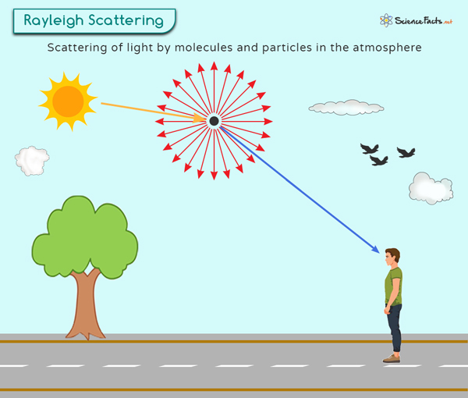


Rayleigh scattering
When the particle is neutral, and the radius $a$ of the particle is small compared to the wavelength of the photon $λ$, $a≪λ$, it is in the regime of Rayleigh scattering,
$$σ∼\frac{1+\cos^{2}{θ}}{λ^{4}}$$
$$θ$$

Slide 19
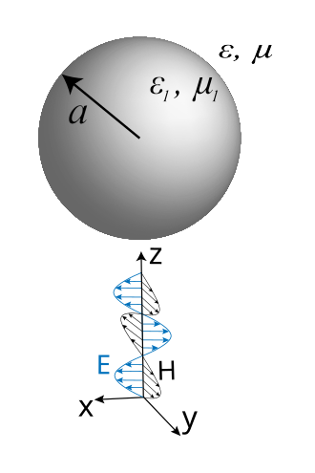
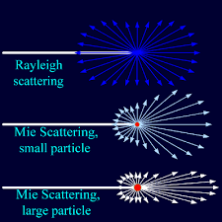

Mie scattering
When $λ≈a$, Rayleigh scattering does not apply. We need to adopt the Mie scattering model.
Assume particles are dielectric sphere, apply separation of variables to the d’Alembert equations,
$$∇^{2}\vec{E}−εμ\frac{∂^{2}\vec{E}}{∂^{2}t}=0, ∇^{2}\vec{H}−εμ\frac{∂^{2}\vec{H}}{∂^{2}t}=0$$
We get Helmholtz equations with constraints from sourceless Maxwell’s equations.
$$∇^{2}\vec{E}+k^{2}\vec{E}=0$$
$$∇^{2}\vec{H}+k^{2}\vec{H}=0$$
$$∇⋅\vec{E}=∇⋅\vec{H}=0$$
$∇×\vec{E}=iωμ\vec{H}$, $∇×\vec{H}=−iωε\vec{E}$
Mie scattering is forward scattering.

Slide 20
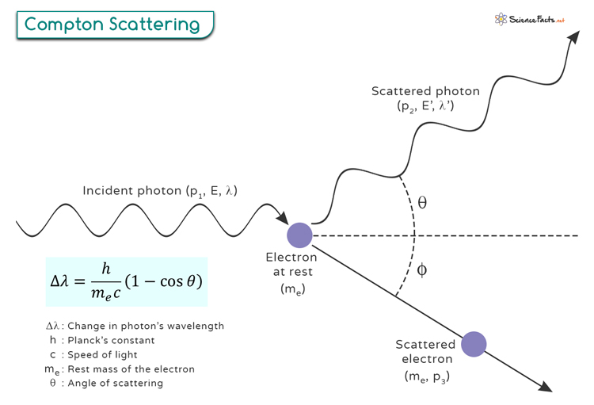



Thomson and compton scattering
When the particle is charged, but $hν≪m_{e}c^{2}∼0.5$ MeV, the interaction between the light and matter obeys Thomson scattering.
When $hν∼m_{e}c^{2}$, the interaction enters the regime of Compton scattering.
$$e^{−}$$
$$θ$$

