Slide 1
Overview on Neutrino Interactions
Jie Cheng 程捷
North China Electric Power University (NCEPU)
2024/4/29
chengjie@ncepu.edu.cn

Slide 2
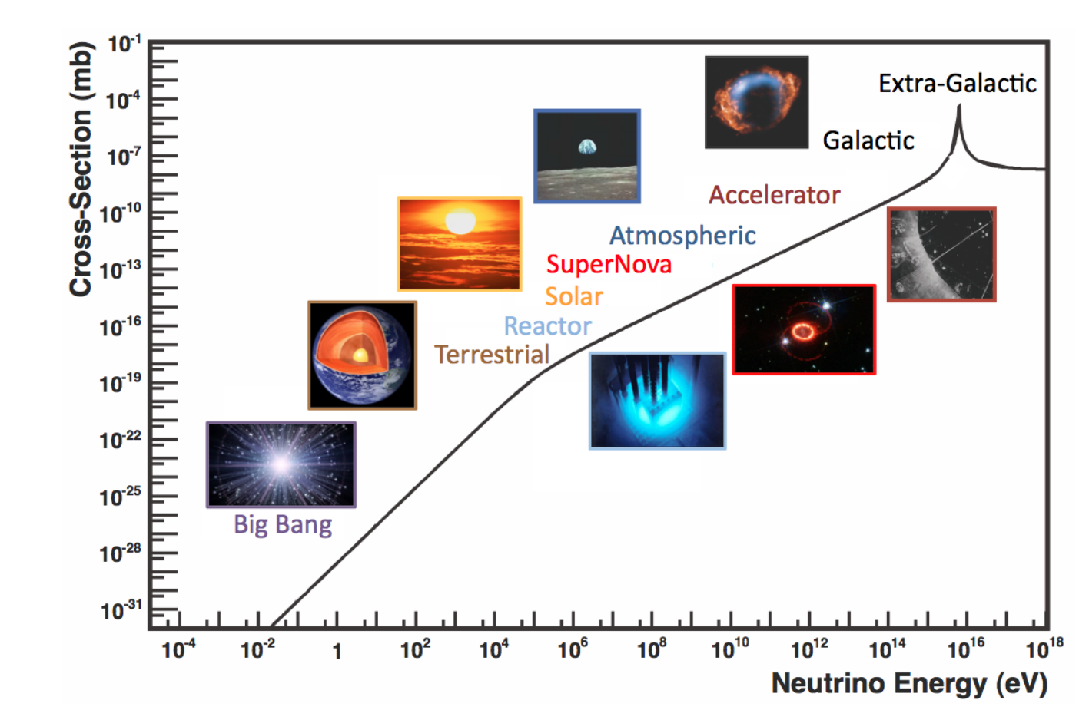
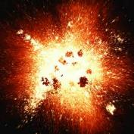
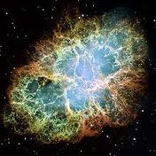
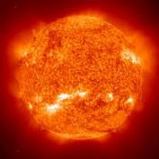
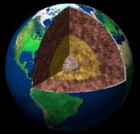
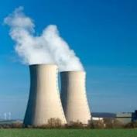
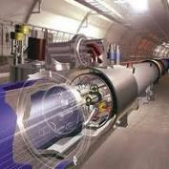
Neutrino Sources
Big Bang
Supernova
Solar
Atmospheric
Formaggio & Zeller, Rev. Mod. Phys. 84, 1307 (2012)
Earth
Human
Reactor
Accelerator

Slide 3
How to Observe Neutrinos
Gabriel N. Perdue @ INSS 2021
Neutrino can be observed via the detection of neutrino interaction in the detector
As the energy increases, the reaction channels are more complicated
The final state neutron multiplicity, pion production, and kinematics are very important distinctions
Neutrino energy range | Important Reaction channels
0 - 1 MeV | e elastic scattering (eES)
1 - 100 MeV | Inverse beta decay (IBD)
0.1 – 20 GeV | Neutral-current (NC), Charge-current (CC)

Slide 4
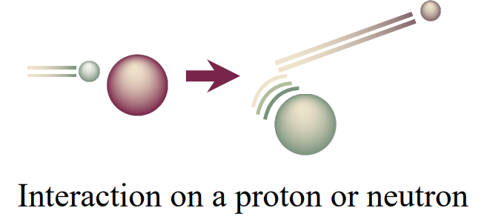
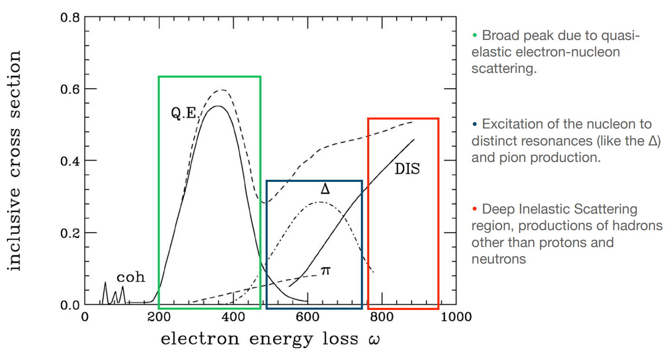
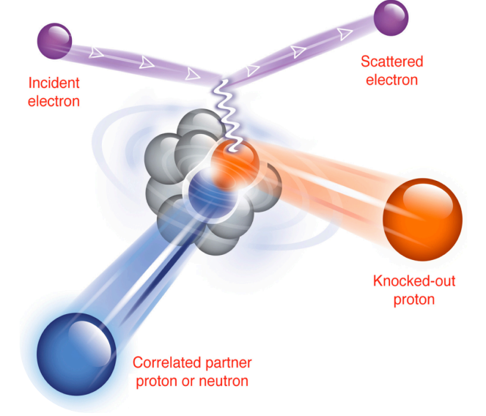
Some Insights from Electron Scattering Interactions
© Cheryl Patrick
From electron-nucleon scattering:
Rev. Mod. Phys. 80, 189
From electron-nucleus scattering:
Bound nucleons are moving – Fermi motion
Breaking up the nucleus – final state interactions
2p2h interaction (not well known)
All these interaction processes and effects also involve neutrino-nucleus scattering, but few neutrino data constraints our understanding
Science 320, 1476 (2008)

Slide 5
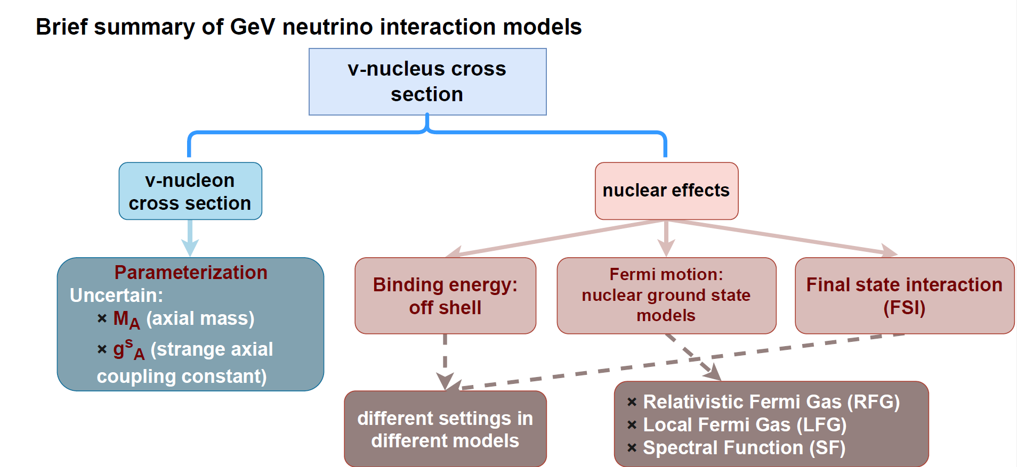
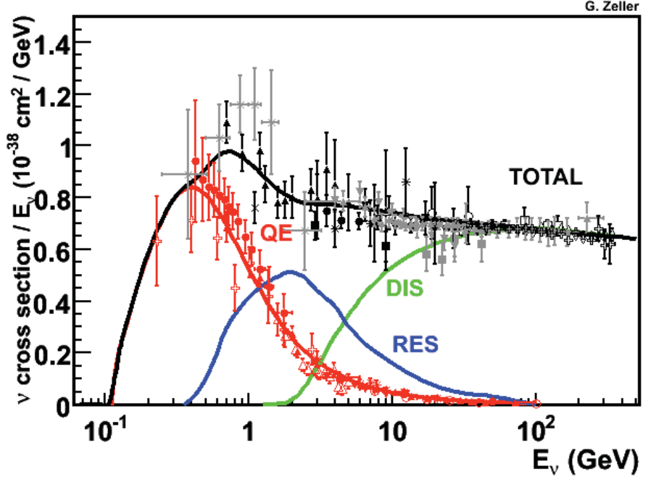
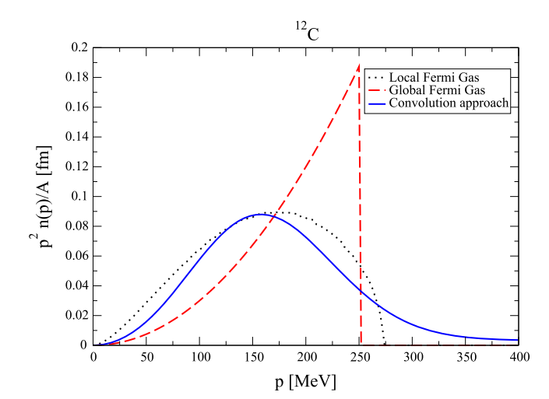
GeV Neutrino Interaction Models
[Rev. Mod. Phys. 84 (2012)]
Nucleon momentum distribution in the ground state of ¹²C in the RFG, LFG, and SF models.
GeV neutrino interaction is model dependent! Existing generators: GENIE/NuWro/GiBUU/NEUT
We are working on the latest versions of the generators, within the GeV v-A high-eNergY MEDium Effect (GANYMEDE) working group

Slide 6
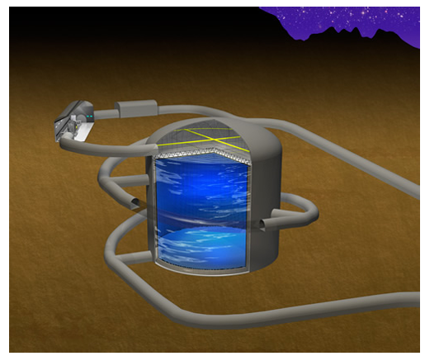
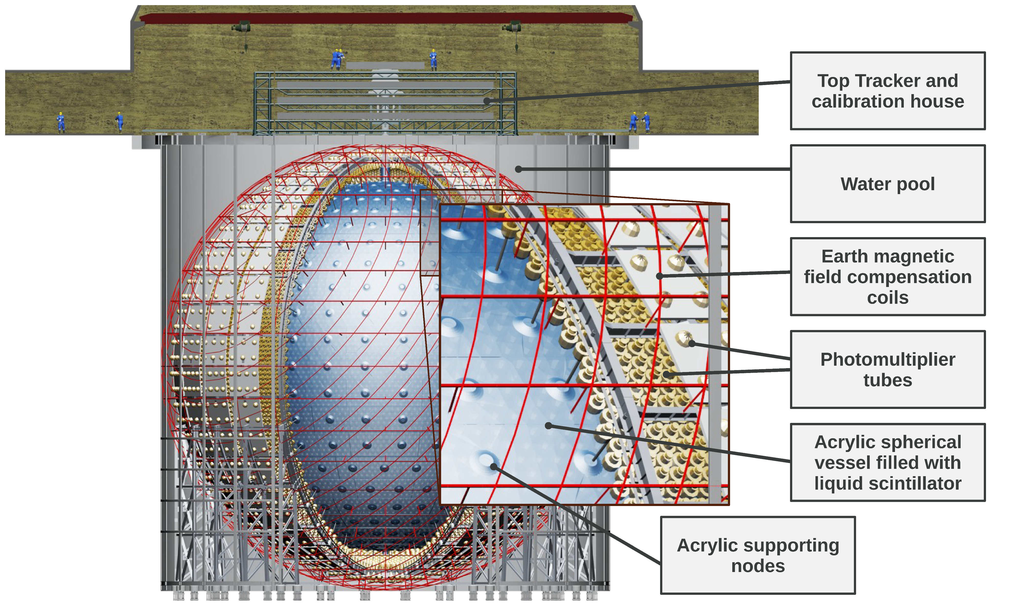
Next-generation Neutrino Detectors
Hyper-Kamiokande
Water detector
Target: ¹⁶O and H
DUNE
Liquid argon time-projection chamber detector
Main targets: Ar
JUNO
Liquid Scintillator (LS)
Main targets: ¹²C and H
Take the JUNO detector for example

Slide 7
JUNO: a broad physics program
Reactor
Atmosphere
Solar
Supernova
Earth
New physics
+
~60 ${\overline{ν}}_{e}$ per day
Hundreds per year
Hundreds per year for ⁸B
Supernova burst:
~7300 at 10 kpc
DSNB: 2-4 ${\overline{ν}}_{e}$ per year
~400 per year
Neutrino oscillation & properties
Neutrinos as probes
J. Phys. G43:030401 (2016)
PPNP 123 (2022) 103927

Slide 8
Reaction Channels
Neutrino sources | Reaction channels are used in JUNO
Geo-neutrino | IBD
Reactor neutrino | IBD
Solar neutrino (⁷Be, pep, CNO) | eES
Solar neutrino (⁸B) | eES, NC:$ν_{x}+{}_{}^{13}C→ν_{x}+{}_{}^{13}{C∗} (3.685 MeV$) , CC: $ν_{e}+{}_{}^{13}C→e^{−}+{}_{}^{13}N (gnd)$
Supernova neutrino (burst) | IBD, eES, pES, NC: $ν_{x}+{}_{}^{12}C→ν_{x}+{}_{}^{12}{C∗} (15.1 MeV$) CC: $ν_{e}+{}_{}^{12}C→e^{−}+{}_{}^{12}N$and ${\overline{ν}}_{e}+{}_{}^{12}C→e^{+}+{}_{}^{12}B$
DSNB | IBD
Atmospheric neutrino | NC, CC
Focus on neutrino interaction with carbon (this talk)
More details on atmospheric neutrino NC interaction study in JUNO are presented

Slide 9
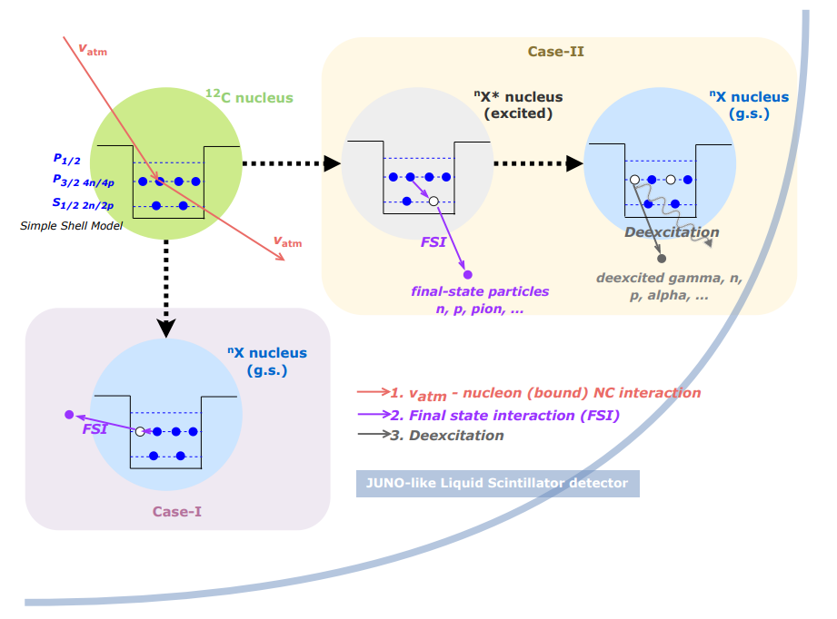
Methodology for Atm-$ν$ and ¹²C NC Interaction Prediction
Cheng et al, Phys. Rev. D 103. 05001 (2021)
Cheng et al, arXiv 2404.07429
GENIE, NuWro, etc.
Neutrino Interaction in LS
Residual nucleus is excited
TALYS
De-excitation of Residual nucleus
Residual nucleus is g.s.
Decay of Residual nucleus
Geant4
Detector simulation
$$N_{det}= φ ⨂{ }P ⨂{ σ} ⨂{ ε}$$
Atm-$ν$ measurement
Detector efficiency
Neutrino flux
Oscillation probability
Cross section
of $v_{x}+12C$

Slide 10
Neutrino Generators
GENIE/NuWro/GiBUU/NEUT: generate interactions of neutrinos
Marco Roda @ NUINT24
Ulrich Mosel and Kai Gallmeister @ NUINT24
Jan T. Sobczyk @ NUINT24
Patrick Stowell @ NUINT24
We are working on the latest versions of GENIE, NuWro, GiBUU, NEUT, and integrating them into the JUNO offline software framework.

Slide 11
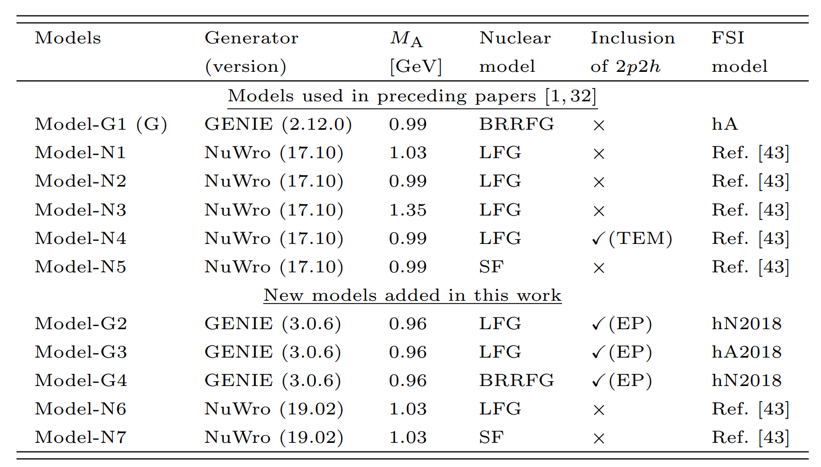
Neutrino Generator Models
Summary of the main features of models used in early and recent stages
BRRFG: relativistic Fermi gas model with “Bodek-Ritchie” modifications
LFG: local Fermi gas model
SF: spectral function
0.99 GeV: deuterium measurements
1.35 GeV: MiniBooNE neutrino QE data
TEM: Transverse Enhancement model for 2p2h
EP: Empirical model for 2p2h
Ref.[43]: Phys. Rev. D 79, 053003 (2009)
for QE

Slide 12
Neutrino Generator Models
Summary of the main features of models used in early and recent stages
for QE
Validated with MINERvA data
https://zenodo.org/records/6774990
Investigate the impact of different generators, nuclear model, FSI models on the prediction
All processes are included, new models primarily focus on variations related to QE and do not fully explore variations related to RES, COH, and DIS
Plan to include GiBUU and NEUT in our calculation

Slide 13
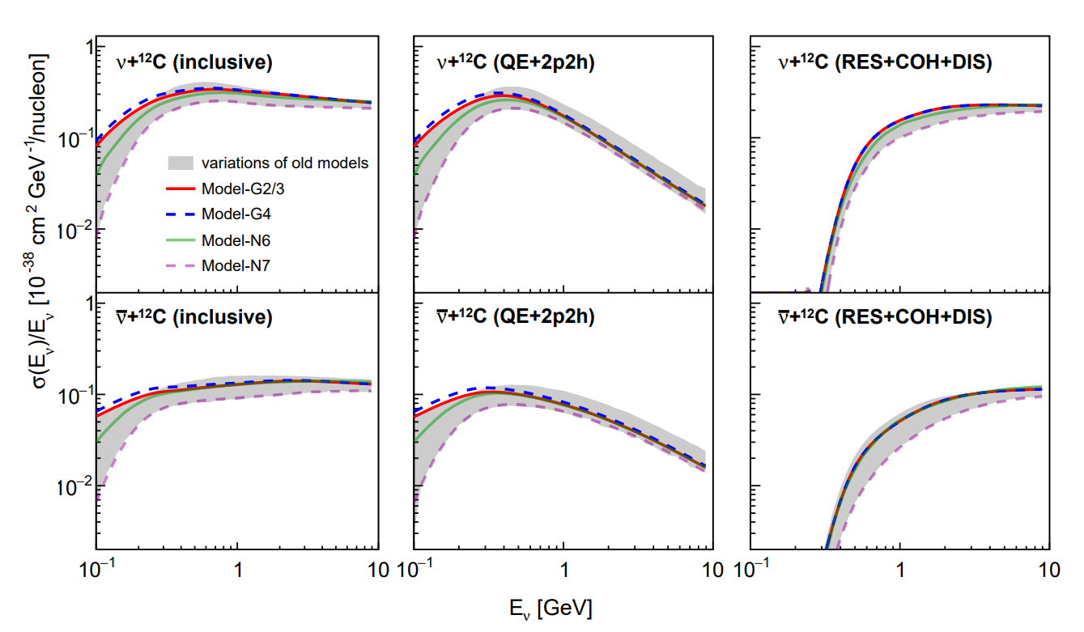
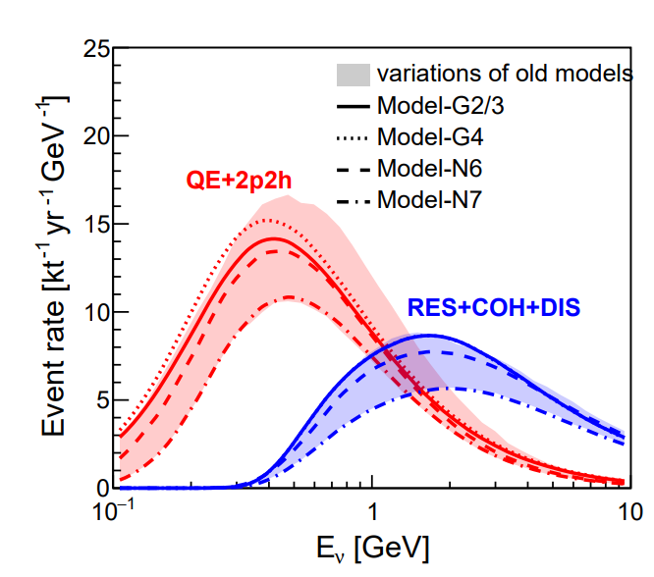
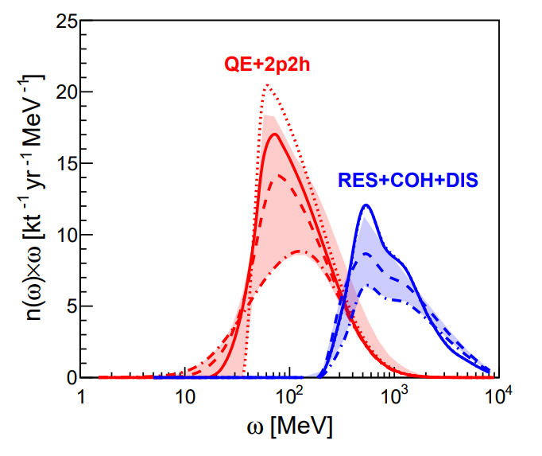
NC Cross-section and Event Rate
Cheng et al, arXiv 2404.07429
LFG
BRRFG
SF
Model variations regarding the initial interactions: a systematic uncertainty
QE and 2p2h events: ~99% of the NC background in the searches for IBD signals below 100 MeV visible energy
Energy transfer

Slide 14
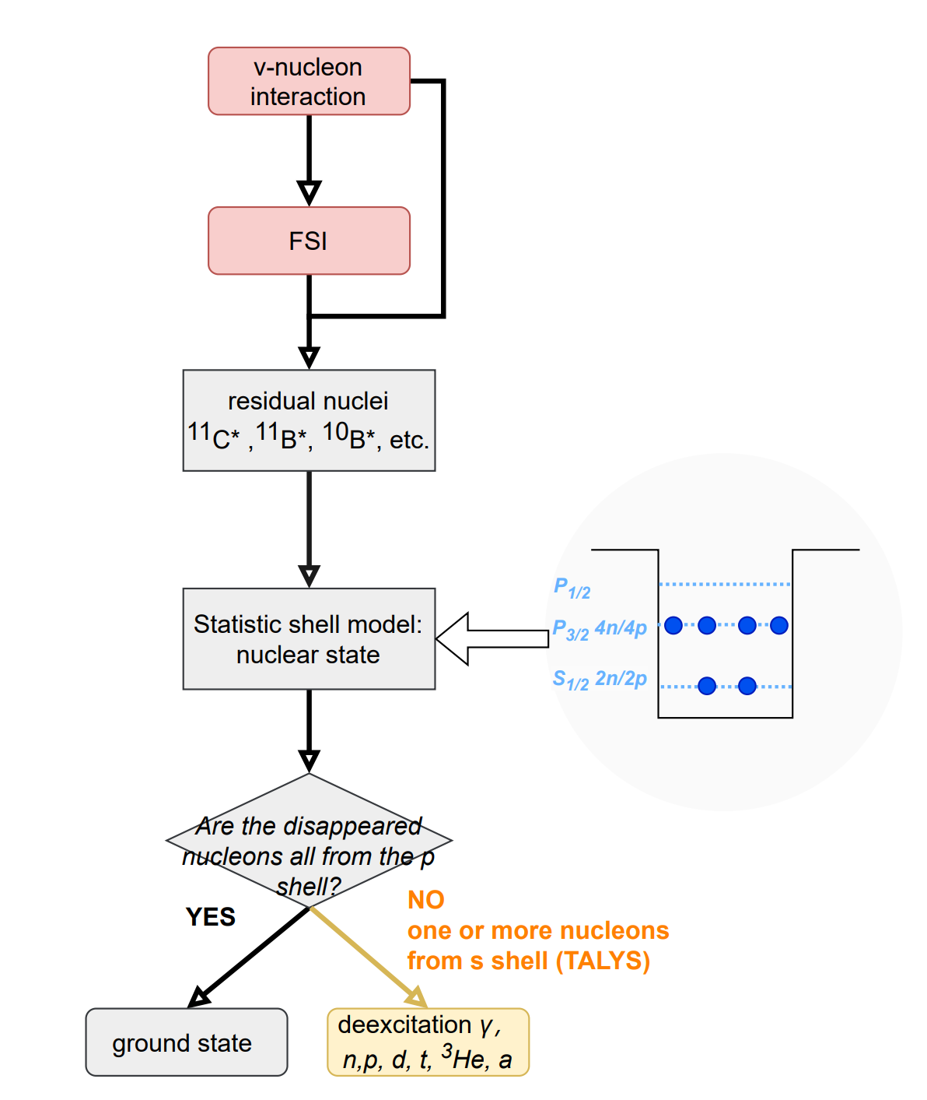
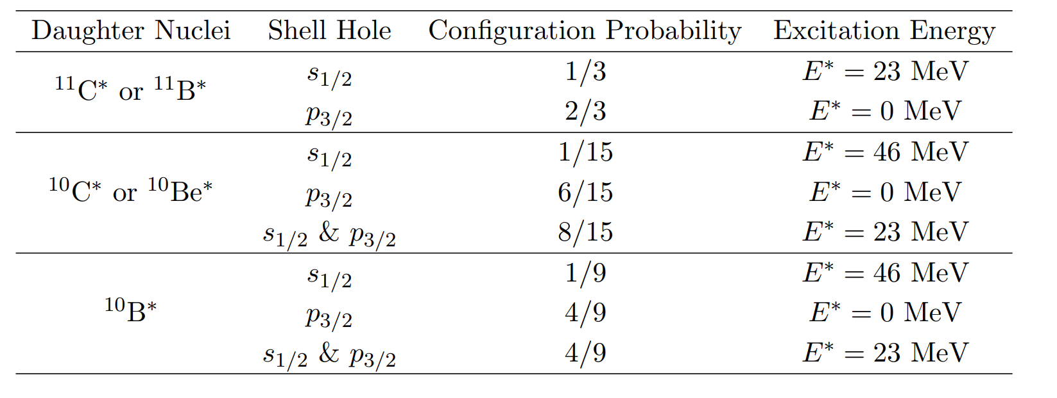
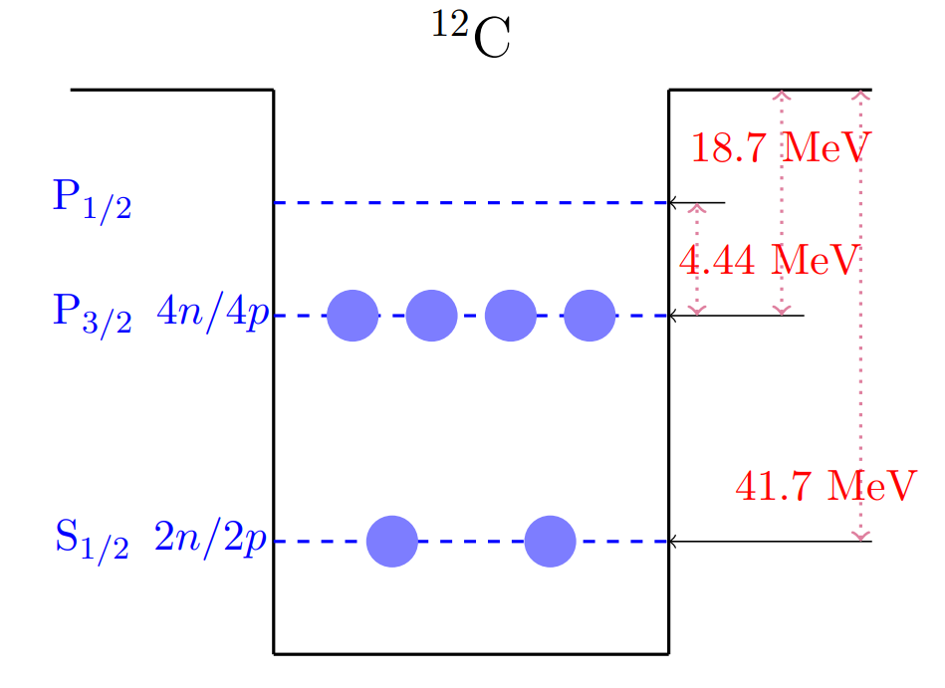
TALYS-based Deexcitation Model of Residual Nucleus
Simple shell model → Status of the residual nuclei
Phys. Rev. D 67 (2003) 076007
All residual nuclei with A>5 have been considered
Taking ¹¹C*, ¹¹B*, ¹⁰C*, ¹⁰Be* and ¹⁰B* for example
Assume each neutron or proton has same possibility(1/6) to leave the shell.

Slide 15
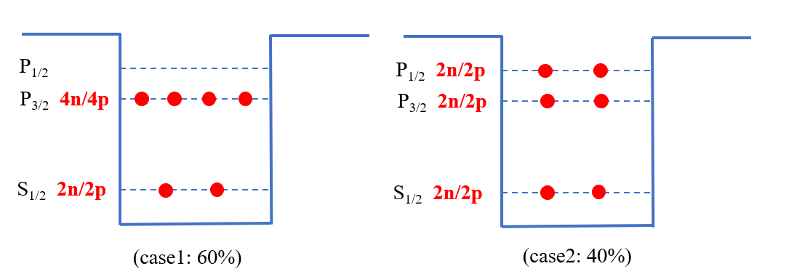
TALYS-based Deexcitation Model of Residual Nucleus
Simple shell model → Status of the residual nuclei
Phys. Rev. D 67 (2003) 076007
Go beyond simple shell model
considering the correlation between P shell (P_{1/2} and P_{3/2})
will be implemented
Assume each neutron or proton has same possibility(1/6) to leave the shell.
e.g, a neutron as well as a proton disappearance (nucleus: ¹¹C, ¹¹B):
Shell | State
S_{1/2} | $E^{∗}=23 MeV$
P_{3/2} | ground state
P_{1/2} | $E^{∗}=2 MeV$
33.3%
53.4%
13.3%

Slide 16
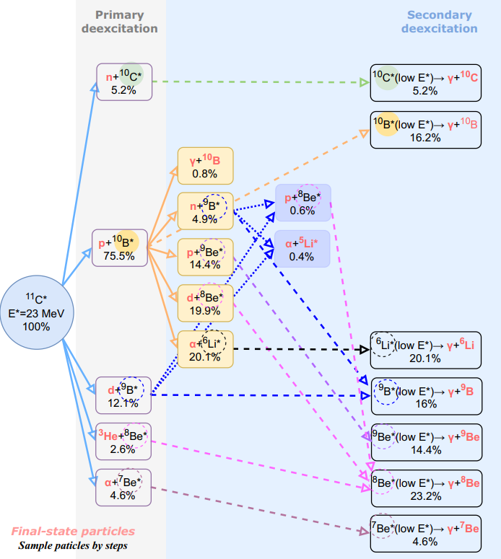
TALYS-based Deexcitation Model of Residual Nucleus
2. TALYS → Simulate residual nucleus at certain excited energy
http://www.talys.eu/home/
Taking the deexcitation chain of ¹¹C* with $E^{∗}$=23 MeV for example
TALYS also provides the energy spectra of the associated final-state particles

Slide 17
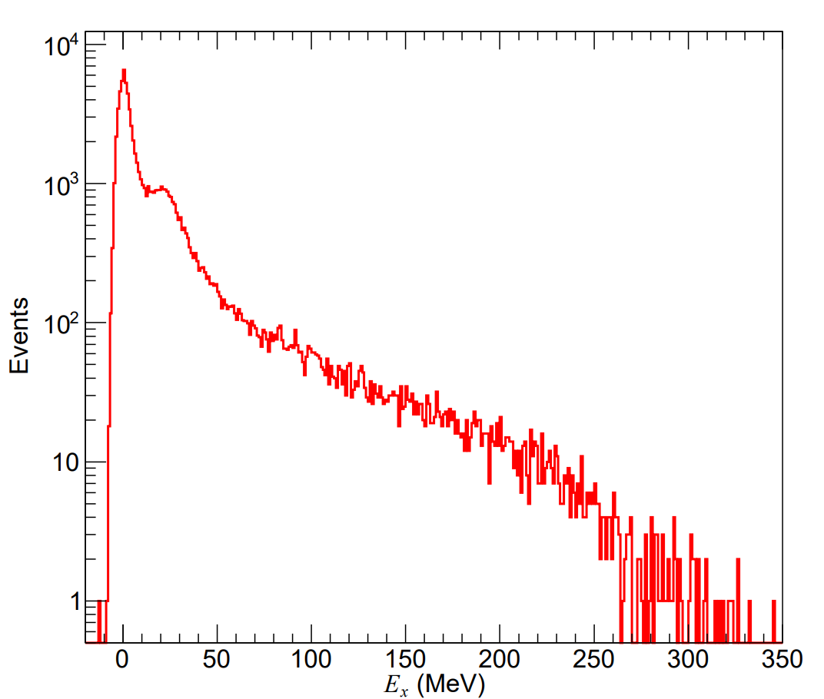
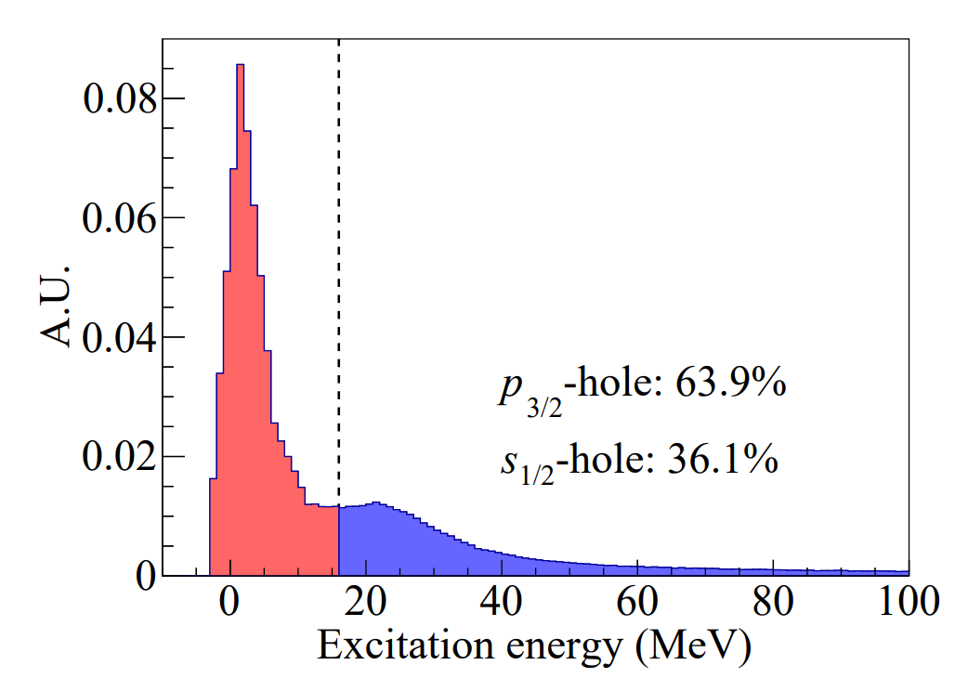
Other Publications for TALYS-based Deexcitation Model
Hu et al, Phys. Lett. B 831 (2022) 137183
Abe, Phys. Rev. D 109 (2024) 3, 036009
The differences from our method:
E* is estimated by (removal energy and separation energy) or (the invariant mass and ground-state mass of the residual nuclei) v.s. the statistic models (our work)
Input of TALYS is the continuous excitation energy spectrum v.s. e.g., 23 MeV for ¹¹B* (our work)
Hu et al
Abe
Challenge for this method:
difficult to get E* of the residual nuclei with using other nuclear models, such as RFG, LFG in neutrino generators
Input of TALYS: E*>16 MeV
33%
Excitation energy E* distribution of ¹¹B* based on SF model

Slide 18
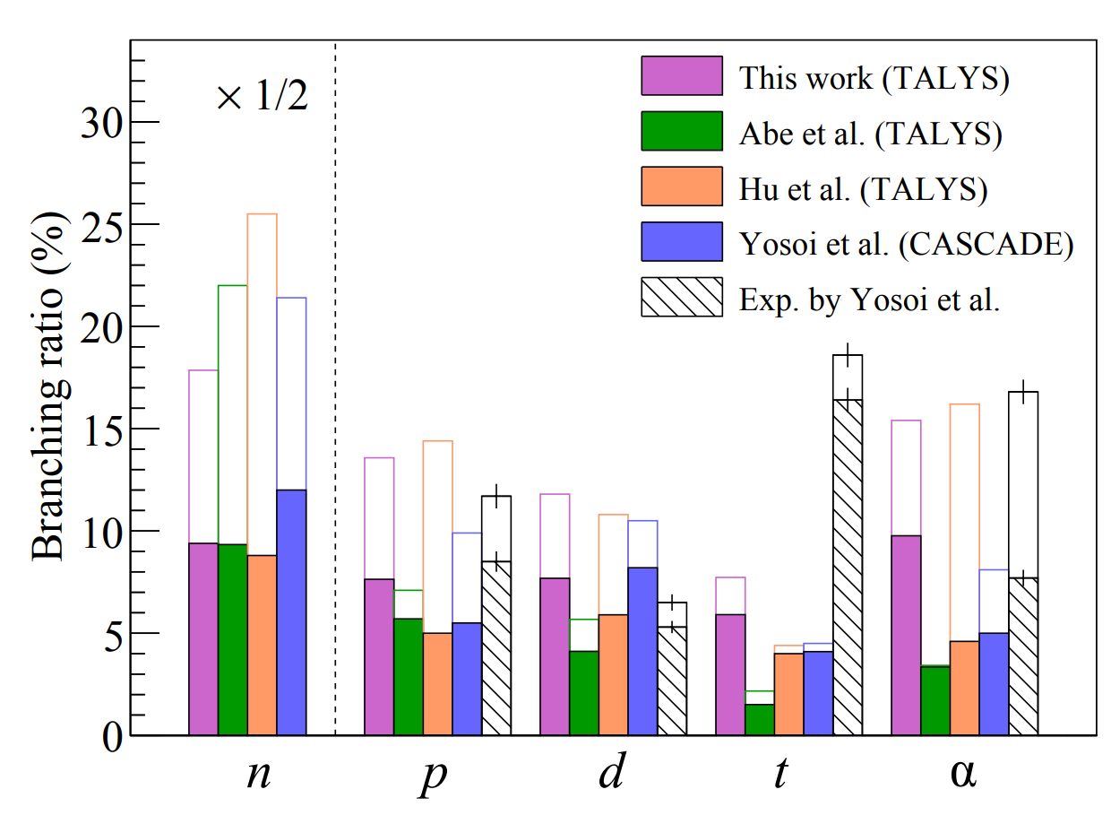
Comparison of Deexcitation Channels of ¹¹B*
Abe, Phys. Rev. D 109 (2024) 3, 036009
Hu et al, Phys. Lett. B 831 (2022) 137183
our work
Reaction ratio with neutron production: ~68% (our work)

Slide 19
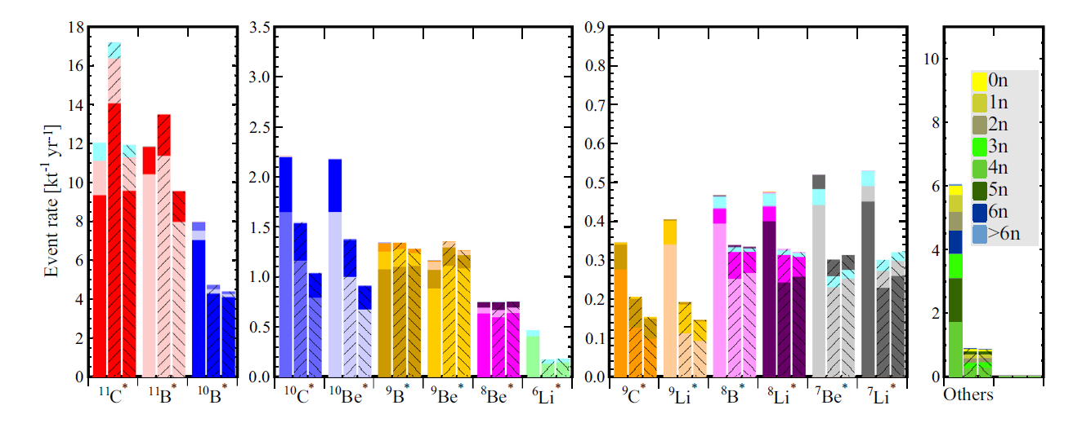
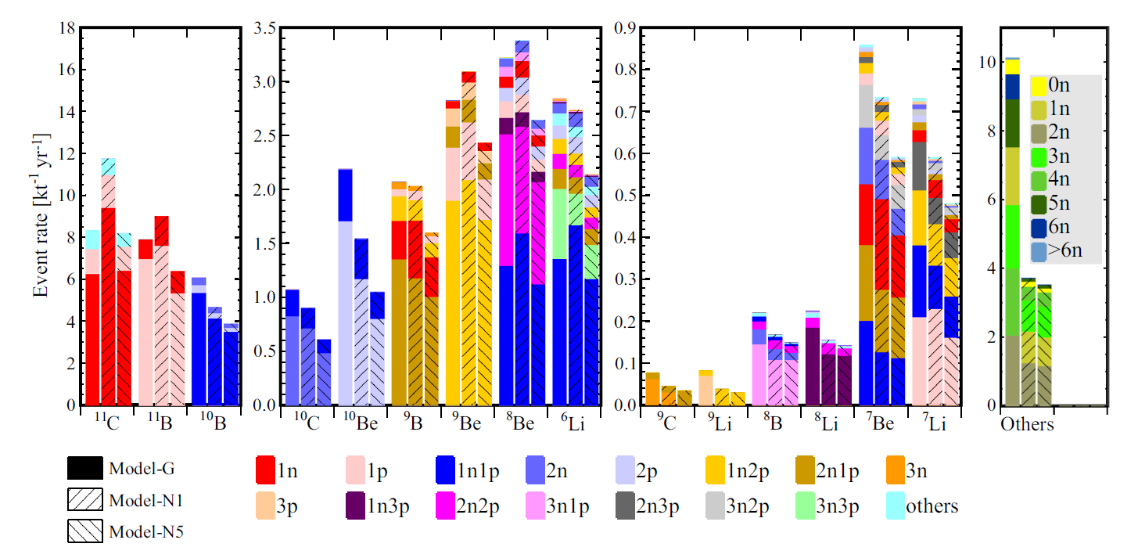
Impact of Deexcitation on Final-state Production of NC Events
Cheng et al, Phys. Rev. D 103. 05001 (2021)
Before deexcitation, ¹¹C, ¹¹B, ¹⁰B dominated
After deexcitation , ¹¹C, ¹¹B, ¹⁰B reduced, with more lighter nuclei
Exclusive final-state information, such as the neutron multiplicity, the charge pion multiplicity, the unstable nuclei, is important for tagging and reducing the background

Slide 20
Decay Modes of Residual Nuclei
Considering decay processes of unstable isotopes after de-excitation stage
 | Half time | Decay mode
$${}_{}^{8}{Li}$$ | 840.3 ms | $β^{−}$
$${}_{}^{9}{Li}$$ | 178.3 ms | ($β^{−}$,n)(50.8%) , $β^{−}$(49.2%)
$${}_{}^{7}{Be}$$ | 53.22 d | $ε$
$${}_{}^{8}{Be}$$ | 6.7X10⁻¹⁷ s | $α$
$${}_{}^{10}{Be}$$ | 1.39X10⁶ years | $β^{−}$
$${}_{}^{8}B$$ | 770 ms | $β^{−}$, $α$
$${}_{}^{9}B$$ | 800X10⁻²¹ s | p
 | Half time | Decay mode
$${}_{}^{9}C$$ | 126.5 ms | $β^{+}$(60%), $β^{+}$and p(23%) , $β^{+}$ and $α$ (17%)
$${}_{}^{10}C$$ | 19.29 s | $β^{+}$
$${}_{}^{11}C$$ | 20.334 min | $β^{+}$(99.79%), $ε$ (0.21%)
Liquid Scintillator
$$ν_{x}$$
$$ν_{x}$$
${}_{}^{6}{Li}$, ${}_{}^{7}{Li}$, ${}_{}^{9}{Be}$, ${}_{}^{10}B$, ${}_{}^{11}B$ and ${}_{}^{12}C$ : stable
neutron
$${}_{}^{12}C$$
Important for the background reduction and in situ measurement
${}_{}^{n}{X }$: residual nucleus with decay information

Slide 21
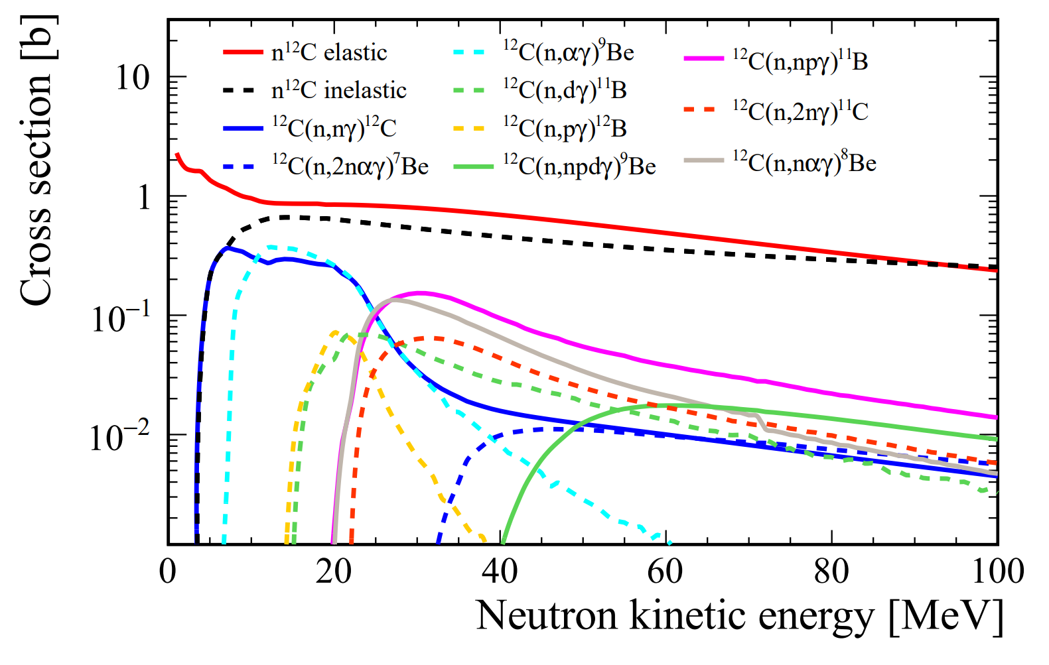
GEANT4-based Detector Simulation
GEANT4 (4.10.p02)➔ simulate the propagation of final-state particles in LS
Hadronic models: QGSP_BERT_HP
JUNO detector as our reference
Considering decay processes of unstable isotopes after deexciation stage in detector simulation
Secondary interactions (SI): final-state particles produced by a primary interaction, subsequently interact within the LS
Neutron tagging takes place after the SI
Tagged neutrons $≠$ final-state neutrons
arXiv 2311.16550
Extracted from the results of TALYS

Slide 22
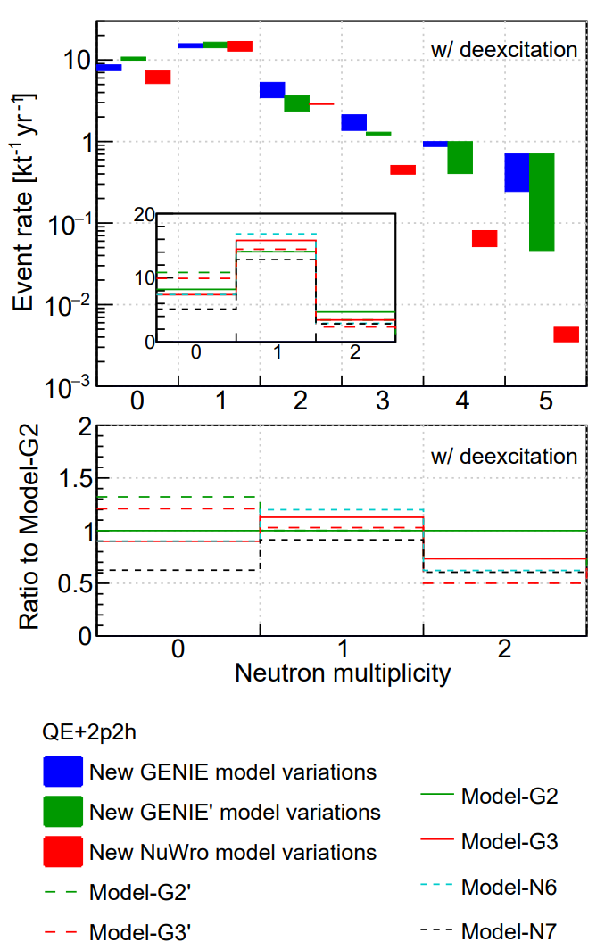
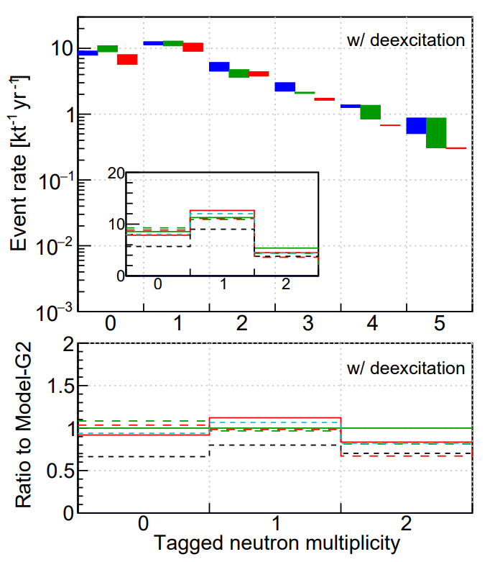
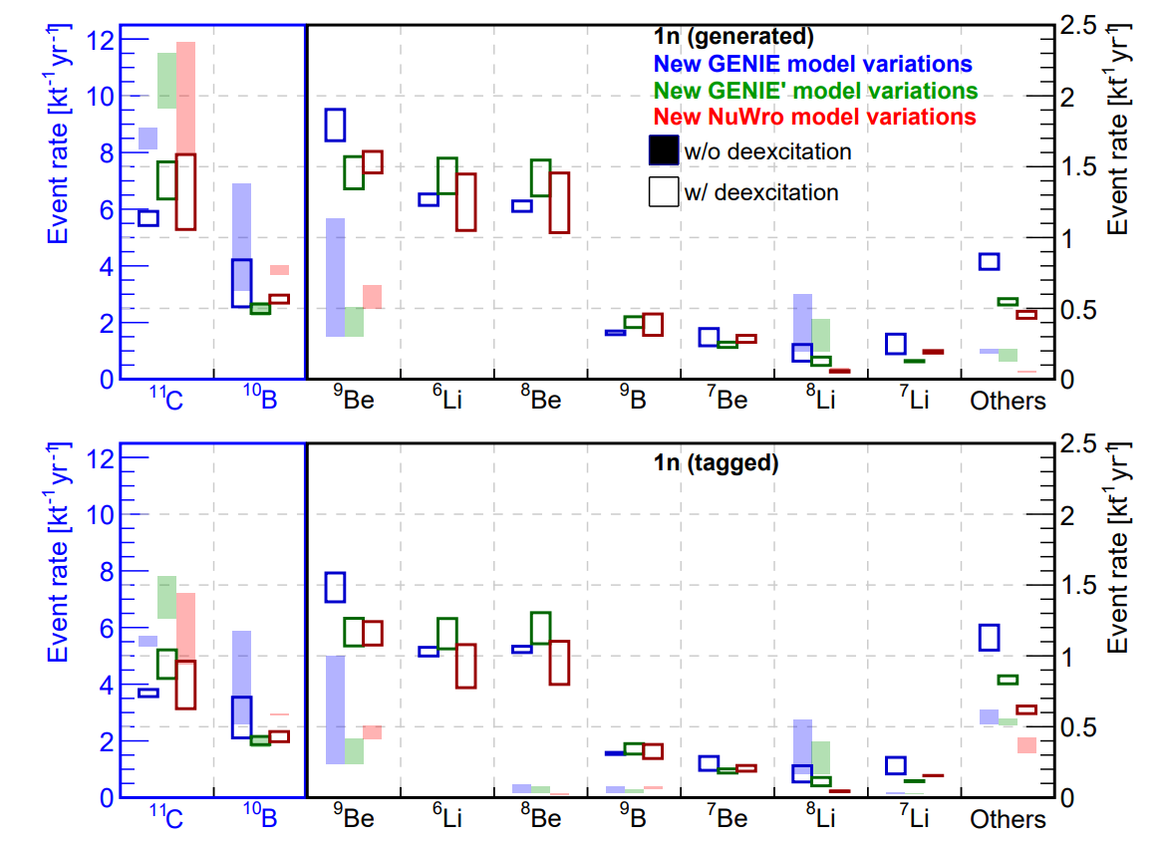
Comparisons
Cheng et al, arXiv 2404.07429
Final-state
Observed
Neutron multiplicity=1 decrease significantly from the final-state to observation due to the secondary interactions
After deexcitation process, ¹¹C, ¹⁰B reduced, with more lighter nuclei
¹¹C (one tagged neutron) significantly decreased due to the higher kinetic energies of fast neutron from NC with ¹¹C, making them more prone to inelastic scattering in LS

Slide 23
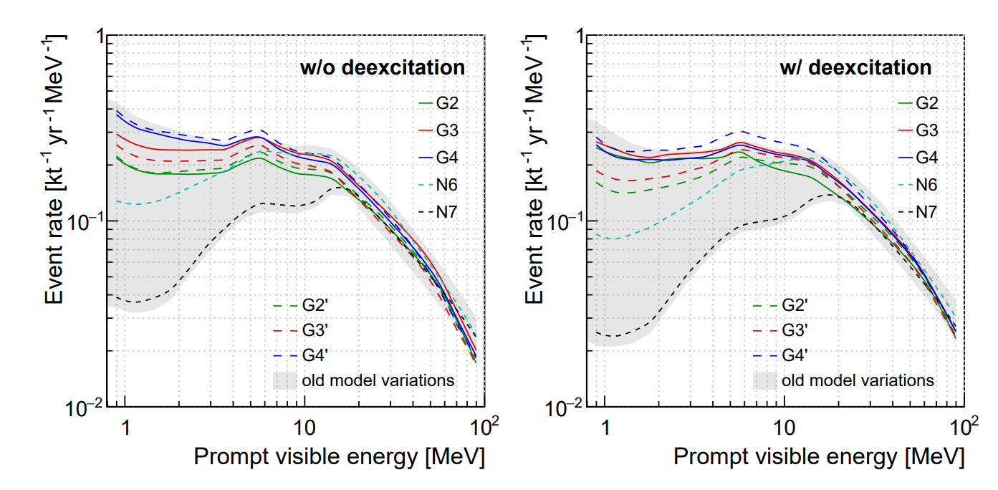
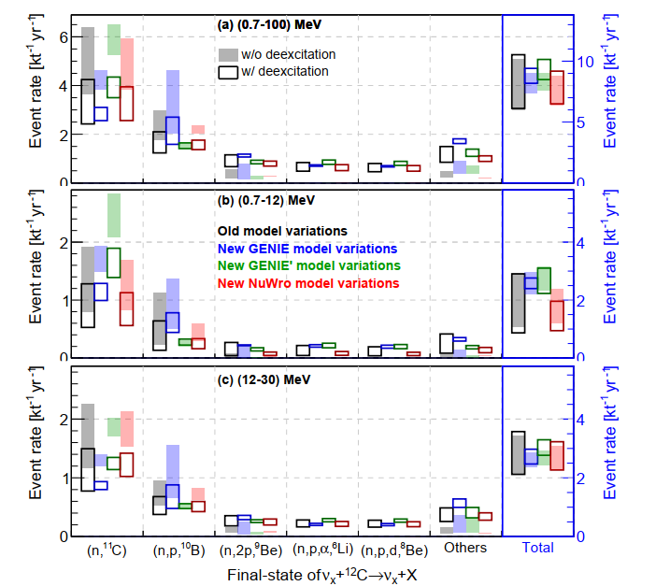
IBD-like NC Background
Cheng et al, arXiv 2404.07429
Reactor neutrino energy range
DSNB energy range
Focus on the prompt visible energy below 100 MeV
Large model variation in energy < 20 MeV, the model prediction lack sufficient experimental constraints.
With deexcitation,
energy spectra shift to higher energies and enlarge the model variations
dominant channels with ¹¹C and ¹⁰B reduce, and channels with lighter nuclei increase
The NC background rate with deexcitation as the nominal result

Slide 24
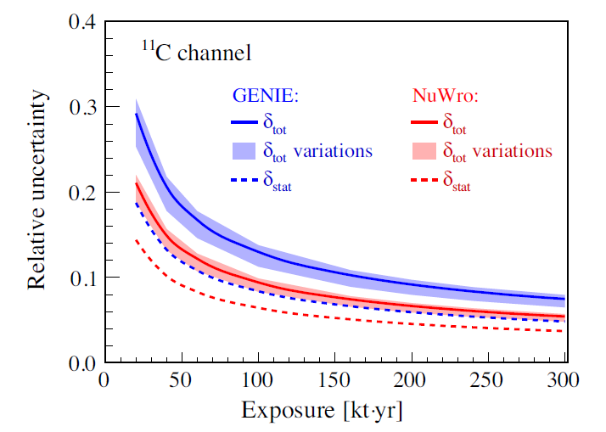
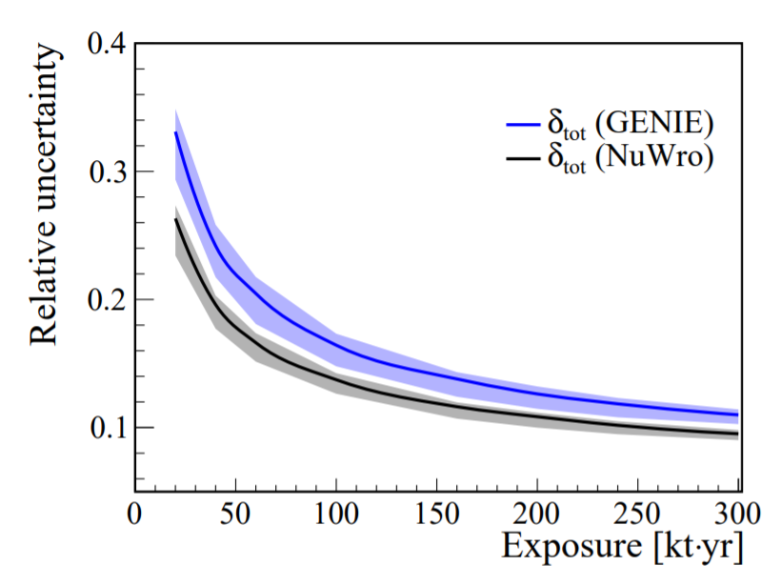
Methodology for In-situ Measurements
Cheng et al, Phys. Rev. D 103 (2021) 5, 053002
A systematic study on the measurement of the NC background and evaluate the associated uncertainties
According to the possible association with unstable residual nuclei, a maximum-likelihood method is proposed to measure the triple-coincident signature of the NC background
Future JUNO will be able to make a unique contribution to the worldwide dataset to improve the prediction of NC interaction on ¹²C
Reproduce NC background uncertainty from the summary in Phys.Rev.D 103 (2021) 5, 053002
JUNO, JCAP 10 (2022) 033
The bands are obtained by assuming different levels of natural radioactivity and cosmogenic ¹¹C in the accidental background
15%
Within 10 years JUNO data, NC background rate can be constrained on 15% level

Slide 25
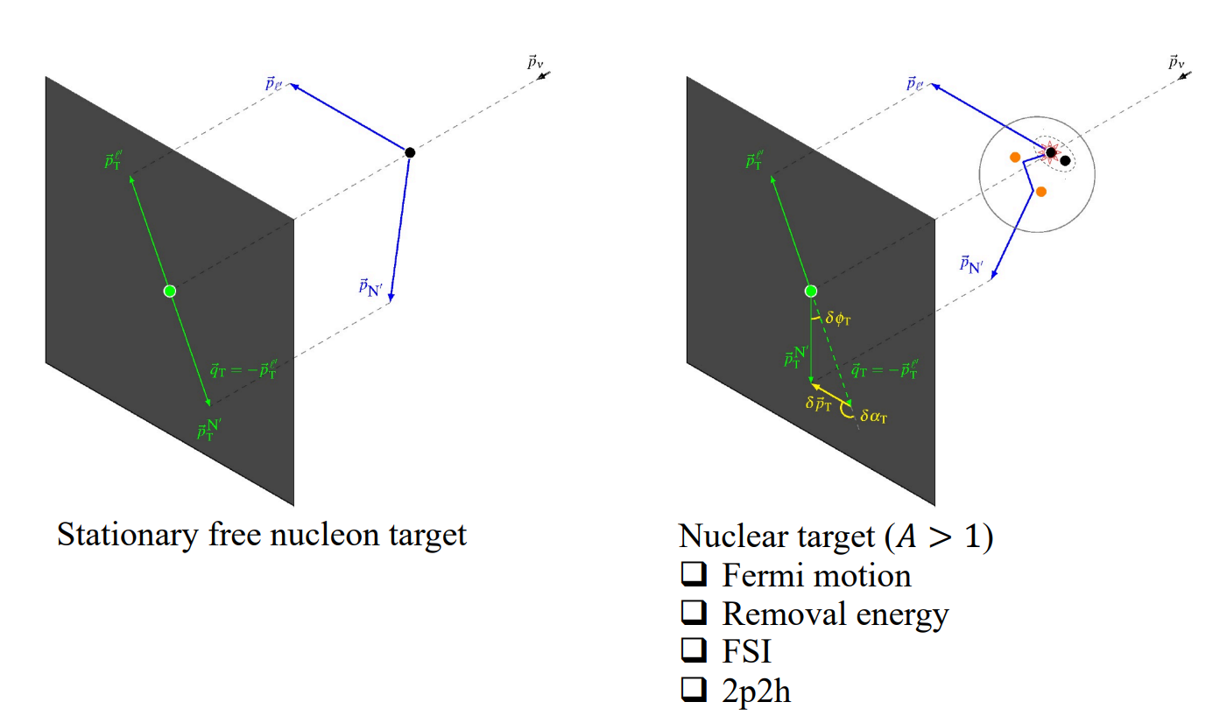
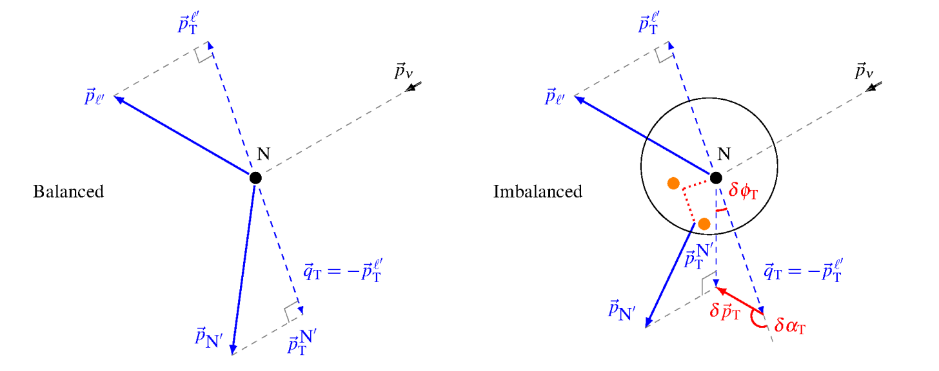
Constraining Neutrino Interactions → Transverse Kinematic Imbalance (TKI)
TKI: precisely identify intranuclear dynamics, or the absence thereof, in neutrino-nucleus interactions – an analogue of the missing energy technique used in collider experiments.
Furmanski-Sobczyk emulated nucleon momentum p_{n}： the Fermi motion of the struck nucleon
Transverse boosting angle $δα_{T}$： the direction of$δp_{T}$

Slide 26
Generator Performance in TKI
Cheng, Qu, Wen, Lu @ neutrino 2022
Predictions of TKI by GENIE, GiBUU, NuWro compared to the MINERvA $π^{0}$ measurement

Slide 27
Summary and Prospects
Neutrino interactions in LS rely on nuclear models
needs precise model predictions
The corresponding neutrino interaction channels have been studied
Atmospheric (GeV) neutrino interactions are more complex
Neutrino interactions (including de-excitation) are developed
Not only rely on the model predictions, but also seek measurements to tune the model and constrain interaction uncertainty
JUNO
…
谢谢!

Slide 28
Backup

Slide 29
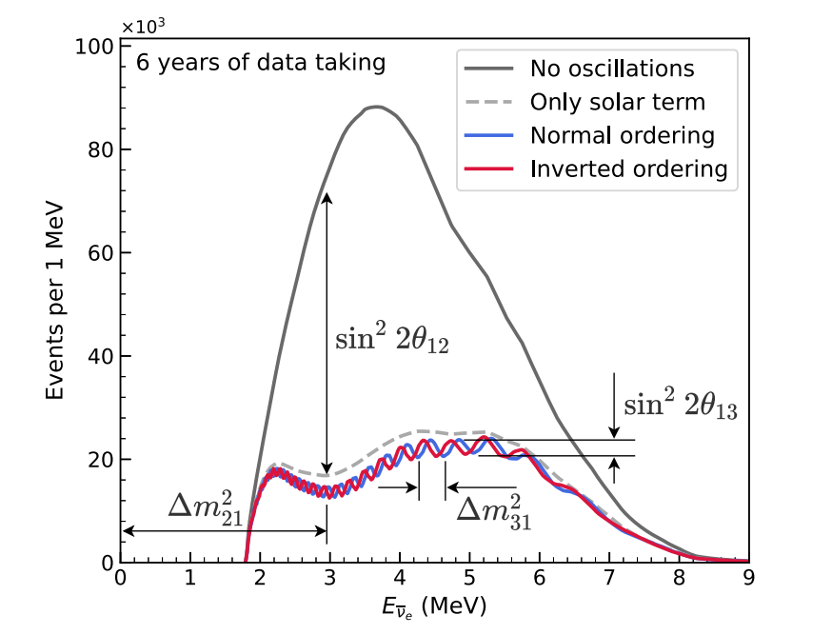
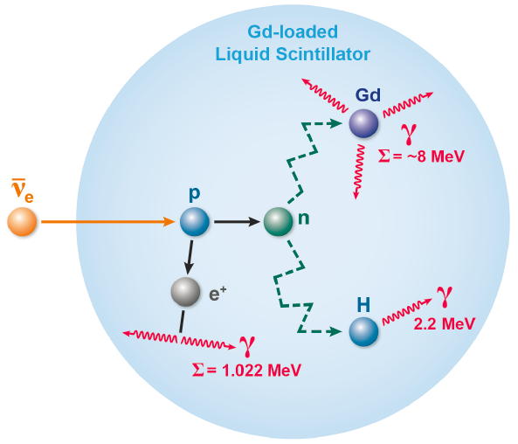
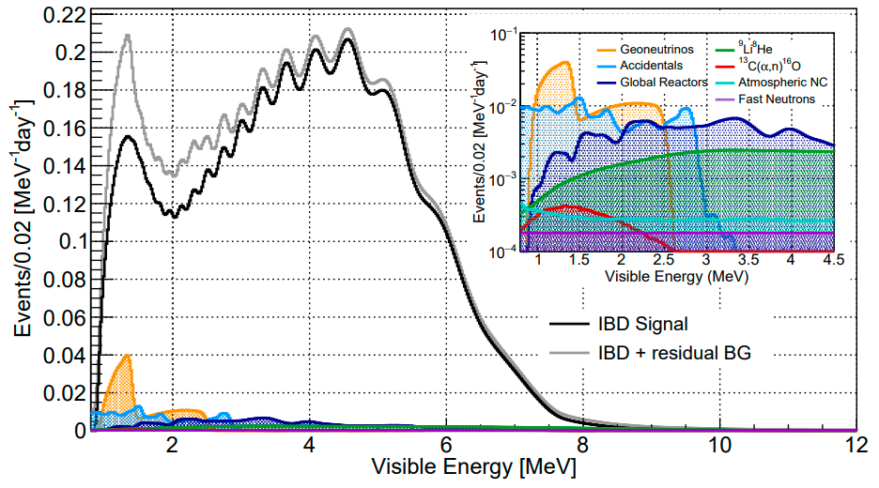
Reactor ${\overline{ν}}_{e}$
Neutrino oscillation & properties
Detection via inverse beta decay (IBD):
JUNO
JUNO, Chin. Phys. C 46 (2022) 12, 123001
Chin. Phys. C 46 (2022) 12, 123001
Expected signal and background:
200 μs
The double coincidence➔ suppression of background
Atmospheric NC➔ non-negligible background for precise measurement

Slide 30
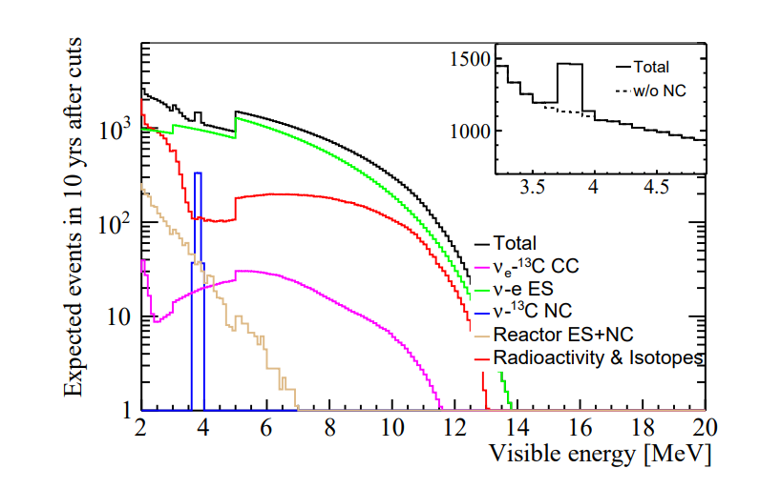
JUNO ⁸B solar $ν$ measurements
⁸B solar neutrino detection [arXiv:2210.08437]
Cross-section of interactions between neutrinos and carbon [Phys. Rev. C 86, 015502 (2012), J. Phys. G 46, 075103 (2019)]
Uncertainties from interaction cross-section are considered
Under these conditions, and combined with SNO, the accuracy of ⁸B flux is 3% @ 10 years
If the cross-section uncertainty becomes 10%, ⁸B flux is 6%

Slide 31
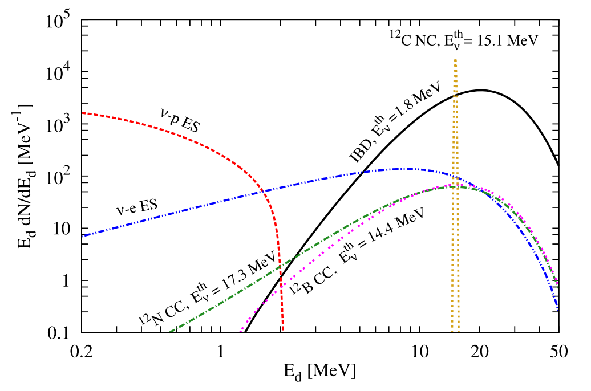
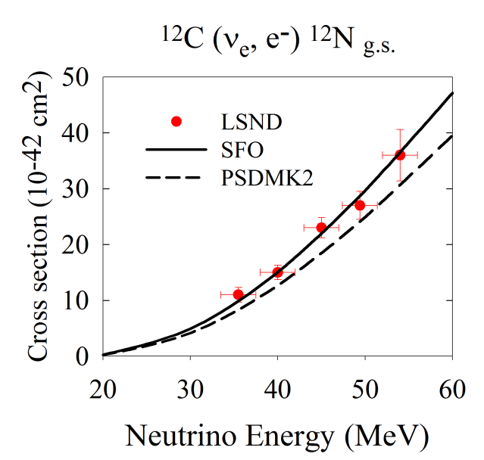
JUNO Supernova Neutrino (burst)
SN @ 10 kpc in JUNO [J. Phys. G43:030401 (2016) ]
Cross-section of interactions between neutrinos and carbon
[Phys. Lett. B 212, 139 (1988)]
Neutrino-¹²C interactions are an important part for supernova neutrino reconstruction
Few and old measurements (e.g., LSND), need more precise predictions and measurements
Phys. Rev. C 86, 015502 (2012)

Slide 32
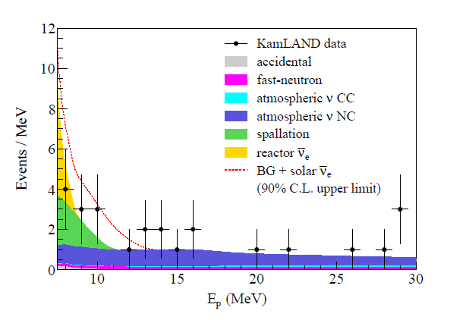
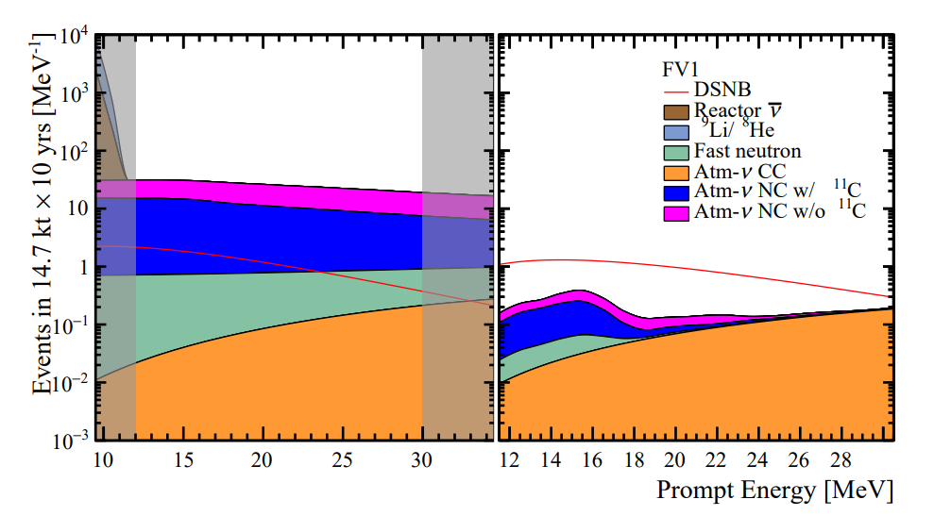
DSNB Research: Signal v.s. Background
Integrated flux of all past SNe:
cosmic star-information, average core-collapse neutrino spectrum, failed SNe rate, etc
DSNB primary detection via IBD
Astrophys.J.745:193,2012
JUNO, JCAP 10 (2022) 033
KamLAND, Astrophys.J.745:193,2012
Before background suppression
After background suppression
KamLAND: NC interactions of atm. neutrino with ¹²C in LS is the most significant source of the background in DSNB study.
JUNO: dominant background for DSNB is atm-$ν$ NC interactions
The key to detect DSNB in LS detector is the precise estimation of atm-$ν$ NC background

Slide 33
Methodology for In-situ Measurements
Phys. Rev. D 103 (2021) 5, 053002
A systematic study on the measurement of the NC background and evaluate the associated uncertainties
According to the possible association with unstable residual nuclei, a maximum-likelihood method is proposed to measure the triple-coincident signature of the NC background
Future JUNO will be able to make a unique contribution to the worldwide dataset to improve the prediction of NC interaction on ¹²C
Reproduce NC background uncertainty from the summary in Phys.Rev.D 103 (2021) 5, 053002
JUNO, JCAP 10 (2022) 033
The bands are obtained by assuming different levels of natural radioactivity and cosmogenic ¹¹C in the accidental background
15%
Within 10 years JUNO data, NC background rate can be constrained on 15% level

Slide 34
DSNB Sensitivity
JCAP 10 (2022) 033
Before background suppression
After background suppression
Improvements compared to JUNO physics book J. Phys. G43:030401(2016) :
Background evaluation: 0.7 per year → 0.54 per year
PSD: signal efficiency 50%→80% (1% residual background)
Realistic DSNB signal model: non-zero fraction of failed Supernova
Signal/Background ratio improved from 2 to 3.5

Slide 35
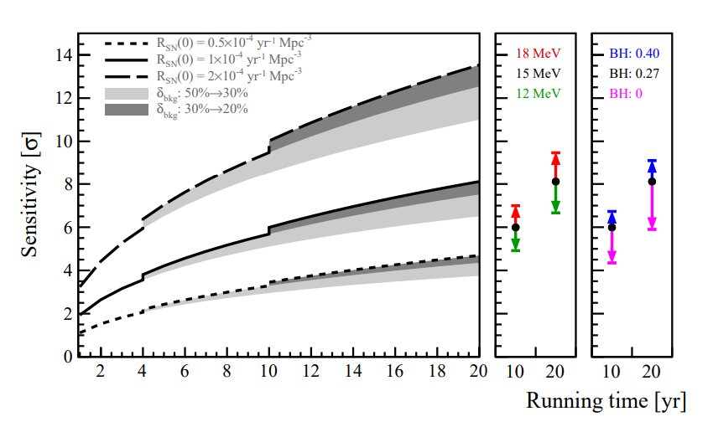
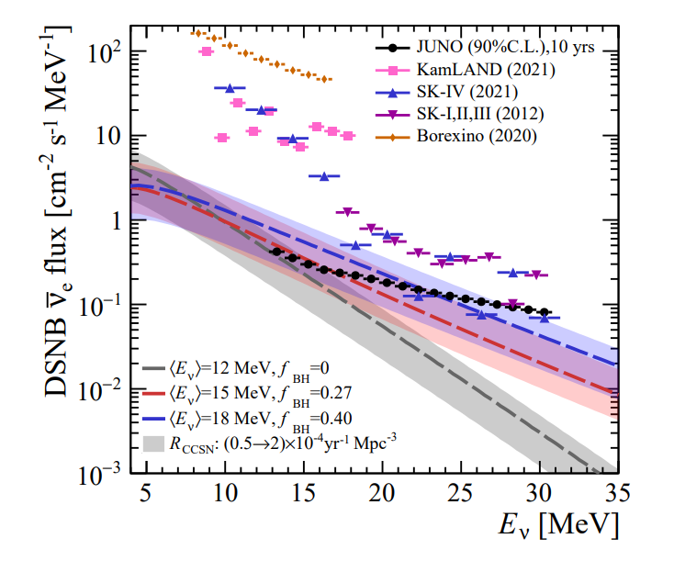
DSNB Sensitivity
JCAP 10 (2022) 033
Nominal model
Supernova (SN) rate ($R_{SN}\left(0\right)$)
Average energy of SN neutrinos ($\left\langle E_{ν}\right\rangle$)
Fraction of black hole ($f_{BH}$)
With the nominal model (black solid curve (left plot)): 3$σ$ (3 yrs) and 6$σ$ (10 yrs)
If no positive observation, JUNO can set the world-leading best limits of DSNB flux

Slide 36
Atmospheric Neutrino Background in Other Topics
Other topics on Atm. Neutrino as background:
Proton decay (to Kaon mode)

Slide 37
退激发工具：TALYS
TALYS is used to provide de-excitation process of residual nucleus at special excited level (http://www.talys.eu/home/)
TALYS : a nuclear reaction program
Created at NRG Petten, the Netherlands, and CEA Bruyeres-le-Chatel, France
Accurate simulation of nuclear reactions: 1keV – 200MeV
Two main purposes:
Nuclear physics tool
Nuclear data tool
TALYS can generate nuclear data for all open reaction channels, interpolating between and extrapolating beyond experimental data, on a user-defined energy and angle grid beyond the resonance region.
www.talys.eu
A stable version is released every 2 years : under development

Slide 38
Some Insights from Electron Scattering Interactions
© Cheryl Patrick
From electron-nucleon scattering:
Rev. Mod. Phys. 80, 189

Slide 39
© Cheryl Patrick
From electron-nucleon scattering:
Rev. Mod. Phys. 80, 189
From electron-nucleus scattering:
Bound nucleons are moving – Fermi motion
Breaking up the nucleus – final state interactions
Science 320, 1476 (2008)

Slide 40
Next-generation Neutrino Detector
Hyper-Kamiokande
Water detector
Target: ¹⁶O and H

Slide 41
Next-generation Neutrino Detector
Hyper-Kamiokande
Water detector
Target: ¹⁶O and H
DUNE
Liquid argon time-projection chamber detector
Main targets: Ar

Slide 42
Neutrino Oscillation
Mixing matrix (PMNS):
PMNS
Solar neutrino
Reactor neutrino
Atmospheric neutrino
Six oscillation parameters:
$$∆m_{21}^{2}$$ | $$\sin^{2}θ_{12}$$ | $\sin^{2}θ_{13}$ $δ_{CP}$ | $$|∆m_{32}^{2}|$$ | $$\sin^{2}θ_{23}$$

Slide 43
Known parameters：
$θ_{12}, θ_{23}, θ_{13} ,\left|∆m_{21}^{2}\right| , |∆m_{31}^{2}|$(or $∆m_{32}^{2}$)
1998 Atm. ν osc. θ_{23,} |Δm²₃₂|
2002 Solar ν osc. θ_{12,} Δm²₂₁
2012 reactor ν osc. θ₁₃
Daya Bay contributes best results of $θ_{13} and \left|∆m_{ee}^{2}\right|=|\cos^{2}θ_{12}∆m_{31}^{2}+$ $\sin^{2}θ_{12}∆m_{32}^{2}$|
Unknown：
Neutrino mass ordering
CP phase $δ$
…

Slide 44
How to Describe Neutrino Interactions
Gabriel N. Perdue @ INSS 2021
[Rev.Mod.Phys. 84 (2012)]

