Slide 1
Back-end electronics design of Muon detector

Slide 2
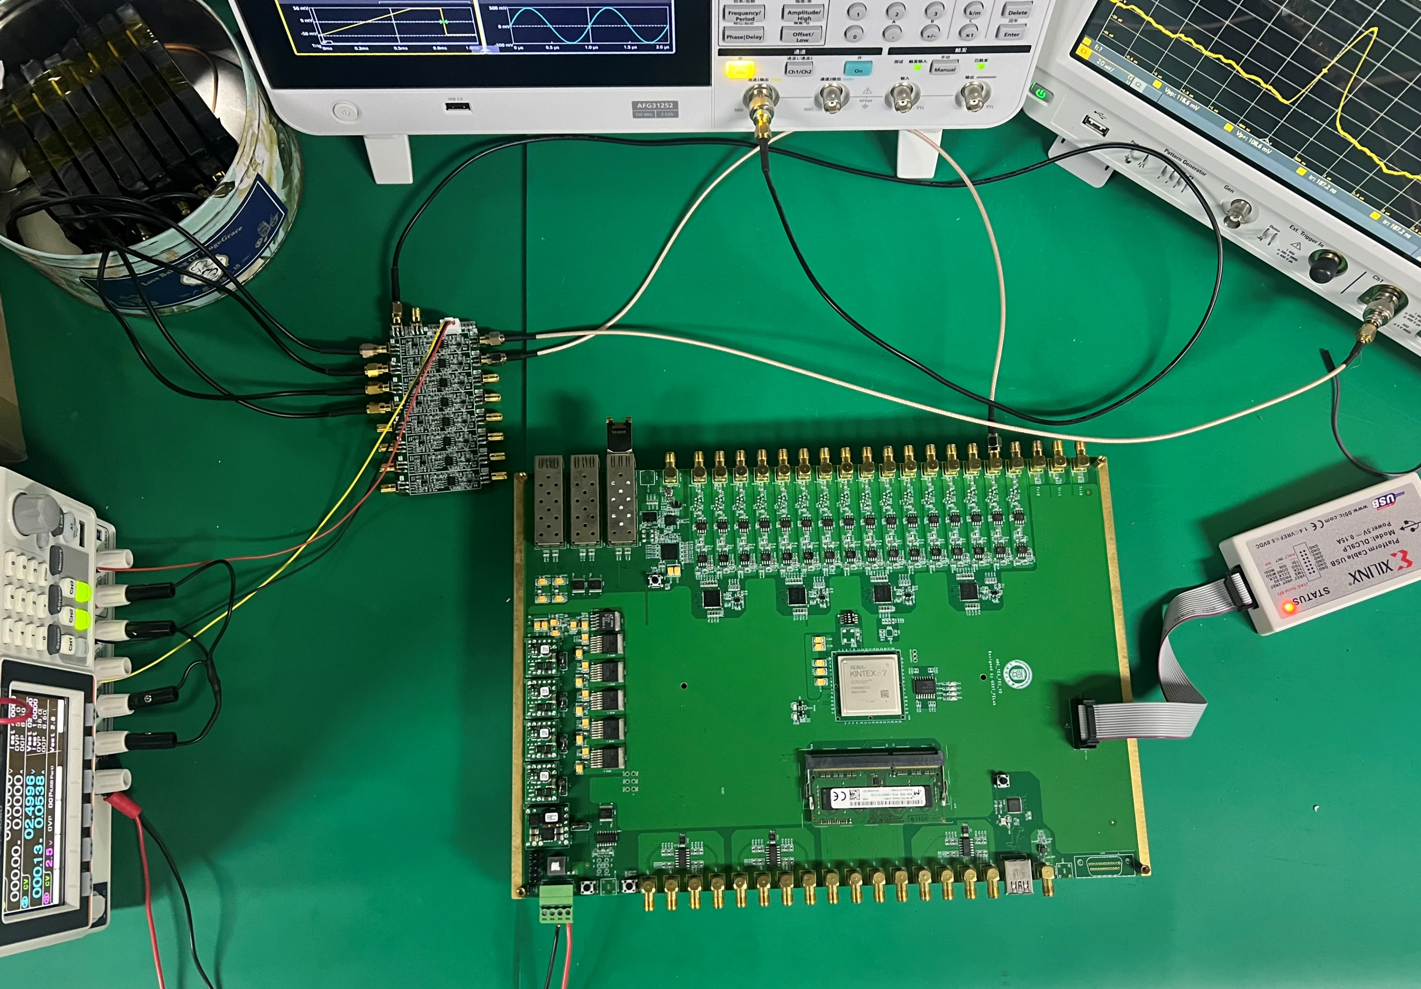
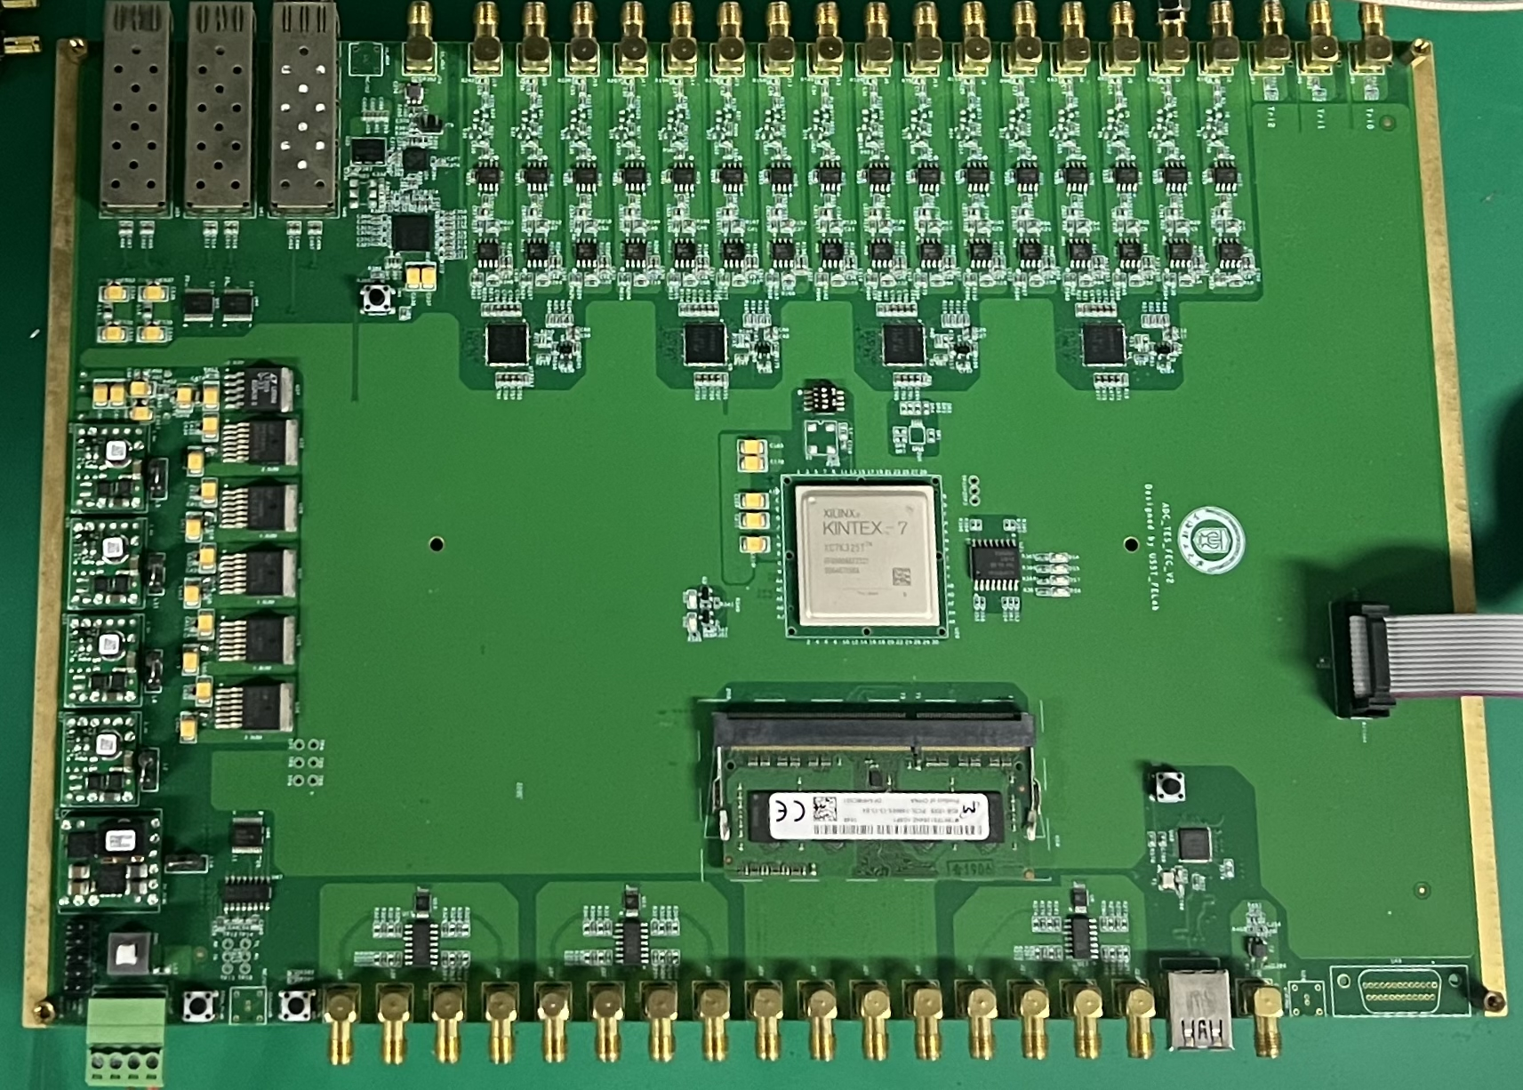
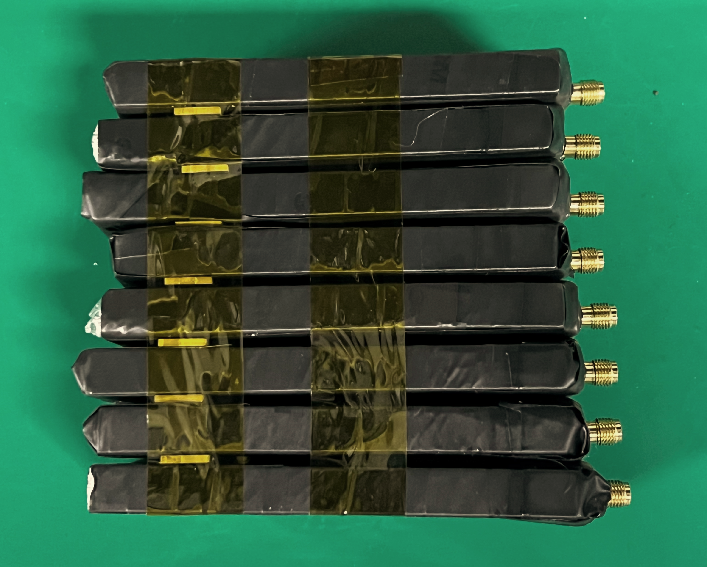
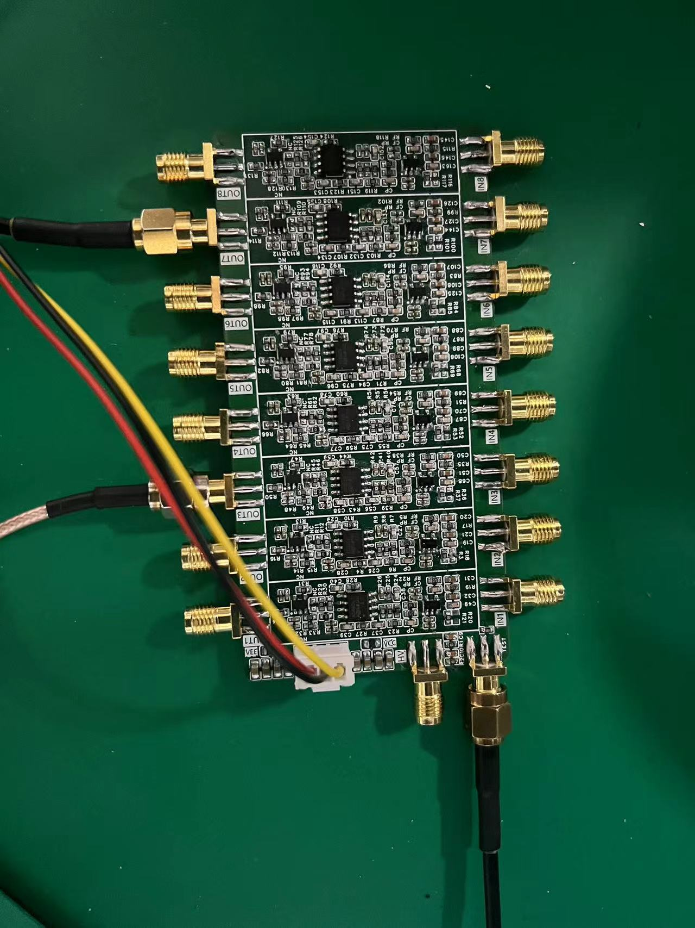
Muon detector back-end electronics
Setup
scintillation detector + preamplifier + acquisition and processing board

Slide 3
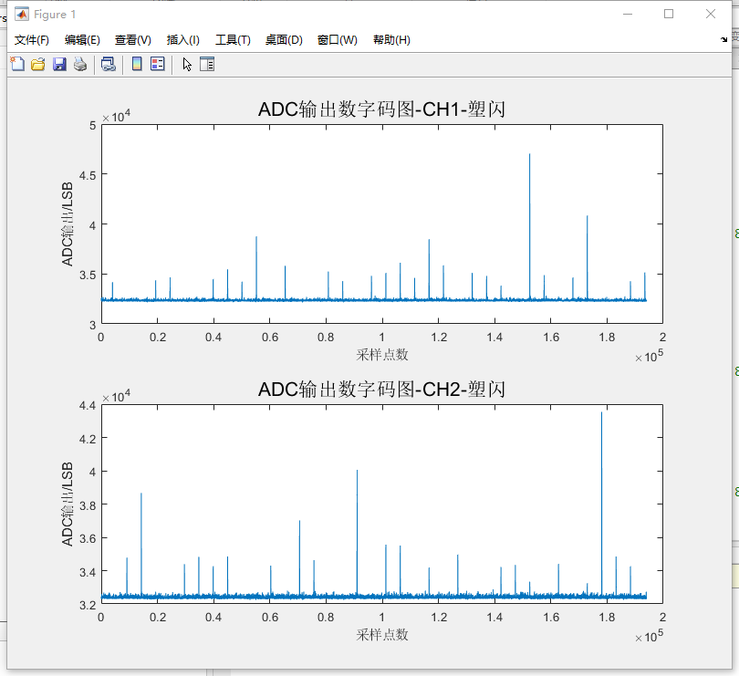
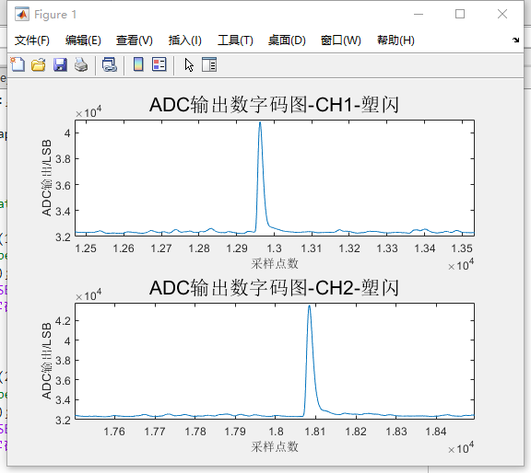
Muon detector back-end electronics
Sampling test of scintillator detector signals

Slide 4
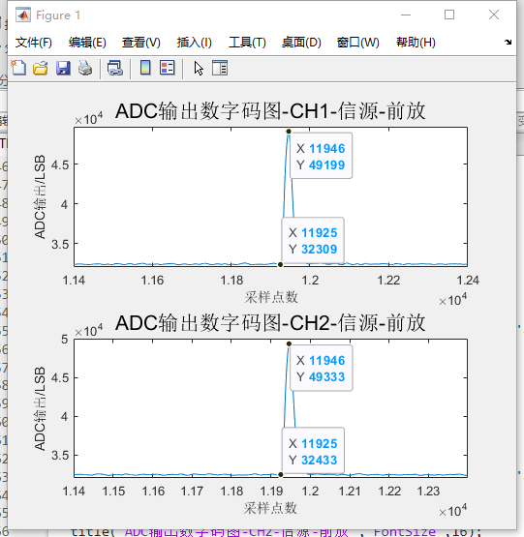
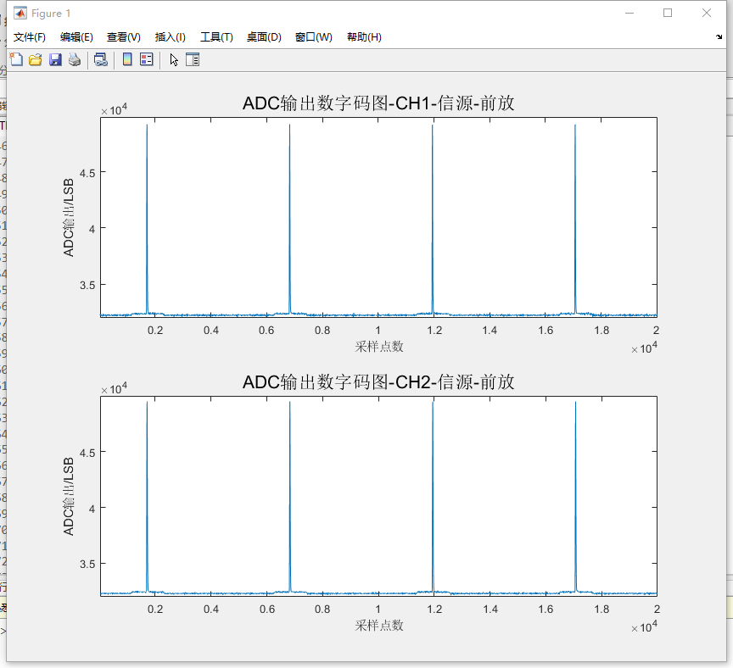
Muon detector back-end electronics
Signal sampling test of preamplifier
Signals from preamplifier : Tr:~300ns ;without time interval

Slide 5
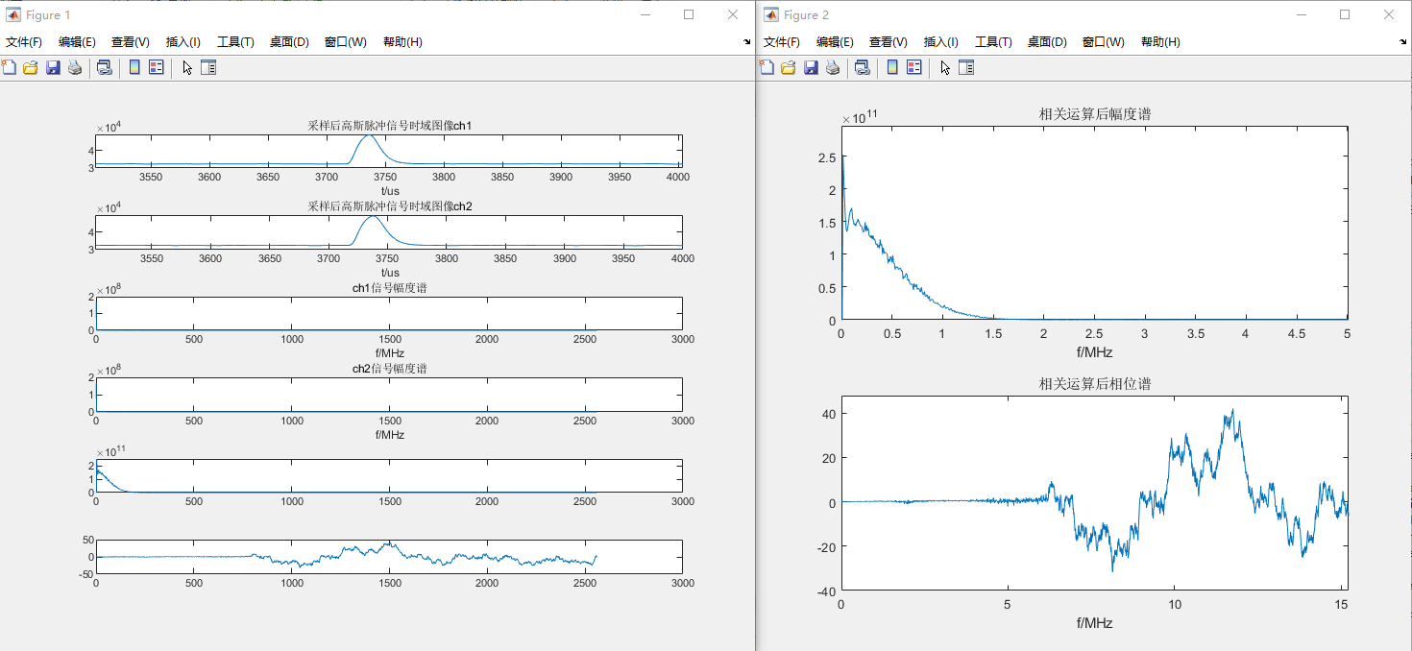
Muon detector back-end electronics
Signal sampling test of preamplifier
There is no phase deviation(without time interval) after correlation treatment.

Slide 6
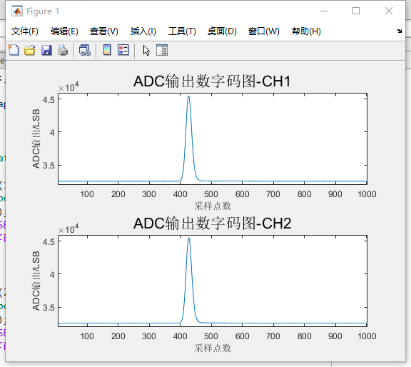
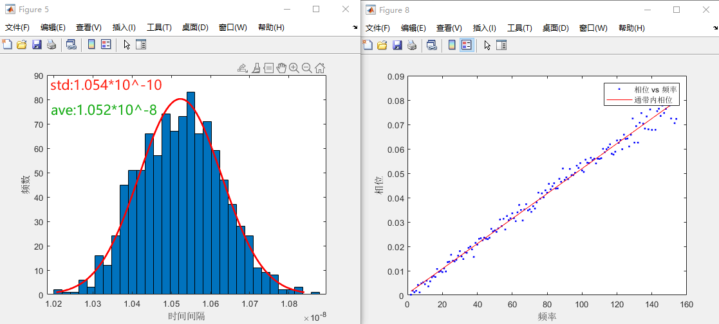
Muon detector back-end electronics
Signal sampling test of the time interval
Signals from the signal source : Tr:~300ns ;with time interval 10ns
Test result: Time difference measurement accuracy(RMS): 0.1ns
1000 measurements of experimental results

Slide 7
Muon detector back-end electronics
Factors affecting the accuracy of time measurement
SNR
Pulse width
Transform length

Slide 8
Muon detector back-end electronics
Factors affecting the accuracy of time measurement
SNR
Pulse width
Transform length

Slide 9
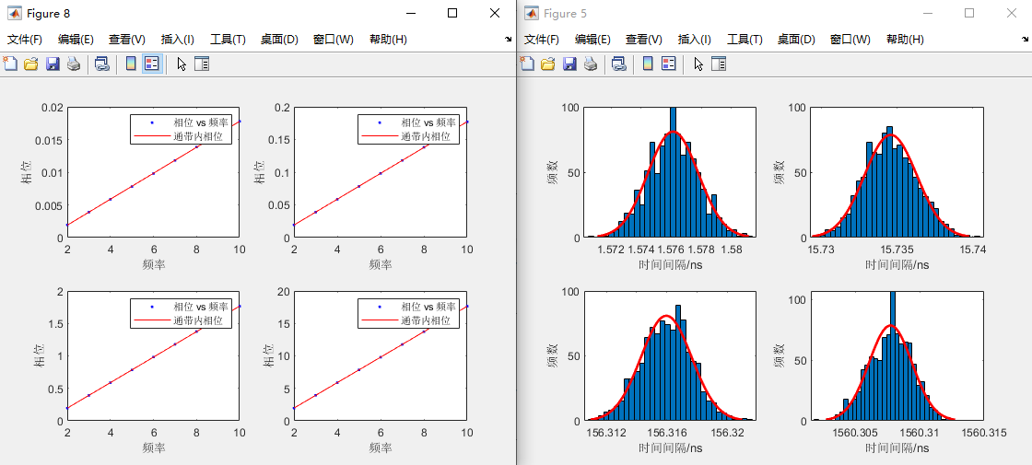
Muon detector back-end electronics
SNR：100dB; Pulse width：1us; Transform length:200
STD:1.67ps
AVE:1.58ns
STD:1.72ps
AVE:15.74ns
STD:1.67ps
AVE:156ns
STD:1.68ps
AVE:1.56us

Slide 10
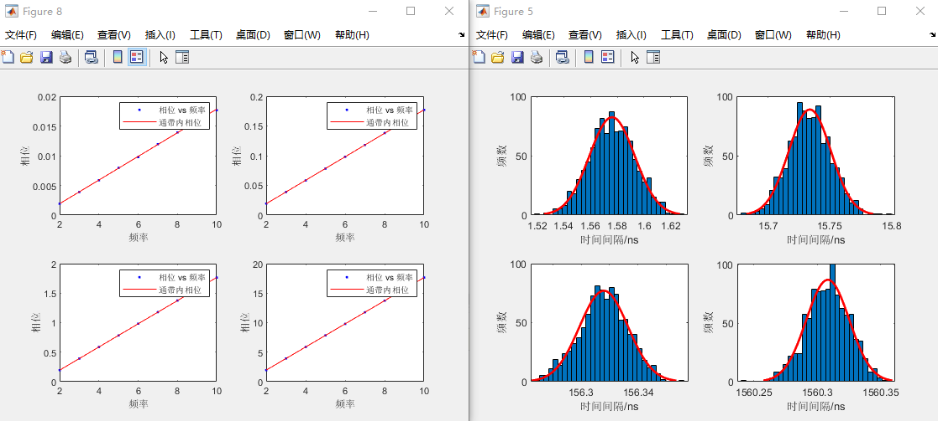
Muon detector back-end electronics
SNR=80dB； Pulse width：1us; Transform length:200
STD:16.96ps
AVE:1.58ns
STD:17.01ps
AVE:15.73ns
STD:17.01ps
AVE:156ns
STD:16.92ps
AVE:1.56us

Slide 11
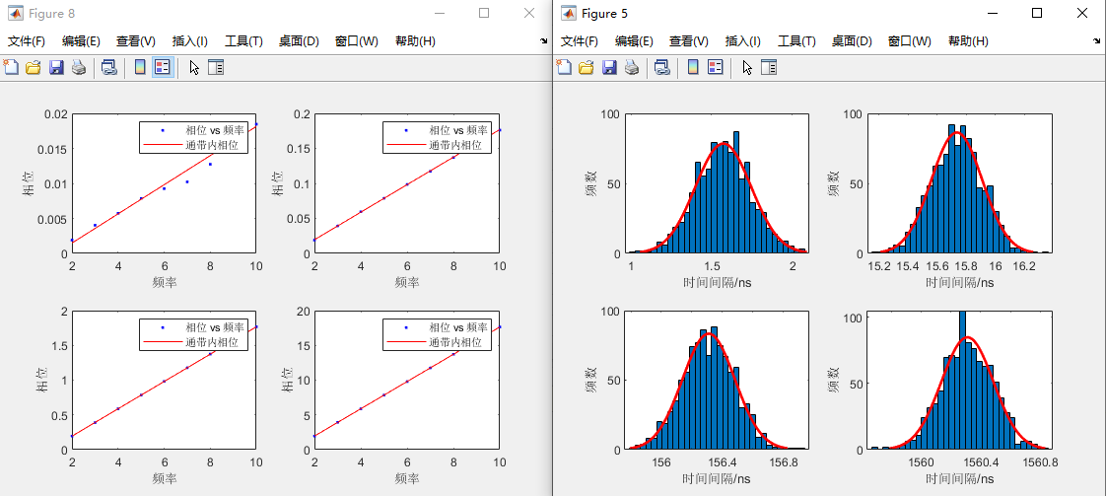
Muon detector back-end electronics
SNR=60dB； Pulse width：1us; Transform length:200
STD:176ps
AVE:1.57ns
STD:176ps
AVE:15.73ns
STD:172ps
AVE:156ns
STD:174ps
AVE:1.56us

Slide 12
Muon detector back-end electronics
SNR=50dB； Pulse width：1us; Transform length:200
STD:536ps
AVE:1.59ns
STD:549ps
AVE:15.74ns
STD:553ps
AVE:156ns
STD:532ps
AVE:1.56us

Slide 13
Muon detector back-end electronics
Factors affecting the accuracy of time measurement
SNR
Pulse width
Transform length

Slide 14
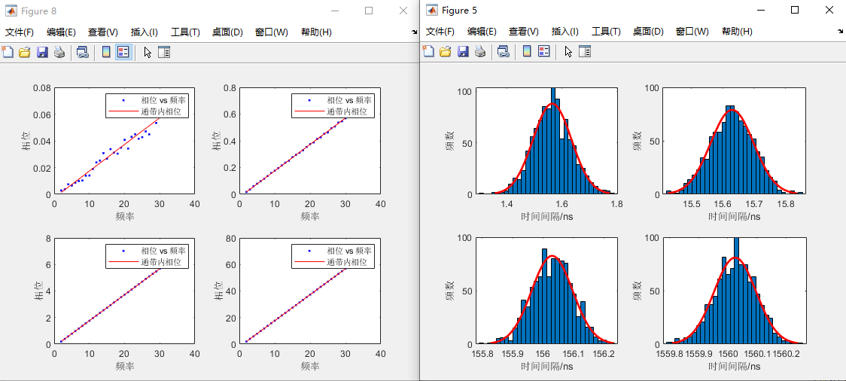
Muon detector back-end electronics
SNR：60dB; Pulse width：250ns; Transform length: 200
STD:69.71ps
AVE:1.56ns
STD:68.71ps
AVE:15.63ns
STD:67.18ps
AVE:156ns
STD:71.20ps
AVE:1.56us

Slide 15
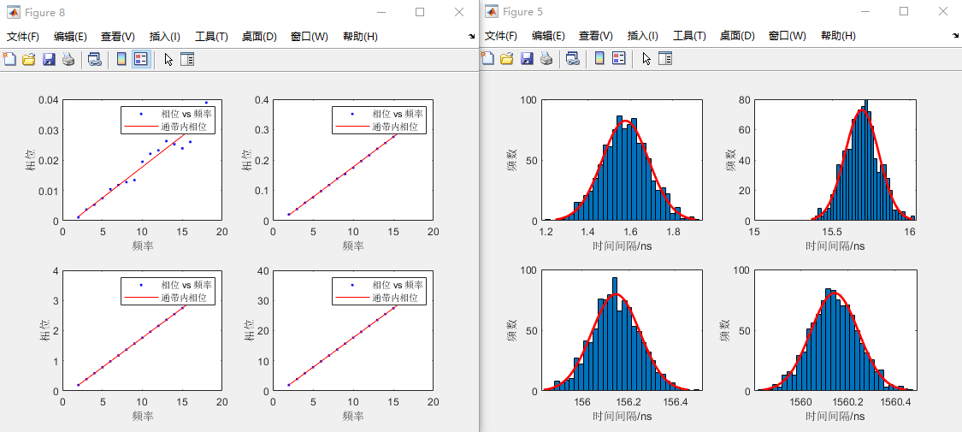
Muon detector back-end electronics
SNR：60dB; Pulse width：500ns; Transform length: 200
STD:110ps
AVE:1.58ns
STD:109ps
AVE:15.69ns
STD:104ps
AVE:156ns
STD:101ps
AVE:1.56us

Slide 16
Muon detector back-end electronics
SNR=60dB； Pulse width：1us; Transform length:200
STD:176ps
AVE:1.57ns
STD:176ps
AVE:15.73ns
STD:172ps
AVE:156ns
STD:174ps
AVE:1.56us

Slide 17
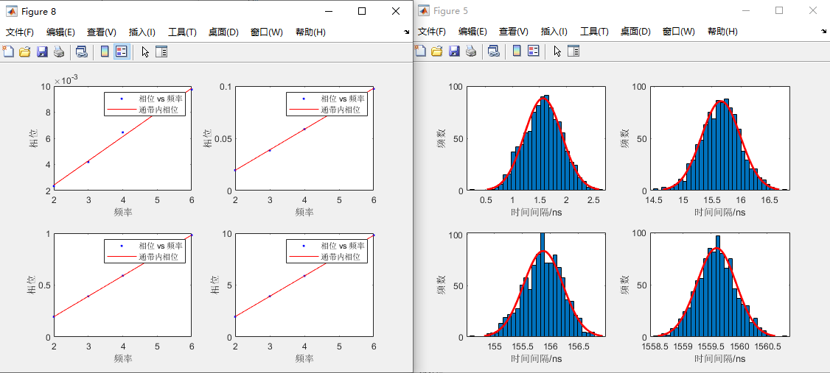
Muon detector back-end electronics
SNR=60dB； Pulse width：2us; Transform length:200
STD:348ps
AVE:1.57ns
STD:356ps
AVE:15.65ns
STD:352ps
AVE:156ns
STD:347ps
AVE:1.56us

Slide 18
Muon detector back-end electronics
Factors affecting the accuracy of time measurement
SNR
Pulse width
Transform length

Slide 19
Muon detector back-end electronics
SNR=60dB； Pulse width：1us; Transform length:200
STD:176ps
AVE:1.57ns
STD:176ps
AVE:15.73ns
STD:172ps
AVE:156ns
STD:174ps
AVE:1.56us

Slide 20
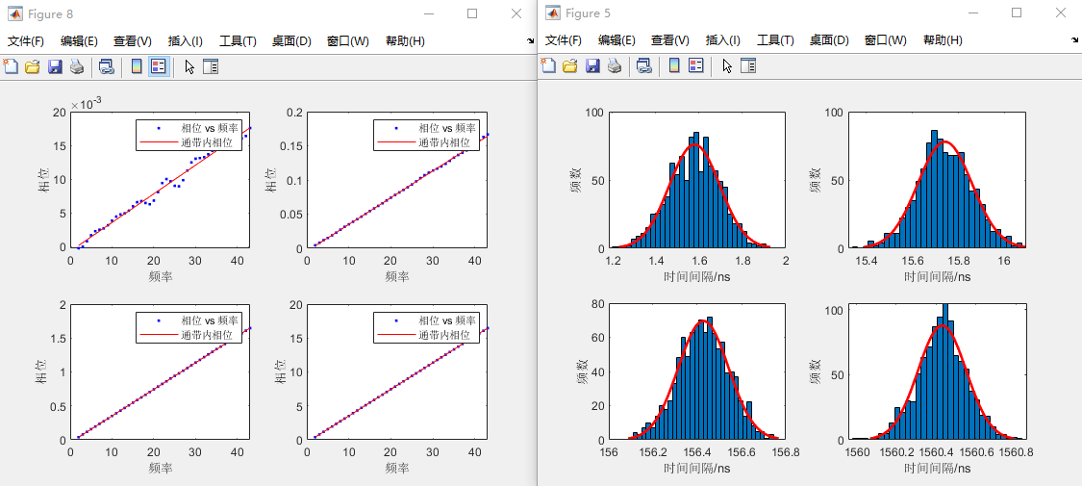
Muon detector back-end electronics
SNR=60dB； Pulse width：1us; Transform length:1000
STD:117ps
AVE:1.58ns
STD:118ps
AVE:15.74ns
STD:113ps
AVE:156ns
STD:120ps
AVE:1.56us

Slide 21
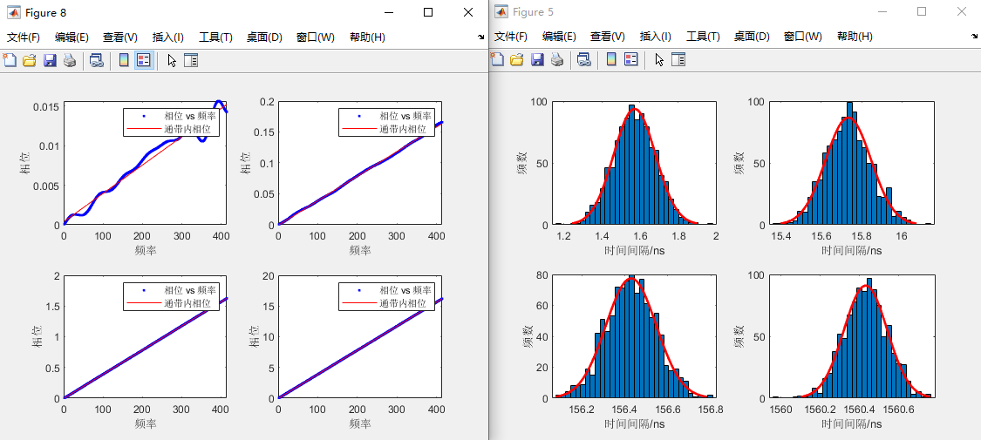
Muon detector back-end electronics
SNR=60dB； Pulse width：1us; Transform length:10000
STD:109ps
AVE:1.57ns
STD:112ps
AVE:15.73ns
STD:117ps
AVE:156ns
STD:110ps
AVE:1.56us

Slide 22
Thanks.

