Slide 1
RPC detector experience at BESIII and DayaBay
Yuguang Xie
2024-04-03

Slide 2
Content
BESIII RPC MUC
DayaBay RPC Veto
CEPC MUON RPC Option

Slide 3
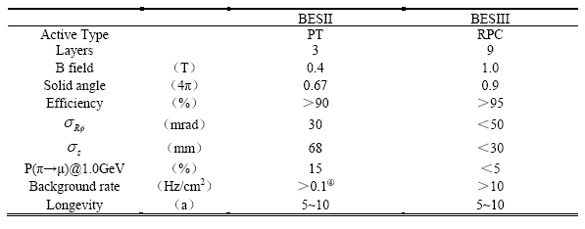
BESIII MUC
Goals and required performance
μ ID, μ/π separation
D physics
Why RPC?
Acceptable performance
Low cost
Easy production

Slide 4
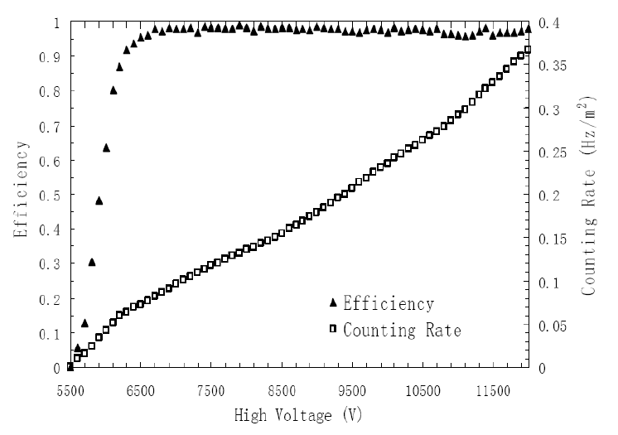
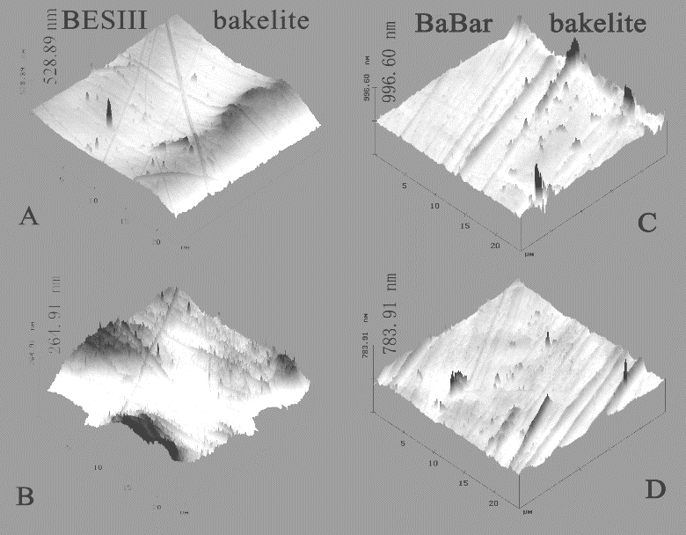
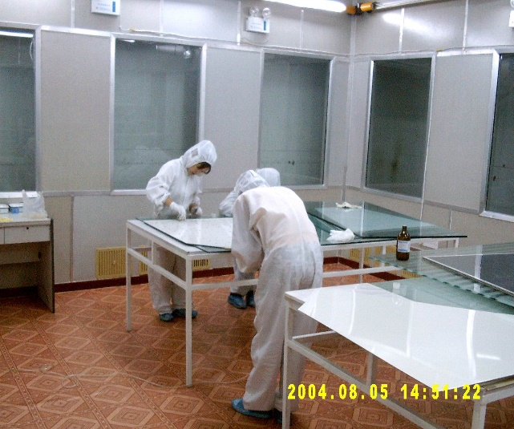
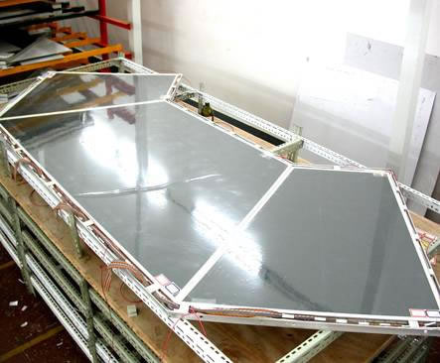
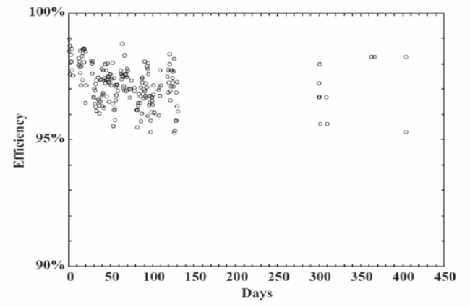
Highlights of BESIII MUC RPC
Homemade Oil-free Bakelite RPC with special surface treatment( Plastic film pressing + chemical condensation polymerization + high pressure forming)
First time successful mass production up 1200 m^2 in China, bare chamber pass rate > 90%;
Good performance and keep running even now(>15years)!
BESIII: 264 ~ 528nm
BaBar: 783 ~ 996nm

Slide 5
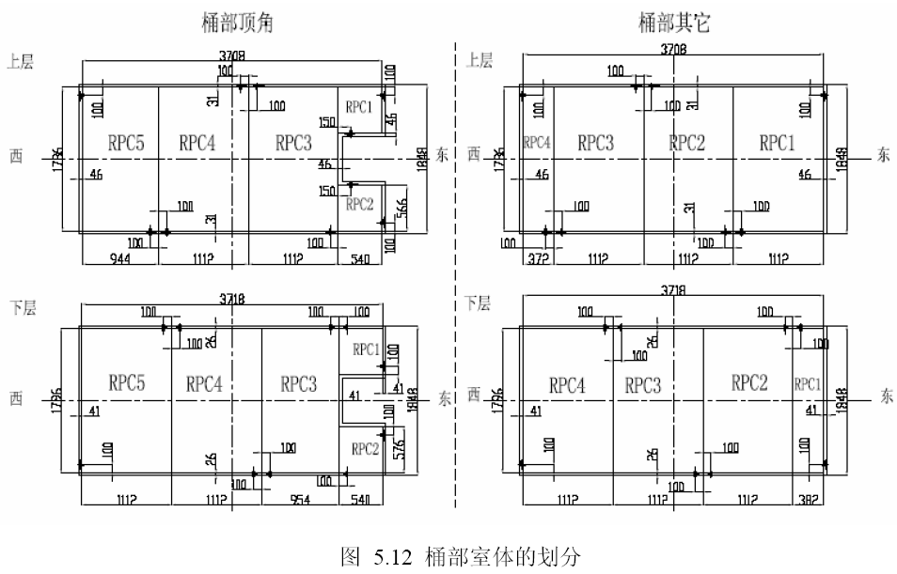
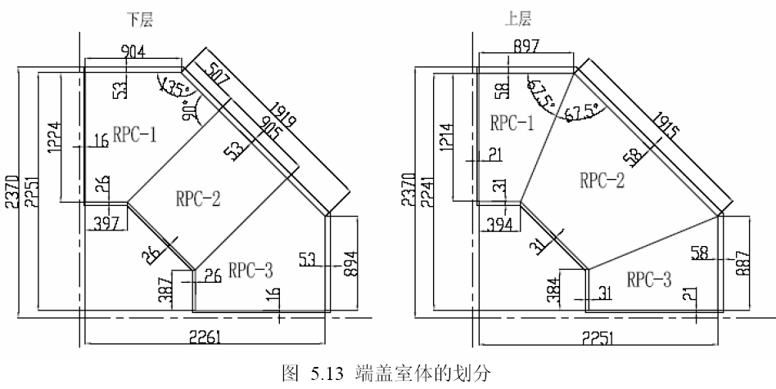
Module structure

Slide 6
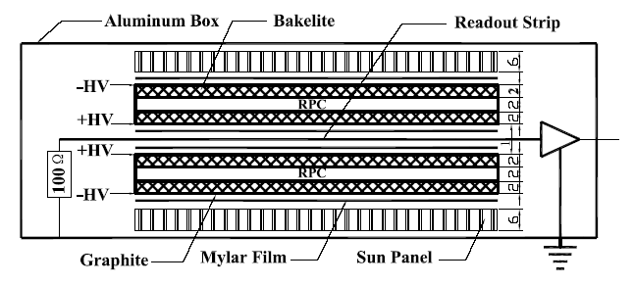
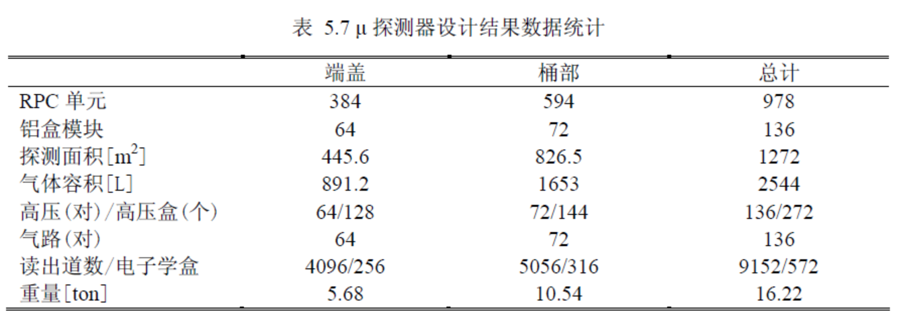
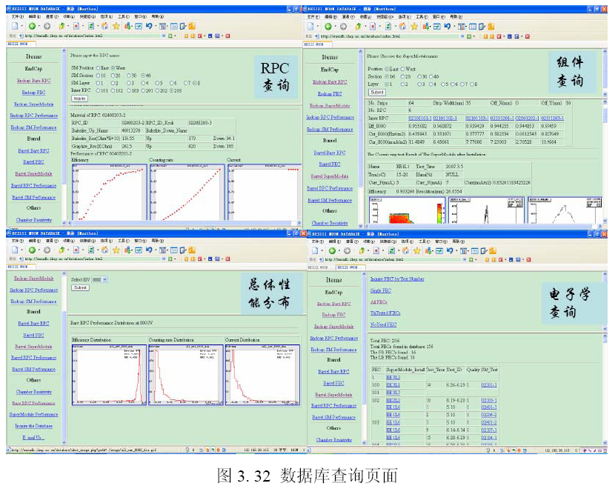
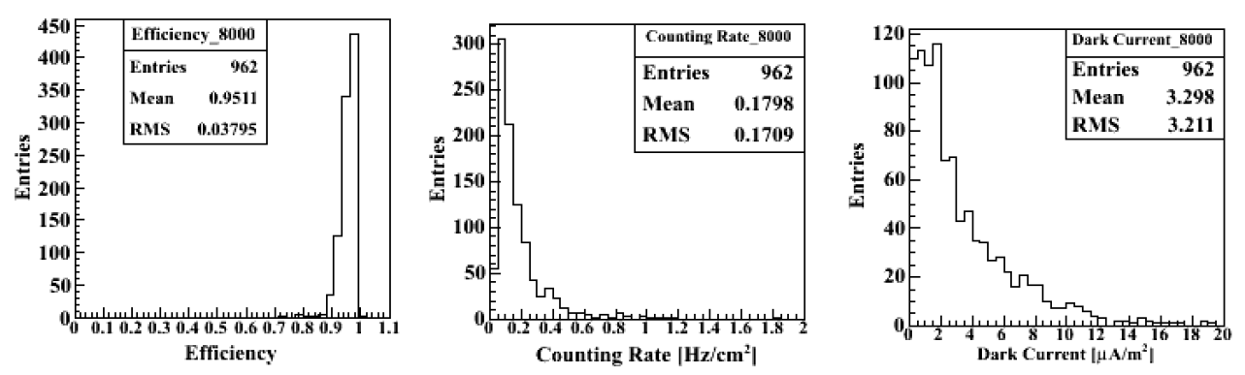
RPC mass production results
1-D readout
2-layer RPCs
1200m^2 bare chamber, pass rate > 90%;
Eff>95%; counting rate < 0.2Hz/cm^2, dark current < 3.3uA/m^2.
Data base for QC results tracking;

Slide 7
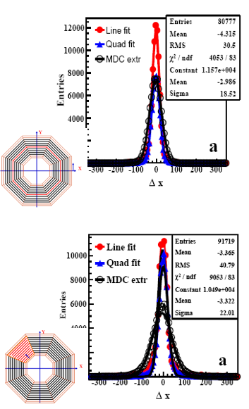
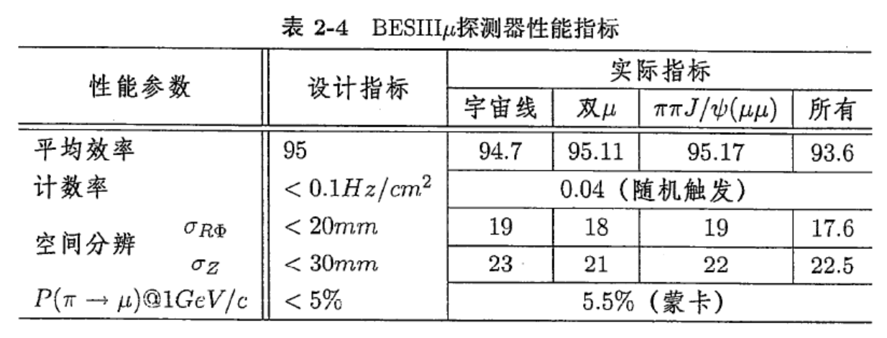
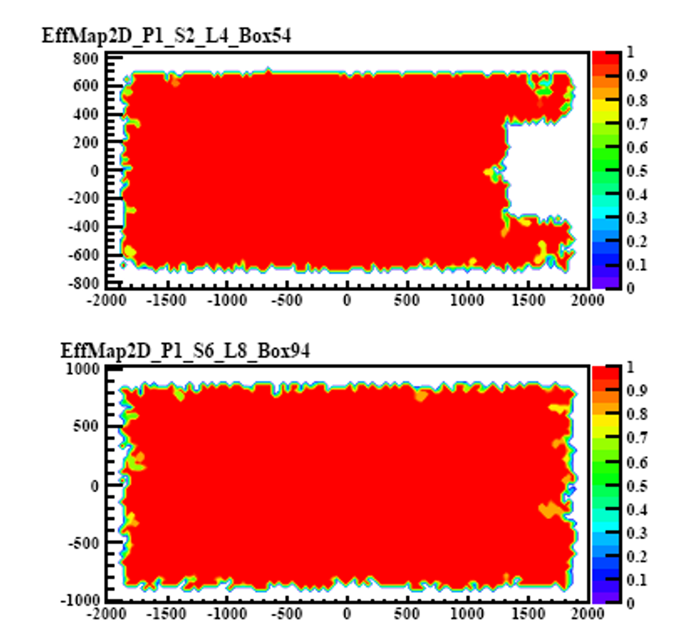
Reached performance
Lessons
Module box should be compressed;
Add sunlight plate in the yoke gaps.
Sparking protection needed in FEE. Major maintenance is to replace FEE boxes for MUC

Slide 8
BESIII MUC cost
Bare RPCs | 1272 m^2 |  | 1.2k/m^2 | 1.526 M | From GNKD
Box | 136 |  | 2000/module | 0.272 M | From GNKD
Readout strip & insulation materials | 636 m^2 |  | 3145/m^2 | 2.0 M | From GNKD
Electronics | 9152ch |  | 200/ch | 1.83 M | From USTC
Sub total | Consistent with Jiawen Zhang: ~560W(all) |  |  | 5.628M
HV system |  |  |  | 0. 4M | Estimated
Gas system |  |  |  | 0. 3M | Estimated
Total |  |  |  | 6.328 M

Slide 9
DayaBay RPC Veto
Goals and requirements
μ tagging
95% single layer efficiency;
Life > 3 years
Due to BESIII RPC success, DayaBay top Veto adopted RPC naturally.
Difference from BESIII:
high humidity environment, even 90%, so dark current higher.

Slide 10
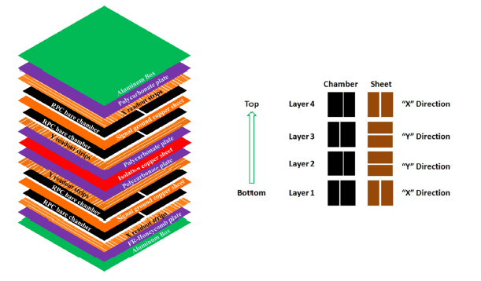
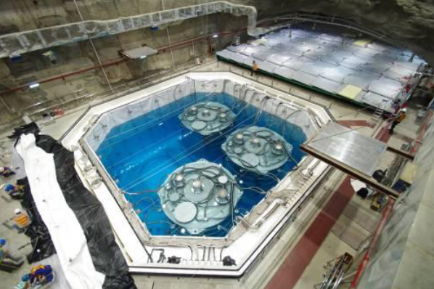
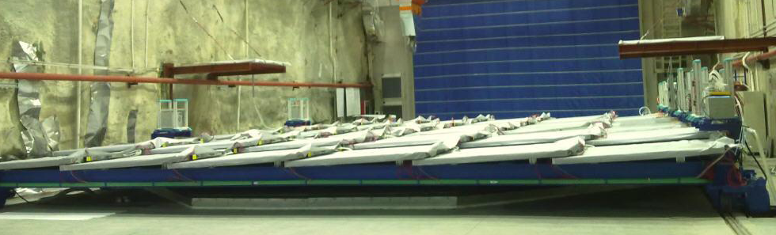
Structure
Module size: 2.17m*2.20m*0.08m
Module number: near hall #1 and #2: 54+54=108; far hall #3 81; total: 189+6;
Bare RPC sizes: 1.0m*2.10m, 1.1m*2.1m
177 degree slanting, 10cm overlap among adjacent modules.
Bakelite plate size limitation: 2.4m*1.2m!
Super module:
Two layers of 2-D readout
4-layer RPCs

Slide 11
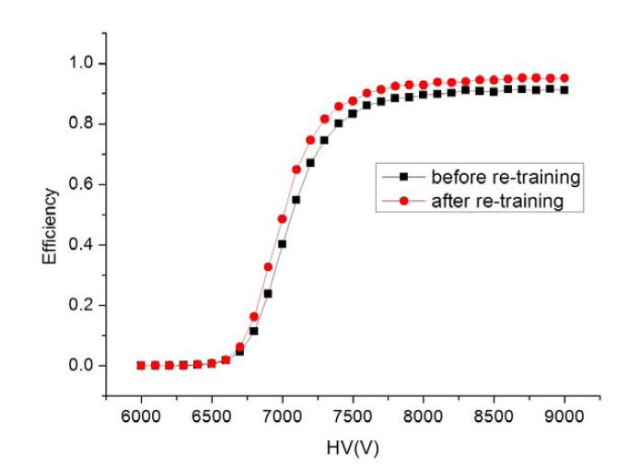
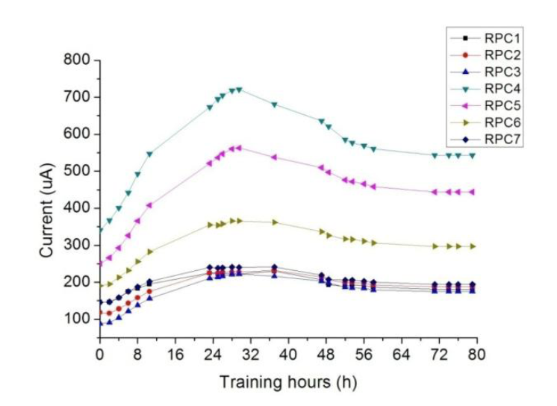
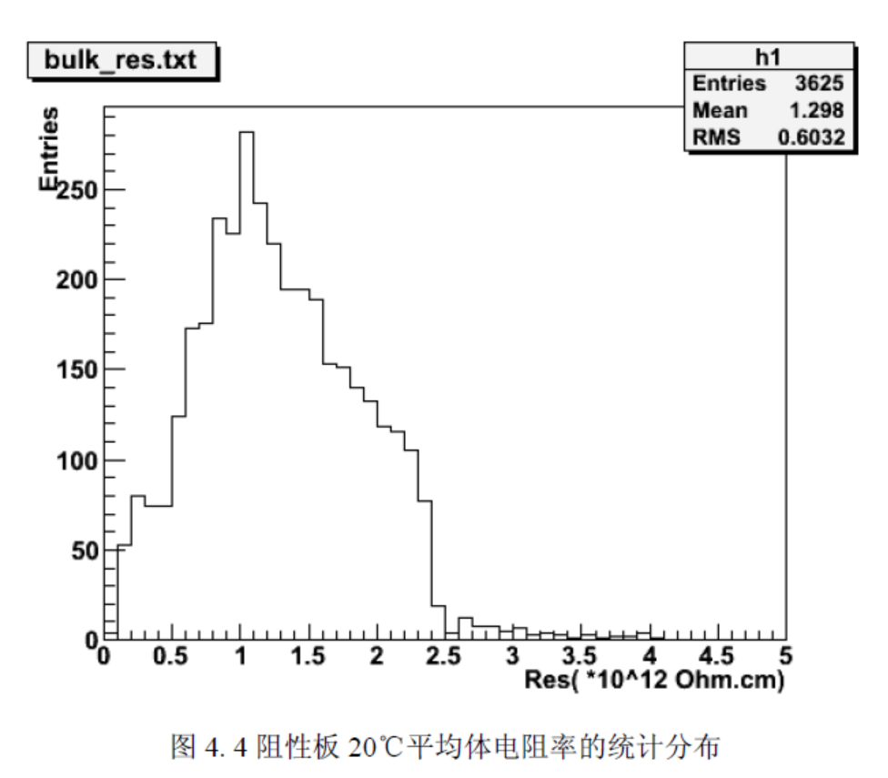
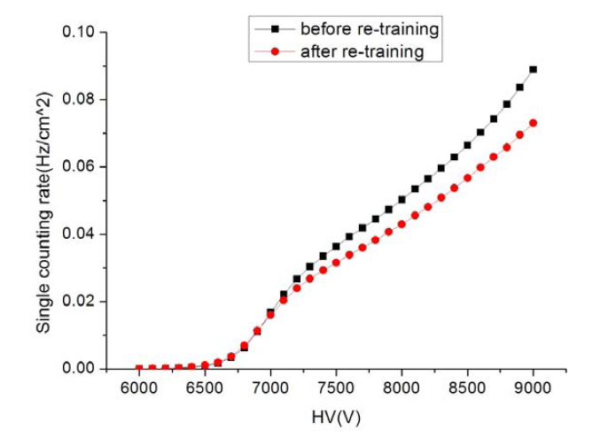
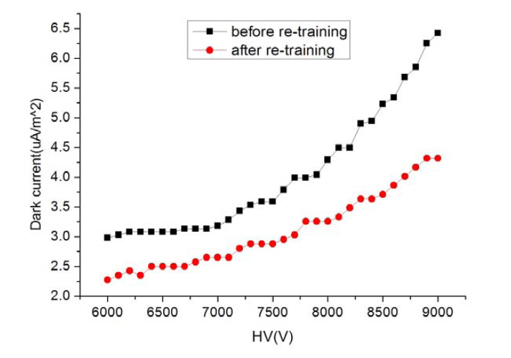
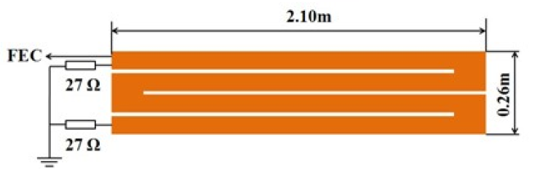
Improvements VS BESIII RPC
Bulk resistivity range optimized: 0.2~2.0 *10^12 Ωcm -> 0.5~2.5*10^12 Ωcm
Readout strip: zigzag readout strip to reduce number of channels and keep signal amplitude;
Bare RPC burn-in(training) to improve performance.
Gas mixture: Ar:R134a:ISO-B=50:42:8 -> Ar:R134a:ISO-B: SF6 =63.5:30:4:0.5. Reduce R134a and ISO-B!

Slide 12
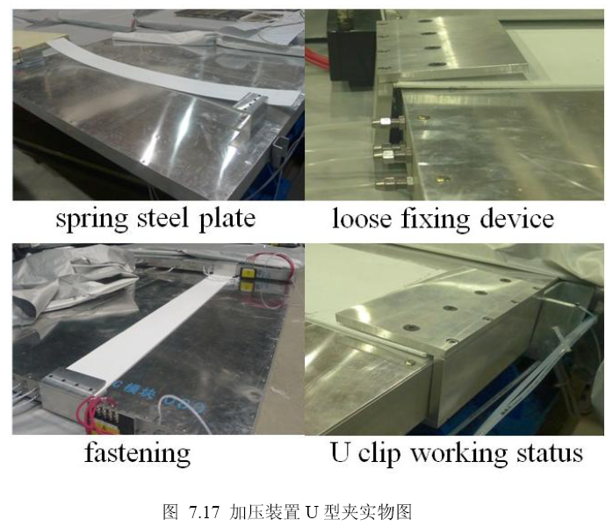
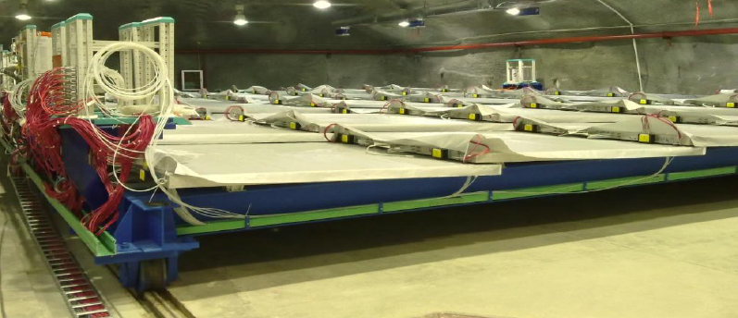
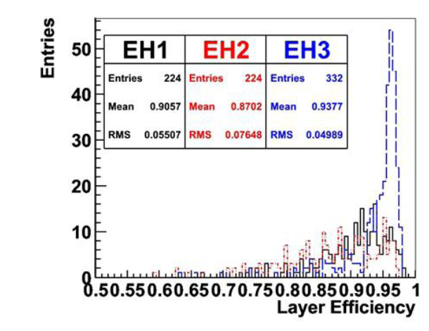
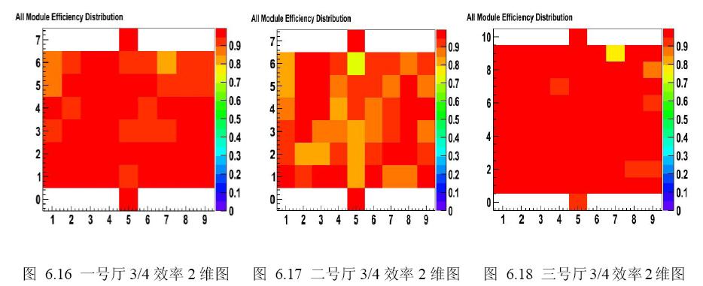
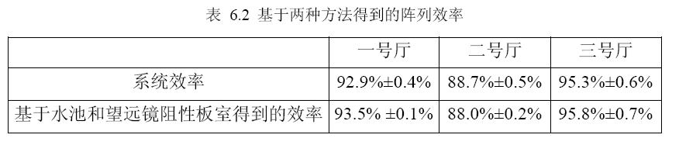
Performance and lessons
Eff @ Hall #3 > 95%; 92.9% @Hall #1; 88.7%@Hall #2;
Bare chamber bulging or cracking due to gas pressure and not enough compression by module(box), no yoke helps;
Dry air flushing inside modules.
Waterproof cloth covered on modules.
Pressure and flow control needed for gas system

Slide 13
DYB RPC veto cost
Bare RPCs | 3200 m^2 | 1600/m^2 | 5.14 M | From GNKD
Box | 195 | ~2500/module | ~0.4875 M | Estimated
Readout strip & insulation materials | 3200 m^2 | ~740/m^2 | 2.37 M | Estimated
Subtotal |  | From Changgeng Yang | 8.0M
Electronics | 6000ch | 200/ch | 1.2 M | From USTC
HV system |  |  | ~1.0M | Estimated
Gas system |  |  | ~0.8M | Estimated
Total |  |  | ~11.0M

Slide 14
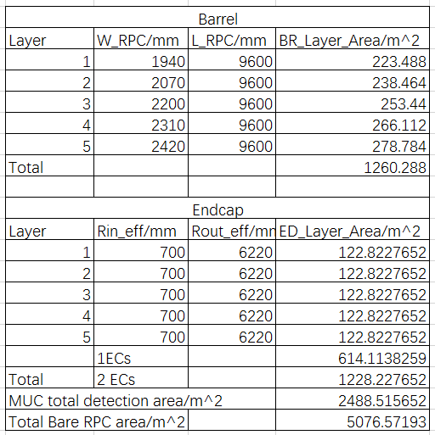
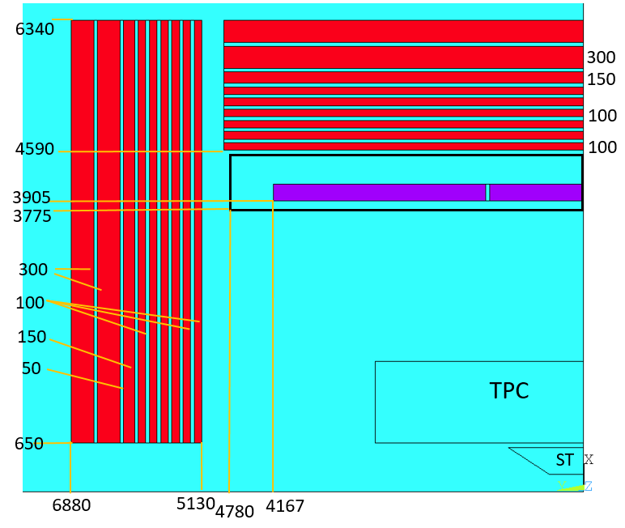
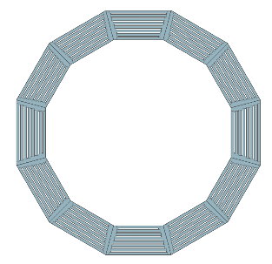
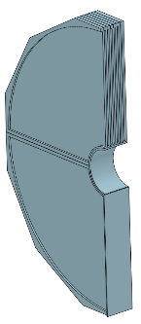
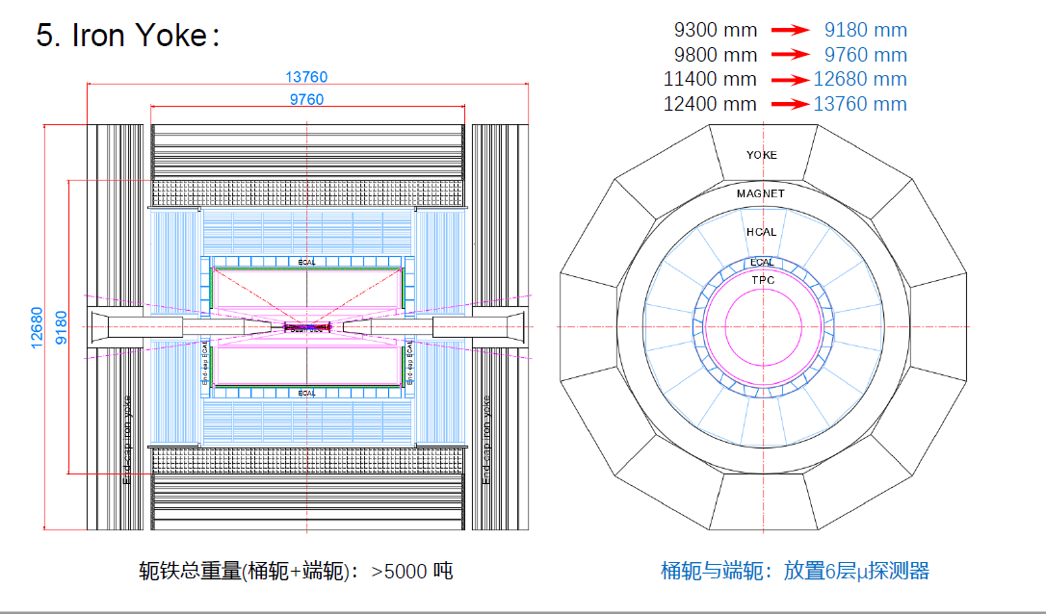
CEPC MUC
MUC Physics goals
u id in jets;
E leakage compensation for CAL
long life BSM particles
Required performance and structure
Note, 2 layers of RPCs in one module; 2% spare RPCs needed.
Detection area: 2490m^2;
Total bare RPC area: 5080 m^2
Item | Index
Solid angle coverage | 0.98×4π
Position resolution(σz, σrφ) | 10 ~15mm | Width 35mm
Detection efficiency | >95%
Rate capability | ~100Hz/cm^2
Time resolution | 1~2 ns
Structure | 5 layers, 12 sections for BR, 4 for each EC

Slide 15
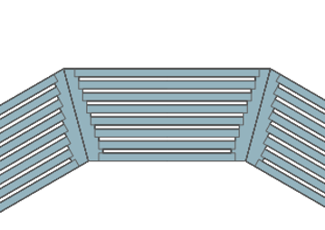
Module(box) design
2-D readouts (X&Y, Z&φ)
Two layers of bare RPCs
9.6
Limitations:
Bakelite plate size: 2.4m*1.2m!
Strip length: <6m; Module length: <6m
Module in Barrel
4
5.6
Insulation layer
X readout
RPC_up
Layer | W_RPC/mm
1 | 1940
2 | 2070
3 | 2200
4 | 2310
5 | 2420
Grounding
RPC_down
Y readout
Insulation layer
4m box: 5*12=60;
5.6m box: 5*12=60; total 120 modules in BR
Z direction strips must be double!

Slide 16
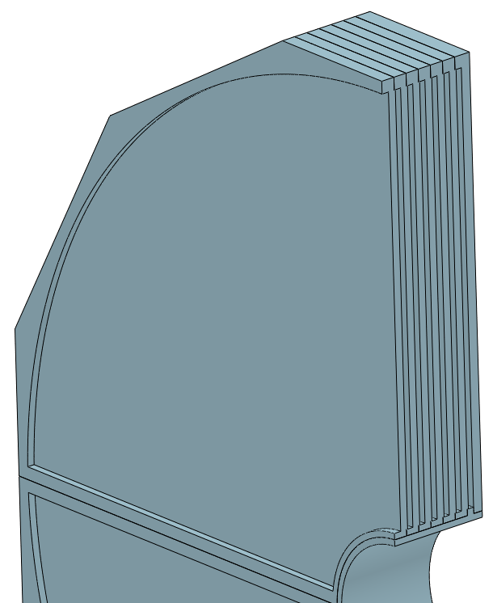
Module in Endcap
4.4m
Option 1:
Tow big modules
in one section
Total 5*8*2=80
3.2m
5.52m
Option 2:
4 modules ( two bigs, two smalls)
in one section
Total 5*16*2=160
Bare RPCs are not easy to arrange for both options!
Max size of bare RPC: 2.3*1.1m^2 !
Rin_eff/mm | Rout_eff/mm
700 | 6220

Slide 17
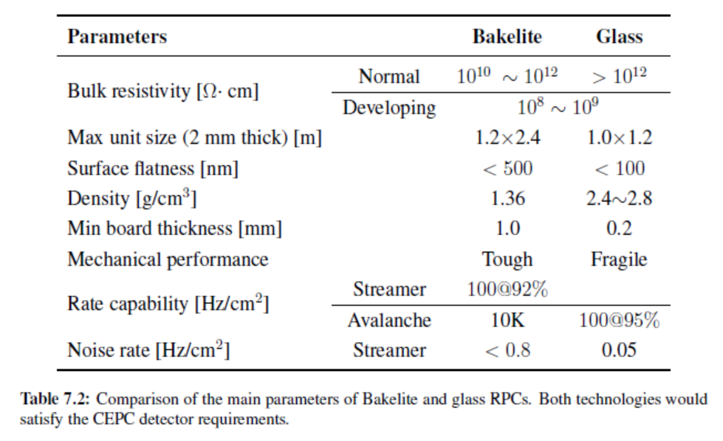
Bakelite or glass?
Major factors for choosing glass:
Module size is too big, Bakelite bare chamber size limited in 2.3*1.1m (Bakelite plate 2.4*1.2m). Glass can be larger, 2.44*2.0m (2mm glass plate 2.44*2.0m) . Two workers can handle.
Much cheaper, float glass plate -2mm, 10.6/m^2, 21.2(double layer)/m^2 for glass RPC. So bare chamber cost should be much lower than the Bakelite one. (e.g, half or 1/3).
Strength and performance improved for glass, not fragile, bulk resistivity could be controlled to 0.1~1*10^12 Ωm*cm
Old data
For CEPC RPC, glass should be a better choice according to current survey in China.
But glass RPC option needs some R&Ds, rate capability and aging are the main issues.

Slide 18
Gas mixture and volume:
Avalanche mode:
Ar:R134a:ISO-B: SF6 =63.5:30:4:0.5
or optimized options: Ar:R134a:ISO-B: SF6 = 68 : 28 : 3.2 : 0.8?
Streamer mode:
C2H2F4:ISO-B: SF6 = 84.5 : 15 : 0.5
or optimized options: Ar:C2H2F4:ISO-B: SF6 = 34.2: 50: 15 : 0.8?
Gas volume: 5080m^2 * 0.002m = 10.2 m^3.
Thin gap 1mm could be considered, then gas volume: 5.1m^3 for all,
Float rate(1 volume/day): 2-mm gap, 7L/min; 1-mm gap, 3.5L/min;

Slide 19
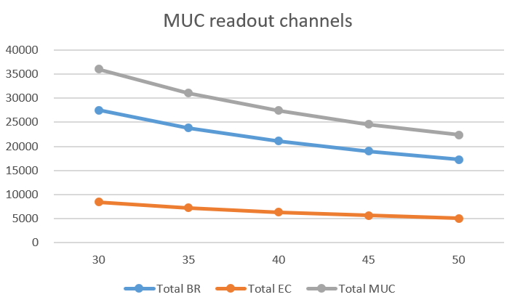
MUC Readout channel estimation
Spatial resolution: σ=10mm
Strip width: W=sqrt(12)* σ=35mm
FEE Scheme from USTC:
A: discrete component, stream mode, ~200RMB/ch
B: ASIC(8ch/chip), avalanche mode (Atlas PRC PhaseII)
B.1 FEE: 50/ch; 100/ch (reply today)
B.2 ASIC(8ch/chip), purchase from ROMA II University (import issue)
or self-developed, <2M in total (R&D cost not included).
B.3 Cables, power, trigger module, etc., 1.0M. (DAQ 2.0M not included)
Strip width/mm | 30 | 35 | 40 | 45 | 50
Total BR (ch) | 27526 | 23817 | 21065 | 18951 | 17284
Total EC (ch) | 8453 | 7246 | 6340 | 5636 | 5072
Total MUC (CH) | 35980 | 31063 | 27405 | 24586 | 22356
Cost A (MRMB） | 7.2 | 6.22 | 5.48 | 4.92 | 4.47
Cost B (MRMB） | 6.85 | 6.324 | 5.93 | 5.63 | 5.39
Cost B (RMB/ch） | 190 | 203.6 | 216.5 | 229 | 241.2
FEE
100/ch

Slide 20
CEPC RPC Muon cost
Bare RPCs (Bakelite) | 5080 m^2 | 2200/m^2 | 11.18 +0.6 = 11.78M | From GNKD
Bare RPCs(glass) | 5080 m^2 | 1000/m^2 | 5.08+0.6=5.68M | Estimated
Box | 280 | 3500/module | 0.98 M | Estimated
Readout strip & insulation materials | 5080 m^2 | 1000/m^2 | 5.08 M | Ref to DYB
Subtotal |  |  | 17.84M(Bakelite)/11.74M(glass)
Electronics (discrete) | 31100 ch | ~200/ch | 6.22 M | From USTC
Electronics (ASIC) | 31100 ch | ~203.6/ch | 6.324M | From USTC
HV system |  |  | 1.5M | Estimated
Gas system |  |  | 1.0M | Estimated
Total | Bakelite RPC: 26.56M(discrete)/26.66(ASIC); Glass RPC: 20.46M(discrete)/20.56(ASIC)
RPC mass production condition
Vendor: GaoNengKeDi co.ltd only, currently; glass RPC no problem. New clean room needed. Raw materials are not issue. (Bakelite, graphite, glass, glue, strips insulation film, etc. )

