Slide 1

Scintillator based muon detector
Xiaolong Wang
For muon Det R&D group
Fudan University
REF TDR meeting, 04/02/2024

Slide 2
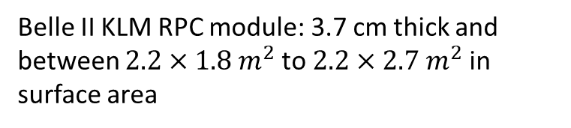
Outline
Performance:
1. H.Y. Zhang et al., arXiv:2312.02553, Design and test for the CEPC muon subdetector based on extruded scintillator and SiPM
2. Belle II TDR,
3. Leo Piilonen, KLM chapter of the Belle II detector paper
  Legacy RPC from Belle
  New scintillator based detector
Belle II KLM RPC module: 3.7 cm thick and between $2.2×1.8 m^{2}$to $2.2×2.7 m^{2}$in surface area

Slide 3
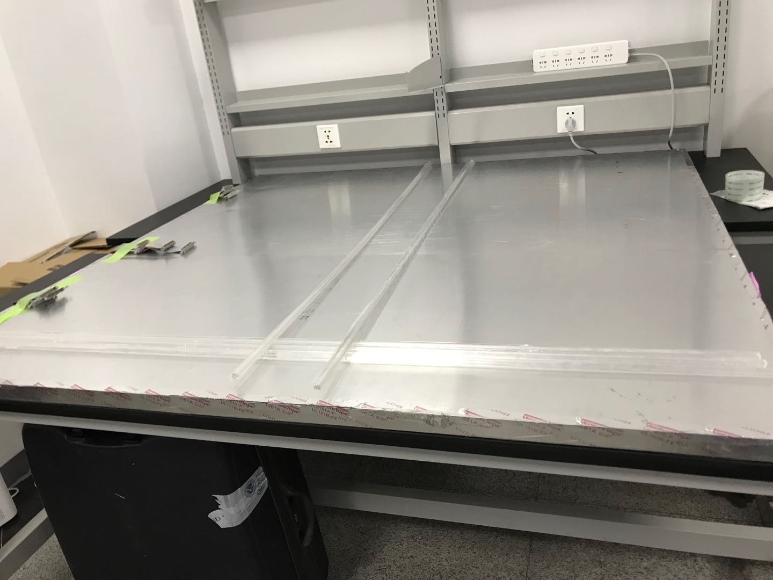

Readout strip parameters of KLM
Typical module: $2m×2m$

Slide 4

Kuraray Y11(200)MSJ fibre
$$φ=1.2mm$$

Slide 5
Electronic readout

Slide 6
Muon identification efficiency

Slide 7
Neutron and gamma backgrounds

Slide 8
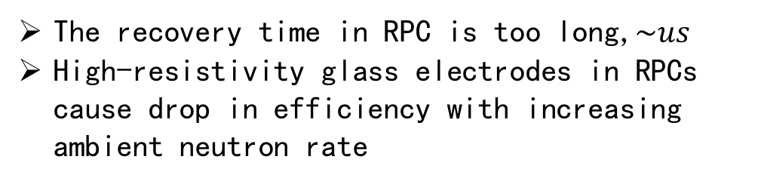
Background event display
The recovery time in RPC is too long,$\sim us$
High-resistivity glass electrodes in RPCs cause drop in efficiency with increasing ambient neutron rate

Slide 9

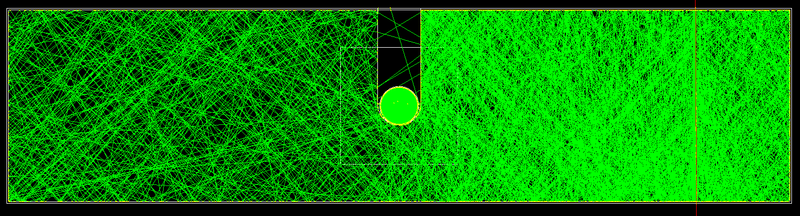
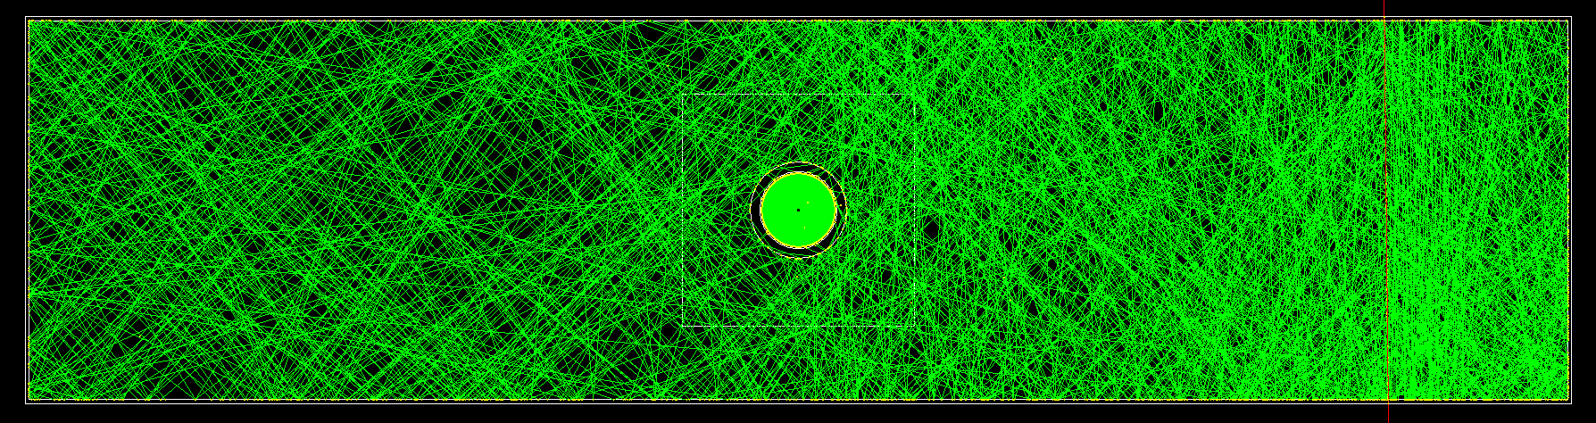
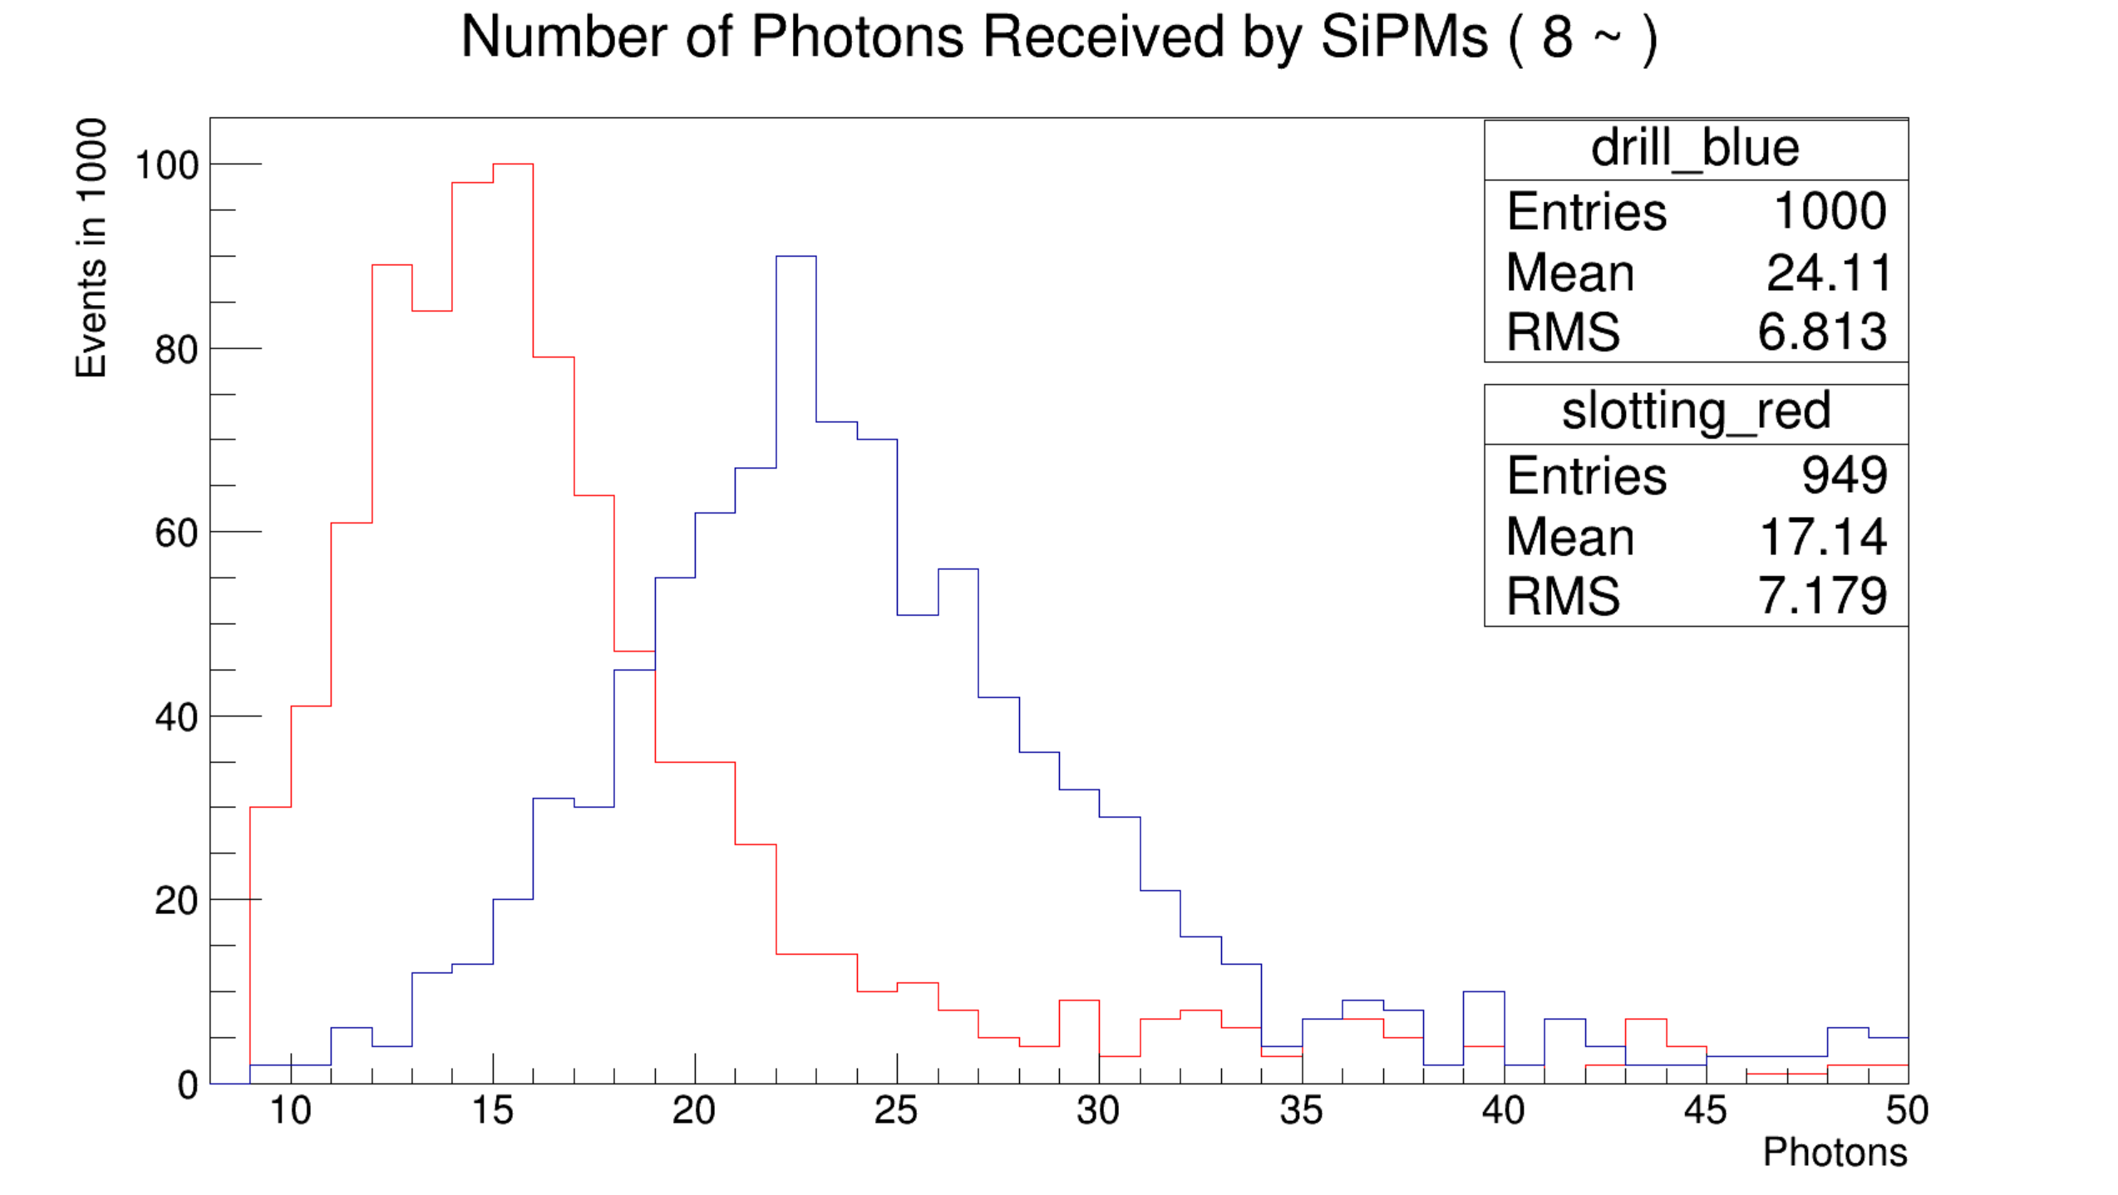
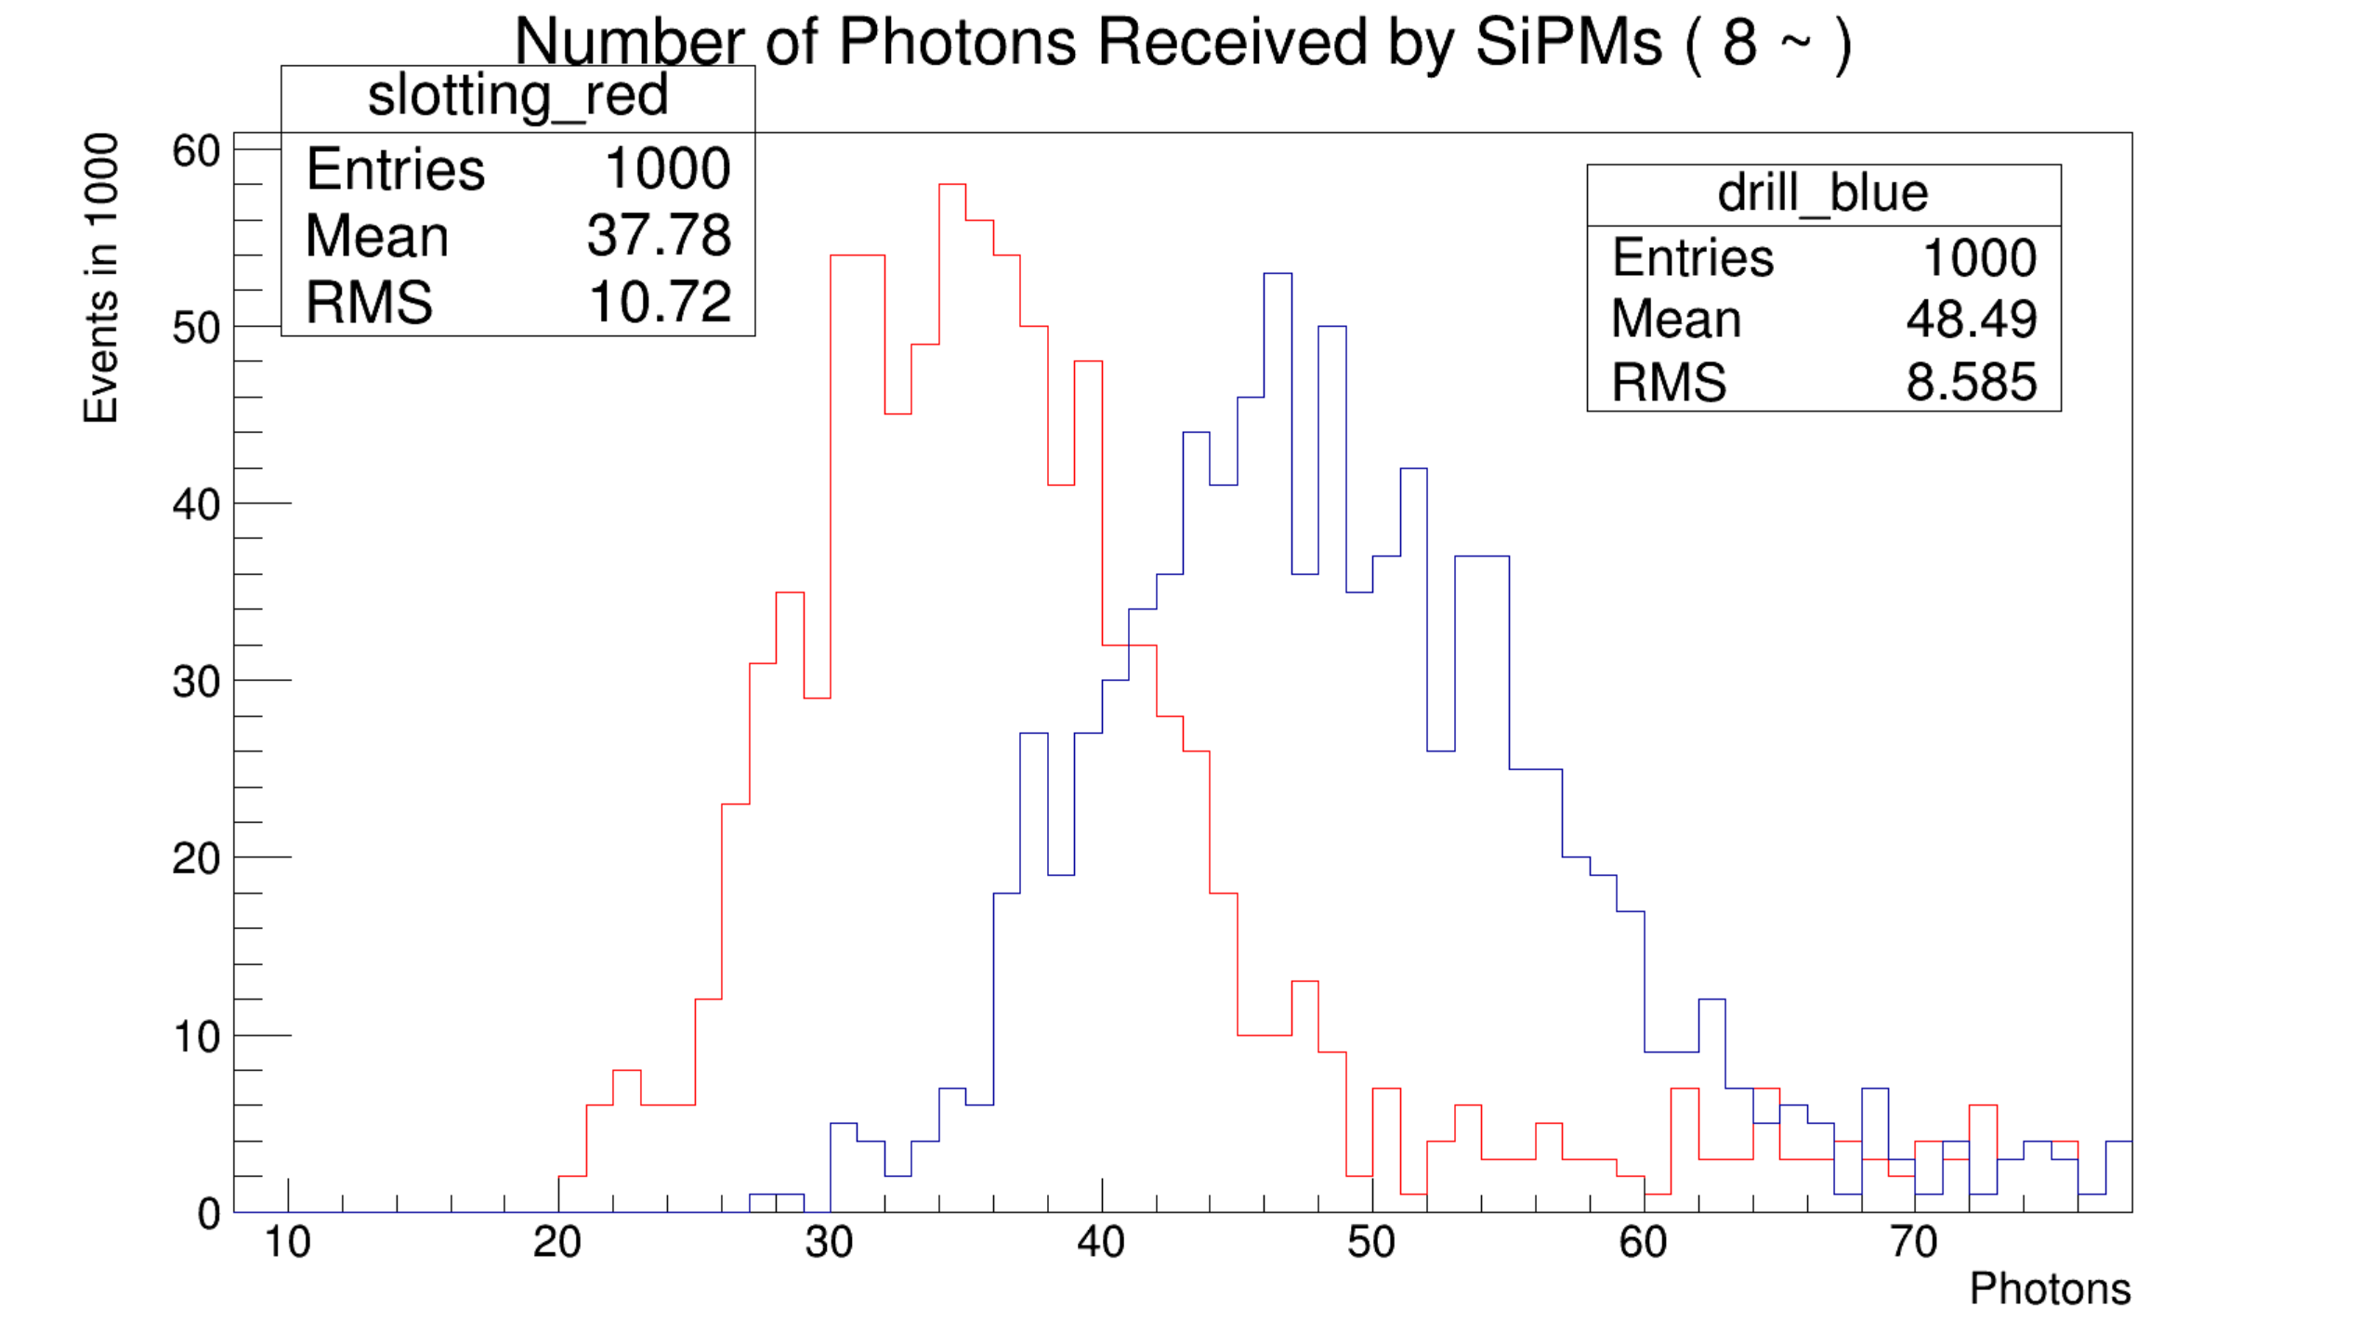
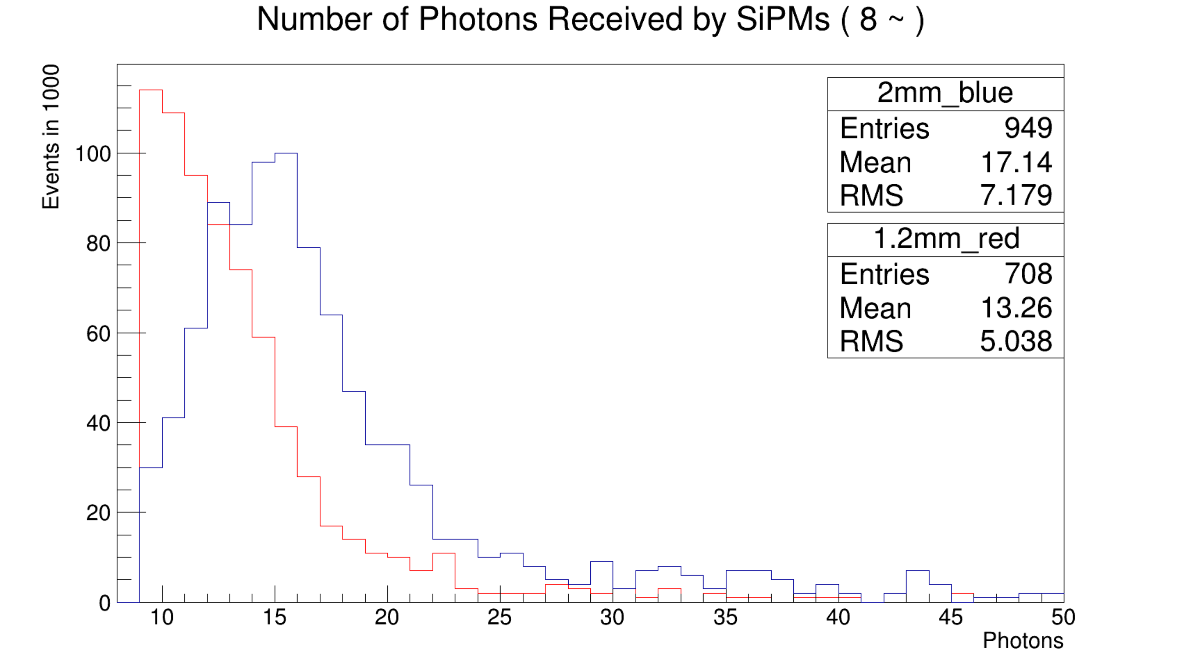
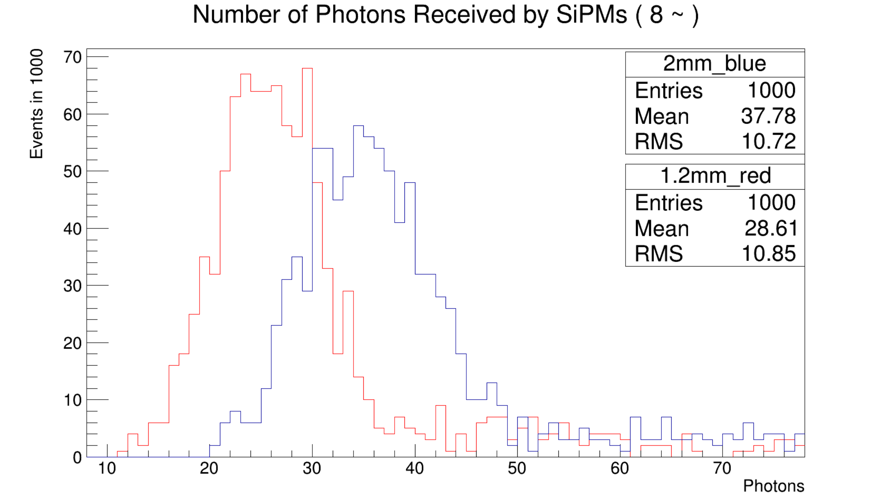
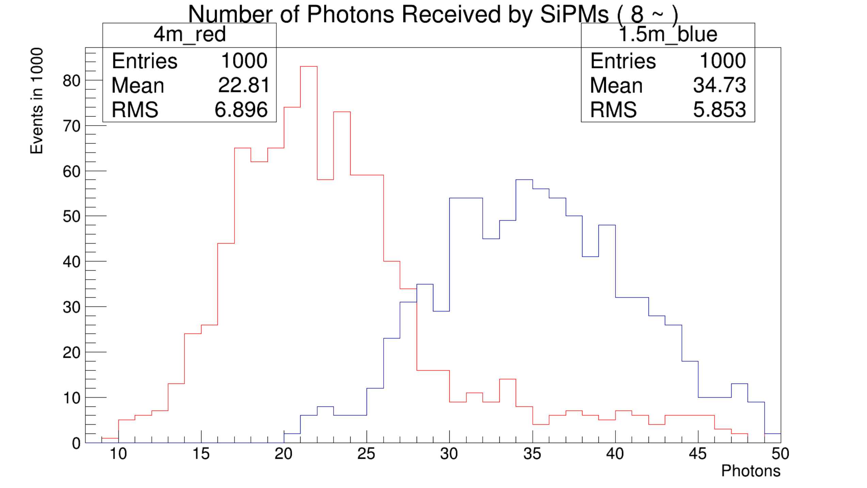
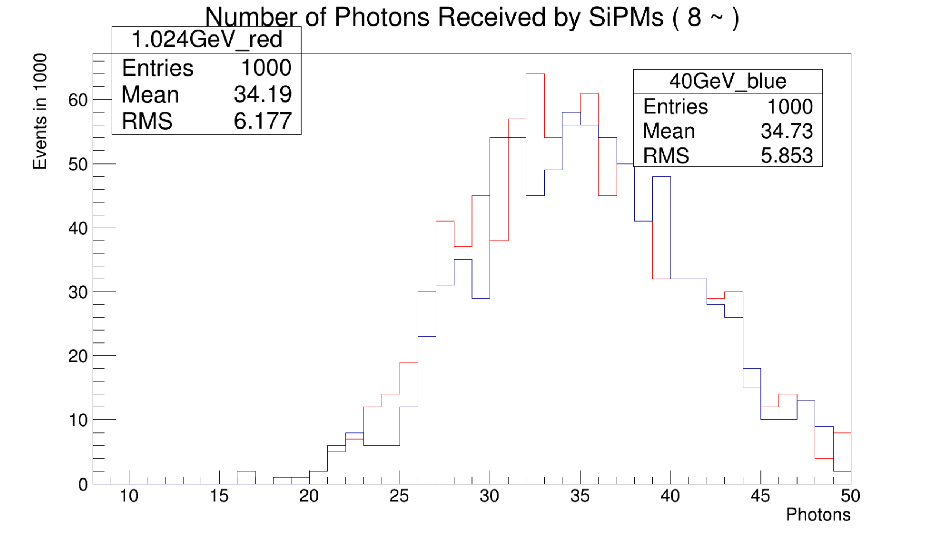
Geant4 simulation of barrel structure
Reflection layer: 90% → 98%
Scintillator for fiber: groove → hole
WLS fibre: 1.2mm → 2.0 mm
Length: 1.5m vs. 4.0m
Comparison of Slotting & Drill (40 GeV mu-) (1.5m)
Comparison of 2mm & 1.2mm (hole) (40 GeV mu-) (1.5m)
90% reflection
98% reflection
arXiv:2312.02553, experimental measurements
Hamamastu MPPC
NDl SiPM
Strip length
Muon energy

Slide 10
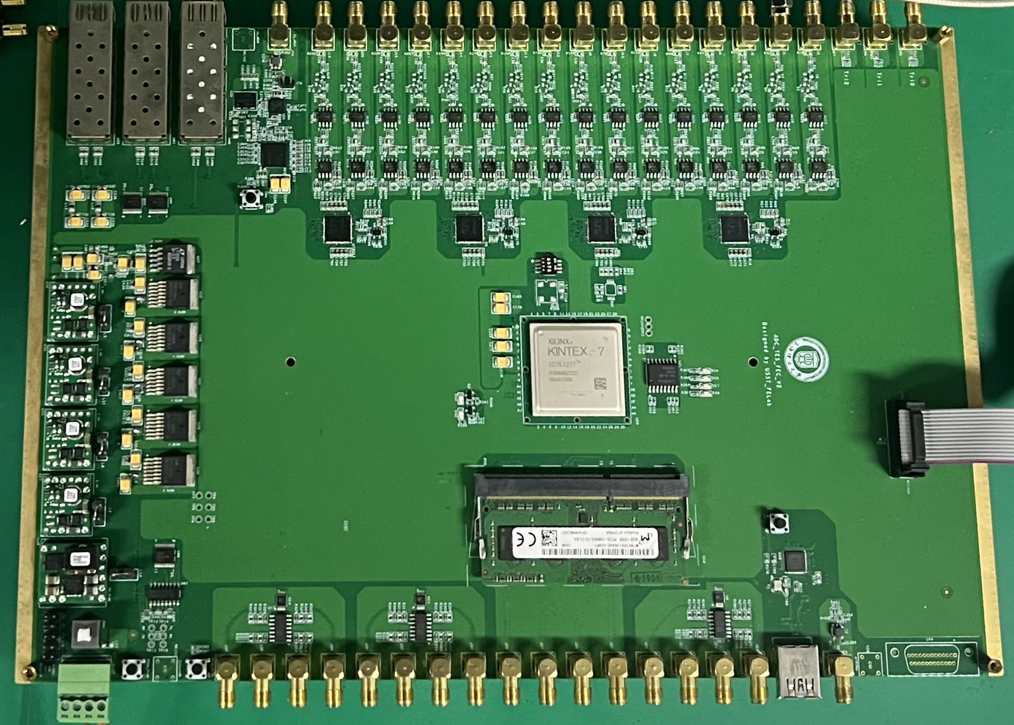
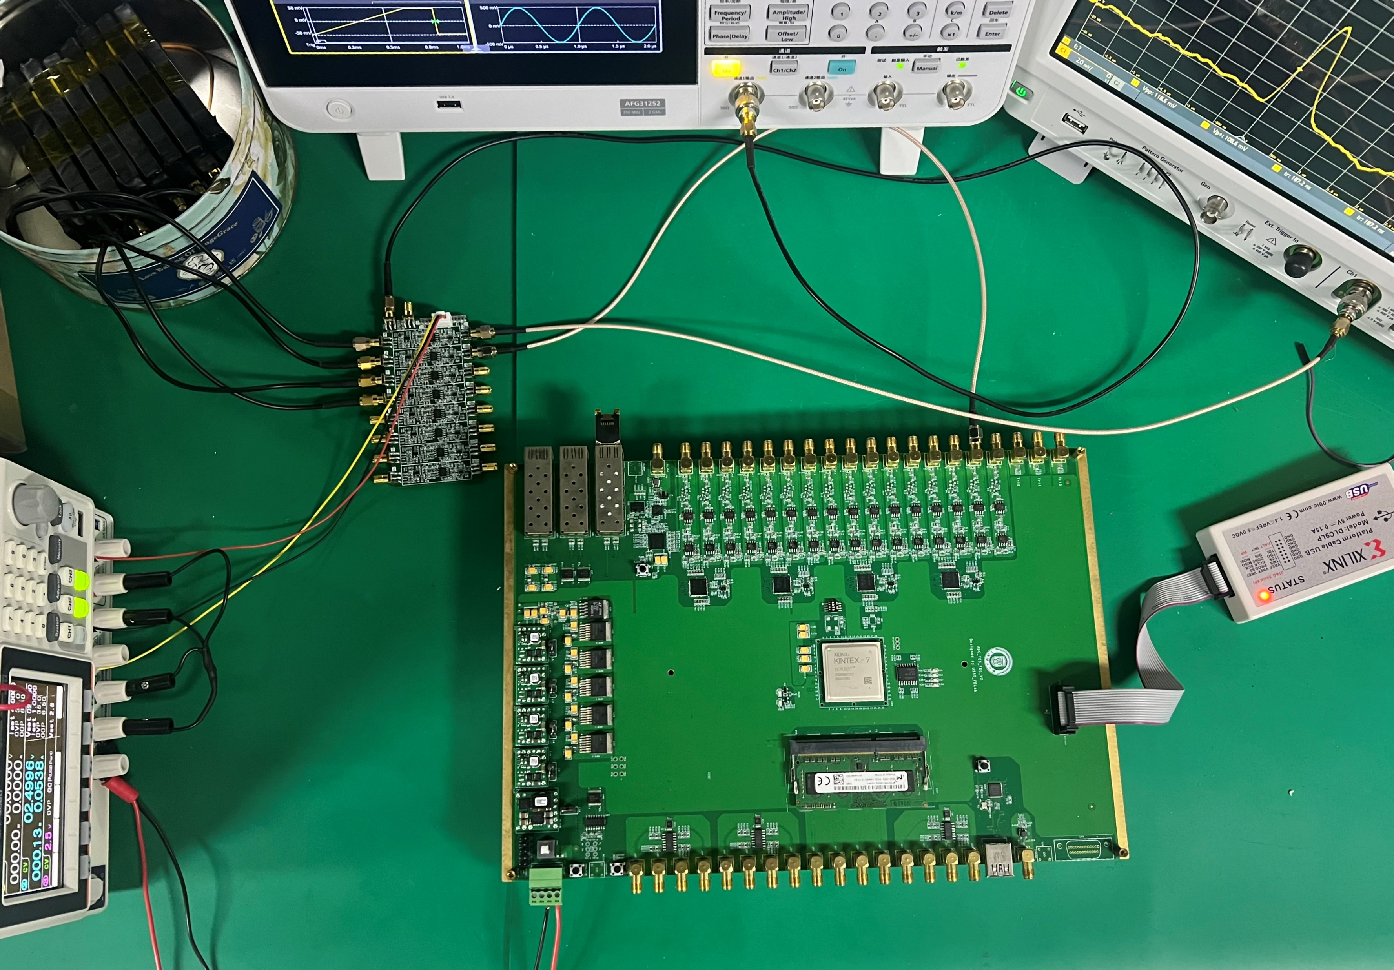
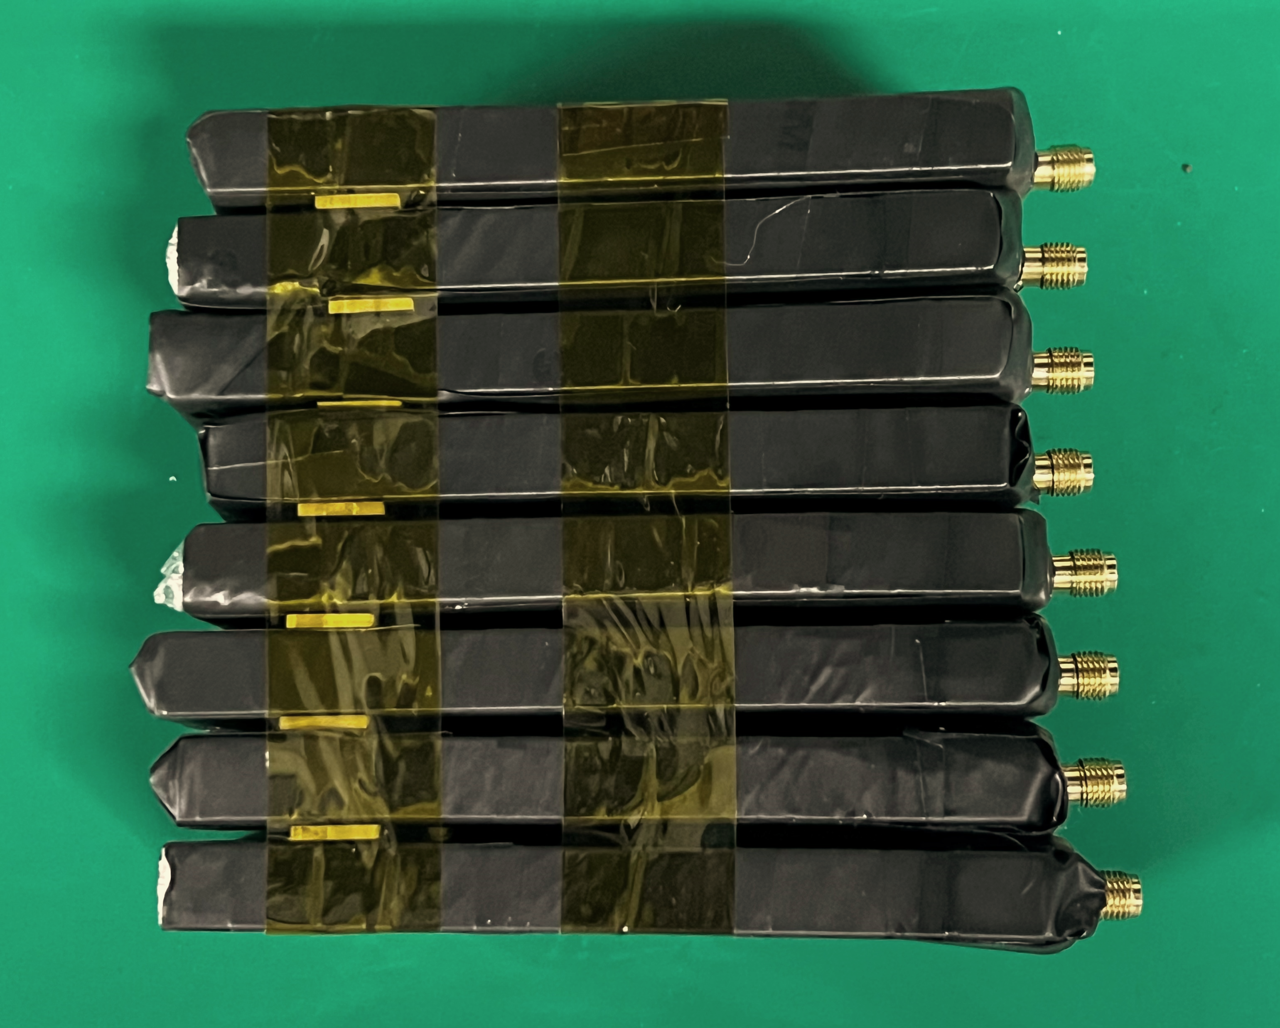
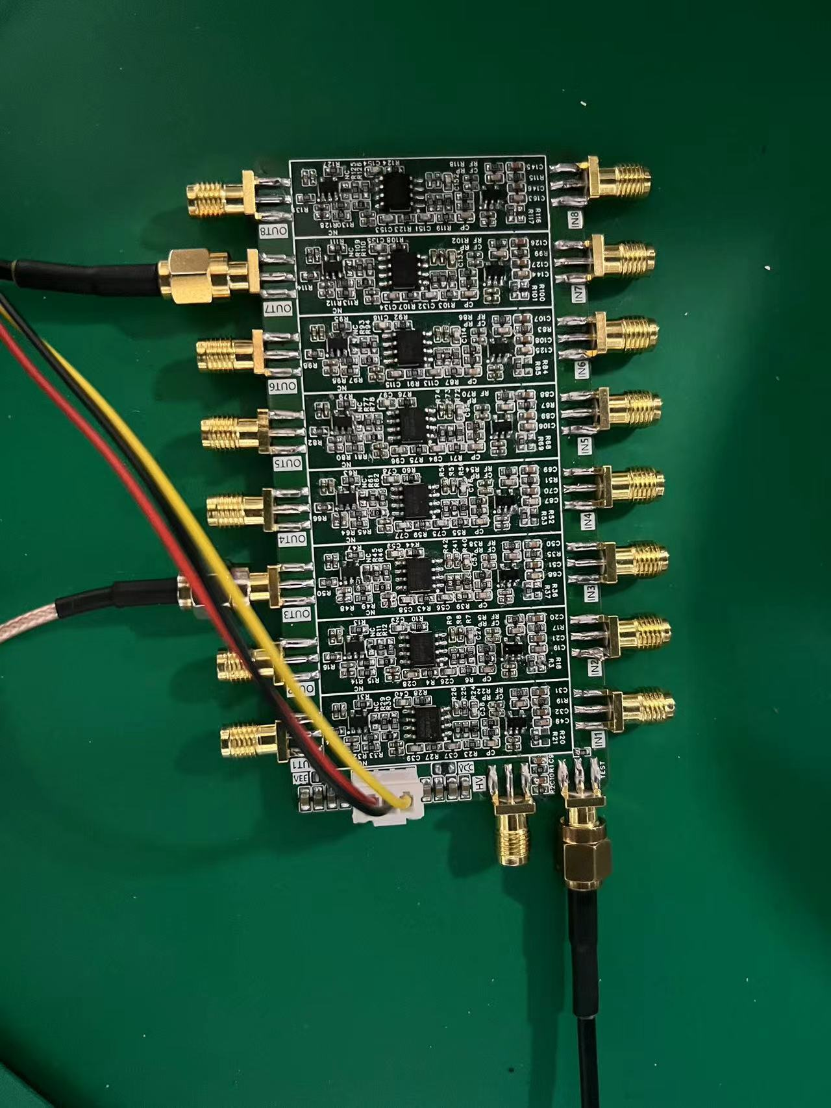
Major Parameters
Sample Rate(MSPS) | 10-100
Resolution (Bits) | 16
Number of input channels | 4
SNR(dB) | 85.5
Muon detector back-end electronics
Setup
scintillation detector + preamplifier + acquisition and processing board
ADS5263

Slide 11
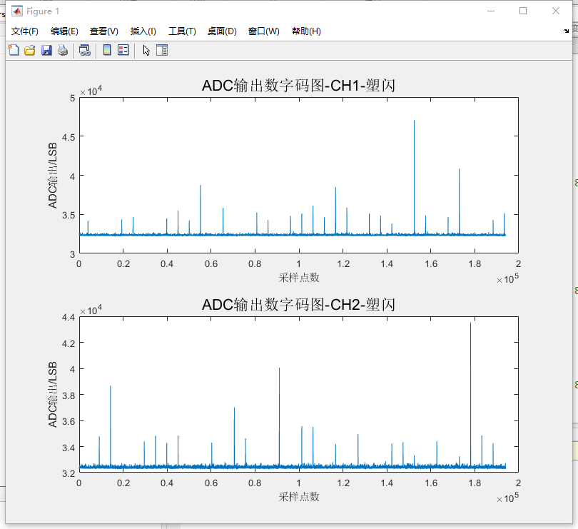
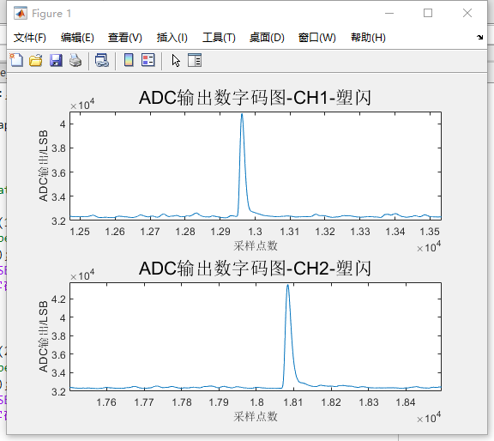
Muon detector back-end electronics
Sampling test of scintillator detector signals

Slide 12
Comparison between scint. and RPC
 | Scintillator scheme | RPC scheme
Spatial resolution | $$≤1.2 cm$$ | $$1cm$$
Time resolution | $$<1.5 ns$$ | $$1−2 ns$$
Muon efficiency | $>95\%$/channel | $$95\%$$
Long term rate limit | $$>25kHz/cm^{2}$$ | $$100 Hz/cm^{2}$$
Background level | Reduce soft neutron, ?? | ??
Peak luminosity | $6×{10}^{35}cm^{−2}s^{−1}$ (Belle II design) | $$\sim 2×{10}^{34}cm^{−2}s^{−1}$$
Cost w/out BEE | $\sim 5600￥/cm^{2}$(estimatation) | $\sim 7500￥/cm^{2}$(Dayabay)
Massive production | Much simple (experience at VT) | 3 years for Belle RPC
Maintenance | LV system | Gas cost per year, HV system
… | … | …

Slide 13
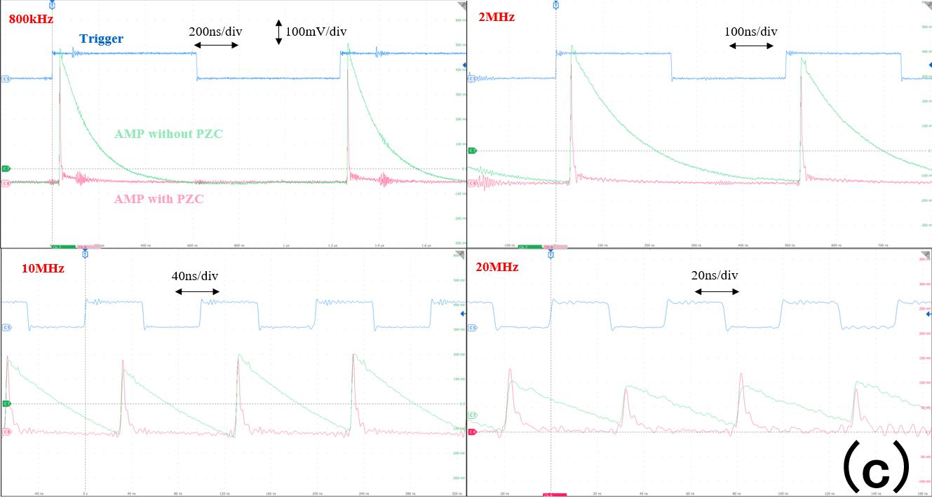
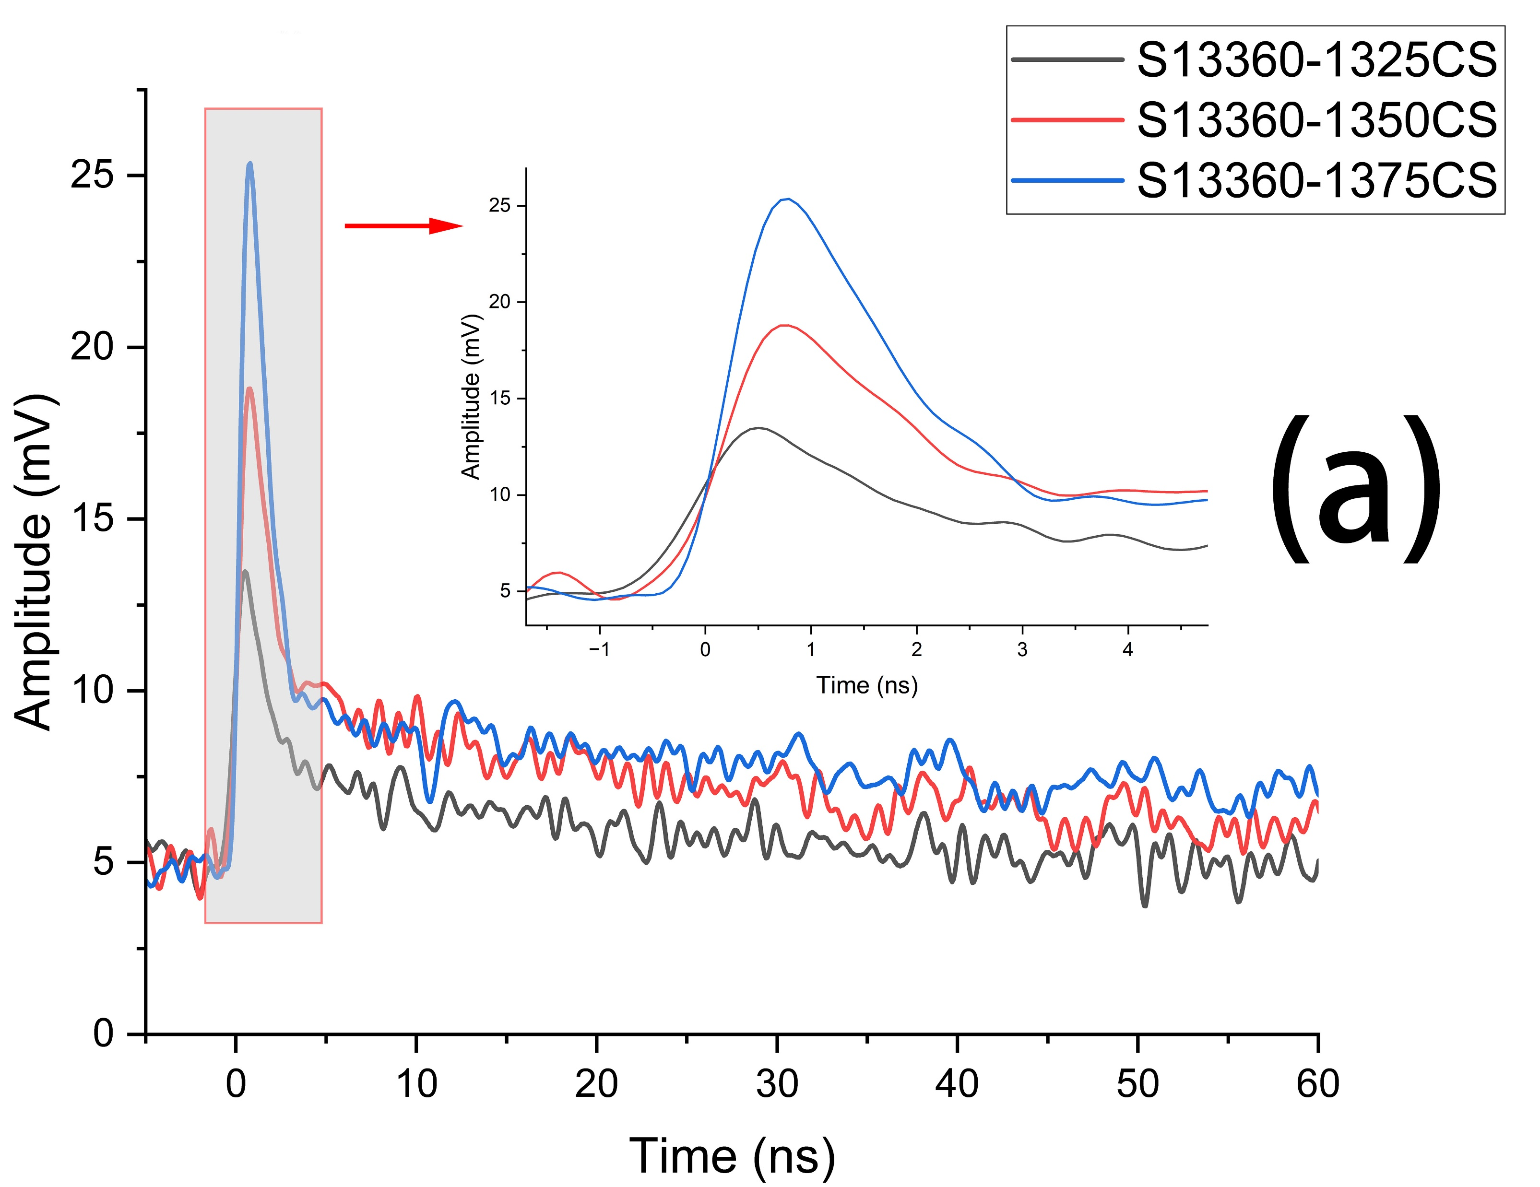
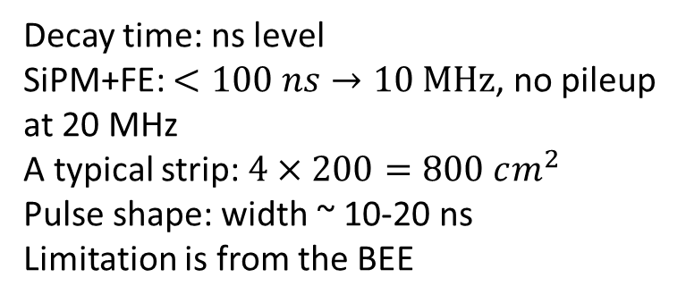
Rate limitation of scintillator
Decay time: ns level
SiPM+FE: $<100 ns→10 MHz$, no pileup at 20 MHz
A typical strip: $4×200=800 cm^{2}$
Pulse shape: width ~ 10-20 ns
Limitation is from the BEE
SPE from MPPC
SPE from NDL EQR15
X.Y. Wang et al., NST34,169(2023)

Slide 14
Cost Estimation
SiPM和电子学部分：
  KLM造价，电子学部分平均价格为$20，SiPM约为$20。我们估计的SiPM造价可以在$10水平。即每一道的总价格约为￥210。因此，电子学和SiPM总造价约为(14208+6290)*210=4.3M￥。
WLS光纤部分：
  桶部：一个超层，垂直方向3.2m*8m/4cm=640m，沿束流方向8m*3.2m/4cm=640m，共1280m。桶部一共需要光纤长度为1280m*4*8=40960m。
  端盖：34000m(eKLM)*0.37=12580m。
  因此，总共53540m。单价估计$4/m，光纤所需造价为1.5M￥。
  (最近的小批量采购价大约1000日元/米，即50元。)
塑闪：
  探测总面积约1600m^2，因此，总体积为1600m^2*1cm（厚）=16000L。塑闪造价估计200￥/L，总造价为3.2M￥。
总造价：4.3+1.5+3.2=9.0M。
Recent estimation (5 layers) according to Geant4 simulation:
探测层：
  桶部: (300*5+93+95+97+99+102)*8=15,888道
  端盖： 996*5*2=9,960道
  总共： 25,848道
厄铁层：
  桶部： 300*0.04m*0.04m*(93+95+97+99+102+104)*0.10m*8 = 226.5m^3
  端盖：129.5 m^2 *0.10m*5*2= 129.5 m^3
  总共：356 m^3，约2,776.8吨。

