Slide 1
Lustre use cases and
Virtualization of Lustre
Philip Zhu
Director, North Asia

Slide 2










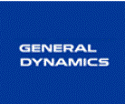




DDN | The Leader In Massively Scalable Storage Solutions & Services
Key Statistics
Industry Validation
Delivers highly scalable and highly efficient storage solutions that enable customers to accelerate time to results, scale simply as data sets continue to grow, and gain competitive advantage through resolving performance and capability scaling challenges
Established: 1998
Financials: Over $200M Annually, Very Profitable
Headquarters: Chatsworth, California USA
Employees: Approximately 400 Worldwide
Customers: Over 1,000 Worldwide
Footprint: 17 Industries, 4 Continents, 49 Countries
Go to Market: Global Partners, VARs, Resellers
Key Market Segments:
  High Performance Computing & Life Science
  Cloud & Web Content
  Rich Media
  Intelligence/Federal
  Surveillance
World’s Largest Privately-Held Storage Co.
Fast500 Technology Company
Inc. 500|5000 High-Growth Company
Best HPC Storage Platforms
Best Practice for Digital Media
1000+ World-Leading Customers

Slide 3












DDN HPC Storage Market Leadership
Powering 60% of the Top50 fifty largest systems
  More than all other technology companies combined
Storage for over 1/3 of compute power for the Top500
  More than 19,500 TeraFlop/s – more than any other technology company
Deployed in 118 of the worlds fastest supercomputers
  More than half of the Top 100
Fastest file systems in the world – over 300GB/s!
  Wright-Patterson AFB >300GB/s
  CEA Tera-100 at 300GB/sec
Sample Customers

Slide 4
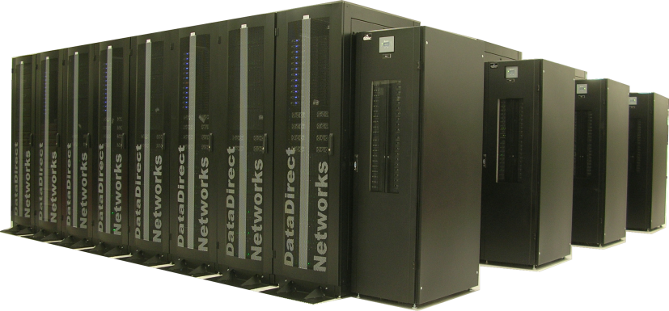
Worldwide Performance Leader
The World's Fastest Parallel File System
RDMA Capable Single Client throughput of 2.5GB/s+
Ideal for 10,000s of concurrent
client access to storage
  Supports full single file concurrency
  Supports full single directory
  concurrency
Network Flexible
  Writes Natively to IP / IB
S2A Real-time storage technology provides guaranteed performance
  Writes are as fast as Reads
  No degradation in performance due to drive errors, rebuild events or enclosure failures
    DDN Exascaler Technology Powers the World's Fastest File Systems:
    350GB/s at CEA
    250GB/s as US DoD
    250GB/s at ORNL

Slide 5
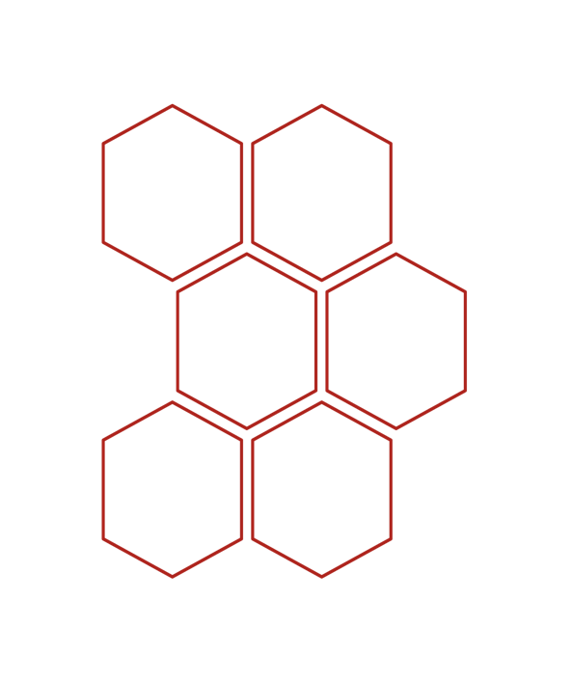
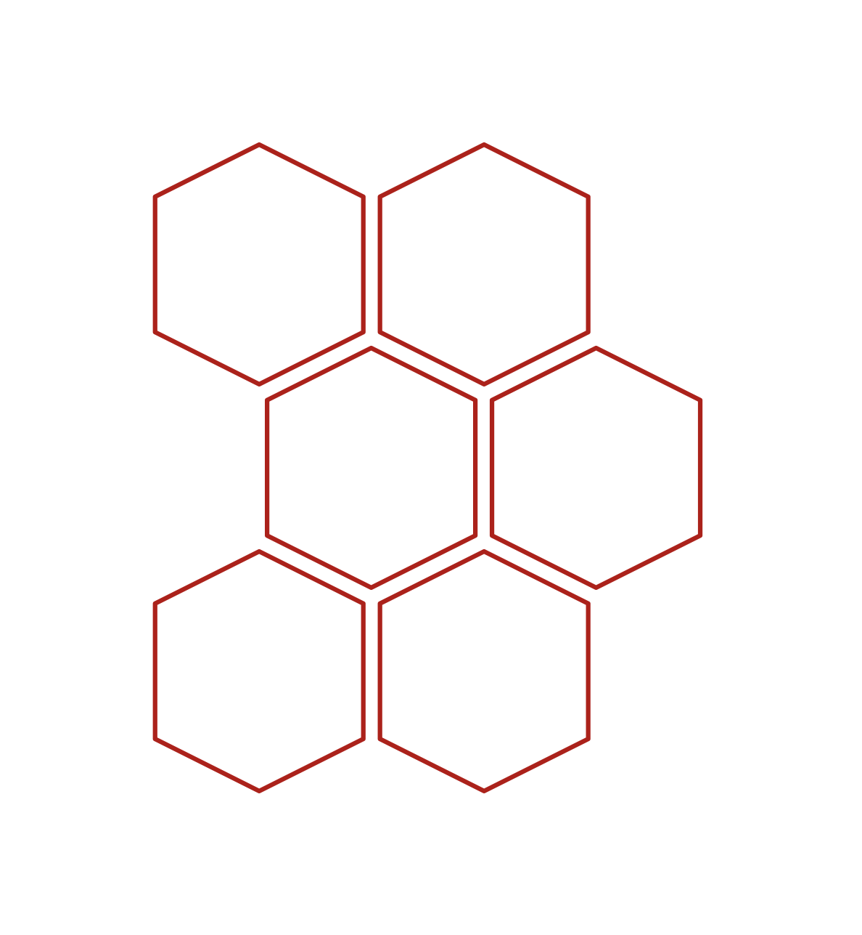






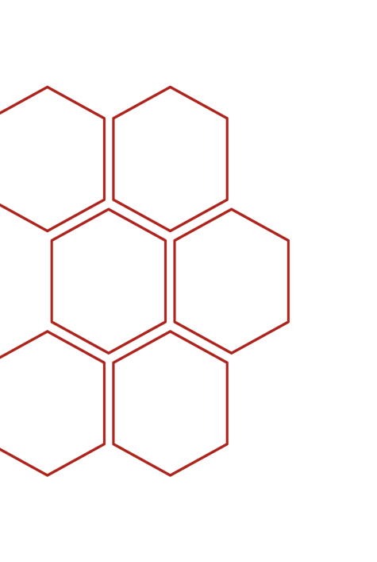























HPC | The Worldwide Storage Leader
100s of Leading HPC Customers Worldwide
Deploying The Fastest Systems On The Planet
Over 50% of The Top100
And many, many more…

Slide 6
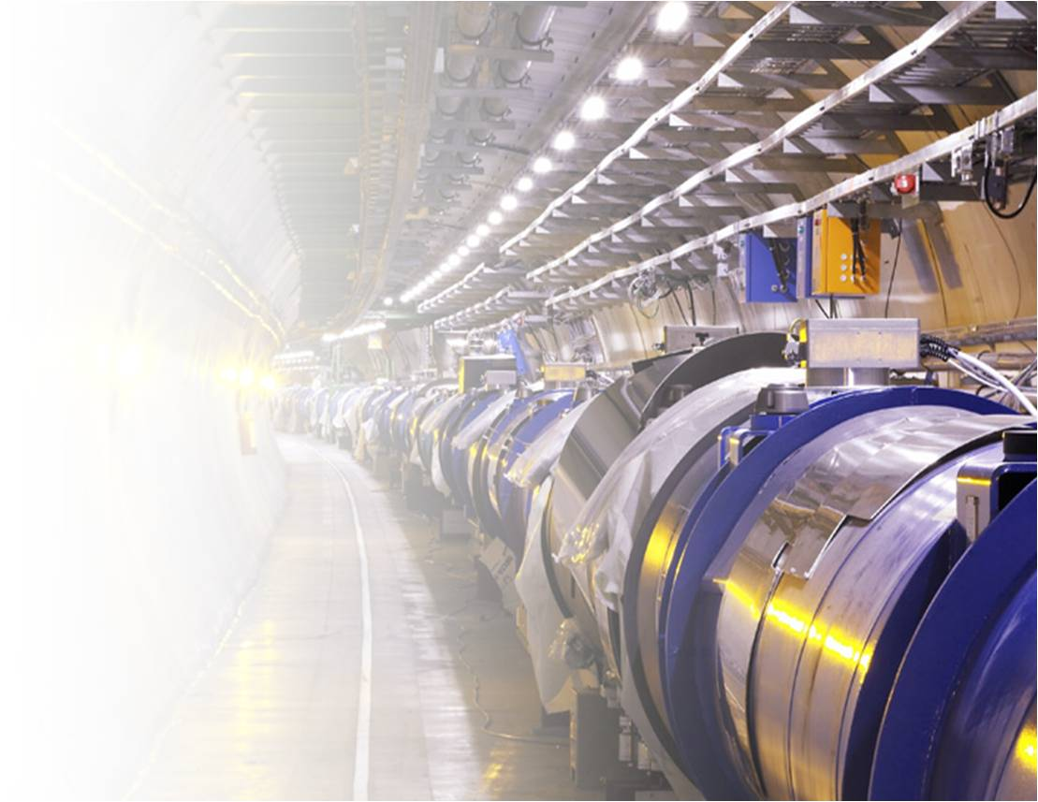













Accelerating Accelerators
DDN is the leading provider of enterprise-grade storage platforms for the next generation of particle physics research.
DDN Supplied Over 30PB of Atlas Storage since 2009

Slide 7


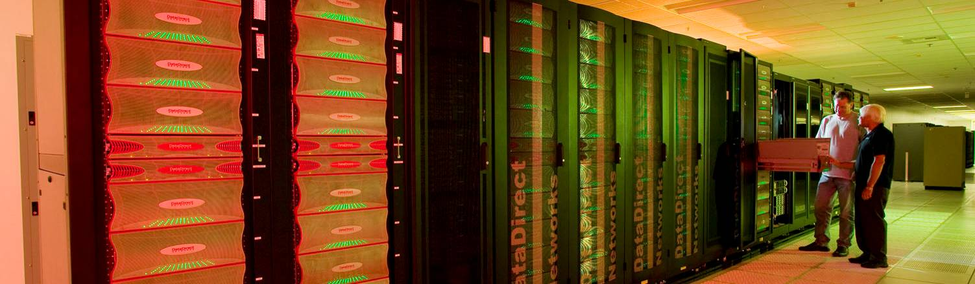
Success Story: LLNL
With a combined 1.6 Petaflop/s of peak performance and over 350GB/s of aggregate DDN storage bandwidth, LLNL is the world's largest data-intensive computing facility.
Since 2005, DDN has delivered world-class solutions and expertise to help LLNL scale computational capabilities by over 1000x.

Slide 8
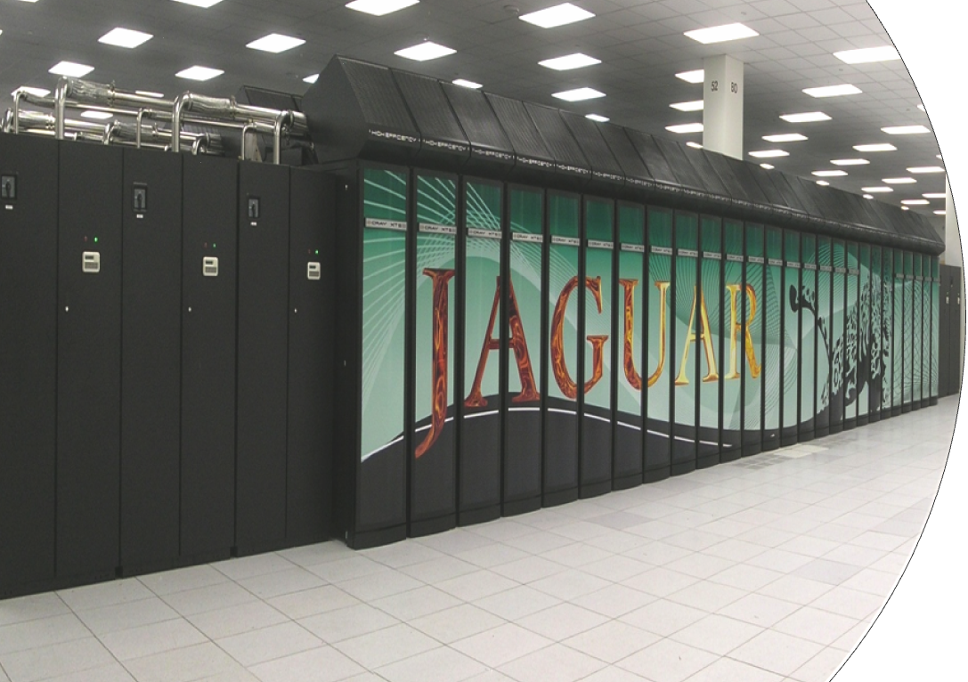


Oakridge National Labs – Jaguar Super Computer
The HPC storage leader, DDN maintains advantage through hyper-scale expertise
At 240GB/s – DDN has delivered the world's most scalable bio-informatics storage solution to ORNL
ORNL has over 400GB/s of DDN performance & capacity efficient solutions
Today's supercomputers are tomorrow's workgroup clusters, only DDN technology scales up and down to meet and grow with the complex requirements of life sciences
Enabling
Petascale
Research
Gating Mechanism of Membrane Proteins
PI: Benoit Roux, Argonne National Laboratory/University of Chicago
Physical Basis of Recalcitrance to Hydrolysis of Lignocellulosic Biomass
Principal Investigator: Jeremy Smith, ORNL
Notes:
Genome Analysis and Systems Modeling Group
Currently Available Tools at ORNL
GrailEXP Gene finder (Human and Mouse Genomes)
Generation Gene finder (Microbial Genomes)
Pipeline, Comprehensive Genome Analysis Pipeline
Genome Channel, Java applet for the comprehensive sequence-based view of genomes.
Grail, a tool for the identification of genes, exons, and various features in DNA sequences.
The Computational Biology and Bioinformatics Group at Oak Ridge National Laboratory conduct genetics research and system development in genomic sequencing, computational genome analysis, and computational protein structure analysis.
They provide bioinformatics and analytic services and resources to collaborators, predict prospective gene and protein models for analysis, provide user services for the general community, including computer-annotated genomes in Genome Channel.
Collaborators include:
- The Joint Genome Institute,
- ORNL's Computer Science and Mathematics Division,
- The Tennessee Mouse Genome Consortium,
- The Joint Institute for Biological Sciences, and
- ORNL's Genome Science and Technology Graduate Program.

Slide 9
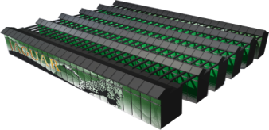
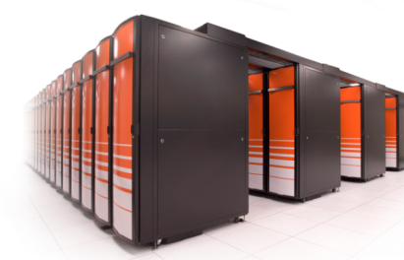
Success Story: ORNL
When ORNL needed to build the world's fastest POSIX file system to support the world's fastest supercomputer, DDN delivered.
S2A9900 delivered the highest performance in ORNL testing while also enabling striped file I/O (with DDN QOS) and leading density.

Slide 10

Success Story: ORNL
Jaguar (XT5)
ESnet, USN, TeraGrid, Internet2, NLR
Jaguar (XT4)
SeaStar Torus
SeaStar Torus
10 – 40 Gbit/s
HPSS
Archive
(10 PB)
Smokey
Lens
GridFTP
Servers
Lustre-WAN
Gateways
RTR
RTR
RTR
RTR
RTR
192 Routers
48 Routers
Scalable I/O Network (SION) - DDR InfiniBand – 889 GB/s
OSS
OSS
OSS
OSS
OSS
OSS
OSS
192 OSSs
1344 OSTs

Slide 11
Spider File System: Facts
253 GB/s of Aggregate Write Bandwidth
48 DDN 9900 Couplets
13,440 1TB SATA Drives
Over 10 PB of RAID6 Capacity
192 Storage Servers
Over 1000 InfiniBand Cables
~0.5 MW of Power
~20,000 LBs of Disks
Fits in 32 Cabinets using 572 ft²

Slide 12
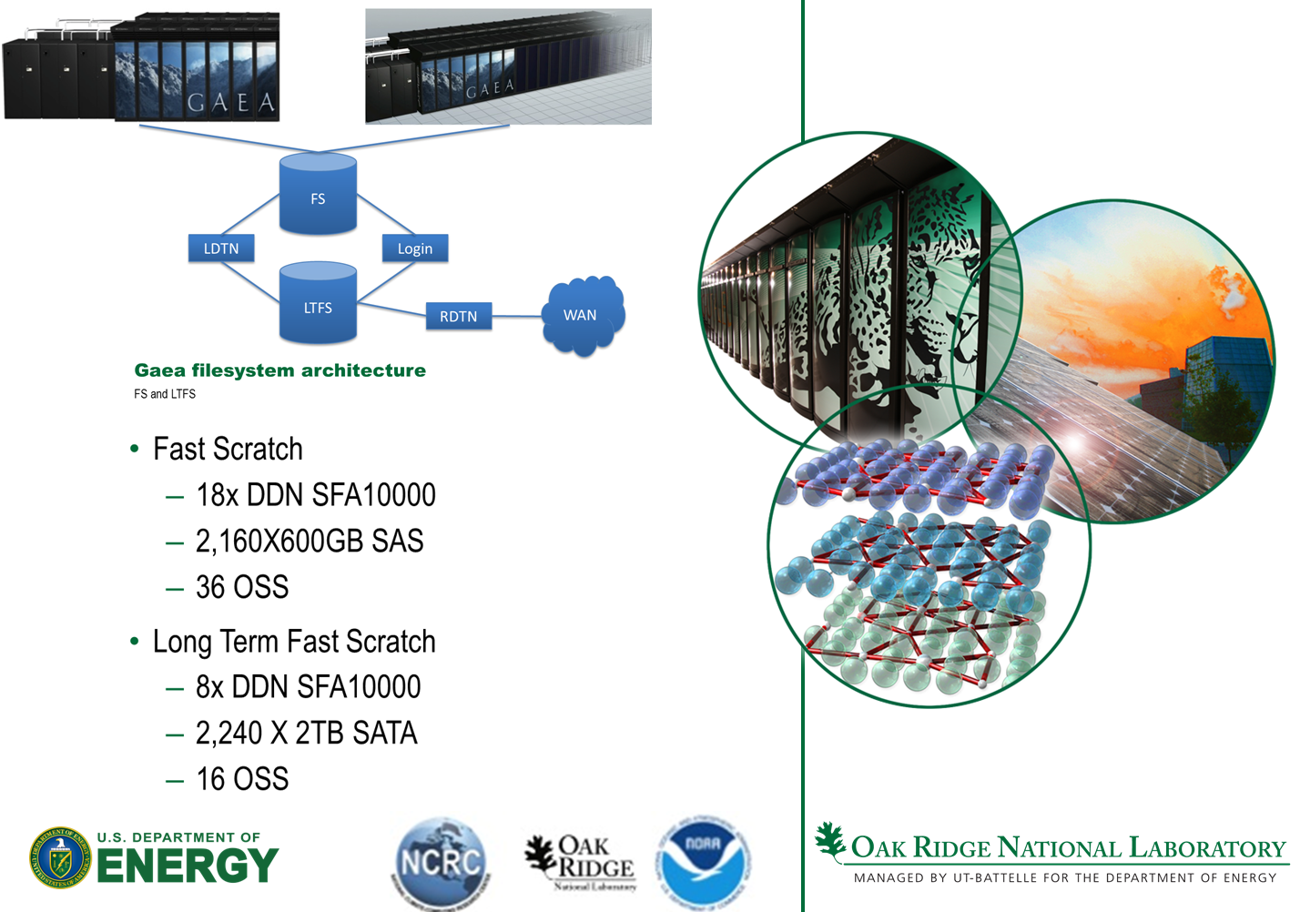
Architecture and Implementation of Lustre at the National Climate Computing Research Center

Slide 13
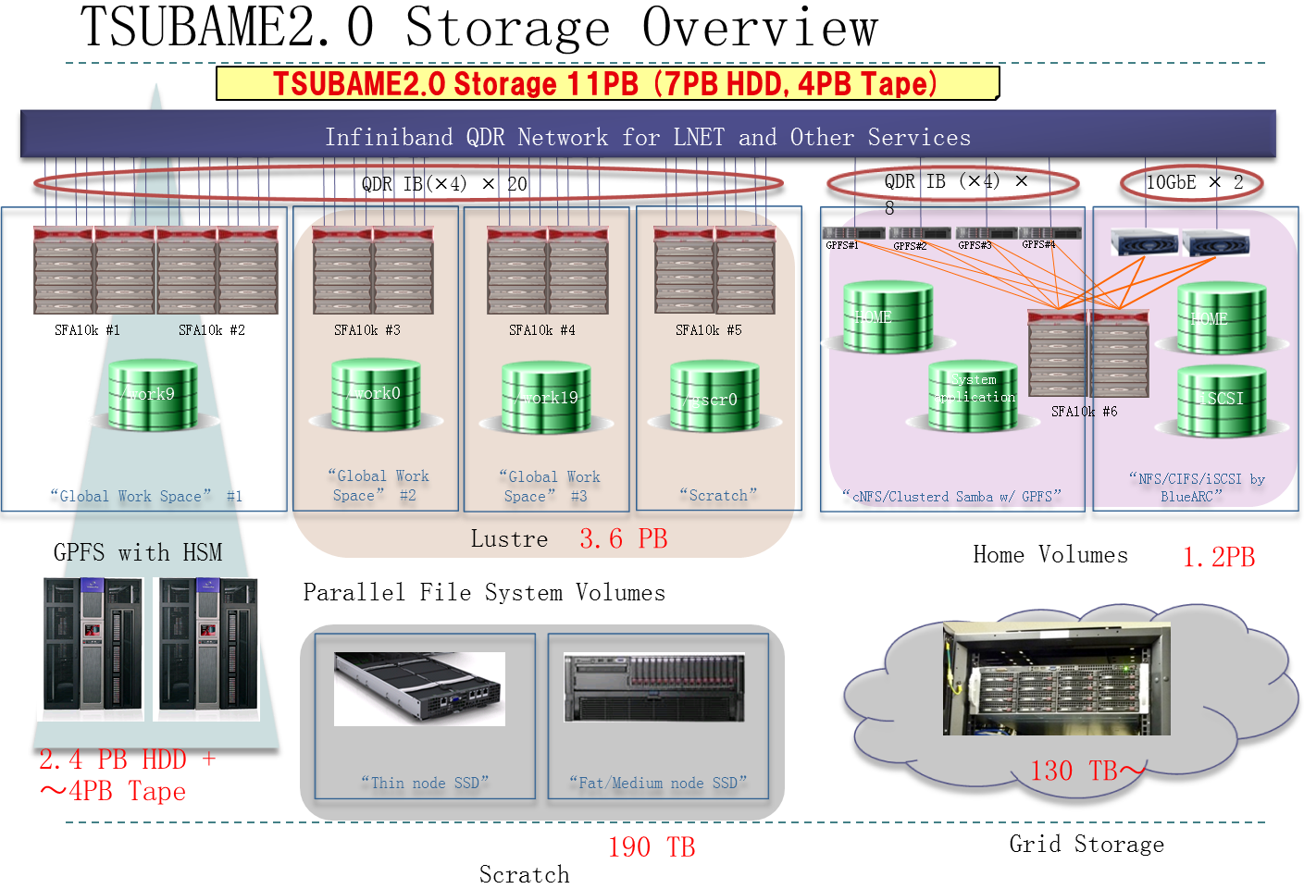
TSUBAME2.0 storage

Slide 14
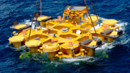

Use Case: TOTAL
DDN was Chosen Because :
ExaScaler provides high performance concurrent client access which allowed all clients to access and read the same set of source files.
  Up to 250GB/s file Storage throughput
  Writes natively to IB
  RDMA capable
ExaScaler scalability allows for TOTAL’s future capacity planning
  Highly scalable, highly-efficient storage system
  ExaScaler leverages commodity technology
  DDN’s parallel architecture enables leading lustre performance
Notes:
14

Slide 15
Markets ExaScaler plays in
Supercomputing Labs
Powering the World's Fastest HPC System, File System over 300 GB/sec
Academic Computing/Research Universities
DDN systems are capable of handling a mixed workload, allowing many researchers to work simultaneously and reduce research cycle times.
Oil & Gas
DDN shortens "time to oil" through accelerating seismic processing algorithms
Government Intelligence
DDN’s real-time, scalable technology ensures rapid ingest and immediate data availability to ensure real-time insight and the shortest possible kill chain.
Provides better ROI by ensuring clusters spend more time computing and less time doing I/O.
World's fastest storage systems for image/motion capture, in-theater reconnaissance
DDN HPC systems provide superior $/performance to ensure optimum HPC TCO.
DDN Systems provide per-client performance and scale to allow customers to support complex 4D modeling and interpretation of seismic surveys.
Life Sciences and Genomics
Enable sequencing centers and bioinformatics departments to accelerate their development pipeline, reduce time to market for new drugs
Reduce the Gene Sequencing pipeline by up to 30% by using native clients

Slide 16
Storage Fusion Architecture™
SFA1XK-X™

Slide 17



Supercharged Building Block
ExaScaler is built with Open Source Lustre^{tm} Technology
100+
75%
Lustre powers more than 100+ of the Top 500 Supercomputing sites
of these 100+ sites run DDN storage in the backend
ExaScaler draws from the experience of the world’s Leading Lustre Deployments

Slide 18
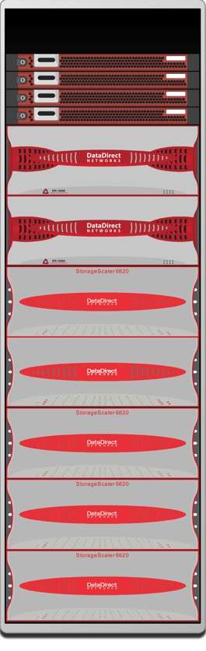


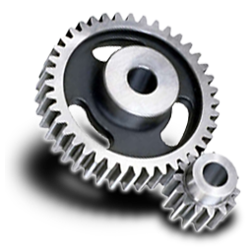

ExaScaler-At a Glance
1Gb / 10Gb / InfiniBandTM
10s to 1000s of Linux HPC Clients
Intelligently Scale Applications
Intelligently Manage Infrastructure
Object-Based File System Enables Granular Read/Write Access And Massively Concurrent Access
Non Disruptive Scaling
Out-Of-Band Metadata Server Cluster Can Handle 10,000s of Operations Per Second
Multi-Tiered
File System
Integrated Backup and HSM Tools
Parallel Configuration Enables Simple Scaling
Multi-Petabyte, Scalable Parallel Storage System
No-Compromise Scale Out Performance & Data Protection
100s of GB/s of Performance, Linear Performance Scaling & Leading Data Center Efficiency

Slide 19
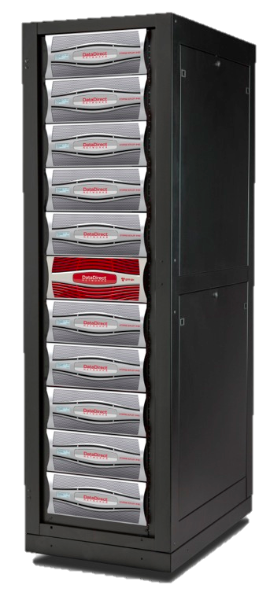
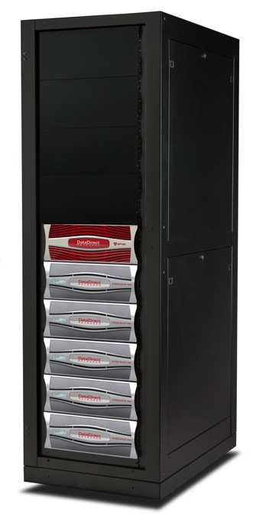
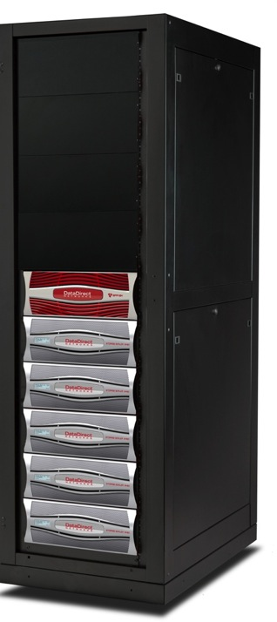
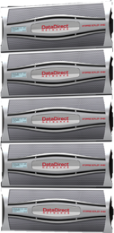
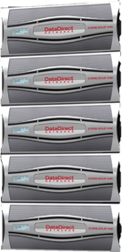
DDN | Scale With Flexibility
Scale-Up For Capacity
Intelligent, Scale-Out File Systems
Aggregate Clustered Storage For Speed & Scale
Each System Is A Scalable Building Block, Supporting Up To 1,680 Disks To Enable Cost-Efficient Capacity & Simple Configuration
Scale-Out For Performance
Notes:
Flexible Scalability Is a unique capability of DDN's whereby we can deliver maximum system-level efficiency to an environment by never shoehorning a customer into a rigid configuration. With traditional scale-up NAS (a la NetApp), customers are forced to deploy silos of non-scalable systems where the lack of a global namespace forces a data management issue within the data center. These systems are often suitable for capacity optimized environments, but cannot scale capacity even beyond a single system.
On the flip side, scale-out technologies are often times over-built with excess CPU, memory, systems and licenses for capacity-intensive applications. Systems such as Isilon's Scale-Out cluster technology can deliver decent performance (1/10th of DDN's delivered performance in high end HPC environments), but the cost of this scaling is punitive for customers looking for a capacity optimized solution.
At DDN...we right-size systems based upon customer requirements to scale-up when capacity is needed, and scale out when performance or a combination of performance and capacity is needed. The result is a dramatically lower TCO than our competitors because we never have to sell more than what a customer needs. And because the customer has invested in the scalability leader – they can be sure that however their requirements evolve – we have the tools to grow with these changes simply, efficiently and intelligently.

Slide 20

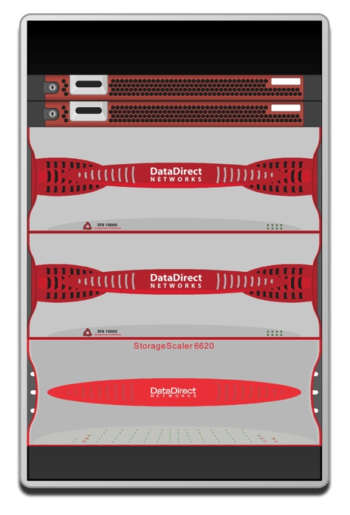
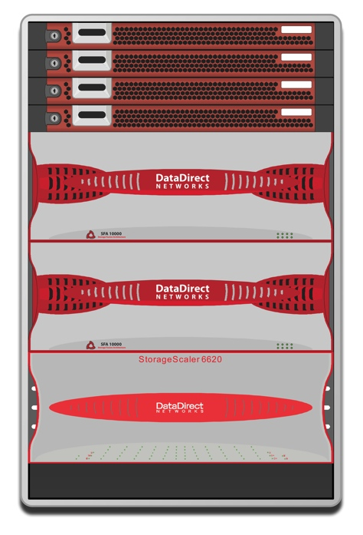
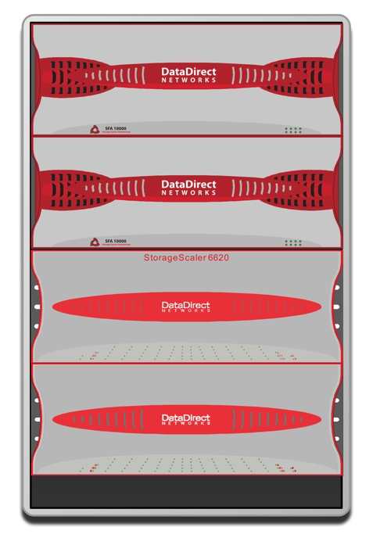

Scalable Building Block Architecture
Allows Seamless and Simple Expansion on Demand
Offers Diagonal Scalability - Scale Up as well as Scale Out
  Individually scale Performance and/or Capacity based on needs
  No hidden licensing or configuration barriers to complicate growth
Build a solution based on your budget - Predictable Growth and TCO
Scale Out
Clustered High Performance File Services
DDN Storage Fusion Architecture Storage Appliance
Scale Up
DDN High-Density
Mixed-Media
Disk Enclosure

Slide 21
The SFA12K Family
SFA12K-20 (Block Appliance)
Highly Parallelized SFA Storage Processing Engine
Active/Active Storage Design
~40GB/s Read & Write Speed
Up to 3.3PB of Disk
1.2+ Million Burst IOPS
700K+ Random Spinning Disk IOPS
850K+ Sustained Random SSD IOPS
32GB+ Mirrored Cache (Protected)
RAID 1/5/6
Intelligent Block Striping
SATAssure Data Protection
GUI, SNMP, CLI, API
8 x FDR IB Host-Ports
8RU Height
16 x 16Gb/s Fibre Channel Host Ports
8 x FDR InfiniBand Host Ports
SFA Interface Virtualization
SFA Interface Virtualization
16-32GB High-Speed Cache
120Gb/s
Cache Link
16-32GB High-Speed Cache
Internal SAS Switching
Internal SAS Switching
480Gb/s Internal SAS Storage Management Network
1
2
3
4
5
6
7
8
P
RAID 5,6
Q
RAID 6
RAID 5,6
1
2
3
4
P
RAID 5,6
Q
RAID 6
SFA RAID 5,6
1
1^{m}
SFA RAID 1

Slide 22
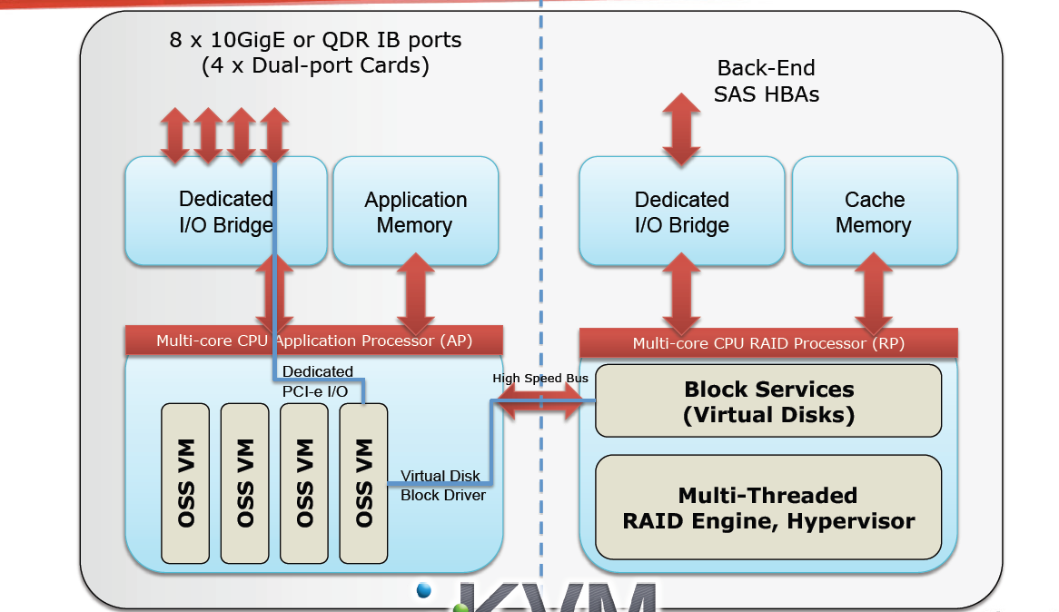

SFA10000 Embedded ExaScaler

Slide 23
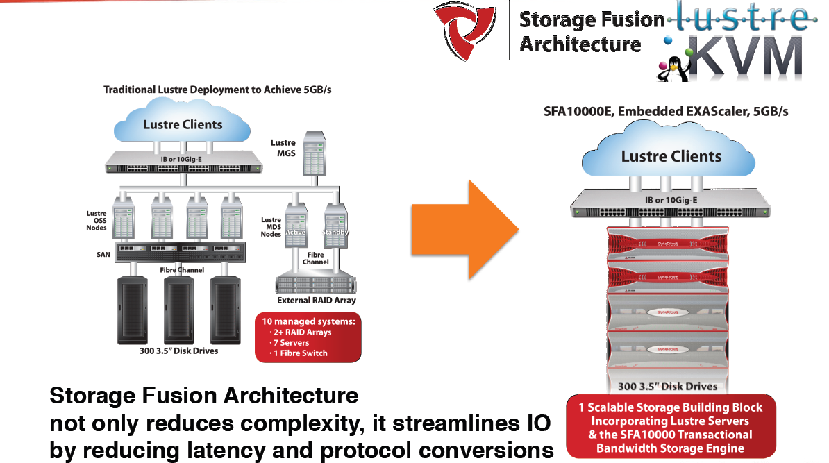
HPC Storage on the SFA10000E Appliance

Slide 24
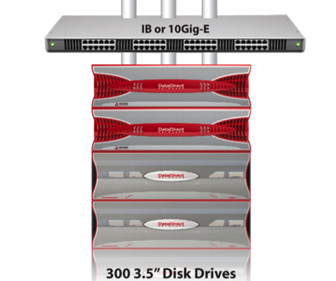
SFA10K-E | Infrastructure Efficiency
Parallel File System Clients
SFA10K-E with embedded File Systems can result in a 10 to 1 or greater reduction in managed systems.
Storage Fusion Architecture
not only reduces complexity, but also streamlines IO by reducing latency and protocol conversion
1 Scalable Building Block Which Incorporates File Services And Eliminates Gateways & Networking for Scale Out

Slide 25
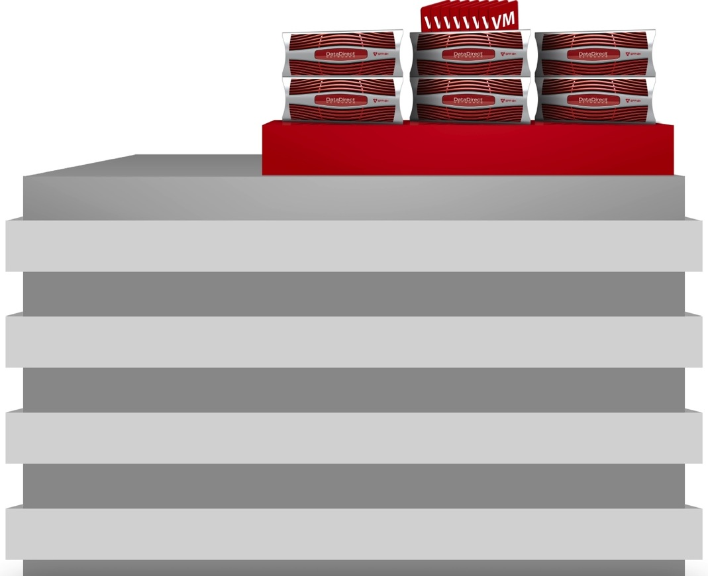

SFA12K™ | Models
SFA12K-20
SFA12K-20E
SFA12K-40
™
Maximum Drives
1,680¹
1,680¹
1,680¹
System Interface
FDR IB
16Gb FC²
FDR IB
10/40GbE
FDR IB
16Gb FC²
Drive Types
3.5” & 2.5” SSD, SAS & SATA (inter-mixable)
System Capacity
6.72PB (w/ 4TB HDDs)¹
Bandwidth
20GB/s
(raw I/O)
20GB/s
(file I/O)
40GB/s
(raw I/O)
Cache IOPS
850K
850K
1.7M
Flash IOPS
700K
700K
1.4M
In-Storage
Processing™
Yes.
ExaScaler, GridScaler
Customer Provided
N/A
N/A
¹ 840 Drives Until 2H12
² 16Gb FC available 2H12

Slide 26
DDN | First in In-Storage Computing
Block Storage
Appliance
File Storage
Appliance
Open Computing
Appliance
SFA12K™-20/40
Block Storage Target
SFA12K-20E
Parallel File Storage
EXAScaler™
GRIDScaler™
SFA12K-20E
Customer Applications
Pre-Processing
Post-Processing
Flexible Deployment Options: 3 System Modalities

Slide 27
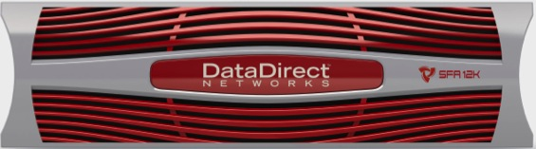
Storage + Processing | Converged
Storage Fusion Processing™
SFA12K-20E Systems Feature Up to 16 Virtual Machines
Support for Linux and Microsoft Windows applications
Highly-optimized virtualization delivers up to 96% efficiency.
Each VM gets dedicated networking for bandwidth & lowest latency
VM
VM
VM
VM
VM
VM
VM
VM
VM
VM
VM
VM
VM
VM
VM
VM
120Gb/s
Cache Link

Slide 28
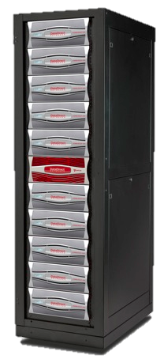
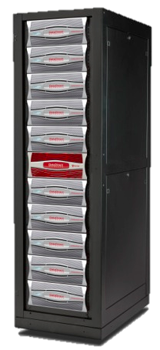
SFA12K™-20E | Parallel File Storage Appliances
SFA12K-20E available with DDN | EXAScaler™ and DDN | GRIDScaler™ parallel file storage solutions
Integrate multiple appliances to scale to over 1000GB/s and 10’s of petabytes
EXAScaler
SFA12K-20E
20GB/s
Up To 5.3PB*
Usable capacity
GRIDScaler
SFA12K-20E
20GB/s
Up To 5.3PB*
Usable capacity
* - Initial release limited to 840 Drives

Slide 29
Thank You
pzhu@ddn.com
13321177500 （中国）
+81-80-3518-9101 （全球）

