Slide 1
Nano-hertz gravitational waves
and cosmic phase transition
Jin Min Yang
Institute of Theoretical Physics, CAS;
School of Physics, Henan Normal University
International Workshop on New Opportunities for Particle Physics
2024.7.20

Slide 2
based on:
Implications of nano-Hertz gravitational waves on electroweak phase transition in the singlet dark matter model，
Yang Xiao, JMY, Yang Zhang， 2307.01072
Self-interacting dark matter implied by nano-Hertz gravitational waves，
Chengcheng Han, Kepan Xie, JMY, Mengchao Zhang, 2306.16966

Slide 3
Outline
1 Introduction
2 Cosmic phase transition and gravitational waves
3 Nano-hertz gravitational waves in xSM (SM+singlet)
4 Nano-hertz gravitational waves in a SIDM model
5 Summary
03/38

Slide 4
1 Introduction
particle physics
gravitational waves
cosmic
evolution
cosmic
phase transition
gravitational waves
bubble
collision
sound waves
04/38

Slide 5
Cosmic evolution is one frontier of particle physics
The current frontiers of particle physics
-- P5 （Particle Physics Project Prioritization Panel）
Higgs
Dark
Matter
Cosmic
Evolution
Neutrino
05/38

Slide 6
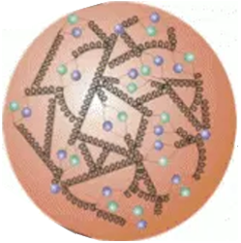
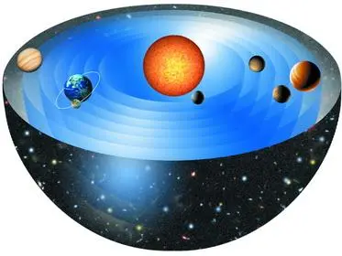
Cosmic evolution is one frontier of particle physics
-- An interdisciplinary topic of particle physics and cosmology
The natural world does not recognize the artificial separation of academia into traditional disciplines.
— David Gross
Nature 467, s8, 14 Oct 2010

Slide 7
2 Cosmic phase transition and gravitational waves
hot
hot
热宇宙
cold
cold
冷宇宙
06/38

Slide 8
We need a first order phase transition for EW baryogenesis
hot
热宇宙
cold
冷宇宙
07/38

Slide 9
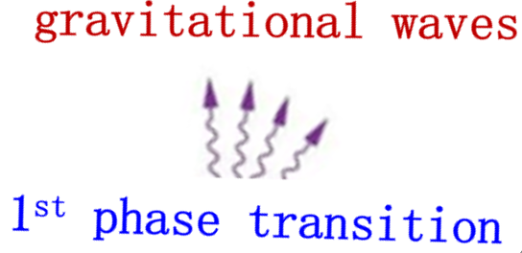
hot
hot
热宇宙
cold
冷宇宙
08/38

Slide 10
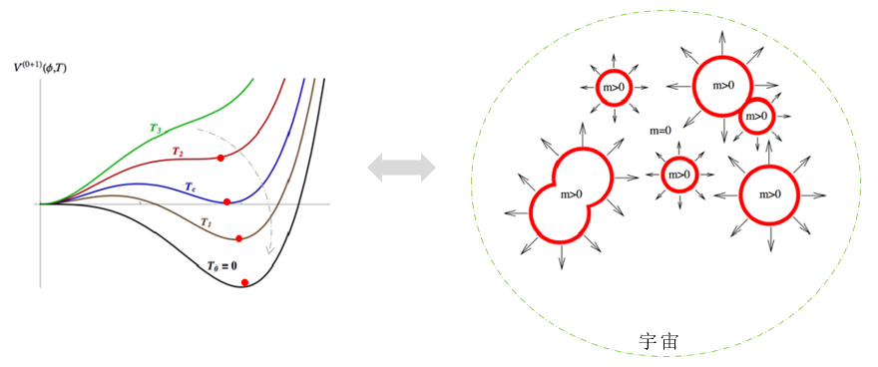
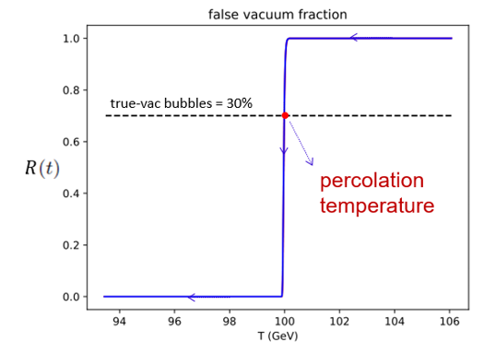
$T_{C}:$ critical temperature (two minimums become degenerate)
$T_{N}:$ nucleation temperature (nucleate a supercritical bubble within one Hubble volume)
$T_{P}:$ percolation temperature (nucleated bubbles of true vacuum occupy nearly 30% of the space)
09/38

Slide 11
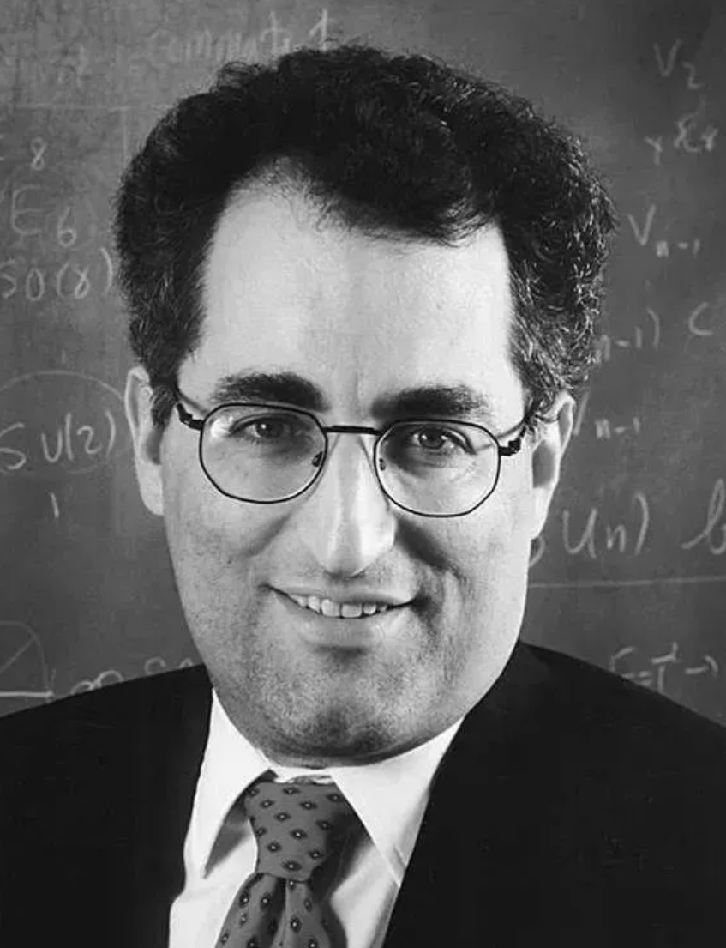
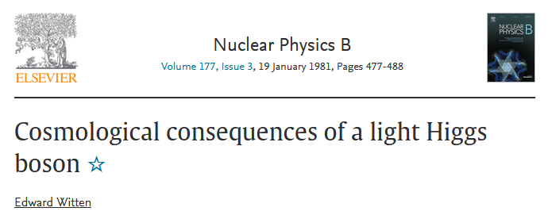
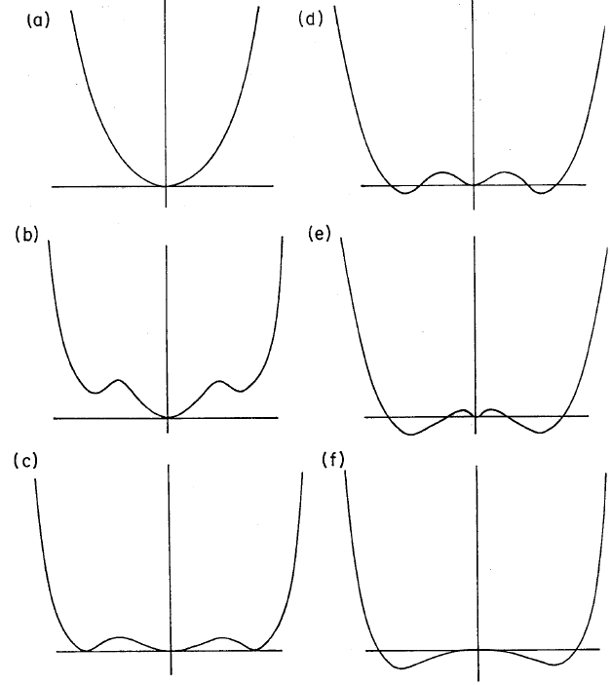
SM
For a light Higgs below 75 GeV,
we can have a first order phase transition
10/38

Slide 12
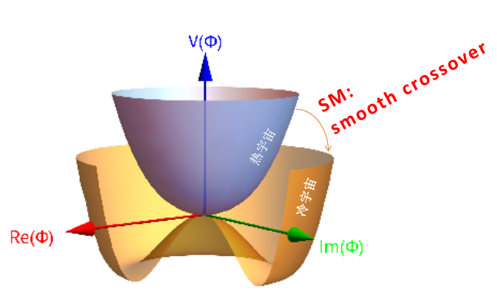
SM
But now the Higgs is 125 GeV
SM just gives a smooth crossover
11/38

Slide 13
So we need new physics for cosmic evolution
We need new physics to generate first-order phase transition
hot
热宇宙
cold
冷宇宙
12/38

Slide 14
A simple extension of SM for cosmic evolution: xSM
Silveira, Zee，PLB161(1985)136
Extend SM by a real singlet scalar with $Z_{2}$-symmetry
SM + a real singlet scalar
Everything should be made as simple as possible, but not simpler
凡事都应当尽可能地简单，而不是较为简单
切勿浪费较多东西去做用较少的东西同样可以做好的事情
—— Albert Einstein
13/38

Slide 15
A simple extension of SM for cosmic evolution: xSM
Extend SM by a real singlet scalar with $Z_{2}$-symmetry
SM + a real singlet scalar
This new simple BSM model, which contains dark matter (a singlet scalar field), can explain the abundance of dark matter in the Universe.
It couples the dark matter (a singlet scalar field) to the Higgs field, extends the Higgs potential and produces a first-order electroweak phase transition
14/38

Slide 16
A simple extension of SM for cosmic evolution: xSM
Extend SM by a real singlet scalar with $Z_{2}$-symmetry
SM + a real singlet scalar
Total effective potential
tree-level effective potential
one-loop corrections
one-loop temperature correction
15/38

Slide 17
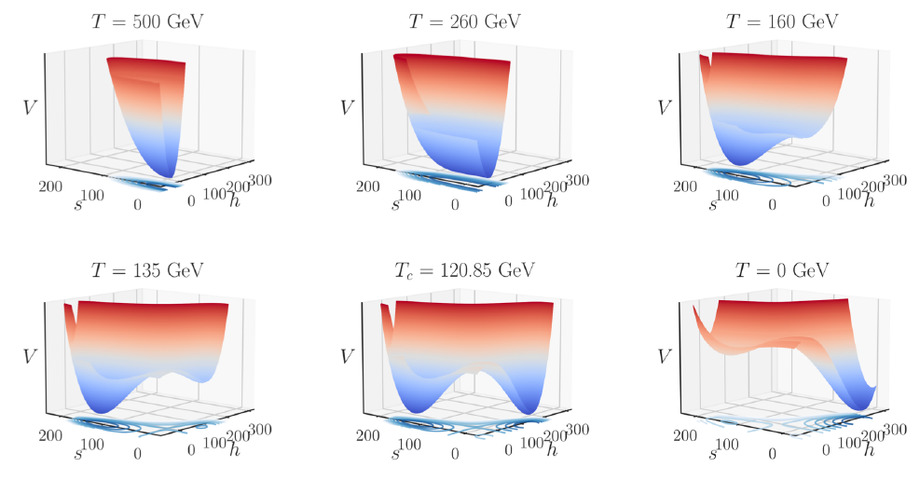
A simple extension of SM for cosmic evolution: xSM
EW-FOPT :
16/38

Slide 18
Nano-hertz gravitational waves in xSM
Yang Xiao, JMY, Yang Zhang， 2307.01072
17/38

Slide 19
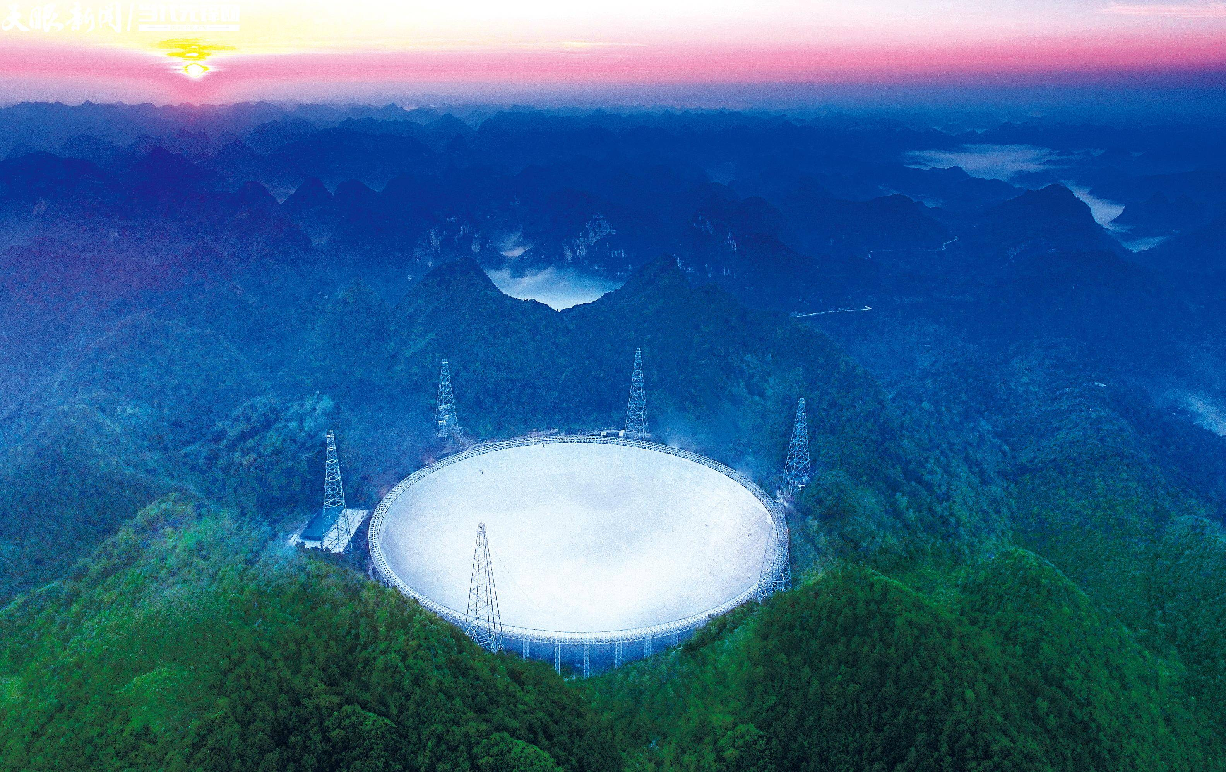
FAST
tourist attraction
18/38

Slide 20
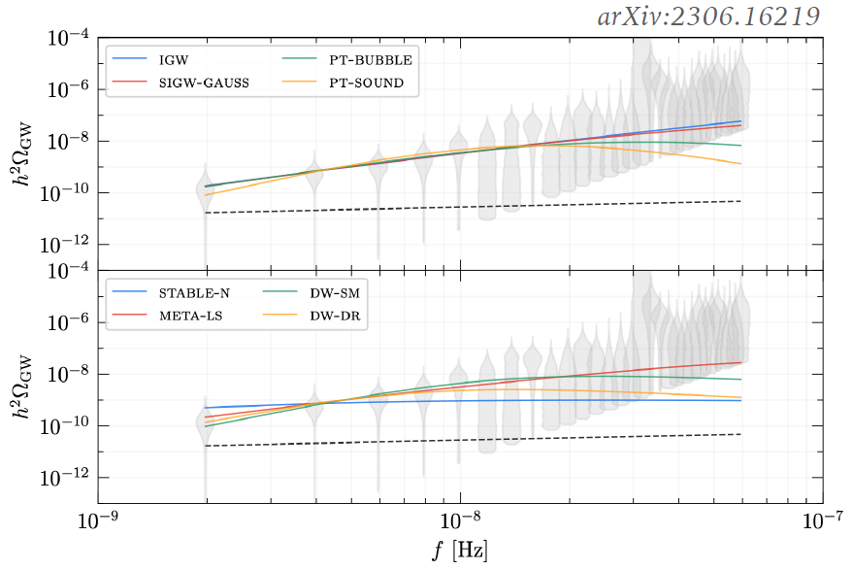
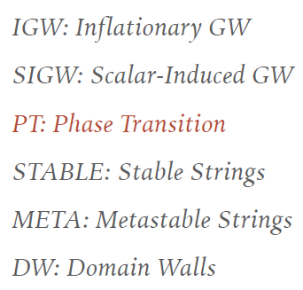
Among various explanations, cosmic phase transition is one of them, which is most interesting and most relevant to particle physics.
To generate such a phase transition, the SM is not enough and we need to extend the SM.
19/38

Slide 21
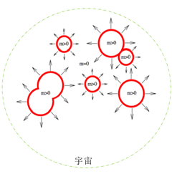
A simple extension of SM for cosmic evolution: xSM
bubble collision
spectrum of GW generated by bubble collision（GW energy density / Universe energy density ）
wave peak of the spectrum
Temperature of phase transition
strength factor of phase transition, the ratio of vacuum energy density released by phase transition to the energy density of the background radiation
average spacing of bubbles in unit Hubble radius
20/38

Slide 22
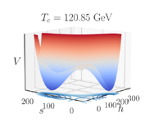
A simple extension of SM for cosmic evolution: xSM
bubble collision
spectrum of GW generated by bubble collision（GW energy density / Universe energy density ）
EW-FOPT in xSM
wave peak of the spectrum
$T_{C}$is too high
Temperature of phase transition
strength factor of phase transition, the ratio of vacuum energy density released by phase transition to the energy density of the background radiation
average spacing of bubbles in unit Hubble radius
21/38

Slide 23
A simple extension of SM for cosmic evolution: xSM
Huber,Konstandin,
0806.1828
bubble collision
spectrum of GW generated by bubble collision（GW energy density / Universe energy density ）
supercooled EW-FOPT
wave peak of the spectrum
Temperature of phase transition
strength factor of phase transition, the ratio of vacuum energy density released by phase transition to the energy density of the background radiation
The critical temperature is about 100 GeV, while the percolation temperature can be as low as 1 GeV, similar to the freezing phase transition of supercooled water
average spacing of bubbles in unit Hubble radius
22/38

Slide 24
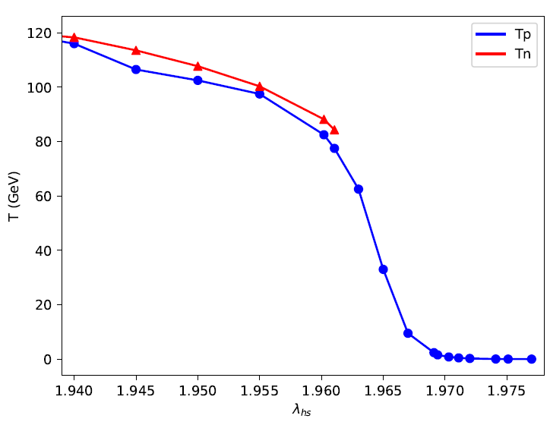
A simple extension of SM for cosmic evolution: xSM
supercooled EW-FOPT
23/38

Slide 25
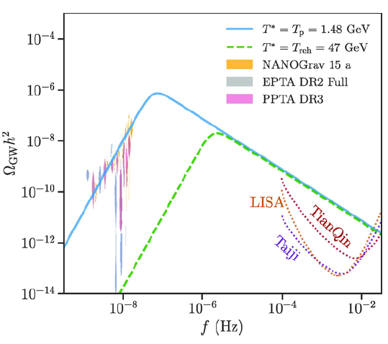
A simple extension of SM for cosmic evolution: xSM
supercooled EW-FOPT
nano-hertz gravitational wave
Note that the energy released during the supercooled phase transition may heat up the surrounding plasma and cause a shift in the peak frequency of the stochastic GW background.
As studied in 2306.17239 (Athron, Fowlie, Lu, Morris, Wu), the reheating temperature is estimated to be approximately at the energy scale of the new physics, assuming conservation of energy density during the reheating process.
Meanwhile, as pointed in 2109.06208 (Ertas, Kahlhoefer, Tasillo), the entropy injection of phase transition could lead to a strong dilution of the GW signal. Consequently, the peak frequency of the GW background will undergo a red-shift from the desired nano-Hertz range.
We illustrate this shift by the green dashed-line, with a simplified estimate of Treh ≈ 47 GeV
24/38

Slide 26
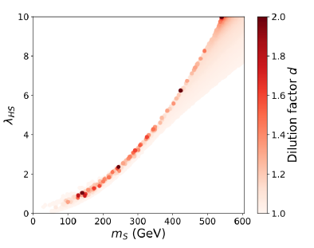
A simple extension of SM for cosmic evolution: xSM
supercooled EW-FOPT
dilute relic density of DM
The freeze-out of DM may occur before the completion of the phase transition, and thus the DM density can be diluted by the entropy release during the first-order phase transition
25/38

Slide 27
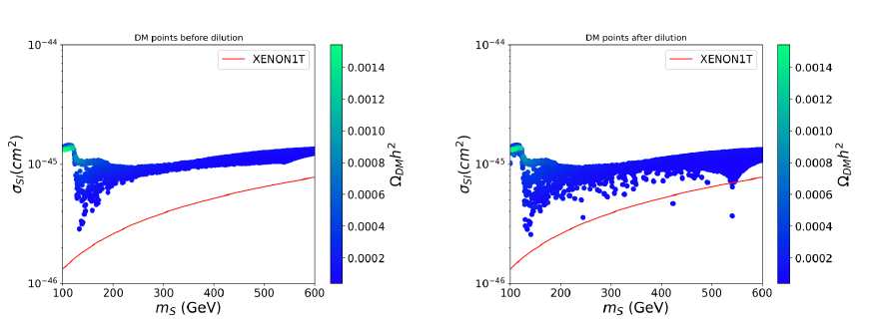
A simple extension of SM for cosmic evolution: xSM
supercooled EW-FOPT
dilute relic density of DM
26/38

Slide 28
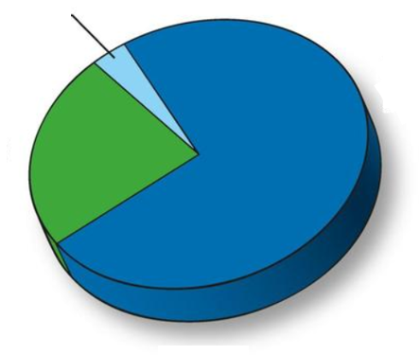
Chengcheng Han, Kepan Xie, JMY, Mengchao Zhang, 2306.16966
Nano-hertz gravitational wave in a SIDM model
-- Self-interacting dark matter (SIDM)
27/38

Slide 29
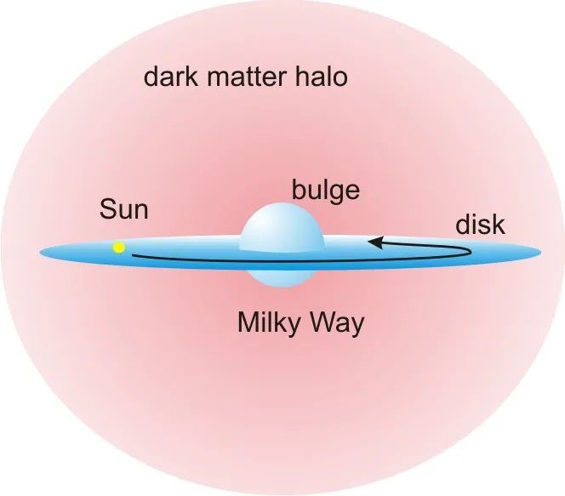
Self-interacting dark matter (SIDM)：
Small-scale structure problems: discrepancies between astrophysical observations and the simulation of collision-less CDM at the scale smaller than O(1) Mpc. For example, the diversity of inner rotation curves of spiral galaxies is difficult to be explained by CDM and also the too-big-to-fail problem (collision-less CDM could form very big (massive) subhalos in Milky Way, which are too big to fail to attract baryons to form very bright stars).
28/38

Slide 30
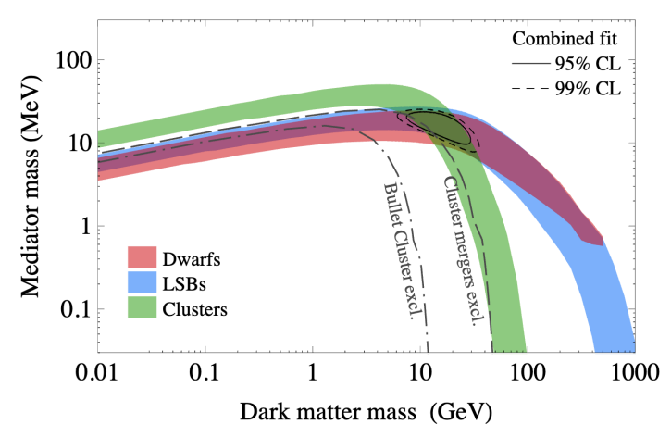
Self-interacting dark matter (SIDM)：
SIDM offers a potential solution to small-scale structure problems faced by the collision-less cold dark matter.
DM particles interact through short-range forces mediated by a new particle called “dark mediator,” typically with a mass of MeV.
Kaplinghat, Tulin, Yu, 2016
29/38

Slide 31
Self-interacting dark matter (SIDM)：U(1)-SIDM
U(1)-SIDM model: the mediator $A’$ is the gauge boson of a spontaneous broken dark U(1) gauge symmetry.
The breaking of this U(1) is through a FOPT in the early Universe, which generates the Nano-hertz gravitational waves.
30/38

Slide 32
Self-interacting dark matter (SIDM)：U(1)-SIDM
is the dark scalar field
31/38

Slide 33
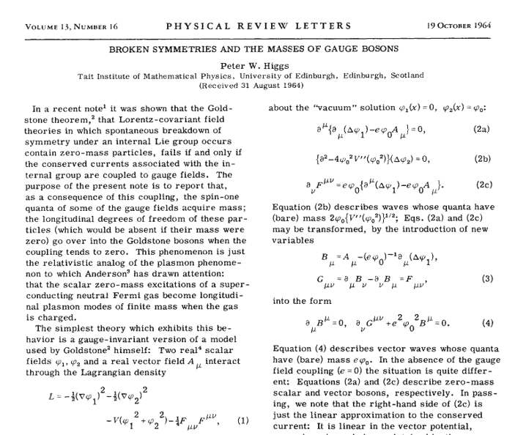
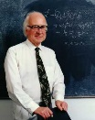
Self-interacting dark matter (SIDM)：U(1)-SIDM
similar to the work by Higgs

Slide 34
Self-interacting dark matter (SIDM)：U(1)-SIDM
DM with mass O(10) GeV and a mediator (dark photon) with mass O(10) MeV can well fit the DM data from dwarf galaxies to galaxy clusters
In this model, for $v_{s}$ ∼ O(10) MeV and $g′$∼ O(1), a mediator mass around 10 MeV can be easily generated.
On the other hand, the MeV scale of $v_{s}$indicates a phase transition at a temperature around MeV.
The one-loop finite temperature potential:
33/38

Slide 35
Self-interacting dark matter (SIDM)：U(1)-SIDM
Some benchmark points
So we see in this model for an O(1) gauge coupling, the DM mass is of GeV scale, the mediator (dark photon) mass and the dark-Higgs mass are of MeV scale, the transition temperature is around MeV
34/38

Slide 36
Self-interacting dark matter (SIDM)：U(1)-SIDM
The sound wave contribution to GWs：
Hindmarsh, Huber, Rummukainen, Weir, 1504.03291
The peak frequency：
35/38

Slide 37
Self-interacting dark matter (SIDM)：U(1)-SIDM
Velocity-dependent DM elastic scattering cross sections (left) and GW spectra (right) for our benchmark points
36/38

Slide 38
6 Summary
EW-FOPT: Supercooled electroweak first-order phase transition, e.g., in xSM, where the percolation temperature can be below 1 GeV, can explain the nano-hertz gravitational waves (but with reheating problem)
Dark sector-FOPT: The potential of a dark scalar of self-interacting dark matter（e.g., U(1)-SIDM）can undergo a first-order phase transition at the temperature around MeV, which can generate nanohertz gravitational waves
37/38

Slide 39
Thanks for your attention！

