Slide 1
Group meeting
2024.04.03
Rui Wen

Slide 2
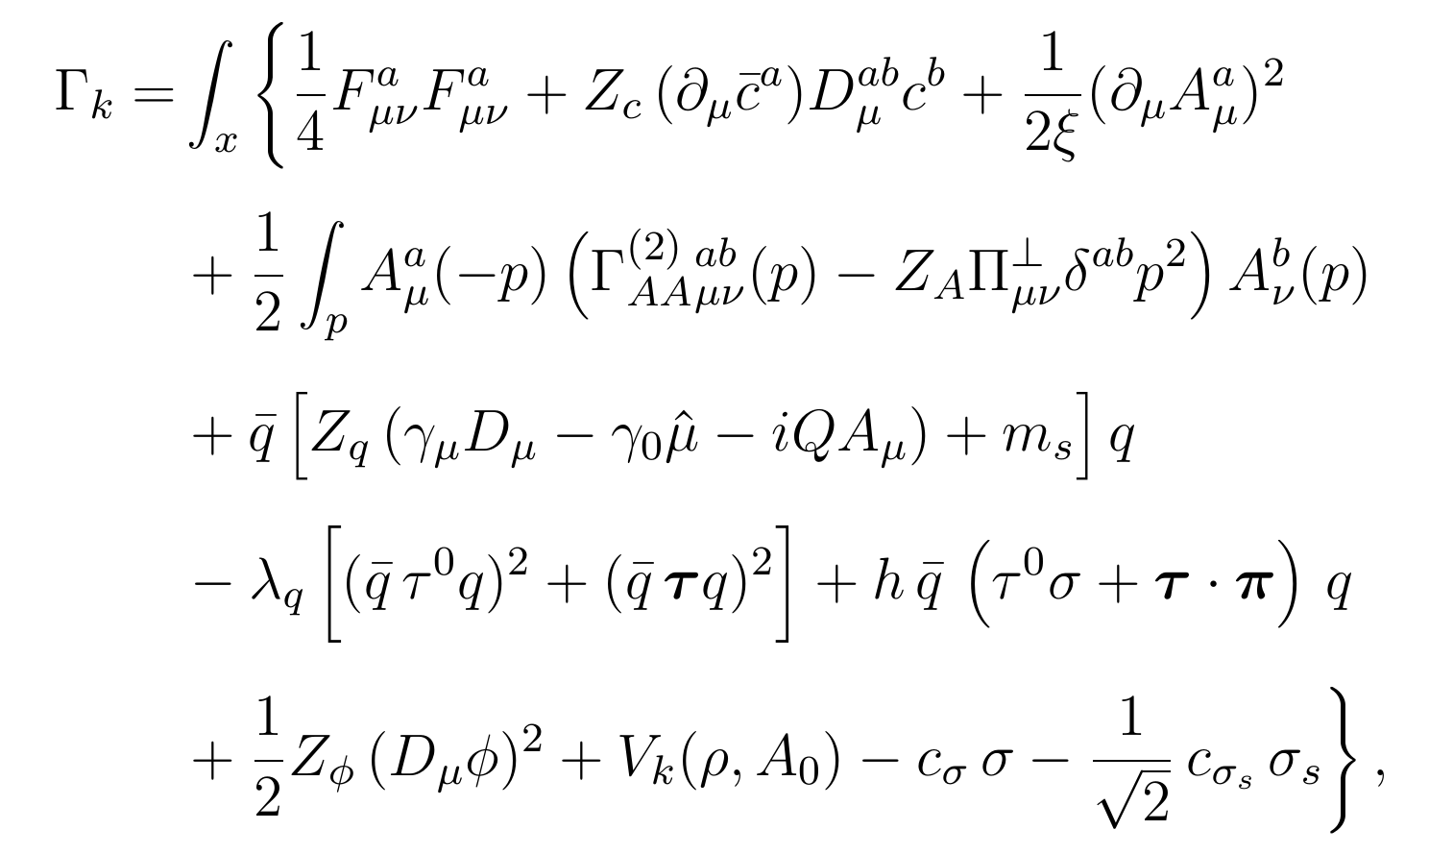





The Euclidean scale-dependent effective action
gluon
Nonclassical gluon two-point function
The mesonic effective potential
Polyakov loop potential
Linear sigma term
Explicitly break chiral symmetry
mesonic field
Improvement of
Wei-jie Fu, Jan M. Pawlowski, Fabian Rennecke arXiv:1909.02991

Slide 3


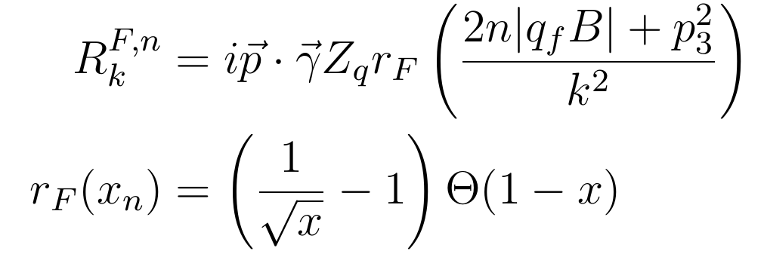


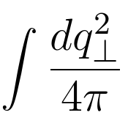
The quark propagator in magnetic fields
pseudo 3d regulator

Slide 4
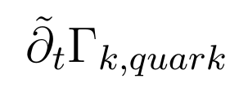

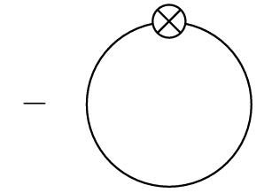

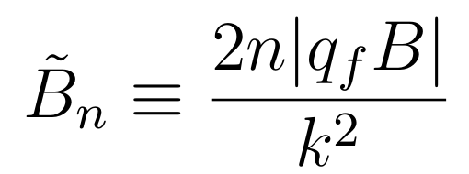




Check pseudo 3d regulator
ignore
PQM model
$$B→0$$
Standard 3d regulator

Slide 5


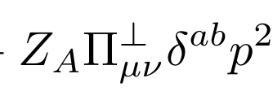
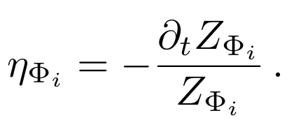

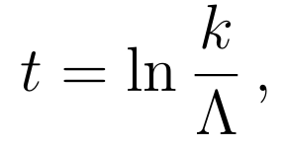
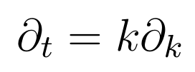




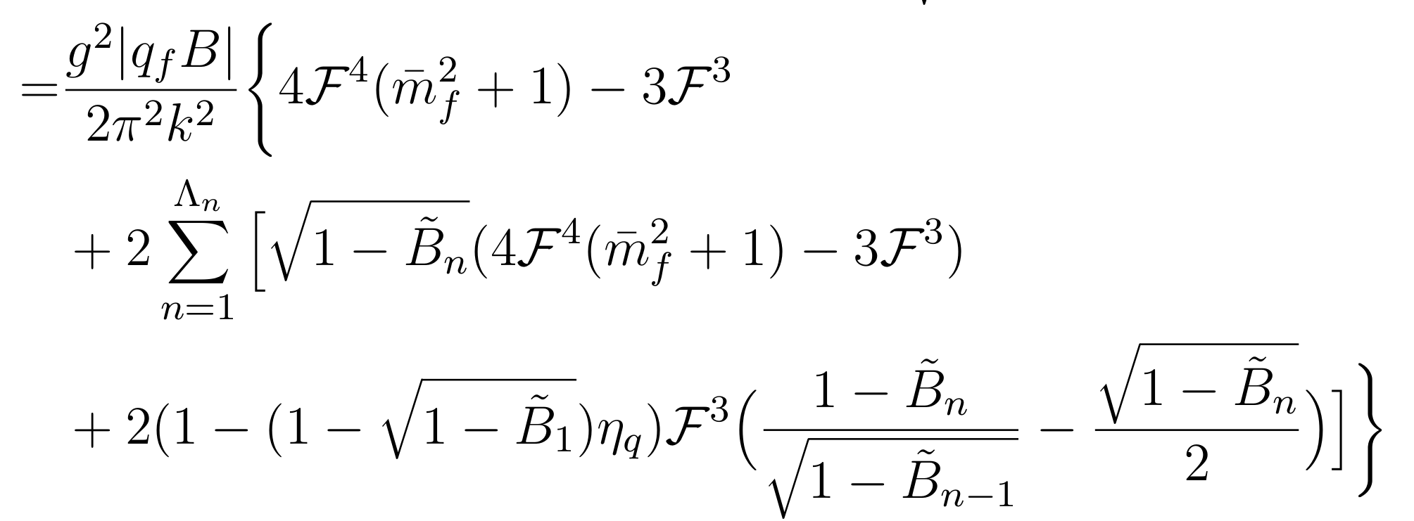




$$B→0$$

Slide 6
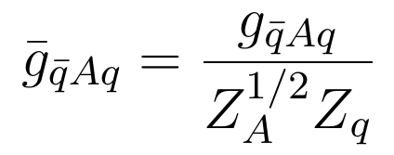

Results
$$T=0$$
Not calculate the three-point functions.

Slide 7

Still MC
The meson mass are almost unchange
in the future Check

