Slide 1




The LHCspin Project
A Polarized Gas Target for the LHC
Rahul Shankar
University of Ferrara and INFN, Italy
on behalf of the LHCspin working group

Slide 2
Progression
Motivation
Current Status
Project Goals
Physics perspective
Why LHCb?
SMOG2
Timeline and Summary
A new generation of fixed-target experiments
Perspective for the future
Storage-cell development
Absolute Polarimeter
Early Results
Why fixed-target?

Slide 3
Motivation
Physics that Polarized Interactions could help unravel

Slide 4
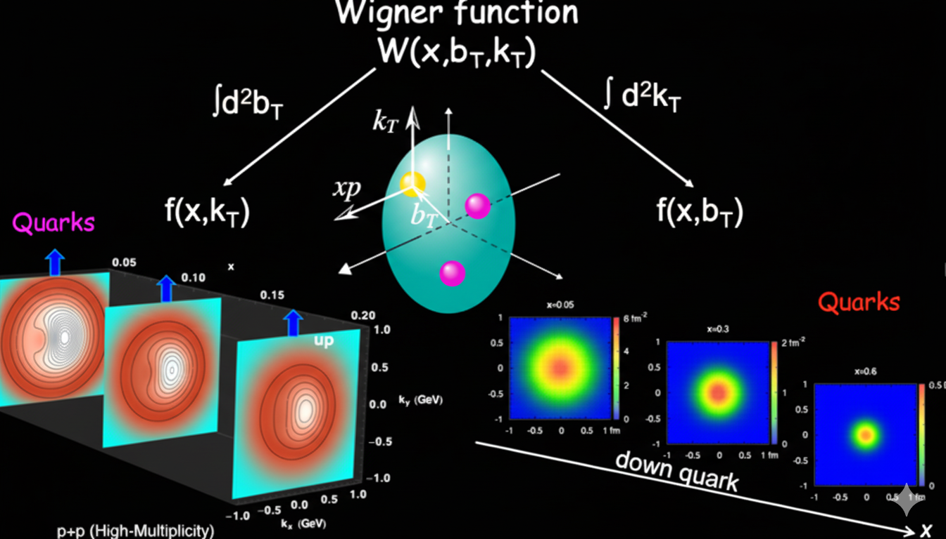
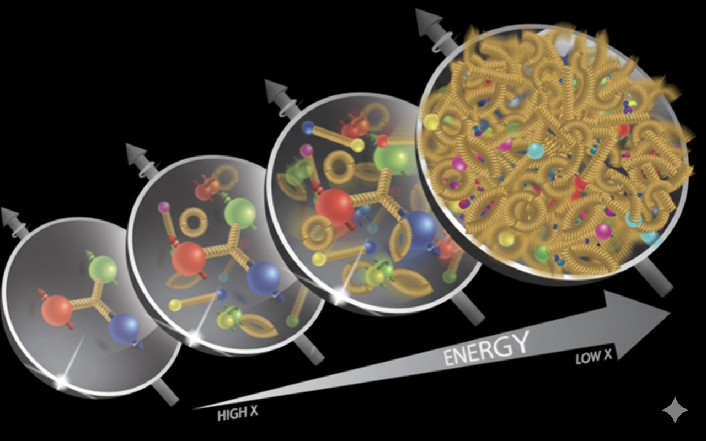
Physics Perspectives
Hadron Tomography
Hadron Structure

Slide 5
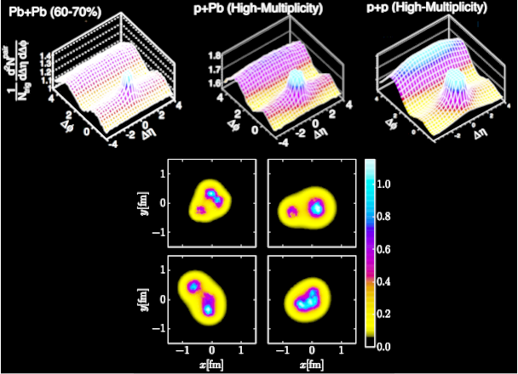
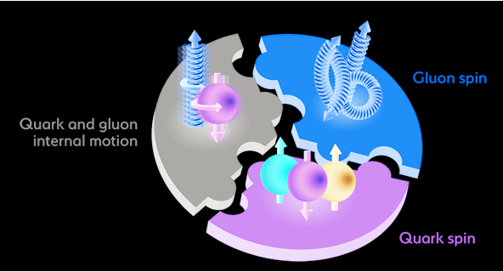
Physics Perspectives
Collective Phenomena
Spin Structure

Slide 6
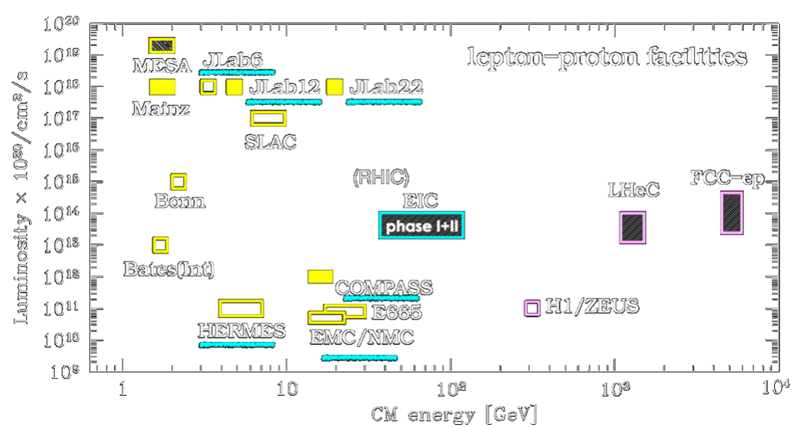

Past, Present and Future experiments with polarization
Issues with LHC:
LHC Beams cannot be polarized
Polarized fixed-target: only option for polarized collisions

Slide 7
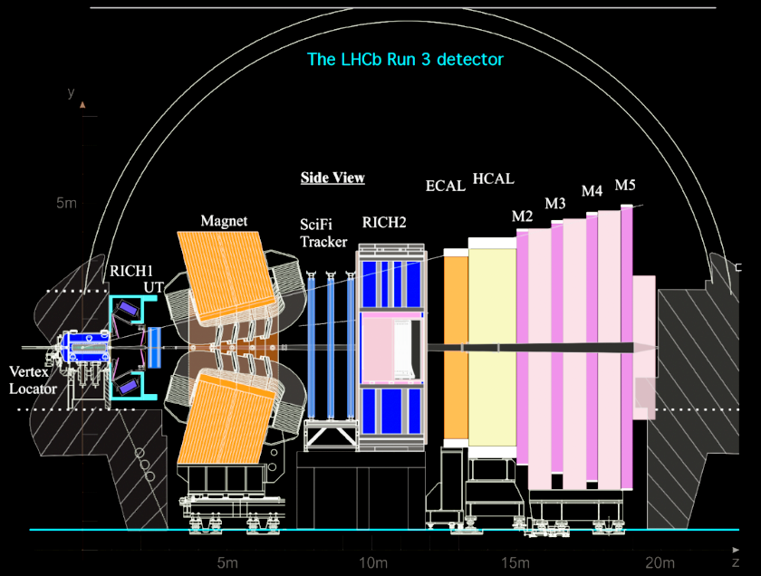
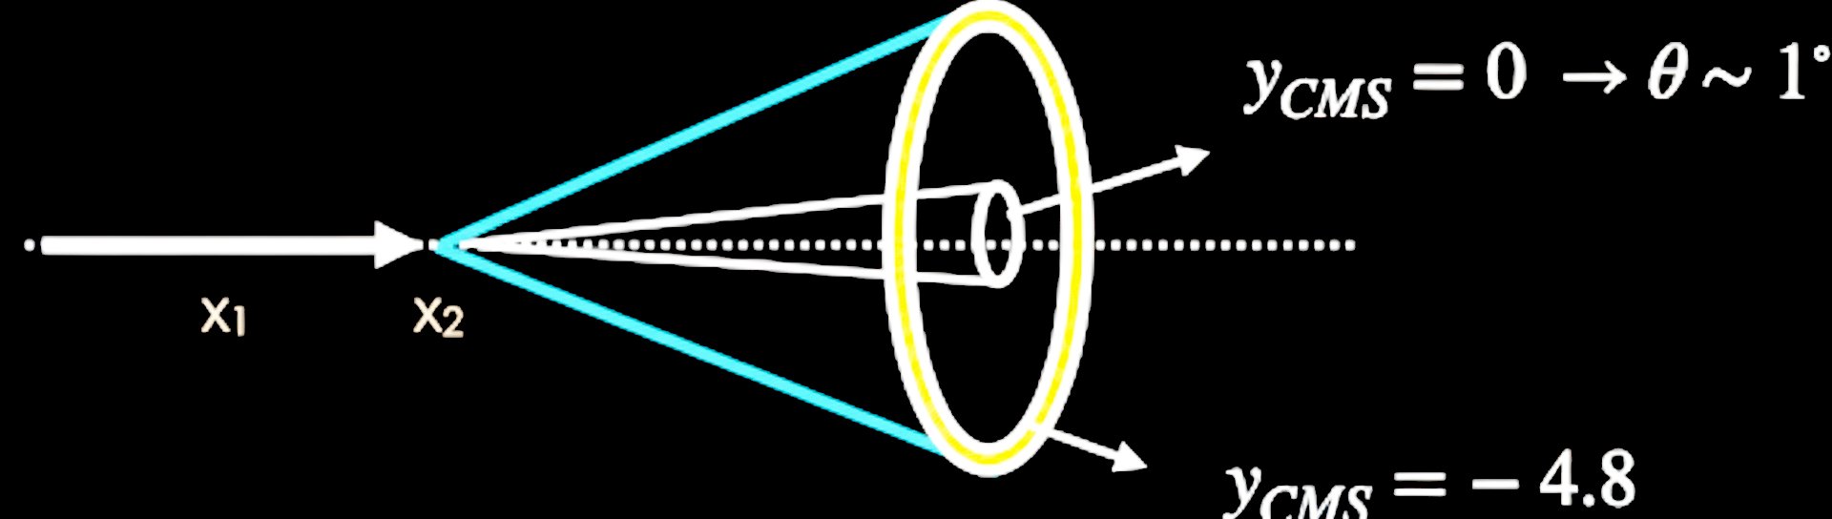
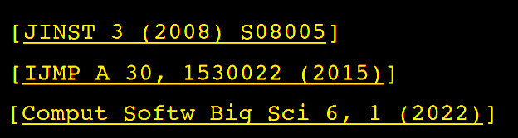

The LHCb detector
…ideal for fixed target experiments
Fixed Target
LHCb is a general purpose forward spectrometer optimized for $c$ and $b$ hadron detection in the $2<η<5$ region.
Major detector upgrades performed during the LS2 for the Run 3 with 5x luminosity.

Slide 8
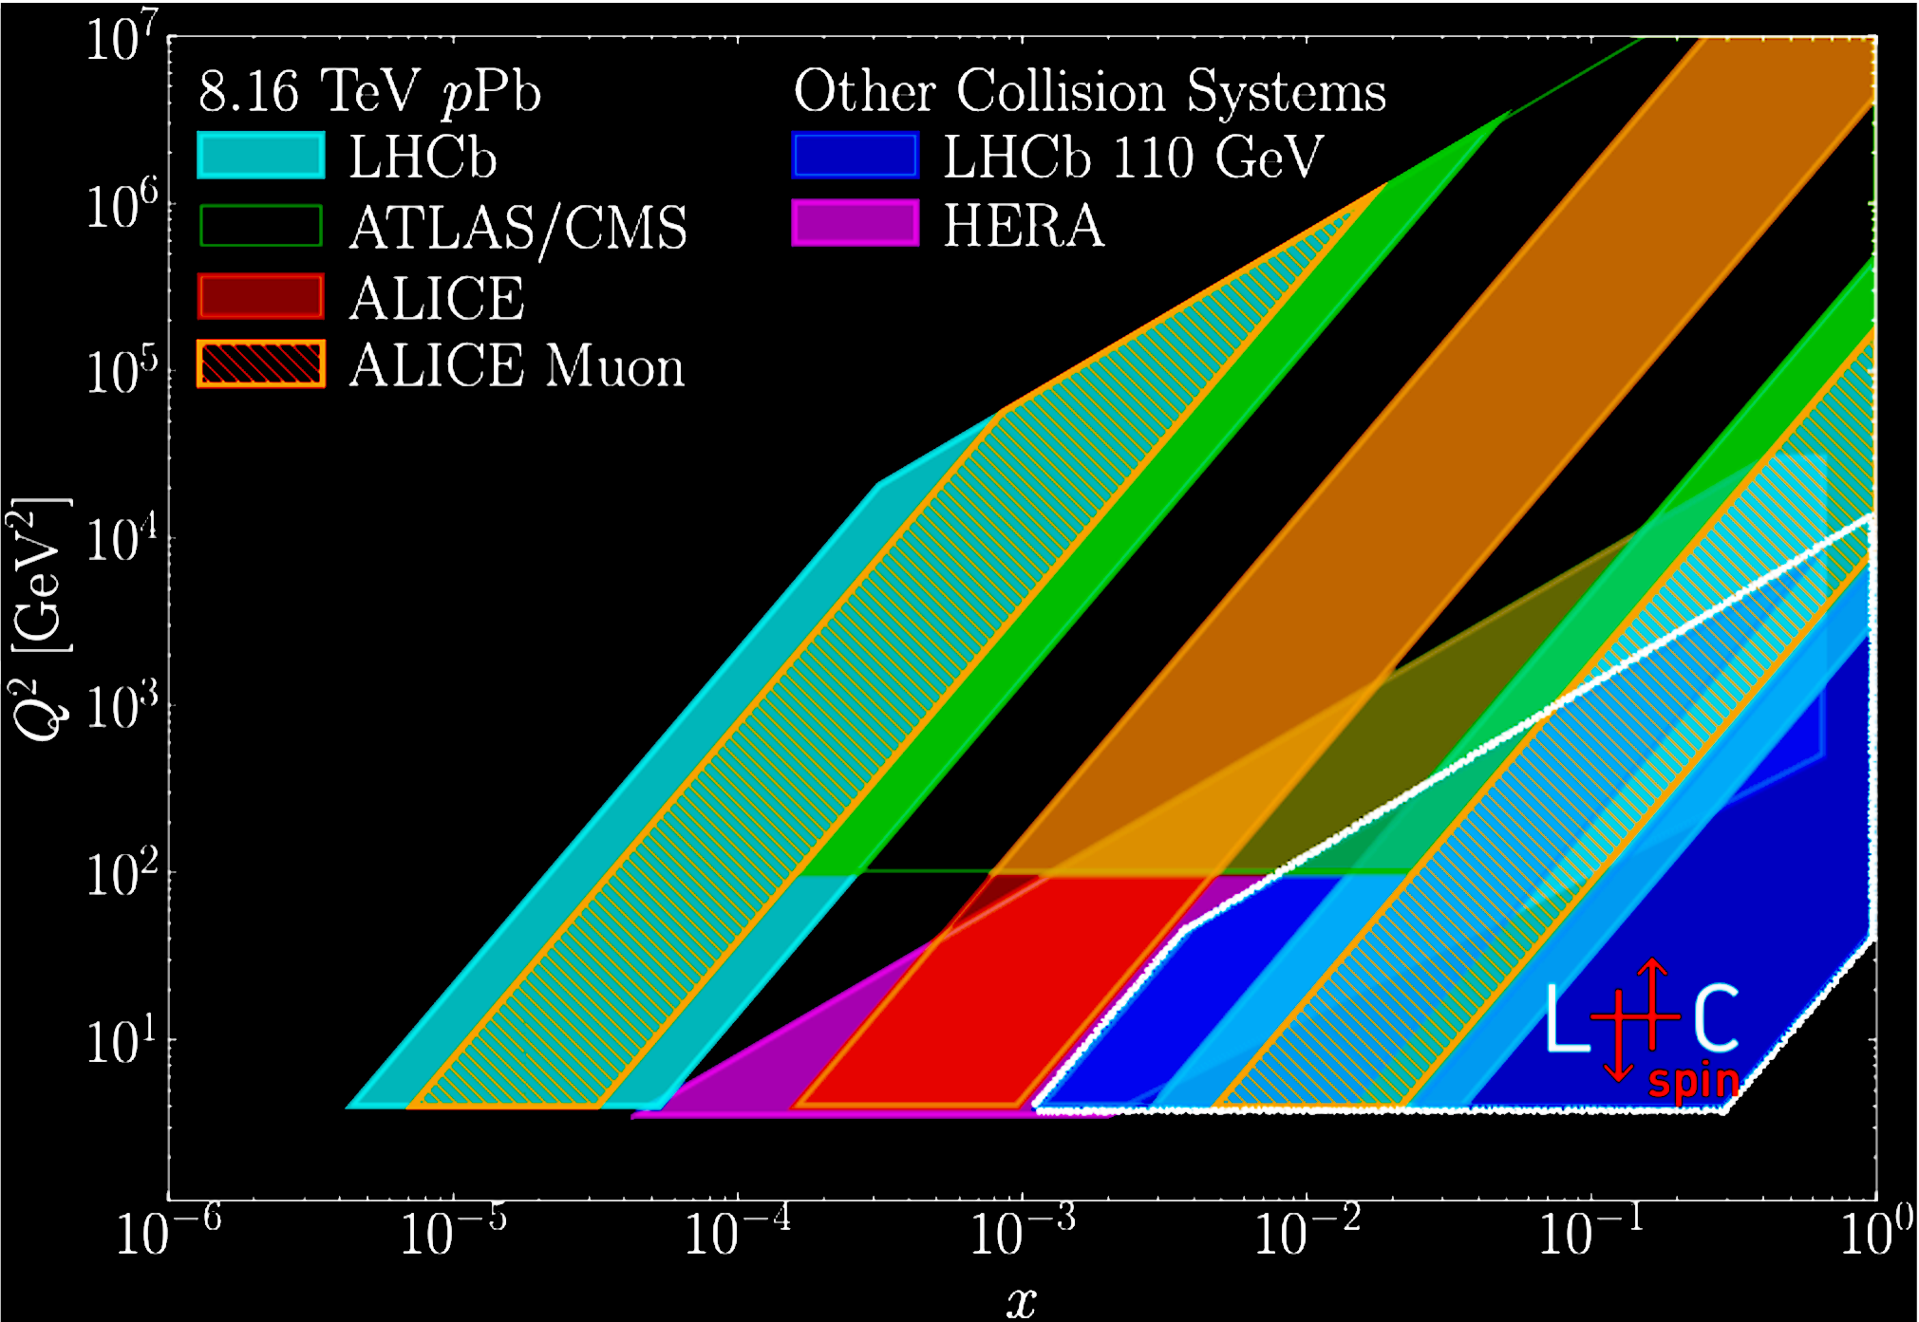
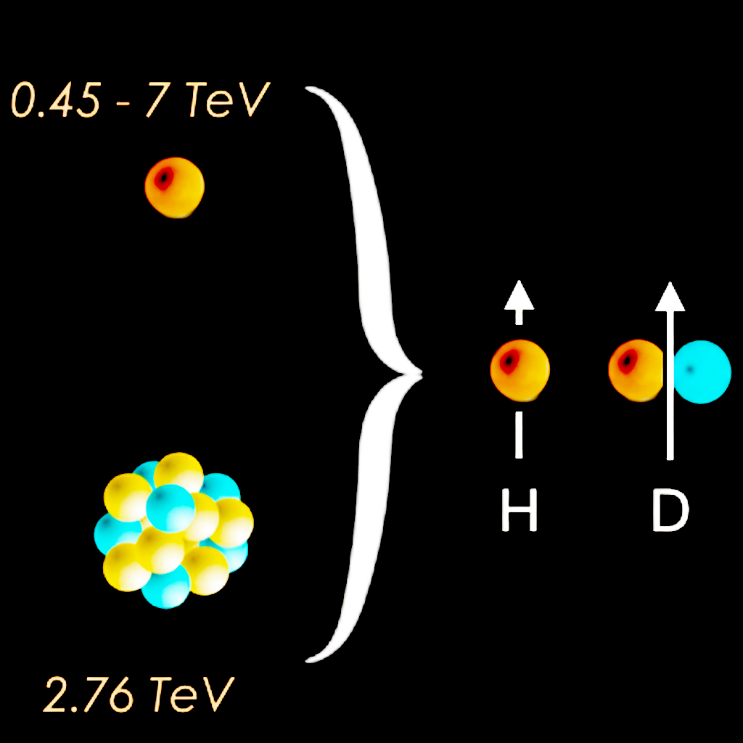
The LHCb detector
…ideal for fixed target experiments
A detector that is ideal for a fixed-target experiment.
An avenue to investigate a broad and poorly explored kinematic range.

Slide 9
The current status of LHCspin
The SMOG2 apparatus and early results

Slide 10
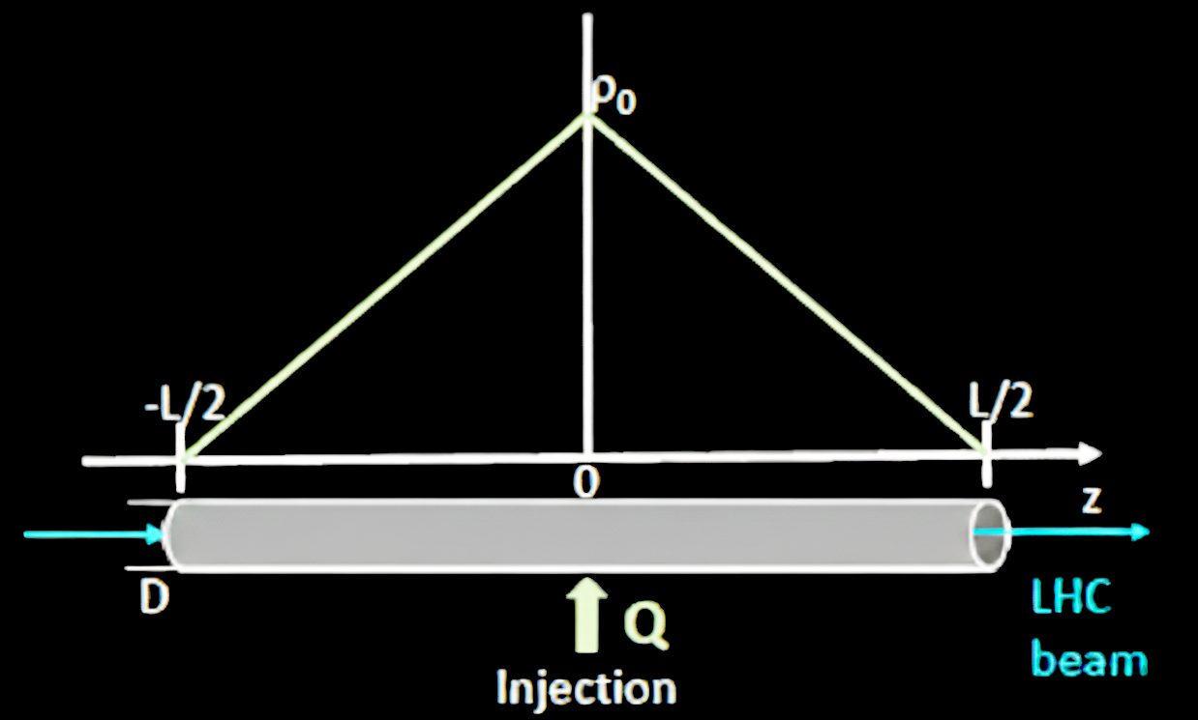
A Storage-Cell Gas Target
Higher density of gas compared to jet targets
Higher luminosity in fixed target experiments by up to a factor of 40.

Slide 11
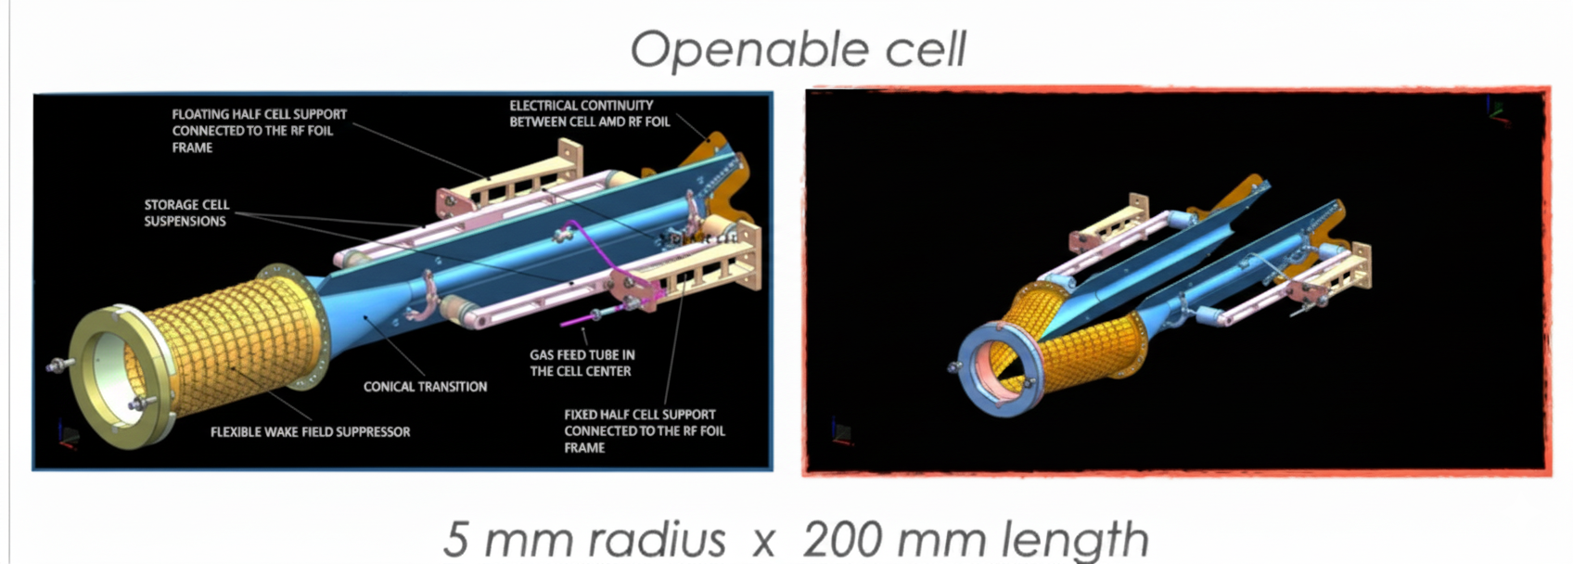
The SMOG2 Apparatus
Open
Closed
JINST 3 (2008) S08005
IJMPA 30 (2015) 1530022

Slide 12

The SMOG2 Apparatus
Advanced Gas Feed System for the gas injection
Negligible impact on the beam lifetime: $τ_{beam−gas}^{p−H_{2}}\sim 2000 d$, $τ_{beam−gas}^{Pb−Ar}\sim 500 h$ (to be compared with typical beam lifetimes of $10 h$ at LHC)
Injectable gases (4 reservoirs): $H_{2}$, $D_{2}$, $N_{2}$, $O_{2}$, $He$, $Ne$, $Ar$, $Kr$, $Xe$
Flux known with 1% precision, measured relative contamination of ${10}^{−4}$
JINST 3 (2008) S08005
IJMPA 30 (2015) 1530022

Slide 13
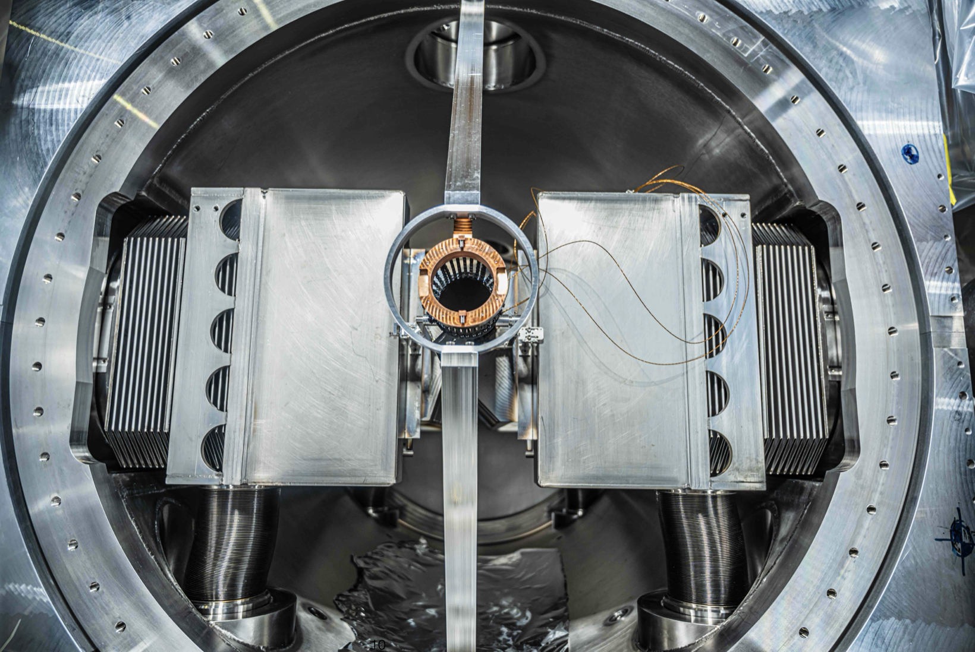
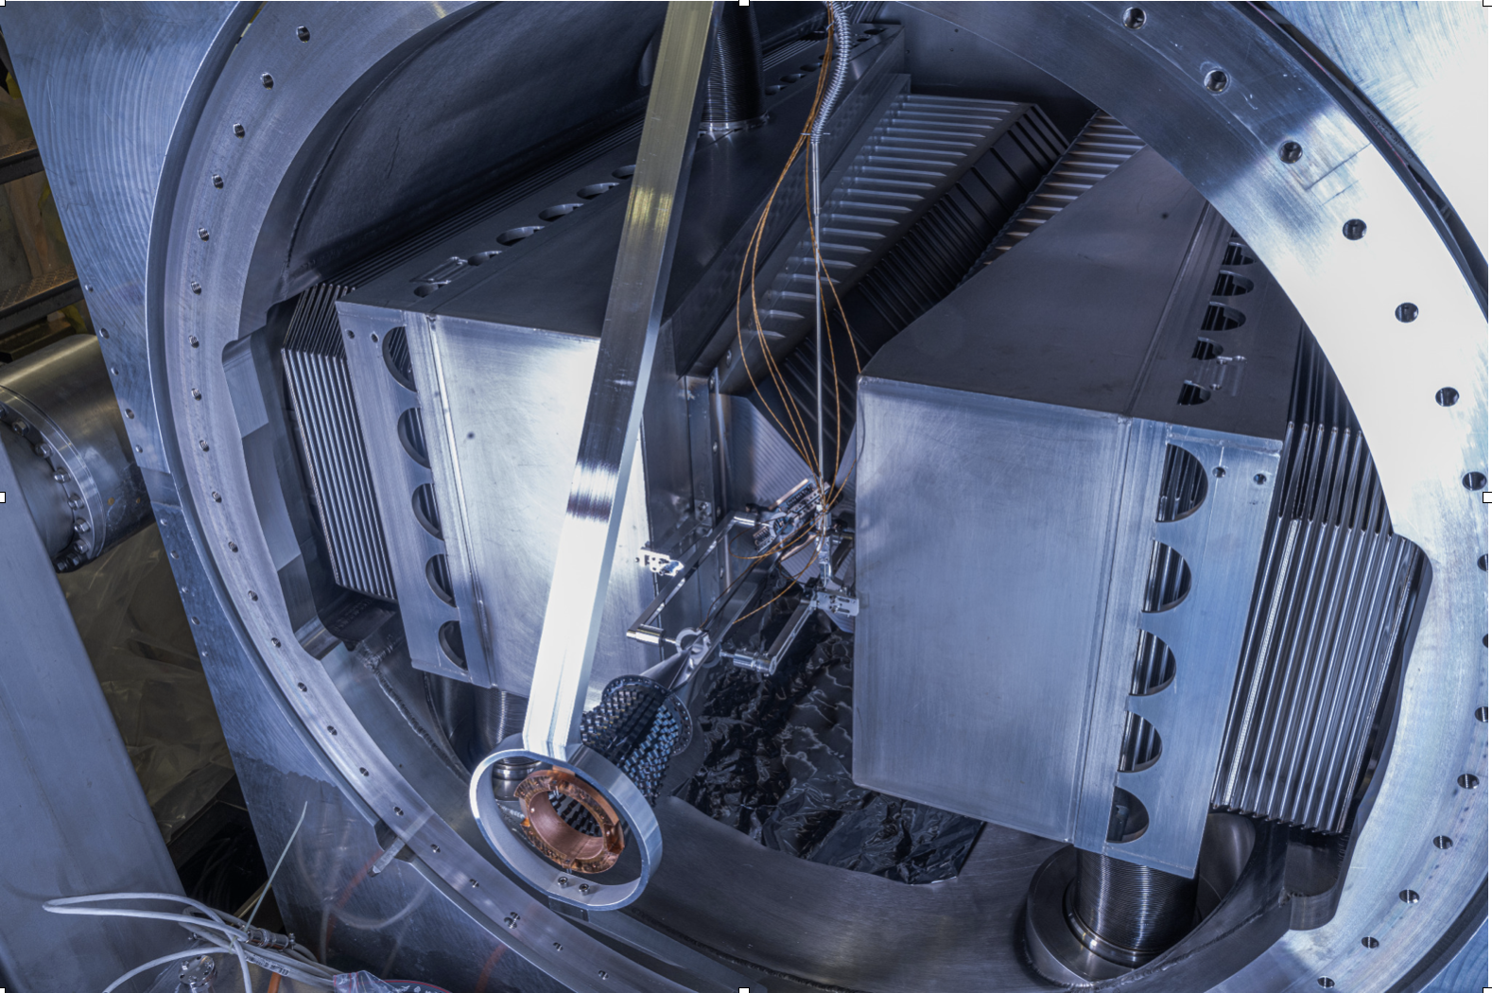
SMOG2 at the LHCb
The only system in the LHC primary vacuum
High-density gas target at the LHCb experiment PHYSICAL REVIEW ACCELERATORS AND BEAMS 27, 111001 (2024)

Slide 14
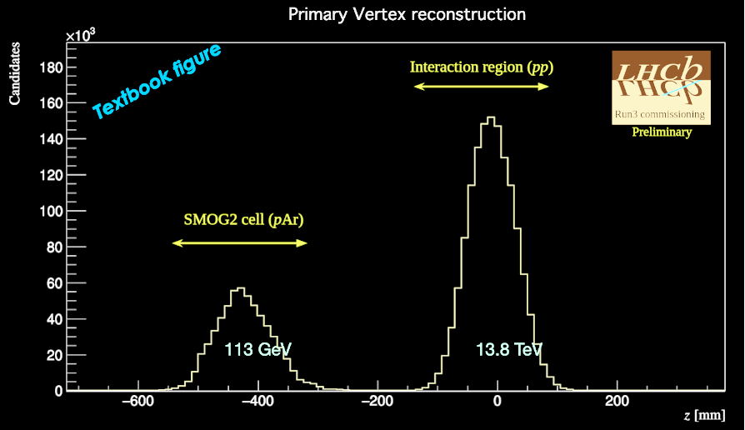
Beam-Beam vs. Beam-Gas
Vertex Distributions
beam-beam and beam-gas interactions well detached
This makes LHCb the only experiment able to run in collider and fixed target modes simultaneously.

Slide 15
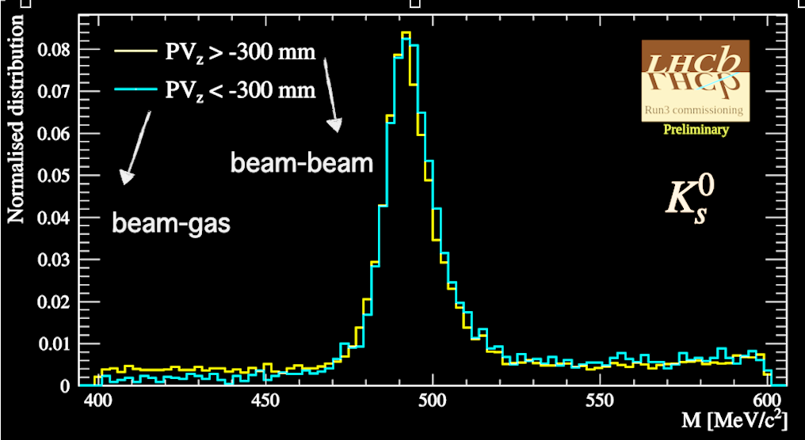

Beam-Beam vs. Beam-Gas
Mass Resolution of $K_{S}^{0}$
Same resolution for beam-gas and beam-beam interactions.
PRAB 27, 111001 (2024)

Slide 16
LHCspin Project Goals
A Polarized Storage Cell at LHCb

Slide 17
Physics Goals
Multi-dimensional nucleon structure in a poorly explored kinematic domain
Measure experimental observables sensitive to both quarks and gluons TMDs
Make use of new probes (charmed and beauty mesons)
Complement present and future SIDIS results
Measure exclusive processes to access GPD

Slide 18
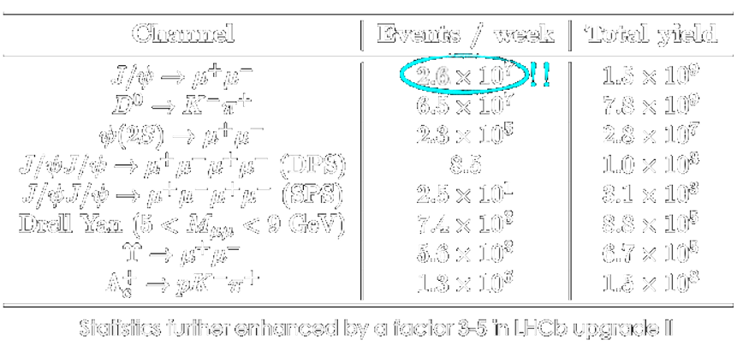

Physics Goals:
Event rates and statistics
Great Statistics
Possibility of precise spin asymmetry on $J/ψ→μ^{+}μ^{−}$ and $D^{0}→K^{+}π^{0}$ for $pH_{↑}$ collisions.

Slide 19
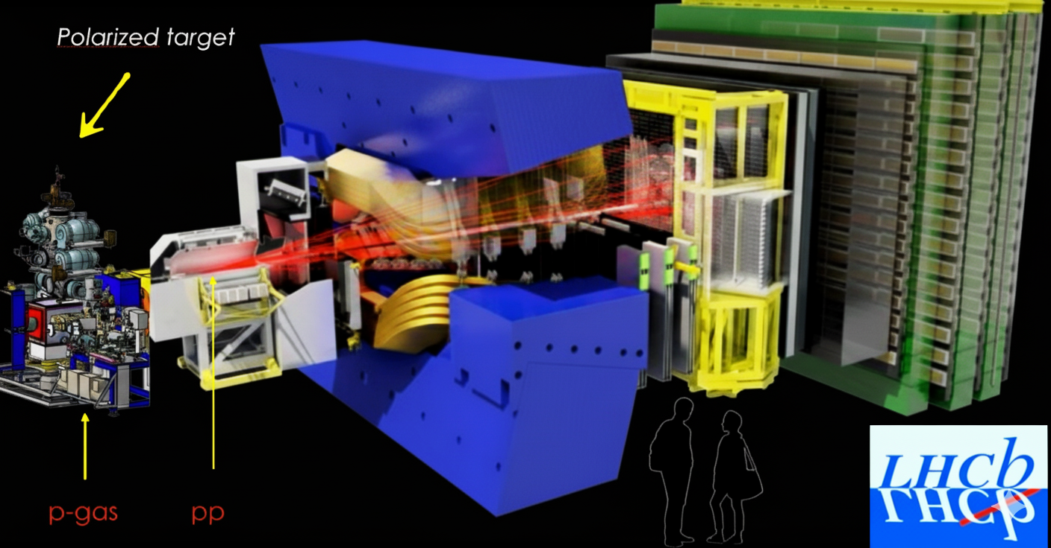
A Polarized Gas Target at LHCb

Slide 20
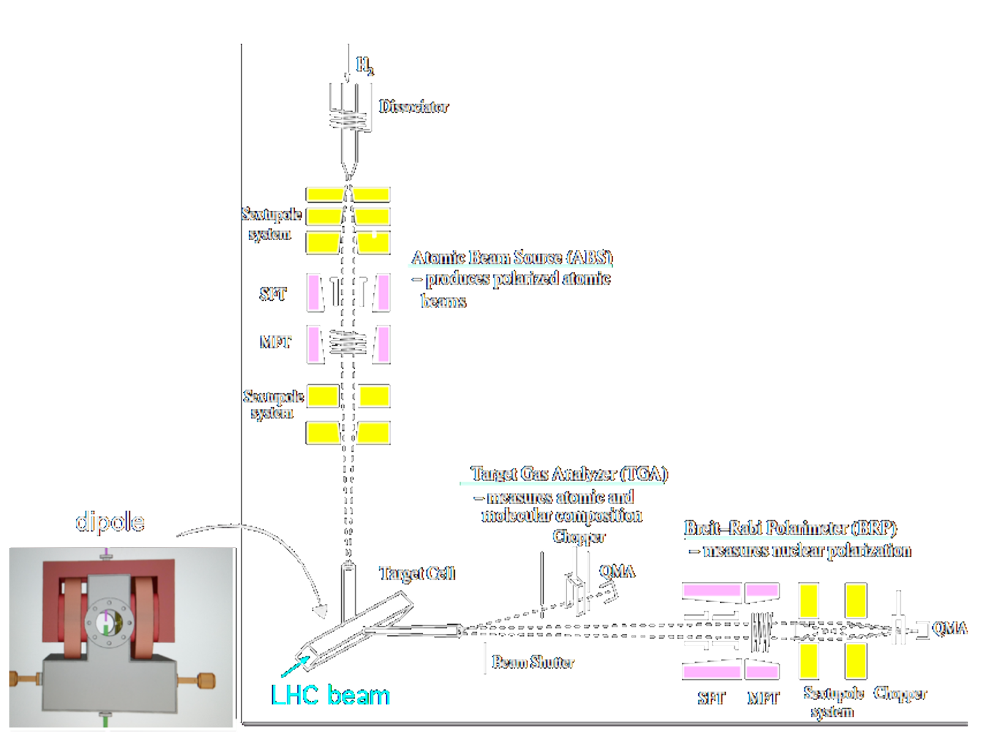

A new Generation of
Fixed-Target Experiments
Starting Point
The HERMES/PAX Target Setup
Luminosity:
  Target density (𝐻): $3.7×{10}^{13}{cm}^{−2}$
  LHC beam (Run5): $6.8×{10}^{18}p/s$
$L_{pH}=2.5×{10}^{32}{cm}^{−2}s^{−1}$
Negligible impact on beam lifetime:
induced $τ_{beam−gas}^{pH}\sim 2000 days$
  Typical $τ_{LHC}$: $10 h$

Slide 21
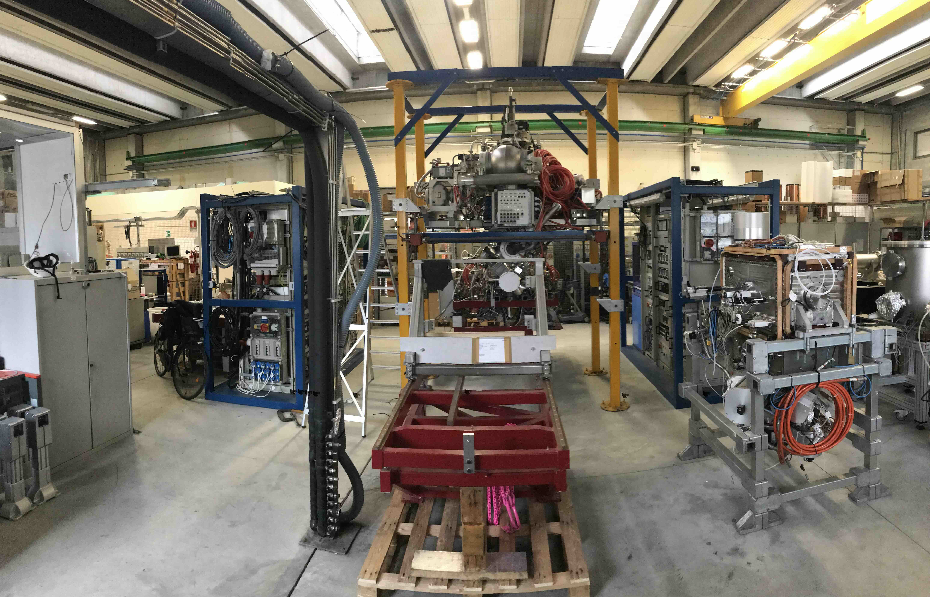
A new Generation of
Fixed-Target Experiments
Ongoing Development at the INFN lab, Ferrara
The HERMES/PAX Target Setup
Luminosity:
  Target density (𝐻): $3.7×{10}^{13}{cm}^{−2}$
  LHC beam (Run5): $6.8×{10}^{18}p/s$
$L_{pH}=2.5×{10}^{32}{cm}^{−2}s^{−1}$
Negligible impact on beam lifetime:
induced $τ_{beam−gas}^{pH}\sim 2000 days$
  Typical $τ_{LHC}$: $10 h$

Slide 22
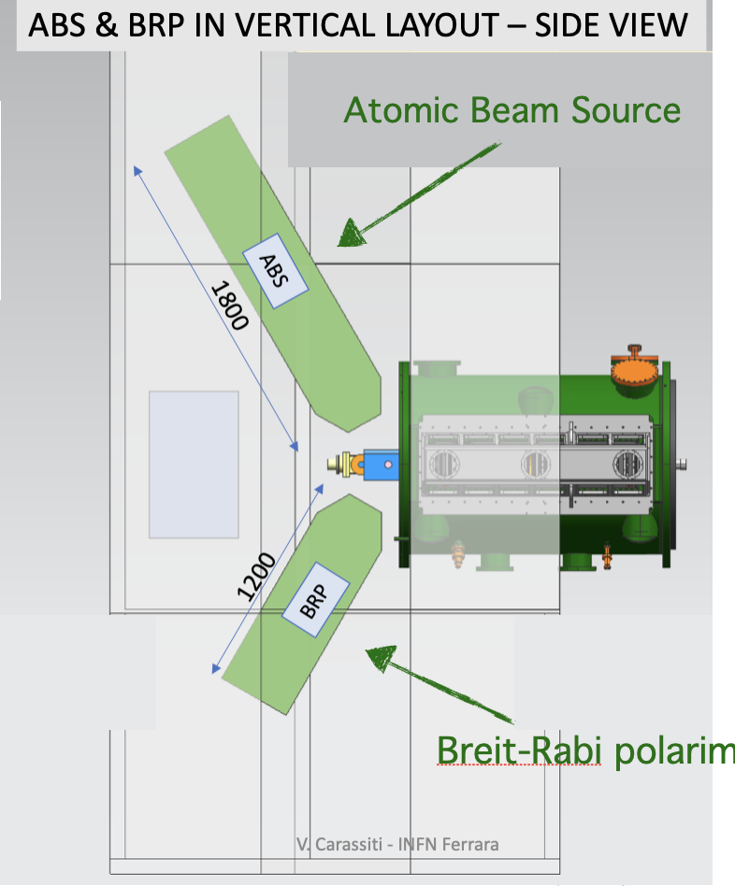
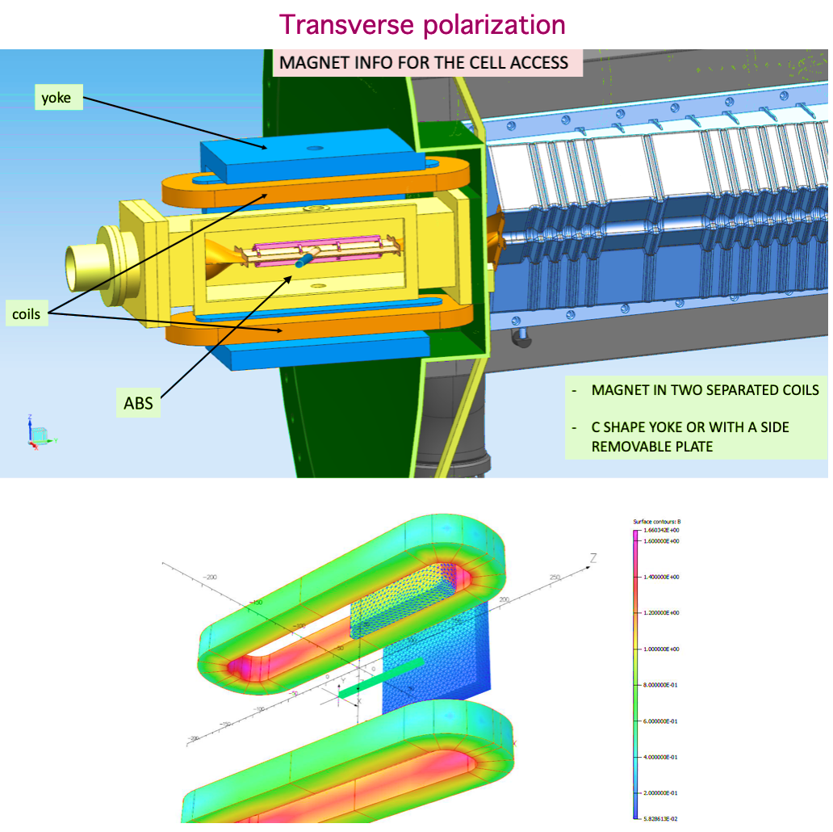
Implementation of a Polarized Gas Target

Slide 23
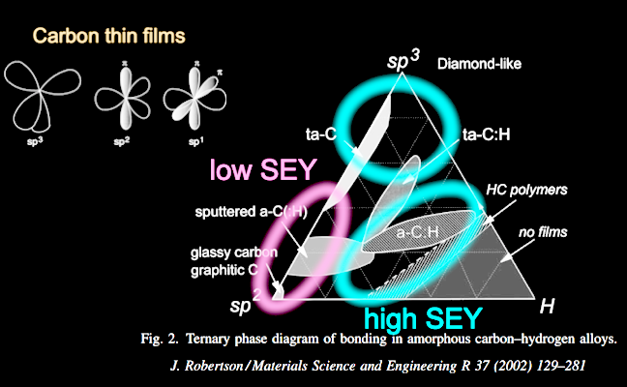
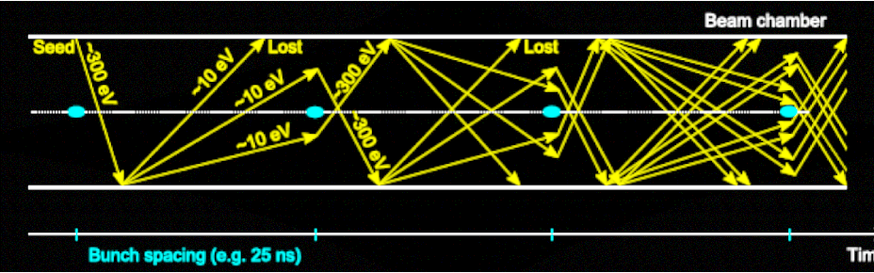
Issue 1: Storage Cell Coating
Previous experience:
  HERA and COSY: Drifilm (silicon) or Teflon (fluoride) coatings combined with ice layers, kept SEY low and prevented recombination
  LHC: no fluoride or silicon materials allowed
Amorphous Carbon:
  excellent for low SEY

Slide 24
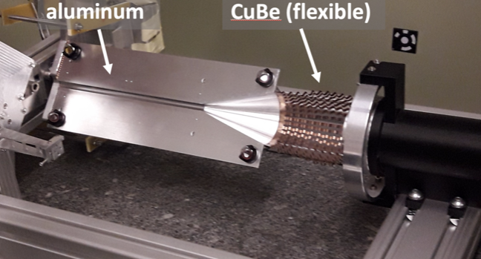
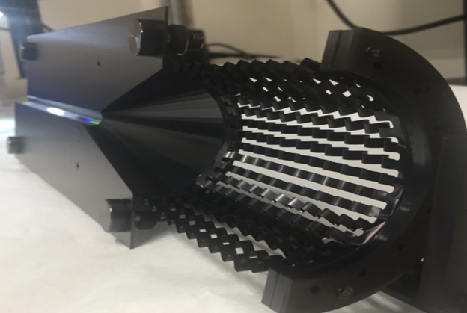
Issue 1: Storage Cell Coating
Uncoated
aC Coated

Slide 25
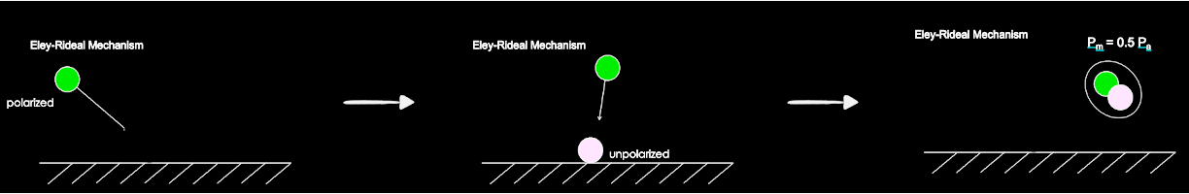
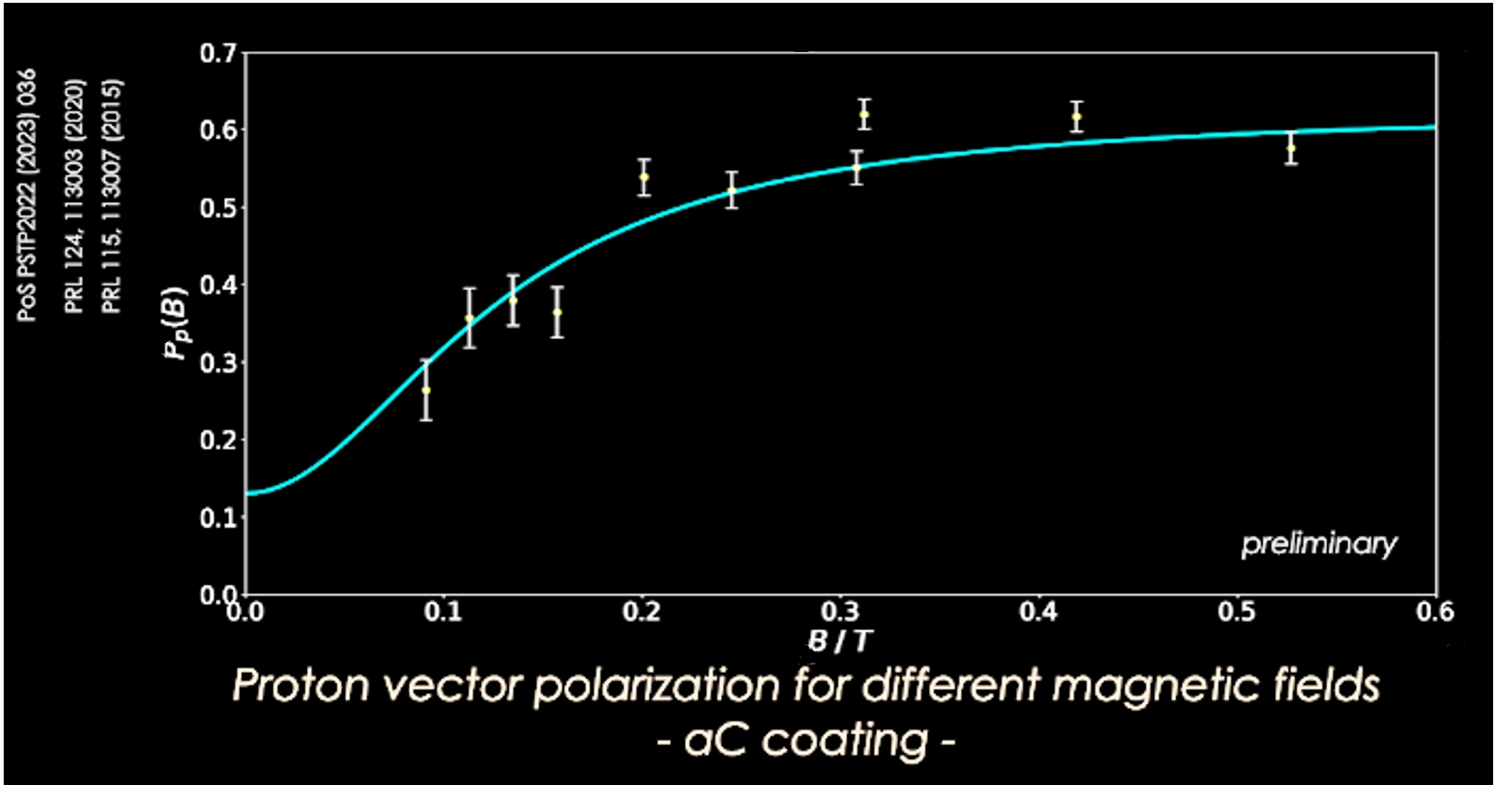
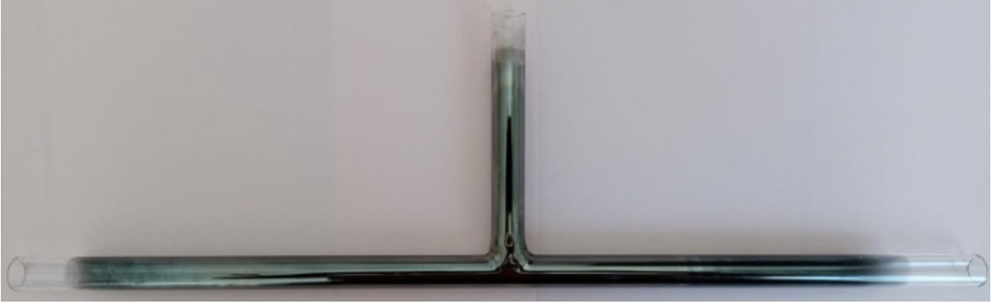
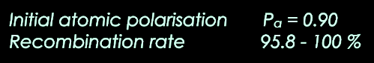
Issue 2: Recombination
Eley-Rideal recombination mechanism:
Polarization measurement on an amorphous carbon coated cell:

Slide 26
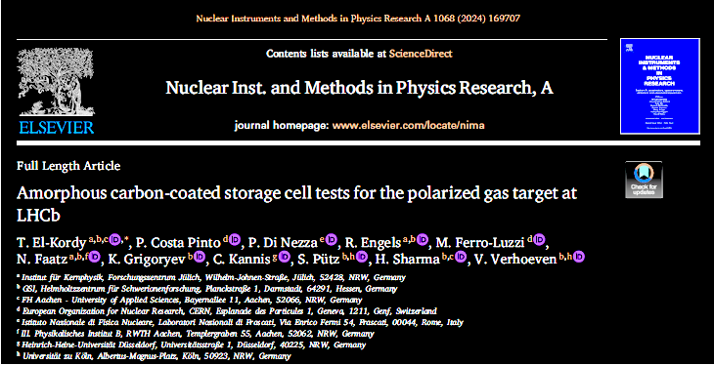
Issue 2: Recombination
Result: Recombined molecules preserve polarization!
Exploitation of recombination effects. Possible if:
  Recombination "fast enough" to recombine two polarized atoms
  Recombination rate high
The paradigm can now be shifted:
Development of a new storage cell with
polarized molecules
  High density
  Better polarization preservation
New Problem: Breit-Rabi polarimeter
cannot measure molecular polarization

Slide 27
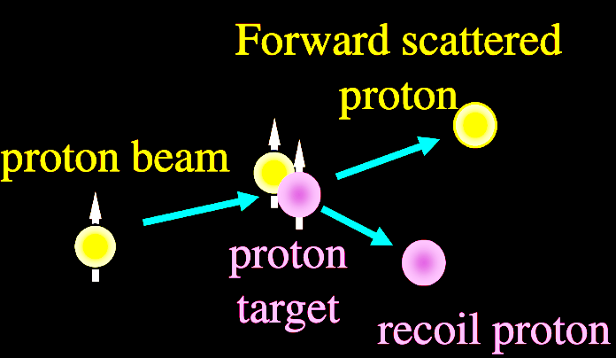
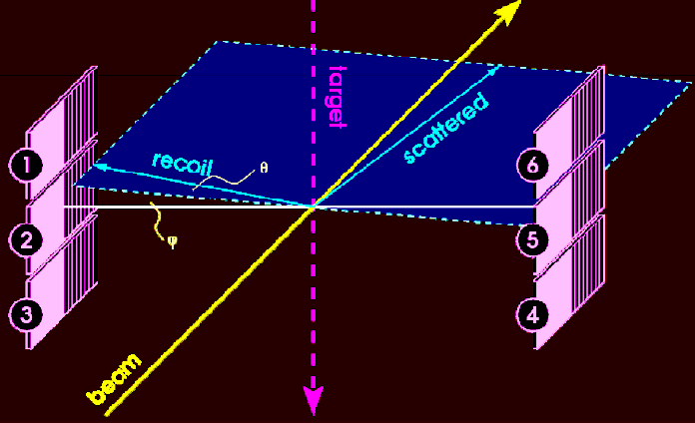
Issue 3: Polarimetry of recombined molecules
Absolute Polarimetry with Coulomb Nuclear Interference (CNI)

Slide 28
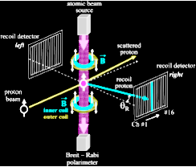
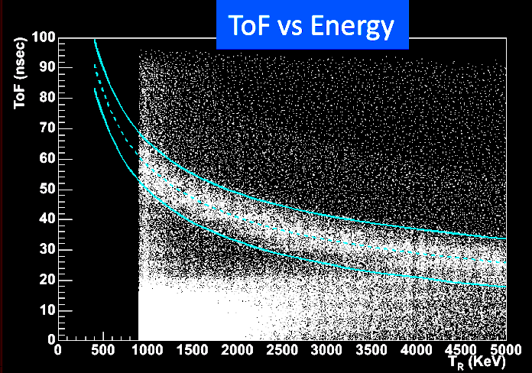
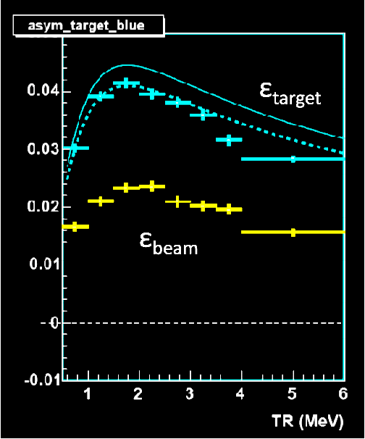
Issue 3: Polarimetry of recombined molecules
Coulomb Nuclear Interference (CNI) at RHIC
Selection of elastic events
Calculation of Asymmetry

Slide 29
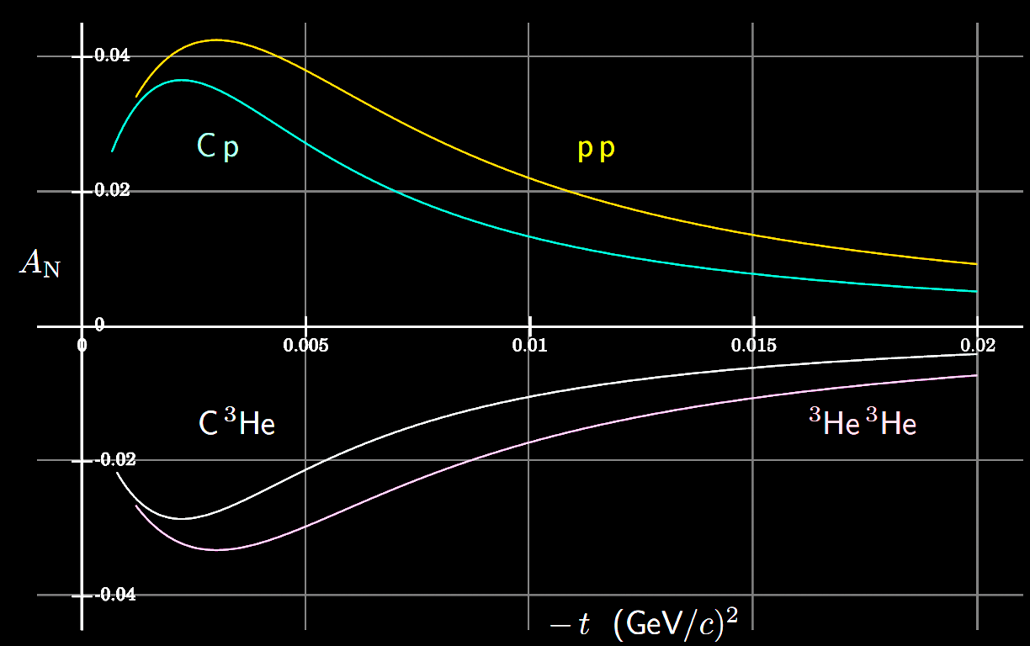

Issue 3: Polarimetry of recombined molecules
To validate the predictions of $A_{N}$ at $7 TeV$, the absolute polarimeter must be installed in coincidence with the BRP polarimeter along the beamline at LHC
Estimations of Analysing Power from N. Buttimore (Trinity College)

Slide 30
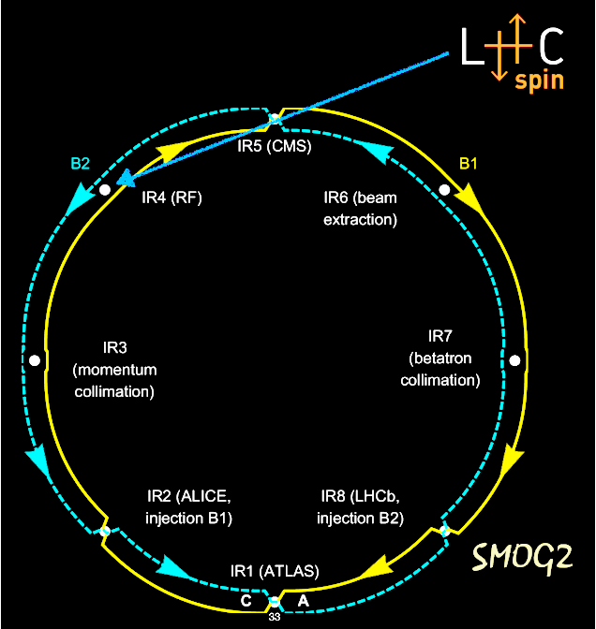
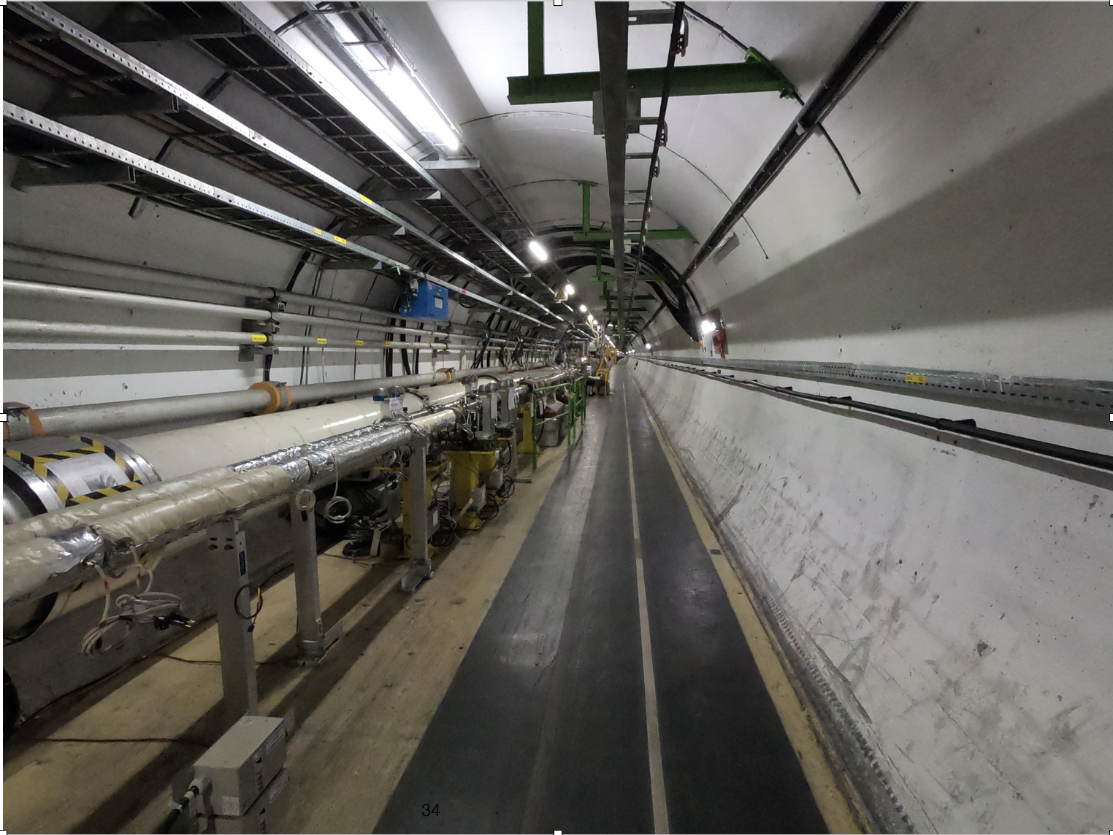
Issue 3: Polarimetry of recombined molecules
Installation of a polarized jet target at LHC Interaction Region 4 (IR4)

Slide 31
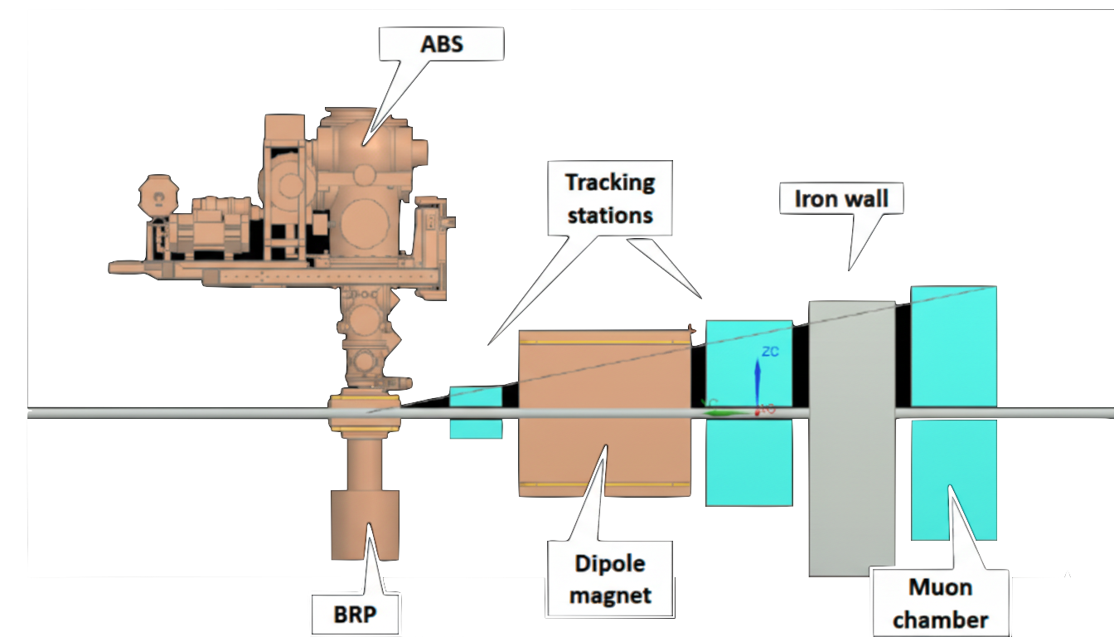
Issue 3: Polarimetry of recombined molecules
Goals:
Proof of Principle of the absolute polarimeter
Proof of Principle of a future experiment at LHCb

Slide 32
A Summary
Phases of the development and projected timeline

Slide 33
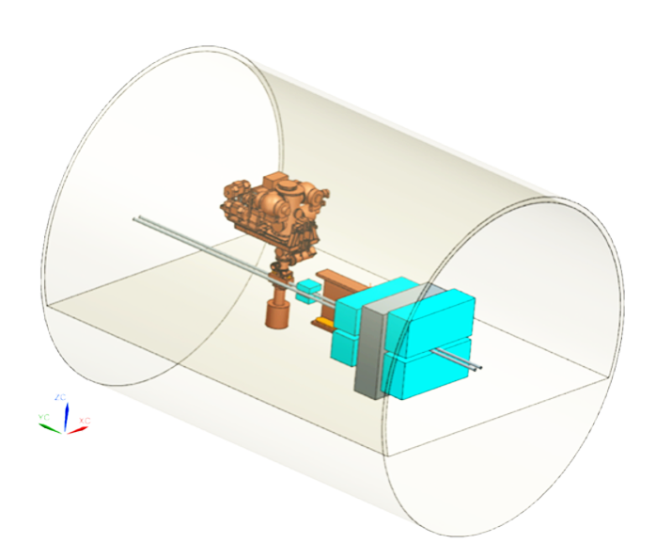
Development Phase 1:
Test installation at IR4
Develop an independent compact apparatus at IR4
Conduct R&D for a PGT for Run5
Feasibility of absolute polarimetry
Possibly perform new physics measurements

Slide 34
Development Phase 2:
Installation at LHCb
Install the Polarized Gas Target in LHCb for Run5
Exploit the potentialities of LHCb (upgrade II)

Slide 35
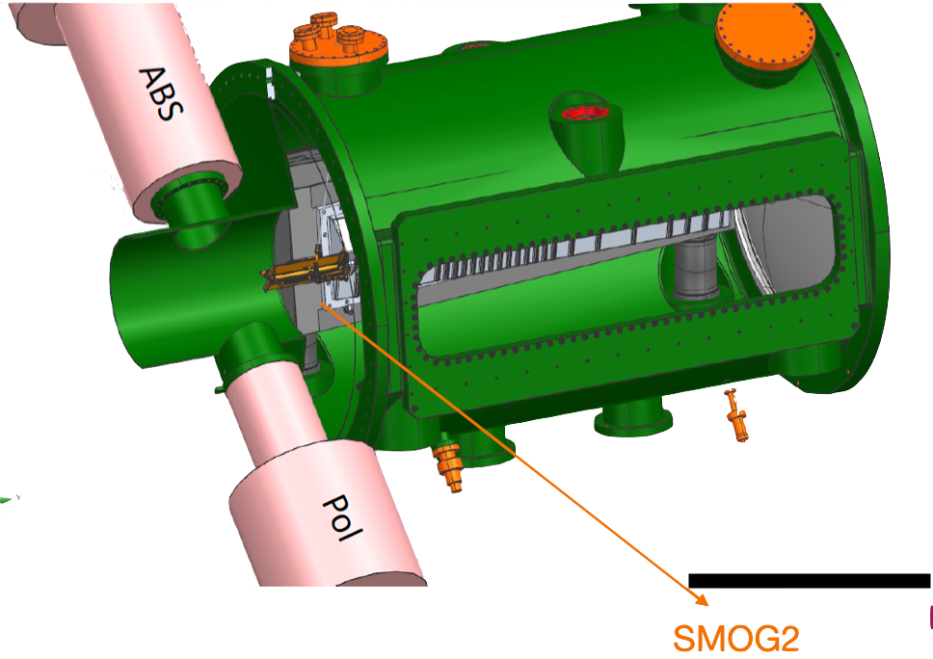

Backup Solution: A Polarized Jet Target
Lower density ($\sim {10}^{12} {atoms}/{{cm}^{2}}$)
Higher polarization ($\sim 90 \%$)
Small Helmholtz coil with no impact on LHCb current and future setup

Slide 36
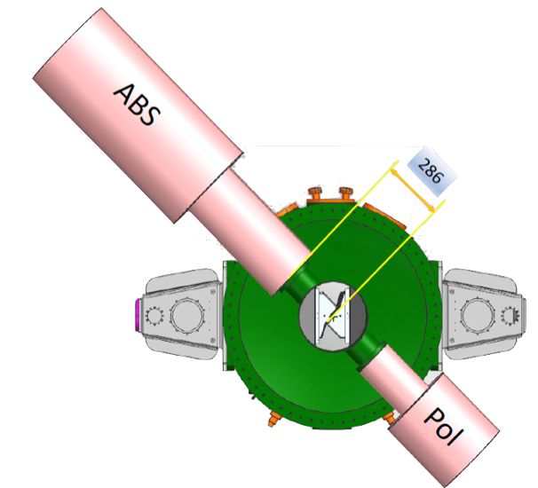
Backup Solution: A Polarized Jet Target
Pros:
no recombination
high polarization
small systematics in P measurements
Cons:
40 times lower luminosity
Tolerable for standard channels
Consequential for rare probes

Slide 37
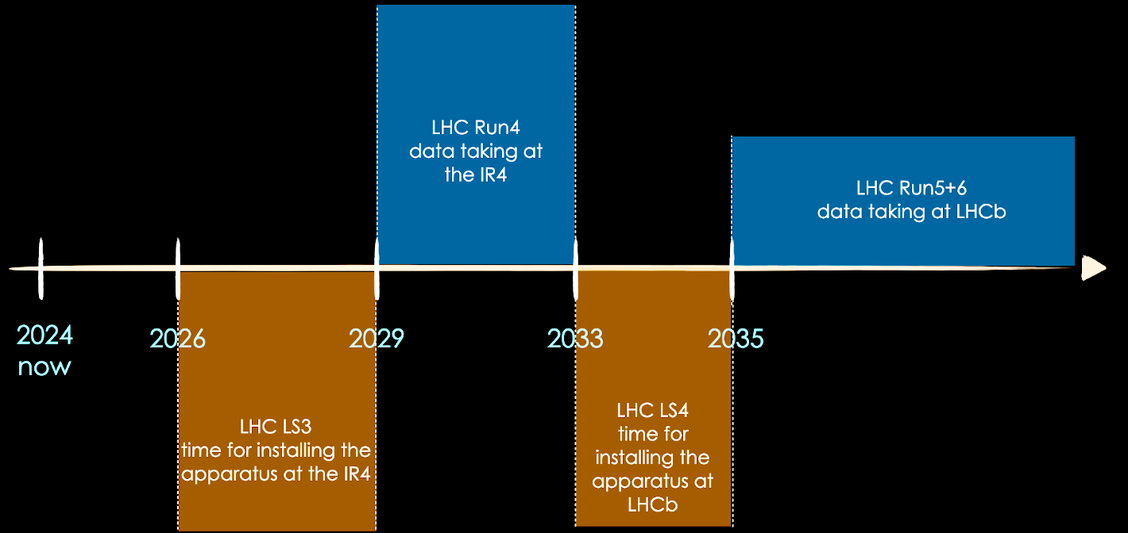
Projected Timeline

Slide 38
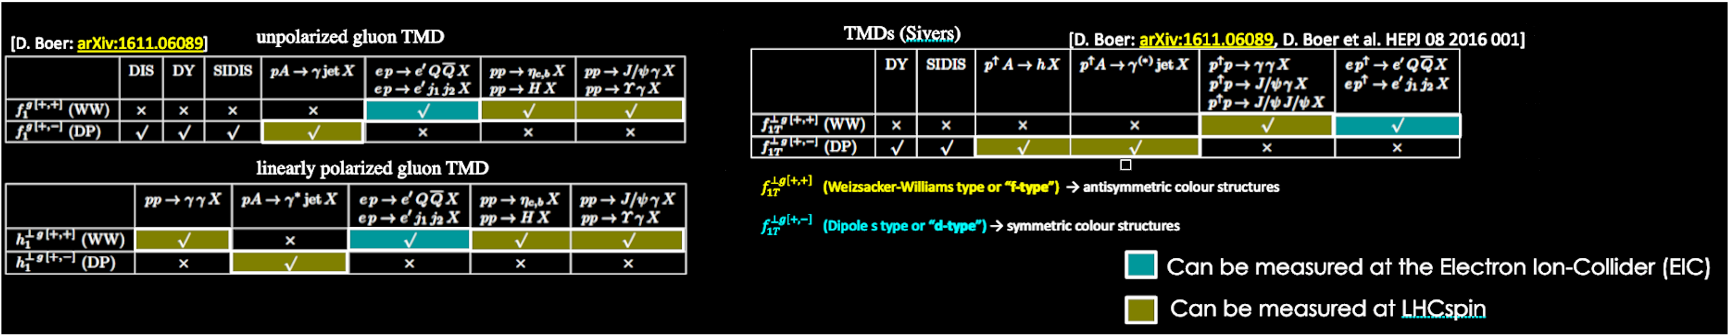
Future Perspectives:
One example of Complementarity with EIC

Slide 39
Conclusion
The LHCspin is an innovative and unique project conceived to bring polarized physics at the LHC .
It is based on the feasibility of employing a gas target at the LHCb, as demonstrated by the SMOG2 system, and could use a location (IR4) along LHC to establish the feasibility of introducing polarization.
It could be implemented within a realistic timeframe (during LHC LS 3 for the LHC Run4 starting in 2030).
It will pave the way for further advances in nucleon structure and spin physics
Kick-off Meeting:
Nov. 20-21, Ferrara, Italy
Post-Doc Position available:
contact: pasquale.dinezza@lnf.infn.it

Slide 40
Thank you for your attention…
Questions are welcome…
Rahul Shankar
(shankar@fe.infn.it)
…on behalf of the LHCspin working group

Slide 41
Backup Slides

Slide 42
Location of SMOG2 at the LHCb
SMOG2
Interaction points for Beam-beam and beam-gas are spatially separated.
Beam-Beam Interaction Point

Slide 43
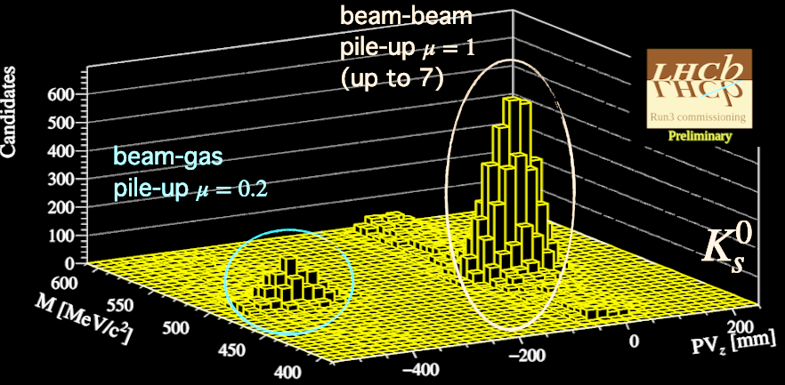
Beam-Beam vs. Beam-Gas Event pileup
Simultaneous mass resolution of the neutral kaon.

Slide 44
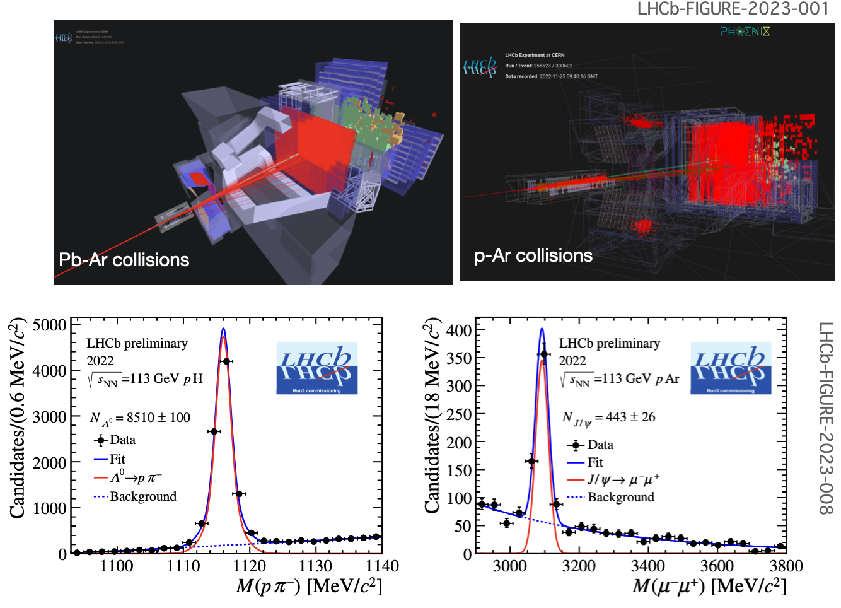
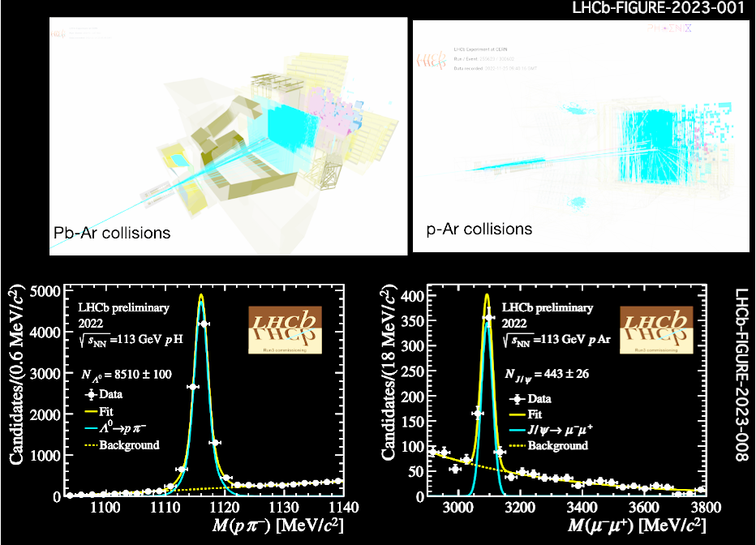

An 18-minute run:
$Λ$ and $J/ψ$ identification

Slide 45
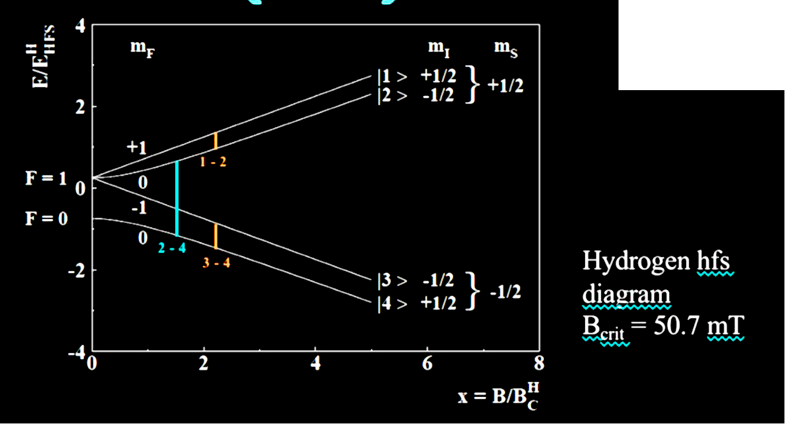
Hyperfine Structure of Hydrogen

Slide 46
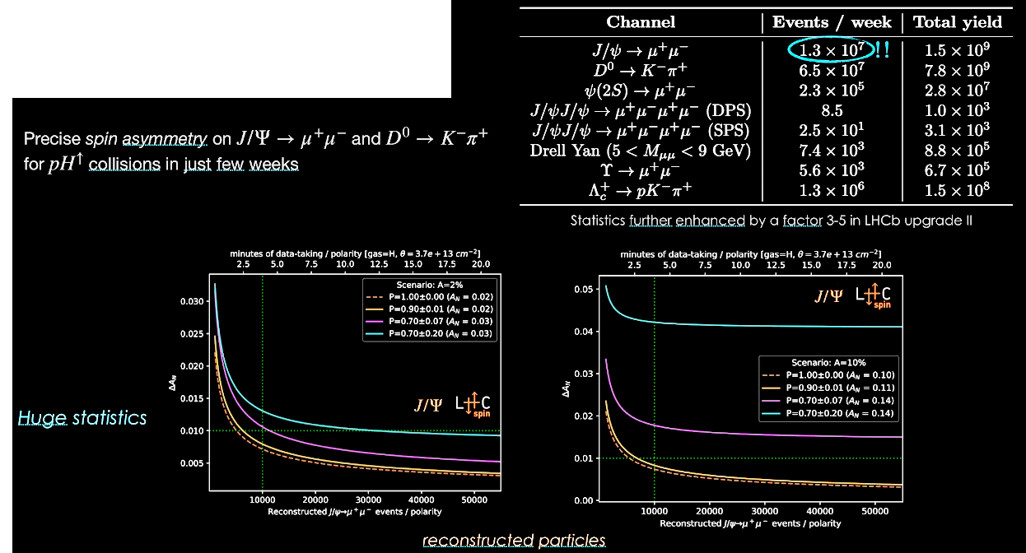
LHCspin Event Rates

Slide 47

Installation at IR4
Available space adequate for the installation.
No showstoppers foreseen so far.

Slide 48

Beam Induced Depolarization (BID)

Slide 49

Beam Induced Depolarization (BID)

Slide 50


Slide 51


Publications and Proposals
The polarized target is part of the LHCb Scoping Document for the Upgrade II
The project has been submitted to the ESPP.
The iter with LHC/PBC has already started

