Slide 1


Development of Polarized ³He at CSNS
Guangdong Provincial Key Laboratory of Extreme Conditions
Junpei (Jupiter) Zhang
Institute of High Energy Physics (IHEP)
China Spallation Neutron Source (CSNS)
Guangdong Provincial Key Laboratory of Extreme Conditions
2025.09.23 Qingdao

Slide 2
Outline
I. Polarized Neutrons and Hyperpolarized ³He
II. Development and Applications of ³He-NSF
III. Conclusion and Future Plans

Slide 3
Outline
I. Polarized Neutrons and Hyperpolarized ³He
II. Development and Applications of ³He-NSF
III. Conclusion and Future Plans

Slide 4
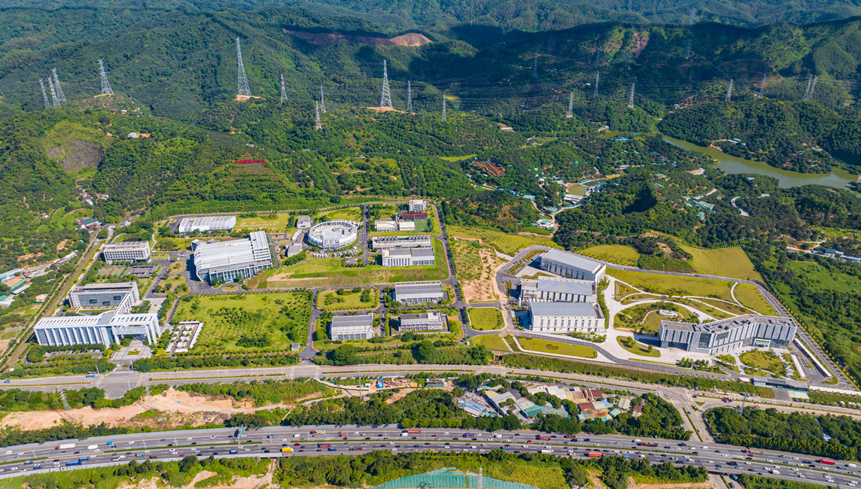
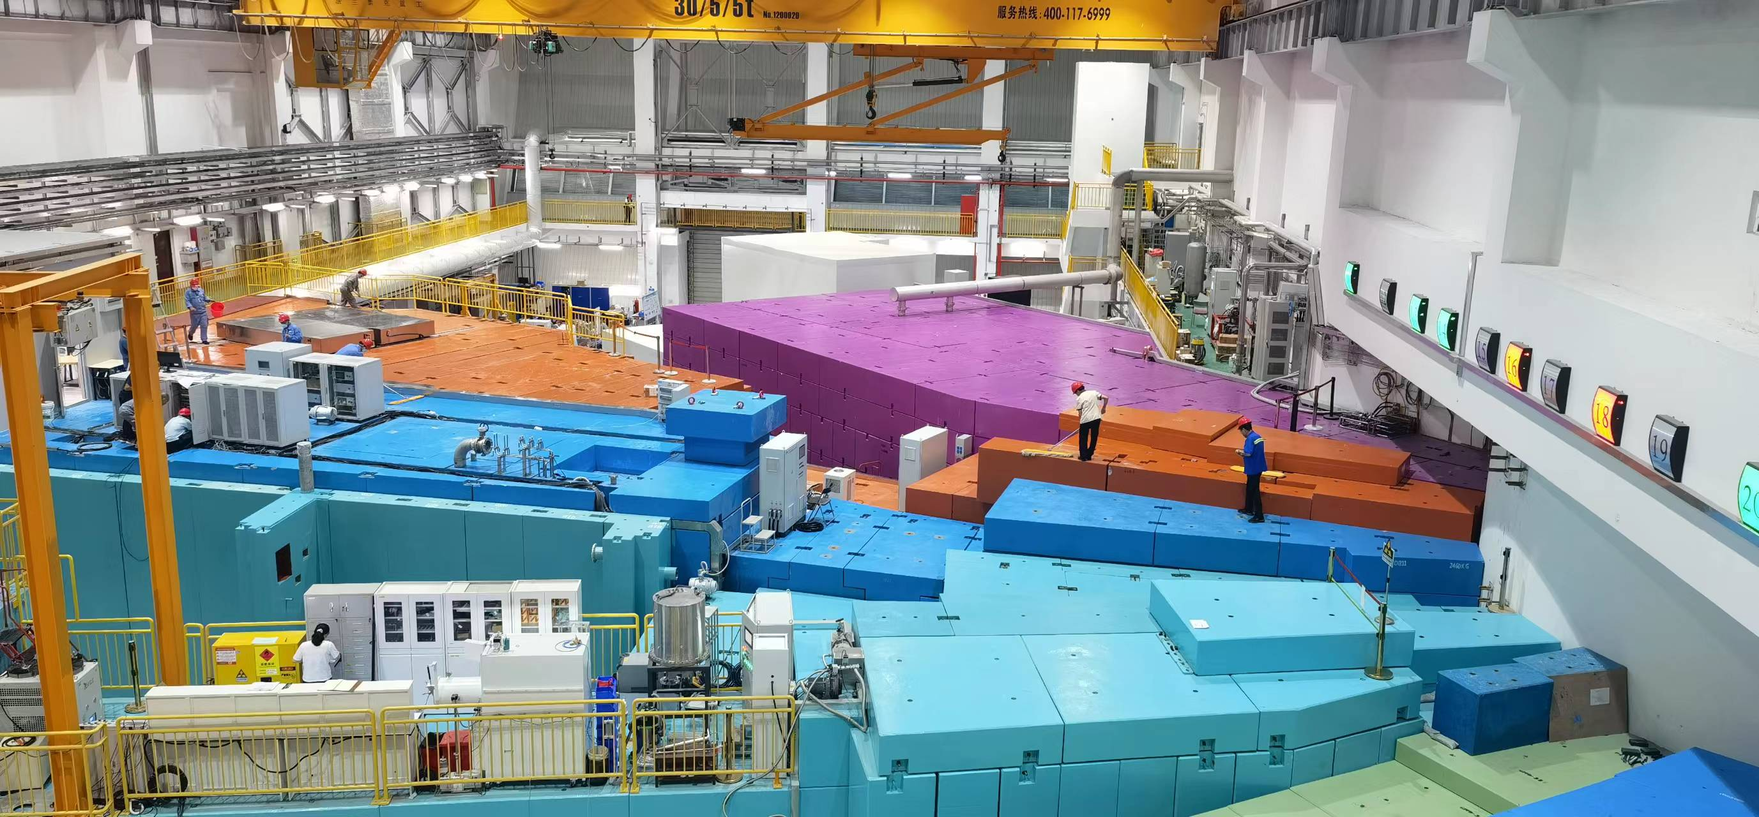
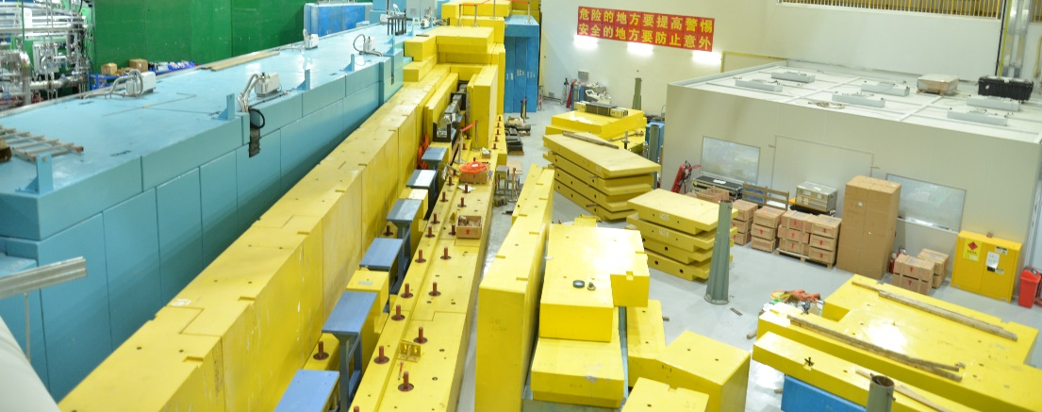
1.1 China Spallation Neutron Source
Introduction of China Spallation Neutron Source (CSNS)
CSNS-Dongguan
Bird View of the CSNS
Bird View of the Target Station

Slide 5
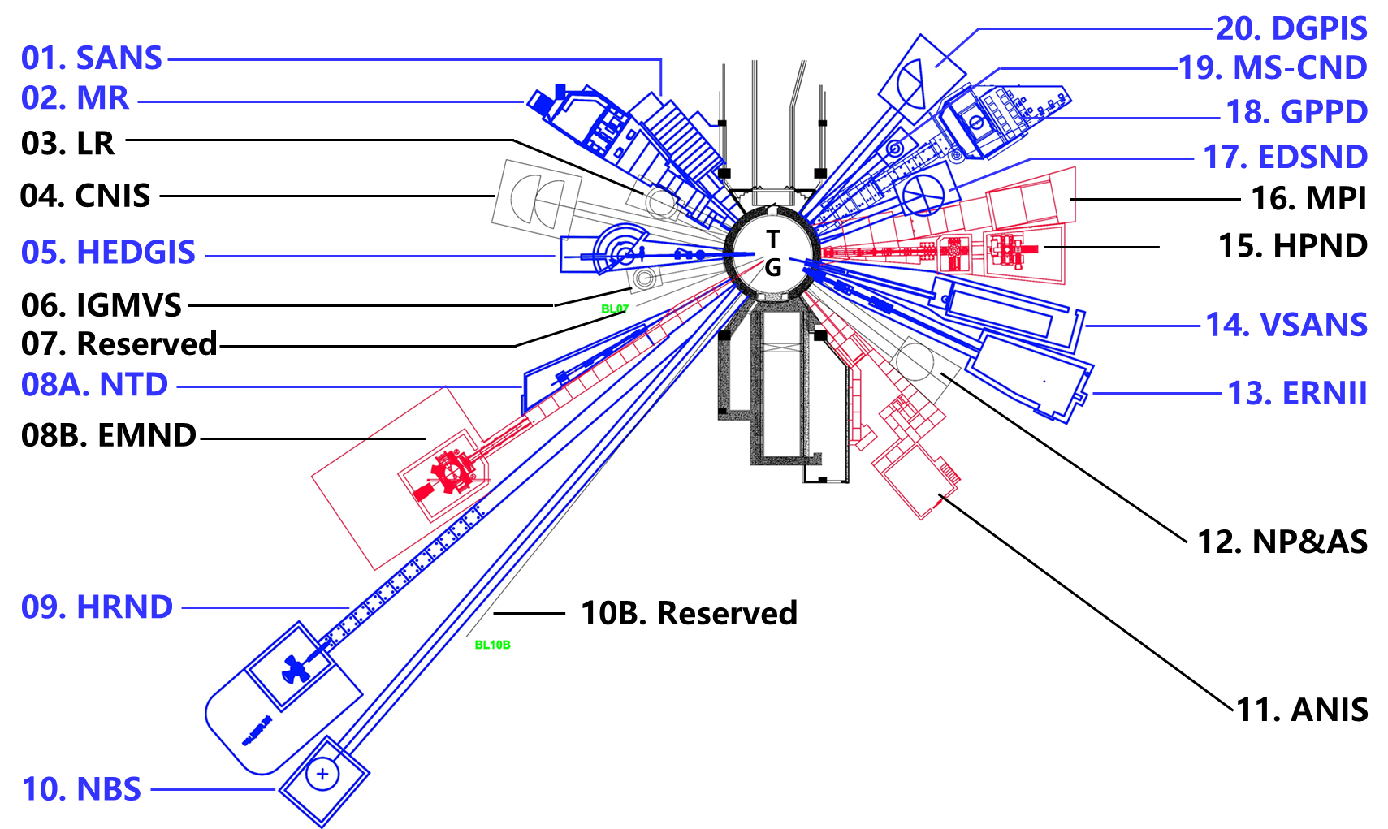
1.2 Polarized Neutron Demand at CSNS
Neutron Instruments at CSNS
More than half of the neutron spectrometers (blue) at the CSNS have the demand or capability to equip with the function of neutron polarizing.

Slide 6
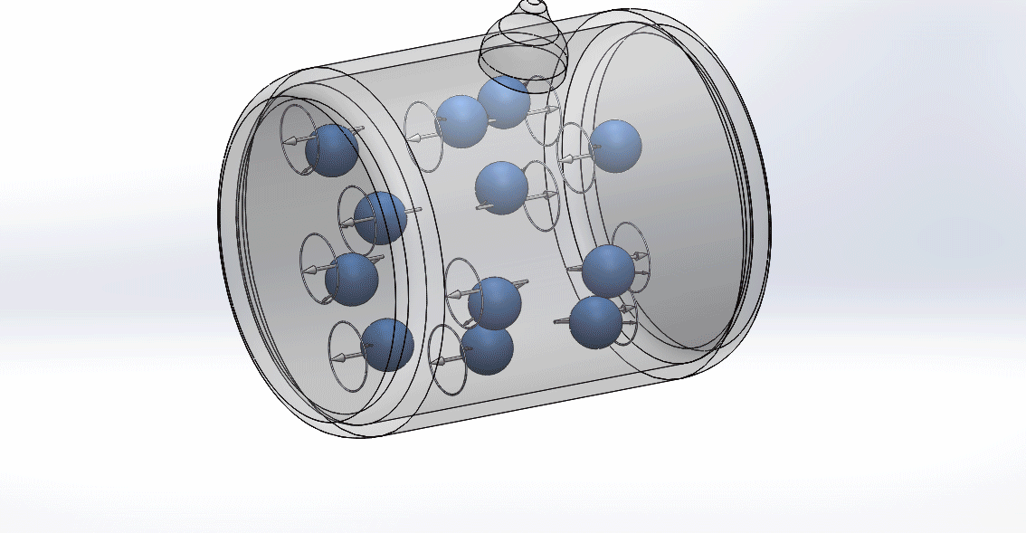
1.3 Polarizing Neutron with Polarized ³He
How Neutron Polarized by Polarized ³He
Neutron Spin Filter
Including system:
Filling Station
Heating/Discharge
Filled Cells: Rb/K/³He
High Power Pumping Laser：795/1083 nm
Uniform Magnetic field
NMR/Compressor
……

Slide 7
Outline
I. Polarized Neutrons and Hyperpolarized ³He
II. Development and Applications of ³He-NSF
III. Conclusion and Future Plans

Slide 8
2.1 Introduction for Polarizing ³He
³He Polarizing：SEOP & MEOP
SEOP (Bouchiat et al., Phys. Rev. Lett. 5, 373, (1960) )
SEOP
Advantages:
Integrable
Relatively Low Cost
Highly Experienced
Disadvantages:
Alkali Metals Required
High-Temperature: ~200 ℃
Low Production Rate: ~0.1 bar ·L /h
Collisional Mixing
5²P_{1/2}
R_{b↑}
³He
R_{b↑} + ³He = R_{b} + ³He↑
794.7 nm σ⁺
Quenching
N₂
R_{b}
³He↑
p_{He} ≈ 1-10 bar
5²S_{1/2}
m_{s} = -1/2
m_{s} = 1/2
MEOP (Colegrove et al., Phys. Rev. 132, 2561, (1963) )
MEOP ：
Advantages:
Alkali Metals Free
Room Temperature：20 ℃
High Production Rate: ＞1 bar·L/h
Disadvantages:
Large Scare
Further Compress
Expensive
F=1/2
³He↑*
³He↑
³He + ³He↑* = ³He↑ + ³He*
RF
2³P₀
F=3/2
C₈
C₉
F=1/2
1083 nm
F=3/2
2³S₁
F=5/2
³He
³He*
p_{He} ≈ 1 mbar
F=1/2
1¹S₀
F=3/2
F=I=1/2

Slide 9
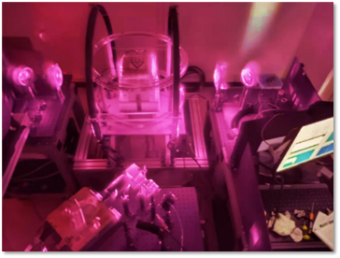
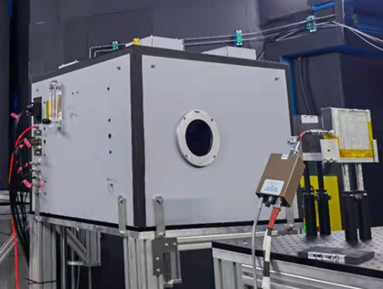
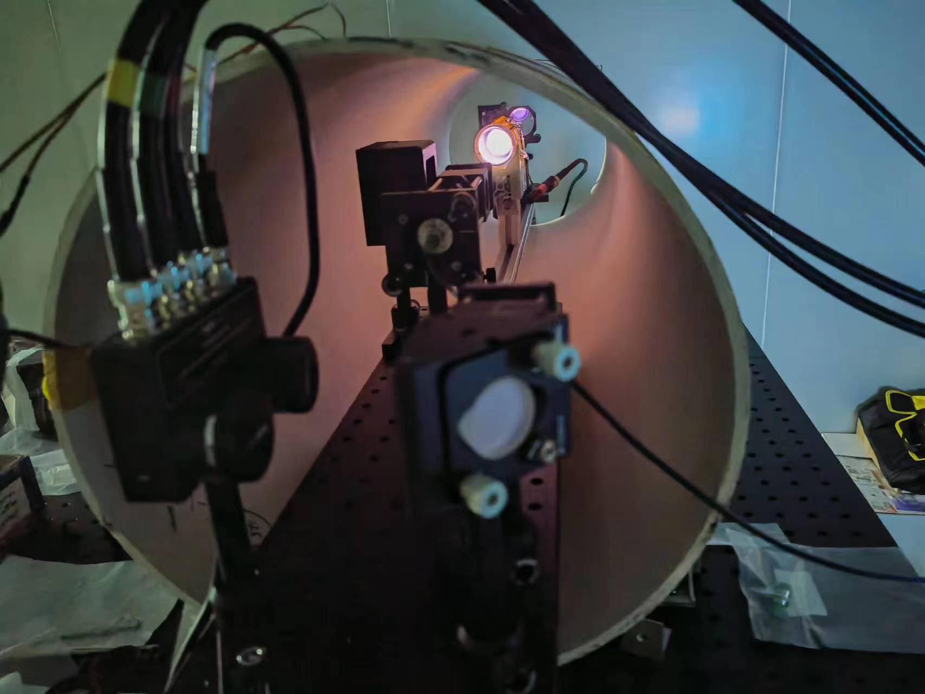
2.2 ³He Neutron Spin Filter (NSF)
Polarized ³He-NSF for CSNS
Off-situ
SEOP
In-situ
³He
Polarizing
MEOP
Off-situ
Provide Polarized ³He-NSF for Neutron Spectrometers

Slide 10
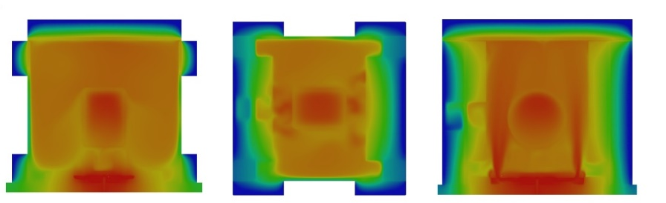
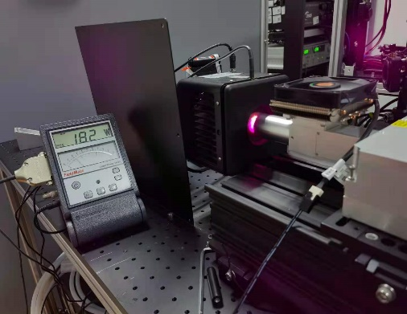
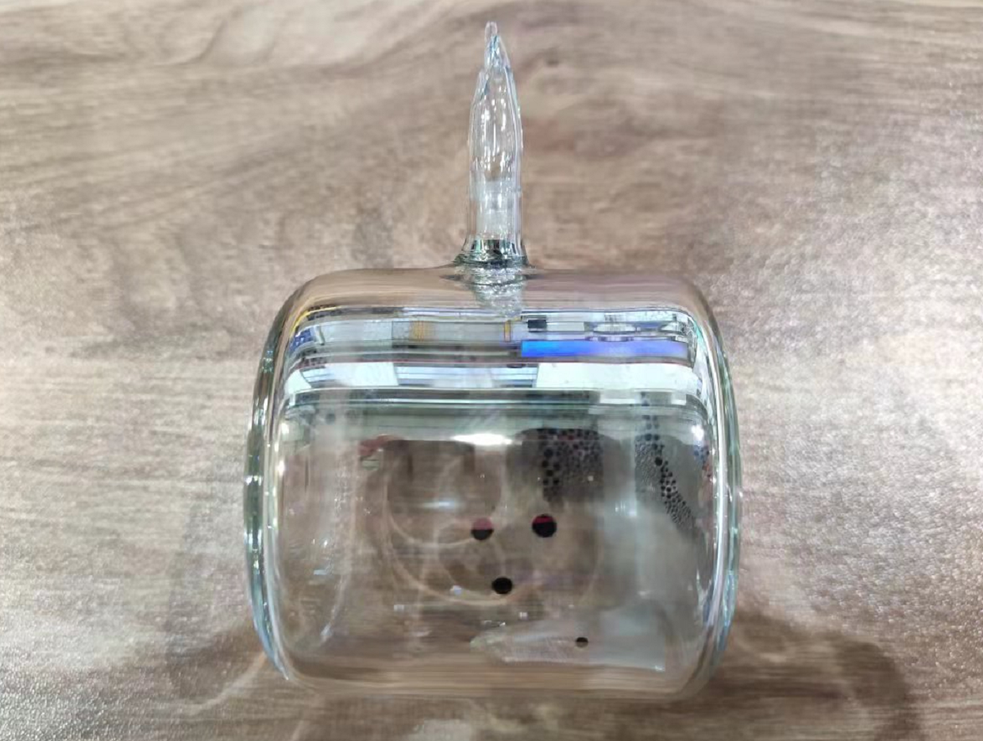
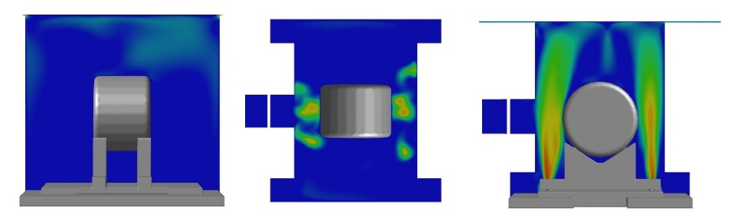
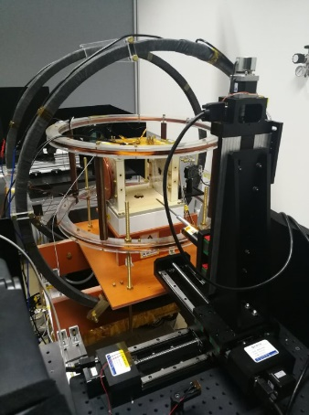
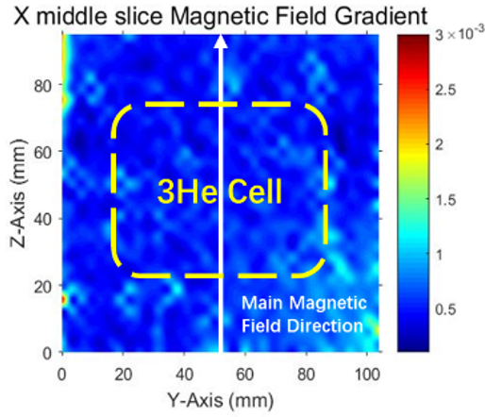
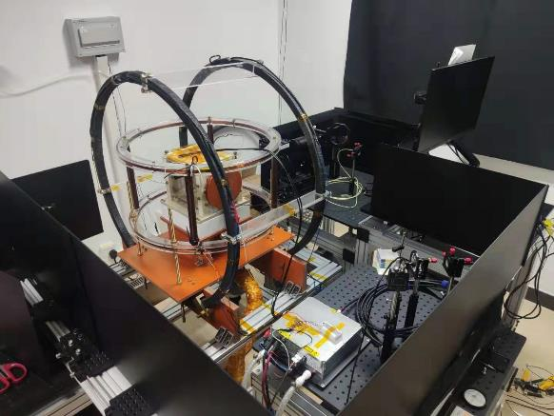
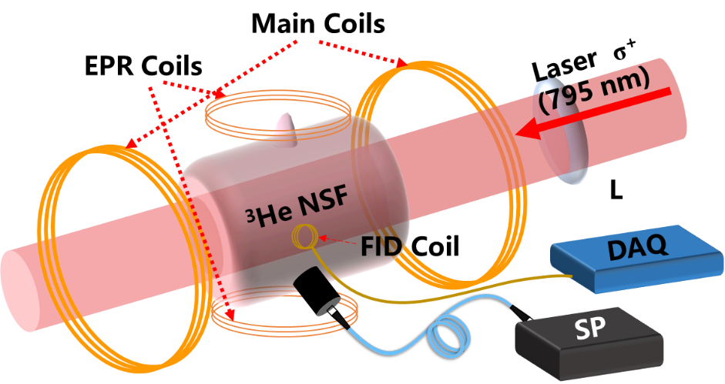
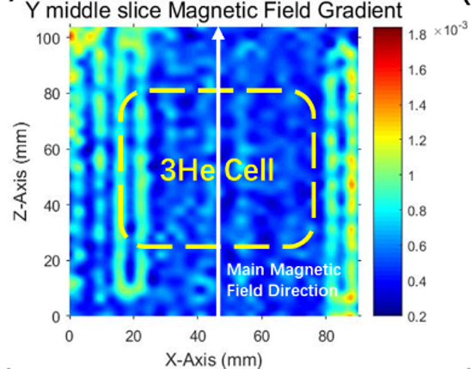
2.3 SEOP ³He-NSF
1. ³He-NSF R&D at CSNS
³He NSF Cell
High Power Pumping Laser
Uniform Heating System
Uniform Magnetic Field
NMR System
Pumping Station

Slide 11
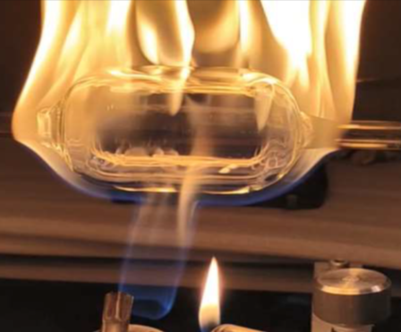
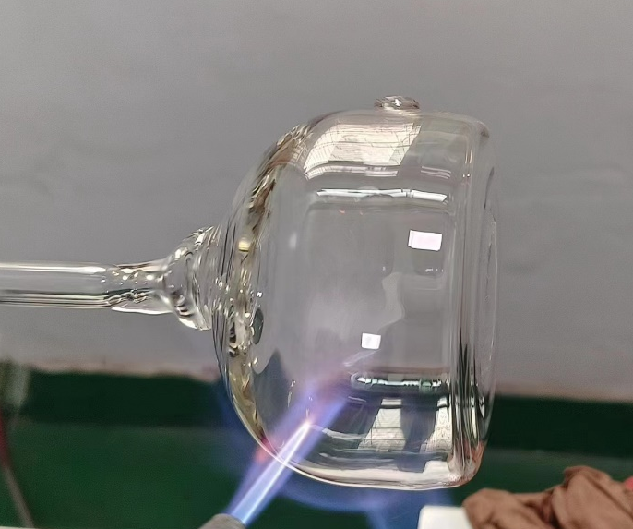
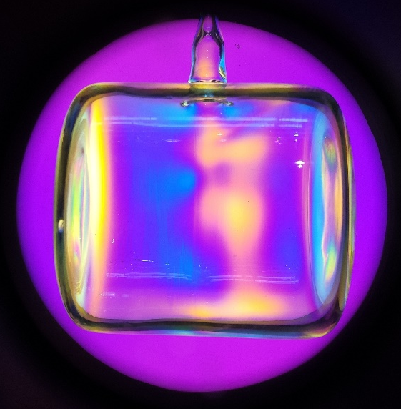
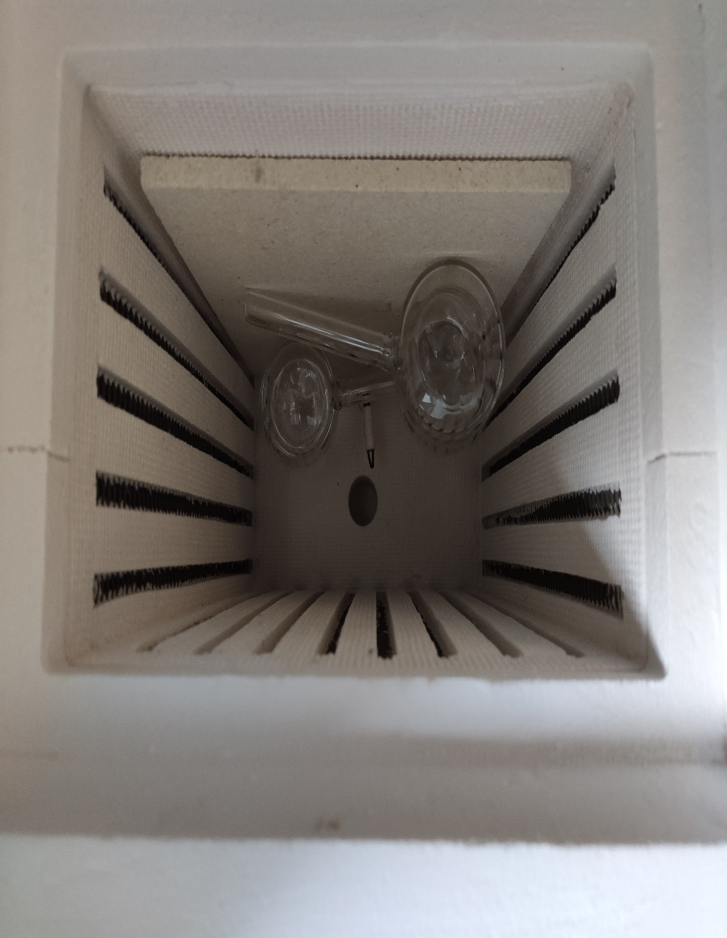
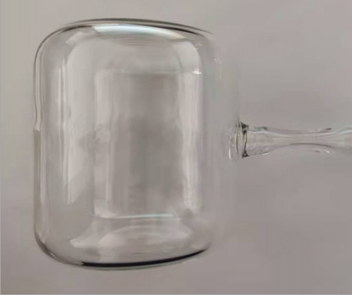
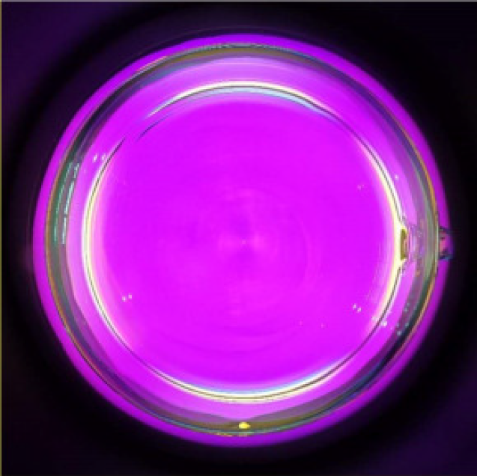
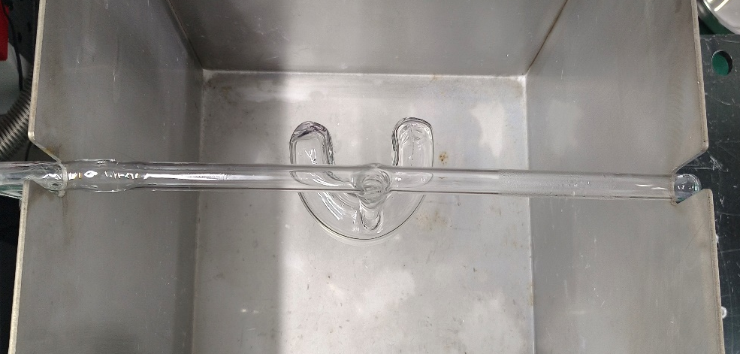
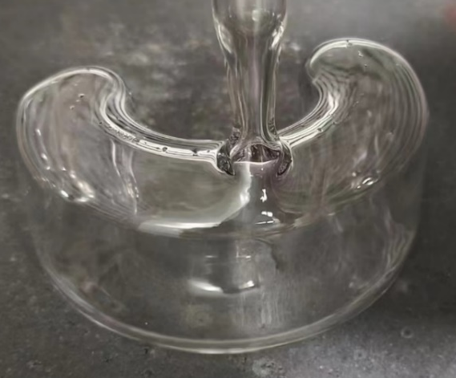
2.3 SEOP ³He-NSF
2. ³He Cell Fabrication
1. Expansion
2. ³He Cell Blowing
3. Stress Check
4. Annealing
≥180°
5. Stress Verification
6. Pressure Test
Cylindrical
Wide-Angle

Slide 12
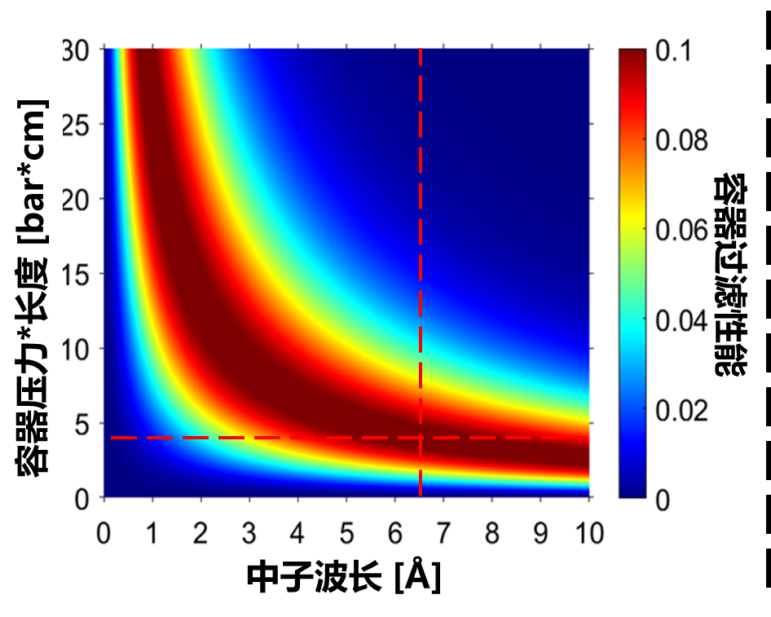
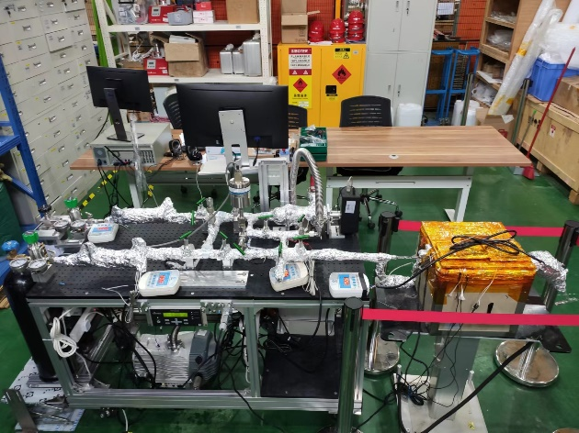
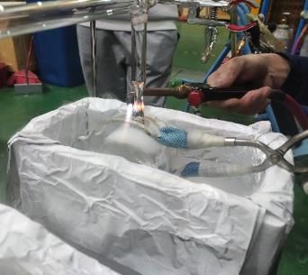
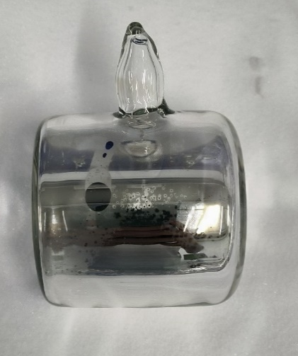
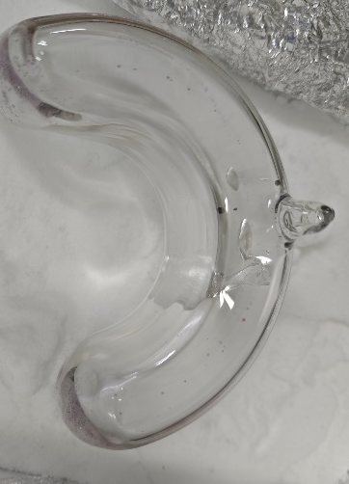
2.3 SEOP ³He-NSF
3. Filling Station for ³He-NSF
GE180 Cells Production: ≥10-20/Year
P*L (barn*cm)
Neutron Wavelength (Å)
Cylindrical
Wide-Angle
³He Filling Station (2022)
Tip-off of ³He-NSF

Slide 13
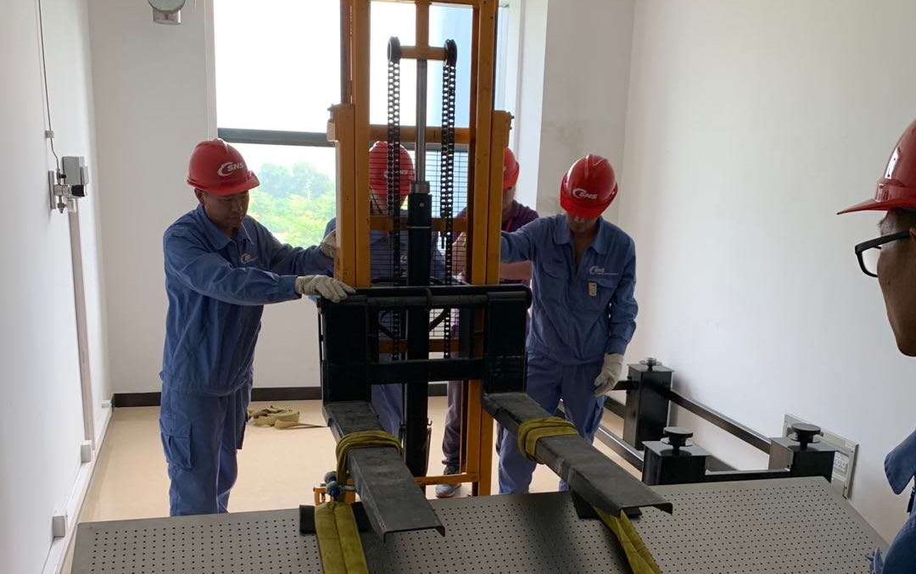
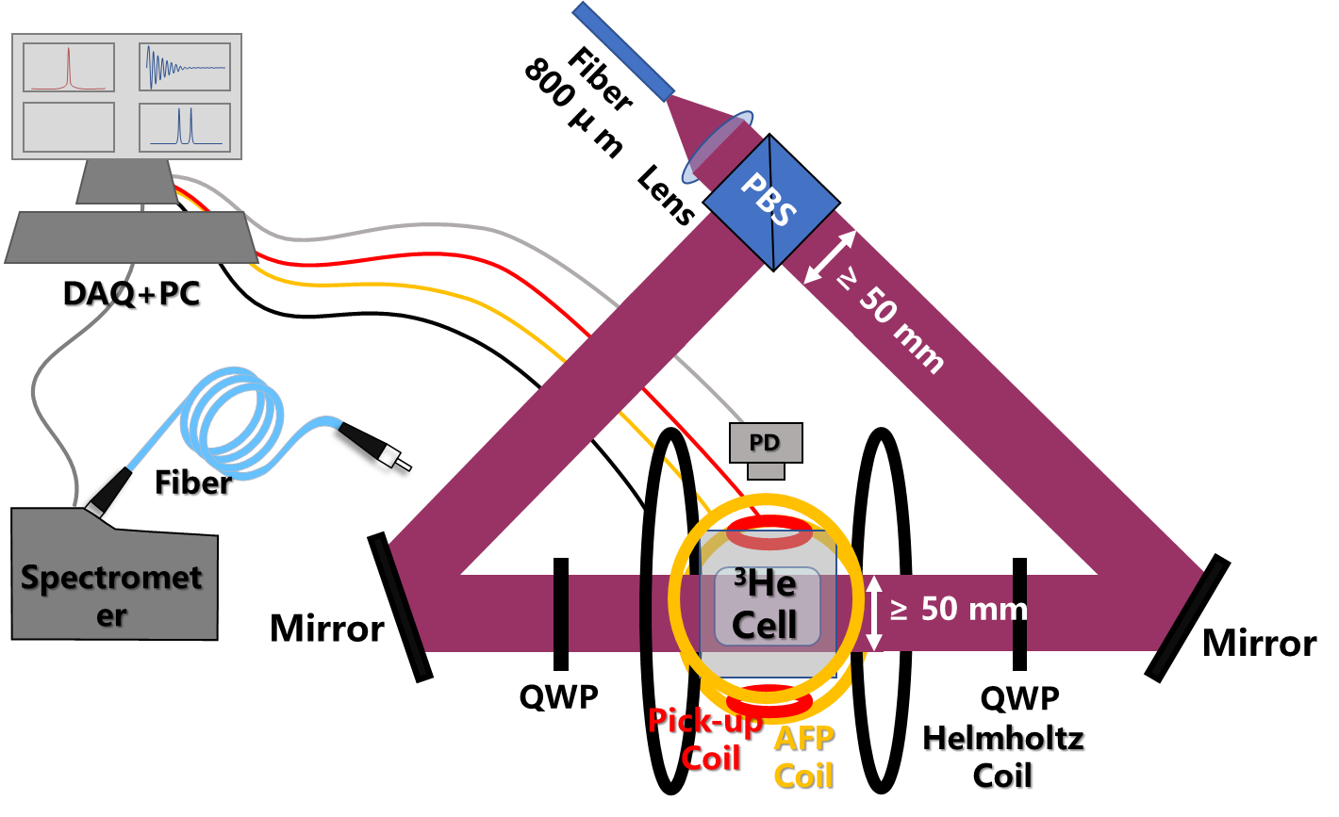
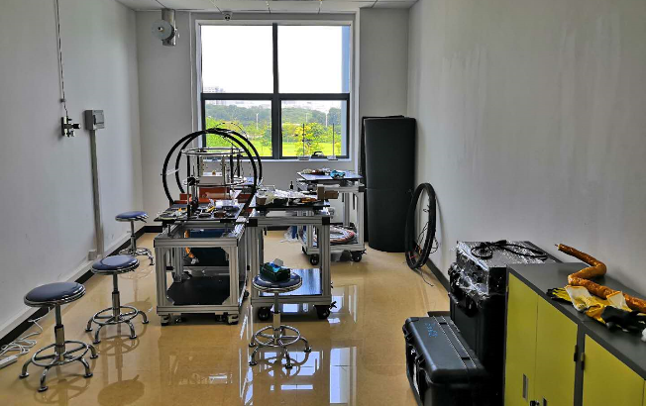
2.3 SEOP ³He-NSF
4. Pumping Station R&D
2019
2020

Slide 14
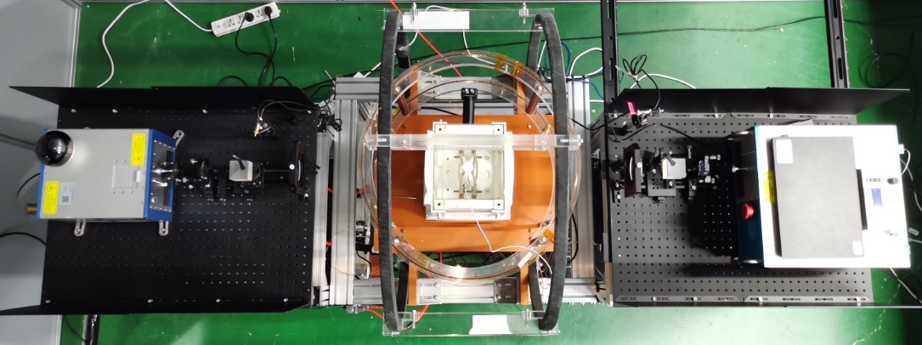
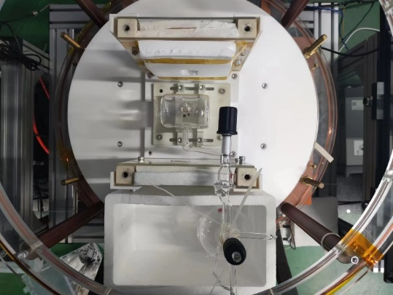
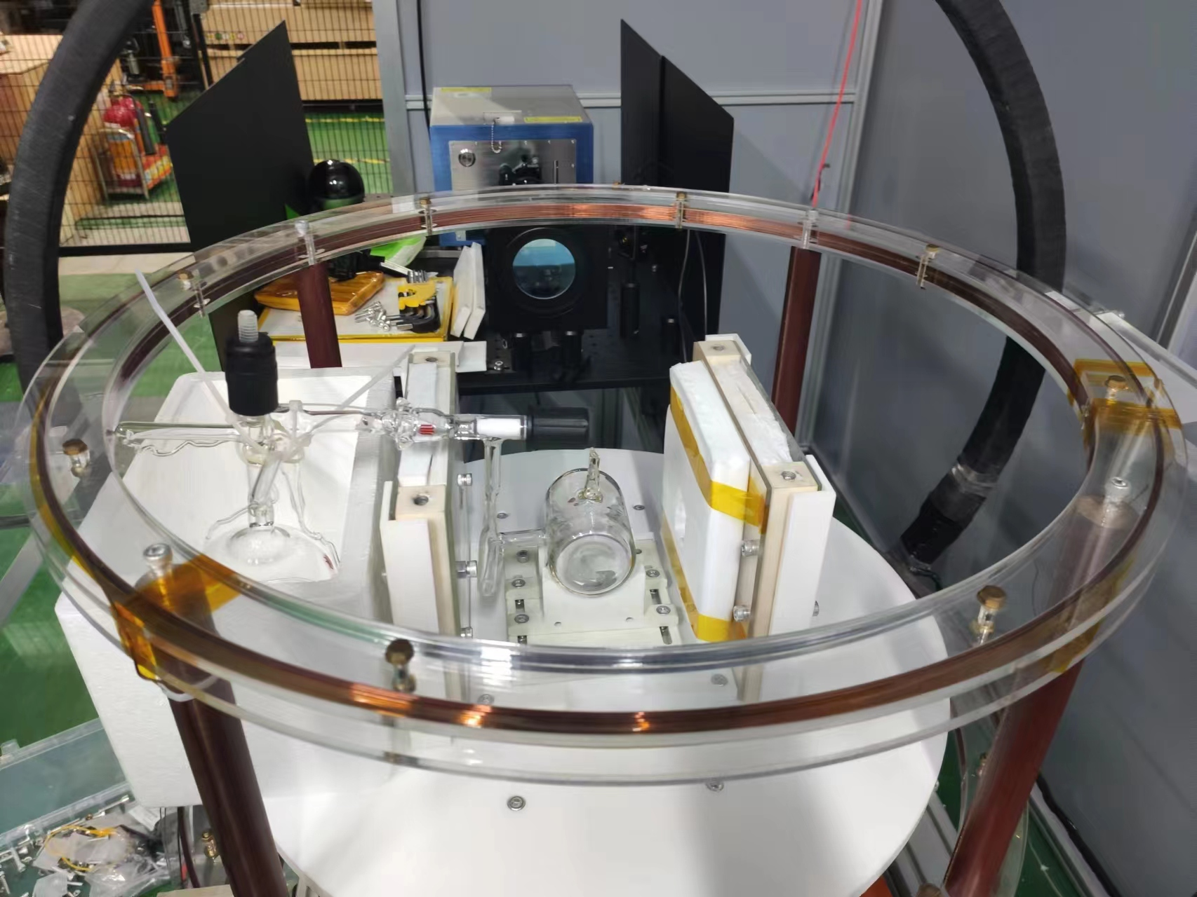
2.3 SEOP ³He-NSF
4. Pumping Station R&D
Pumping Time：≤12 hours，Polarization：≥70%
Contents | Off-situ1 | Off-situ2
Power | ~ 160 W | ~ 130 W
Laser Type | Commercial | Home Build
Pumping Rate (τ) | 3-6 hours | 4-6 hours
Oven Size | ~ 8000 cm³ | ≥ 8000 cm³
Magnetic Filed | ≥ 12 G | ≥ 12 G
Gradient | ~ 4.2 ×10 ⁻⁴ | ~ 4.2 ×10 ⁻⁴
Hating Power | 200 ℃ 50 min | 200 ℃ 30 min
NMR | FID、AFP、EPR

Slide 15
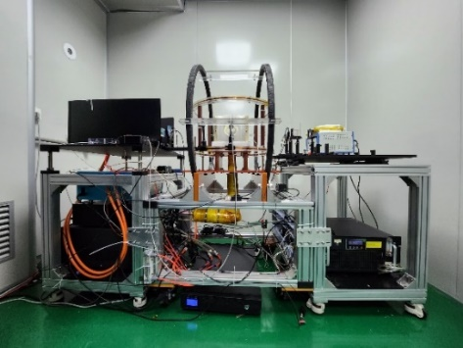
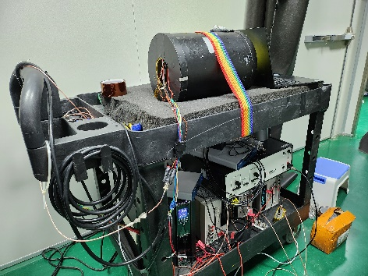
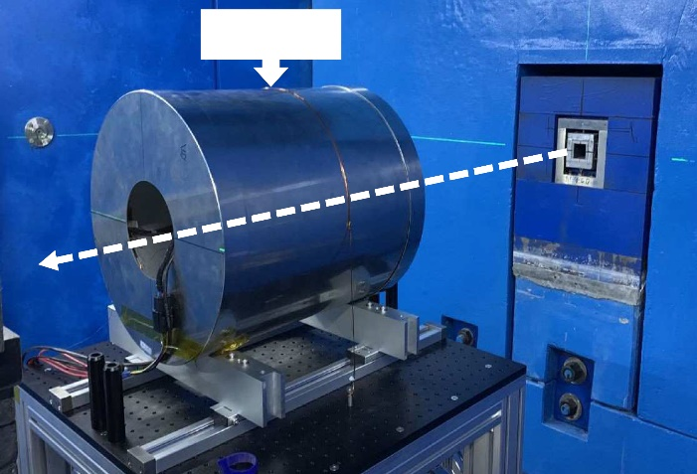
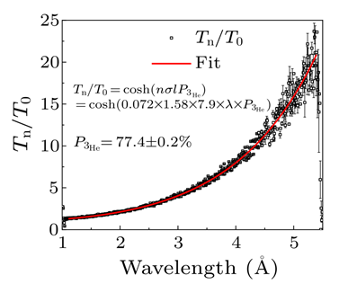
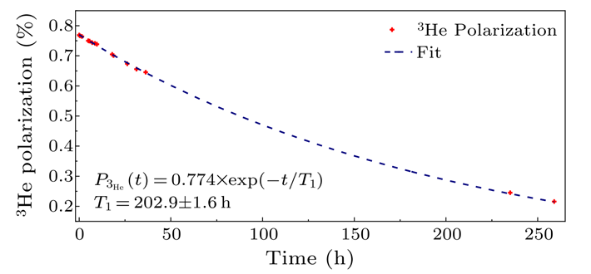
2.3 SEOP ³He-NSF
5. Off-situ ³He-NSF R&D
Chinese Physics Letters, 38(9), 092801(2021).
³He NSF
Neutron Beam
Pumping
Transportation
Polarized Neutron Experiment
Pumping time: 10-12 hours
Transport: ~30 minutes
Decay Constant: ≥100 hours
Continuing Decay→Short Experiment
Calibrating Required
Decay Constant ≥202.9 hours
77.4%
³He Polarization ≥ 77% and Decay constant ≥ 200 hours are achieved since 2020.

Slide 16
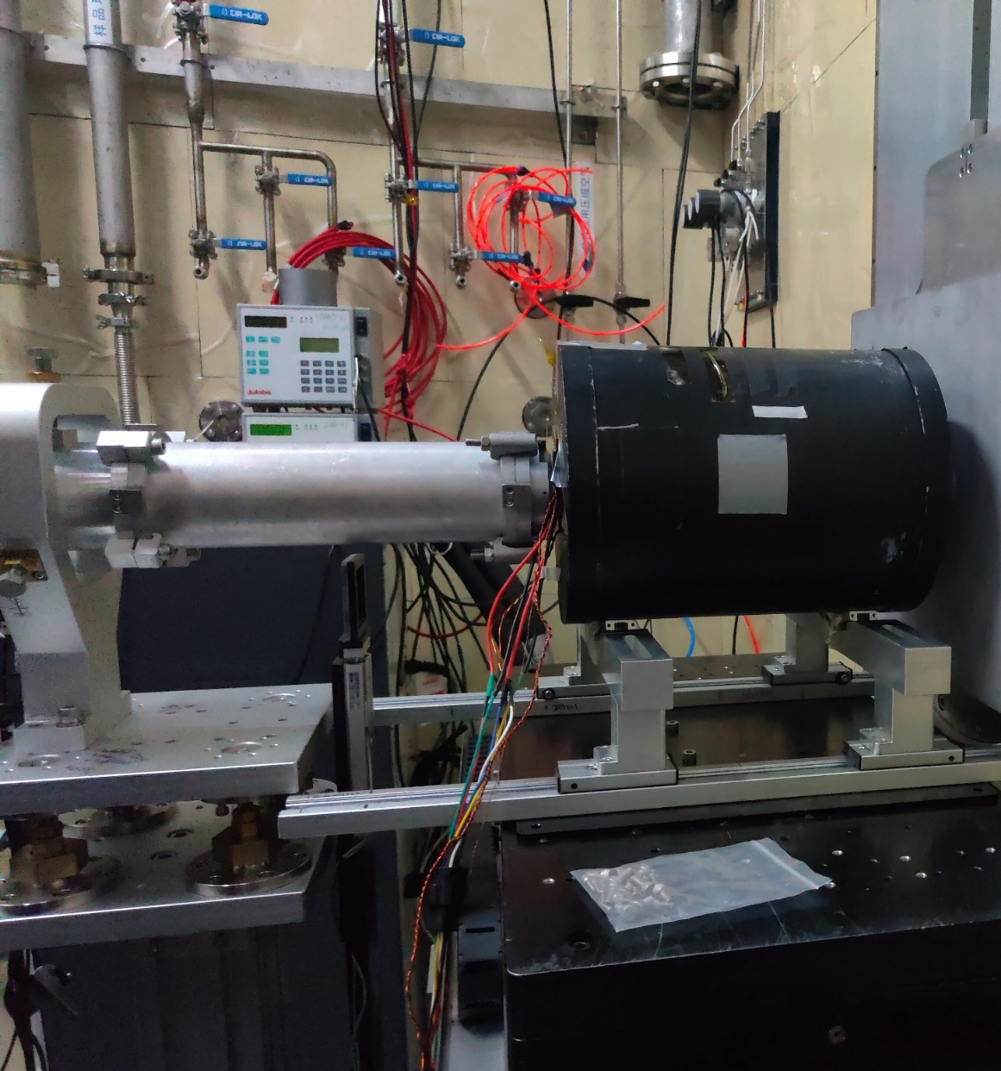
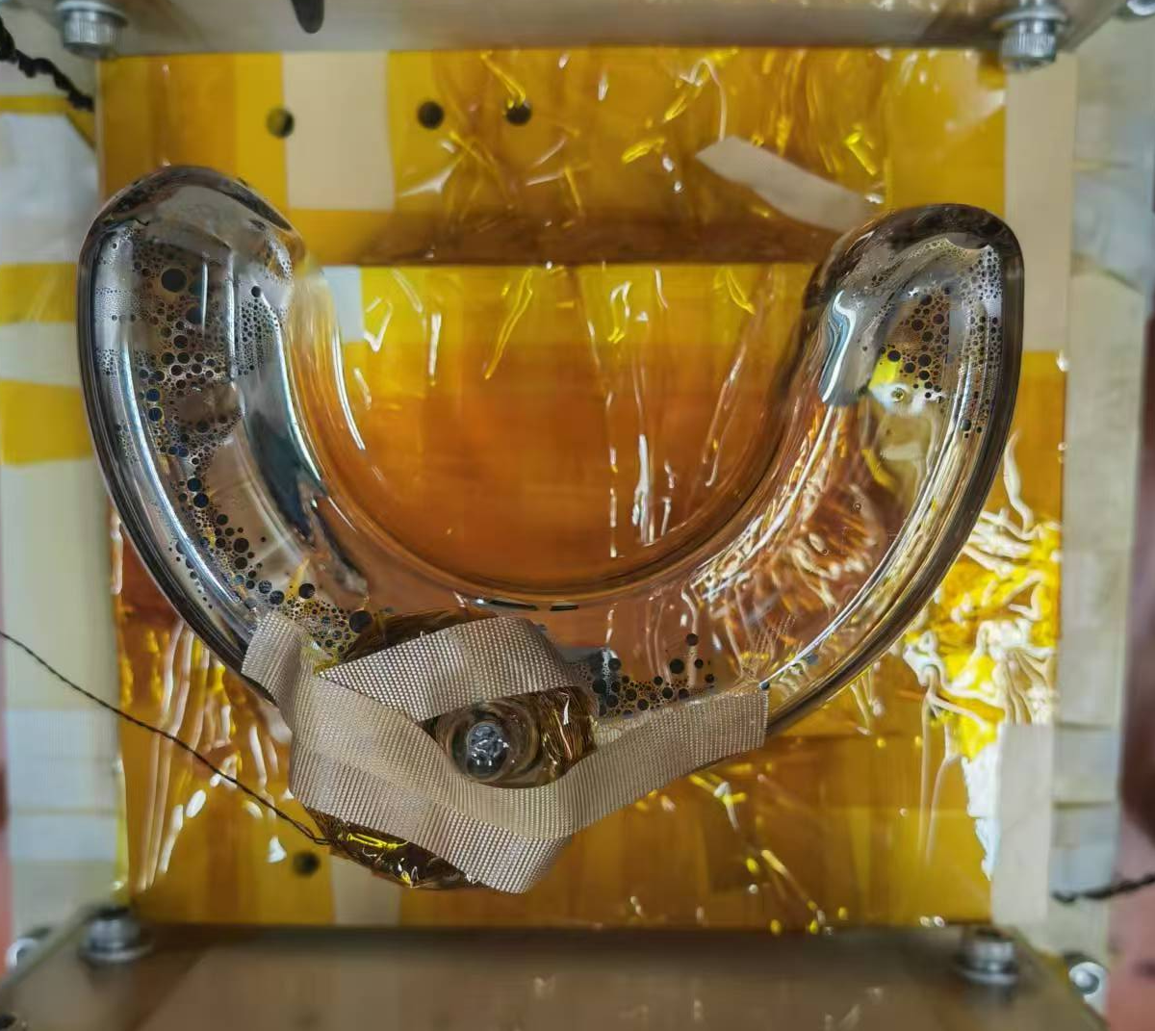
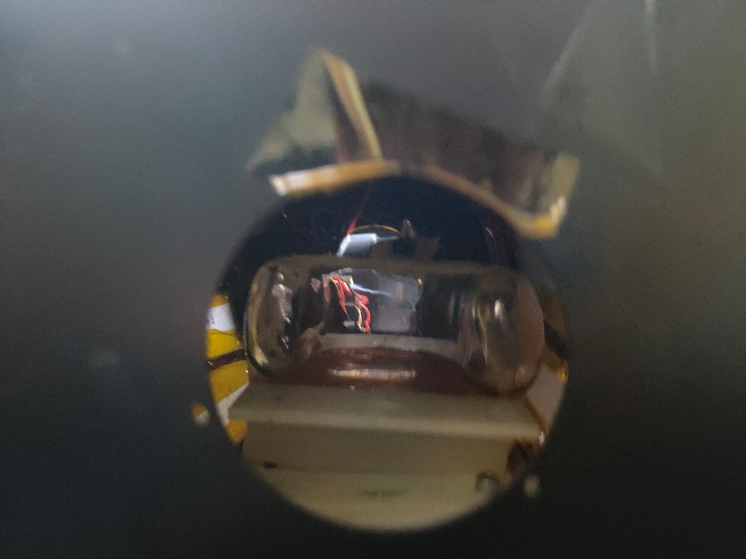
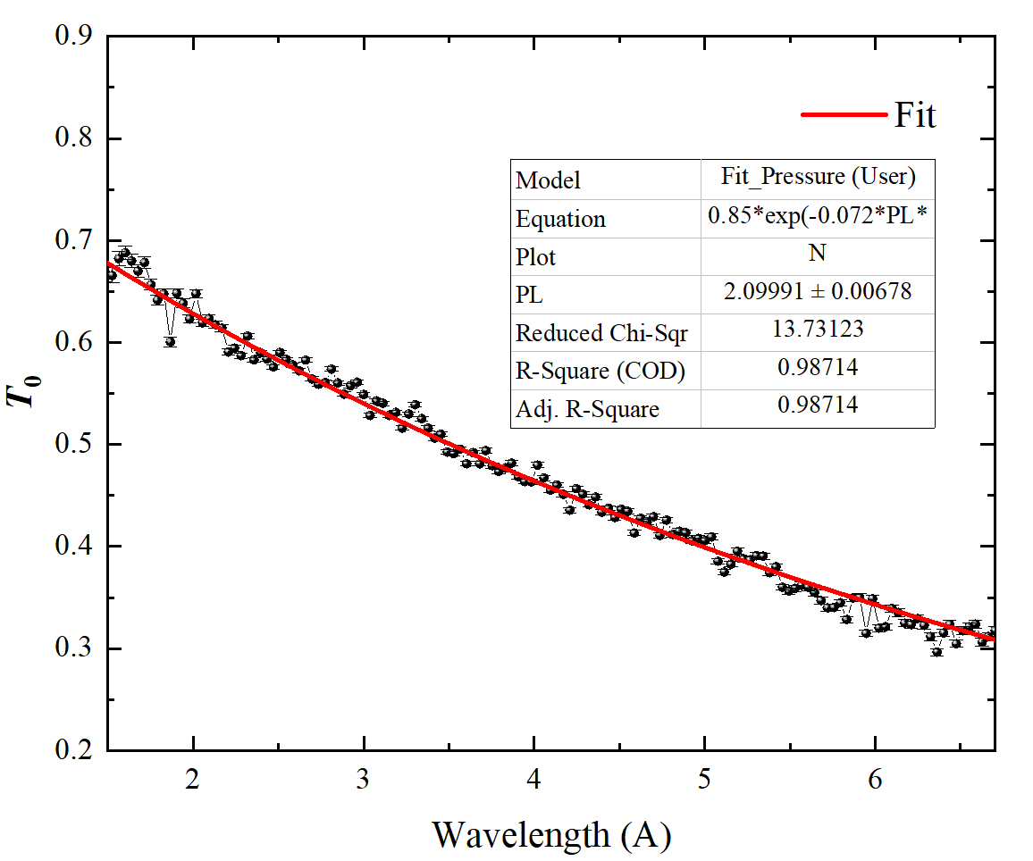
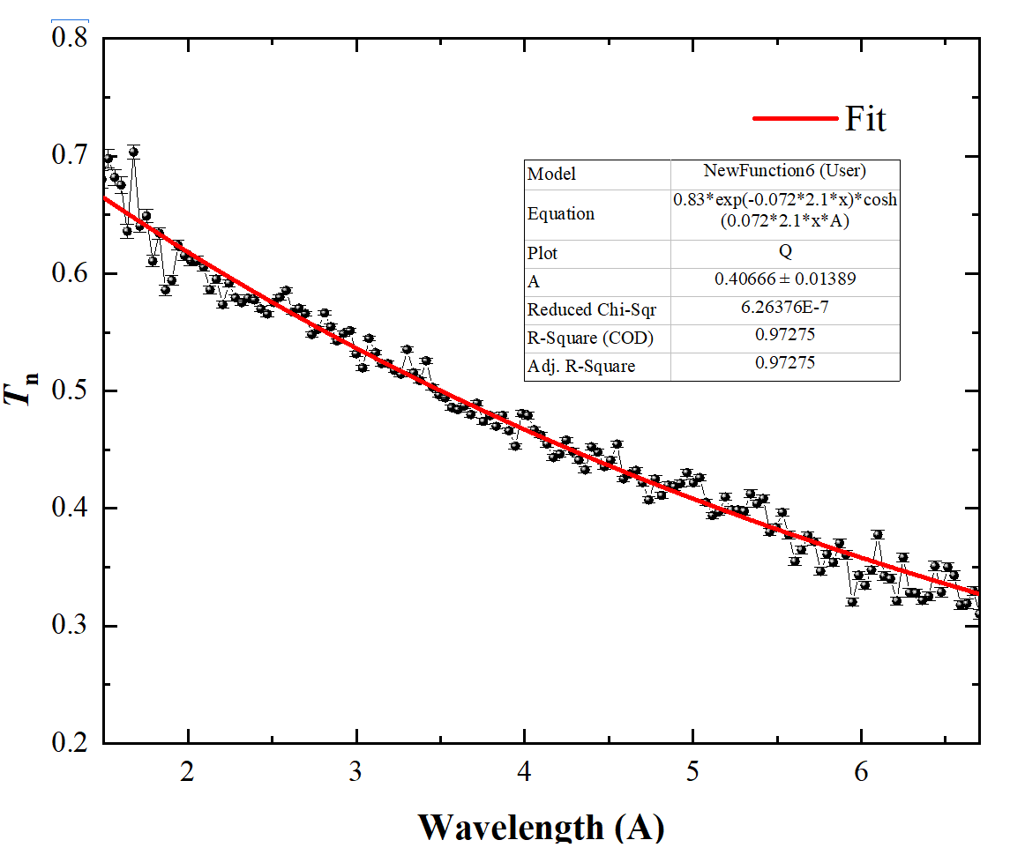
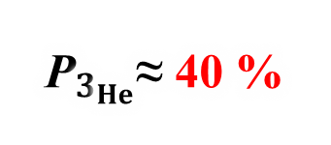
2.3 SEOP ³He-NSF
6. Off-situ ³He-NSF-Wide Angle
Length ≈ 16 cm
pl ≈2.1
${\text{P}}_{3_{He}}$≈ 40 %
p ≈0.4~0.5 bar
Established the capability for wide-angle cell production at CSNS.

Slide 17
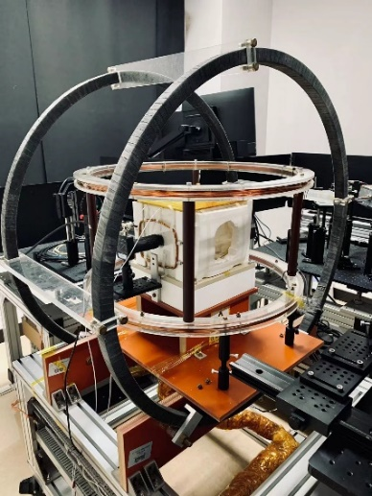
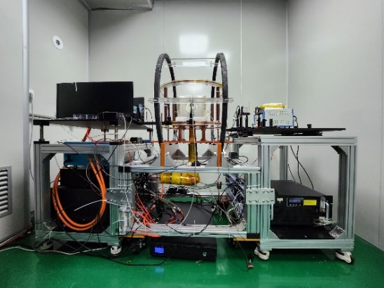
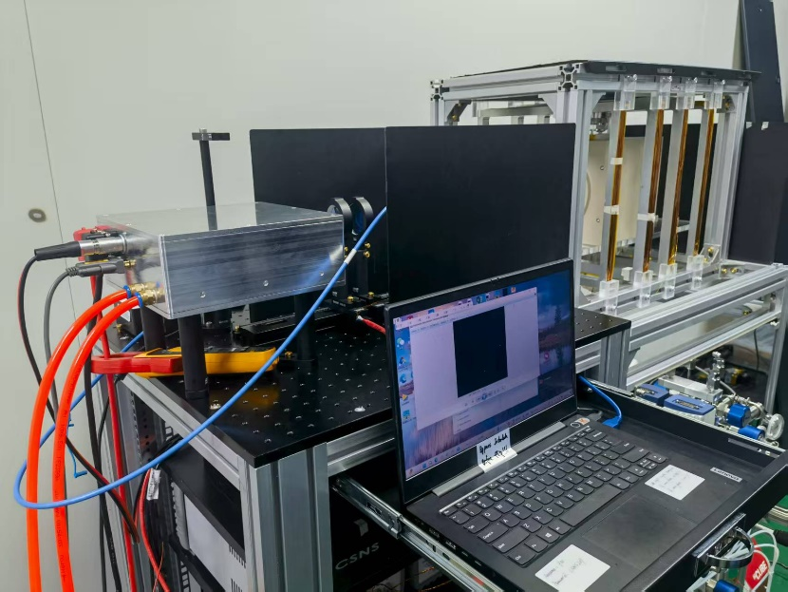
2.3 SEOP ³He-NSF
7. Off-situ ³He Pumping Stations
Off-situ 1
Off-situ 2
Off-situ 3
Key Performance of the Current Off-situ Pumping System
System Type | System Length | Cell Length | Cell Pressure | ³He Polarization | Lifetime | Neutron Polarization （2 Å） | Neutron Transmission （2 Å）
Off-situ1 | ＜ 160 cm | ≥ 8 cm | ≥ 0.8 bar | 40%-77% | ≥ 100 h | ≥ 80% | ≥ 30%
Off-situ2 | ＜ 240 cm | ≥ 8 cm | ≥ 0.6 bar | 50%-75% | ≥ 100 h | ≥ 80% | ≥ 30%
Off-situ3 | ＜ 150 cm | ≥ 8 cm | ≥ 0.3 bar | 30%-75% | ≥ 100 h | -- | --
Chin. Phys. Lett., 38 (2021), DOI: 10.1088/0256-307x/38/9/092801

Slide 18



2.3 SEOP ³He-NSF
8. In-situ ³He-NSF R&D
Stable Polarization
Integrated、Mobile
Easy Data Analysis
In-situ ³He-NSF

Slide 19




2.3 SEOP ³He-NSF
9. In-situ ³He-NSFs
Sci. China Phys. Mech. Astron., 65, 241011 (2022).
China. Phys. Lett., 42, 022901 (2025).
In-situ SEOP NSF Provides Long-Time Stable Polarized Neutron
In-situ 1
In-situ 2
In-situ 1+In-situ 2
In-situ 3
System Type | System Length | Cell Length | Cell Pressure | ³He Polarization | Neutron Polarization （2 Å） | Neutron Transmission （2 Å）
In-situ1 | ＜ 70 cm | ≥ 10 cm | ≥ 1.5 bar | ≥ 74% | ≥ 90% | ≥ 20%
In-situ2 | ＜ 55 cm | ≥ 8 cm | ≥ 2.5 bar | ≥ 75% | ≥ 95% | ≥ 15%
In-situ3 | ＜ 60 cm | ≥ 8 cm | ~ 0.9 bar | ≥ 65% | ~ 80% | ≥ 20%

Slide 20
2.4 MEOP ³He Pumping Station
1. MEOP System
Cell
Filling with ³He
Magnet
Buffer 2.5 L
Holding field for ³He
Polarized ³He Cells
RF Discharge
Hydraulic Piston
Generate metastable ³He*
Optical Pumping
5.2 L Compressor
1083 nm circular polarized narrow line laser for ³He pumping
B₀
Discharge
OPC
Optical Polarimeter
³He Polarimetry
OPC
Mirrors
Calibrate the polarization of ³He
Optical Pumping Cells
Compressor
1083 nm
Capillary
Yb Fiber Laser
Compress polarized ³He from mbar to ≥1 bar
³He Bottle
Purifier
Yb Fiber Laser

Slide 21




2.4 MEOP ³He Pumping Station
2. MEOP R&D
Cell
Design
Cleaning & Filling
Tip off
Sealed Cell

Slide 22


2.4 MEOP ³He Pumping Station
2. MEOP R&D
Magnetic Field
Magnetic Field Optimization
Magnet System
Distribution of Magnetic Field & Gradient

Slide 23

2.4 MEOP ³He Pumping Station
2. MEOP R&D
Optical System
Probe Laser
PBS
C8: 1083.356 nm
Beam Shaping
Light Trap
Pump Laser
³He Cell
PBS
C9: 1083.327 nm
HWP
QWP
Mirror
Mirror
PBS
RF Discharge
QWP
Magnet
Mirror
PBS
Balanced Photodiode
Balanced Photodiode

Slide 24



2.4 MEOP ³He Pumping Station
3. Current Status
RF Electrode & Probe Laser
Ionization & Pumping
Current Status of MEOP

Slide 25

2.4 MEOP ³He Pumping Station
3. Current Status
Pumping Parameters:
Cell Diameter: 5 cm
Cell Length: 10 cm
Pressure: ~1 mbar
Pumping Power: 4 W
Pumping Results:
Pumping Rate: 5 s/15 s
Decay Time: 195 s
³He Polarization: ~65%

Slide 26

2.4 MEOP ³He Pumping Station
4. Next step Horizontal or Vertical
Horizontal （ILL Tyrex）
Vertical （ANSTO Flynn）

Slide 27








2.5 ³He-NSF Commissioning
Neutron Beam
Calibration of Neutron Spin Control Devices
Inelastic Spectrometer
Supports
In-situ
³He-NSF
Detector
Sample
Neutron Beam
Back-n
NOPTREX
CARR
Sample
Neutron Beam
Neutron Beam
In-situ
³He NSF
SM
Neutron Beam
Neutron Beam
MR
P-SANS
Sample
In-situ ³He NSF
Detector
³He Supports
In-situ NSF

Slide 28



2.5 ³He-NSF Commissioning
1. Calibrating R&D Devices
Multiple Calibration：
Supper Mirror
Mezei Flipper
RF Spin Flipper
Supper conducting
Flipper
Zero Field Chamber
··· ···
RF Spin Flipper
Supper Mirror
Off-situ ³He-NSF
Off-situ
³He-NSF
Supper conducting
Flipper
Zero Field Chamber
Supper conducting
Flipper
Off-situ ³He-NSF
Supper conducting
Flipper
In-situ
³He-NSF

Slide 29


2.5 ³He-NSF Commissioning
First use of a polarized ³He neutron spin filter on the Back-n White Neutron Source of CSNS
2. ³He-NSF for NOPTREX @ Back-n (1st)
Polarized ³He：In-situ2
Polarization：≥68%
Pressure：2.53 bar
Beam diameter: Φ = 50 mm

Slide 30


2.5 ³He-NSF Commissioning
2. ³He-NSF for NOPTREX @ Back-n (1st)
³He Polarization＞68%, Statablity~100 hours.
Neutron Counts
³He Polarization＞68%
Polarized ³He
Un-Polarized ³He
Neutron Energy（eV）
First use of a polarized ³He neutron spin filter on the Back-n White Neutron Source of CSNS, NIMA, 1072 (2025) 170184.

Slide 31

2.5 ³He-NSF Commissioning
2. ³He-NSF for NOPTREX @ Back-n (2nd)
³He Polarization＞68%, Statablity~80 hours.
⁶Li & 5 cm La
Neutron Detector
Un-polarized Beam
GTAF BaF₂ Array
In-situ #2
³He-NSF

Slide 32
2.5 ³He-NSF Commissioning
3. ³He-NSF for Superconducting Neutron Spin Flipper
Flipping Ratio vs λ
Flipper
Neutron Detector
Guide Field
Supper Mirror
In-situ NSF
NUCL. SCI. TECH., 2022, 33:145.
Transmission vs λ

Slide 33


2.5 ³He-NSF Commissioning
4. ³He-NSF based Time-of-Flight Neutron Imaging（CSNS）
Parameters
Contents | Parameters
Type | Time-of-Flight
Neutron Band | 1 – 5 Å
Flipper | In：Superconducting Spin Flipper Out：³He-NSF
Polarizing | In：Supper Mirror Out：³He-NSF
Sample | Electrified Solenoid
Sample
Supper Mirror
Flipper
Camera
Guide Field
In-situ ³He NSF
Energy Resolved
Real-space resolved
P
Magnetic Field
Reconstruction
Chin. Phys. Lett., 2022, 39 (6): 062901.
NUCL. SCI. TECH., 2022, 33, 145.

Slide 34




2.5 ³He-NSF Commissioning
5. ³He-NSF Based Polarized Neutron Imaging at CARR (Beijing)
Deliver In-situ#2 ³He-NSF from CSNS (Dongguan) to CARR (Beijing) - 2023.09
Camera
In-situ ³He
Guide field
Guide field
Neutron
Resolution:
400 μm
FOV: 5 cm×5 cm
³He-NSF in Front of Camera
Uniform Polarization within FOV (65%, 2.7 )

Slide 35




2.5 ³He-NSF Commissioning
6. ³He-NSF for Very Small Angle Scattering Spectrometer
Spin Flipper
In-situ
³He-NSF
Results of C₂₂H₄₃AgO₂ Powder
Sample
Results for BiFeO₃ SDW Spin Density Wave (SDW) Hexagonal Structure
NUCL. SCI. TECH., 2025, Accept.

Slide 36
Outline
I. Polarized Neutrons and Hyperpolarized ³He
II. Development and Applications of ³He-NSF
III. Conclusion and Future Plans

Slide 37


Conclusion & Plans
Conclusion
Fabrication of SEOP Polarized ³He-NSF (≥70%), including: Cells, Filling Station, Pumping Laser, In-situ/off-situ.
Initiated the MEOP R&D.
Plans
R&D ³He Cells for wide-angle neutron scattering experiments.
Scaling up MEOP system as an alternative option for ³He polarizing.
Optimizing parameters of the polarized ³He devices to quickly respond the experimental requirements from the spectrometers at CSNS.

Slide 38



Acknowledgements
Development of polarized ³He-NSF at CSNS is a Team Effort
Members of Polarized Neutron Team
Group Leader: X. Tong (Tony)
Staff Members: J. Zhang, T. Wang, Z. Qin, M. Musgrave, F, Ye, L. Tian et al.
Engineer: J. Xie, Y. Li, Y, Zheng
Ph.D. Students: J. Tang, B. Wang, M. Zhang, X. Qin, Q. Zheng, T. Cui, Y. Yao, S. Wang, Q, Jiang
Master Students: G. Qiu, J. Li
Graduated Student: C. Y. Huang (Fellowship at FRM-II), Y. Dong, S. Ahmed, Y. Xiong
Open positions for Post Doc and Staff
tongxin@ihep.ac.cn
zhangjunpei@ihep.ac.cn
wangtianhao@ihep.ac.cn
Thank you for your attention.

