Slide 1


Current developments of polarized sources and polarimeter at FZ Jülich and further applications
23th September 2025
Ralf Engels (IKP-2@FZJ/GSI)
Notes:
25 minutes + 5 minutes discussion

Slide 2
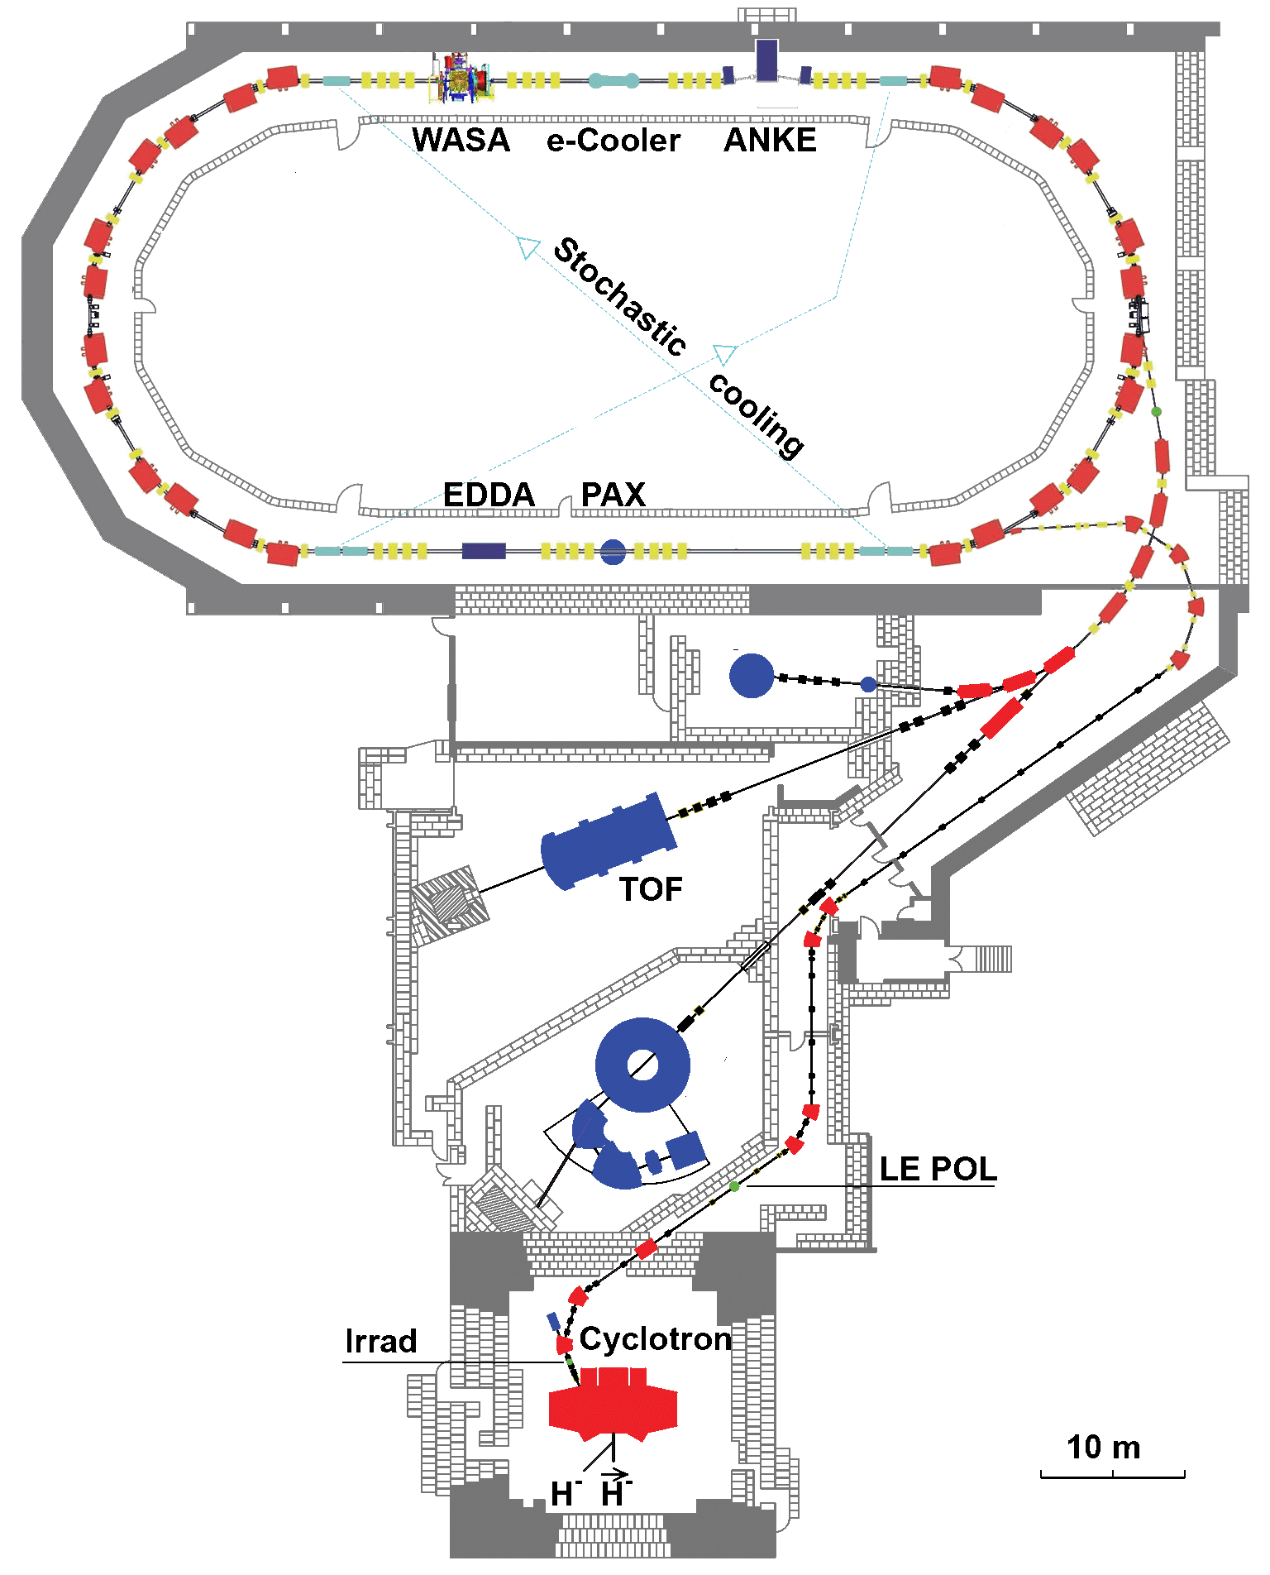
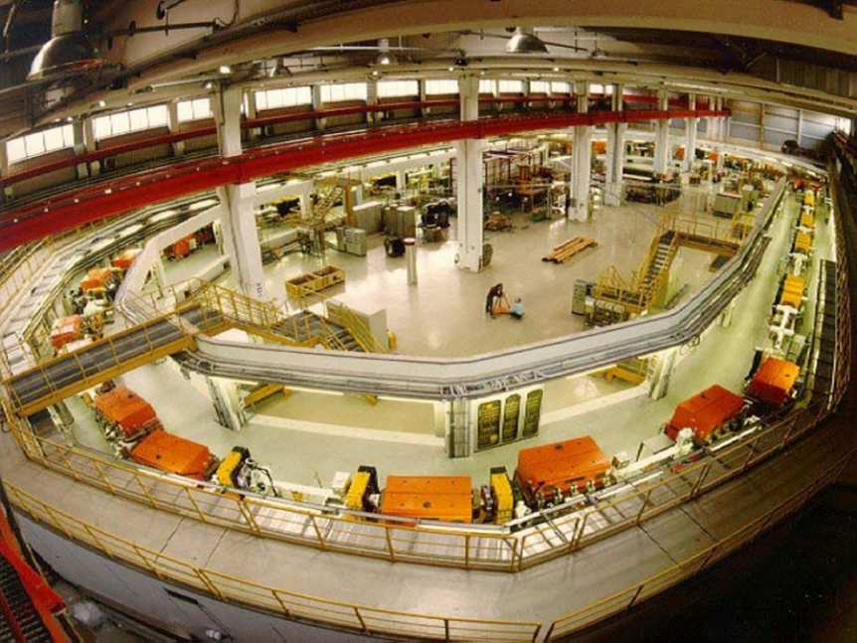
COSY@FZ Jülich
p, p, d, d
with momenta up to 3.7 GeV/c
internal experiments –
with the circulating beam
external experiments –
with the extracted beam

Slide 3
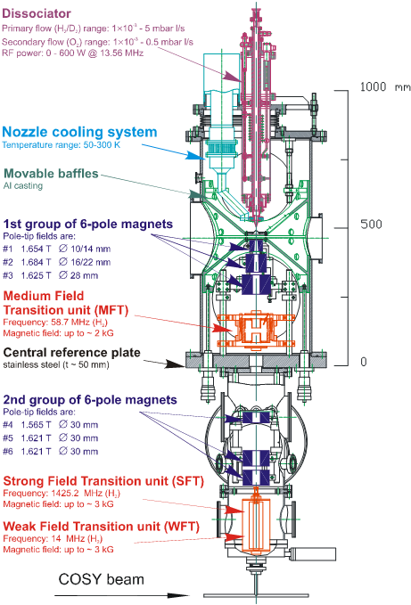
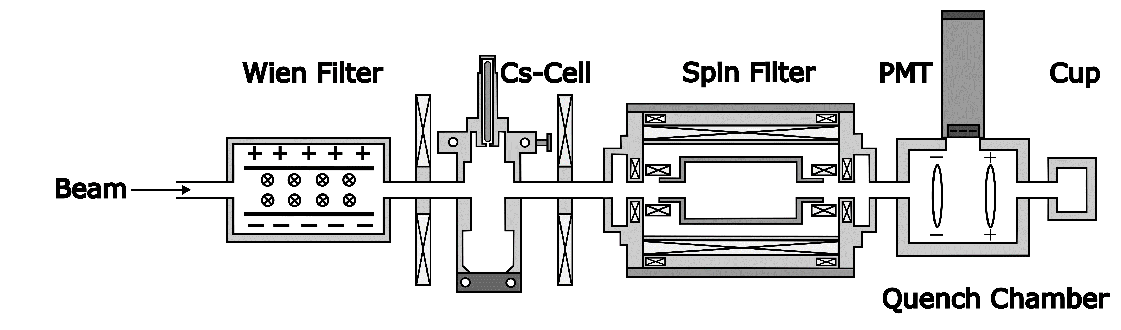




The Tools: ABS and LSP
$${\overset{⃑}{H}}^{+}/{\overset{⃑}{D}}^{+}$$
$${\overset{⃑}{H}}_{2S}/{\overset{⃑}{D}}_{2S}$$
$$α_{1},α_{2},\left(α_{3}\right)$$
$$H_{1S}/D_{1S}$$

Slide 4
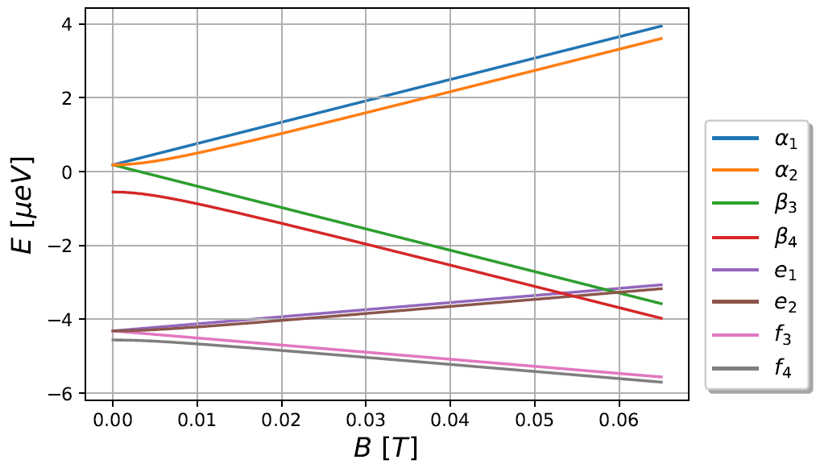
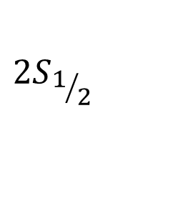
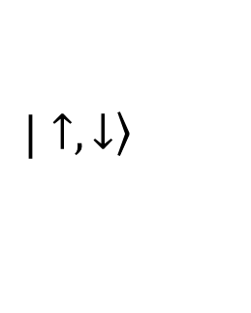

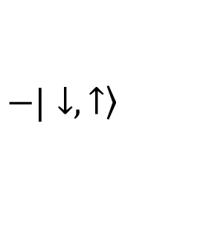
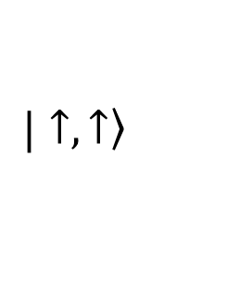

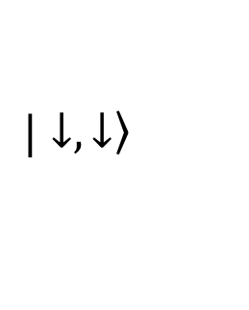

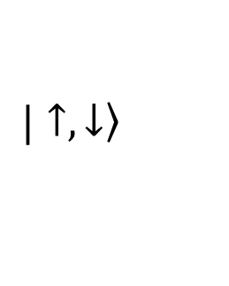
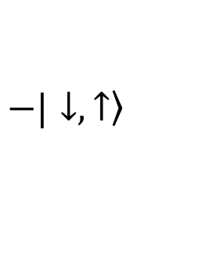
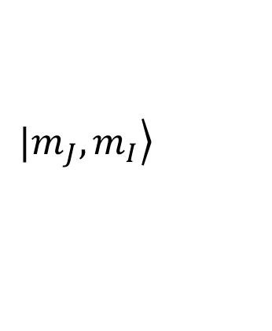
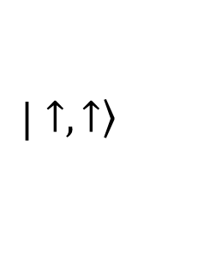
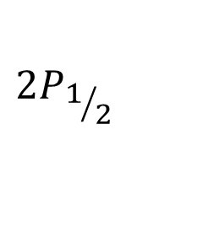
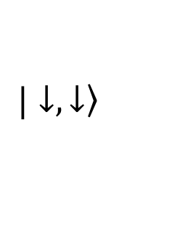
Breit-rabi diagram
$$B≫B_{c}$$
$$τ=0.14 s$$
$$\left.|m_{J},m_{I}\right\rangle$$
$${2S}_{1/2}$$
$$\left.|↑,↑\right\rangle$$
$$\left.|↑,↓\right\rangle$$
$$\left.|↓,↓\right\rangle$$
$$\left.−|↓,↑\right\rangle$$
$$τ=1.6 ns$$
$$\left.|↑,↑\right\rangle$$
$$\left.|↑,↓\right\rangle$$
$$\left.|↓,↓\right\rangle$$
$${2P}_{1/2}$$
$$\left.−|↓,↑\right\rangle$$

Slide 5
The Lamb-shift polarimeter
m_{I} = +1/2
N_{+1/2} – N_{-1/2}
N_{+1/2} + N_{-1/2}
P=
m_{I} = -1/2
R. Engels et al., Rev. Sci. Instr. 74 4607 (2003)
R. Engels et al., Rev. Sci. Instr. 85 103505 (2014)
4

Slide 6
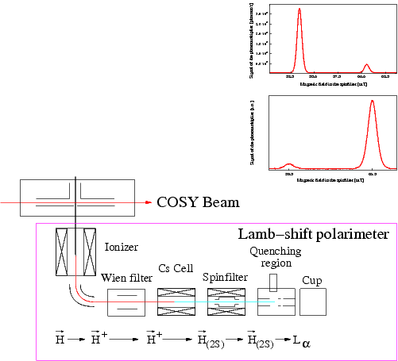

The Lamb-shift Polarimeter
6-pole
magnet
Projects at COSY:
1.) Tuning of the ANKE-ABS
→ $p, d, H, D$
N₋
rf-transition
M. Mikirtytchiants et al., NIM A 721 83 (2013)
6-pole
magnet
N₊

Slide 7
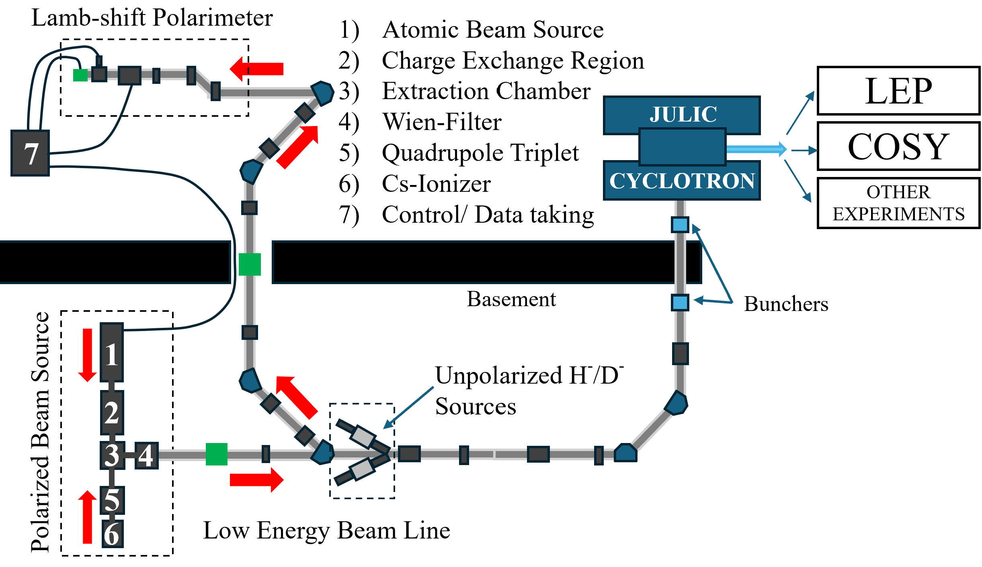

The Lamb-shift Polarimeter
Projects at COSY:
1.) Tuning of the ANKE-ABS
→ $p, d, H, D$
2.) Polarization measurement
of the polarized ion source
of COSY → $H^{−}, D^{−}$
(see talk by S. Pütz)
M. Mikirtytchiants et al., NIM A 721 83 (2013)

Slide 8
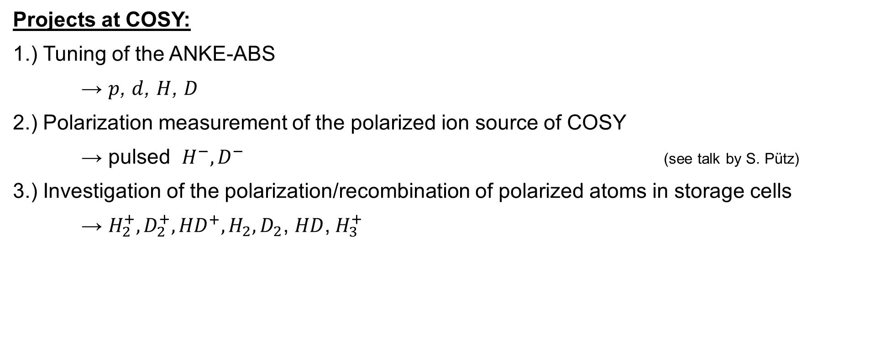
The Lamb-shift Polarimeter
Projects at COSY:
1.) Tuning of the ANKE-ABS
→ $p$, $d$, $H$, $D$
2.) Polarization measurement of the polarized ion source of COSY
→ pulsed $H^{−}, D^{−}$ (see talk by S. Pütz)
3.) Investigation of the polarization/recombination of polarized atoms in storage cells
→ $H_{2}^{+}, D_{2}^{+}, {HD}^{+}, H_{2}, D_{2}$, $HD$,${ H}_{3}^{+}$
M. Mikirtytchiants et al., NIM A 721 83 (2013)

Slide 9
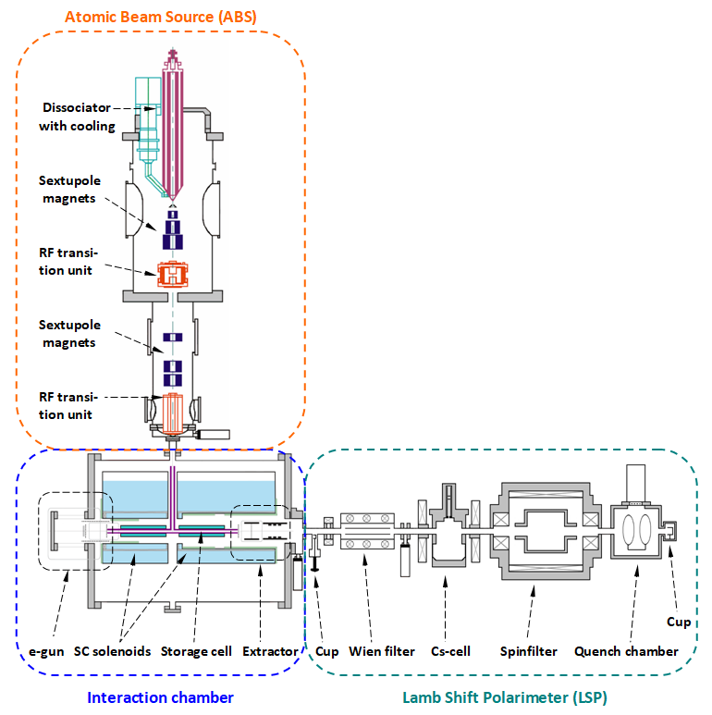
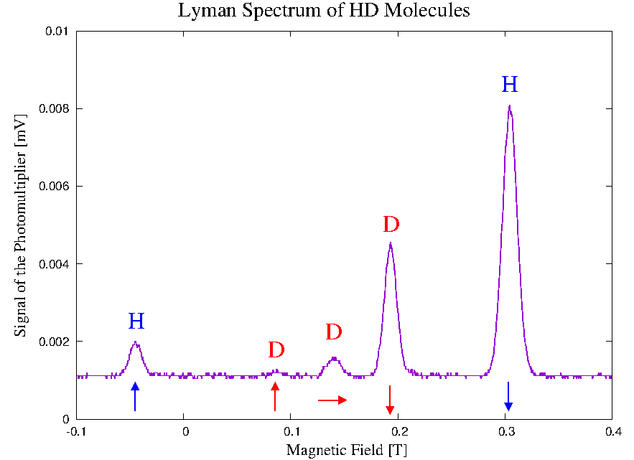
Storage-Cell investigations
2nd / parallel life of the ANKE ABS:
Investigation of the nuclear polarization during:
Recombination processes
Wall interaction
---
R. Engels et al., Phys. Rev. Lett. 124 113003 (2020)
R. Engels et al., Phys. Rev. Lett. 115 113007 (2015)

Slide 10
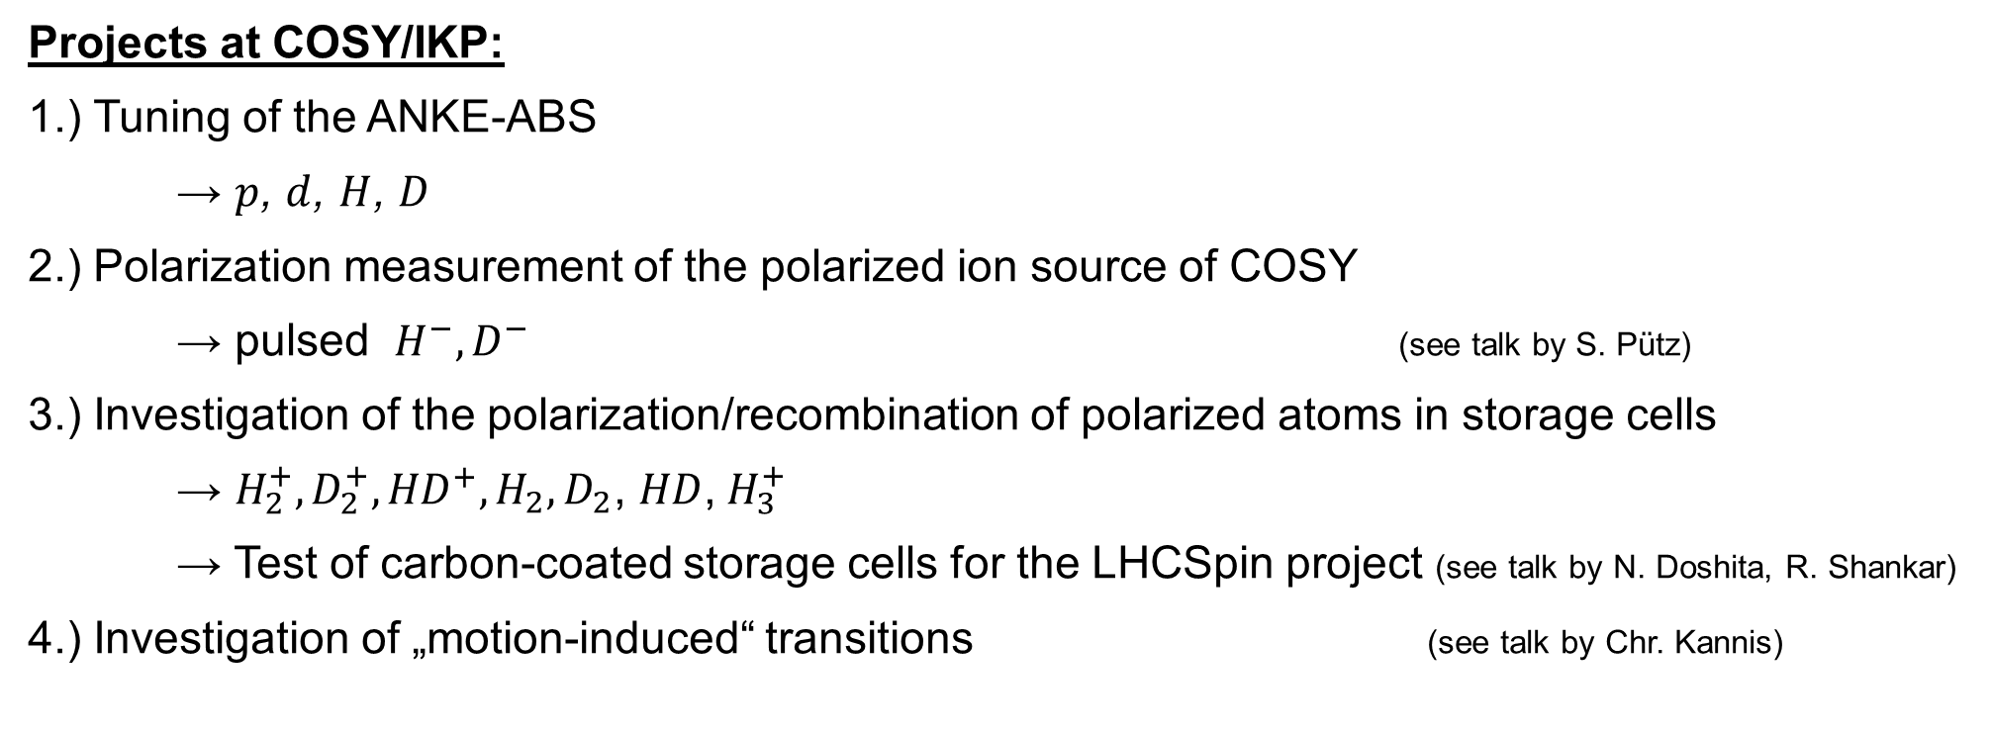
The Lamb-shift Polarimeter
Projects at COSY/IKP:
1.) Tuning of the ANKE-ABS
→ $p$, $d$, $H$, $D$
2.) Polarization measurement of the polarized ion source of COSY
→ pulsed $H^{−}, D^{−}$ (see talk by S. Pütz)
3.) Investigation of the polarization/recombination of polarized atoms in storage cells
→ $H_{2}^{+}, D_{2}^{+}, {HD}^{+}, H_{2}, D_{2}$, $HD$,${ H}_{3}^{+}$
→ Test of carbon-coated storage cells for the LHCSpin project (see talk by N. Doshita, R. Shankar)
4.) Investigation of „motion-induced“ transitions (see talk by Chr. Kannis)
M. Mikirtytchiants et al., NIM A 721 83 (2013)
T. El-Kordy et al., Chinese Phys. C 49 084002 (2025)
T. El-Kordy et al.; NIM A 1068 169707 (2024)
E. Engels et al., EPJ D 75 257 (2021)

Slide 11
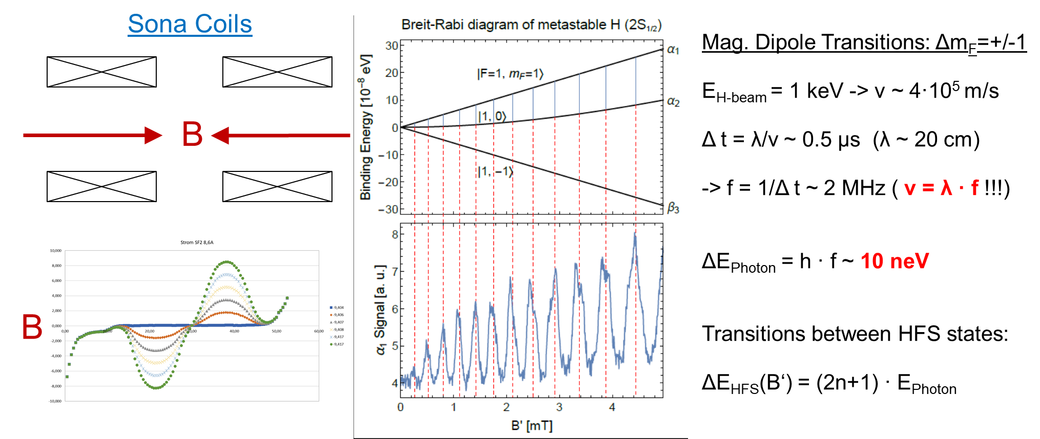
Motion-induced transitions
Modified Sona transitions

Slide 12
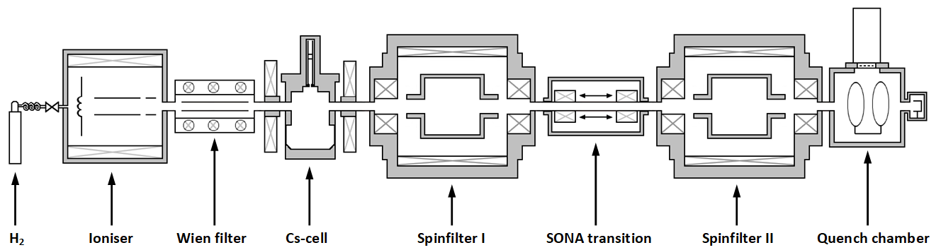
Motion-induced transitions
H₂ -> H₂⁺, p -> p -> H_{(2S)} -> H_{(2S / α1)} -> ? -> H_{(2S / α1)} -> Ly-α

Slide 13

More Projects with the LSP
5.) Bound beta decay: BOB $n →p+e+ \overline{ν}$ ↔ $n → H_{2S}+ \overline{ν} ($branching ratio: 10⁻⁷)
spin conservation + helicity: β3 is not allowed
→ search for this forbidden state needs Spinfilter to separate the β states
N. Faatz et al., Physics Open 22(11) 100248 (2024)

Slide 14
Breit-rabi diagram
$$B≫B_{c}$$
$$τ=0.14 s$$
$$\left.|m_{J},m_{I}\right\rangle$$
$${2S}_{1/2}$$
$$\left.|↑,↑\right\rangle$$
$$\left.|↑,↓\right\rangle$$
$$\left.|↓,↓\right\rangle$$
$$\left.−|↓,↑\right\rangle$$
$$τ=1.6 ns$$
$$\left.|↑,↑\right\rangle$$
$$\left.|↑,↓\right\rangle$$
$$\left.|↓,↓\right\rangle$$
$${2P}_{1/2}$$
$$\left.−|↓,↑\right\rangle$$

Slide 15
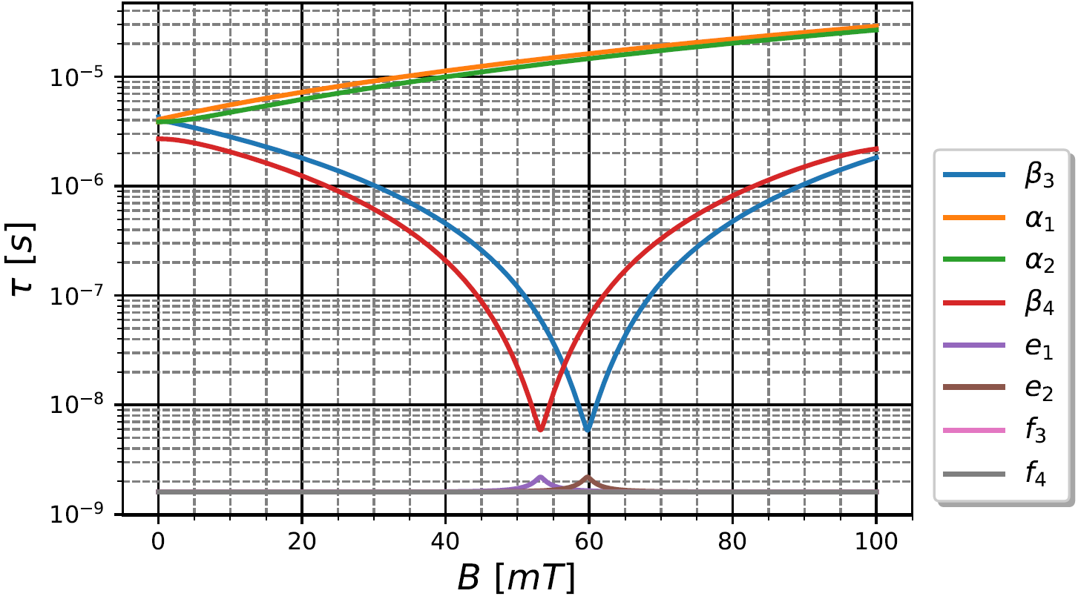
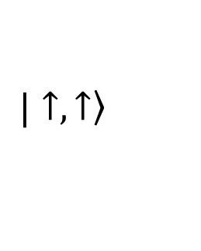

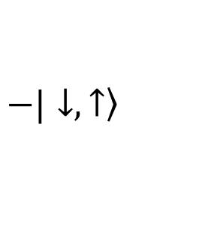

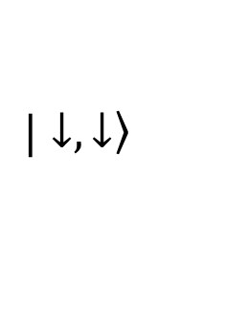
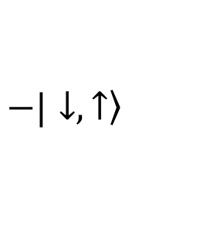
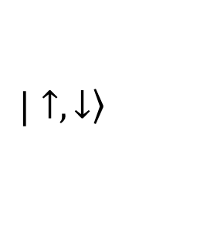
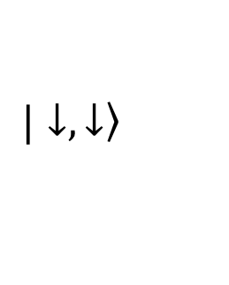
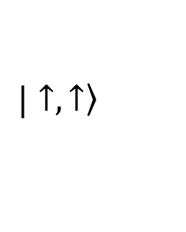
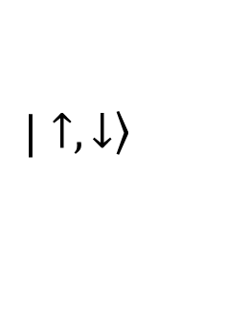
The Lamb-shift polarimeter
$$E_{x}={10}^{3}\frac{V}{m}$$
$$B≫B_{c}$$
$$\left.|↓,↓\right\rangle$$
$$\left.|↑,↑\right\rangle$$
$$\left.|↑,↓\right\rangle$$
$$\left.−|↓,↑\right\rangle$$
$$\left.|↑,↑\right\rangle$$
$$\left.|↑,↓\right\rangle$$
$$\left.|↓,↓\right\rangle$$
$$\left.−|↓,↑\right\rangle$$

Slide 16
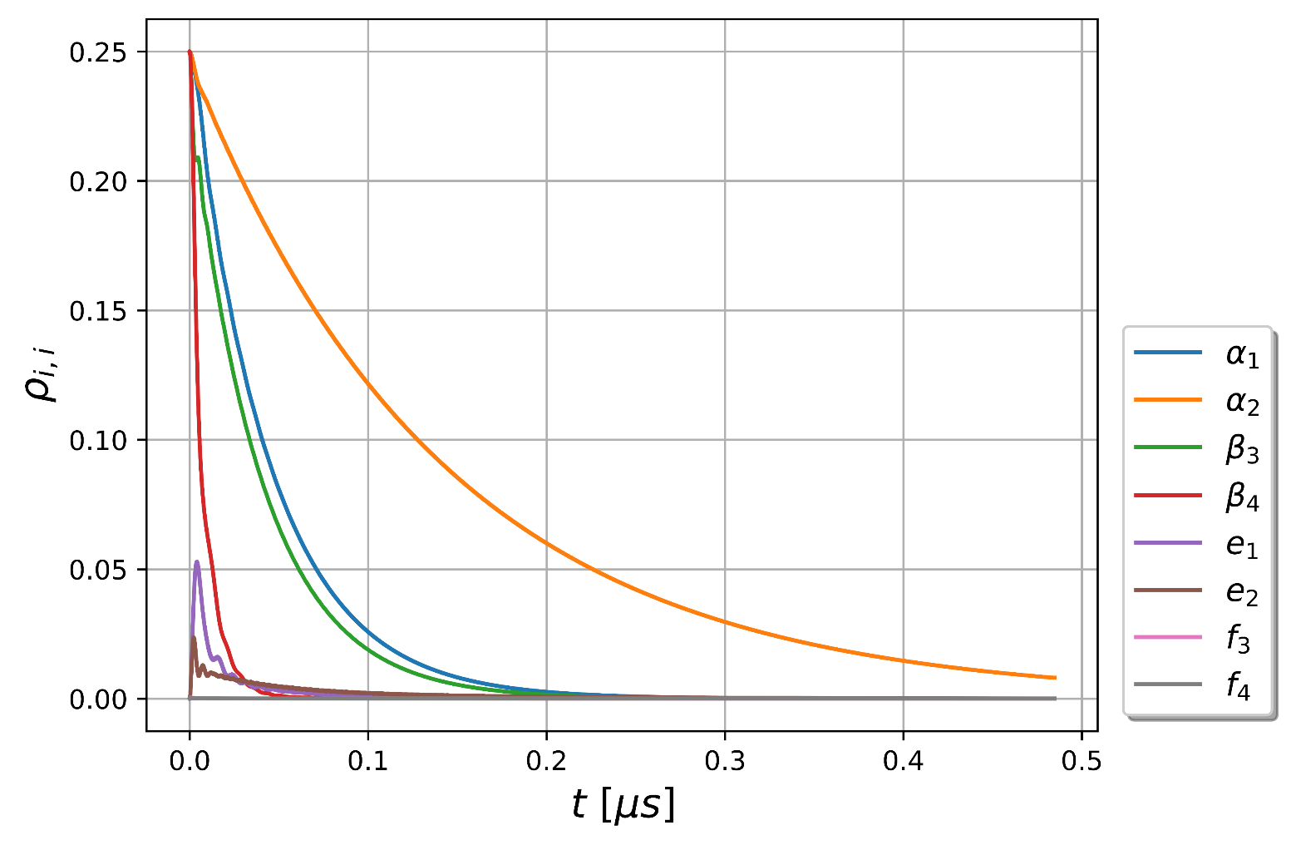
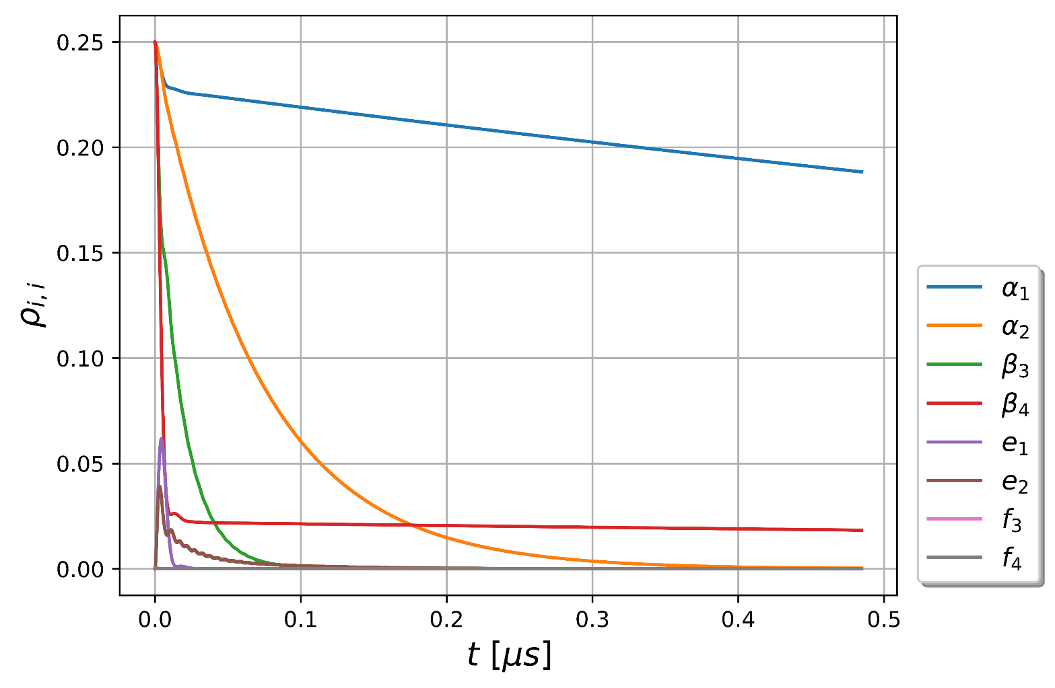



The Lamb-shift polarimeter
$$B=50 mT$$
$$B=54 mT$$
$$ρ_{i,i}{\left.​\right|}_{t=0}=0.25$$

Slide 17
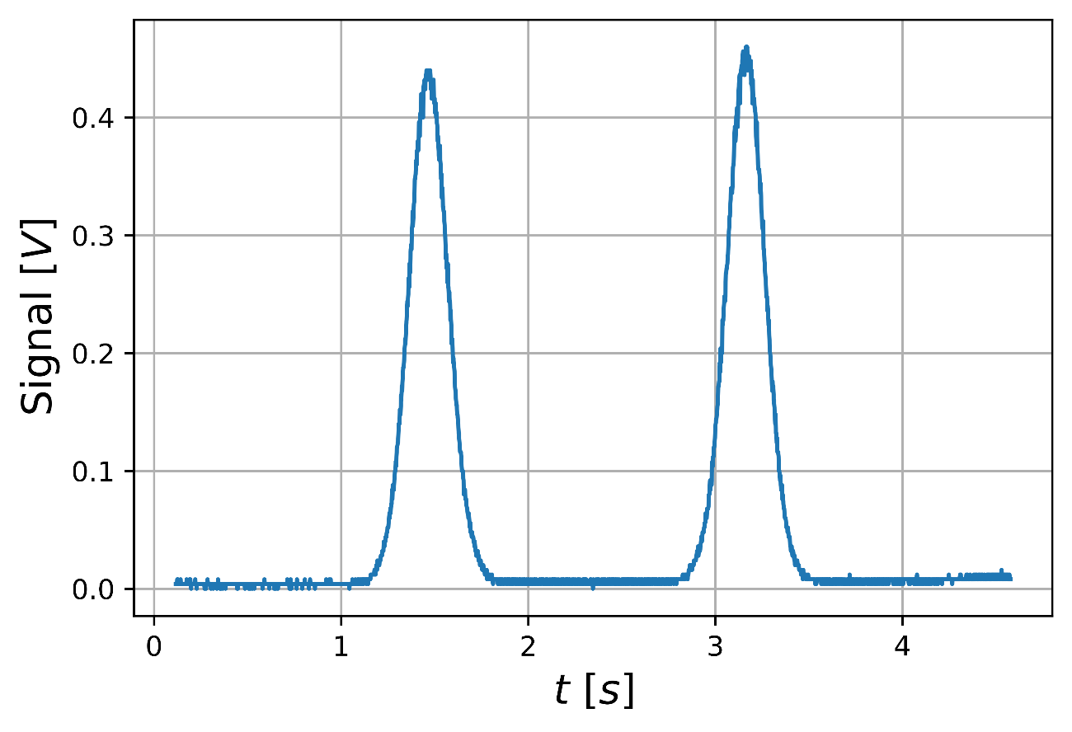
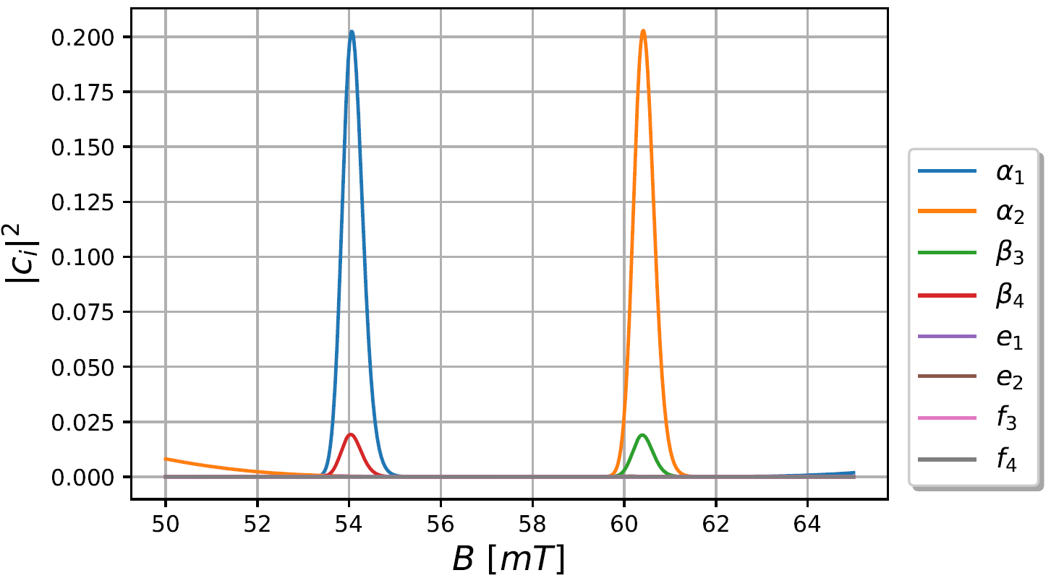



The Lamb-shift polarimeter
Measurement
Simulation
$$α_{1}$$
$$α_{2}$$
$$B\sim t$$

Slide 18
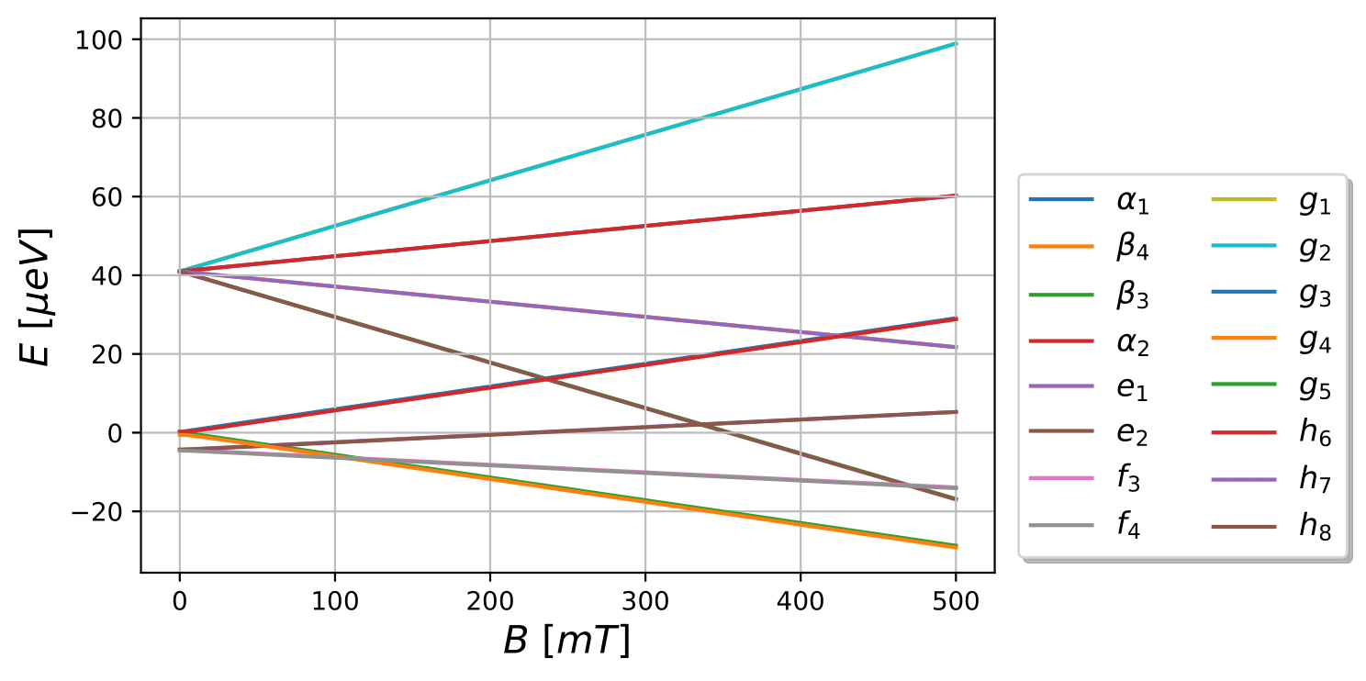

A second-generation Spinfilter
2P_{3/2}
2S_{1/2}
$$11,94GHz$$
2P_{1/2}

Slide 19
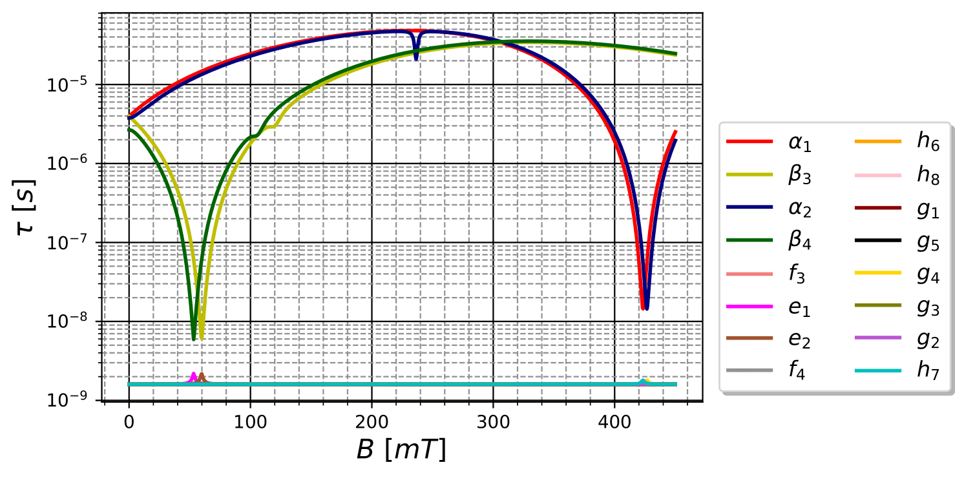

A second-generation Spinfilter
$$E_{x}={10}^{3}\frac{V}{m}$$

Slide 20
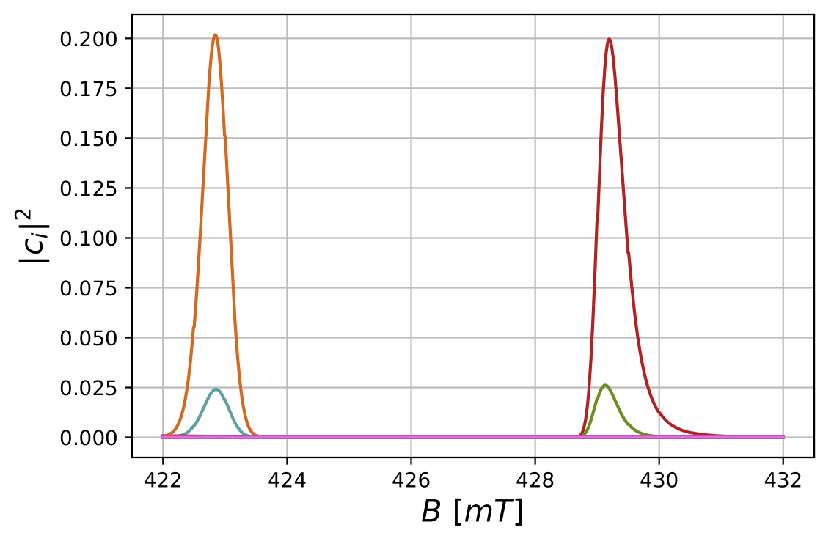
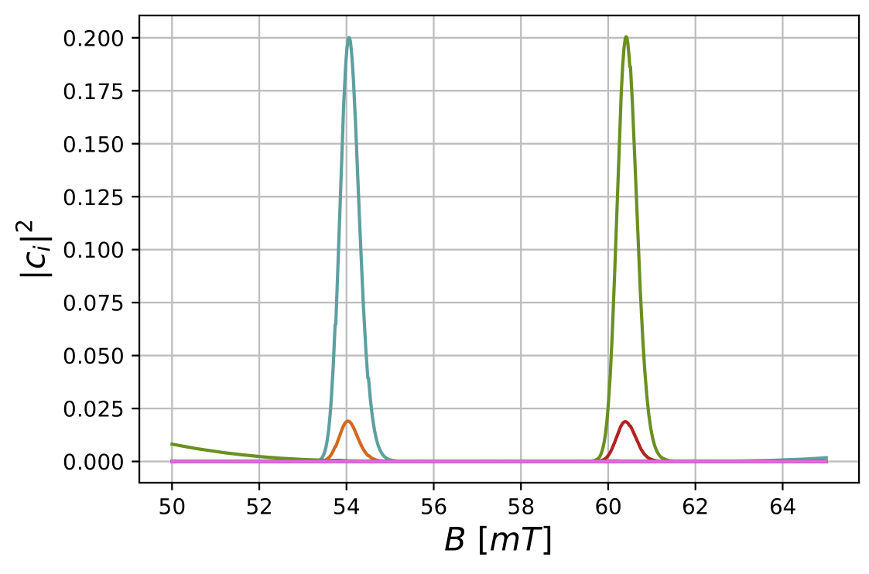








A second-generation Spinfilter
$$E_{0}=0.9⋅{10}^{3}\frac{V}{m}$$
$$E_{x}=2.6⋅{10}^{3}\frac{V}{m}$$
$$E_{0}=1.1⋅{10}^{3}\frac{V}{m}$$
$$E_{x}=1.8⋅{10}^{3}\frac{V}{m}$$
$$β_{4}$$
$$β_{3}$$
$$α_{1}$$
$$α_{2}$$

Slide 21
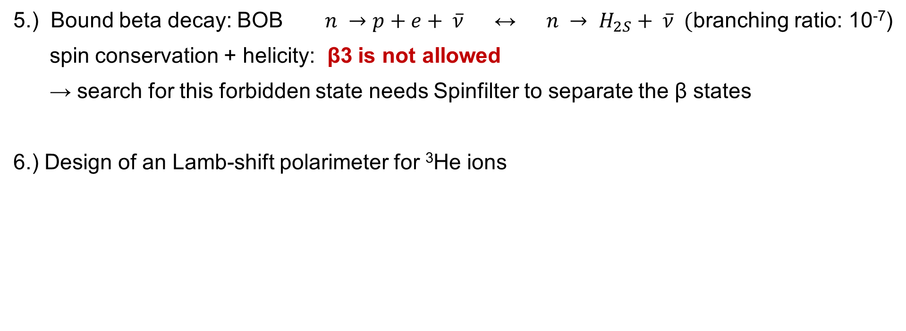
More Projects with the LSP
5.) Bound beta decay: BOB $n →p+e+ \overline{ν}$ ↔ $n → H_{2S}+ \overline{ν} ($branching ratio: 10⁻⁷)
spin conservation + helicity: β3 is not allowed
→ search for this forbidden state needs Spinfilter to separate the β states
6.) Design of an Lamb-shift polarimeter for ³He ions
N. Faatz et al., Physics Open 22(11):100248 (2024)

Slide 22
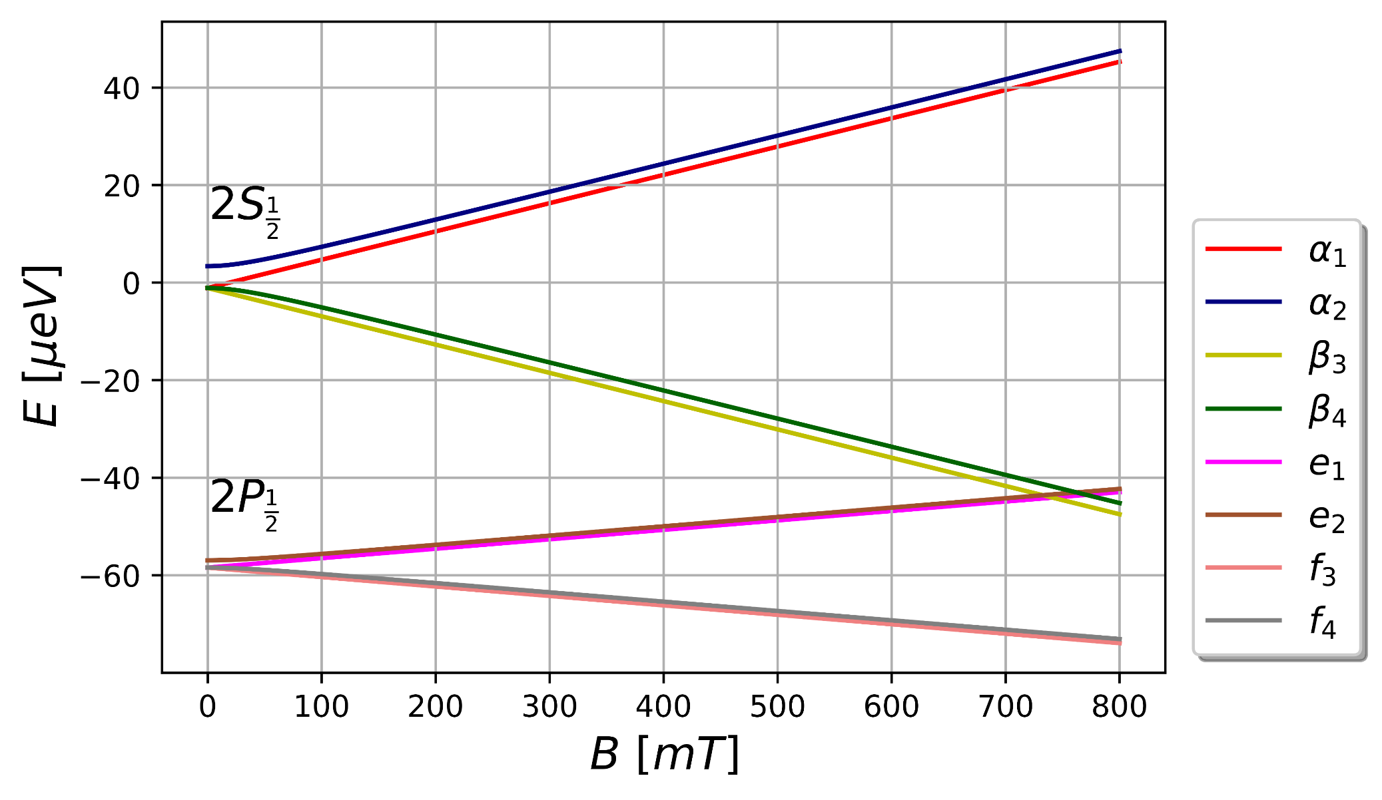
A spinfilter for ³He ions
³He⁺

Slide 23
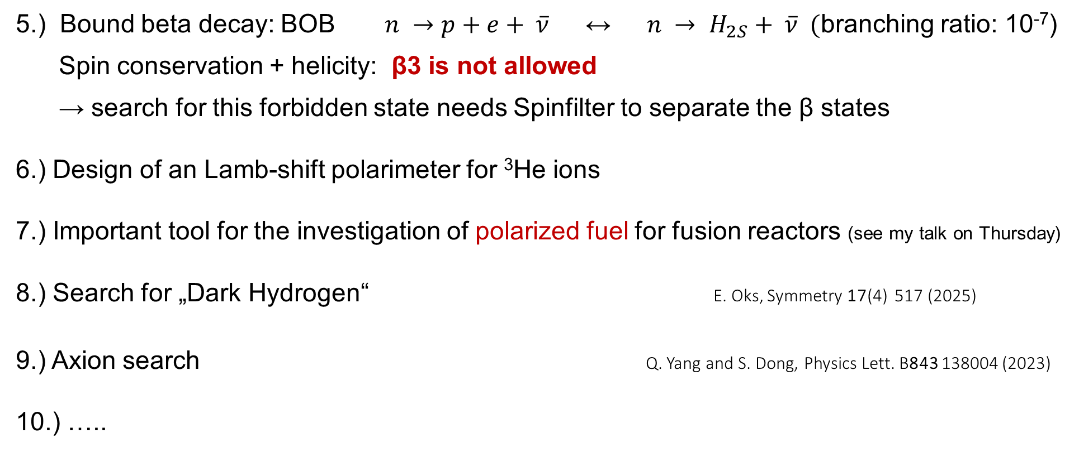
More Projects with the LSP
5.) Bound beta decay: BOB $n →p+e+ \overline{ν}$ ↔ $n → H_{2S}+ \overline{ν} ($branching ratio: 10⁻⁷)
Spin conservation + helicity: β3 is not allowed
→ search for this forbidden state needs Spinfilter to separate the β states
6.) Design of an Lamb-shift polarimeter for ³He ions
7.) Important tool for the investigation of polarized fuel for fusion reactors (see my talk on Thursday)
8.) Search for „Dark Hydrogen“ E. Oks, Symmetry 17(4) 517 (2025)
9.) Axion search Q. Yang and S. Dong, Physics Lett. B843 138004 (2023)
10.) …..
N. Faatz et al., Physics Open 22(11):100248 (2024)

Slide 24
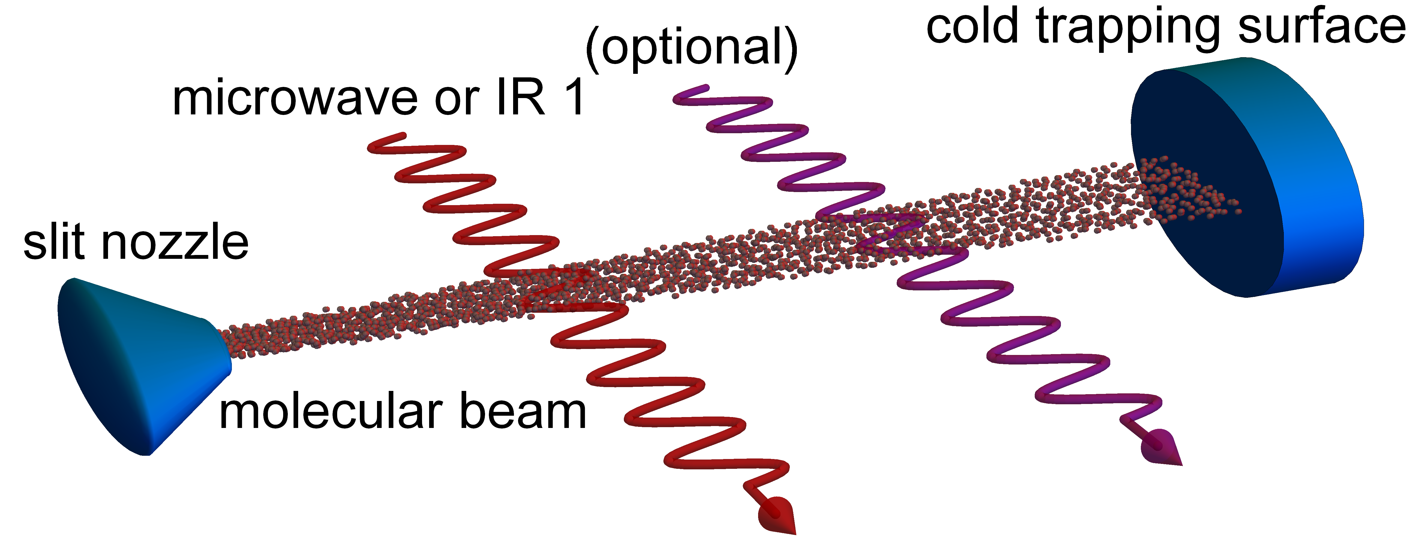
How to produce enough polarized fuel, i.e. D, T and ³He?
New Idea from P. Rakitzis: (Patent)
Collecting pol. molecules on a cold surface as ice inside a strong magnetic field
Intense cold D₂ or HD beam:
10²² mol./s, sharp velocity
Transfer of rotational polarization into nuclear polarization with „motion-induced“ transitions or via coherent hyperfine beat
→ see talk of Ch. Kannis on Tuesday
Optical pumping of the rot. magnetic moment J into m_{J} = +1/-1 with
IR laser or microwaves

Slide 25
Conclusion
ABS and Lamb-shift polarimeter with its Spinfilter is
a nice tool for fundamental and applied physics.
Lamb-shift polarimeter/Spinfilter were used at Los Alamos, Moscow State Uni., TUNL,
Uni. Cologne, KVI, RHIC, Uni. Tsukuba, FZ Jülich, PNPI, BINP and now at IMP.
(see talks by Yaojie Zhai and Sheng Zhang)

Slide 26
How to measure „Dark Hydrogen“ with an LSP
H₂ →

Slide 27



How to measure axions with an LSP

