Slide 1



Spin-Polarized Proton-Boron (p-¹¹B) Fusion:
Pathways to Clean Energy
LI Zhi
¹ Hebei Key Laboratory of Compact Fusion, Langfang, China
² ENN Science and Technology Development Co., Ltd., Langfang, China
³ Shandong University, Qingdao, China
*Email：lizhiz@enn.cn
2025.09.22-26, Qingdao, China

Slide 2
Outline
Fusion approaches, fuel options, and critical conditions
Ideal ignition conditions and reaction rate enhancement for p-¹¹B fusion
Polarization research advances toward p-¹¹B fusion energy applications

Slide 3
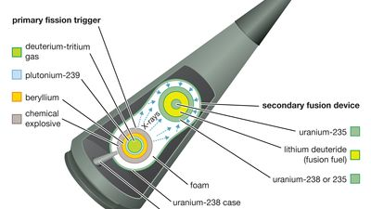
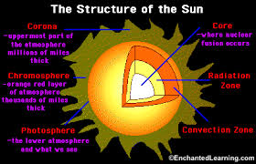
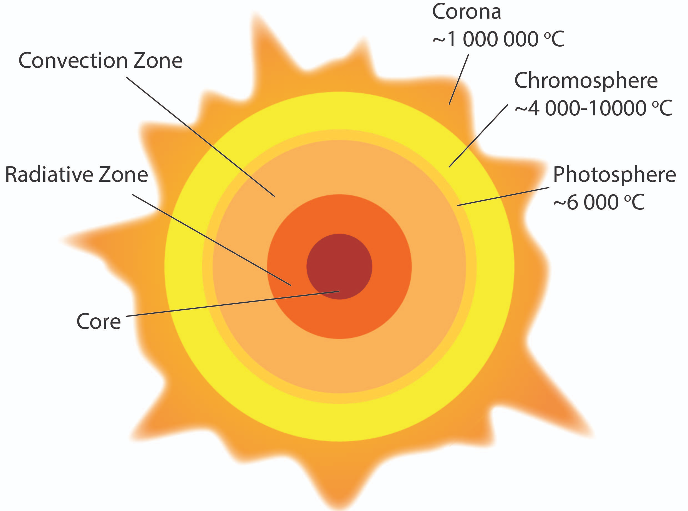
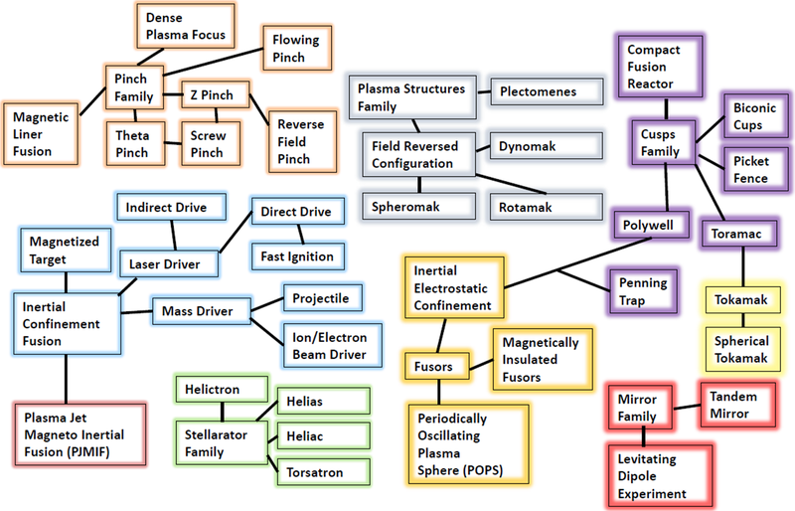
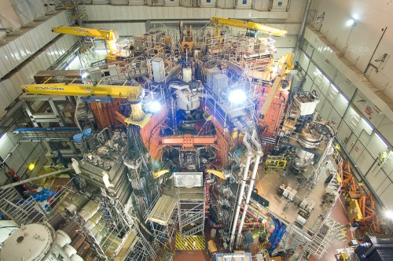

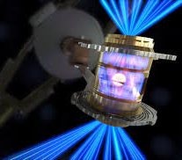

Achieved Fusion Approaches
Stars
Hydrogen bomb
JET
Directions for Controlled Fusion
Inertial Confinement Fusion (ICF)
Magnetic Confinement Fusion (MCF)
NIF
3

Slide 4
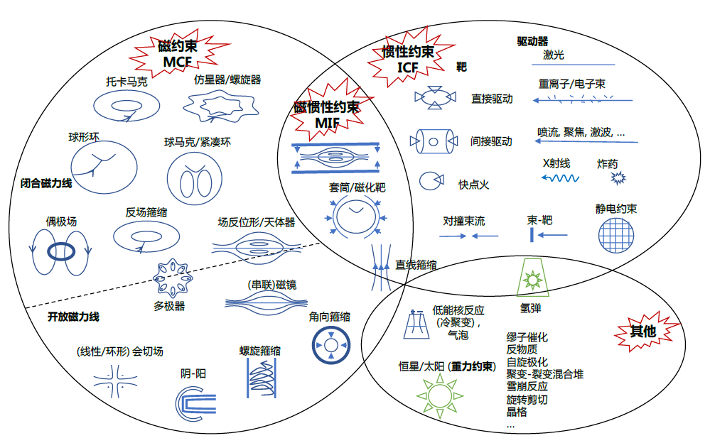
Zoo of Fusion Devices
聚变点火原理概述，H.S. XIE(2023)

Slide 5
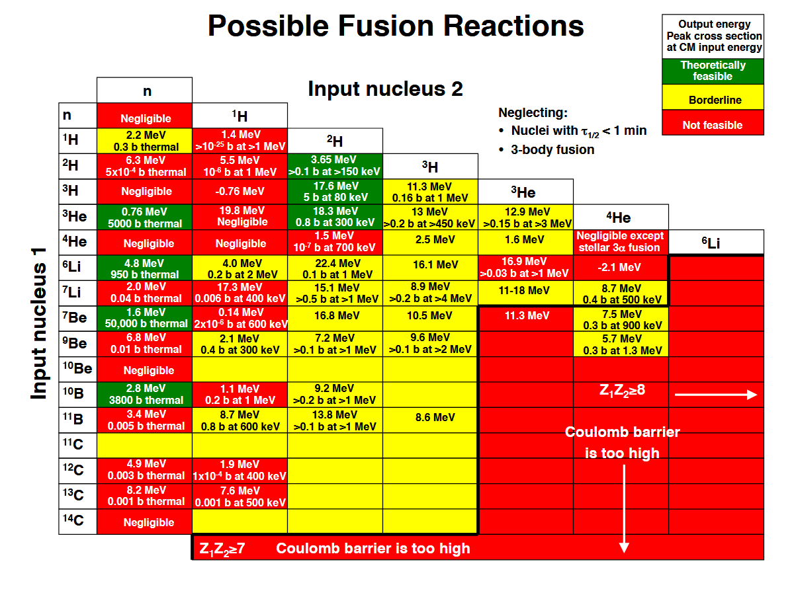
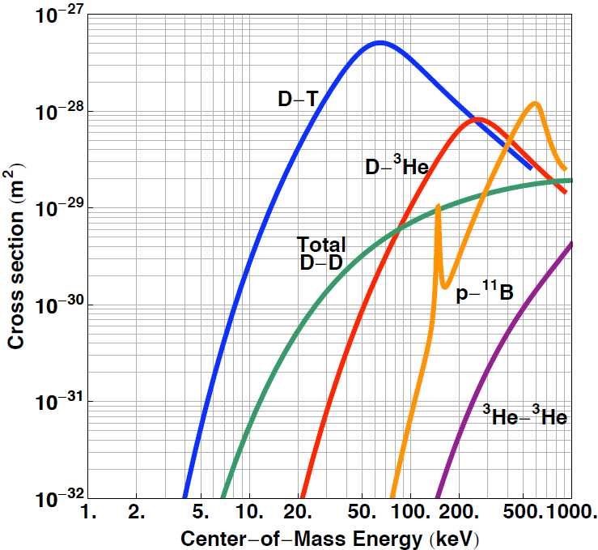
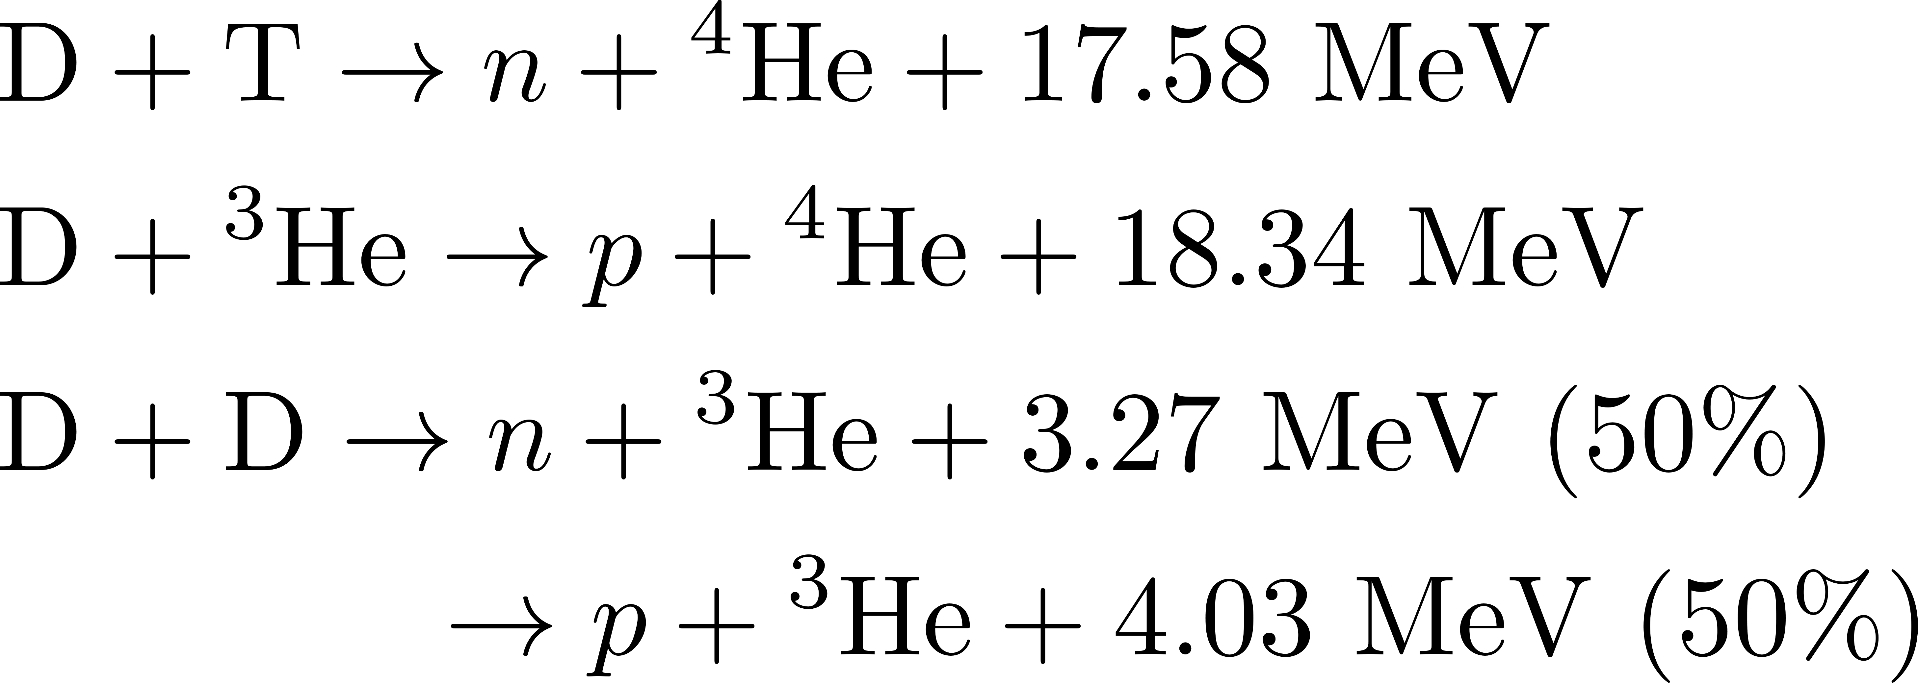
Fusion Reactions for All Candidate Fuels
Criteria for fusion fuel viability:
Reaction threshold
Reaction cross-section
Energy released
D, T, ³He :
Advanced fusion fuels
H, ¹¹B :
H. Rider. LLNL High Energy Density Science Seminar
Notes:
criteria is easy

Slide 6

A Visionary Goal: Commercially Viable Fusion Power
Aneutronic
Pollution-free
Low-cost power generation (cheaper than wind and PV)
Compact facility
High energy conversion rate
Safe
ENN Fusion
Cost-effective
Abundant Fuel Resources
Abundant and accessible fuel
Suitable for distributed energy market
Notes:
hardest, but the final solution

Slide 7

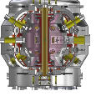
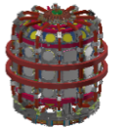
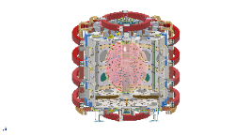
ENN’s Roadmap for p-¹¹B Fusion Power Based on the Spherical Torus (ST)
Commercial demo
2035-
Fusion power
2035
p-¹¹B Burn （EHL-3A&3B）
2027-
Deliver commercially viable fusion energy at competitive cost
Achieve p-¹¹B plasma ignition and demonstrate net electricity generation
p-¹¹B Reaction (EHL-2)
2023-
Phys, engineering, tech. scale-up
Sustained energy gain (Q>3)
Validate all critical aspects of p-¹¹B fusion
Experimental verification of high-temperature plasma technologies
Feasibility assessment of boosted p-¹¹B fusion reaction rates
EXL-50U
2022-
Develop key technologies for ST p-B fusion
Enhance plasma performance parameters
Achieve boron fueling and robust operation control
EXL-50
2018-2023
Established the basis of ST p-B fusion
Initiation, ramp-up, sustainment
ST device design, assembly, and operation

Slide 8
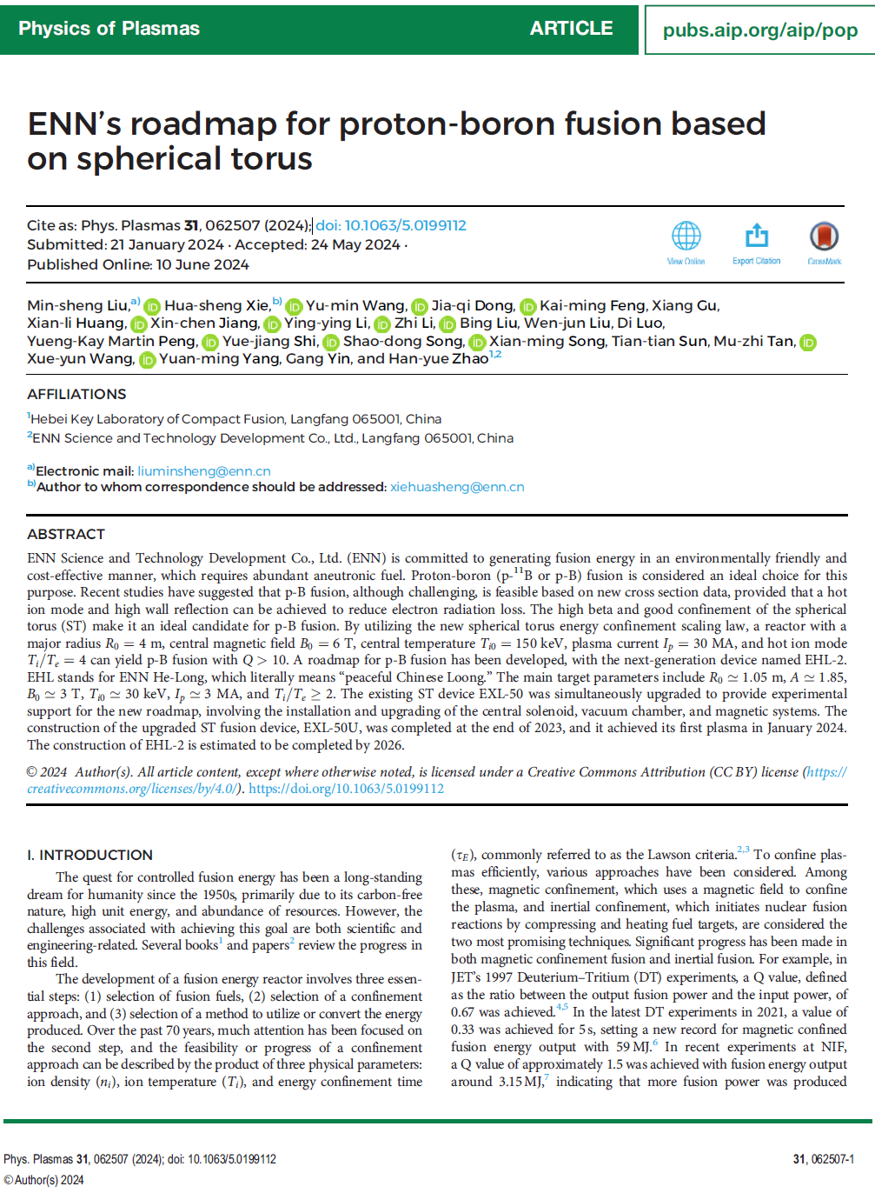
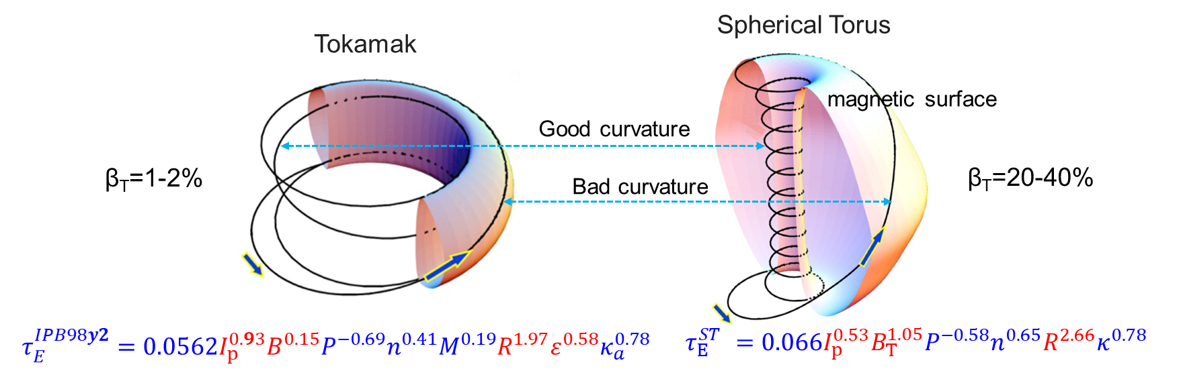
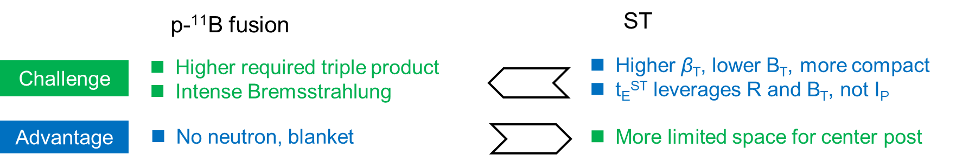
ENN’s Roadmap for p-¹¹B Fusion Power Based on the Spherical Torus (ST)
M. S. Liu, H. S. Xie, Y. M. Wang, et al., ENN’s Roadmap for p-¹¹B Fusion Based on Spherical Torus, Phys. Plasmas 31, 062507 (2024)
Commercial demo
2035-
Fusion power
2035
p-¹¹B Burn （EHL-3A&3B）
2027-
Deliver commercially viable fusion energy at competitive cost
Achieve p-¹¹B plasma ignition and demonstrate net electricity generation
p-¹¹B Reaction (EHL-2)
2023-
Phys, engineering, tech. scale-up
Sustained energy gain (Q>3)
Validate all critical aspects of p-¹¹B fusion
Experimental verification of high-temperature plasma technologies
Feasibility assessment of boosted p-¹¹B fusion reaction rates
EXL-50U
2022-
Develop key technologies for ST p-B fusion
Peng1986
Enhance plasma performance parameters
Achieve boron fueling and robust operation control
EXL-50
2018-2023
Established the basis of ST p-B fusion
Initiation, ramp-up, sustainment
ST device design, assembly, and operation
Complementary advantages and disadvantages!

Slide 9
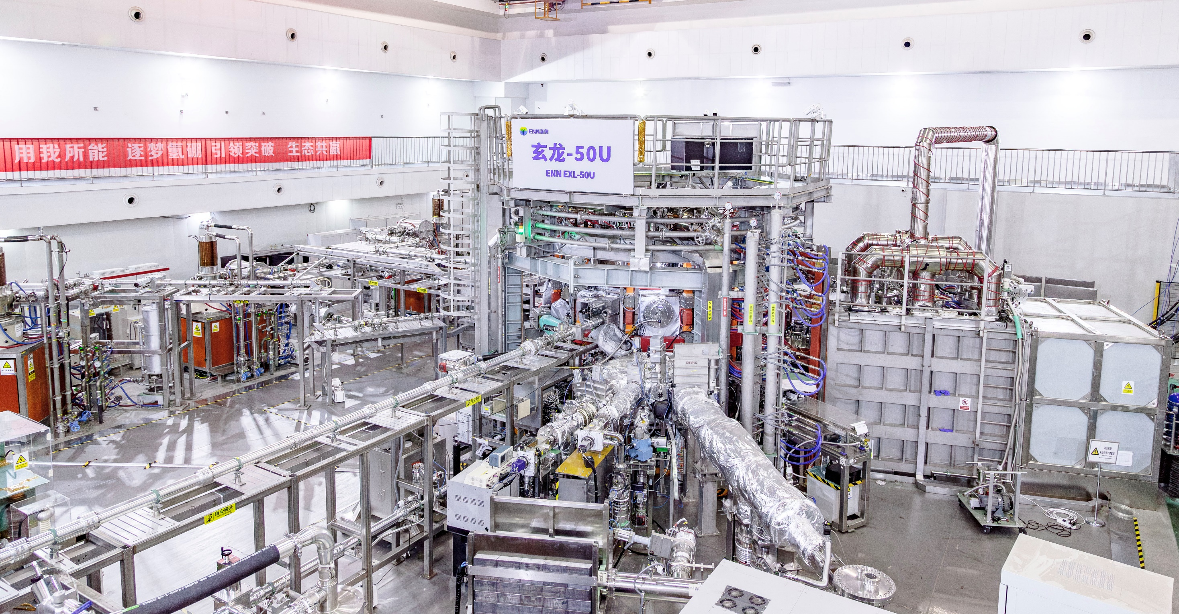
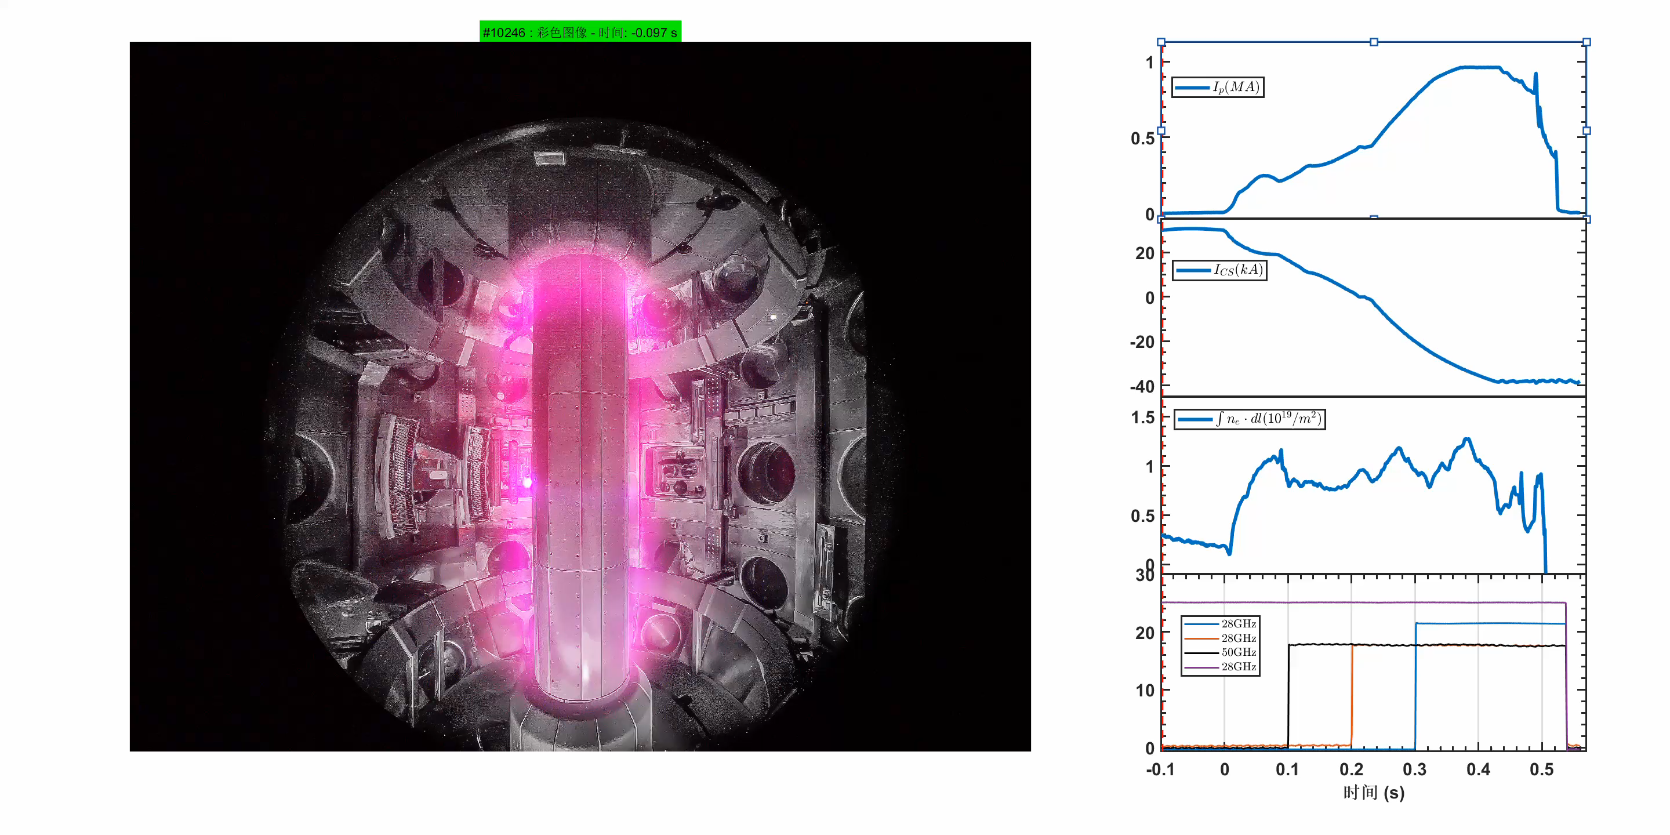

EXL-50U （ENN Xuan Long-50U）Spherical Torus (ST)
✓ Generated 1 MA plasma current with hydrogen-boron fuel
✓ Sustained ion temperatures >40 million°C
✓ Demonstrated robust magnet performance:
150 kA toroidal field current
1.2 tesla central magnetic fields
✓ 18 months: From design to completed construction
✓ 3 months: From commissioning to physics experiments

Slide 10



Theoretical Possibility of p-¹¹B Fusion: Need for Enhanced Reaction Rates
Fusion Enhancement factor
fusion power
$$\frac{\text{thermal} \text{energy}}{\text{energy} \text{confinement} \text{time}}$$
Fraction of fusion energy carried by charged particles
radiation power loss
Simplified ignition criterion
More precise cross-section data required.
Energy carried per reaction by charged particles.

Slide 11
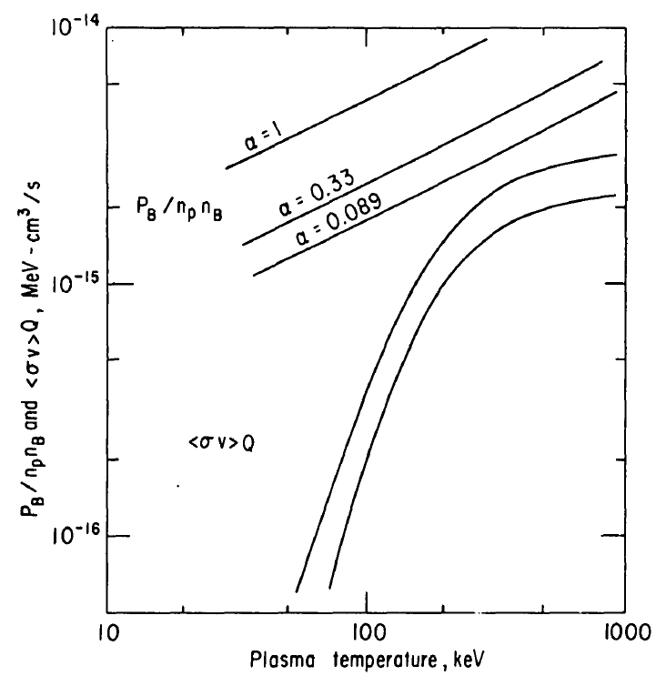
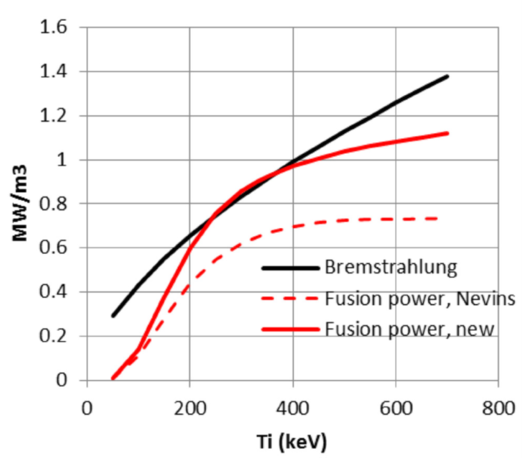
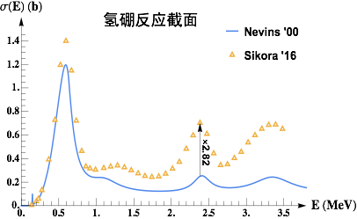

Theoretical Possibility of p-¹¹B Fusion: Need for Enhanced Reaction Rates
Fusion Enhancement factor
fusion power
p-¹¹B fusion achieves ignition with new cross-section.
$$\frac{\text{thermal} \text{energy}}{\text{energy} \text{confinement} \text{time}}$$
Fraction of fusion energy carried by charged particles
radiation power loss
Simplified ignition criterion
Moreau1977
Putvinski2019
More precise cross-section data required.
Energy carried per reaction by charged particles.
Fusion reactivity
Higher fusion reaction rate needed.

Slide 12
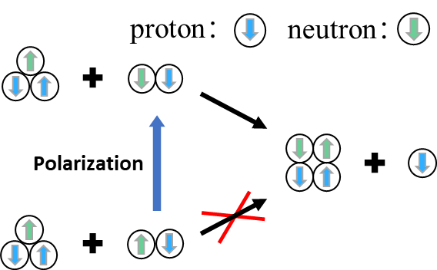
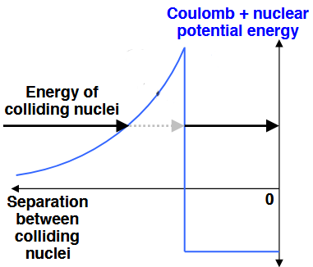
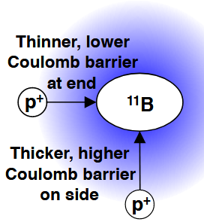
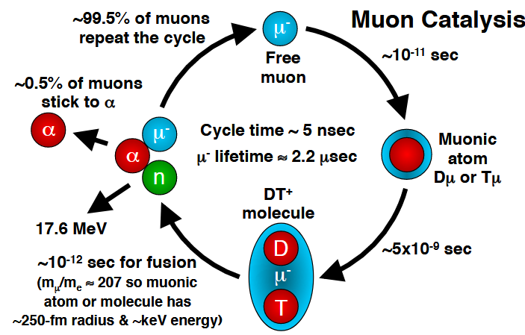
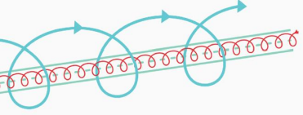
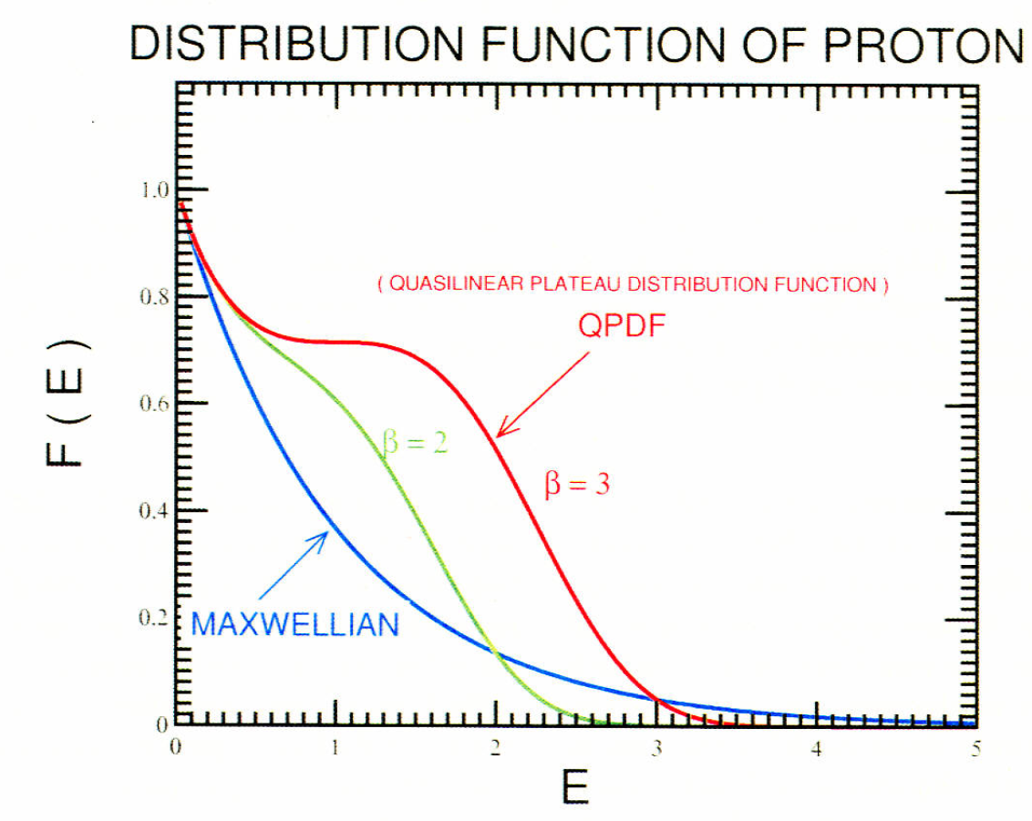
Theoretical Possibility of p-¹¹B Fusion: Need for Enhanced Reaction Rates
Fusion Enhancement factor
fusion power
p-¹¹B fusion achieves ignition with new cross-section.
$$\frac{\text{thermal} \text{energy}}{\text{energy} \text{confinement} \text{time}}$$
Fraction of fusion energy carried by charged particles
radiation power loss
Simplified ignition criterion
Putvinski2019
Moreau1977
More precise cross-section data required.
Energy carried per reaction by charged particles.
Fusion reactivity
Higher fusion reaction rate needed.
Spin-polarization
Shave Coulomb barrier
Shape-polarization
Muon Catalysis
Velocity Differential
Non-thermal
H. Rider. LLNL High Energy Density Science Seminar
Kulsrud1982, Perkins1997, Leotta1987, Wanatabe2003

Slide 13
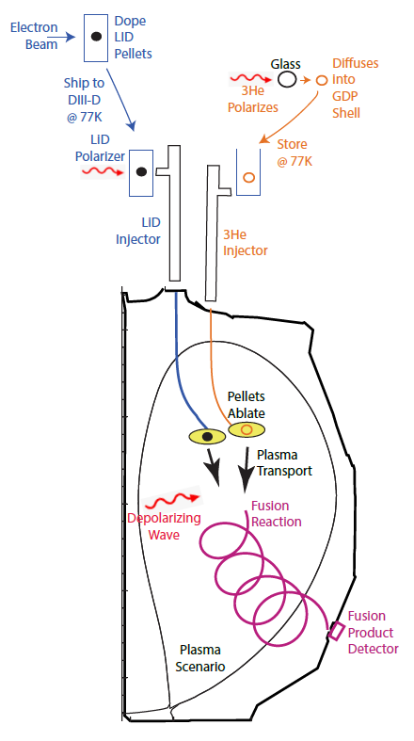
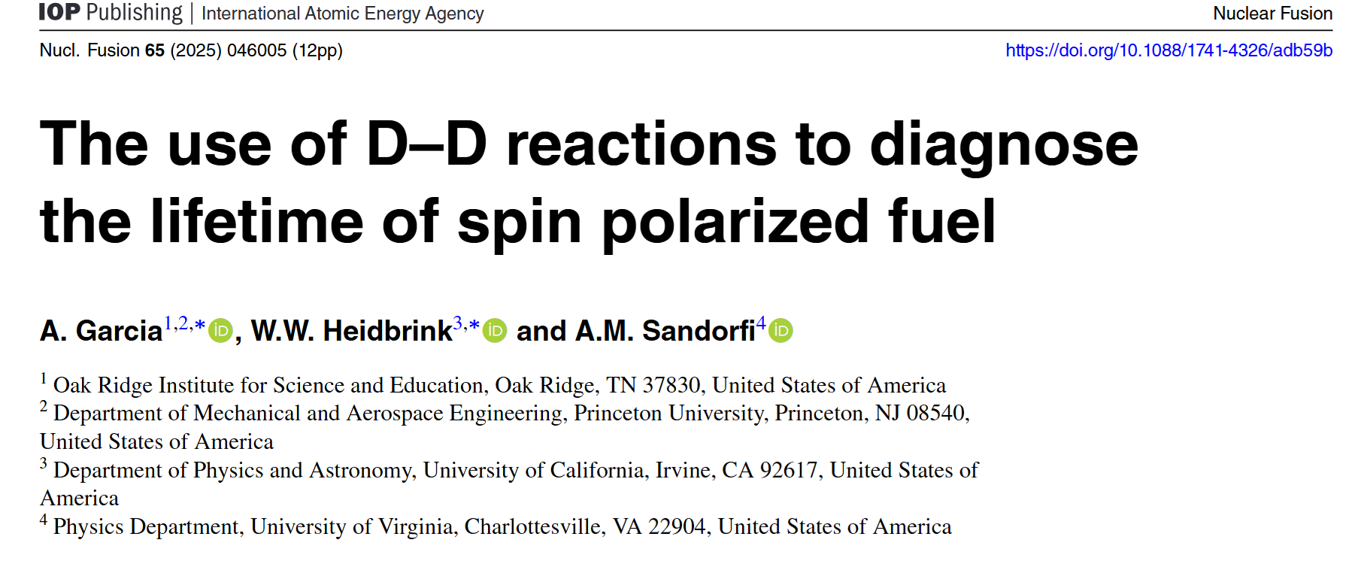
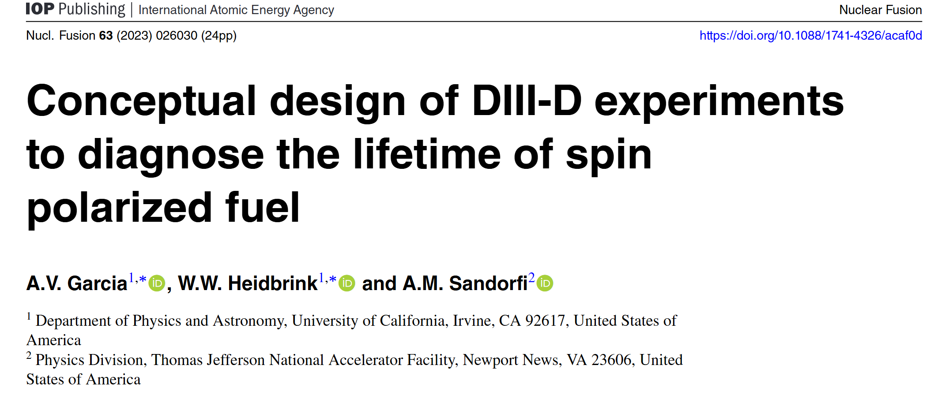
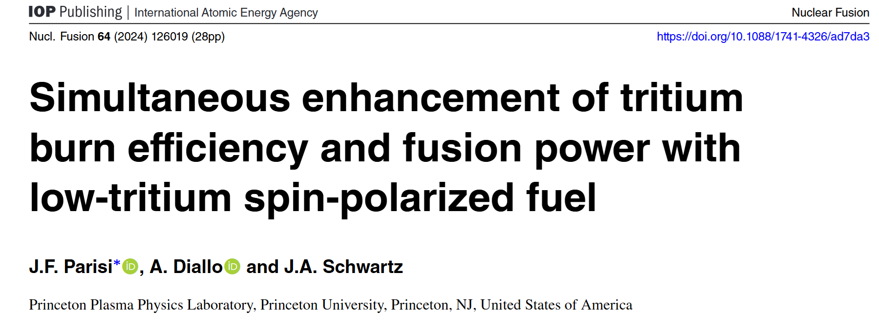
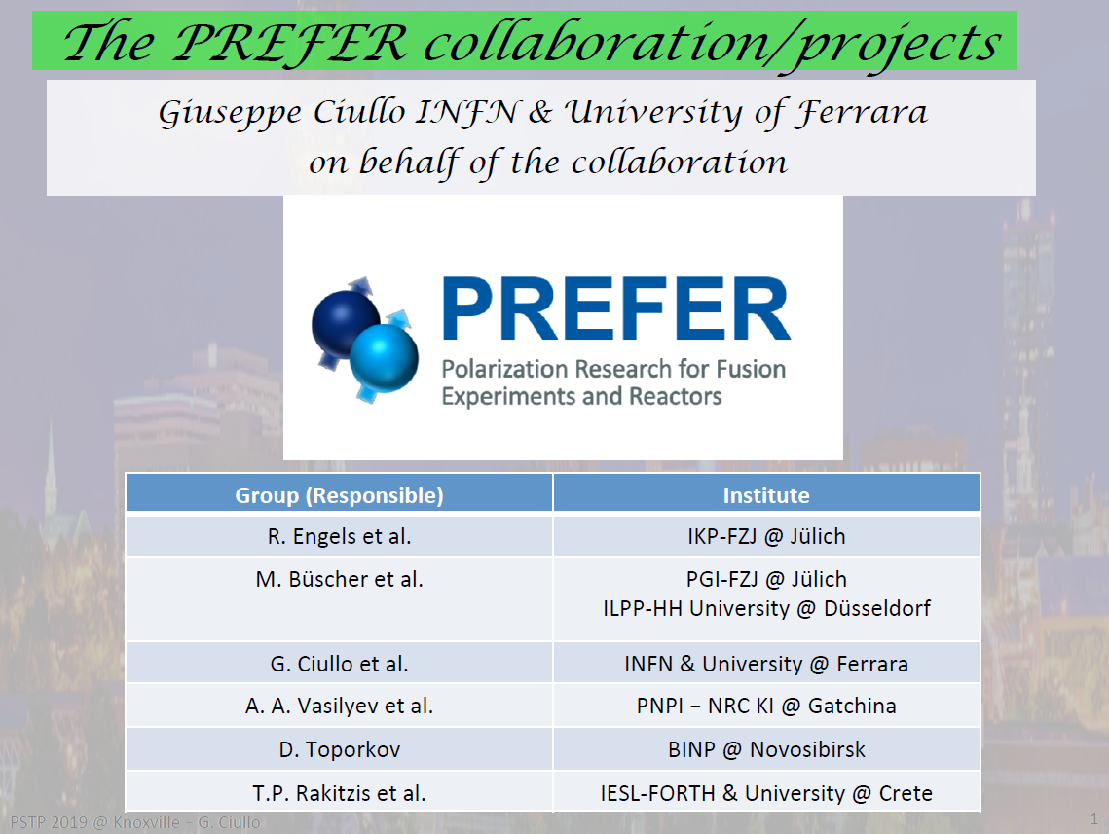

Polarization Research Advances toward Fusion Energy Applications
International research directions in polarized fusion fuels:
Reduce T consumption in D-T fusion
Control neutron emission direction in D-T fusion
Enhance D-³He/D-D fusion performance
Suppress neutron emission in D-³He fusion
Global spin-polarized nuclear data status:
D-D: Scarce
D-³He: Deficient
p-¹¹B: Virtually nonexistent
Lots of efforts in last 2 years!
Heidbrink (SPIN2023)
Extremely groundbreaking and brilliant research initiative!
Ciullo (SPIN)
A comprehensive and systematic research plan!

Slide 14
Polarization Research Advances toward Fusion Energy Applications
International research directions in polarized fusion fuels:
Reduce T consumption in D-T fusion
Control neutron emission direction in D-T fusion
Enhance D-³He/DD fusion performance
Suppress neutron emission in D-³He fusion
Global spin-polarized nuclear data status:
D-D: Scarce
D-³He: Deficient
p-¹¹B: Virtually nonexistent
Numerous advantages, research agendas, and experimental proposals
— yet why not p-¹¹B?
Lots of efforts in last 2 years!
Heidbrink (SPIN2023)
Extremely groundbreaking and brilliant research initiative!
Ciullo (SPIN)
A comprehensive and systematic research plan!

Slide 15
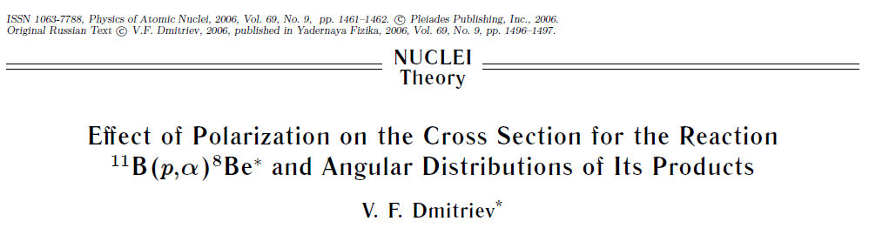
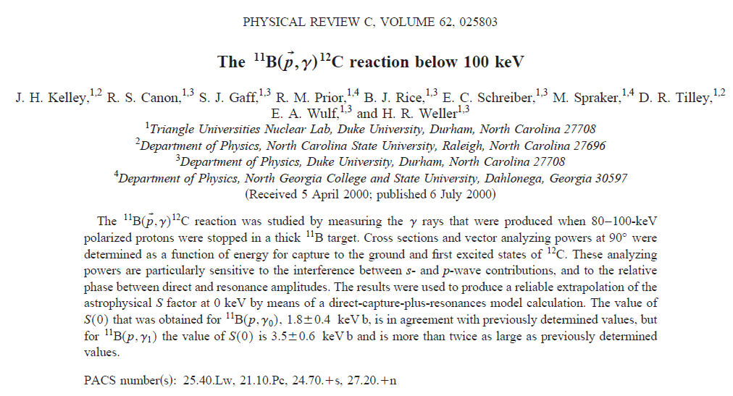
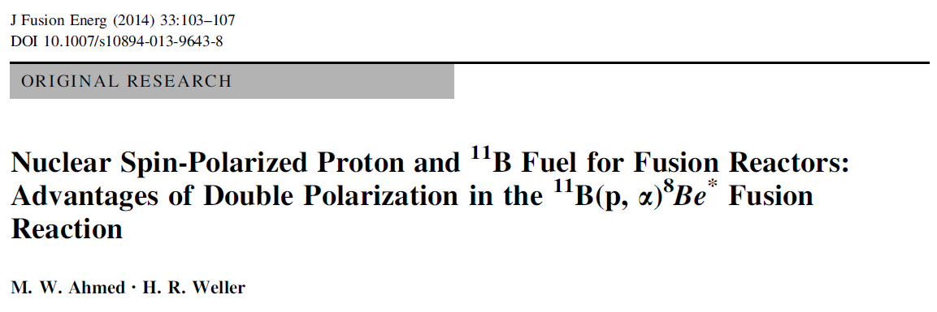
Polarization Research Advances toward p-¹¹B Fusion Energy Applications
Polarized p-¹¹B fusion research
Remains largely unexplored
priorities:
  Differential cross-section measurements of spin-polarized p-¹¹B reactions
  Development of boron fuel spin-polarization techniques
  Sustenance of spin-polarized hydrogen-boron plasma
Theoretical efforts
Experimental contribution

Slide 16
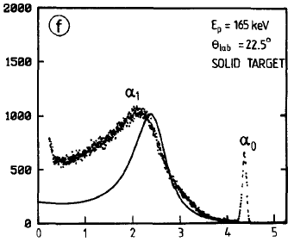
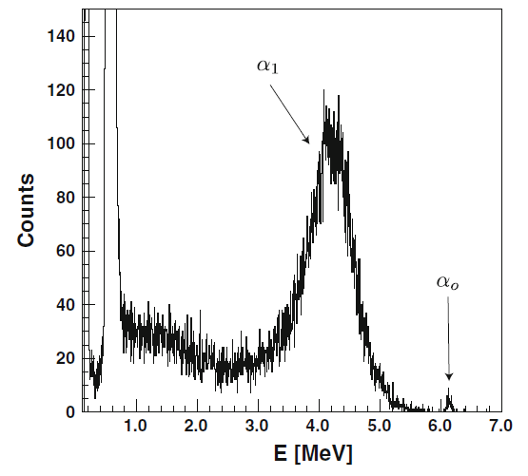
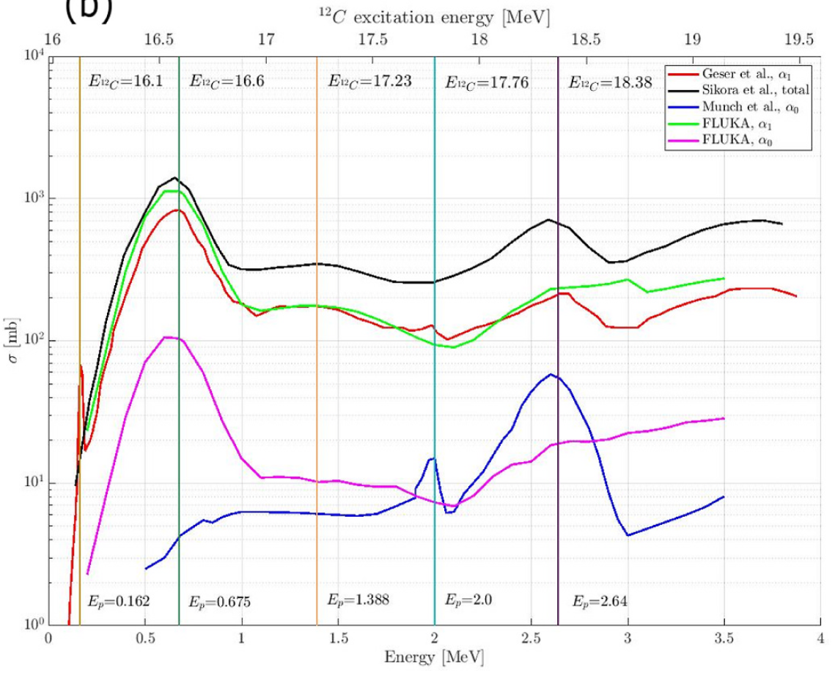
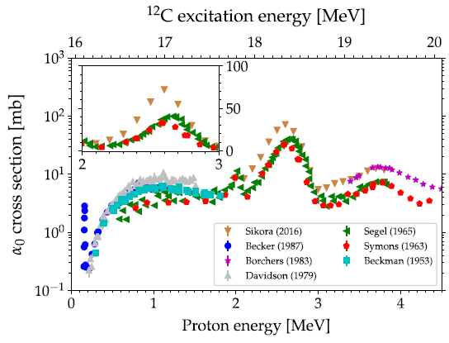
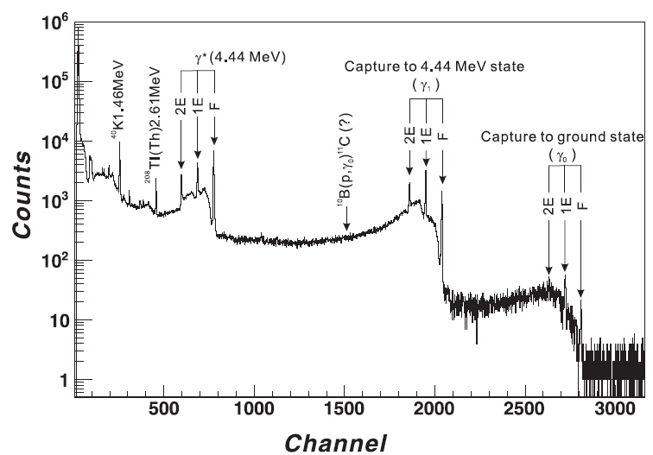

p-¹¹B Reaction: A Complex Process
Multi-pathway process with excited intermediates (¹²C, ⁸Be)
p+¹¹B→¹²C*→α₀+⁸Be→α₀+α₀₁+α₀₂: $11B\left(p,α_{0}\right)αα$
p+¹¹B→¹²C*→α₁+⁸Be*→α₁+α₁₁+α₁₂ : $11B\left(p,α_{1}\right)αα$
p+¹¹B→¹²C*→3α : $11B\left(p,2α\right)α$
p+¹¹B→¹²C+γ₀: $11B\left(p,γ_{0}\right)12C$
p+¹¹B→¹²C+γ₁+γ* (4.439 MeV) : $11B\left(p,γ_{1}\right)12Cγ^{∗}$
E_{p}=675 keV
Becker1987, Spraker2012
Mazzucconi2023
Munch2020
He2016

Slide 17
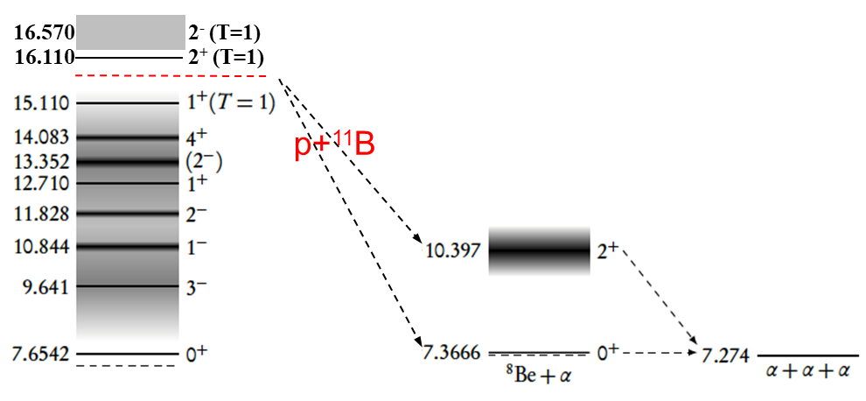
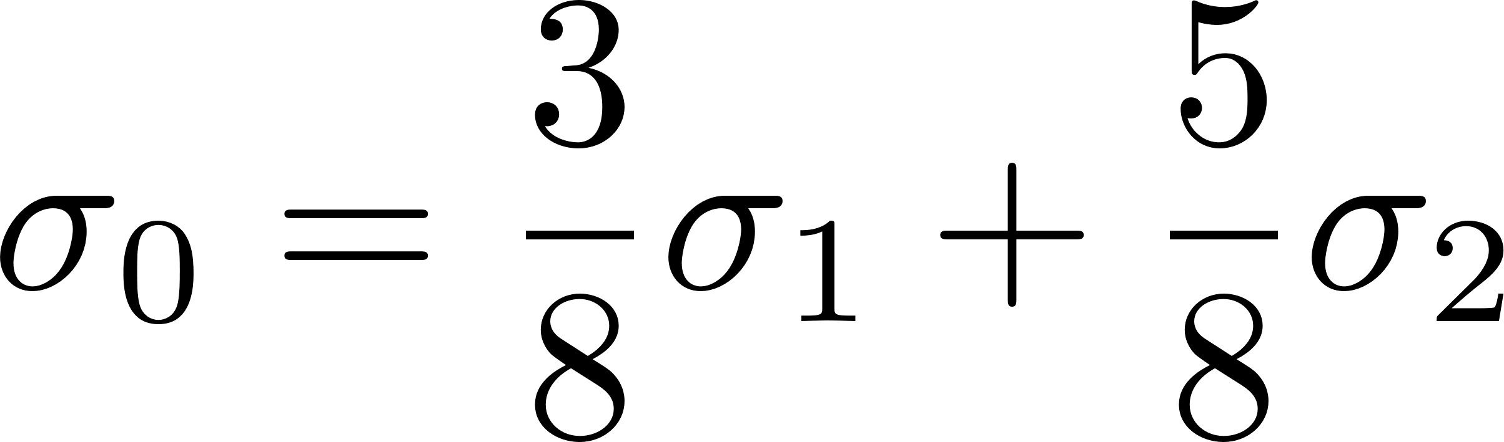


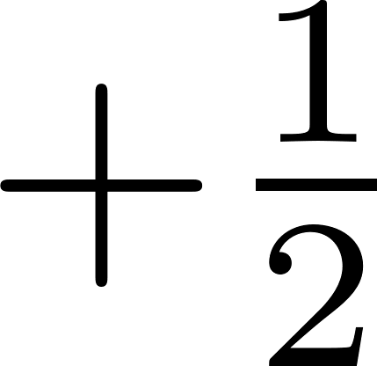
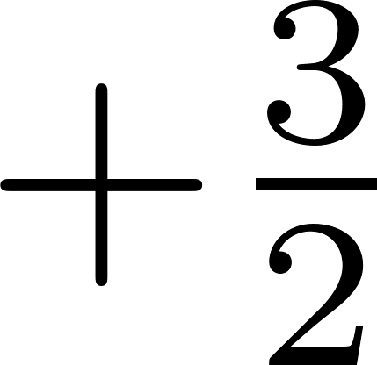



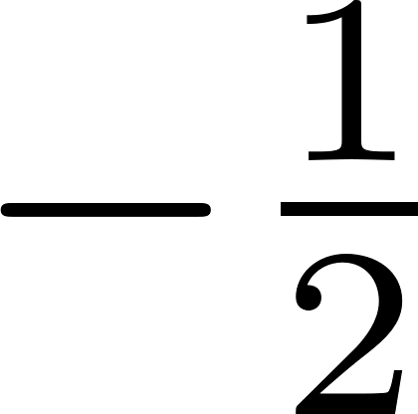
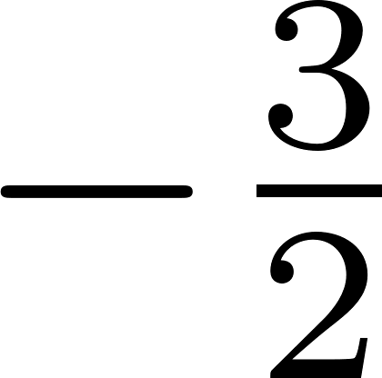
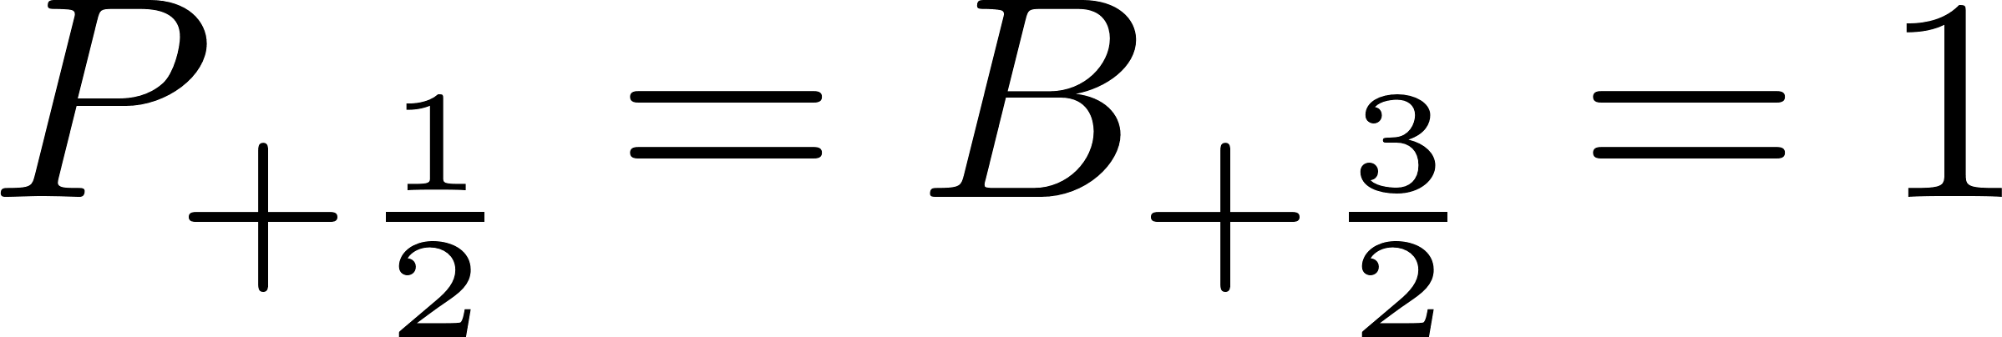
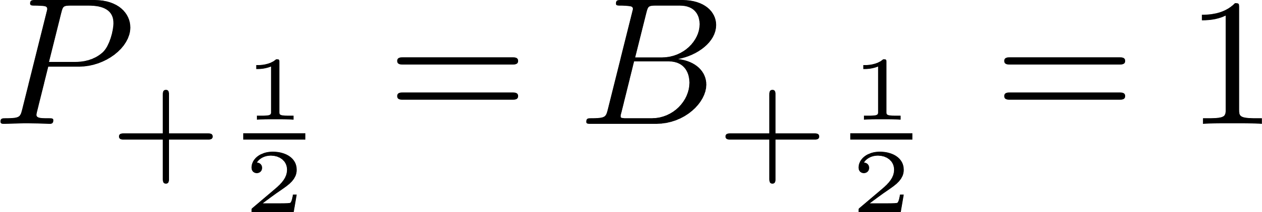

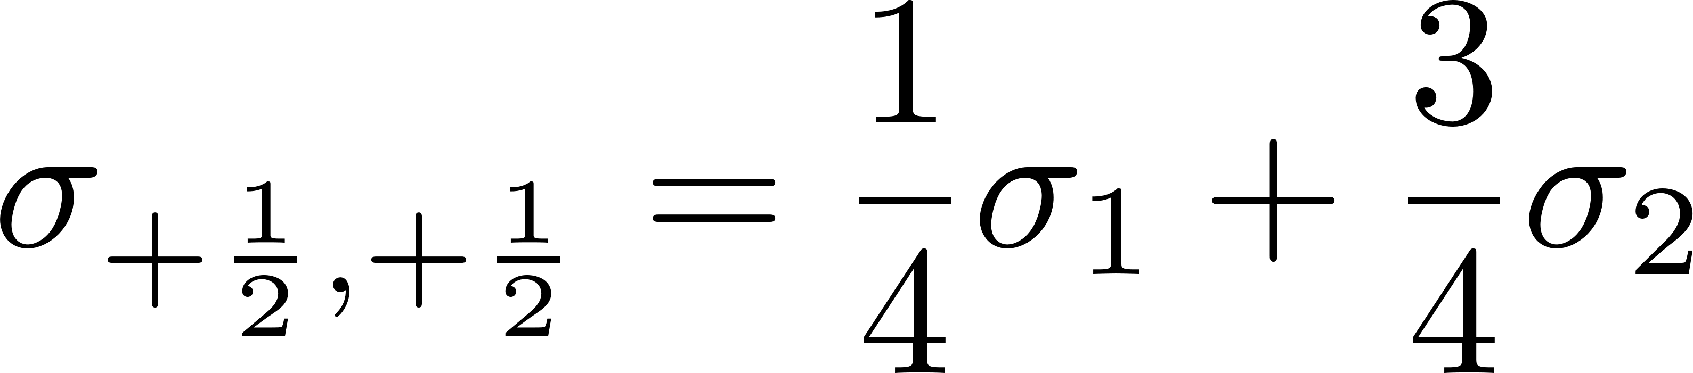


Key Challenges Demand Theoretical and Experimental Advances
For further details, see the subsequent report by YANG Wei
Polarization effects on reaction cross-section
Unpolarized spin
Spin aligned along the magnetic field
Reaction channel
Polarization resistance
Differential Cross-Section | proton-polarized | boron-polarized | Double polarized
1st resonance peat@148 keV | ？ | ？ | ？
2st resonance peat@620 keV | ？ | ？ | √
Non-resonant | ？ | ？ | ？
Compared with the unpolarized scenario
Polarized hydroboration shows ~60% enhancement in total cross-section vs. unpolarized case
Numerous known unknowns await exploration!
Requiring experimental verification!

Slide 18







Proposes for p-¹¹B Polarization Studies Towards Fusion Application
Proposes for p-¹¹B fusion reaction experiments
EXL-50U (operational): experiment proposes before 2027
EHL-2 (next generation): start in 2027
Non-uniform magnetic field
RF waves
particle collisions
NBI-ICRF synergy-driven energetic protons initiating p-¹¹B fusion
wall recycling
+
Spin-polarization sustainment and polarized reaction experiments?
Zhi2024
Thermonuclear p-¹¹B fusion platform

Slide 19
Summary
p-¹¹B Fusion: The Most Promising Commercialization Pathway
Advantages: Neutron-free, abundant fuel, high safety
Challenge: High ignition requirements
Research Directions:
  Synergy with spherical torus configurations
  Enhancing p-¹¹B reaction rates (60%↑@620 keV)
Proposals for polarized p-¹¹B fusion research:
  Polarized p-¹¹B database establishment
  Boron polarization techniques development
  Polarized hydrogen-boron plasma sustenance
Experimental exploration on EXL-50U and EHL-2 devices
  (Polarized) fusion reaction experiments
  Polarized plasma generation and sustainment

Slide 20

Thank you for your attention!
Research interests and collaborations are welcome!
20
Email：lizhiz@enn.cn

Slide 21
Fusion Fuel of Great Promise and Challenge
Fuel options for commercial fusion energy
Fuel | Pros | Cons | Fuel Price (USD/g) | Proven Reserves
1. D-T | Lowest ignition temp (100-200MK), high energy yield, proven scientific basis | Tritium fuel scarcity, neutron radiation challenges, nuclear waste concerns | Tritium: 30,000 | 25 kg
2. D-D | Abundant deuterium, no tritium needed, lower neutron yield | Higher ignition temp (400MK), lower energy yield, neutron damage | Deuterium: 4 | 45 trillion tons
3. D-³He | Minimal neutrons, high energy yield, direct conversion | Rare ³He, higher ignition temp (400MK), side reactions | ³He: 13700 | ³He scarcity: Extremely rare on Earth, requiring lunar mining or D-D breeding
4. p-¹¹B | Abundant boron fuel, direct energy conversion, environmentally safe | Highest ignition temp (>1000MK), low reaction rate, S&T challenges | ¹¹B: 4 | 1 billion metric tons
Tritium (T), helium-3 (³He), and lithium-6 (⁶Li) are government-controlled materials that are not accessible to private companies in China.

