Slide 1


The PREFER collaboration
Giuseppe Ciullo & University of Ferrara
on behalf of the
COLLABORATION
at present time.
Group (Responsible) | Institute
R. Engels et al. | IKP - FZJ @ Jülich & GSI- Darmstadt, Germany
M. Büscher et al. | PGI - FZJ @ Jülich & ILPP- HH University @ Düsseldorf
G. Ciullo et al. | INFN & University @ Ferrara
T.P. Rakitzis et al. | IESL-FORTH & University @ Crete

Slide 2
Polarized fuel for fusion: benefits and open questions
From the point of view of the nuclear physics, the use of polarized fuel can help fusion reactions thanks to:
enhancement of cross sections,
control on the angular distributions of the reaction products,
possible neutron lean reactors.
Open questions need still answers:
higher polarization and higher density (orders of magnitude more than available in nuclear polarized targets).
Preparation and Manipulation of fuel for fusion environments.
Survival of polarization in fusion environments.
It’s a challenging deal providing, manipulating, and testing polarized fuel in order to gain from the benefits of it in FUSION environments, and answer to the open questions.
We’ll gain deeper insights on knowledge for still “better and better” polarized sources, targets and polarimetry.

Slide 3
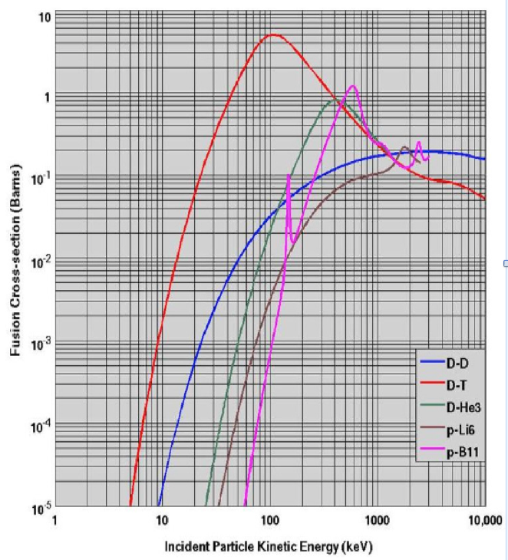
Polarized fuel: Benefits and open questions
Reaction generations sorted vs the relative energy (temperature) of reactants.
!! proven in scattering experiments and theoretically models are available, but still to be proven in fusion environments
?? Data not available in order to constrain theoretical models.
Generation: D + T → ⁴He + n
1.a) Enhancement of total cross section!!
1.b) Differential cross section: control on product angular distribution!!
2. Generation: D + D → T + p or ³He + n
Fuel available (30 g m⁻³ in ocean water) !!
2.a) Enhancement of total cross section??
2.b) Differential cross-section and angular distrib. control?!
Still missing data for a complete description.
2.c) Possibility to suppress the reaction ³He + n / QSF (Quintet Suppression Factor)??
3. Generation: ³He + D → ⁴He + p
3.a) and 3.b) expected like 1.a) and 1.b)!!
3.c) Possibility of Neutron lean reactor ?? This is conditioned by 2.c):
D+D → ⁴He* → ³He + n suppressed (QSF)?
Missing data on D-D
spin-dependent cross-sections.
Challenge objectives for PREFER
Missing polarized fuel
for fusion tests.

Slide 4
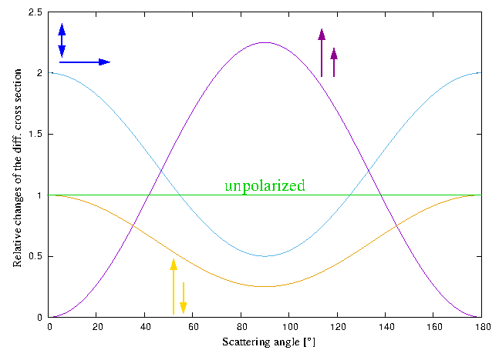
Fusion o f spin ½ + spin 1 - polarized fuel
T + D → ⁴He + n and ³He + D → ⁴He + p
May the differential cross section of the fusion reactions be controlled by polarized particles ?
dσ/dΩ (ϑ) = σ₀/4π [1 – ½ P_{D}^{V} P_{T} + 3/2 P_{D}^{V} P_{T} sin² ϑ + ¼ P_{D}^{T} (1 – 3 cos² ϑ)]
Total cross section
³He(d, p)⁴He Reaction
Factor 0.5
Experimental confirmatio
from 1972
Factor 1.5
Leeman et al. ANN. PHYS. 66 (1971) 810.
.
.
.
.
.
.
.
.
Factor 1
... from 1972 many
experiments and
pubblications on
measuments and
theoretical models
R.Engels et al. Advantages of Nuclear Fusion with Polarized Fuel in PoS 423 (SPIN2018) 176.
Theoretical transposition to DT
G. Hupin «Ab initio prediction for polarized deuterium-tritium fusion reaction»Nat. Comm. 10 (2019) 351.

Slide 5
Fusion of spin 1+ spin 1 – polarized fueld
D + D → T + p / ³He + n
Fusing D + D, then D + T can fuses (n)
³He does not contribute at the ignition energy of D-D.
The total cross section D + D in respect to the incoming polarization of the fusing particles:
In the case of D+D also P-, D-wave, togheter with S-wave and their interferences!
D ↑ + D ↑ spin dependent cross-section (data set very poor), and stilll less data at lower energy (electron screening ?)

Slide 6


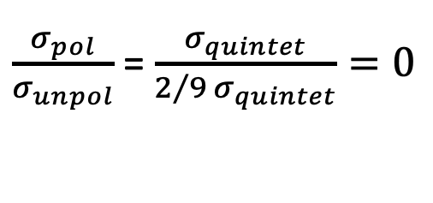
Fusion of spin 1 + spin 1 – polarized fuel
Neutron lean fusion: QSF (Quintet Suppression Factor)
Question: spin alignements allows to enhance, or suppress, reaction channels?
D↑ (d ↑ p) T and D↑ (d ↑ n) ³He suppressed
by choosing deuteron spin parallel each others
S 1 1 = 0 ⁵S₂ Quintet State Suppressed
$\frac{σ_{pol}}{σ_{unpol}}$ = $\frac{σ_{quintet}}{2/{9 }σ_{quintet}}=0$
D↑
D↑
⁴He*
S 1 -1 0 ¹S₀ Singlet state allowed

Slide 7


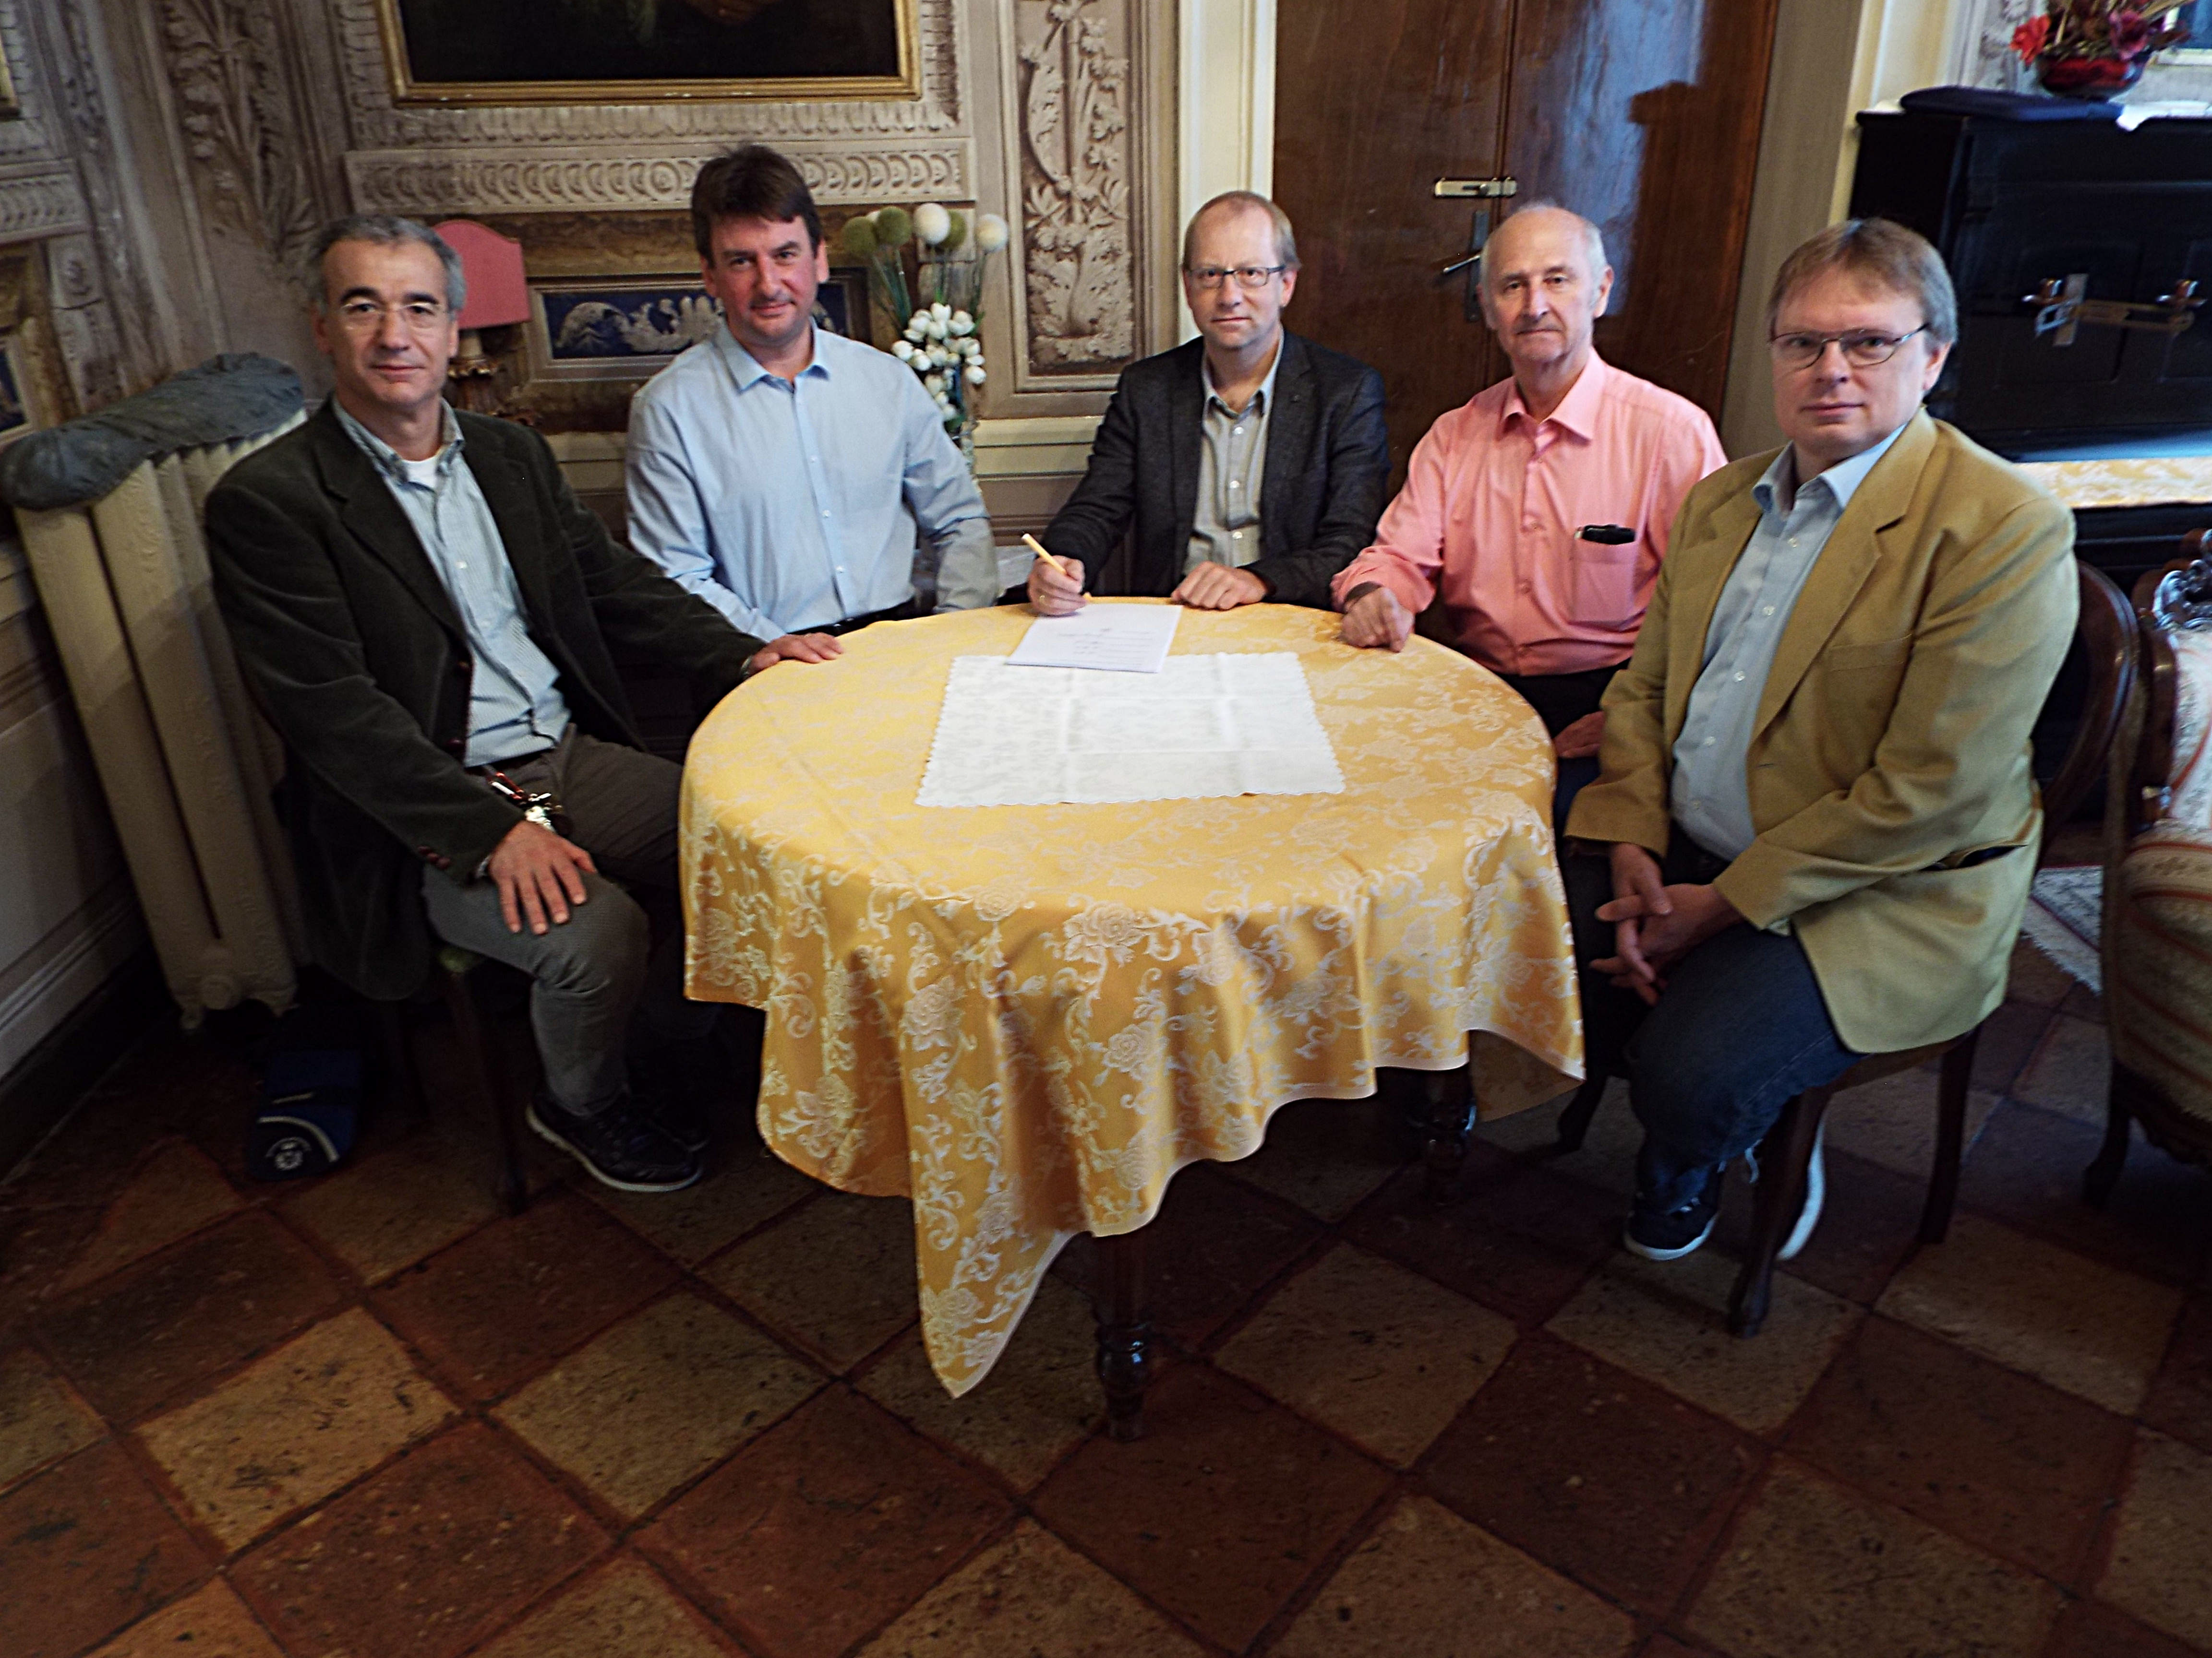
PSTP people trys to involve fusion community
Contributions of the Workshops held in 2013 at Trento, and in 2015 at Ferrara, collected in “Nuclear Fusion with Polarized Fuel”
(ed.s G. Ciullo, R. Engels, M. Büscher and A. Vasyliev)
Springer Proceedings in Physics 187
(Springer - 2016 - Switzerland)
The PREFER collaboration (early stages)
The PREFER collaboration was signed in 2017 in Ferrara during a
Workshop on Polarized Fuel for Nuclear Fusion.
COVID ended our meetings.
Russia-Ucraina conflict interrupted official collaborations and official contacts with the russian colleagues.

Slide 8
Challenging objectives of PREFER
still now
& officially before 02/2022
  @PNPI - D-D spin dependent cross-section measurements officially before 02/2022.
  @IKP-FZJ - Production of polarized fuel: from pABS and new proposals.
  @BINP - Production of polarized fuel: from MBS officially before 02/2022.
  @ IESL-FORTH - Production polarized fuel: by Laser IR-Quantum Beat (QB) excitation and Ultra Violet (UV) dissociation, joined the collaboration a little bit later.
  @PGI-FZJ/HHDU - Laser Induced Plasma LIP: production, acceleration and reaction studies.
  @FE - Magnets for holding, manipulating and transporting polarized fuel .

Slide 9

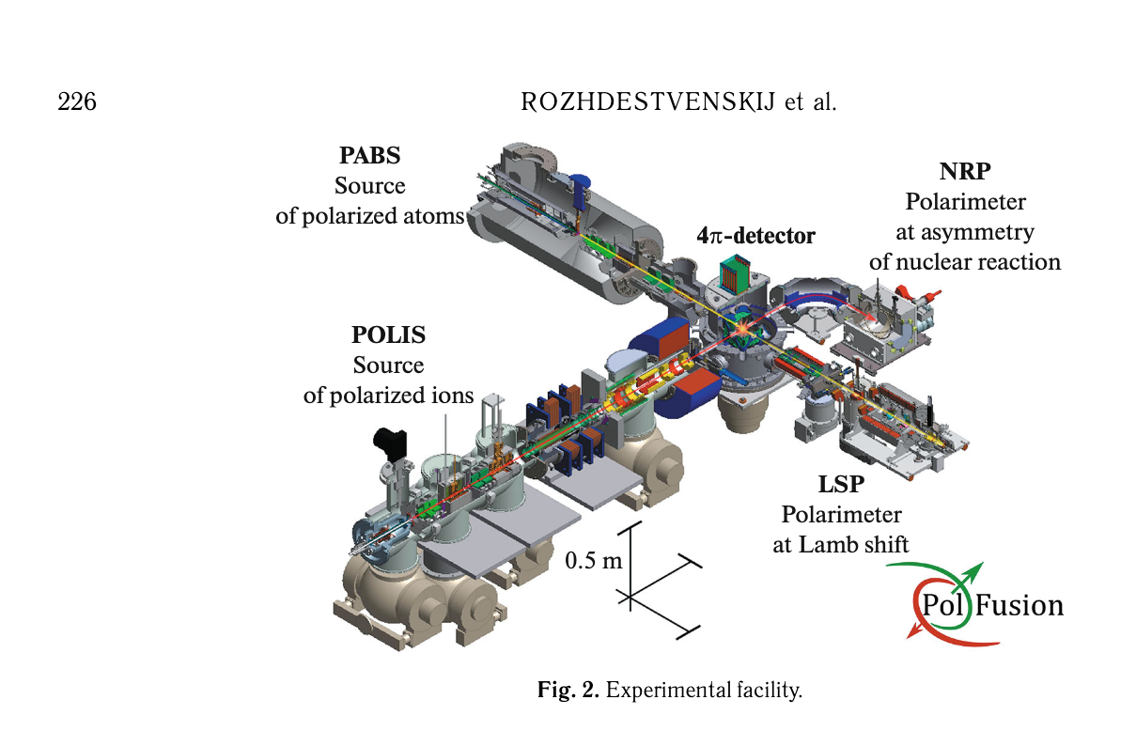



D ↑ - D ↑ spin dependent cross-sections
  @PNPI – D-D spin dependent cross-section measurements, officialy before 02/2022.
B. P. Ad'yasevich Czech. J. Phys. B 32 (1982) 1349.
P. Kozma et al. Czech. J. Phys. B 35 (1985) 1118.
$$\vec{d}$$
10¹¹ atom/s
Unpolarized with solid target
Unpolarized with gas target
Polarized beam with unpolarized solid target
Polarized beam with unpolarized gas target
A. Yu. Rozhdestvenskij et. al Phys. Atom. Nucl. 87 (2024) 224.
$$\vec{d} \left(0.1 keV\right)$$
4 10¹⁶ atom/s
$${\vec{d}}^{+} \left(30 −100 keV\right)$$
15 μA
Theoretical models and experiment settings: H. Paez gen Schieck
«Spin Physics and Polarized Fusion: where we stand» in Nuclear Fusion with Polarized fuel Ed.s. G. Ciullo et al. Spr. Proc. Phys. 187 (2016).

Slide 10
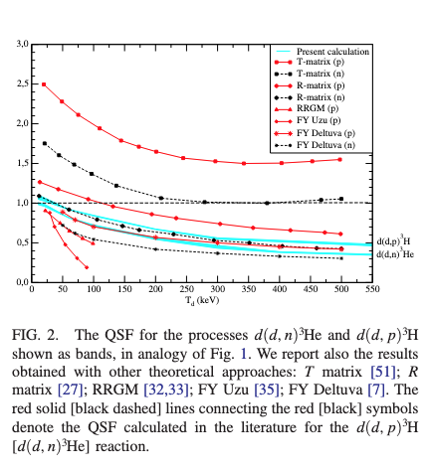
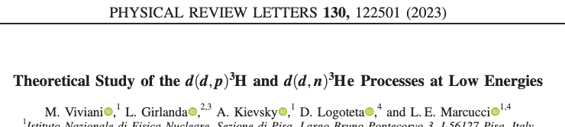
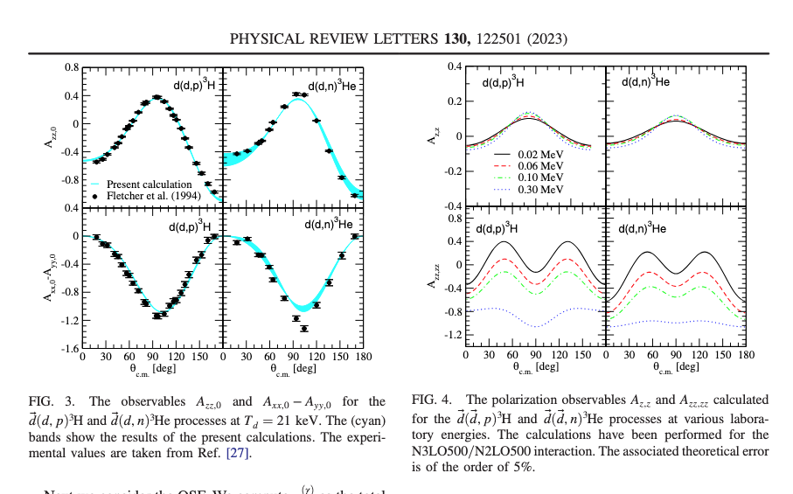


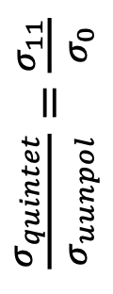

D ↑ - D ↑ demanding of measurements
$\frac{σ_{quintet}}{σ_{uunpol}}=\frac{σ_{11}}{σ_{0}}$
$$\vec{d} \left(0.1 keV\right)$$
4 10¹⁶ atom/s
A. Yu. Rozhdestvenskij et. al Phys. Atom. Nucl. 87 (2024) 224.
  @PNPI
$${\vec{d}}^{+} \left(30 −100 keV\right)$$
15 μA
[9] A. Solovev et al., J. Instrum. 15, C08003 (2020)

Slide 11
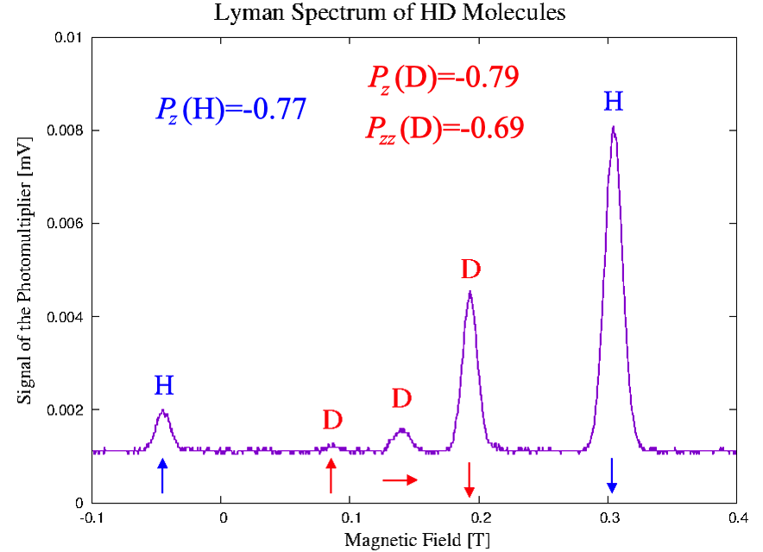
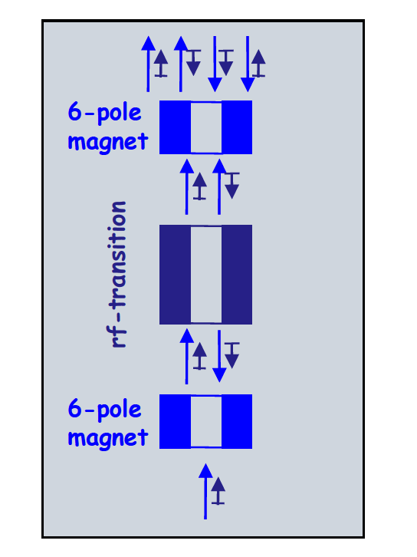

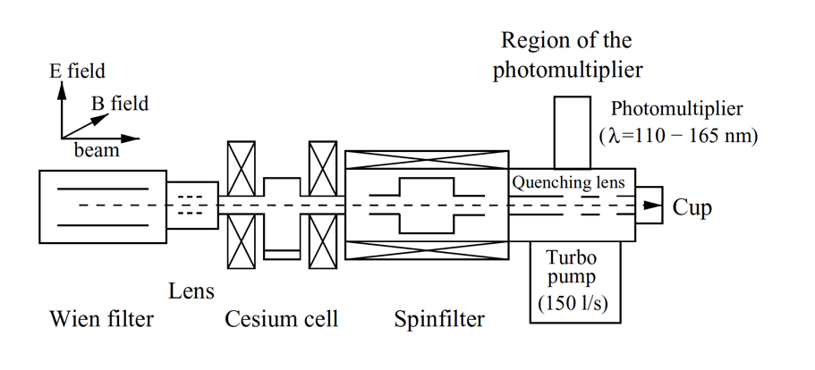
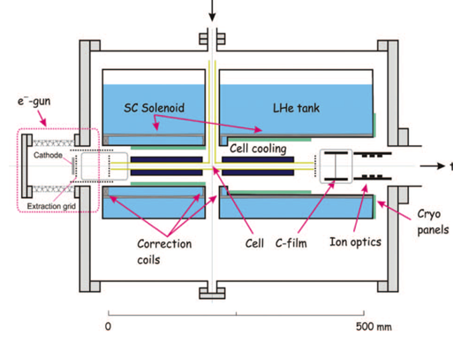

Production of polarized fuel by pABS
  @IKP-FZJ - Production of polarized fuel: from pABS, and new proposals.
and new proposals.
Production
R. Engels - Current developments of polarized sources and polarimeter at FZ Jülich and further applications,
this symposium.
S. J. Pütz - Polarimetry of pulsed H⁻ /D⁻ ion beams: extended applicability of the Lamb-shift polarimeter,
in this symposium.
Polarimetry
recombination
R. Engels et al. «Production of HD molecules in definite hyperfine substates» Phys. Rev. Lett. 124 (2020) 113003

Slide 12
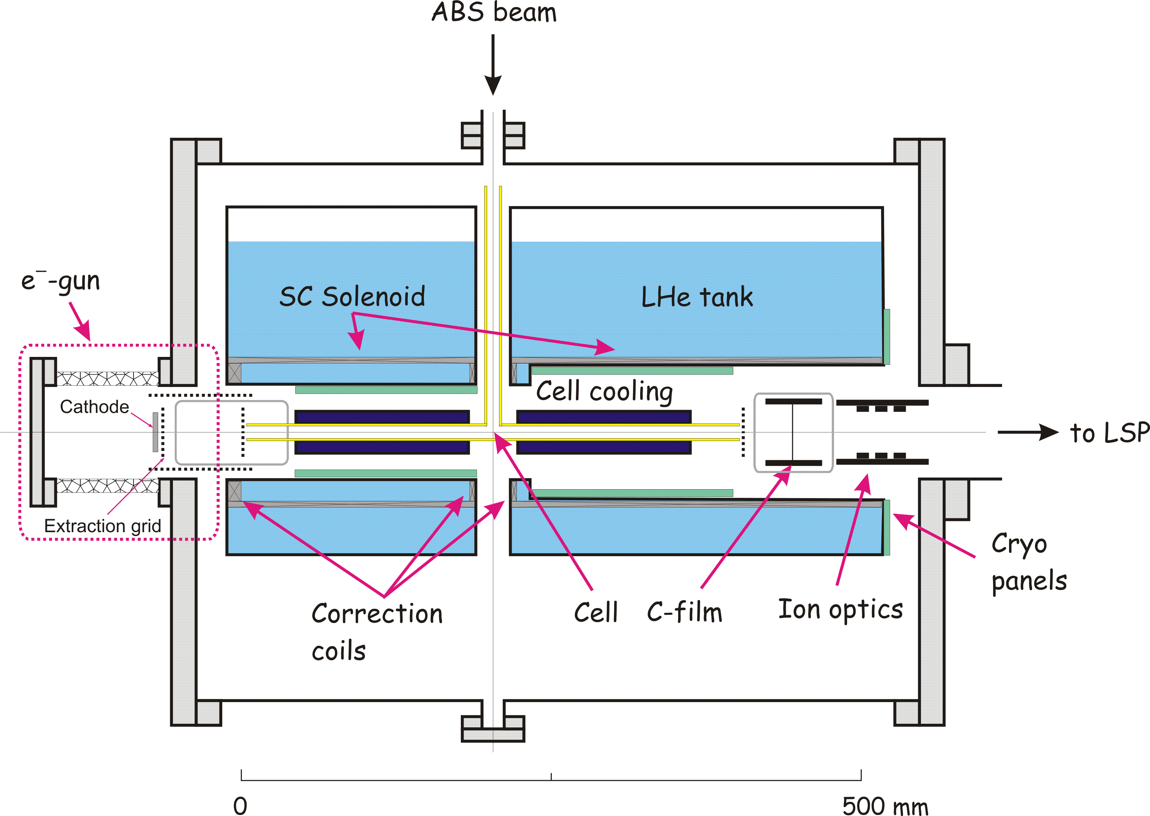
Condensation & transp. of pol. fuel
Production of polarized fuel
A holding magnetic field is required, for its transportation: superconducting MgB2 hollow Bulk material under investigation @ Fe.
Production of 1 day
(>10²¹ molecules) is enough to feed a Tokamak for seconds,
in pellets, or for tests in ICF !!
Cold
Head
T= 3-10K
D₂ ice
The Target can be used for LIP fusion test and esperiments @PGI-FZJ/HHDU
H₂, D₂, and HD hyperpolarized molecules can be produced with polarization of P ~ 0.8 ! For HD any spin combination is possible !
HD is a perfect training ground for the handling of TD !
The condenser is surrounded by a S.C. MgB₂ cylinder,
which provides the holding field also for transportation.
The super-conducting hollow bulk material is also useful for other techniques under R&D
for polarized fuel production, like the ones propose by the colleagues of @ IESL-FORTH .

Slide 13
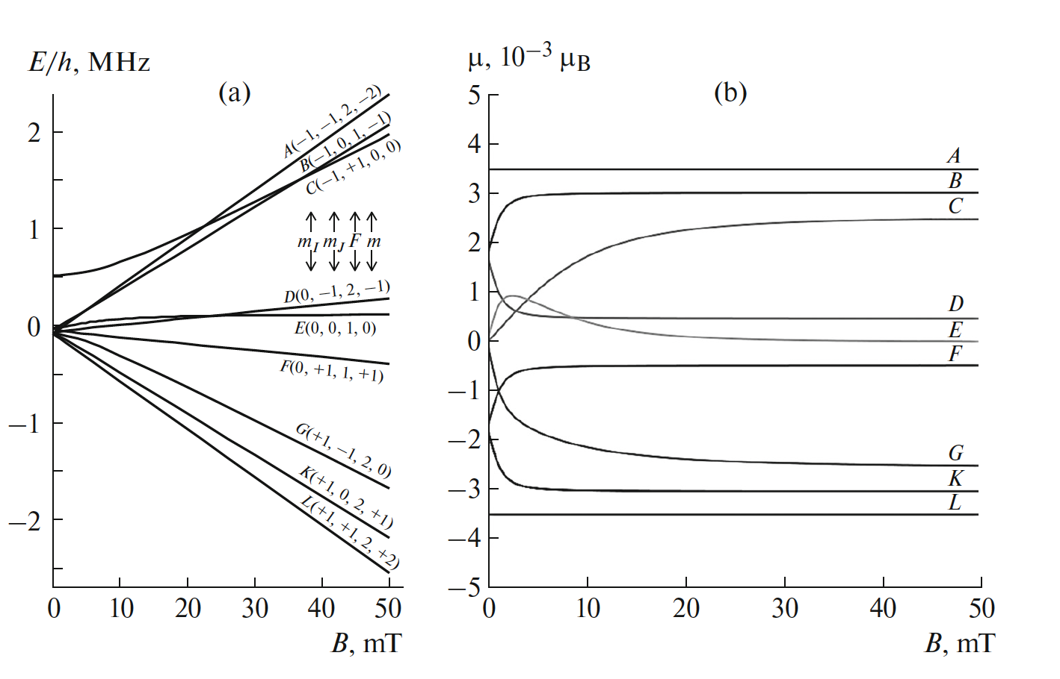
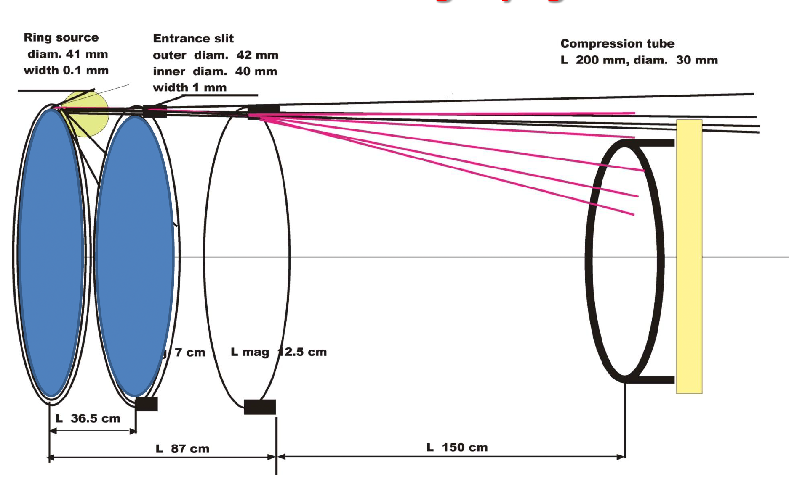
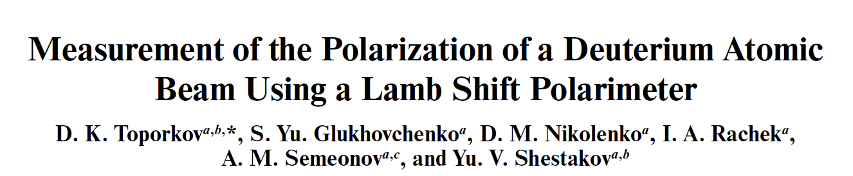
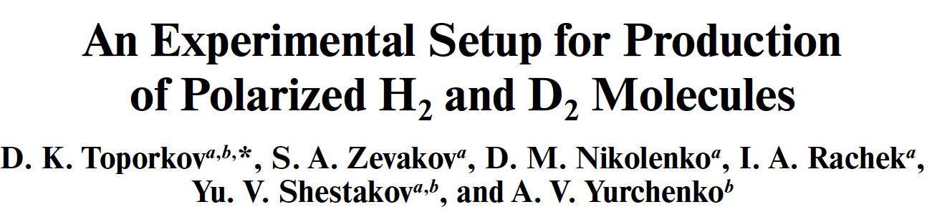
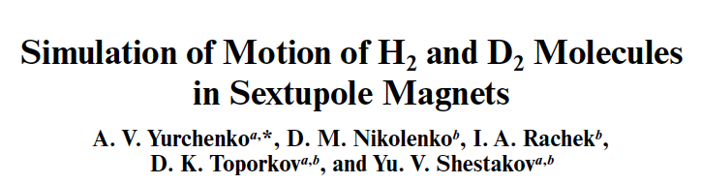
Production of polarized fuel from pMBS
  @BINP - Production of polarized fuel: from MBS officially before 02/2022.
Instrum. Exper. Tecn. 62 (2019) 56-61.
Instrum. Exper. Tecniques 66 (2024) 531-537.
Instrum. Exper. Tecn. 62 (2019) 56-61.
D. Toporkov Status of experiments with polarized deuteron target at VEPP-3 electron storage ring,
this symposium.

Slide 14
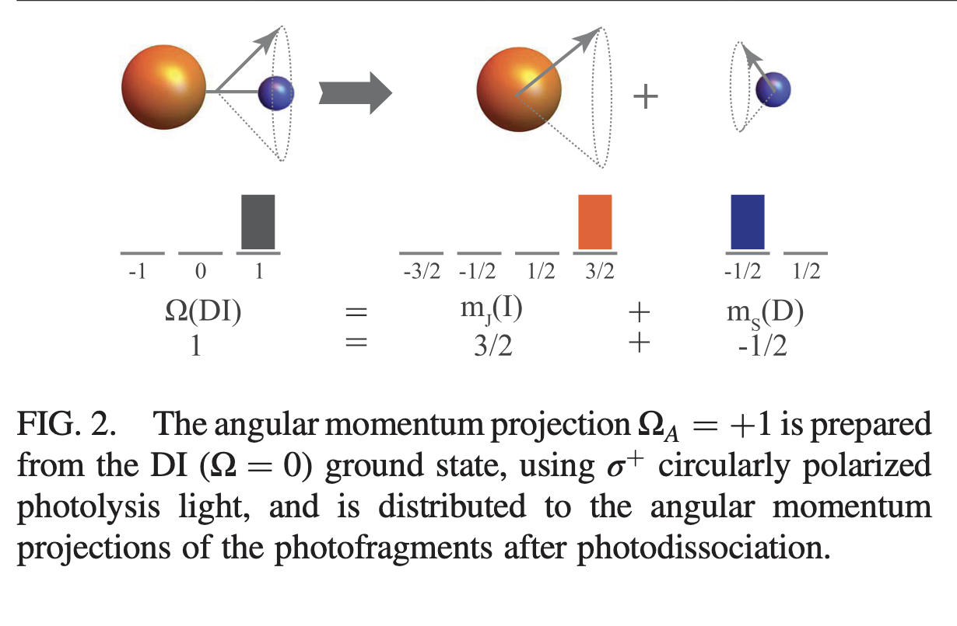
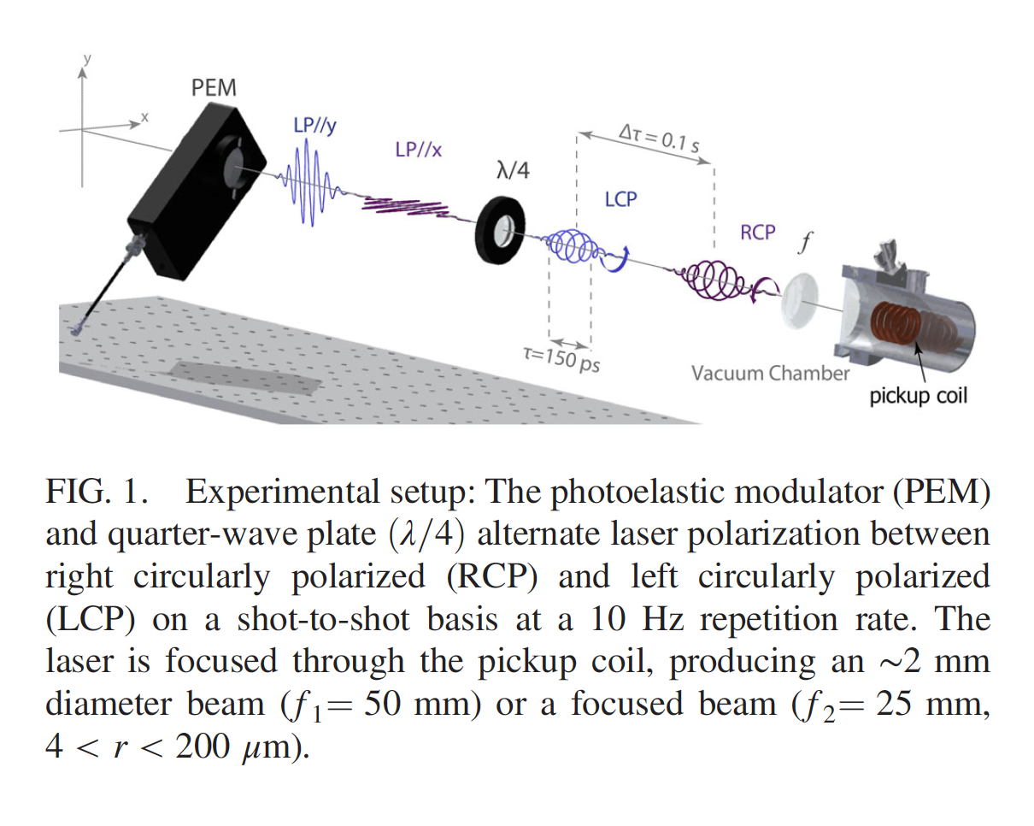
Production of polarized fuel by laser manipulation
  @ IESL-FORTH – Production polarized fuel: by Laser IR-Quantum Beat (QB) excitation and Ultra Violet (UV) dissociation, joined the collaboration later.
The idea: ‘‘Highly nuclear-spin polarized deuterium atoms
from the UV dissociation of Deuterium Iodide”
Pulsed Nozzle
DI
D atoms
LSP of Jülich Type
10¹⁸ cm⁻³ SPD from DI
Sofikitis et a.; PRL. 118 (2017) 233401.
Laser
Excitation
> 10¹⁹ cm⁻³ SPH & SPD
Laser
Dissociation
Electron-Polarization = 1
Deuteron-Polarization ~ 2/3
HI
(Proton-Polarization = 1)
Proof-of-principle
(Univ. of Crete/FORTH, IKP/PGI in FZJ/HHUD).
Sofikitis et a.; Phys. Rev. Lett. 121 (2018) 083001.

Slide 15
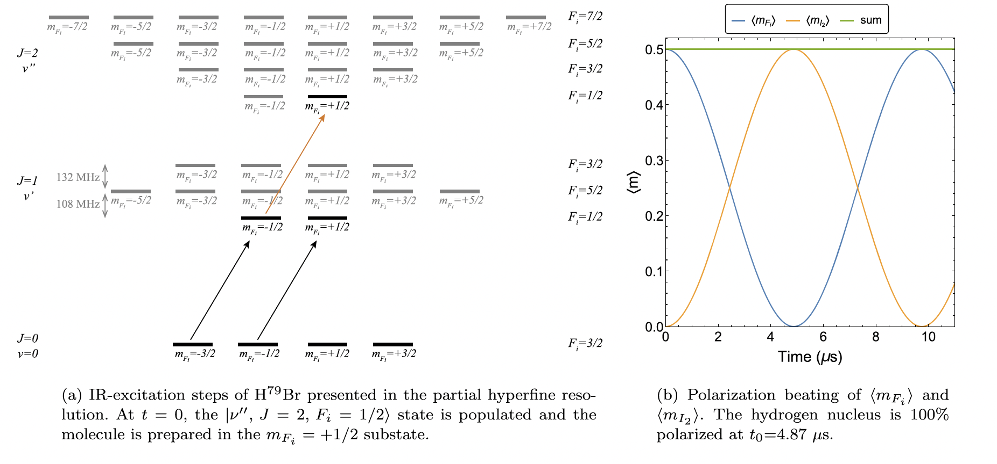
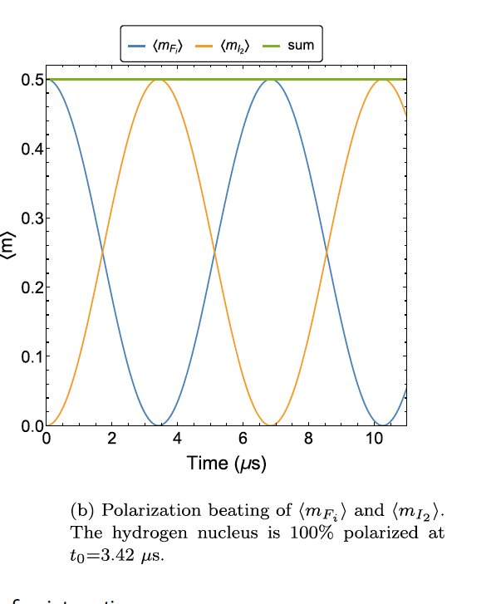
Production of polarized fuel by laser
  @ IESL-FORTH – Production polarized fuel: by Laser IR-Quantum Beat (QB) excitation and Ultra Violet (UV) dissociation, joined the collaboration a little bit later.
HBr
I₂ proton spin and F_{i}=J+I₁
I₂ proton spin and F_{i}=J+I₁
HI
HBr excited with σ+ IR.
HBr excited with σ+ IR.
SPH and SPD
> 10¹⁹ /cm³
SEOP and S-G ~10¹³ /cm³
vs
H isotope -Y diatomic molecules
Notation: I₁ (Y nuclear spin) I₂ (H isotope nuclear spin) J (rotational angular momentum, F_{i}=J + I₁ and F=F_{i}+I_{2.}
After the IR excitation the UV shooting after the trasfer of polarization to p, which can be «frozen» by a magnetic field.
C. S. Kannis et al. Chem. Phys. Lett. 784, 139092 (2021)
C. S. Kannis et al. Mol. Phys. 120 (2022) e1975053.
C.S. Kannis Spin manipulation in atomic and molecular systems for nuclear spin applications. This Symposium

Slide 16
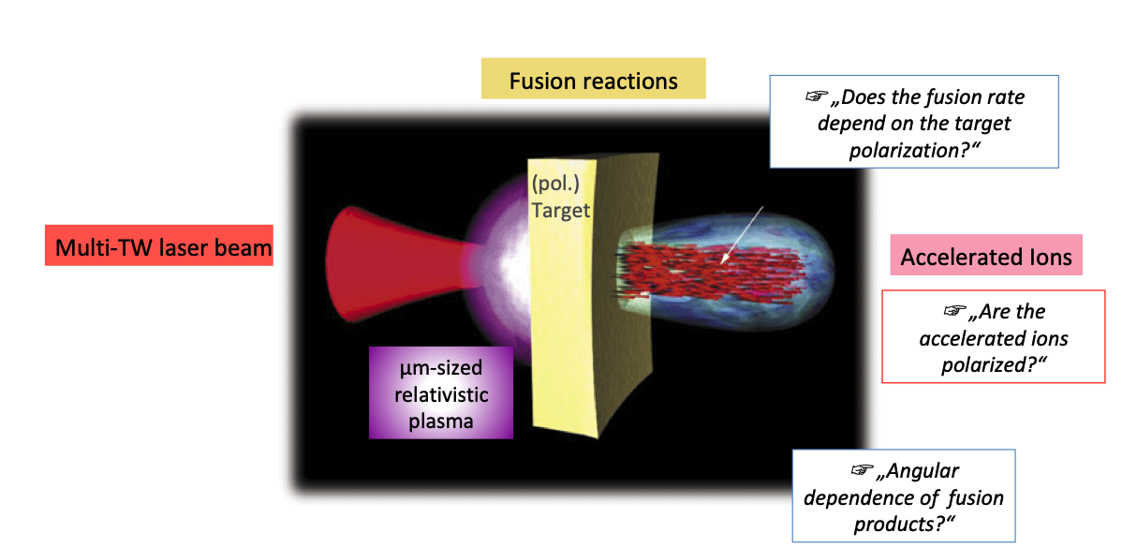
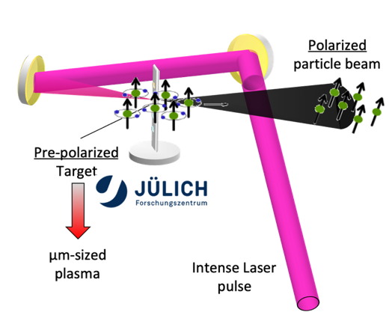
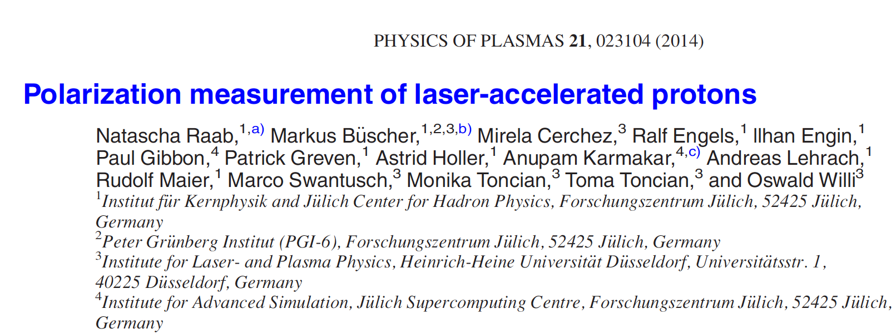
Laser Induced plasma (LIP)
  @PGI-FZJ/HHDU - Laser Induced Plasma LIP: production, acceleration and reaction studies.
There are various proposal to produce high intense
and pure polarized fuel for fusion, but ...
... still an question is pending:
... the polarization will survive in fusion environments?
... then let’s jump a step and start from polarized beam and test its survival in PW laser. As a result this will be a goal on providing polarized ion sources too.

Slide 17

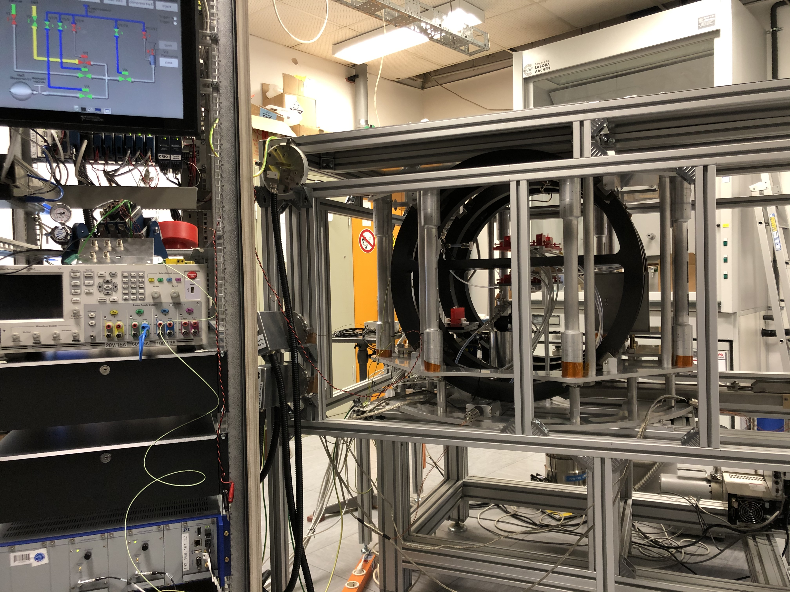
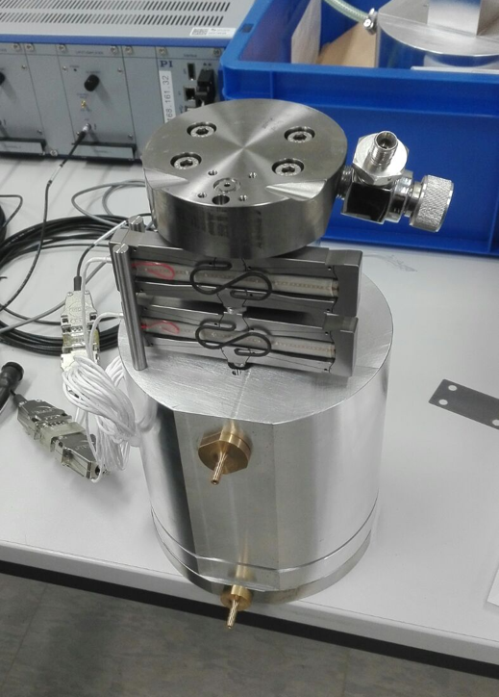
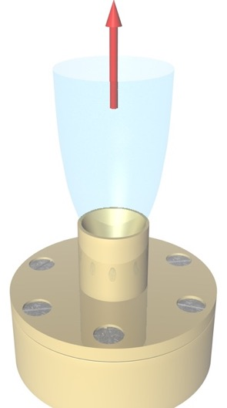
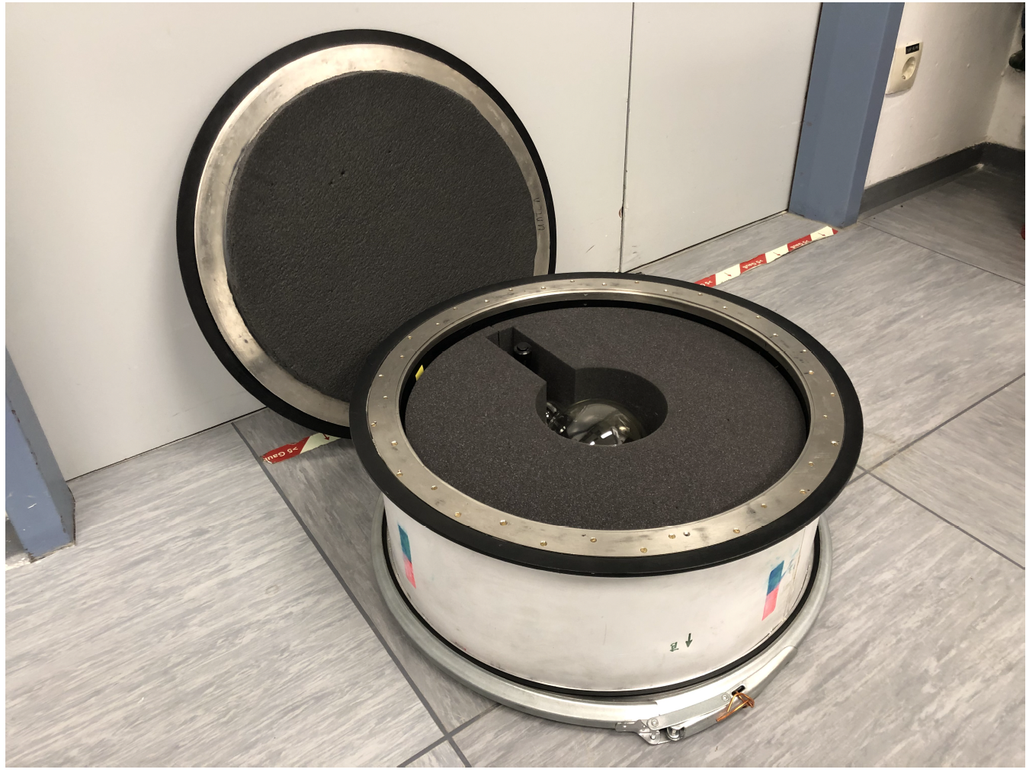
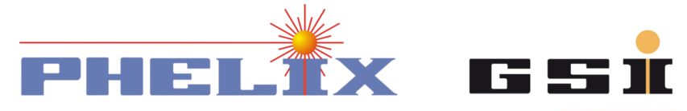
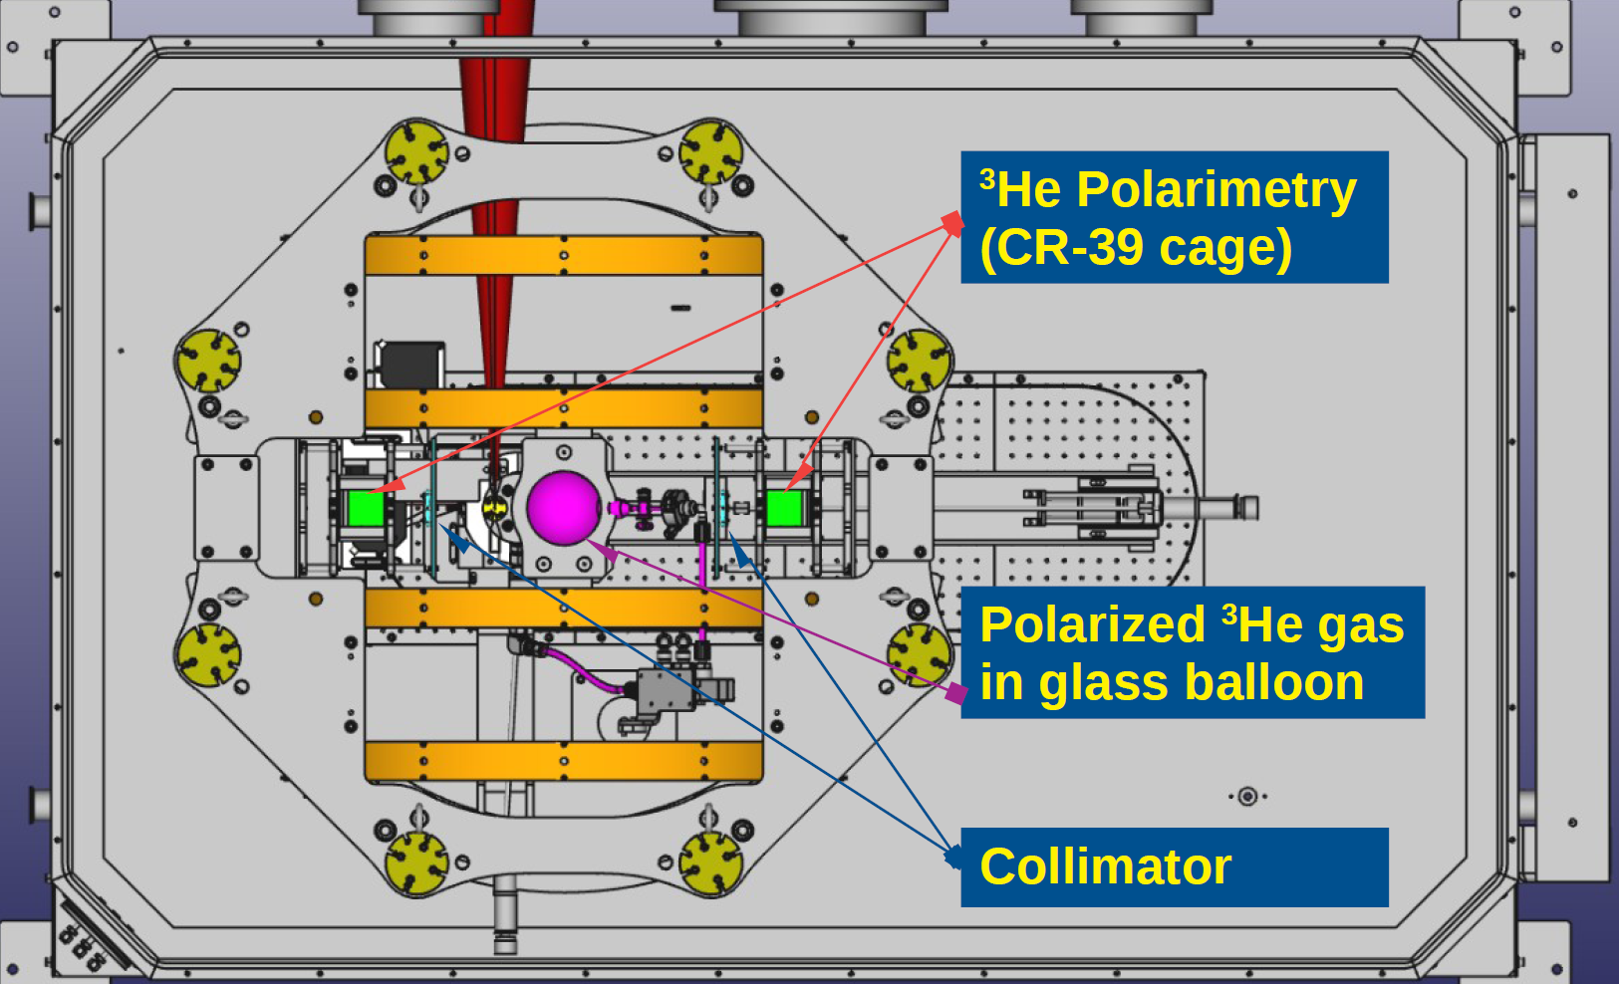

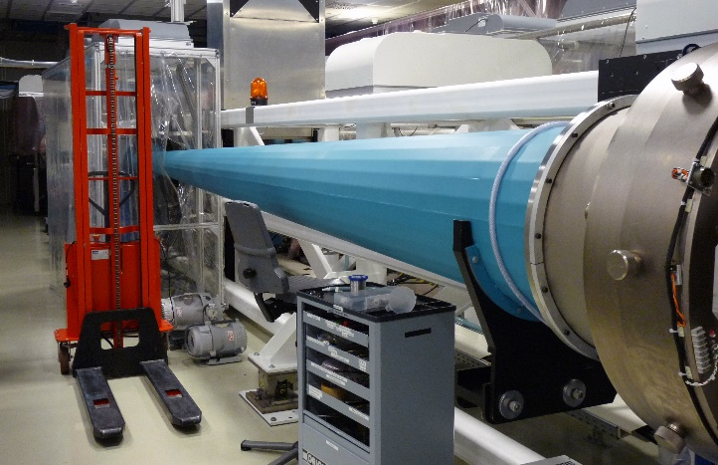

Polarized ³He gas-jet for LIP acceleration
³He polarized @Jülich
³He polarized jet beam at @GSI
magnetic holding field
for storing pre-polarized
³He gas @3 bar
compressor increases pressure of
³He gas to ~30 bar
non-magnetic nozzle provides the desired gas-jet target
Up to 80% nuclear polarization
Target @
Feasibility studies of laser induced acceleration on ⁴He
Best Working points: + 90° Laser dir.
⁴He⁺⁺ 4.65 MeV, ⁴He⁺ 3.27 MeV.
Gas Backing p= 30 bar, 40-60 J & 1.6-3.2 ps
jet of 4 10 ¹⁹ cm⁻³
I. Engin et al.,
Plasma Physics and Controlled Fusion 61 (2019) 115012
High density polarized ³He Gas-Jet Target 3/4 10¹⁹ cm⁻³
FZJ
P. Fedorets et al.
Instruments 6 (2022) art.n. 18
~ 250 km
GSI

Slide 18
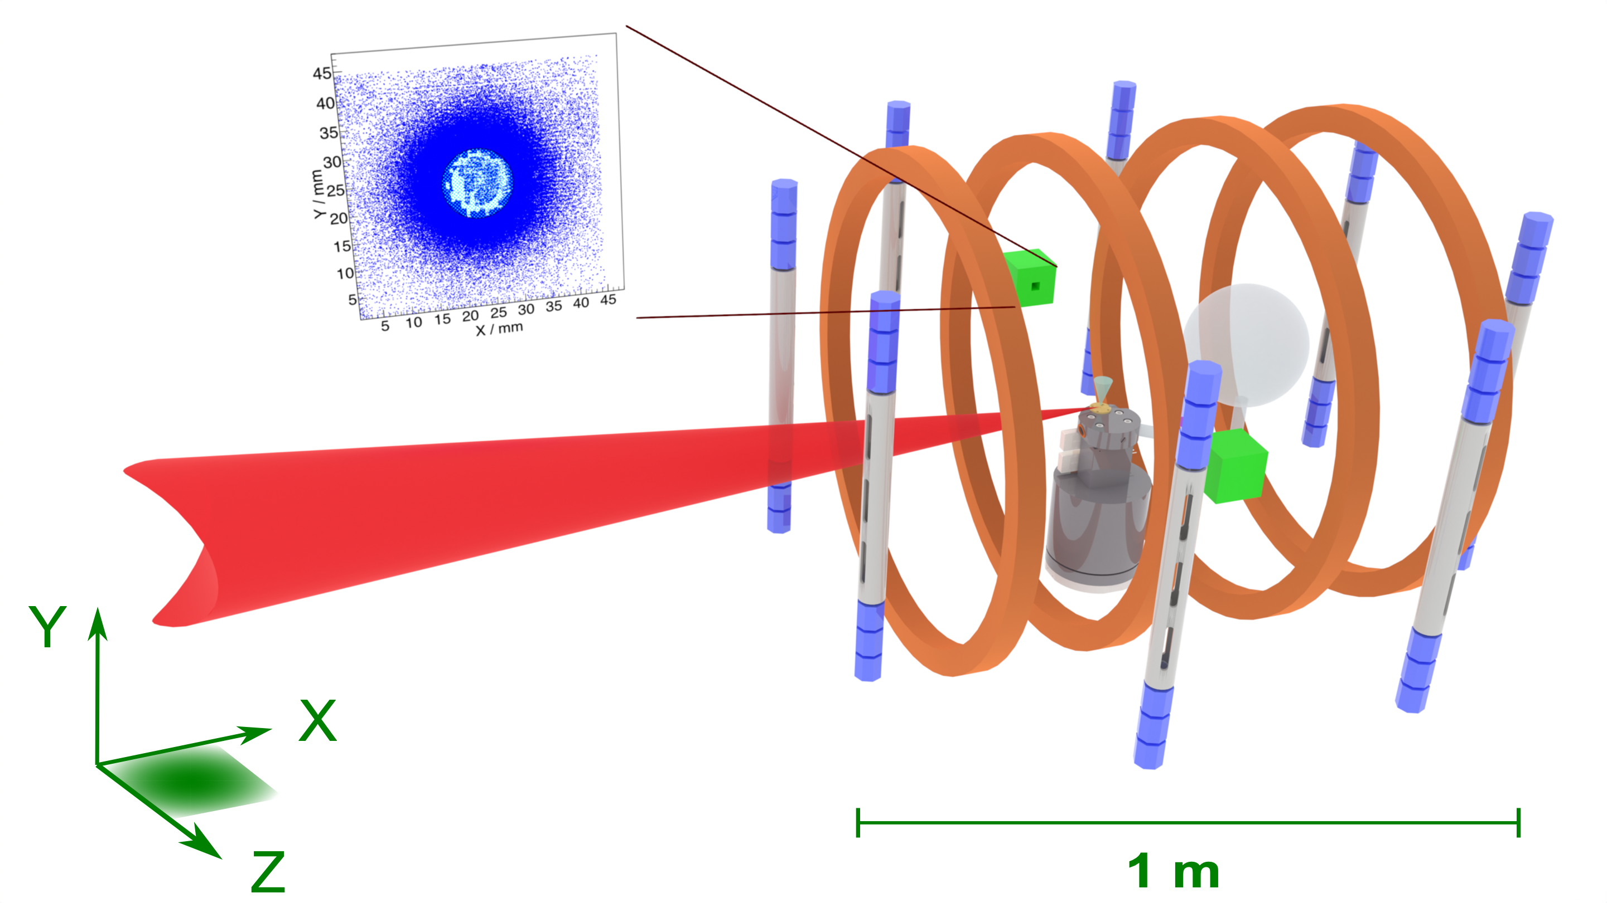
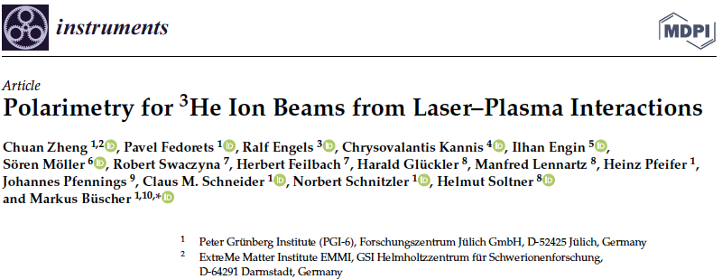
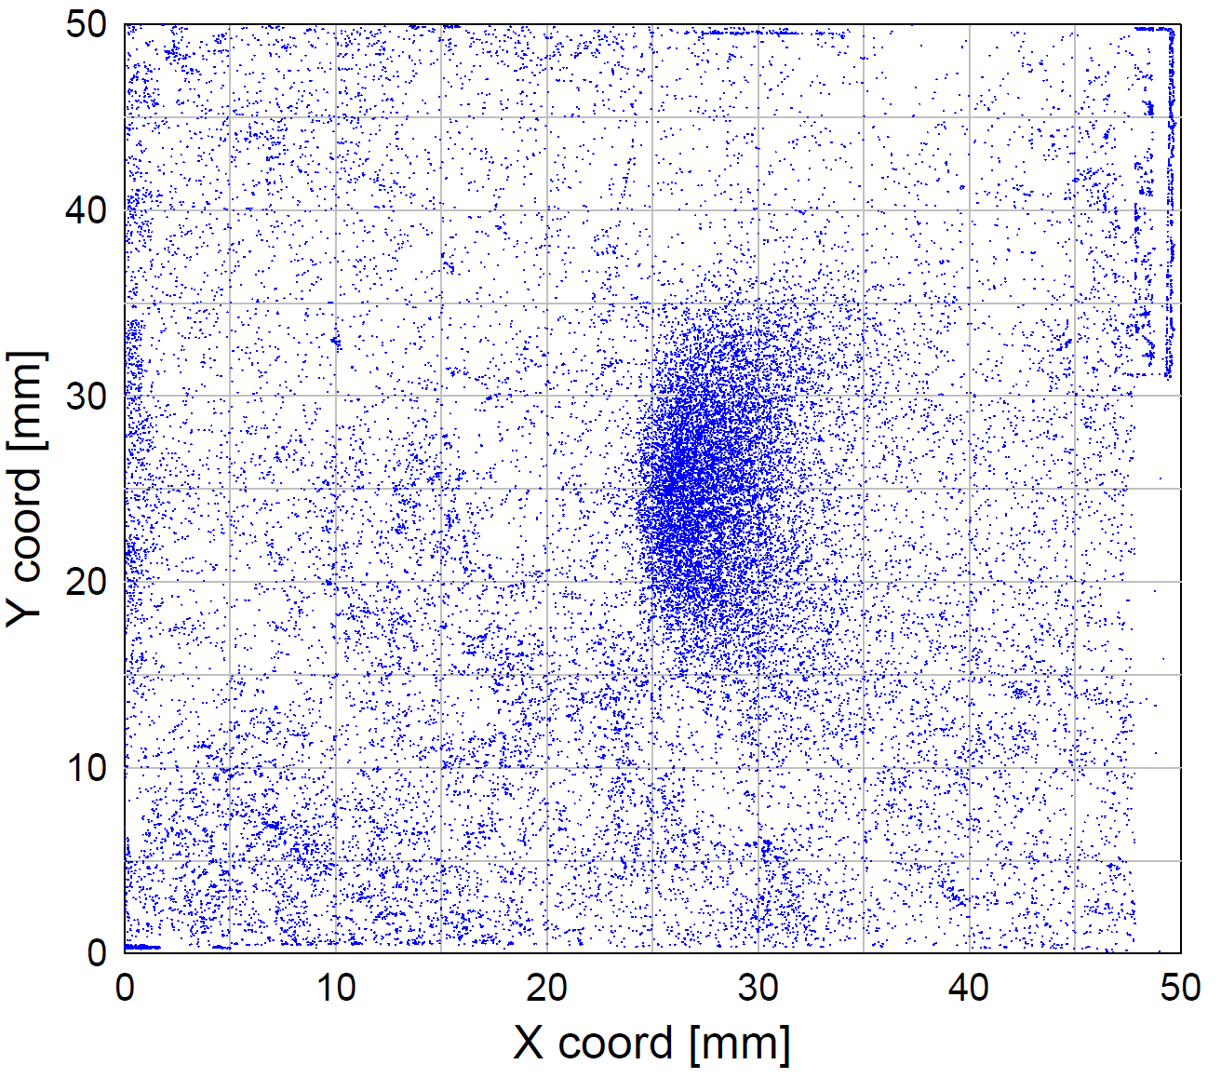
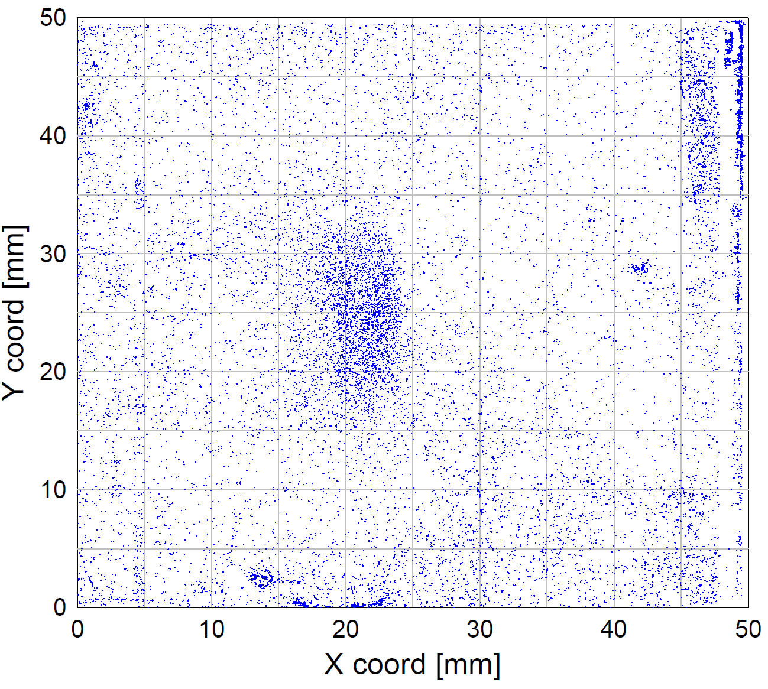

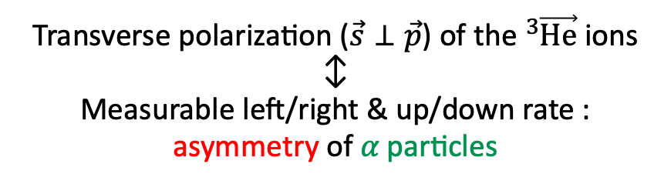
Polarimetry for ³He ions for LIP
Employing the know analyzing power of the $D\left({}_{ }^{3}{\vec{He}},α\right)p$ reaction
Polarimeter
Polarimeter
on
CD₂ foil
Helmholtz coils
off
x
CR-39 stack
− on
z
³He⁺⁺ beam
³He polarization along z mantained with B ~ 1.3 mT (——), Helmoltz coils (10 A and 5 mT max) hallow to rotate the polarization along the x axis (+ 75.5°) relative to the ³He ion momenta (- - -).
CD₂ foil:
$$D\left({}_{ }^{3}{He},p\right){}_{ }^{4}{He}$$
Transverse polarization ($\vec{s}⊥\vec{p}$) of the ${}_{ }^{3}{\vec{He}}$ ions
↕︎
Measurable left/right & up/down rate : asymmetry of 𝛼 particles
CR-39 stack

Slide 19
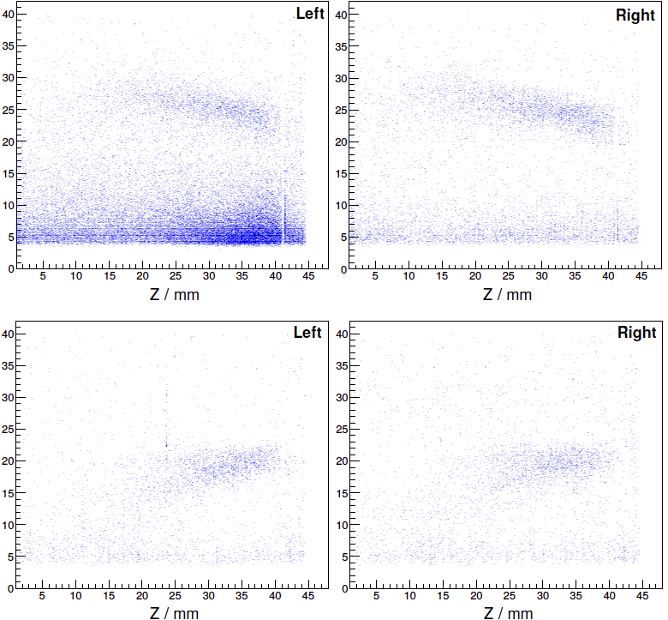
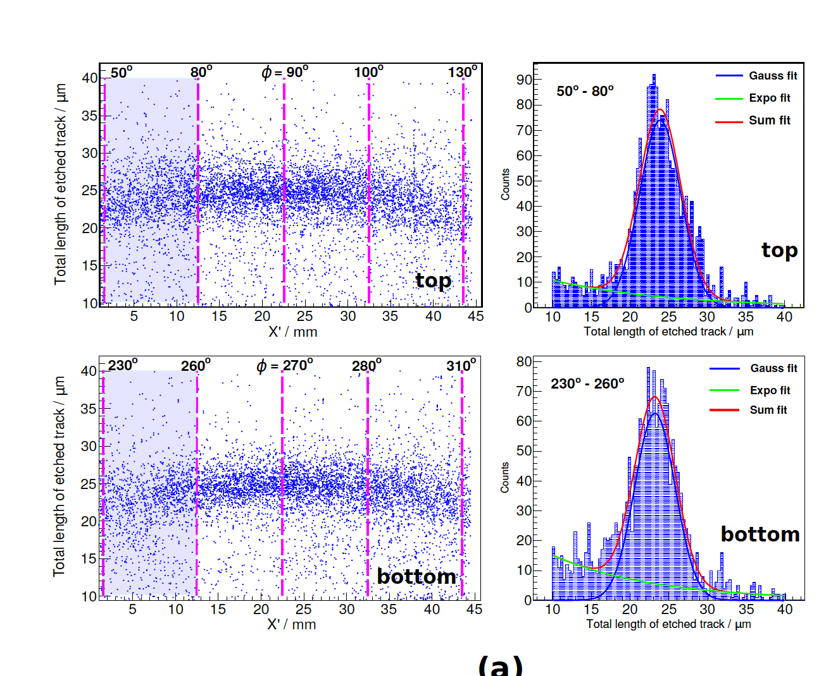
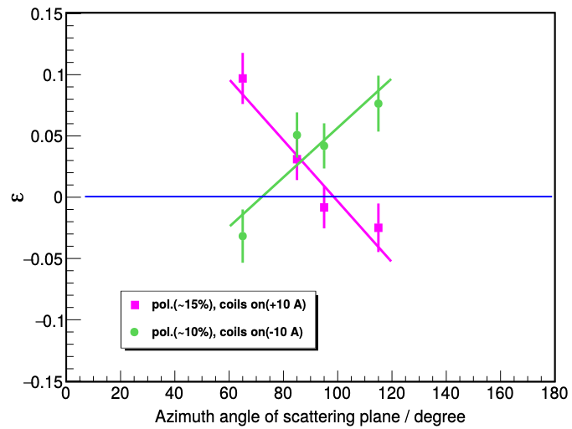


Observed (a-)symmetry for LIP
Unpolarized ³He gas
$D\left({}_{ }^{3}{\vec{He}},α\right)p$
x
z
Long. polarized ³He gas
😮
Change of 𝛼-distribution: modified kinematics for polarized ³He gas
In both cases no L/R (U/D) asymmetry ➔ polarimeter works as expected
Higher sensitivity on α particle.
😀
Asymmetry ε
ε=$\frac{(N_{t}−N_{b})}{(N_{t}++Nb)}$
³He-ion polarization conserved after acceleration
2x increased ³He-ion flux from pol. plasma
Our concept (polarized target @ PW laser) works
Plasma acceleration of polarized beams (e–, p, ions) feasible
Models/simulation codes seem incomplete (spin-dependent ionization?)
signal for unpolarized or longitudinally pol. ions

Slide 20
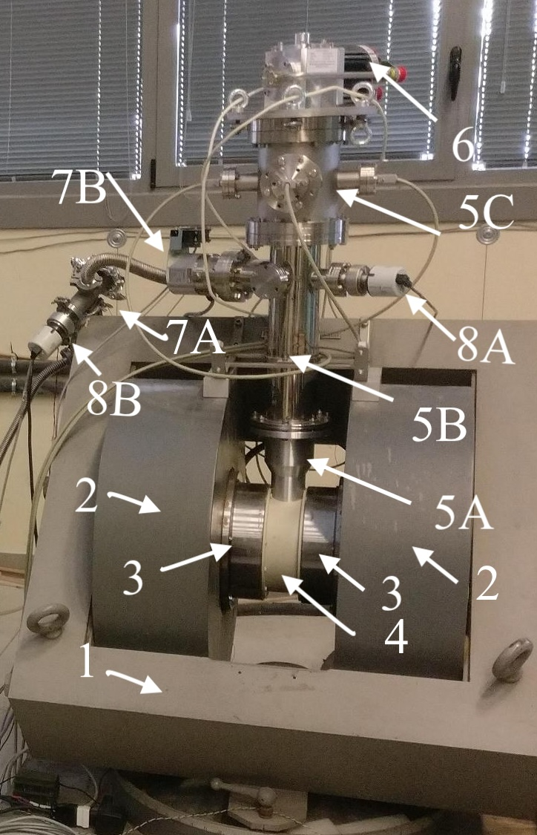
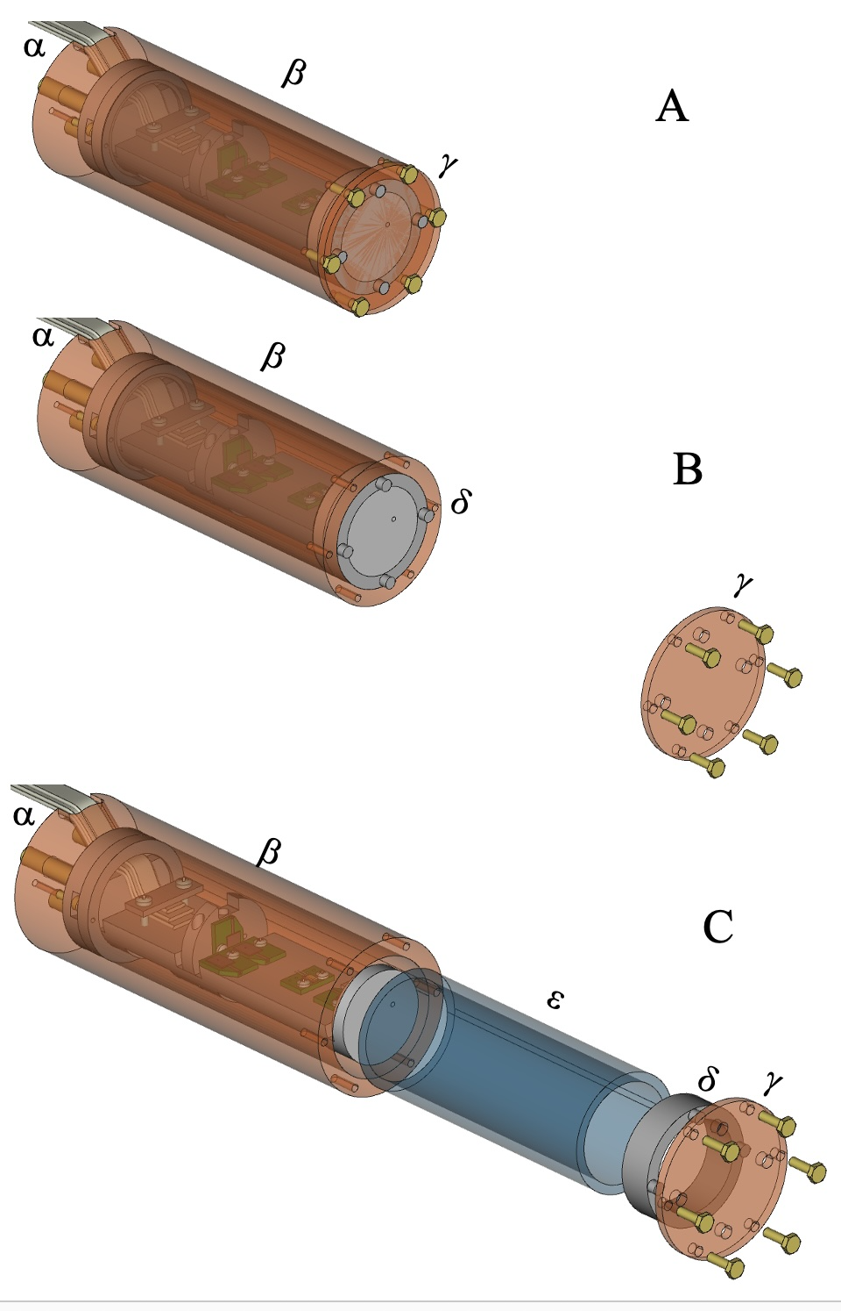
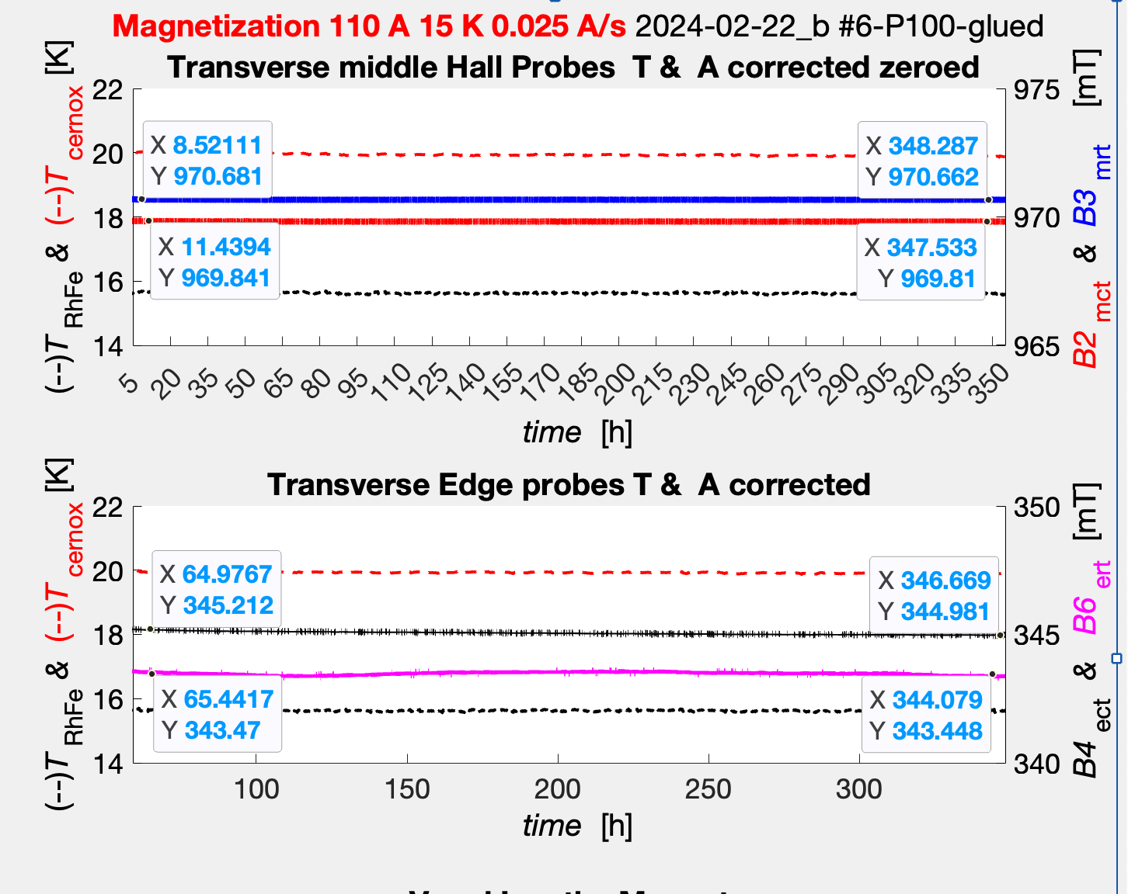
Superconducting Bulk magnets
  @FE - Magnets for holding, manipulating and transporting polarized fuel .
We found the optimal MgB₂ bulk tube and tested it in the so called
FC (Field Cooling) condition and keep useful fields for a long time more than the requirements for transportation.
ΔB ~ 0.02 mT
on 970 mT
in 15 days
M. Statera et al. NIM A 882
(2018) 17-21.
G. Ciullo et al. Front. Phys. 12
(2024) 1358369
A- Cu-can hosting
sensors and MgB₂ tube.
B – Opening Cu-cover.
C- Extracting MgB₂ tube
from the Cu-can.
1- iron yoke, 2 –coils, 3-iron poles, 4- nylon support, 5A –Al Chamber, 5B-5C SS chambers, 6-cold-head, 7B -7A TM pumps, 8A-8B Penning gauges
We tested the tube in the so called ZFC (Zero Field Cooling) condition and it shielded 970 mT for more than 1480 h ~ 61.5 days.

Slide 21
Estending framework and collaboration
SPINPOL: Novel Methods for Hyperpolarized electron and nuclear spin production for: hyperolarized magnetic resonance (MRI/NMR/ESR) and Polarized Laser Fusion.
(1) in vivo medical imaging, and (2) atmospheric chemistry (3) polarized nuclear fusion
Spin-polarized HD trapped at a surface is done in the following steps:
(1) production of cold HD beam, with all molecules in the J=0 rotational state. (2) IR excitation of all molecules in the ground J=0 state using STIRAP [42], producing polarization of HD bond rotation ; (3) transfer of rotational polarization to HD nuclear spin through hyperfine beating; (4) trapping of HD at a cold surface; (5) transport of trapped HD to measurement facility; (6a) (polarized) laser fusion at the PALS in IPP, which possesses the intensity to produce collision energies high enough to trigger fusion reactions, such as D-D fusion (and D-³He fusion, in the presence of both hyperpolarized D and ³He; the latter supplied by UDUS);
6b) Hyperpolarized MRI on animals using hyperpolarized hydrocarbons (instead of HD), at Aarhus.
(The main novelty of SPINPOL is to combine all 6 steps, and to produce spin-polarized molecules at a scaled up level (at least mmol quantities of SPMs). Given that each of these 6 steps has been demonstrated individually (references given in each case), the likelihood of success for SPINPOL is very high.
Foundation of Research Technology- FORTH-Hellas; University of Düsseldorf - UDUS ; University of Münster- UMU; Quamtum Diamonds - QD – Münich; Aarhus University – AU; Institute of Plasma Physics - IPP – Prague; SpinFlex Ashkelon; University of Creta-UOC-Hellas, University of Ferrara – UNIFE.

Slide 22
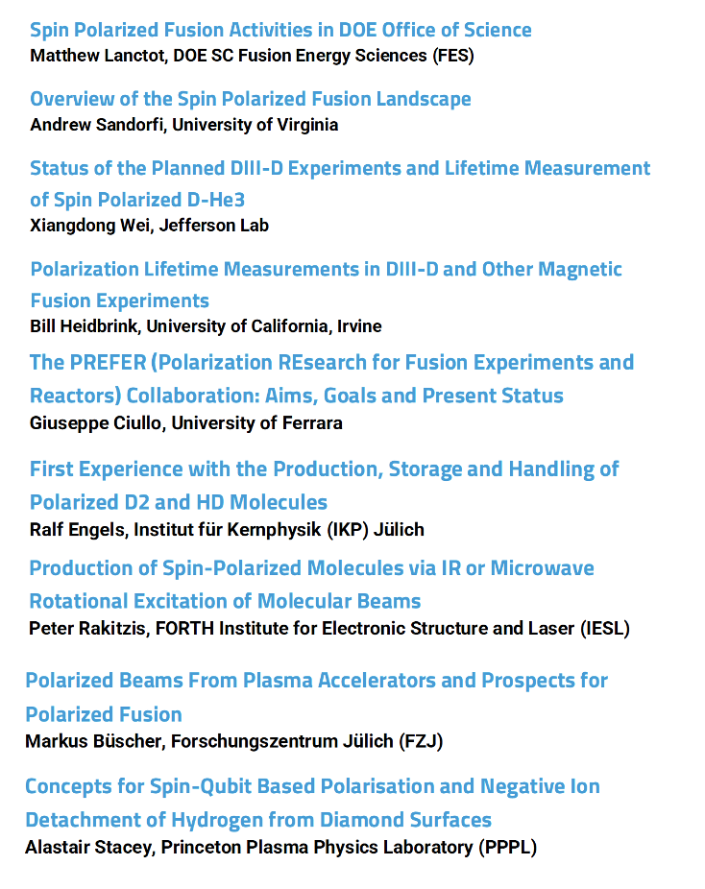
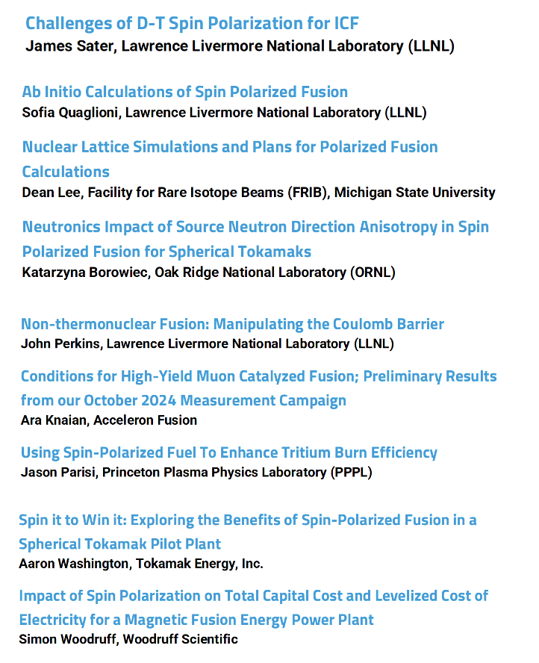
The ARPA-E ad hoc workshop
ARPA_E involved the PREFER in a very workshop on polarized fuel for the improvement of fusion facilities.
https://arpa-e.energy.gov/news-and-events/events/spin-polarized-fusion-spf-workshop

Slide 23
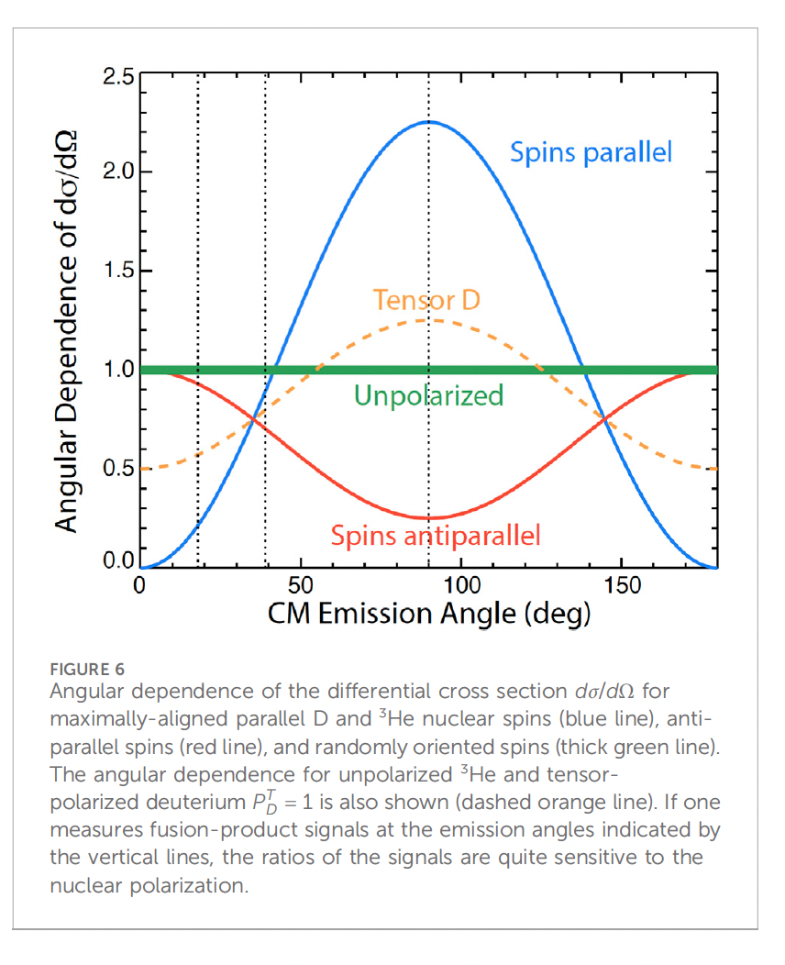
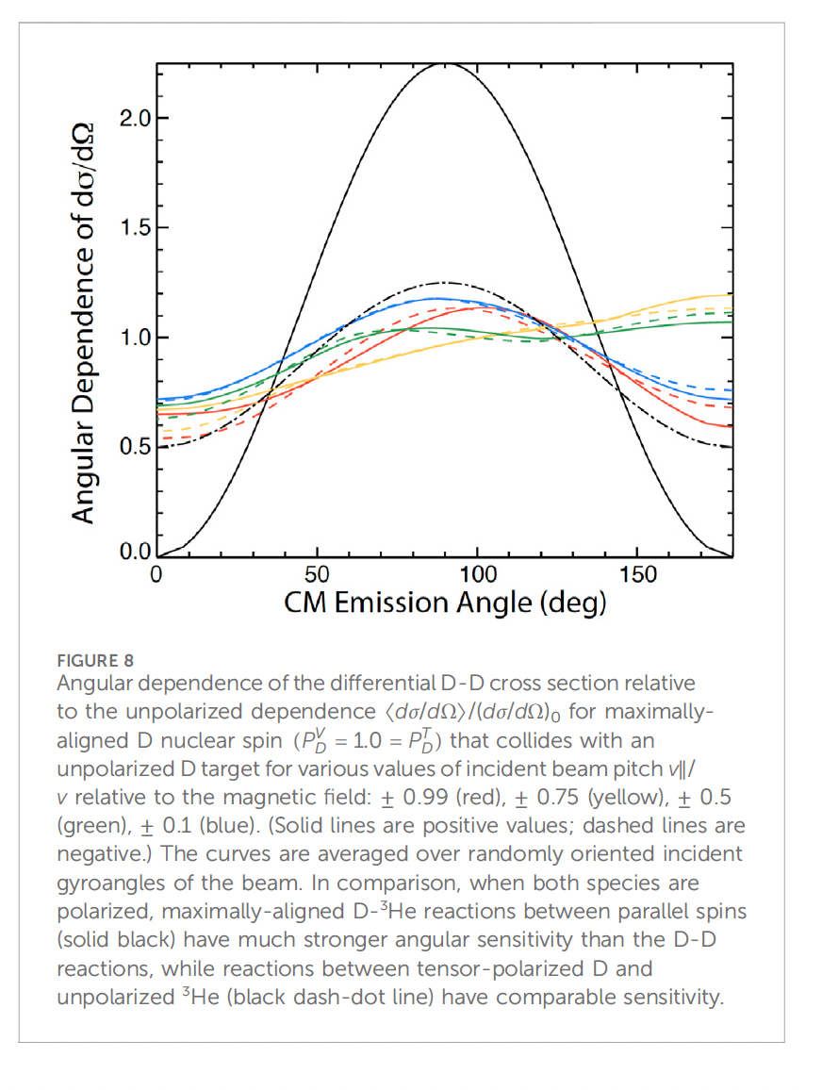
The SPF (Spin Polarized Fusion) program at DIII--D
A project is funded by the DOE in USA for the test at the DIII-D tokamak for the survival of polarization.
W. W. Heidbrink et. al. A research program to measure the lifetime of spin polarized fuel Front. Phys. 12 ((2024) 1355212.
Feeding pellet of
³He and LiD with spin parallel
and antiparallel
with proper diagnostics of the angular
distribution of fusion products,
will provide evidence of the
survival of the polarization.
Also the D polarized +
D unpolarized reaction has to be considered, they compared
different beam pitch v||/v and
with the D+³H spin aligned reaction
and tensor polarized D + ³He unpolarized
reaction.

Slide 24
Conclusions
Interests and activities on fusion with polarized fuel are “boiling” around, involving fusion experts too.
This is another good result, which will be surely fruitful.
The proposal SPINPOL, submitted to the European community, enlarged already our collaboration.
A program in USA has been funded, in which our collaboration was determinant.
The most impelling and determinant result is to provide useful and “easy to handle” polarized fuel,
but we engaged excellent teammates for our spin games.
Sebastiano Filippi (named Bastianino)
“The spin game”
A fresco on the cieling of the Games’s Hall of the
Este Castle in Ferrara,
dated after earthquake of 1570.

