Slide 1

Rapidity-Spectral Decomposition and Spin Dynamics in Coupled Lorentz Spacetime Coordinates
N. S. Akintsov Research Center for Intelligent Information Technology Nantong University Nantong, China ORCID: 0000-0002-1040-1292 e-mail: akintsov777@mail.ru

Slide 2
The idea of ​​a gyrovector
A gyrovector is the analog of "angular momentum," but defined not in Euclidean geometry, but in hyperbolic geometry.
Actually: In Euclidean space, rotations are described by spherical coordinates (𝑟, 𝜃, 𝜙).
In Minkowski space, the natural replacement is hyperbolic spherical coordinates (θ, θ⊥, θs), where
θ - rapidity (hyperbolic angle associated with boost along the axis of motion);
θₛ = gd(θ) - angular variable via the Gudermannian function (connects hyperbola and circle);
θ⊥ = ln(sinh θ) - logarithm of the transverse component, describes the growth of the transverse "amplitude".

Slide 3
The idea of ​​a gyrovector
(xx)

Slide 4
The concept of spin within the framework of the approach through hyperbolic functions with coupled parameters
The main idea: The description of the dynamics of relativistic particles using rapidities (θ, θ⊥, θs), which serve as universal parameters of motion. These parameters allow for a compact representation of the Hamilton–Lagrange equations, as well as new Lorentzian coordinates.

Slide 5
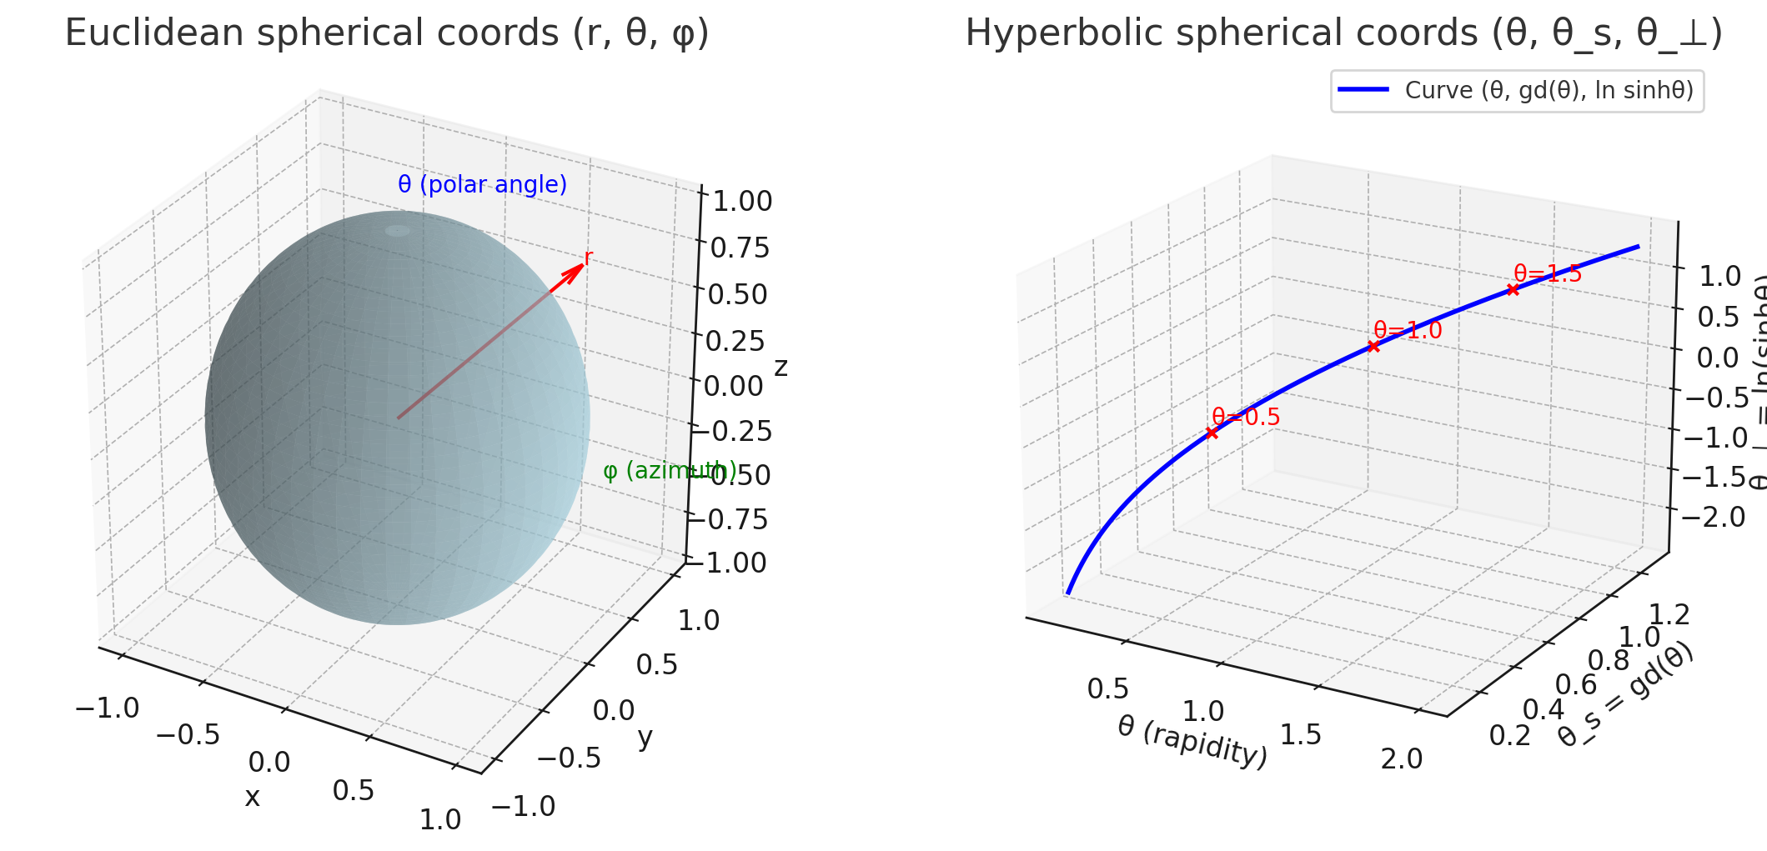
Comparison of spin orientation in Euclidean and hyperbolic spherical coordinates.

Slide 6
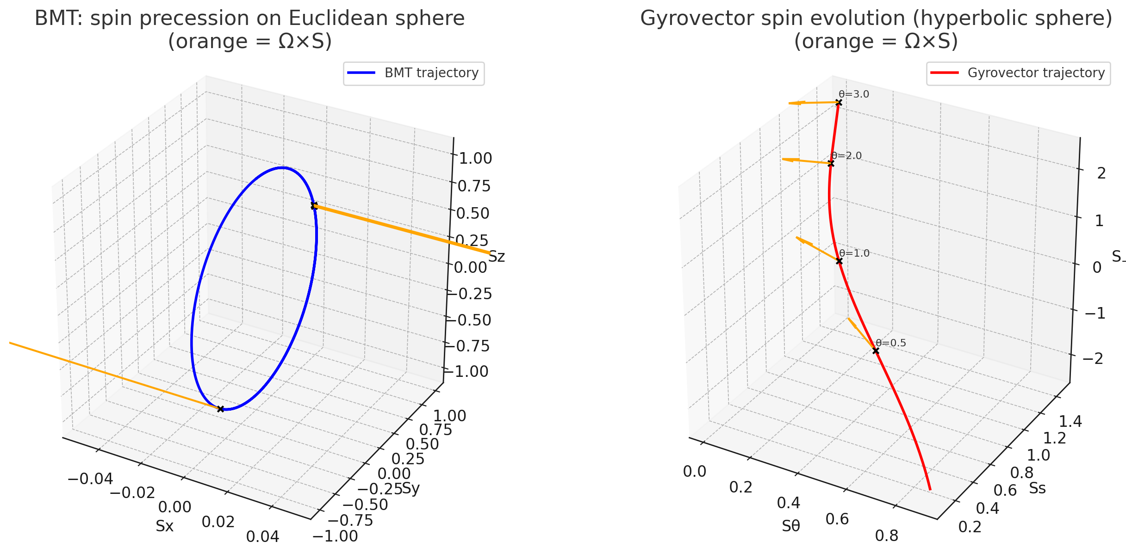
Spatial orientation of spin in Euclidean and hypergeometric geometry.
Bargmann–Michel–Telegdi (BMT)

Slide 7
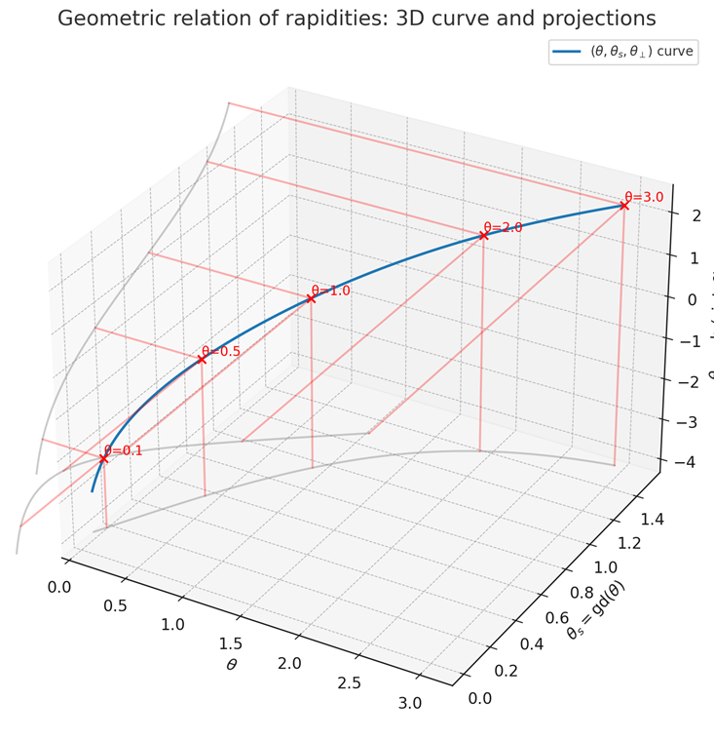
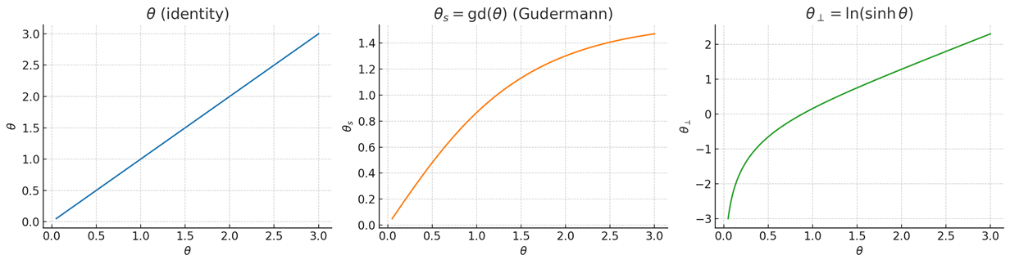
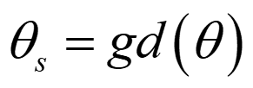
The concept of rapidities for relativistic particle.
where - Gudermann function
Karapetoff V. Rev. Mod. Phys. 1944, 16, 33
Akintsov N.S. et al. Symmetry 2024, 16, 357

Slide 8
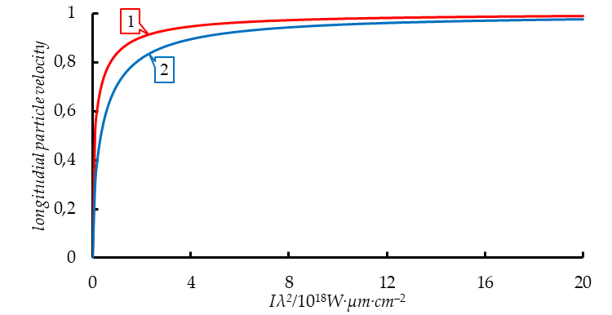
Coupled parameters
is proper time and is proper coordinate.
Lorentzian space-time coordinates and ,
where is an invariant.
(3)
Fig. 1.Velocities (labeled 1) and (labeled 2) depend on dimensionless field amplitude .

Slide 9
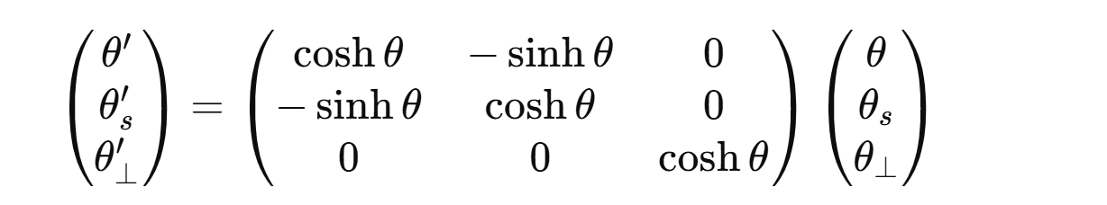
Lorentz Transformation of Spin Expressed via Rapidity.
(9)
Spectral (rapidity) decomposition of spin.
(10)

Slide 10
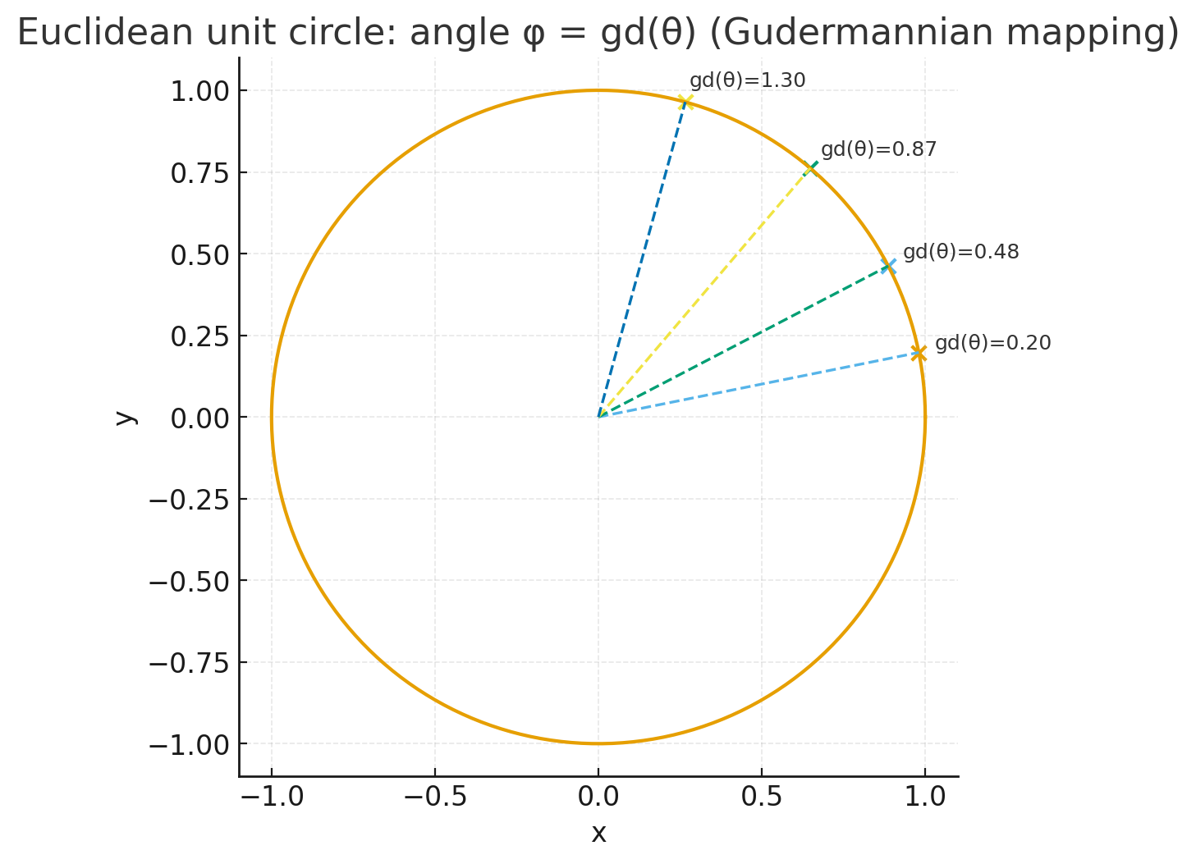
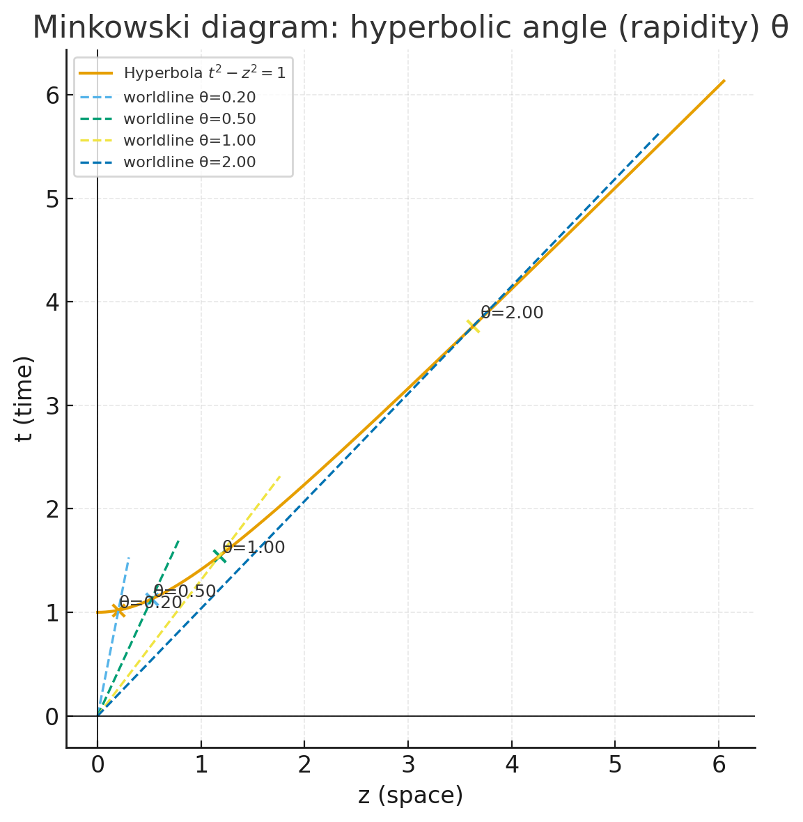
Minkowski and Euclidean diagrams as a function of rapidity.
v

Slide 11
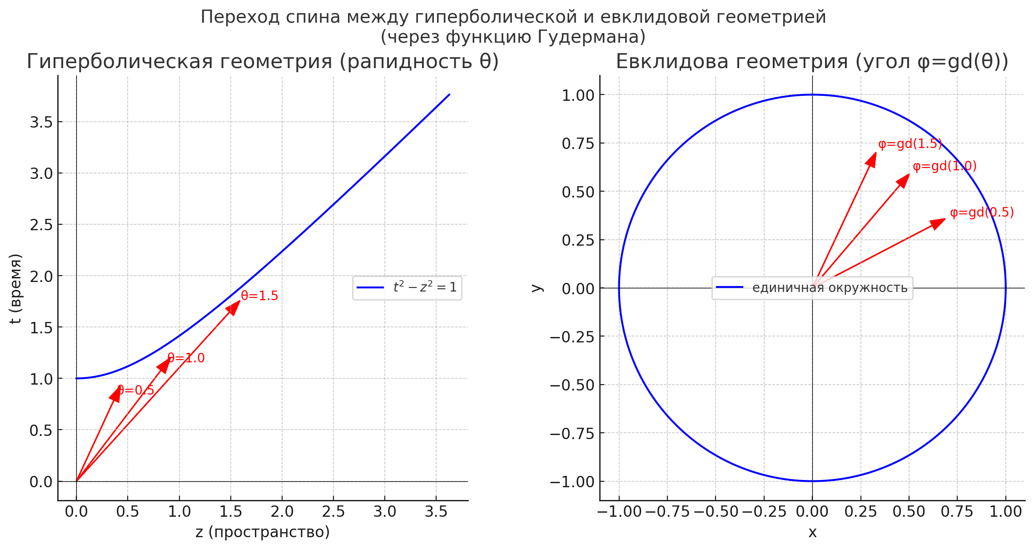
The transition of spin between hyperbolic and Euclidean geometry.

Slide 12
The transition of spin between hyperbolic and Euclidean geometry.
When transitioning, we usually want to transfer the spin components from one basis to another. Problem: The components are given in the gyrovector (hyperbolic) basis.
in basis (xx)
Find the components in a certain Euclidean basis (e.g., a spherical one).
in basis (xx)
We will construct an explicit connection via the coordinate map, relying on natural correspondences.

Slide 13
Basic identities
This is a natural way to transfer hyperbolic quantities into the Euclidean pair (r, φ) and an additional variable ψ, which can be angular or radial.
(xx)
(xx)
(xx)

Slide 14
The Jacobian for a change of basis: relating the basis vectors.
Let's consider the coordinate mapping
(xx)
with selected definitions
(xx)
(xx)

Slide 15
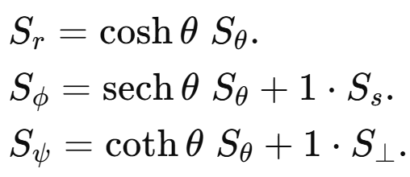
Transformation of spin components
If the bases are related via the Jacobian, the components in the new basis take the form (approximately, under the assumption of a direct correspondence between the bases):
(xx)
i.e.,
(xx)

Slide 16
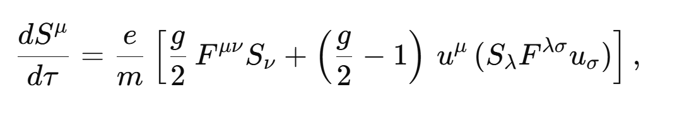
The classical form of the Bargmann–Michel–Telegdi equation
In the standard formulation, the BMT equation for the spin 4-vector Sμ in an electromagnetic field is:
(xx)
(xx)

Slide 17
Spin Parametrization via Rapidity Variables
(xx)
(xx)

Slide 18
Equations of motion (precession) for S in the rapidity form.
For the spin, we have the following precession equation
(xx)
where the "time" parameter 𝑠 is the invariant interval. The precession frequency 𝛺 can be expressed in terms of the variational derivatives of the Hamiltonian with respect to the angular rapidities, using equations of the form (Euler–Hamilton):
(xx)
where - is a proper coordinate.

Slide 19
Comparison of Classical BMT with Rapidity Adaptation
Characteristic | Classical BMT | Rapidity Adaptation
Variables | Time t, velocity v, γ-factor | Rapidity θ,θs,θ⊥
Precession Frequency | ΩBMT∝(e/m) (B,E,γ) ΩBMT​∝(e/m)(B,E,γ) | Ω=(∂H/∂θ, ∂H/∂θs, ∂H/∂θ⊥) Ω=(∂H/∂θ,∂H/∂θs​,∂H/∂θ⊥​)
Invariance | Depends on the reference frame choice (γ, v) | Natural hyperbolic structure (additivity of rapidities)
Solutions | Require complex integrals, especially in variable fields | Spectral decomposition in θ is possible, yielding elementary integrals
Physical Interpretation | Geometry in space-time via γ and v | Geometry via hyperbolic functions and conjugate coordinates
Spin-Orbit Interaction | Appears as a correction in the equation of motion | Built into the structure via θs, θ⊥

Slide 20
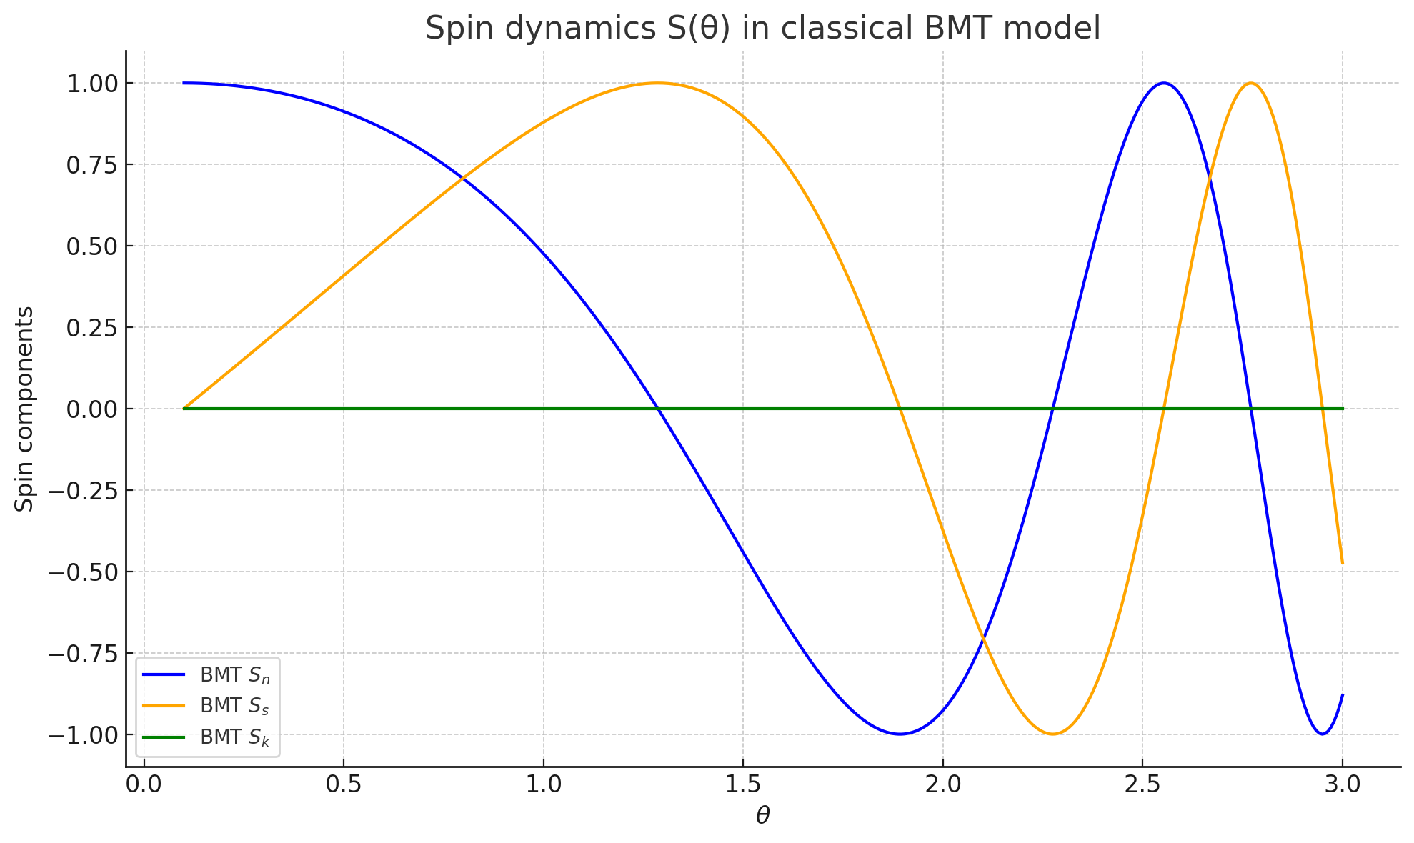
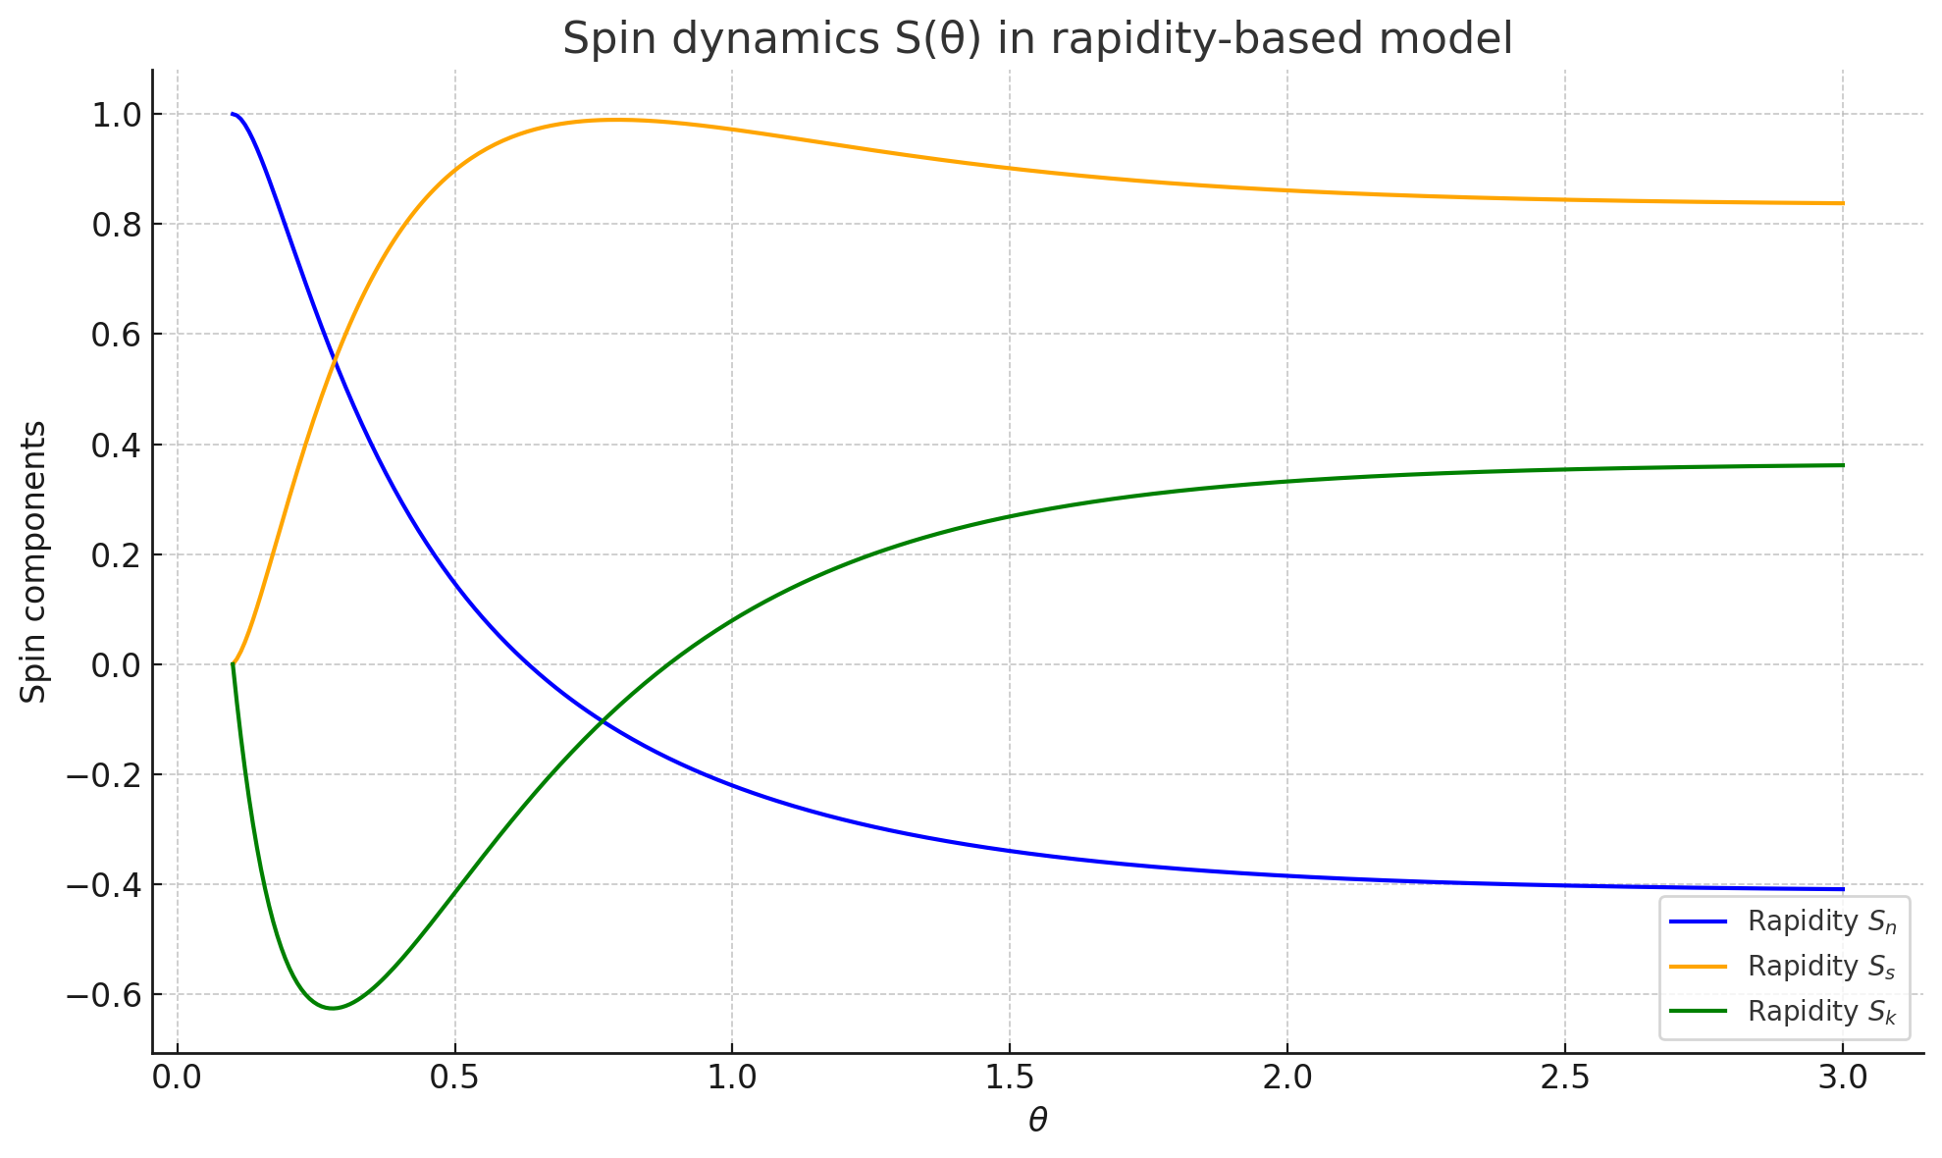
Comparison of Classical BMT with Rapidity Adaptation

Slide 21
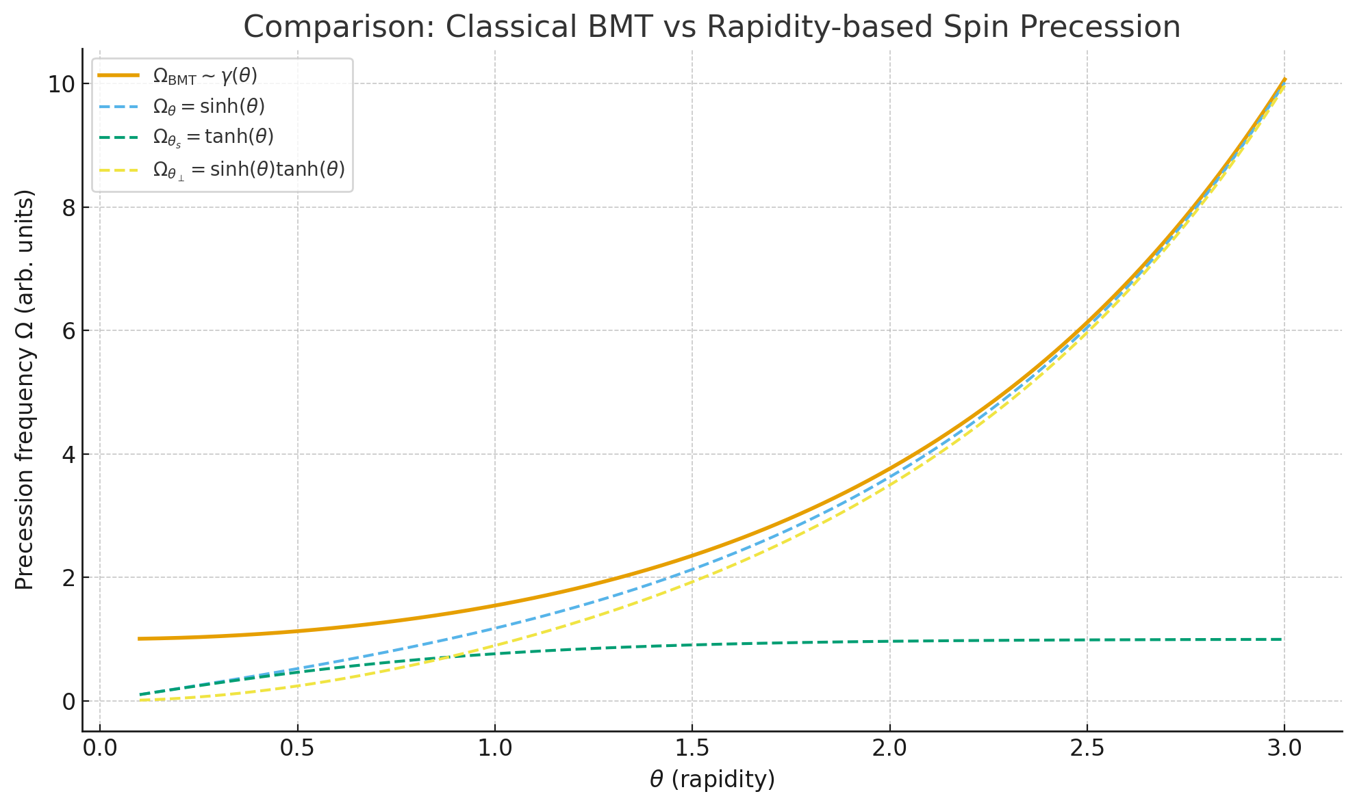
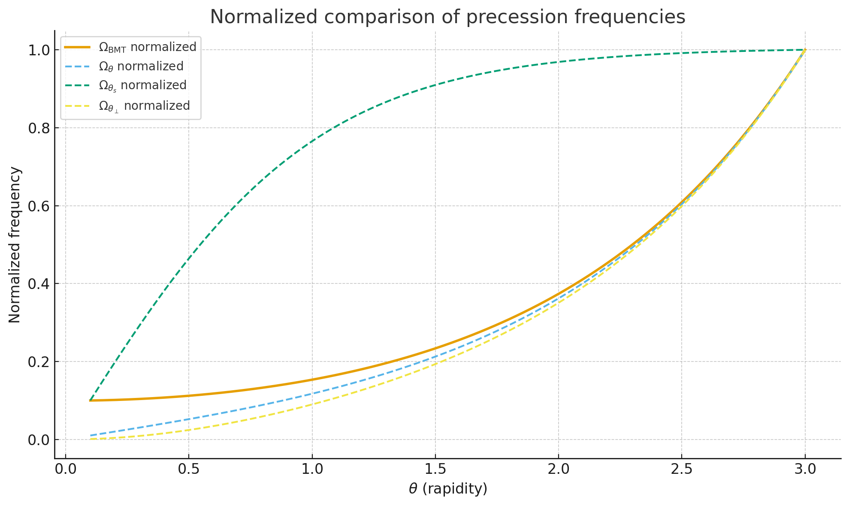
Comparison of Classical BMT with Rapidity Adaptation

Slide 22
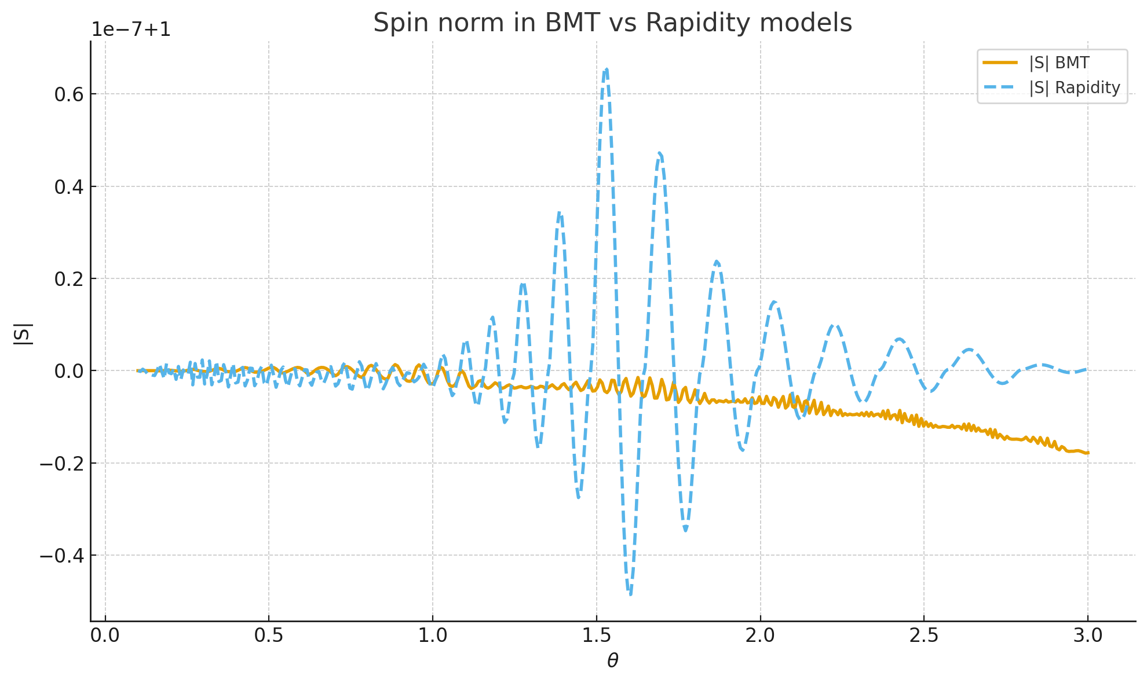
Spin norm

Slide 23
The Dirac equation for a 4-component spinor.
The Dirac equation is a relativistic wave equation for particles with spin-1/2 (like electrons). Because it must be consistent with special relativity, the wavefunction is not a scalar or a vector, but a more complex object that transforms under a specific representation of the Lorentz group, known as a 4-component spinor or bispinor.
(xx)

Slide 24
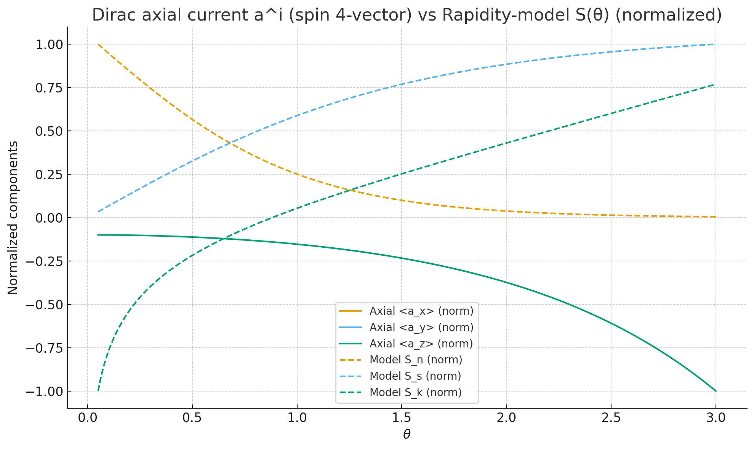
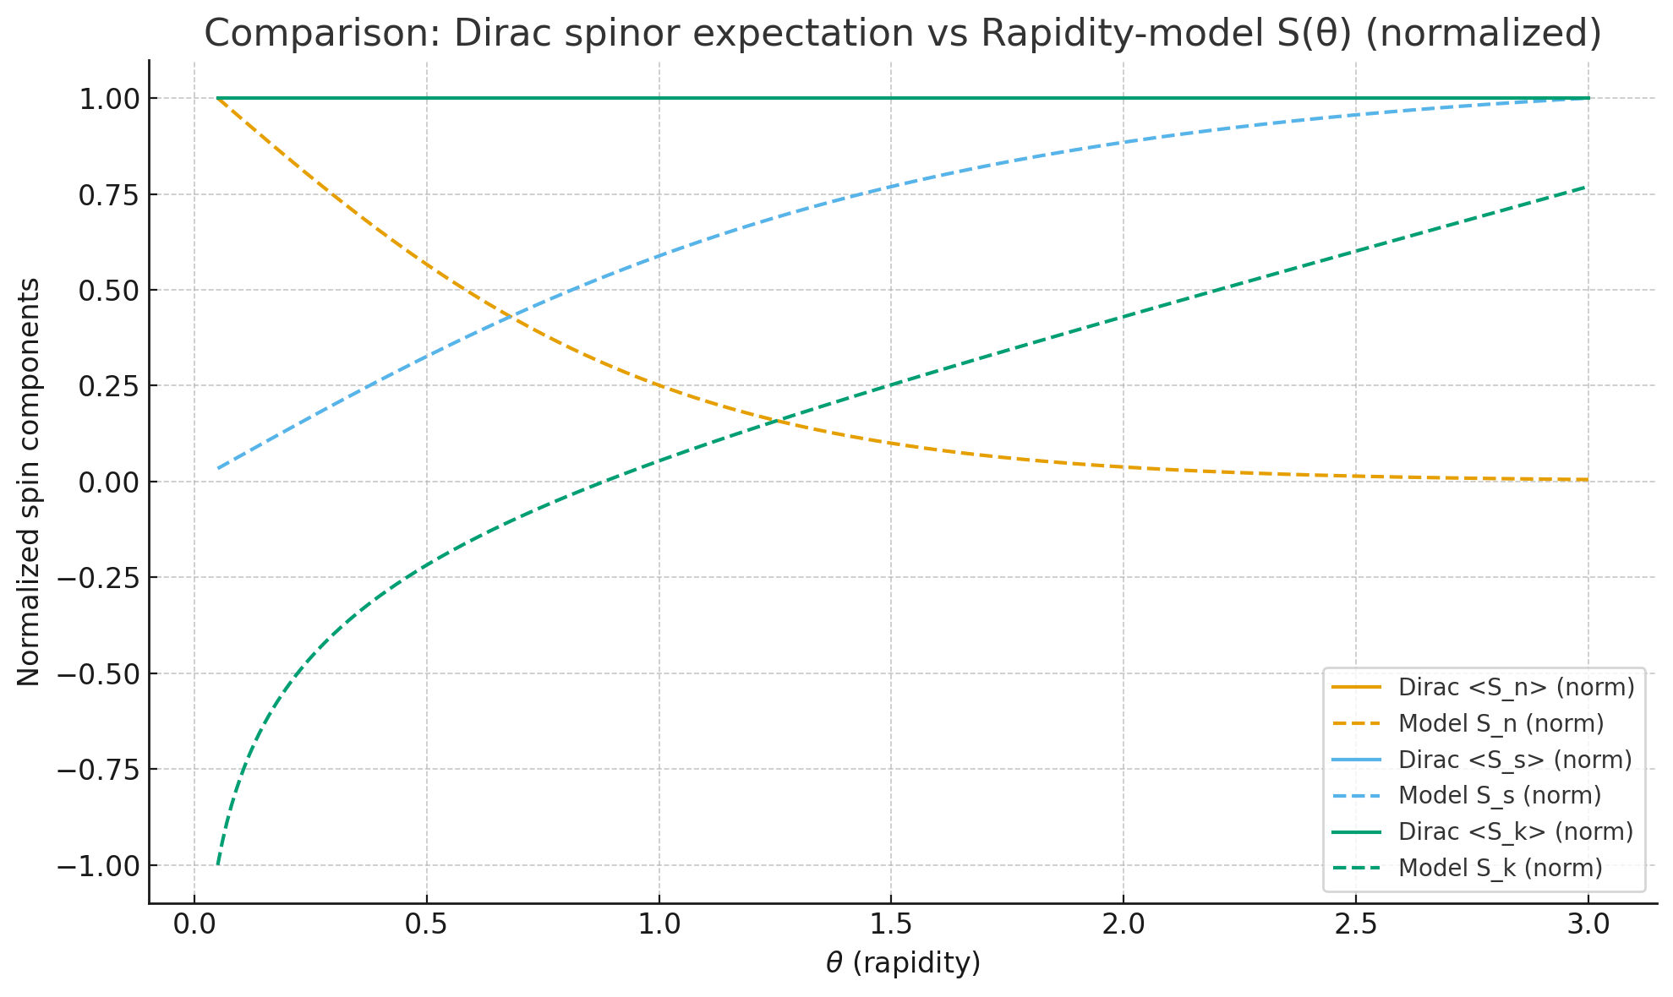
Comparison of Dirac Spinor with Rapidity Model

Slide 25
Relativistic hydrodynamics with spin

Slide 26
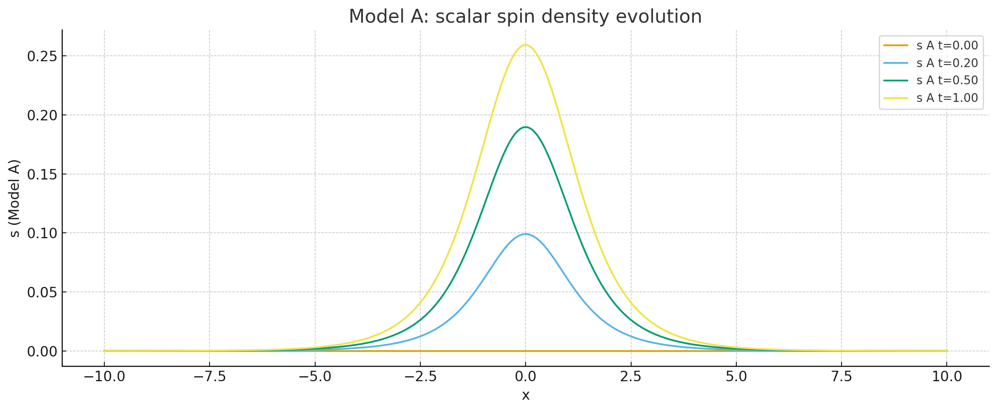
Spin evolution in relativistic hydrodynamics

Slide 27
Conclusions

