Slide 1


Spin alignment of vector mesons induced by spin density fluctuation
Based on Phys.Rev.D 110 (2024) 9, 094034 [arXiv:2408.06581]
Kun Xu 许坤
Beijing Institute of Technology
2025/9/23
26th International Symposium on Spin Physics (SPIN2025) @ Qingdao ，2025/9/22-2025/9/26

Slide 2
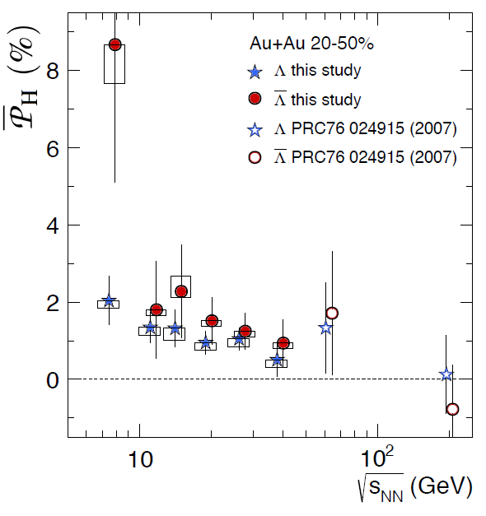
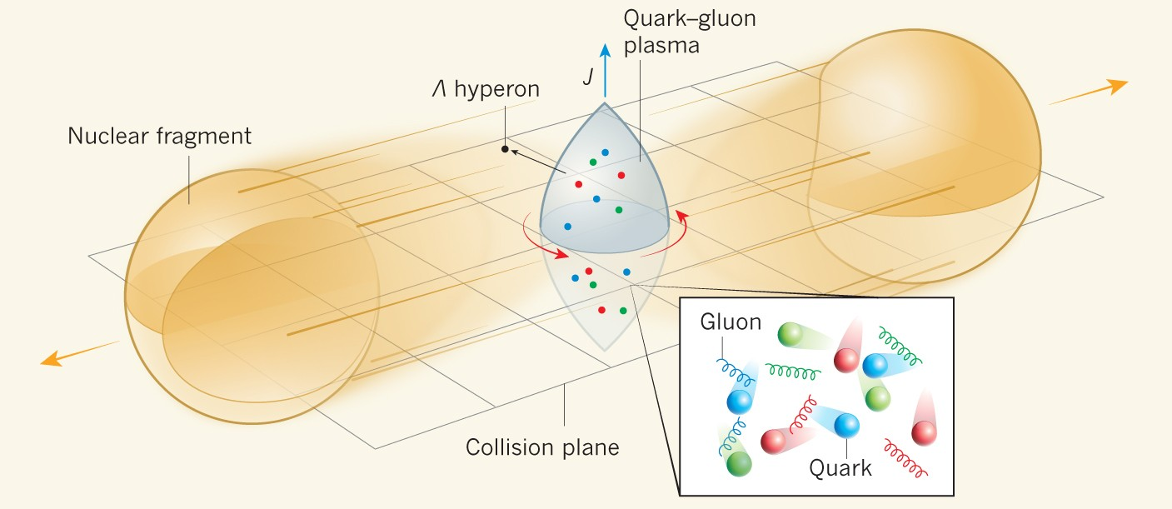
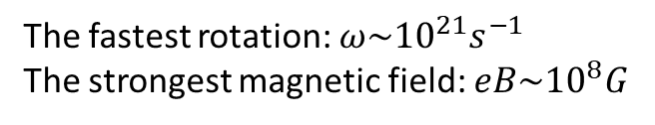
Spin polarization of Hyperon
Non-central heavy ion collision
The fastest rotation: $ω\sim {10}^{21}s^{−1}$
The strongest magnetic field: $eB\sim {10}^{8}G$
Nature 548, 62–65 (2017).
➔ Spin polarization of quarks
Rotation-> Spin polarization
Magnetic field-> splitting
References: Phys.Rev.Lett. 94 (2005) 102301; Phys.Lett.B 629 (2005) 20-26

Slide 3
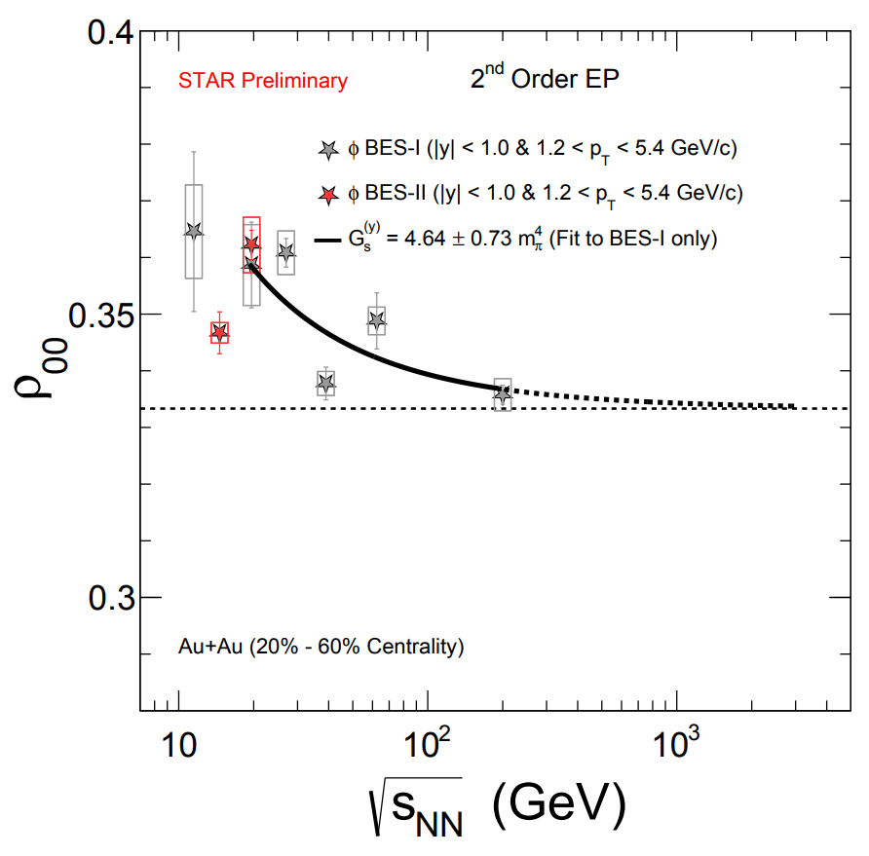
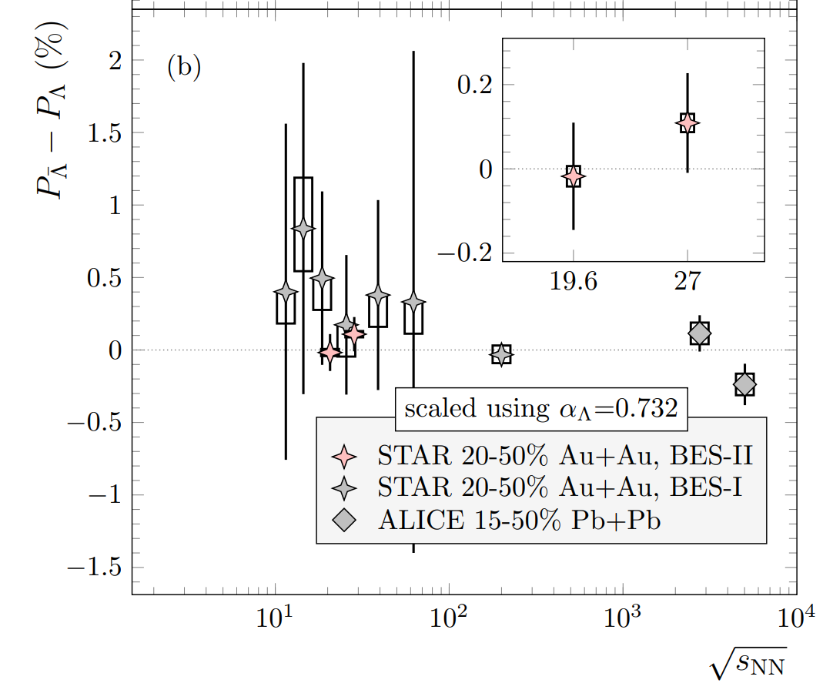
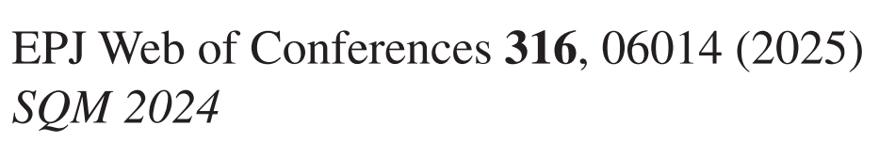
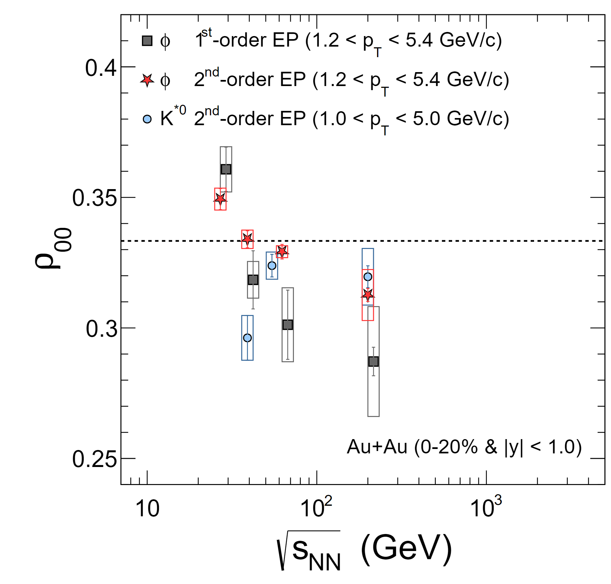
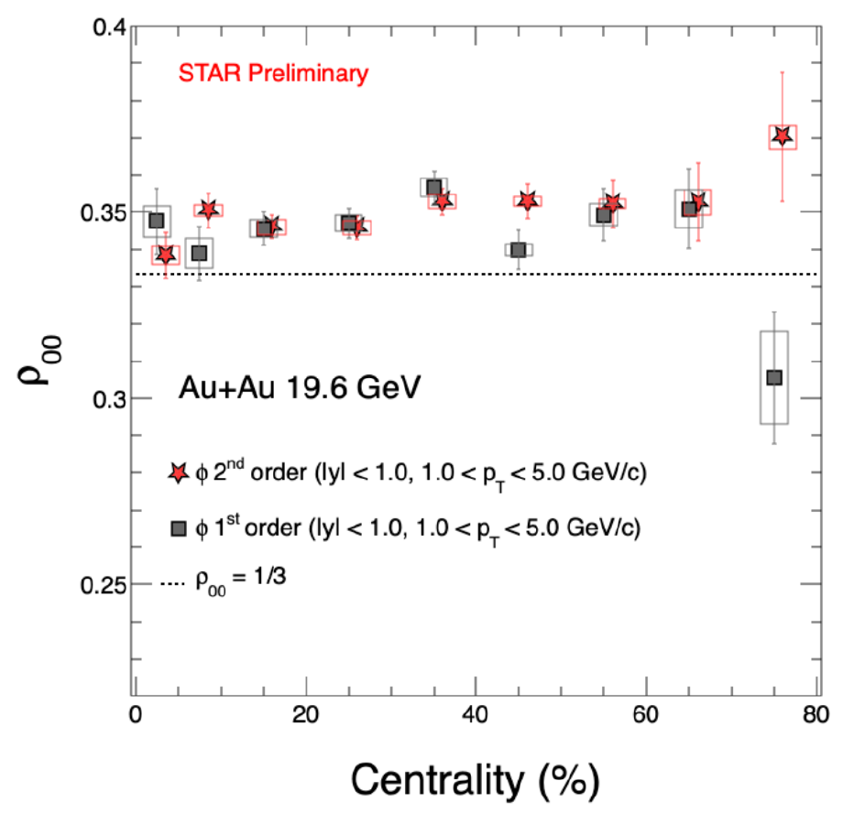

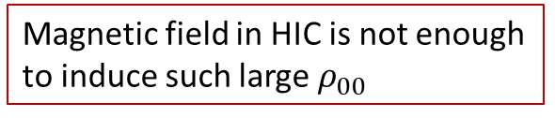

STAR. Phys.Rev.C 108 (2023) 1, 014910 [2305.08705]
Spin alignment
of
vector meson
Non-monotonic behavior
No splitting of $P_{Λ}$ and $P_{\overline{Λ}}$→ No magnetic field
Rotation led to $ρ_{00}<1/3$
Magnetic field in HIC is not enough
to induce such large $ρ_{00}$
STAR. Nature 614 (2023) 7947, 244-248
Why spin alignment?
No-centrality dependence

Slide 4
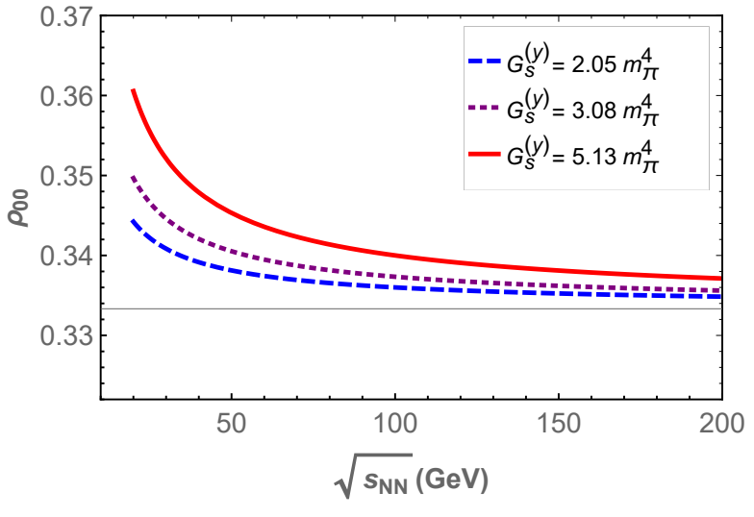
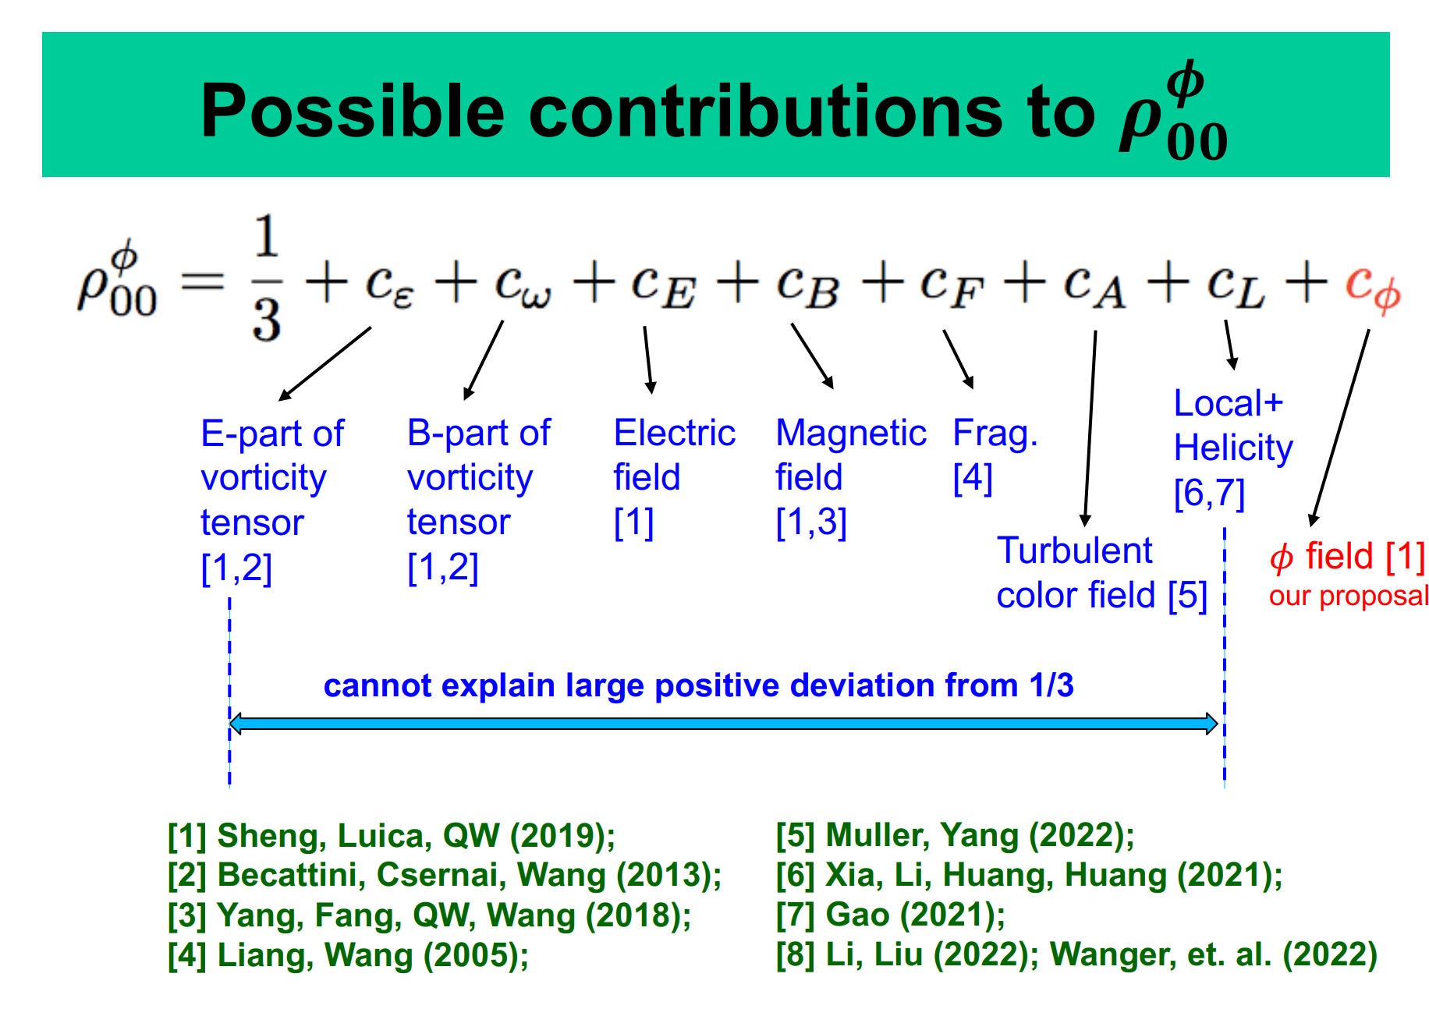

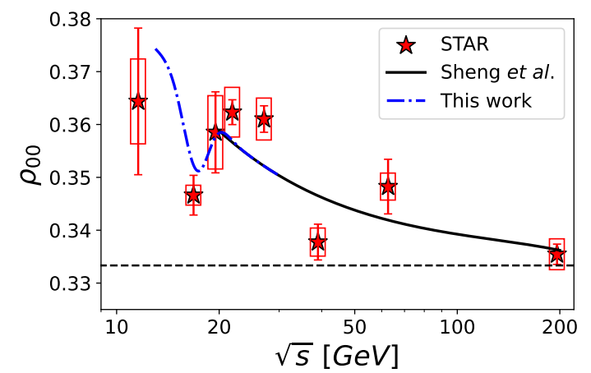

From Prof. Qun Wang’s Talk
Lots of theoretical explanations
$φ$ field
X.L. Sheng et al.
Phys.Rev.D 101 (2020) 9, 096005,
Phys.Rev.Lett. 131 (2023) 4, 042304
Pic is fine,
now its mine
See talks in this room:
Defu Hou, Holographic spin alignment of vector mesons in magnetized plasma
Ji-peng Lv, Global quark spin correlations in relativistic heavy ion collisions
H.L. Chen, W.J.Fu, X.G. Huang, G.L.Ma.
Phys.Rev.Lett. 135 (2025) 3, 032302
Spin alignment & CEP

Slide 5
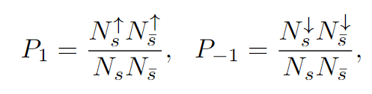
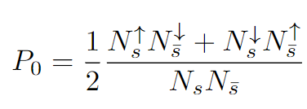
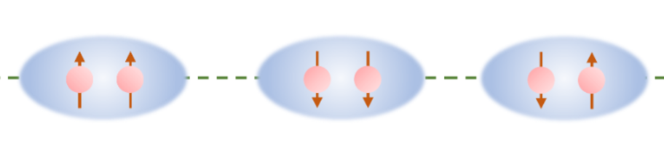
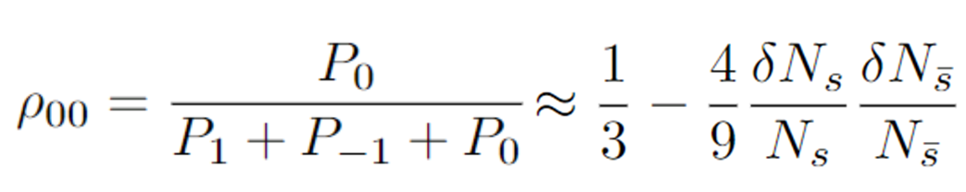

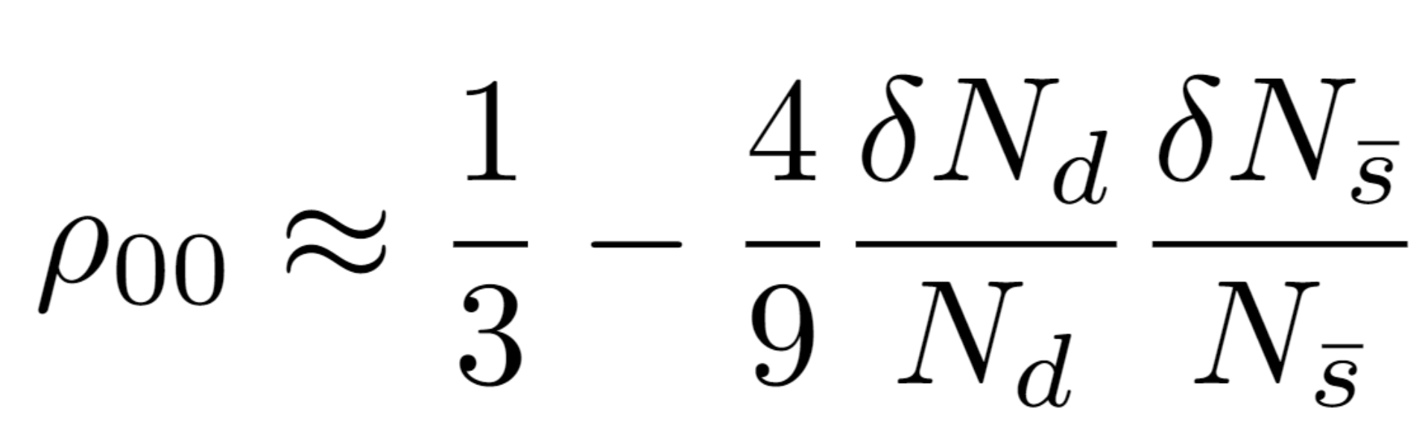






Can we obtain spin alignment without any rotation, magnetic field ……?
Yes, with fluctuation and interaction.
In a local region, the possibilities to find $φ$ of $s_{z}=1,0,−1$:
$N_{s}^{↑}/N_{s}^{↓}$:the number of s quark with spin-up/-down
$δN_{s}=N_{s}^{↑}−N_{s}^{↓}$:
the number difference between spin-up and spin-down
$$N_{s}=N_{s}^{↑}+N_{s}^{↓}$$
: the total number of s quark
Assume small imbalance between spin-up and spin-down:
$$δN_{s}/N_{s}≪1$$
Then spin alignment of $φ$:
Average over all events or thermal states:
Spin correlation
Similarly, spin alignment of $K^{∗0}$:

Slide 6



Fluctuation:
In a free system, the spins are random
$\left\langle \left\langle δN_{s}\right\rangle \right\rangle =0$, $\left\langle \left\langle δN_{\overline{s}}\right\rangle \right\rangle =0$
No global polarization.
$N_{s}^{↑}/N_{s}^{↓}$:the number of s quark with spin-up/-down
$δN_{s}=N_{s}^{↑}−N_{s}^{↓}$:
the number difference between spin-up and spin-down
However, local spin polarization could appear due to the fluctuation, both thermal and quantum.
=0 in a non-interacting system

Slide 7


Interaction:
effective potential energy for different spin pairings are different, thus, different production possibilities
Spin-dependent force
Effective attraction or repulsion
Energy
$$ρ_{00}<1/3$$
$$ρ_{00}>1/3$$
The sign of as well as the spin alignment $ρ_{00}$ depends on the type of interactions

Slide 8
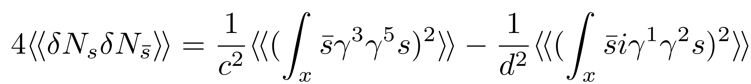
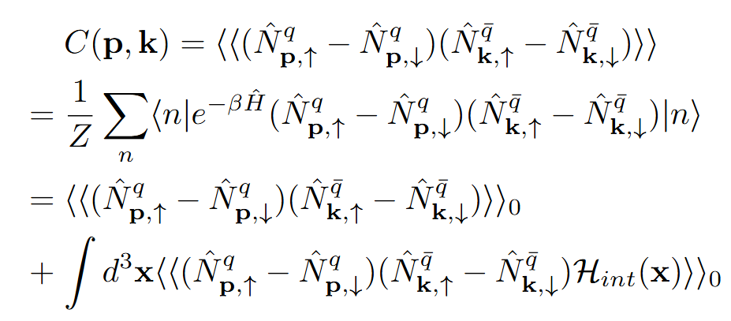
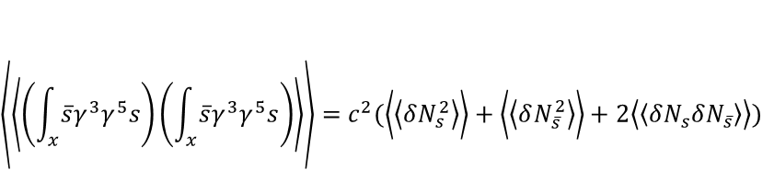
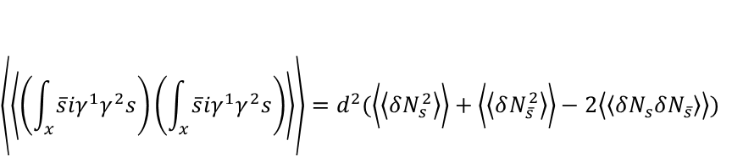
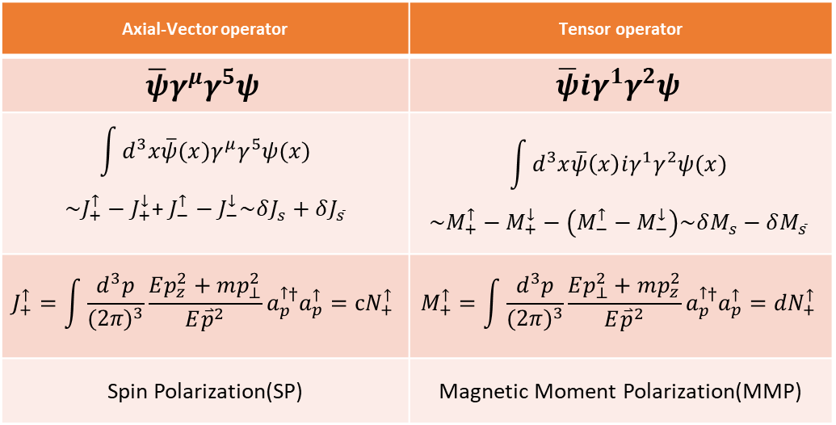
Method 1:
Method 2:
$$\left\langle \left\langle \left(\int_{x}^{ }{\overline{s}γ^{3}γ^{5}s}\right)\left(\int_{x}^{ }{\overline{s}γ^{3}γ^{5}s}\right)\right\rangle \right\rangle =c^{2}(\left\langle \left\langle δN_{s}^{2}\right\rangle \right\rangle +\left\langle \left\langle δN_{\overline{s}}^{2}\right\rangle \right\rangle +2\left\langle \left\langle δN_{s}δN_{\overline{s}}\right\rangle \right\rangle )$$
c/d is function of temperature, mass,…
$$\left\langle \left\langle \left(\int_{x}^{ }{\overline{s}iγ^{1}γ^{2}s}\right)\left(\int_{x}^{ }{\overline{s}iγ^{1}γ^{2}s}\right)\right\rangle \right\rangle =d^{2}(\left\langle \left\langle δN_{s}^{2}\right\rangle \right\rangle +\left\langle \left\langle δN_{\overline{s}}^{2}\right\rangle \right\rangle −2\left\langle \left\langle δN_{s}δN_{\overline{s}}\right\rangle \right\rangle )$$
Still on working…
Axial-Vector operator | Tensor operator
$$\overline{ψ}γ^{μ}γ^{5}ψ$$ | $$\overline{ψ}{iγ}^{1}γ^{2}ψ$$
$$\int{d^{3}x\overline{ψ}(x)γ^{μ}γ^{5}ψ(x)}$$ $$\sim J_{+}^{↑}−J_{+}^{↓}\text{+ }J_{−}^{↑}−J_{−}^{↓}\sim δJ_{s}+δJ_{\overline{s}}$$ | $$\int{d^{3}x\overline{ψ}\left(x\right)iγ^{1}γ^{2}ψ(x)}$$ $$\sim M_{+}^{↑}−M_{+}^{↓}−\left(M_{−}^{↑}−M_{−}^{↓}\right)\sim δM_{s}−δM_{\overline{s}}$$
$$J_{+}^{↑}=\int{\frac{d^{3}p}{{(2π)}^{3}}\frac{Ep_{z}^{2}+mp_{⊥}^{2}}{E{\overset{⃑}{p}}^{2}}a_{p}^{↑†}a_{p}^{↑}}=cN_{+}^{↑}$$ | $$M_{+}^{↑}=\int{\frac{d^{3}p}{{(2π)}^{3}}\frac{Ep_{⊥}^{2}+mp_{z}^{2}}{E{\overset{⃑}{p}}^{2}}a_{p}^{↑†}a_{p}^{↑}}={dN}_{+}^{↑}$$
Spin Polarization(SP) | Magnetic Moment Polarization(MMP)
Notes:
Introduce two method two calculate the spin correlation.

Slide 9
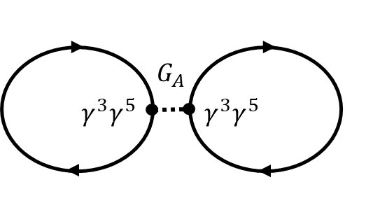
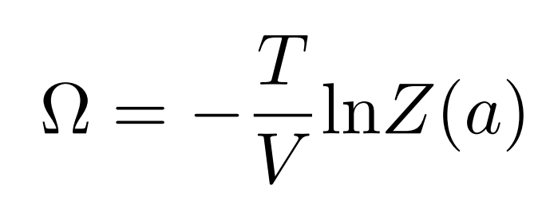
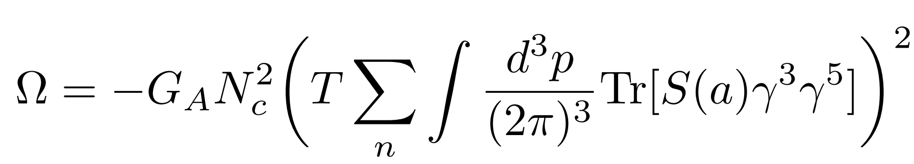
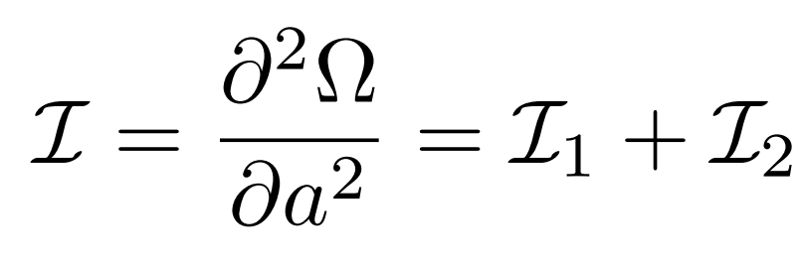
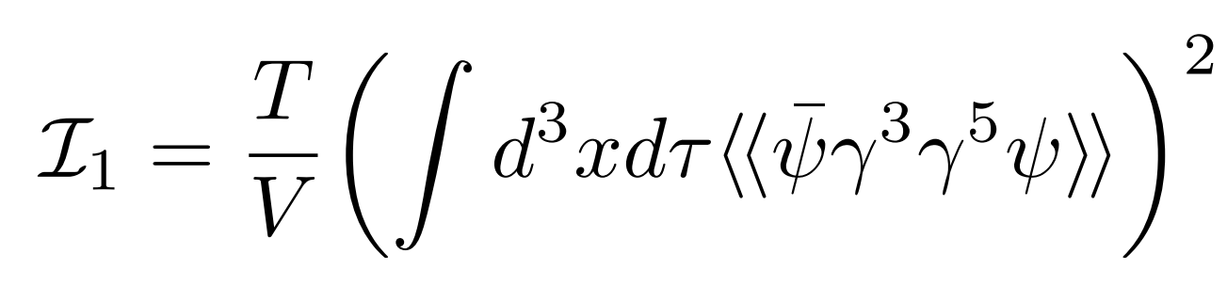
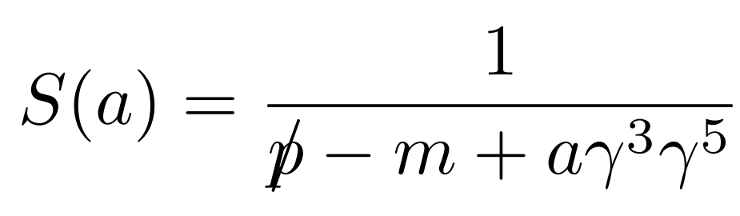
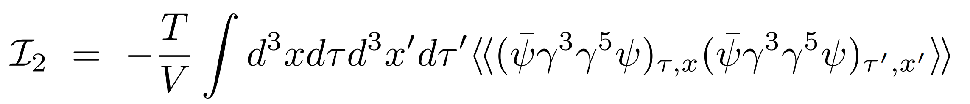
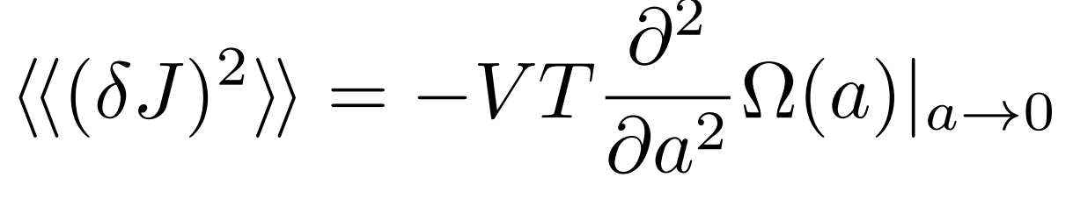


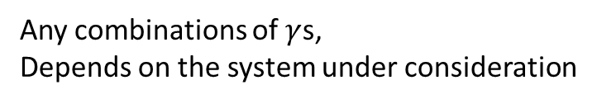

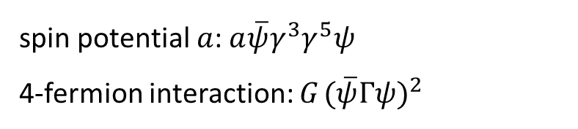
Nambu-Jona-Lasinio model: 4-fermion contact interaction
$$ℒ=\overline{ψ}\left(i∂−m+aγ^{3}γ^{5}\right)ψ+{G_{ }(\overline{ψ}Γψ)}^{2}$$
Any combinations of $γ$s,
Depends on the system under consideration
spin potential $a$: $a\overline{ψ}γ^{3}γ^{5}ψ$
4-fermion interaction: ${G_{ }(\overline{ψ}Γψ)}^{2}$
$$G$$
$$Γ$$
$$Γ$$
The grand potential, first-order expansion over $G_{ }$:
The grand potential:
Consider :
Where the quark propagator:
=0 for a→0
≠0 for a→0
With similar process we can obtain

Slide 10
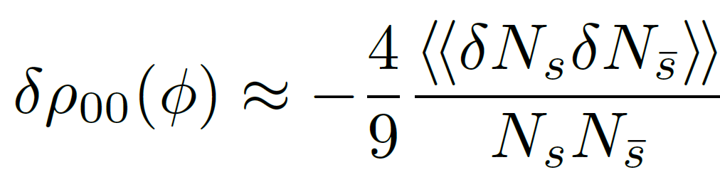

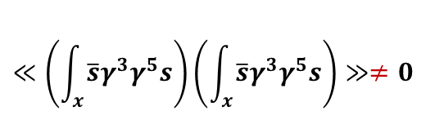
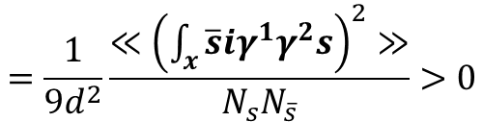
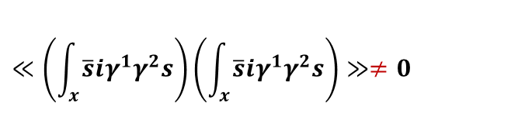
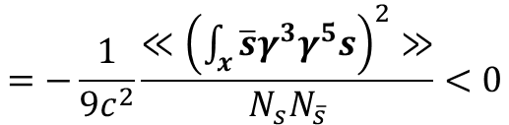

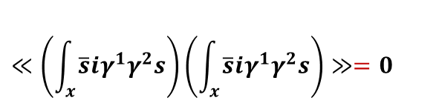

spin correlation :
(1) Axial-vector interaction:
$${G_{A}(\overline{ψ}γ^{3}γ^{5}ψ)}^{2}$$
$$≪\left(\int_{x}^{ }{\overline{s}γ^{3}γ^{5}s}\right)\left(\int_{x}^{ }{\overline{s}γ^{3}γ^{5}s}\right)≫≠0$$
$$≪\left(\int_{x}^{ }{\overline{s}iγ^{1}γ^{2}s}\right)\left(\int_{x}^{ }{\overline{s}iγ^{1}γ^{2}s}\right)≫=0$$
$$=−\frac{1}{9c^{2}}\frac{≪{\left(\int_{x}^{ }{\overline{s}γ^{3}γ^{5}s}\right)}^{2}≫}{N_{s}N_{\overline{s}}}<0$$
(2) Tensor interaction:
$${G_{T}(\overline{ψ}iγ^{1}γ^{2}ψ)}^{2}$$
$$≪\left(\int_{x}^{ }{\overline{s}γ^{3}γ^{5}s}\right)\left(\int_{x}^{ }{\overline{s}γ^{3}γ^{5}s}\right)≫=0$$
$$≪\left(\int_{x}^{ }{\overline{s}iγ^{1}γ^{2}s}\right)\left(\int_{x}^{ }{\overline{s}iγ^{1}γ^{2}s}\right)≫≠0$$
$$=\frac{1}{9d^{2}}\frac{≪{\left(\int_{x}^{ }{\overline{s}iγ^{1}γ^{2}s}\right)}^{2}≫}{N_{s}N_{\overline{s}}}>0$$
Axial-vector interaction induce $ρ_{00}<\frac{1}{3}$, while tensor interaction induces $ρ_{00}>\frac{1}{3}$

Slide 11
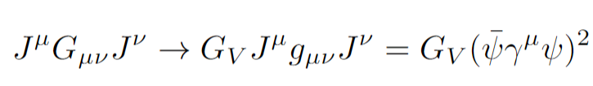
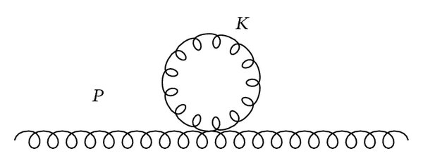
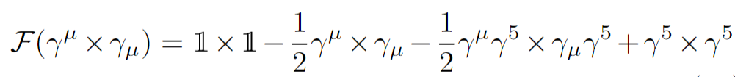
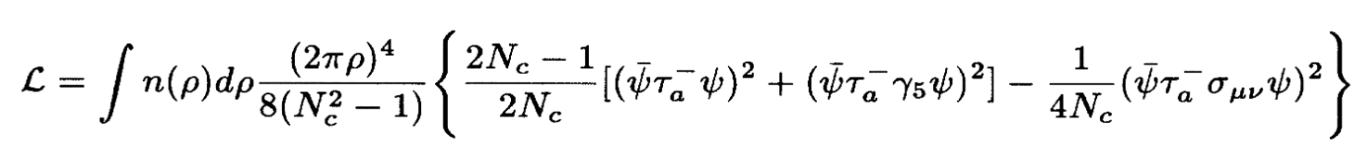
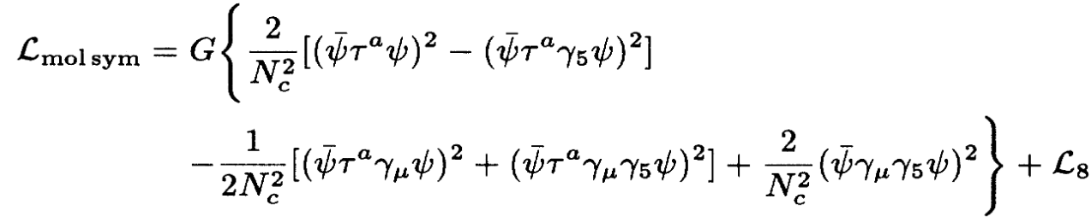
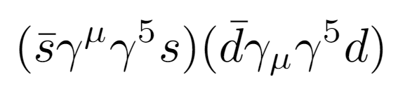



where is the interaction?
1. One-Gluon-Exchange(OGE)
Gluon propagator with large gluon mass to an effective four-fermion contact interaction
Fierz transformation
Axial-vector interaction appears!
2. Instanton-induced
interaction
Low temperature: Non-interacting $I\overline{I}$- Gas
Phys.Rev.D 51 (1995) 1267-1281
Tensor interaction
High temperature$T≳T_{c}$: $I\overline{I}$-Molecule
Axial-vector interaction
Flavor-mixed interaction:
Contributes to the spin alignment of $K^{∗0}$

Slide 12
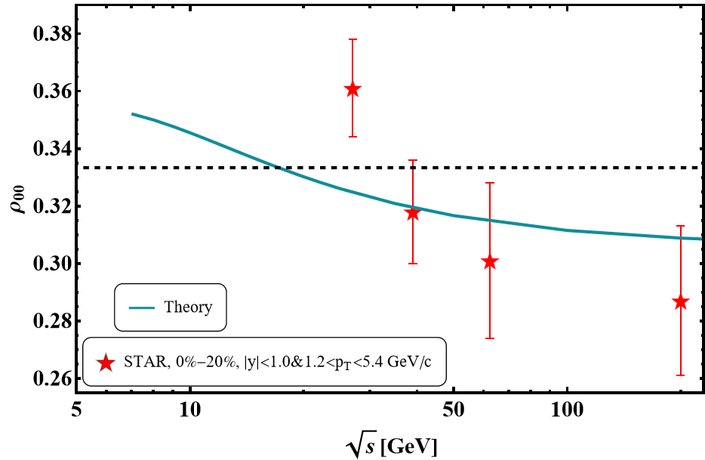





Naïve numerical example
Coupling constant as a function of chemical potential
$$G_{A}=\frac{1}{2}G_{s}−8μ_{B}$$
$$G_{T}=40μ_{B}$$
radius
$$r=2fm$$
Freeze-out line:
$$μ_{B}=\frac{1.477}{1+0.343\sqrt{s}}$$
$$T=0.158−0.14μ_{B}^{2}−0.04μ_{B}^{4}$$

Slide 13

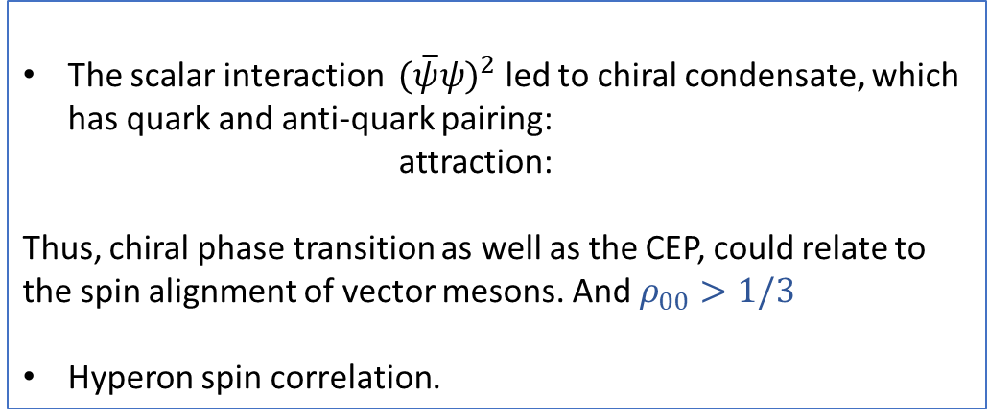
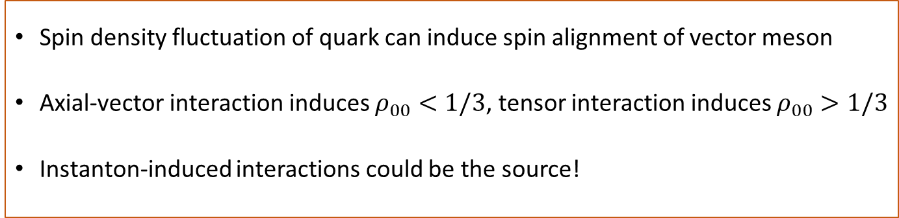


Thank you
Outlook
Energy
$$ρ_{00}<1/3$$
The scalar interaction ${ (\overline{ψ}ψ)}^{2}$ led to chiral condensate, which has quark and anti-quark pairing:
attraction:
Thus, chiral phase transition as well as the CEP, could relate to the spin alignment of vector mesons. And $ρ_{00}>1/3$
Hyperon spin correlation.
$$ρ_{00}>1/3$$
Summary
Spin density fluctuation of quark can induce spin alignment of vector meson
Axial-vector interaction induces $ρ_{00}<1/3$, tensor interaction induces $ρ_{00}>1/3$
Instanton-induced interactions could be the source!

