Slide 1


Polarized beam studies for CEPC and BEPCII
Zhe Duan
Institute of High Energy Physics, CAS
on behalf of the CEPC Polarization Working Group
Sep 22-26, 2025, 26th International Symposium on Spin Physics, Qingdao, email: duanz@ihep.ac.cn

Slide 2
Outline
Polarization studies at CEPC
R&D for polarized beams at IHEP
Concepts of longitudinal polarization at BEPCII
Summary

Slide 3
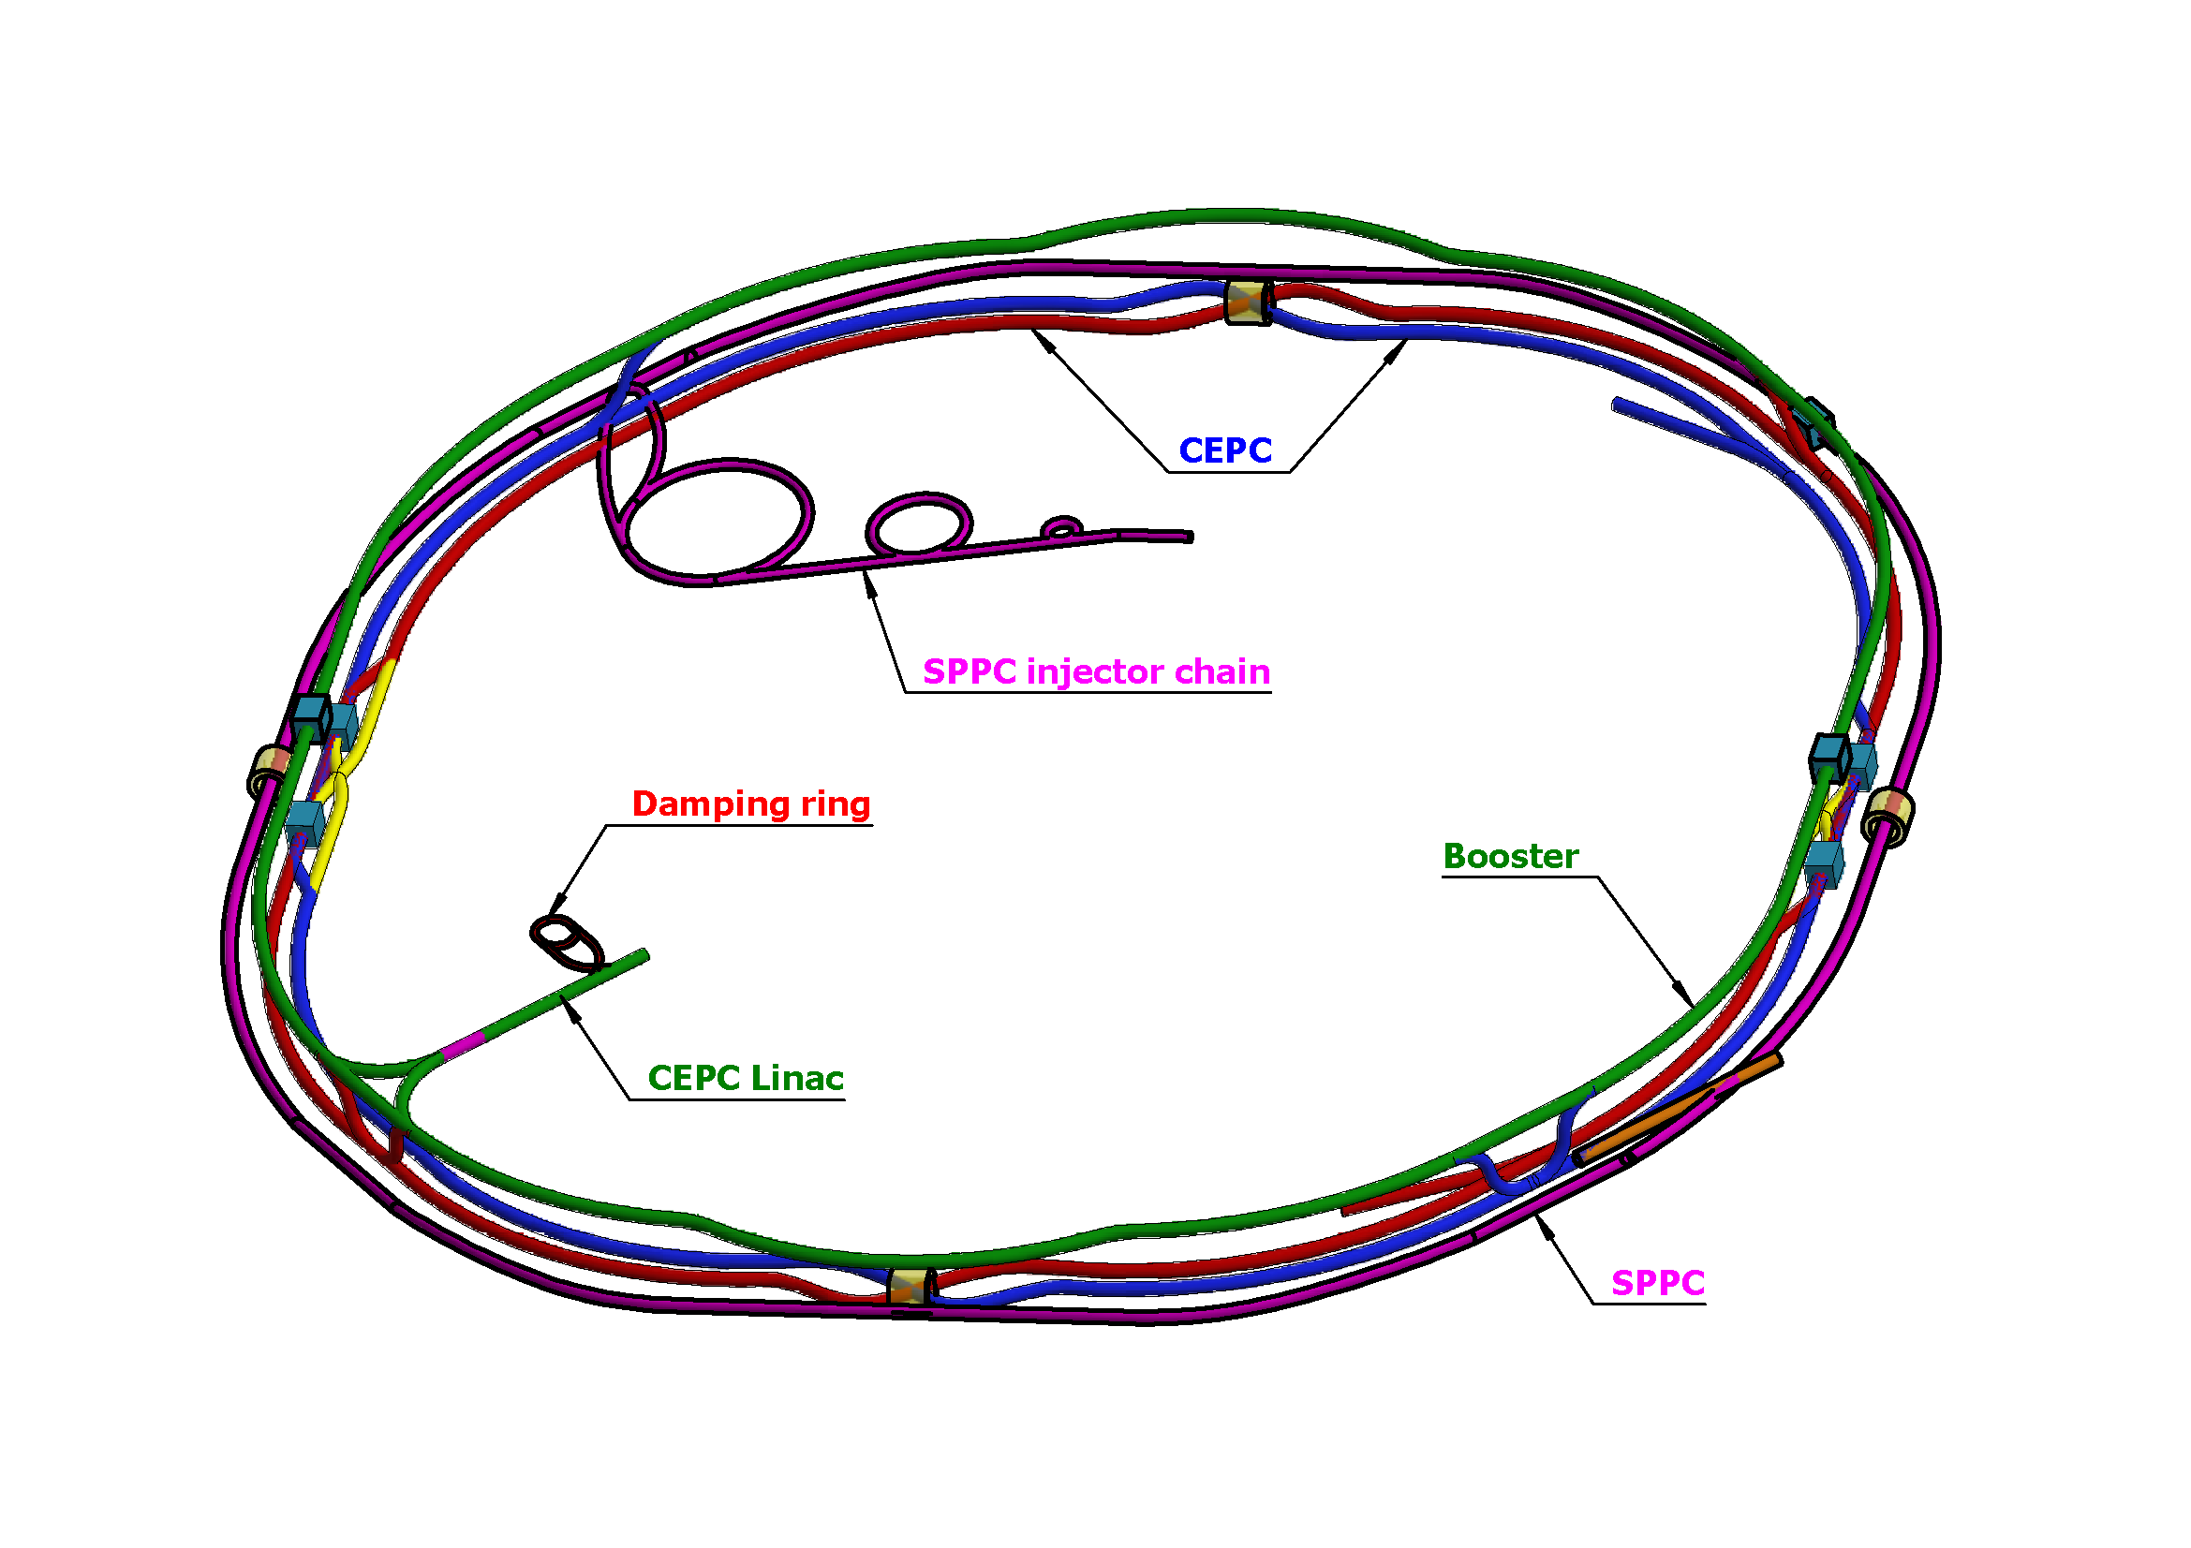
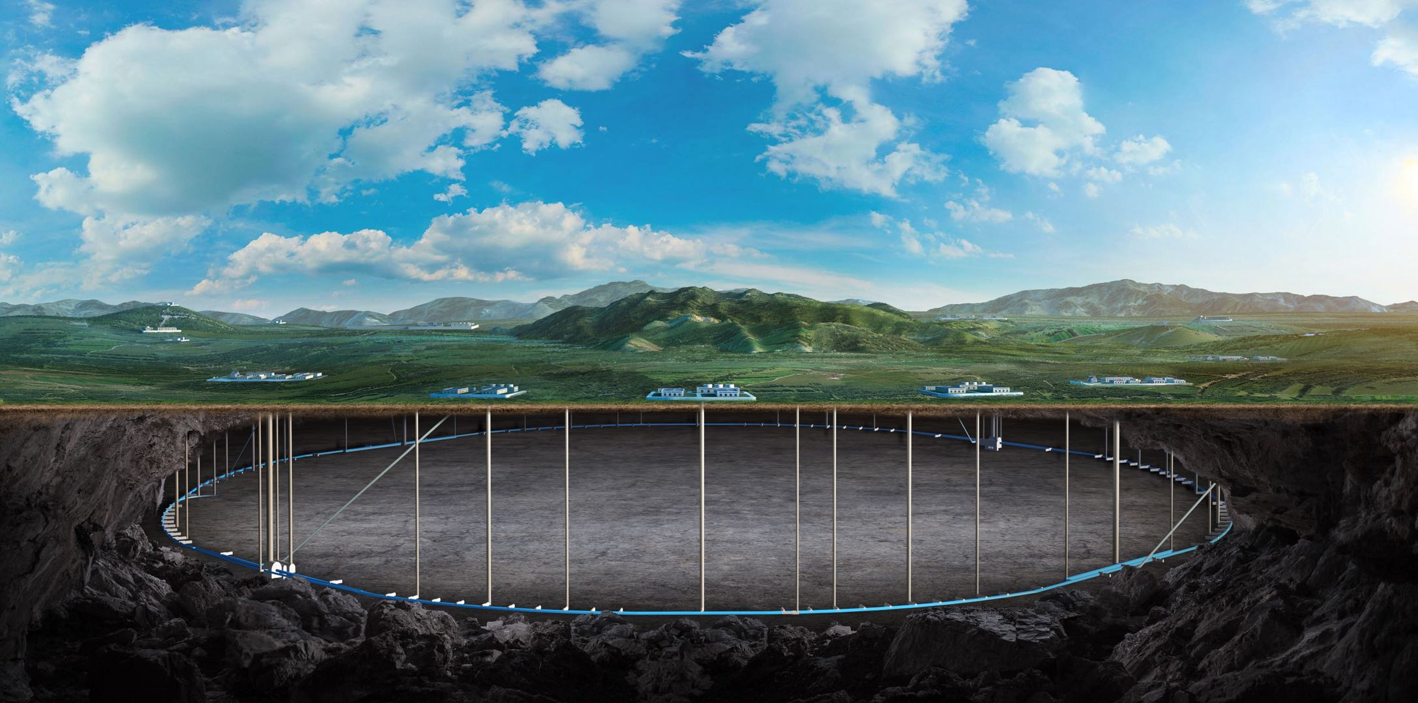
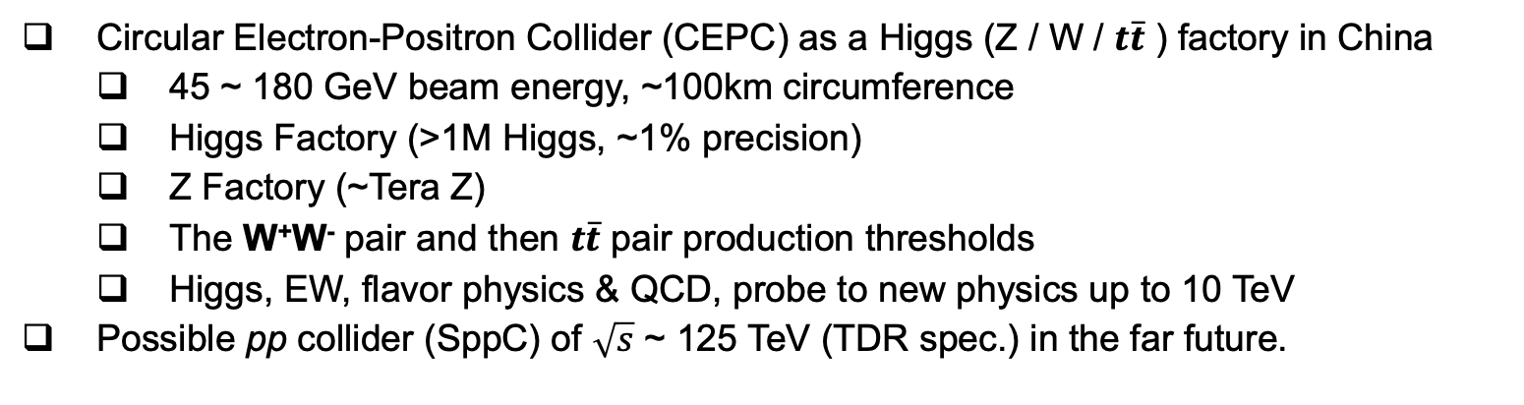
Circular Electron Positron Collider (CEPC)
Circular Electron-Positron Collider (CEPC) as a Higgs (Z / W / $t\overline{t}$ ) factory in China
45 ~ 180 GeV beam energy, ~100km circumference
Higgs Factory (>1M Higgs, ~1% precision)
Z Factory (~Tera Z)
The W⁺W⁻ pair and then $t\overline{t}$ pair production thresholds
Higgs, EW, flavor physics & QCD, probe to new physics up to 10 TeV
Possible pp collider (SppC) of $\sqrt{s}$ ~ 125 TeV (TDR spec.) in the far future.

Slide 4
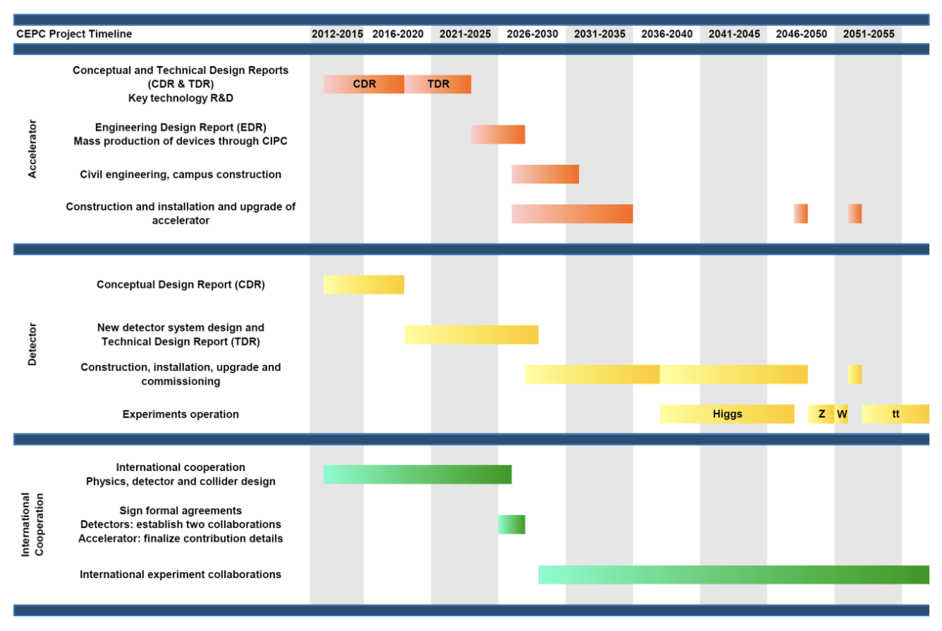
Progress and schedule
Now in the phase of Engineering Design Report
CEPC plan to submit a proposal to the central government to be included in 15th FYP

Slide 5
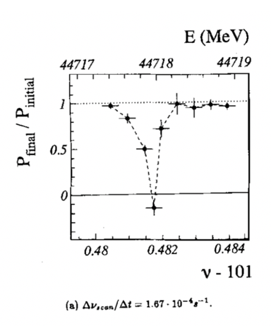
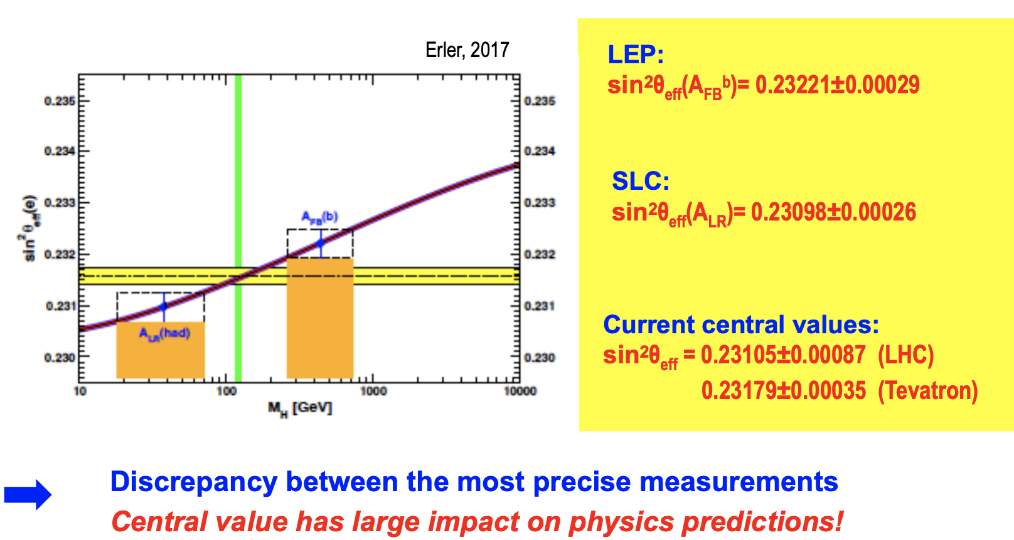
Physics motivation of polarized beams @ CEPC
Precision beam energy calibration @ Z, W (~100keV)
resonant depolarization with vertically polarized beams (> 10% pol)
Precision measurement of weak mixing angle @ Z
Longitudinally polarized colliding beams for measuring A_{LR}
could resolve the tension between A_{FB} & A_{LR}, by measuring both in the same experiement
CPV with polarized beams in e+e- → HZ. H → ττ etc
ECFA meeting on e+e- to ZH angular measurements
Polarized beam applications @ ILC,
arXiv:2105.09691, 2111.06687, 2202.07385
L. Arnaudon, et al., Z. Phys. C 66, 45-62 (1995).
G. Moortgat-Pick’s talk on CEPC Workshop EU @ Marseille, 2024 April

Slide 6
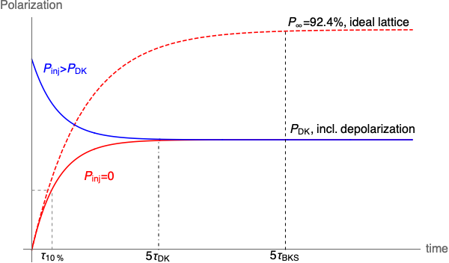
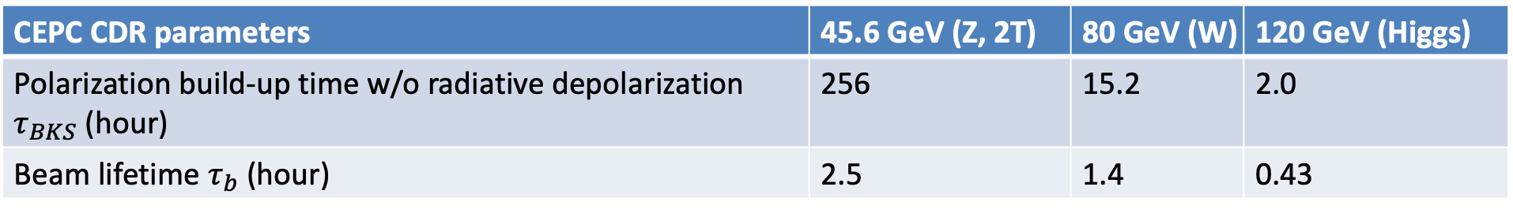
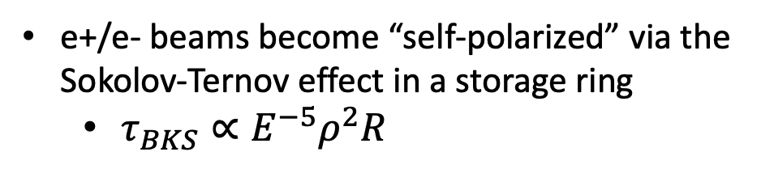
Self-polarization in the CEPC
e+/e- beams become “self-polarized” via the Sokolov-Ternov effect in a storage ring
$τ_{BKS}∝E^{−5}ρ^{2}R$
Beam polarization build-up rate much slower than the beam decay rate @ Z-pole
Boosted with asymmetric wigglers in the Collider (FCC EPOL)
Hard to achieve a high-level polarization
In conflict with a high luminosity
CEPC CDR parameters | 45.6 GeV (Z, 2T) | 80 GeV (W) | 120 GeV (Higgs)
Polarization build-up time w/o radiative depolarization $τ_{BKS}$ (hour) | 256 | 15.2 | 2.0
Beam lifetime $τ_{b}$ (hour) | 2.5 | 1.4 | 0.43

Slide 7
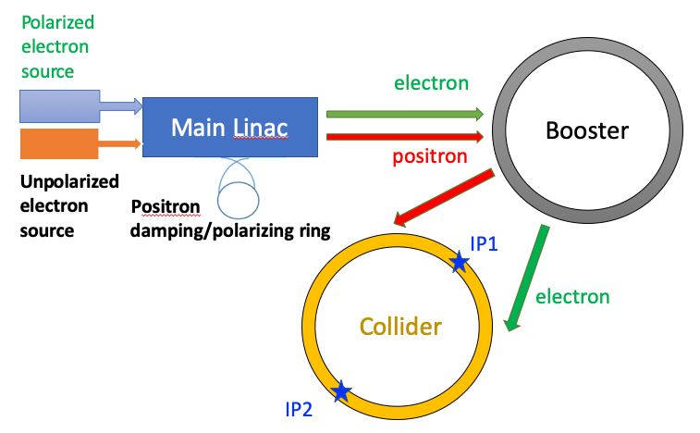
Injecting polarized beams for resonant depolarization
Polarized source
Polarized electron gun w/ superlattice GaAs cathode (>85% polarization)
Positron damping/polarizing ring(>20% polarization)
Linac & Transport lines
no interleaved H & V bendings
polarization loss is negligible
Booster
free from intrinsic spin resonances
polarization can be well maintained for Z & W
T. Chen, Z. Duan, D. H. Ji, D. Wang, Phys. Rev. Accel. Beams, 26, 051003 (2023).
Similar approach is now being studied for FCC-ee
J. Wenninger, Injecting polarized beams , FCC Week 2025, FCC-FS EPOL group meeting 40
> 70% polarization transmission in the injector chain for Z & W operation.

Slide 8
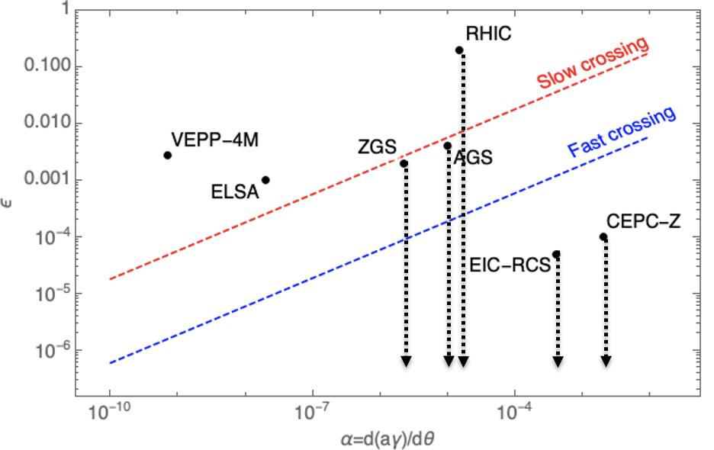
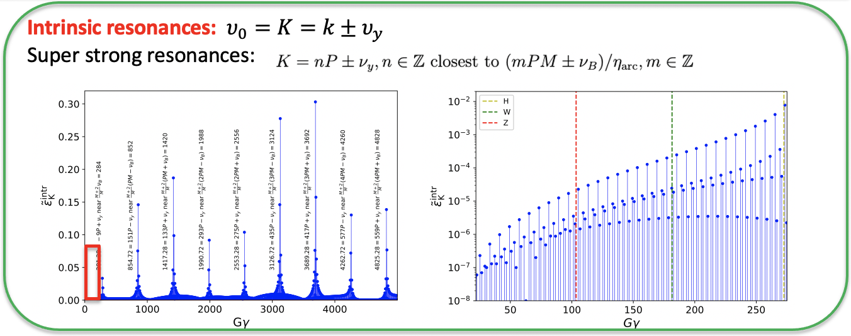
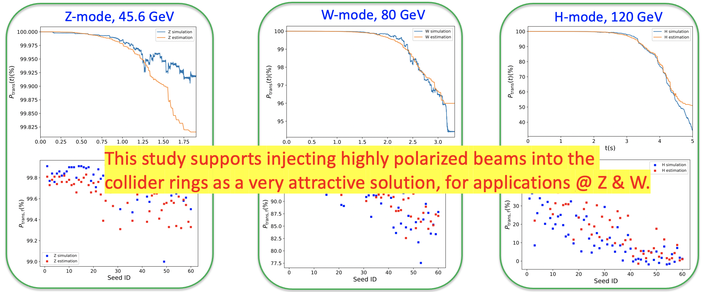
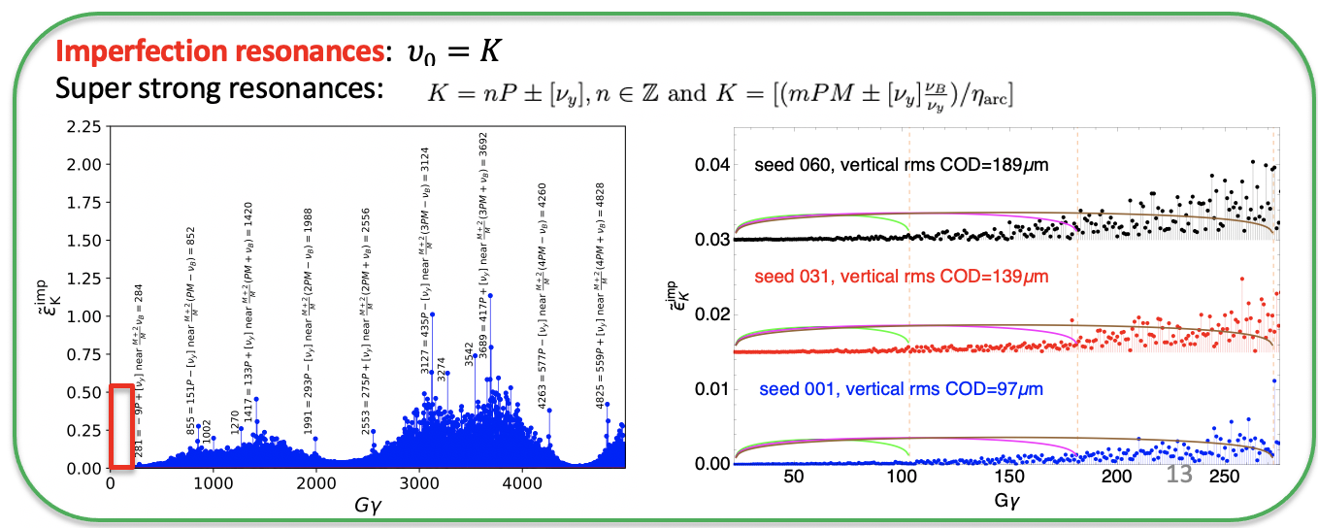
Polarization Maintenance in the Booster
Concern
Depolarization due to crossings of hundreds of spin resonances, during Booster acceleration
Finding
Highly periodic lattice -> structural cancellation -> weak spin resonances
Spin resonance crossings lead to negligible depolarization to Z
Resonance strength vs ramping rate:
CEPC-Z in the regime of negligible depolarization
Polarization transmission to Z, W and Higgs energies in Booster:
Z: over 99%, W: 77.5%~ 98%, Higgs: no better than 40%
T. Chen, et al., Booster free from spin resonance for future 100-km-scale circular e+e- colliders, Phys. Rev. Accel. Beams, 26, 051003 (2023).

Slide 9
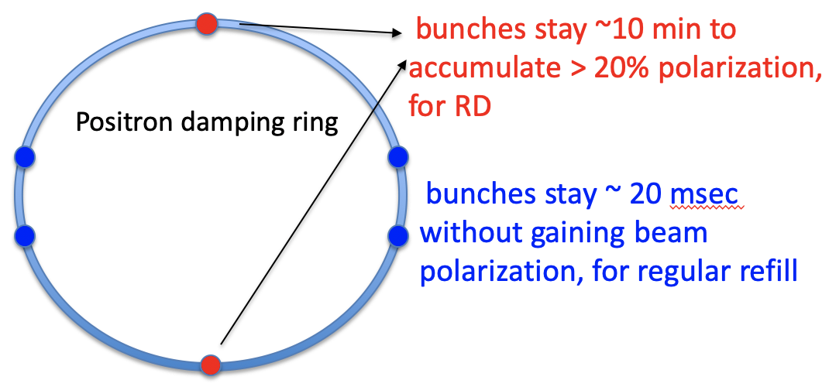
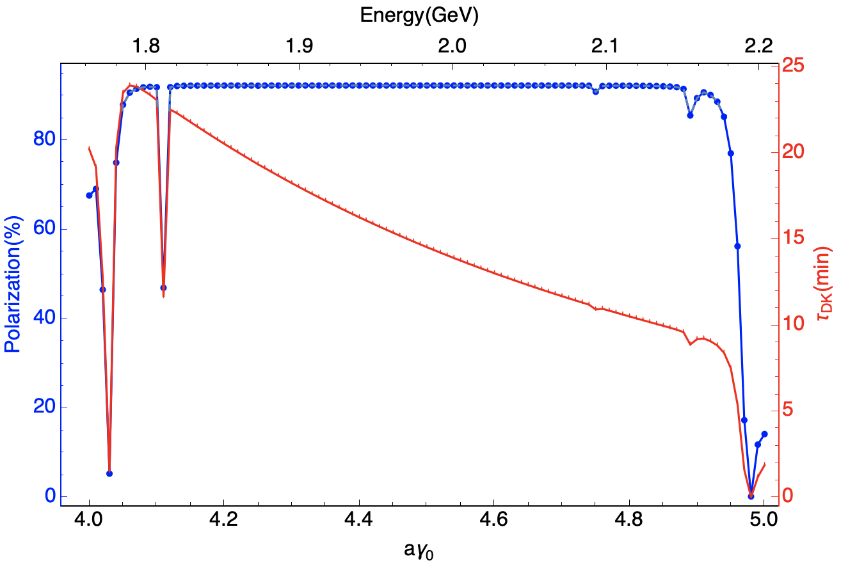
Dual-purpose e+ damping/polarizing ring
Use self-polarization at the e+ damping ring
polarization build-up time ~ 14.5 min
extracted beam polarization @ 10min ~ 44%
DR V4.0 | unpolarized e+ | polarized e+
Energy (Gev) | 1.983
Circumference (m) | 144.2
Number of trains | 2(4)
Number of bunches/trian | 1(2)
Total current (mA) | 12.4
Dipole strength B₀ (T) | 1.92
U₀ (kev/turn) | 397.9
Damping time x/y/z (ms) | 4.8/4.8/2.4
Momentum compaction | 0.0078
Storage time | 20 ms | 10 min
δ₀ (%) | 0.0917
ε₀ (mm.mrad) | 132
injection σ_{z} (mm) | 6
Extract σ_{z} (mm) | 6.7 | 6.6
ε_{inj} (mm.mrad) | 2500
ε_{ext x/y} (mm.mrad) | 133/13 | 132/13
δ_{inj} /δ_{ext} (%) | 0.18 /0.092
RF acceptance (%) | 1.85
Longitudinal tune | 0.025

Slide 10
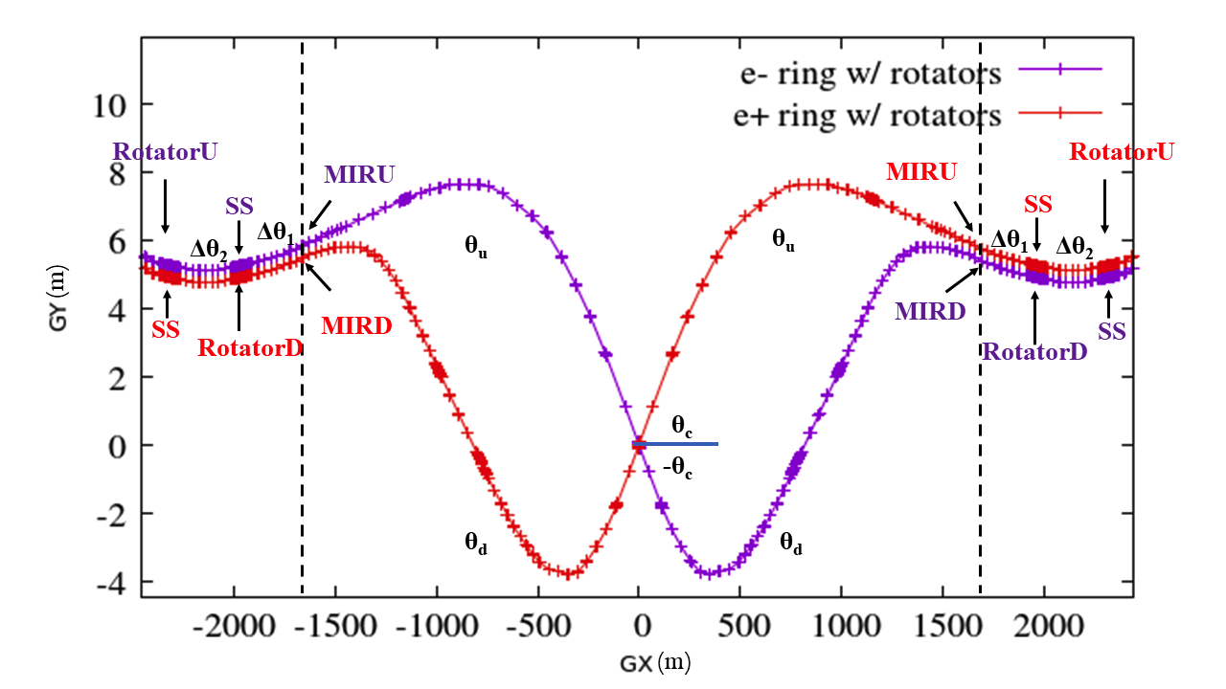
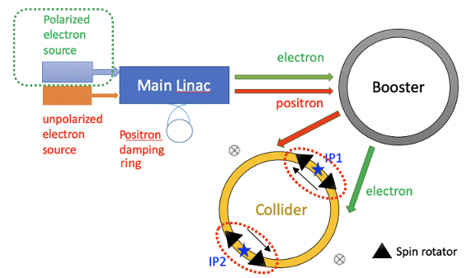
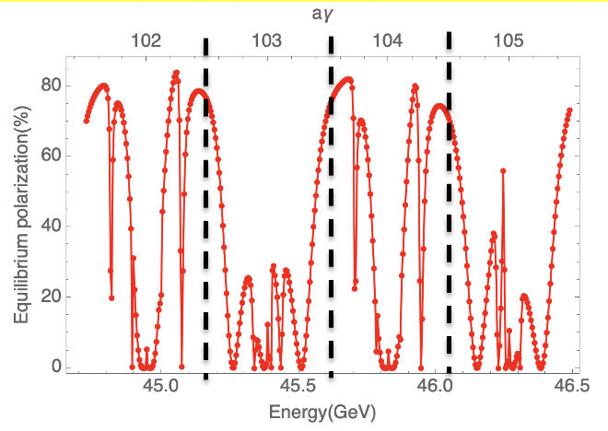
A high-level longitudinal polarization @ Z-pole
50%-70% longitudinal polarization for e- bunches is a reasonable goal
Unpolarized e+ is assumed
Over 70% injected e- beam polarization
Simulated equilibrium longitudinal polarization > 70%, leaving a large margin for effects not yet covered.
Implementation of the spin rotators adjacent to the IR
Simulated equilibrium polarization for an imperfect lattice w/ rotators after closed orbit correction
W. Xia et al., Investigation of spin rotators in CEPC at the Z-pole,
Radiat. Det. Tech. Meth. 6:490 (2022).

Slide 11
Outline
Polarization studies at CEPC
R&D for polarized beams at IHEP
Concepts of longitudinal polarization at BEPCII
Summary

Slide 12
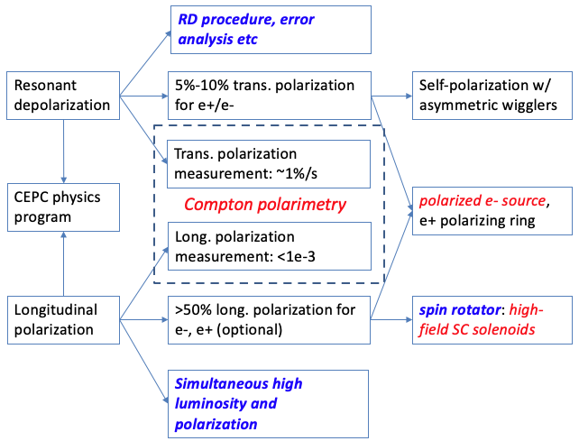
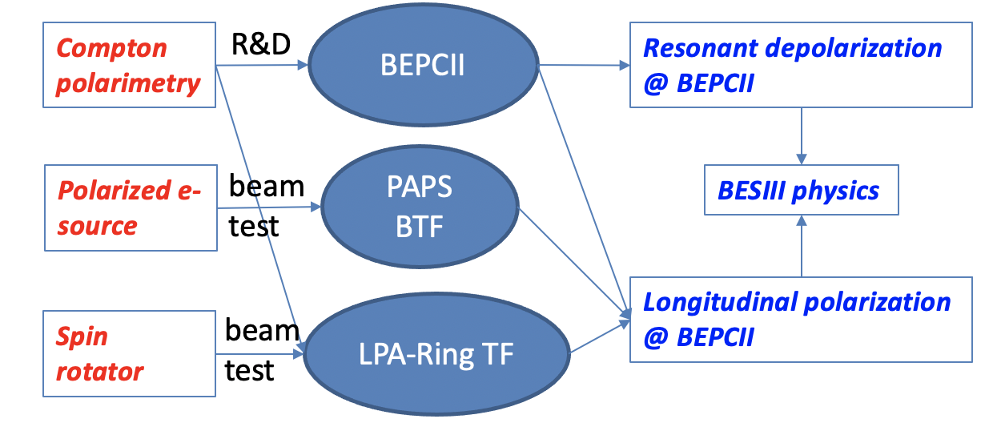
Beam polarization R&D in the EDR phase
CEPC requirements, R&D items,
and required experiment demonstration
R&D, beam tests, and foreseen experimental demonstration at IHEP accelerator facilities
These activities will set the basis for polarized beam applications @ CEPC.

Slide 13
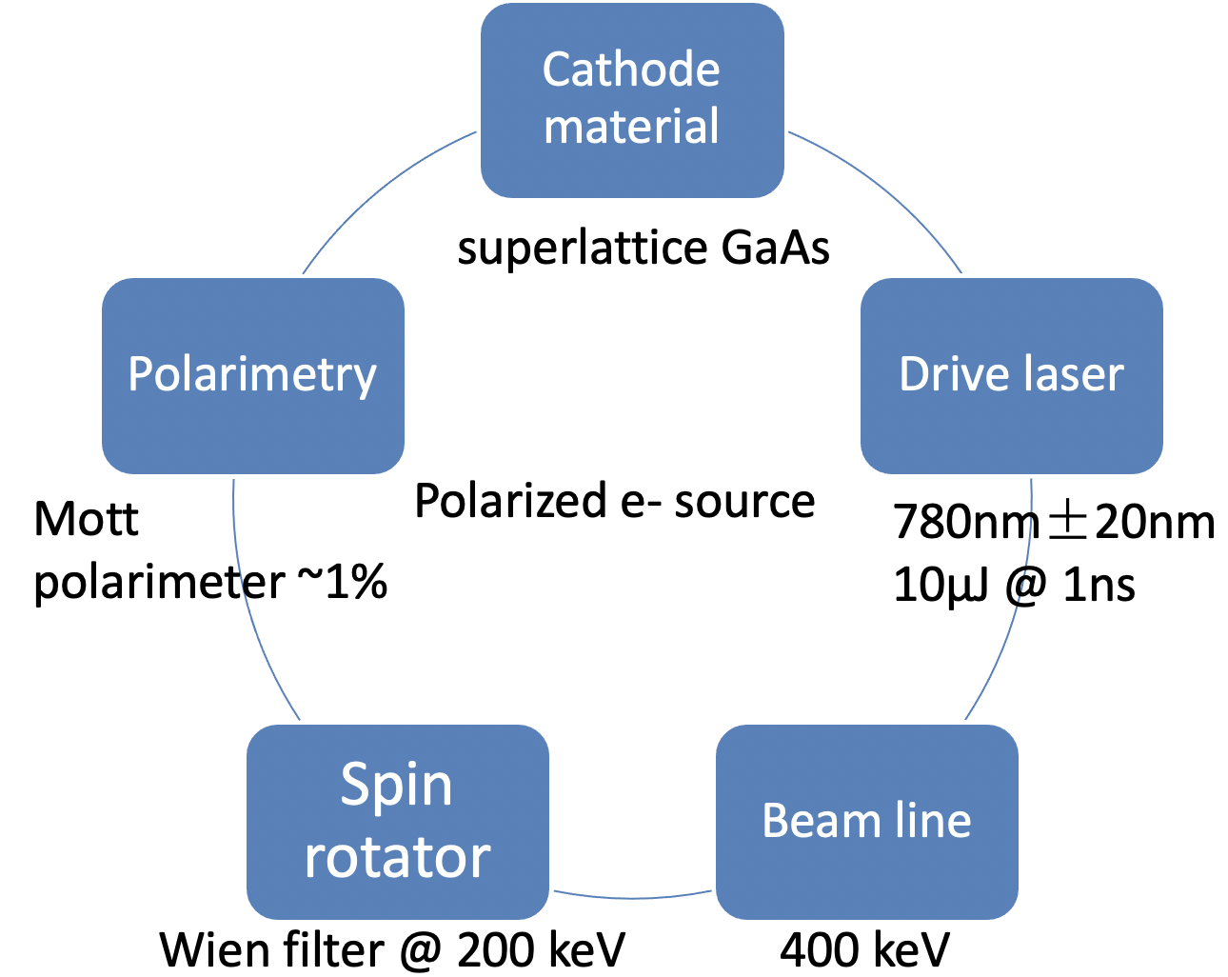
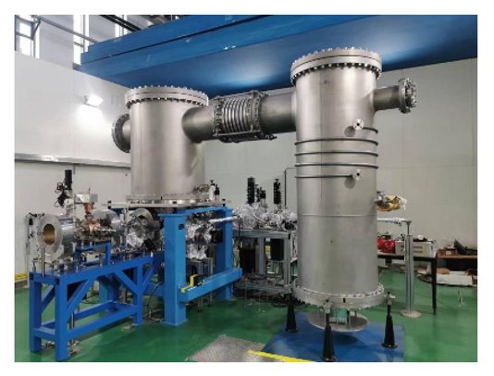
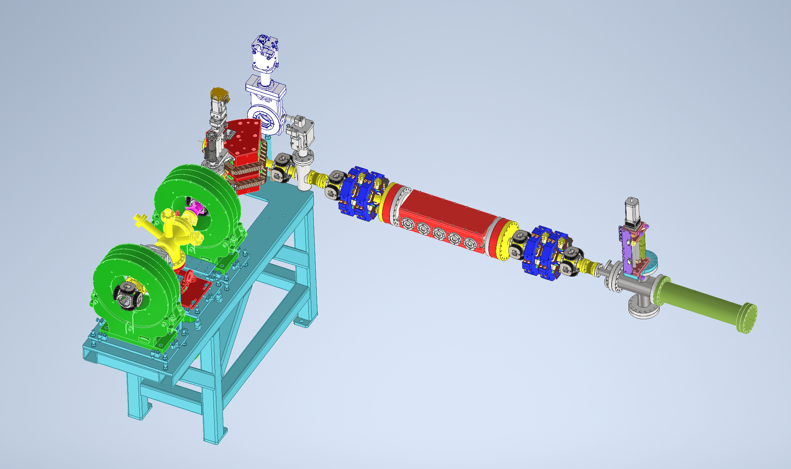
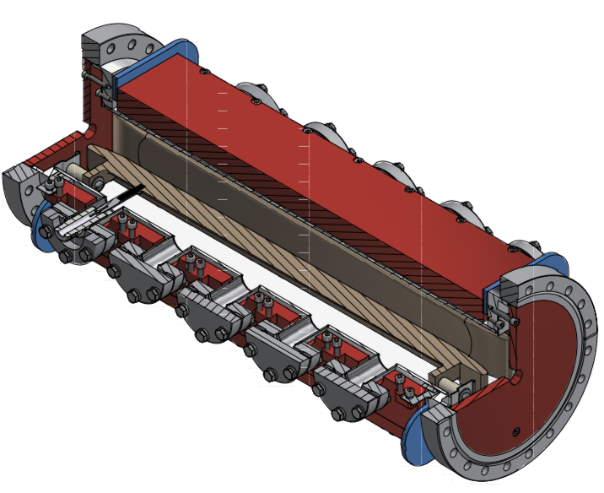
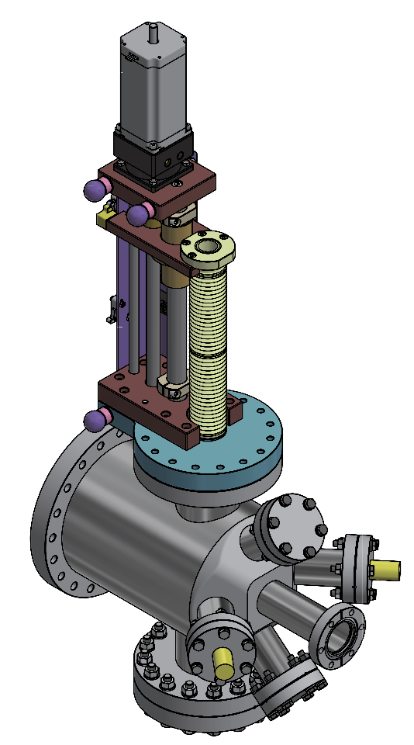
A test facility for polarized electron source
Convert a HV DC gun to a polarized electron source
Beamline physics design in progress, in particular the Wien filter and Mott polarimeter
Beam commissioning scheduled in 2027
500kV photocathode DC gun @ PAPS
Beamline for polarization measurement
Wien filter
Mott polarimeter
Li Xiaoping, V. Tyukin, Liu Wei, Meng Cai, Wang Jianli, Wang Haijing, Liu Jindong, Liang Zhijun, Liu Zhongtian etc

Slide 14
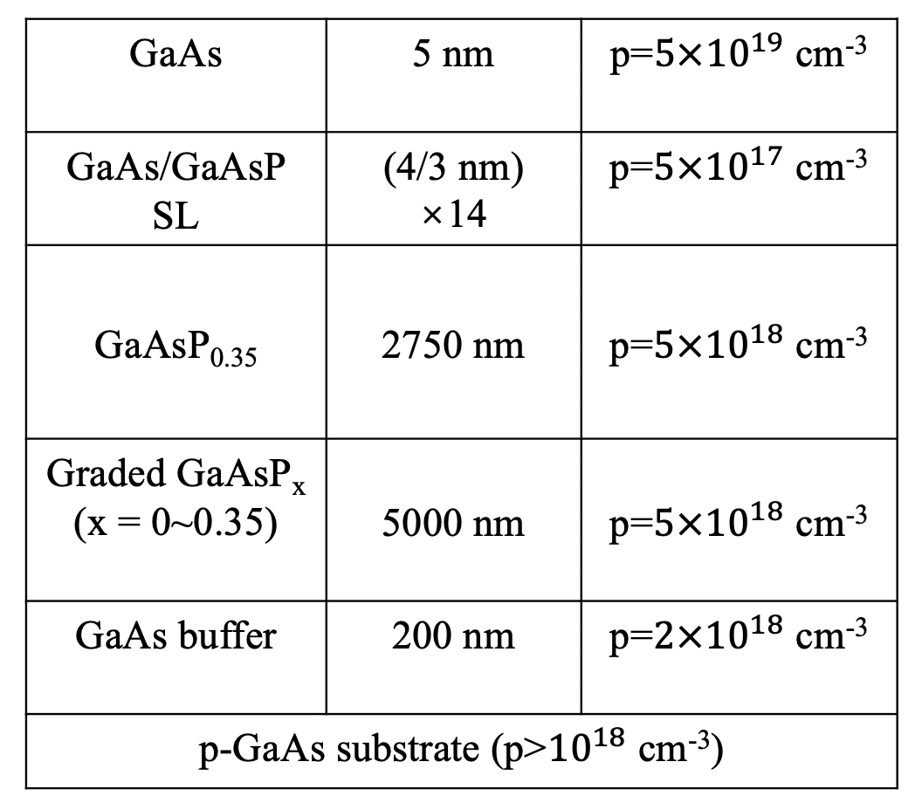
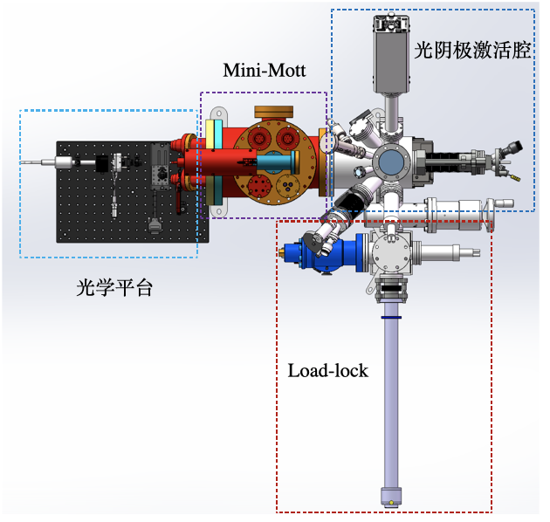
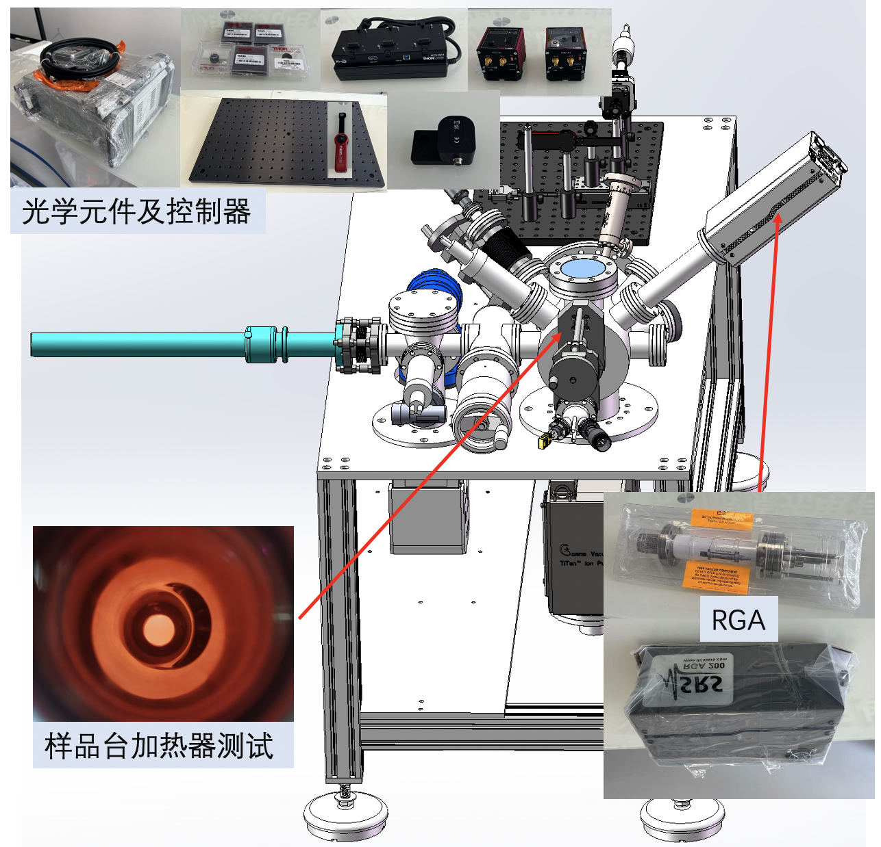
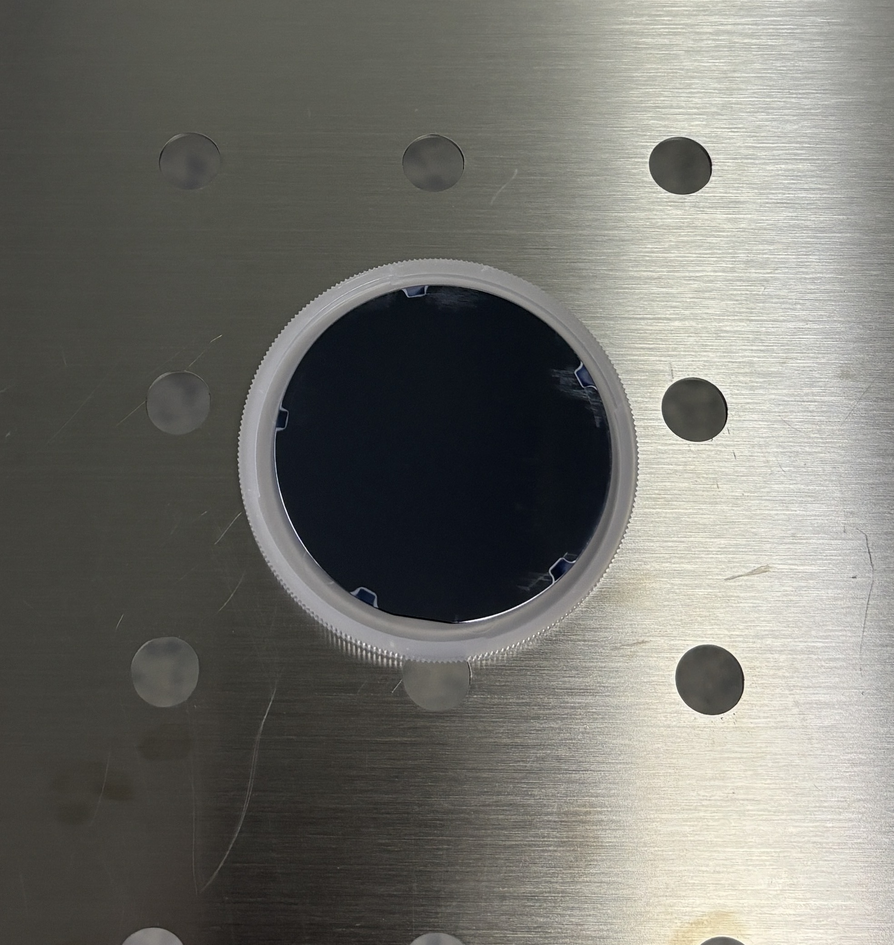
A test facility for polarized electron source
Domestic R&D on superlattice GaAs cathode
cathode production: polarization > 85%, QE > 0.8%
build a platform for cathode performance test (pol & QE)
First cathode has been produced and will be tested soon
First sample of superlattice GaAs/GaAsP cathode
Platform for cathode test:
ESP & QE
component fabrication and tests under way

Slide 15
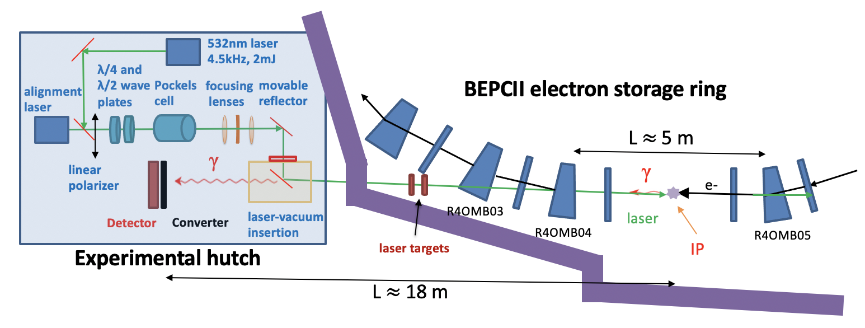
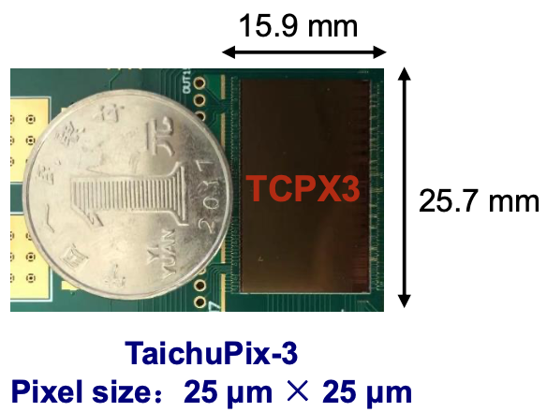
Compton polarimeter @ BEPCII
A Compton polarimeter is under commissioning at BEPCII (see Mengyu Su’s talk)
CEPC vertex detector prototype
15
Su Mengyu, Duan Zhe, A. Martens (IJClab), Liang Zhijun, Tang Guangyi, Wang Jianli etc
15

Slide 16
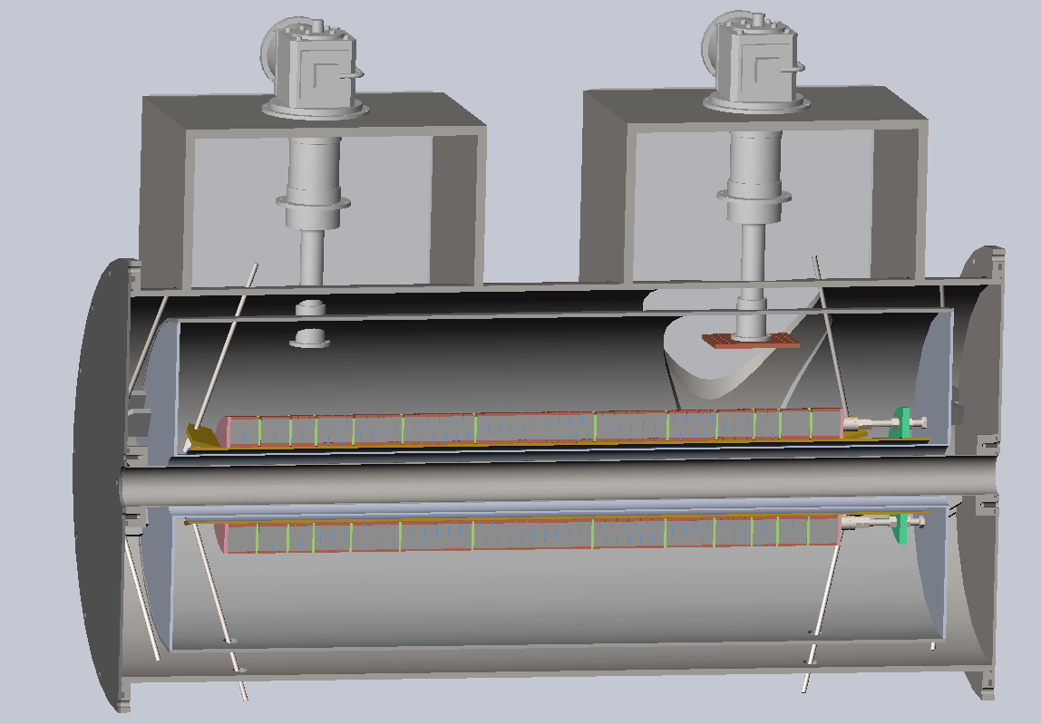
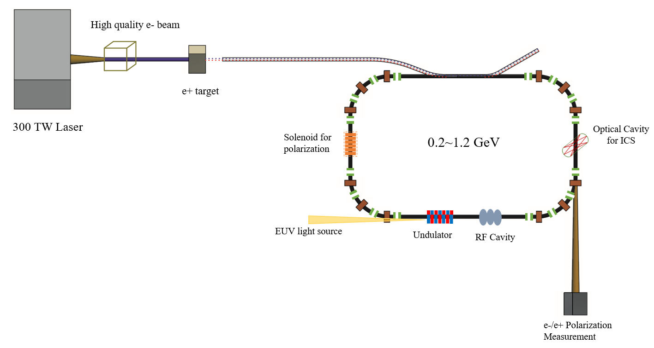

YBCO Superconducting solenoid spin rotator R&D
Cryo-cooler
HTS with conduction-cooling
Coil design and experimental studies under way
Measurements scheduled in 2027
Beam tests at LPA-Ring TF foreseen
Vacuum Dewar
Solenoid
Design specs：
Peak field: 12 T
Integral field：10.34T.m
Length：1.018m
Working current：300A
Coil aperture：140mm
magnet aperture > 64mm
10.5 T$∙$m Solenoid as a Siberian snake
Longitudinal polarization
LPA-Ring TF under design
Zhao Ling, Xu Qingjin, Hou Zhilong, Zhou Jin, Liu Zhongxiu etc

Slide 17
Outline
Polarization studies at CEPC
R&D for polarized beams at IHEP
Concepts of longitudinal polarization at BEPCII
Summary

Slide 18
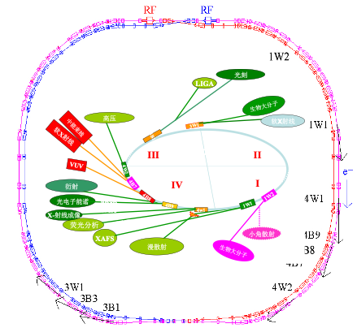
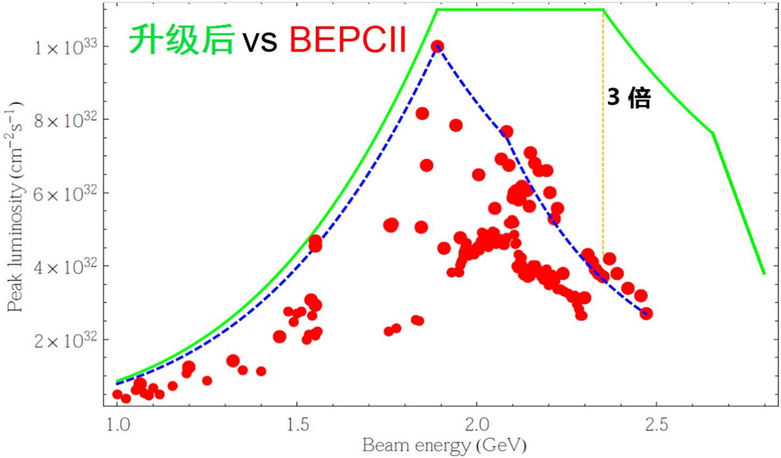
Status of BEPCII
2025-2030: BEPCII upgrade to higher luminosity (x3 @ 2.35 GeV) & higher energy (up to 2.8 GeV) with rich physics potential (see Haibo Li’s talk yesterday)
SR commissioning
Colliding beams at 1.84 GeV
Start tunnel installation
2024.7
2025.1
2025.5
2025.10
Linac resumes operation
Colliding beams at 2.35 GeV

Slide 19
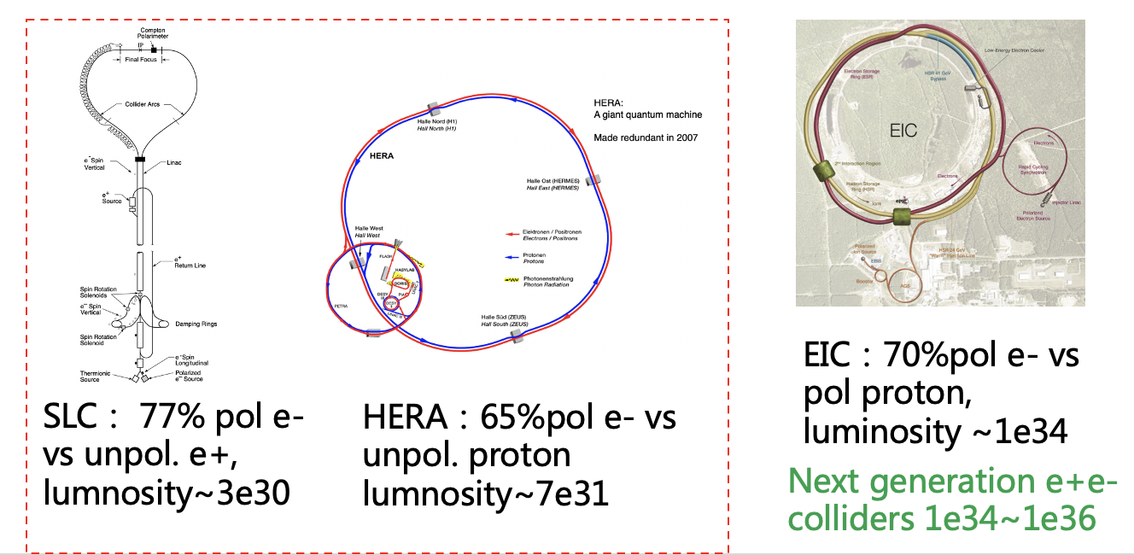
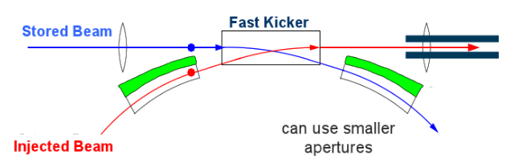
Motivation for longitudinal polarization at BEPCII
Upgrade to e- longitudinal polarization could further enrich spin physics studies at BESIII
Spin entangled hyperon-antihyperon pairs for CP tests (see Hong-Fei Shen’s talk)
Fragmentation function (see Yateng Zhang’s talk)
...
A test bed for e- longitudinal polarization in future colliders incl. CEPC
simultaneous achievement of high luminosity and high longitudinal polarization
swap-out injection applied to e+e- collider, already demonstrated at APS-U & HEPS
swap-out injection

Slide 20
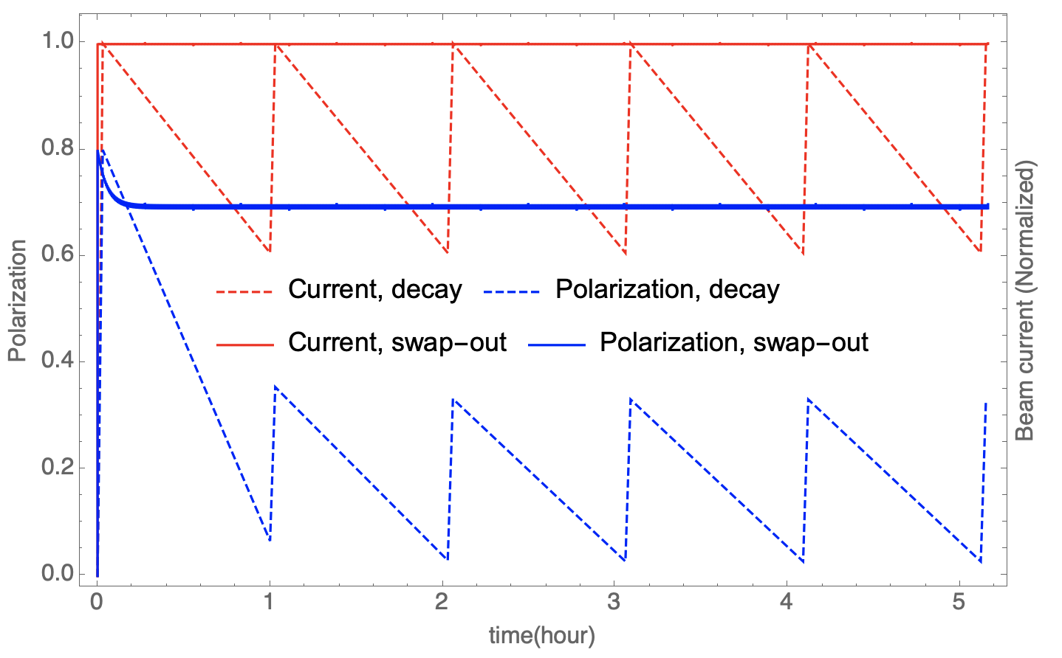
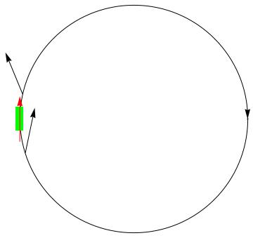
Polarization issues at 1.55 GeV
Sokolov-Ternov time is 10.5 hour, beam lifetime is 1~2 hour
Inserting a Siberian snake to attain longitudinal polarization at IP
Depolarization time is 24 min for a spin matched snake (requirements on lattice design)
Frequent extraction of depolarized bunches & injection of fresh polarized bunches
e.g. replace 1/12 of all 120 bunches every 20 seconds
for an injected beam polarization 80%, time-averaged polarization ~ 70%
A single full snake

Slide 21
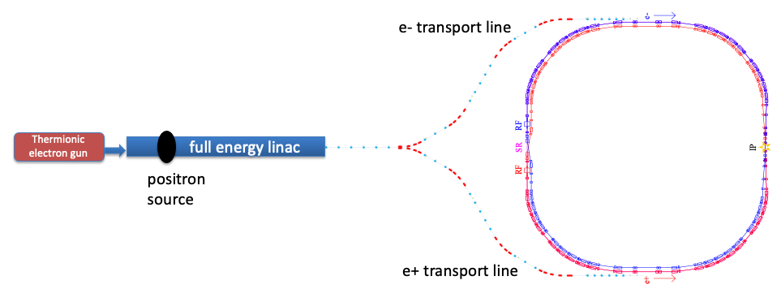
Envisaged modification and research topics
Issue #1： polarized e- source
Issue #3: Compton polarimetry
150kV polarized DC gun
wien filter
Mott polarimeter
spin rotator
Compton polarimeter
Siberian
snake
Issue #2: polarization manipulation
extraction to beam dump
Detailed design study is under way.
Issue #4: Extraction to beam dump

Slide 22
International collaborators
Spin dynamics studies
D. Barber (DESY), E. Forest (KEK), S. Nikitin (BINP)
contribute to FCC-ee EPOL collaboration
Compton polarimeter
A. Martens (IJCLab, supported by France-China Particle Physics Laboratory/Network)
Instructive discussions with I. Nikolaev, V. Kaminskiy (BINP)
A laser-vacuum insertion was borrowed from BEMS @ BESIII for early commissioning, granted by N. Muchnoi and M. Achasov (BINP)
Polarized electron source
V. Tyukin (JGU Mainz, supported by PIFI program of CAS)

Slide 23
Summary
A scheme of injecting polarized beams is promising for CEPC
R&D of key technologies in progress
Compton polarimeter at BEPCII
Test facility for polarized electron source
Prototype of a HTS solenoid spin rotator
Longitudinal polarization option is being studied for BEPCII
These activities will set the basis for polarization applications at CEPC
Thank you for your attention!

