Slide 1



The 26th international symposium on spin physics (SPIN2025)
Design and Preliminary Implementation of a Laser Compton Polarimeter for BEPCII
Reporter：Mengyu Su
Authors：M. Y. Su, Z. Duan, Z. J. Liang, Q. F. Han, D. H. Ji, G. Lei, Q. Li, Y. C. Li, X. J. Sun, G. Y. Tang, J. L. Wang, C. H. Yu, W. Zhang, Y. L. Zhang, N. C. Zhou, D. C. Zhu, A. Martens, F. Castellanos, C. Sandoval
Date：20250923

Slide 2
CONTENTS
1
Background
2
Design considerations
3
Implementation status
4
Summary

Slide 3
1
PART
Background

Slide 4
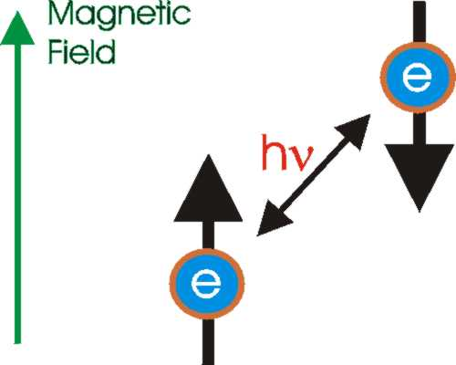
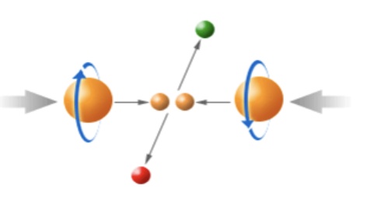
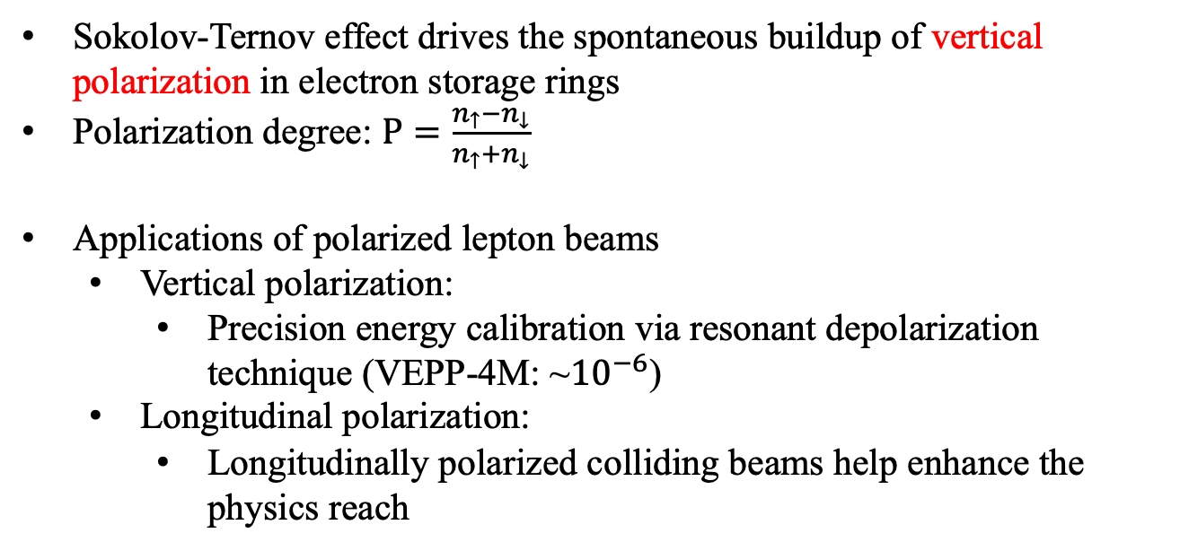
SPIN2025 Design and Preliminary Implementation of a Laser Compton Polarimeter for BEPCII
1.1 Polarized lepton beams
Sokolov-Ternov effect drives the spontaneous buildup of vertical polarization in electron storage rings
Polarization degree: $P=\frac{n_{↑}−n_{↓}}{n_{↑}+n_{↓}}$
Applications of polarized lepton beams
  Vertical polarization:
    Precision energy calibration via resonant depolarization technique (VEPP-4M: ~${10}^{−6}$)
  Longitudinal polarization:
    Longitudinally polarized colliding beams help enhance the physics reach
(Dokl. Akad. Nauk SSSR 153(5), 1052–1054 (1963))
Synchrotron radiation photons can induce electron spin flips, with unequal probabilities for up→down versus down→up transitions.
(Blinov:Nuclear and Particle Physics Proceedings 273-275, 210–218 (2016)
(CLENDENIN19941,Moortgat-Pick:2008,PhysRevD.110.014035)
Require high precision polarimeter !
Longitudinal polarized lepton beam collision
Achieved：SLC, HERA
Planning：CEPC, CCF, SuperTC, EIC, SuperKEKB
(CCF study report,CEPC TDR, EIC design report)

Slide 5
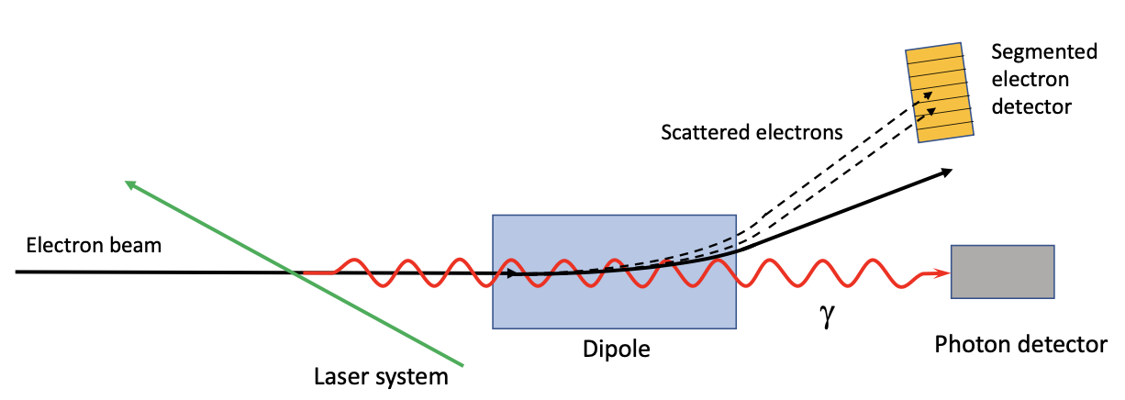
SPIN2025 Design and Preliminary Implementation of a Laser Compton Polarimeter for BEPCII
1.2 Compton polarimeter
Compton polarimeter are commonly used in electron storage rings with GeV beam energies because of their advantages of accurate and nondestructive measurement.
Real-time polarization measurement is required by polarized beam applications
Polarimeter | Direction | Type | Energy (GeV) | Systematic Uncertainty
CERN LEP (R. Assmann:CERN SL/93-02 (BI)) | Vertical | γ | 46 | 5%
HERA LPOL (hep/ex 1201.2894) | Longitudinal | γ | 27 | 2.0%
HERA TPOL (hep/ex 1201.2894) | Vertical | γ | 27 | 1.9%
SLD @ SLAC (PhysRevLett.84.5945) | Longitudinal | e | 45.6 | 0.5%
CREX@ JLAB Hall A (PhysRevC.109.024323) | Longitudinal | γ, e | 2 | 0.36%
JLAB Hall C | Longitudinal | γ, e | 1.1 | 0.6%
the above list of polarimeters is not exhaustive

Slide 6

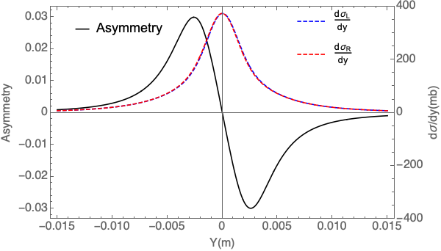


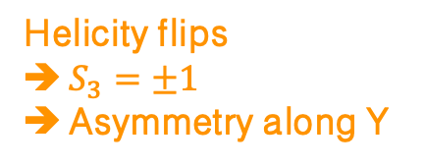

SPIN2025 Design and Preliminary Implementation of a Laser Compton Polarimeter for BEPCII
1.3 The principle of laser Compton polarimeter
E_{b}=2.35 GeV, λ_{laser}=532 nm
The differential cross section
(ginzburg_colliding_1984, SLAC-PUB-4656)
$$x$$
$$x$$
For a circularly polarized laser and transversely polarized electron beam,
$$\frac{dσ}{dY}(Y)={(\frac{dσ}{dY})}_{unp}\left(Y\right)\left[1−S_{3}P_{y}A_{y}\left(Y\right)\right]$$
Asymmetry=$\frac{N_{L}−N_{R}}{N_{L}+N_{R}}(Y)$=$|S_{3}|P_{y}A_{y}(Y)$
Degree of vertical polarization of electron
Helicity flips
$S_{3}=±1$
Asymmetry along Y
Analyzing power
Can be calculated
Degree of circular Polarization of laser ~100%
Can be measured

Slide 7
2
PART
Design considerations

Slide 8
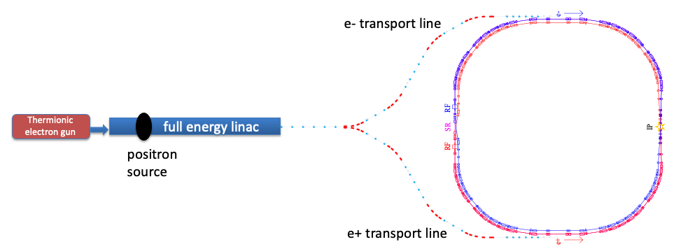
SPIN2025 Design and Preliminary Implementation of a Laser Compton Polarimeter for BEPCII
2.1 Introduction to BEPCII
Beijing Electron Positron Collider II (BEPCII), a double-ring electron positron collider operating in the tau-charm energy range.
Driven by increasing particle physics research interests at higher beam energies, it is undergoing an upgrade, BEPCII-U, to achieve a threefold increase in the luminosity at 2.35GeV and a higher beam energy up to 2.8 GeV.
The polarization build-up time is about 72.5 min at 2.35 GeV for BEPCII storage rings, and the electron beams are injected normally every 1.5 hour.
(Yu: 7th International Particle Accelerator Conference, p.01 (2016))

Slide 9
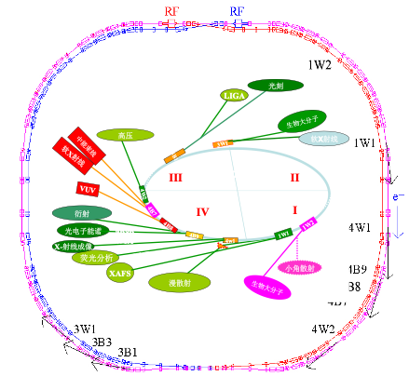
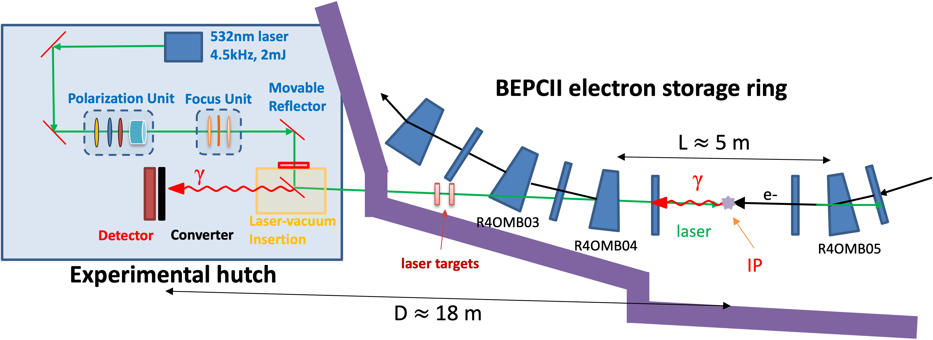
SPIN2025 Design and Preliminary Implementation of a Laser Compton Polarimeter for BEPCII
2.2 A Compton polarimeter at BEPCII
4W2, a wiggler-based X-ray beamline of BEPCII has retired from operation under the upgrade
We propose to modify the front end and the hutch to set up a Compton polarimeter.
Close to head-on collision
LOOK HERE!

Slide 10
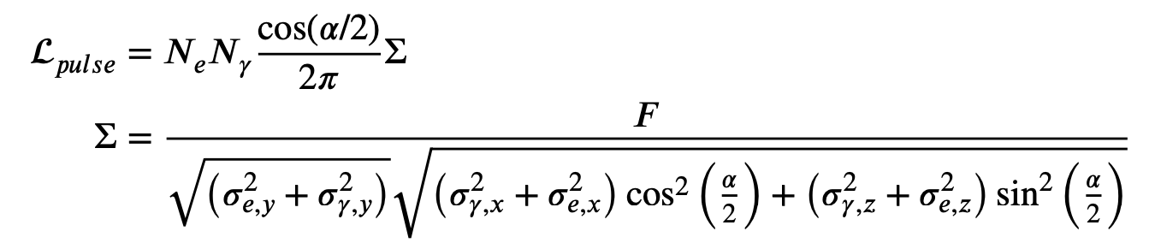
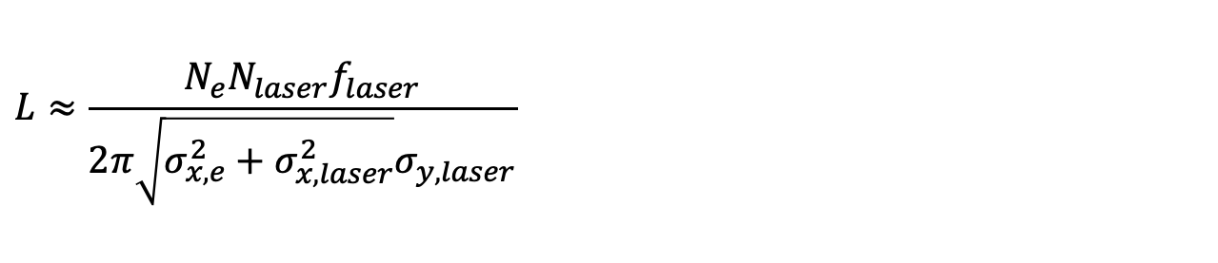
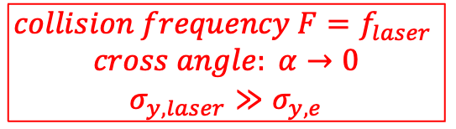
SPIN2025 Design and Preliminary Implementation of a Laser Compton Polarimeter for BEPCII
2.3 The luminosity of laser Compton polarimeter
For electron beam bunches and pulsed lasers, the collision luminosity is
The laser frequency and single pulse energy,
need to adjust the time synchronization between the laser and the electron beam.
$$collision frequency F=f_{laser}$$
$$cross angle: α→0$$
$$σ_{y,laser}≫σ_{y,e}$$
$$L≈\frac{N_{e}N_{laser}f_{laser}}{2π\sqrt{σ_{x,e}^{2}+σ_{x,laser}^{2}}σ_{y,laser}}$$
Reduce beam size, increase luminosity

Slide 11
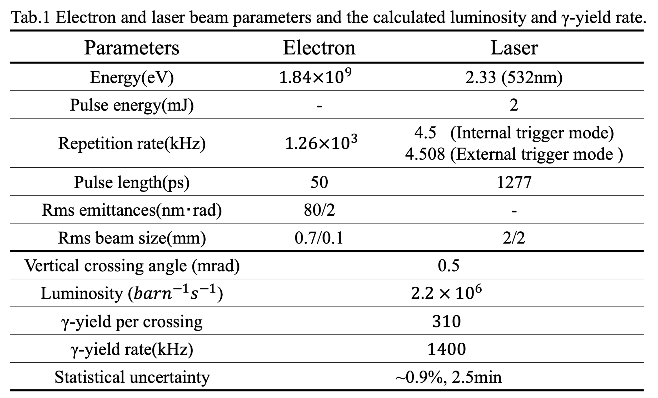
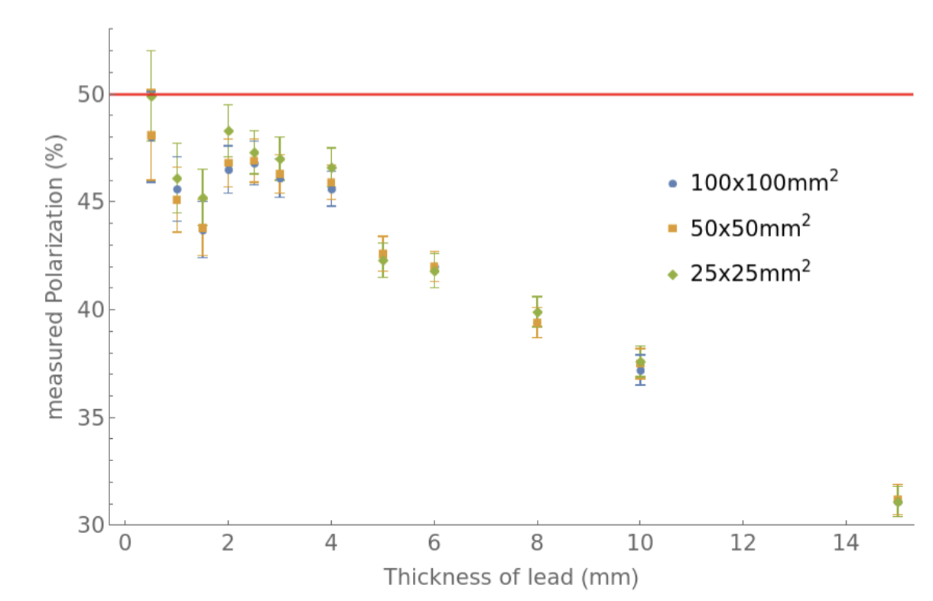


SPIN2025 Design and Preliminary Implementation of a Laser Compton Polarimeter for BEPCII
2.4 Design parameters and MC simulation
Asymmetry of a simulation of ${10}^{8}$ gamma
[Guangyi Tang]
$$×\frac{1}{280}$$
Laser can be synchronized with an arbitrary bunch by the timing system
Assume 50% vertical polarization
Thickness of lead (mm)
[Guangyi Tang]

Slide 12
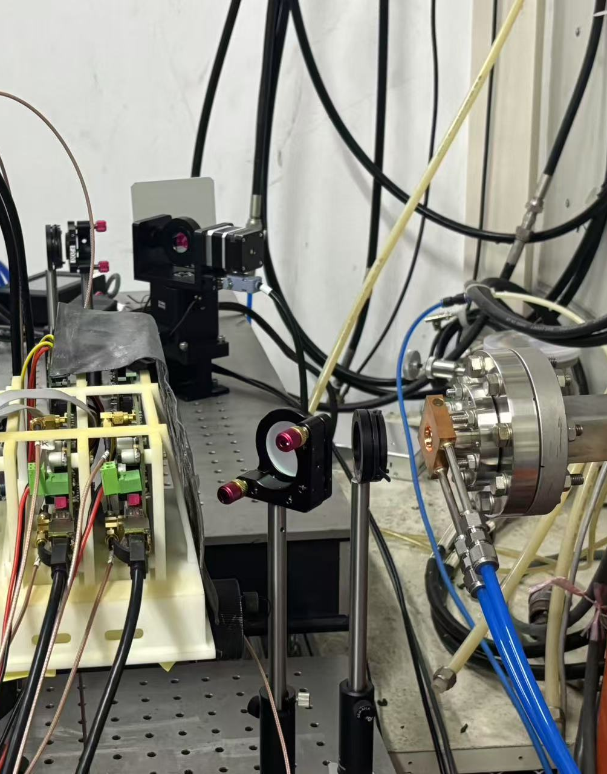
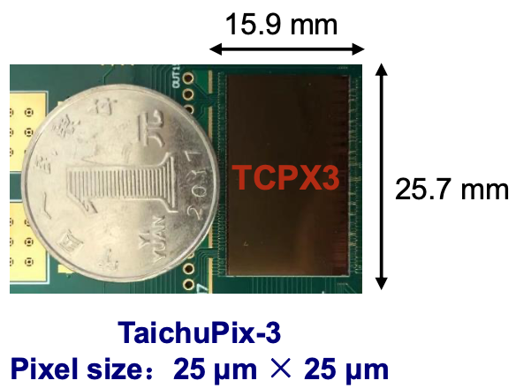
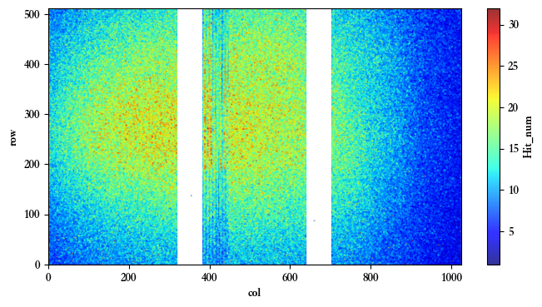
SPIN2025 Design and Preliminary Implementation of a Laser Compton Polarimeter for BEPCII
2.5 Detection system
The TaichuPix-3 silicon detector, a CMOS pixel sensor prototype for the CEPC vertex detector with a sensitive area of 15.9 × 25.7mm² and a pixel size of 25 × 25μm².
Since the lepton detection efficiency is higher than that of γ photons for such a detector, a lead converter with a thickness of a few millimeters, subject to optimization, is placed just in front of the detector to convert γ photons into leptons.
Detector readout active pixels with a time resolution of 50ns
Signal on Taichu-Pix 3
lead (~3mm)
Backscattering photon
2 layers of chips

Slide 13
3
PART
Implementation status

Slide 14
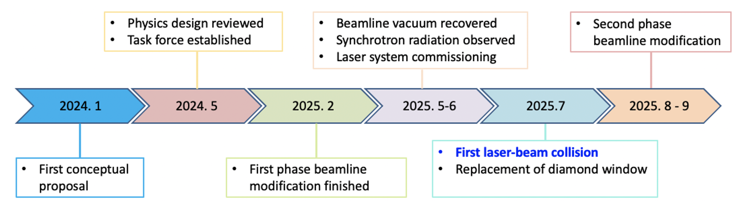
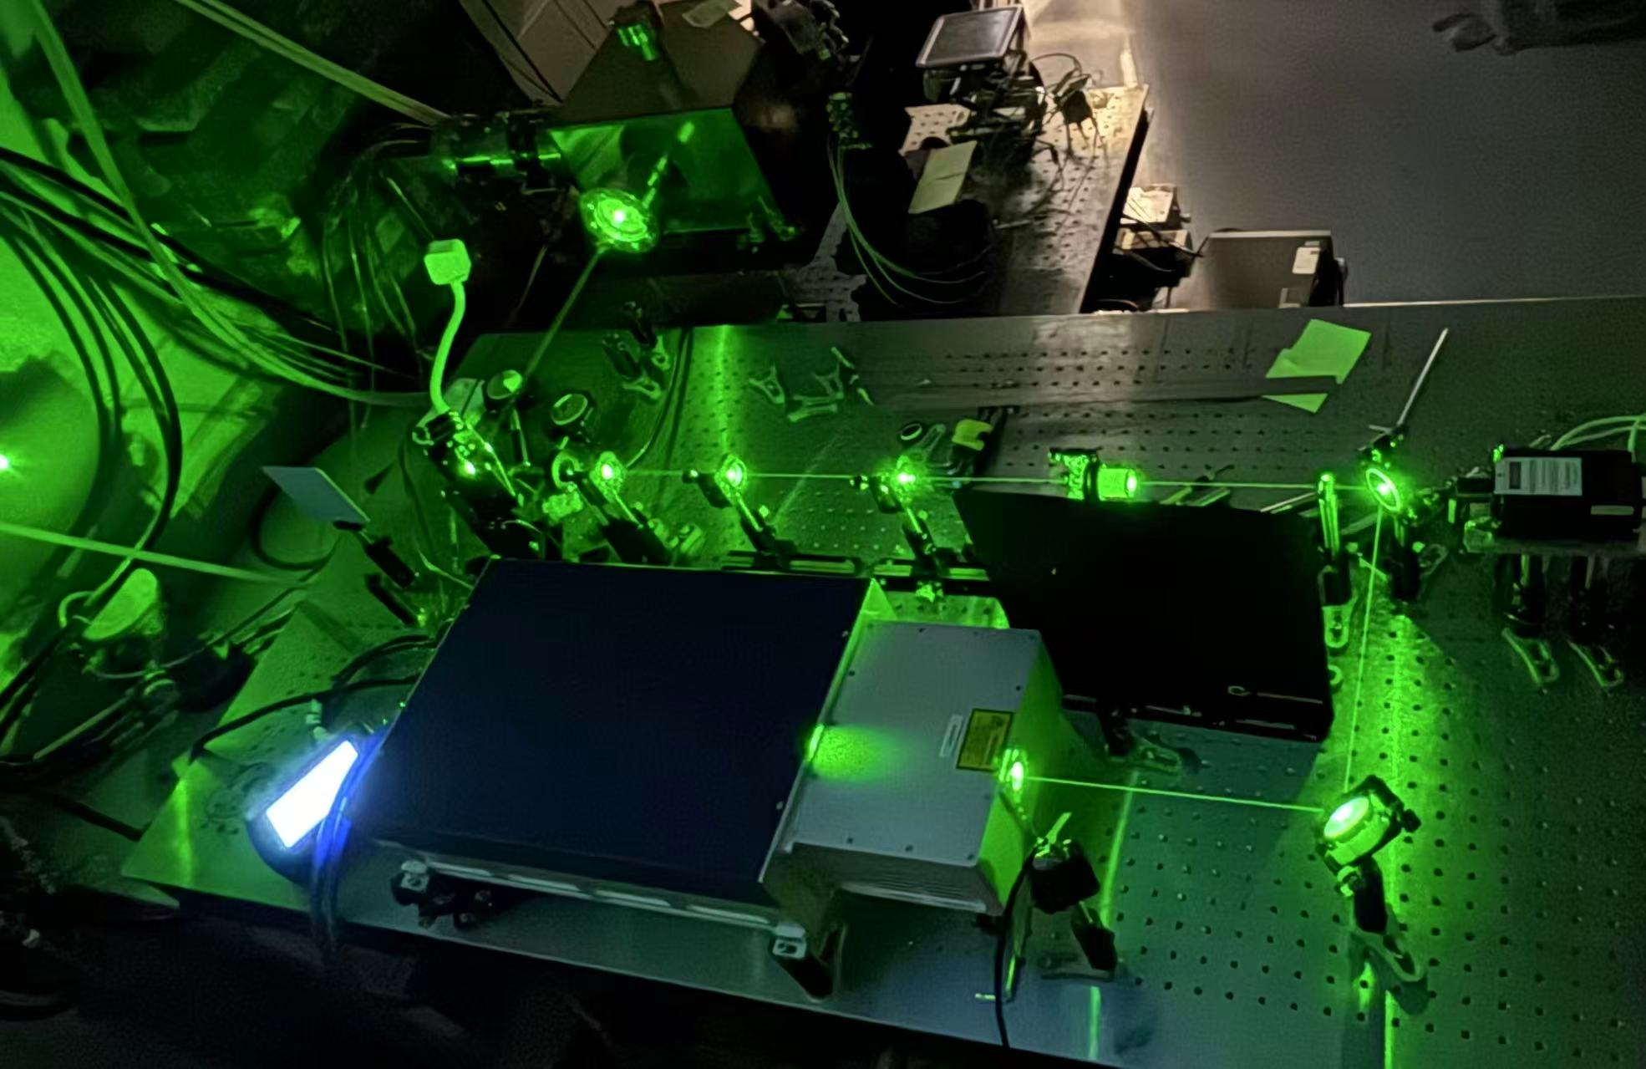
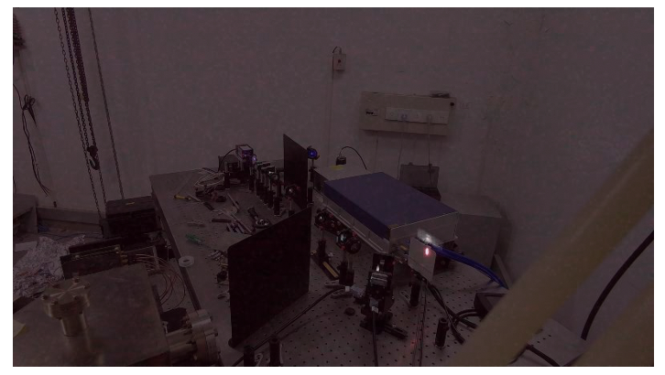
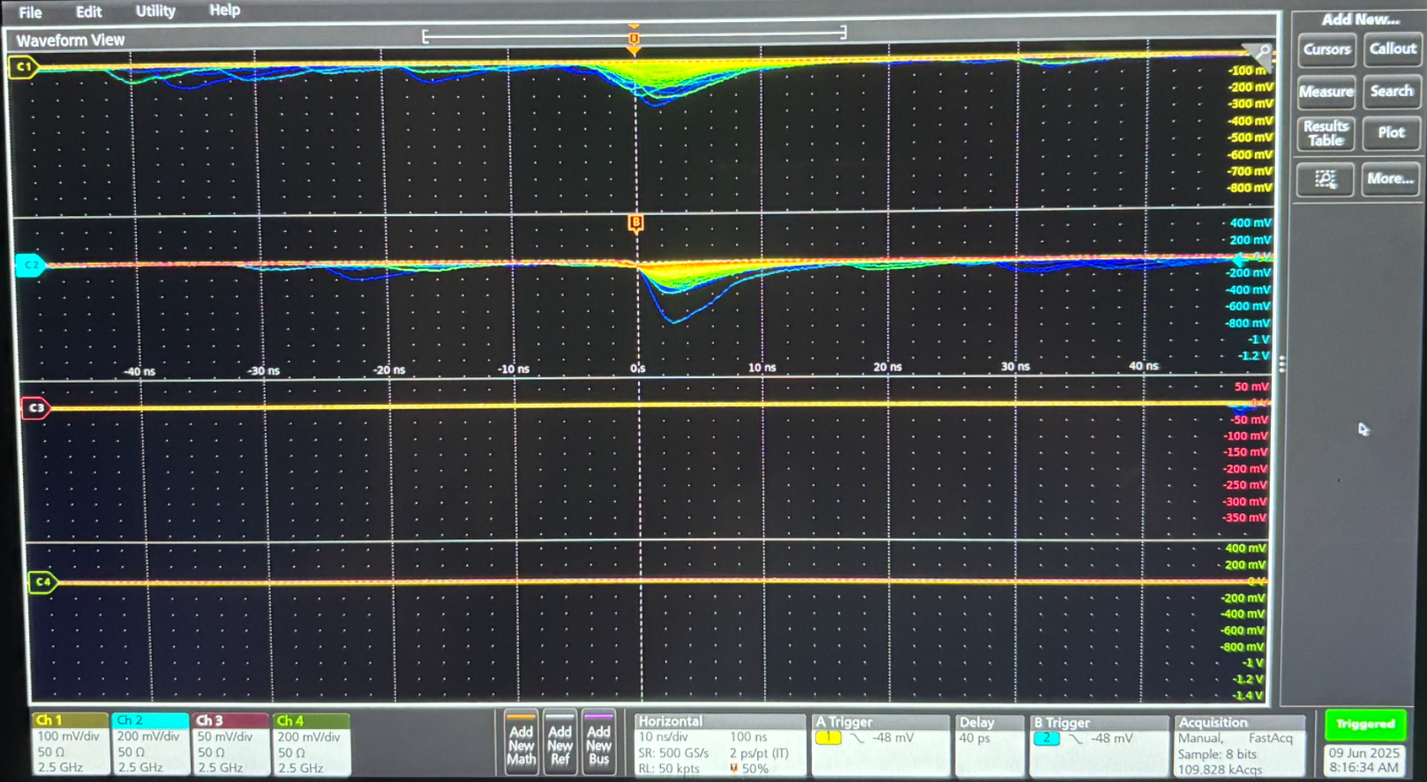
SPIN2025 Design and Preliminary Implementation of a Laser Compton Polarimeter for BEPCII
3.1 Overall progress
Visible light part of synchrotron radiation from the reflector mirror
Background measured by lead preshower + scintilator + PMT
Laser optics

Slide 15
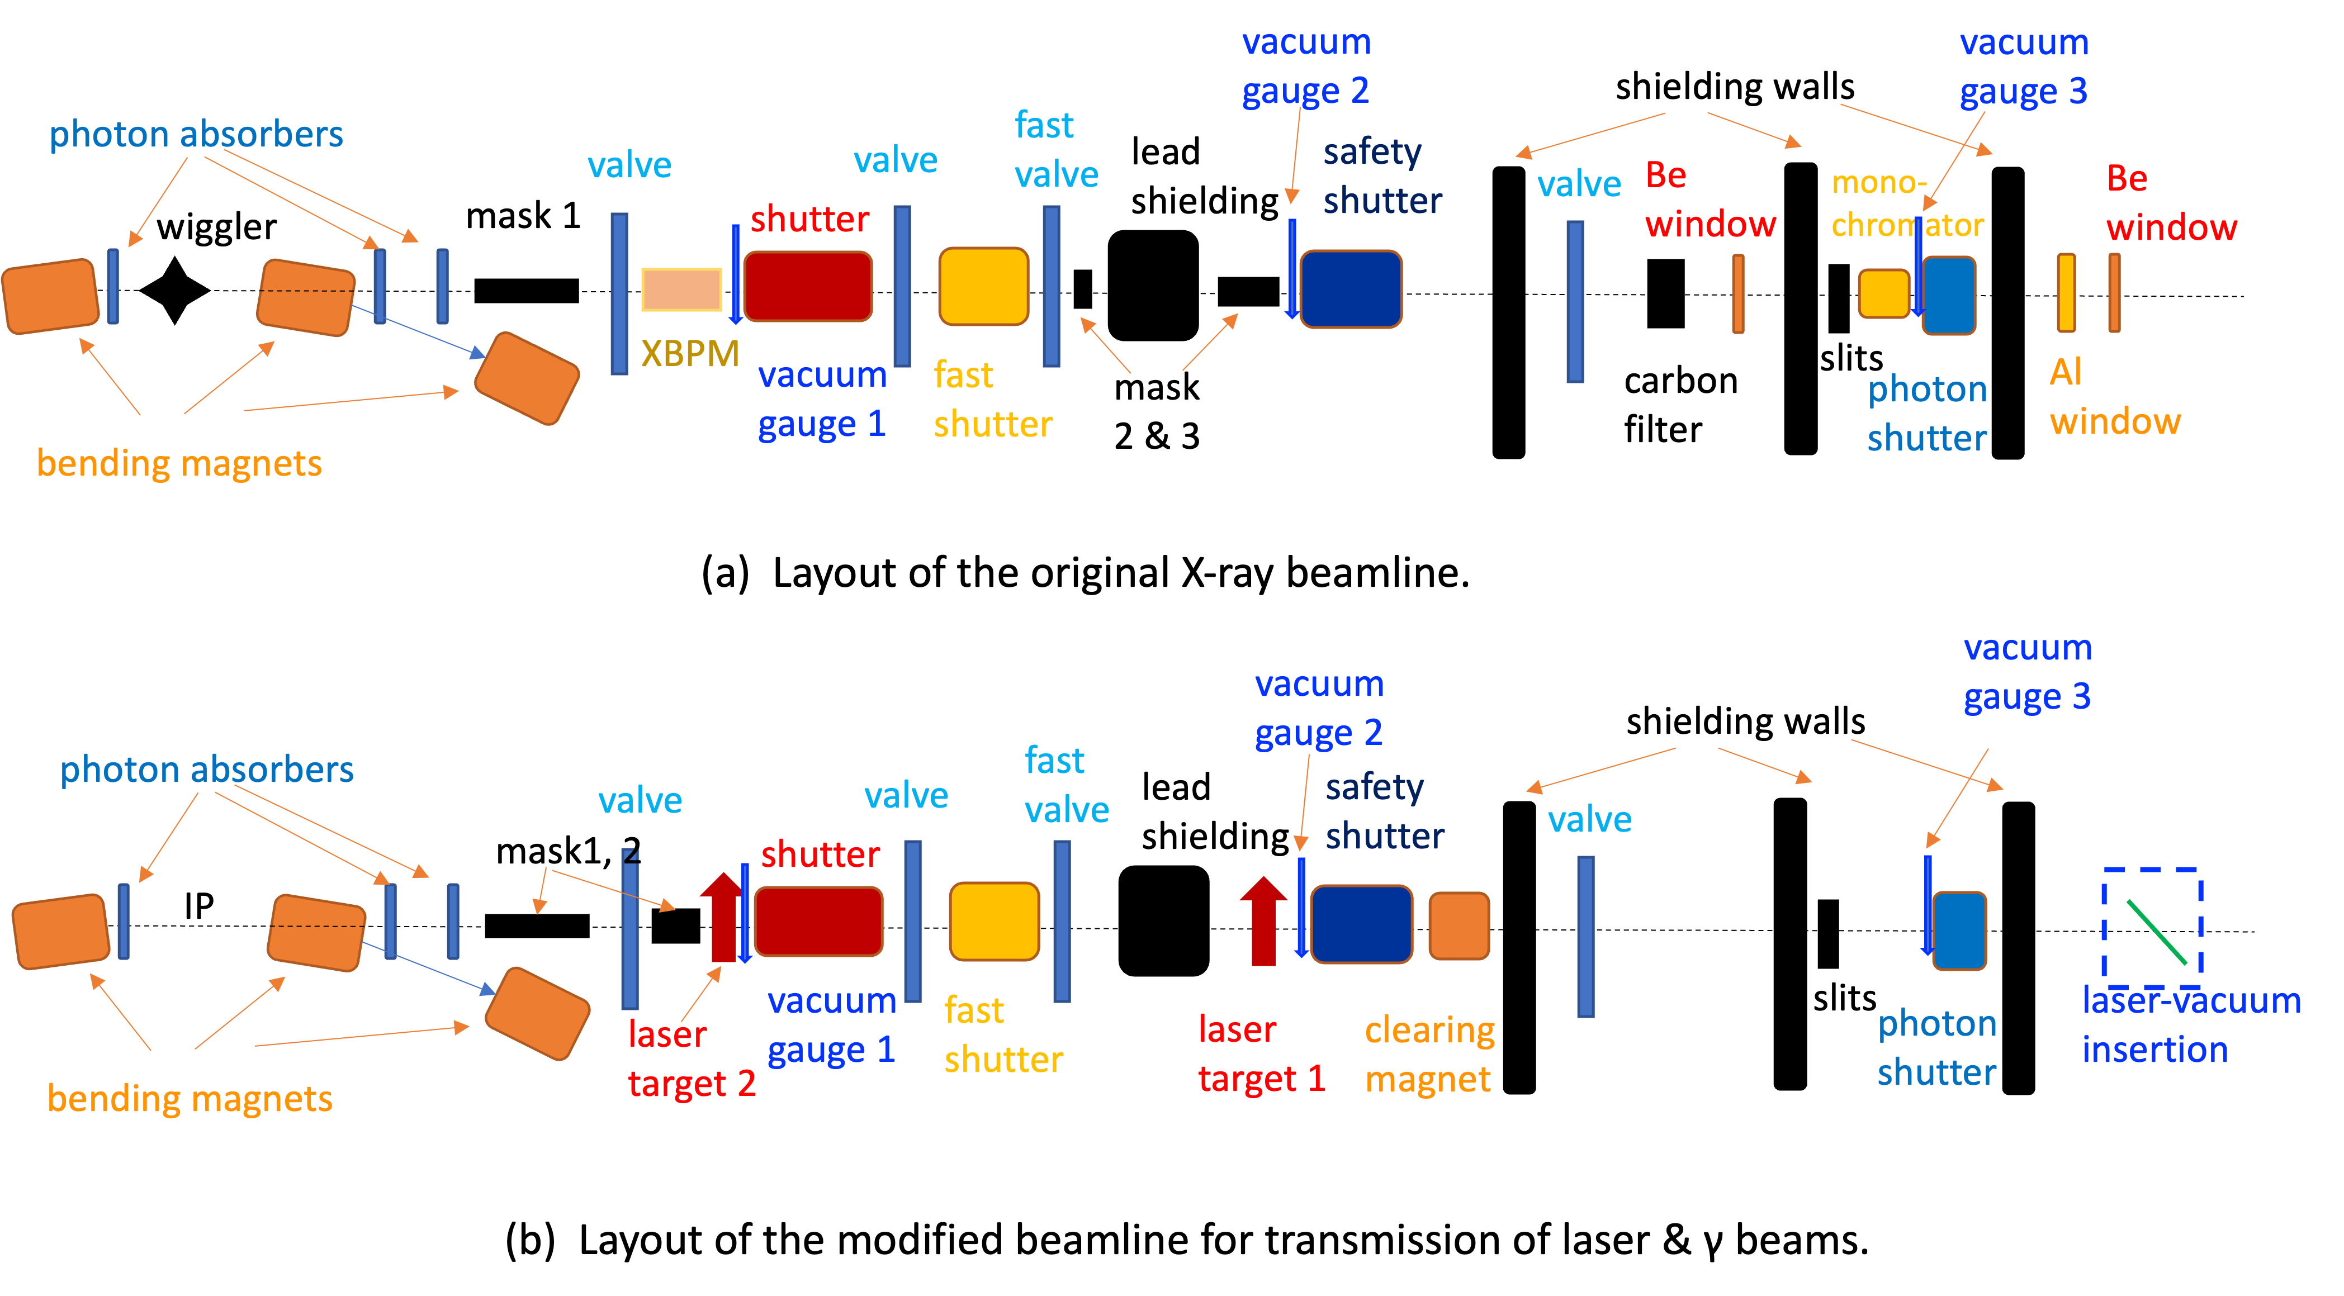
SPIN2025 Design and Preliminary Implementation of a Laser Compton Polarimeter for BEPCII
3.2 Modification of the photon beamline

Slide 16
SPIN2025 Design and Preliminary Implementation of a Laser Compton Polarimeter for BEPCII
3.3 Laser optics tuning
To ensure a specific circular polarization state at the IP.

Slide 17
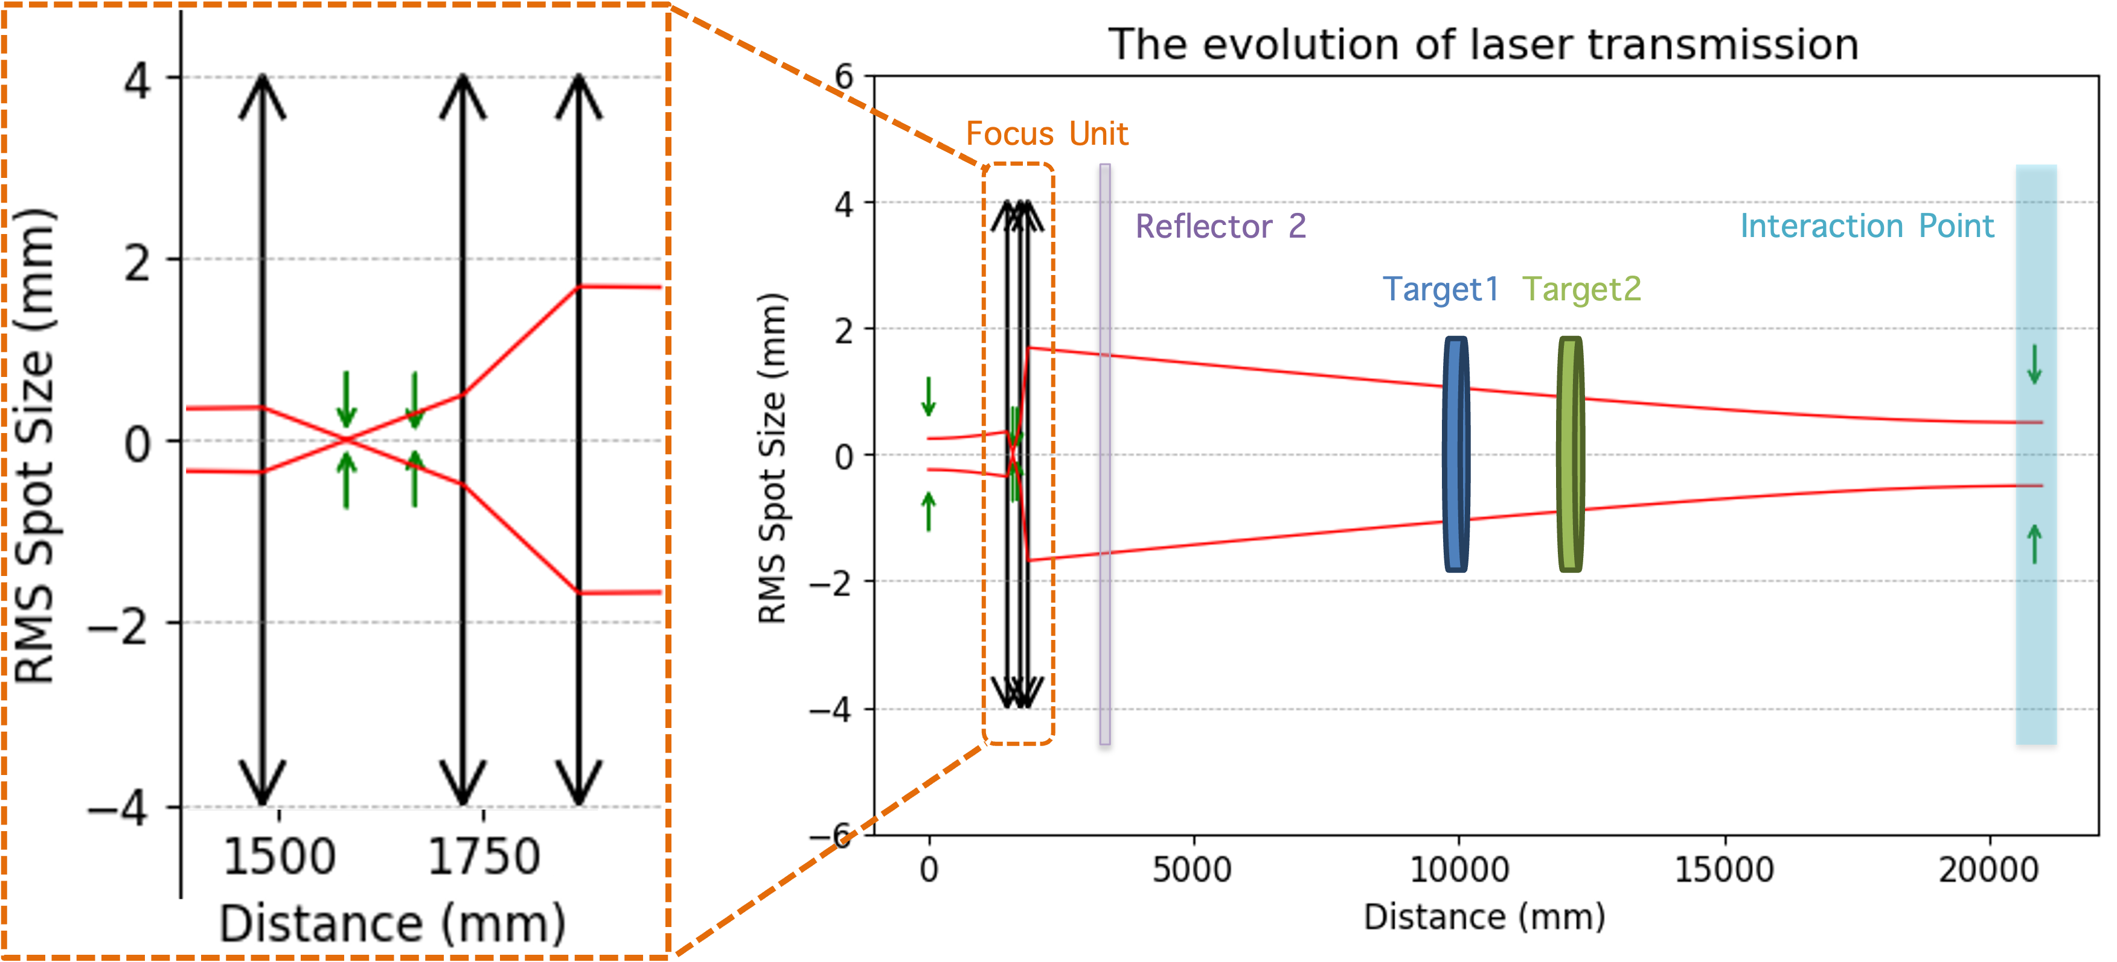
SPIN2025 Design and Preliminary Implementation of a Laser Compton Polarimeter for BEPCII
3.3 Laser optics tuning
To adjust the spot size at IP

Slide 18
SPIN2025 Design and Preliminary Implementation of a Laser Compton Polarimeter for BEPCII
Here we can see the visual part of synchrotron radiation light
3.3 Laser optics tuning

Slide 19
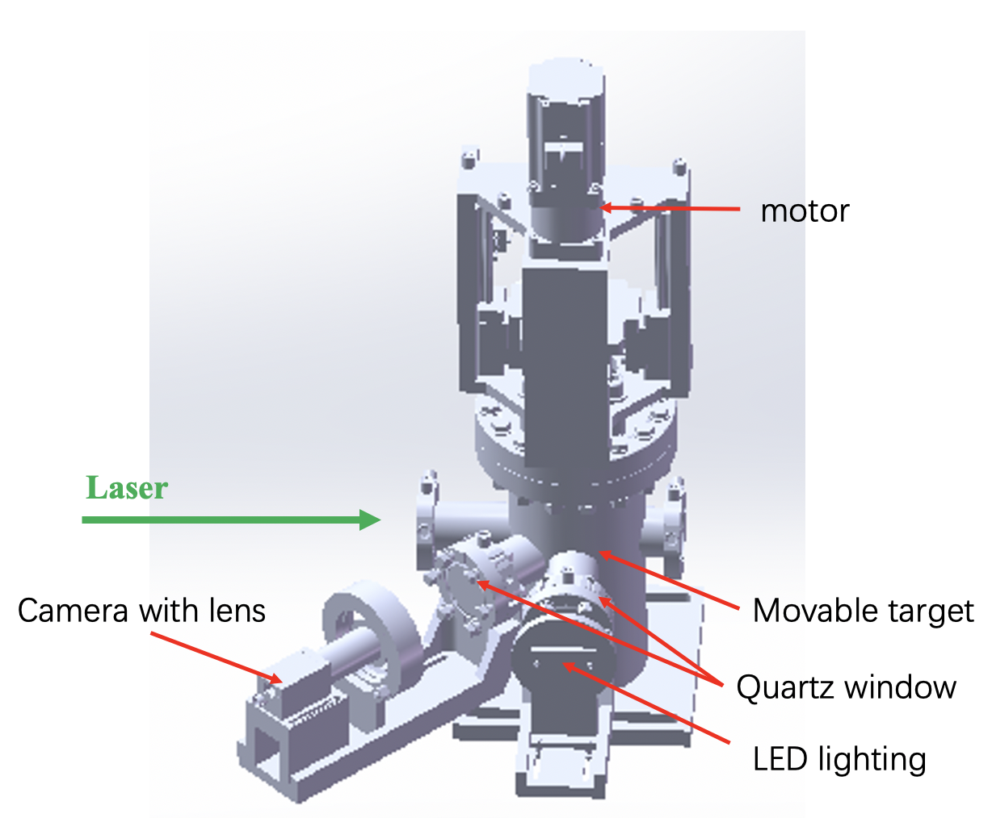
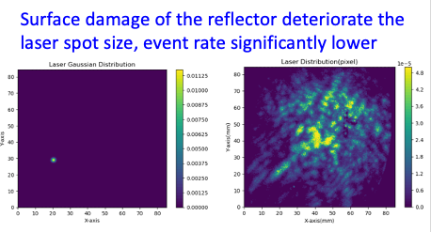
SPIN2025 Design and Preliminary Implementation of a Laser Compton Polarimeter for BEPCII
3.3 Laser optics tuning
The spot on target

Slide 20
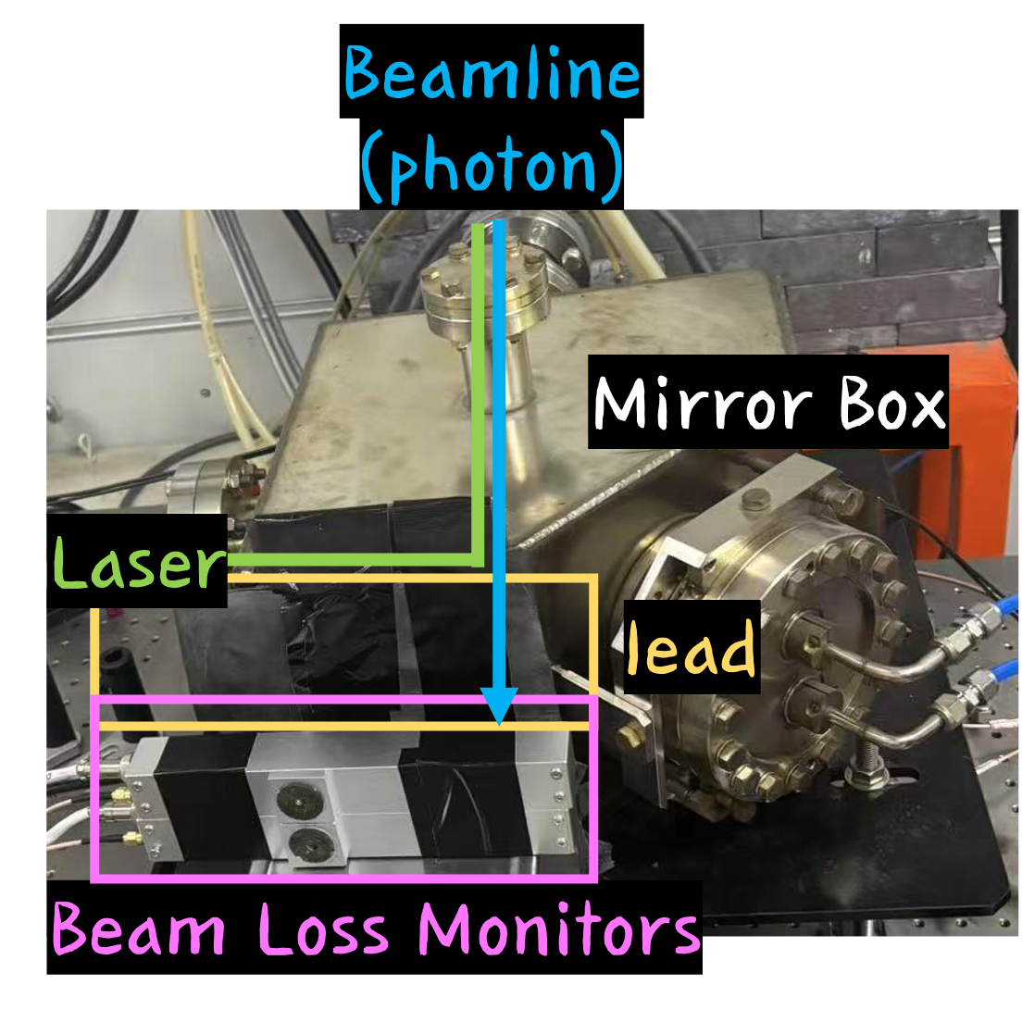
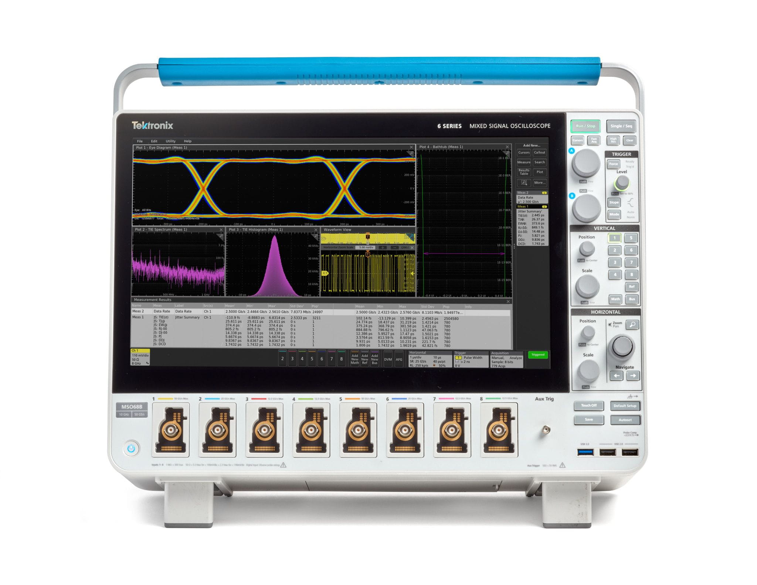
SPIN2025 Design and Preliminary Implementation of a Laser Compton Polarimeter for BEPCII
3.4 Beam commissioning
Alignment of detector & electron beam based on background
~100 colliding bunches in storage ring
Online adjustment of the electron position at the IP by the local bump of the storage orbit.
Connected to an oscilloscope
~5mm lead + glass scintillator (~$5×5cm^{2}$)+ PMT

Slide 21
SPIN2025 Design and Preliminary Implementation of a Laser Compton Polarimeter for BEPCII
3.4 Beam commissioning
Scan the position of laser to find the collision signal
Online adjustment of the laser position at the IP by rotating along pitch and yaw axes.
~100 colliding bunches in storage ring
The laser is configured in internal trigger mode (4.5 kHz) , asynchronized with the ring RF frequency, the straight section is 5m long, the laser pulse is likely to coincide with up to 3 bunches
We can disregard the longitudinal matching here
Connected to an oscilloscope
~5mm lead + glass scintillator (~$5×5cm^{2}$)+ PMT

Slide 22
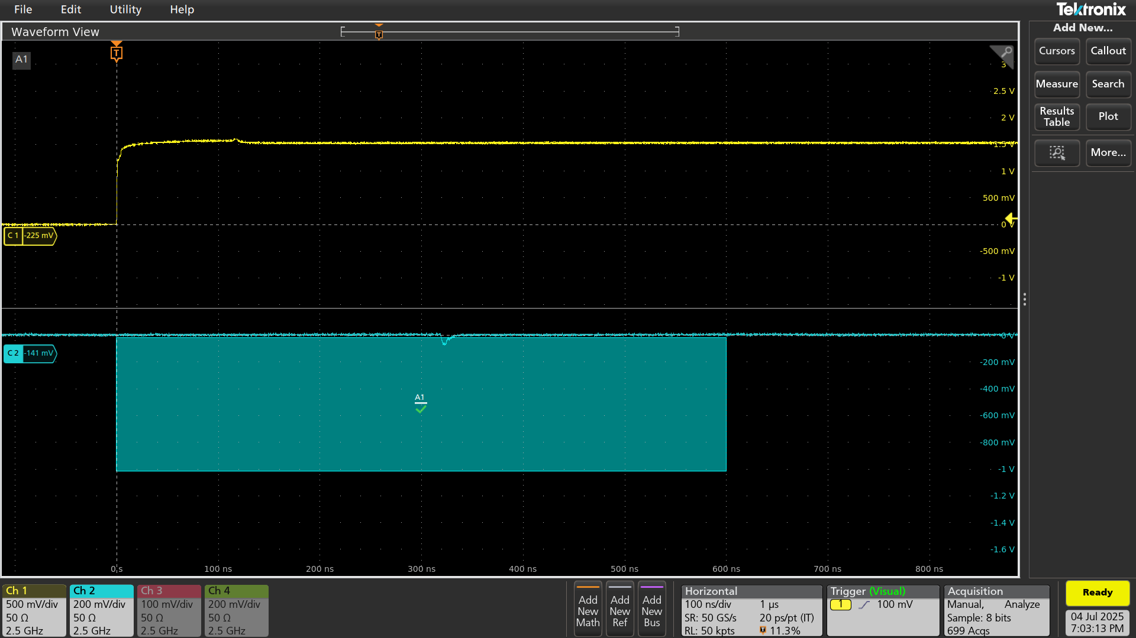
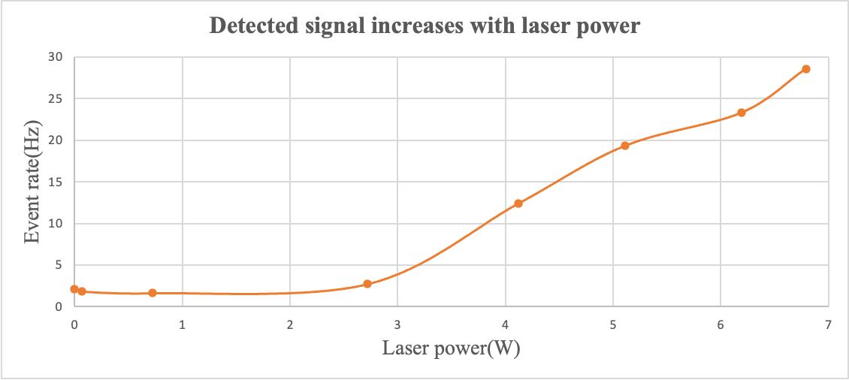
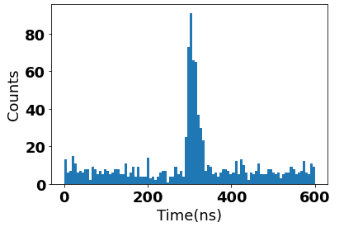
SPIN2025 Design and Preliminary Implementation of a Laser Compton Polarimeter for BEPCII
3.4 Beam commissioning
laser Qout
internal trigger at 4.5kHz
Causality between laser and backscattered γ signal
Event rate increases with laser power in a narrow temporal window
a 600ns window
Connected to an oscilloscope
Temporal distribution of detected peaks of 1000 triggered waveforms

Slide 23
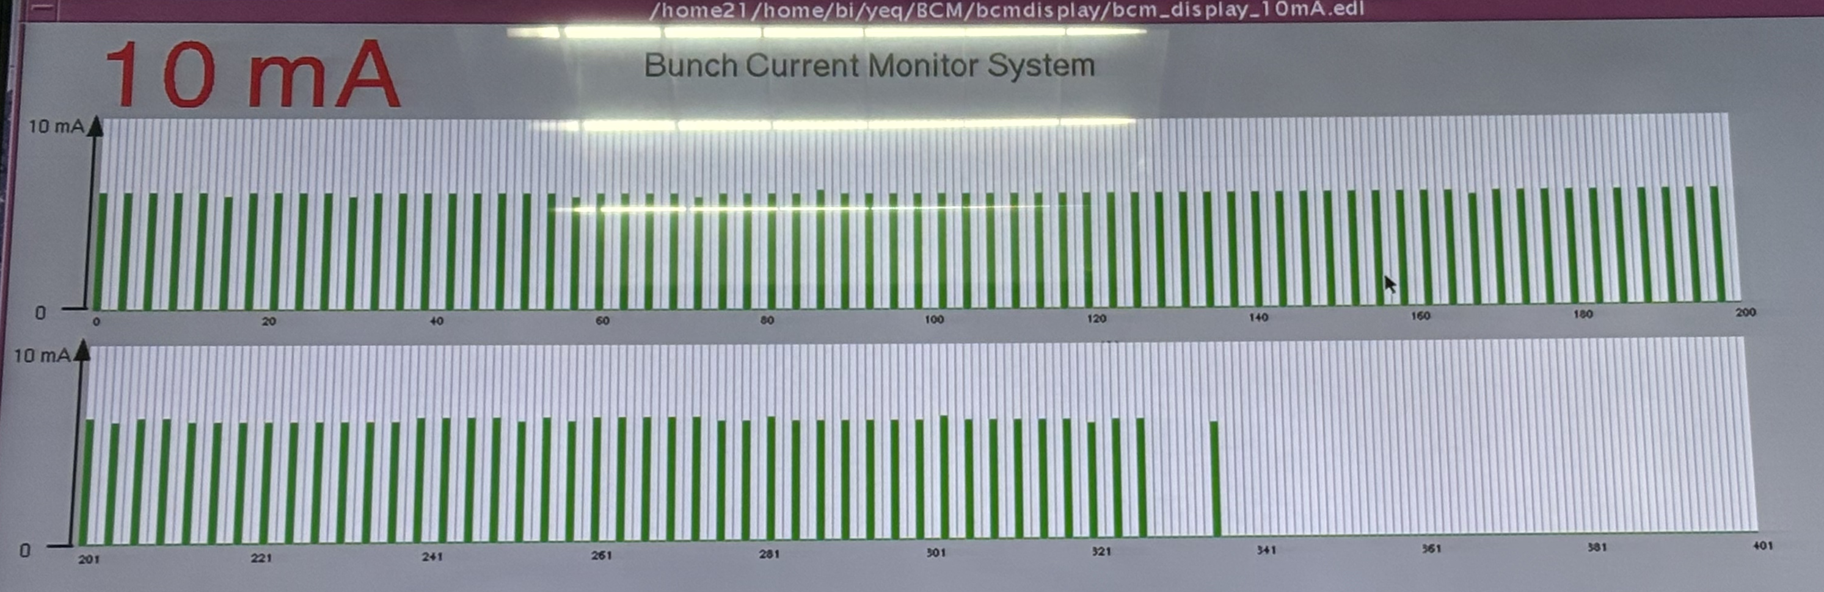
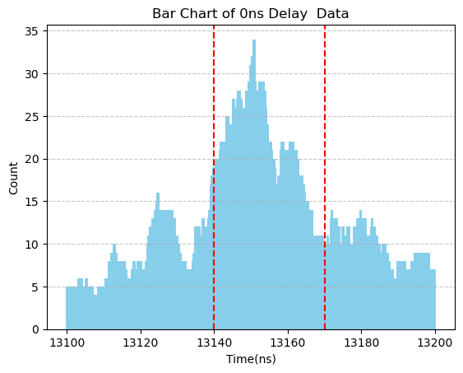
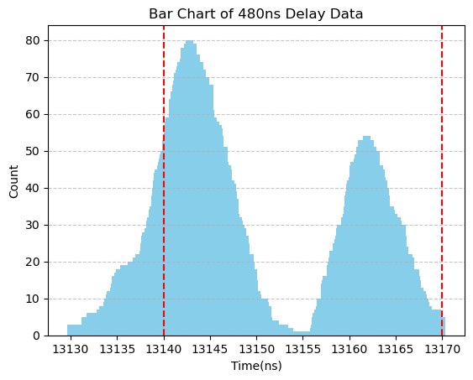
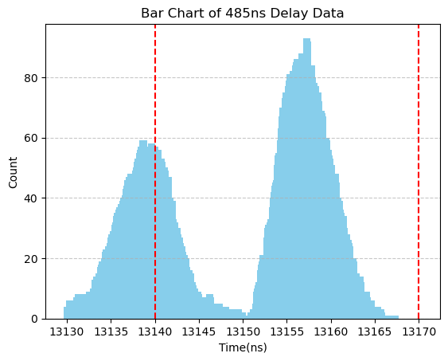
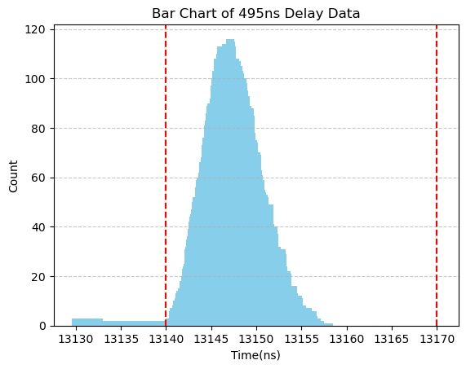
SPIN2025 Design and Preliminary Implementation of a Laser Compton Polarimeter for BEPCII
3.4 Beam commissioning
Timing system sends 4.508kHz trigger to laser, in synchronization with ring RF frequency
Laser is now synchronized with one pilot bunch
BEPCII e- Ring Bunch current Monitor
6ns bunch spacing, ~108 colliding bunches
18ns gap
delay
delay + 480ns
delay + 485ns
delay + 495ns

Slide 24
SPIN2025 Design and Preliminary Implementation of a Laser Compton Polarimeter for BEPCII
Single bunch collision via BLM
3.5 Detector commissioning
We have observed the gamma signals via Taichu-Pix 3.
The next step is to distinguish the collision signals from the background
Taichu-Pix 3 detection system
Signal on Taichu-Pix 3
Event timestamp
Time resolution = 50ns

Slide 25
4
PART
Summary

Slide 26
SPIN2025 Design and Preliminary Implementation of a Laser Compton Polarimeter for BEPCII
4 Summary
A laser Compton polarimeter has been designed and implemented in the electron storage ring of BEPCII, for vertical polarization measurement via detection of the vertical asymmetry of the back-scattered γ.
First laser-beam collision has been observed (BLM), commissioning is underway to detect electron beam polarization (TaichuPix-3).
Such a polarimeter can enable tests of resonant depolarization and study radiative depolarization mechanism, and contribute to spin physics research at BESIII experiments.

Slide 27
The 26th international symposium on spin physics (SPIN2025)
THANKS
Reporter：Mengyu Su
Authors：M. Y. Su, Z. Duan, Q. F. Han, D. H. Ji, G. Lei, Q. Li, Y. C. Li, Z. J. Liang, X. J. Sun, G. Y. Tang, J. L. Wang, C. H. Yu, W. Zhang, Y. L. Zhang, N. C. Zhou, D. C. Zhu, A. Martens, F. Castellanos, C. Sandoval
Date：20250923

Slide 28
SPIN2025 Design and Preliminary Implementation of a Laser Compton Polarimeter for BEPCII
Backup
Type | Scattered γ | Scattered e-
Transverse | Calorimeter or pixelized detector | Pixelized detector
Longitudinal | Calorimeter
Accelerator implementation | 😀 | ~100m drift for spectrometer
Background | SR & bremstrahlung | 😀
Intrinsic issues | Limited resolution for calorimeter Sys. error due to converter for PD | only measure 2 components

Slide 29
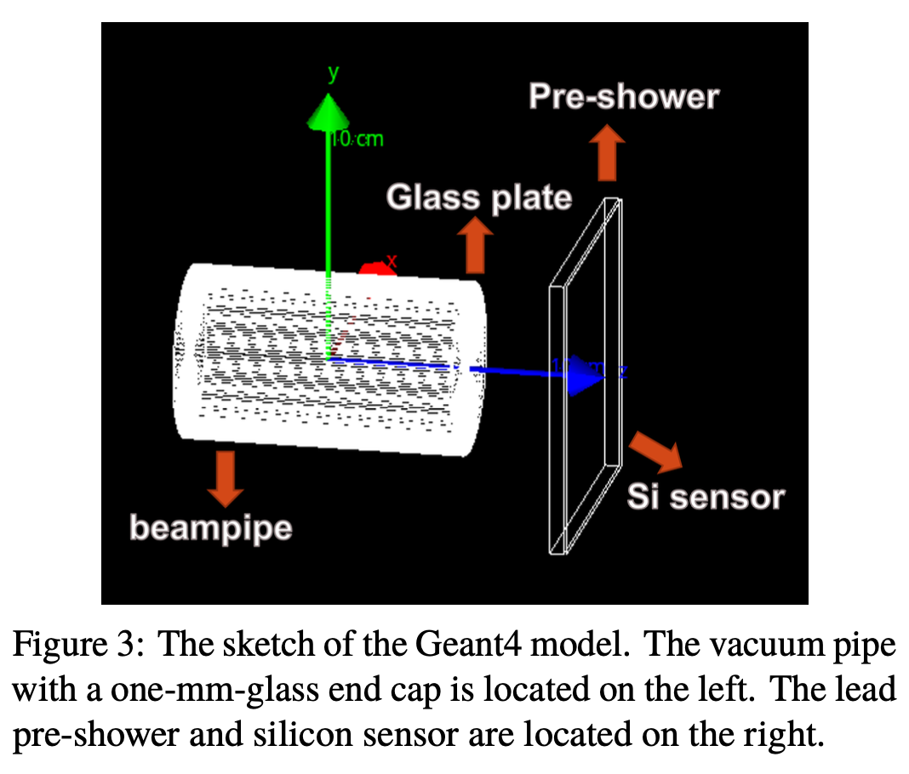
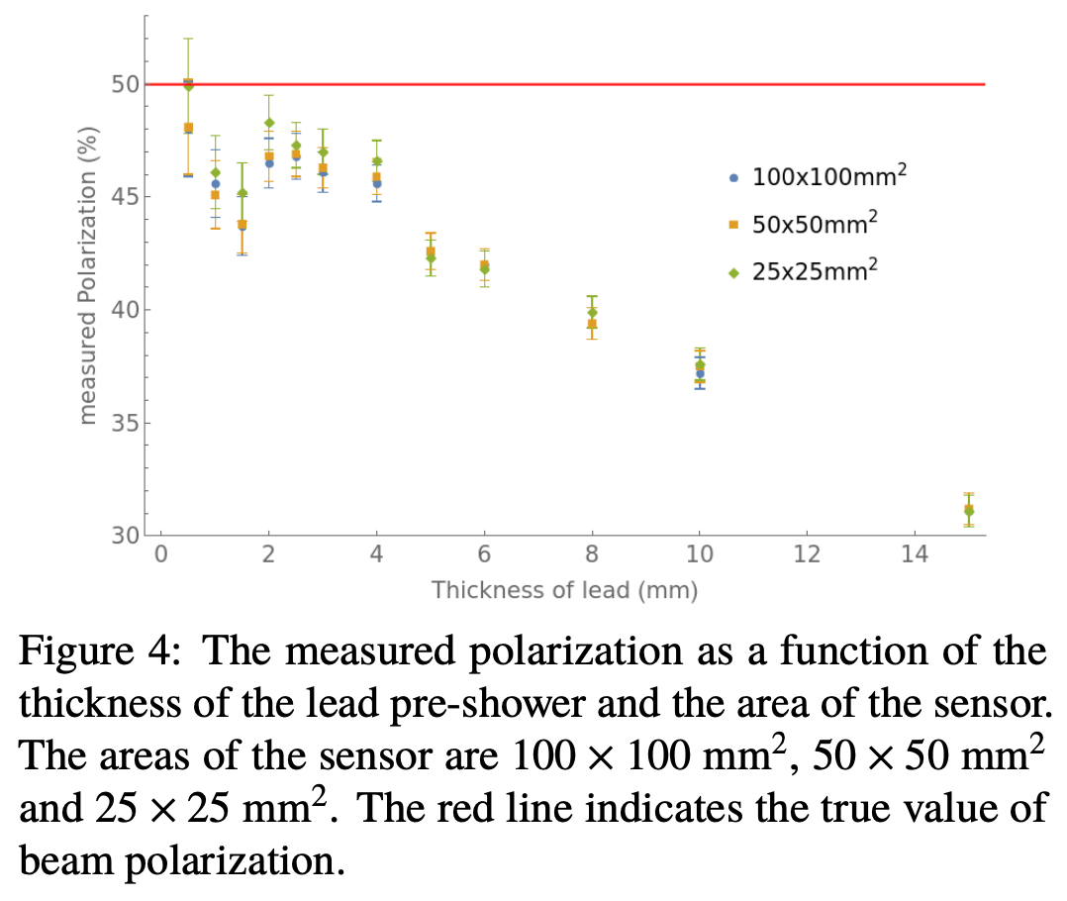
SPIN2025 Design and Preliminary Implementation of a Laser Compton Polarimeter for BEPCII
Backup
系统误差和统计误差受铅转换体的厚度影响
  取铅厚度3mm，则取数20s 统计误差~1%
  铅同时用来屏蔽同步辐射
背散射gamma事例率12.8MHz，康普顿边缘~180MeV
Location | beamline and experimental hall of 4W2 wiggler
Laser | 532nm, 4.5 kHz, 2 mJ, 1 ns, flippable circular polarization
Observable | Vertical asymmetry of backscattered γ (up to 180 MeV)
Detector | lead preshower + silicon pixel detector
Signal | backscattered γ ~ 20kHz/mA/W
Background | bremsstruhlung γ ~ 1kHz/mA

