Slide 1


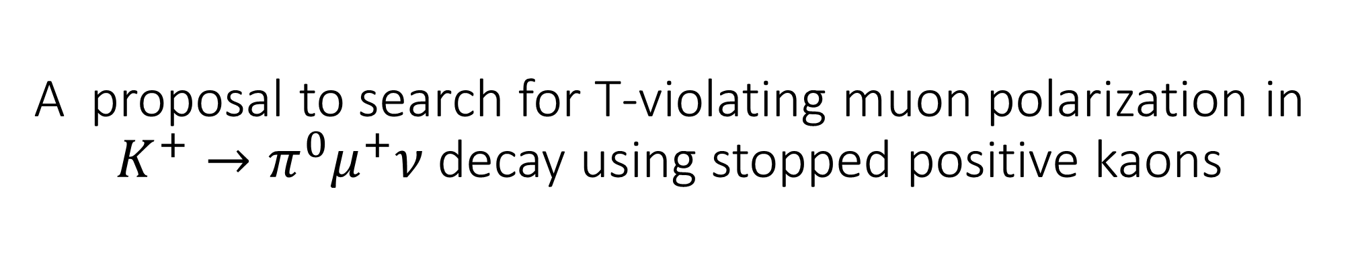
A proposal to search for T-violating muon polarization in $K^{+}→π^{0}μ^{+}ν$ decay using stopped positive kaons
S. Ide, K. Horie, S. Ide, R. Imai, S. Ishitani, M. Mihara, S. Shimizu, K. Yasuda
Department of Physics, The University of Osaka
K. Kamada, A. Yoshikawa
Institute for Material Research, Tohoku University

Slide 2
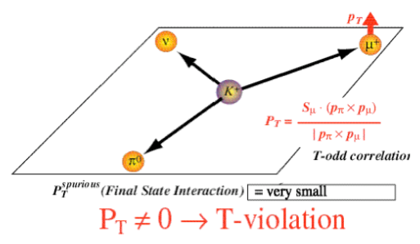
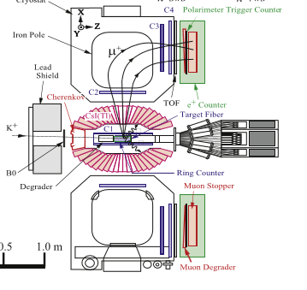
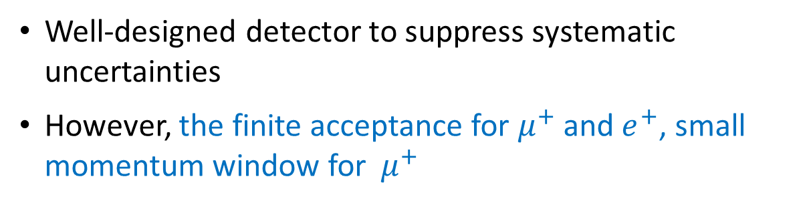
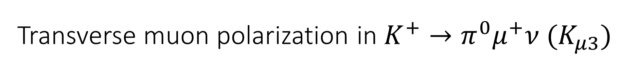
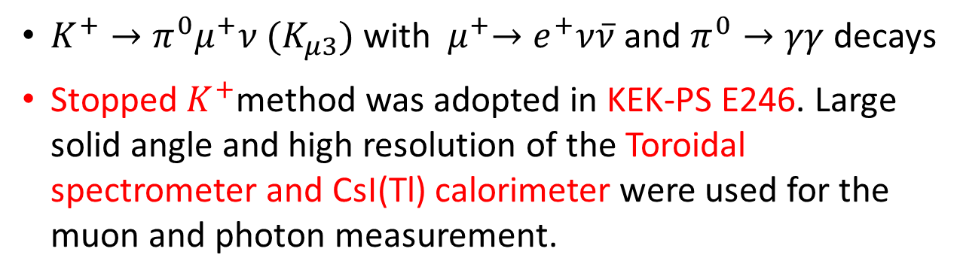
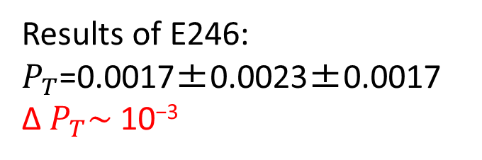
Transverse muon polarization in $K^{+}→π^{0}μ^{+}ν (K_{μ3})$
$K^{+}→π^{0}μ^{+}ν (K_{μ3})$ with${ μ}^{+}→e^{+}ν\overline{ν}$ and $π^{0}→γγ$ decays
Stopped $K^{+}$method was adopted in KEK-PS E246. Large solid angle and high resolution of the Toroidal spectrometer and CsI(Tl) calorimeter were used for the muon and photon measurement.
M. Abe et al.,
Phys. Rev. D40 (2006) 072005
Results of E246:
$P_{T}$=0.0017±0.0023±0.0017
Δ $P_{T}\sim$10⁻³
J.A. Macdonald et al.,
NIM A 506 (2003) 60
Well-designed detector to suppress systematic uncertainties
However, the finite acceptance for $μ^{+}$ and $e^{+}$, small momentum window for${ μ}^{+}$

Slide 3
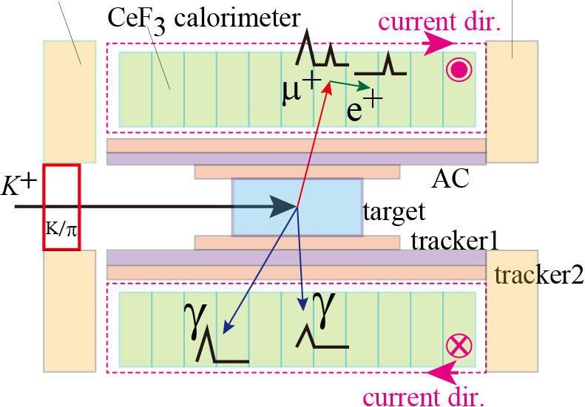
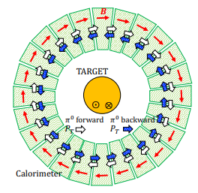
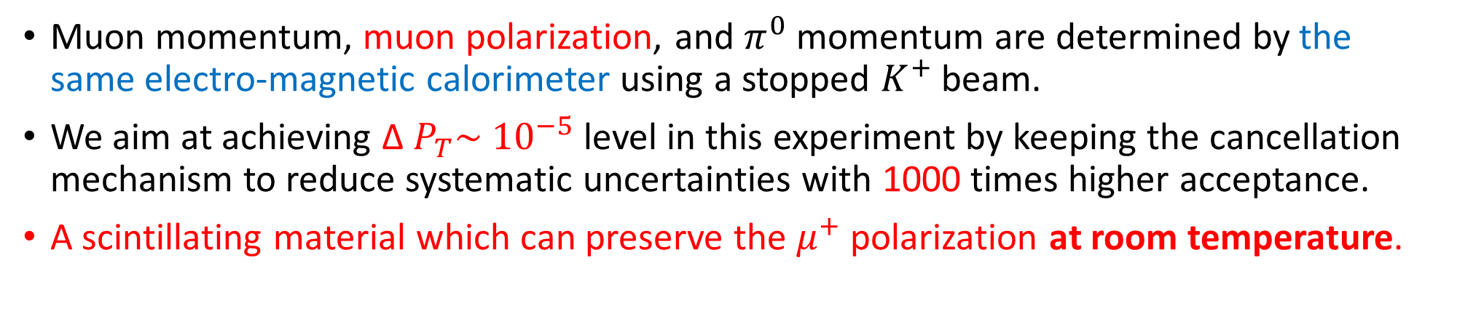
T-violation experiment using integrated calorimeter and polarimeter system
Front
calorimeter
~1.2m
S. Shimizu et al.,
Nucl. Instrum. Methods
A 945 (2019) 162587
~1.5m
x
Muon momentum, muon polarization, and $π^{0}$ momentum are determined by the same electro-magnetic calorimeter using a stopped $K^{+}$ beam.
We aim at achieving Δ $P_{T}\sim {10}^{−5}$ level in this experiment by keeping the cancellation mechanism to reduce systematic uncertainties with 1000 times higher acceptance.
A scintillating material which can preserve the $μ^{+}$ polarization at room temperature.
x

Slide 4
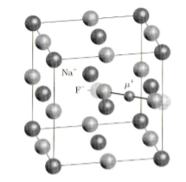
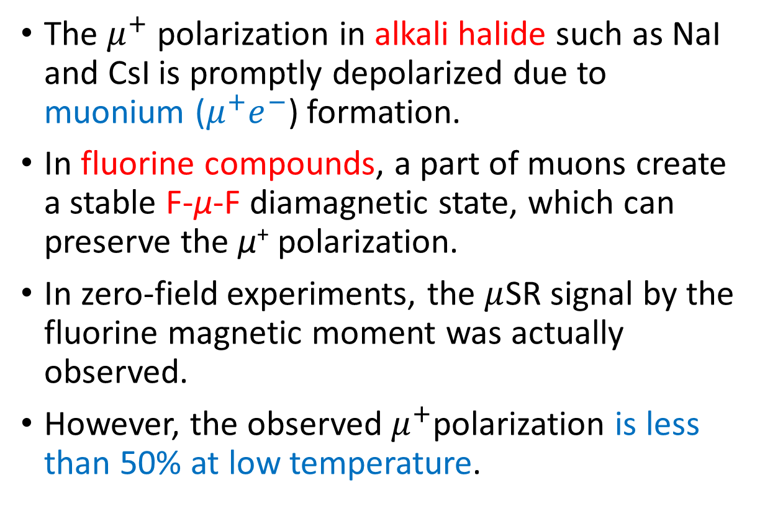
Muon behavior in Fluorine compounds
The $μ^{+}$ polarization in alkali halide such as NaI and CsI is promptly depolarized due to muonium ($μ^{+}e^{−}$) formation.
In fluorine compounds, a part of muons create a stable F-μ-F diamagnetic state, which can preserve the μ⁺ polarization.
In zero-field experiments, the $μ$SR signal by the fluorine magnetic moment was actually observed.
However, the observed $μ^{+}$polarization is less than 50% at low temperature.
R. Kadono, Muon Spin Rotation

Slide 5
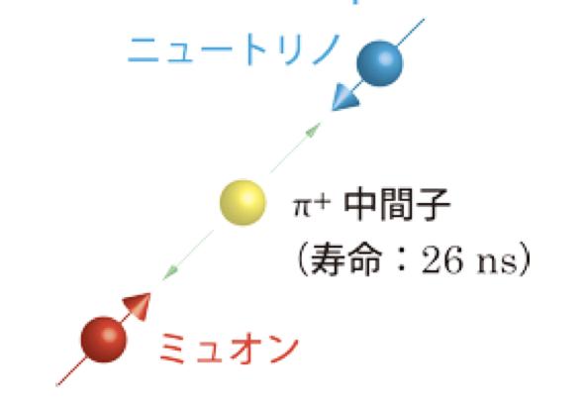
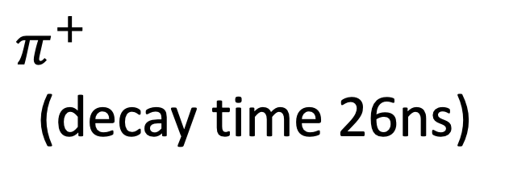
Polarized muon beam
Pion decays into a neutrino and a muon
Neutrinos are always left-handed, so muons produced in decay are 100% polarized
At J-PARC, polarized muon beam can be obtained to confirm the preservation of spin polarization.
Neutrino
$$π^{+}$$
(decay time 26ns)
muon

Slide 6
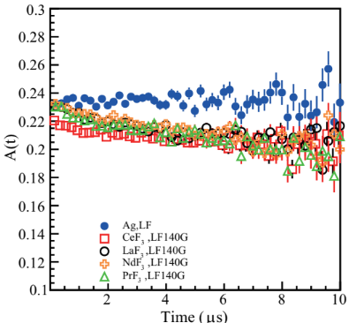
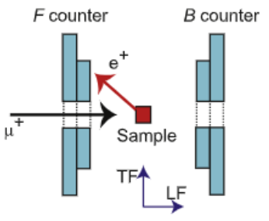
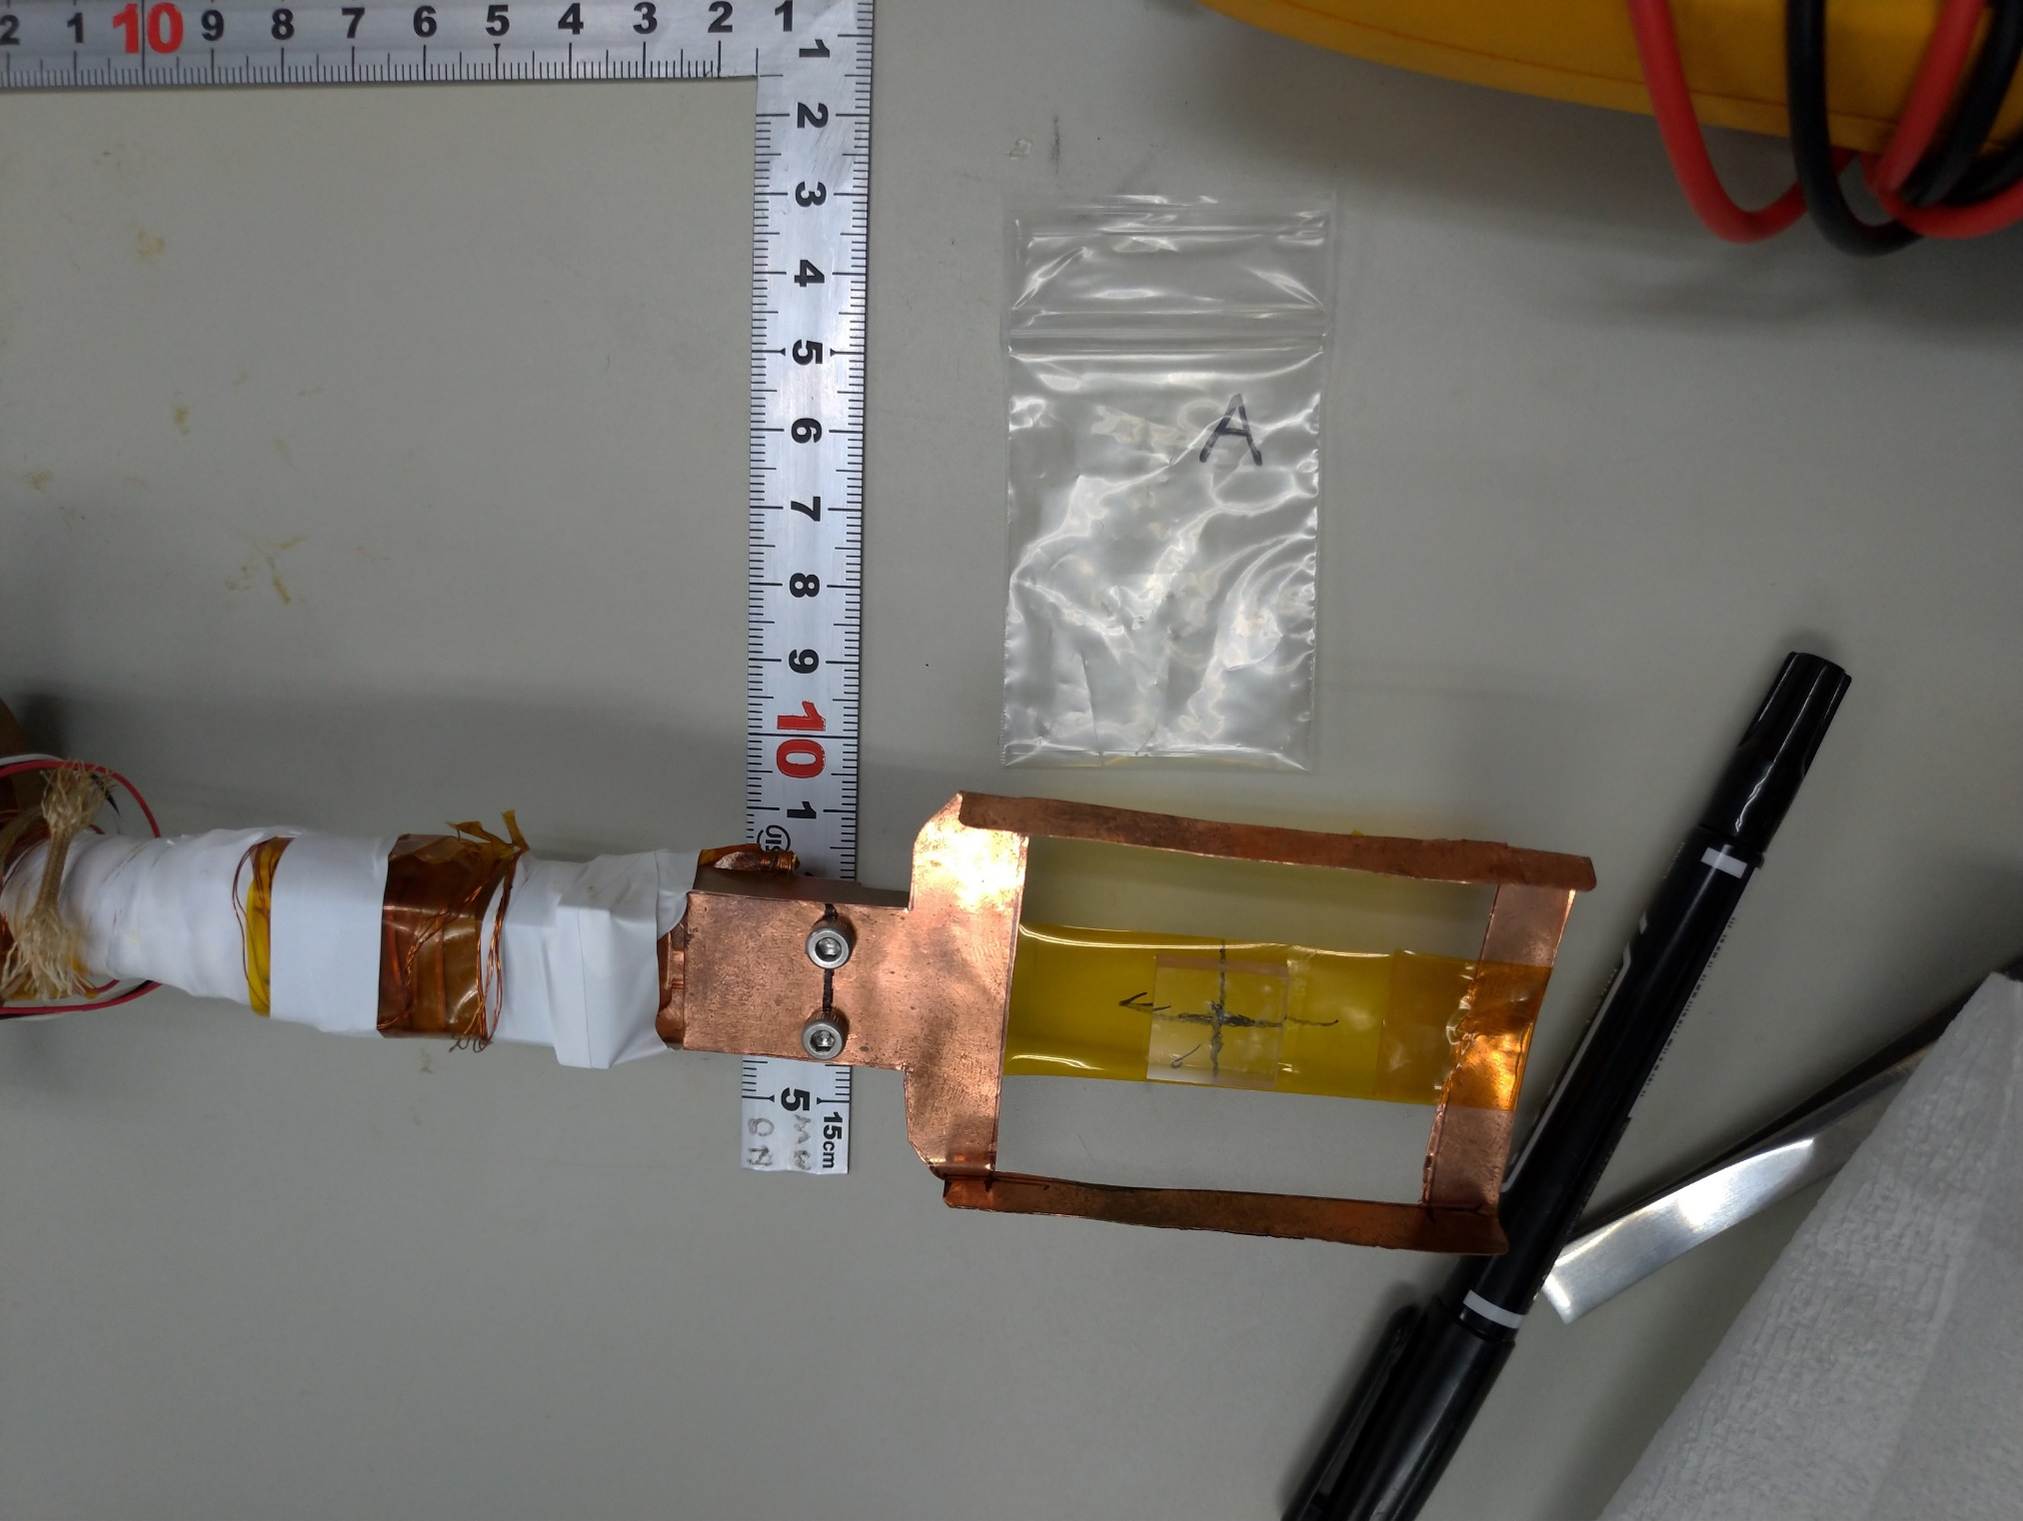
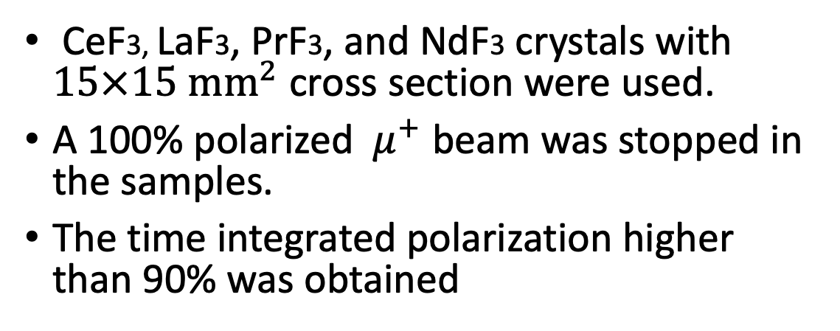
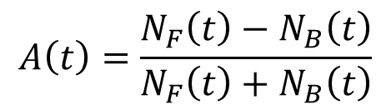

Measurement of${ μ}^{+}$polarization in Lanthanoid Fluoride materials
CeF3, LaF3, PrF3, and NdF3 crystals with $15×15 {mm}^{2}$ cross section were used.
A 100% polarized ${ μ}^{+}$ beam was stopped in the samples.
The time integrated polarization higher than 90% was obtained
$$A\left(t\right)=\frac{N_{F}\left(t\right)−N_{B}\left(t\right)}{N_{F}\left(t\right)+N_{B}\left(t\right)}$$
At room temperature
100%
K. Horie et al., Nucl. Instrum. Methods A 1037 (2022) 166932
K. Horie et al., Nucl. Instrum. Methods A 1066 (2024) 169606
2cm
J-PARC, MLF
Magnetic Field

Slide 7
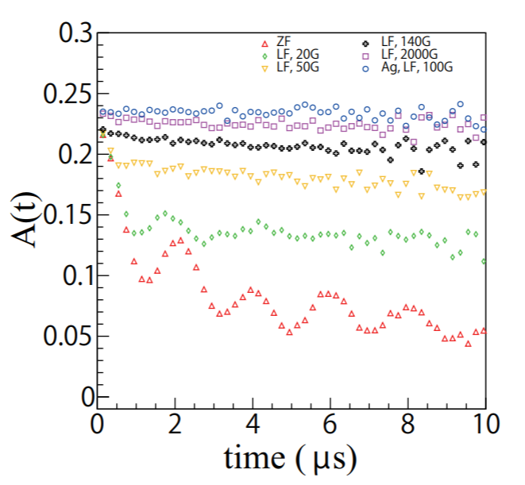
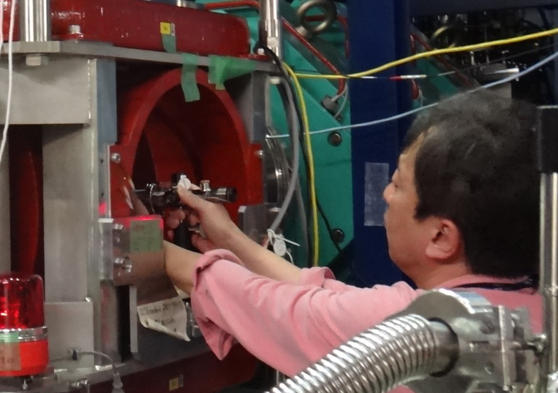
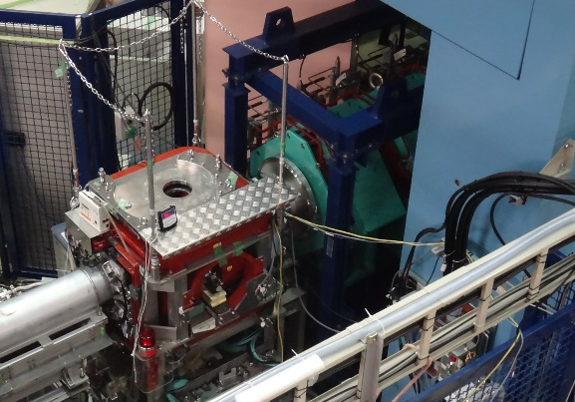
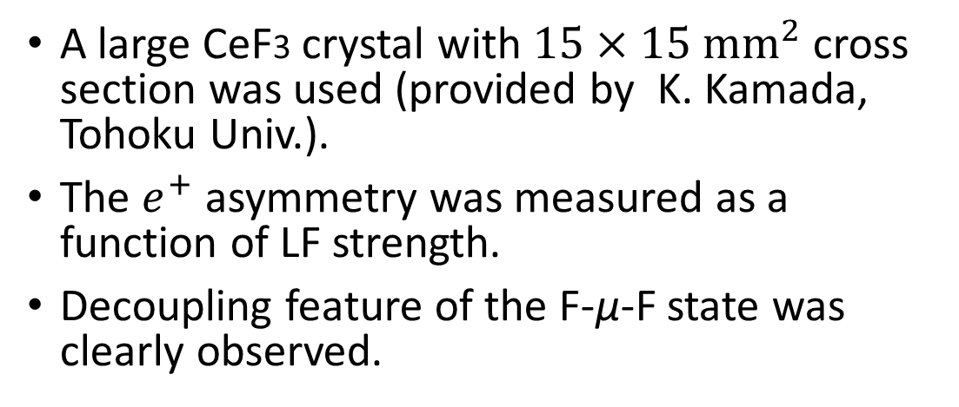
$e^{+}$ asymmetry as a function of LF strength
K. Horie et al.,
Nucl. Instrum. Methods A 1037 (2022) 166932
A large CeF3 crystal with $15×15 {mm}^{2}$ cross section was used (provided by K. Kamada, Tohoku Univ.).
The $e^{+}$ asymmetry was measured as a function of LF strength.
Decoupling feature of the F-μ-F state was clearly observed.

Slide 8
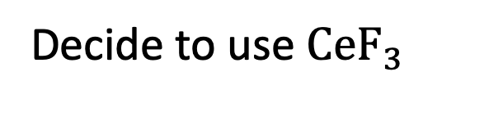
Properties of CeF₃
density | 6.16g/cm
Radiation length | 1.68-1.7cm
Emission wavelength （peak） | fast=300nm slow=340nm
Decay time | 5-8ns
Luminous amount（NaI） | 4-8.6%
Decide to use $CeF_{3}$
Merit
Possible to preserve
poralization
High time resolution
No hygroscopic
Good radiation hardness
Demerit
The emission wavelength of CeF₃ is around 300 nm. (NaI is around 400 nm.) it cannot be detected by a standard photon readout device.
→Special detector for short emission wavelengths is employed.
Low luminous intensity (8% of NaI)

Slide 9
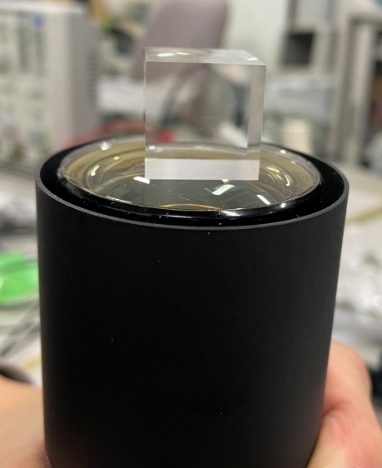
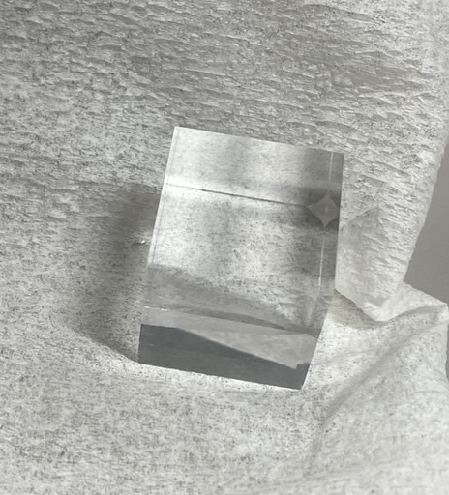
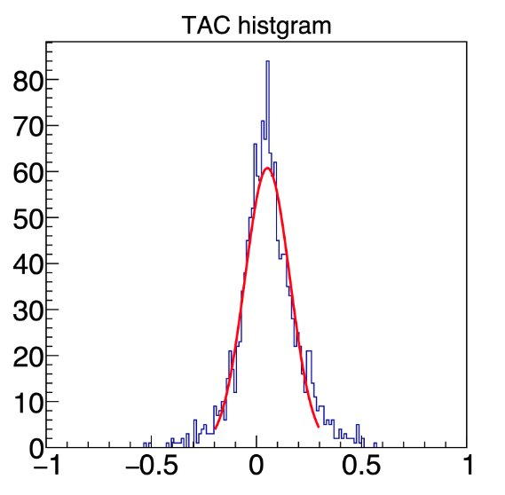
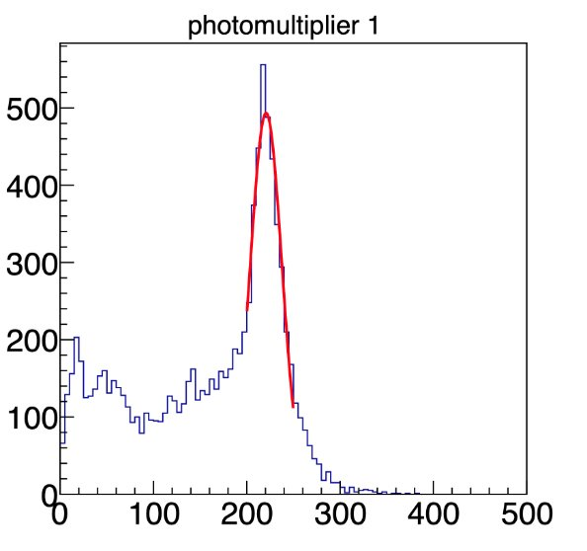


Bench test to research CeF3 properties
Cosmic rays
The detector system is very close to the beam.
The timing resolution is required to be better than 1 ns.
20 mm
20 mm
CeF3 crystals
S. Ide
Thesis work
$$σ∼7.7\%$$
$$@24 MeV$$
$$σ∼100 ps$$
Backgrounds
Channel
Time (ns)

Slide 10
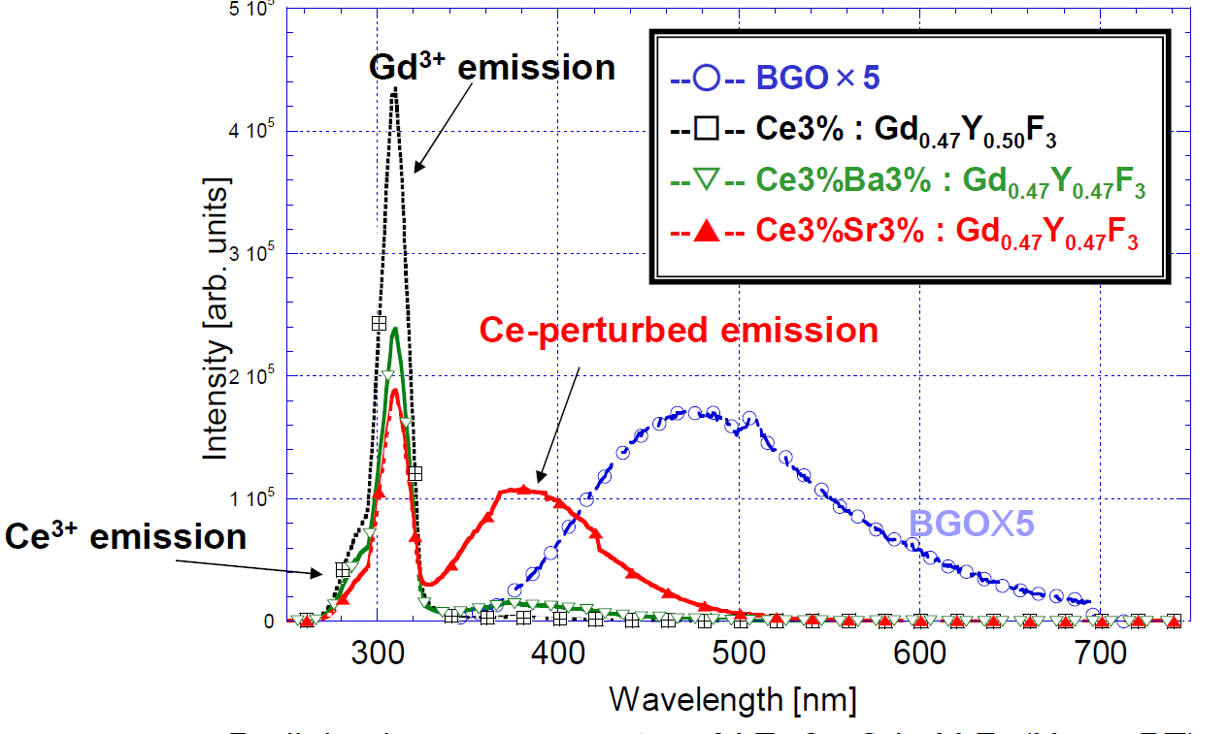
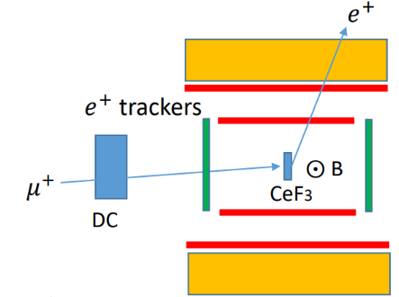
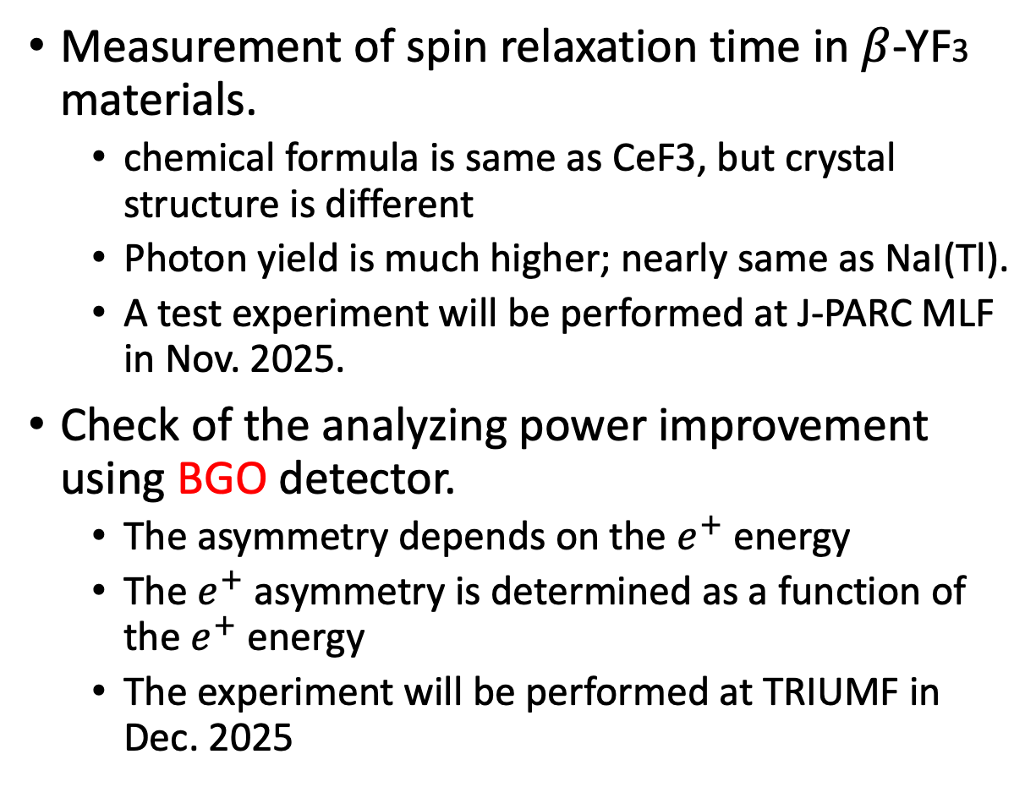
Further tests to obtain better detector performance
Measurement of spin relaxation time in $β$-YF3 materials.
chemical formula is same as CeF3, but crystal structure is different
Photon yield is much higher; nearly same as NaI(Tl).
A test experiment will be performed at J-PARC MLF in Nov. 2025.
Check of the analyzing power improvement using BGO detector.
The asymmetry depends on the $e^{+}$ energy
The $e^{+}$ asymmetry is determined as a function of the $e^{+}$ energy
The experiment will be performed at TRIUMF in Dec. 2025
BGO detector

Slide 11
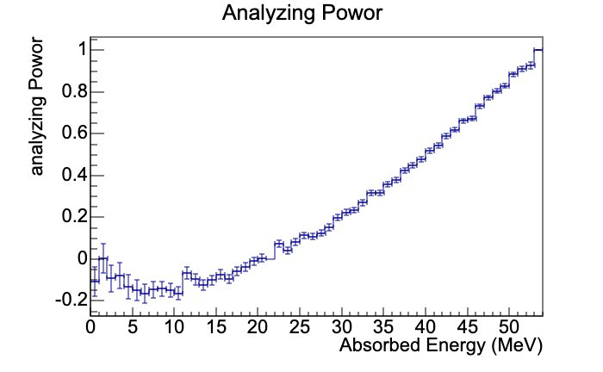
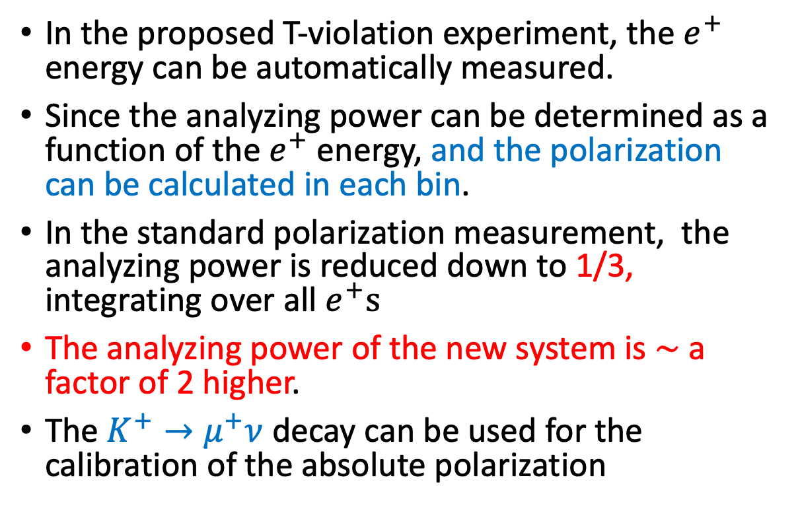

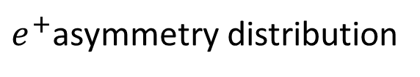
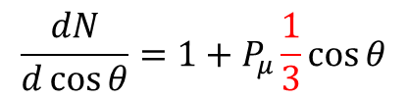
Analyzing power of the polarimeter system
$e^{+}$asymmetry distribution
In the proposed T-violation experiment, the $e^{+}$ energy can be automatically measured.
Since the analyzing power can be determined as a function of the $e^{+}$ energy, and the polarization can be calculated in each bin.
In the standard polarization measurement, the analyzing power is reduced down to 1/3, integrating over all $e^{+}s$
The analyzing power of the new system is $\sim$ a factor of 2 higher.
The $K^{+}→μ^{+}ν$ decay can be used for the calibration of the absolute polarization
A factor of 1/3 attenuation
Using thin $e^{+}$ detectors,
$$\frac{dN}{d\cos{θ}}=1+P_{μ}\frac{1}{3}\cos{θ}$$
$A\left(t\right)=α P（t） A:asymmetry P：polarization α$:analyzing power

Slide 12
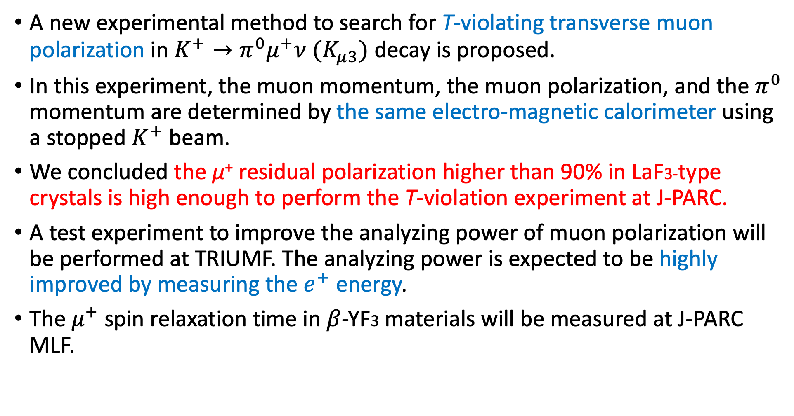
Summary
A new experimental method to search for T-violating transverse muon polarization in $K^{+}→π^{0}μ^{+}ν (K_{μ3})$ decay is proposed.
In this experiment, the muon momentum, the muon polarization, and the $π^{0}$ momentum are determined by the same electro-magnetic calorimeter using a stopped $K^{+}$ beam.
We concluded the μ⁺ residual polarization higher than 90% in LaF3-type crystals is high enough to perform the T-violation experiment at J-PARC.
A test experiment to improve the analyzing power of muon polarization will be performed at TRIUMF. The analyzing power is expected to be highly improved by measuring the $e^{+}$ energy.
The $μ^{+}$spin relaxation time in $β$-YF3 materials will be measured at J-PARC MLF.

Slide 13
Backup

Slide 14
muSR imagingの話(時間がなければskip)

Slide 15
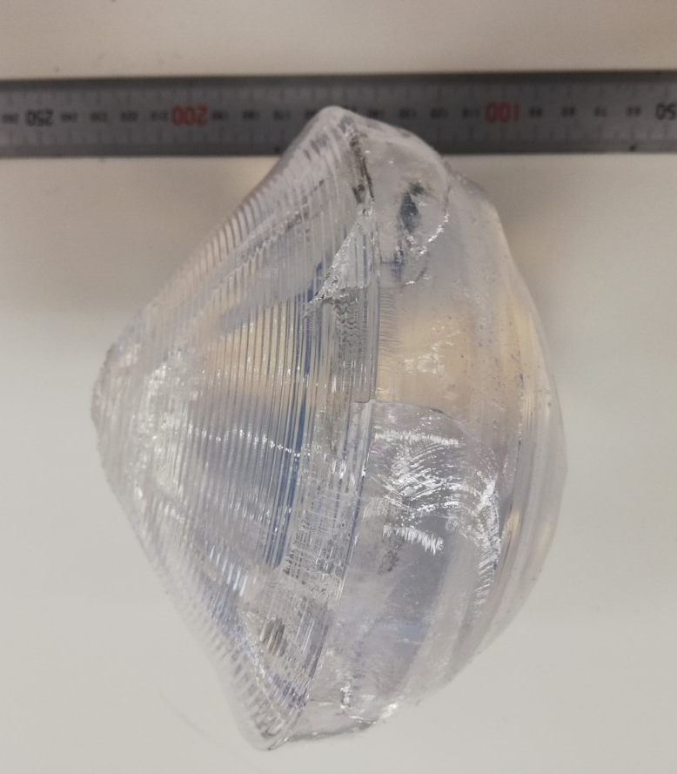
CeF3 crystal fabrication for the T-violation experiment
Large CeF3 crystal can be fabricated by K. Kamada et al. @Tohoku University.
It will take a year to produce all of the CeF3 modules.
Cost estimation of the CeF3 calorimeter
Calorimeter weight is ~1ton
Cost of raw materials is 0.3-0.4 M$

Slide 16
CeF_{３}の一般的性質
 | CeF₃ | PWO | CsI(pure) | NaI(Tl)
密度(g/cm³) | 6.16 | 8.2 | 4.86 | 3.67
輻射長(cm) | 1.7 | 0.92 | 1.86 | 2.6
光量相対的 | 4-5 | 0.26 | 4 | 100
光の減衰時間(nsec) | 30 | 15 | 10～1000 | 230
発光波長 (nm) | 340 | 430 | 300～400 | 415
屈折率 | 1.68 | 2.2 | 1.8 | 1.85
放射線耐性(rad) | 10⁶ |  | 10⁴⁻⁵ | 10³
潮解性 | なし | なし | 少し | あり
･光量の温度依存性 0.05(%/℃)
･モリエル半径 2.8(cm)
･圧縮強度 3.1×10⁹(dyn/cm²)
･ヤング率 1.1×10¹²(dyn/cm²)
･熱膨張率 1.3×10⁻⁵(/℃)

Slide 17
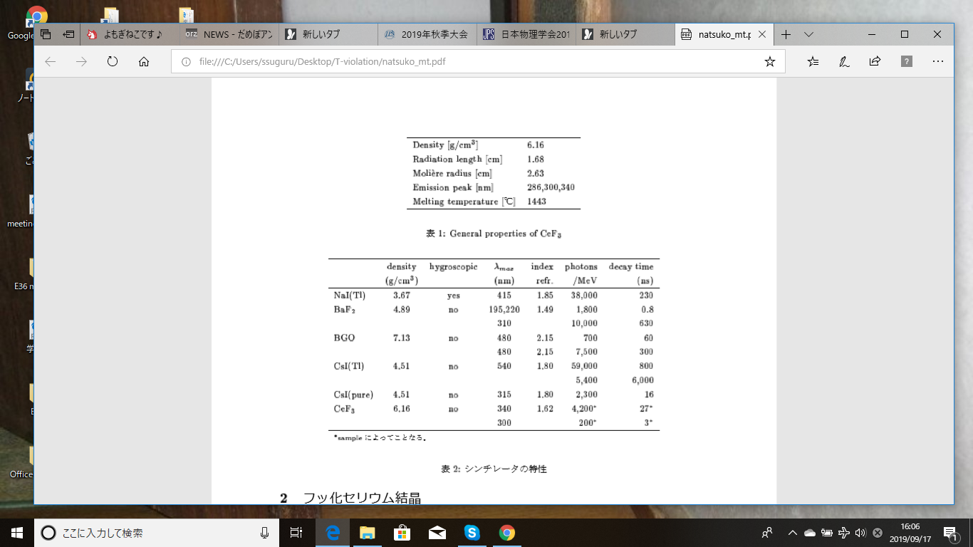
Properties of CeF3 as a scintillating material

Slide 18
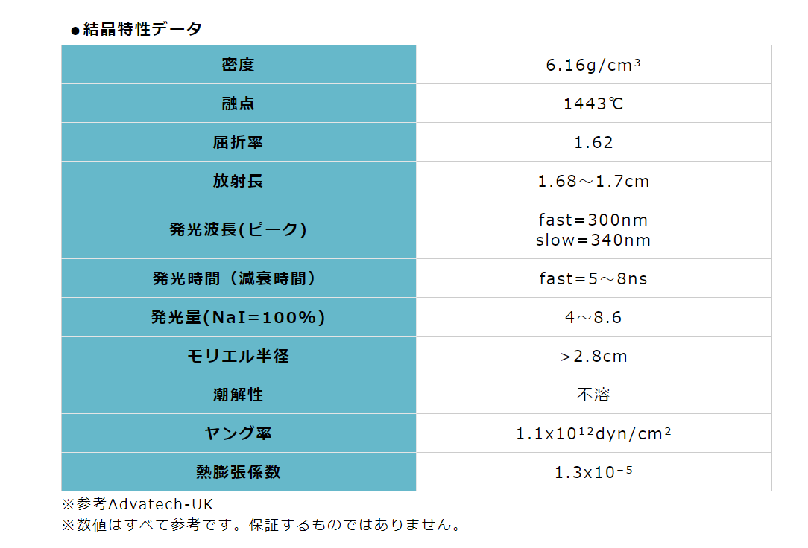
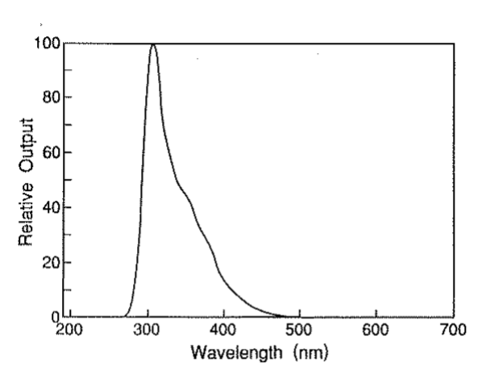
Properties of CeF3 scintillating material
density
Fast (~300nm)
melting point
refractive index
radiation length
wave length
Slow
very fast
response
decay time
photon yield
(NaI=100%)
Moliere radius
hygroscopic
No

Slide 19
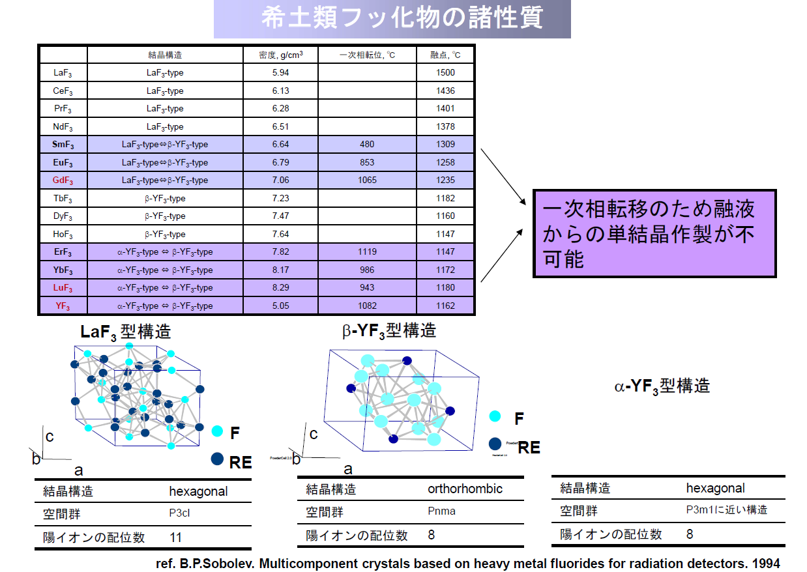

Slide 20
